Slide 1
Improvements of the GEMS NO₂ operational retrieval algorithm
Yeonjin Jung^{1,2}, Hanlim Lee¹, Junsung Park³, Hyunkee Hong⁴, Jhoon Kim⁵
Rokjin Park⁶, Yoonbae Chung⁶, Nickolay A. Krotkov⁷
¹Division of Earth Environmental System Science, Major of Spatial Information Engineering, Pukyong National University
²Institute of Sustainable Earth and Environmental Dynamics (SEED), Pukyong National University
³Harvard-Smithsonian Center for Astrophysics, ⁴ National Institute of Environmental Research
⁵Dept. of Atmospheric Sciences, Yonsei University,
⁶School of Earth and Environmental Sciences, Seoul National University,
⁷Atmospheric Chemistry and Dynamics Laboratory, NASA Goddard Space Flight Center

Slide 2
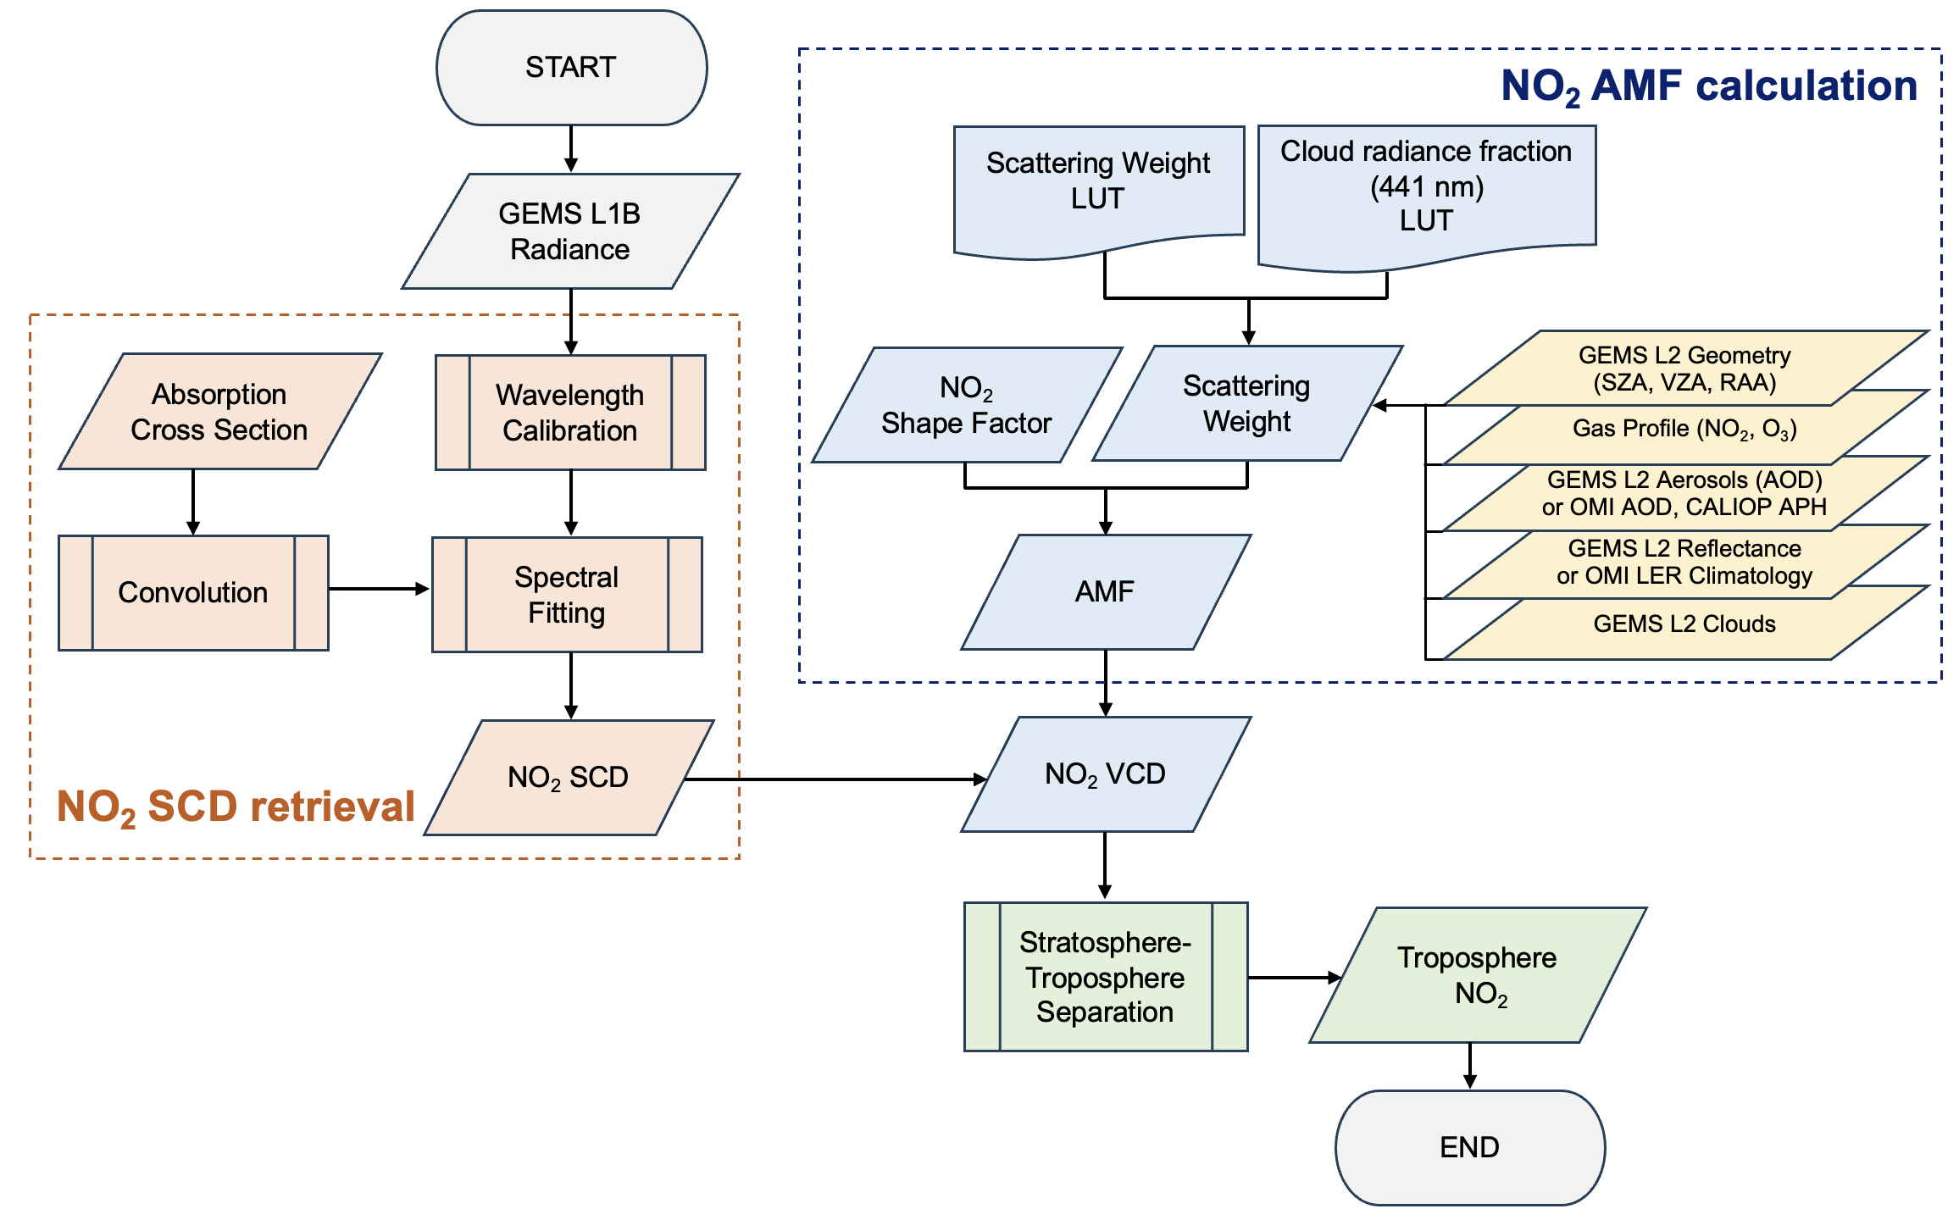
Flowchart of GEMS NO₂ Retrieval Algorithm
Updates in V3.0
Update absorption cross sections
Optimize Wavelength calibrations
Optimize Spectral fitting
Shape factors
Updates in GEMS L2 products
NO₂ shape factor calculated by
GEOS-Chem CTM model from SNU
NO₂ AMF Calculation
NO₂ SCD Retrieval
Stratosphere-Troposphere Separation (STS)
DOAS Fitting Parameters
Parameters |  | Detail | Temperature
Fitting window |  | 432 – 450 nm
Absorption Cross sections | O₃ | Bogumil et al. (2000) | 243 and 293 K
NO2 cross section | NO₂ | Vandaele et al. (1998) | 220 K
O4 cross section | O₄ | Thalman and Volkamer (2013) | 293 K
Ring | Ring | Chance and Spurr (1997)
Calibration fitting parameters |  | 3rd order polynomial Shift: 2nd, SFP: 3rd 400.9 -500.8 nm
Analysis fitting parameters |  | 2nd polynomials
Notes:
Let me explain the GEMS NO2 retrieval algorithm.
Using the observed spectrum, NO2 SCD is derived through DOAS fitting.
The scattering weight derived from pre-calculated using a radiative transfer model, and shape factors from the NO2 profile provided by GEOS-Chem are used to calculate the AMF
Total NO2 VCD is calculated by the SCD and AMF, and trop. ad strat. NO2 are calculated by STS method, and finally retrieve tropospheric NO2.
Red boxes show updates in V3.0 in this study.
------------------------------------------------------------------------------------------ 30’

Slide 3
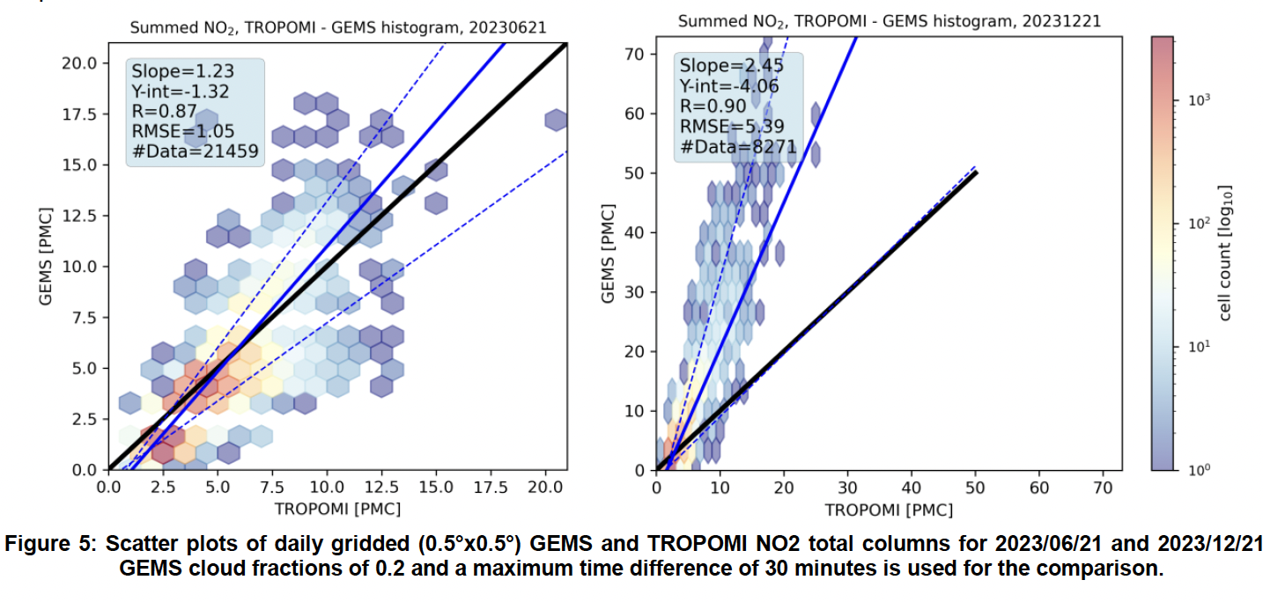
Issues in GEMS total NO₂ V2.0 Products
Total NO₂
Slope=1.23R=0.87
Slope=2.45
R=0.90
PEGASOS Report V3.0 (2024)
GEMS values below 4 PMC are mostly lower than TROPOMI.
For larger columns, GEMS values are higher but do not deviate too much from TROPOMI in summer (slope=1.23).
In winter, the deviation from TROPOMI is much larger (slope=2.45).
→ We focus on improvement of GEMS total NO₂ by optimizing SCD retrievals
Notes:
There are some issues in current released V2.0.
This figure shows the GEMS vs TROPOMI on 1-day in June and December.
As seen this figure, GEMS lower values are mostly lower than TROPOMI,
But for larger column regions, GEMS values are higher especially in winter.
Therefore, first of all, we focus on improvement of total NO2 by optimizing SCD retrievals.

Slide 4
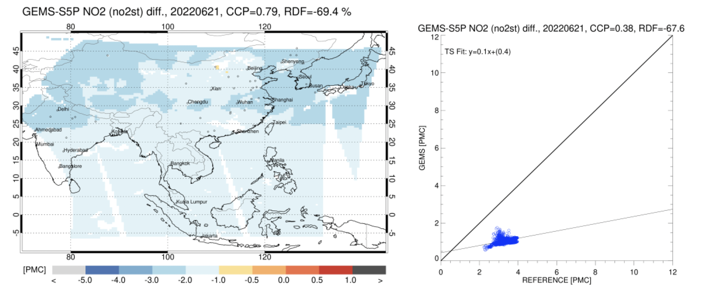
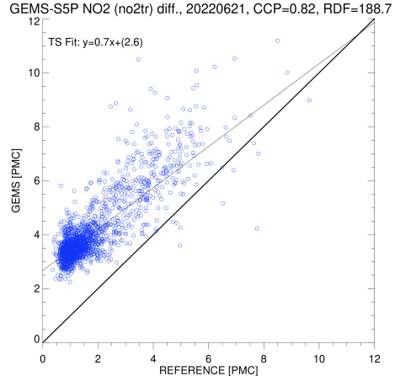
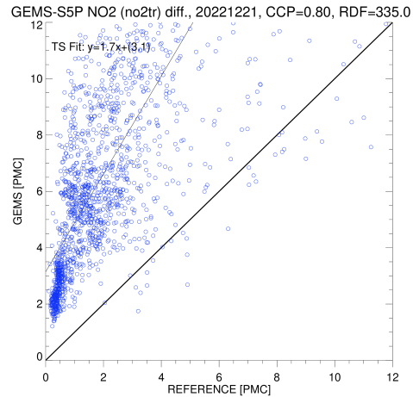
Issues in GEMS Trop. & Strat. NO₂ V2.0 Products
Tropospheric NO₂
Stratospheric NO₂
GEMS V2.0 vs TROPOMI (1-day)
Y=0.7x+2.6
Y=1.7x+3.1
Y=0.1x+0.4
GEMS V2.0 [PMC]
GEMS V2.0 [PMC]
2022/06/21
2022/06/21
2022/12/21
TROPOMI [PMC]
TROPOMI [PMC]
PEGASOS Report V3.0 (2024)
Largest relative difference are detected for low values in summer and higher values in winter. (>175% in both seasons, slope = 1.7).
GEMS stratospheric NO₂ columns show a strong low bias in comparison to TROPOMI (>-67%).
→ due to the error in the AMF calculation of the tropospheric/stratospheric columns
Notes:
tropospheric and stratospheric NO2 also have an issues.
For Tropospheric NO2, very large difference are shown in lower values in summer and in high values in winter, which result in big biases over than 170%.
Also stratospheric NO2 show unrealistic values.
Therefore we thought that it caused by the errors in the AMF calculation

Slide 5
Updates of GEMS NO₂ Retrievals
 | Detailed description | Availability
V2.0 (2022) | Delete the variable of pixel quality flag from GEMS L1C Replace CTM data of WRF-Chem and CAM-Chem to GEOS-Chem. Improve troposphere and stratosphere NO₂ column densities Apply GEMS L2 BSR product to calculate the NO₂ AMF | Current released version
V3.0 (2024, TBD) | Update slant column density (SCD) Retrievals Update troposphere and stratosphere AMF & Columns Change smoothing method in Stratosphere-Troposphere Separation (STS) Apply updated GEMS L2 AOD (V2.1), O3T (V2.1), CLD (V3.0), BSR (V3.0) products.
Notes:
This is detailed description for GEMS V2.0 and V3.0
In GEMS V3.0 retrieval algorithm, we optimize SCD fitting methods, update tropospheric and stratospheric AMF and apply updated GEMS L2 products.
In this study, we just tested v3.0 retrievals, so, it is not decided yet to be released version or not.
NIER will decide final version at their earliest convience.

Slide 6
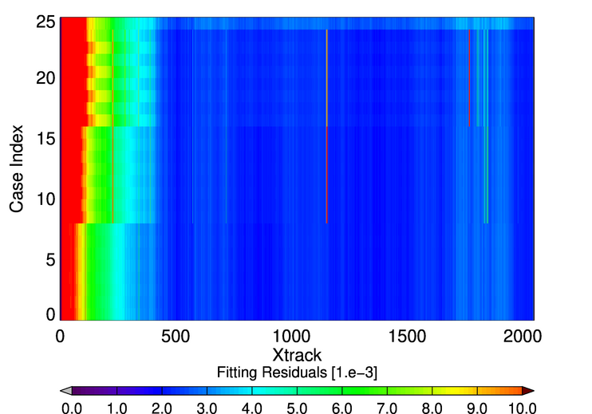
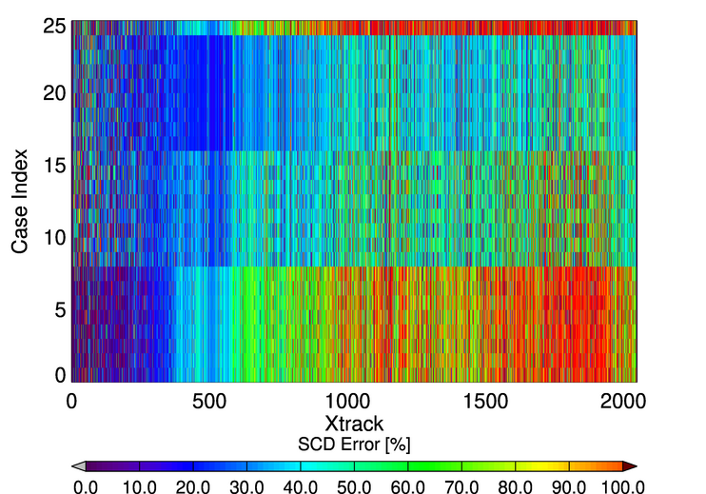
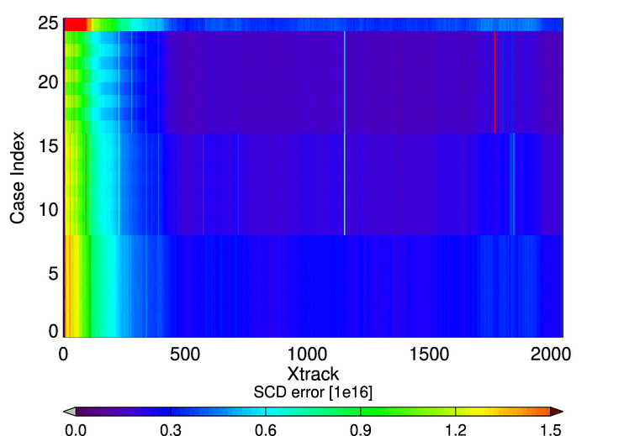
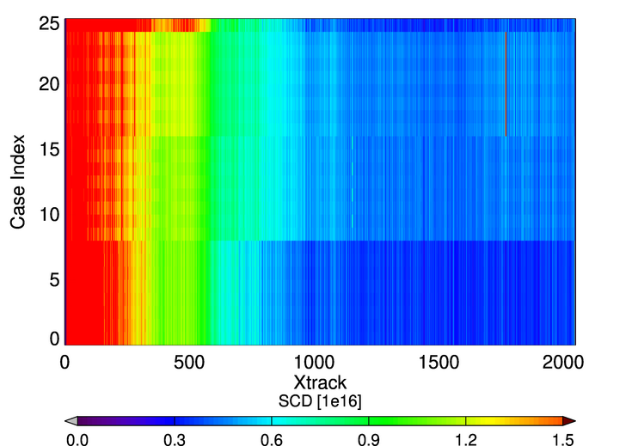
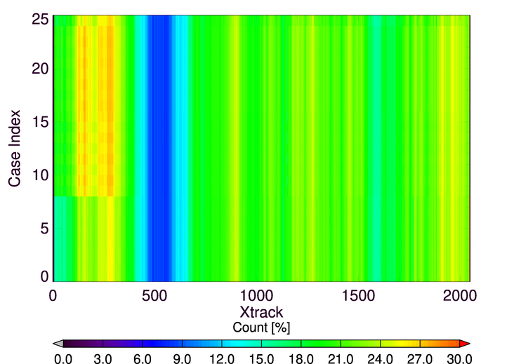
Test for GEMS NO₂ Slant Column Density Retrievals
Fitting Residuals [10⁻³]
SCDerror/SCD [%]
Update absorption cross-sections
Optimize the calibration windows & #divisions
3) 406-466 nm
Case 25 : GEMS v2.0 results (432-450 nm)
2) 426-456 nm
Case 1-24 : Test for spectral fitting window, polynomial degree (shift, SFP), Linear polynomials and offset, analysis polynomials
1) 432-450 nm
SCD error [10¹⁶]
SCD [10¹⁶]
Count (SCD>0) [%]
To increase stability and availability, spectral fitting window of 426-456 nm have changed.
Notes:
In SCD retrievals, we optimized the current SCD spectral fitting setting with updated absorption cross-sections.
Among many fitting parameters, spectral fitting window, polynomial degree, linear polynomials and offset and analysis polynomials are tested for determining the optimization of fitting setting, which shows in case index
In the left-top figure, case index 1-8 shows the results for same spectral fitting window with V2.0, but after DOAS fitting optimizing results
And case index 9-16 and 17-24 shows the results for different spectral fitting window.
As you can seen in this figure, after optimizing result shows similar residual values to V2.0, but it is large variability with xtrack in relative SCD errors,
And also there is still negative values in SCD as seen in right bottom figures.
So, To increase stability and availability, we changed spectral fitting window to 426-456 nm.

Slide 7
Improved NO₂ SCD Retrievals
DOAS Fitting Parameters
Fitting Results (2023/06/01 0445 UTC)
 |  | V2.0 | V3.0
Spectral Fitting window |  | 432-450 nm | 426-456 nm
Calibration window |  | 400.9-500.8 nm | 400.9-480.8 nm
Absorption Cross-sections | NO₂ | 294K (vandaele et al., 1998) | 220 K (Vandaele et al., 1998)
 | O₃ | 243 K and 293 K (Bogumil et al., 2000) | 223 K (Serdyuchenko et al., 2014)
 | O₄ |  | 293 K (Thalman and Volkmaer, 2013)
 | H₂O |  | 293 K (Rothman et al., 2012)
Calibration Polynomials |  | Order 3 | Order 4
Analysis Polynomials |  | Order 2 | Order 5
Reference Spectrum |  | Solar reference | Solar reference
A priori profiles |  | GEOS-Chem from SNU | GEOS-Chem from SNU
Input dataset (GEMS L2) | BSR | V2.0 | V3.0
 | CLD | V2.0 | V3.0
 | O3T | V2.0 | V2.1
 | AERAOD | V2.0 | V2.1
Calibration Residual
Fitting
Residual
NO₂ SCD
V2.0
V3.0
→ Residuals after calibration and analysis are reduced, resulting decreased NO₂ SCD
Notes:
This is summarized in DOAS fitting parameters used in GEMS V3.0
We change the spectral fitting window to 426-456 nm and calibration windows to 400-480 nm,
and update absorption cross-section for NO2 and O3, and add that for O4, H2O.
Also, we modify calibration polynomials and analysis polynomials.
As shown in these figures, we confirmed that fitting residuals are mostly reduced and result in decrease of NO2 SCD.

Slide 8
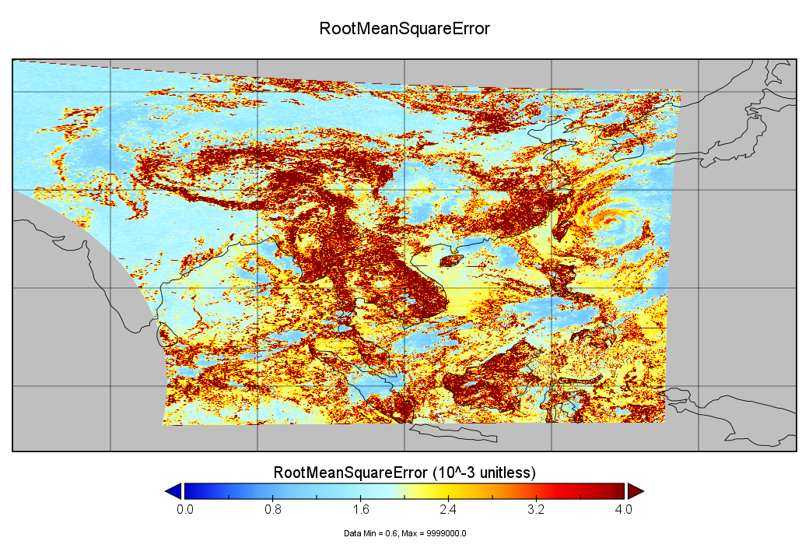
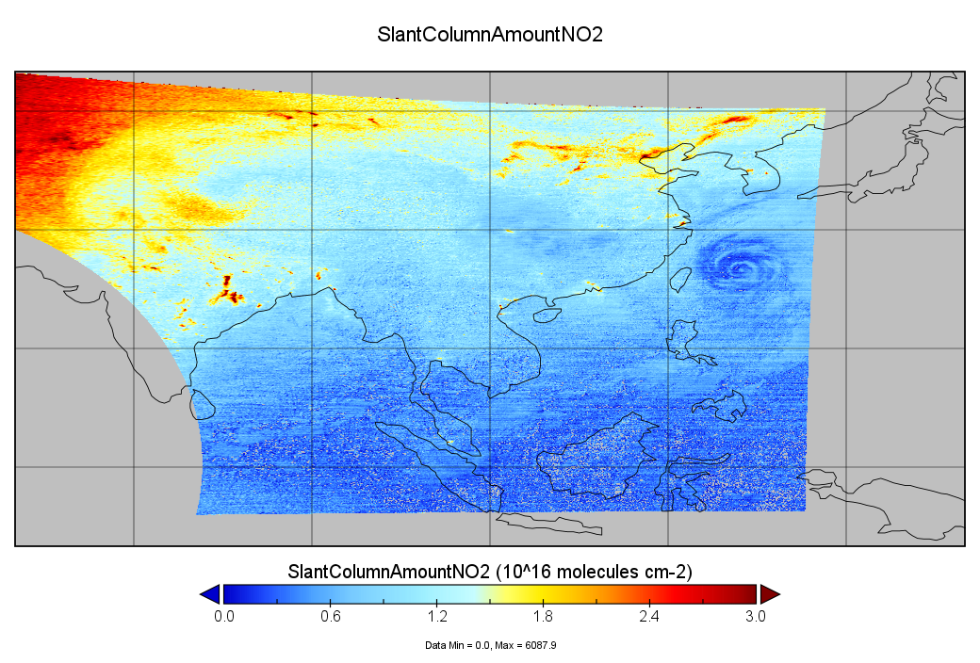
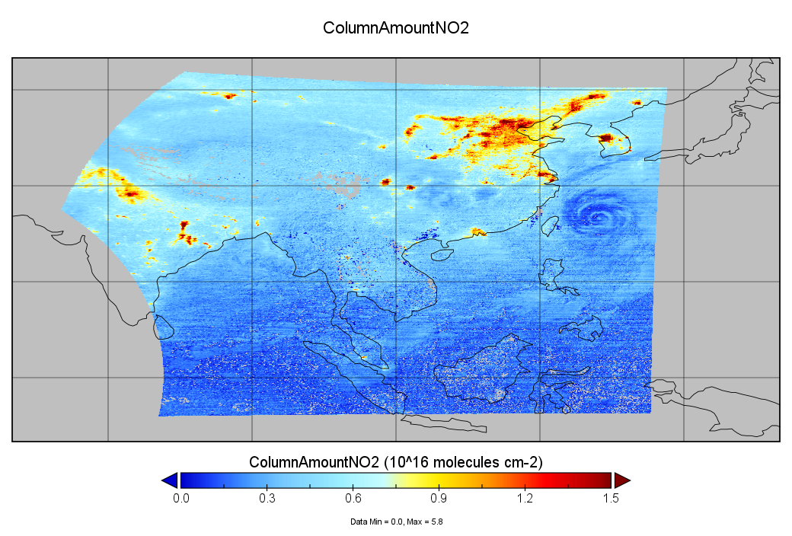
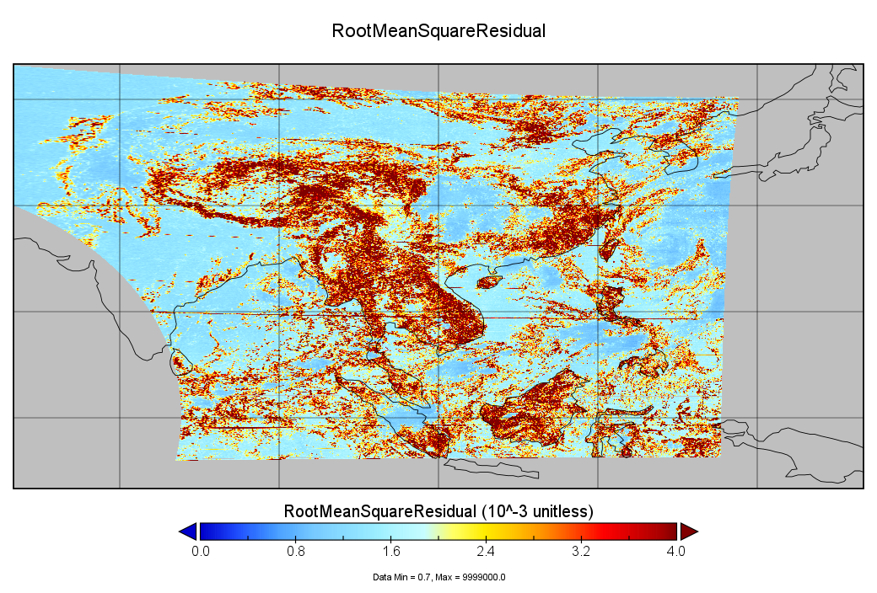
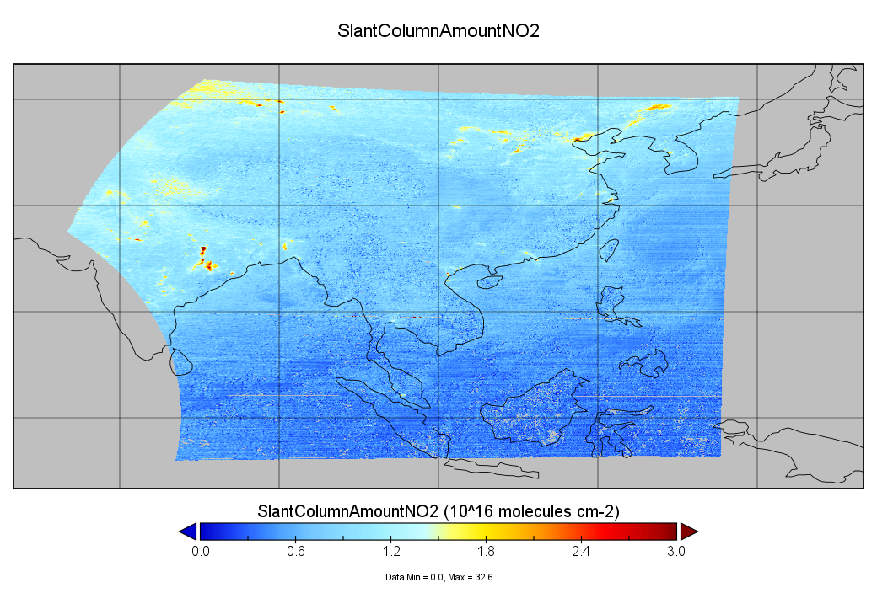
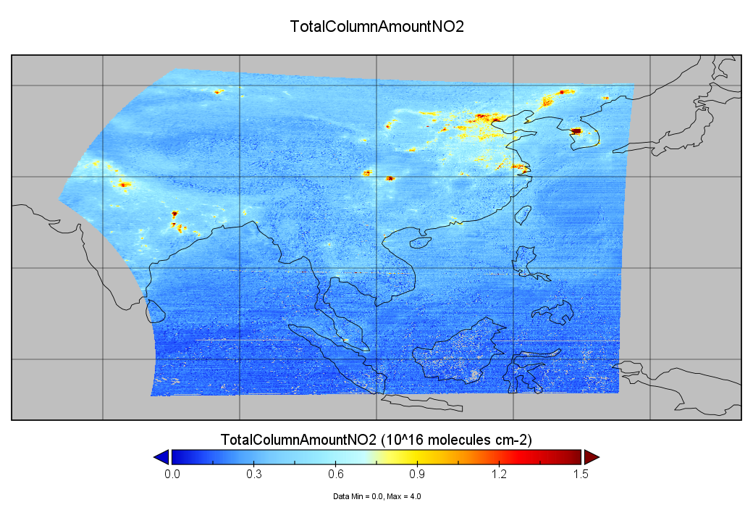
GEMS NO₂ SCD V3.0 Products
June 1, 2023 (0445 UTC)
Fitting Residuals
NO₂ SCD
Total NO₂ VCD
V2.0
V3.0
Notes:
This is the example for spectral fitting results on June 1, 2023.
Compared to GEMS V2.0, the fitting residual in V3.0 decreased overall. A general decrease in high-column region was observed in SCD and VCD .
and pixels that previously showed negative values were significantly reduced overall.

Slide 9
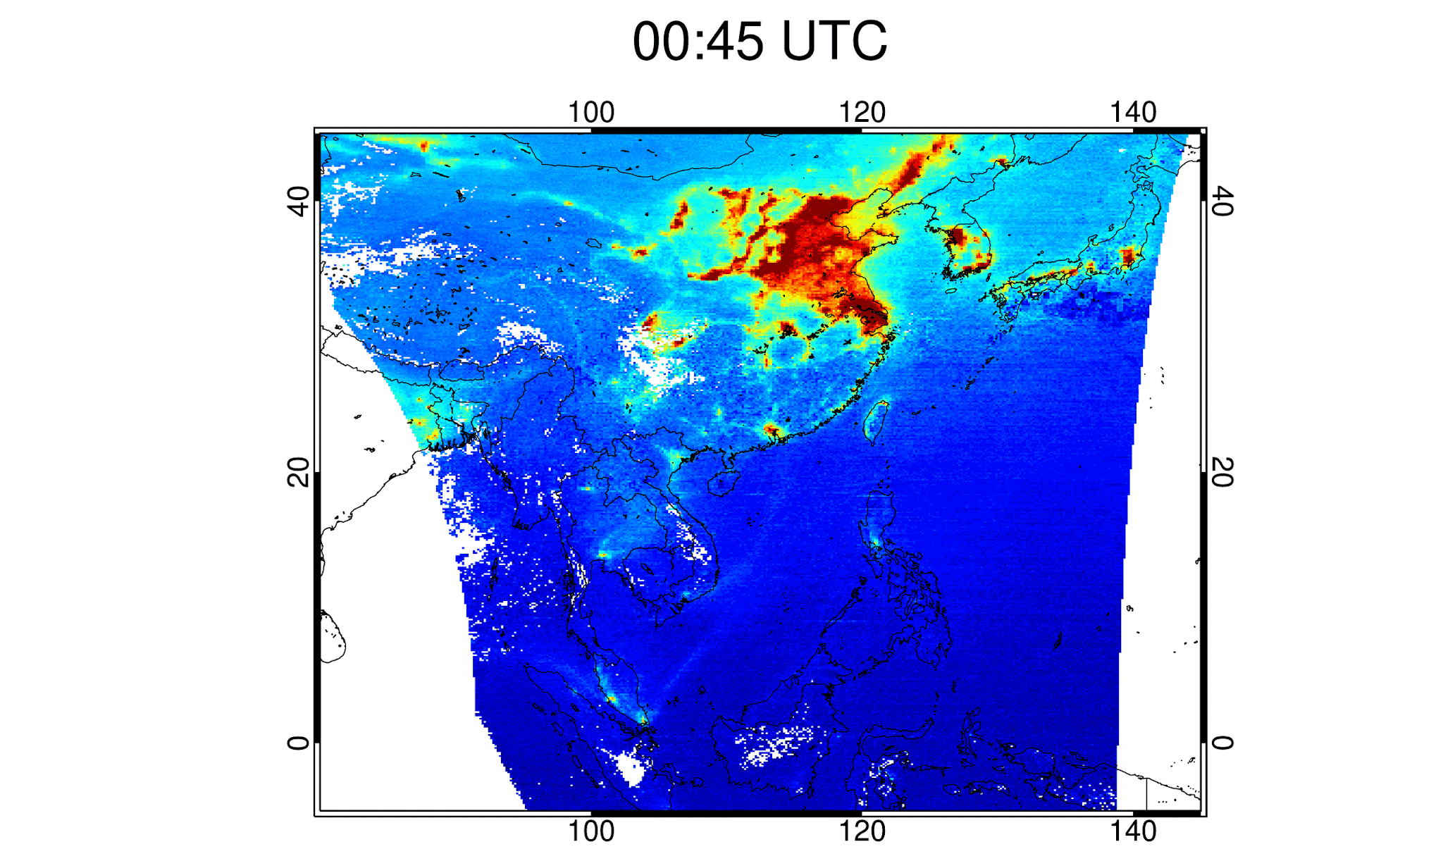
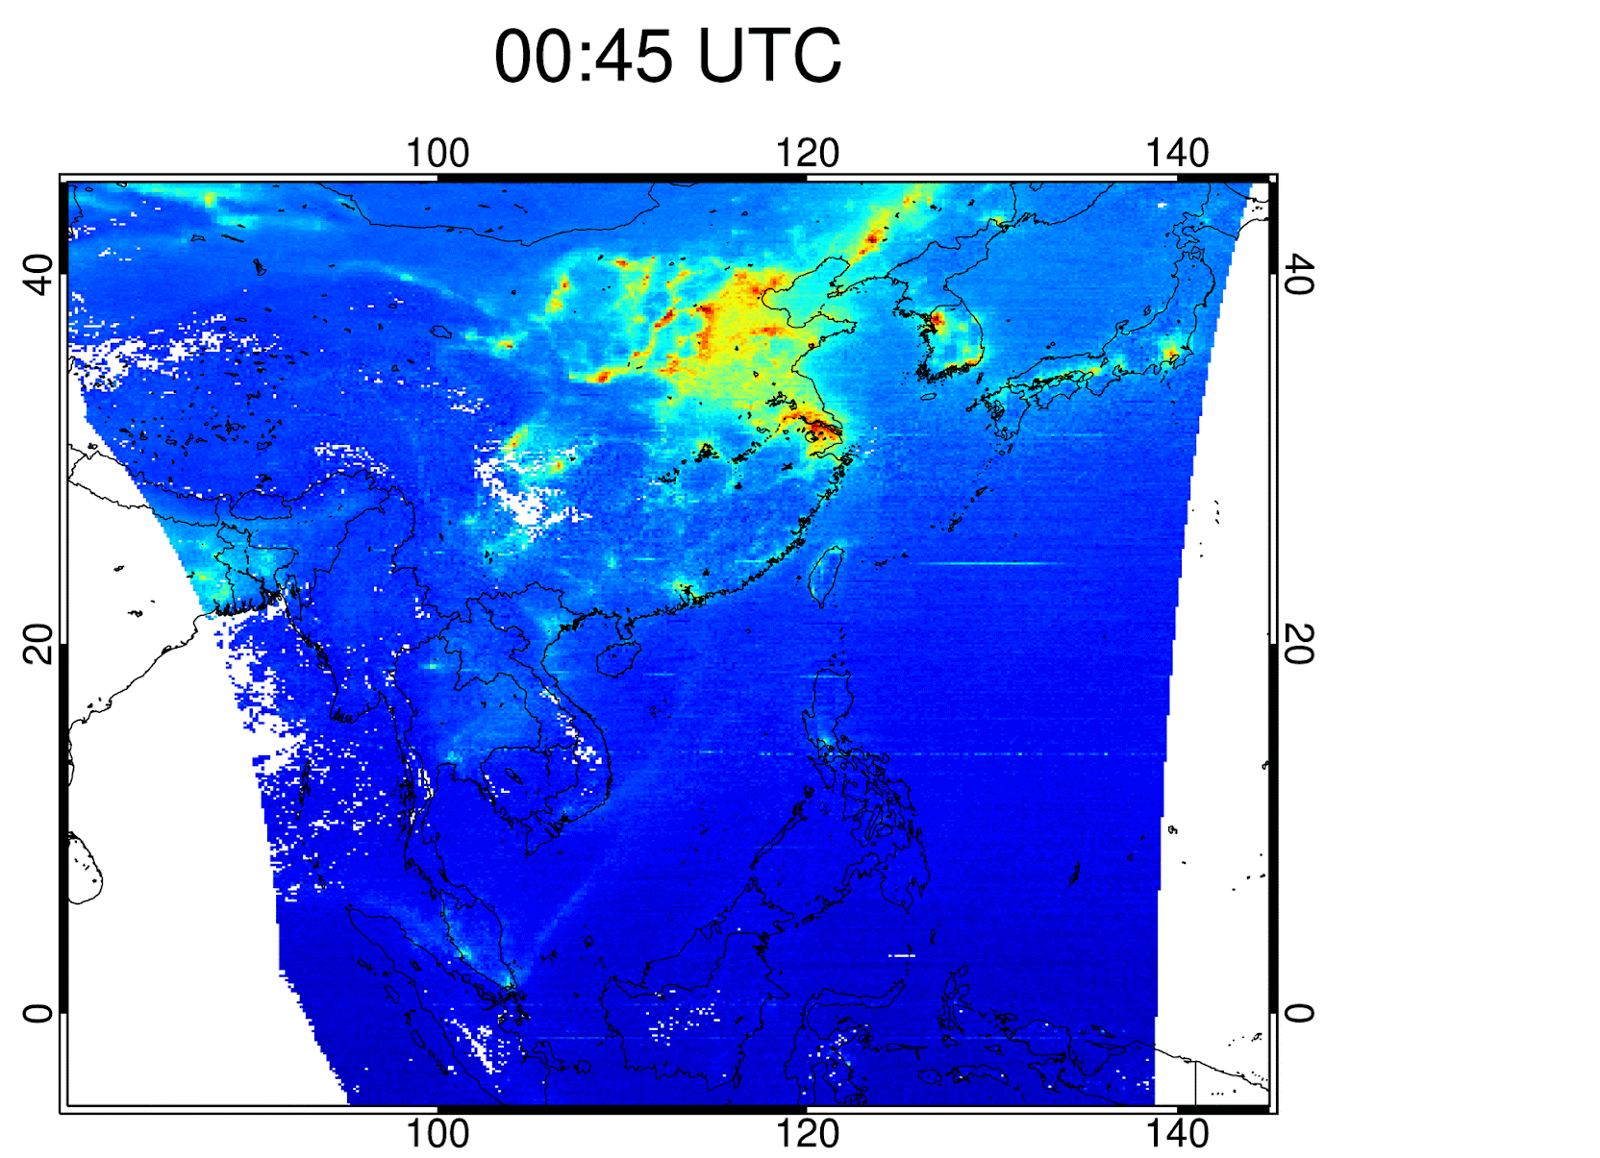
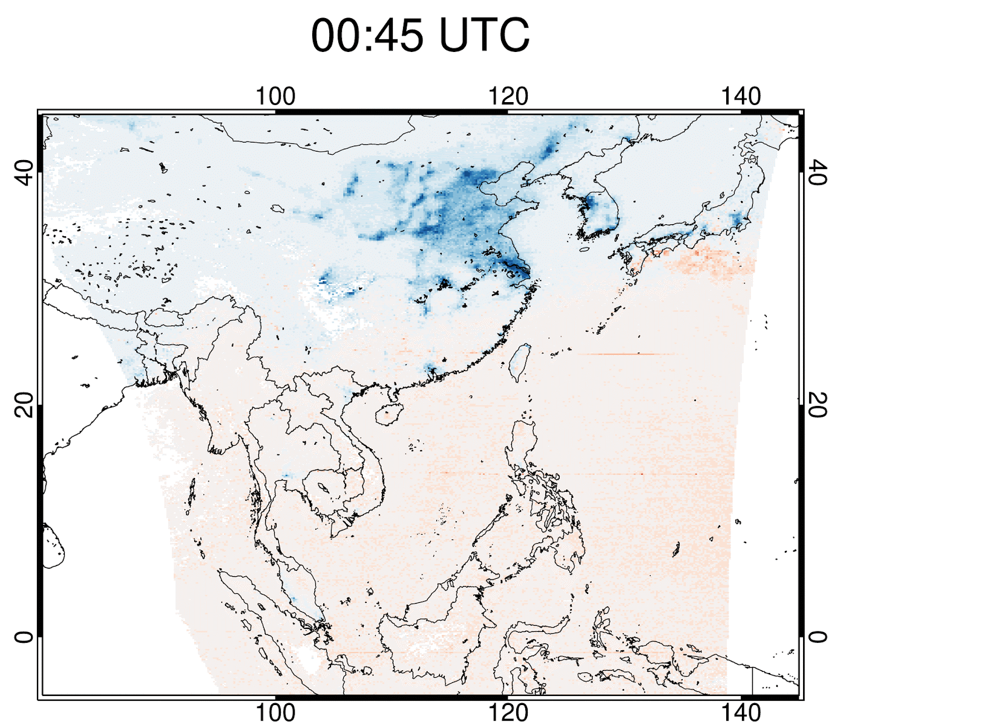
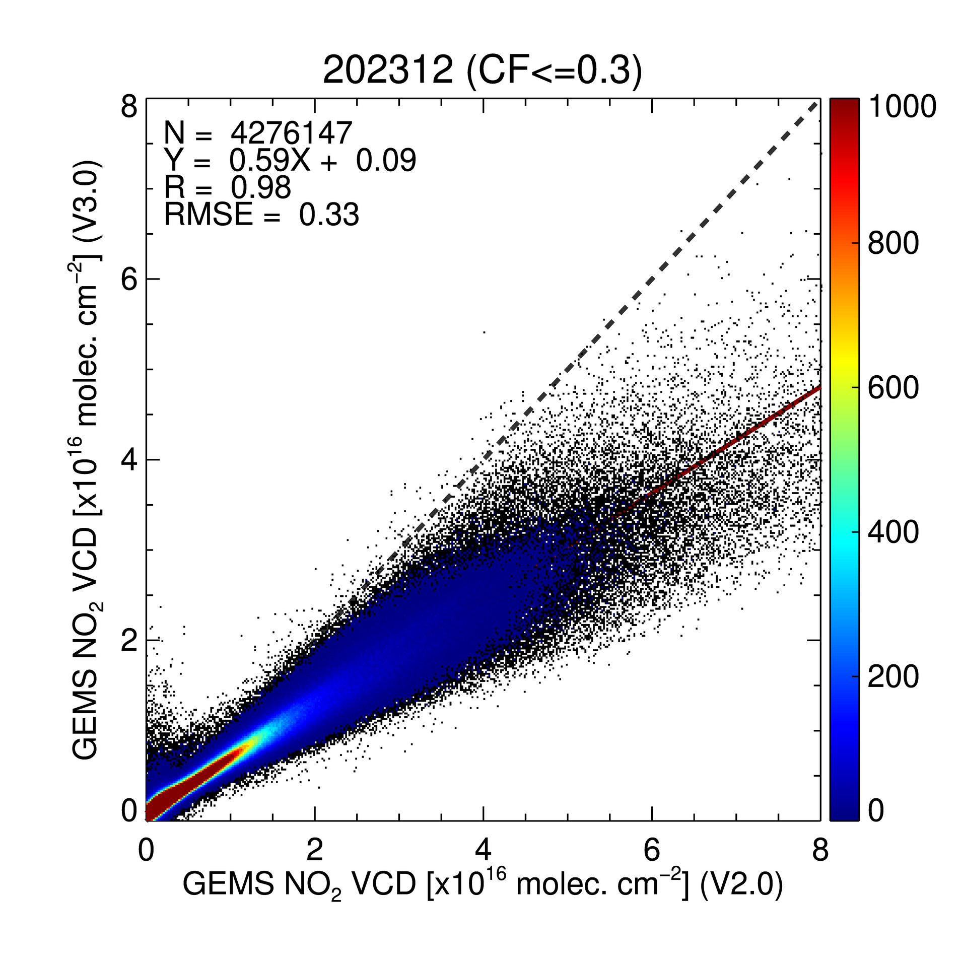
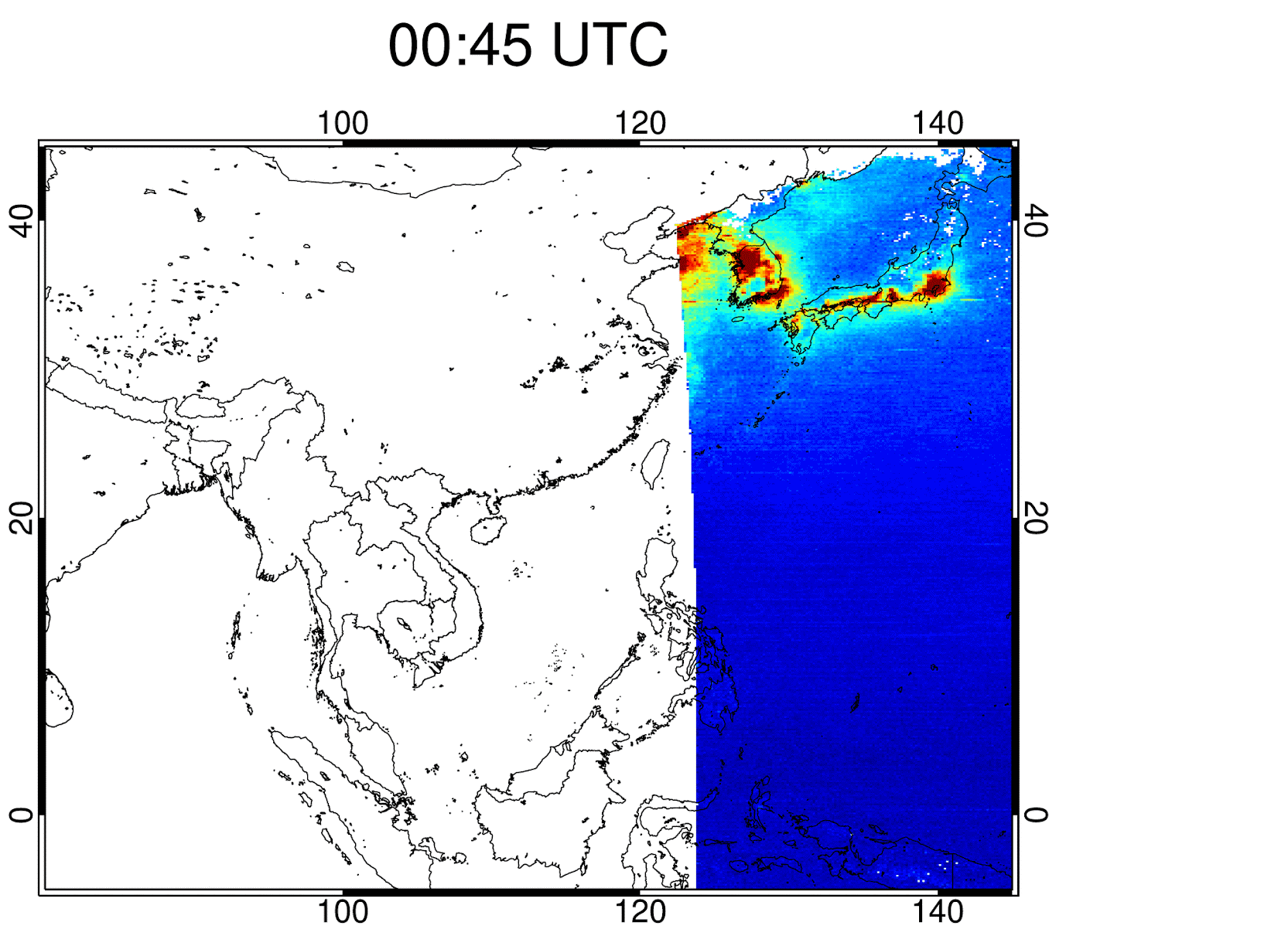
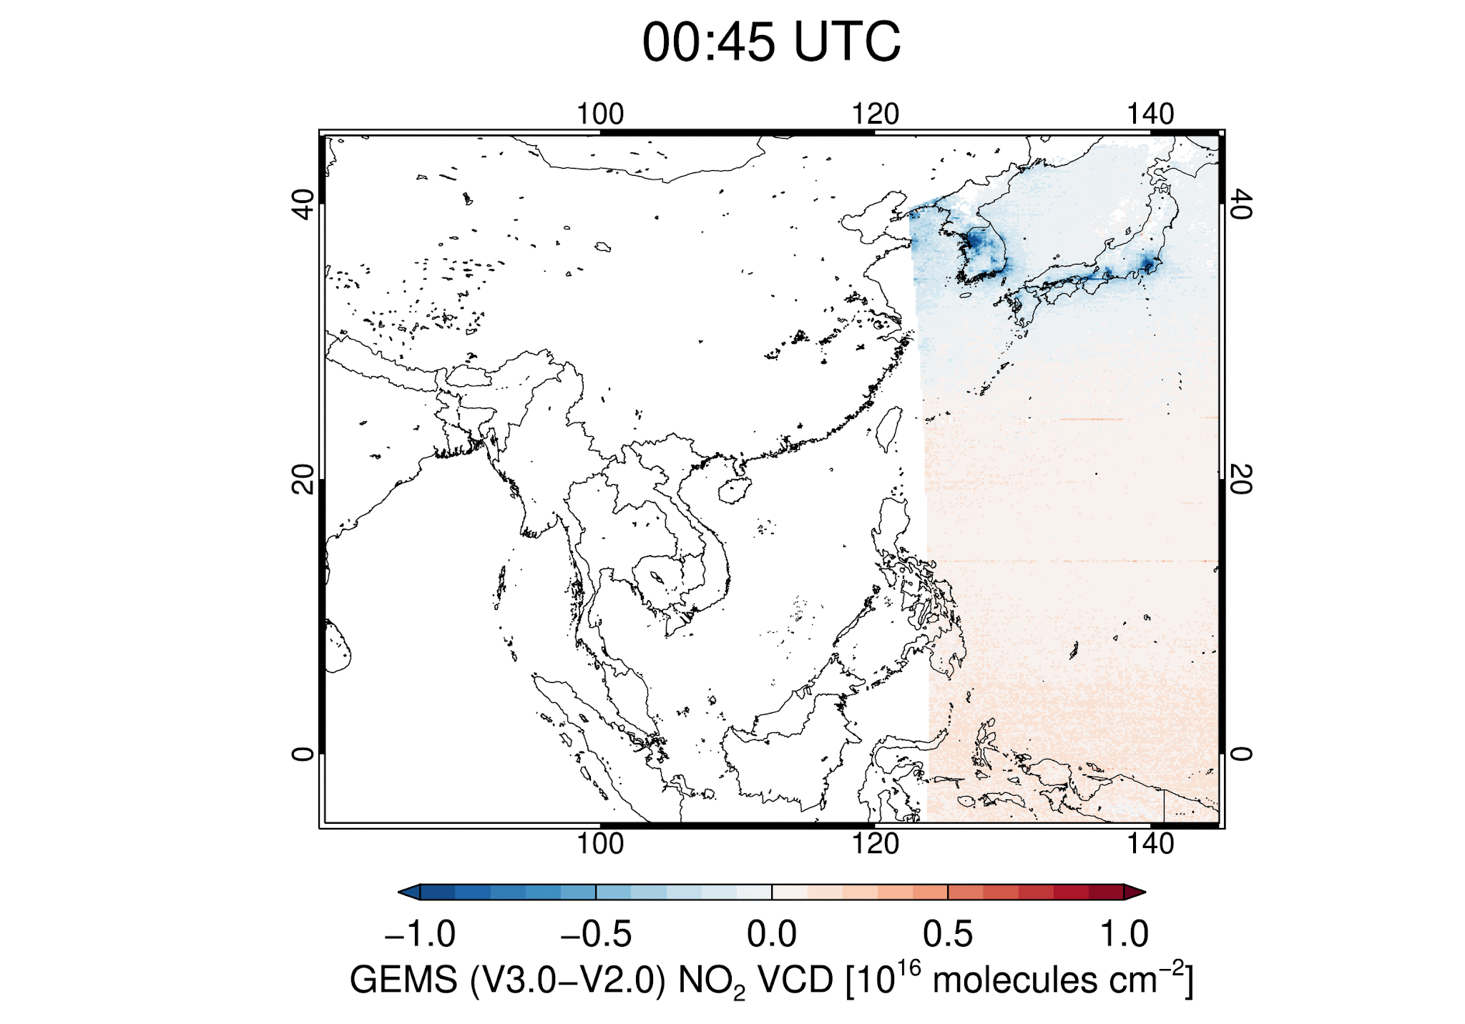
GEMS Total NO₂ V3.0 Products
Difference
(V3.0 – V2.0)
V2.0
V3.0
June 1-15,
2023
Y=0.59X+0.09
R=0.98
RMSE=0.33
DEC
GEMS Total NO₂ VCD (V3.0)
[10¹⁶ molec/cm²]
December 1-15,
2023
GEMS Total NO₂ VCD (V2.0)
[10¹⁶ molec/cm²]
Filtering criteria :
SZA<70º, VZA<70º, CF<0.3
GEMS Total NO₂ VCD [10¹⁶ molec/cm²]
Notes:
Currently, only 4 months of GEMS V3.0 has been partially produced.
The figure shows hourly mean total NO2 for V2.0, V3.0 and their difference As mentioned before, there were significant decrease in high-column regions, especially in winter.
over low-column regions, negative values generally decreased and then result in increasing total NO2.
Although the retrieved products is not sufficient, total NO2 V3.0 showed an overall reduction of approximately 40 % in December.

Slide 10
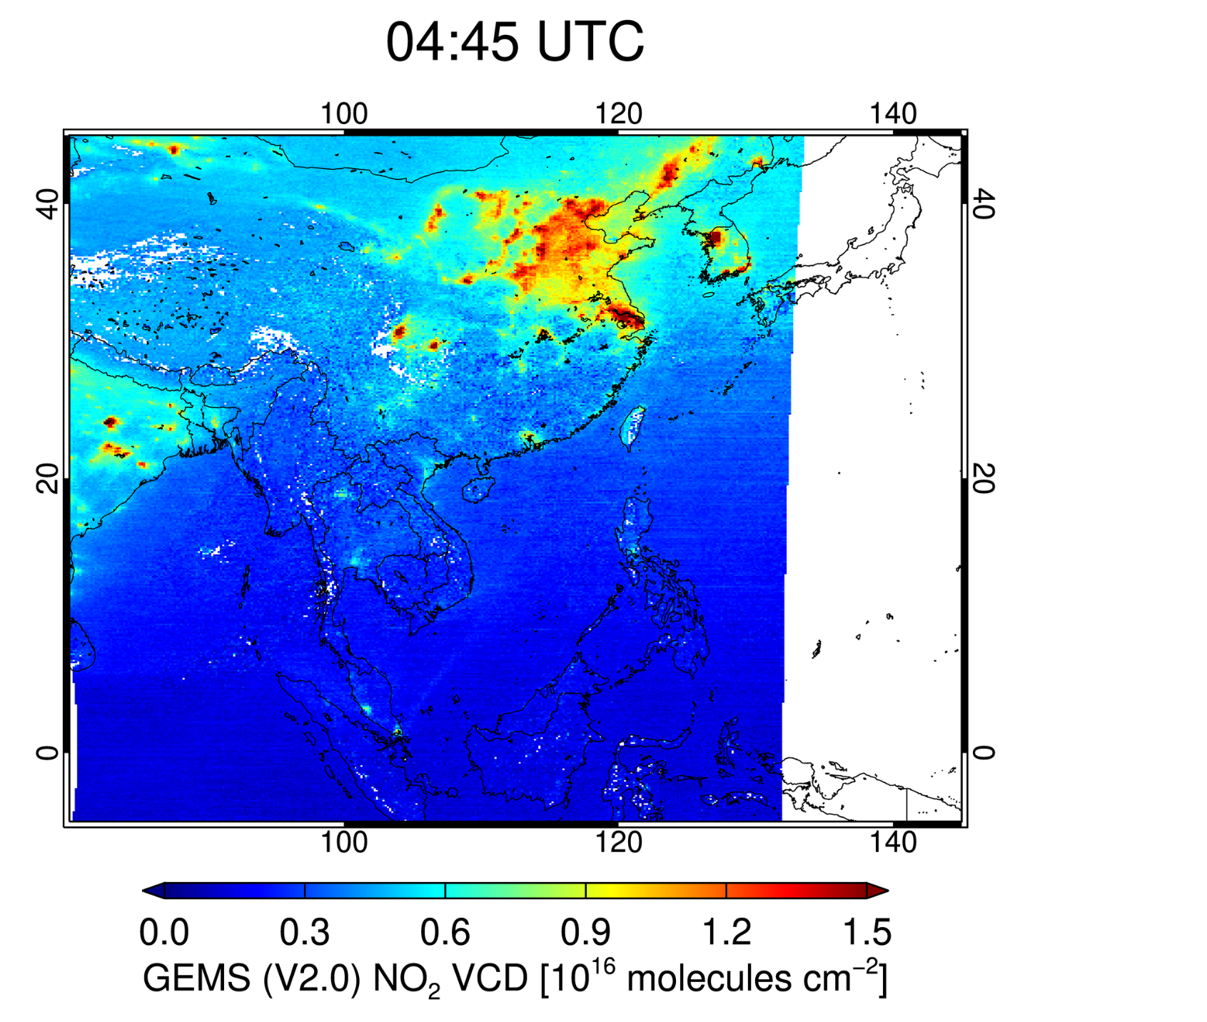
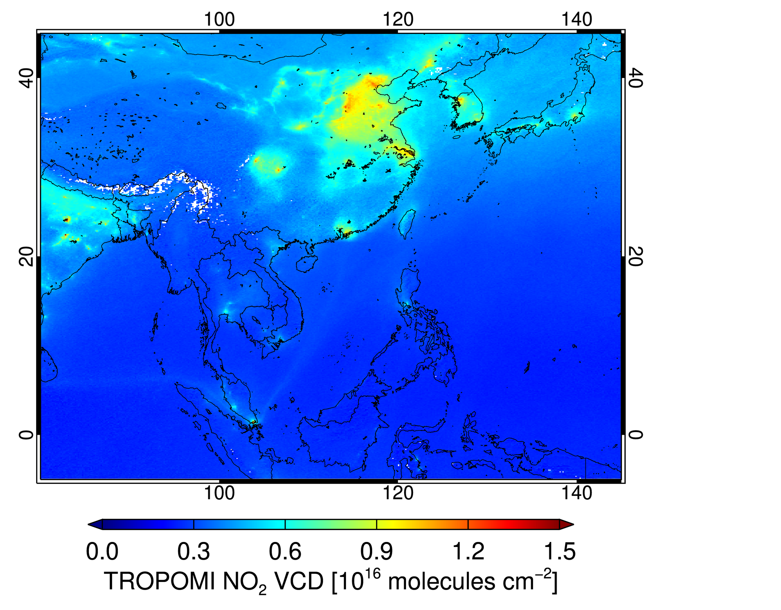
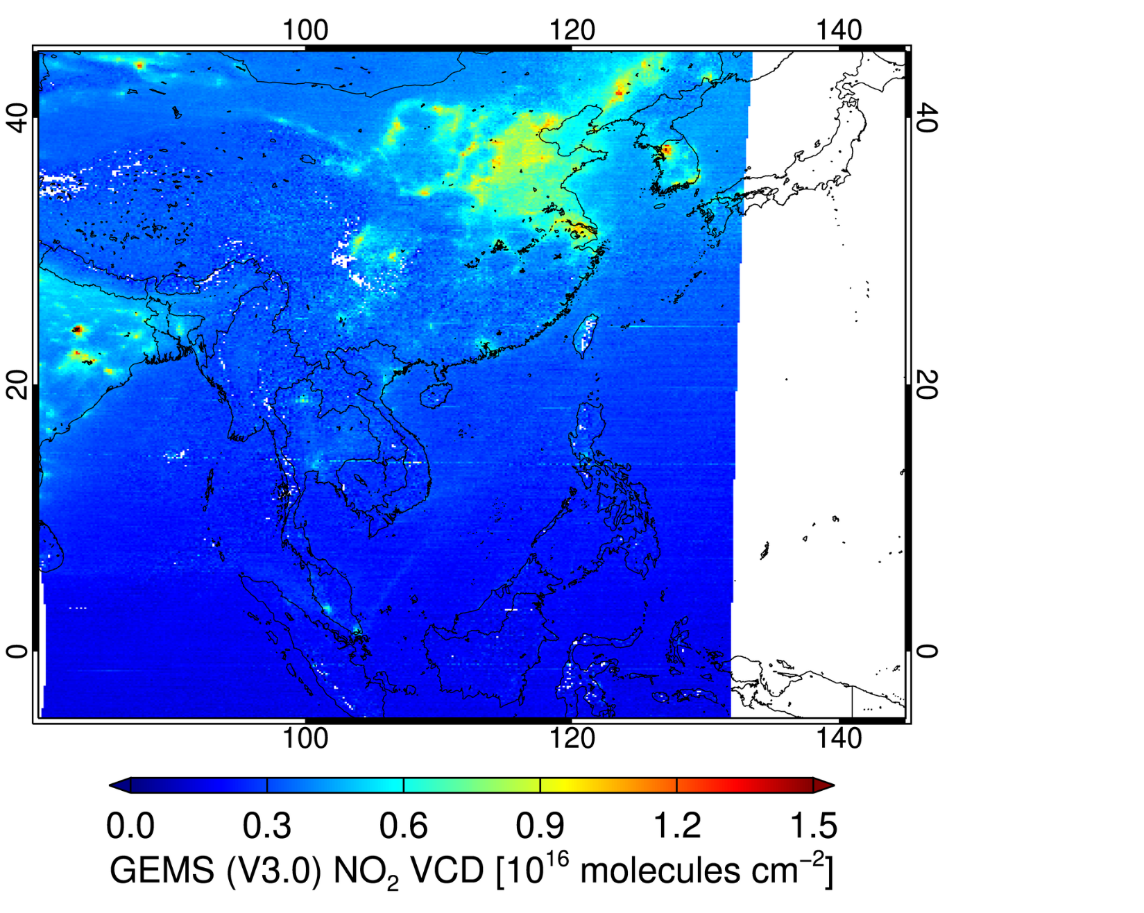
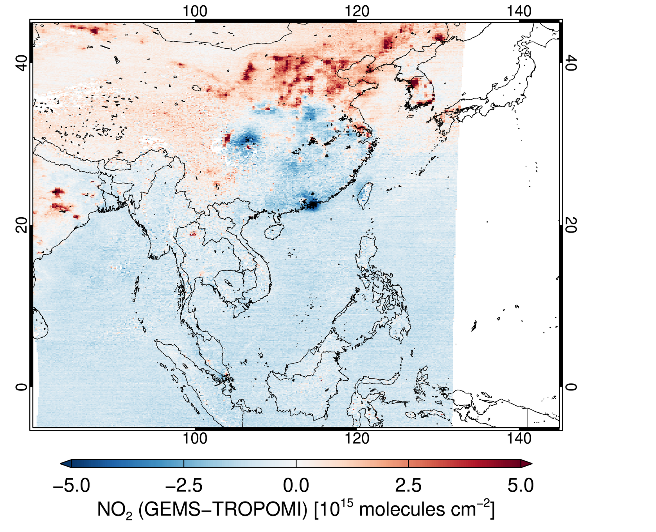
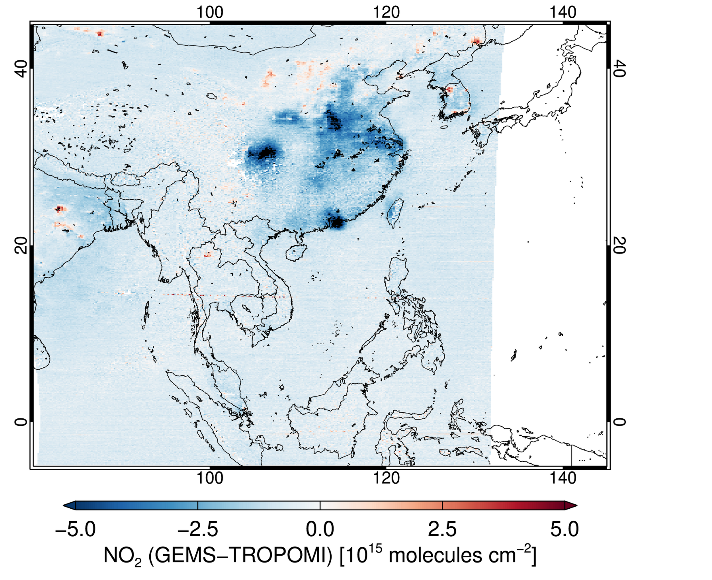
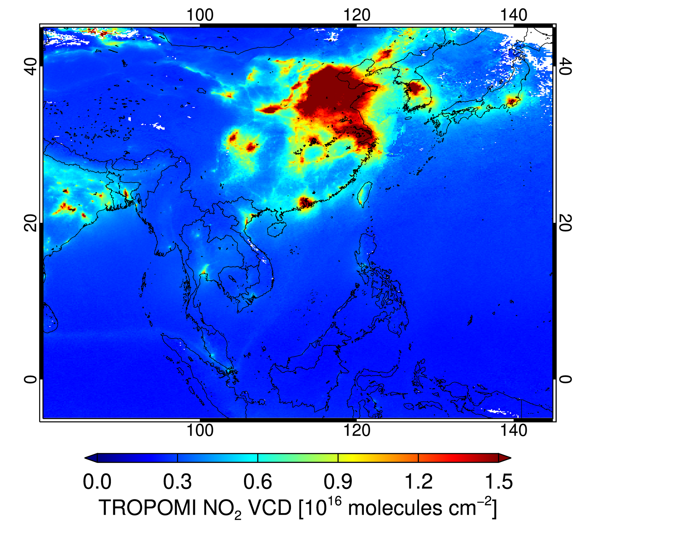
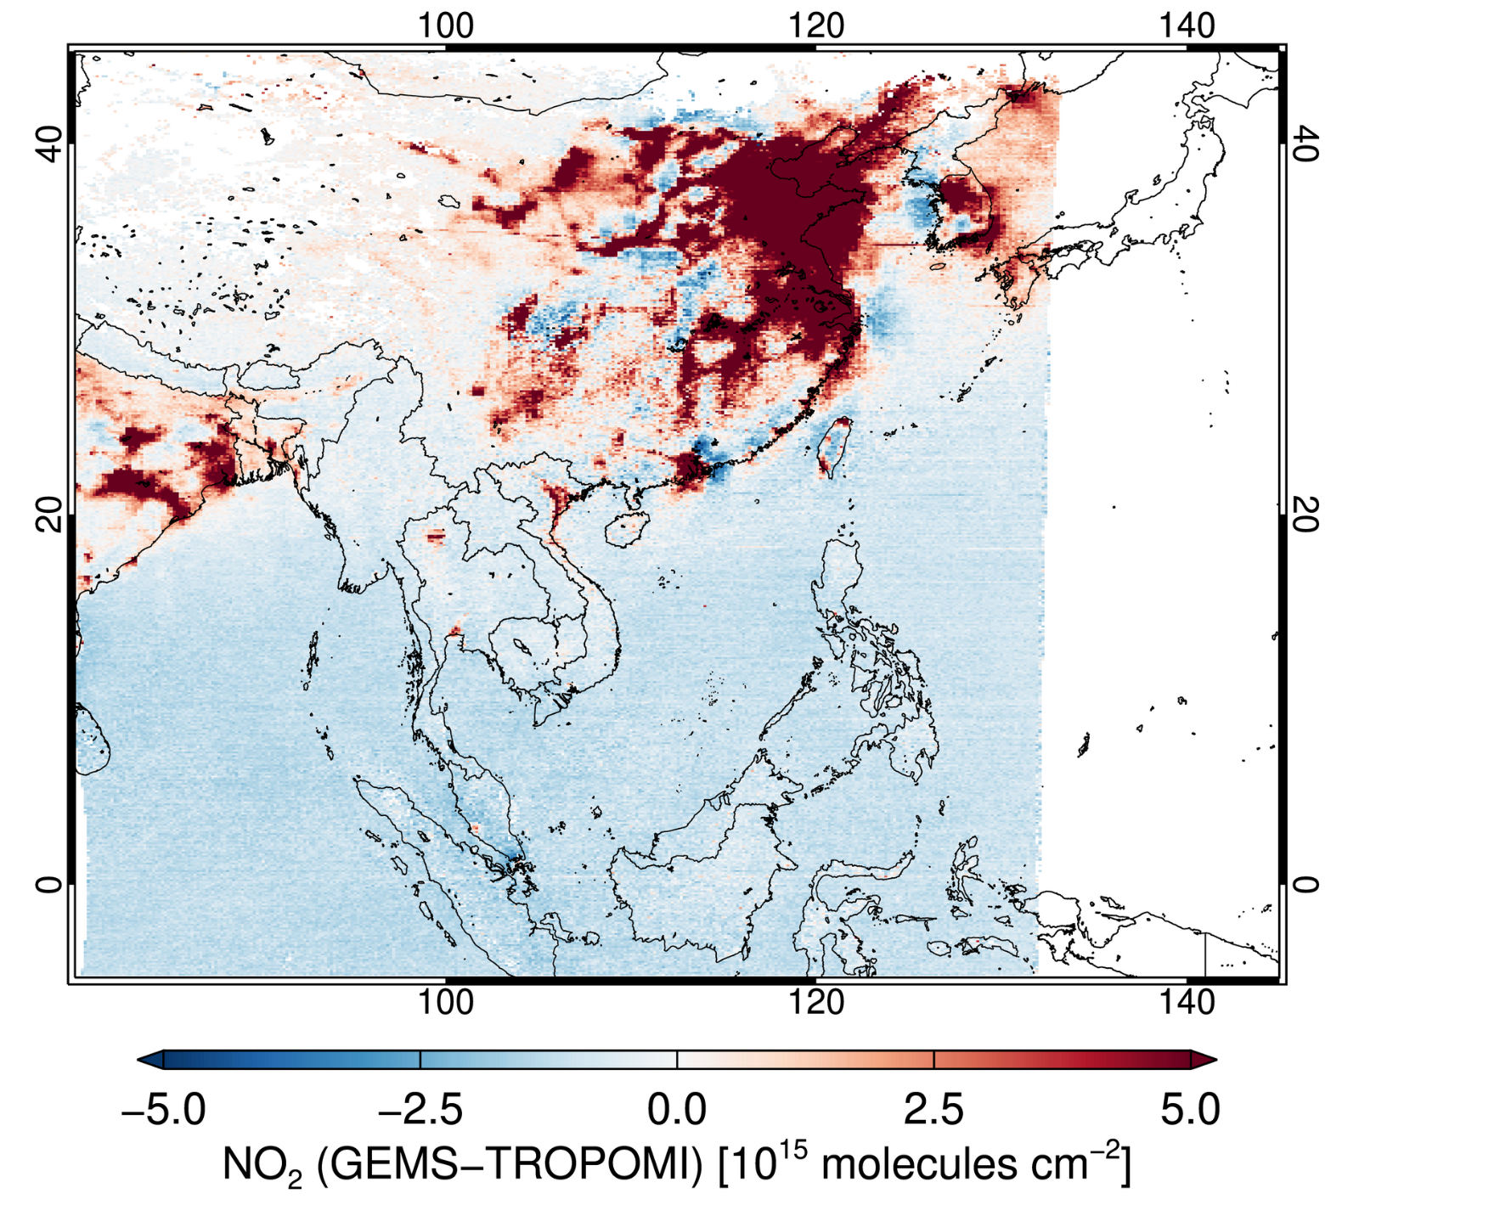
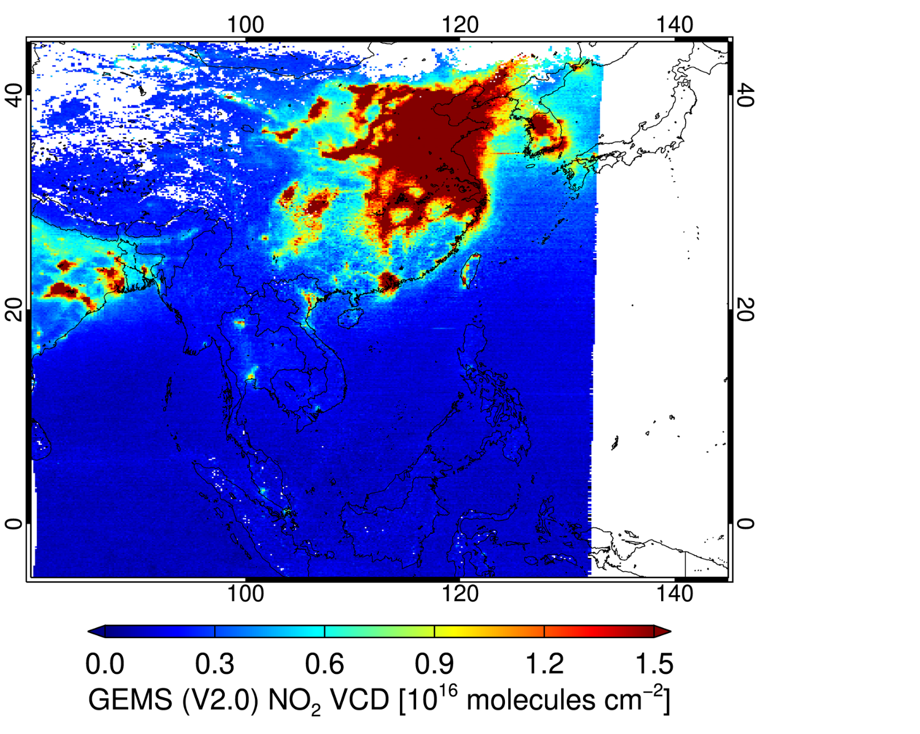
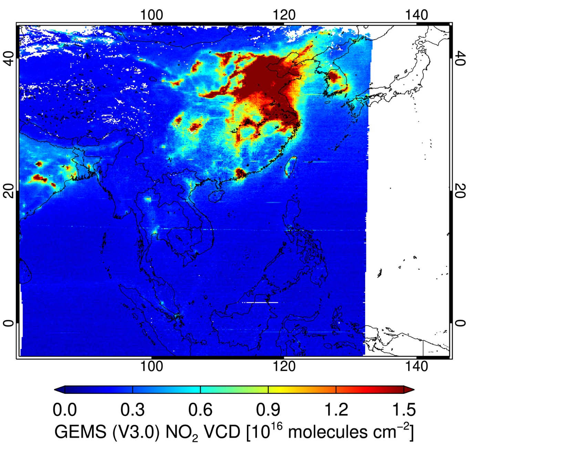
GEMS Total NO₂ V2.0 and V3.0 vs. TROPOMI
Difference [%]
(V2.0-TROPOMI)
Difference [%]
(V3.0-TROPOMI)
GEMS
(04:45)
TROPOMI
GEMS (V2.0)
GEMS (V3.0)
June 1-15,
2023
Difference (GEMS-TROPOMI) of Total NO₂
[10¹⁵ molec/cm²]
Total NO₂ VCD [10¹⁶ molec/cm²]
December 1-15,
2023
Notes:
Compared to TROPOMI,
V2.0 shows large differences in high-column regions,
But, GEMS V3.0 shows similar or lower values than TROPOMI in June.
In December, GEMS V3.0 generally shows lower values, but in high-column regions, it either increases or displays a pattern compared to TROPOMI.

Slide 11
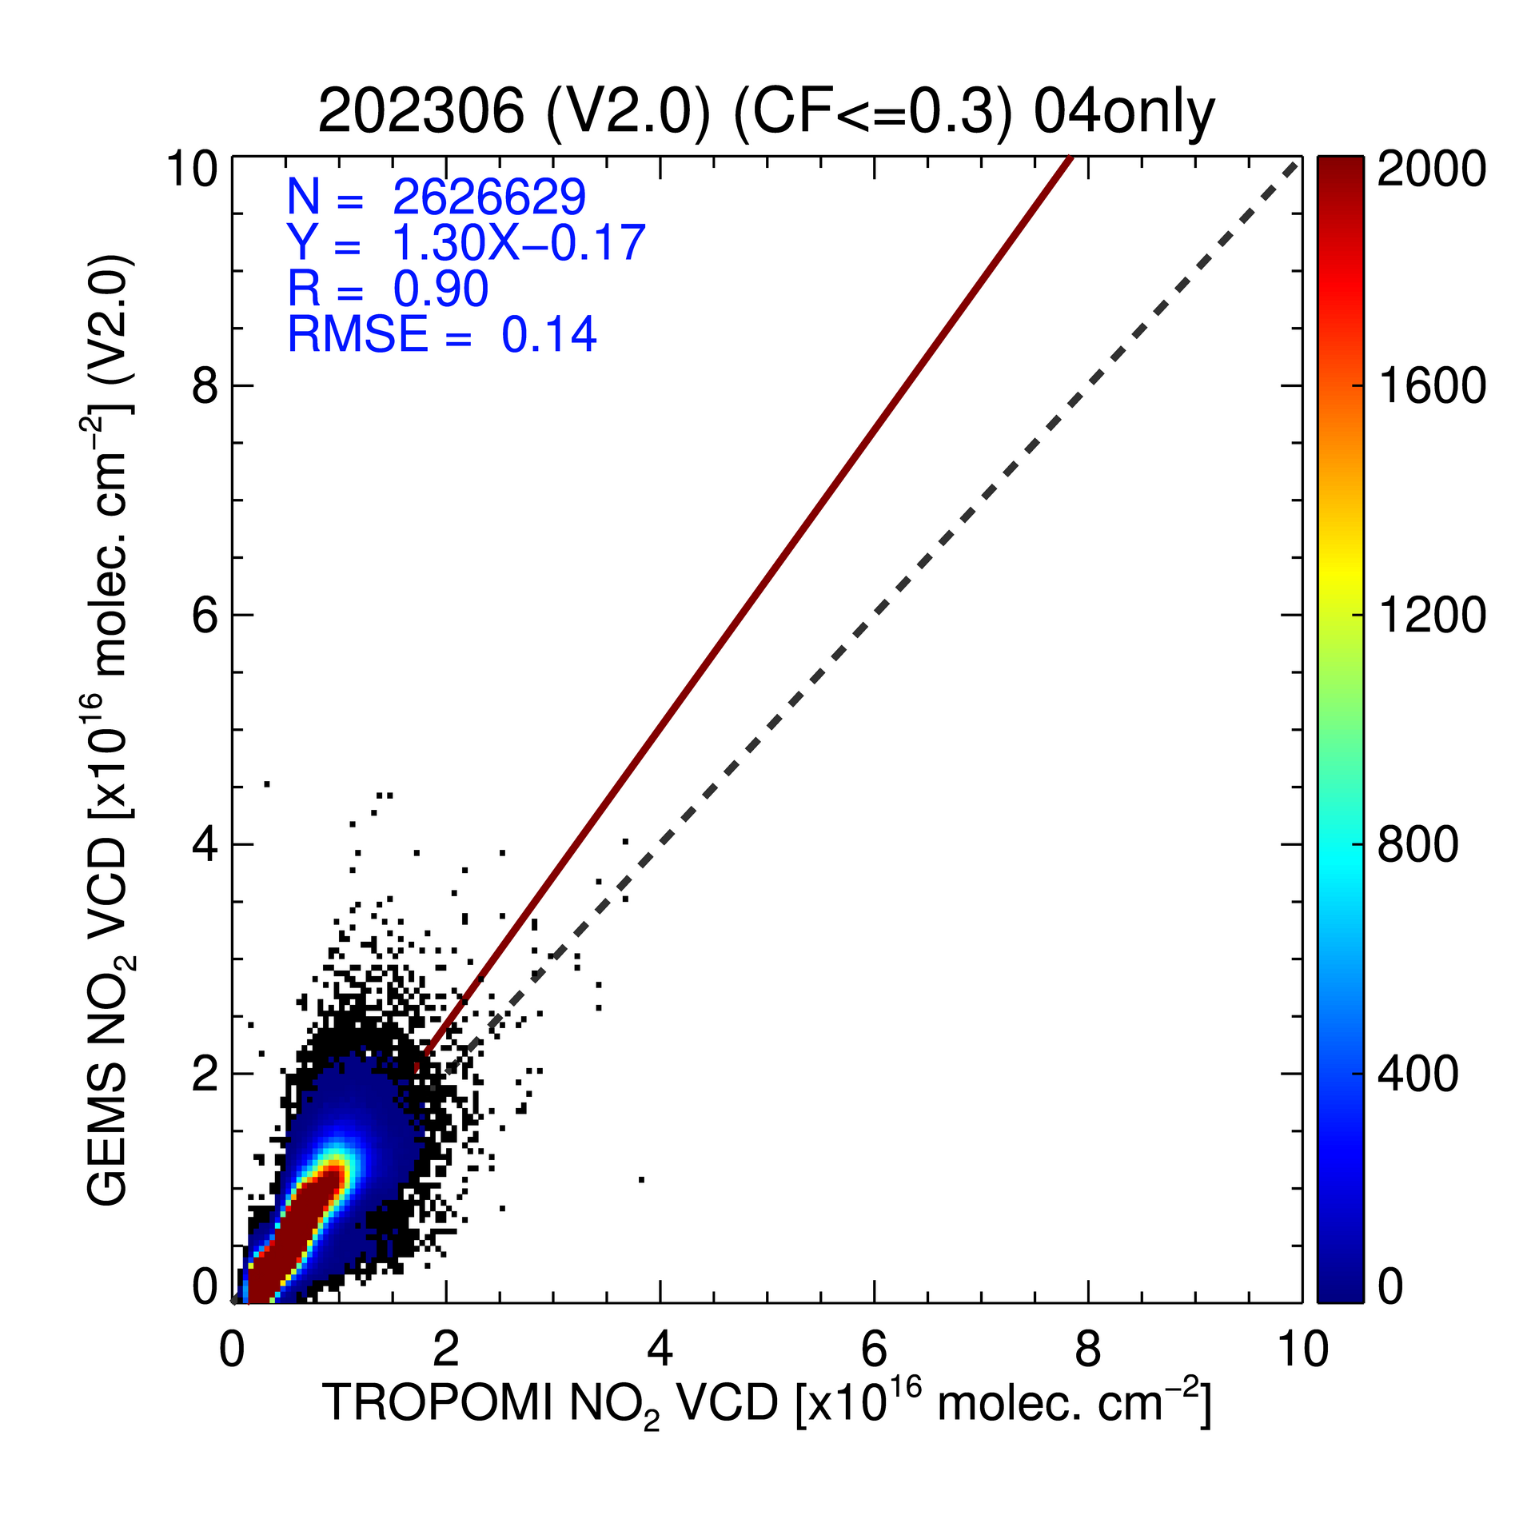
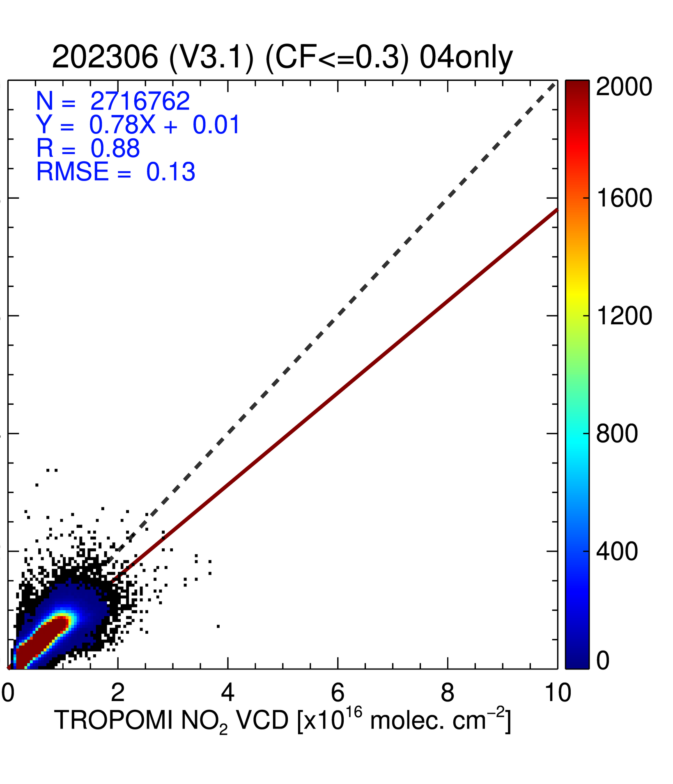
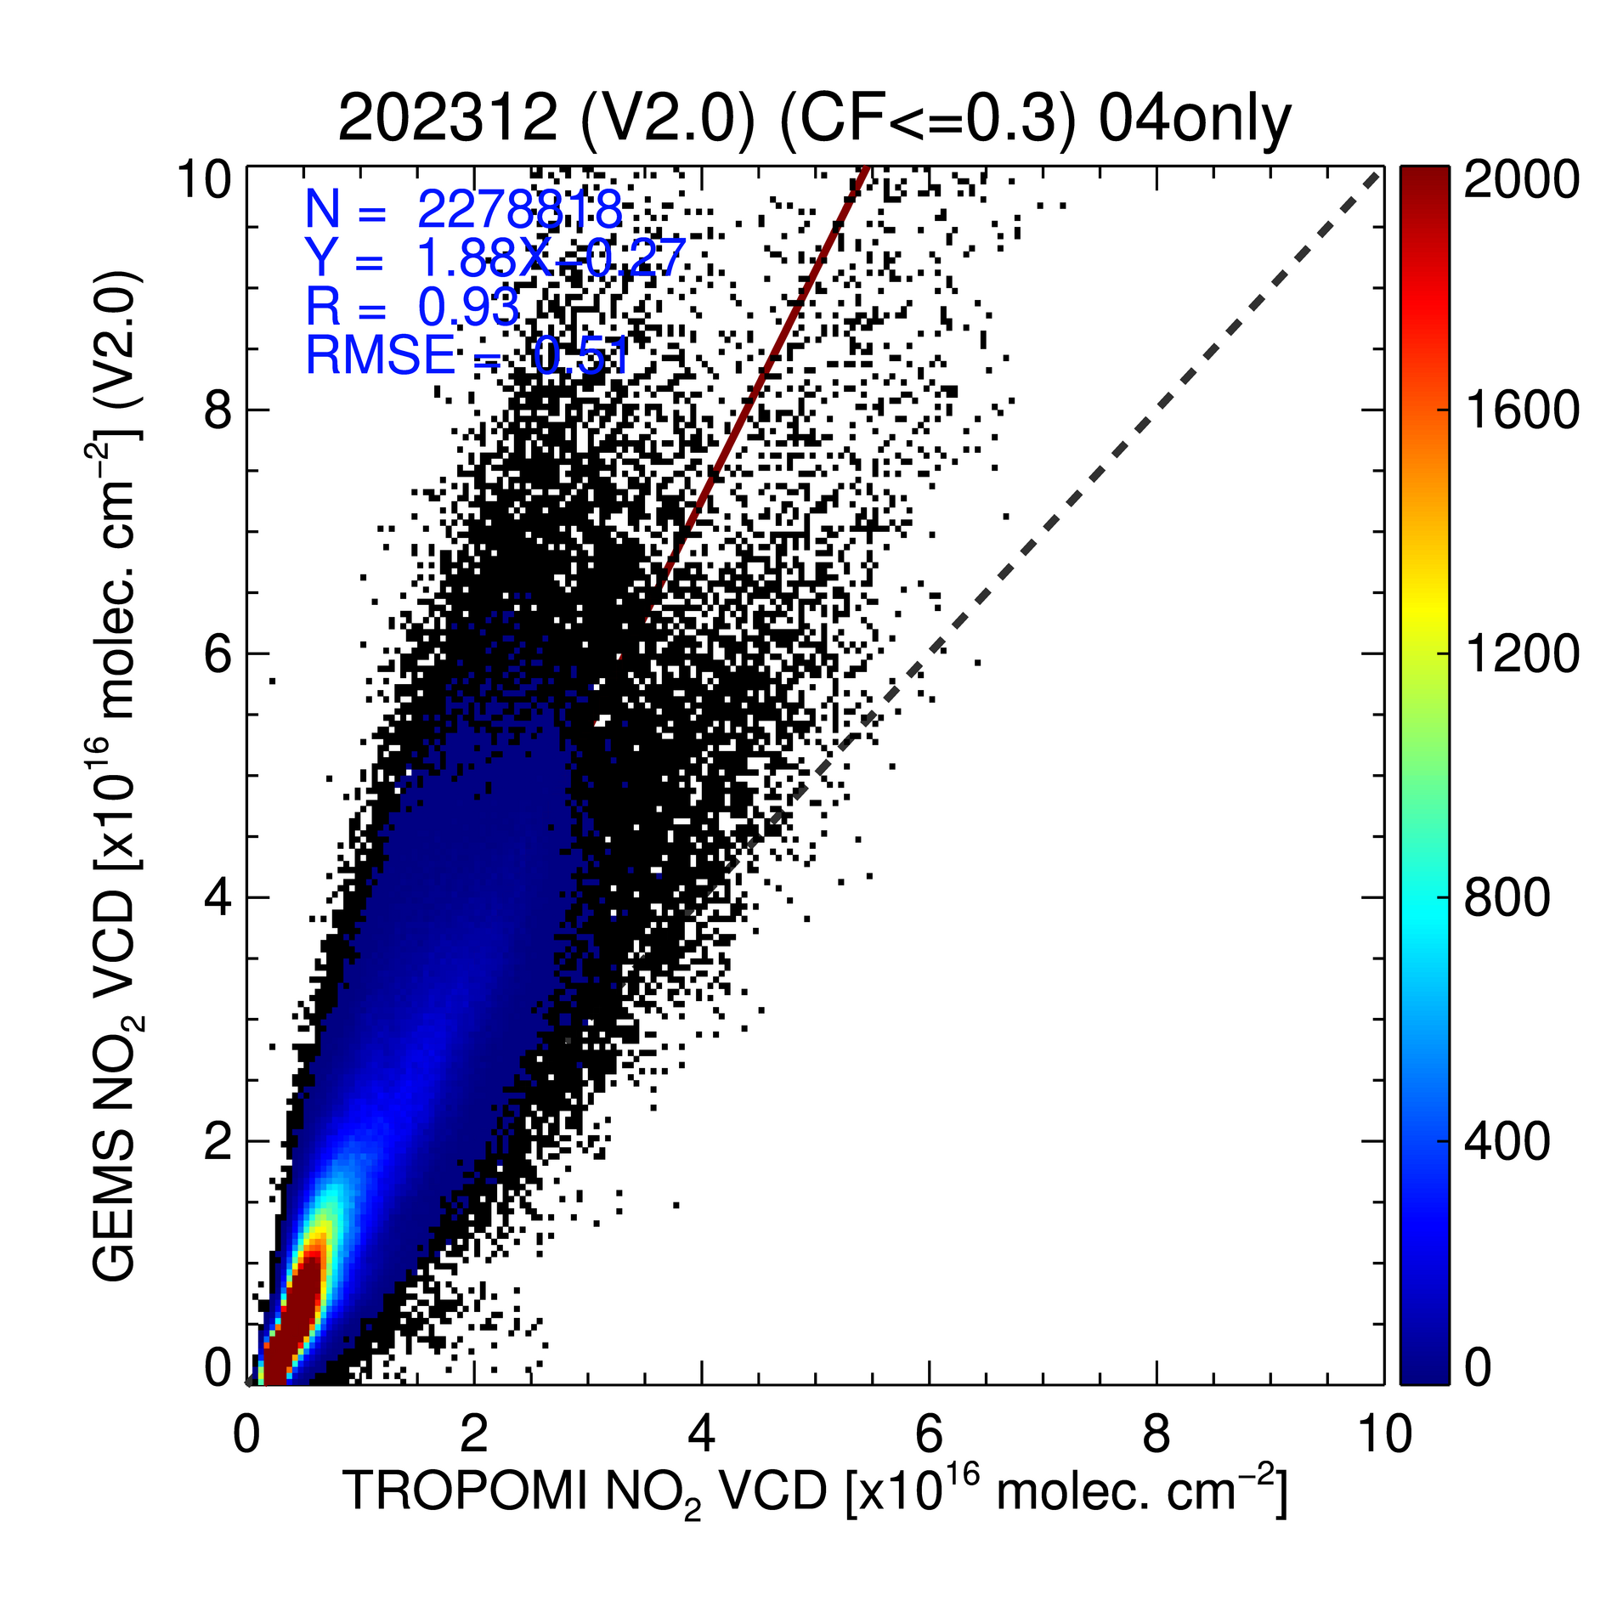
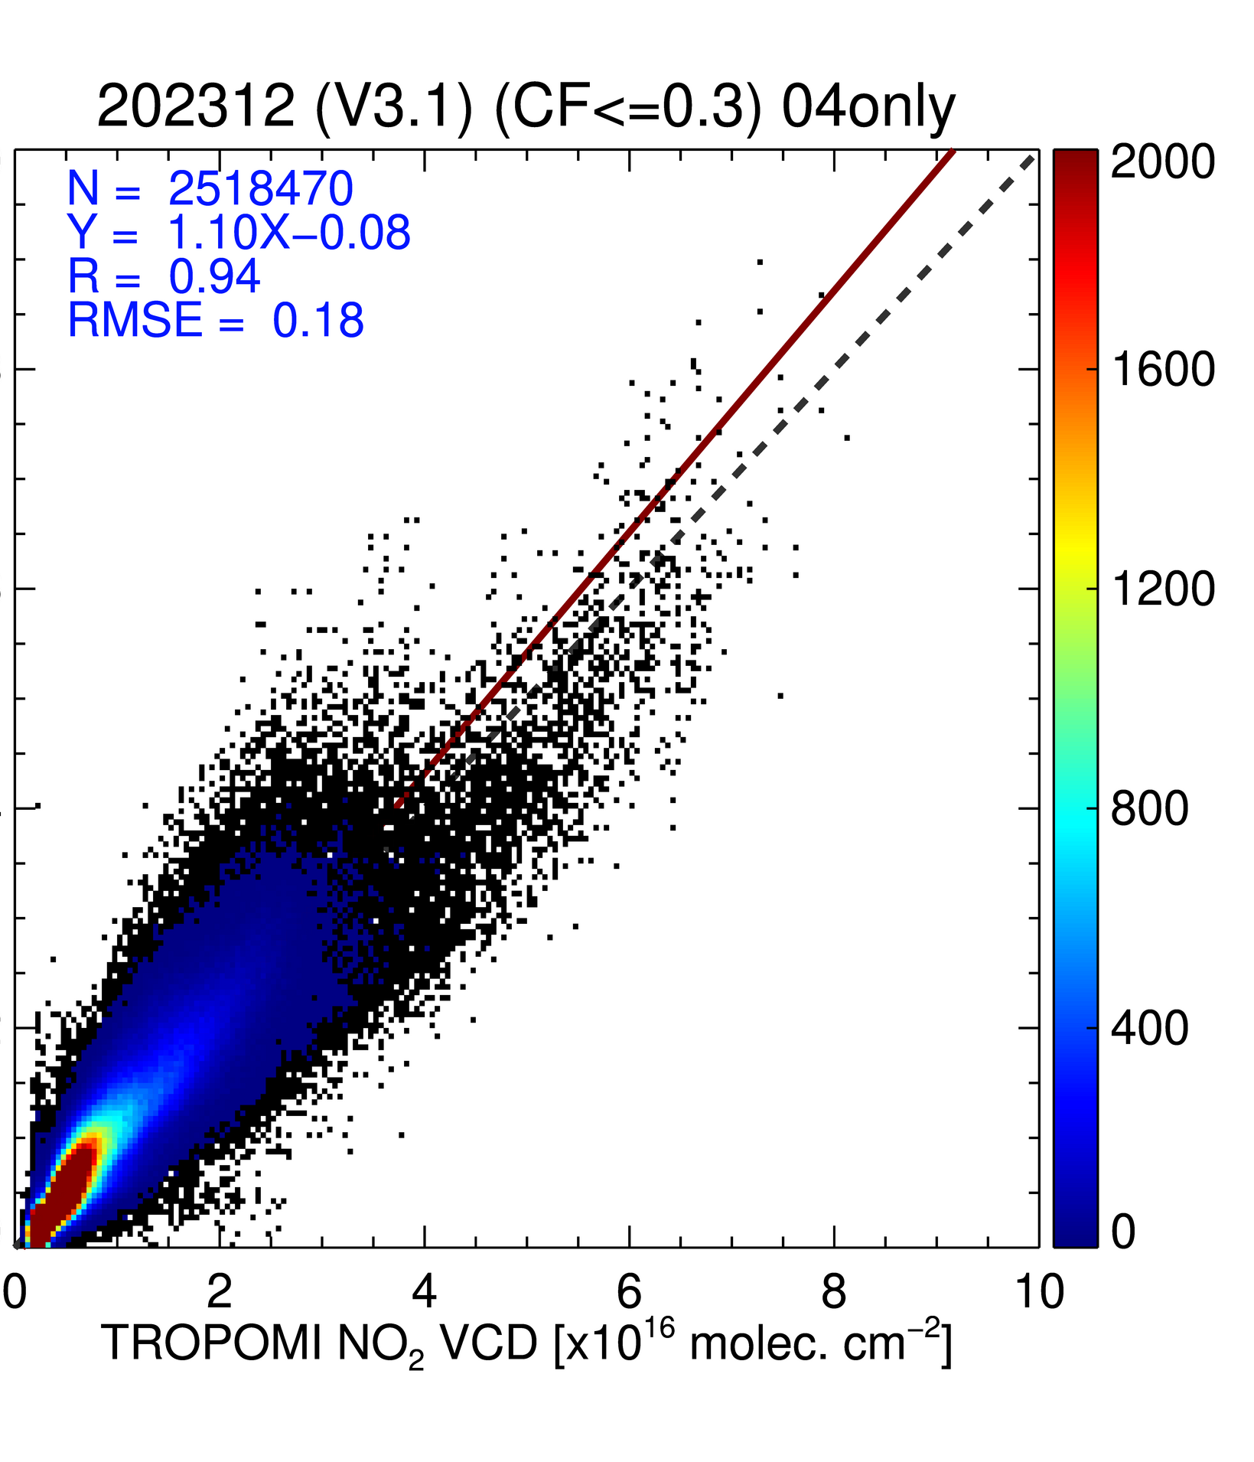
GEMS Total NO₂ V2.0 and V3.0 vs. TROPOMI
June 1-15, 2023
December 1-15, 2023
N=2626629
Y=1.30-0.17
R=0.90
RMSE=0.14
N=2716762
Y=0.78+0.01
R=0.88
RMSE=0.13
GEMS Total NO₂ VCD
[10¹⁶ molec/cm²]
N=22788818
Y=1.88+1.27
R=0.93
RMSE=0.51
N=2518470
Y=1.10X-0.08
R=0.94
RMSE=0.18
V2.0
V3.0
V2.0
V3.0
TROPOMI Total NO₂ VCD [10¹⁶ molec/cm²]
 |  | 2023/03 |  | 2023/06 |  | 2023/09 |  | 2023/12
 |  | V2.0 | V3.0 | V2.0 | V3.0 | V2.0 | V3.0 | V2.0 | V3.0
Total | Slope (R) | 1.58 (0.93) | 0.89 (0.92) | 1.30 (0.90) | 0.78 (0.88) | 1.58 (0.88) | 0.87 (0.88) | 1.88 (0.93) | 1.10 (0.94)
Filtering criteria :
SZA<70º, VZA<70º, CF<0.3
Notes:
The results calculated for March, June, September, and December 2023, for the 1st to the 15th of each month, showed that the absolute difference decreased across all months.
While V2.0 showed significantly higher values than TROPOMI for all months,
V3.0 showed a decreasing values in all months except December.
In December, TROPOMI was reported to have been approximately 10% lower than ground-based observation data, whereas V3.0 shows about a 10% positive bias.
Therefore, long-term retrievals of V3.0 are expected to yield promising results in comparison with ground-based observation data.

Slide 12
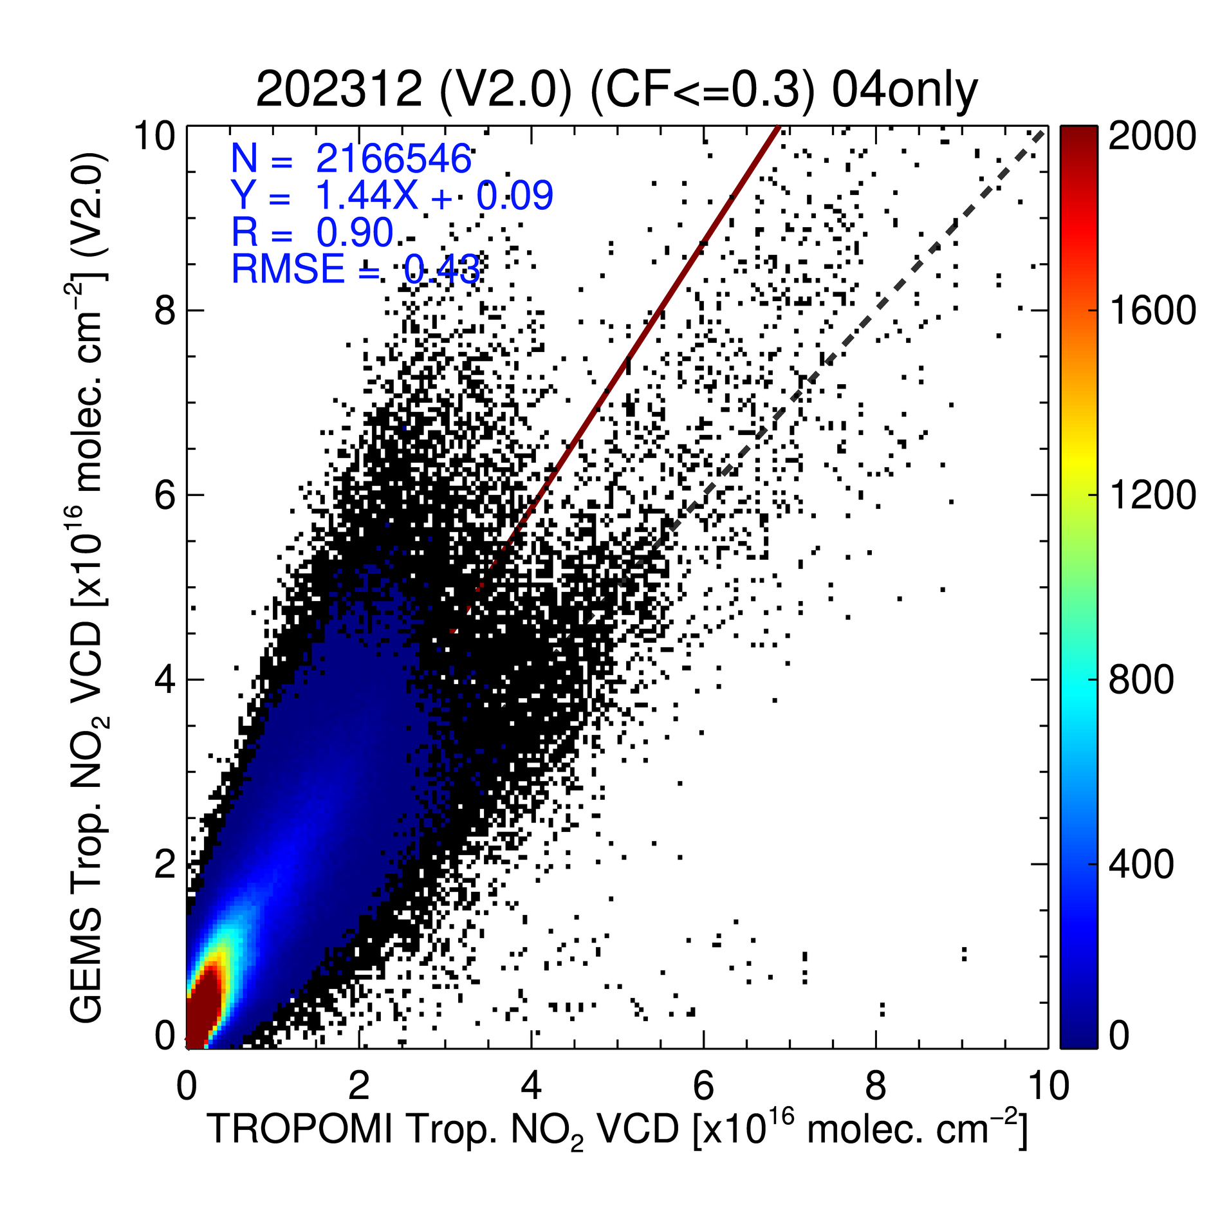
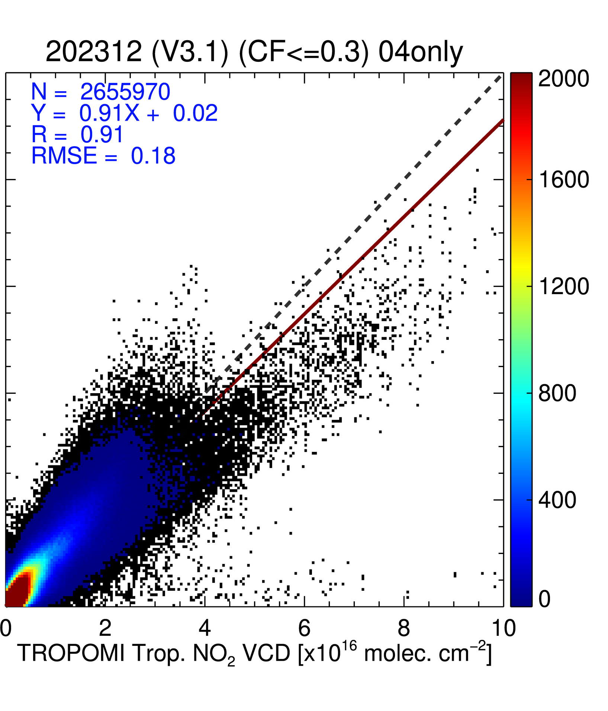
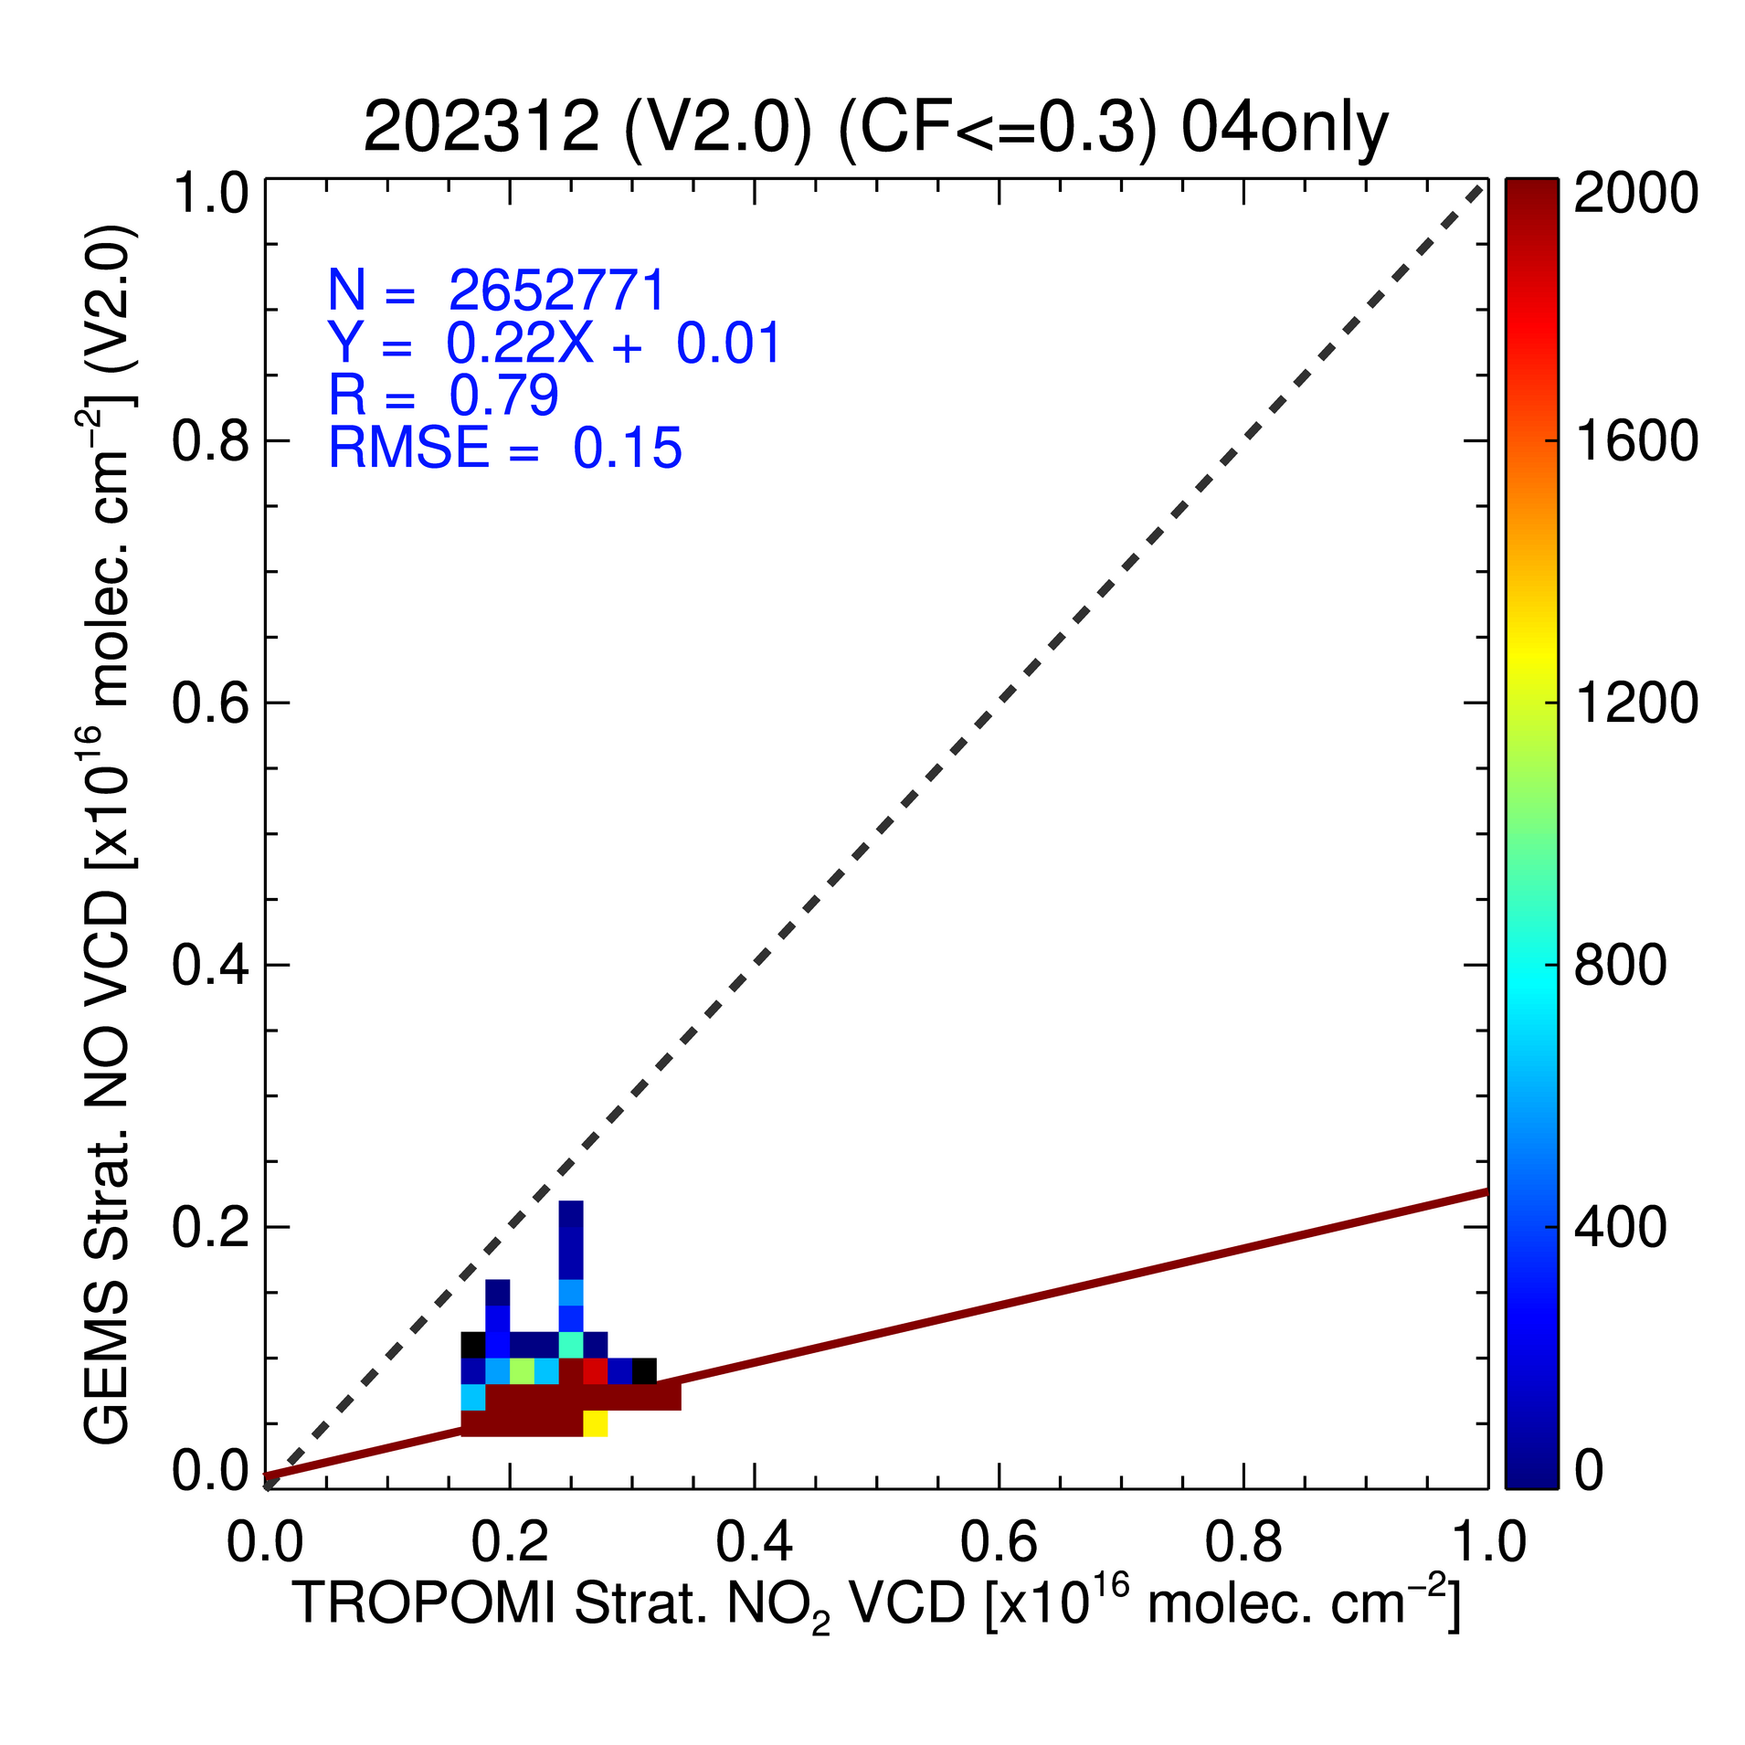
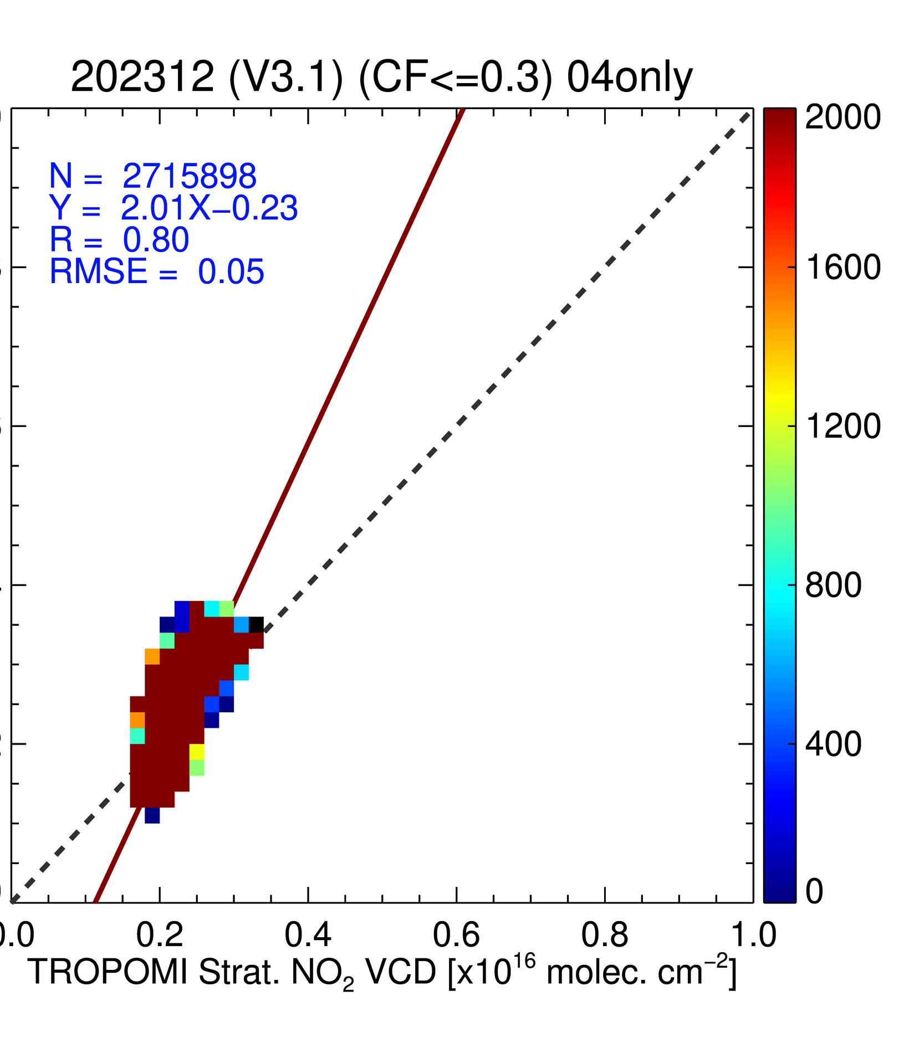
GEMS Trop & Strat NO₂ V2.0 and V3.0 vs. TROPOMI
Tropospheric NO₂
(December 1-15, 2023)
Stratospheric NO₂
(December 1-15, 2023)
N=2166546
Y=1.44X+0.09
R=0.90
RMSE=0.43
N=2655970
Y=0.91X+0.02
R=0.91
RMSE=0.18
N=2652771
Y=0.22X+0.01
R=0.79
RMSE=0.15
N=2715898
Y=2.01-0.23
R=0.80
RMSE=0.05
GEMS Total NO₂ VCD
[10¹⁶ molec/cm²]
V2.0
V3.0
V2.0
V3.0
TROPOMI Total NO₂ VCD [10¹⁶ molec/cm²]
→ The improvement is expected to optimization of threshold in Stratosphere-Troposphere-Separation (STS).
 |  | 2023/03 |  | 2023/06 |  | 2023/09 |  | 2023/12
 |  | V2.0 | V3.0 | V2.0 | V3.0 | V2.0 | V3.0 | V2.0 | V3.0
Troposphere | Slope (R) | 1.25 (0.87) | 0.70 (0.89) | 1.16 (0.79) | 0.42 (0.71) | 1.37 (0.78) | 0.47 (0.64) | 1.44 (0.90) | 0.91 (0.91)
Stratosphere | Slope (R) | 0.22 (0.88) | 1.49 (0.89) | 0.27 (0.94) | 1.42 (0.95) | 0.24 (0.89) | 1.63 (0.92) | 0.22 (0.79) | 2.01 (0.80)
Filtering criteria :
SZA<70º, VZA<70º, CF<0.3
Notes:
In addition to total NO2, tropospheric NO2 also showed a decrease of approximately 40% in December.
However, in all seasons except winter, the slope of tropospheric NO2 in V3.0 tends to be significantly under-estimated compared to V2.0.
For the stratosphere, the unreasonably low values in V2.0 were somewhat corrected to more reasonable values in V3.0.
This improvement is expected to continue through further optimization of the threshold in the STS method and better representation of the tropopause.

Slide 13
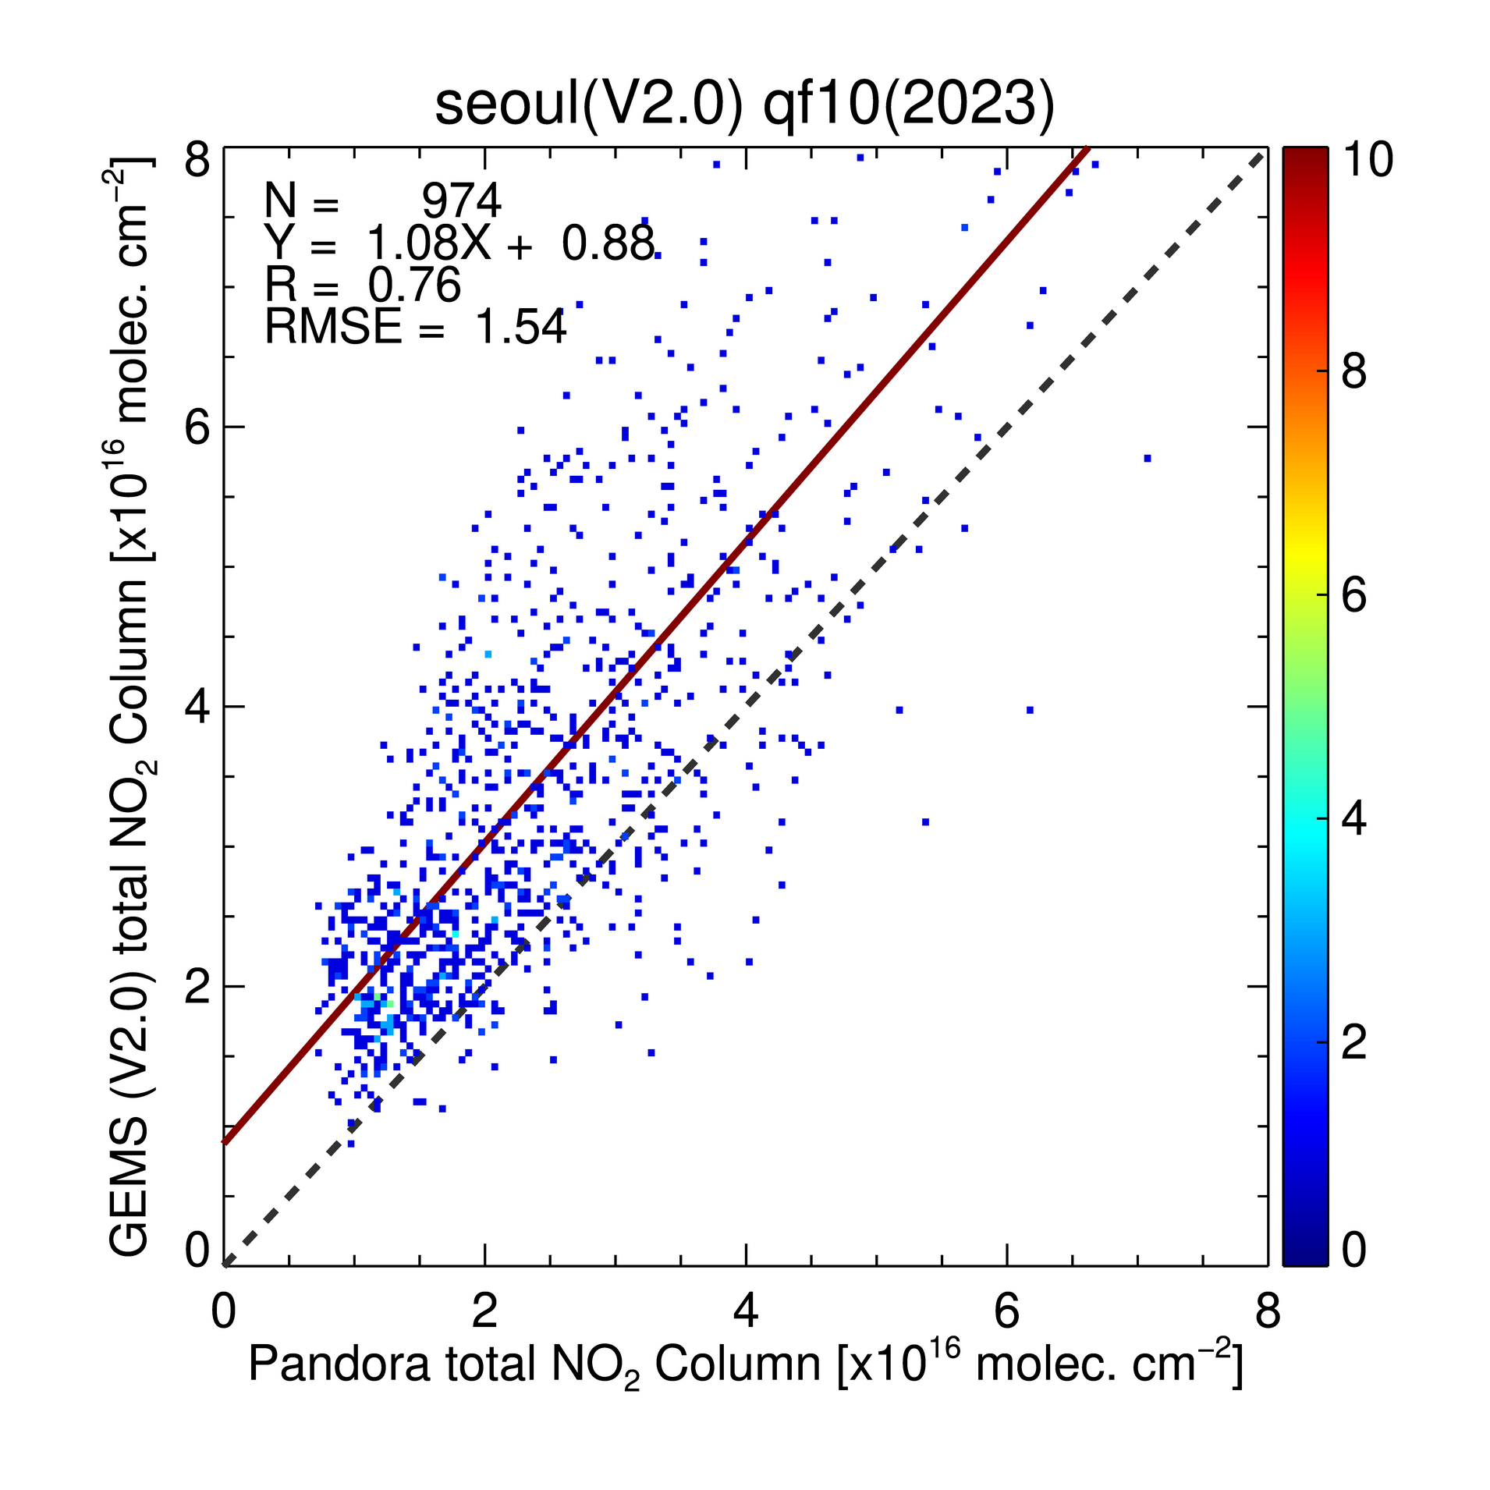
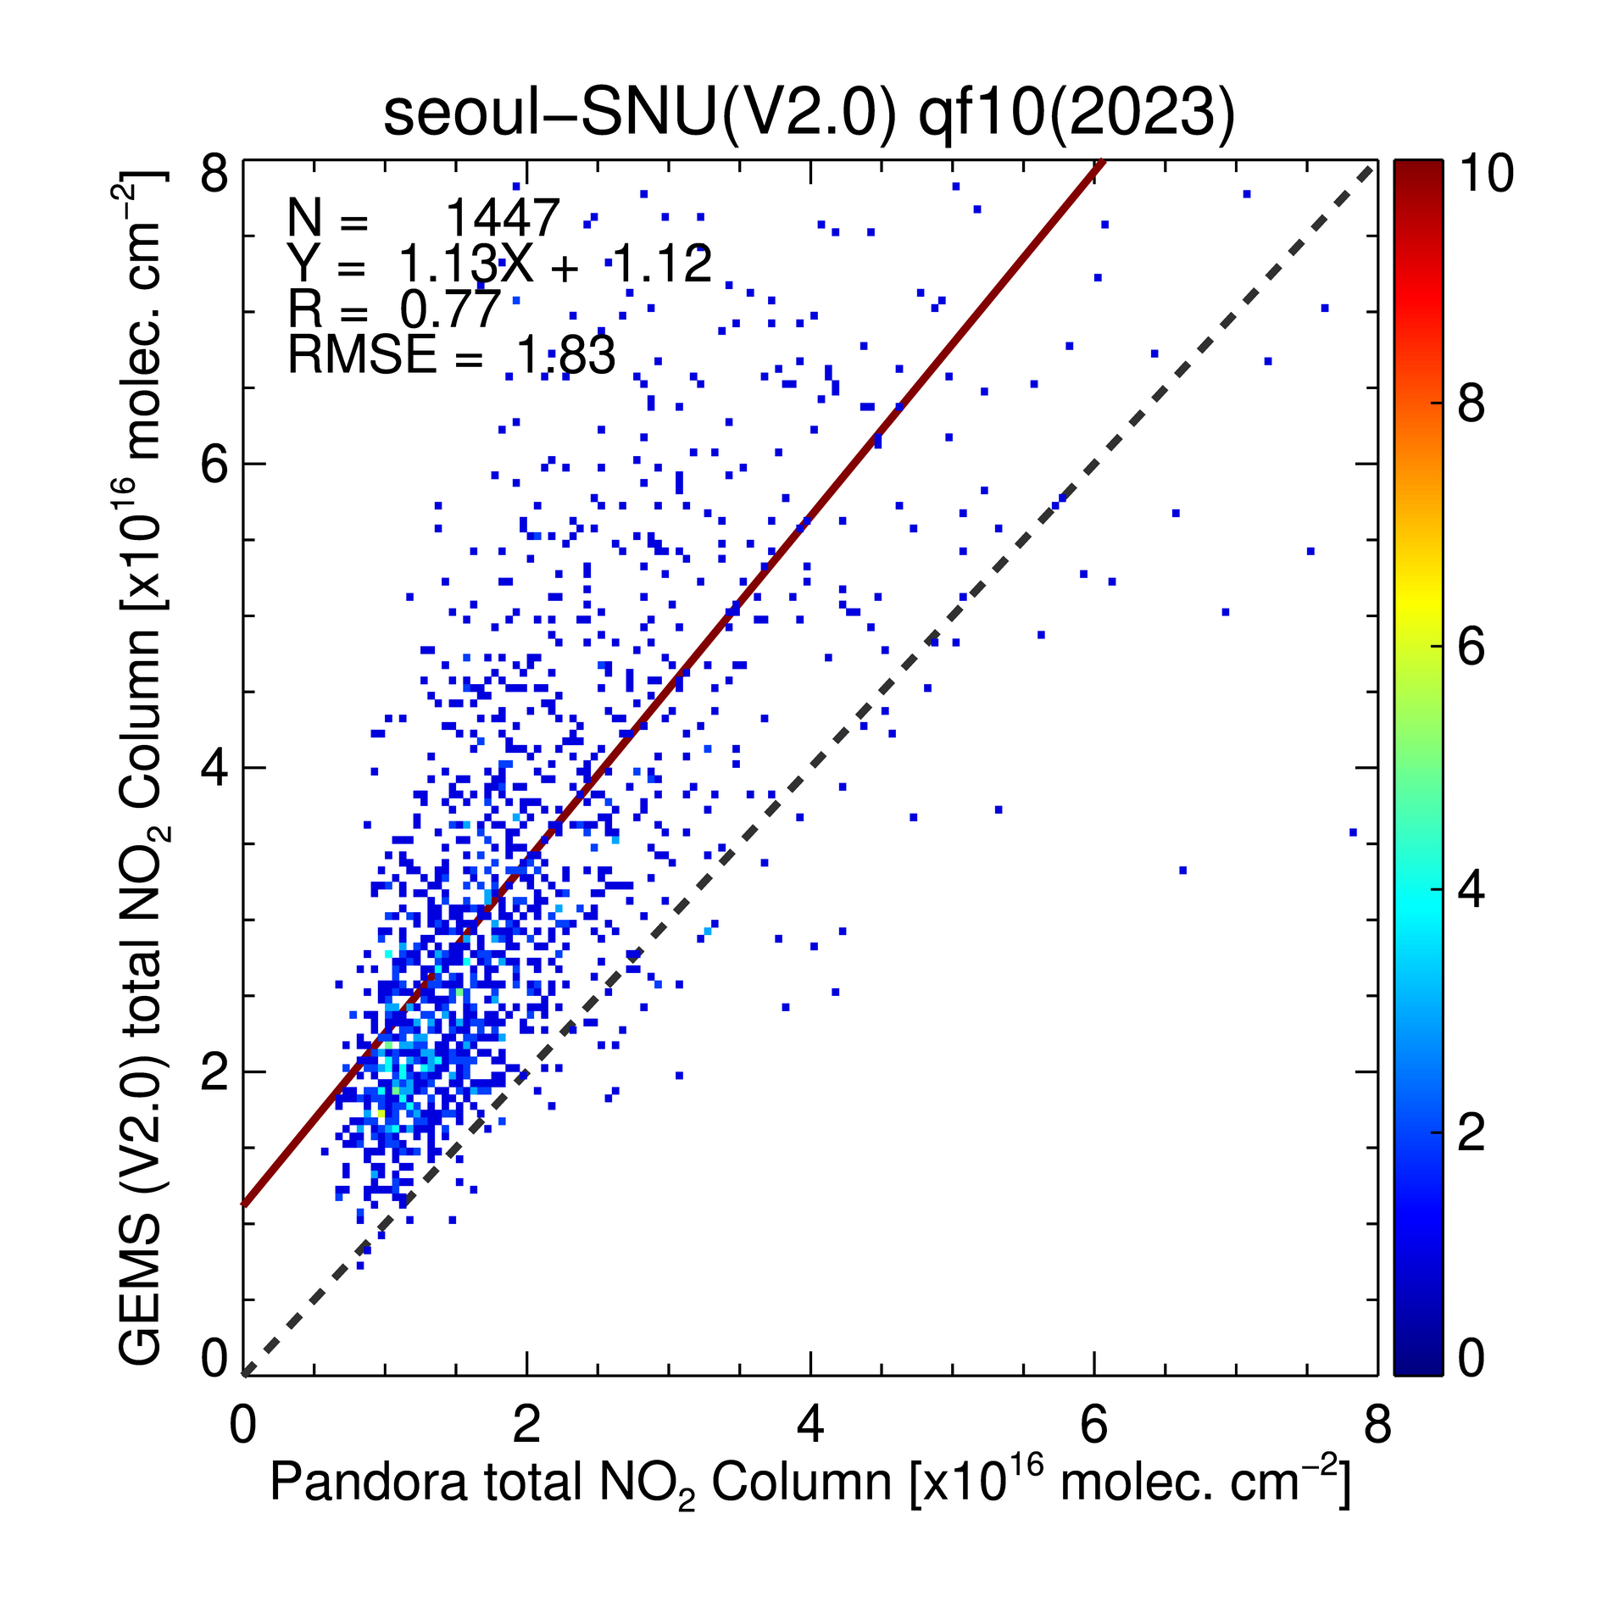
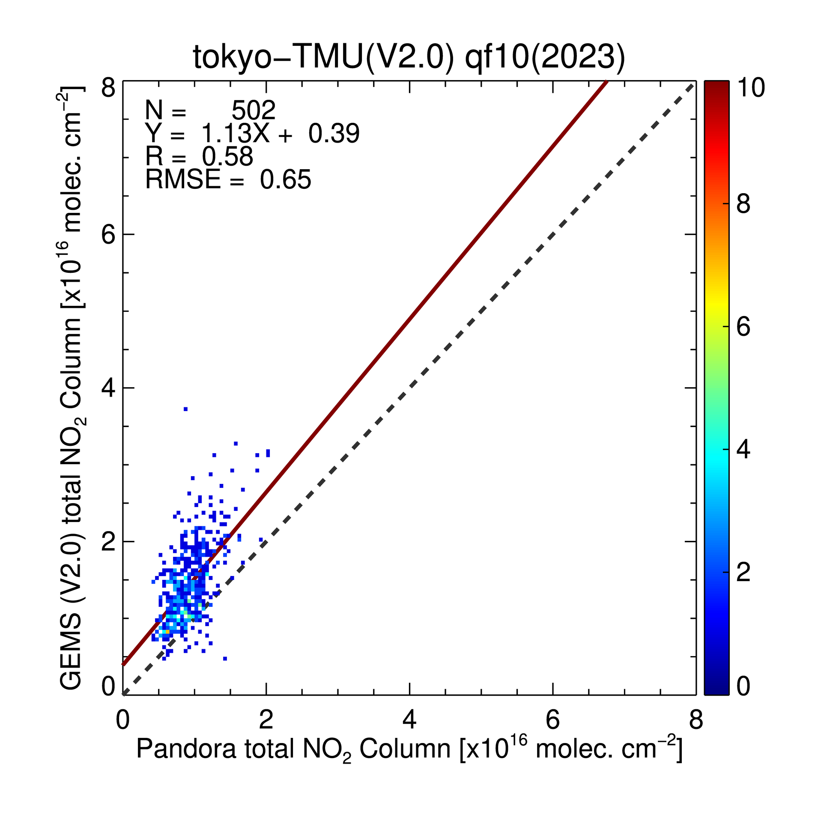
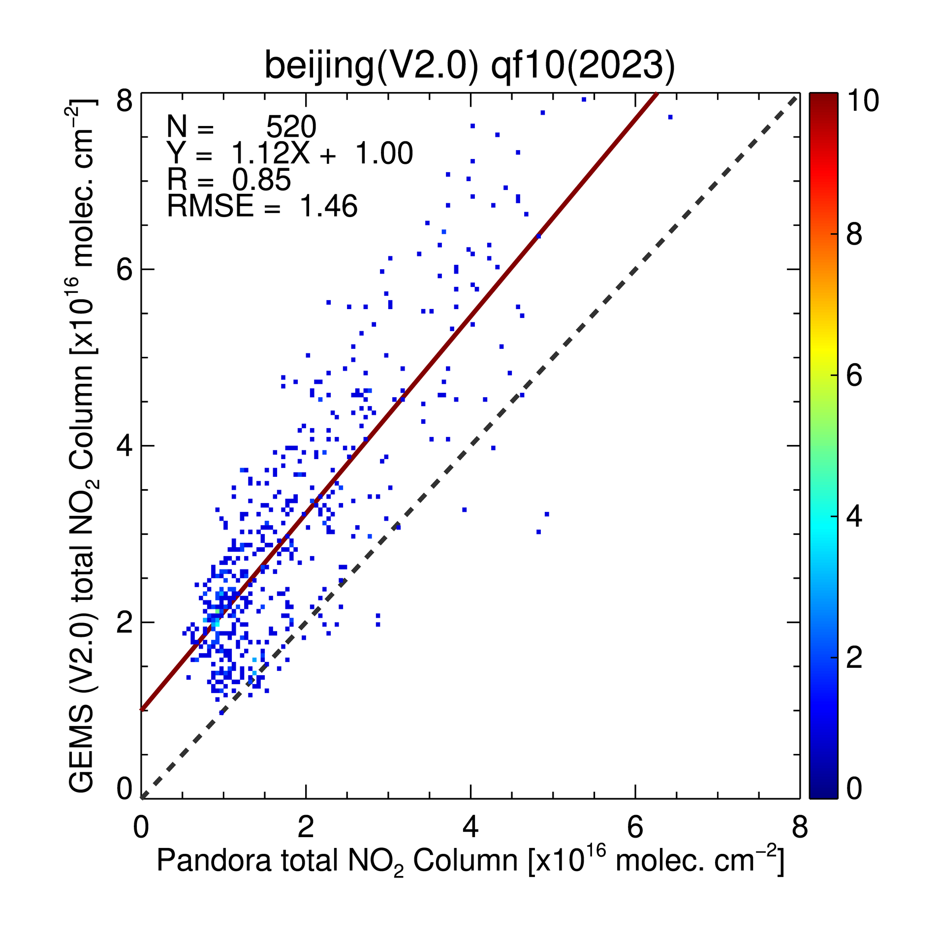
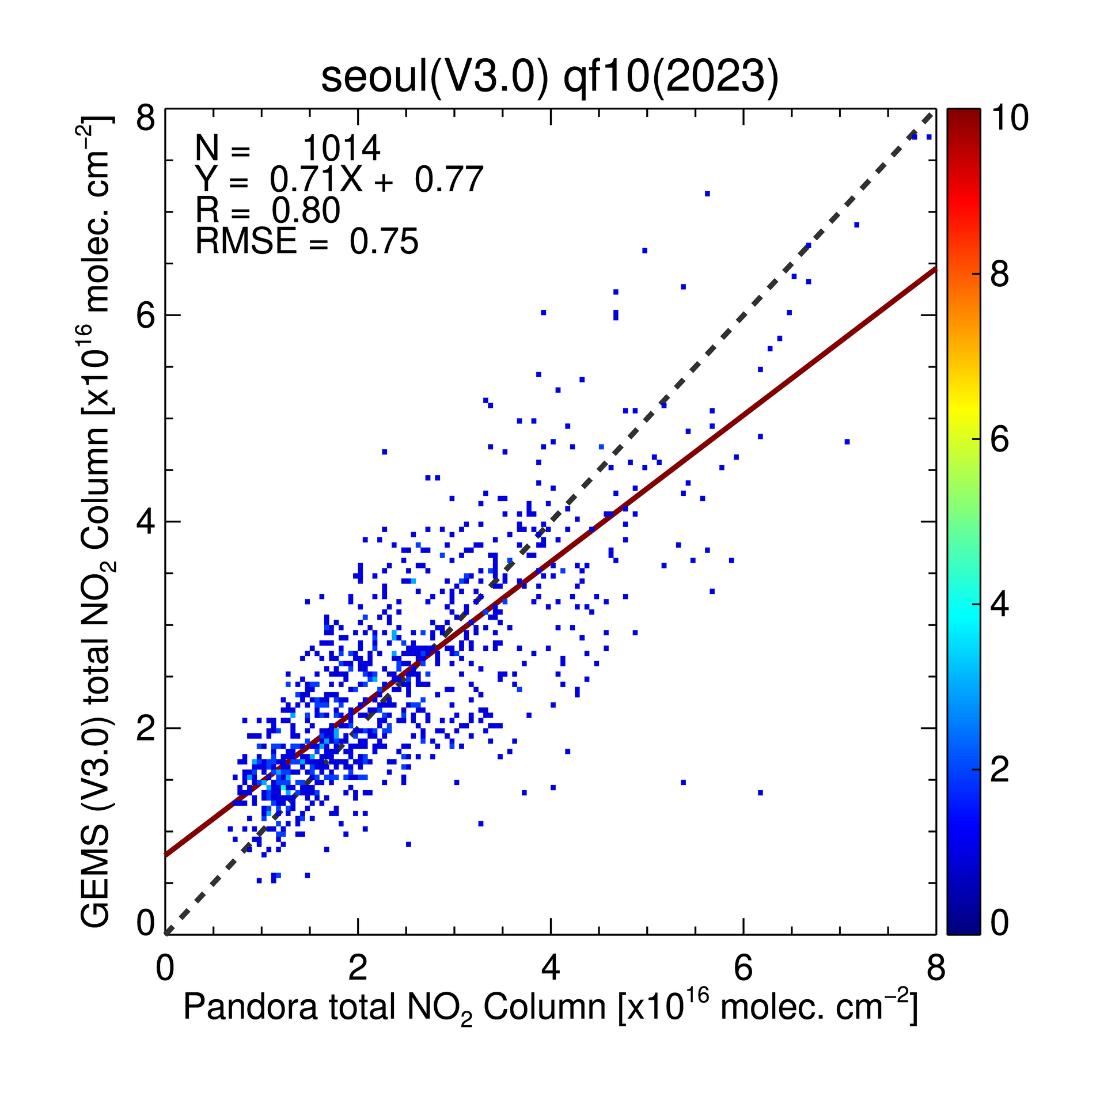
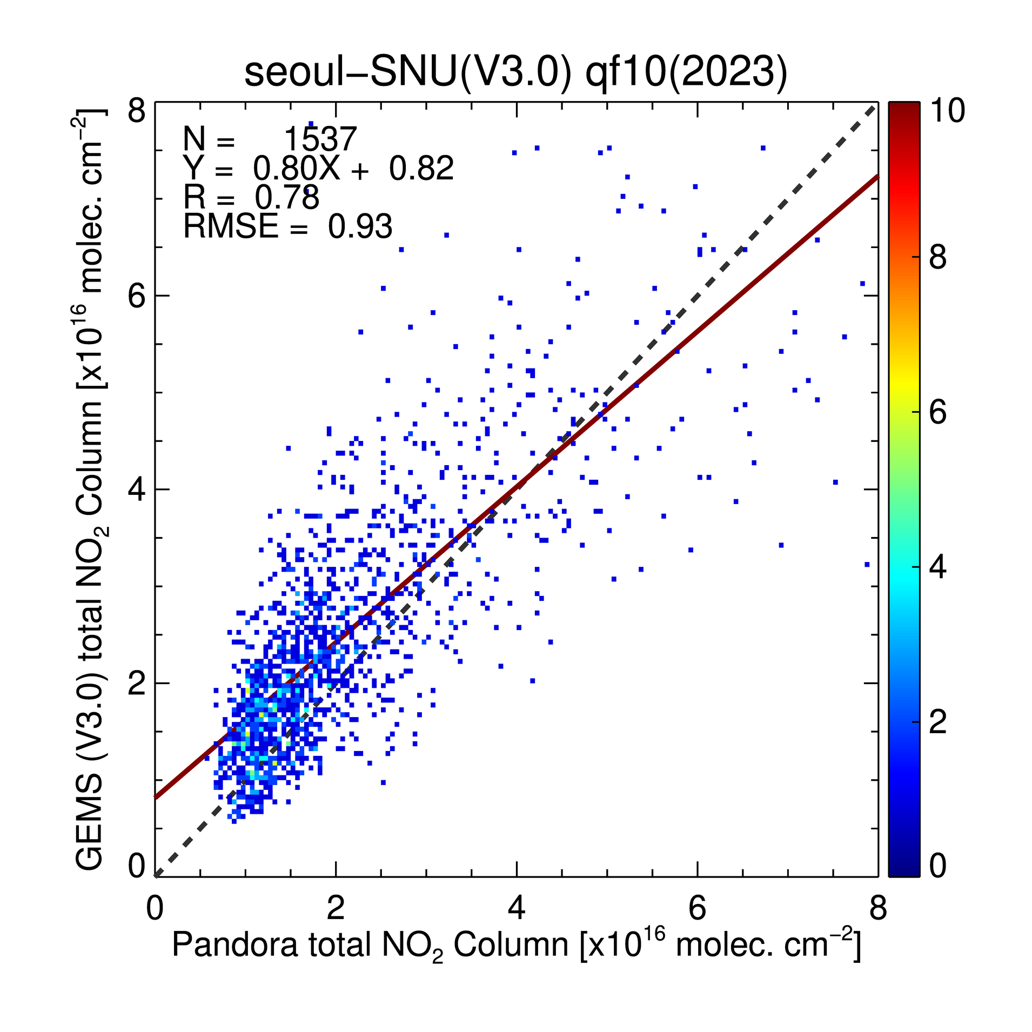
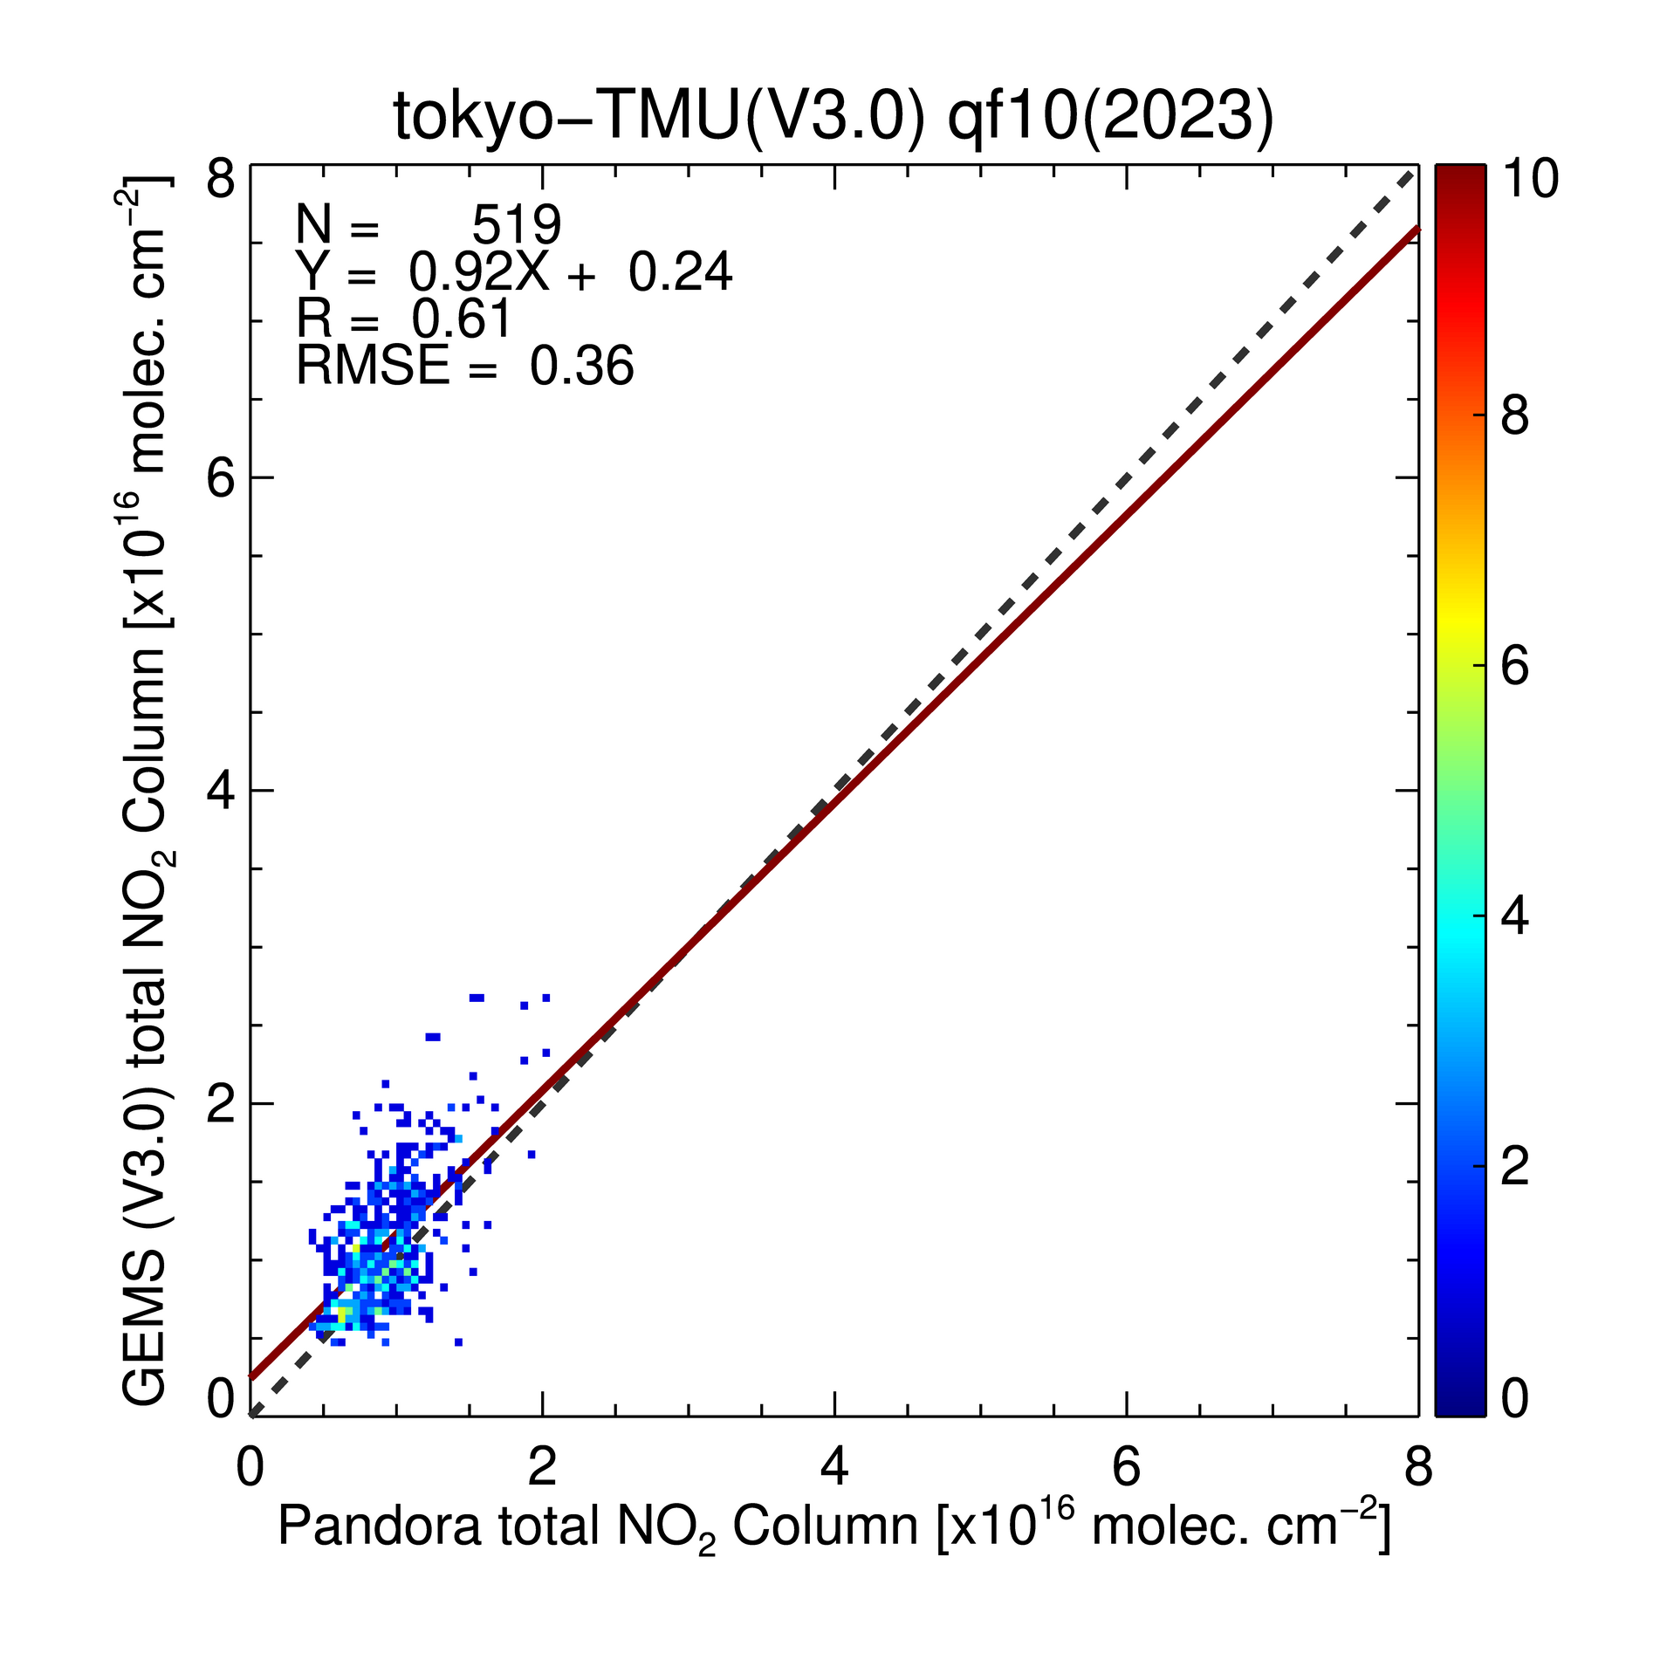
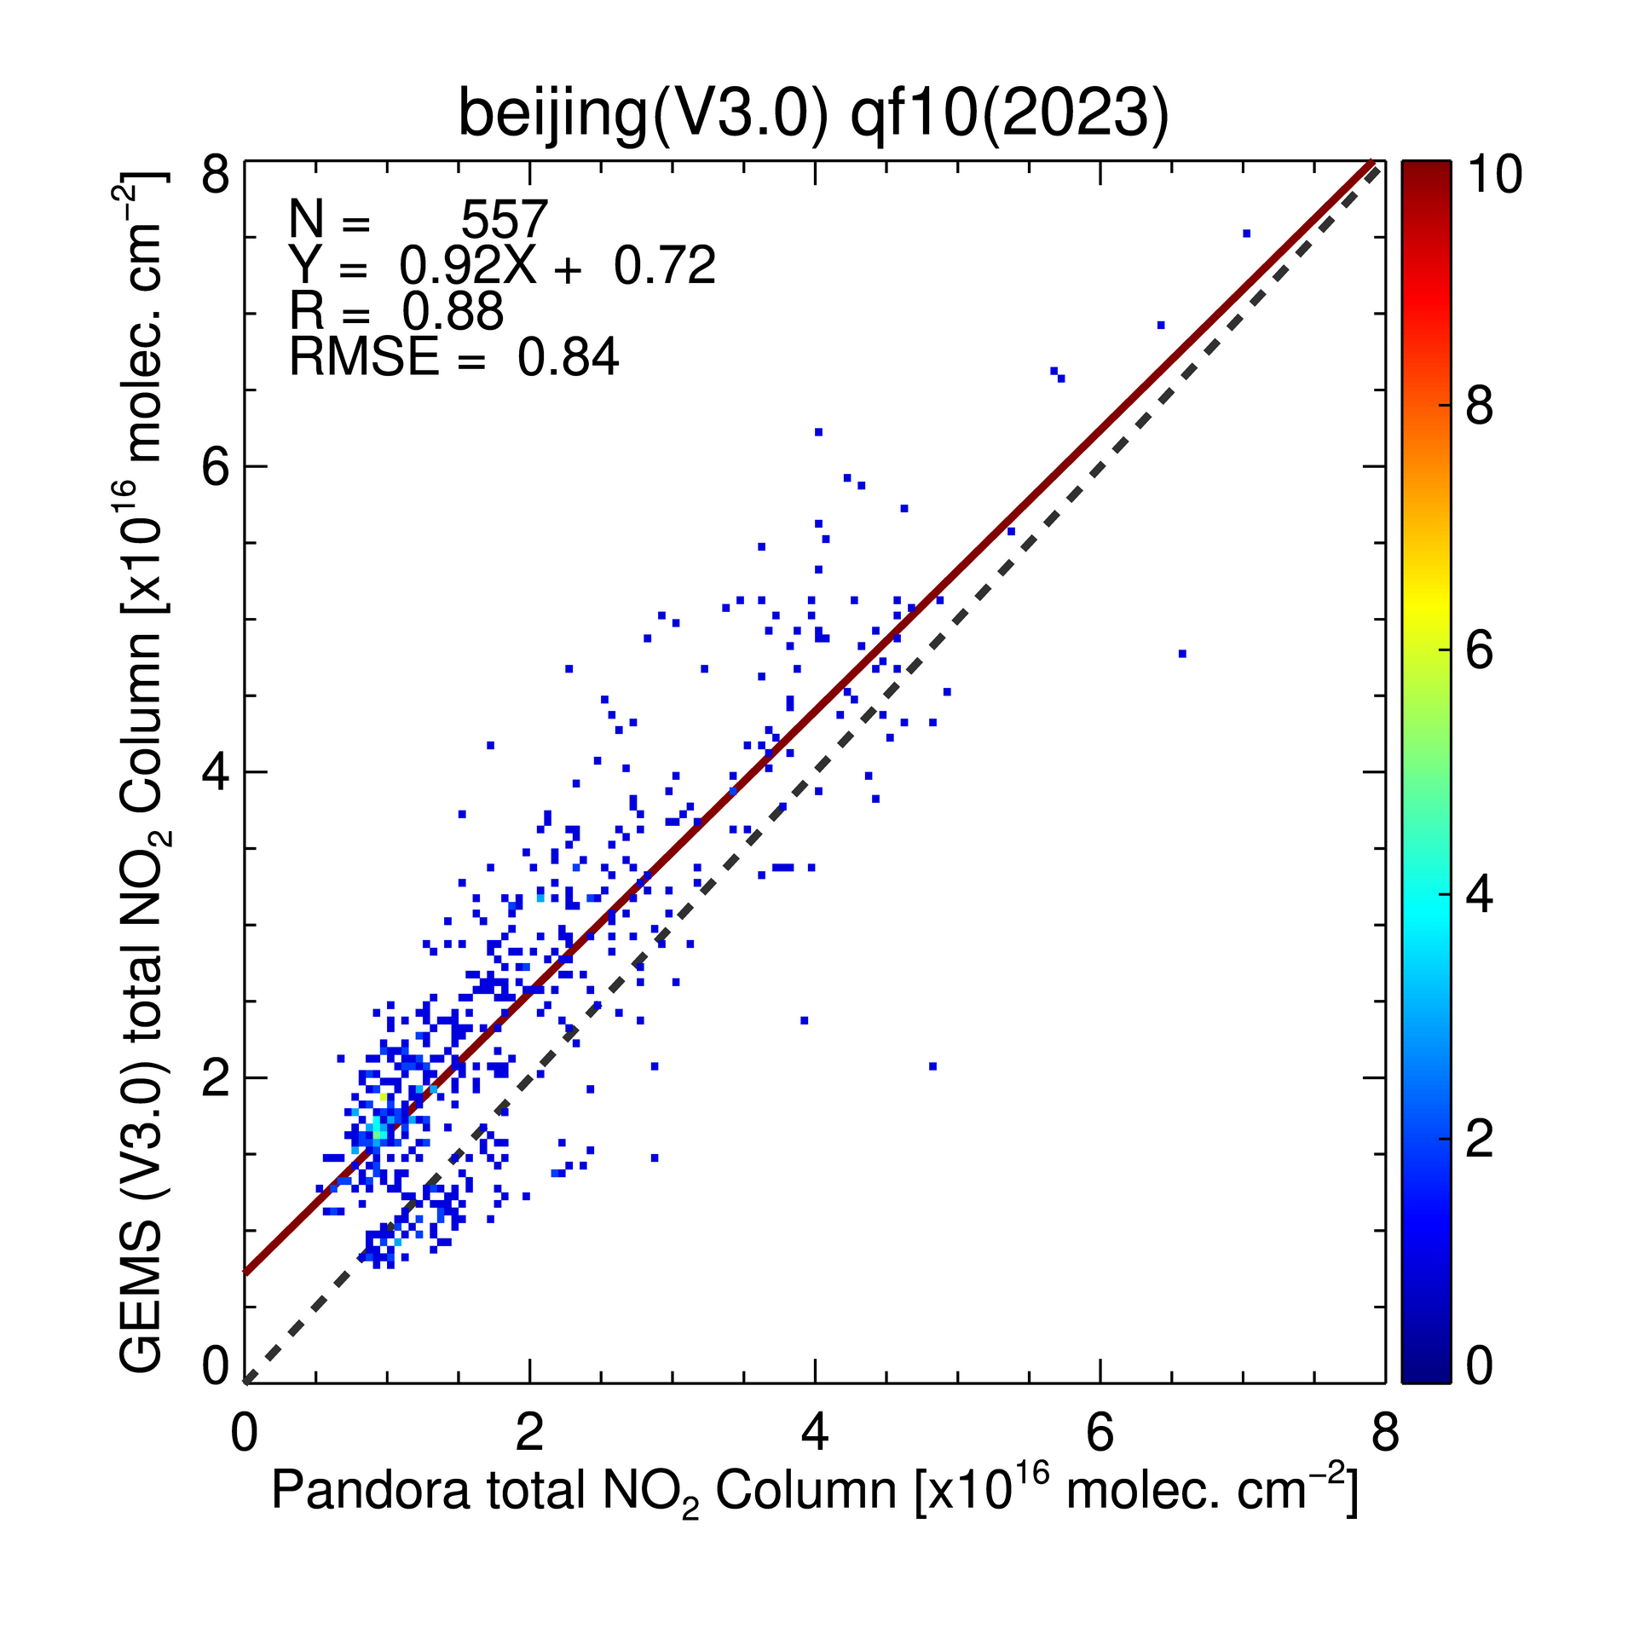
GEMS Total NO₂ V2.0 and V3.0 vs. Pandora
Jan. – Dec., 2023
Seoul-YSU
Seoul-SNU
Tokyo
Beijing
V2.0
V2.0
V2.0
V2.0
GEMS Total NO₂ Column
[10¹⁶ molec/cm²]
V3.0
V3.0
V3.0
V3.0
Pandora Total NO₂ Column [10¹⁶ molec/cm²]
Notes:
Although validation has not been done much due to the lack of retrievals,
over the high-column regions, most of the slopes decreased to close to the 1:1 line in V3.0 compared to V2.0.
In the future, validation with ground observation is scheduled to be done.

Slide 14
Summary & Future Work
GEMS NO₂ retrieval algorithm V3.0 have improved in SCD retrievals and addressed errors in the CTM model and calculations in the troposphere/stratosphere, and improved the STS smoothing technique.
In V3.0, the positive/negative biases of the tropospheric and stratospheric NO₂ have been mostly reduced by about 40 % on a seasonal average.
In next version, we will focus on the improvement of the tropospheric NO₂ retrievals by optimizing threshold of stratospheric-tropospheric separation.

