Slide 1
Current Status of
GEMS total and ozone profile product
Jae-Hwan Kim
Jeseon Bak, Hyunjin Lee, Sungjae Hong, Kanghyun Baek
Pusan National University
Session 7, August 29, 2024
TEMPO/GEMS Joint Science Team Meeting

Slide 2
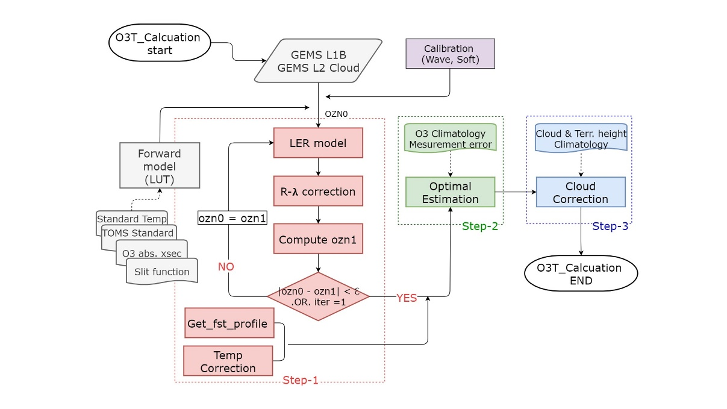
O3T version update summary: V2.0 to V2.1
GEMS O3T algorithm
- Based on NASA/TOMS V9 algorithm
- retrieved total ozone with (312.5, 317.5,
331nm) and then optimized them to get
final total ozone
V2.0 operation | V2.1 updated in 2023 | V3.0 Planning
 | LUT updated | LUT updated
L1C irradiance | L1C irradiance | L1C updated (irradiance + BTDF irr)
GEMS L2 CLOUD V2.0 | GEMS L2 CLOUD V3.0 | GEMS L2 CLOUD V3.0
Conventional TOMS
Residual & Jacobian at 312, 317. 331 nm

Slide 3
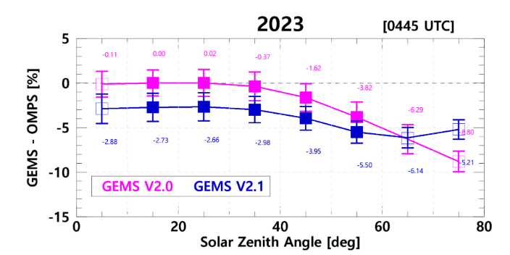
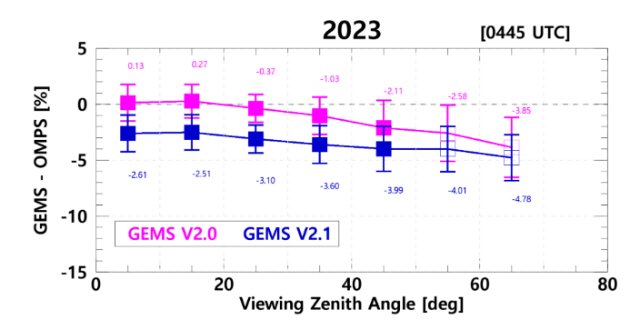
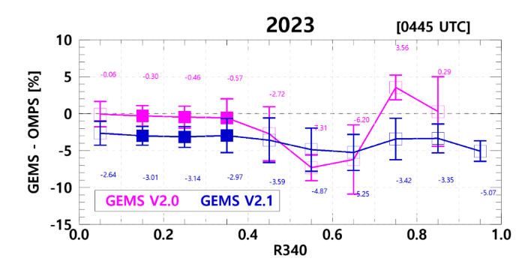
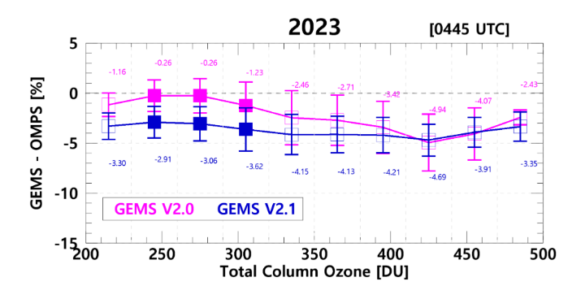
Comparison between v2.0 and v2.1 (with OMPS)
Solar zenith Angle | Viewing Zenith Angle
Reflectivity of 340nm | Total Column Ozone
- Sensitivity Test for v2.0 and v2.1
V2.1 is stable for all variables
However, the negative bias of v2.1 increases compared to v2.0.
 | V2.0 | V2.1
SZA | 7.4% | 3.9%
VZA | 4.0% | 2.2%
R340 | 7.0% | 1.8%
R380 | 3.0% | 1.1%
TCO | 4.7% | 1.8%
Height | 1.18% | 0.6%
not shown
not shown

Slide 4
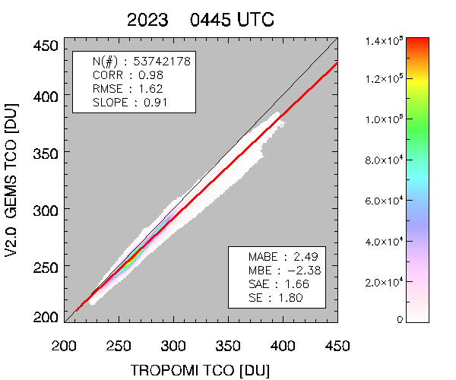
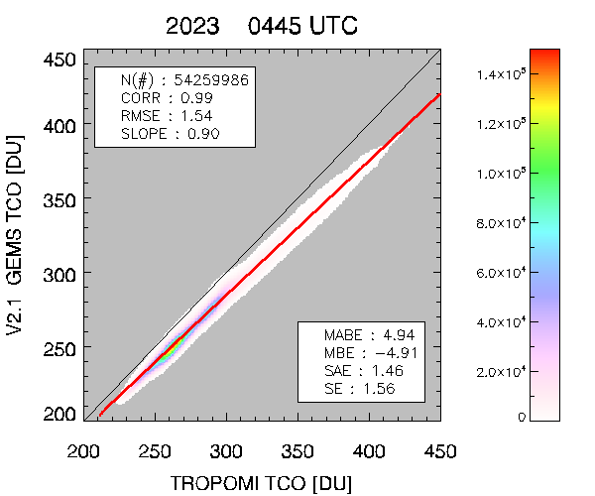
Validation Results with TROPOMI TCO
GEMS V2.0
GEMS V2.1
Winter season
In high-concentration areas(High Latitude),
differences between GEMS and TROPOMI
- Seasonal variation
: bias of winter is higher than that of summer.
The value of bias increases, but seasonal variation decrease.
MBE increase(-2.38→-4.91), but most of the other verification indices improve (RMSE, SAE, SE etc.)

Slide 5
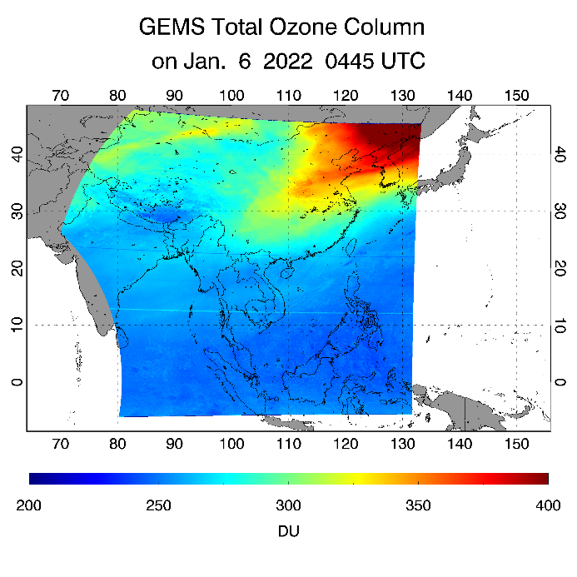
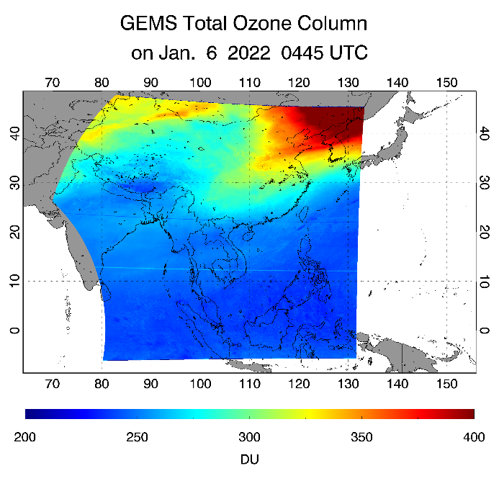
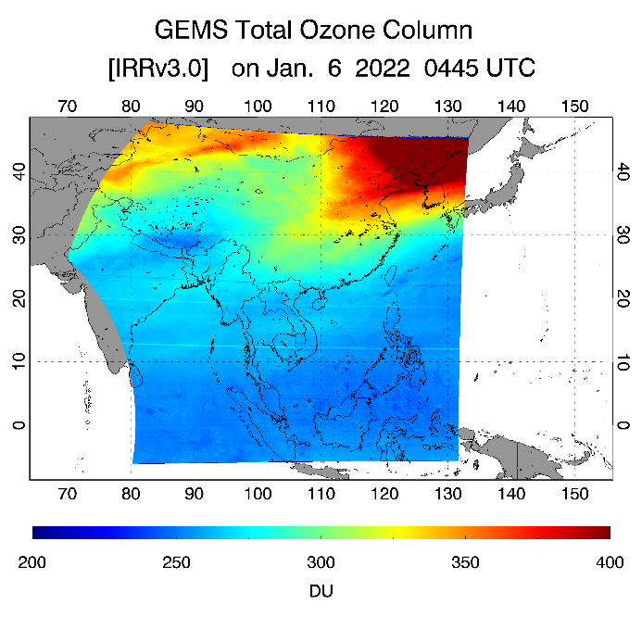
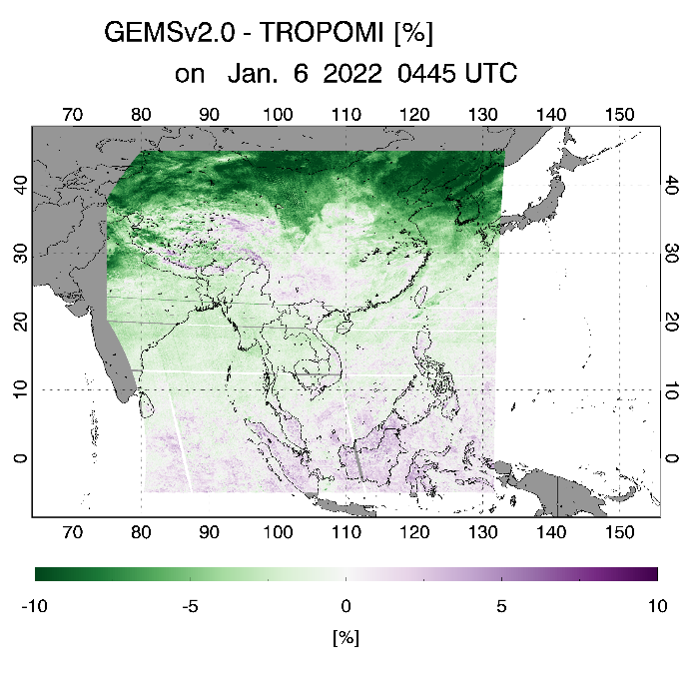
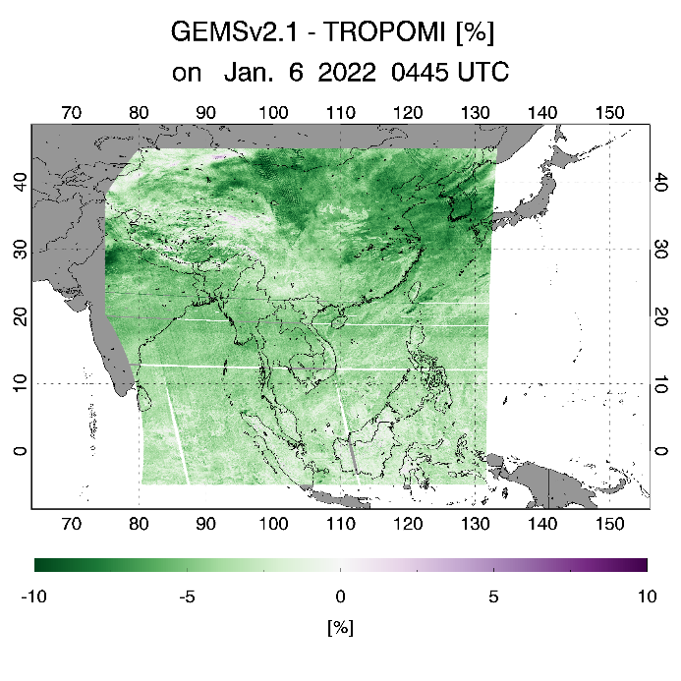
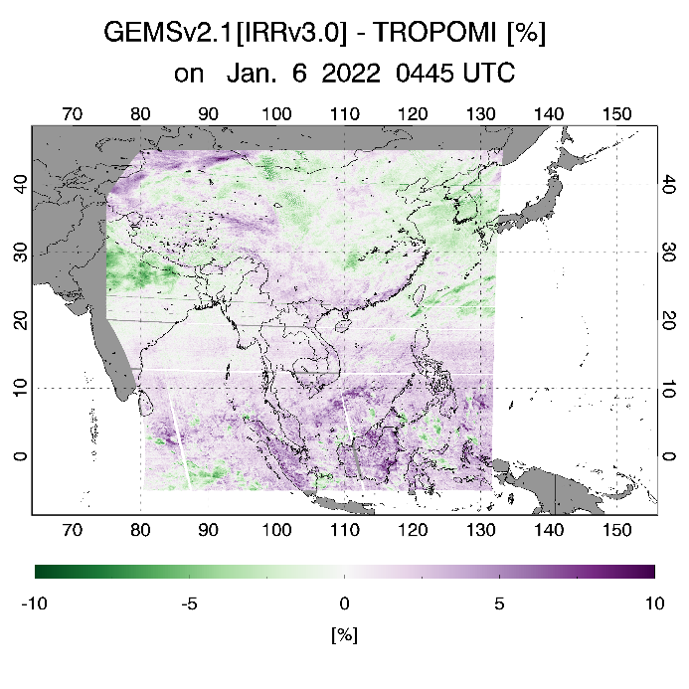
GEMS O3T Result with L1C (Jan. 6 2022 0445UTC)
V2.0 [IRRv2.0]
V2.1 [IRRv2.0]
V3.0 [IRRv3.0]
- L1C updated
(irr+BTDF)
- LUT updated
- L2 Cloudv3.0
- L1C irradiance
- LUT updated
- L2 Cloudv3.0
- L1C irradiance
- L2 Cloudv2.0
GEMS – TROPOMI [%]
-1.43±3.02%
-3.97±1.81%
0.94±1.85%
decrease bias according to latitude
Convert to positive estimation
Reduce the bias

Slide 6
O3P version update summary: V2.0 to V3.0
Inverse method is an optimal estimation, which iteratively estimates the geophysical variables until the simulated spectrum closely matches the measured spectrum, within the retrieval constraints of the a priori information.
Version | 2.0 (operational) | 3.0 (in preparation)
Fitting window | 310-340 nm | 310-330 nm
Slit function | Preflight measurements | On-orbit retrieval (super gaussian)
Irradiance wavelength | X | O
Radiance wavelength | X | O
Irradiance radiometric correction | X | Polynomial fitting (based on solar reference)
Radiance radiometric correction | X | Soft calibration (based on RT simulation)
Solar reference | SAO2010 | TSIS-1 Hybrid Solar Reference Spectrum (HSRS)
Ozone cross-section | BDM(1995) | Birk and Wagner (2018)
Radiative transfer model | VLIDORT 2.4 | PCA-VLIDORT 2.8 + LUT correction
This presentation will introduce the wavelength and radiometric calibrations applied for improving GEMS ozone profile retrievals.
Notes:
-Our ozone profile algorithm is based on an optimal estimation inversion which iteratively estimates the geophysical variables until the simulated spectrum closely matches the measured spectrum, within the retrieval constraints of the a priori information.
The below table show an overview of updates from version 2 to version 3, mainly focusing on the calibration process including slit function characterization, wavelength shift, and radiometric biases on both solar irradiance and earth radiance. In addition, the solar reference has been switched from SAO2010 to TSIS. The ozone cross-section from BDM and Birk and Wager. In particular, forward model is improved by employing PCA-VLIDORT v2.8 for speed up and LUT correction for simulation accuracy.
In this presentation, we are going to introduce the wavelength and radiometric calibrations applied for improving GEMS ozone profile retrievals.

Slide 7
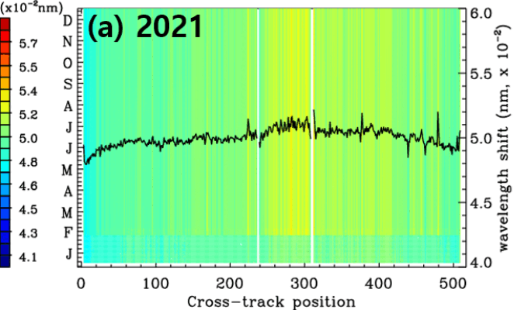
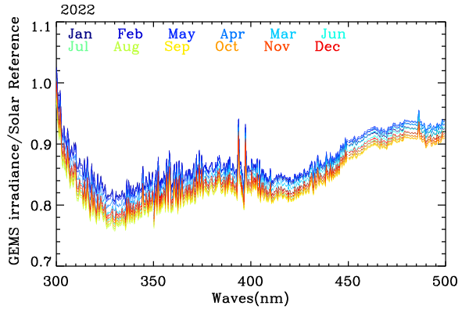
Calibration process for v2.0 irradiance spectrum
$λ$shift relative to TSIS-1 hybrid solar reference
Irradiance offset
Monthly offset in 2022
Yearly offset
December
January
North South
GEMS irradiance shift (0.05 nm) is larger by an order of magnitude compared to other missions
(e.g., S5P, OMI, 1.0E-3)
At CCD 250-300 pixels (near 10-20N), wavelength shift increased from 5.0 X1E-2 nm to 5.8 X1.0E-2 nm
Pixel-to-pixel noise became increasingly severe over the course of the mission.
Relative to solar reference, GEMS irradiance levels are lower by 5-25 %, depending on CCD positions.
This offset shows seasonal variations related to angle geometry as well as yearly increasing trend
(10-15 % during the mission)
We account for the irradiance offset as follows:
$$F_{G} =F_{G} /A$$
A : represent the ratio between GEMS and reference.
Notes:
1) Irradiance wavelength와 irradiance radiometric uncertainties가 변화하고 있기 때문에,
이에 대한 보정을 위해 TSIS-1 태양 기준자료를 통해 보정함.

Slide 8
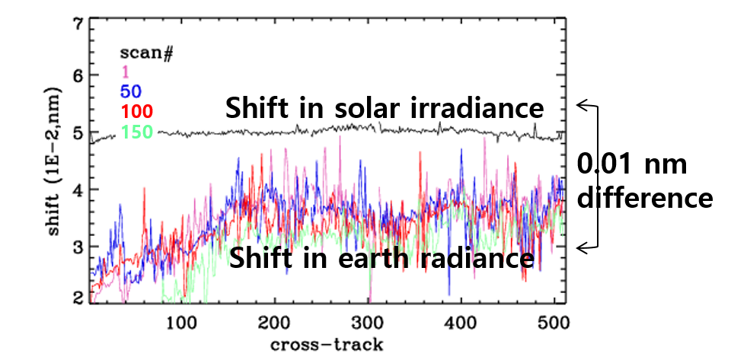
Calibration process for v1.0 radiance spectrum
$λ$shift relative to TSIS-1 hybrid solar reference
Soft calibration (Normalized radiance)
Soft spectra: systematic residuals of normalized
Radiances between GEMS and RTM simulation in July
w/o irradiance correction
2021.07
2023.07
with irradiance correction
2021.07
2023.07
The shift of radiance wavelength relative to solar
Reference is estimated only at the first along pixel for
each cross-track and applied for all along pixels, to reduce
the computational budget and computational stability.
The remaining shift is accounted for as a pseudo absorber in fitting shift between radiance and irradiance.
We use time-independent soft spectrum, only accounting
for CCD-dependent biases ($λ, cross).$
Normalized radiances show the slow-degradation impact
if the irradiance degradation is removed.
Notes:
* Irradiance 뿐만 아니라 radiance에도 파장 shift가 발생하고 있고, radiance 검보정 이슈는 soft calibration을 통해 해소됨.
*

Slide 9
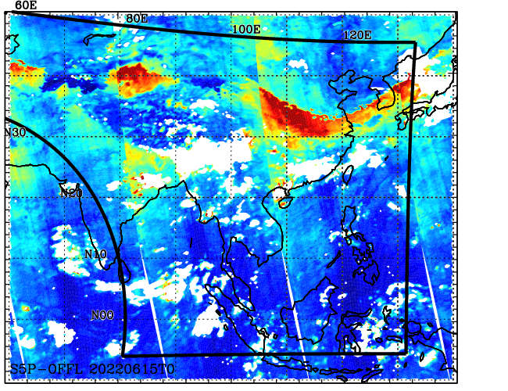
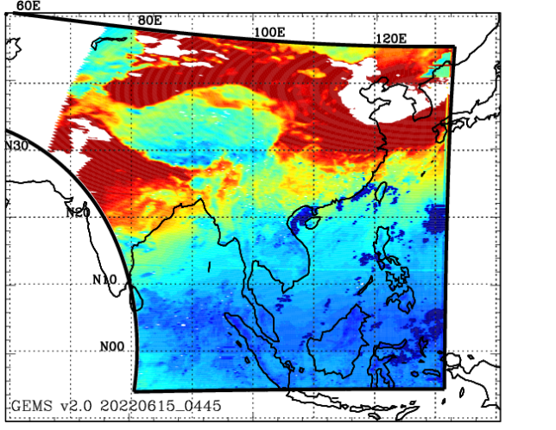
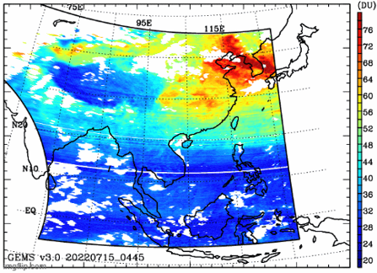
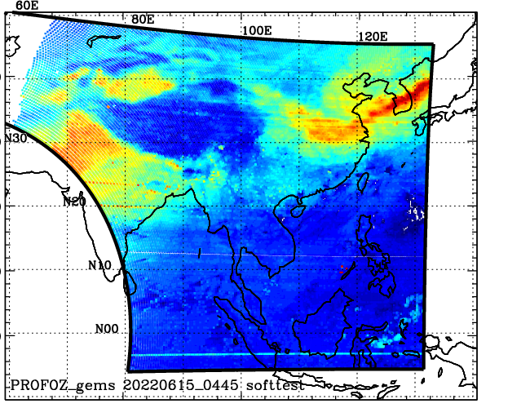
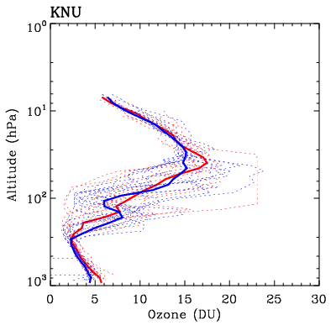
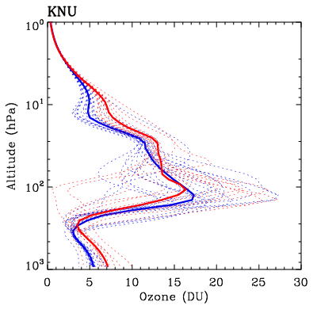
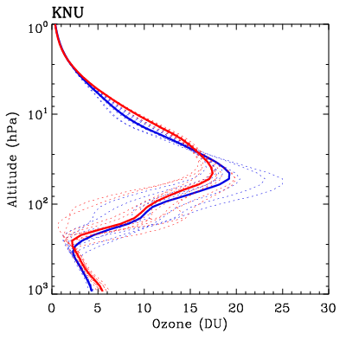
Comparison of O3P product with TROPOMI and ozonesonde
2022.06.15_0445
TROPOMI/KNMI
GEMS v2.0
GEMS workshop 2023
GEMS/TEMPO workshop 2024
- Irradiance offset being
corrected
Irradiance offset and
Normalized radiance being
corrected
2024 ASIA-AQ O3sonde
O3sonde
GEMS v2.0
GEMS/TEMPO workshop 2024
Feb Mar
GEMS v3.0 product contains
better tropospheric and stratospheric
information compared to v2.0
O3P v3.0 suffers from overestimation
biases in tropospheric retrievals and under-
Estimation biases in stratospheric
retrievals

Slide 10
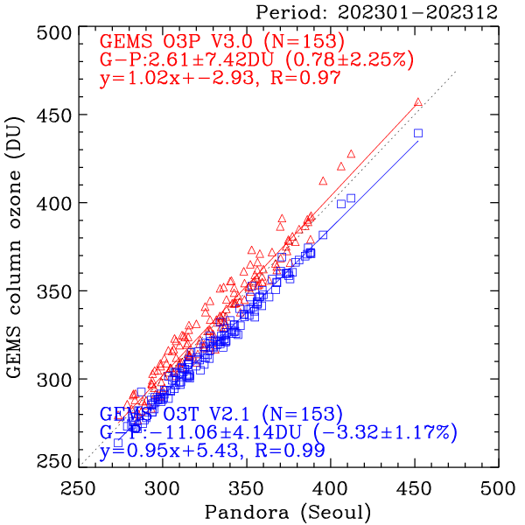
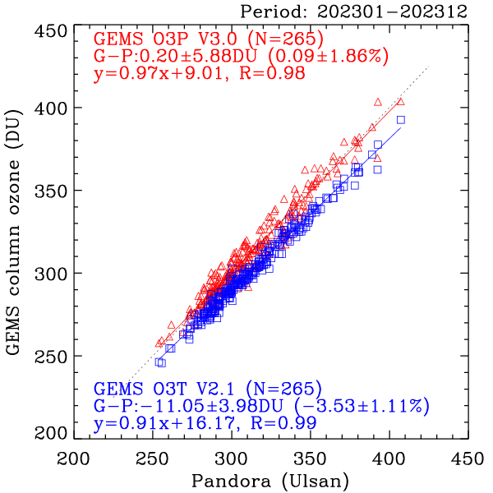
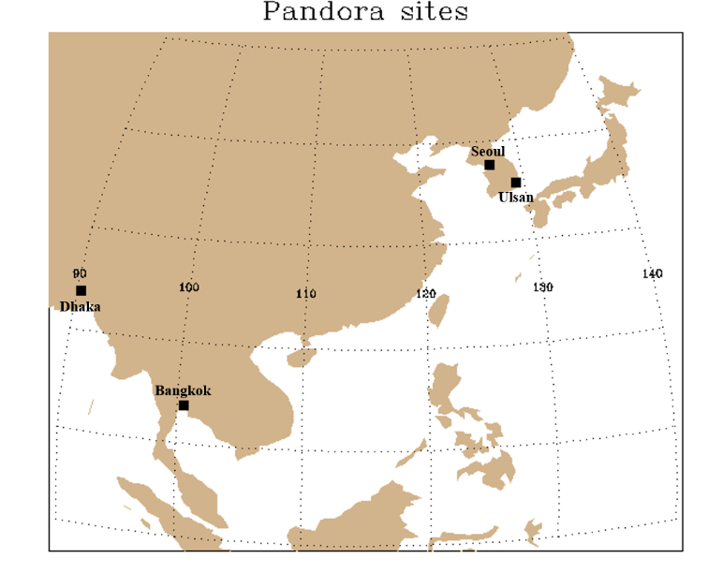
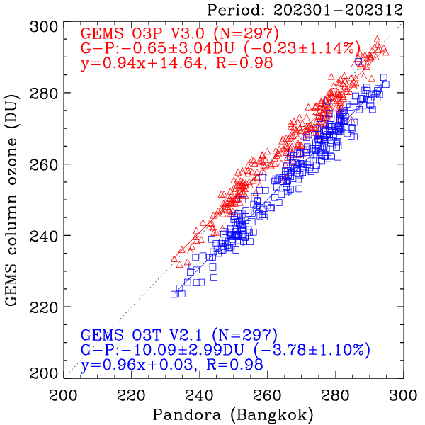
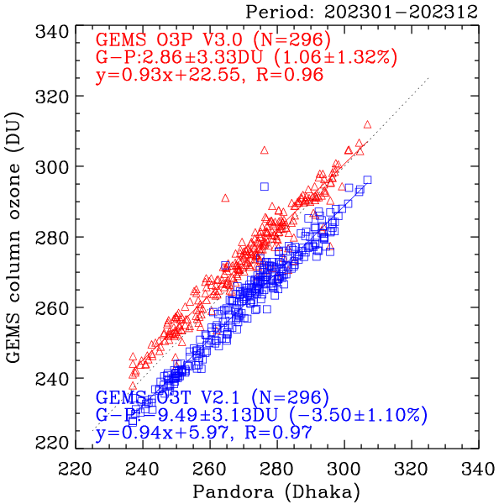
Consistency check between GEMS O3P and GEMS O3T
Evaluate with Pandora (Seoul & Ulsan)
4 Pandora stations
2023.01 ~ 2023.12 (1year)
0445 UTC (GEMS)
Nearest collocation
Cloud fraction < 0.6
Quality flag = 0
 | Seoul (54) |  | Ulsan (150) |  | Bangkok (190) |  | Dhaka (76)
 | O3P | O3T | O3P | O3T | O3P | O3T | O3P | O3T
Reg. | 1.02 | 0.95 | 0.97 | 0.91 | 0.94 | 0.96 | 0.93 | 0.94
R | 0.97 | 0.99 | 0.98 | 0.99 | 0.98 | 0.98 | 0.96 | 0.97
ME(%) | 0.78 | -3.32 | 0.09 | -3.53 | -0.23 | -3.78 | 1.06 | -3.50
STD.(%) | 2.25 | 1.17 | 1.86 | 1.11 | 1.14 | 1.10 | 1.32 | 1.10

Slide 11
Summary & conclusions
Total O3
The Lookup tables are improved to address the inconsistency of GEMS v2.0 quality w.r.t. latitude/season. However, the V2.1 is still suffering from systematic underestimation error of 4% against OMPS/Pandora, due to the irradiance radiometric biases.
The update/improvement on v2.1 will be carried out when the BTDF-corrected GEMS irradiances are available.
O3 profile
GEMS wavelength and radiometric calibration processes have been implemented for both
radiances and irradiances, leading to significant improvements in ozone profile retrievals.
The enhanced GEMS v3.0 product is planned for public release later this year.

