Slide 1
Current status of GEMS VOCs and their future development plan
2024.08.29. TEMPO-GEMS joint science team workshop
Rokjin J. Park¹⁾, Gitaek T. Lee¹⁾, Eunjo S. Ha¹⁾, Yoonbae Chung ¹⁾, Hyeong-Ahn Kwon²⁾, Isabelle De Smedt³⁾, Michel Van Roozendael³⁾, and Jhoon Kim⁴⁾
¹⁾School of Earth and Environmental Sciences, Seoul National University, Republic of Korea
²⁾Department of Environmental & Energy Engineering, University of Suwon, Republic of Korea
³⁾Belgian Institute for Space Aeronomy, Brussels, Belgium
⁴⁾Department of Atmospheric Sciences, Yonsei University, Seoul, Republic of Korea
Atmospheric Chemistry Modeling Group,
Seoul National University
Notes:
Today, I will speak about the GEMS VOCs status and our future development plan. If time allows, I will switch gear to talk about NO2 retrieval using the SNU algorithm for ASIA-AQ.

Slide 2
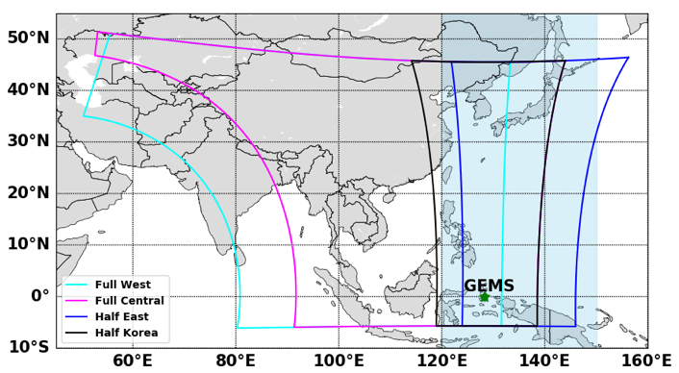
GEMS VOCs retrieval algorithm
[Configurations of GEMS VOCs v3]
[GEMS VOCs version history]
v1 (initial) → v2 (operational) → v3 (scheduled to be reproduced soon)
*Red: Changes in v3
 | HCHO | CHOCHO
Fitting window (calibration window) | 329.3-358.6 nm (326.3-361.0 nm) | 433-461.5 nm (431-463.5 nm)
Fitting method | Direct fitting [González Abad et al., 2015]
Absorption cross-sections | HCHO, $O_{3}, {NO}_{2}$, Br$O$, $O_{4}$, Ring effect, polarization sensitivity | CHOCHO, $O_{3}, {NO}_{2}$, $O_{4}$, $H_{2}O$ (vapor), $H_{2}O$ (liquid), Ring effect, polarization sensitivity
Polynomials | Third order | Third order
Reference spectrum | 120-150∘E three-day running mean zonal mean radiances (cloud fraction < 0.4)
A priori profile | GEOS-Chem 0.25∘ x 0.3125∘ Monthly mean hourly HCHO/CHOCHO | A priori profile
Background correction | Variable background concentrations in the radiance reference sector
Surface reflectance | GEMS L2 BSR
Poster by Gitaek Lee
Evaluation of GEMS formaldehyde vertical column densities during ASIA-AQ
Poster by Eunjo Ha
Analysis of drought effects on VOC emissions in Asia using GEMS products
Modified GEMS scan schedule (2020.10.01. ~)
[Lee et al., 2023, ACP]
Notes:
Currently, version 2 products are open to the public and will be updated to version 3 later this year so I will show how much improvement we can get in v3 compared to v2.
For both HCHO and CHOCHO, the most significant change is the background correction. In v3, we use model values in the region where we calculate the radiance reference.

Slide 3
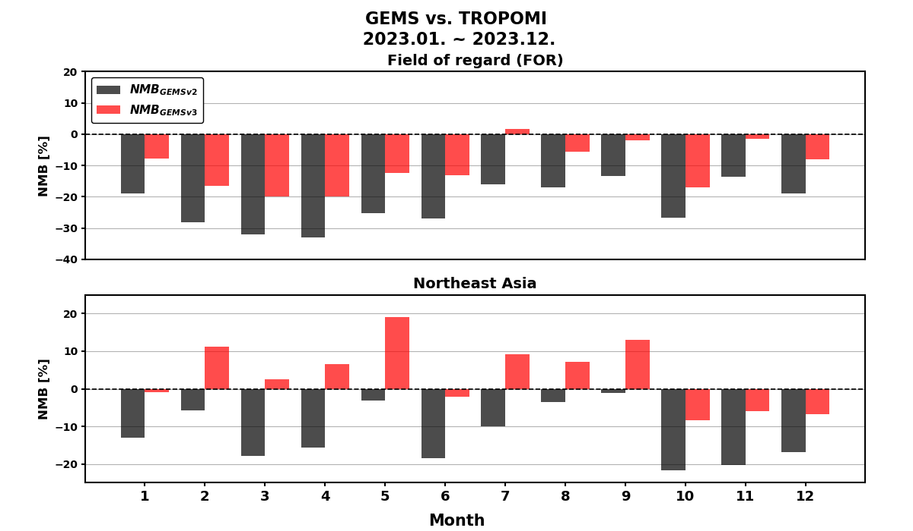
HCHO VCDs comparison: GEMS v3 vs. TROPOMI
GEMS HCHO v3 reduced negative NMBs with TROPOMI, compared to v2
Monthly mean field for
TROPOMI overpass time (13:30 LT)
[GEMS]
Final algorithm flags: “Good”
Cloud fraction < 0.4
[TROPOMI]
QA value < 0.5
Cloud fraction < 0.4
NMB [%]
Northeast Asia (110-130∘E, 20-45∘N)
Average of correlation coefficients(R) | FOR | Northeast Asia
v2 | 0.59 | 0.70
v3 | 0.58 | 0.68
Notes:
Ok, this is a comparison of GEMS HCHO VCDs with TROPOMI for 2023.
Top panel shows NMBs over the filed of regard and bottom is for north east asia for each month.
Black indicates NMB of v2 and red is version 3.
NMB are significantly reduced in v3 compare to v2.

Slide 4
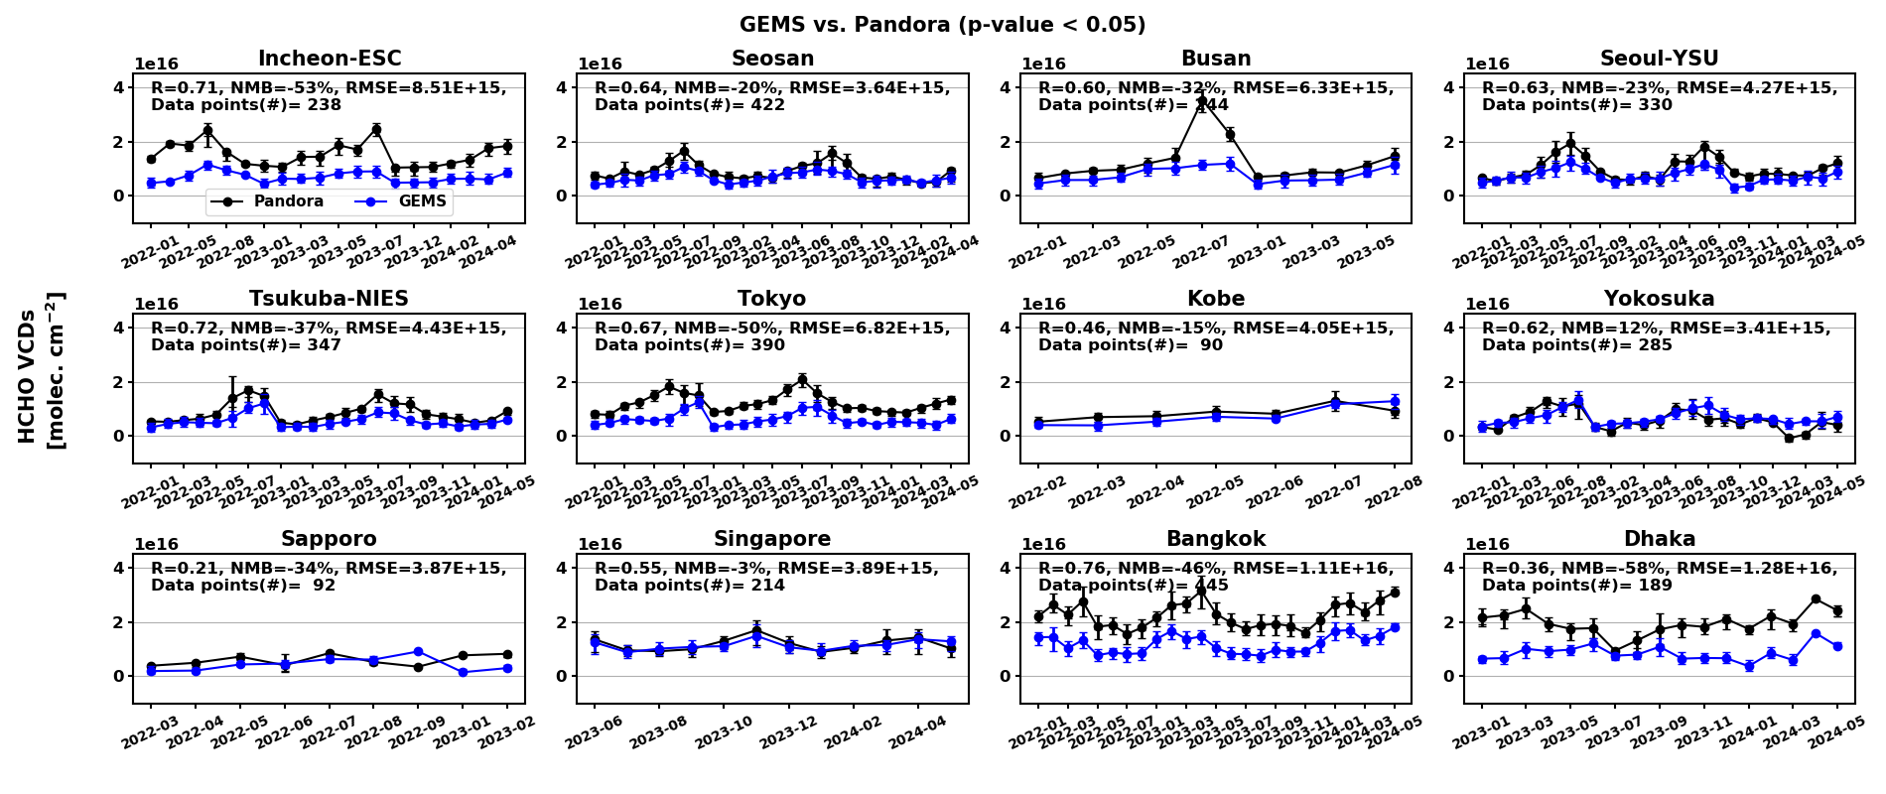
HCHO validation results: GEMS v3 vs. Pandora
GEMS HCHO shows strong agreement (r ~ 0.76) across East Asia.
January 2022 ~ May 2024
*statistics: daily mean data
Notes:
This is a comparison of gems with pandora. You have already seen this kind of comparison in the poster presentations. In summary, gems hcho shows a strong agreement with pandora across east asia.

Slide 5
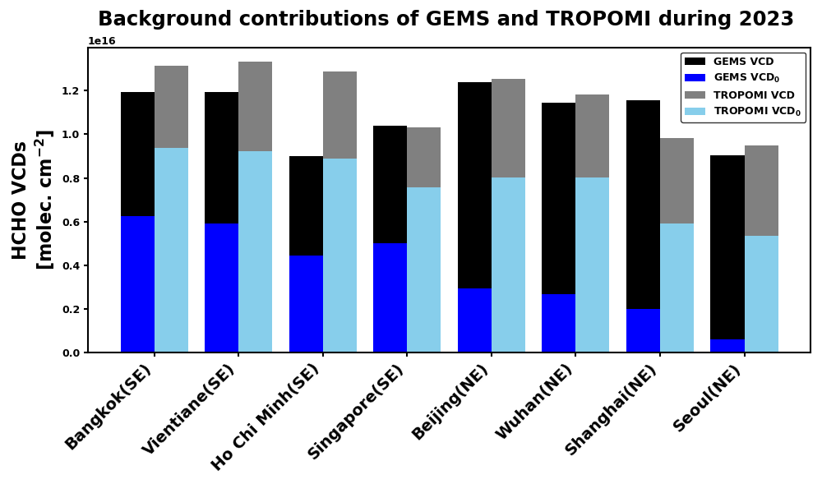
Underlying issue for GEMS HCHO (PEGASOS report)
Background correction contributes ~70% of total VCDs for the eastern part of the scan domain
Radiance reference sector partially includes some of East China, Korean Peninsula, and Japan
Model-dependent value should be reduced
Relative contributions of dSCD to VCD in GEMS v3 and TROPOMI for 2023
VCD₀ = dSCD/AMF
SE: Southeast Asia
NE: Northeast Asia
Notes:
However, there is still an issue, which is raised by the pegasos report that background correction contributes too much in gems vcds.
For example, individual bards are hcho vcds at major cities in asia. Left is gems and right is tropomi. And black and dark grey indicate how much of vcds are contributed from background correctior I show say model values. As you can see gems vcds are too much dependent on a model and this is especially true in east asia where getting clean radiance references is quite limited.

Slide 6
dSCDs comparison: irradiance vs. radiance reference
March 2021, 09:45 ~ 15:45 KST
dSCD ↑, background VCD ↓
(a) GEMS HCHO v3
(irradiance reference)
(b) GEMS HCHO v3
a - b
R=0.94
dSCDs retrieved using irradiance references are by ~70 % higher than those using radiance references.
*Background corrections are performed using minimum background concentrations (143~150E)
dSCD가 더 크다 = dSCD 기여율이 커진다
Notes:
So in order to address this issue, we plan to use irradiance in the retrieval. Left panel shows gems hcho using irradiance reference and the middle is version 3 based on radiance references.
Overall, we have a similar value in the field of regard.

Slide 7
Relative contributions of dSCDs in VCD calculation
[March 2021]
*VCD₀ (VCD without background correction)= dSCD/AMF
GEMS v3
(irradiance reference)
GEMS v3
TROPOMI
Contribution of dSCDs to VCDs
[VCD₀/VCD]
GEMS HCHO VCDs using irradiance references show about 2~6 times higher dSCD contributions.
dSCD contributions of GEMS over India are consistently lower than those of TROPOMI.
Notes:
Moreover, dscd contribution to vcd becomes larger in our new product based on irradiance reference compared to the product using radiances.
This is especially true in north east asia.

Slide 8
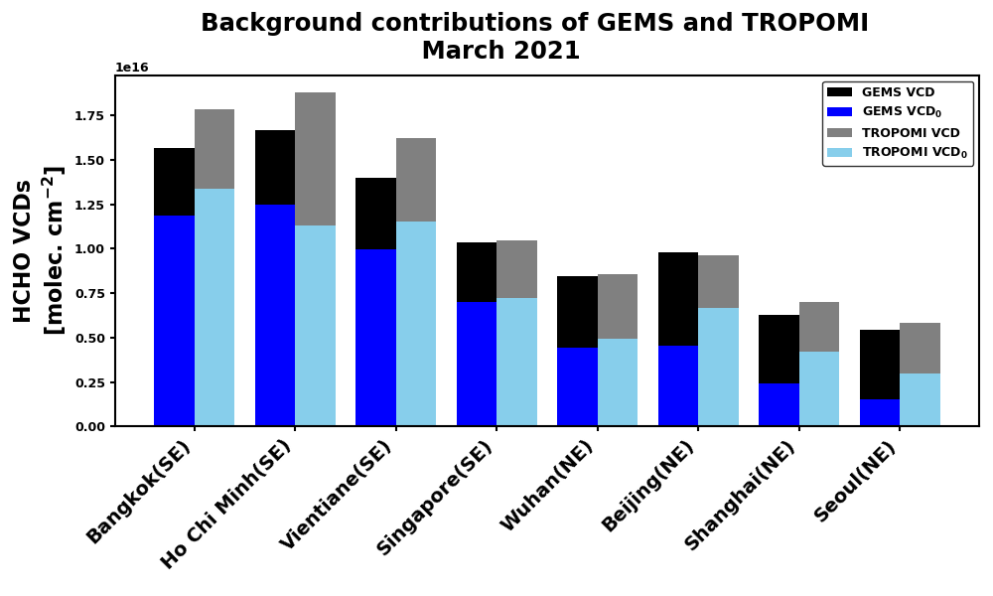
Impact of irradiance reference retrieval on background contributions
*VCD₀ (VCD without background correction)= dSCD/AMF
Relative contributions of dSCD to VCD in GEMS v3 and TROPOMI (March 2021)
SE: Southeast Asia
NE: Northeast Asia
Notes:
Less model dependency is also clearly shown in this comparison. So we have bigger blue bars. I think this improvement is very promising.

Slide 9
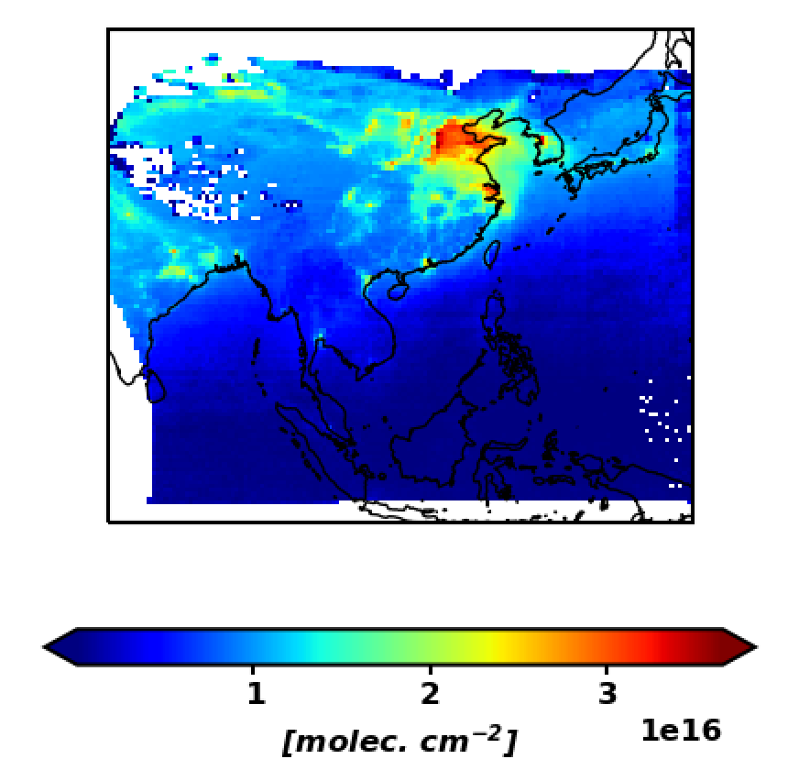
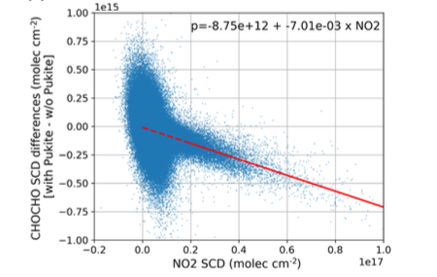
Improvement in GEMS CHOCHO
Empirical correction as a function of NO₂ SCDs
CHOCHO retrieval is significantly affected by the strong absorption of NO₂.
GEMS CHOCHO SCDs are empirically corrected using the regression line used to correct TROPOMI CHOCHO SCDs.
Regression line: $−8.75×{10}^{12}−7.01×{10}^{−3}×{NO}_{2} SCD$
Period: December, 2022
CHOCHO VCDs (GEMS- TROPOMI)
GEMS NO₂ VCDs
[Lerot et al., 2021]
Notes:
For chocho, the most significant change is empirical correction as function of NO2 scd following the way done for tropomi.

Slide 10
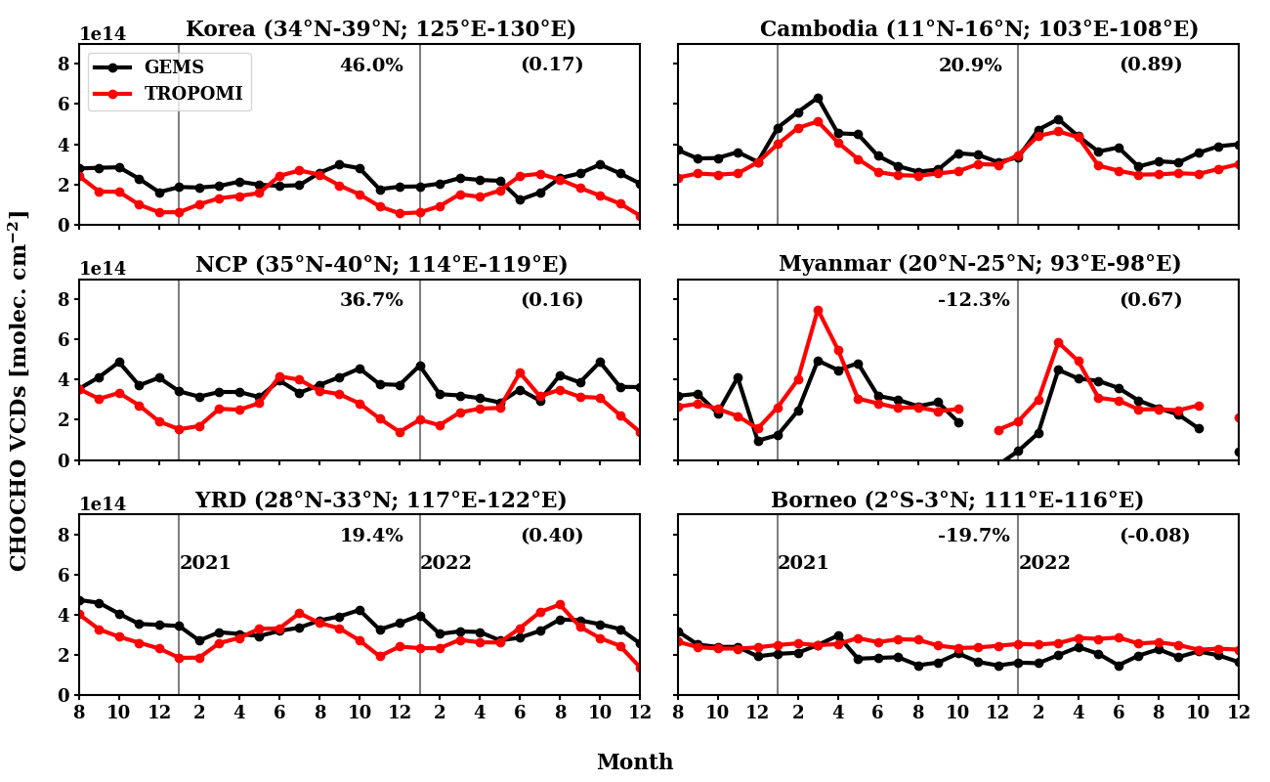
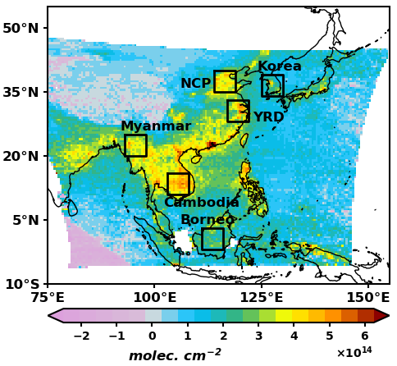
Seasonal variation before the NO₂ correction
Period: 2020/8 ~ 2022/12
NCP: North China Plain
YRD: Yangtze River Delta
PRD: Pearl River Delta
High bias in Northeast Asia (Korea, NCP, YRD) in winter (The Region and season in which NO₂ concentration is high).
Notes:
This shows monthly variation of chocho at major cities in asia. Black is gems and red is tropomi.
As you can see that gems chocho is much higher than tropomi especially in wintertime.

Slide 11
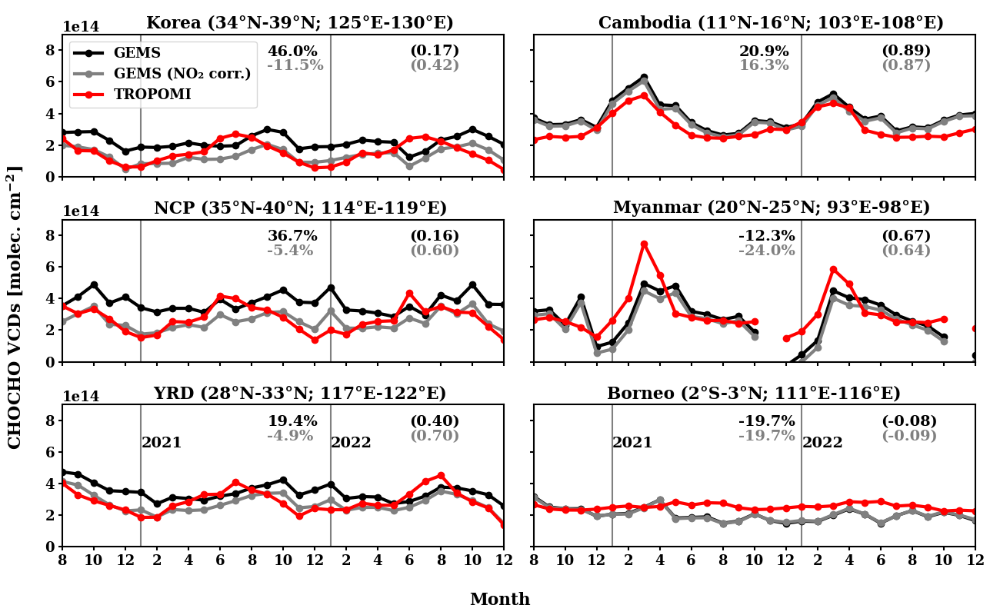
Seasonal variation after the NO₂ correction
Period: 2020/8 ~ 2022/12
NCP: North China Plain
YRD: Yangtze River Delta
PRD: Pearl River Delta
Increase of the correlation coefficients in Northeast Asia.
Notes:
After we perform an empirical correction based on the no2 vcds. The agreement is a lot better.

Slide 12
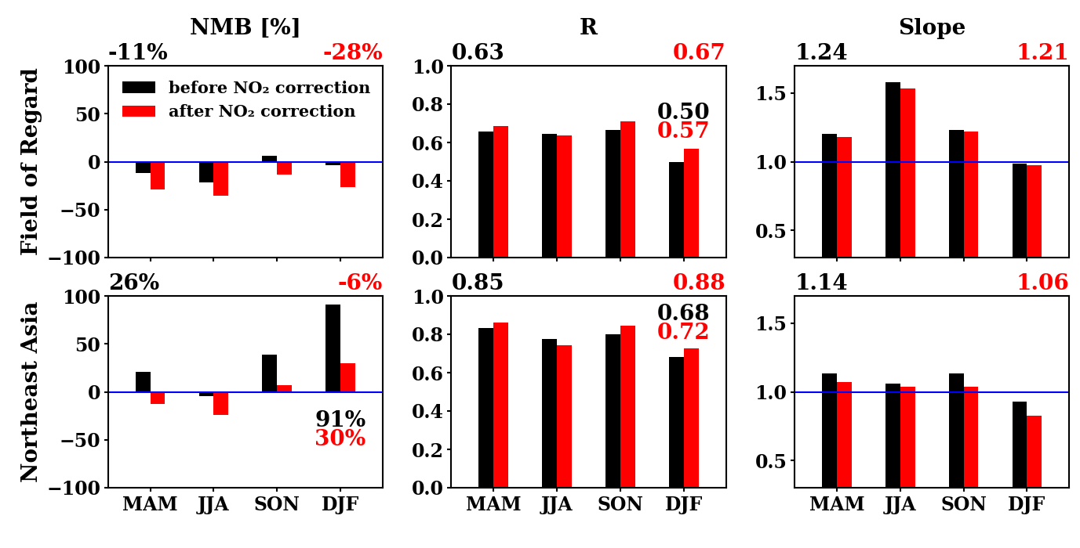
Comparison of GEMS and TROPOMI CHOCHO
: statistics before and after the NO₂ correction
Period: 2021 – 2022
More consistent NMB across the seasons
Higher R
Slope closer to 1
Notes:
This is clearly shown in the statistics. For northeast asia with high NO2 concentration. Nmb for djf season show much lower values after the correction.

Slide 13
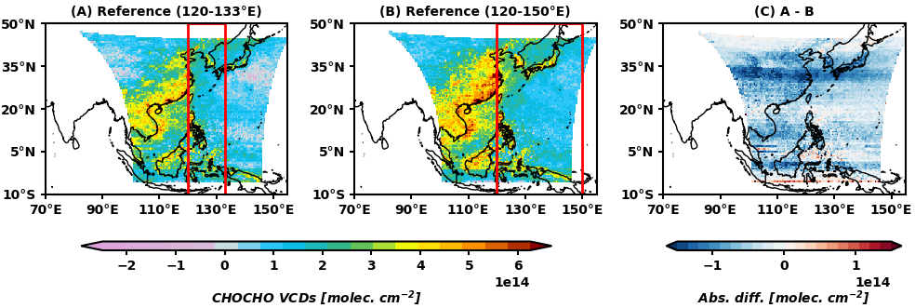
Influence of the polluted radiance reference
Sensitivity test for the radiance reference sector
Period: August, 2020
NMB=-22%
(A) 120-133°E: the narrow reference sector limited by the FW scan, frequently conducted after the IOT
(B) 120-150°E: the reference sector that could be obtained by nominal scan conducted during the IOT
The current polluted reference spectrum could reduce the retrieved CHOCHO VCDs and inhibit the accurate representation of temporal variation.
Scan areas have shifted eastward since 2024, enabling the use of a cleaner reference spectrum.

Slide 14
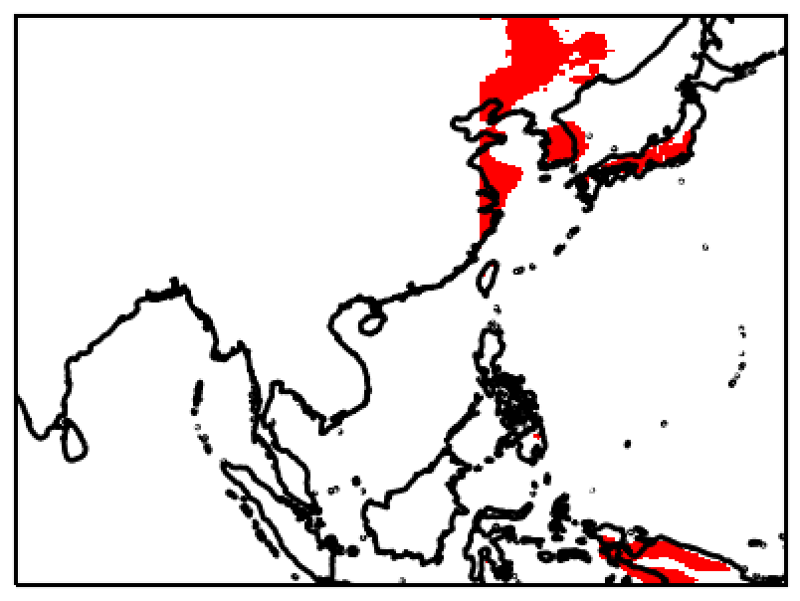
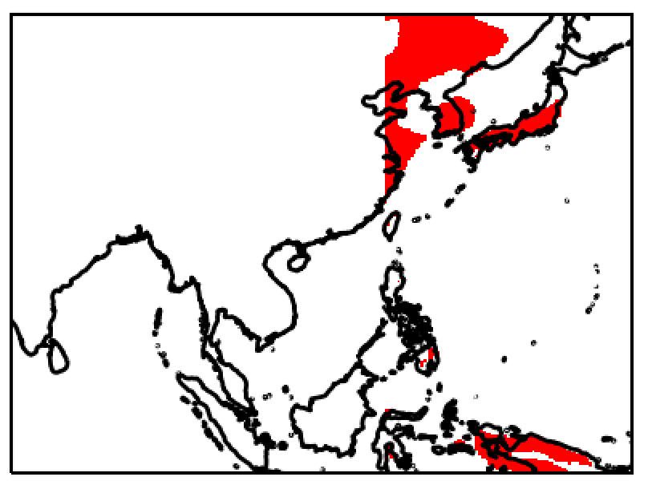
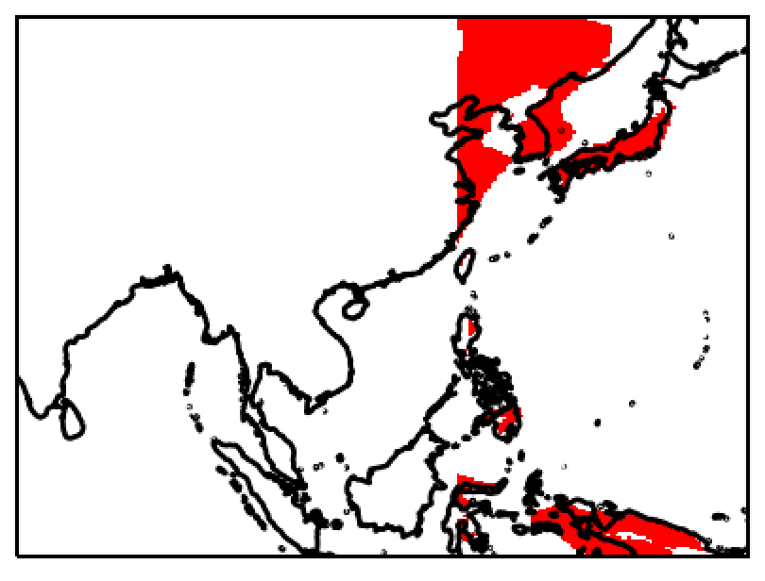
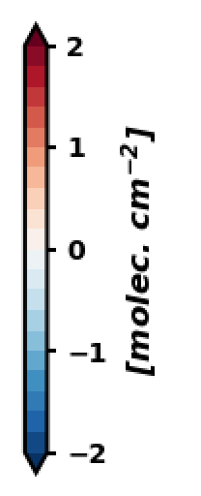
Effect of screening polluted regions in the reference sector
Screening with simulated glyoxal concentration (column-averaged mixing ratio)
Period: August, 2020
xCHOCHO >1.8 ppt
xCHOCHO >1.5 ppt
xCHOCHO >1.2 ppt
Screened regions over the reference sector (>120$°$ E)
Increase of CHOCHO VCDs when screening is applied
NMB = 5.4%
NMB = 6.8%
NMB = 8.8%

Slide 15
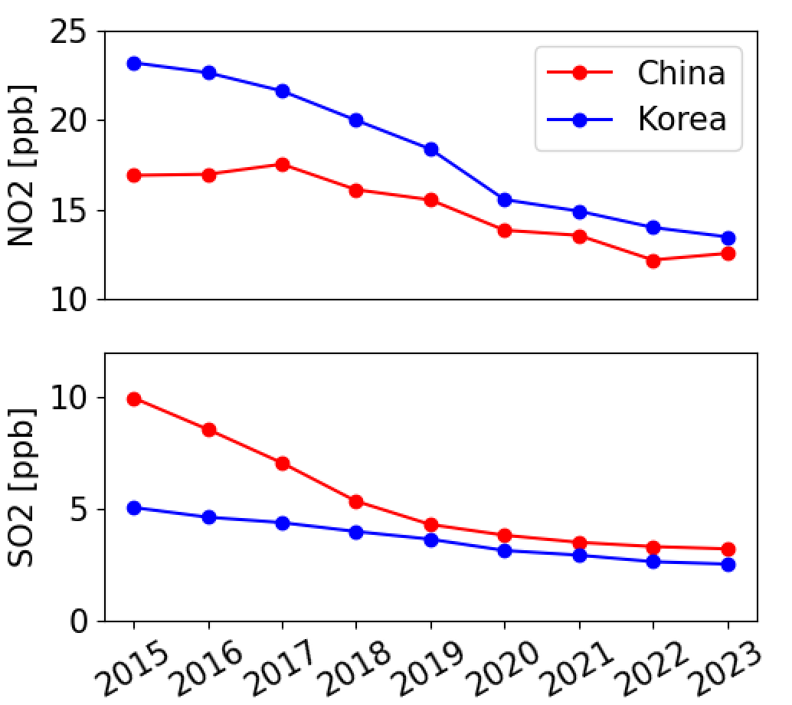
Model Updates
Poster by Yoonbae Chung
Update of a priori profiles and its effect on GEMS observations
Yearly Average Surface Mixing Ratio
NO₂ and SO₂ show a decreasing trend in East Asia. In China, NO₂ concentration has decreased from 16.9 ppb to 12.5 ppb (-25.8%) and SO₂ concentration was reduced from 10.0 ppb to 3.2 ppb (-67.8%) from 2015 to 2023.
For accurate satellite retrievals, it is crucial that we update our CTM to reflect recent changes. The CTM results are used as a priori information to calculate the air mass factor (AMF).
 | GEOS-Chem (Prior) | GEOS-Chem (Update)
Resolution | 0.25º x 0.3125º, 47 layers
Meteorological data | GEOSFP 0.25º x 0.3125º
Target period | 2020.08 ~ 2021.07 | 2023.02
Anthropogenic emission | KORUSv5 (2015) | AQNEAv3 (2019)

Slide 16
Configuration of GEMS (SNU) NO₂ retrieval algorithm
 | GEMS official NO₂ | GEMS (SNU) NO₂
Version | v2 (operational) → v3 (Preliminary) | -
Fitting window | 432.0-450.0 nm | 405.0-465.0 nm
Reference spectrum | Irradiance | Irradiance
Absorption cross-sections | NO₂ at 220K (Vandaele et al., 1998) O₃ at 243 K and 293 K (Bogumil et al., 2000) O₄ (Thalman and Volkamer, 2013) H₂O (HITRAN 2012 data) | NO₂ at 220 K (Vandaele et al., 1998) O₃ at 243 and 293 K (Serdyunchenko et al., 2014) O₄ at 293 K (Thalman and Volkamer, 2013) H₂O (HITRAN 2012 data) Polarization sensitivity
Ring efffect | Chance and Spurr (1997)
Polynomial | 2nd order | 3rd order
A priori profile | GEOS-Chem 0.25∘ x 0.3125∘ Monthly mean hourly NO₂ for 2021 | GEOS-Chem 0.25∘ x 0.3125∘ Monthly mean hourly NO₂ for 2021
Notes:
Ok how much time do I have? Ok..
Let me switch gears to talk about our pet project about no2 retrieval using our snu algorithm, which uses slightly different configuration from the official gems no2 algorithm.
we used this to produce no2 vcds for aisa-aq campaign which occurred feb-march this year.

Slide 17
NO₂ VCD comparison: GEMS (SNU) vs. GEMS (NIER)
Feb. 2024, 11:45 ~ 15:45 KST
*NO₂ total column
GEMS NO₂ v2
GEMS NO₂ v3
GEMS (SNU) NO₂
TROPOMI
Notes:
This is monthly mean no2 vcds for feb this year. As you noted that gems no2 v3 is lower than v2.
But our snu no2 show a bit lower values compared to both gems v2 and v3.

Slide 18
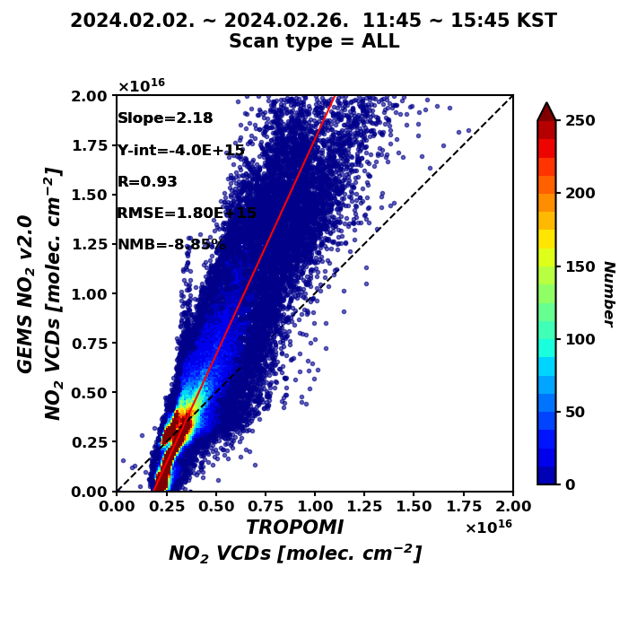
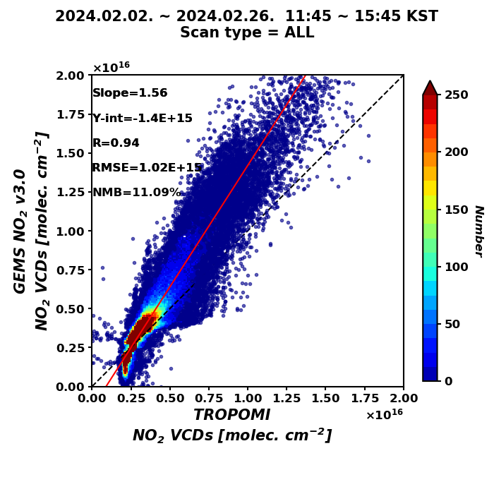
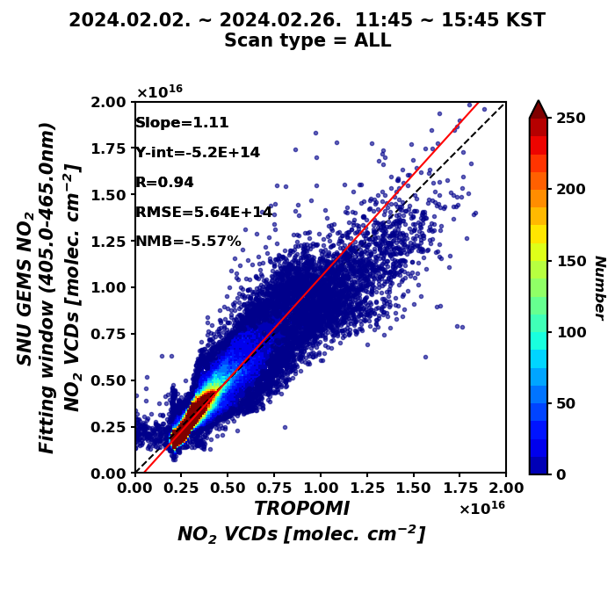
NO₂ VCD comparison: GEMS (SNU) vs. GEMS (NIER)
*NO₂ total column
February 2024, 11:45 ~ 15:45 KST
vs. GEMS NO₂ v2
vs. GEMS NO₂ v3
vs. GEMS (SNU) NO₂
GEMS NO₂ v2
NO₂ VCDs [molec. cm⁻²]
GEMS NO₂ v3
NO₂ VCDs [molec. cm⁻²]
GEMS (SNU) NO₂
NO₂ VCDs [molec. cm⁻²]
Notes:
This is clearly shown tin this scatter plot comparison against tropomi. Gems operation products are higher than tropomi but snu vcds are slightly lower.

Slide 19
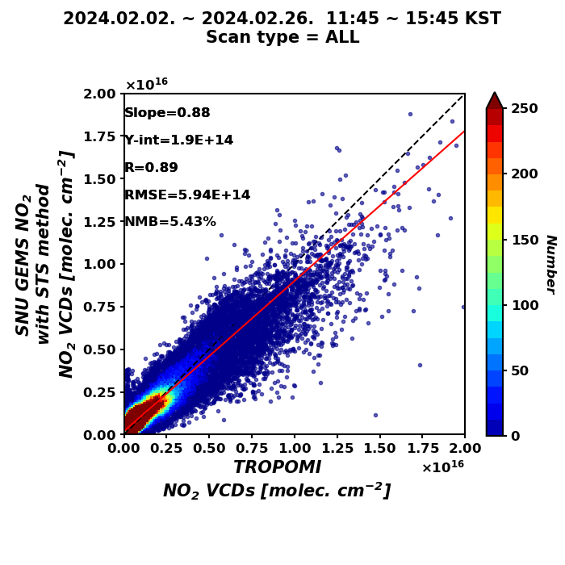
Tropospheric NO₂ VCD comparison: GEMS (SNU) vs. TROPOMI
GEMS (SNU) shows good consistency in tropospheric NO₂ VCD with TROPOMI
February 2024, 11:45 ~ 15:45 KST
(a) GEMS (SNU) NO₂
(b) TROPOMI NO₂
(a - b)/b
GEMS (SNU) NO₂
NO₂ VCDs [molec. cm⁻²]
Notes:
We also calculated tropospheric no2 vcd and compared them against tropomi. Again our snu no2 vcds show good agreement with tropomi.

Slide 20
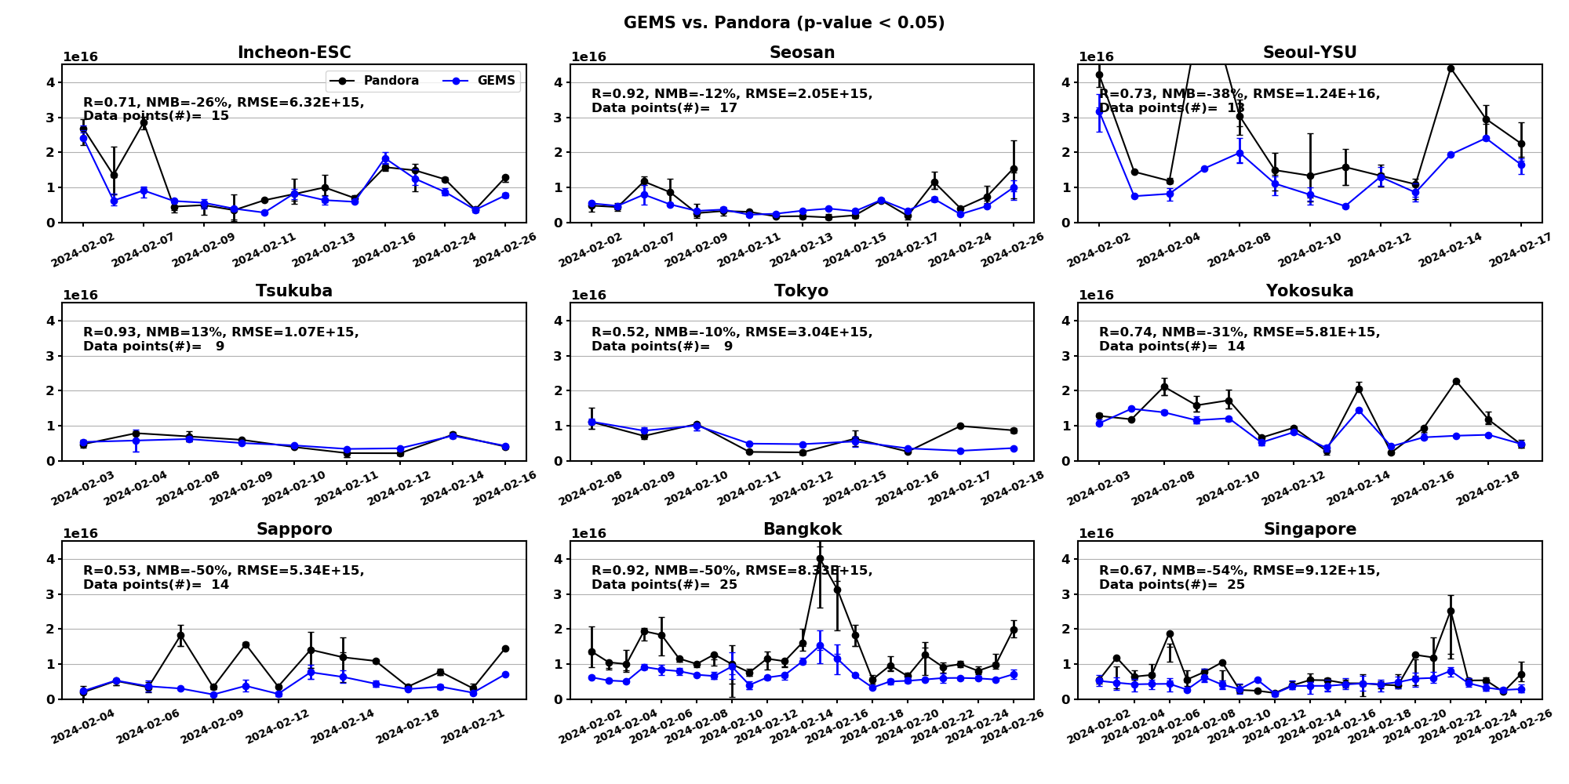
Tropospheric NO₂ validation results: GEMS (SNU) vs. Pandora
GEMS (SNU) tropospheric NO₂ shows strong agreement (r ~ 0.93) across East Asia.
_{February 2024}
NO₂ VCDs
[molec. cm⁻²]
Notes:
We have compared agaist pandora across asia and correlations are relatively high.

Slide 21
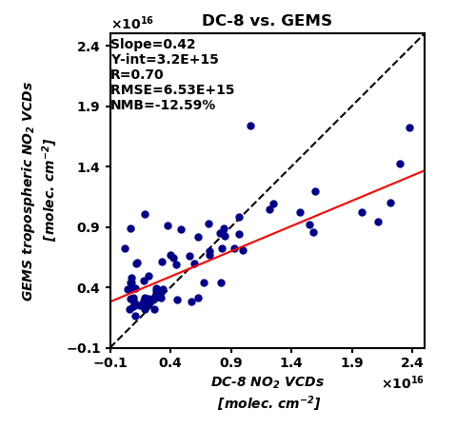
Tropospheric NO₂ validation results: GEMS (SNU) vs. DC-8 during ASIA-AQ
DC-8 NO₂: Courtesy of Alessandro Franchin (NCAR)
franchin@ucar.edu
GEMS (SNU) NO₂ shows good agreement with DC-8 observations during ASIA-AQ
DC-8 observations are 30~40% higher than GEMS over SMA
GEMS: tropospheric NO₂ VCDs
DC-8: 10 minutes mean NO₂ VCDs below 2km
GEMS (SNU) vs. DC-8: Korea
DC-8 vs. GEMS (SNU)
Notes:
Finally, we have compared our no2 vcds with dc-8 observations. So this is an apple and orange comparison because dc-8 did not measure column amount
But we want to focus on spatial variability, and in the future, we have to compare against geo-taso observations.
Anyhow, we find that gems and dc-8 are well correlated in Korean peninsula during the campaign.

Slide 22
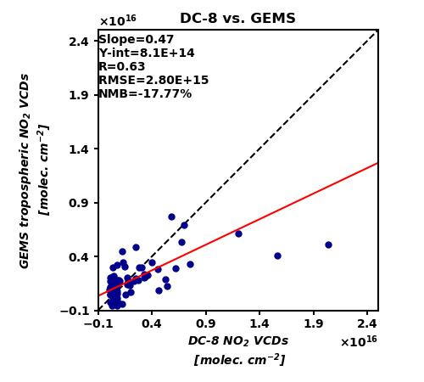
Tropospheric NO₂ validation results: GEMS (SNU) vs. DC-8 during ASIA-AQ
GEMS: tropospheric NO₂ VCDs
DC-8: 10 minutes mean NO₂ VCDs below 2km
GEMS (SNU) vs. DC-8: Philippines
DC-8 vs. GEMS (SNU)
Notes:
And this is spatial variability of gems and dc-8 over philippines, scatter is shown on the right.

Slide 23
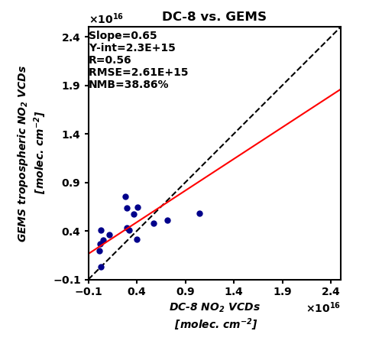
Tropospheric NO₂ validation results: GEMS (SNU) vs. DC-8 during ASIA-AQ
GEMS: tropospheric NO₂ VCDs
DC-8: 10 minutes mean NO₂ VCDs below 2km
GEMS (SNU) vs. DC-8: Taiwan
DC-8 vs. GEMS (SNU)
Notes:
This is Taiwan.

Slide 24
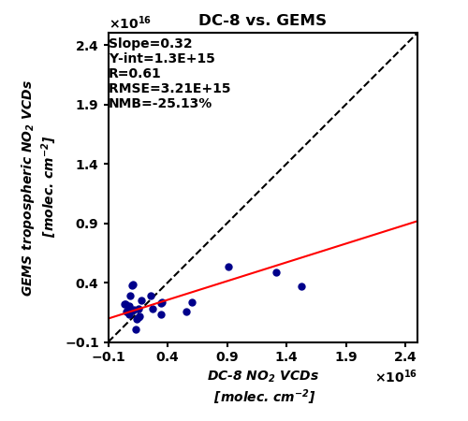
Tropospheric NO₂ validation results: GEMS (SNU) vs. DC-8 during ASIA-AQ
GEMS: tropospheric NO₂ VCDs
DC-8: 10 minutes mean NO₂ VCDs below 2km
GEMS (SNU) vs. DC-8: Thailand
DC-8 vs. GEMS (SNU)
Notes:
Finally, over Thailand.

Slide 25
Summary
HCHO
GEMS HCHO strongly correlates with TROPOMI and Pandora but shows high contribution of model background HCHO in the eastern scan domain.
Irradiance references partially reduce model contributions, but further improvements are needed to address fitting residuals and advanced de-striping algorithm.
GEMS (SNU) NO₂ align closely with TROPOMI and DC-8 observation during ASIA-AQ
CHOCHO
The seasonal variations of GEMS and TROPOMI measurements become more consistent after applying the NO₂ correction.
CHOCHO VCDs decrease when the radiance reference is polluted, particularly in latitudes above 28$°$ N. This issue can be partly resolved by screening polluted regions in the reference sector using simulated glyoxal concentrations.
DC-8 and GEMS observed similar spatial distributions of CHOCHO concentrations during the ASIA-AQ campaign, with elevated concentrations in SMA and Daegu.
Notes:
Ok this is summary slide which I am not going to read. Thanks!

Slide 26
Thank you

