Slide 1
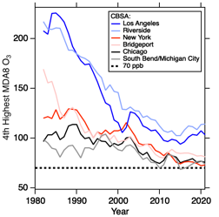
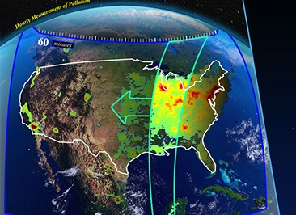
2023
https://csl.noaa.gov/projects/aeromma/
Carsten Warneke
NOAA Chemical Sciences Laboratory (CSL)
1. New paradigms in emissions and the future of urban air quality (volatile chemical products?)
AEROMMA 2023 DC-8 aircraft mission
2. Improvement in air quality has slowed down in recent years
3. Geostationary remote sensing of atmospheric composition – validation and new scientific capability (TEMPO)

Slide 2
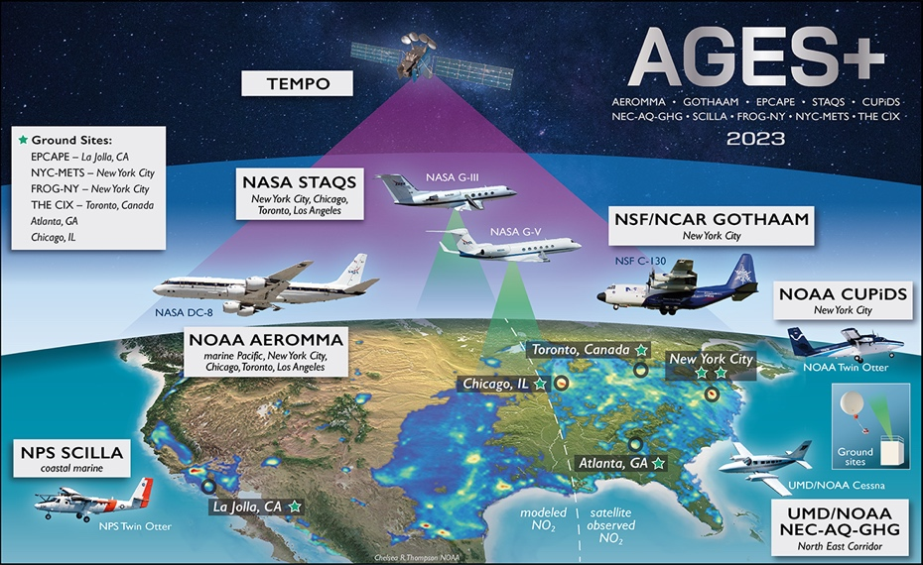
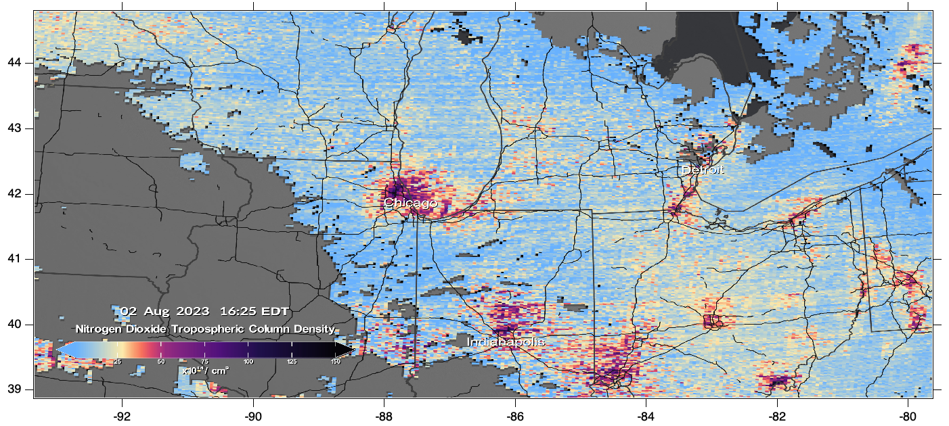
TEMPO and AEROMMA/AGES+
AEROMMA DC-8: emissions & chemistry
STAQS G3&V: remote sensing AQ & GHG
CUPiDS TO: coastal dynamics, AQ
LMBreeze Searey: low altitude over lake
Ground sites: - Pandora, TOLNet
- downtown, downwind, fluxes
- long term monitoring
Data sources:
AEROMMA: https://csl.noaa.gov/projects/aeromma/
STAQS:
https://www-air.larc.nasa.gov/cgi-bin/ArcView/staqs?JSC-GV=1
Searey:
https://www-air.larc.nasa.gov/cgi-bin/ArcView/staqs?SEAREY=1
TEMPO:
https://svs.gsfc.nasa.gov/5142
TEMPO (other satellites): hourly AQ data

Slide 3
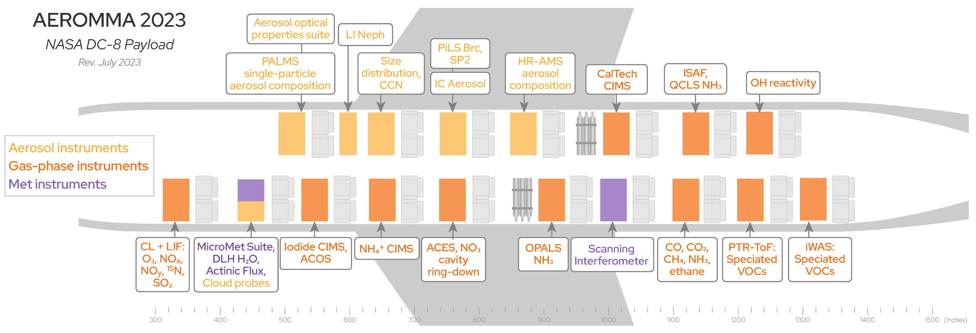
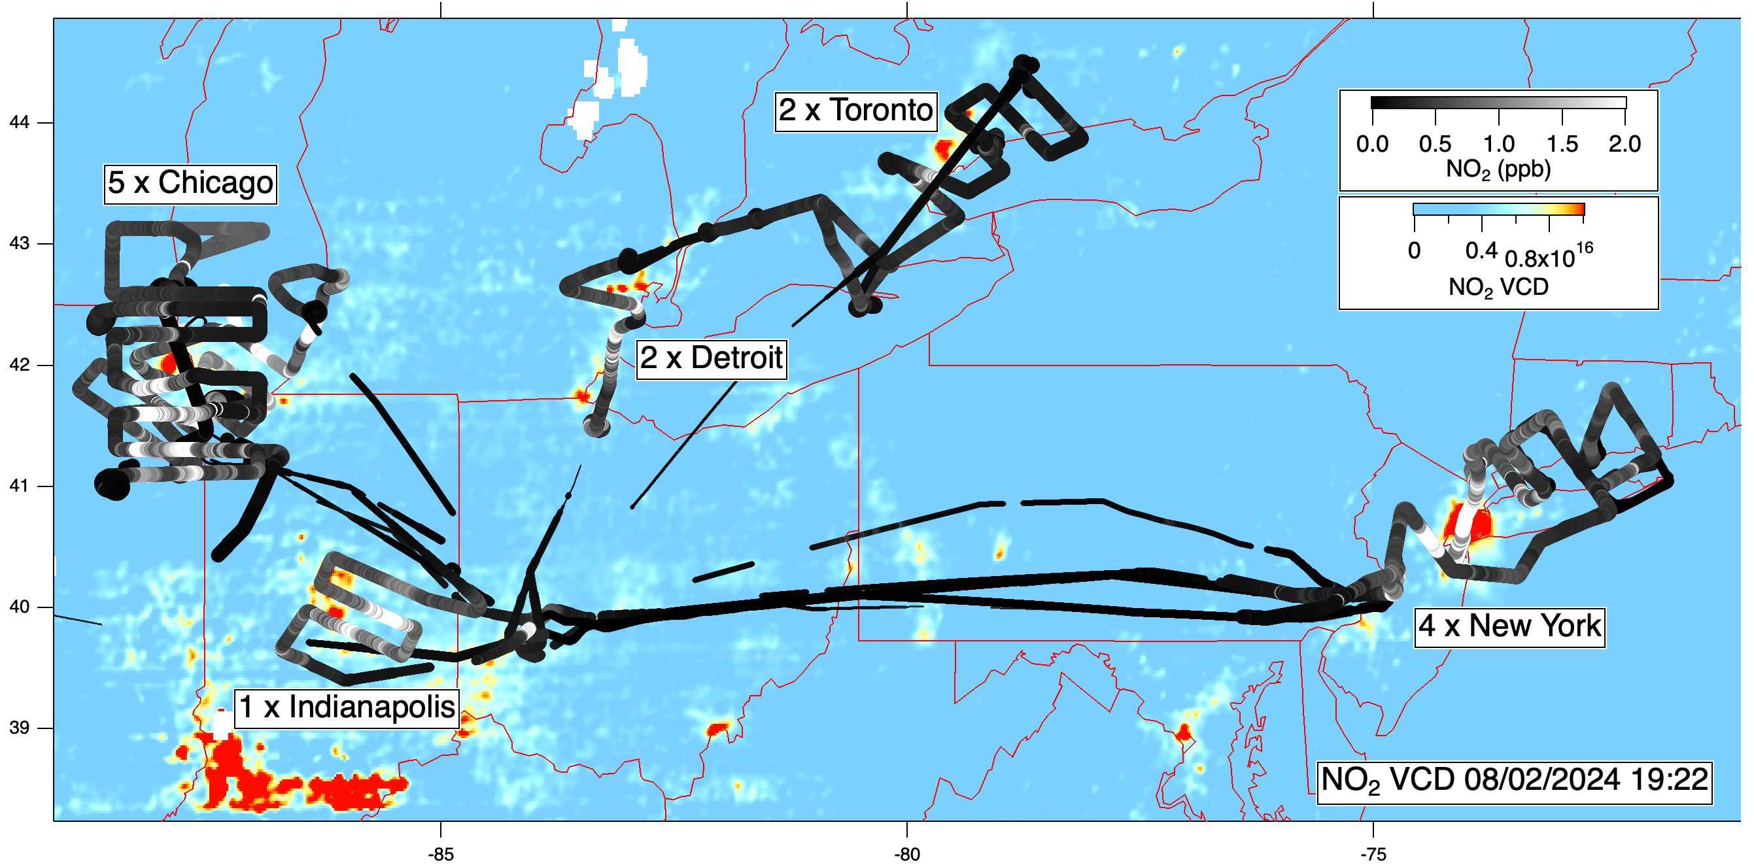
AEROMMA DC-8 Flight Statistics (Jun-Aug 2023)
City | # of flights
Los Angeles | 3 + SARP (4)
New York | 4
Chicago | 5
Toronto + Detroit | 2
Central Valley | 1 + SARP (1)
Indianapolis | 1
Salt Lake City | 1
All TEMPO parameters included
Flights under TEMPO:
New York, Toronto+Detroit with 3 aircraft (DC8, NASA G3&GV), Chicago with 4
Los Angeles with two aircraft (DC8, G3)
12 flights under TEMPO
6-12 altitude profiles per flight

Slide 4
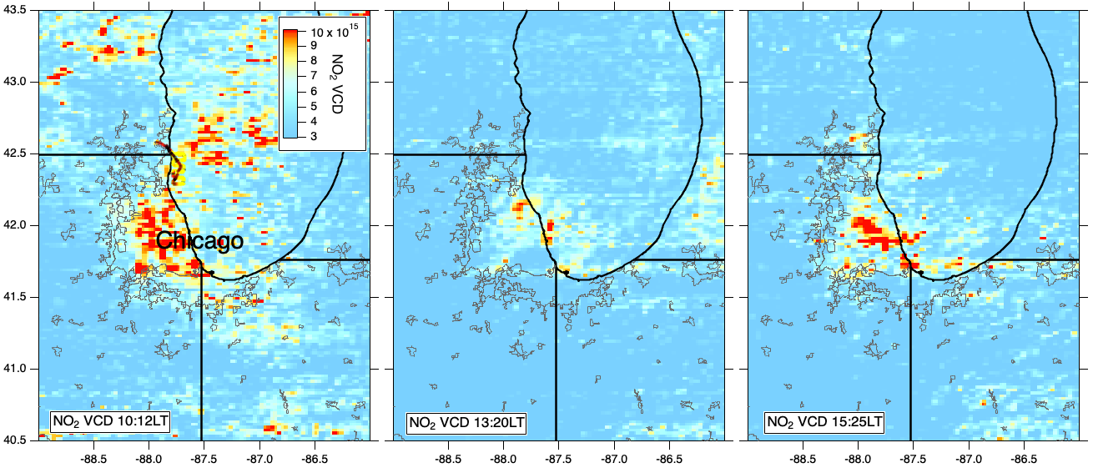
AEROMMA/AGES+ coordination for TEMPO First Light
Aug 02, 2023
morning early afternoon late afternoon

Slide 5
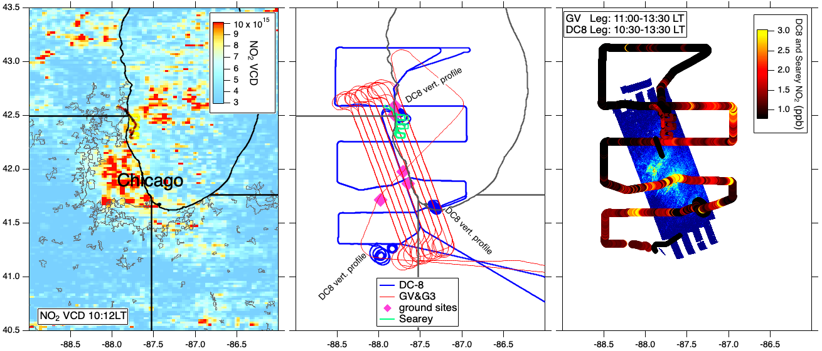
AEROMMA/AGES+ coordination for TEMPO First Light
Aug 02, 2023
GV data courtesy of L. Judd NASA
TEMPO data AGES+ measurements AGES+ data
morning early afternoon late afternoon

Slide 6
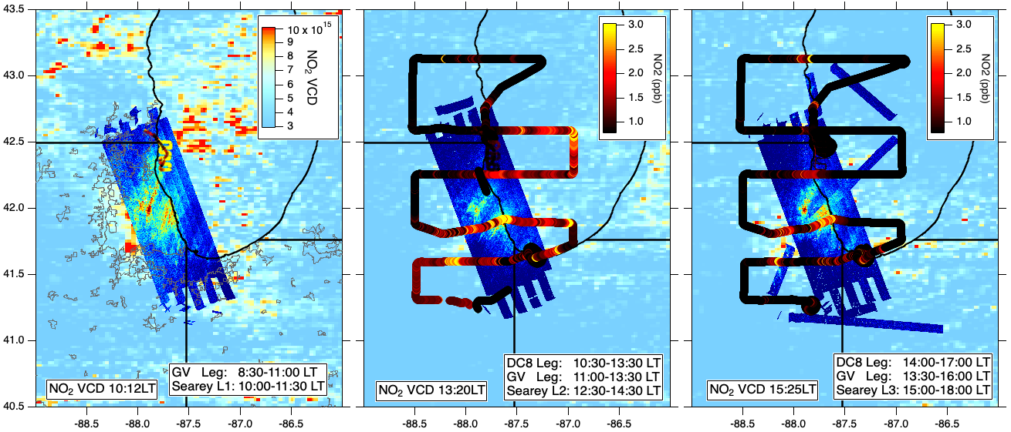
AEROMMA/AGES+ coordination for TEMPO First Light
Aug 02, 2023
morning early afternoon late afternoon

Slide 7
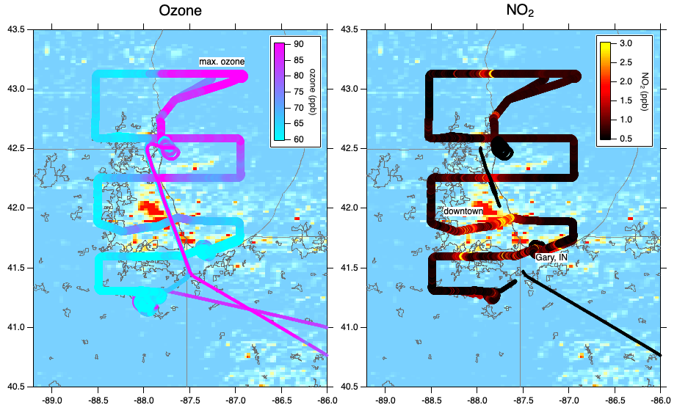
AEROMMA Chicago Aug 02, 2023
- High ozone over the lake: chemistry and transport
- NO₂ only high over the city in the afternoon
- Fresh emissions from downtown and Gary, IN
- Several spirals for altitude profiles

Slide 8
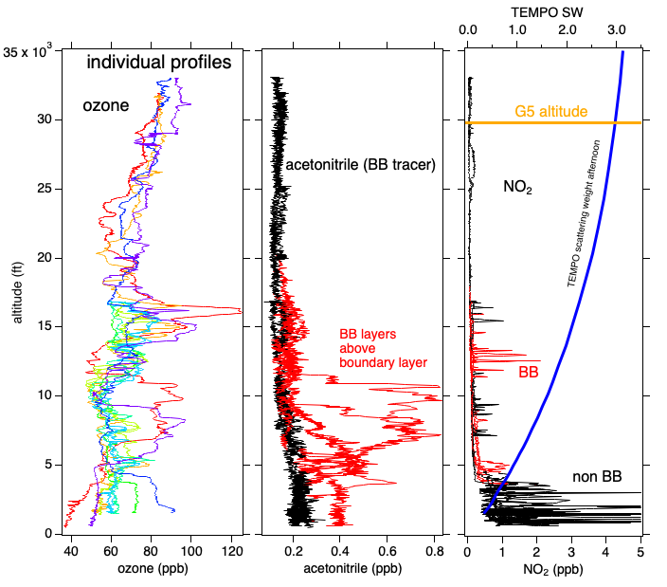
AEROMMA Chicago Aug 02, 2023
Spirals as altitude profiles for TEMPO validation:
- Biomass Burning (BB) layers aloft
- Some NO₂ in the free troposphere not from BB
- Layers aloft important due to larger scattering weights for TEMPO NO₂ at higher altitudes
Brown et al poster

Slide 9
Planned/Ongoing AEROMMA TEMPO Science
Direct comparisons in-situ with TEMPO data (with AEROMMA and CUPiDS):
- NO₂
- HCHO
Direct comparisons with future/potential TEMPO data (with AEROMMA, CUPiDS, and STAQS):
- Aerosol Optical Centroid Height (AOCH) or ALH
- AOD forthcoming (Adam Ahern, Dan Cziczo)
- ozone (Steve Brown poster)
- glyoxal (Carrie Womack)
- SO₂ (Drew Rollins)
Other topics:
- Can we relate column to BL NO₂ around urban areas and in the Central Valley
- What other tracers do we need to understand VCDs of NO₂, O₃, HCHO and AOD
- Relationship between HCHO/NO₂ ratios and ozone NOx-sensitivities
- Effect of aerosol and trace gas profiles on TEMPO retrievals

Slide 10
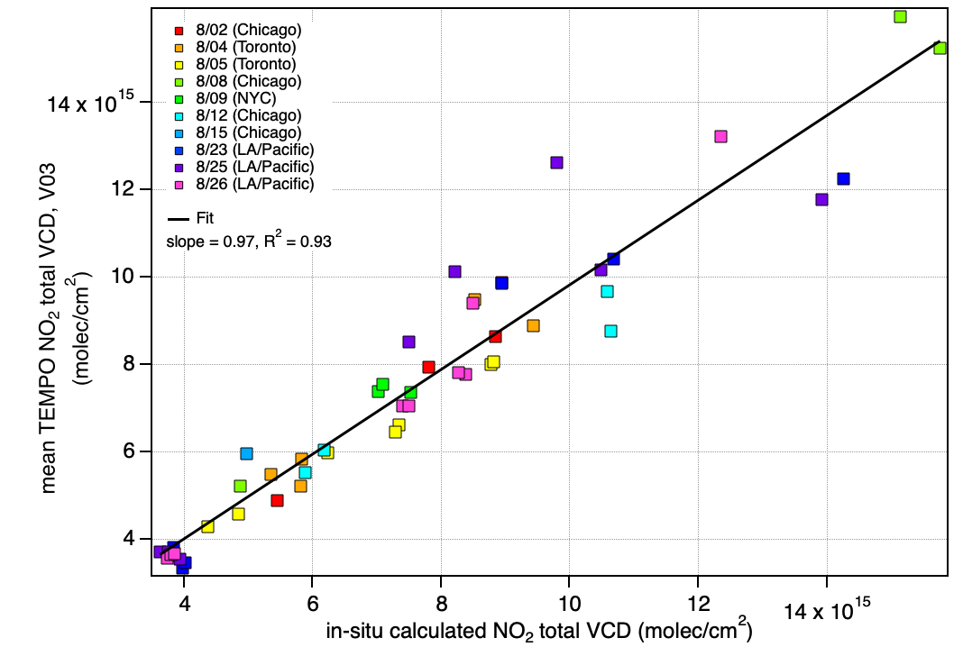
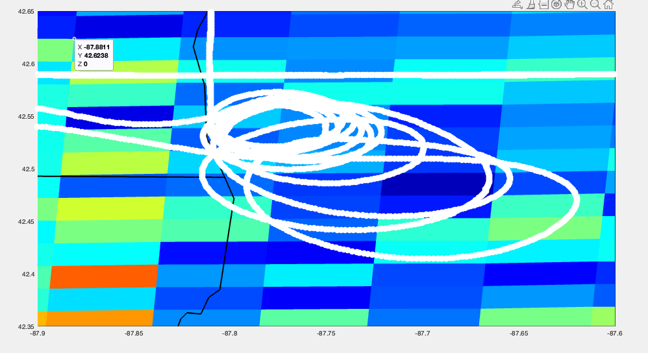
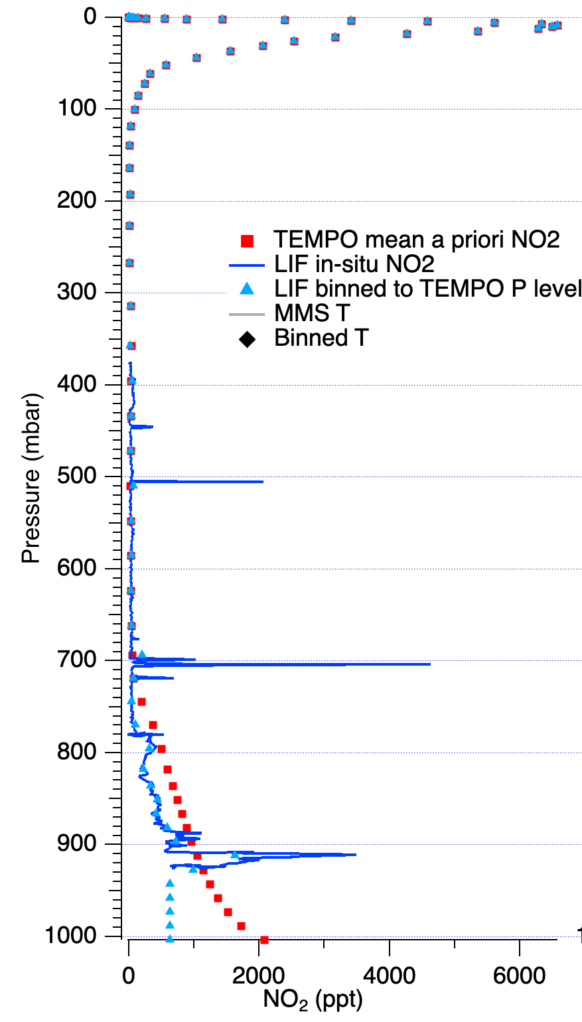
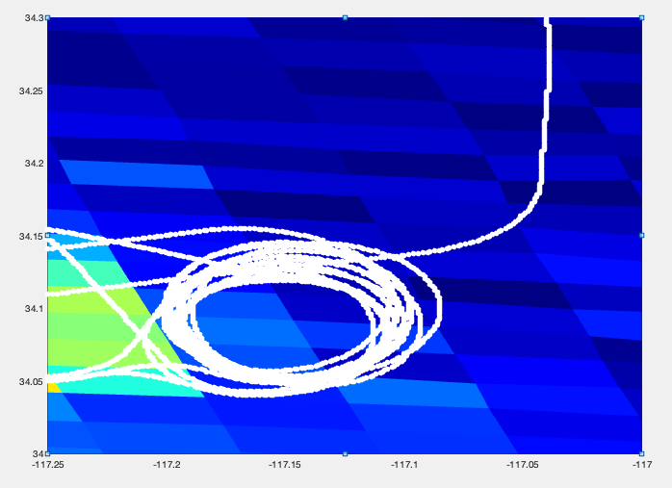
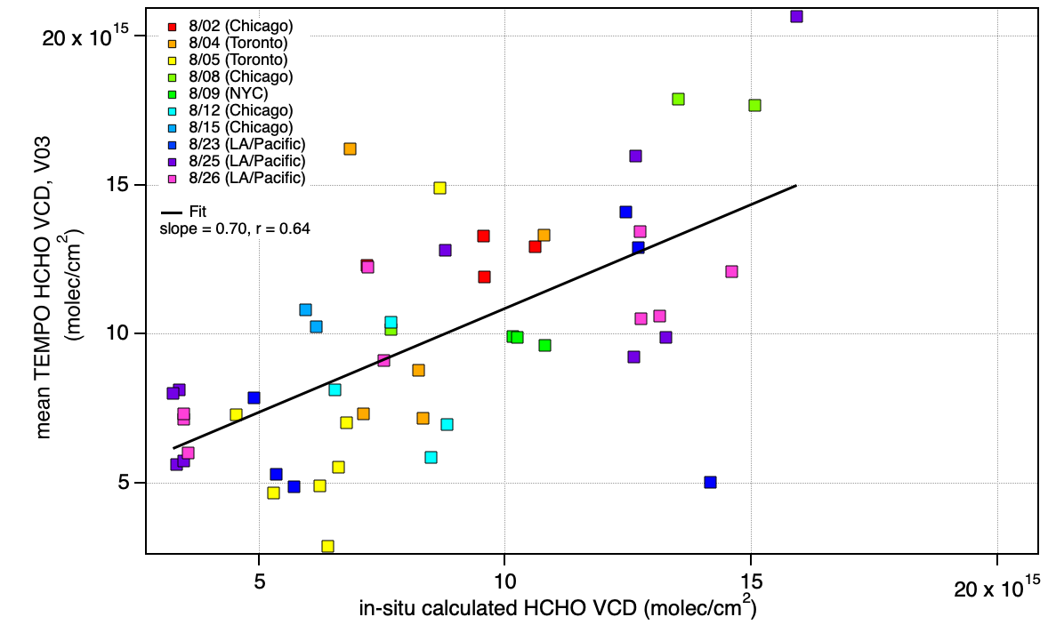
Comparison of Aircraft In-situ Profiles with TEMPO
Lake Michigan on 8/02
NO₂
Slope 0.97
R² 0.93
Redlands/San Bernadino 8/23
HCHO
Slope 0.70
R² 0.64
Spirals and TEMPO pixels Interpolate altitude profile VCD comparison
Waxman et al talk

Slide 11
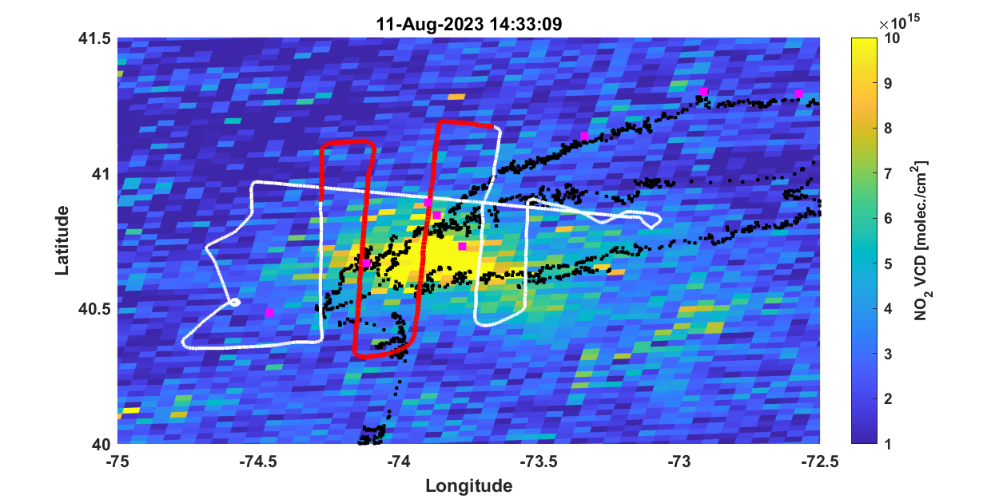
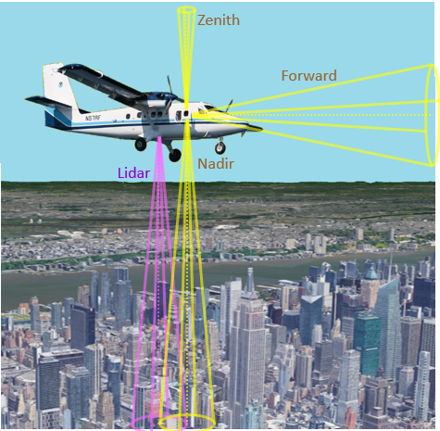
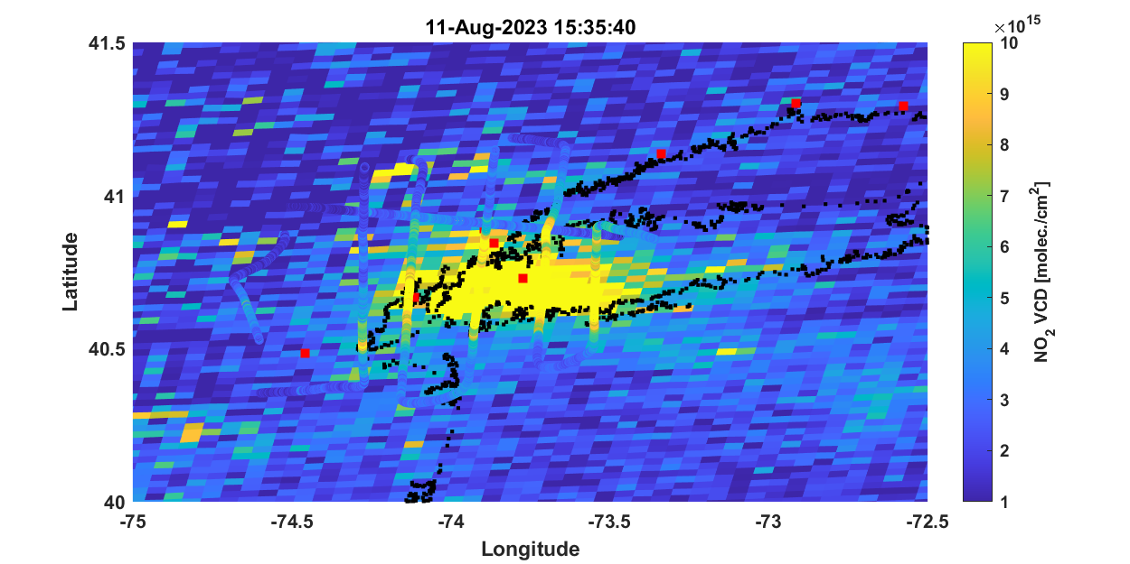
CUPiDS: MAX-DOAS vs TEMPO
Sunil Baidar, Rainer Volkamer

Slide 12
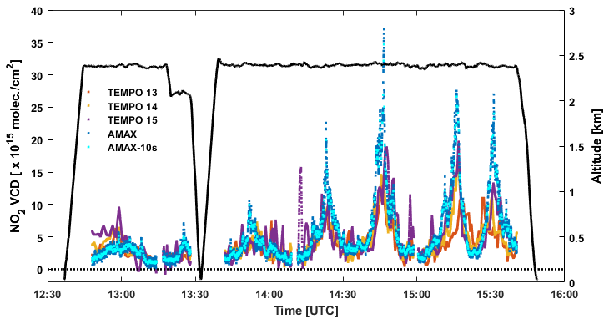
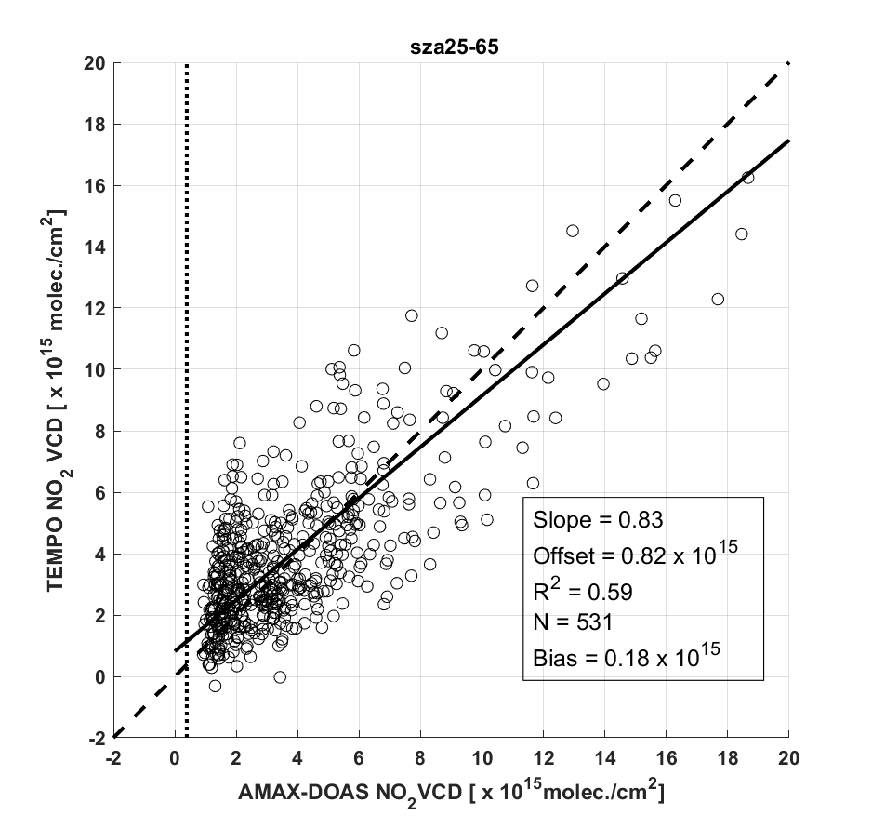
VCD along flight track

Slide 13
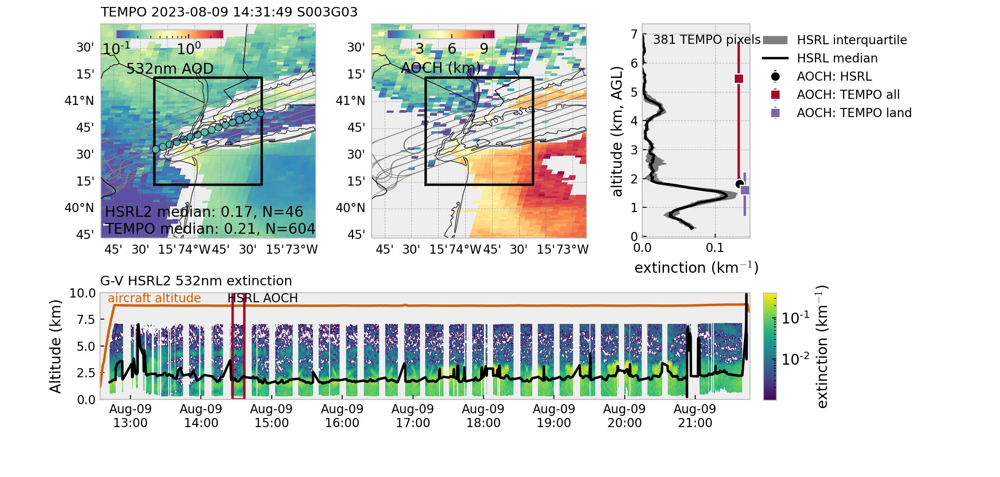
TEMPO Aerosol Optical Centroid Height Evaluation
Siyuan Wang (CIRES/CU Boulder, NOAA/CSL), Hai Zhang & Shobha Kondragunta (NOAA/NESDIS)
Example:
HSRL2 on G-V detected multiple BB aerosol layers with extinction peaking at ~1.5km.
TEMPO AOCH shows discontinuity between land and water pixels
Land pixels show very good agreement while water pixels drastically overestimates AOCH
First cut comparisons and will be redone with reprocessed data that ingests L1B data with updated calibration

Slide 14
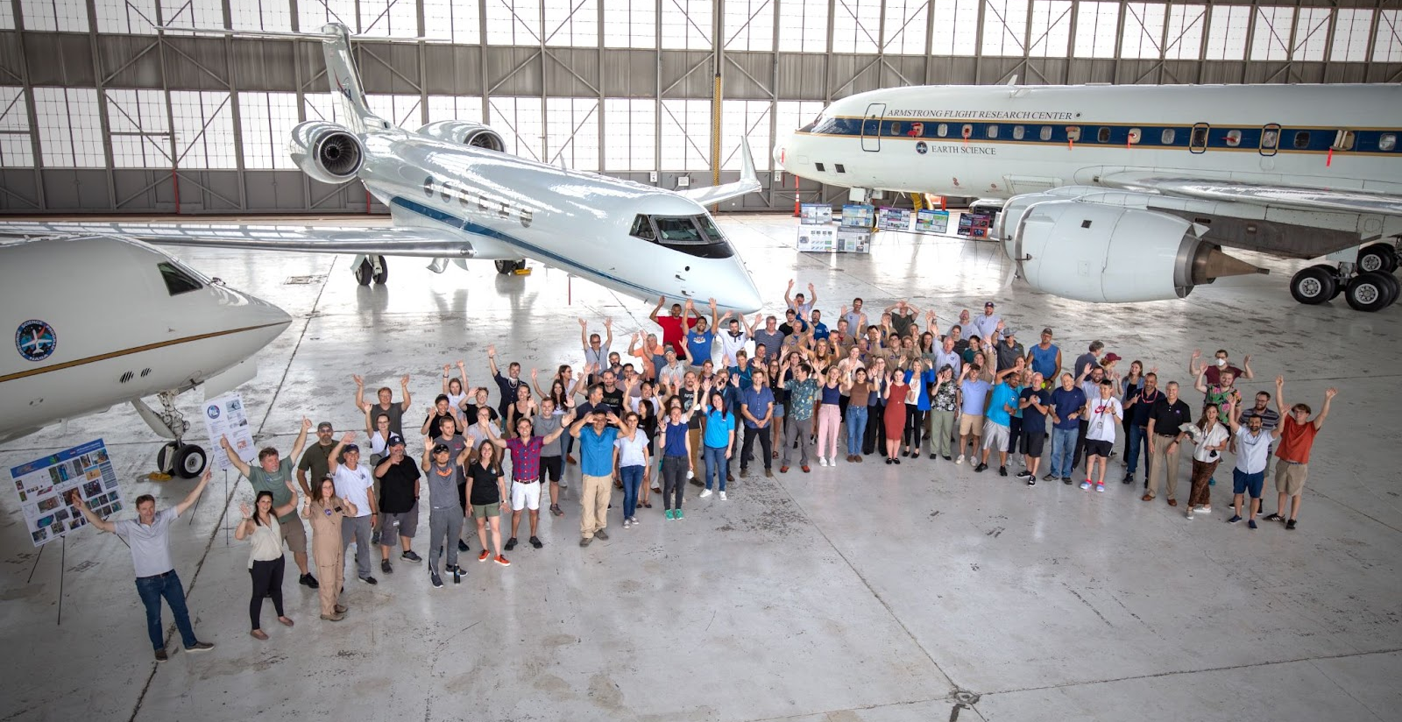
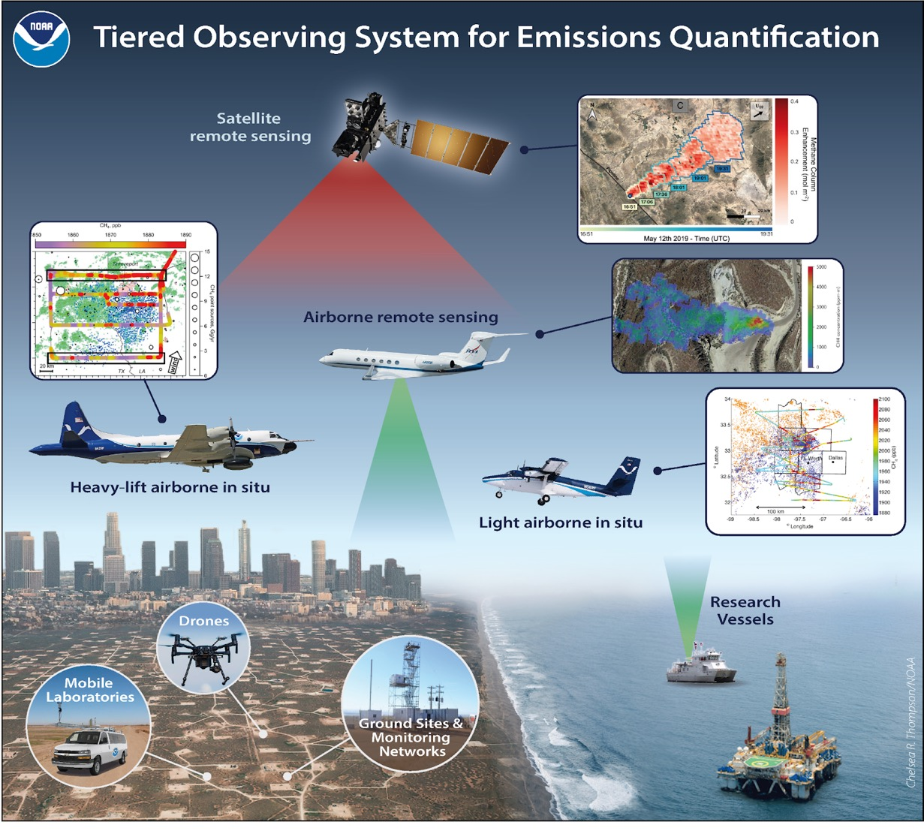
Next @AEROMMA
AiRMAPS 2024-27
Airborne and Remote Sensing Methane and Air Pollutant Surveys
2024 AGES+ Seminars
Date: every 4th Tuesday
Data: https://csl.noaa.gov/projects/aeromma/data.html
Data are final
Password protected until Oct.
(happy to share pwd)

