Slide 1
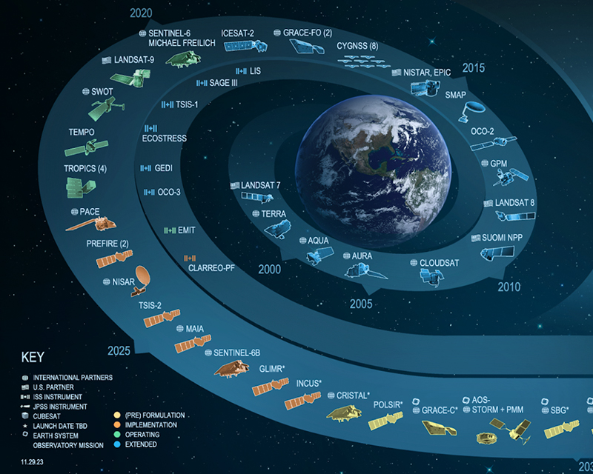
Satellite Needs Working Group:
Solutions for TEMPO and Air Quality
**Insert project-specific image here**
Kelley Murphy, Pontus Olofsson, Katrina Virts, Anita Leroy, Ryan Wade, Kevin Fuell
1,3
2
1,4
1,3,4
1,3
1,3
University of Alabama in Huntsville, Huntsville, AL
Marshall Space Flight Center, Huntsville, AL
NASA Short-term Prediction Research and Transition Center (SPoRT), Huntsville, AL
NASA Interagency Implementation and Advanced Concepts Team (IMPACT), Huntsville, AL
1
2
3
4
TEMPO/GEMS Joint Science Team Workshop
August 27th, 2024

Slide 2
What is Satellite Needs Working Group (SNWG)?
“A coordinated approach to identify and communicate Federal satellite Earth observation needs…
…and develop solutions to help federal agencies use Earth-observing satellite data products in their decision-making.”
Mandated through the White House National Science and Technology Council’s U.S. Group on Earth Observations (USGEO)
SNWG surveys federal agencies every 2 years to determine what Earth Observation data they need to fulfill their mission
NASA, NOAA, and USGS review responses and complete an assessment of agency needs (Do existing or upcoming missions help meet needs? Do organizations overlap in desired information? Can new products be made from existing data?)
NASA is funded to develop solutions, engage with stakeholders, provide training, and ensure impact
TEMPO/GEMS Joint Science Team Workshop
August 26-30, 2024 Kailua-Kona, Hawaii, USA

Slide 3
Co-designing Actionable Solutions
Sweet spot!
Incorporating co-design into the SNWG assessment and solution formulation process, so that solutions are useable, accessible, and actionable upon completion.
Desirable
Understanding US government agency partners, how they work, what decisions they make, how they use Earth observations
Defining who our agency champions may be, engaging and building relationships
Ideating with them to co-develop and prototype ideas
Testing and iterating on solutions as they are developed; sharing feedback early and often
Evaluating solutions together with end-users and incorporating necessary changes
Raising awareness and offering training to build our user community within agencies
Laying groundwork to sustainably transition solutions into users’ hands and workflow
Feasible
Viable
TEMPO/GEMS Joint Science Team Workshop
August 26-30, 2024 Kailua-Kona, Hawaii, USA

Slide 4
Stakeholder Engagement Program (SEP)
Within the SNWG Management Office at NASA IMPACT
Goals:
Fostering greater visibility of SNWG survey importance and beneficial outcomes to NASA, NOAA, USGS, and partnering federal agencies​.
Co-design solutions with agencies to ensure that the solution is ultimately actionable, accessible, and usable upon completion.
Ensuring thoughtful inclusion and funded support to training, coordinating, and outreach efforts supporting integration of SNWG solutions into agency decision making.
Enhancing coordination among solution implementation teams, NASA’s Distributed Active Archive Centers (DAACs), SNWG stakeholders, and end user communities.
TEMPO/GEMS Joint Science Team Workshop
August 26-30, 2024 Kailua-Kona, Hawaii, USA

Slide 5
Stakeholder Engagement Program (SEP)
Within the SNWG Management Office at NASA IMPACT
Goals:
Fostering greater visibility of SNWG survey importance and beneficial outcomes to NASA, NOAA, USGS, and partnering federal agencies​.
Co-design solutions with agencies to ensure that the solution is ultimately actionable, accessible, and usable upon completion.
Ensuring thoughtful inclusion and funded support to training, coordinating, and outreach efforts supporting integration of SNWG solutions into agency decision making.
Enhancing coordination among solution implementation teams, NASA’s Distributed Active Archive Centers (DAACs), SNWG stakeholders, and end user communities.
NASA SPoRT is leading SEP activities for 3 2020 Solutions, two of them air-quality related:
- Air Quality Forecasts and Distributed Pandora Sensors
- TEMPO/GOES Near Real-Time Products
- Merged Planetary Boundary Layer (PBL) Product
Contact: kelley.m.murphy@nasa.gov
Contact: kevin.fuell@nasa.gov
Contact: ryan.a.wade@nasa.gov
TEMPO/GEMS Joint Science Team Workshop
August 26-30, 2024 Kailua-Kona, Hawaii, USA

Slide 6
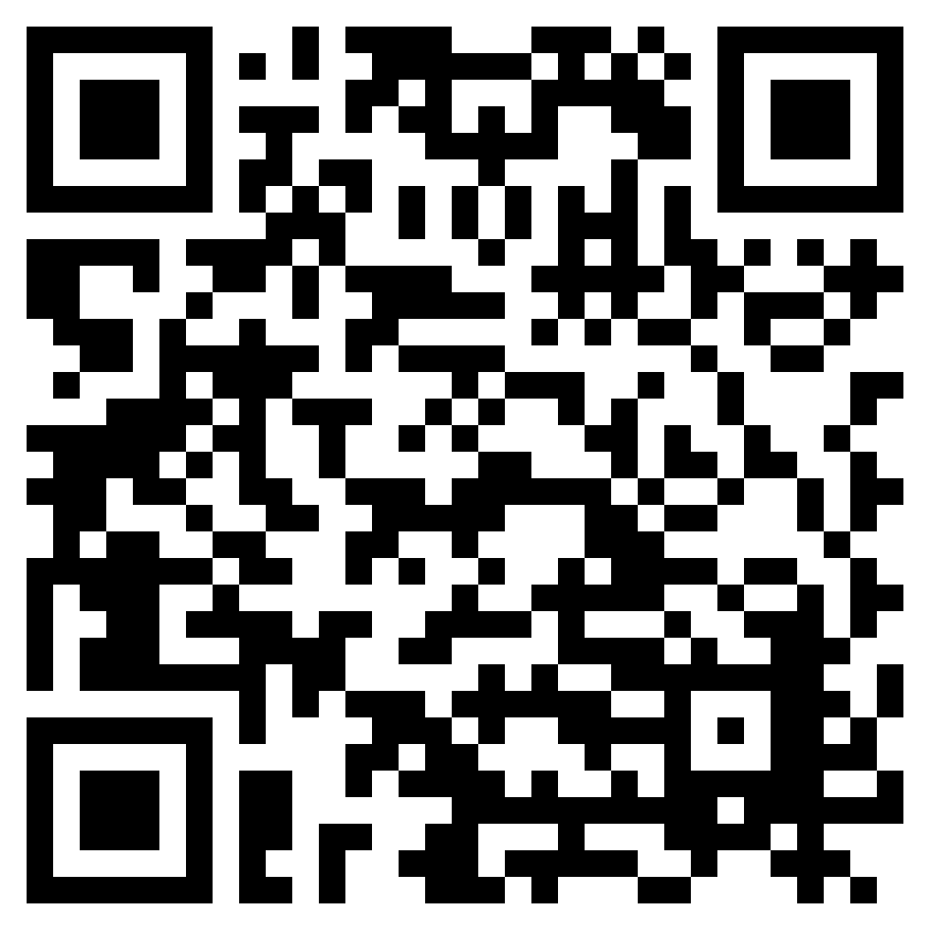
Status of SNWG Program of Record
SNWG-2016 Activities
Historical airborne data products
Harmonized Landsat Sentinel-2 product
Support for Maxar products
NISAR high-resolution North America
Support for agency data discovery
SNWG-2018 Activities
Global NISAR soil moisture product
Water quality products
OPERA Global surface water extent
OPERA Global land surface disturbance
OPERA North Amer. land surface deformation
Radiation & clouds – SatCORPS
Atmospheric composition using GEOS-5
Low latency freeboard & ice thickness products
Animal tracking (“Internet of Animals”)
SNWG-2020 Activities
TEMPO near real-time products
Global HLS-derived vegetation indices suite
Air quality forecasts and distributed Pandora sensors
Merged GNSS-RO/atmospheric sounder planetary boundary layer products
Sea surface salinity with sea ice mask
Commercial Data via CSDA
High-resolution DEMs from commercial data
Broader access to Planet data
Access to DESIS data
Broader access to Spire data
Enable discovery of commercial data
SNWG solutions on Earthdata
https://www.earthdata.nasa.gov/esds/impact/snwg/solutions
TEMPO/GEMS Joint Science Team Workshop
August 26-30, 2024 Kailua-Kona, Hawaii, USA
Notes:
Ask about TEMPO now being green

Slide 7
2020 Solutions: TEMPO and Pandora/Air Quality
Air Quality Forecasts and Distributed Pandora Sensors
The Pandora air quality sensors network will be expanded to include selected U.S. embassies and U.S. agricultural/rural sites.
The U.S. NASA’s Global Modeling and Assimilation Office (GMAO) will integrate the Pandora data into the Goddard Earth Observing System-Composition Forecast (GEOS-CF) model with downscaling approaches used for more precise air quality forecasts.
Development of consistent and high quality PM2.5 forecasts at over 270 Department of State posts and additional cities worldwide.
Dr. Thomas Hanisco
Dr. Emma Knowland
Dr. Pawan Gupta
TEMPO/GOES Near Real-Time Products
Production of hourly near real-time (NRT) air quality products with a 3-hour latency for NO₂, HCHO, and O₂-O₂ clouds along with a Level 1B product that will enable NOAA to produce an NRT aerosol product.
APPROVED (!) 2022 Solution – Near Real-Time SO2 and Enhanced Products! Complements the above 2020 solution with hourly SO2 concentration. Also will provide non-NRT TEMPO-based trace gas products. Enhanced Products: UVAOD, aerosol height, H2O, UVB, CHOCHO, and BrO.
Dr. Xiong Liu
Implementation Leads
TEMPO/GEMS Joint Science Team Workshop
August 26-30, 2024 Kailua-Kona, Hawaii, USA

Slide 8
Recent Engagement and Ways to Get Involved
Snapshot of SEP Working Engagement Plan
Stakeholder Groups
Phase 1 – Preliminary Gap/Requirement Analysis
Phase 2 – Stakeholder Feedback Sessions
Phase 3 – Integration of Feedback/Needs/Requirement
into Solution Development
Phase 4 – Develop/Deliver Training to Early Adopters
Phase 5 – Assessment of Solutions (Early Adopter
Feedback)
Phase 6 – Integration of Assessment Feedback into
Final Solutions
Integration with SNWG Transition Plan
NASA Earth Sciences​
Implementation Leads / Developers​
Commercial Data Providers​
Scientific Research Community (agencies,
universities, gov. labs, etc)​
SNWG Agencies
Operational End-Users​
Downstream Users / Decision-Makers
Ongoing
TEMPO/GEMS Joint Science Team Workshop
August 26-30, 2024 Kailua-Kona, Hawaii, USA

Slide 9
Recent Engagement and Ways to Get Involved
Joint TEMPO Early Adopters/SNWG meeting held August 6th, 2024
~200 attendees, 7 speakers, recording available soon
SNWG engagement updates, TEMPO mission and product update, early research application examples, data access
To join TEMPO Early Adopters, contact Aaron Naeger: aaron.naeger@nasa.gov
We would love to know:
How will you use TEMPO data, and what are your current barriers?
What are your training needs to incorporate TEMPO data into applications, operations, decision-making?
Are you interested in testing early versions of NRT products and providing feedback?
Contact: kevin.fuell@nasa.gov
TEMPO/GEMS Joint Science Team Workshop
August 26-30, 2024 Kailua-Kona, Hawaii, USA

Slide 10
Let us know if you’d like to get involved with SNWG Solutions!
Please let us know
…if you require changes to any SNWG solutions in order to use them
…if you require any form of training or support in order to use a SNWG solution
…if you are interested in co-designing new solutions
…if you want to help raise awareness of solutions and their applications to your agency
Pontus Olofsson: SNWG MO Project Scientist, contact: Pontus.olofsson@nasa.gov
Natasha Sadoff: Satellite Needs Program Manager, contact: natasha.sadoff@nasa.gov

