Slide 1
Reduced Dimensionality Analysis of TEMPO Ozone Profile Retrievals Using the Compact Phase Space Retrieval Algorithm
A. Mizzi (NASA/BAERI, NOAA/CIRES, CUB MecE), J. Park (Harvard & Smithsonian), X. Liu (Harvard & Smithsonian), A. Naeger (NASA SPoRT), M. Newchurch (UAH AtmSci), and B. Lefer (NASA HQ)
August 26 – 30, 2024
TEMPO GEMS Joint Science Team Workshop
Kona, HI USA

Slide 2
Overview
The goal of this project is to document and interprete the temporal and latitudinal trends and sensitivities for the TEMPO and TROPOMI ozone (O₃) profile retrieval averaging kernels.
The presented analysis is for 13:45 UTC March 29, 2024 studying TEMPO S0006 and TROPOMI latitude variations only.
Data was filtered for the CONUS (26 $≤$ lat $≤50;−179≤$lon $≤−20$). Note: this analysis uses all TROPOMI points because there were no CONUS points.
Introduction to the Compact Phase Space Retrieval Analysis (CPSR) method.
Review results from applying CPSRs to TEMPO and TROPOMI O₃ profile retrievals.
Singular value bar charts.
Degrees of freedom of signal (DOFS) histograms.
Averaging kernel profiles.
Left singular vector profiles.
Compressed averaging kernel profiles.
Rotated and compressed averaging kernel profiles.
Summary and Conclusions.

Slide 3
CPSRs: Full Retrieval Profiles
Mizzi et al. (2016): The retrieval equation is
$y_{r}=Ay_{t}+\left(I−A\right)y_{a}+E_{m}$. (1)
After removing the retrieval prior contribution, we get
$y_{r}−\left(I−A\right)y_{a}−E_{m}=Ay_{t}$ (2)
$where A$ is singular, and its leading left singular vectors span its range. The quantity on the left side is called the “quasi-optimal retrieval”.
Do an SVD of $A$, set the “zero” singular values and vectors to zero so that $A=ΩΣΨ^{T}$= $Ω_{0}Σ_{0}Ψ_{0}^{T}, and$project (2) onto the singular vectors
$Ω_{0}^{T}(y_{r}−{\left(I−A\right)y}_{a}−E_{m}$) = $Σ_{0}Ψ_{0}^{T}y_{t}$. (3)
This is the “Compression Transform.” The ‘compressed’ retrieval error covariance $\tilde{E_{m}^{2}}=Ω_{0}^{T}E_{m}^{2}Ω_{0}$ is still non-diagonal.

Slide 4
CPSRs: Full Retrieval Profiles cont.
Do an SVD of ${\tilde{E}}_{m}^{2}$ so that ${\tilde{E}}_{m}^{2}=ΠΛΘ^{T}$and project (3) onto the singular vectors
$Π^{T}Λ^{{−1}/2}Ω_{0}^{T}(y_{r}−\left(I−A\right)y_{a}−E_{m}$)=$Π^{T}Λ^{{−1}/2}Σ_{0}Ψ_{0}^{T}y_{t}.$(4)
This is the “Diagonalization Transform.” Together the “Compression” and “Diagonalization” Transforms are the “CPSR Transform.”
For a given retrieval profile, the CPSR Transform reduces the number of observations from the dimension of $A$ to the rank of $A$.
The associated assimilation computational savings is significant because: (i) the difference between the dimensions and rank of $A$is large (~70% MOPITT CO, ~85% IASI CO, ~90% IASI O₃, ~77% TEMPO O₃, and ~81% TROPOMI O₃); and (ii) the number of retrieval profiles is large O(100k).

Slide 5
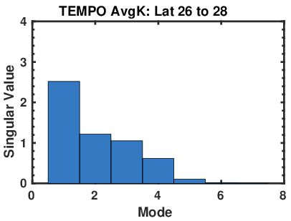
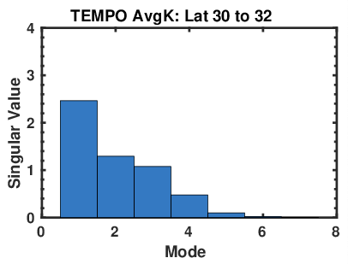
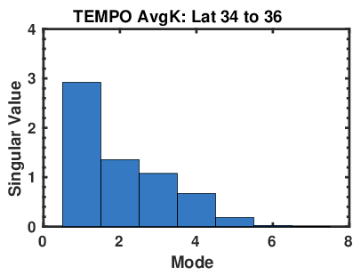
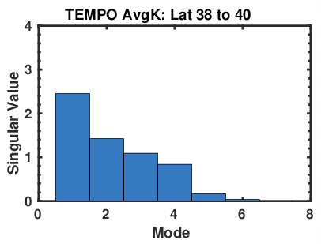
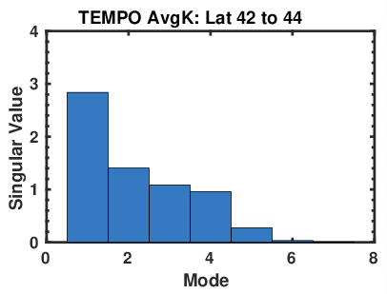
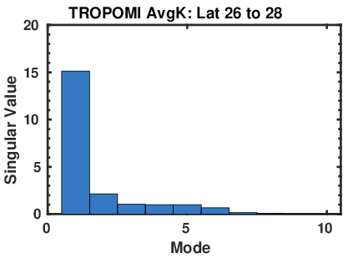
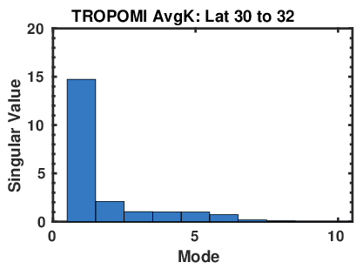
AvgK Mean Singular Value by Mode and Latitude Band
TEMPO:
TROPOMI:
TEMPO has four to five dominant modes with singular values ranging between ~1 and ~3. TROPOMI has one dominant mode (suspect) with a singular value of ~15 (six dominant modes).
TEMPO singular values increase from south to north.
TROPOMI singular values are constant from south to north.

Slide 6
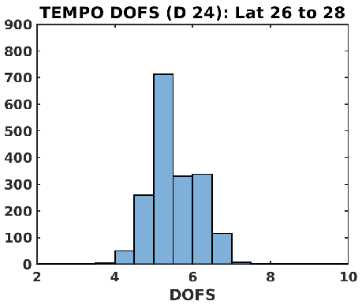
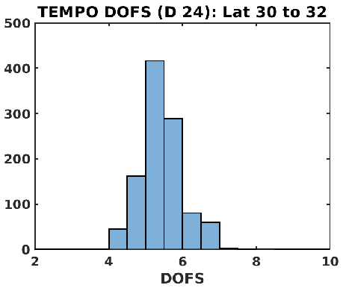
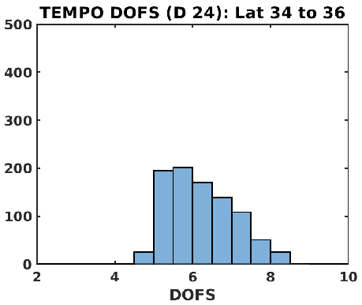
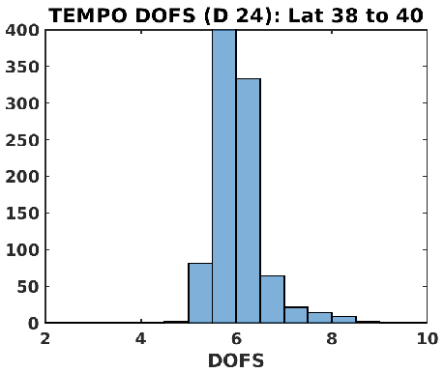
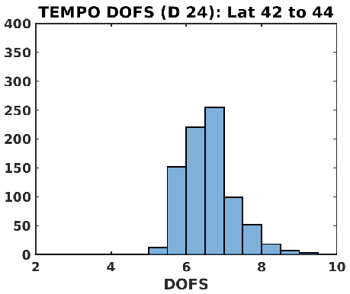
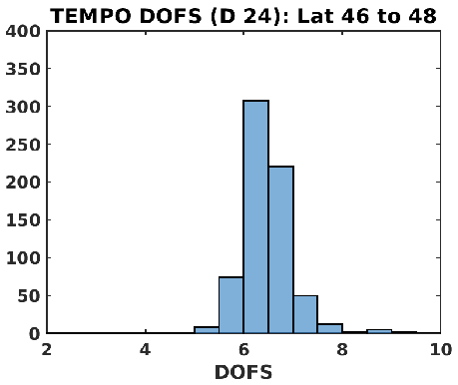
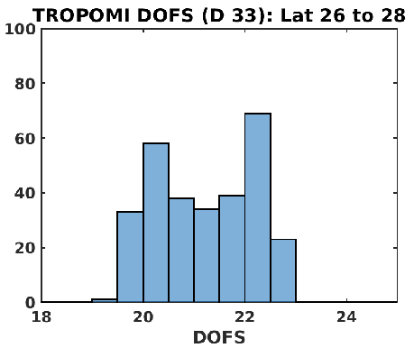
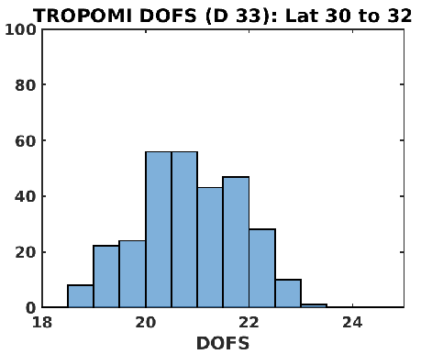
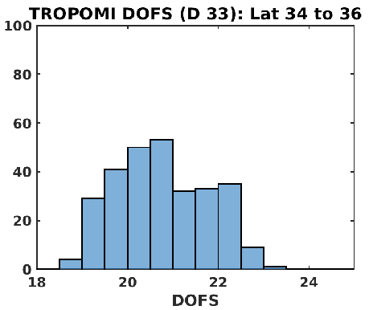
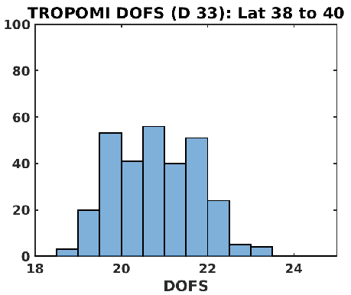
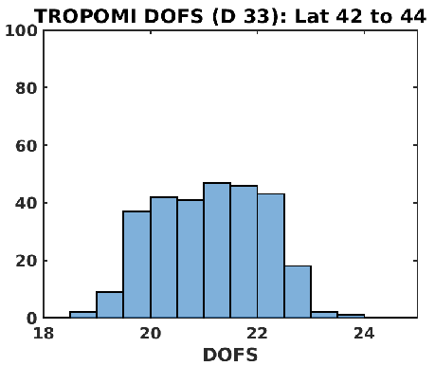
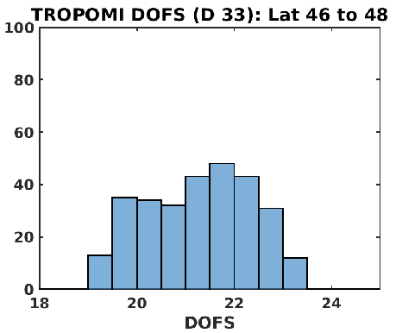
DOFS Histograms by Latitude Band
TEMPO:
TROPOMI:
TEMPO DOFS is 4 – 5 in south and increases to north with maximum of 6 – 7. TROPOMI DOFS is 20 – 22 (suspect due to the mode one singular values) and remains constant from south to north.
TEMPO has a greater number of accepted retrievals (expected) decreasing from south to north.

Slide 7
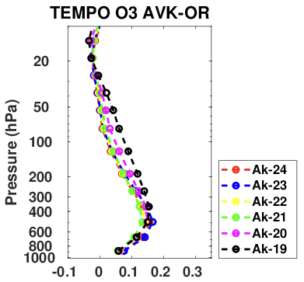
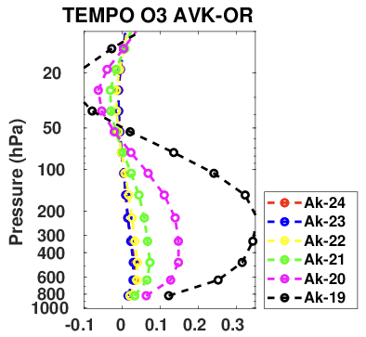
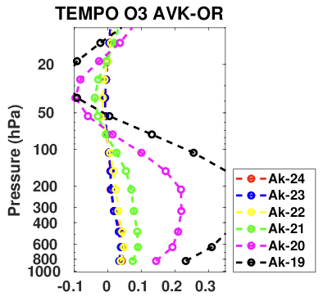
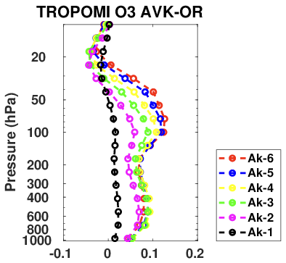
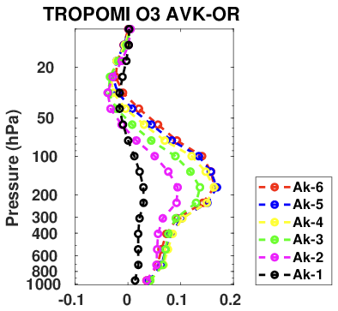
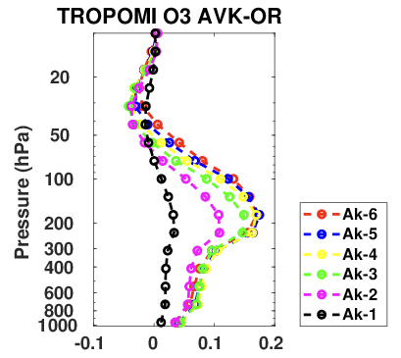
AvgK 1 - 6 from Surface by Latitude Band
Latitude Band 26 - 28
Latitude Band 38 - 40
Latitude Band 46 - 48
Raw sensitivities are misleading due to rank deficiency of AvgKs (TEMPO: 5/24; TROPOMI: 6/33).
TROPOMI has greater vertical resolution than TEMPO.
TEMPO: southern peak sensitivities in lower troposphere (500 – 700 hPa); northern sensitivities bimodal, greater; and higher in profile (20 – 50 hPa; 200 – 500 hPa).
TROPOMI: southern peak bimodal peak (50 – 100 hPa; 400 – 700 hPa); single northern peak, greater (150 – 300 hPa).

Slide 8
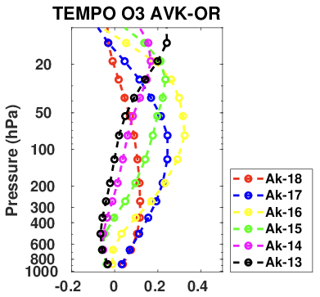
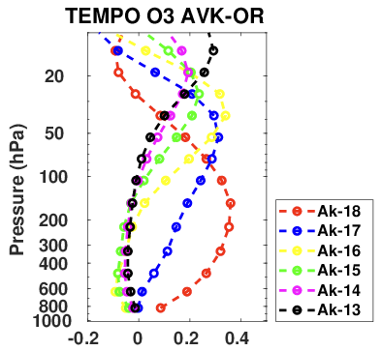
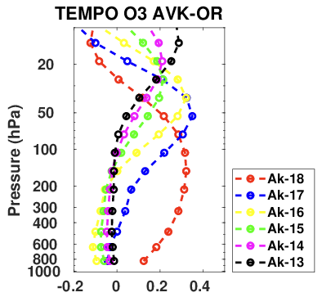
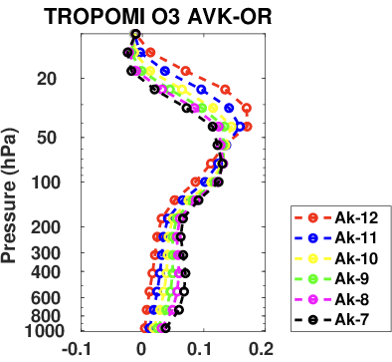
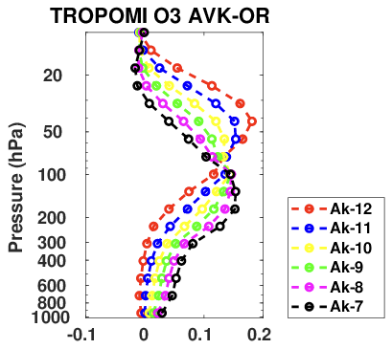
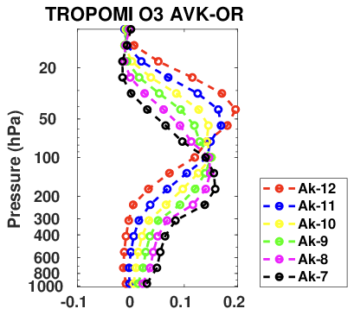
AvgK 7 - 12 from Near-Surface by Latitude Band
Latitude Band 26 - 28
Latitude Band 38 - 40
Latitude Band 46 - 48
TEMPO: southern peak sensitivities in upper troposphere (50 – 100 hPa); northern sensitivities greater, more distributed vertically (50 – 100 hPa and 200 – 400 hPa).
TROPOMI: single southern peak (20 – 100 hPa); northern peak is bimodal (20 – 50 hPa and 150 – 300 hPa).
TROPOMI has sensitivities in the stratosphere (1 – 100 hPa) while TEMPO does not due to TEMPO’s lack of spectral coverage and weak signal to noise ratio.

Slide 9
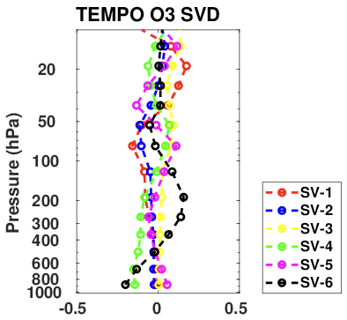
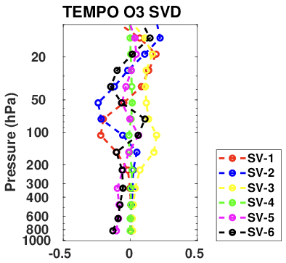
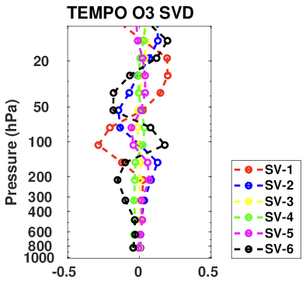
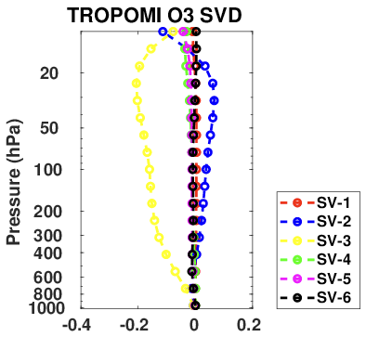
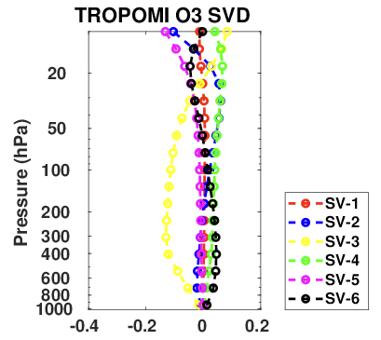
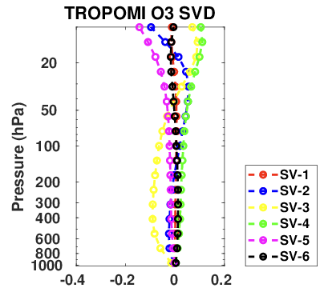
Ranked Left Singular Vectors by Latitude Band
Latitude Band 26 - 28
Latitude Band 38 - 40
Latitude Band 46 - 48
Left singular vectors are a basis for the range of the AvgK.
TEMPO: left singular vectors have structure throughout the troposphere
TROPOMI: left singular vectors are uniform in the troposphere.
The greater the singular vector vertical structure, the greater the averaging kernel’s ability of to resolve the O₃ profile.
The singular vector signs are immaterial because the left and right vectors can be multiplied by -1 with the same result.

Slide 10
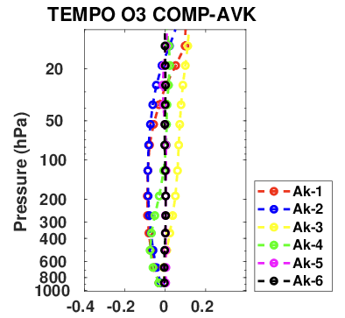
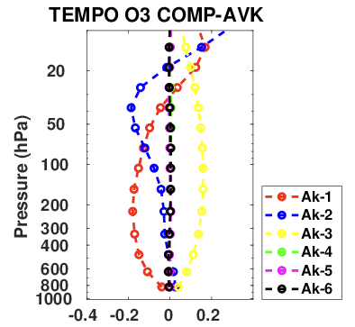
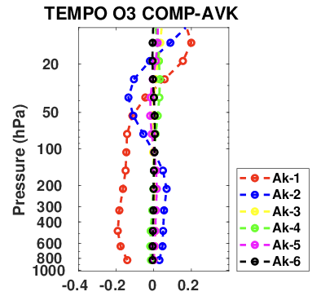
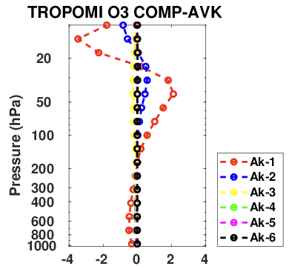
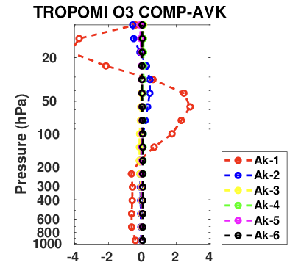
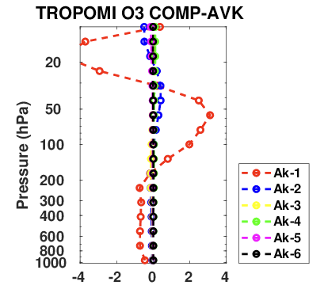
Ranked Compressed AvgK by Latitude Band
Latitude Band 26 - 28
Latitude Band 38 - 40
Latitude Band 46 - 48
‘Compressed’ AvgKs show the actual vertical sensitivities (no linear dependencies).
TEMPO: Ak-1 – Ak-3 have most sensitivities; south has weak sensitivities; middle has sensitivities throughout troposphere with Ak-1 having broad peak (100 – 800 hPa).
TROPOMI: Ak-1 has most sensitivities – all in stratosphere; south has weak sensitivities relative to middle and north (20 hPa and 70 hPa); also weak sensitivities in troposphere (250 – 800 hPa).

Slide 11
Ranked Compressed AvgK by Latitude Band
Latitude Band 26 - 28
Latitude Band 38 - 40
Latitude Band 46 - 48
‘Compressed’ AvgKs show the actual vertical sensitivities (no linear dependencies).
TEMPO: Ak-1 – Ak-3 have most sensitivities; south has weak sensitivities; middle has sensitivities throughout troposphere with Ak-1 having broad peak (100 – 800 hPa).
TROPOMI: Ak-1 has most sensitivities – all in stratosphere; south has weak sensitivities relative to middle and north (20 hPa and 70 hPa); also weak sensitivities in troposphere (250 – 800 hPa).

Slide 12
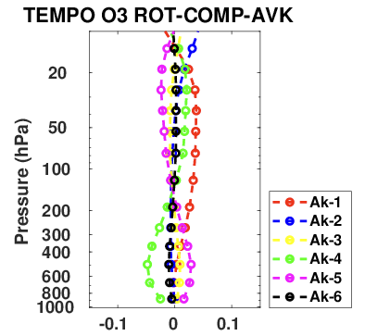
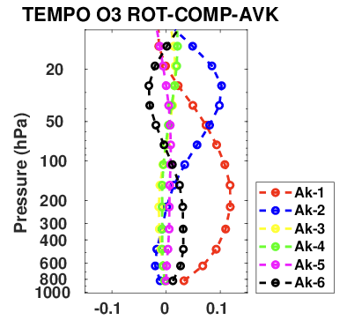
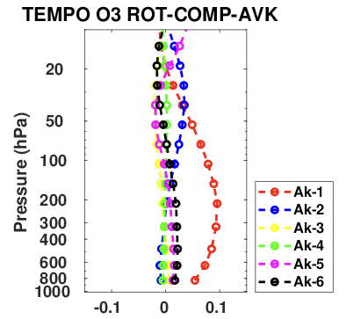
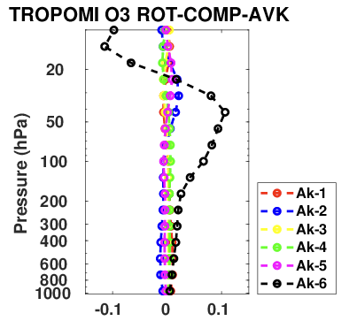
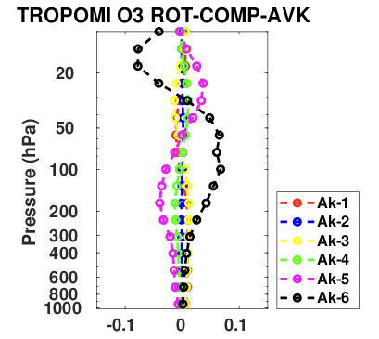
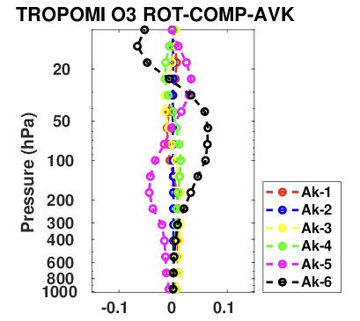
Ranked Rotated and Compressed AvgK by Latitude Band
Latitude Band 26 - 28
Latitude Band 38 - 40
Latitude Band 46 - 48
‘Rotated and compressed’ AvgKs account for the solution error covariance by rotating into a space where the covariance is projected onto the variance.
‘Rotated and compressed’ AvgKs are also normalized by the rotated and compressed solution error variance.

Slide 13
Ranked Rotated and Compressed AvgK by Latitude Band
Latitude Band 26 - 28
Latitude Band 38 - 40
Latitude Band 46 - 48
TEMPO: Ak-1 and Ak-2 have most sensitivities in middle latitudes; northern and southern latitudes have weaker sensitivities due to greater uncertainties. Ak-6 has greater sensitivities (compared to the compressed AvgK) due its smaller uncertainties).
TROPOMI: Ak-5 and Ak-6 have most sensitivities. Ak-6 has stratospheric sensitivities in south; Ak-5 and Ak-6 have sensitivities in upper troposphere for middle and northern latitudes.

Slide 14
Ranked Rotated and Compressed AvgK by Latitude Band
Latitude Band 26 - 28
Latitude Band 38 - 40
Latitude Band 46 - 48
TEMPO: Ak-1 and Ak-2 have most sensitivities in middle latitudes; northern and southern latitudes have weaker sensitivities due to greater uncertainties. Ak-6 has greater sensitivities (compared to the compressed AvgK) due its smaller uncertainties).
TROPOMI: Ak-5 and Ak-6 have most sensitivities. Ak-6 has stratospheric sensitivities in south; Ak-5 and Ak-6 have sensitivities in upper troposphere for middle and northern latitudes.

Slide 15
Summary and Conclusions
TEMPO and TROPOMI O₃ profile retrievals have rank deficient averaging kernels. TEMPO has four to five dominant modes with singular values ranging 1 – 3. TROPOMI has five to six dominant modes with singular values ranging 1 – 15 (the singular values of O(15) are suspect).
Computational and storage cost for TEMPO can be reduced by ~77% and for TROPOMI by ~81%. Additionally, the rank deficiencies can be leveraged for reduced dimensional emission estimation. This one direction of our future work.
The TEMPO AvgK left singular vectors have considerable vertical structure throughout the troposphere. TROPOMI AvgK left singular vectors are generally uniform throughout the troposphere. This means that the TEMPO averaging kernels should be better able to resolve the O₃ profile structure in the troposphere.
The TEMPO ‘compressed’ (Ak-1) and ’rotated and compressed’ (Ak-1) AvgKs have sensitivities in the mid- to lower troposphere. The TROPOMI ‘compressed’ (Ak-1) has similar sensitivities but the ‘rotated and compressed’ AvgK does not. These results suggest that even after considering ‘solution uncertainties’ TEMPO is better able to resolve tropospheric O₃ profiles compared to TROPOMI.
Another direction of future work will be extending this analysis to consider temporal variations.

