Slide 1
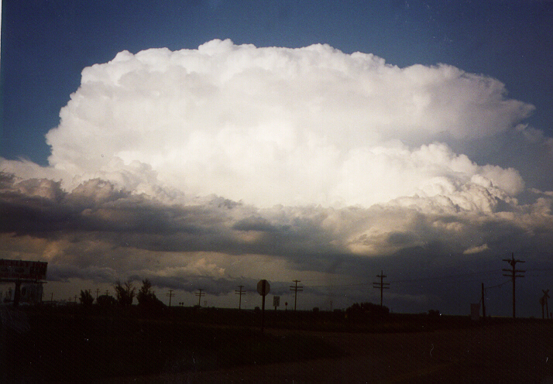
Observations of Lightning NO_{x} Production from TEMPO Case Studies over the U.S.
Dale Allen¹, Kenneth Pickering¹, Eric Bucsela², Madilynn Seiler¹, William Koshak³, and Caroline Nowlan⁴
¹University of Maryland, College Park (djallen@umd.edu)
²Science Systems and Applications Inc (SSAI)
³NASA Marshall Space Flight Center
⁴Center for Astrophysics, Harvard & Smithsonian
Photo of northeast Colorado STEREO storm
Courtesy of K. Pickering

Slide 2
Introduction
Lightning-NO_{x} (LNO_{x}) accounts for 10-15% of NO_{x} production globally or 2 – 8 Tg N a⁻¹ (100 to 400 moles per flash).
Much of the uncertainty in the magnitude of the source is due to uncertainties in lightning NO_{x} production per flash (LNO_{x} PE).
LNO_{x} is injected into mid- and upper-troposphere, where away from deep convection its lifetime is longer than in lower troposphere. LNO_{x} enhances NO_{y}, OH, and O₃ while decreasing CH₄ and thus contributes to enhanced longwave radiation absorption by O₃ and decreased longwave radiation absorption by CH₄.
In this study, we estimate LNO_{x} PE using flash counts from GLM and tropospheric NO₂ columns from TEMPO.
\

Slide 3
Geostationary Lightning Mappers (GLMs)
GOES-R GLMs (Goodman et al., 2013) are near-infrared optical transient detectors that detect lightning from changes in the optical scene due to the release of electromagnetic radiation by lightning.
GLMs are a part of the payloads for NOAA's GOES-R series that includes GOES-16 (operational since Dec 18, 2017) and GOES-18 (operational since Jan 4, 2023).
GLM maps CG and IC flashes with a mean day time detection efficiency (DE) > 70%, although DE is often lower over inverted polarity storms, severe storms, and/or storms with deep liquid water paths (Koshak et al., 2018).
In this study, GLM-16 flashes are used east of 106.2° W and GLM-18 flashes are used west of 106.2° W. No correction is made for DE.
Scalloped regions show fields of view of
GLM-16 centered at 75.2° W and GLM-18
centered at 137° W. Background colors show climatological flash density.

Slide 4
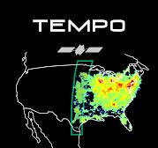
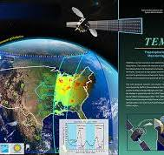
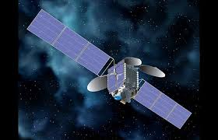
TEMPO
Each TEMPO retrieval has a data quality flag. This study uses ”high-quality” (main_data_quality_flag = 0) V03 TEMPO retrievals over deep convective scenes, i.e., pixels with cloud radiative fractions > 0.97 and cloud optical pressures < 500 hPa.
Overexposure of CCDs (saturation) and blooming (spread of saturation influence to neighboring wavelengths and pixels) is common for TEMPO pixels over deep convective scenes during the middle of day. Thus, only morning (12-16 UTC) and late afternoon / evening (20-23 UT) scans are used in this study.
Caution:
TEMPO VO3 product is designated as of ”Beta” maturity and has only been minimally validated over cloud-free scenes; this study uses V03 product over deep convective scenes where validation is even more minimal.

Slide 5
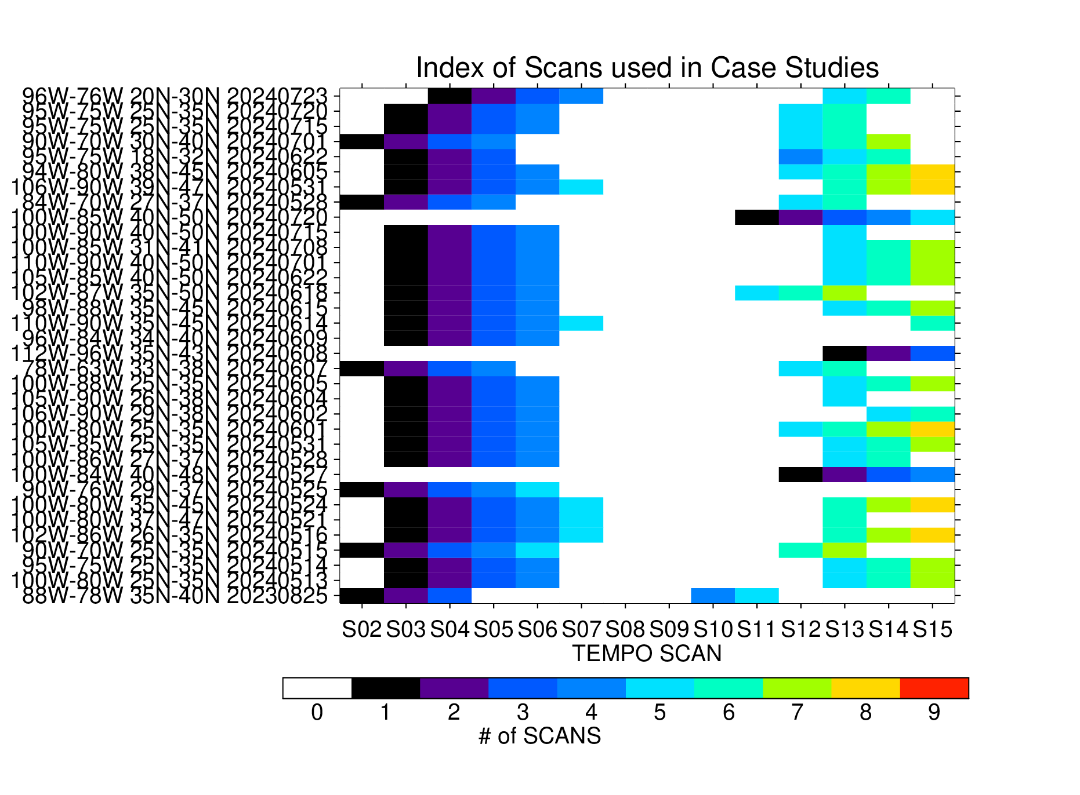
Analysis is limited to morning and late afternoon / evening hours. On a given day, we utilize observations from 3-8 scans.
Overall, we utilize 213 scans from 34 case studies on 26 days
Nominal times covered by the scans are
1120-1200 UTC (Scan 2),
1200-1240 UTC (3),
1240-1320 UTC (4),
1320-1400 UTC (5),
1400-1500 UTC (6),
1500-1600 UTC (7),
2000-2100 UTC (12),
2100-2200 UTC (13),
2200-2240 UTC (14),
2240-2320 UTC (15).
Note: 20230825 case study occurred
before nominal operations were in place

Slide 6
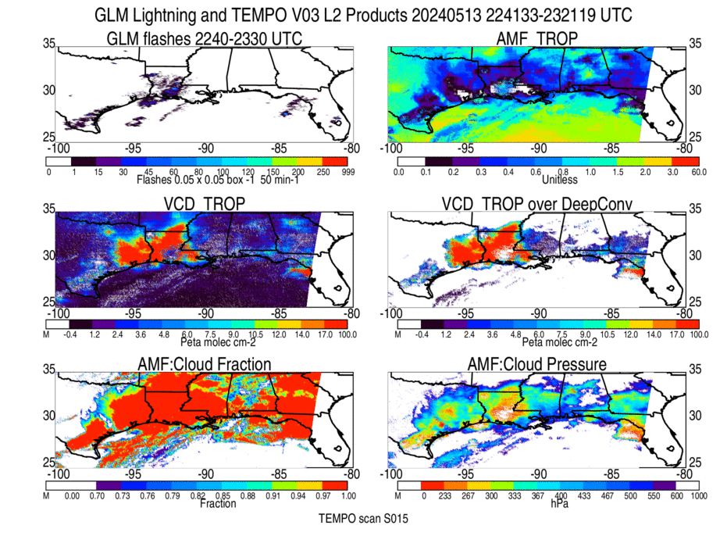
Lightning flash counts
during time of scan
Tropospheric AMF used
in converting TEMPO obs
to VCD, i.e., VCD_Trop =
SCD_Trop / AMF_Trop
Tropospheric VCD
of NO₂ Transparent
when saturated, of
suspect quality,
or outside of scan
Tropospheric VCD of
NO₂ but only high quality
retrievals over deep
convective pixels
Cloud radiative
fraction at 440 nm
>0.97 (red) →
Deep convection
Optical Cloud Pressure
< 500 hPa →
Deep convection
For this May 13 case study, scans 3-6 and 13-15 used to estimate PE.

Slide 7
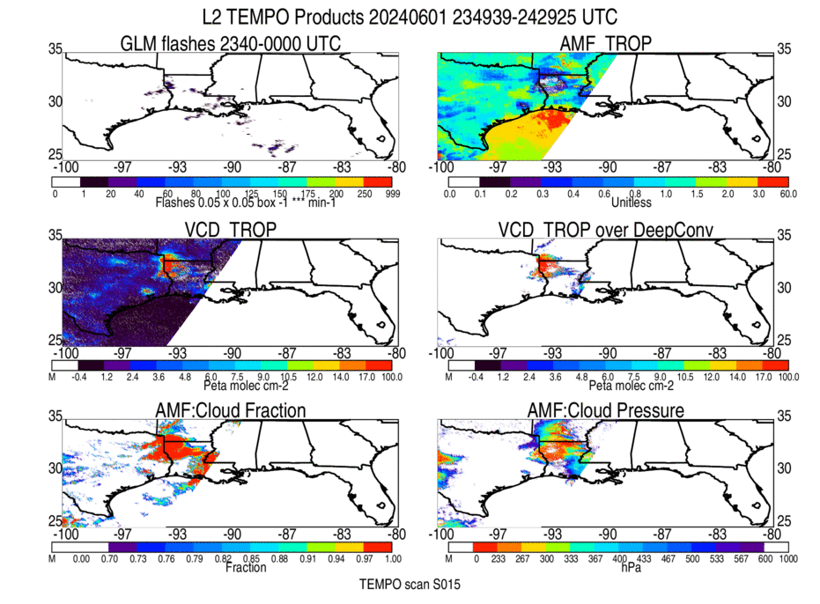
Tropospheric AMF used
in converting TEMPO obs
to VCD, i.e., VCD_Trop =
SCD_Trop / AMF_Trop
Lightning flash counts
during time of scan
Tropospheric VCD
of NO₂ Transparent
when saturated, of
suspect quality,
or outside of scan
Tropospheric VCD of
NO₂ but only high quality
retrievals over
deep convective pixels
Cloud radiative
fraction at 440 nm
>0.97 (red) →
Deep convection
Optical Cloud Pressure
<500 hPa →
Deep convection
For this June 1 case study, scans 3-6 and 12-15 used to estimate PE.
Scan 11 was unavailable.

Slide 8
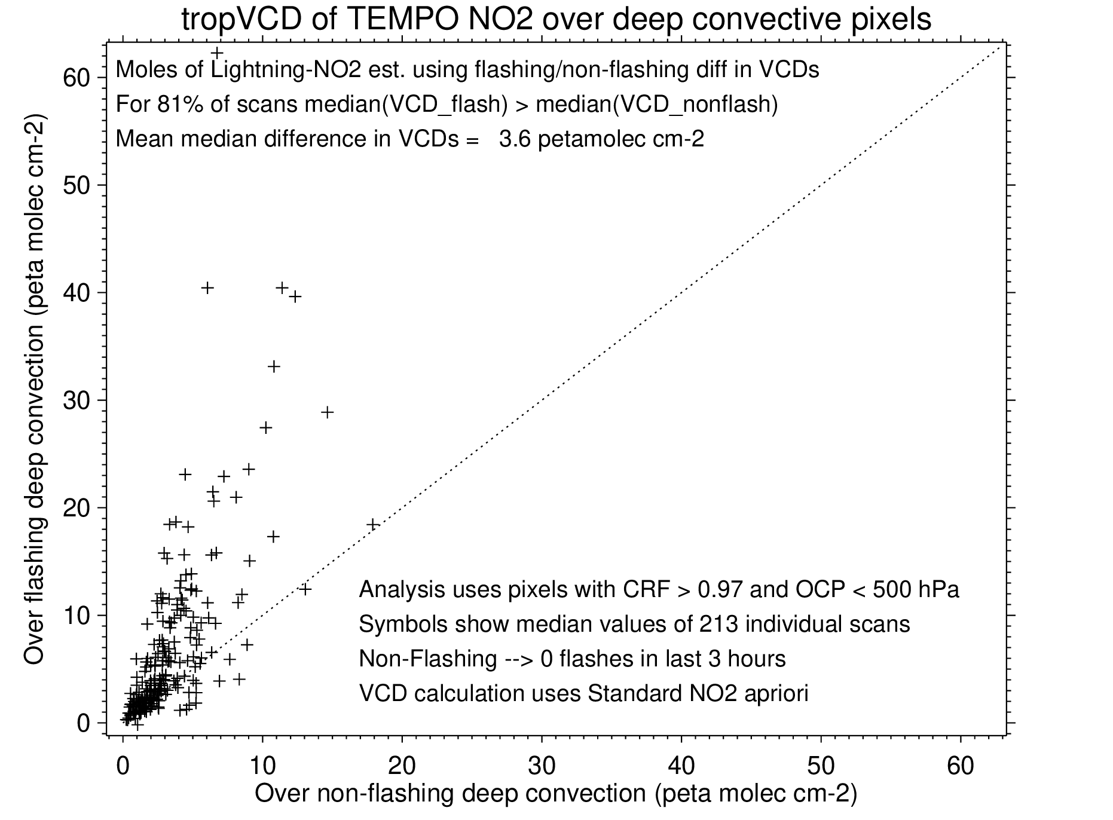
Tropospheric NO₂ columns over flashing
retrievals usually exceed those over non-flashing retrievals
This makes it possible to estimate the molecules of NO₂ due to recent lightning
Flashing retrievals are defined here as retrievals occurring in 0.05 × 0.05° GLM grid boxes with 1 or more GLM flashes during the 3-hour period preceding the scan time.

Slide 9
Mean moles of NO₂ produced per lightning flash (PE)
PE = [V_{tropLNO2} × Σ Area_{i}] / [N_{A} × Σ (Flash_{i} × exp(-t_{i} / 𝝉) )]
V_{tropLNO2} ≡ Difference in median trop. VCD between flashing and non-flashing pixels
Σ Area_{i} ≡ Area of deep convective pixels within region-of-interest (ROI)
Flash_{i} ≡ # of flashes an individual GLM flash represents (1 if no DE adjustment)
t_{i} ≡ Age of individual flash at time of scan (hours)
𝝉 ≡ Assumed lifetime of NO_{x} in near field of convection (𝝉 = 1,2,3,4,5,6,8,10,12, & ∞ hours) (Nault et al., 2016, 2017)
Note: Integration is performed over total number of flashes within ROI between 00 UTC and scan-time.

Slide 10
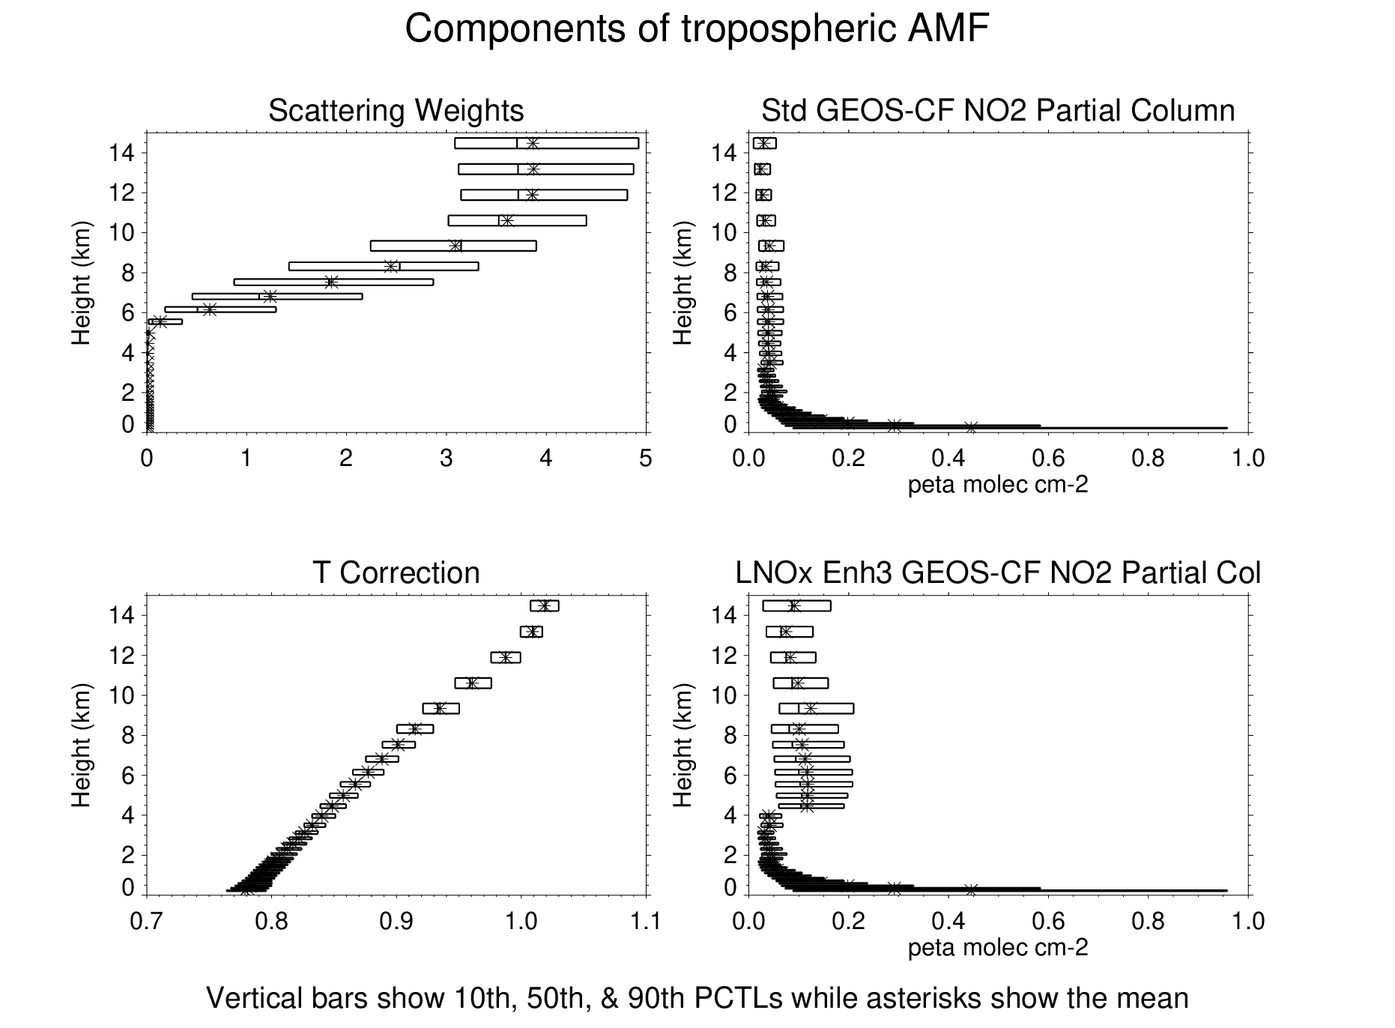
Tropospheric VCD of NO₂ is sensitive to a priori NO₂ profile (Ω) via AMF_{trop}
VCD_Trop = SCD_Trop / AMF_{trop},
where AMF_{trop} = Σ_{I} W_{i} Ω_{I} α_{I} / Σ_{I} Ω_{I}
(integration over layers in troposphere)
W_{i} = scattering weight, Ω_{I} = trace gas partial column, α_{i} = temperature correction
Scattering weights, near zero below the OCP,
increase rapidly between 5 and 10 kms. Underestimating the a priori NO₂ column in this altitude range due to a misplacement of deep convection could cause a low-bias in AMF_{trop} & consequently an overestimation of LNO₂ PE.
To assess sensitivity of columns to these possible biases, the tropospheric VCD was re-calculated over deep convective pixels (both flashing and non-flashing) after enhancing Ω at P < 600 hPa by factors of 1.5, 3.0, and 5.0
Representative values shown for deep convective pixels

Slide 11
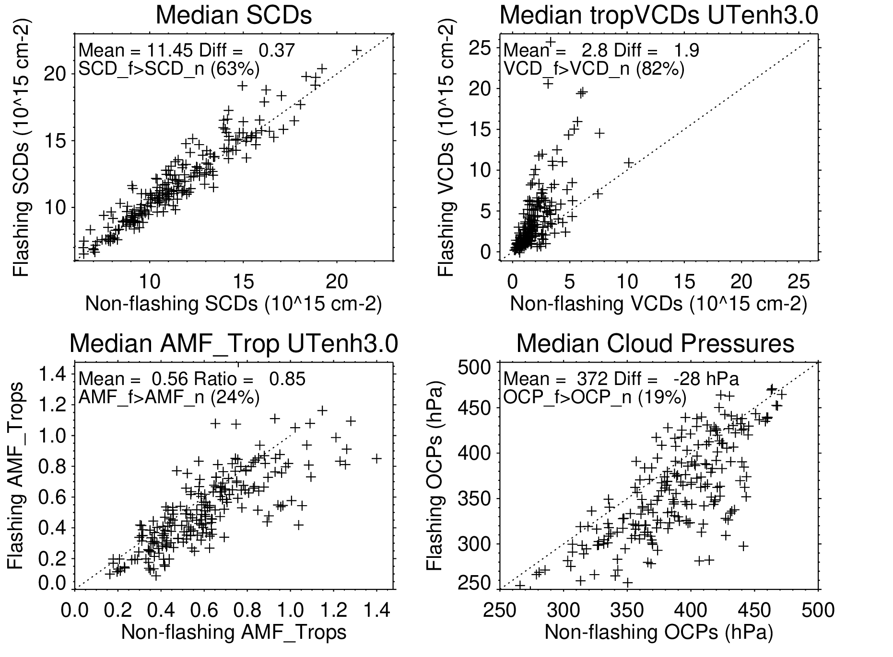
Over recent flashes, median SCDS are enhanced on
63% of the scans
by a mean
difference of 0.37 peta molec cm⁻²
Over recent lightning, median tropospheric VCDs are enhanced on 82% of the scans by a
mean difference of 1.9
peta molec cm⁻².
Over recent flashes,
median AMF_trops
are smaller on 76%
of the scans by a
mean value of 15%.
Over recent lightning,
median OCPs are lower
on 81% of the scans by
a mean difference of
28 hPa

Slide 12
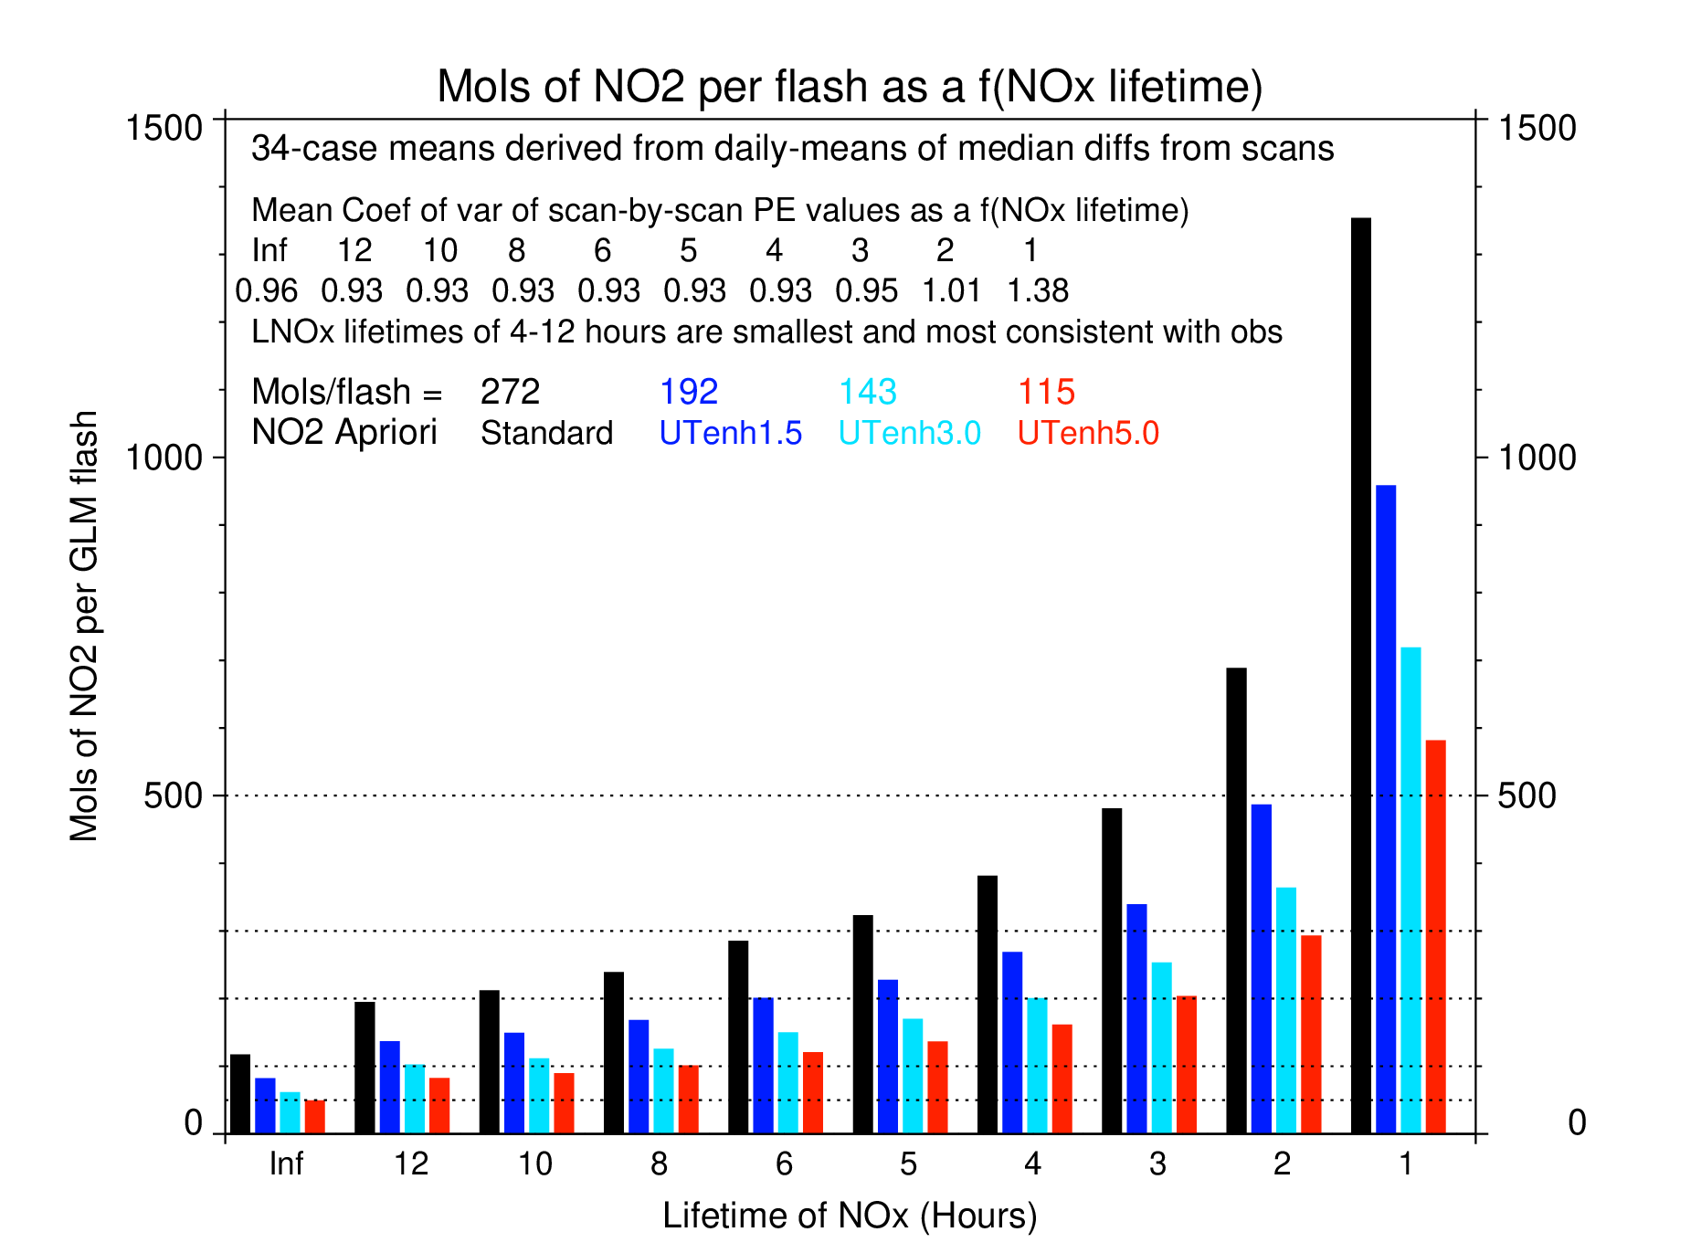
By comparing the variability of scan-by-scan estimates of PE as a function of assumed NO_{x} lifetime it is possible
to determine the NO_{x} lifetime in the near-field of deep convection and reduce uncertainties in LNO₂ PE.
For these case studies, the relative standard deviation of single day PE estimates is smallest for 𝝉 = 4-12 hours. Averaging these values, LNO₂ PE is 272 moles per flash using the standard AMF but only 115-192 moles per flash when using modified AMFs more appropriate for deep convective conditions.

Slide 13
Summary
TEMPO spectra saturate over very bright clouds, esp. between 10 AM and 4 PM LT.
Tropospheric VCDs of NO₂ are larger over deep convective pixels with recent lightning than over other deep convective pixels enabling estimation of LNO_{x} PE.
TEMPO LNO₂ signal is exaggerated by ~25-50% due to biases a priori AMF over deep convection.
An LNO₂ PE of 120 to 190 moles per flash was obtained for an NO_{x} lifetime of 4-12 hours after adjusting the a priori air mass factor for biases.
Higher time resolution TEMPO special operation experiments would provide a Lagrangian view of LNO_{x} plumes over a storm’s lifetime. Coupled with continuous lightning observations, this would allow for the examination of LNO_{x} PE as a function of flash rate and also constrain NO_{x} lifetime in the near-field-of-convection.
Note: All of the numbers given here are preliminary and subject to change.

Slide 14
Future Work
Examine variations in PE with flash rate and uncertainties in NO_{x} lifetime using carefully chosen case studies and/or higher temporal resolution TEMPO scans.
Increase sample size over deep convection by including a subset of “suspect” retrievals (main_data_quality_flag = 1) in analysis. Improve approach used to separate pixels into flashing- and non-flashing camps. Both of these steps could enhance PE.
Reduce uncertainties in flashes contributing to observed NO₂ column via adjustment of GLM flashes for DE, use of an alternate (ENTLN) flash source, and refinement of region-of-interests (ROIs) and integration periods
Not all flashes are the same. Examine the impact of variations in optical energy per flash on the observed NO₂ column.
Continue examining alternative AMFs for use over deep convective systems.
Convert LNO₂ PE to LNO_{x} PE using tropospheric profiles of NO_{x} and NO₂ from NASA GEOS-CF in regions of deep convection

