Slide 1
Interests and Applications of TEMPO Special Operations in Colorado
Dan Welsh
Air Quality Meteorologist
Colorado Department of Public Health and Environment
dan.welsh@state.co.us

Slide 2
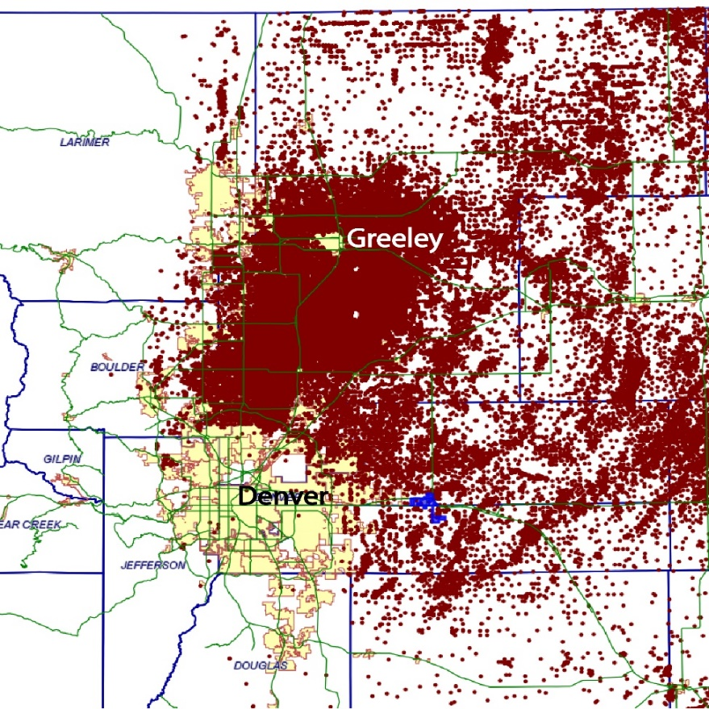
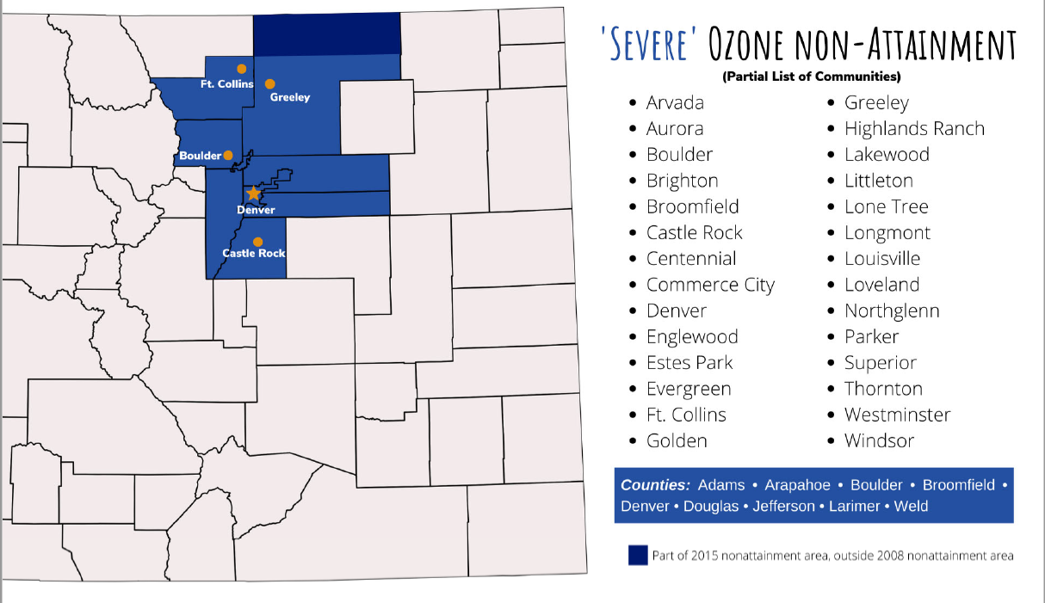
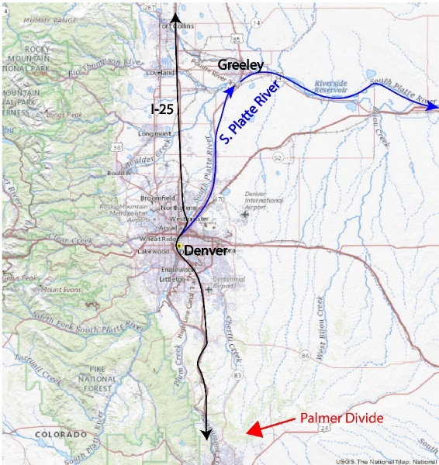
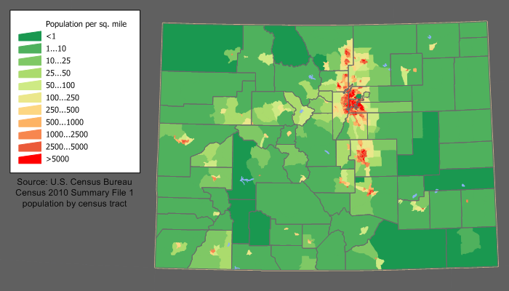
Background
Ozone Nonattainment area
-Repeated downgrade
-> Marginal (2008)
-> Moderate (2016)
-> Serious (2020)
-> Severe (2022)
Contributions:
-Urban, industrial, traffic emissions
-O&G Operations
Topography/terrain
Population Density
https://cogccmap.state.co.us/cogcc_gis_online/
Source: https://commons.wikimedia.org/wiki/File:Colorado_population_map.png

Slide 3
Background, Green Paper Proposal
With due consideration of local meteorology, CDPHE air quality forecasters are able to predict ozone with reliable accuracy.
Further documentation of these processes will lead to greater understanding of the timing, spatial extent, and severity of air pollution episodes.
Use of TEMPO standard/special ops observations will help to observe trace gasses and ozone precursors, and follow the evolution as they convert to ozone and accumulate along the Colorado Front Range.

Slide 4
2024 Has been no exception to both traditional ozone production, as well as episodic contributions to poor air quality in Colorado

Slide 5
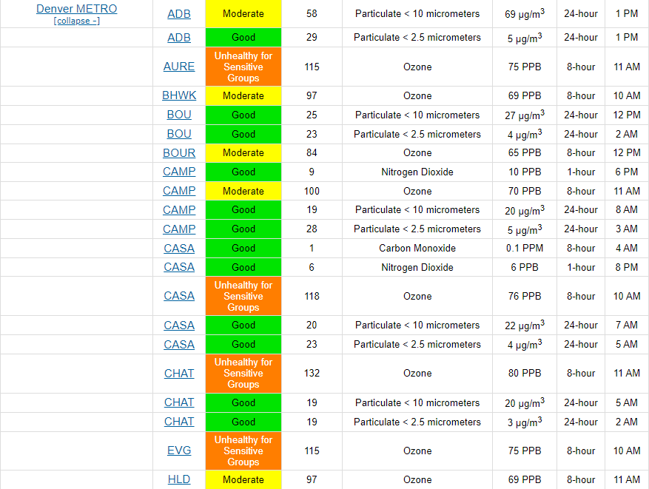
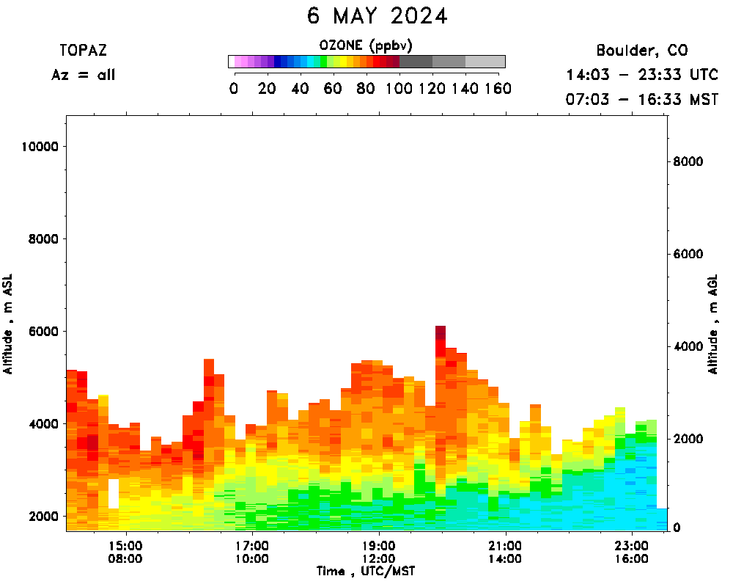
Continued need/justification:
Early (ozone) season exceedance:
Stratospheric intrusion, 6 may 2024
Source: https://csl.noaa.gov/

Slide 6
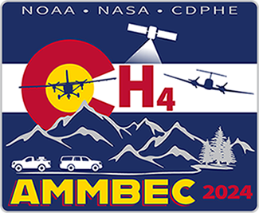
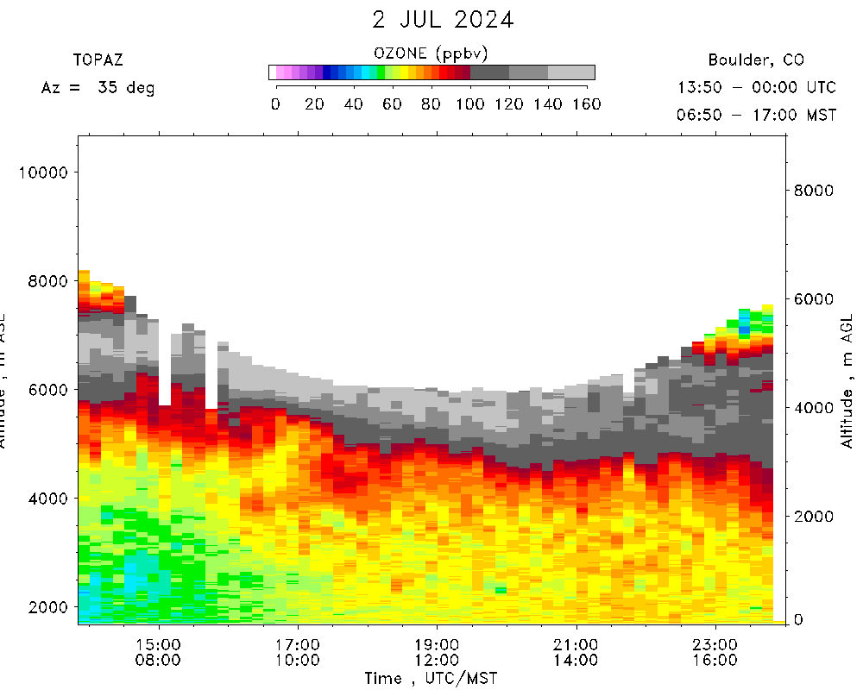
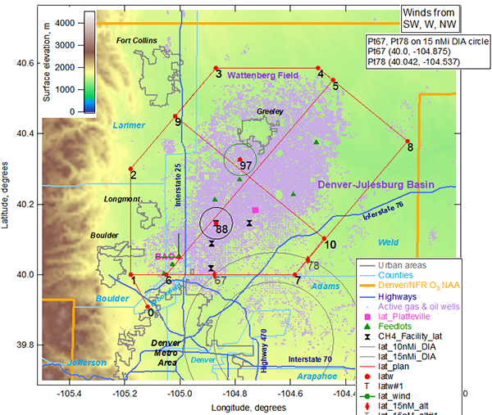
Continued need/justification
Stratospheric intrusion (7/2/24),
Airborne Methane Mass Balance Emissions in Colorado (AMMBEC), July 1-15, 2024
https://csl.noaa.gov/groups/csl3/measurements/2024ammbec/
Instrument | Measurement | Institution / PI
scanning Micro-pulse Doppler lidar | 3D wind velocities and aerosol profiles, boundary layer depth | NOAA CSL / Sunil Baidar, Alan Brewer, Max Holloway, Scott Sandberg
Picarro GHG analyzer | CO, CH₄, CO₂, H₂O | NOAA ARL / Xinrong Ren
Aeris MIRA Ultra | CH₄/C₂H₆ | NOAA ARL / Xinrong Ren
Teledyne CAPS + Thermo dissociation | NO, NO₂, Noy | NOAA ARL / Xinrong Ren
Ozone analyzer | O₃ | NOAA ARL / Xinrong Ren
Airborne MAX-DOAS | NO₂, glyoxal, and HCHO column, and profiles | CU Boulder / Rainer Volkamer
Filter radiometers | Upward and downward actinic flux / NO₂ photolysis rate | NOAA CSL
Met package | T, P, RH, Winds, GPS Position | NOAA CSL
Source: https://csl.noaa.gov/
TEMPO Validation?

Slide 7
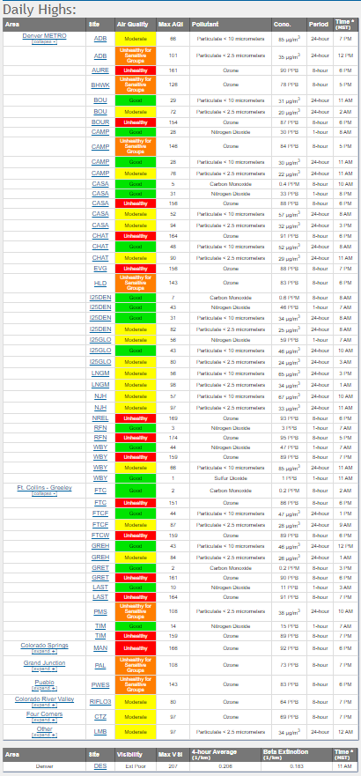
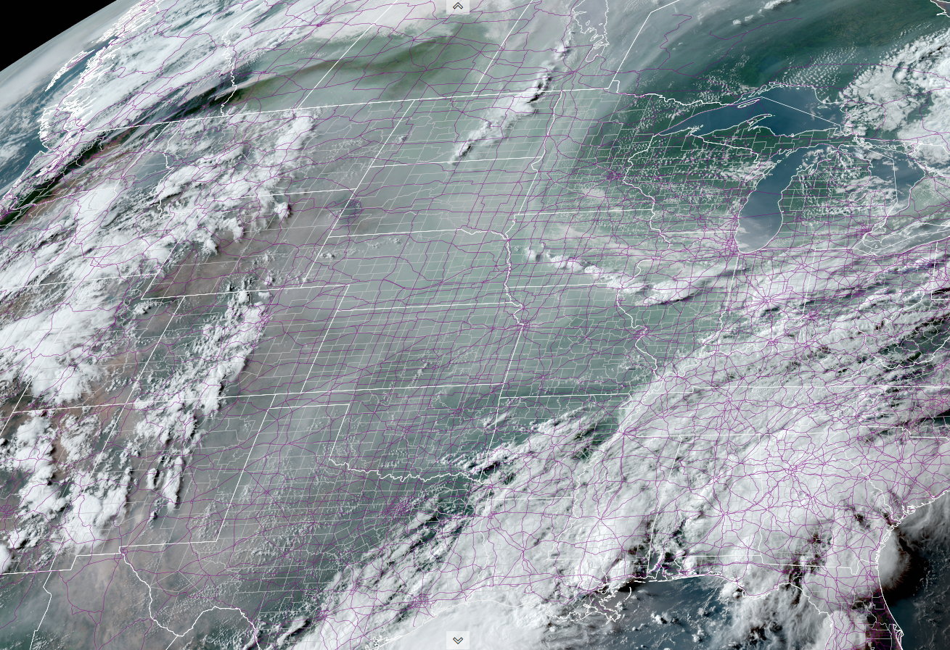
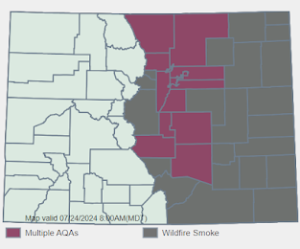
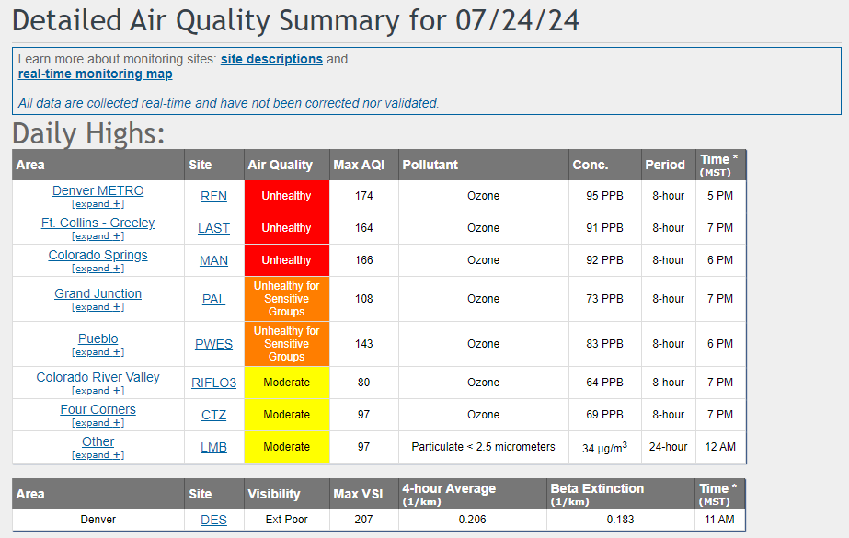
Continued need/justification Wildfires, remote
Smoke from Canada, Western U.S., 2320 UTC, 7/24/2024
Image Credit: https://rammb-slider.cira.colostate.edu/
Notes:
Alexander Mountain Fire: 9630 ac
Stone Canyon Fire: 1557 ac
Quarry Fire: 580 ac

Slide 8
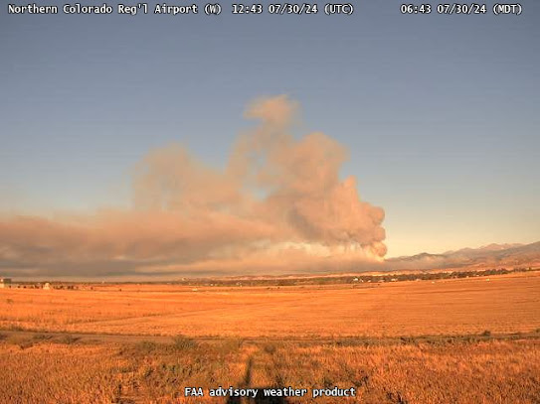
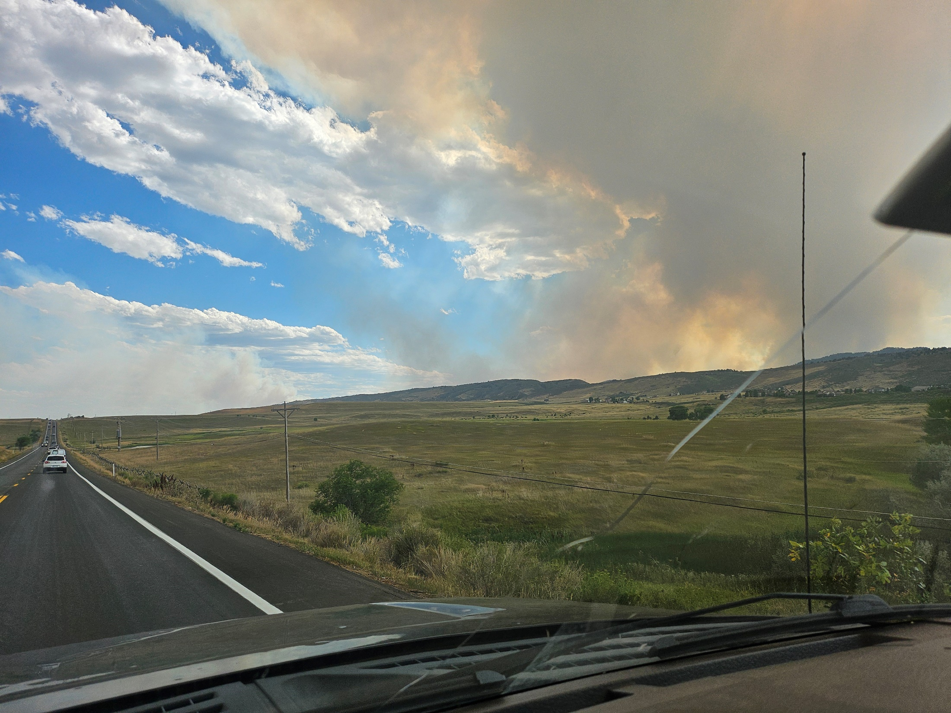
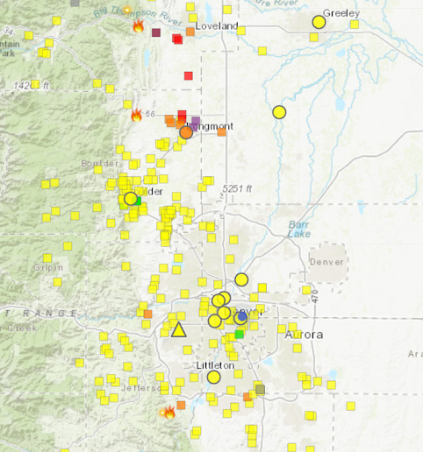
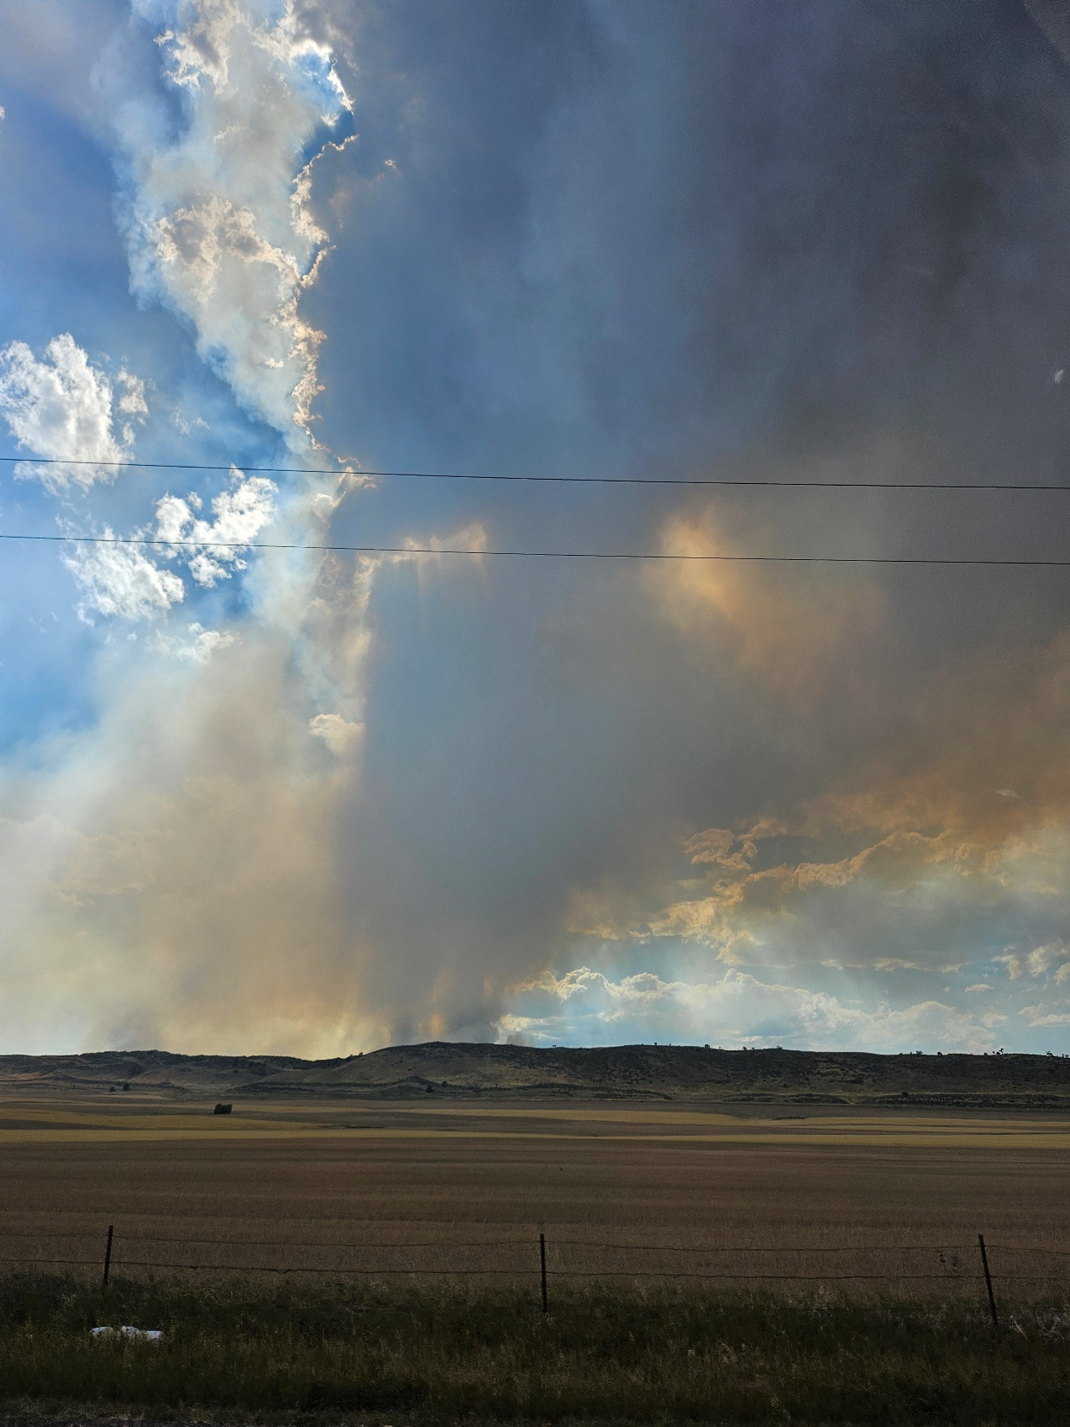
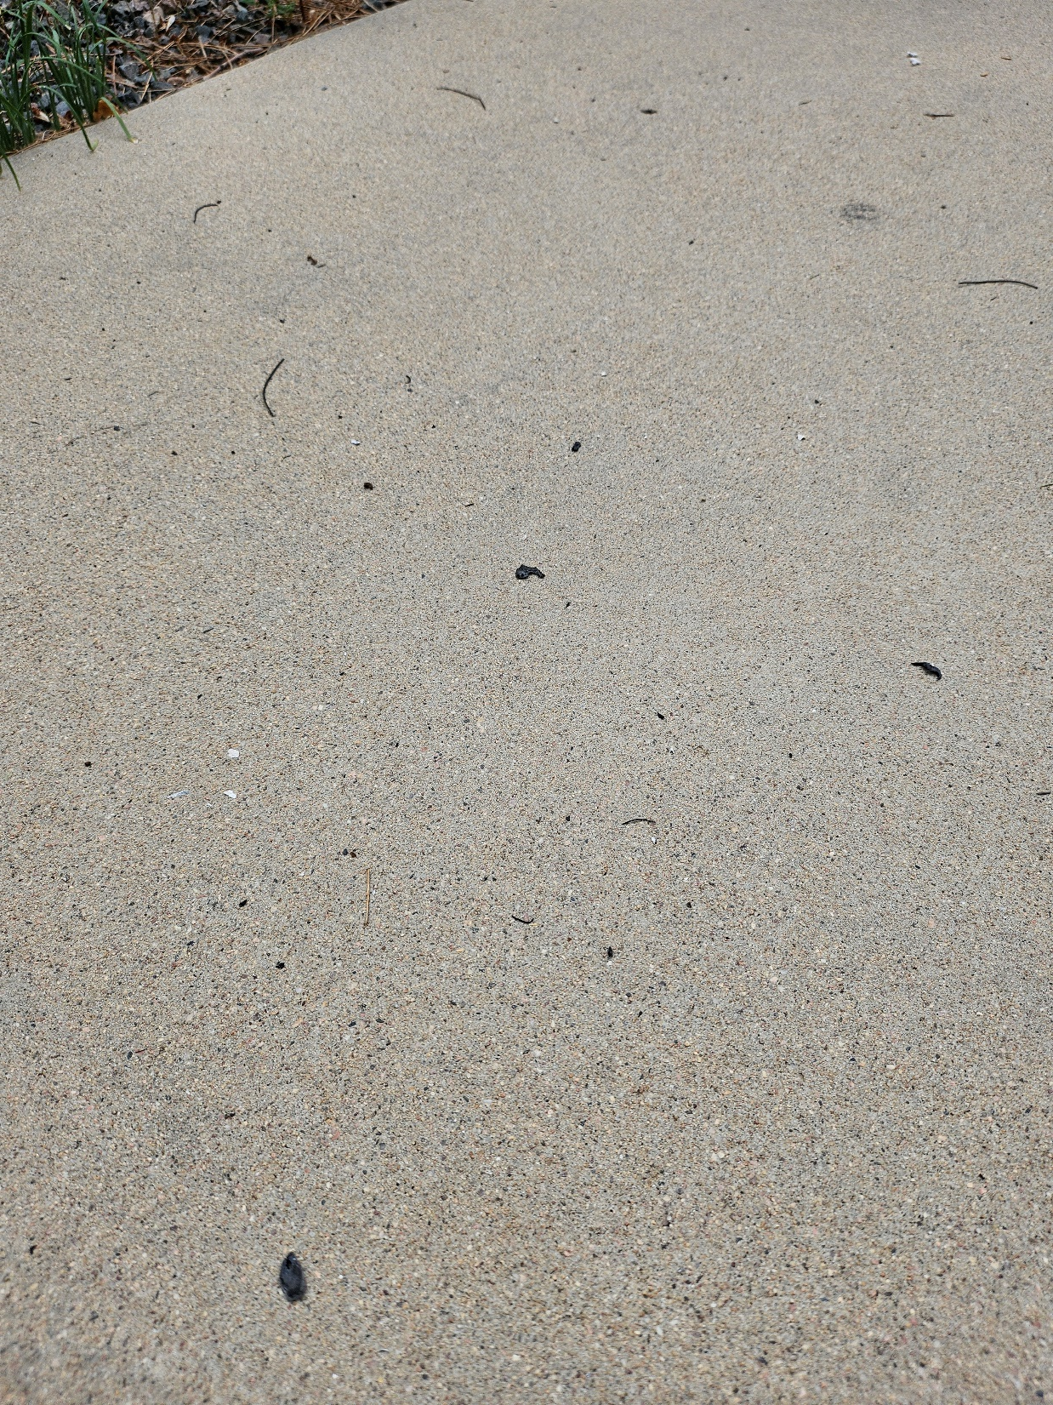
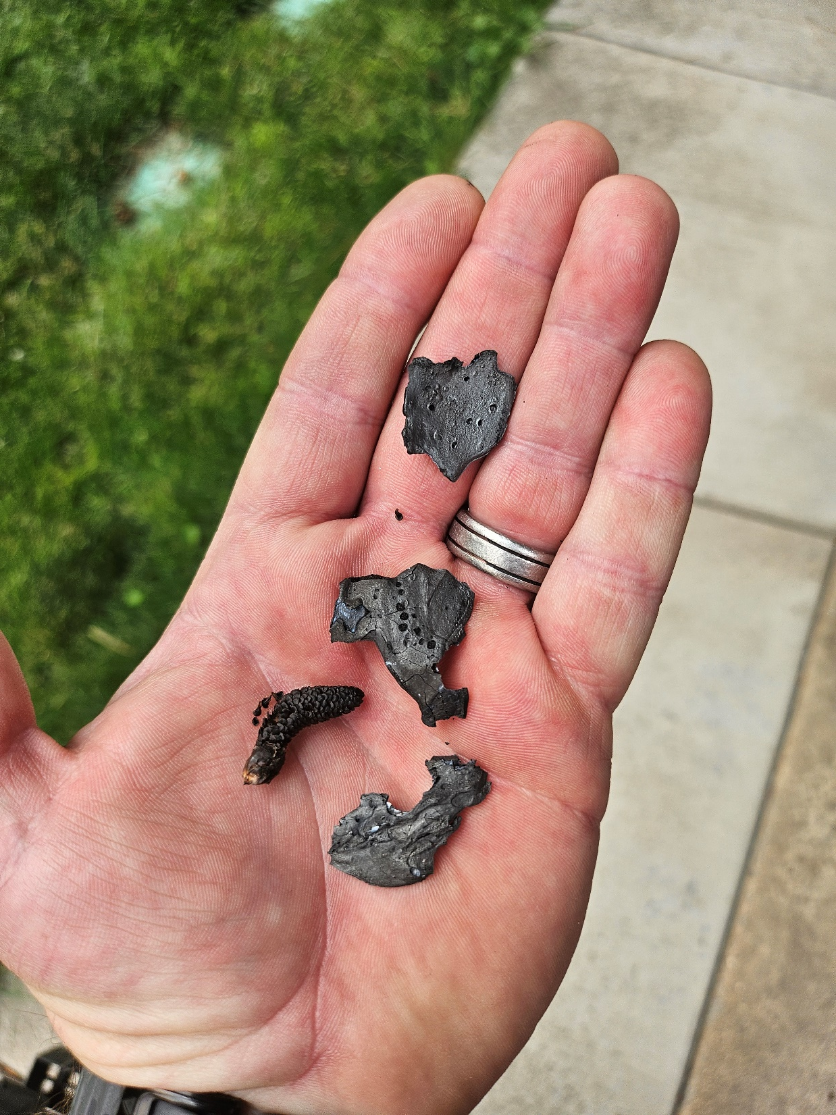
Continued need/justification Wildfires, Local
Alexander Mountain Fire, ~10,000 acres, started 7/29/24
Alexander Mountain Fire
Stone Canyon Fire
Stone Canyon Fire
Alexander Mountain Fire
Fires
Alexander Mountain Fire, 7/30/24
Quarry Fire
8/1/2024, https://fire.airnow.gov
Notes:
Alexander Mountain Fire, ~11 miles from my house

Slide 9
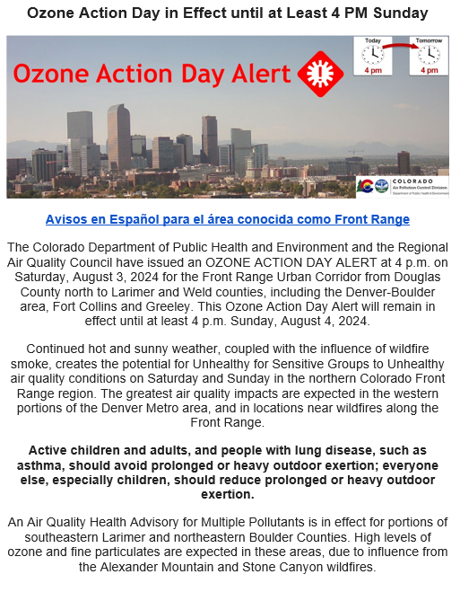
Continued need/justification
Year | Number of Ozone Action Alert Days
2011 | 30
2012 | 43
2013 | 33
2014 | 18
2015 | 25
2016 | 36
2017 | 45
2018 | 52
2019 | 32
2020 | 43
2021 | 65
2022 | 40
2023 | 37
2024 | 49
Average | 39
2024 numbers are up-to-date as of 8/22/24
These are Ozone Action Day Alerts issued May 31-August 31
From 2011-2015, O3 standard: 75 ppb (8-hour)
From 2016-present, O3 standard: 70 ppb (8-hour)
More Alerts should be expected from 2016-present
2024 is third highest Action Day count in the past 14 years

Slide 10
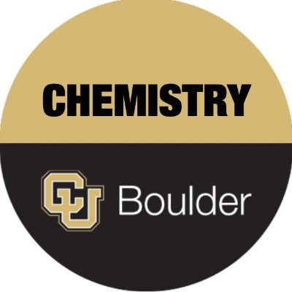
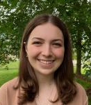
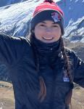
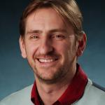
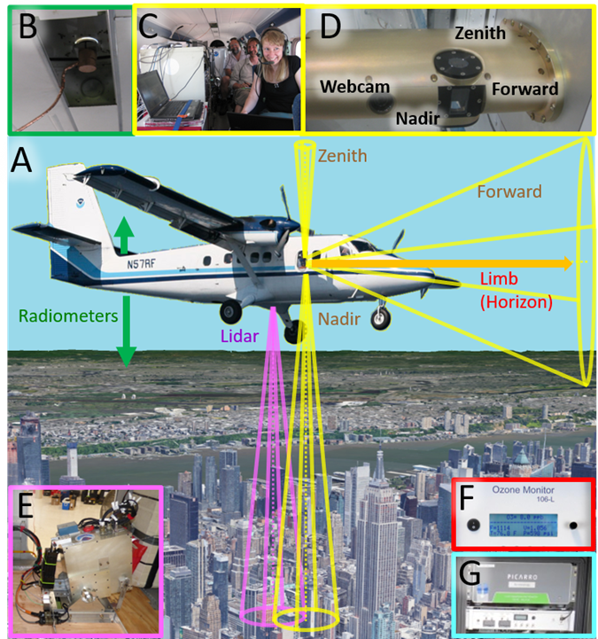
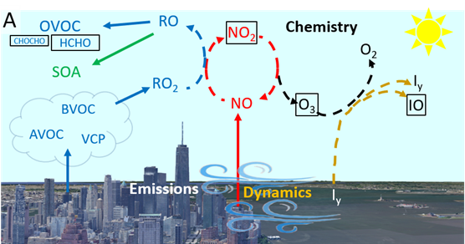
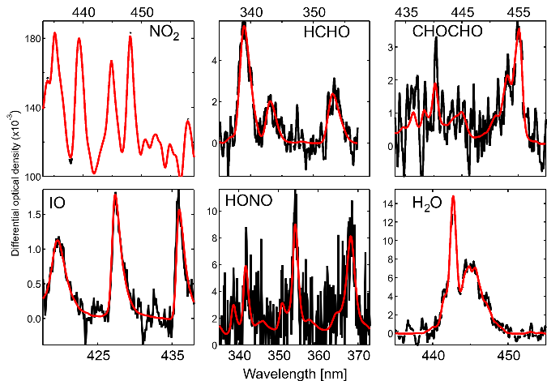
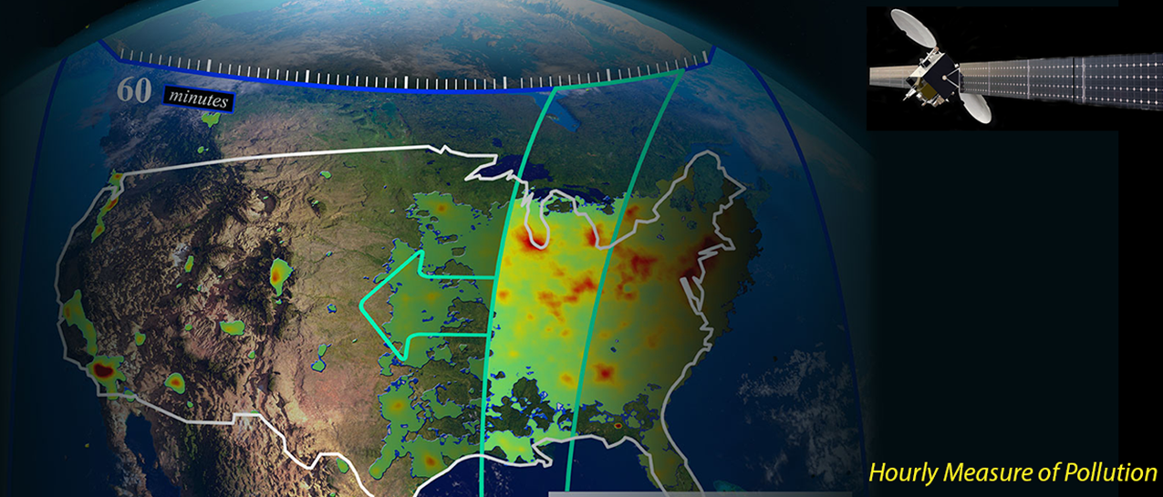
Volkamer Group: Airborne NO_{x} Mass Balance - Emissions over Colorado
Quantify NO_{x} emissions by mass balance (urban, O&G-diesel, flares, CAFO-soils) VOC vs NO_{x} sensitivity in O₃ photochemistry TEMPO satellite
Clara
Nicole
Valentina
Max
Mago
Clara.Lietzke@colorado.edu Rainer.Volkamer@colorado.edu
CU Airborne Multi-Axis DOAS
NO₂, HCHO column observations
2x CCDs: 320-465nm & 415-525nm
FOV: 300 m along track x 20 m cross track
1-2 sec integration time
Surface albedo sensor
4-channels: 360, 477, 630, 870 nm
in support of RTM calculations
Rainer
CUPIDS 2023 Denver 2024
TEMPO: Tropospheric Emission Monitoring of Pollution
Notes:
Upcoming activities: - USOS field campaign: Jun-Aug ‘24 over Denver and Salt Lake City; collaboration with NOAA; Photochemistry & NOx emission fluxes - CLOUD17 funded through 2025; Laboratory experiments to study nucleation and particle growth at CERN, Switzerland
- TI3GER-2 & RHI3NO: Develop instrumentation for research aircraft & take a CLOUD experiment airborne.

Slide 11
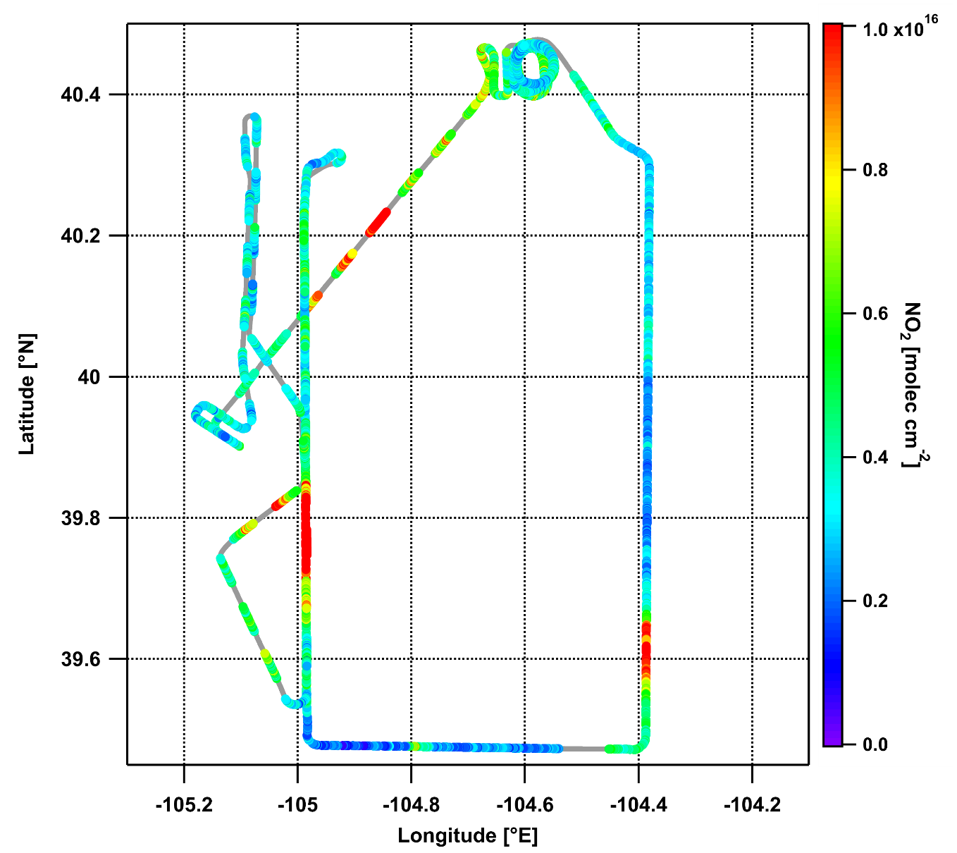
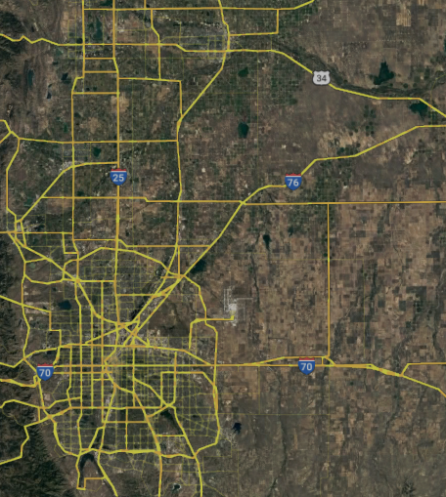
AMMBEC Flights
22 science flights + 1 ferry flight
~67 total flight hours
9 Air Quality flights
9 Mass Balance flights
2 Raster flights
Suitable for TEMPO evaluation:
~15 flights with clear skies (~45 hours)
~13 flight hours at high altitude (~12 500 ft)
Air Quality Flight: Nadir NO₂ (9:37 AM - 12:47 PM MDT 13 Jul 2024)

Slide 12
Air Quality Flight Track Overlap with TEMPO (9:37 AM - 12:47 PM MDT 13 Jul 2024)
changes in NO₂ observed
10:00
11:00
12:00
TEMPO tropospheric NO₂ VCDs overlaid with AQ flight track. The flight track within ± 30 min of the TEMPO granule time is highlighted in red.

Slide 13
Thanks/Questions
Acknowledgements:
NOAA Chemical Sciences Laboratory: Sunil Baidar, Alan Brewer, Caroline Womack, Steven Brown, Carsten Warneke and Brian McDonald
NOAA Air Resources Laboratory (ARL): Xinrong Ren, Winston Luke, Phillip Stratton, Paul Kelley, and Jiayang Sun
NOAA Global Monitoring Laboratory (GML): Colm Sweeney, Jeff Peischl and Kathryn McKain
NOAA National Environmental Satellite Data Information Service (NESDIS): Shobha Kondragunta
University of Colorado Atmospheric Spectroscopy Lab: Rainer Volkamer (et al.)
NASA Jet Propulsion Laboratory (JPL): Andrew Thorpe, Daniel Jensen, Robert Green
Colorado Department of Public Health and Environment (CDPHE): Ben Hmeil, Dan Welsh
dan.welsh@state.co.us

