Slide 1
TEMPO assimilation with the JEDI system
J. Barré¹, M. Abdi-Oskouei¹, A. Griffin¹, V. Shah², C. Keller^{2*}, E. Knowland², B. McDonald³, C. Martin⁴, S.-W. Wei¹, C. Hardy-Gas¹, A. Shlyaeva¹, B. Ménétrier⁵ B. Ruston¹, Y. Tremolet¹, T. Auligné¹ and all JCSDA
¹UCAR, Joint Center for Center for Satellite Data Assimilation
²NASA, GSFC, Global Modeling and Assimilation Office
^{2*}now at SWiss Re
³NOAA, OAR, Chemical Science Laboratory
⁴NOAA, NWS, NCEP, Environmental Modeling Center
⁵Norwegian Meteorological Institute

Slide 2
JCSDA Atmospheric COMPOsition – Research to Operations Elements
Enhance Coupled Data assimilation with NWP:
Aerosols
Stratospheric Ozone
Tropospheric chemistry and GHG
L1 DA
Facilitate high resolution data assimilation:
New sensors i.e. TEMPO, GEMS, S4, (GeoXO)
Novel geometries, stretched and refined grids
Scalability
Surface observations/ field campaigns
Coupled DA with AC
JCSDA
COMPO
Emissions
& fluxes
Air quality
& scales
Extend DA for fluxes and emission constraint:
Anthropogenic emissions
Fires
Vegetation
Chemical reactions

Slide 3
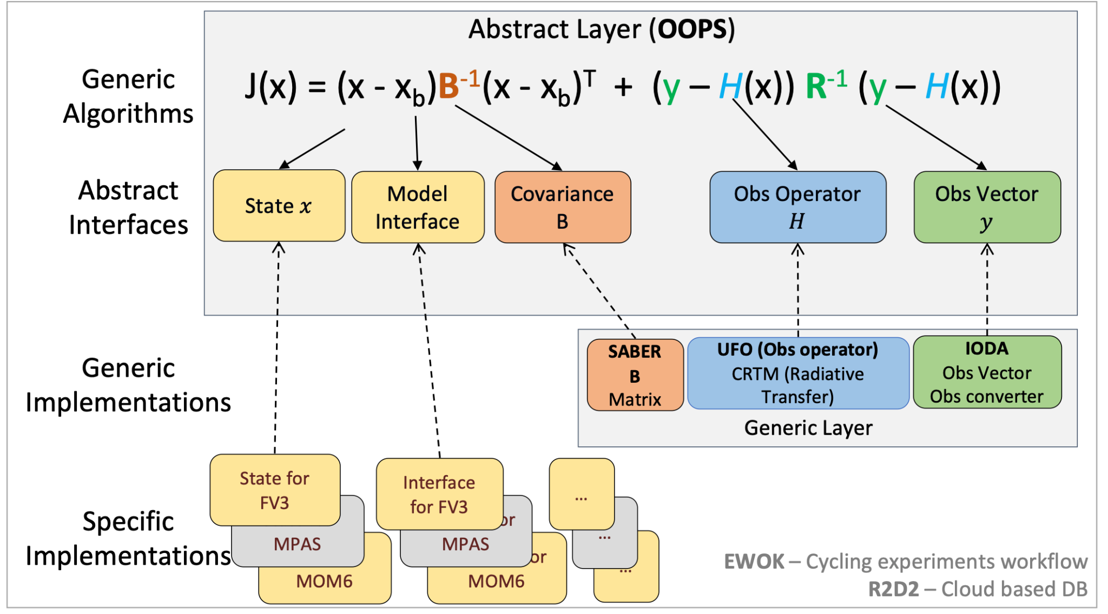
JEDI principles: Build DA blocks once and update for all components of earth-system in one DA system
Generic
Specific

Slide 4
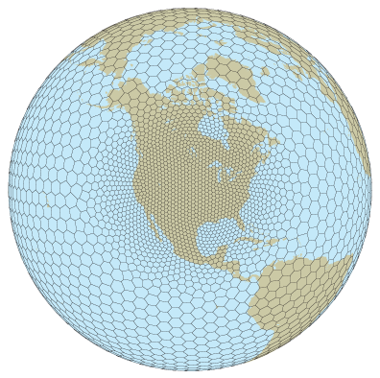
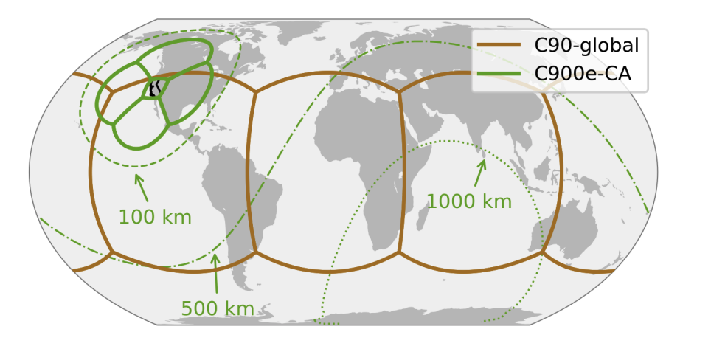
Specific: Air Quality and global Atmospheric Composition interfaces
Modelling configurations
FV3 – nested domain
FV3 stretch grids
MPAS refined grid
NCAR/NOAA
NOAA
NASA
GOCART global, CMAQ regional
GEOS w GOCART-2G, GEOS-CF, GEOS-Chem
Implementation of GOCART-2G, MICM, UFS-Chem

Slide 5
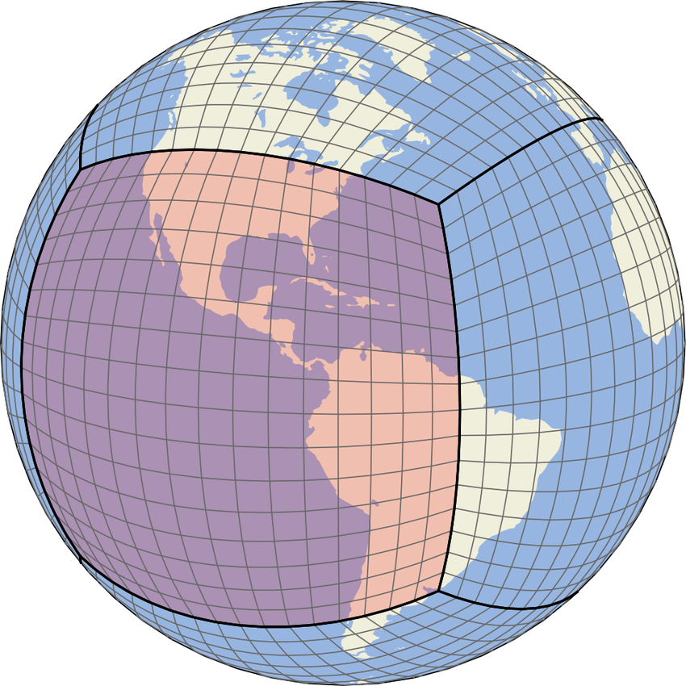
Generic: L2 observation operator
IODA-converters:
Obs native format to IODA netCDF format
IODA (observation traits)
IODA (observation traits)
Pressure, averaging kernel/scattering weights, apriori
lon, lat
1
OOPS (HofX or DA app)
Get Values
GeoVals: z
UFO
Geometry
State: x
Generalized Column retrieval operator
Simple vertical interpolation
Interfaces (e.g FV3, MPAS, etc.)
H(x) = A z’ + (I-A) z’_{a-priori}
(In-situ obs operator)
Works for all L2 products, tested for TEMPO, TropOMI, MOPITT, OMPS, GCAS aircraft data. Adopted for operational OMPS NWP O3 DA at NOAA/NWS
No need to recode an obs operator per instrument in JEDI!

Slide 6
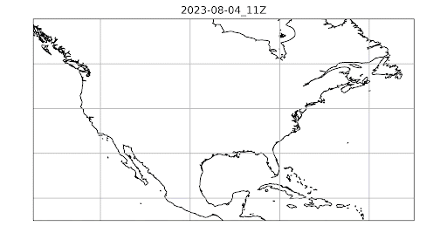
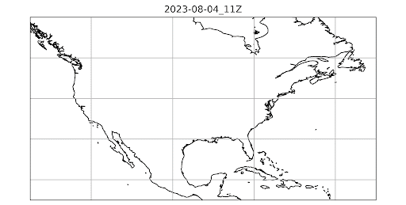
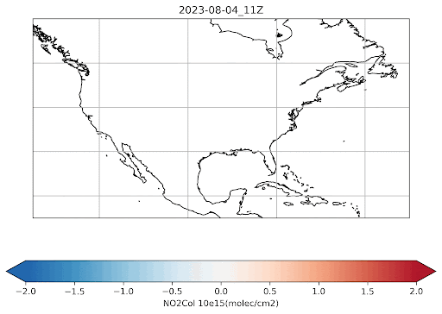
TEMPO NO2 and TropOMI NO2 H(x)
JEDI can run UFO on hourly model outputs (e.g. GEOS-CF) at the TEMPO hourly resolution
H(x)
OmB
TEMPO NO2
TEMPO NO2
TropOMI NO2
TropOMI NO2

Slide 7
TEMPO NO2 and TropOMI NO2 Data assimilation experiments
Demonstrate TEMPO DA JEDI capabilities Using GEOS-CF v2. Special Thanks to Viral, Christoph at NASA/GMAO for their GEOS-CF help!
We ran an ensemble of data assimilation with a 4DEnVar: each member has its own minimization making the ensemble DA update much less gaussian. We match the temporal resolution of TEMPO with the DA system with a 4D methodology
Meteorology is from the operational GEOS-FP ensemble, plus we perturb the observations and the emissions
The main control variable is NO2 concentration for this demonstration
We can use the ensemble covariances to infer extended control variables:
sectoral emissions - very important to develop an emission monitoring capability and if we want to use co-emission
Prototype testing experiments run at low resolution (~1 degree) and low ensemble size (~10 members) - it’s for prototyping and calibration only we don’t expect the best results

Slide 8
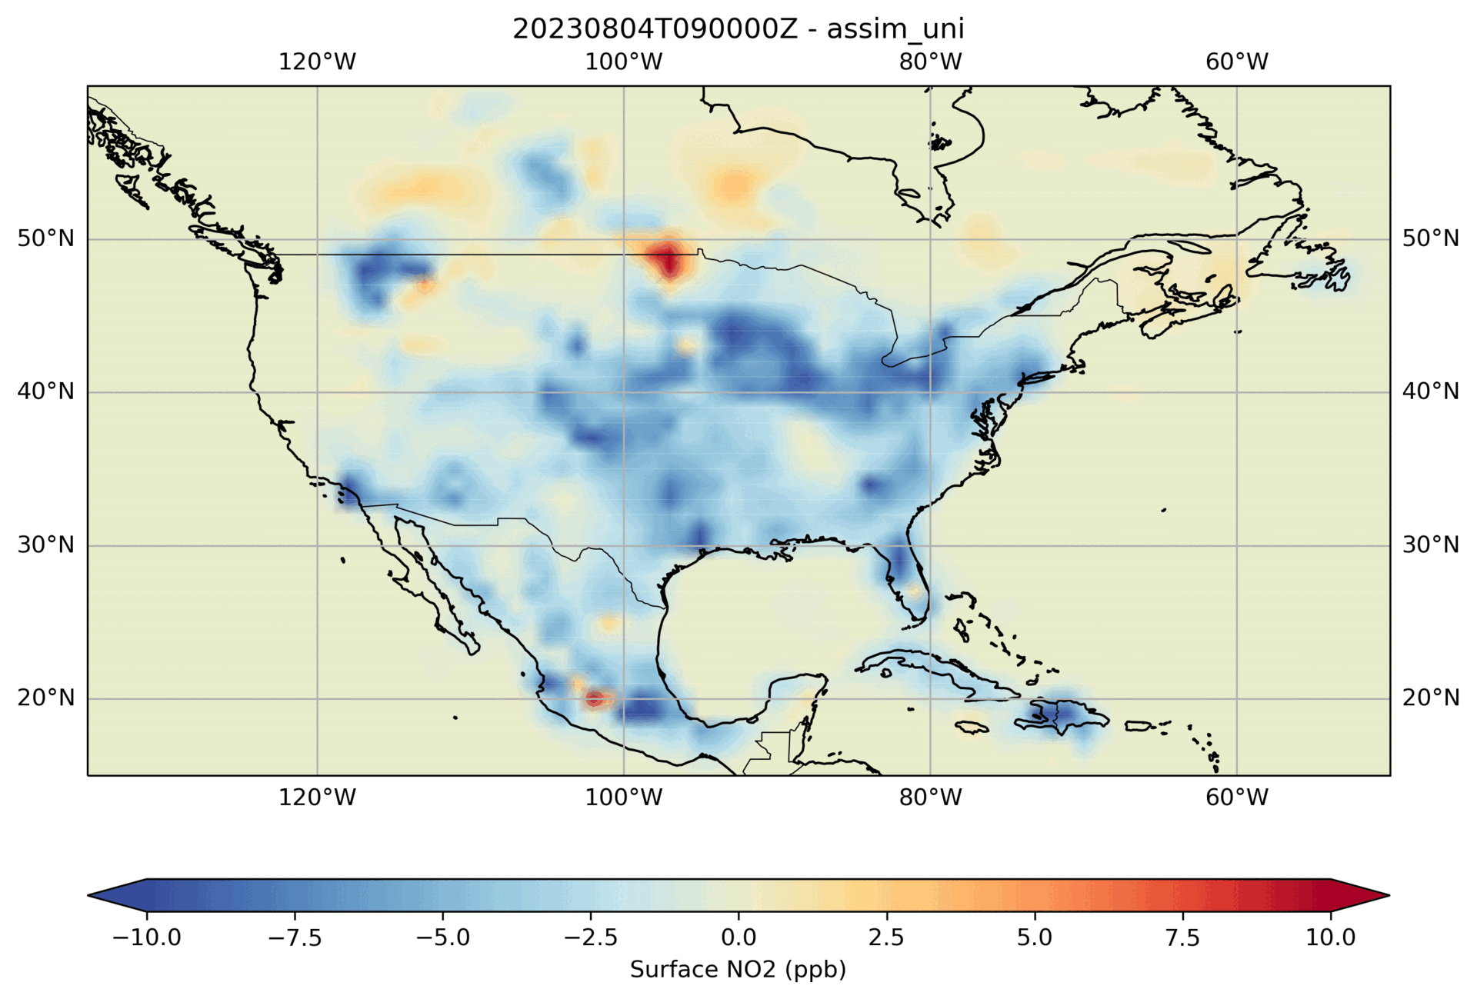
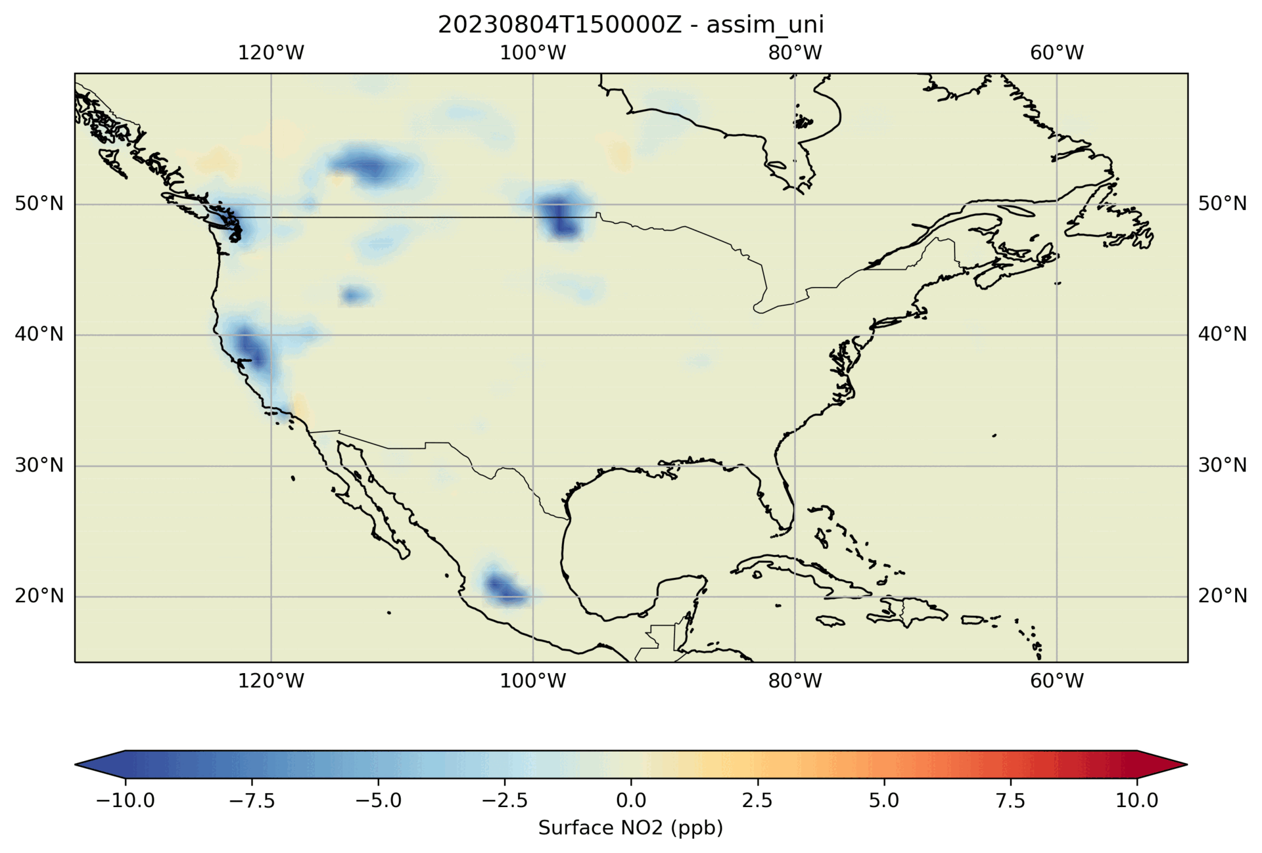
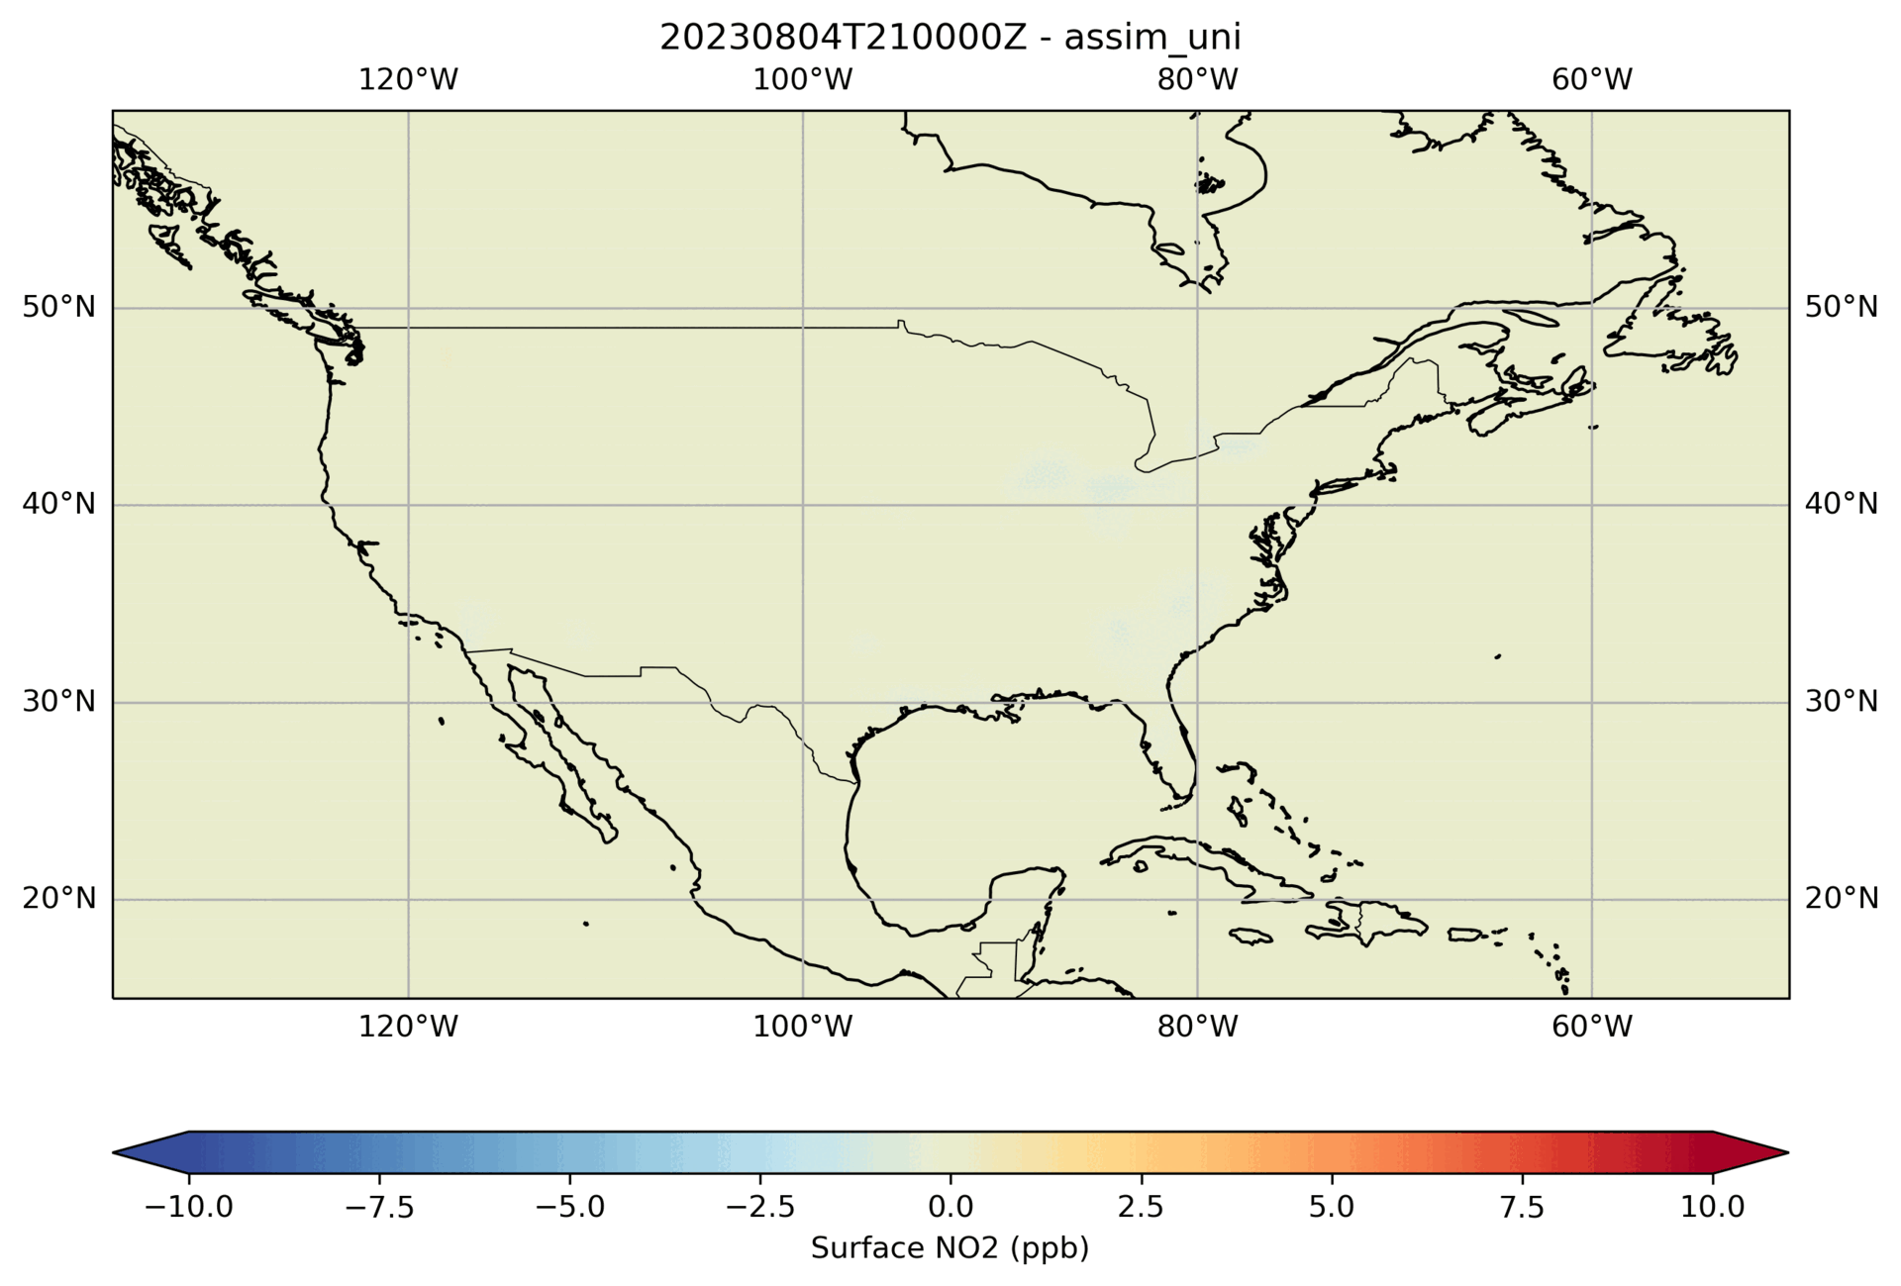
TEMPO NO2 and TropOMI NO2 Data assimilation increments
09z
15z
21z
03z
Forecast
JEDI Hourly Analysis Increments
Forecast
JEDI Hourly Analysis Increments
Forecast
JEDI Hourly Analysis Increments
Forecast

Slide 9
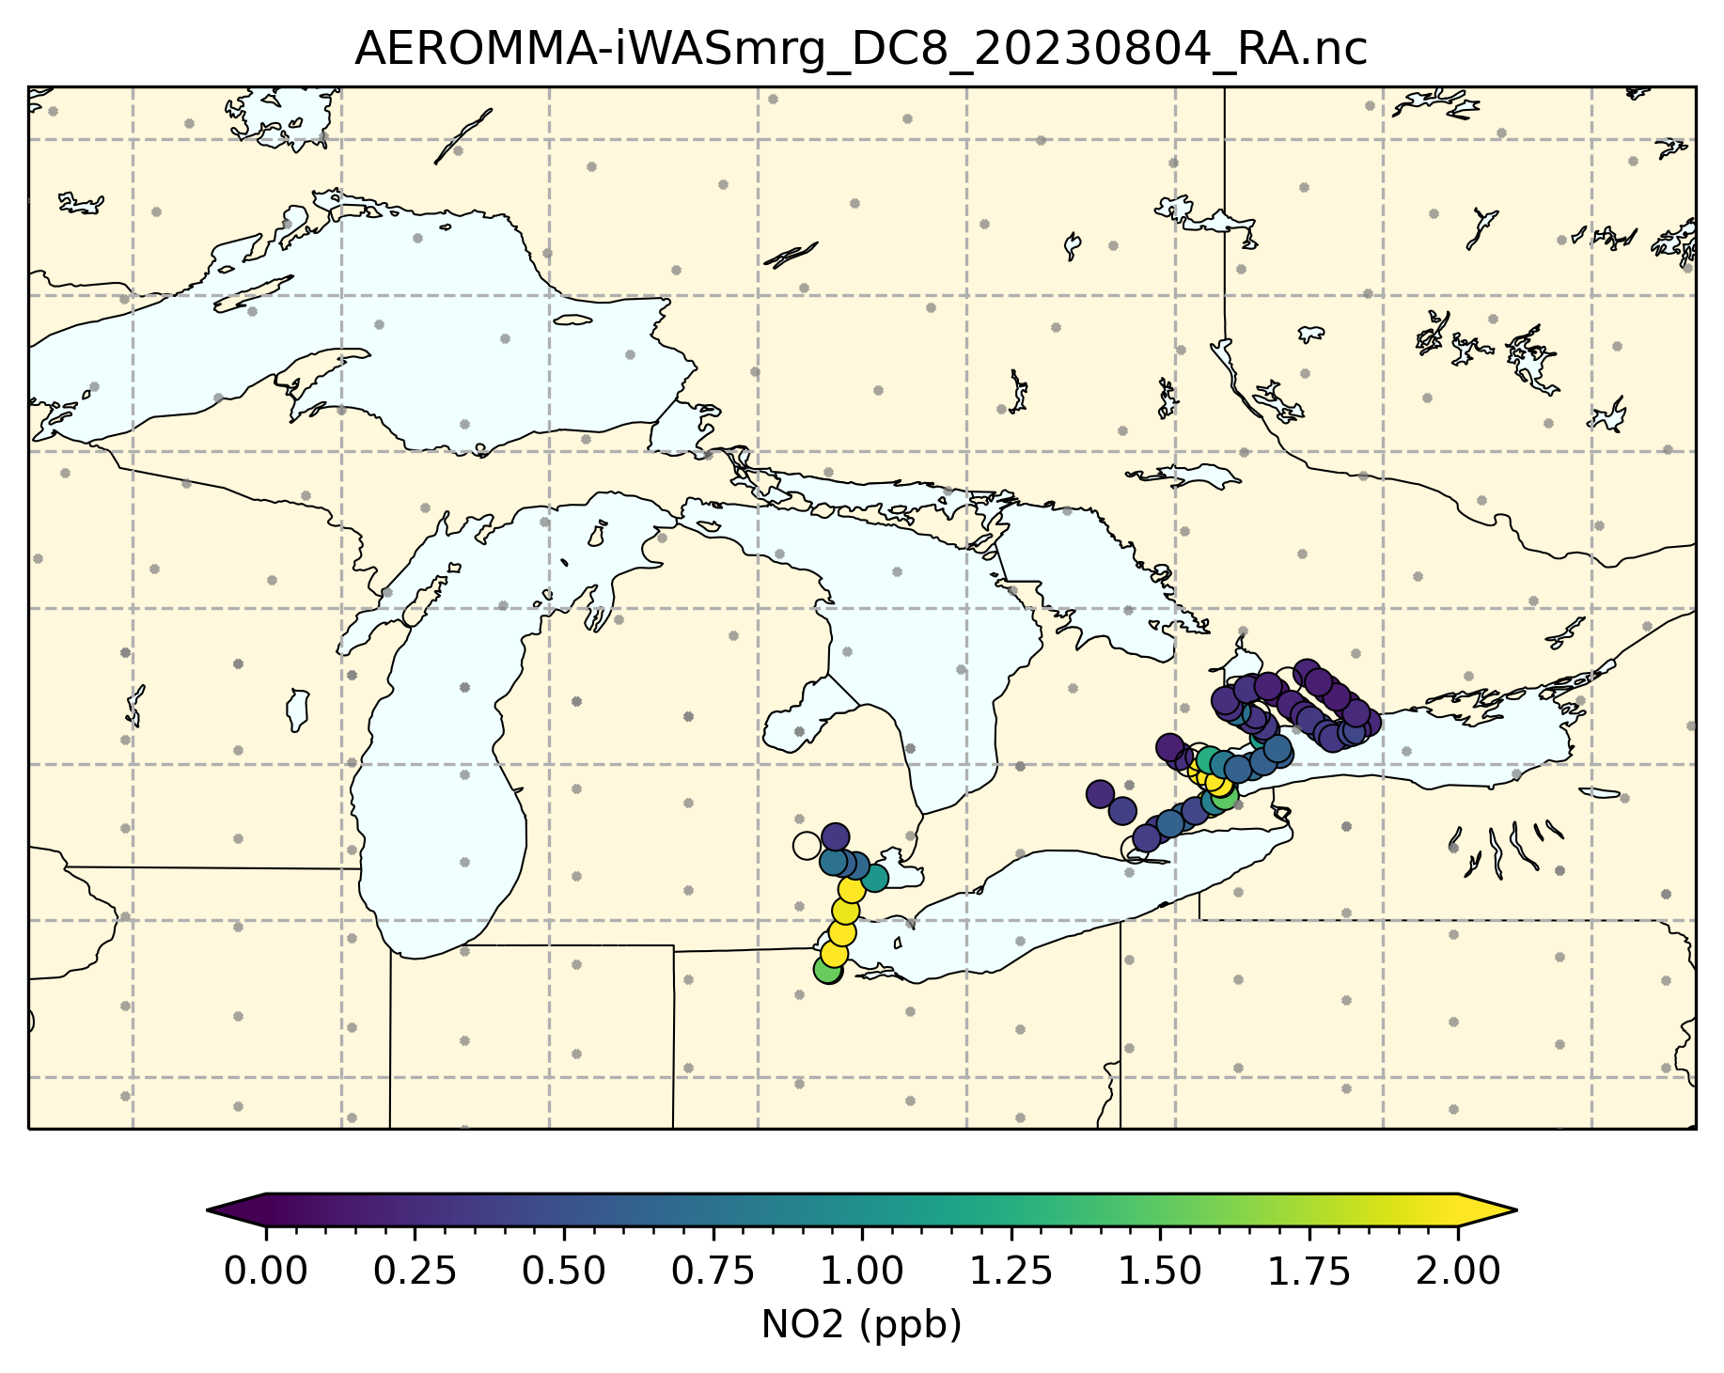
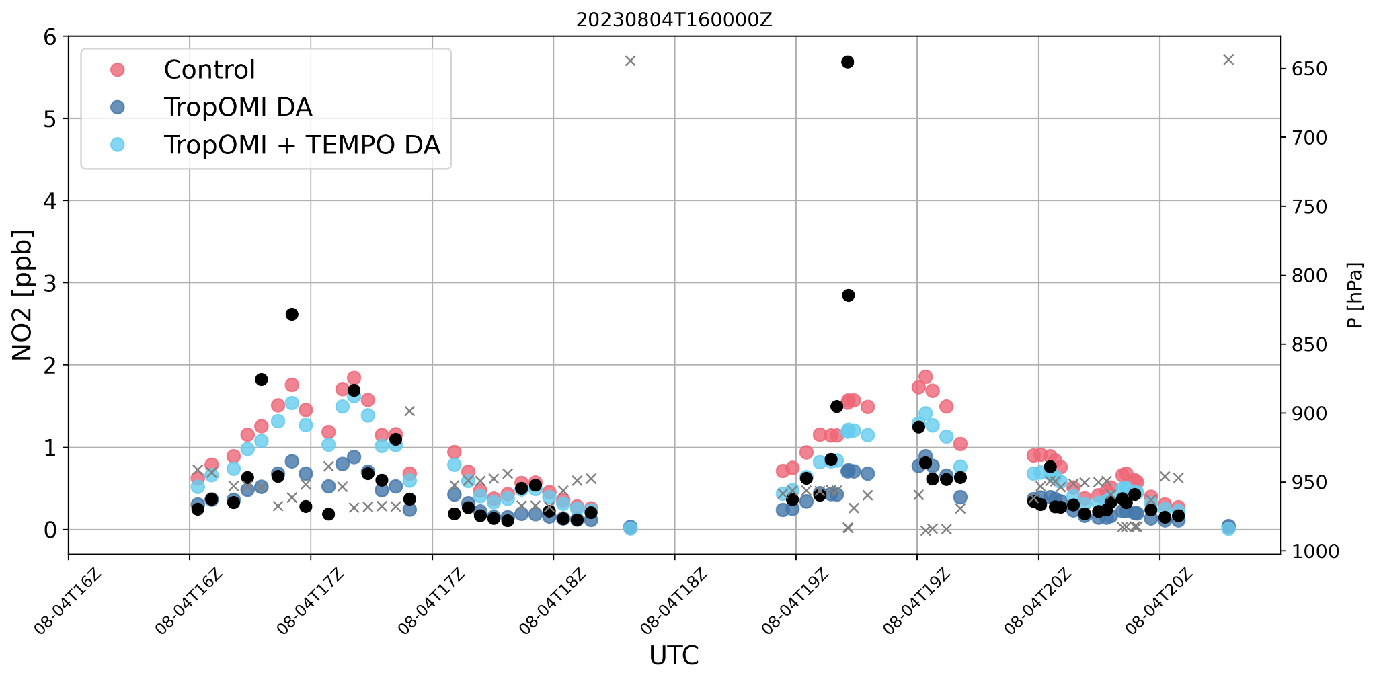
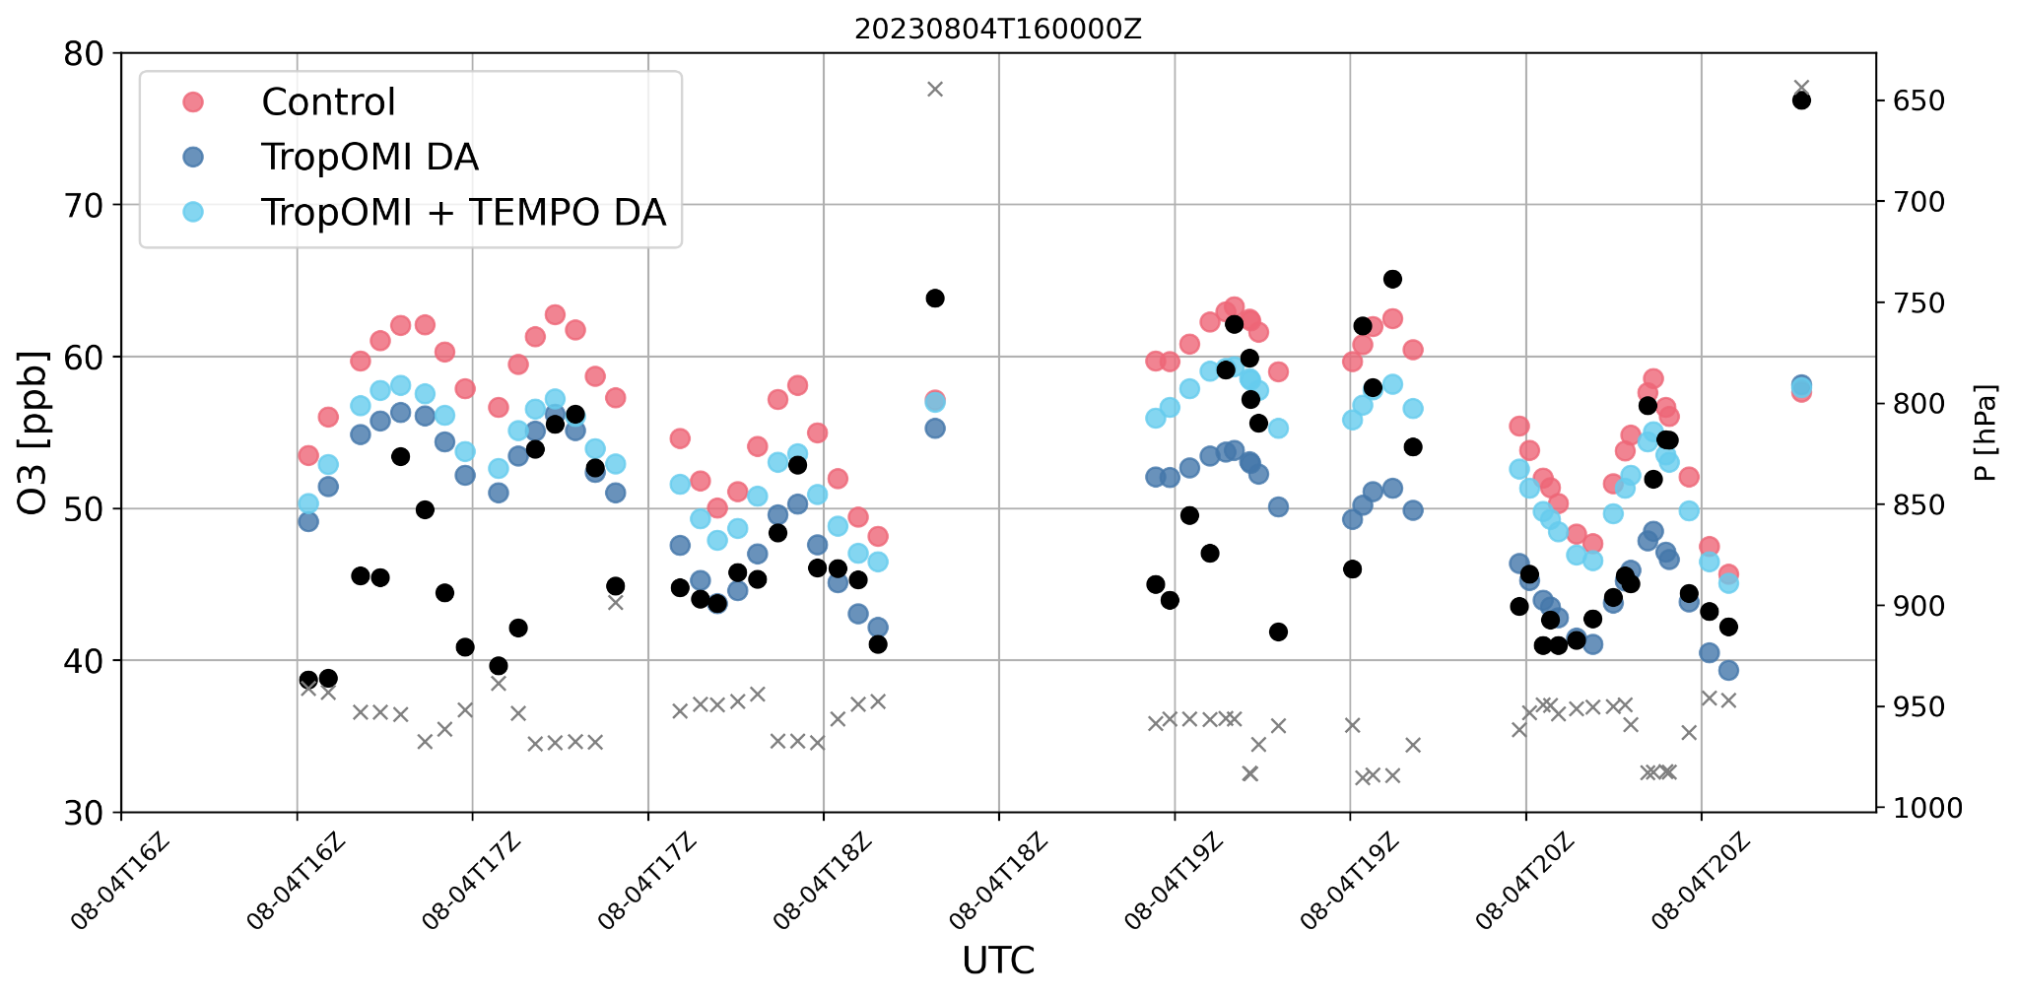
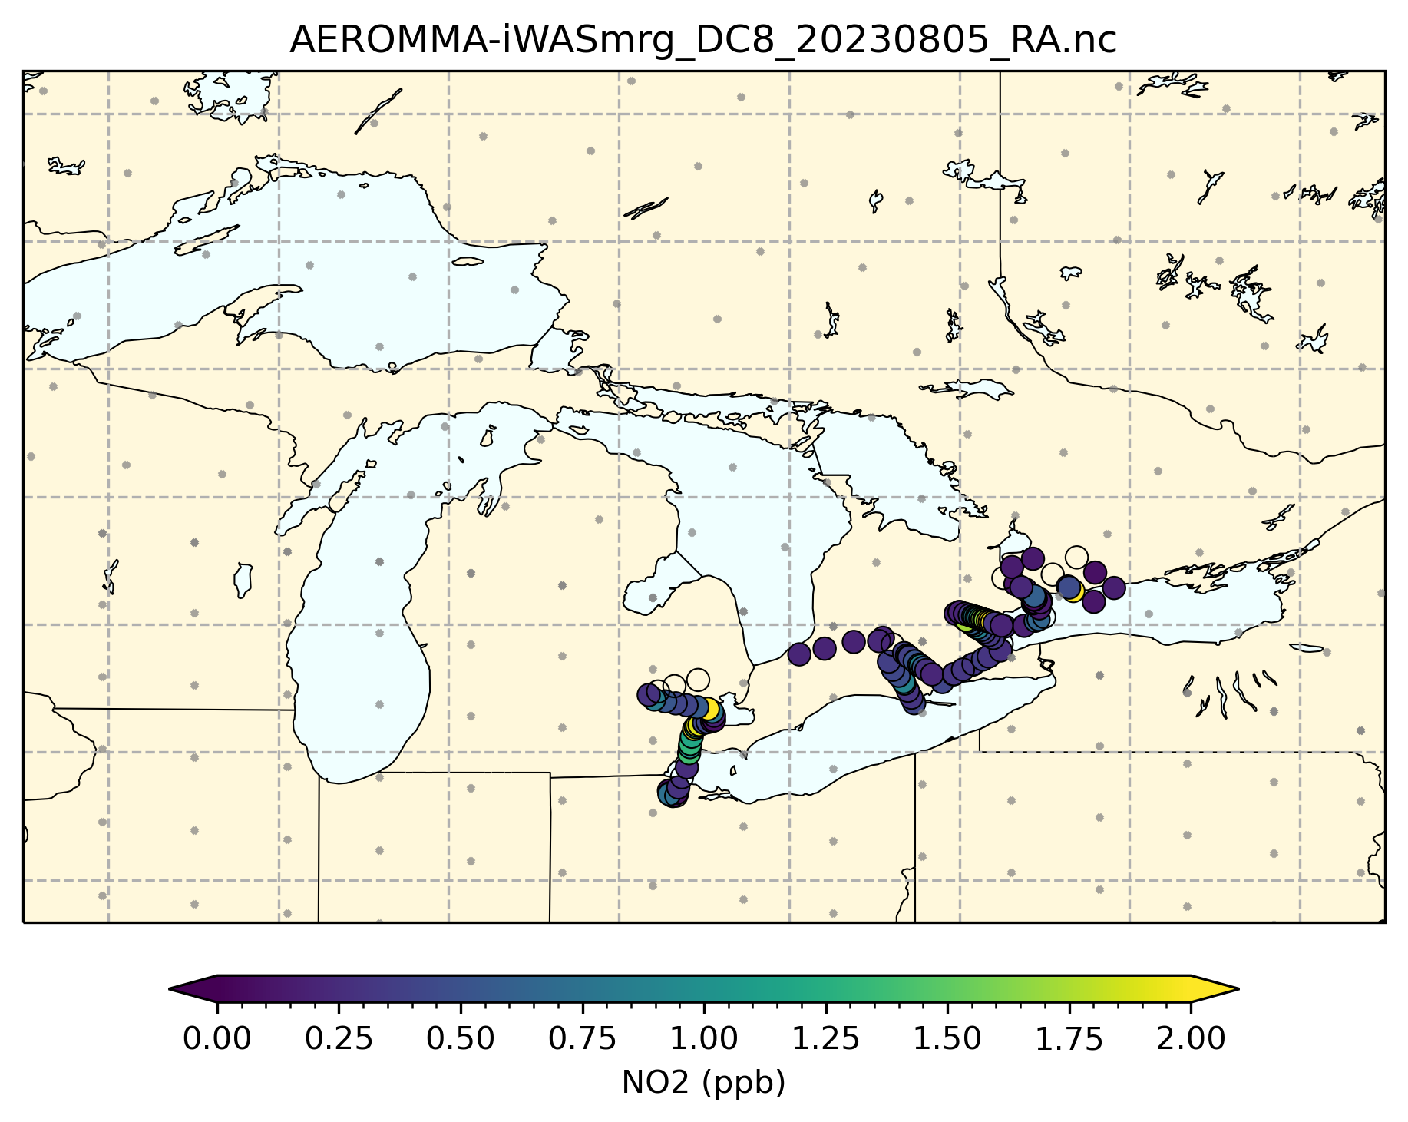
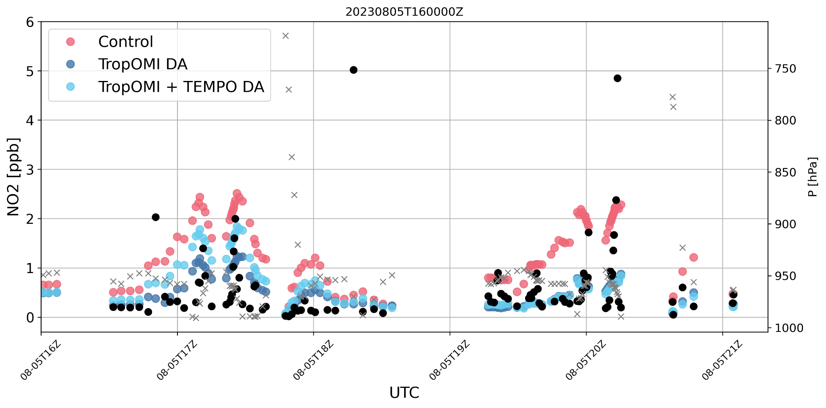
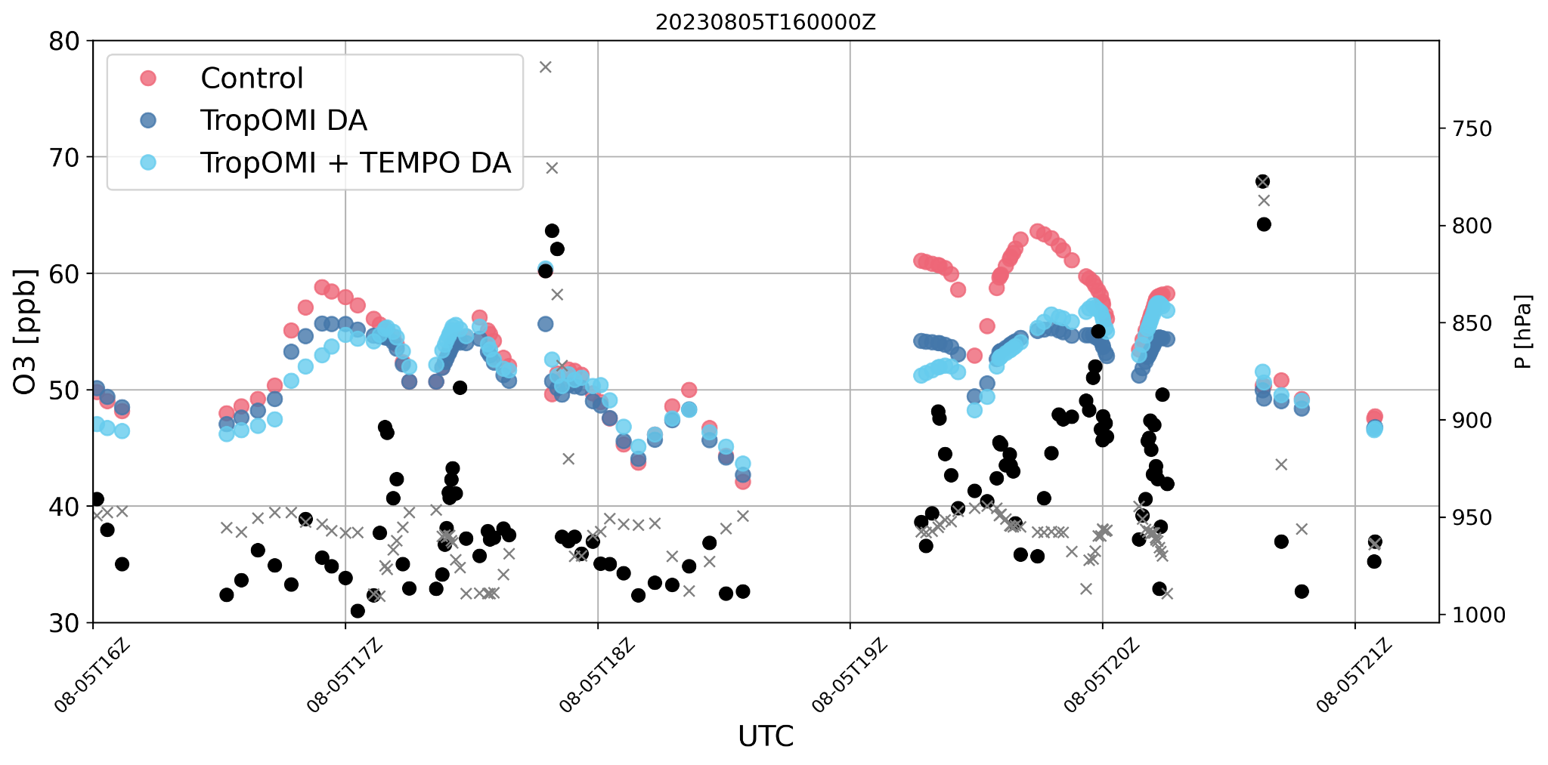
TEMPO NO2 and TropOMI NO2 Evaluation with AEROMMA
ACES (Airborne Cavity Enhanced Spectrometer) comparisons
Special Thanks to B. McDonald, NOAA/CSL

Slide 10
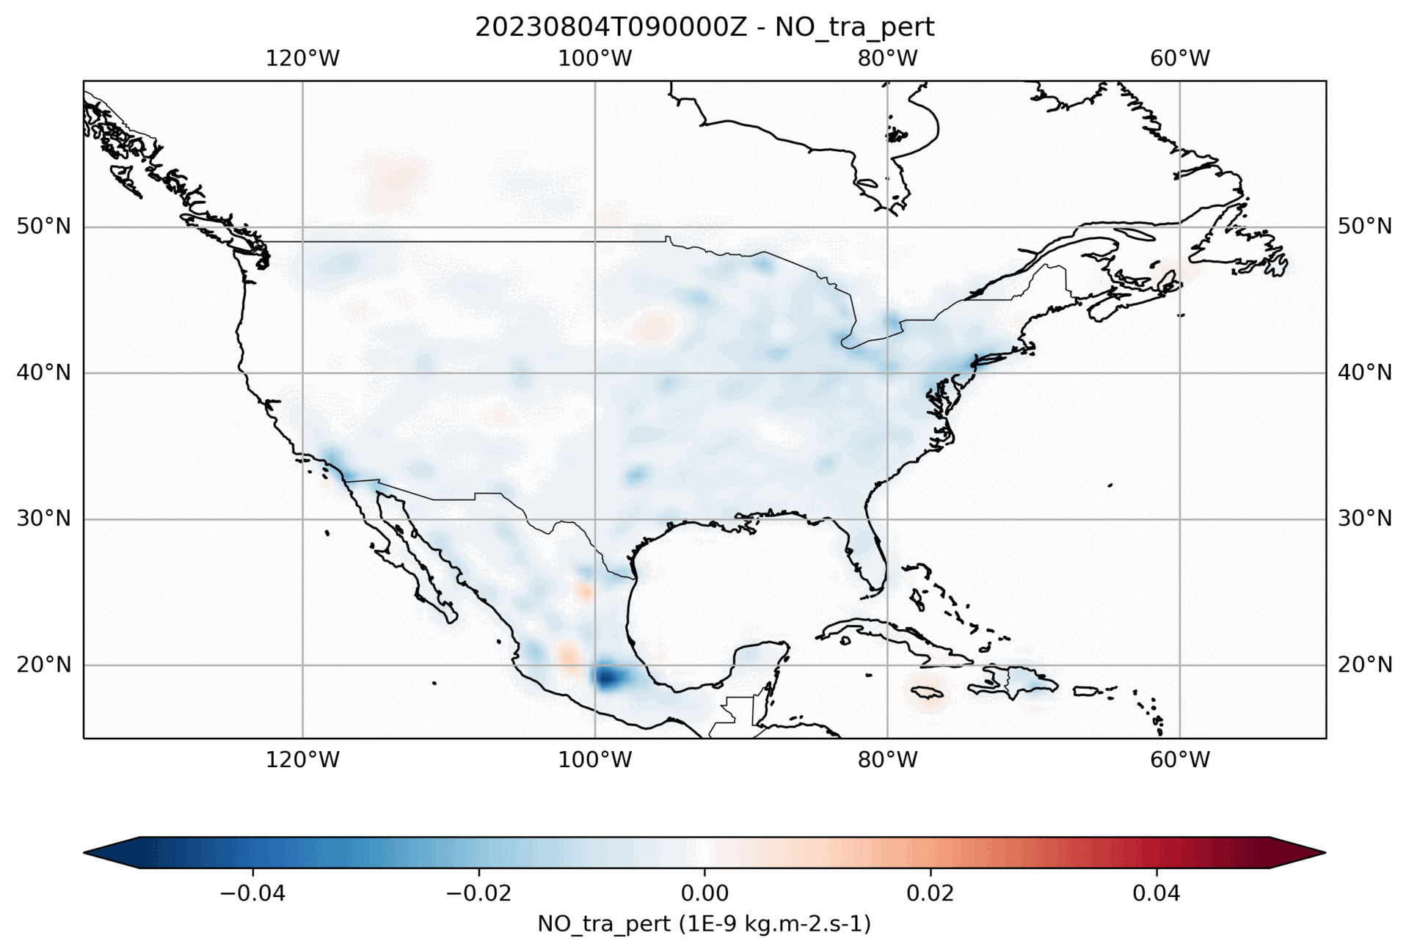
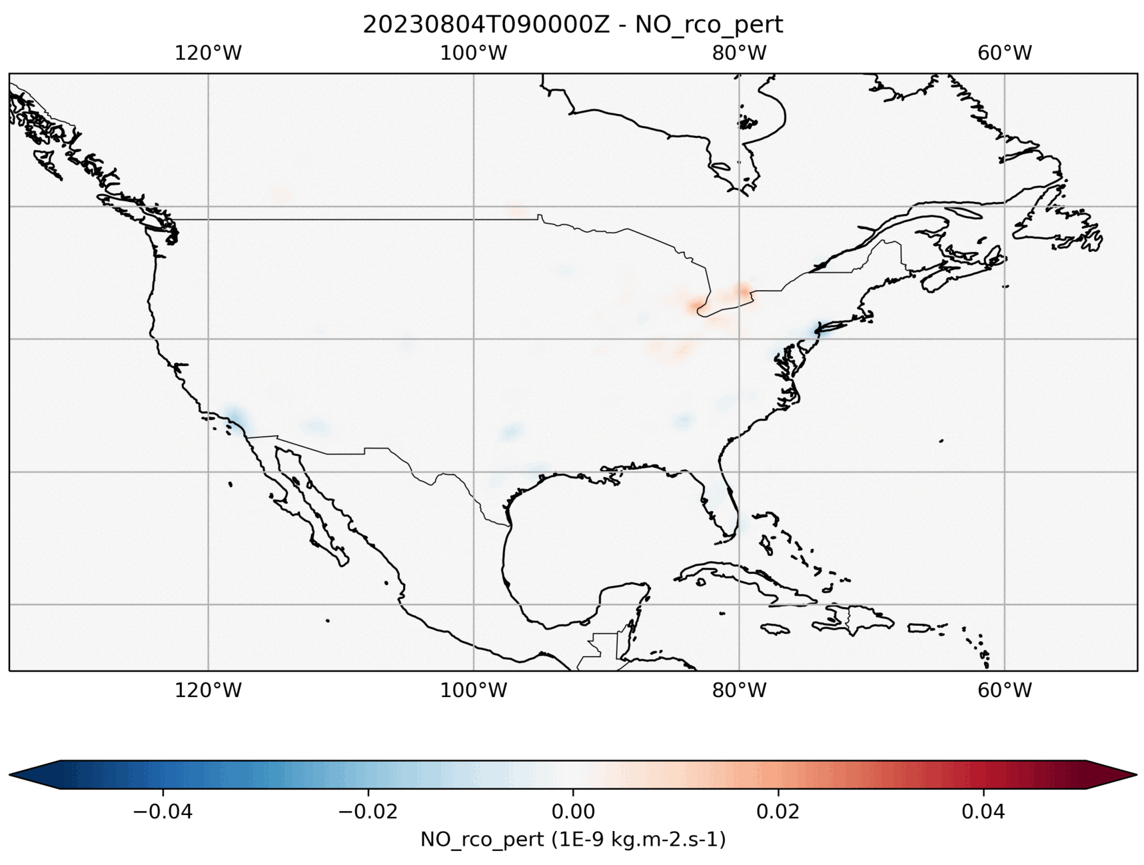
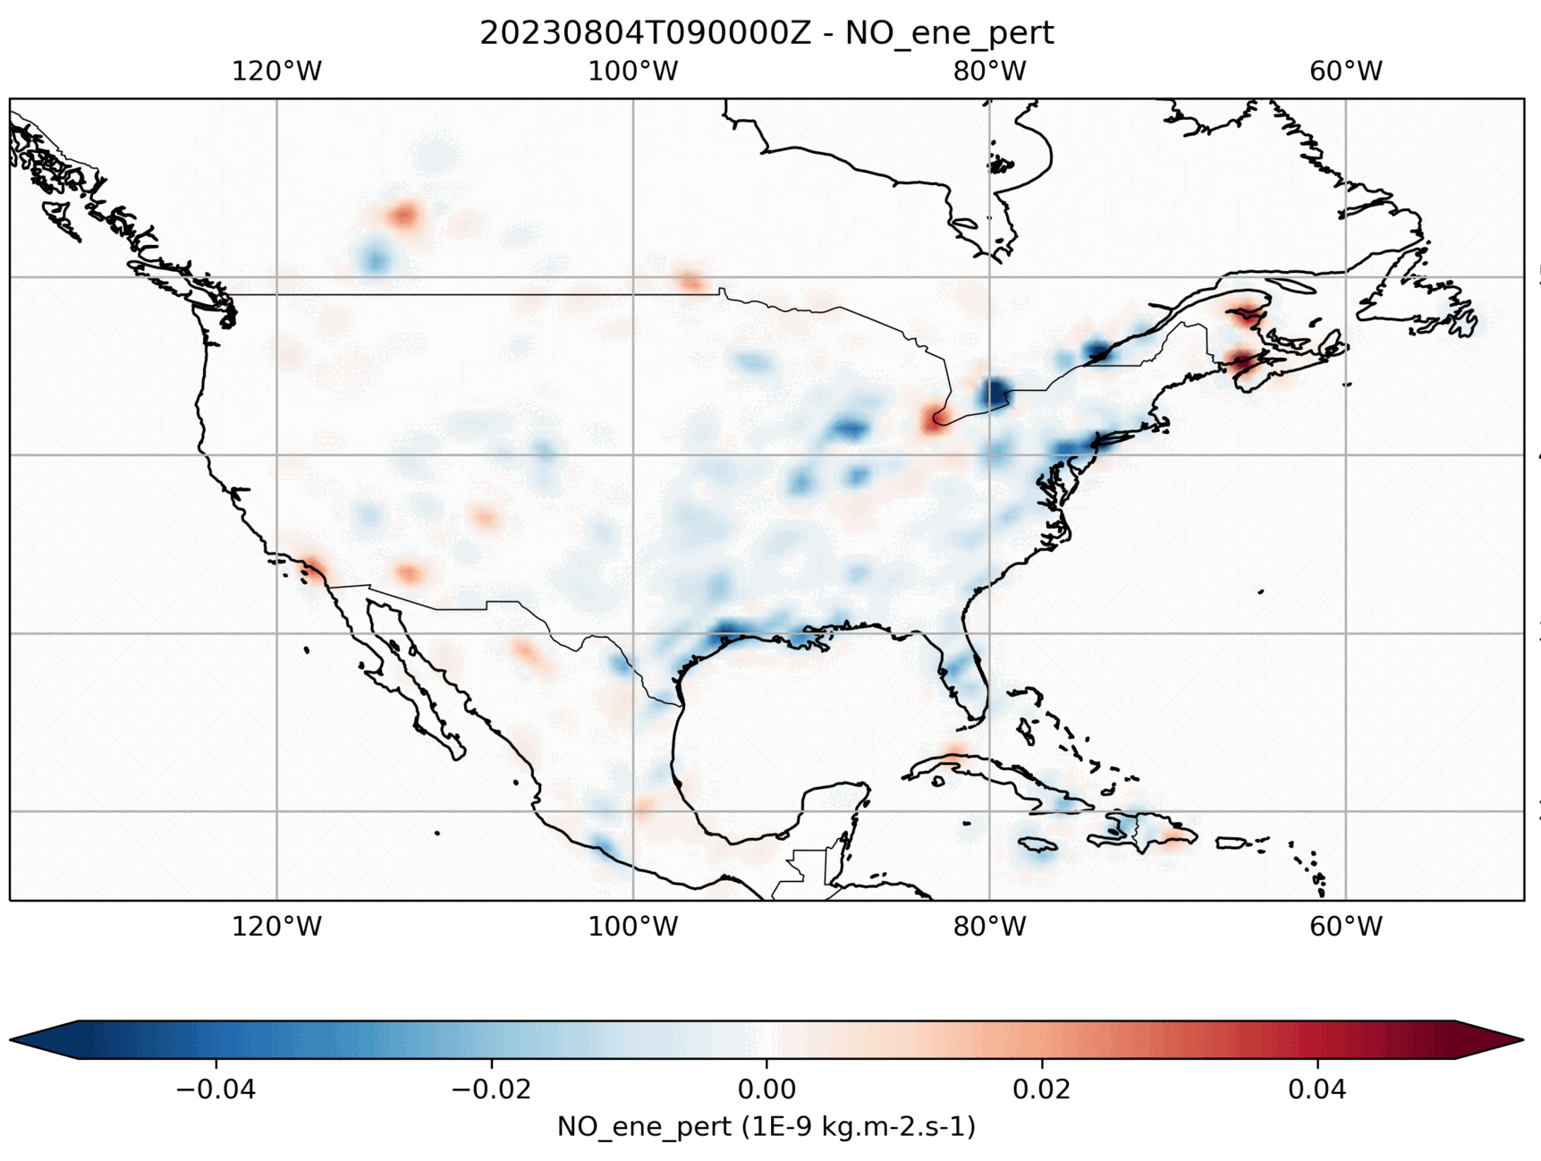
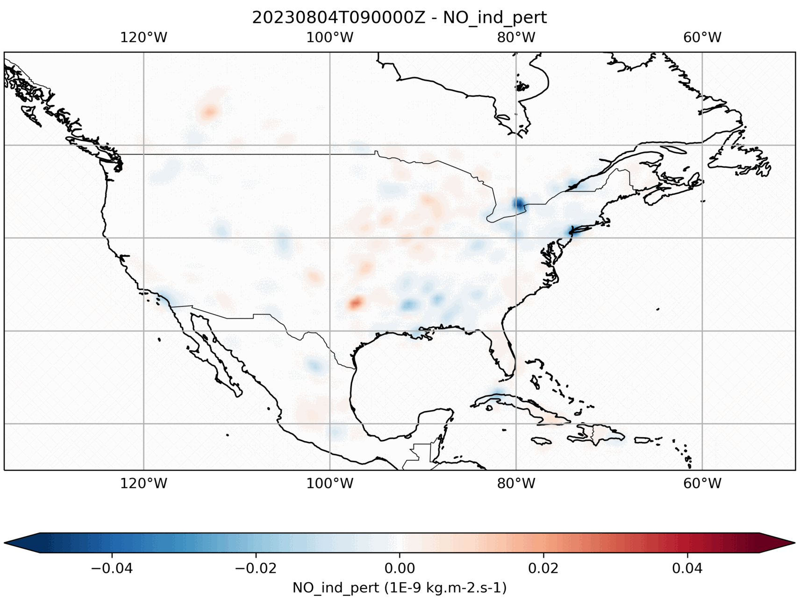
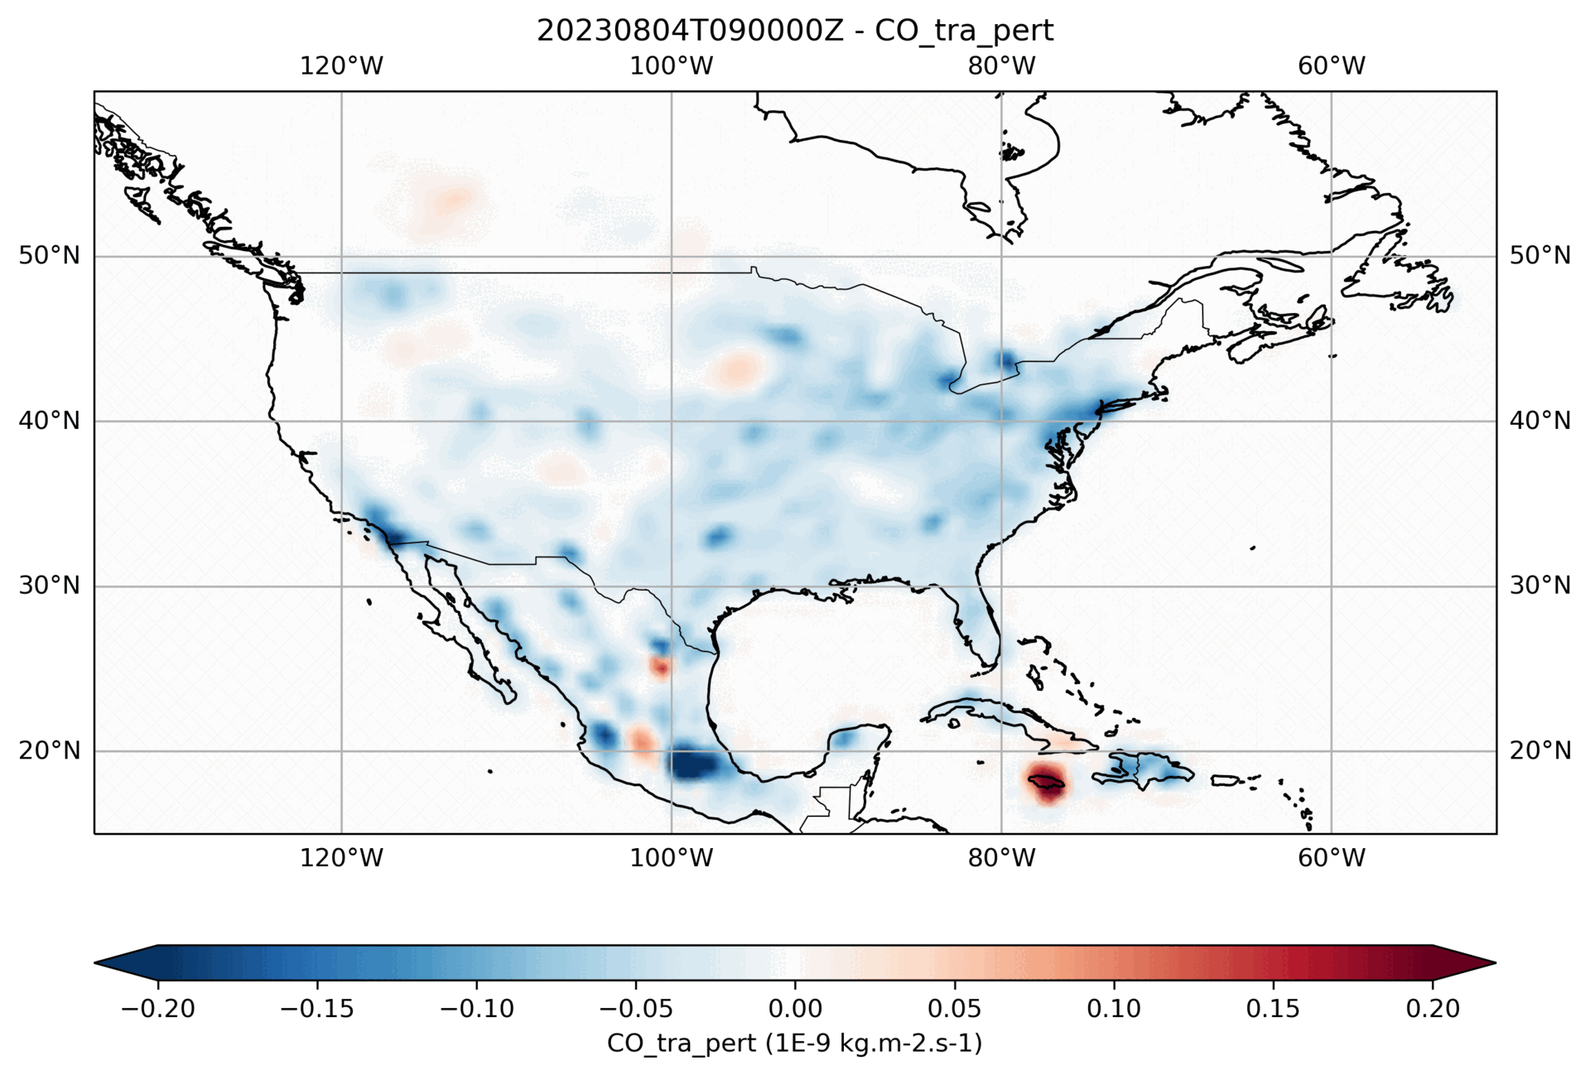
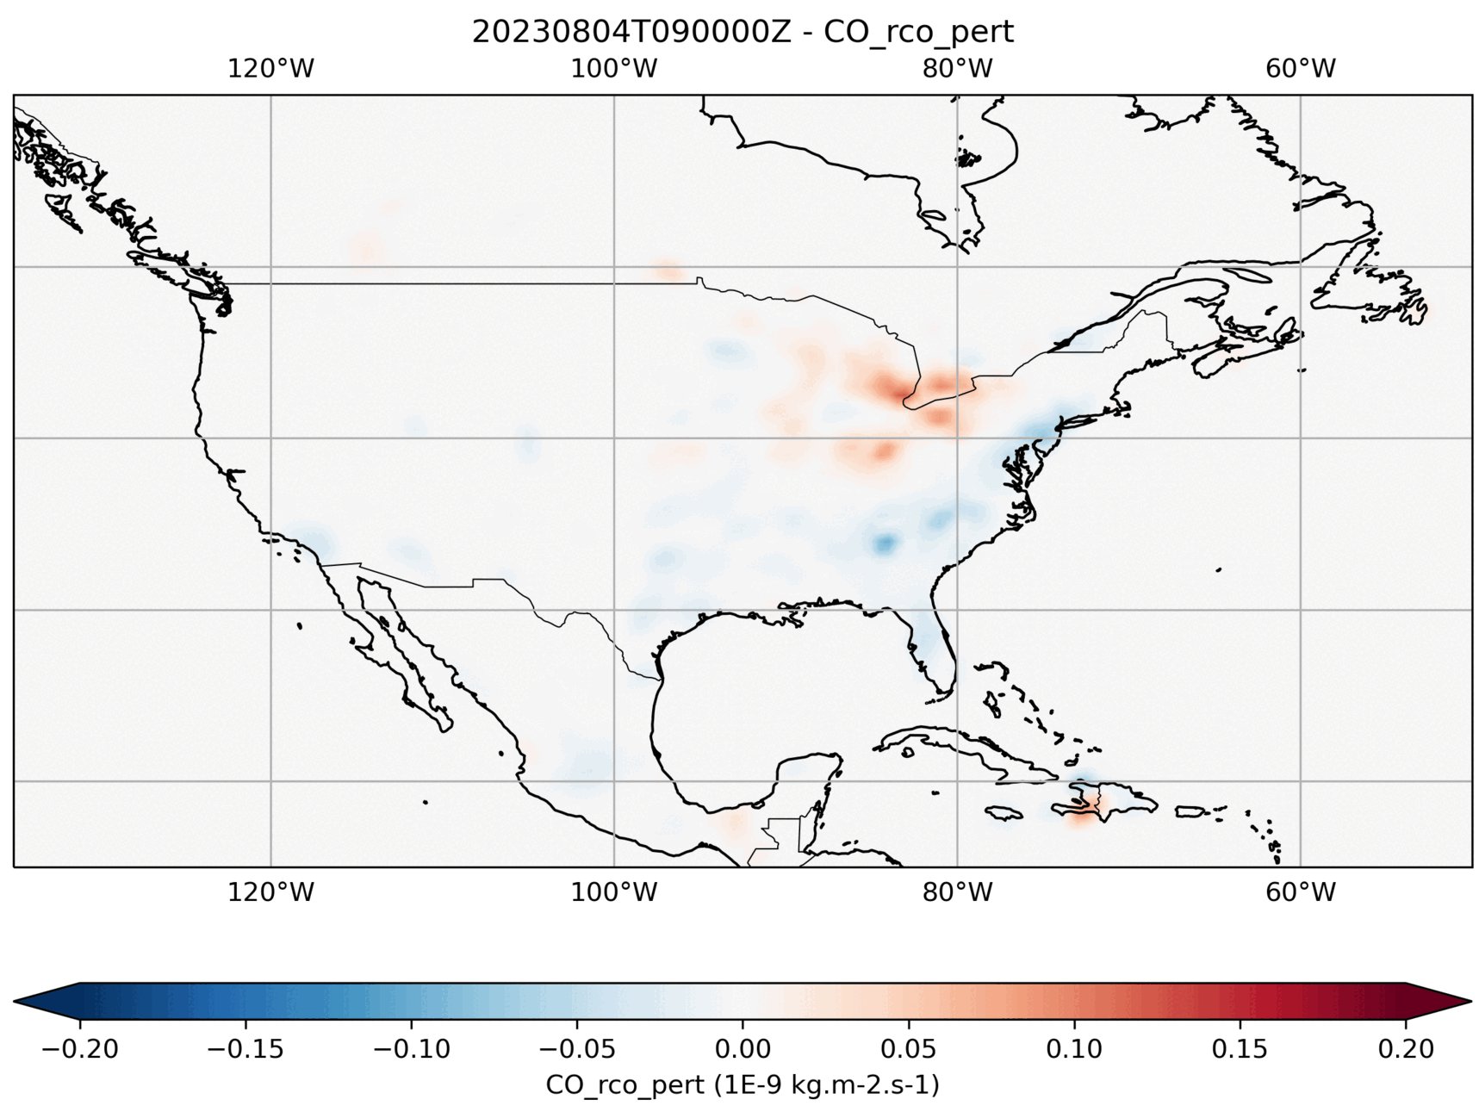
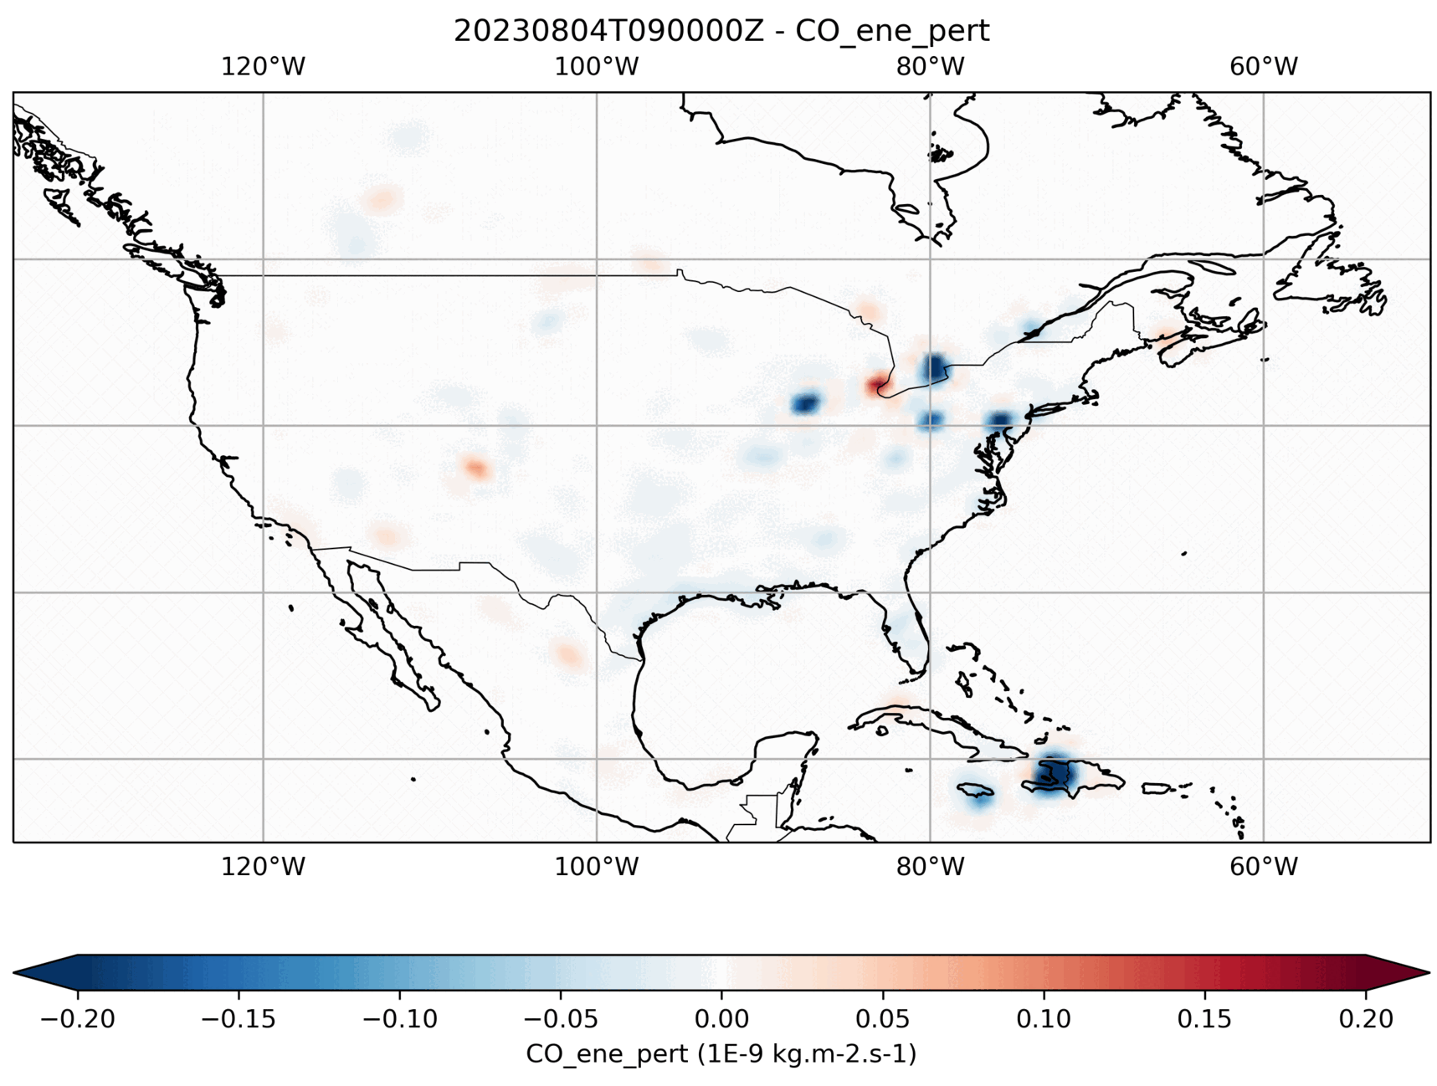
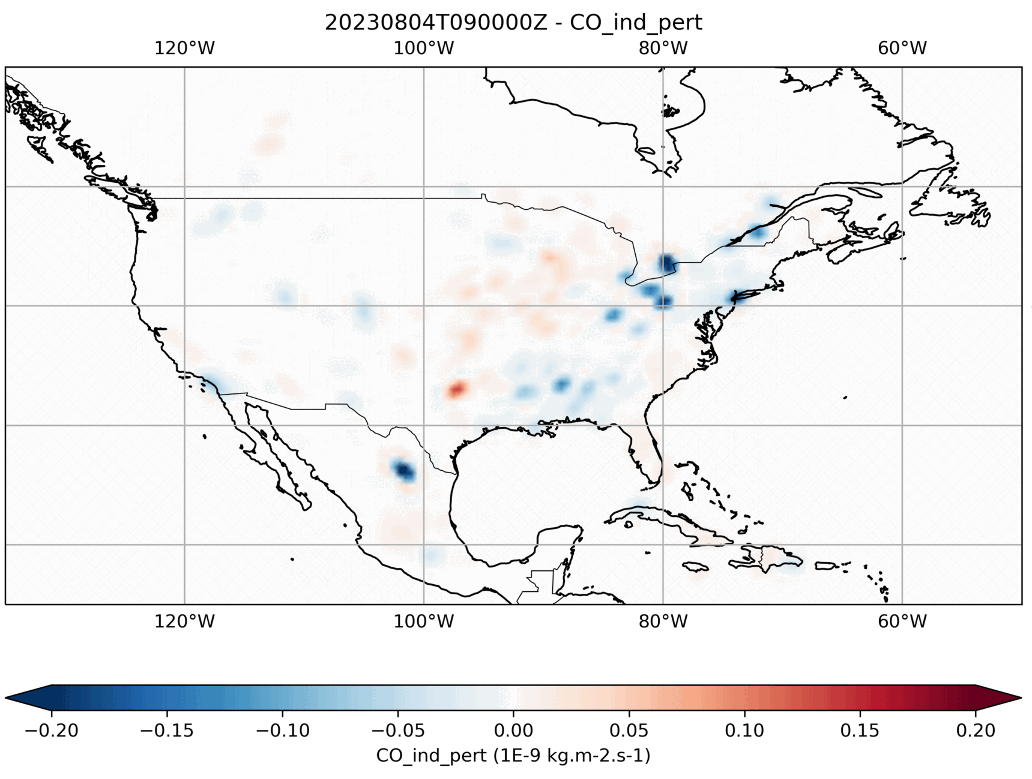
TEMPO NO2 and TropOMI NO2 Co-Emission Inversions
Using HEMCO emission preprocessing to update scaling factors from DA increments to cary the emission constrain forward
NOx emission increments
Traffic
Residential & Commercial
Energy production
Industry
CO emission increments
Traffic
Residential & Commercial
Energy production
Industry

Slide 11
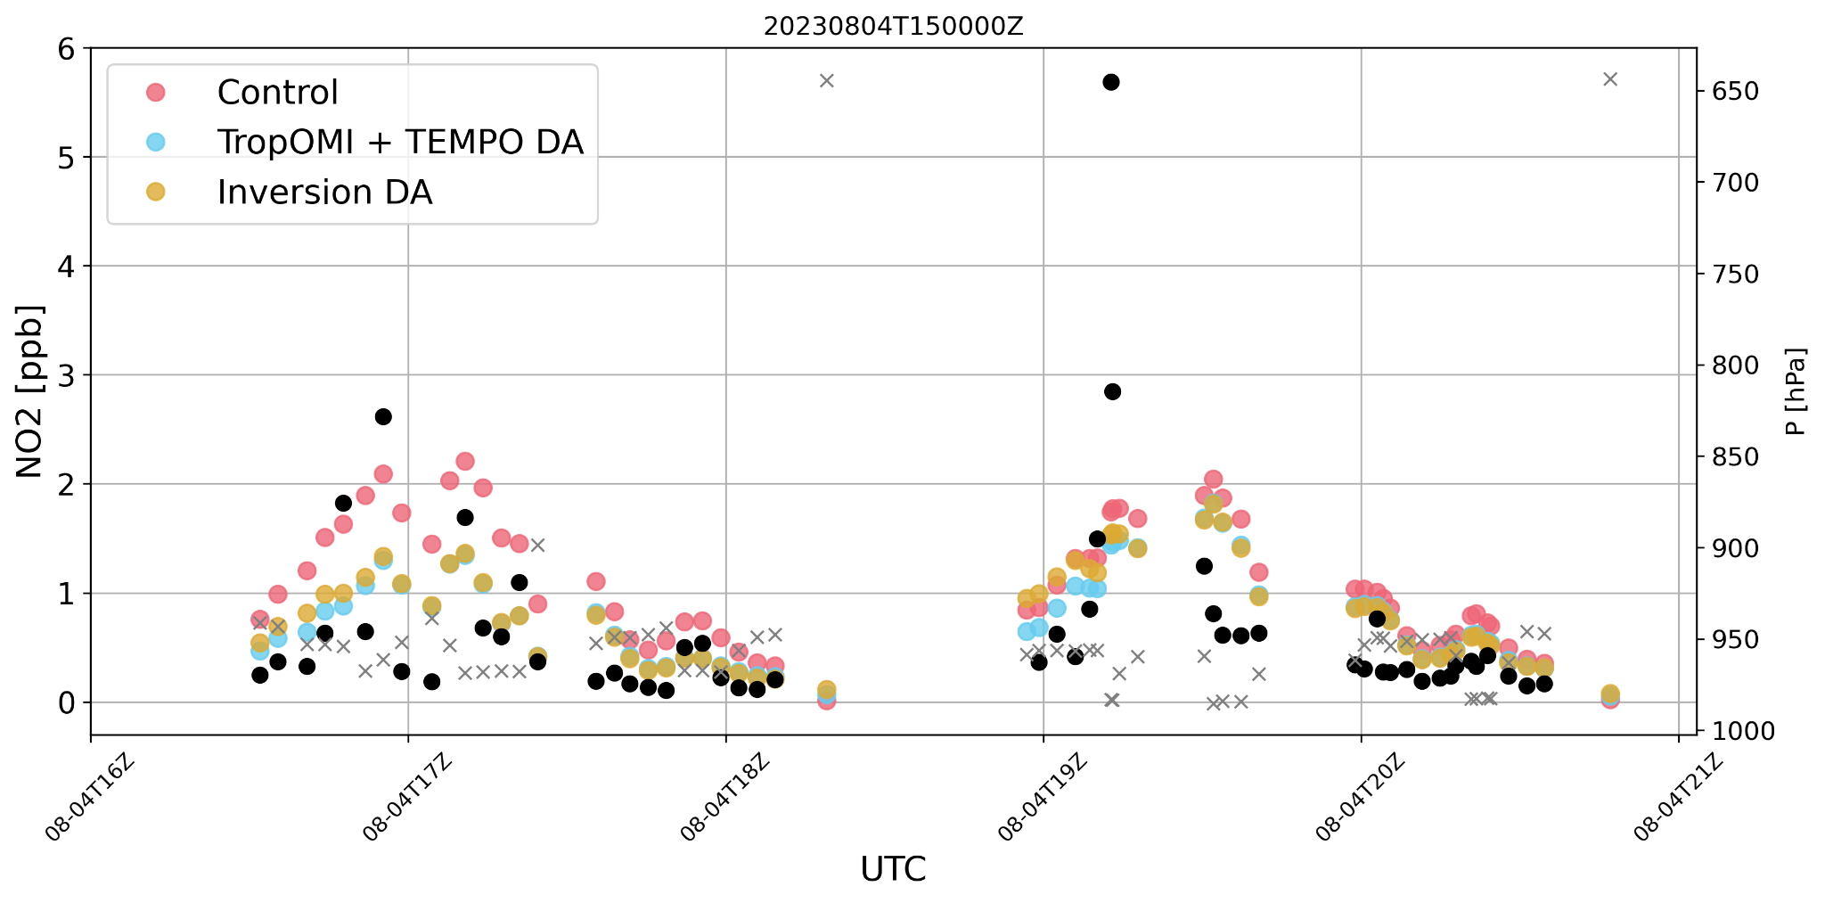
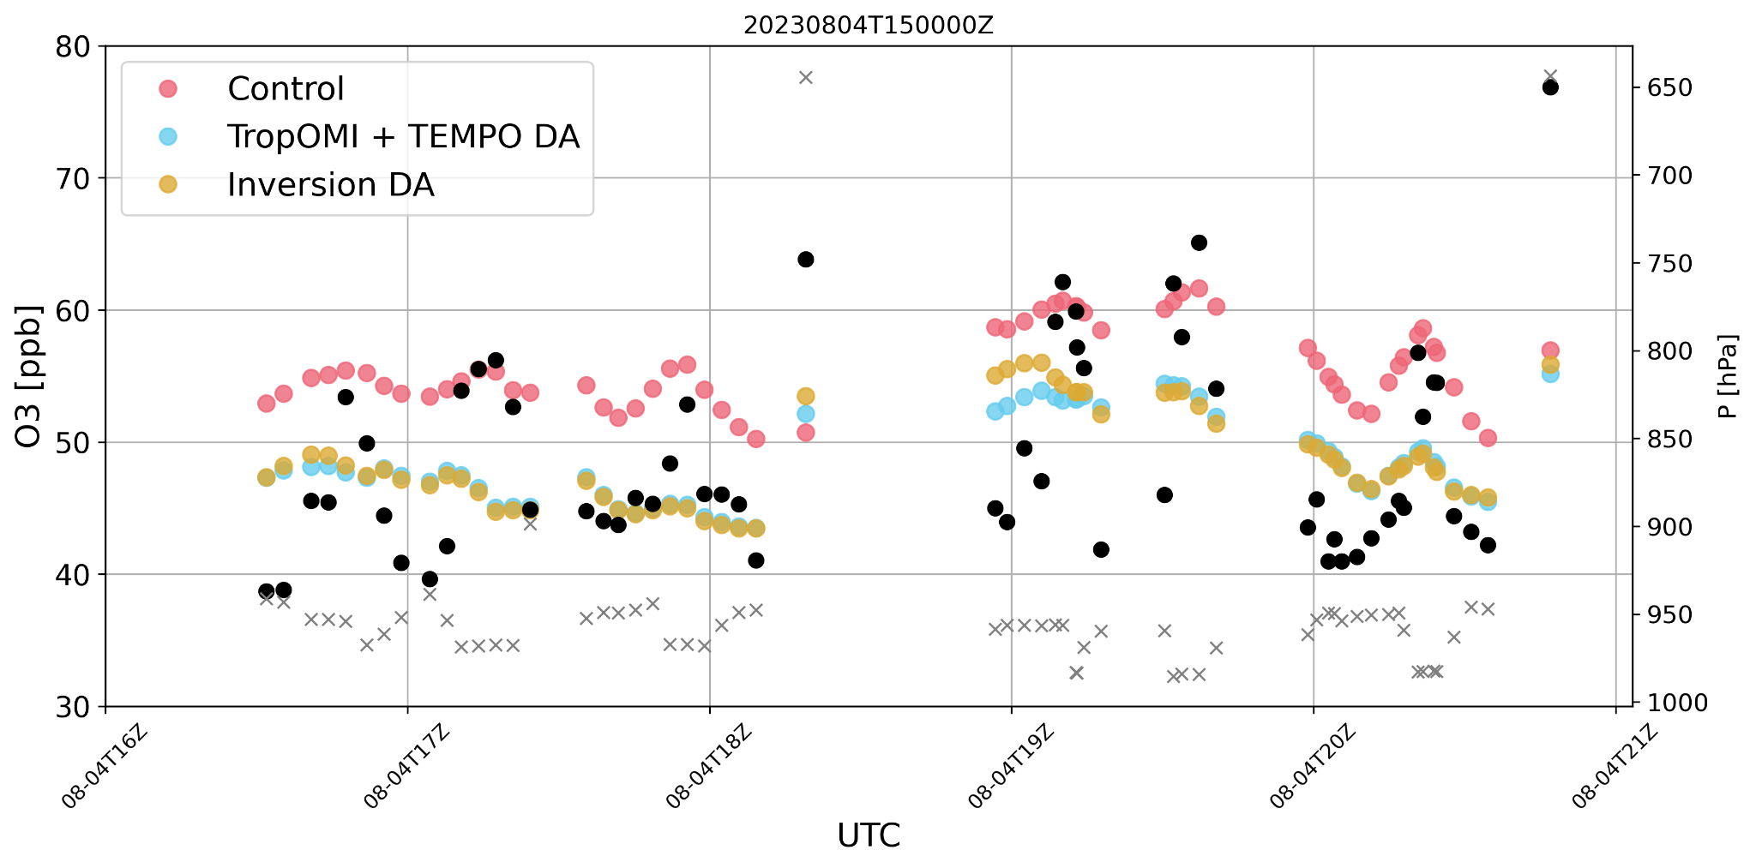
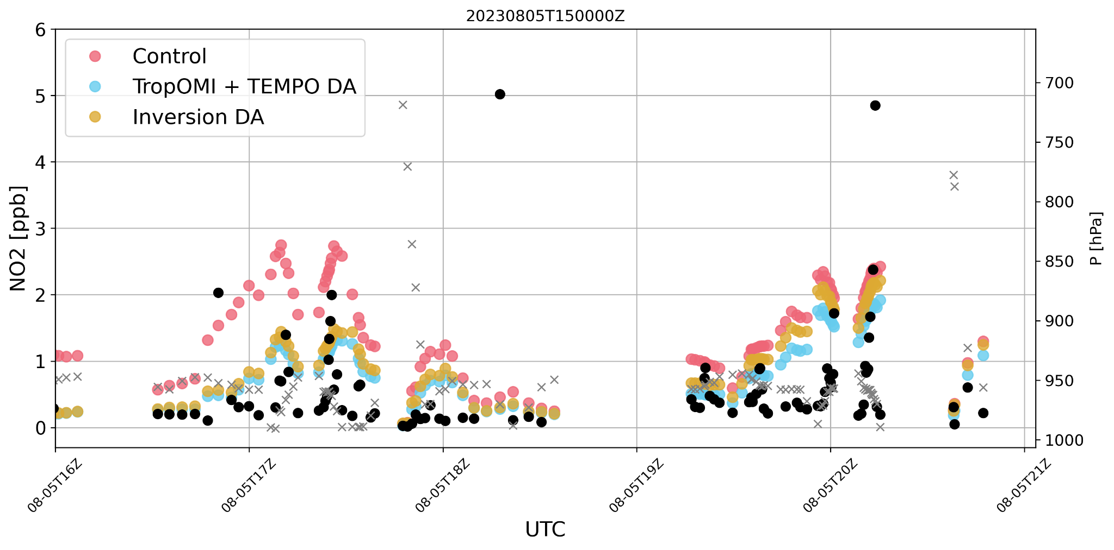
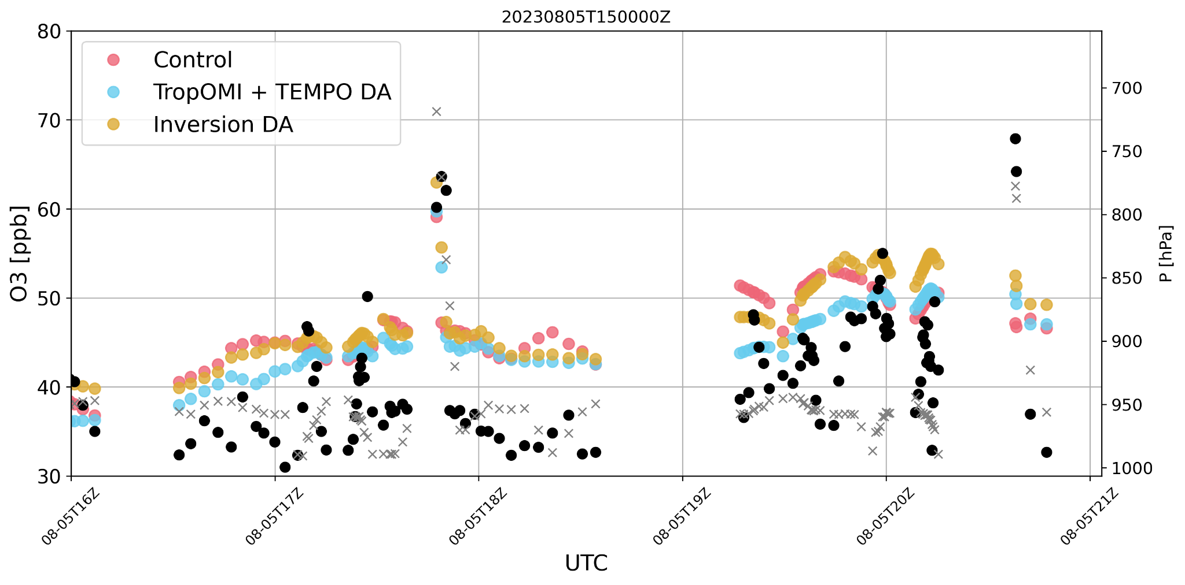
Inversion runs Evaluation with AEROMMA (ACES)
No significant improvement or degradation from inversion. The ensemble size and resolution plays a role. We only inject scaling factors from the first time step of the analysis for now. We need to constrain the diurnal profiles, i.e. inject hourly scaling factors in the next day. We need to look at longer forecasts ranges.

Slide 12
Conclusions & Future work
The demonstration shown here proves readiness of JEDI for first implementation of a novel DA inversion system
We will re-conduct experiments increasing to 32-members ensemble at 1 degree and 1 high-res member at ¼ degree.
Adding airnow for surface obs DA and STAQS in the evaluation
Paper in writing for system description (TropOMI only) and documentation for JEDI users - and TEMPO DA paper when the product validation allows it!
Plans for the next 12 months:
stretch grid with next GEOS version to match TEMPO resolution
Include CH2O TEMPO and TropOMI retrievals
Look at surface O3 predictability
Calibrating and optimizing the co-emission inversion system: diurnal profile constrain
Transfer the DA capability to other models: MPAS, UFS-Chem, (AI emulations)

Slide 13
Extra slides

Slide 14
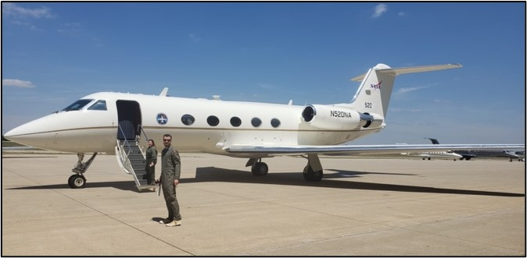
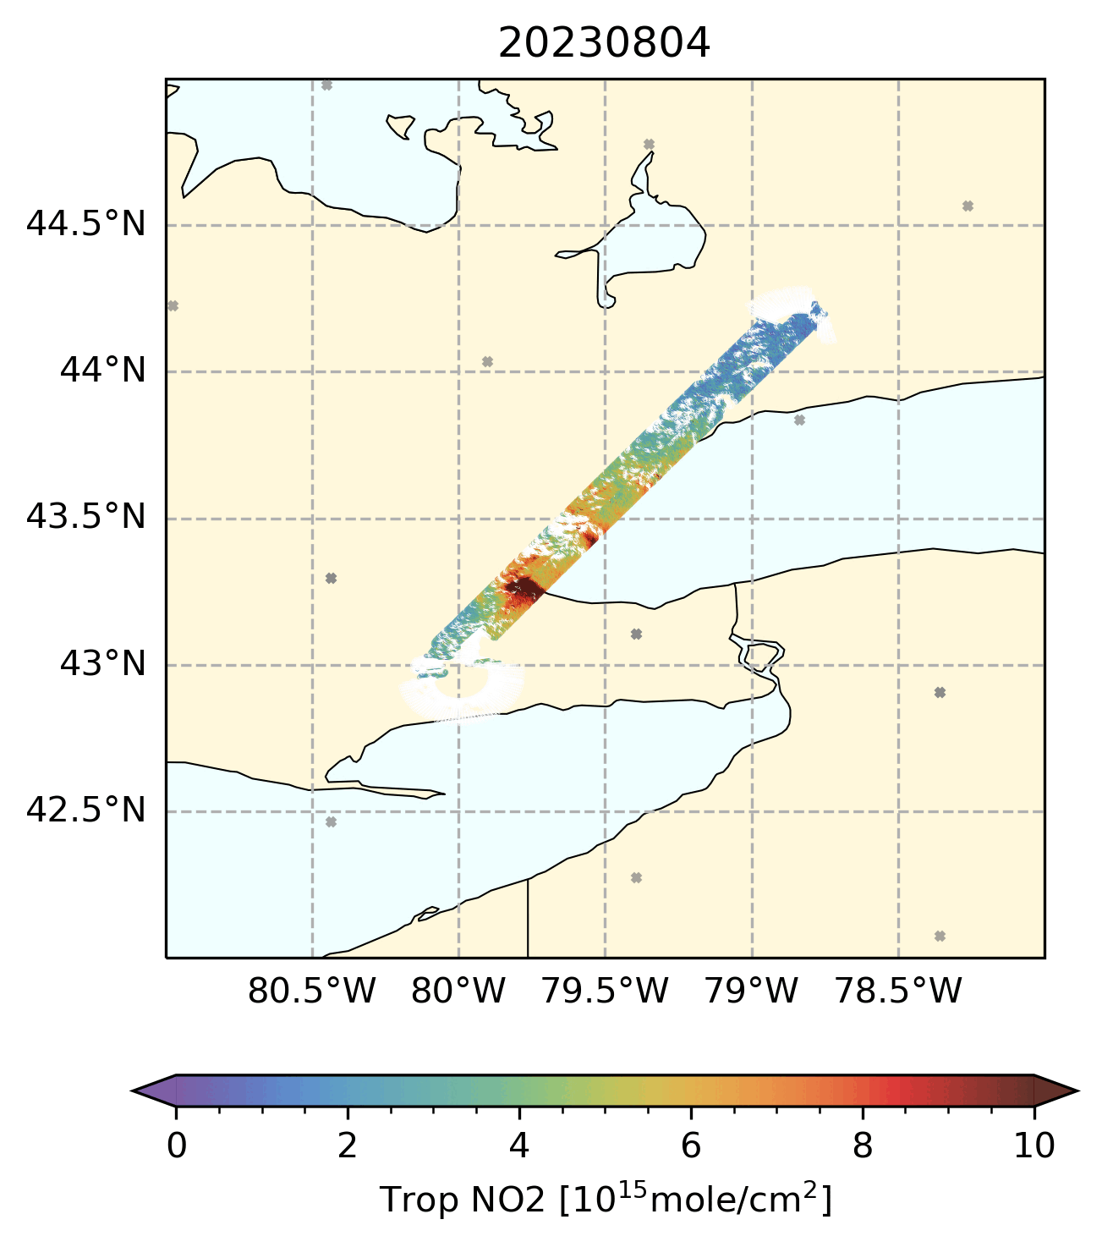
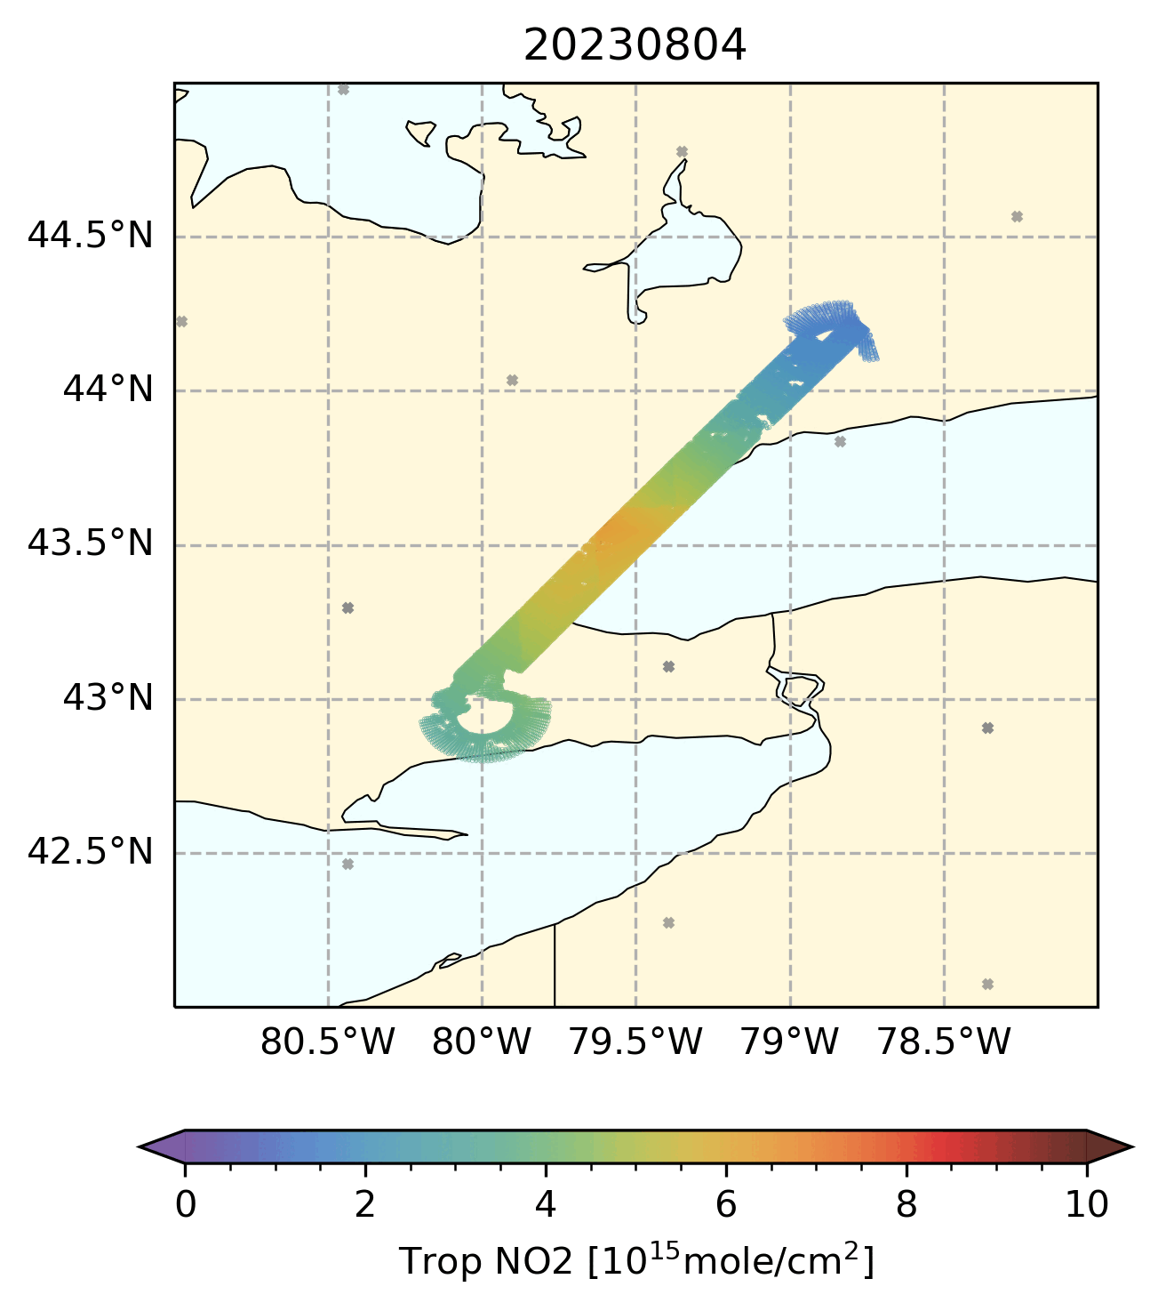
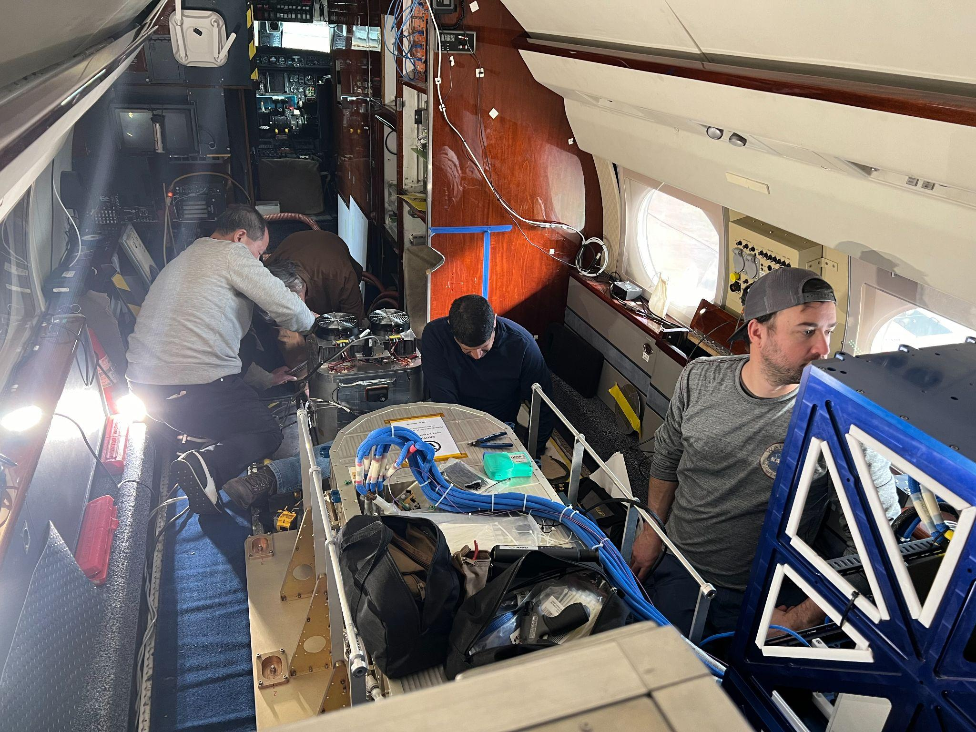
STAQS-GCAS comparison
STAQS – Synergistic TEMPO Air Quality Science
Column Operator in UFO operator could be used out of the box for these measurements

Slide 15
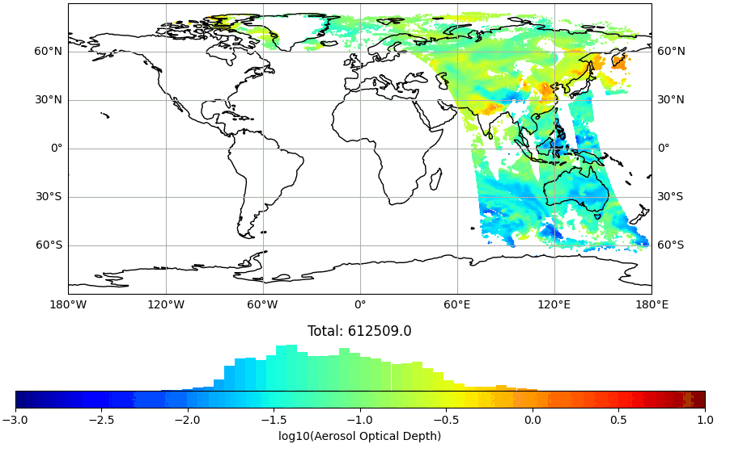
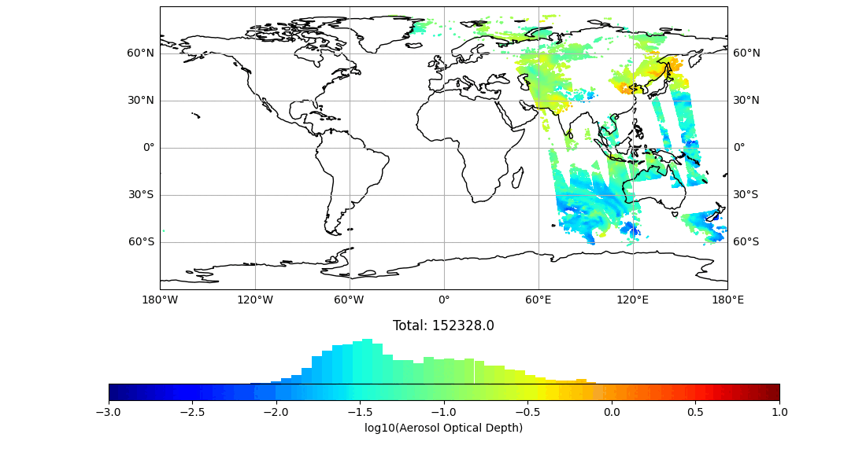
Tested and/or Assimilated observation products in JEDI
VIIRS NPP AOD
Aerosols:
VIIRS NPP AOD and L1b in development
VIIRS NOAA 20 AOD and L1b in development
MODIS Aqua AOD
MODIS Terra AOD
PACE AOD planned
TEMPO AOD??
Trace gas:
TropOMI NO2 (tropospheric and total columns)
TropOMI CO total column
TropOMI O3 total column planned
MOPITT CO total column
TEMPO NO2 and HCHO columns, O3 profiles planned
MLS O3 limb profile
OMPS LP, NP and TC O3 (limb and nadir)
MODIS AQUA

