Slide 1
Health and Air Quality Applied Sciences Team (HAQAST)
Jenny Bratburd, HAQAST Outreach Program Manager
University of Wisconsin—Madison
https://haqast.org/
bratburd@wisc.edu

Slide 2
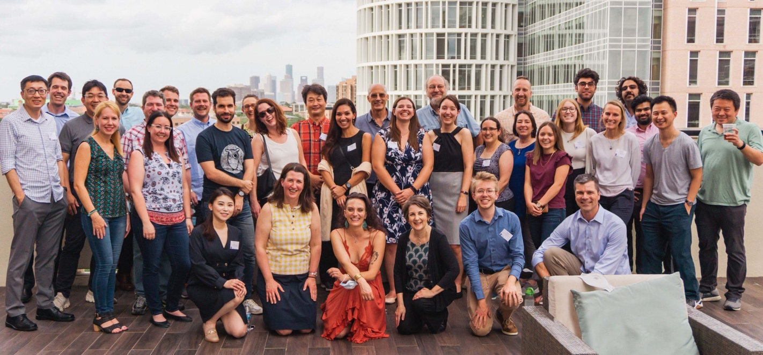
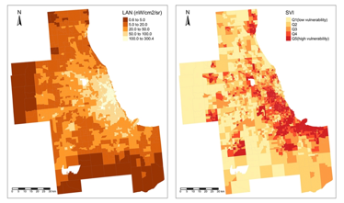
What is “hay-kast”?
Health and Air Quality Applied Sciences Team
Mission: Connect NASA science with air quality and health applications
14 Members and 60+ co-investigators
Four types of work:
Member projects
Tiger team projects (collaborative)
Rapid response (emergent/immediate)
Outreach and engagement

Slide 3
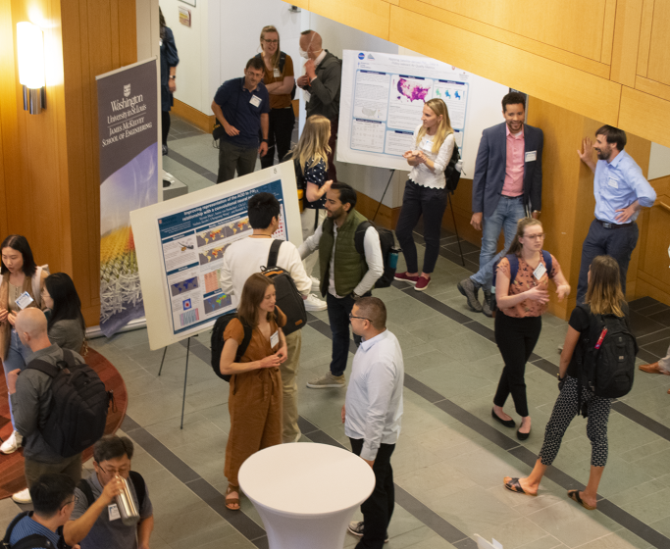
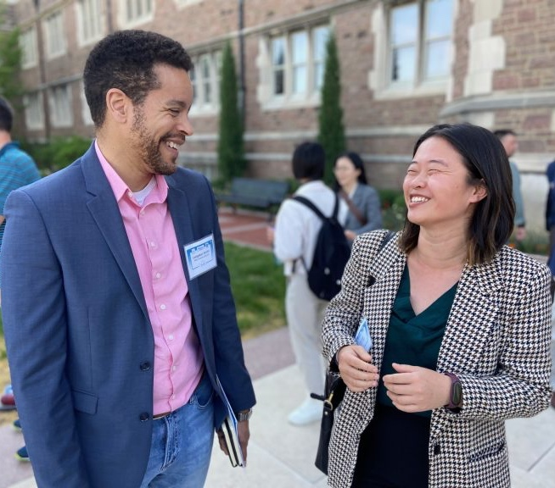
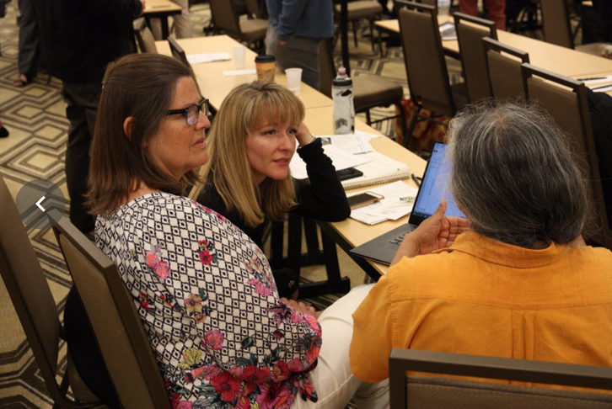
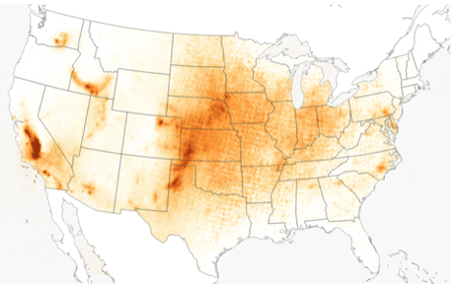
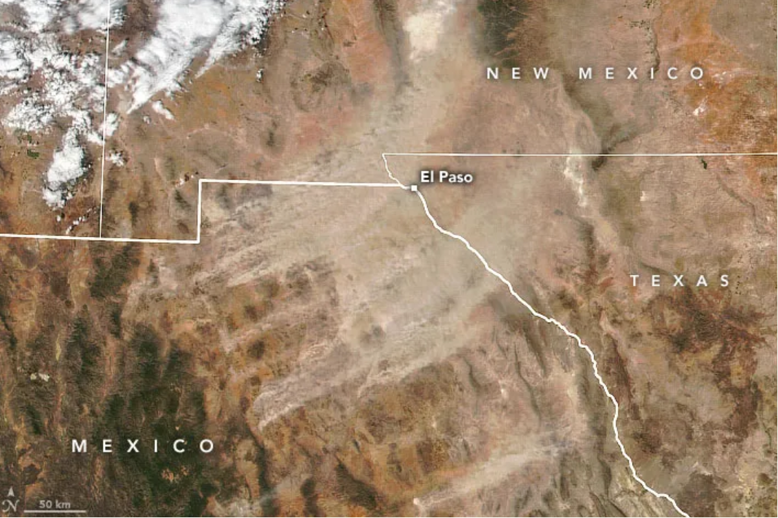
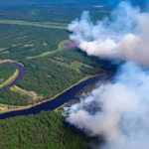
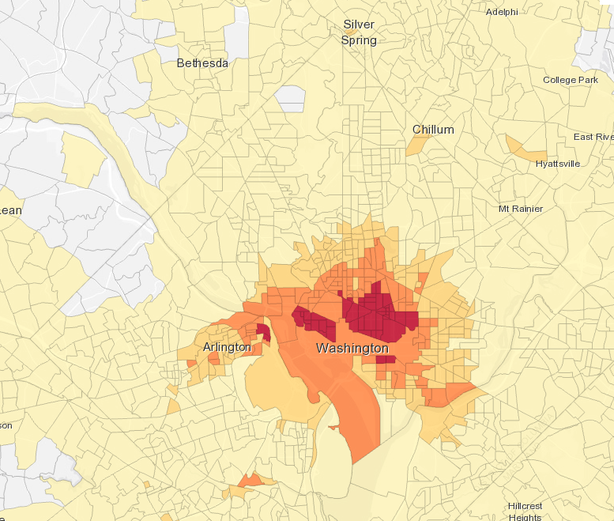
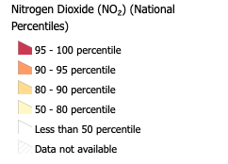
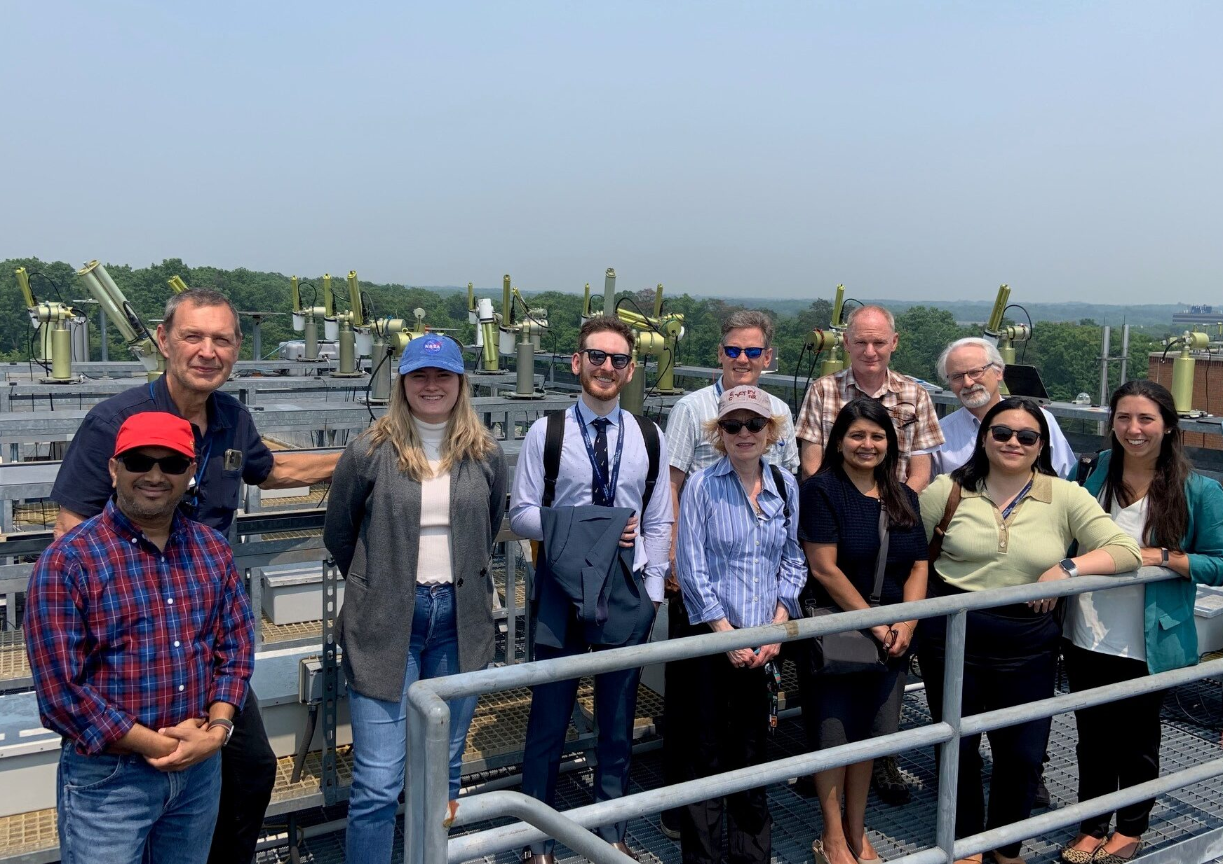
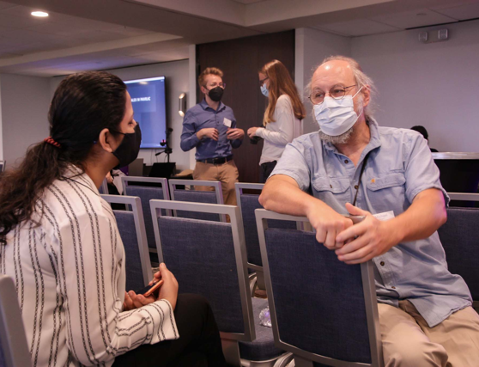
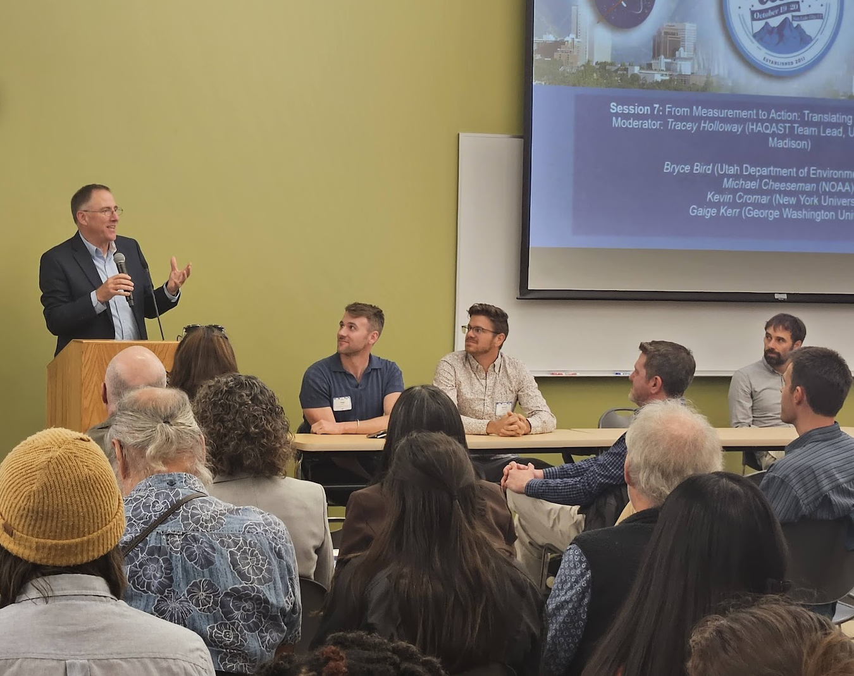
HAQAST1
2011-2016
HAQAST2
2016-2020
HAQAST3
2021-2025
HAQAST4
2025-2029
ZONDLO SHOWS HOW AGRICULTURE BREATHES
Mark Zondlo’s work on the season rhythm of the NH₃ profiles by NASA’s Image of the Day.
SATELLITE DATA CAN HELP LIMIT THE DANGERS OF WINDBLOWN DUST
HAQAST research led by Daniel Tong uses NASA and NOAA data to provide early warnings to the public.
NASA WORLDVIEW VIDEO TUTORIAL NOW AVAILABLE
Watch HAQAST’s NASA Worldview tutorial produced by the HAQAST Communications Team.
WILDFIRE EXPOSURE LINKED TO HIGHER RISK FOR DEATH AFTER LUNG CANCER SURGERY
This transformative collaboration combined satellite data to measure wildfire exposure with data from the American Cancer Society.
NO₂ NOW INCLUDED IN EPA EJSCREEN
The Satellite Data for Environmental Justice Tiger Team incorporated NO₂ data into EJScreen.
EXPANDING RELIABLE AIR QUALITY DATA FOR THE DEPARTMENT OF STATE
HAQAST satellite data and forecasts now incorporated into the DoS ZephAir app, led by Pawan Gupta.

Slide 4
HAQAST Ambassadors
Zach Adelman (Lake Michigan Air Directors Consortium)
Temilayo Adeyeye (New York State Department of Health)
Doug Boyer (Texas Commission on Environmental Air Quality)
Kelly Crawford (US Department of Energy)
Michael Geigert (Connecticut Department of Energy and Environmental Protection)
Barron H. Henderson (US EPA)
Tabassum Z Insaf (New York State Department of Health)
Alex Karambelas (NESCAUM)
Byeong-Uk Kim (Georgia Environmental Protection Division)
Maeve MacMurdo (Cleveland Clinic)
Magdalene McCarty Sanders (Earth Stewards)
Libby Mohr (Environmental Defense Fund)
Steve Moran (Google)
Amirhosein Mousavi (Waste Management)
Leticia Nogueira (American Cancer Society)
Pallavi Pant (Health Effects Institute)
Allison Patton (Health Effects Institute)
Eric Stevens (National Park Service)
Mary Tran (US Department of State)
Mary Uhl (WESTAR)

Slide 5
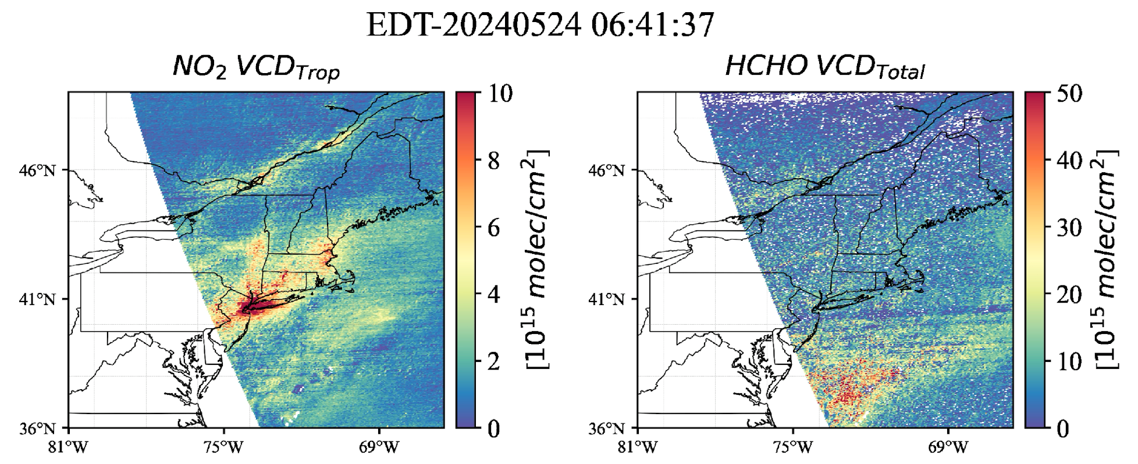
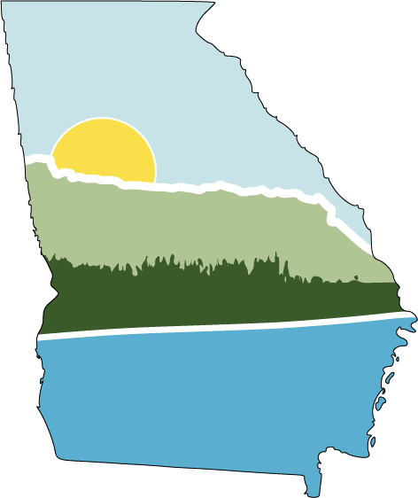
Analysis to support air quality and health TEMPO applications for surface ozone
Tiger Team Lead: Arlene Fiore
Partners: LADCO, MDE, CT DEEP, NYS DEC, GA EPD, Tracking California, US EPA, UCS, HEI, Urban Institute
HAQAST PIs/Co-Is: Arlene Fiore (MIT and LDEO/Columbia), Daniel Goldberg (GW), Tracey Holloway (U WI Madison), Jen Kaiser (Georgia Tech), Jingqiu Mao (U AK Fairbanks), Talat Odman (Georgia Tech), Randall Martin (WUSTL), Ted Russell (Georgia Tech), Daniel Tong (GMU), Chris Uejio (FSU), Jun Wang (U Iowa), Amber Soja (NASA LaRC); Emily Gargulinski (NIA) & many other collaborators

Slide 6
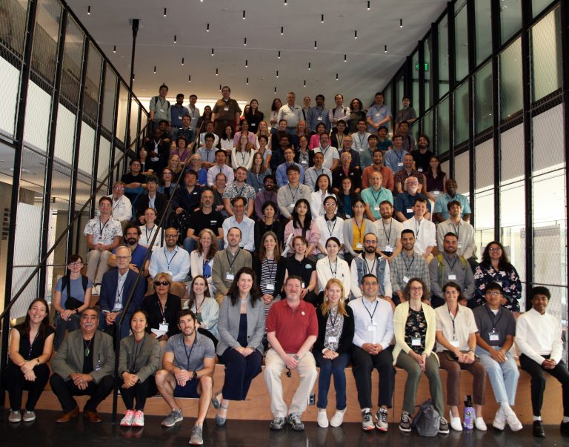
Overarching User Needs
Users with range of experience
Reduce technical skill needed to access resources
Lack of expertise / training
Strengths, limitations, and caveats of the data
Methods/papers/how-to guides
Interest in addressing specific policy needs

Slide 7
Common themes emerging from TEMPO TT listening sessions
HAQAST TT member coordinator
Exposure burdens (aggregate, multi-stressor)
smoke/ozone; pollution/heat; EJ; time-of-day variations
Fire smoke and ozone exceedances
prescribed burns; non-fire sources; spring events; attribution
Understanding and communicating uncertainties
ozone profile; validation; column-vs-surface; data fusion
Emission inventories
trends; location; sectoral (traffic, ports; ag; soil; intermodal)
Ozone-forming chemistry
evaluation: field campaigns, Pandoras, lidars; attribution
Gaige Kerr
(gaigekerr@email.gwu.edu)
Amber Soja
(amber.j.soja@nasa.gov)
Randall Martin
(rvmartin@wustl.edu)
Ted Russell
(ted.russell@gatech.edu)
Arlene Fiore
(amfiore@mit.edu)
Next TEMPO-ozone Tiger Team Call: Tuesday, September 17th at 2:00 ET

Slide 8
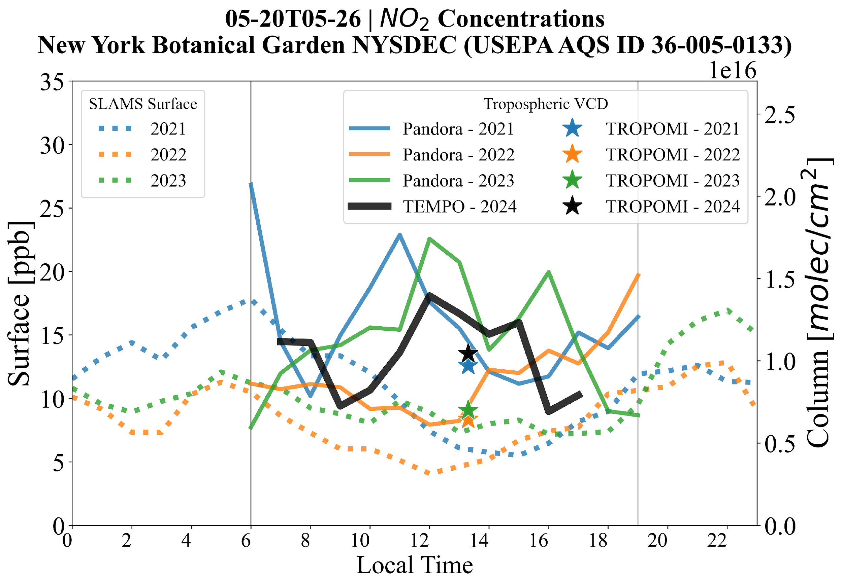
Tropospheric column NO₂ from Pandora vs. surface NO₂
Similar tropospheric column NO₂ concentrations from TEMPO and TROPOMI in 2024, and from TEMPO versus Pandora in earlier years.
Interannual variability in surface O₃ is also reflected in column densities.
The 7-day mean indicates substantial local variations in the column densities
Surface & Pandora measurements c/o NY DEC, EPA and PGN
Slide courtesy of Madankui Tao (Tao-ma)

Slide 9
Tropospheric column NO₂ from Pandora vs. surface NO₂
Similar tropospheric column NO₂ concentrations from TEMPO and TROPOMI in 2024, and from TEMPO versus Pandora in earlier years.
Interannual variability in surface O₃ is also reflected in column densities.
The 7-day mean indicates substantial local variations in the column densities
Surface & Pandora measurements c/o NY DEC, EPA and PGN
Slide courtesy of Madankui Tao (Tao-ma)

Slide 10
Tropospheric column NO₂ from Pandora vs. surface NO₂
Similar tropospheric column NO₂ concentrations from TEMPO and TROPOMI in 2024, and from TEMPO versus Pandora in earlier years.
Interannual variability in surface O₃ is also reflected in column densities.
The 7-day mean indicates substantial local variations in the column densities
Surface & Pandora measurements c/o NY DEC, EPA and PGN
Slide courtesy of Madankui Tao (Tao-ma)

Slide 11
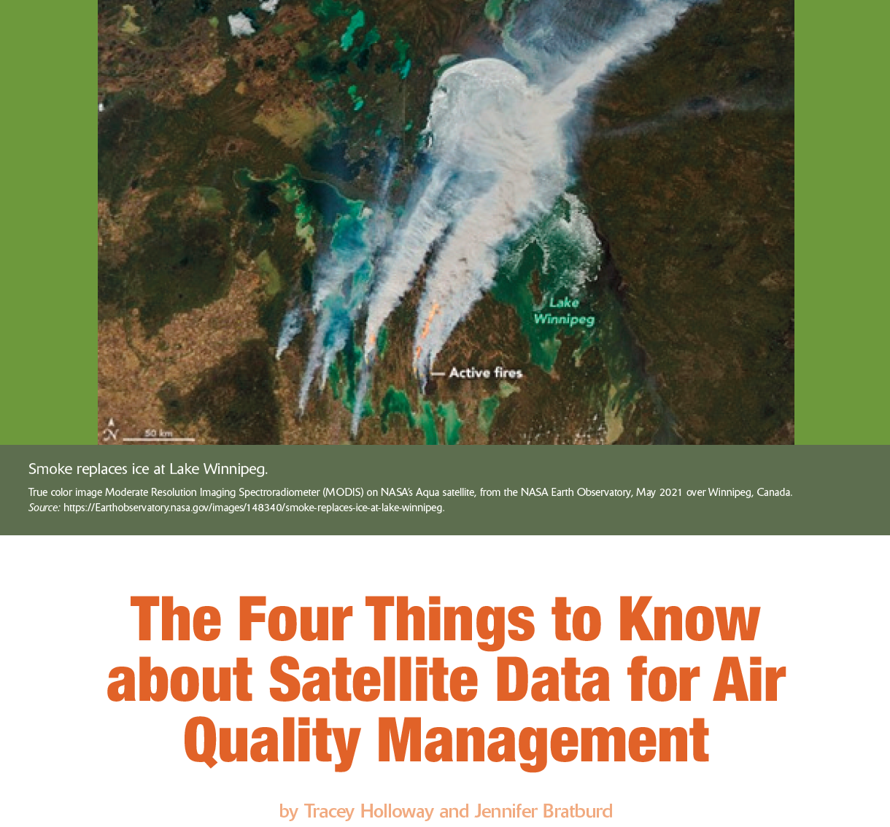
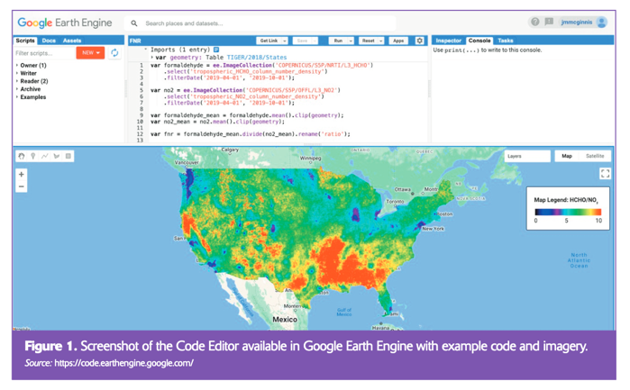
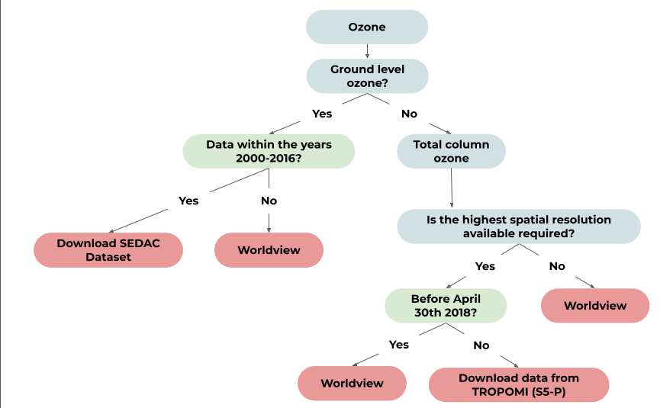
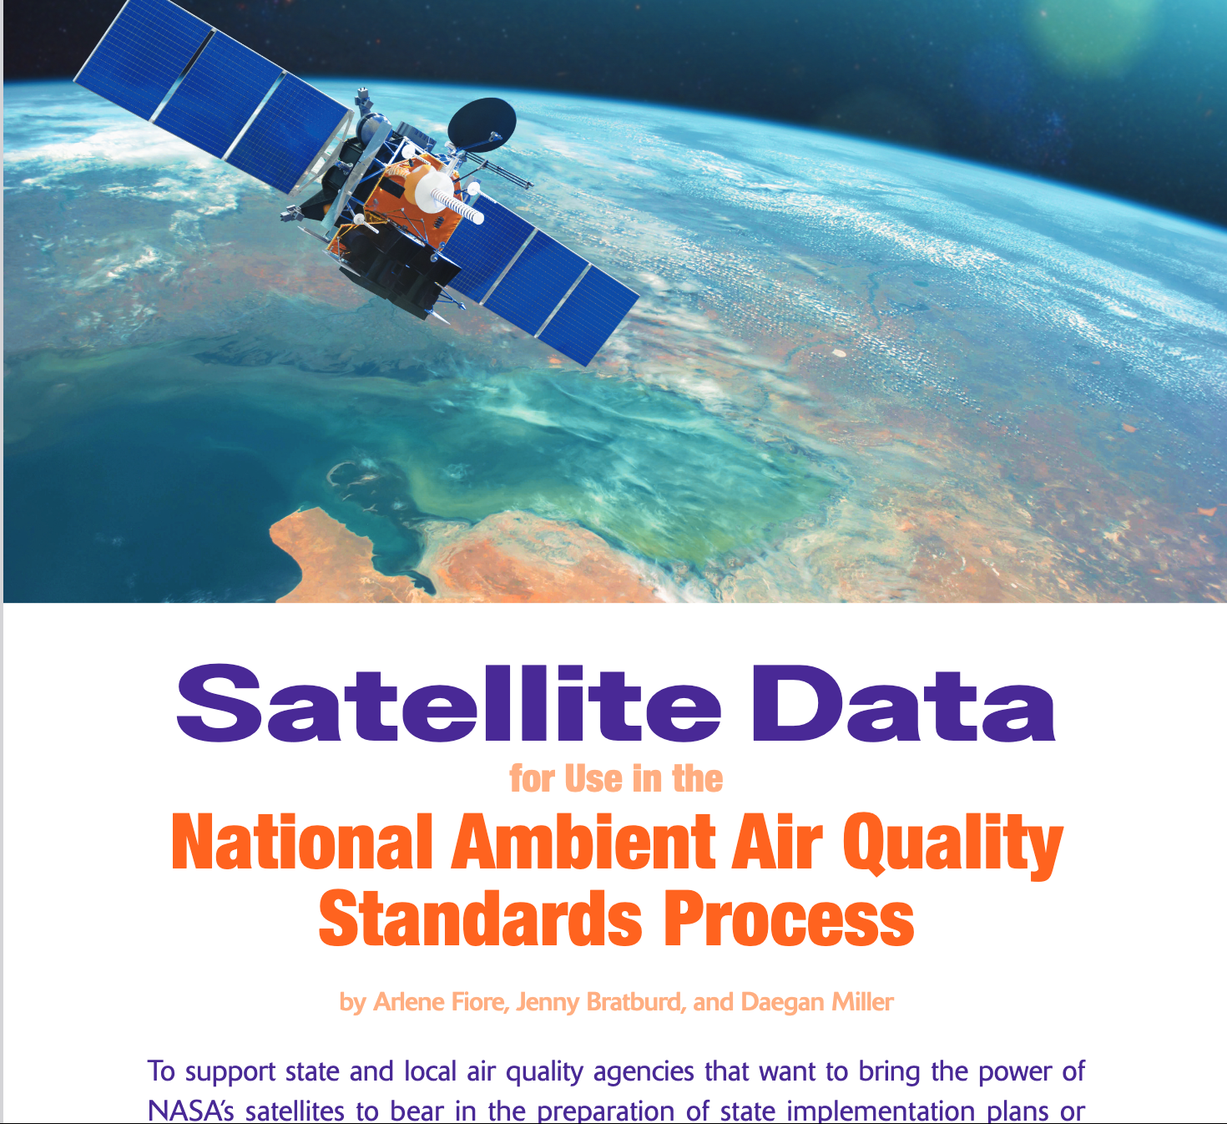
Resources to Support Users
Short Explainers
Satellite Data Flowchart
Training/Tutorials
https://haqast.org/data-and-tools

Slide 12
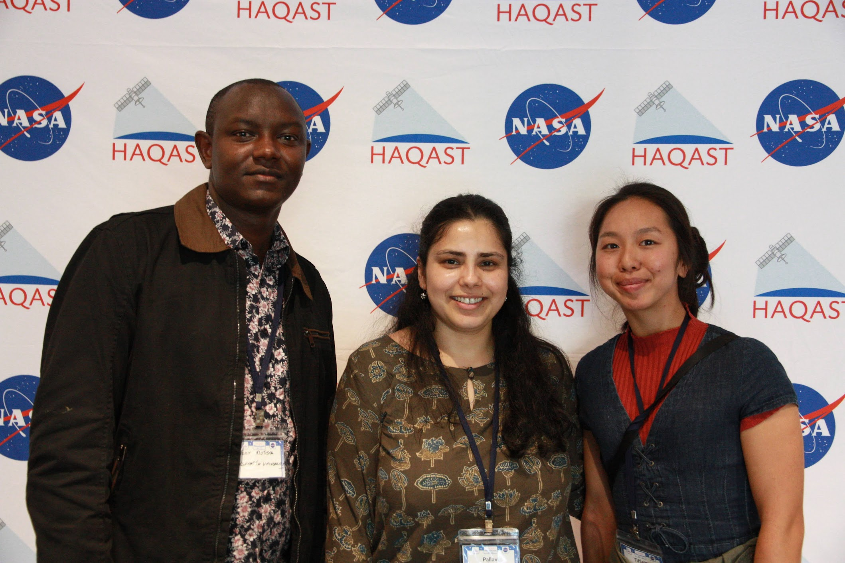
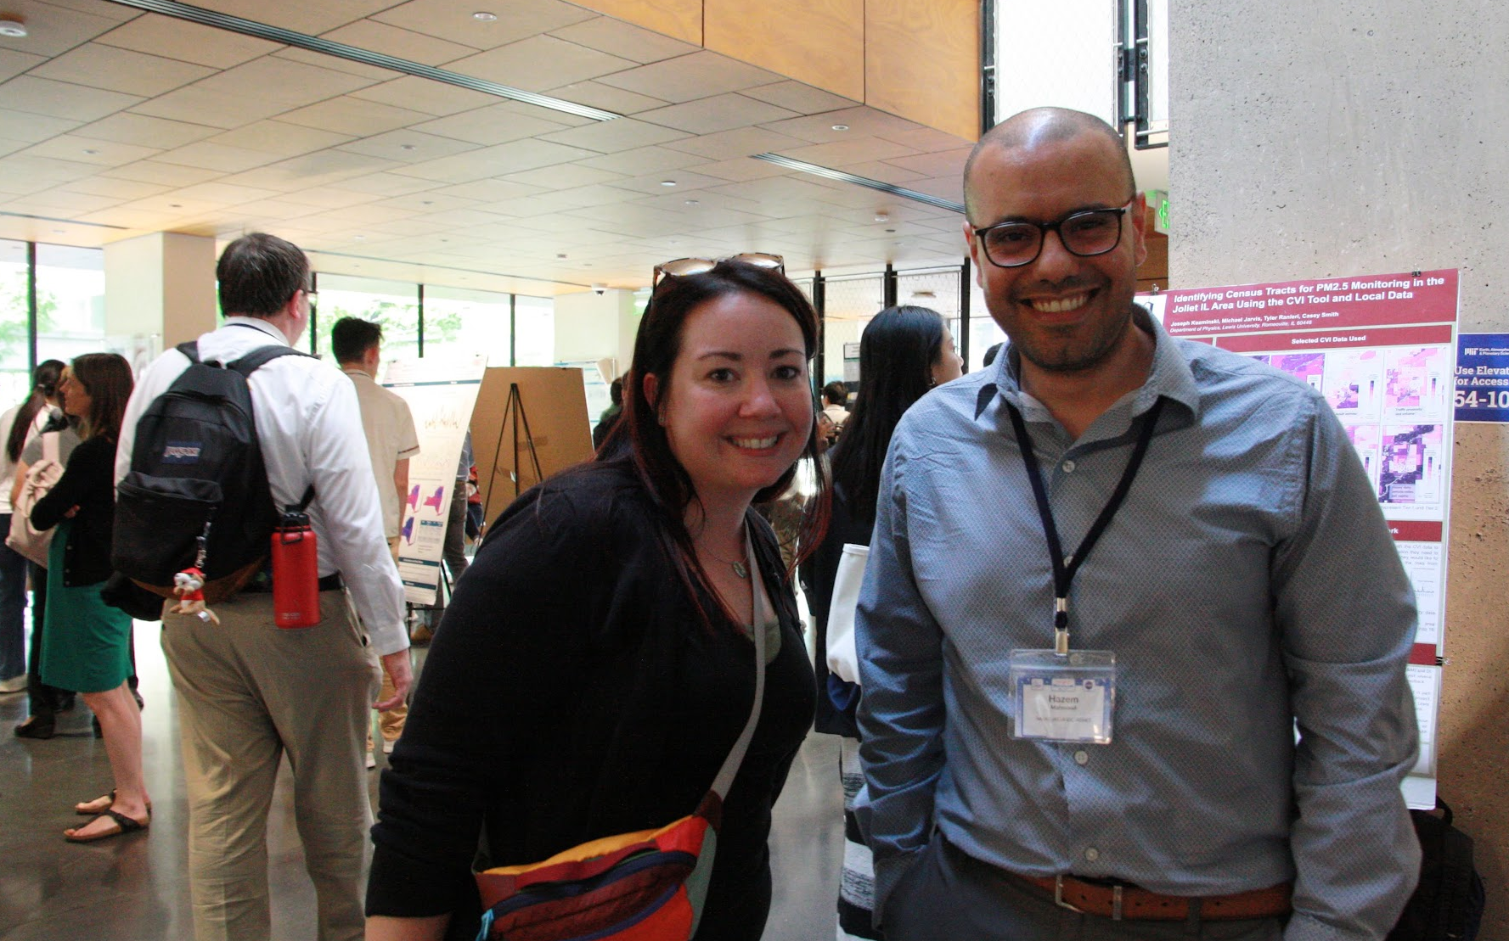
HAQAST Showcase
Public, hybrid meeting
Portfolio of team-wide effort and high-level impacts
January 28, 2025 at NASA HQ, Washington DC

