Slide 1
http://tempo.si.edu/
Use of TEMPO Data in Early Adopter and Earth Science to Action Initiatives
TEMPO-GEMS Joint Science Team Workshop
Kailua-Kona, Hawaii
August 27, 2024
Aaron Naeger
& SPoRT & TEMPO Teams
TEMPO Mission Applications Lead
NASA Marshall Space Flight Center

Slide 2
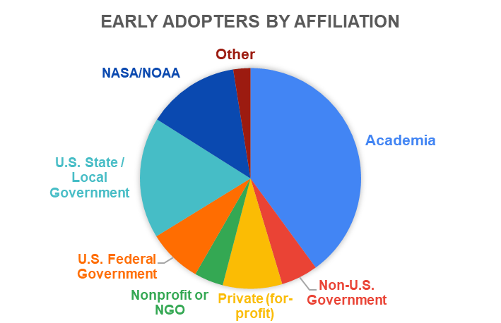
TEMPO Early Adopters to Community of Practice
Objective 1
Engage a broad spectrum of stakeholders & end users to characterize needs and expand use of TEMPO data
Objective 2
Use current sensors and proxy data to demonstrate capabilities and prepare applications of TEMPO data
Objective 3
Align the TEMPO observing time, products, and data interfaces to user needs and applications
Application Focus Areas
Prepare users for operational TEMPO data
Weather Analysis & Forecasting
Air Quality Modeling & Forecasting
Enhance and accelerate applications of TEMPO data
Vegetation & Ocean Monitoring
Air Pollution Emissions & Monitoring
Maximize the value of TEMPO data for societal benefit
Public Health
Air Quality Management
Extend TEMPO mission lifetime
2
2
~ 650 Early Adopters (as of August 2024) from a wide range of organizations and application interests

Slide 3
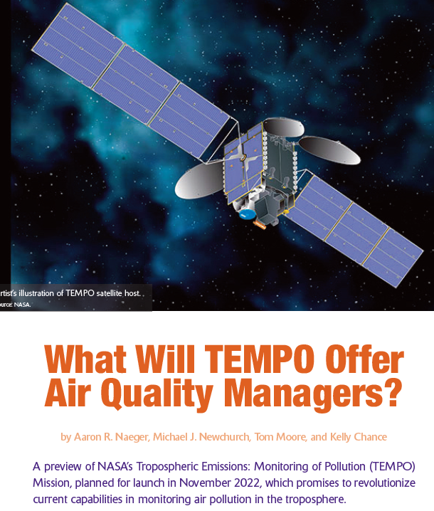
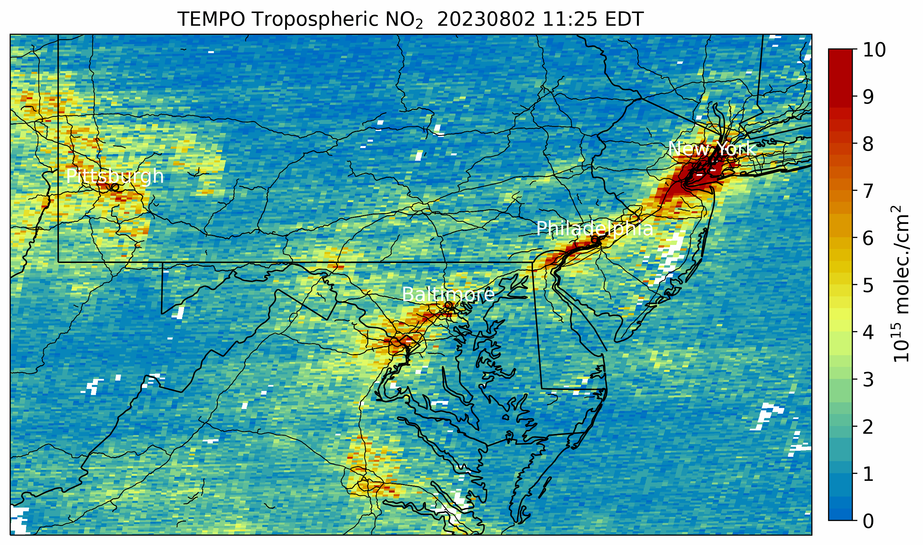
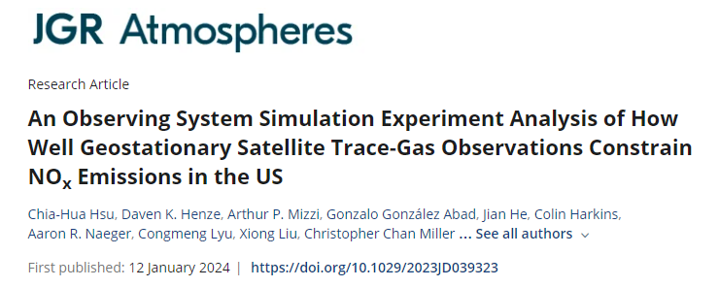
Successes of TEMPO EA Program
Provided realistic pre-launch proxy data and file formats to early adopter community
Enabled early development of architectures to ingest operational TEMPO data after launch
Active engagement activities expanded knowledge and understanding of TEMPO data and applications
Characterized EA needs for TEMPO products, data services and tools, and near real-time data
Coal Plants
I-95
Fire
3
3

Slide 4
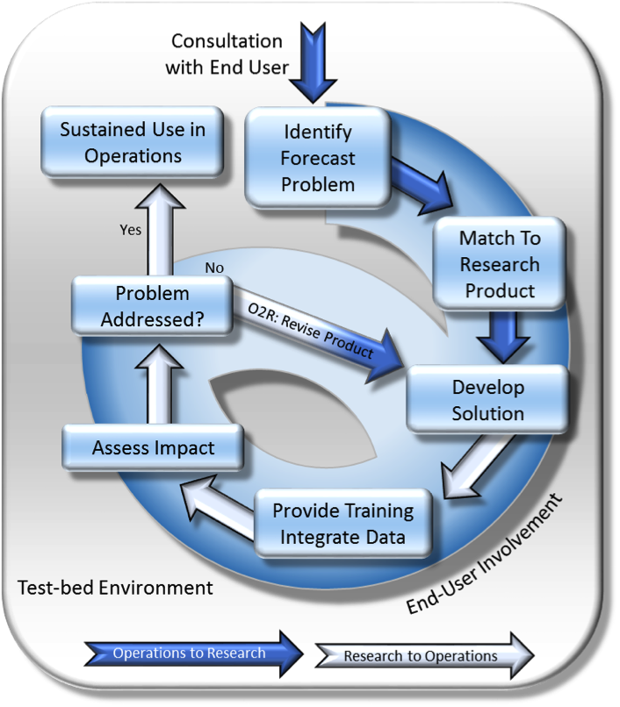
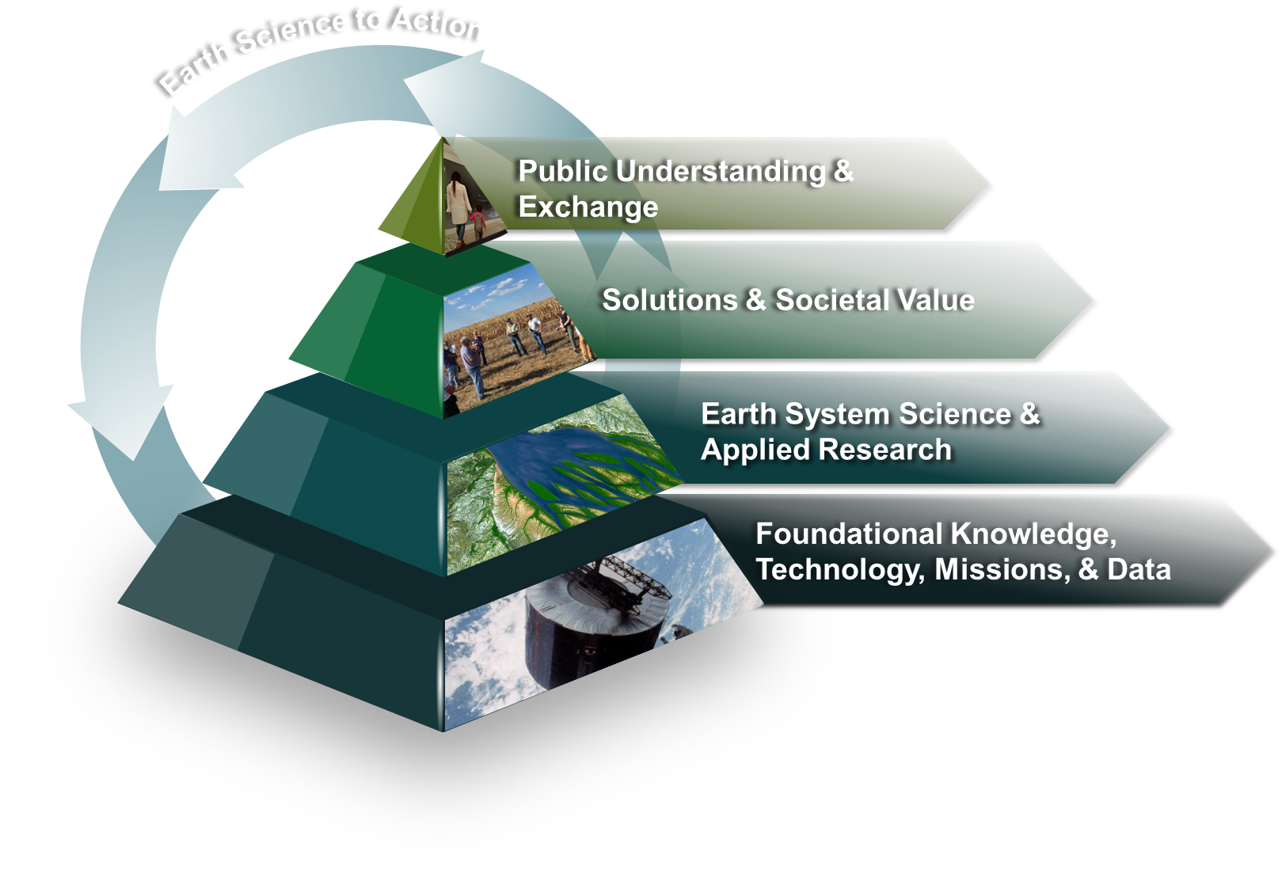
NASA SPoRT Paradigm for TEMPO
SPoRT’s R2A/A2R paradigm is a proven mechanism to accelerate the translation of science to stakeholders and enable Earth Action
Keys to Success:
Collaborative interaction with end users to match challenges, needs, decision making to NASA data
Integrate observations into end user decision support tools and formats
Applications-focused training
End user assessment and applications-to-research feedback
Designing and developing products and capabilities with the user involved in the process leads to sustained use of products, capabilities, and tools
SPoRT has expertise in bridging communities to develop and transition solutions that have enabled Earth Action over the last 20 years
4
4

Slide 5
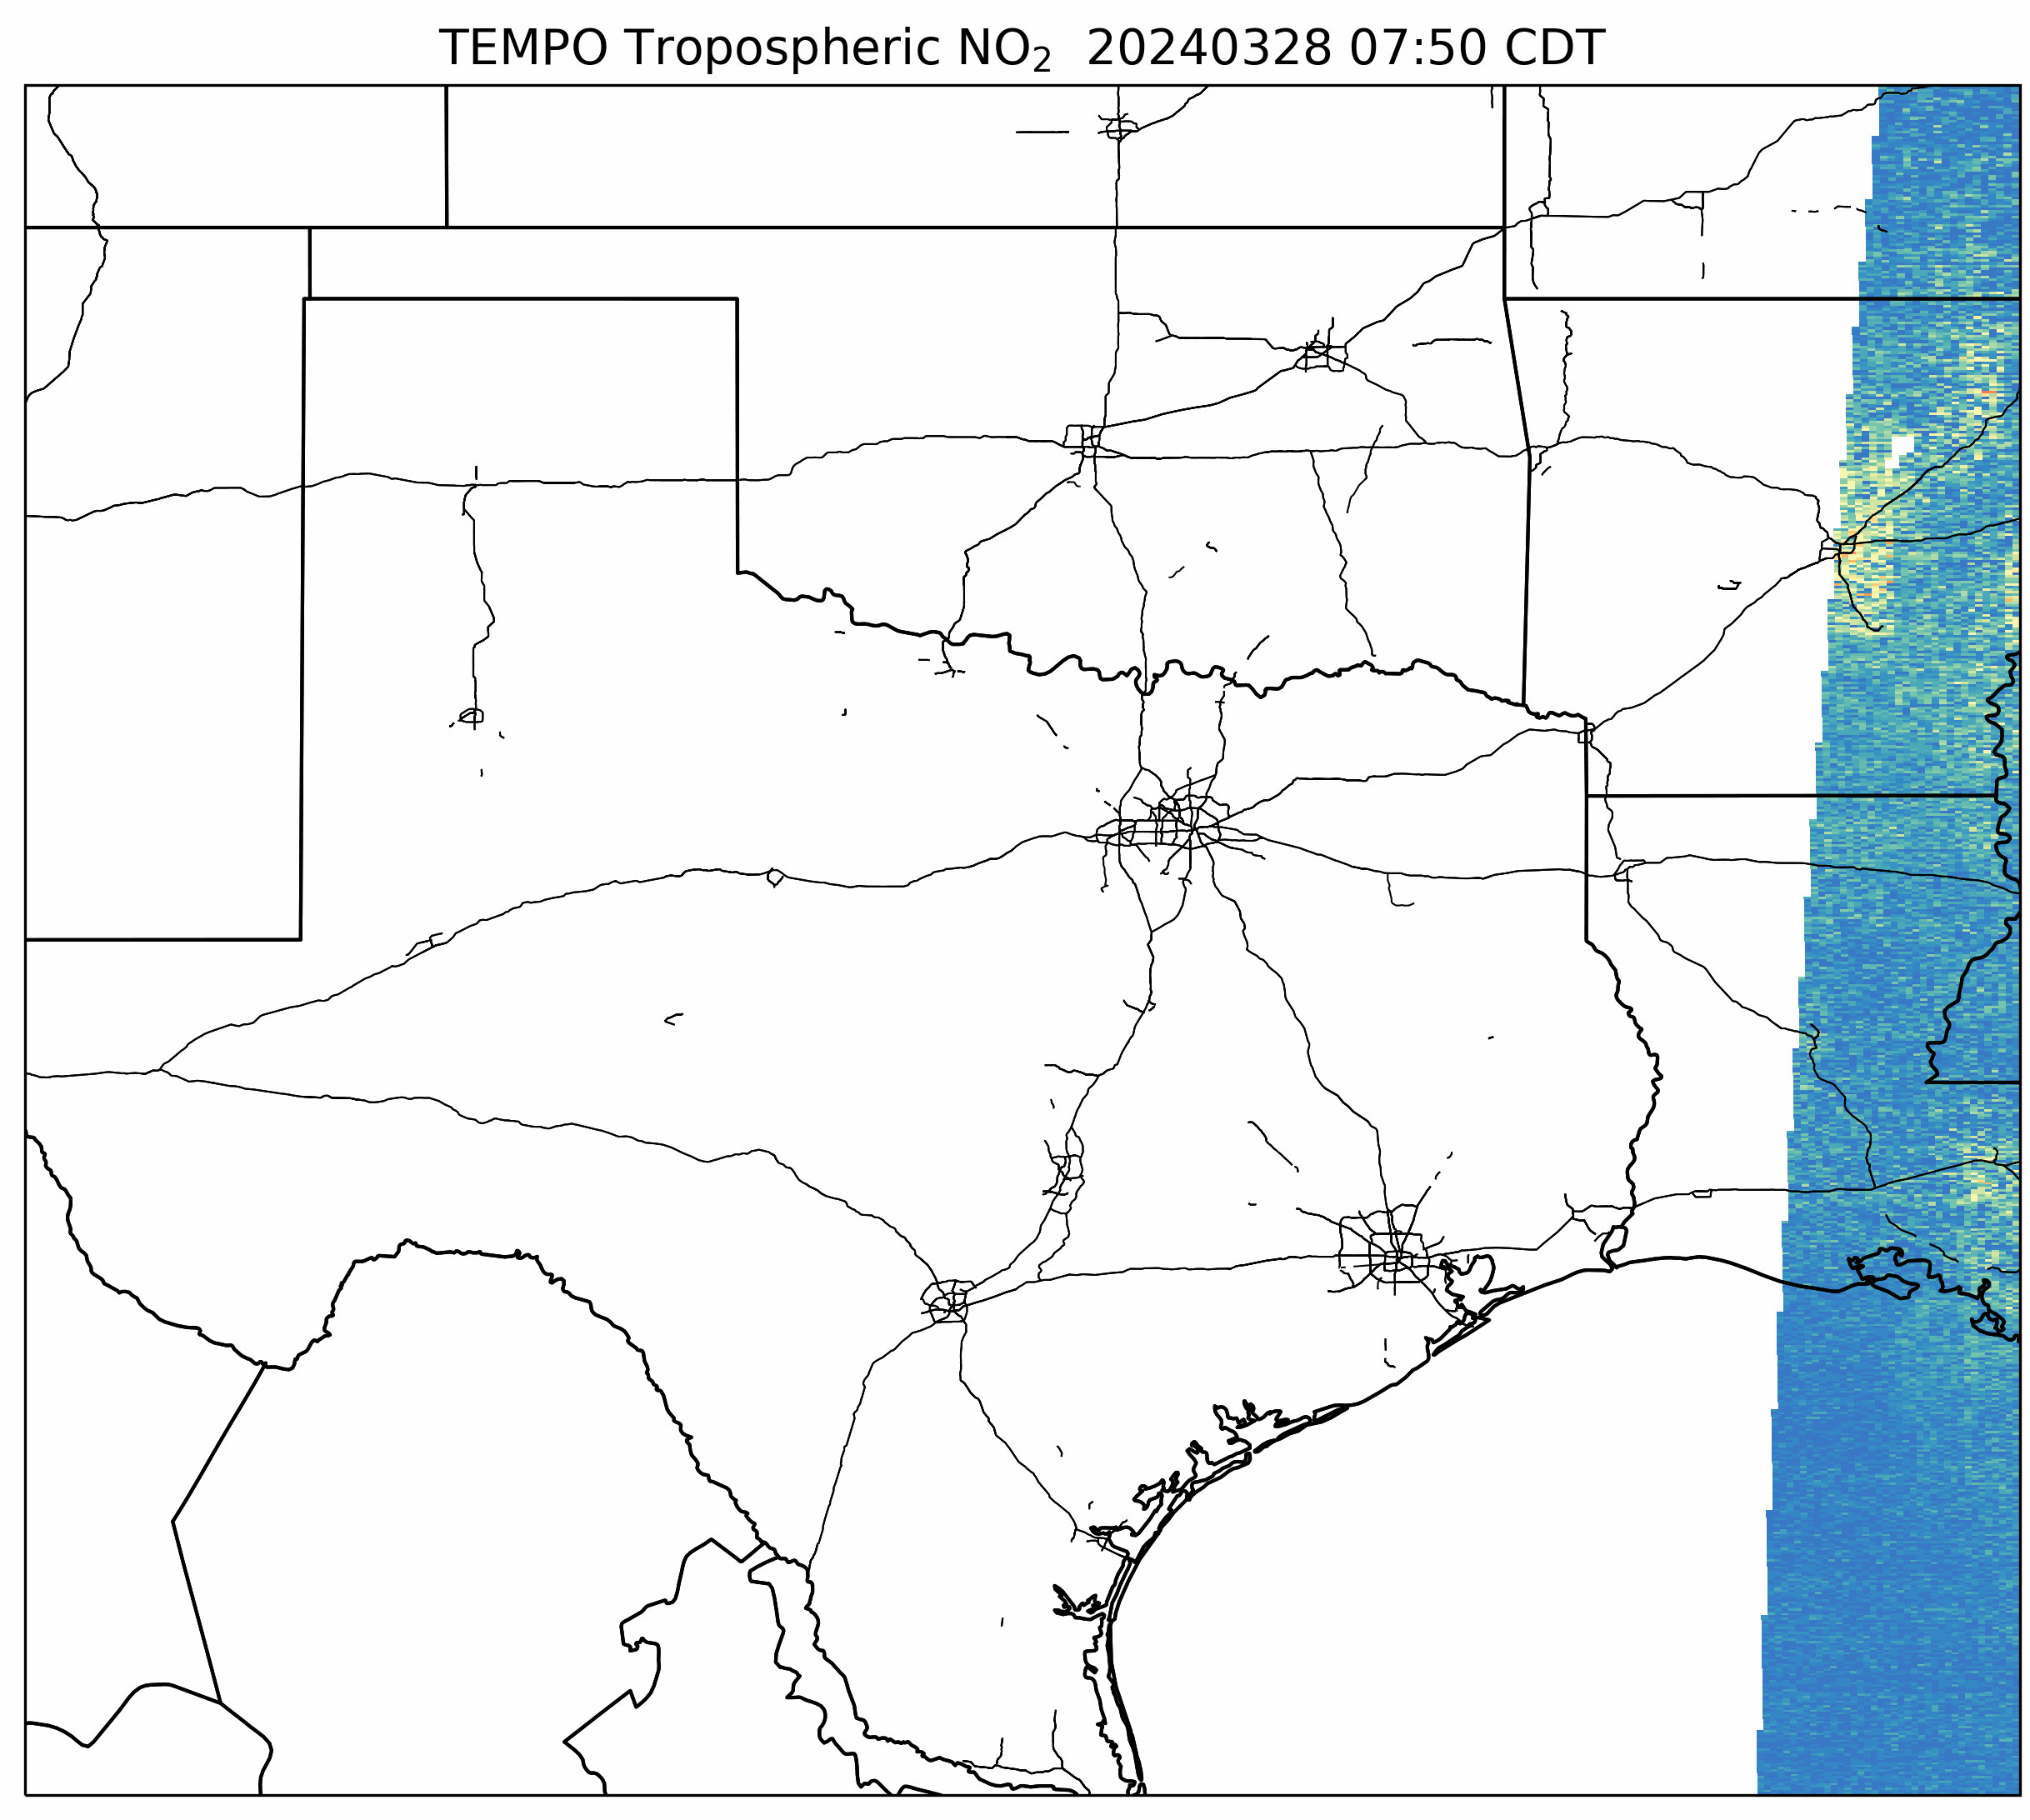
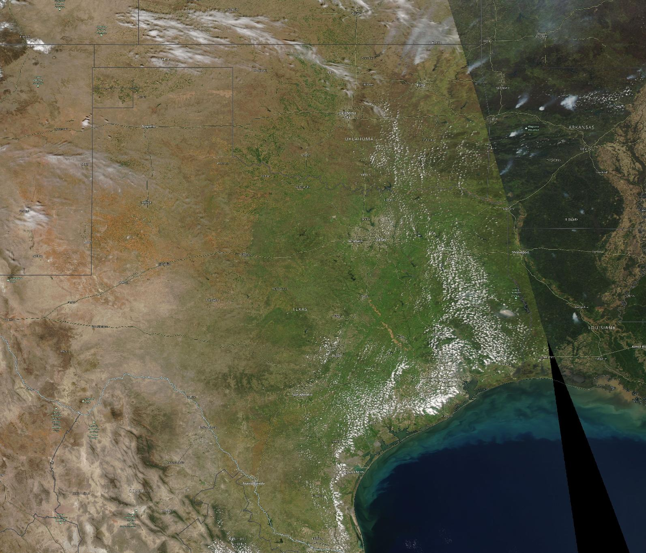
March 28, 2024 – South U.S. Zoom
A mostly clear day across South U.S. with prescribed burning during the afternoon
TEMPO captured high NO₂ levels across cities, traffic corridors, power plants, oil and gas fields, and prescribed burns
5
5

Slide 6
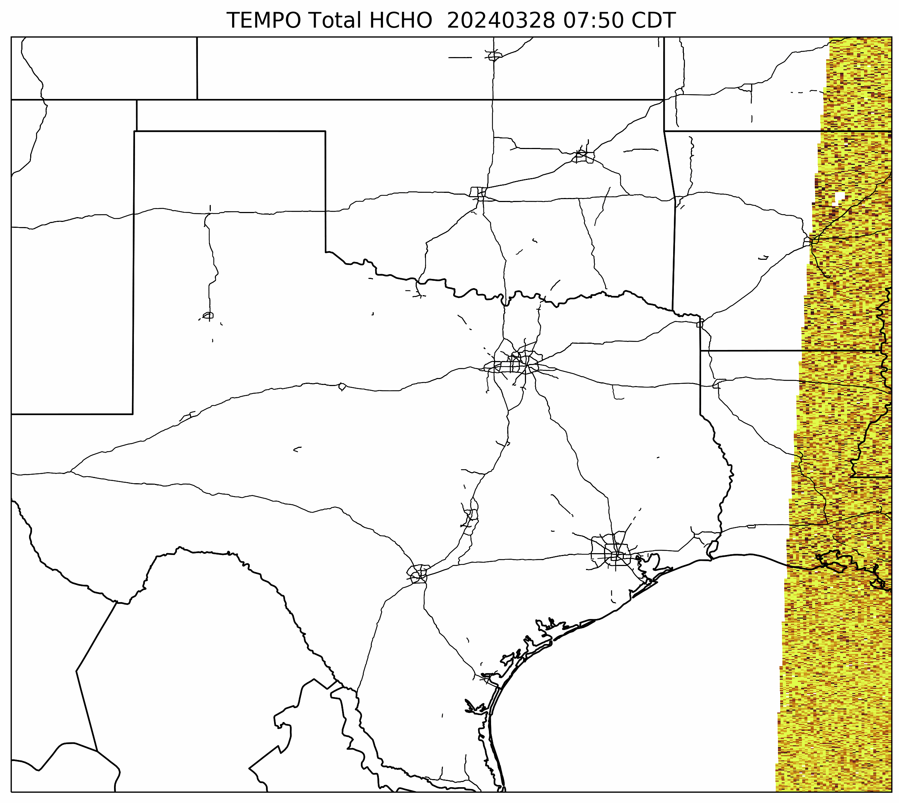
March 28, 2024 – South U.S. Zoom
High HCHO levels across Houston and prescribed burns
Possible secondary formation of formaldehyde downwind of Permian basin
6
6

Slide 7
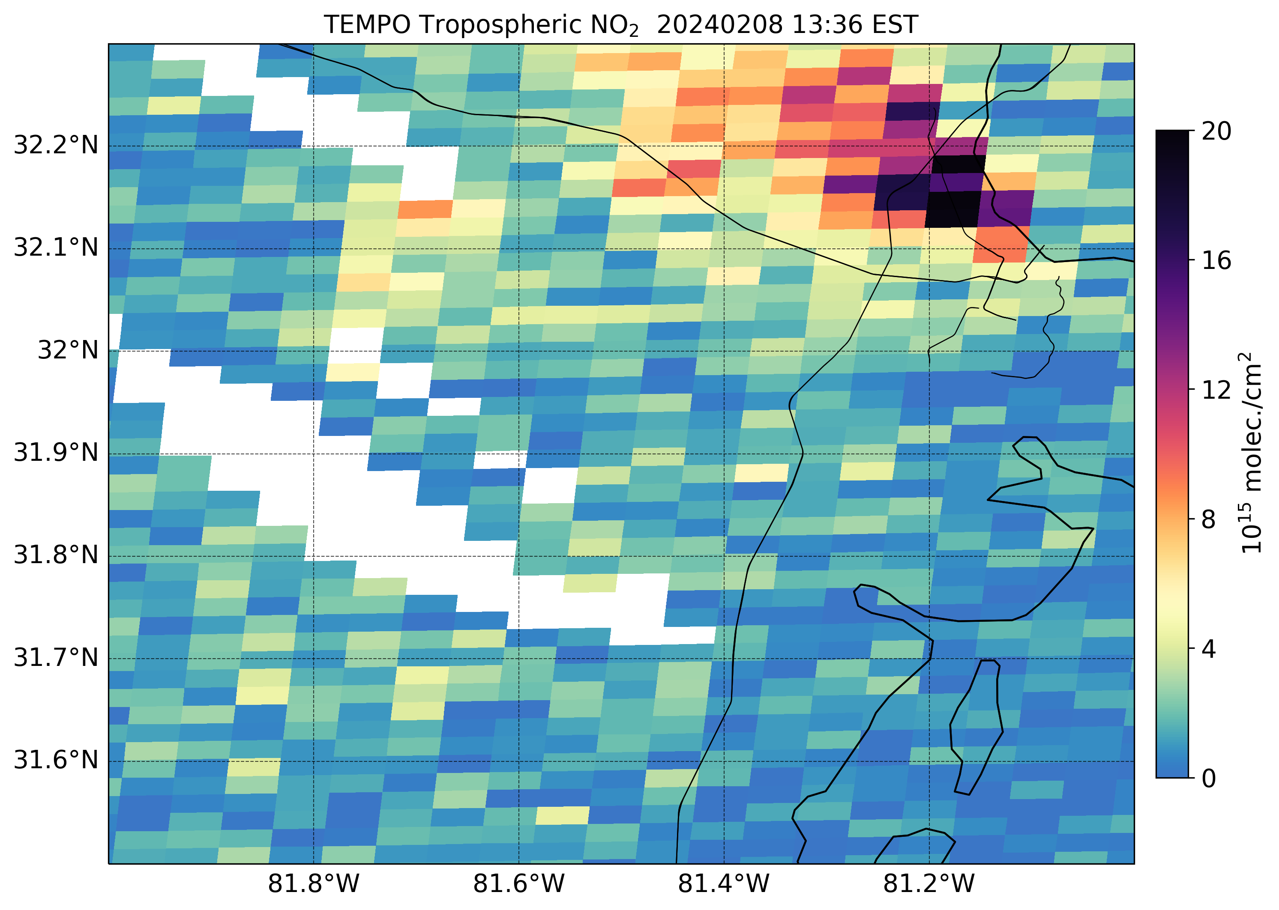
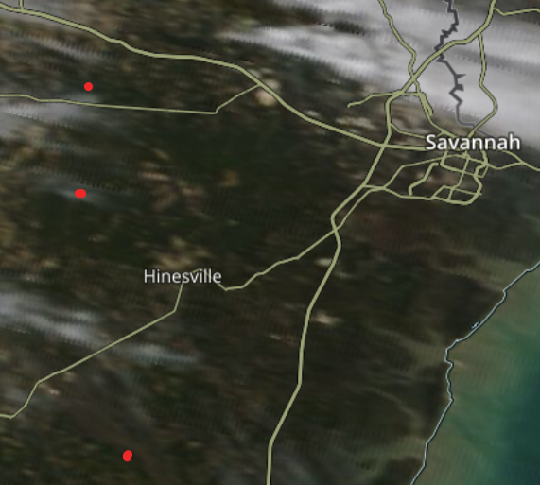
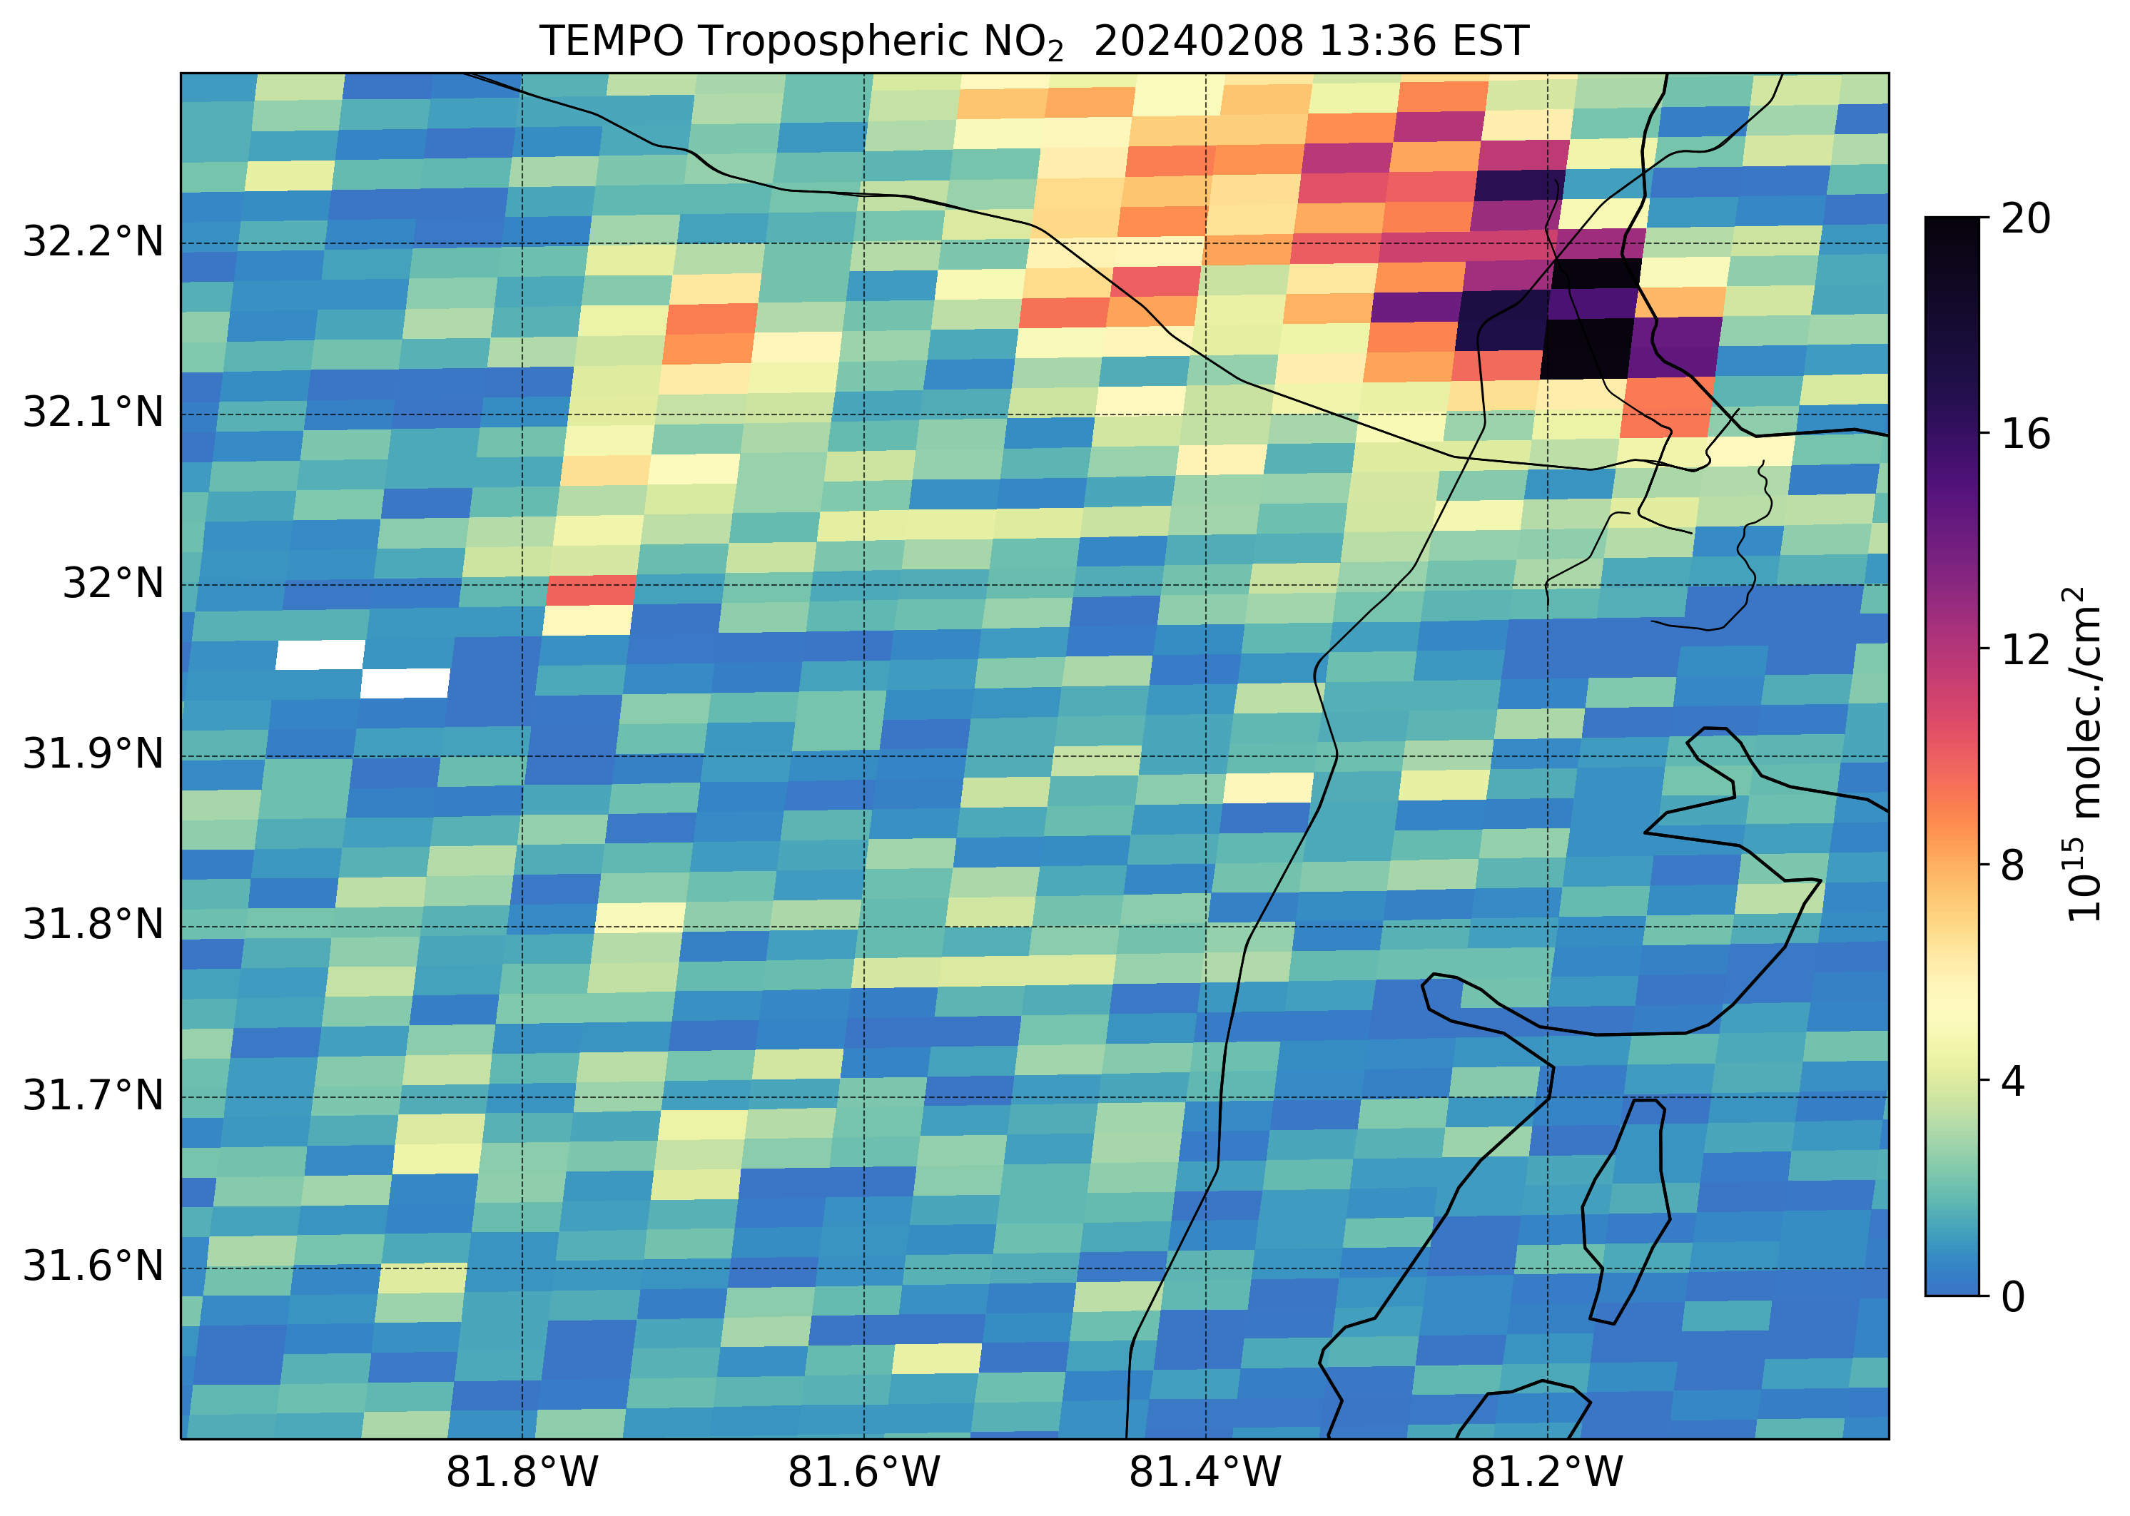
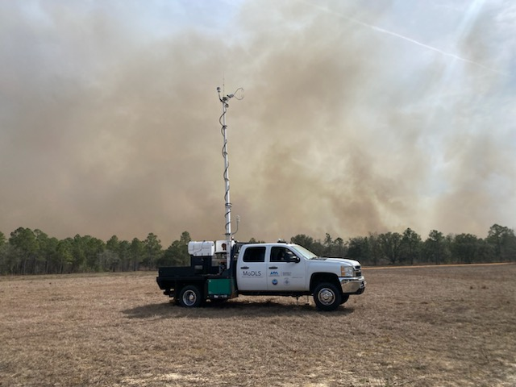
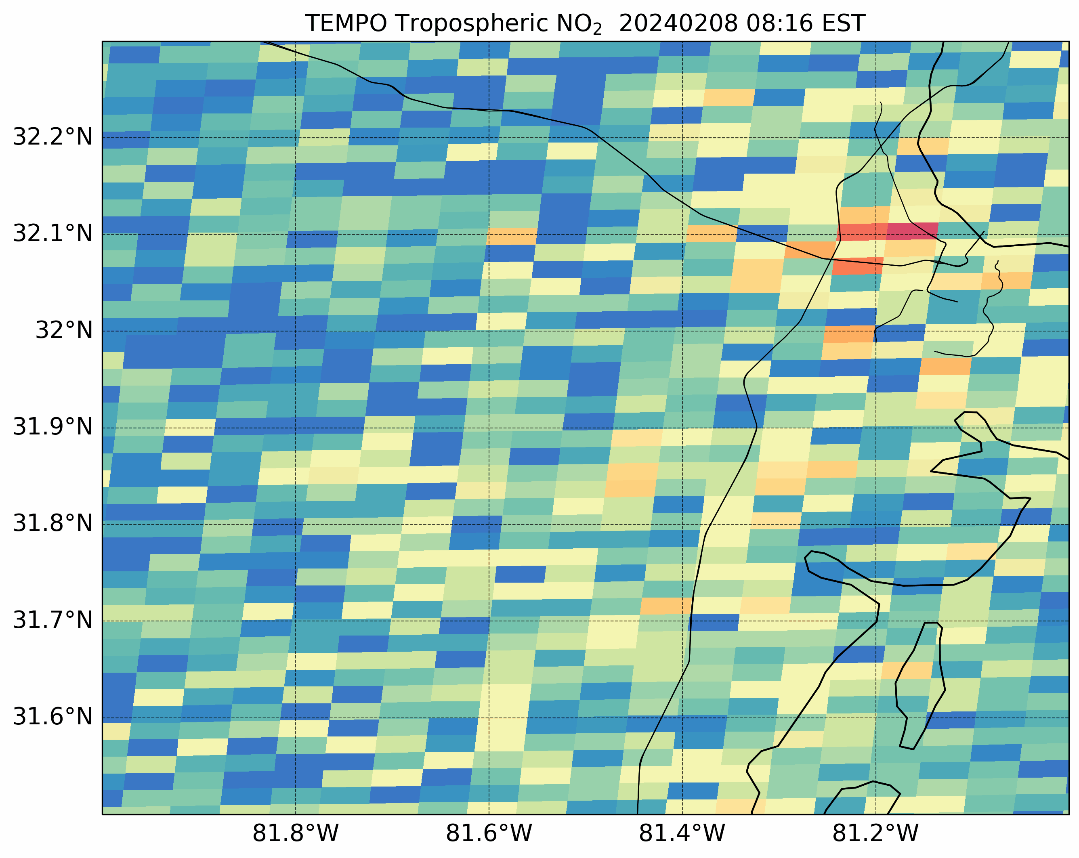
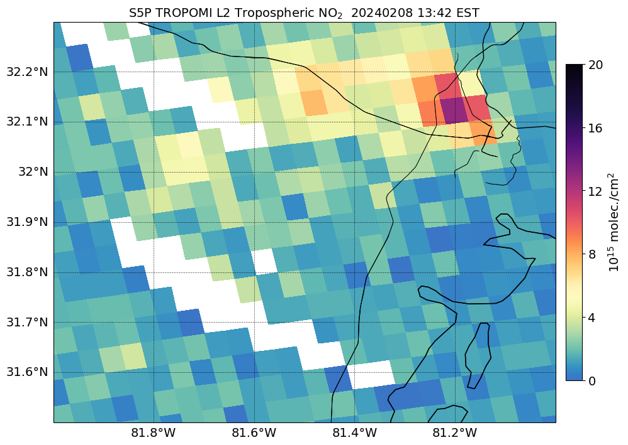
Fort Stewart Prescribed Burn
Photo Credit: Ryan Wade (UAH)
MODIS Terra
Worldview
Cloud Fraction > 20%
MSFC & UAH coordinated with Forest Service and others on a prescribed burn study in Fort Stewart, GA.
TEMPO observed strong NO₂ hot sport from the prescribed burn on Feb 8 which were not well captured by TROPOMI
7
7

Slide 8
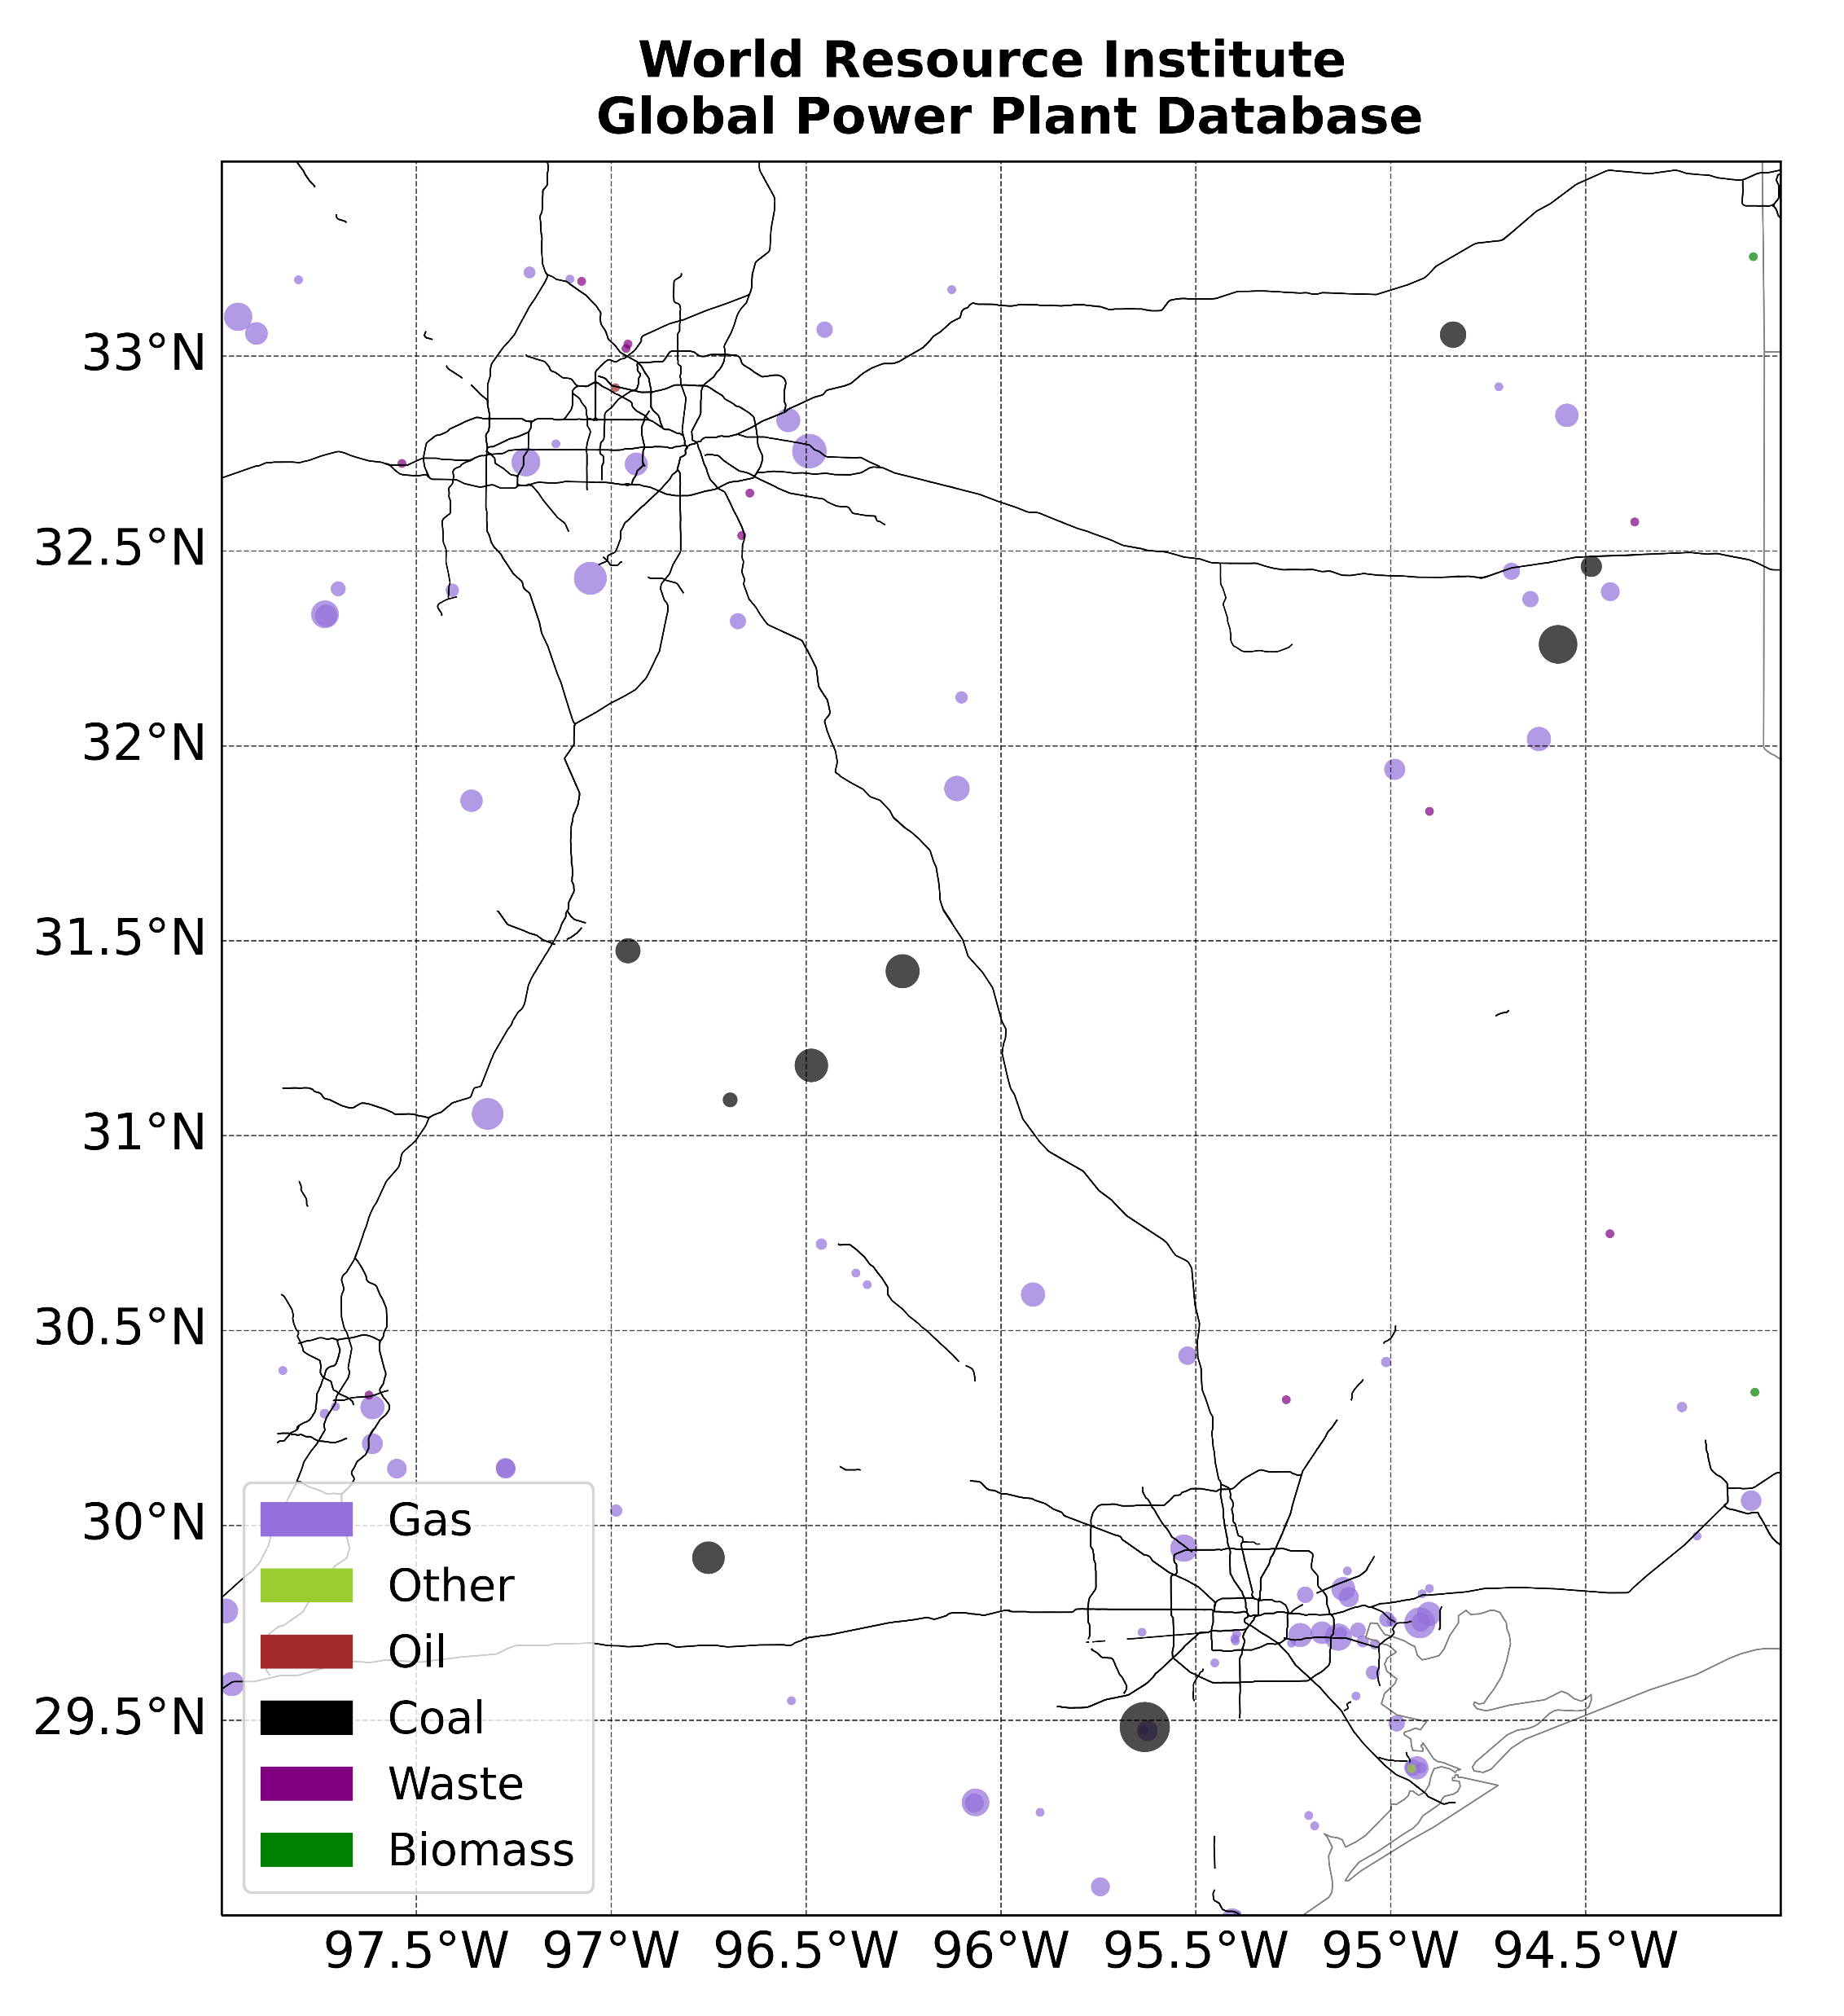
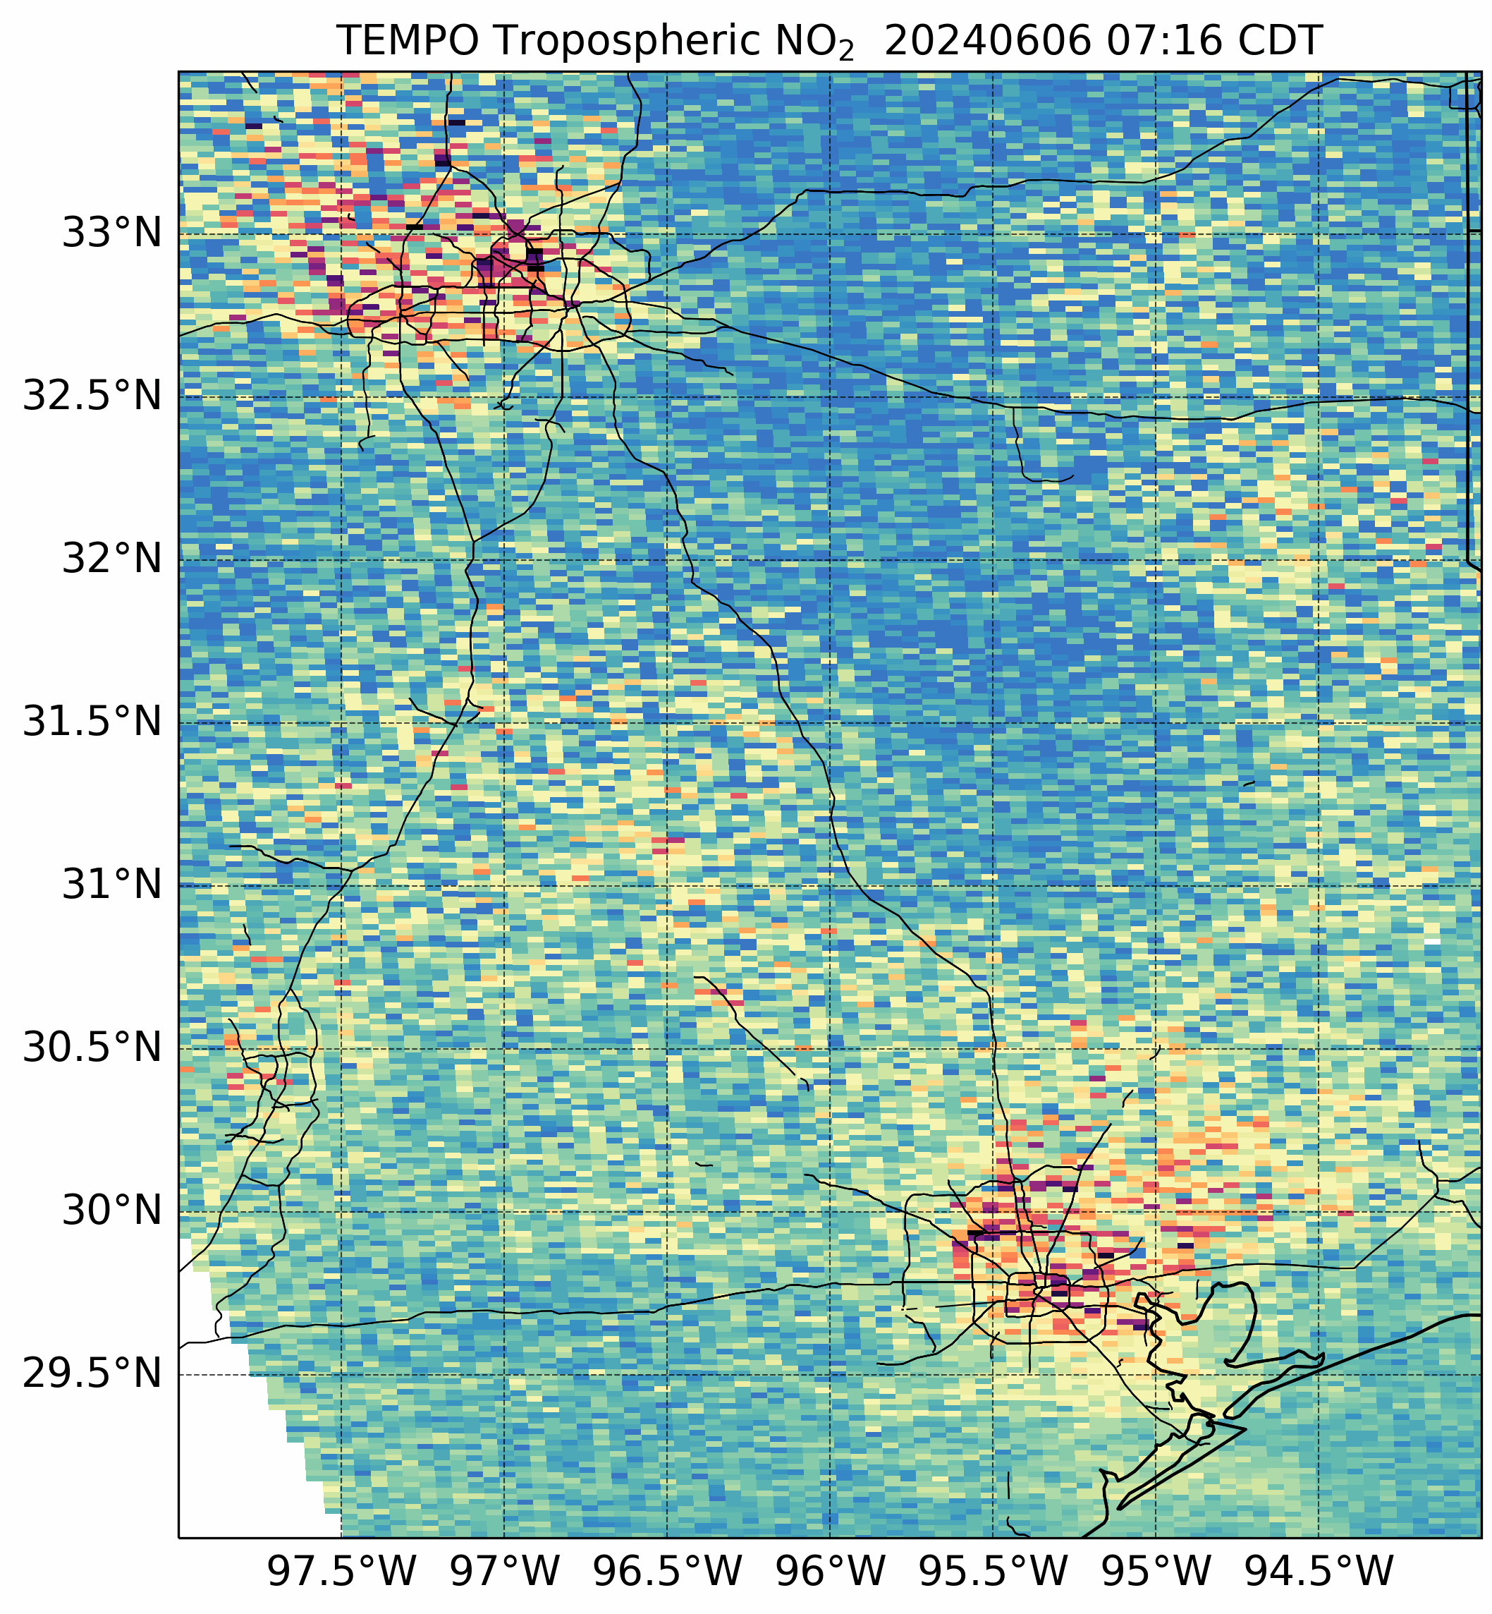
June 6, 2024 – East Texas Zoom
TEMPO captures NO₂ hot spots in the vicinity of coal- and gas-fired power plants

Slide 9
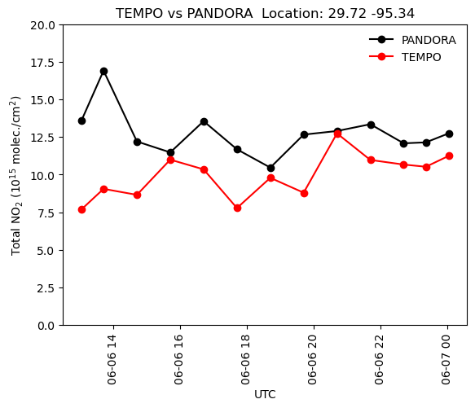
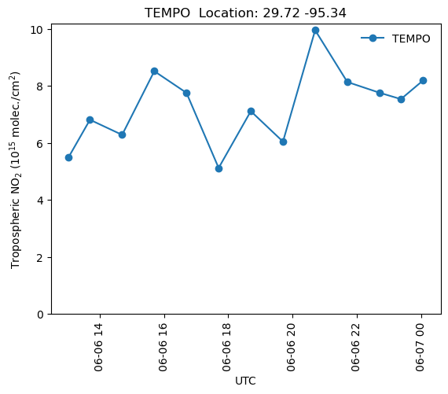
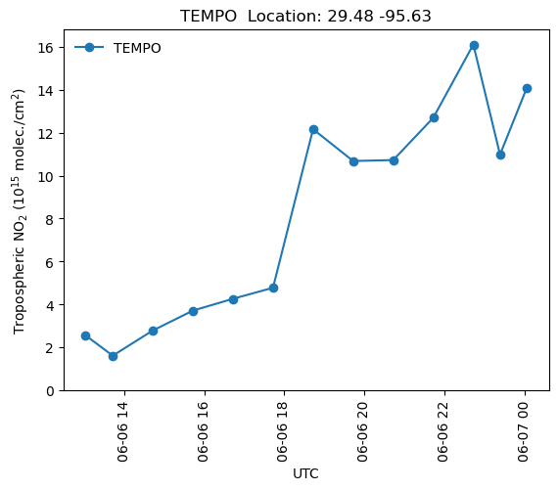
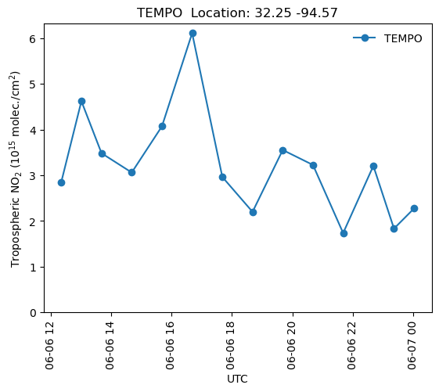
June 6, 2024 – NO₂ Time Series
Houston
Houston
Power Plant
Power Plant
TEMPO observes strongly evolving NO₂ trends in the vicinity of coal-fired power plants

Slide 10
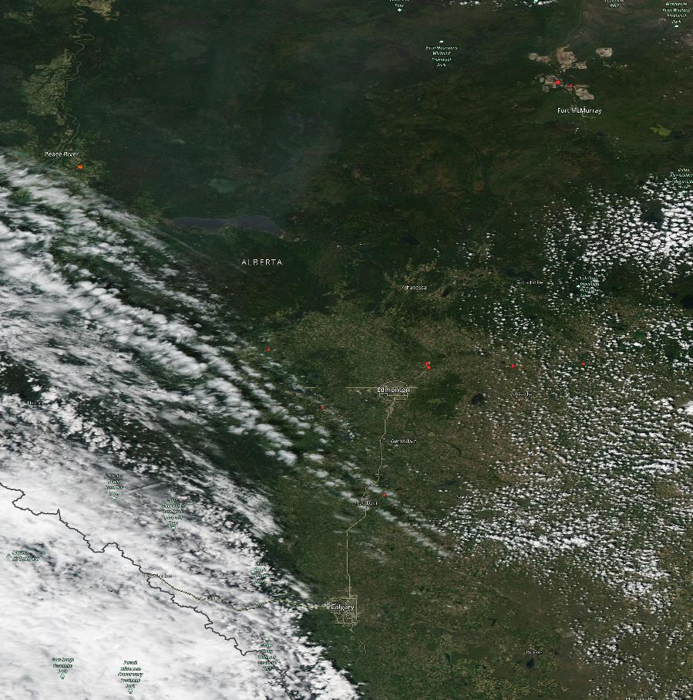
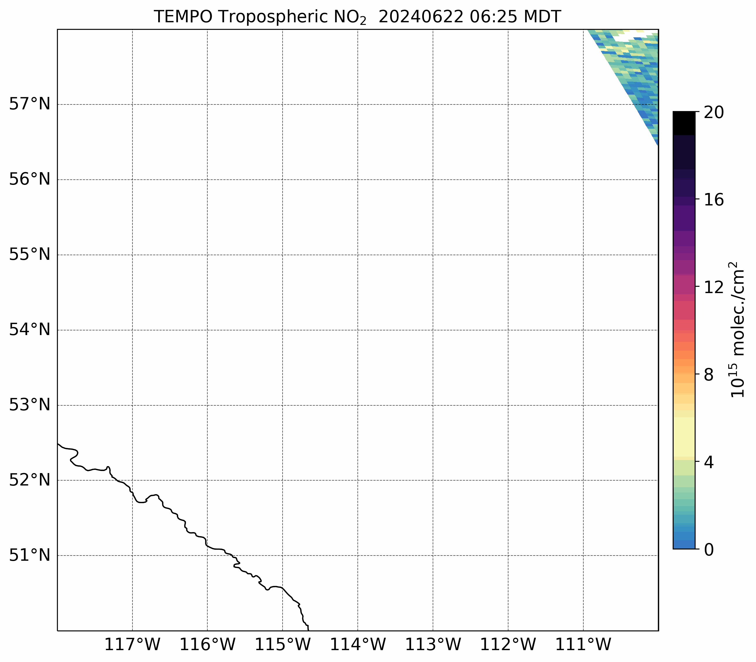
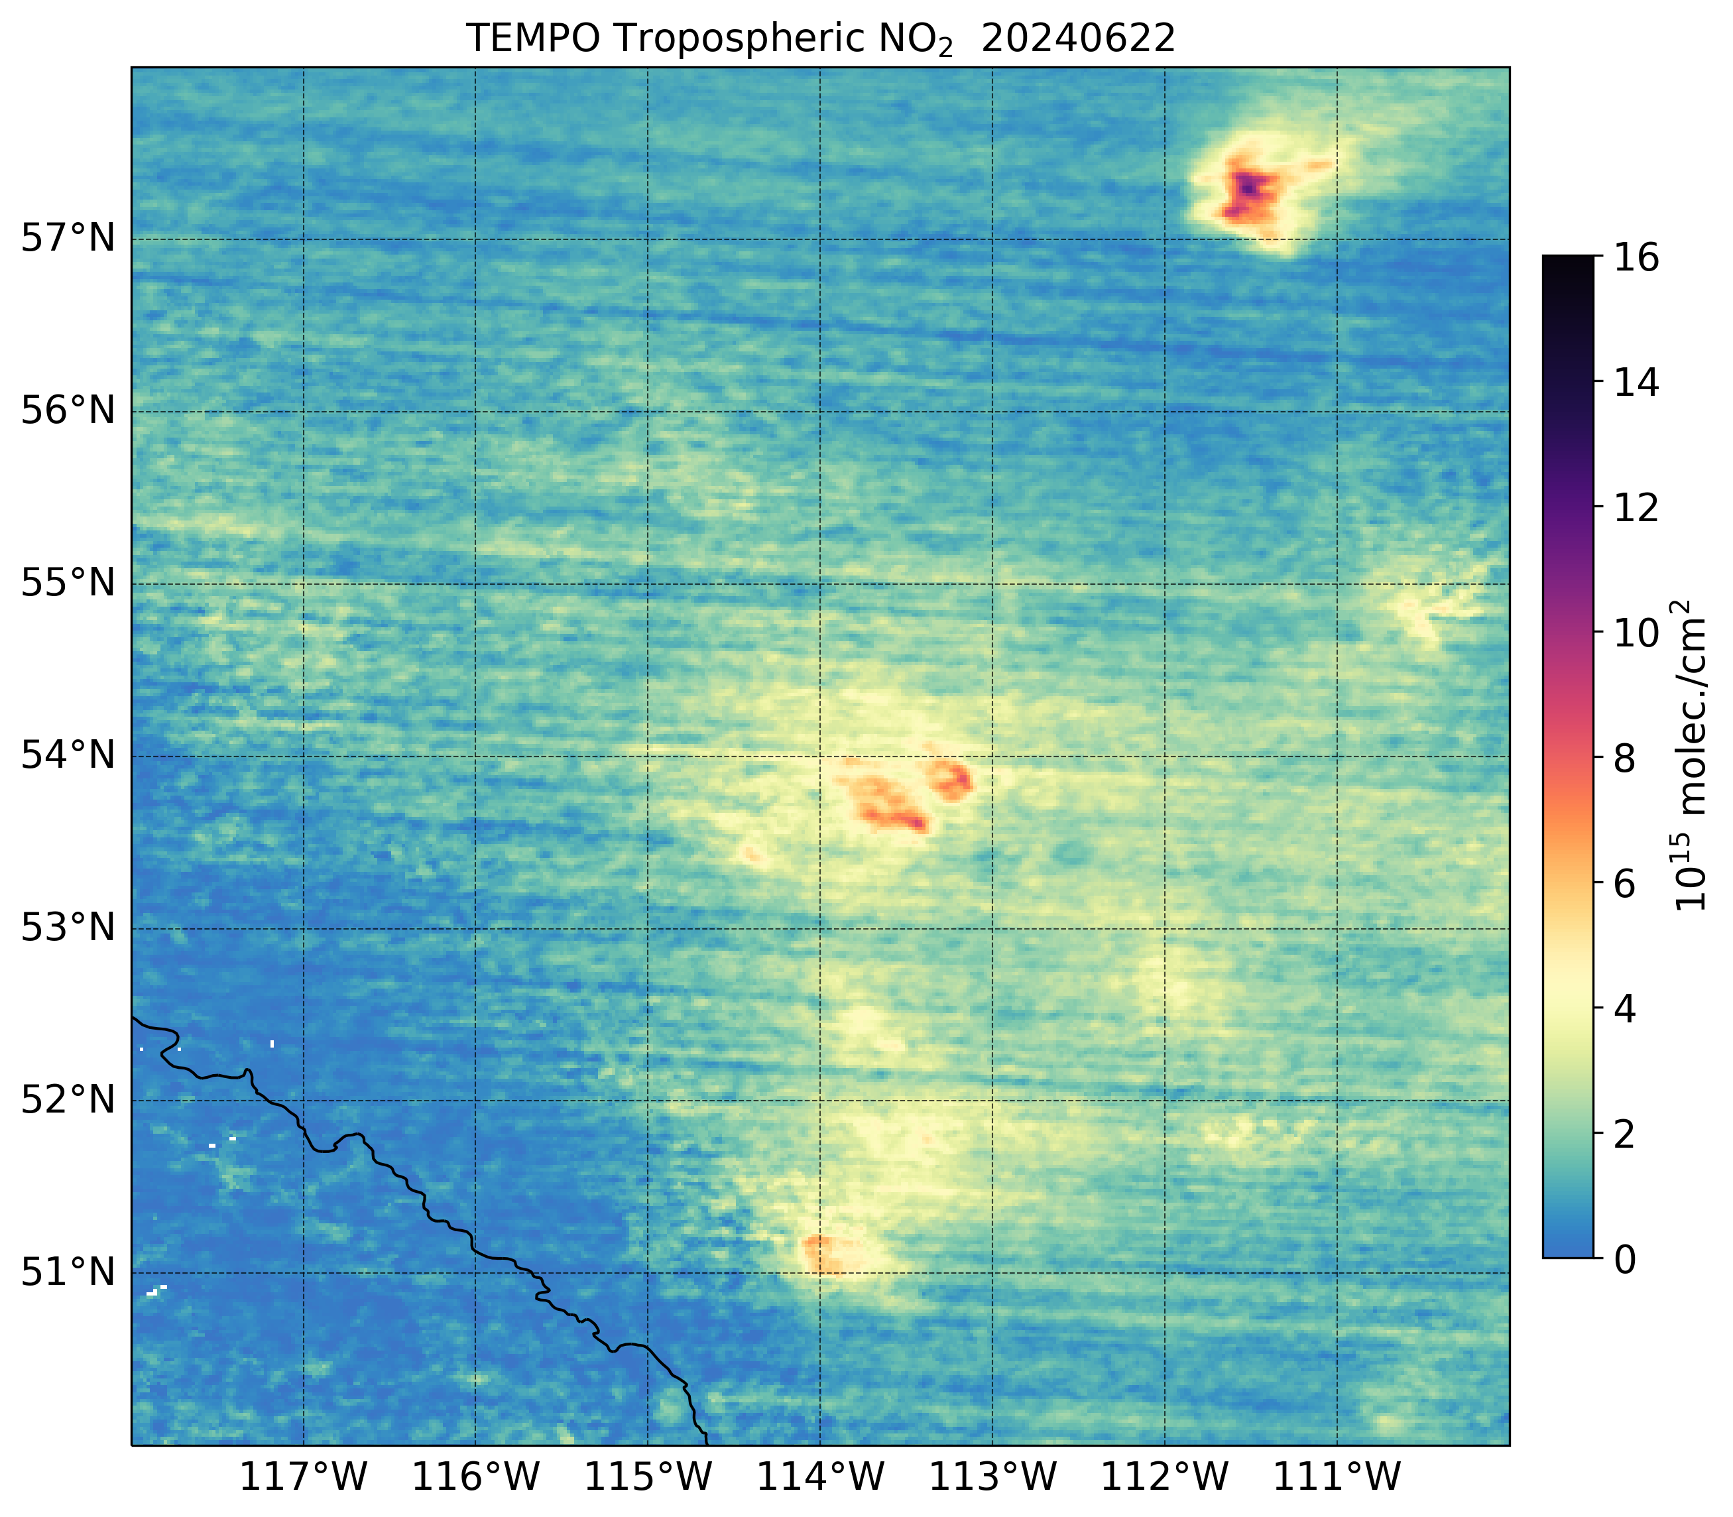
June 22, 2024 – Alberta Zoom
Aqua MODIS
Level 2 NO₂
Edmonton
Level 3+ NO₂
Calgary
Strong NO₂ plumes from Calgary and Edmonton
Large NO₂ hot spot north of Fort McMurray in location of active mining operations
NO₂ hot spot in the Cold Lake Oil Sands

Slide 11
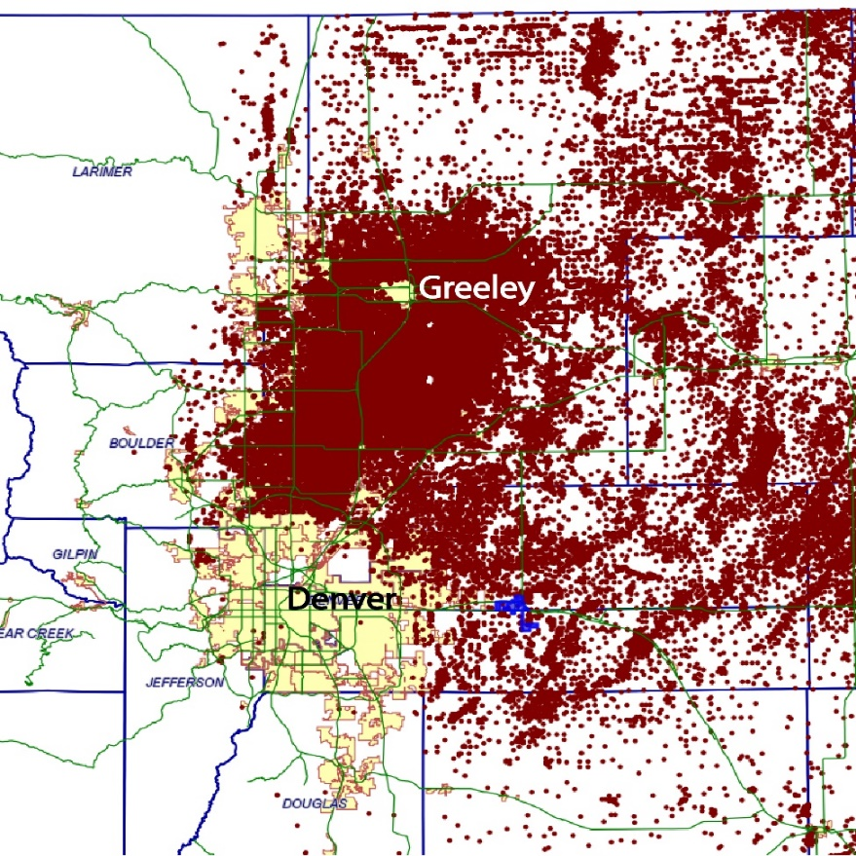
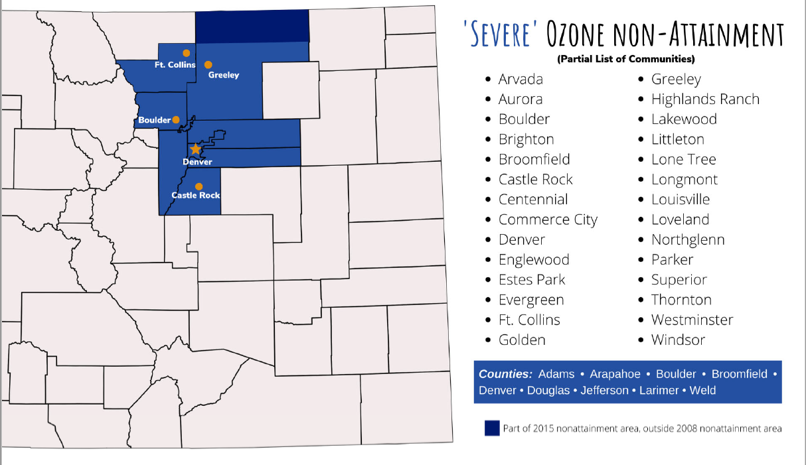
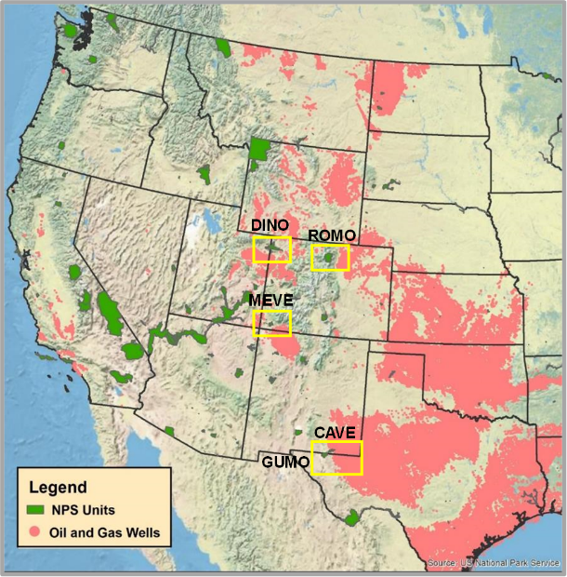
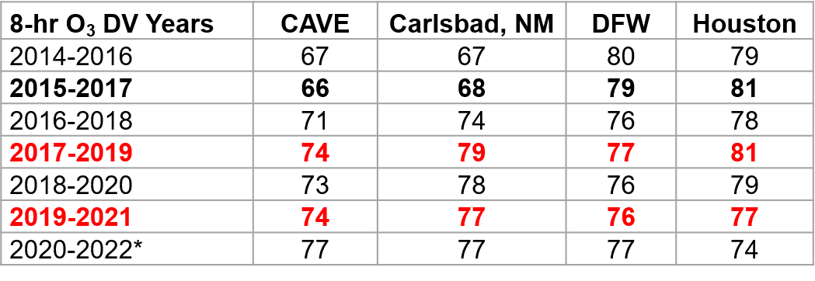
TEMPO Data for Policy-Relevant Applications
Focus Areas:
Colorado Front Range – Large number of oil and gas wells contribute to the O₃ nonattainment designation since 2008
National Park Service Units – Emissions from oil & gas activities have been contributing to degraded air quality across National Parks
California – O₃ nonattainment areas persist across much of the state
Goal: Use TEMPO data for better characterizing emissions and O₃ precursors and O₃ production in exceptional event demonstrations
Oil & gas wells (red dots)
Location of NPS units (left) and O₃ design values at NPS units and Dallas and Houston (above)
11
11

Slide 12
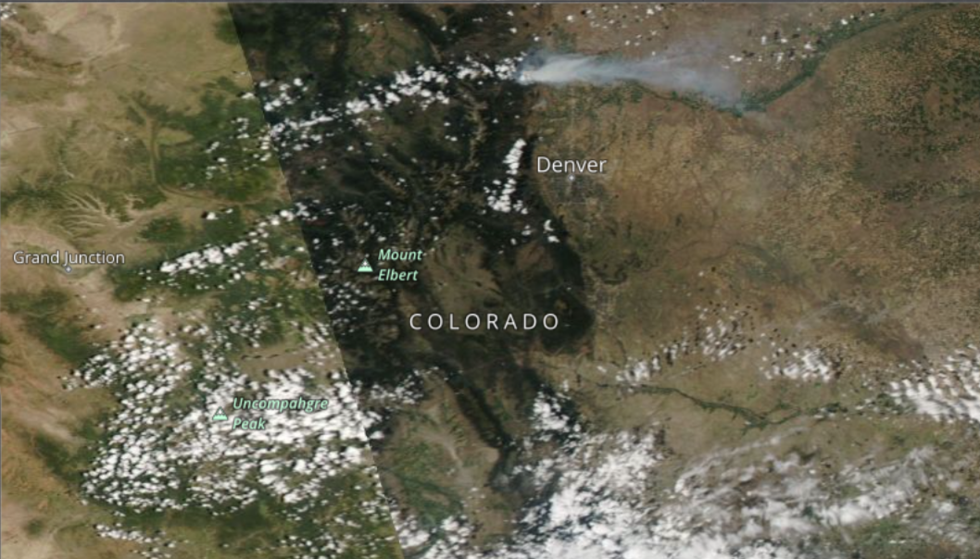
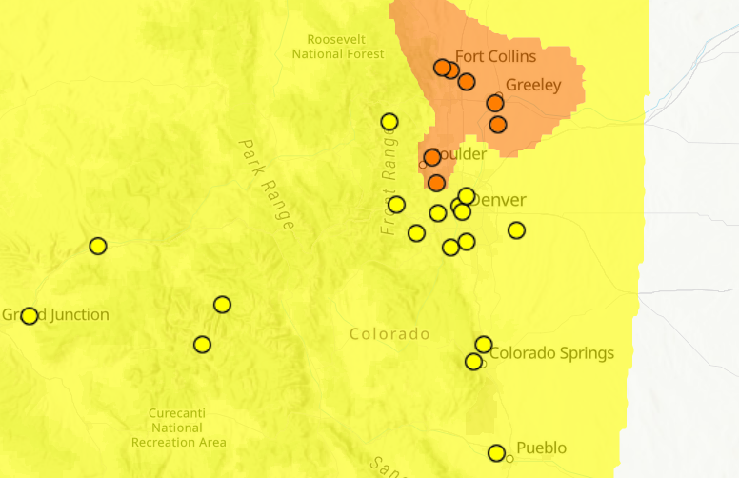
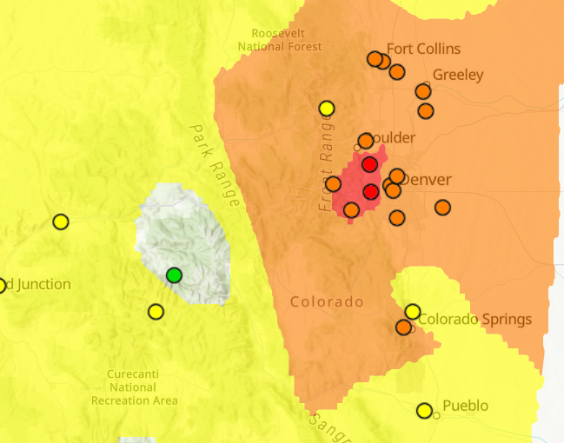
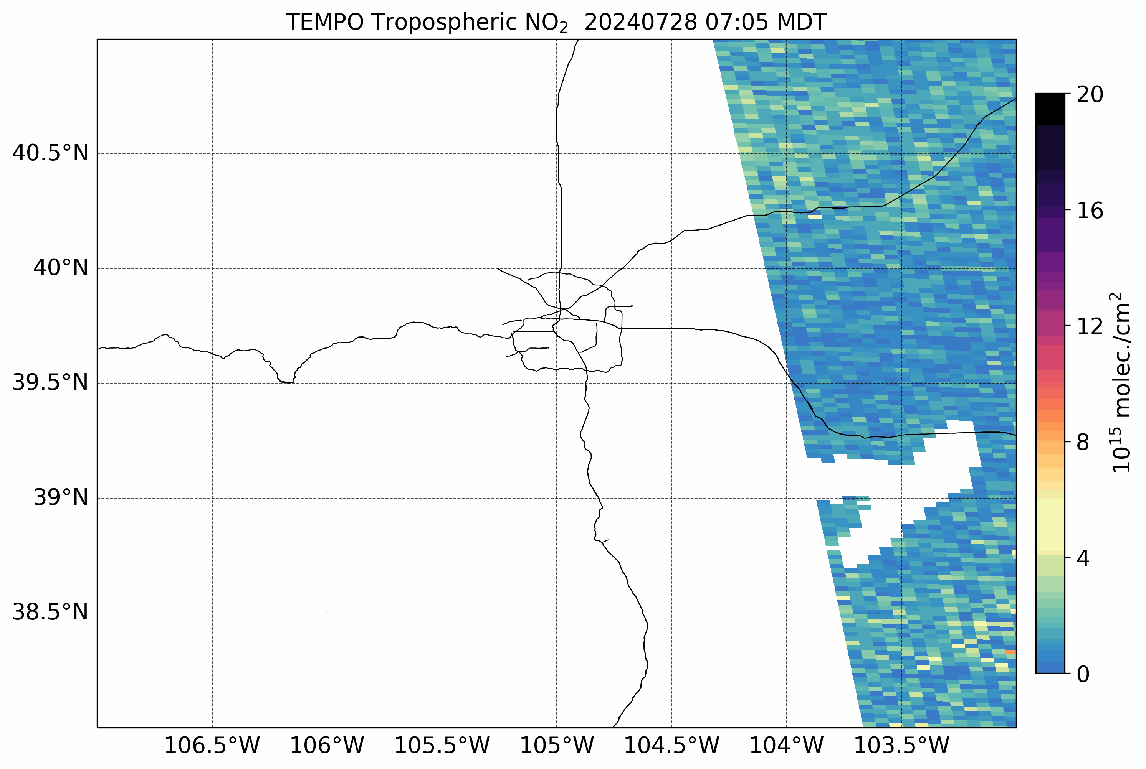
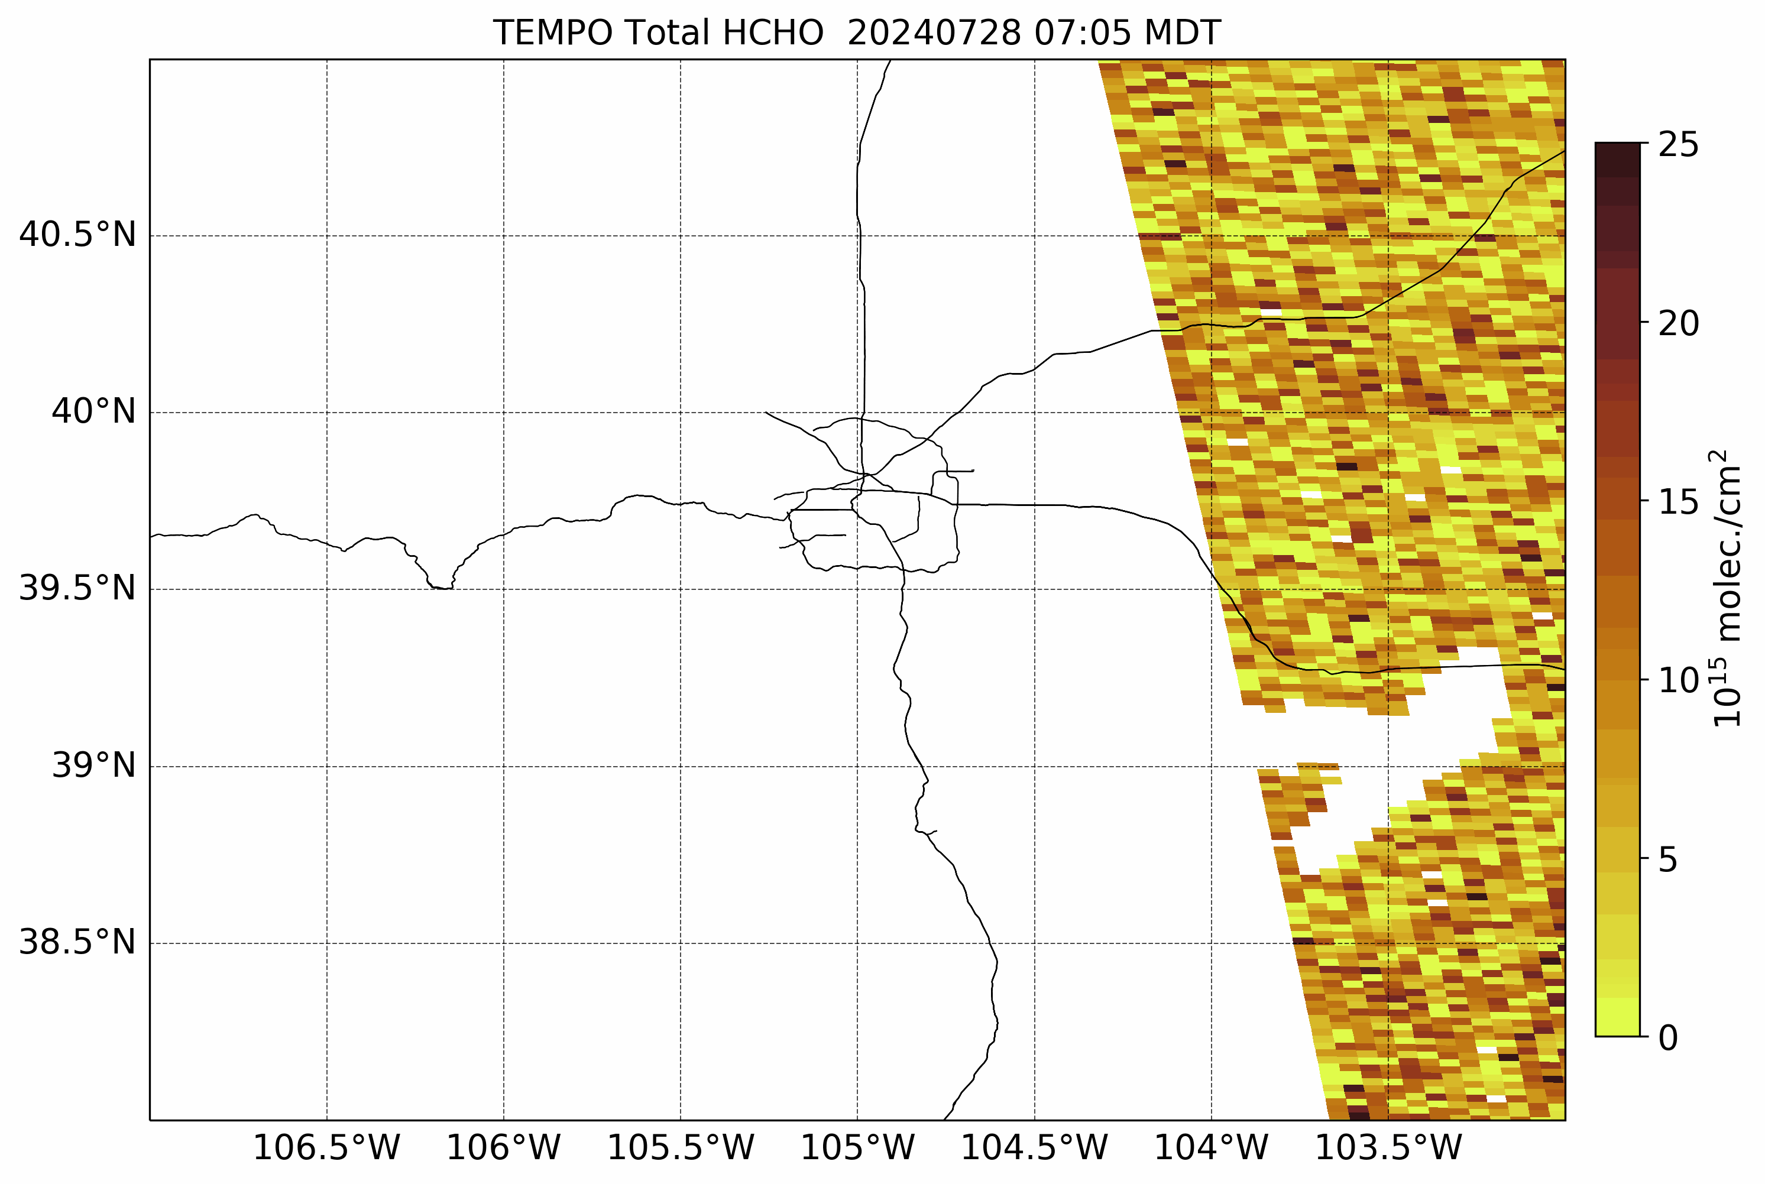
O₃ Exceedances Along CO Front Range
MODIS Aqua
AirNow
Ozone monitors
Worldview
July 30, 2024
July 29
July 31
Numerous O₃ exceedances were observed across CO Front Range during July 2024
Wildfire smoke from regional and local sources impacted the CO Front Range and contributed to the O₃ exceedances
July 28 – July 30
July 28 – July 30
12
12

Slide 13
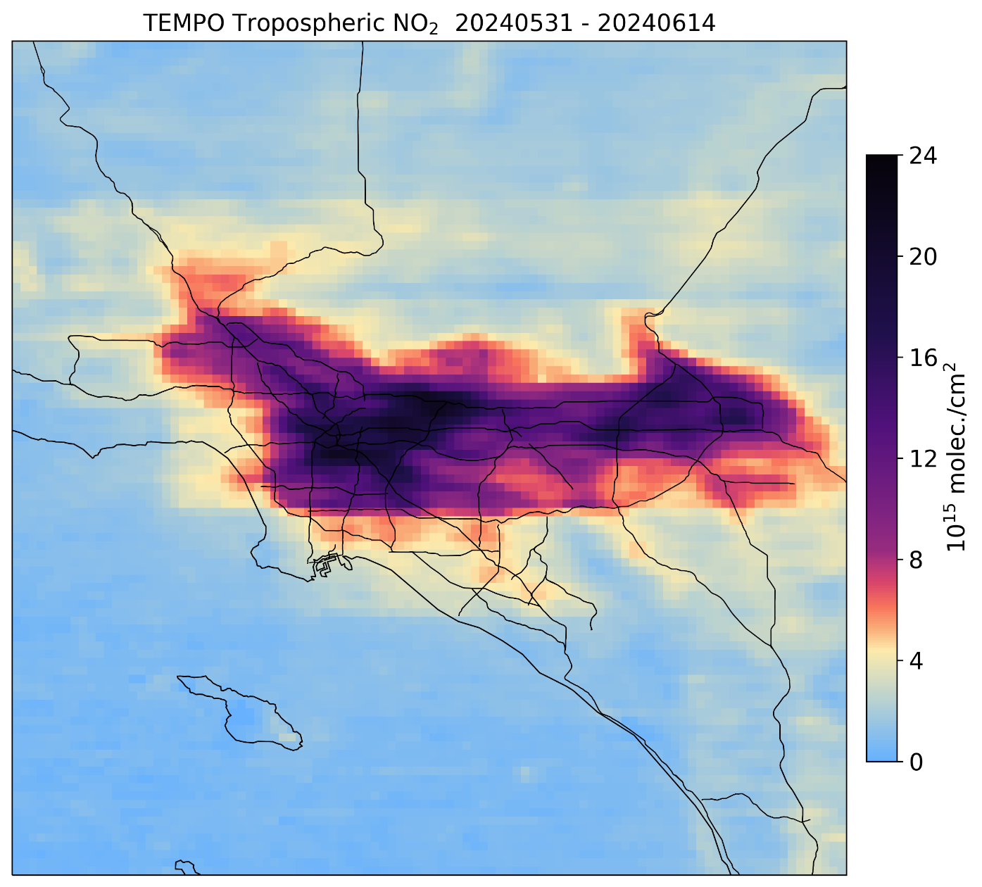
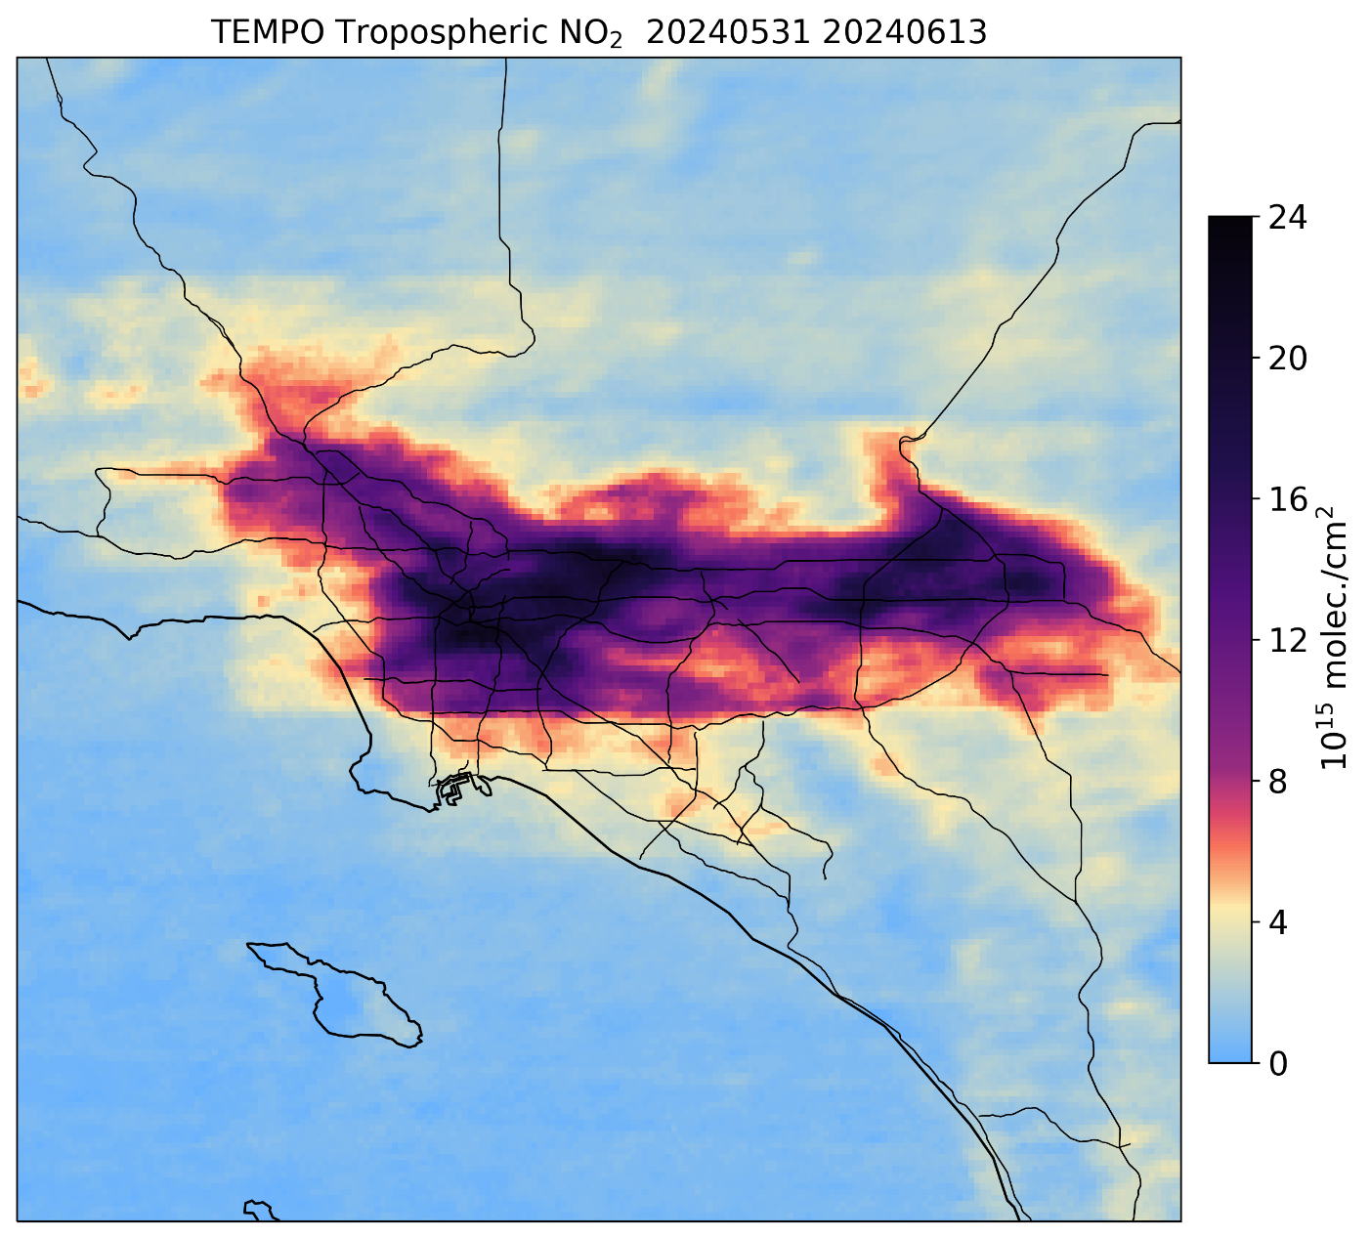
Level 3 vs Oversampled NO₂ Maps
TEMPO L3 NO₂
TEMPO L3+ NO₂ oversampled

Slide 14
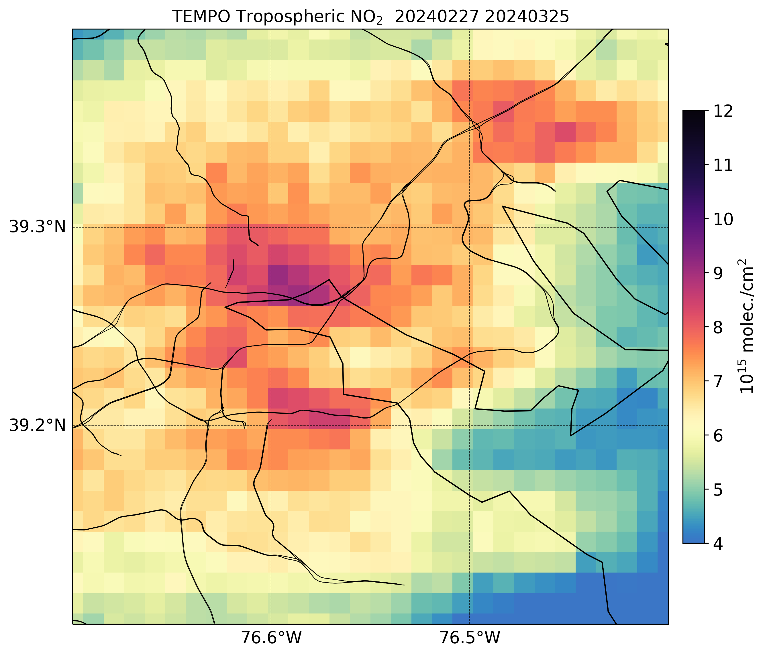
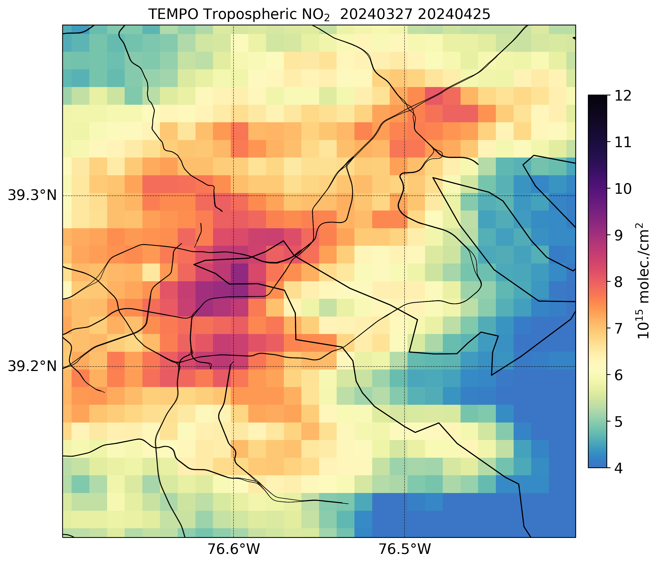
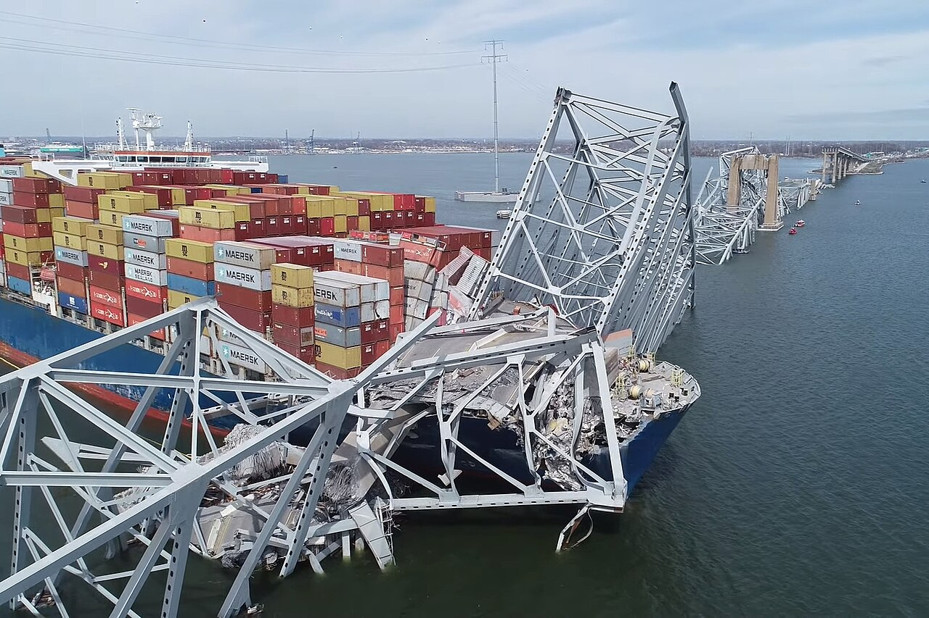
Francis Scott Key Bridge Collapse in Baltimore
Before bridge collapse
After bridge collapse
Francis Scott Key Bridge in Baltimore collapsed on March 26
Major changes in traffic patterns due to the bridge collapse
Distinct decreases in NO₂ along the bridge and over the Patapsco River
Increases in NO₂ columns along I-895 and change in NO₂ pattern along I-695

Slide 15
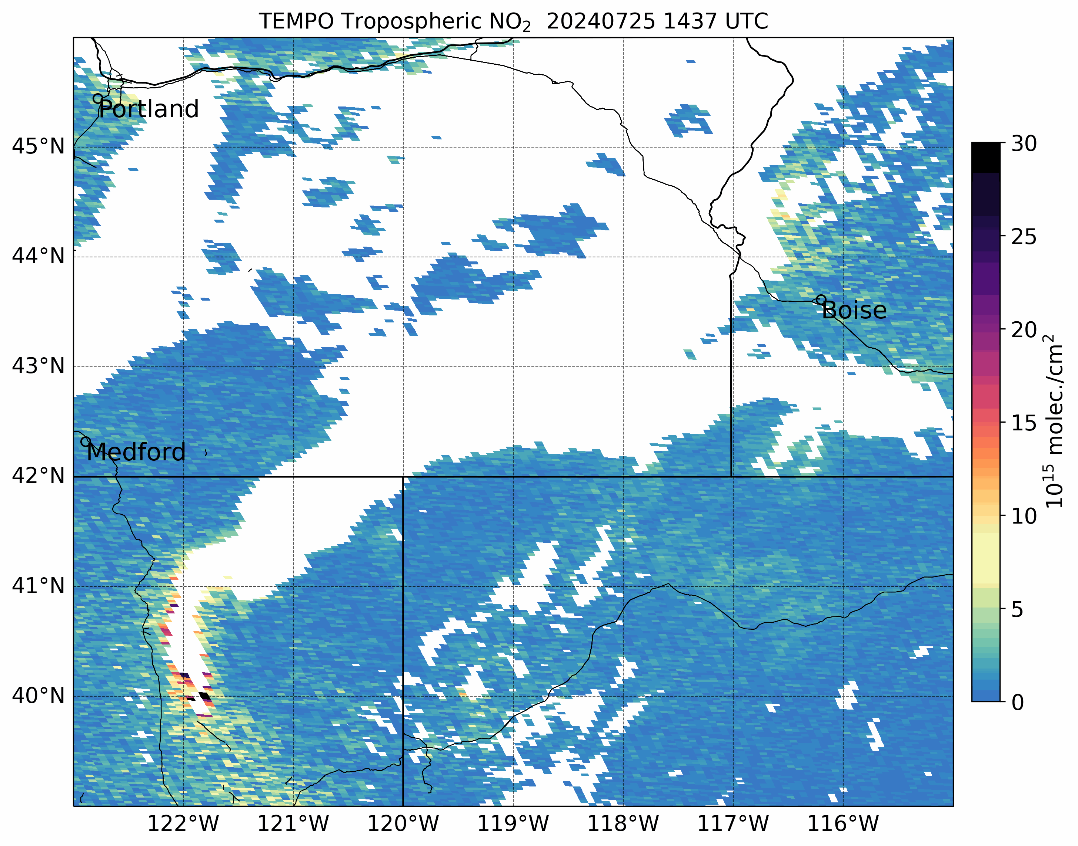
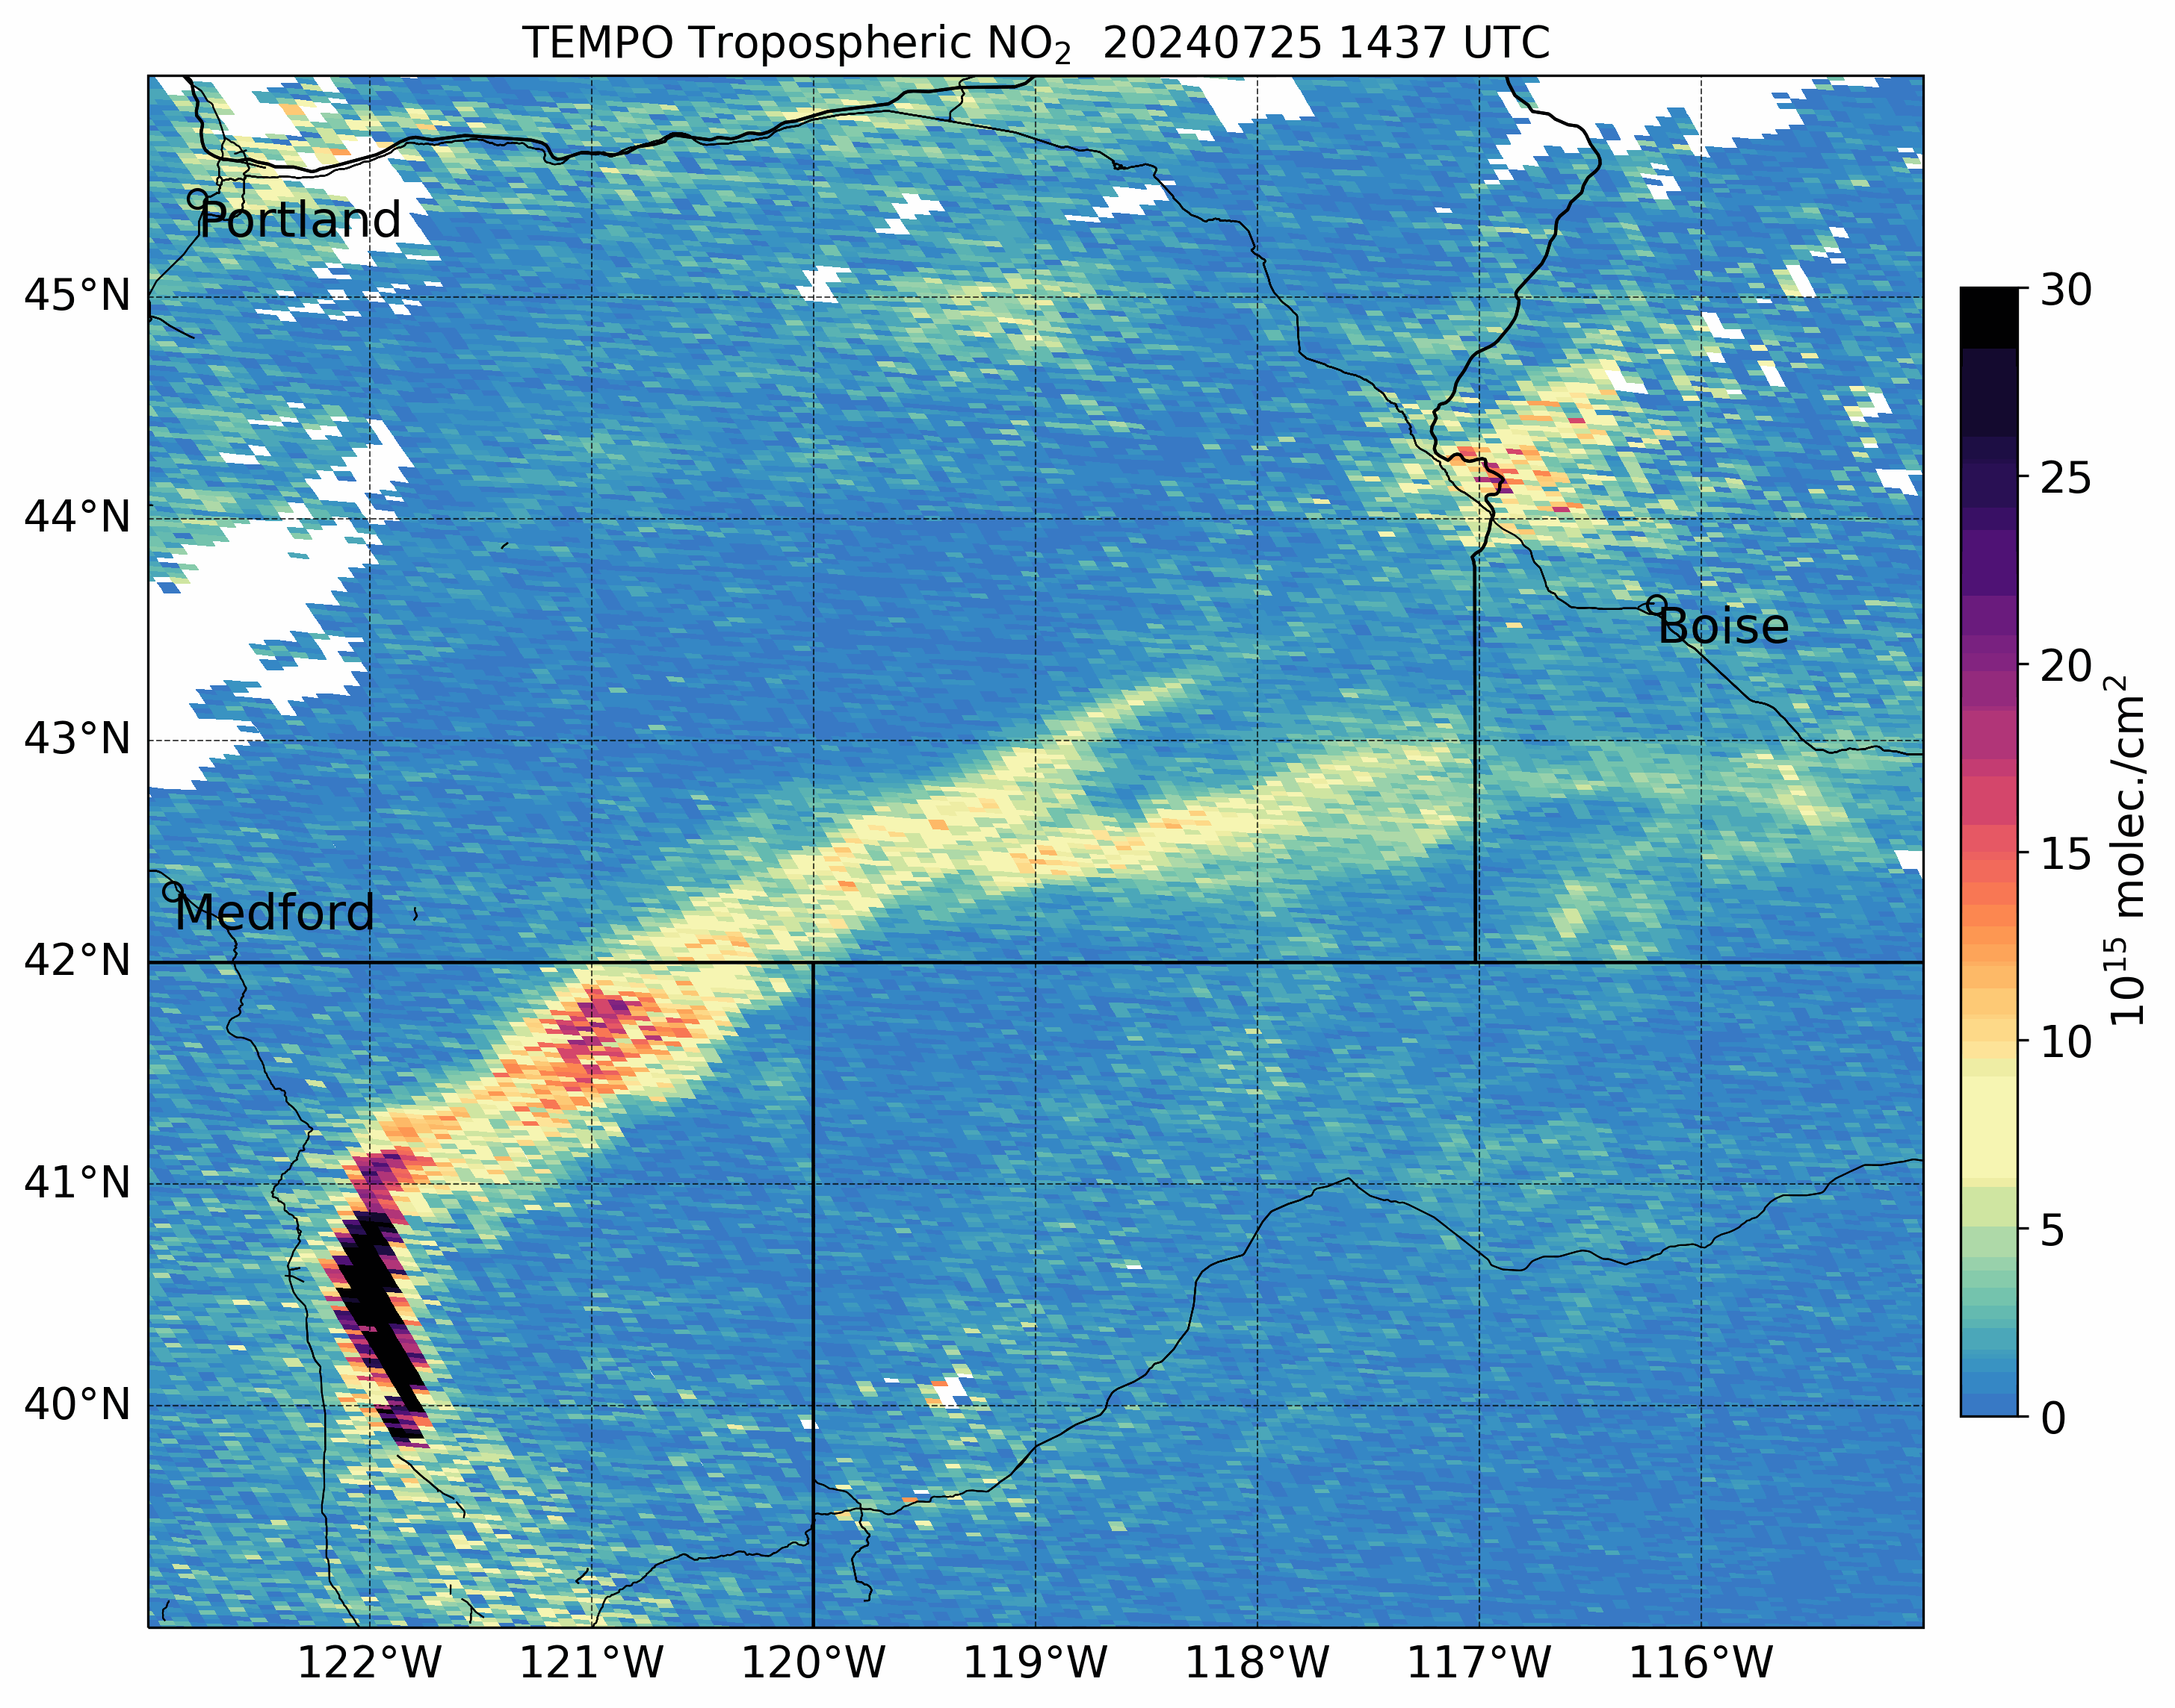
Much more to come!
Park Fire!
Continue working with stakeholders on use of TEMPO data in AQ management applications
Validation of TEMPO NO₂ at locations of interest to stakeholders
Implement refined oversampling techniques for TEMPO data
Working on machine learning model for estimating surface-level NO₂ based on TEMPO NO₂ data
Targeting first launch of TEMPO dashboard at SPoRT this fall
Development of user guides and other training materials for TEMPO data in preparation for the TEMPO training event
Training event for TEMPO data targeted for first quarter 2025
Cloud fraction filter > 20%
aaron.naeger@nasa.gov
@NaegerAaron
Cloud fraction filter > 50%

