Slide 1
Seamless integration of geostationary and low Earth orbiting satellites for city-to-global scale atmospheric composition and emission analysis using JPL MOMO-Chem
Kazuyuki Miyazaki
NASA Jet Propulsion Laboratory, California Institute of Technology , USA
Copyright 2024, California Institute of Technology. Government sponsorship acknowledged.

Slide 2
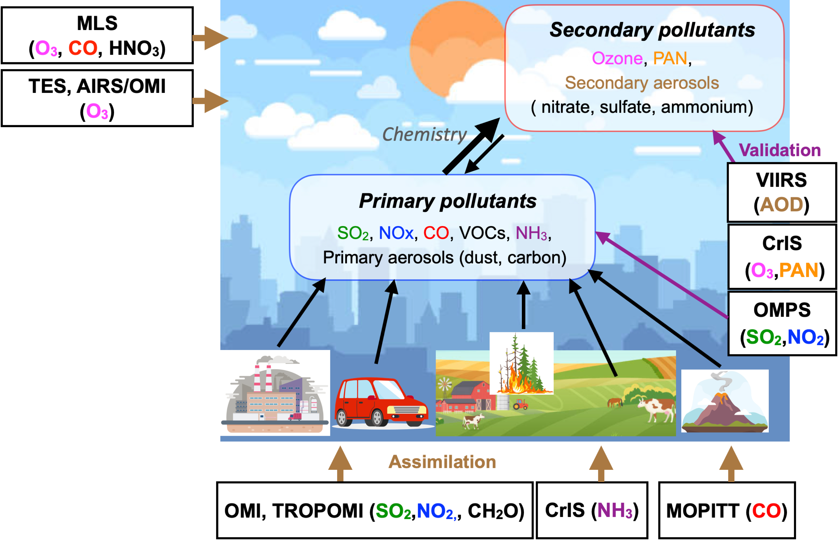
Miyazaki et al.,
In prep.
(updated from Miyazaki et al., 2020)
Long-lived GHGs
Oxidation capacity (OH)
↓
CH4
AQ-GHG co-emissions
↓
CO2
MOMO-Chem Tropospheric Chemistry Reanalysis (TCR-3)
“Decadal Aura era” +
“New satellite era”

Slide 3
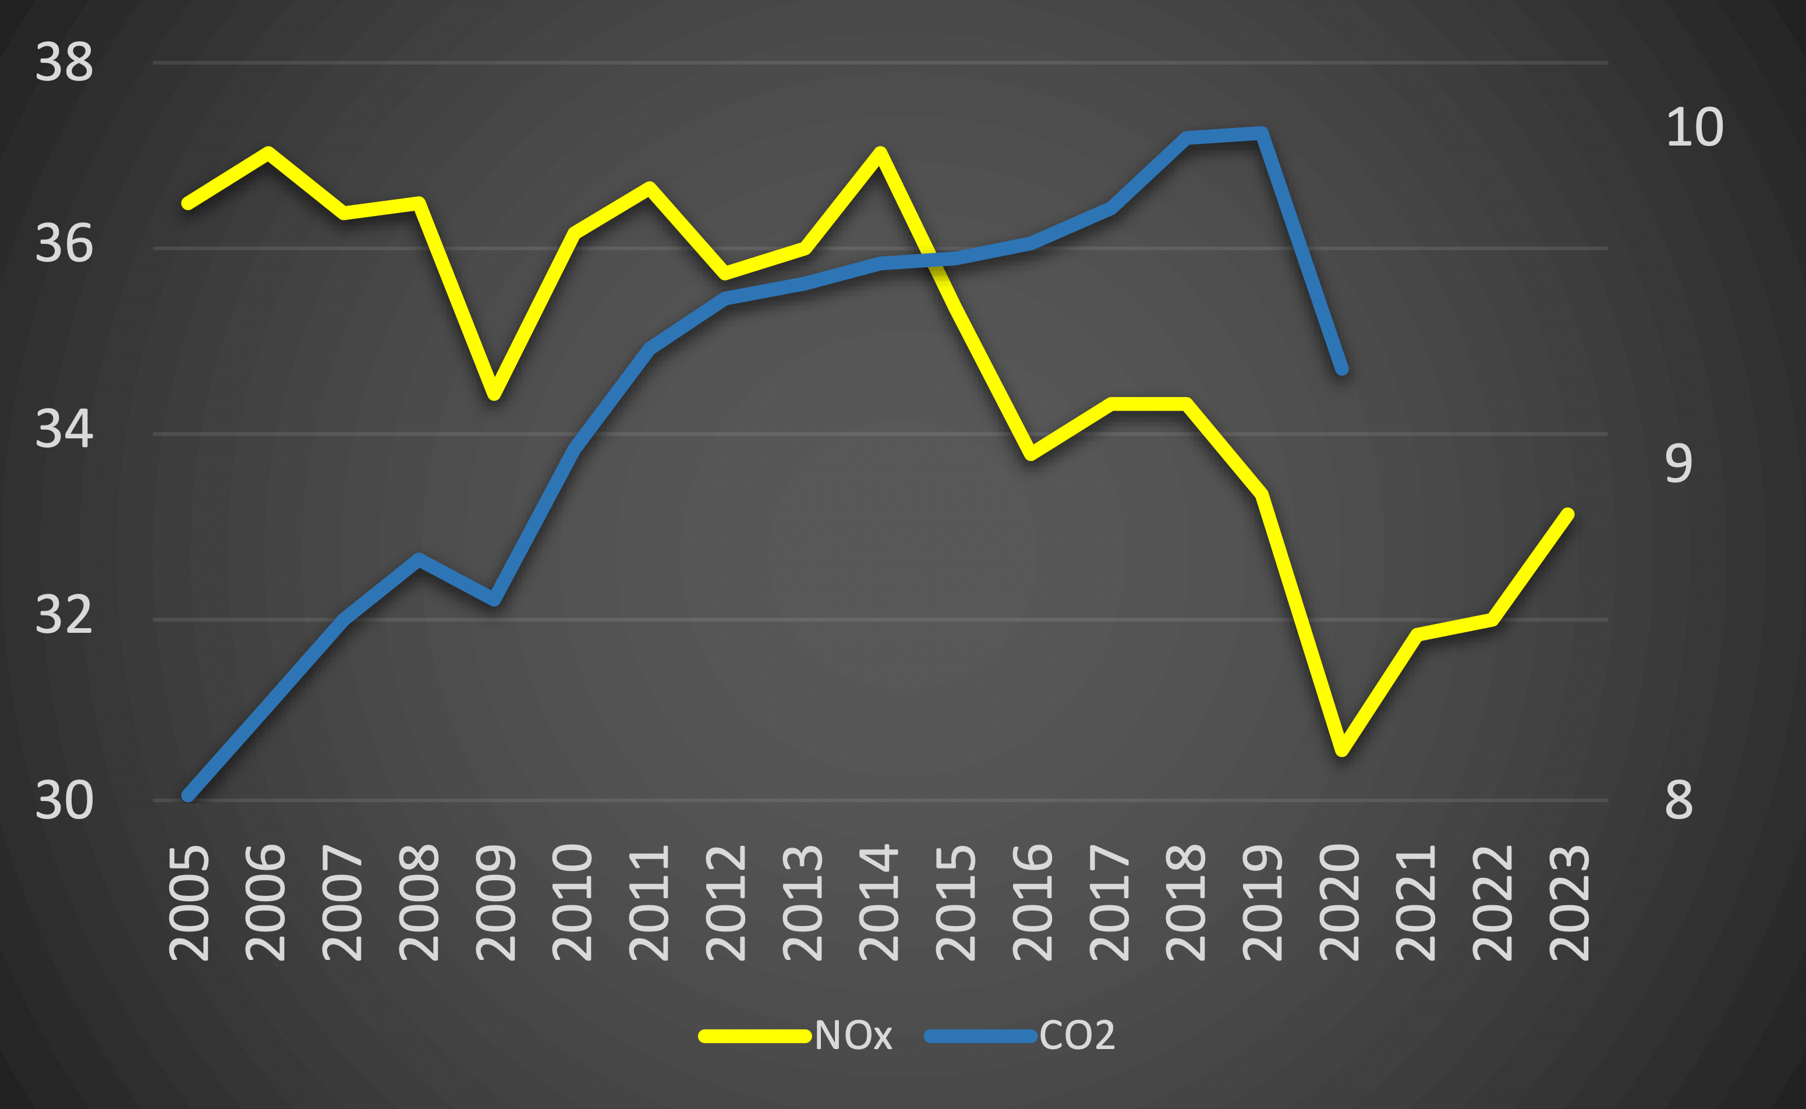
Global anthropogenic emissions over 19 years
Europe & USA ↓
China ↑
China ↓
India ↑
Top-down NOx (TgN/yr)
MOMO-Chem
Bottom-up CO2 (GtC/yr)
Le Quéré (2020)
Recovery & India ↑
COVID
Updated from Laughner et al 2021 (PNAS)
and Miyazaki et al. 2021 (Sci Adv)

Slide 4
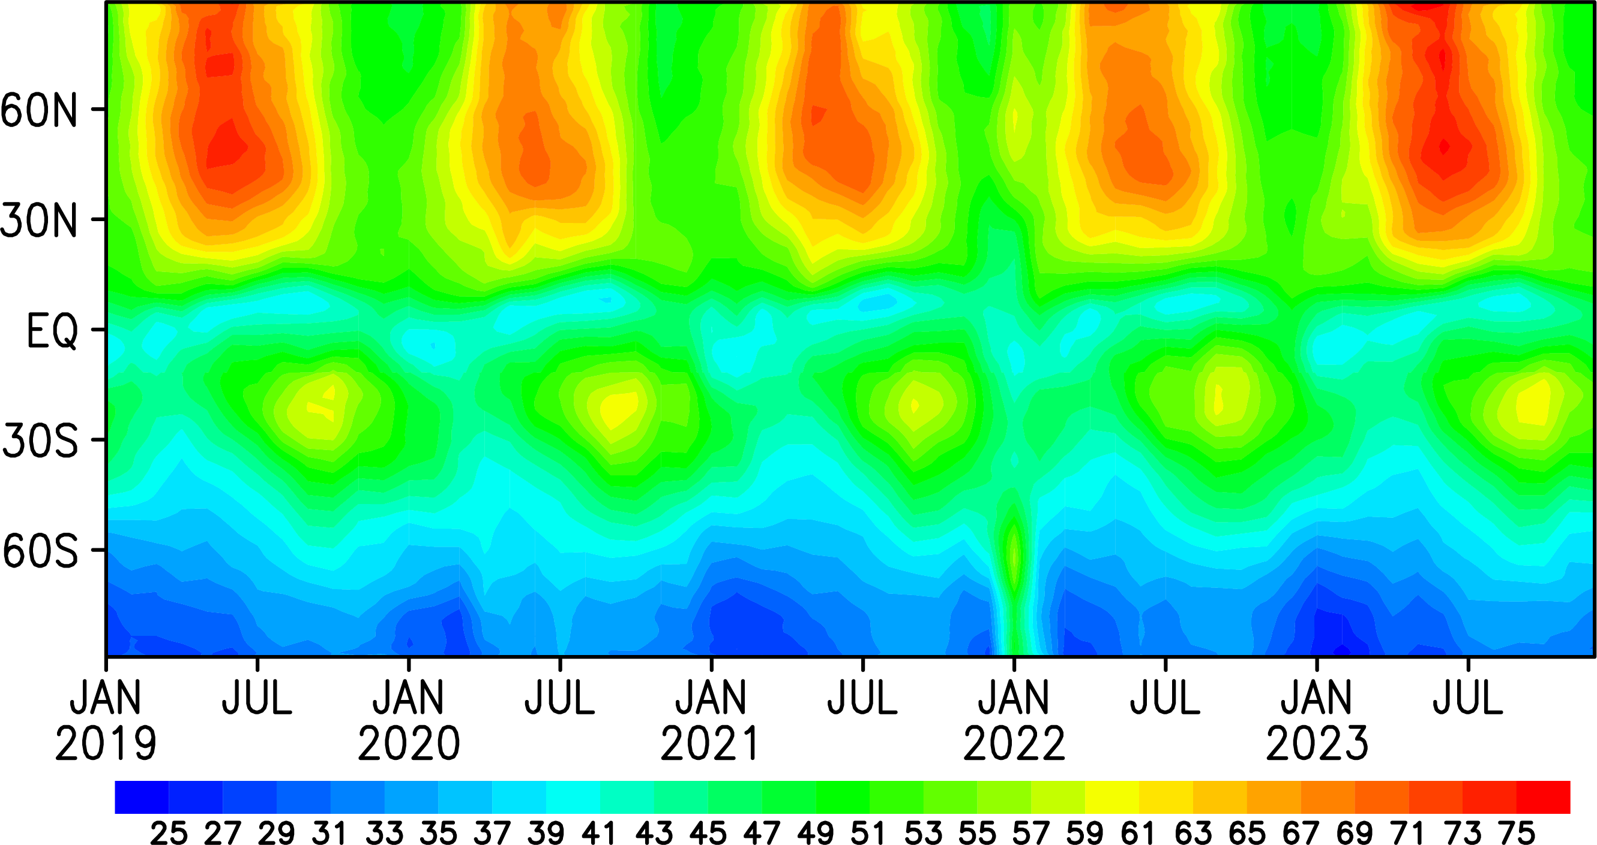
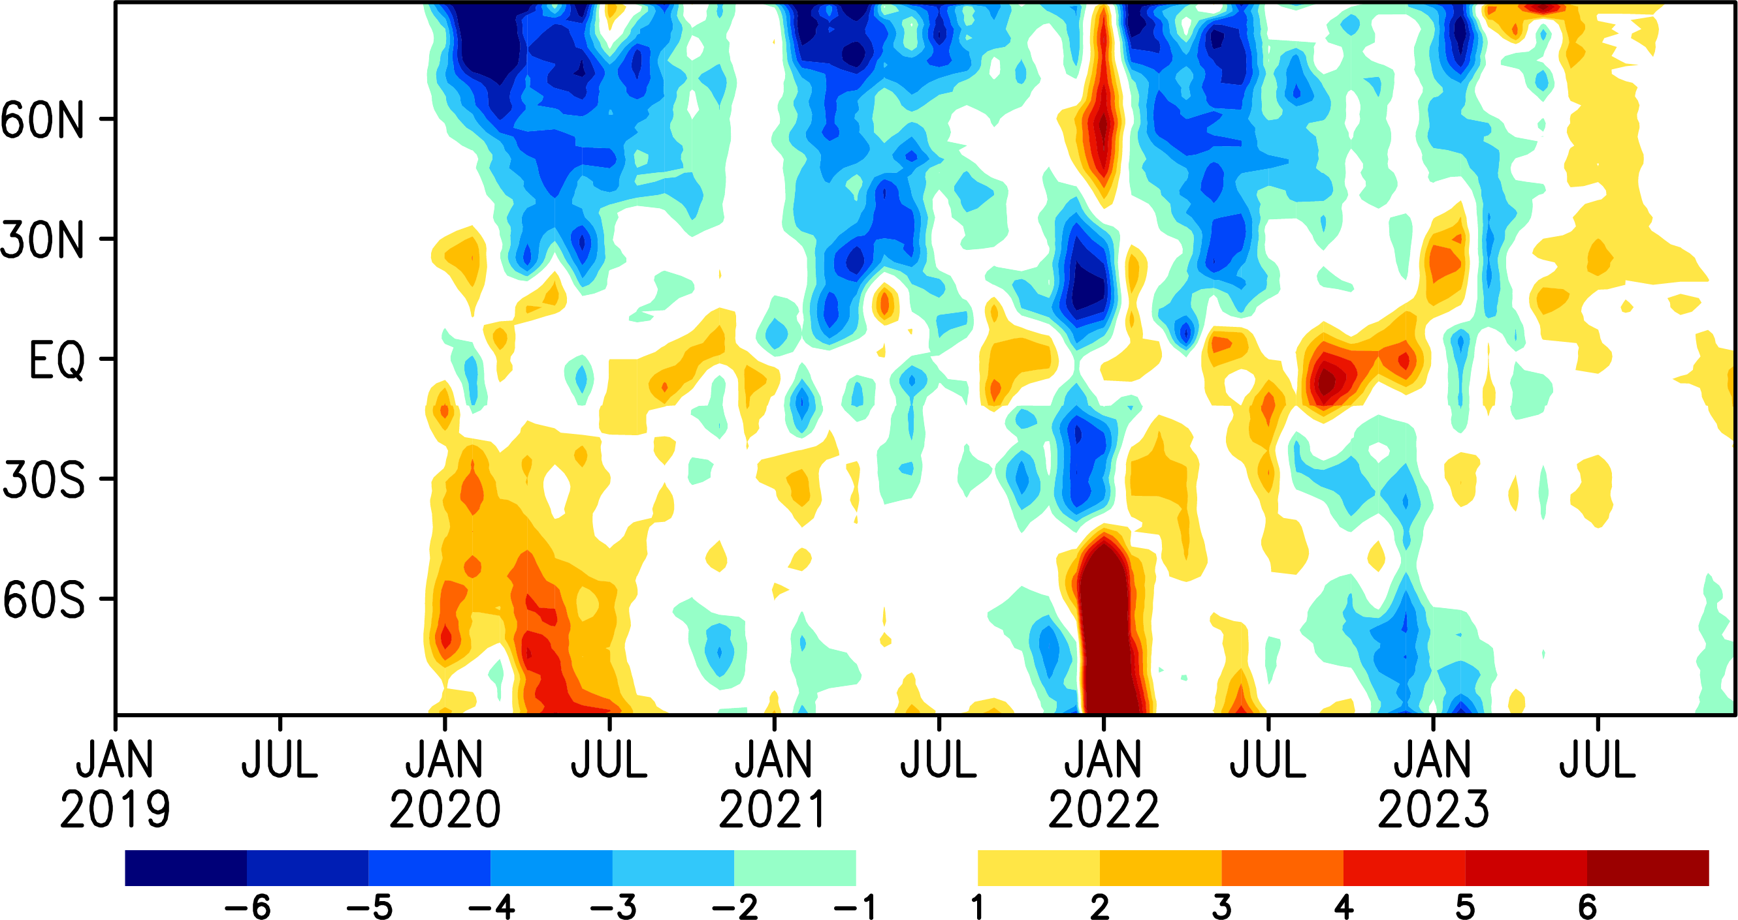
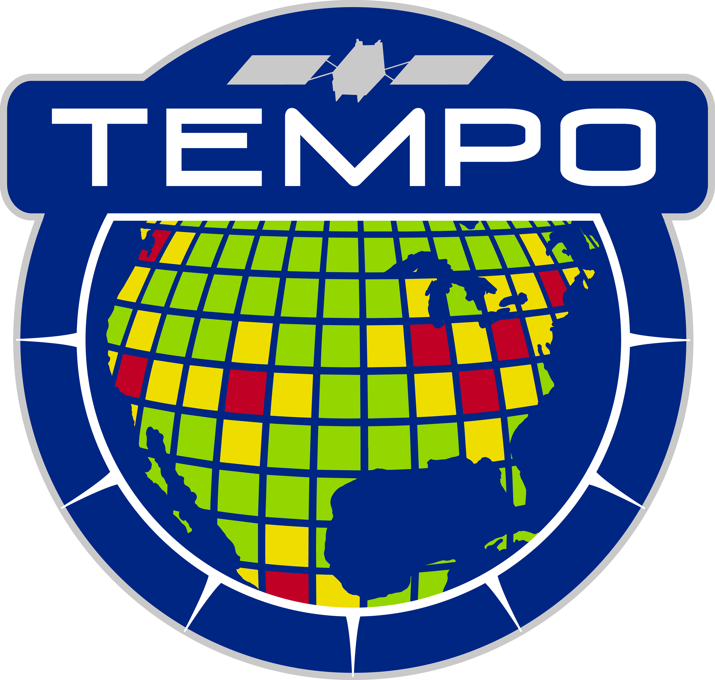
Updated from Miyazaki et al. 2021 (Sci Adv)
Zonal mean O3
at 500 hPa
from MOMO-Chem
?
Anomaly from 2019
?
2020: The tropospheric ozone burden declined by 6TgO3 (∼2%)
2021-early2023: Continued low ozone in NH?
COVID
Hunga Tonga–Hunga
Australian fires
Canadian fires

Slide 5
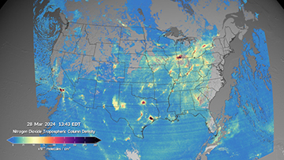
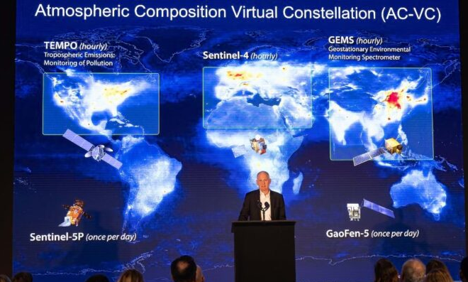
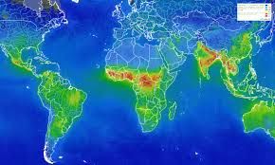
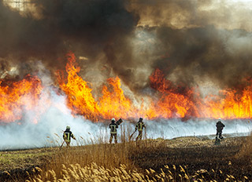
Attribution
4. Consistent validation of multi-GEO satellites
1. Emission patterns with improved diurnal variability
Human or natural?
Evaluate inventories
GEO (TEMPO, GEMS)
2. Cross-Continental air pollution dynamics: Link Asia—N. America
MOMO-Chem integration
Local or remote?
Super observation (Rijsdijk et al., GMDD)
Global impacts?
LEO
3. Extreme events & decadal statistics
Integrated composition & emission products (0.25°-1.1°)
ML downscaling (<0.1°)
Health & Climate
Toward unique contributions to the GEO missions through
its long-term record and global/emission/attribution analysis capabilities
Earth Science to Action

Slide 6
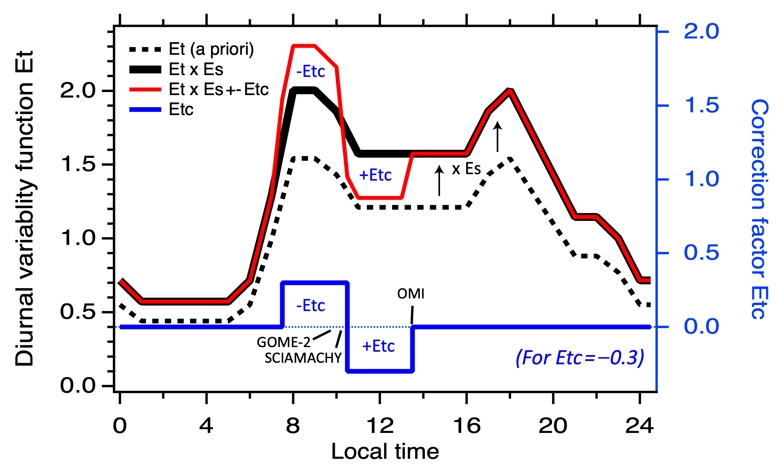
Diurnal emission variability: anthropogenic, lightning, soil
GOME-2 NO2
SCIAMACHY NO2
➡️ 07:30-10:30
TROPOMI, OMI NO2
➡️ 10:30-13:30
GEMS,TEMPO NO2
➡️ 09-10
➡️ 10-11
➡️ 11-12
➡️ 12-13
➡️ 13-14
➡️ 14-15
TROPOMI, OMI
GOME-2
SCIAMACHY
Miyazaki et al.
2012b, 2014, 2017
Modify the shape of diurnal emission variability using multiple satellites at different overpass time
GEO: provide detailed constraints to help identify dominant sectors and evaluate its impacts

Slide 7
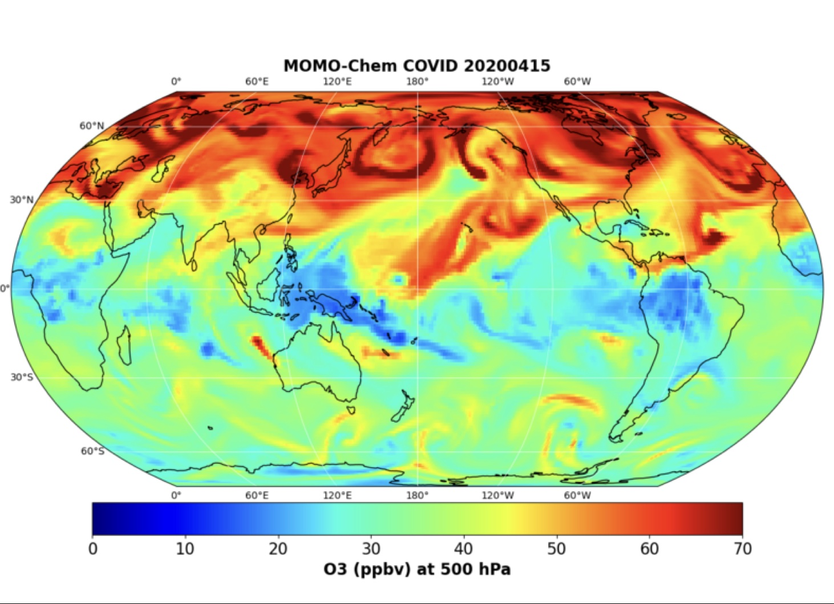
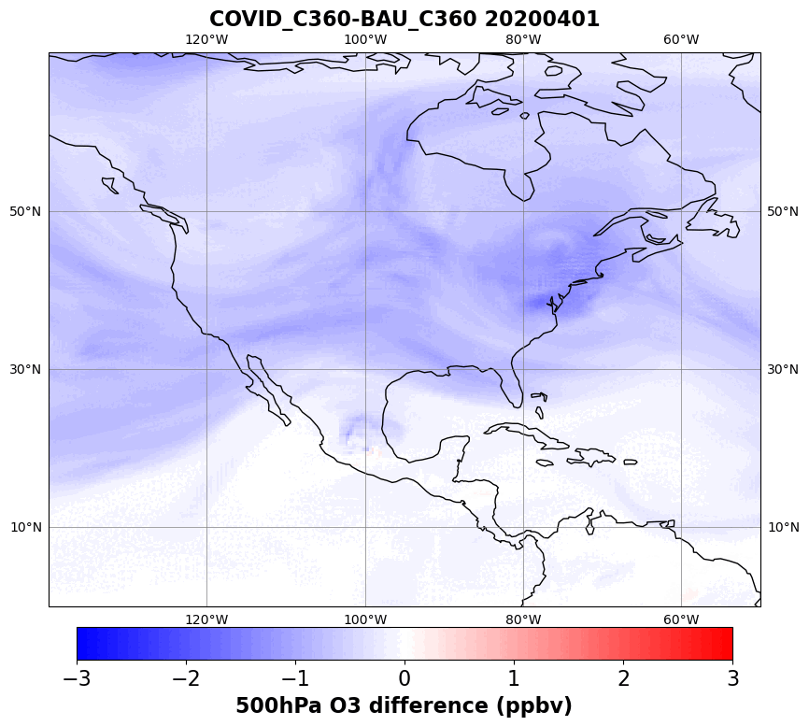
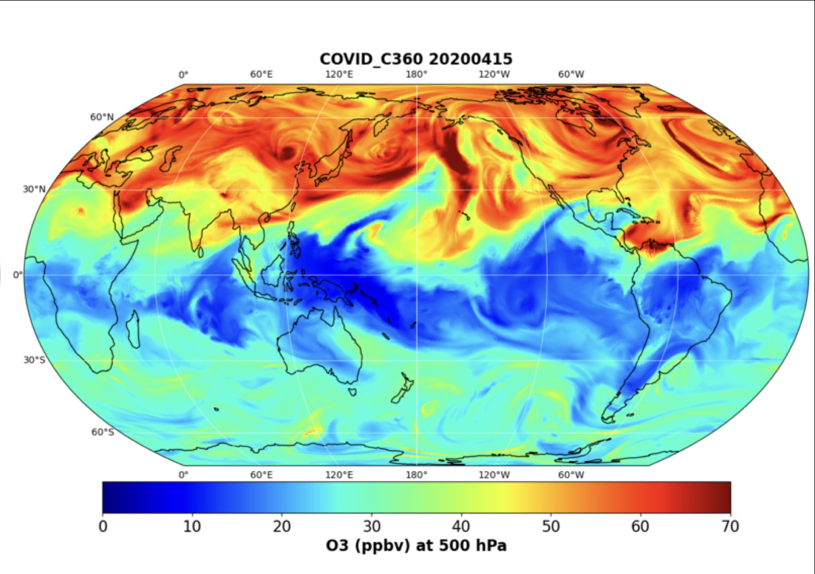
Global high-resolution DA in MOMO-Chem
Ozone at 500 hPa
TCR-2 (1.1 deg)
GCHP (0.25 deg)
COVID ozone anomaly
GCHP (0.25 deg)
Effective assimilation of high-resolution obs (GEO, in situ + LEO)
Evaluation of DA uncertainty ranges due to model errors
City-to-global scale atmospheric composition variation

Slide 8
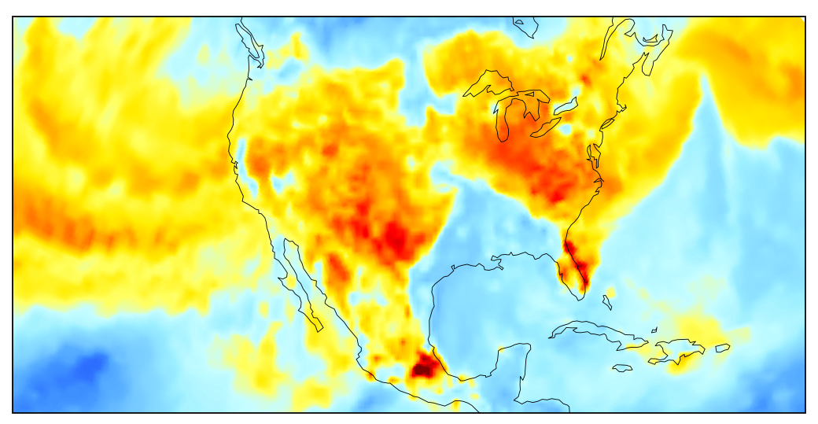
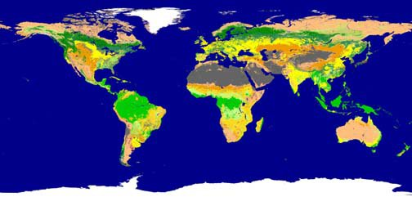
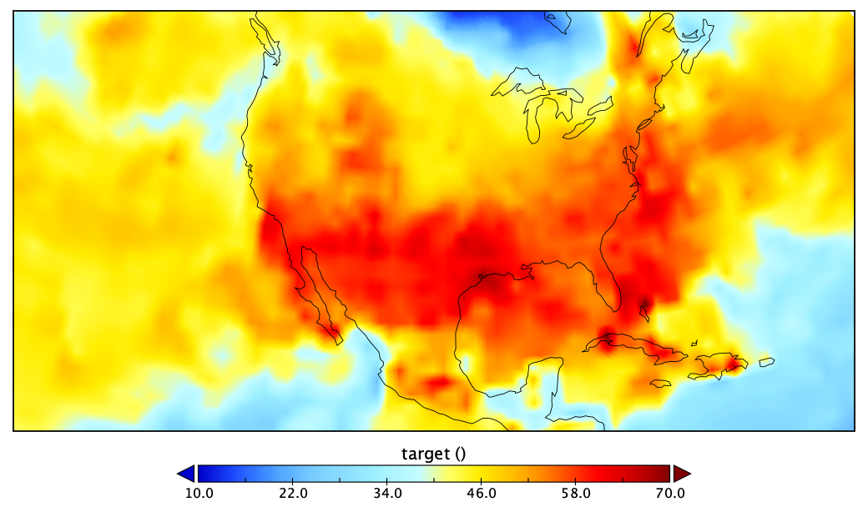
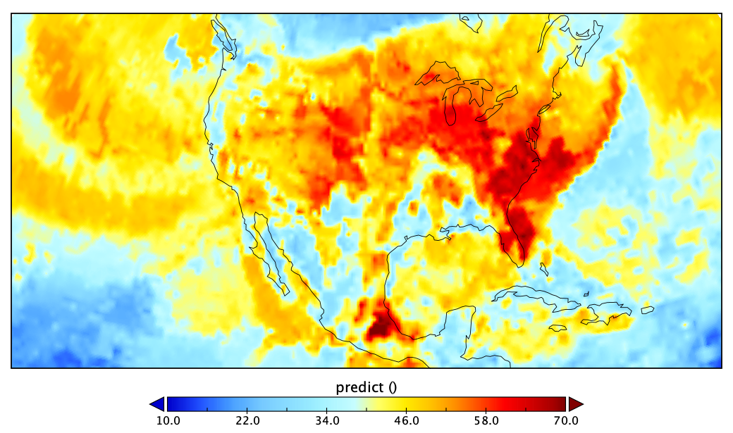
MOMO-Chem + ML for downscaling and bias correction
High-reso met +
Truth [0.5°]
MOMO-Chem
at 0.25—1.1°
ML
downscaling
GEMS/TEMPO
Emissions, surface conc.,
attributions
< 0.1°resolution data for AQ applications
MOMO-Chem [1.1°]
ML [0.5°]
Surface O3
downscaling
at reduced computational cost
ML bias correction (Miyazaki et al.
to be submitted)

Slide 9
Summary
GEO measurements provide much-improved spatial and temporal resolution and coverage. Combined use of GEO and LEO in MOMO-Chem will greatly advance air quality and climate applications.
Current & future applications: Satellites (GOSAT-GW, CO2M, GEMS, TEMPO, GEO-XO, Sentinel-4), aircraft missions (ASIA-AQ), scientific focuses (AQ+GHG, trace gas + aerosol interactions, OH, wildfires, VOCs), techniques (DA+ML).
Contributions/collaborations: Explore class missions, Schmidt Futures FETCH4 (Co-I), IGAC AMIGO (SC), IGAC TOAR-2 (Lead: Chemical reanalysis WG & satellite assessment report), ISSI (GEO AQ summary paper), JEDI, WMO observing system impacts, CEOS-AC-VC, TRACER-1 (NASA Ames regional reanalysis), JPL TROPESS (new satellite products)
NASA funded projects: AST (PI, Decadal reanalysis), ACMAP (PI, MOMO-Chem), ESUSPI (PI, GOSAT-GW), Earth to Action for Air Quality (PI), JPL ML-AQ (PI), HAQAST (LBC), CMS-Flux (CO2-CO-NOx), NPP (VOCs), ACMAP (trace gas atmospheric river)
Look forward to further collaborations!

