Slide 1
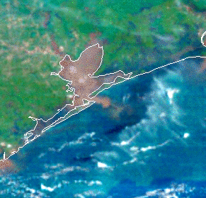
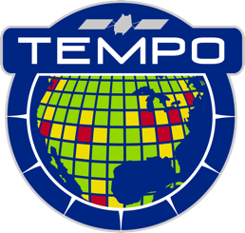
Harnessing Machine Learning to Explore the Potential of Ocean Color Measurements from TEMPO
Zachary Fasnacht (zachary.fasnacht@ssaihq.com)
Joanna Joiner, Matthew Bandel, Nickolay Krotkov, Alexander Vasilkov, Amir Ibrahim, Andrew Heidinger, Michael Himes, Xiong Liu, Heesung Chong, Jim Carr

Slide 2
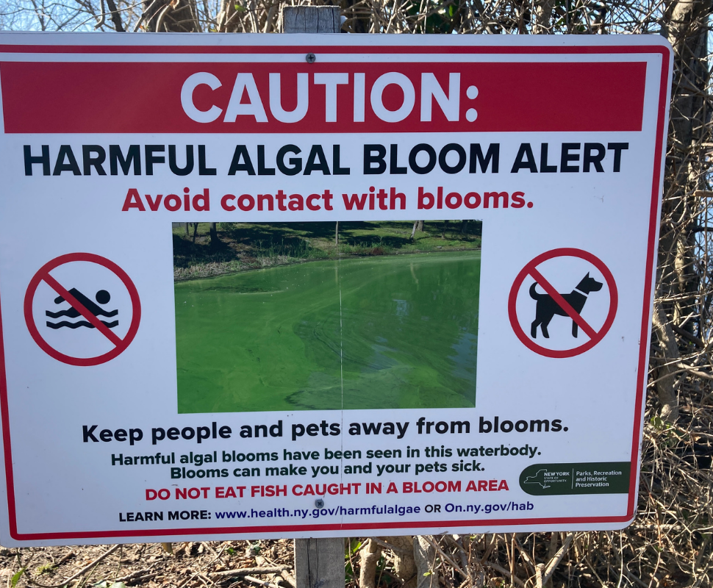
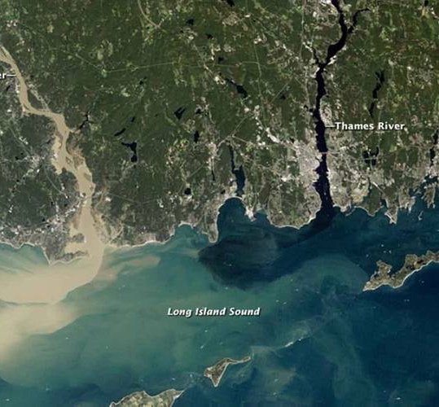
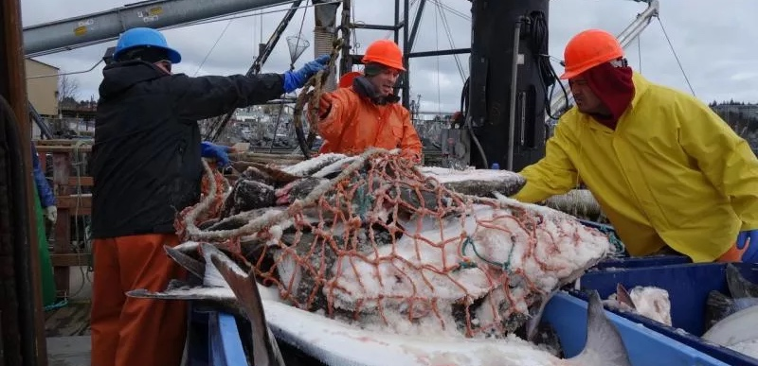
Why Geostationary Ocean Color?
U.S. fisheries contributed $321 billion to economy in 2023 (NOAA fisheries)
Health impacts from harmful algae blooms (HABs) are estimated to cost around $1 billion annually
Ocean color (OC) retrievals from polar orbiting satellites have numerous gaps caused by clouds & aerosols, significantly hindering operational monitoring of events like HABs as well short-term modeling of fisheries
KIOST launched first Geostationary Ocean Color Instrument (GOCI) in 2010 to measure the coastal waters of NE Asia, follow on GOCI-II launched in 2020
GOCI and GOCI-II have been shown to improve short-term monitoring of events such as HABs
Two future North America Geostationary OC instruments:
Geostationary Littoral Imaging and Monitoring Radiometer (GLIMR) in 2026-2027
Geostationary Extended Observations Ocean Color Instrument (GeoXO OCX) launching in mid 2030’s

Slide 3
Where Does
TEMPO Fit?
TEMPO
GLIMR/OCX
MODIS
PACE/OCI
Spectral Resolution
0.6nm | 10-50nm | 5nm | Sub-nanometer in UV to 20nm in NIR
0.2nm | Multi-band | 2.5nm | 5-15nm
290-490nm 540-740nm | 400nm-14.385um | 340- 890nm* | 340-1040nm
2x4.75km² at center | 0.25-1km IFOV | 1km IFOV | 300m-500m
Hourly | 1 per day | 1 per day | Every 2-3 Hours
Since OC Geo sensors in N. America are years away, TEMPO provides an opportunity to prepare for those instruments
While spatially coarser than typical OC instruments, TEMPO’s spectral range and resolution make it a good proxy to explore Geostationary Ocean Color
We developed initial GEMS ocean color retrievals, but here we focus on TEMPO since it has the additional green/red wavelengths which are important in coastal ecosystems
Spectral Sampling
Spectral Range
Spatial Resolution
Revisit Time
*PACE OCI also has 7 band measurements further in to NIR/SWIR

Slide 4
Pre-Processing
TEMPO L1b V3 reflectances from UV (345-485nm) and Vis (545-735nm) decomposed into principal components to train ML model (smoothed to 1nm FWHM)
Covariance matrix stored so that it can be applied to unseen spectra when making chlorophyll estimates
NN Training
Feed forward neural network with Bayesian approximation provides uncertainty estimate
PC’s + solar angle provided as input to NN
Optically thick clouds excluded using TEMPO O4 cloud radiance fraction
Predicted Output
Training data co-located from traditional OC instruments
Level 2 chlorophyll data from MODIS, VIIRS, and OLCI is gridded hourly at 2km spatial resolution before being co-located in time and space to the TEMPO field of regard using nearest neighbor approach

Slide 5
TEMPO ML+PCA Sensitivity to Clouds Nov 11, 2023
TEMPO ML-based chlorophyll compares with MODIS/VIIRS/OLCI 8-day composites, showing that the ML approach works even under moderate cloud conditions
With addition of green/red wavelengths, the technique works better for higher chlorophyll concentrations than when applied to OMI/TROPOMI instruments which don’t include this spectral information

Slide 6
Hurricane Beryl passed through the NW Gulf of Mexico in early July 2024 having an impact on coastal ecology in the northern Gulf of Mexico
Outer clouds from Hurricane Beryl moved quickly on July 7, 2024 allowing TEMPO to measure different parts of the region throughout the day
MODIS/OLCI/VIIRS spatial coverage was very limited, particularly in the immediate coastal zones due to the clouds

Slide 7
Improved daily coverage from Geostationary OC satellite (shown above from TEMPO) can better assist monitoring of events like HABs/red tide as well as provide important information for short-term modeling of fisheries
Geostationary OC in the Gulf of Mexico will also be capable of assisting in monitoring of oil spills which can occur in this region due to widespread offshore drilling
Fishing in the Mississippi River Delta contributes around $1.5 billion per year to the US economy (Olson and Suski 2021)

Slide 8
Movement of chlorophyll in mid-Atlantic Bight region of eastern U.S. due to frontal passage in late June 2024
Since frontal boundaries tend to move through within hours, multiple hourly scans from TEMPO provides near complete coverage and a better understanding of the resulting changes in the ocean from the passage of the front
Fisheries in the mid-Atlantic Bight contribute nearly $500 million to the economy, but the region is warming at 3x the global average leading to potential change that needs to be closely monitored (Xu et al. 2020)

Slide 9
TEMPO provides improved temporal resolution of quickly developing circulation features in southern Bay of California during late Summer resulting from Pacific Ocean influence on the bay
GLIMR/GeoXO OCX spatial resolution will be ~100x that of TEMPO, providing an even more detailed understanding of these gyre-features along with smaller scale coastal features that are too small for TEMPO

Slide 10
Take Home Messages
TEMPO provides a great opportunity to explore some of the future possibilities from GLIMR/GeoXO OCX
Machine learning can be utilized to quickly develop efficient retrievals and provide gap-filling/near real time approach (does not replace physically based approaches needed to develop training data!)
Geostationary orbit will provide significant ocean color advances for North America and provide impactful real time monitoring capabilities

Slide 11
References
Figueredo, N., Bentley, S. J., Chaytor, J. D., Xu, K., Jafari, N., Georgiou, I. Y., Damour, M., Duxbury, J., Obelcz, J., and Maloney, J. (2024). Sedimentary Processes and Instability on the Mississippi River Delta Front near the Shipwreck of the SS Virginia. Water, 16(3), 421.
Office of Sustainable Fisheries: NOAA Fisheries, Status of Stocks 2023, NOAA, May 6, 2024, https://www.fisheries.noaa.gov/national/sustainable-fisheries/status-stocks-2023.
Olson, K. R., & Suski, C. D. (2021). Mississippi River Delta: Land subsidence and coastal erosion. Open Journal of Soil Science, 11(3), 139-163.
GeoXO Ocean Color Instrument (OCX) Fact Sheet, National Environment Satellite, Data, and Information Service, July 2024, https://www.nesdis.noaa.gov/s3/2024-07/2024_OCX-Fact-Sheet.pdf.
Xu, Yi, Travis Miles, and Oscar Schofield. "Physical processes controlling chlorophyll-a variability on the Mid-Atlantic Bight along northeast United States." Journal of Marine Systems, 212, 2020.

