Slide 1
TEMPO Aerosol Optical Depth and Layer Height Algorithm Development
Hai Zhang¹, Shobha Kondragunta², Pubu Ciren¹
^{1. IMSG at NOAA; 2. NOAA}
TEMPO/GEMS Joint Science Team Workshop 2024
Hawaii, August 26-30, 2024
Disclaimer: The scientific results and conclusions, as well as any views or opinions expressed
herein, are those of the author(s) and do not necessarily reflect those of NOAA or
the Department of Commerce.
Disclaimer：TEMPO L1B data courtesy of NASA and all results are preliminary.

Slide 2
Aerosol Retrieval Algorithm Development
The algorithm retrieves AOD and ALH
Adapt AOD retrieval algorithm from VIIRS and ABI
Adapt ALH retrieval algorithm using O₂ bands by Chen et al. 2021
Spectral selection
Hyperspectral measurements are convolved to the bands 354, 388, 416, 440, 494, 670, 687.75 nm using a triangle function
Look-up Table (LUT) generation
TOA reflectance of the bands for different AOD, ALH, surface reflectance, surface pressure, and Sun-satellite geometry
Smoke, dust, generic aerosol models
UNL-VRTM (VLIDORT)
TEMPO Directional Lambertian Equivalent Reflectivity (DLER) Database
Regridded into fixed 0.05 degree lat-lon grid
Atmospheric correction using 0.025 background AOD (from AERONET analysis)
Generate lower bound using historical data
Build hourly DLER

Slide 3
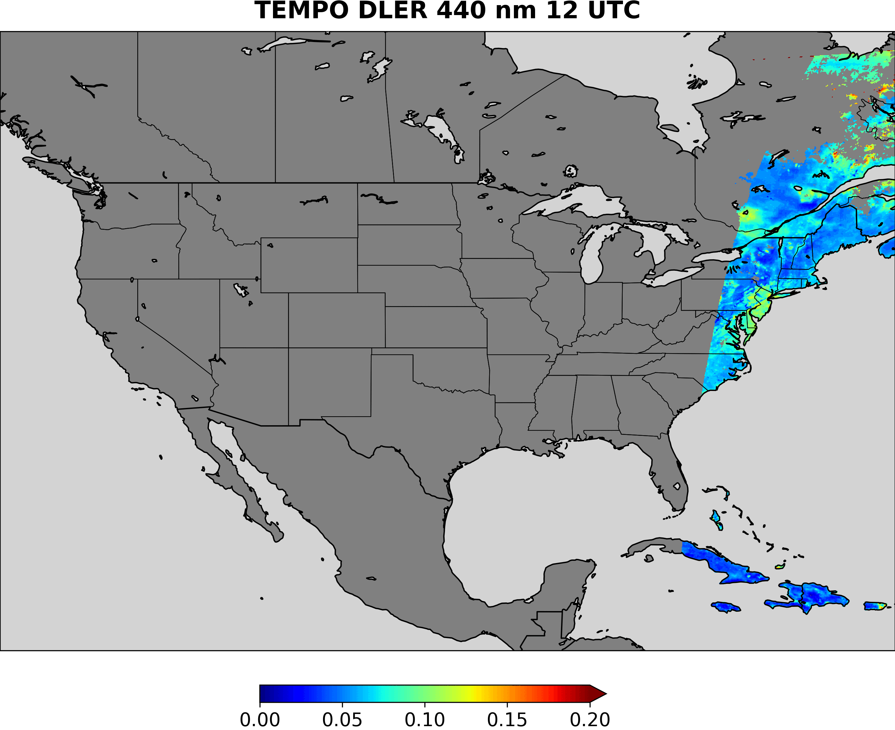
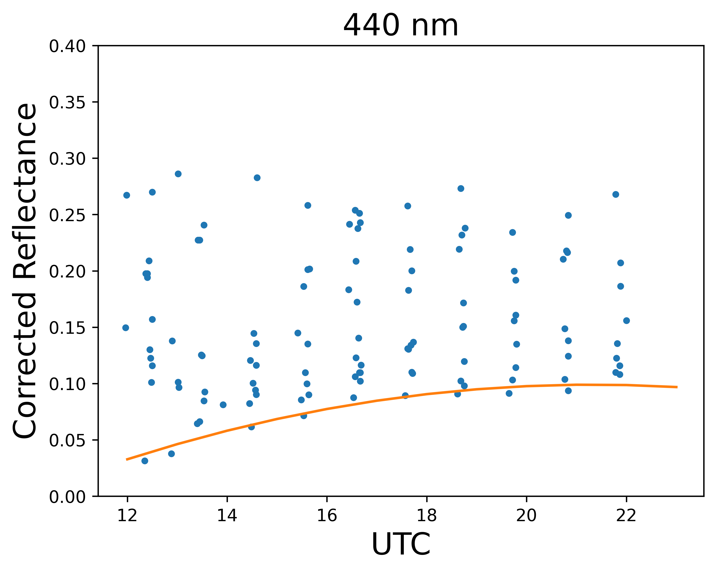
Example TEMPO DLER at 440 nm animation (August, 2023)
The pixel at GSFC
DLER
Regridded into 0.05 degree spatial resolution
Data binned into 1-hr bin and lowest atmospheric corrected reflectance at 440 nm is selected
Derived from 25 days of L1b data in August
DLER for the other bands are also obtained (354, 388, 416, 494, 670, 688 nm)
Similar approach was used to obtain VIIRS surface reflectance for bright surface (Zhang et al. JGR,2016)
Disclaimer：TEMPO L1B data courtesy of NASA and all results are preliminary.

Slide 4
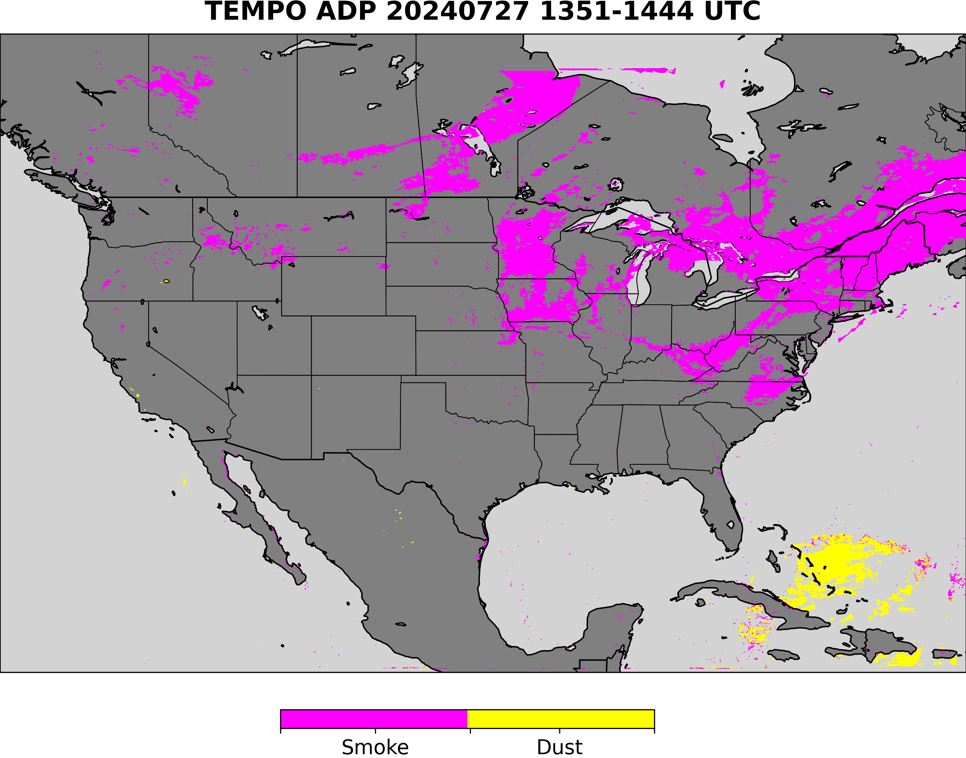
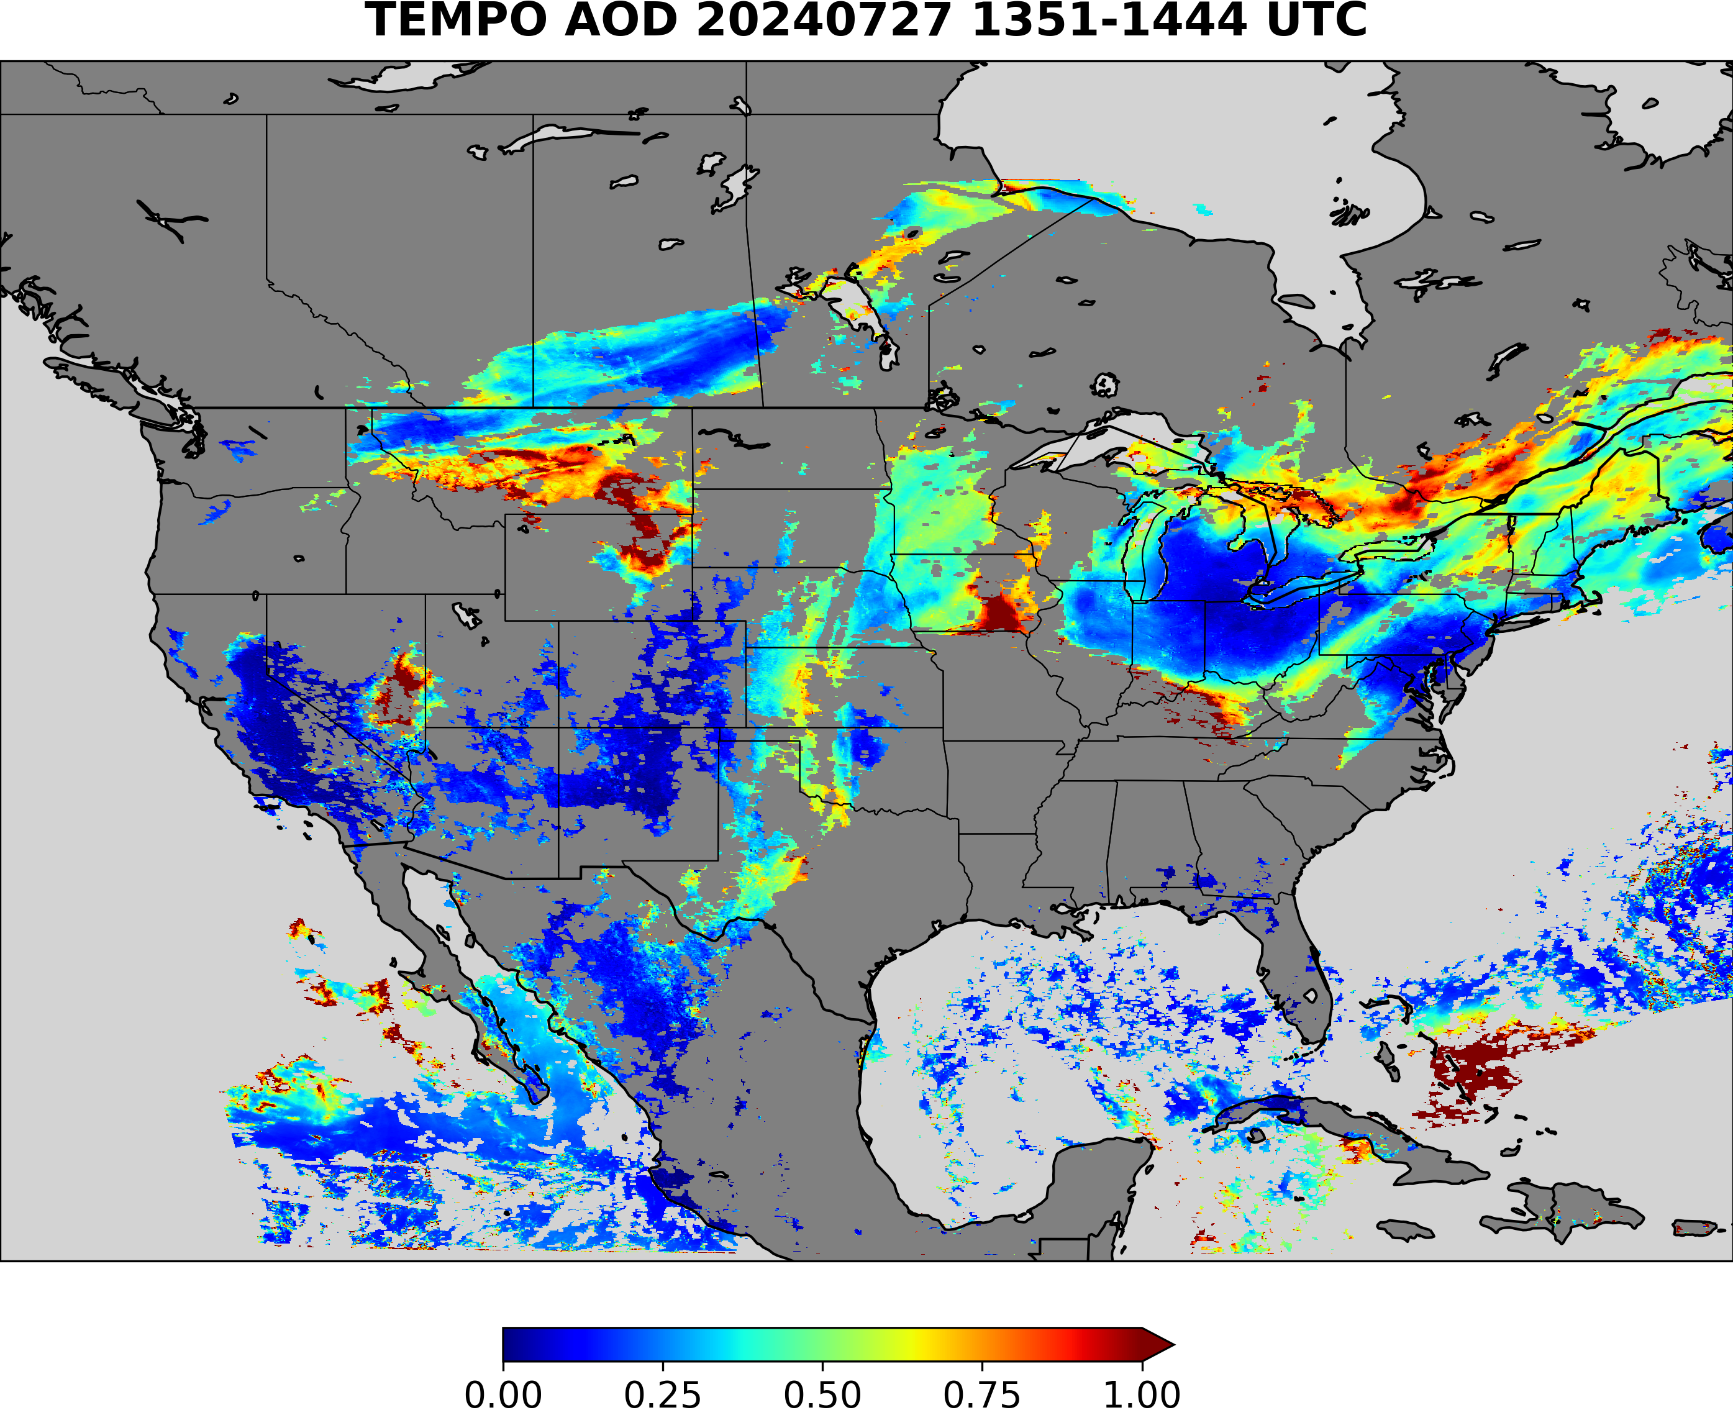
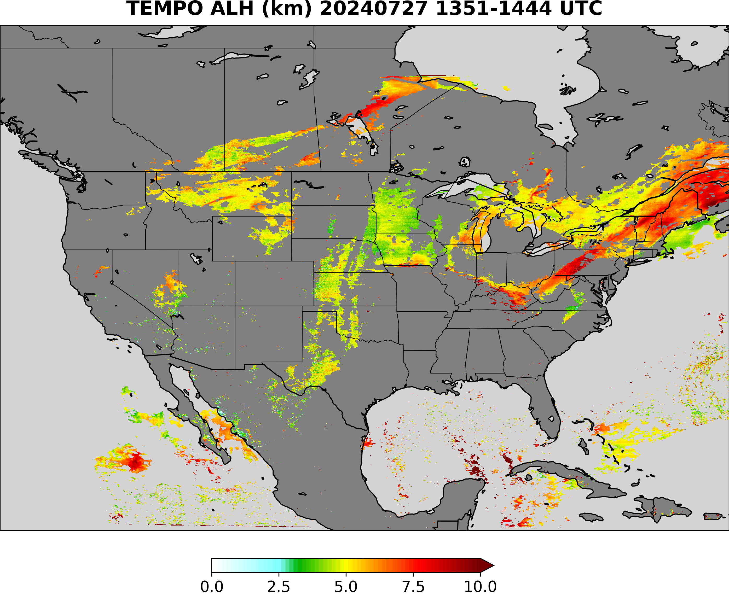
TEMPO AOD and ALH aerosol type selection using ADP
Smoke
TEMPO ADP Smoke Dust Mask Input
smoke
Smoke or dust ?
dust
No detection
Use smoke model
Use generic model
Use dust model

Slide 5
TEMPO AOD and ALH aerosol type selection using ADP
Dust
TEMPO ADP Smoke Dust Mask Input
smoke
Smoke or dust ?
dust
No detection
Use smoke model
Use generic model
Use dust model

Slide 6
TEMPO AOD and ALH aerosol type selection using ADP
Generic
TEMPO ADP Smoke Dust Mask Input
smoke
Smoke or dust ?
dust
No detection
Use smoke model
Use generic model
Use dust model

Slide 7
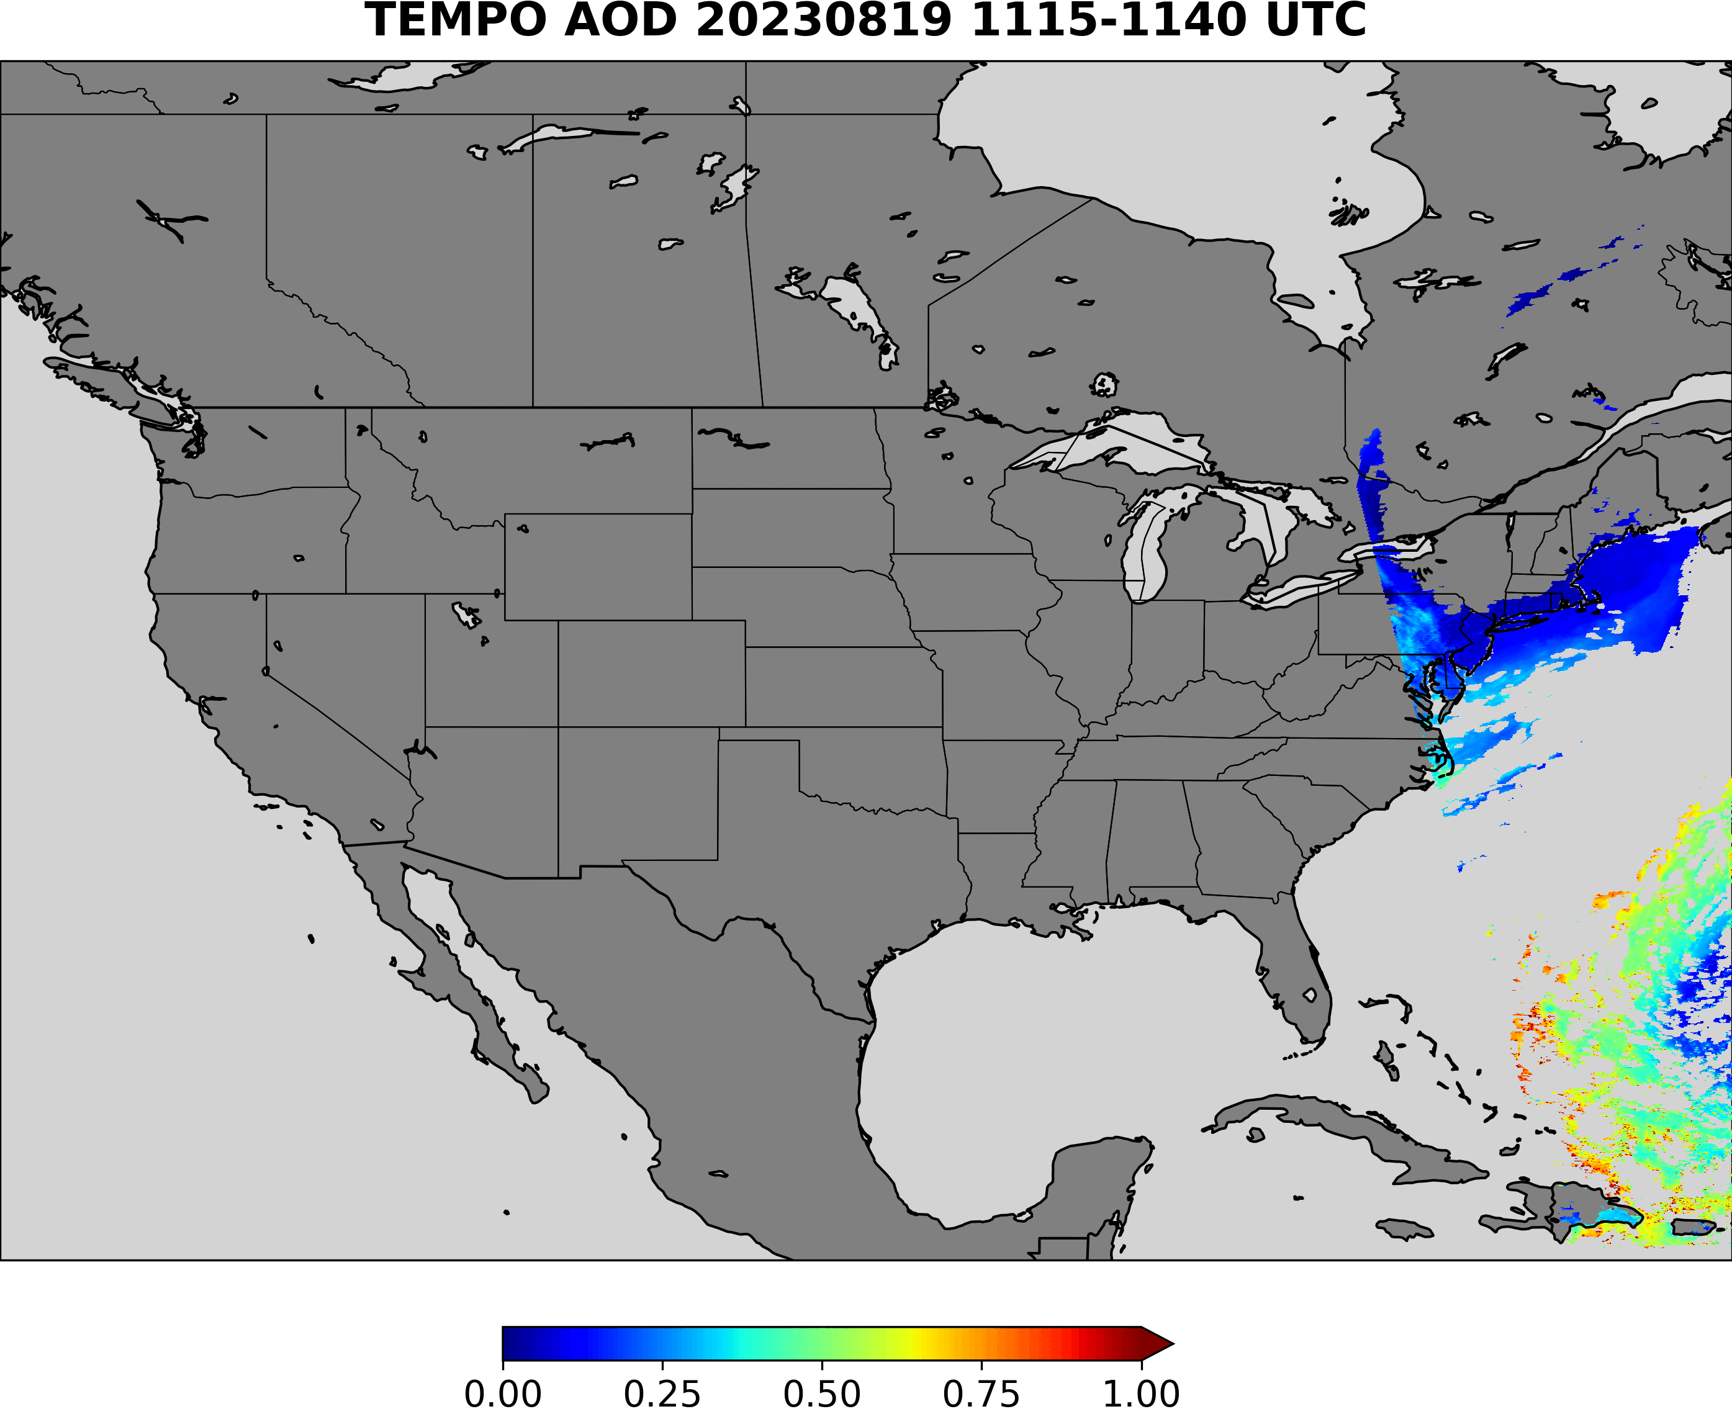
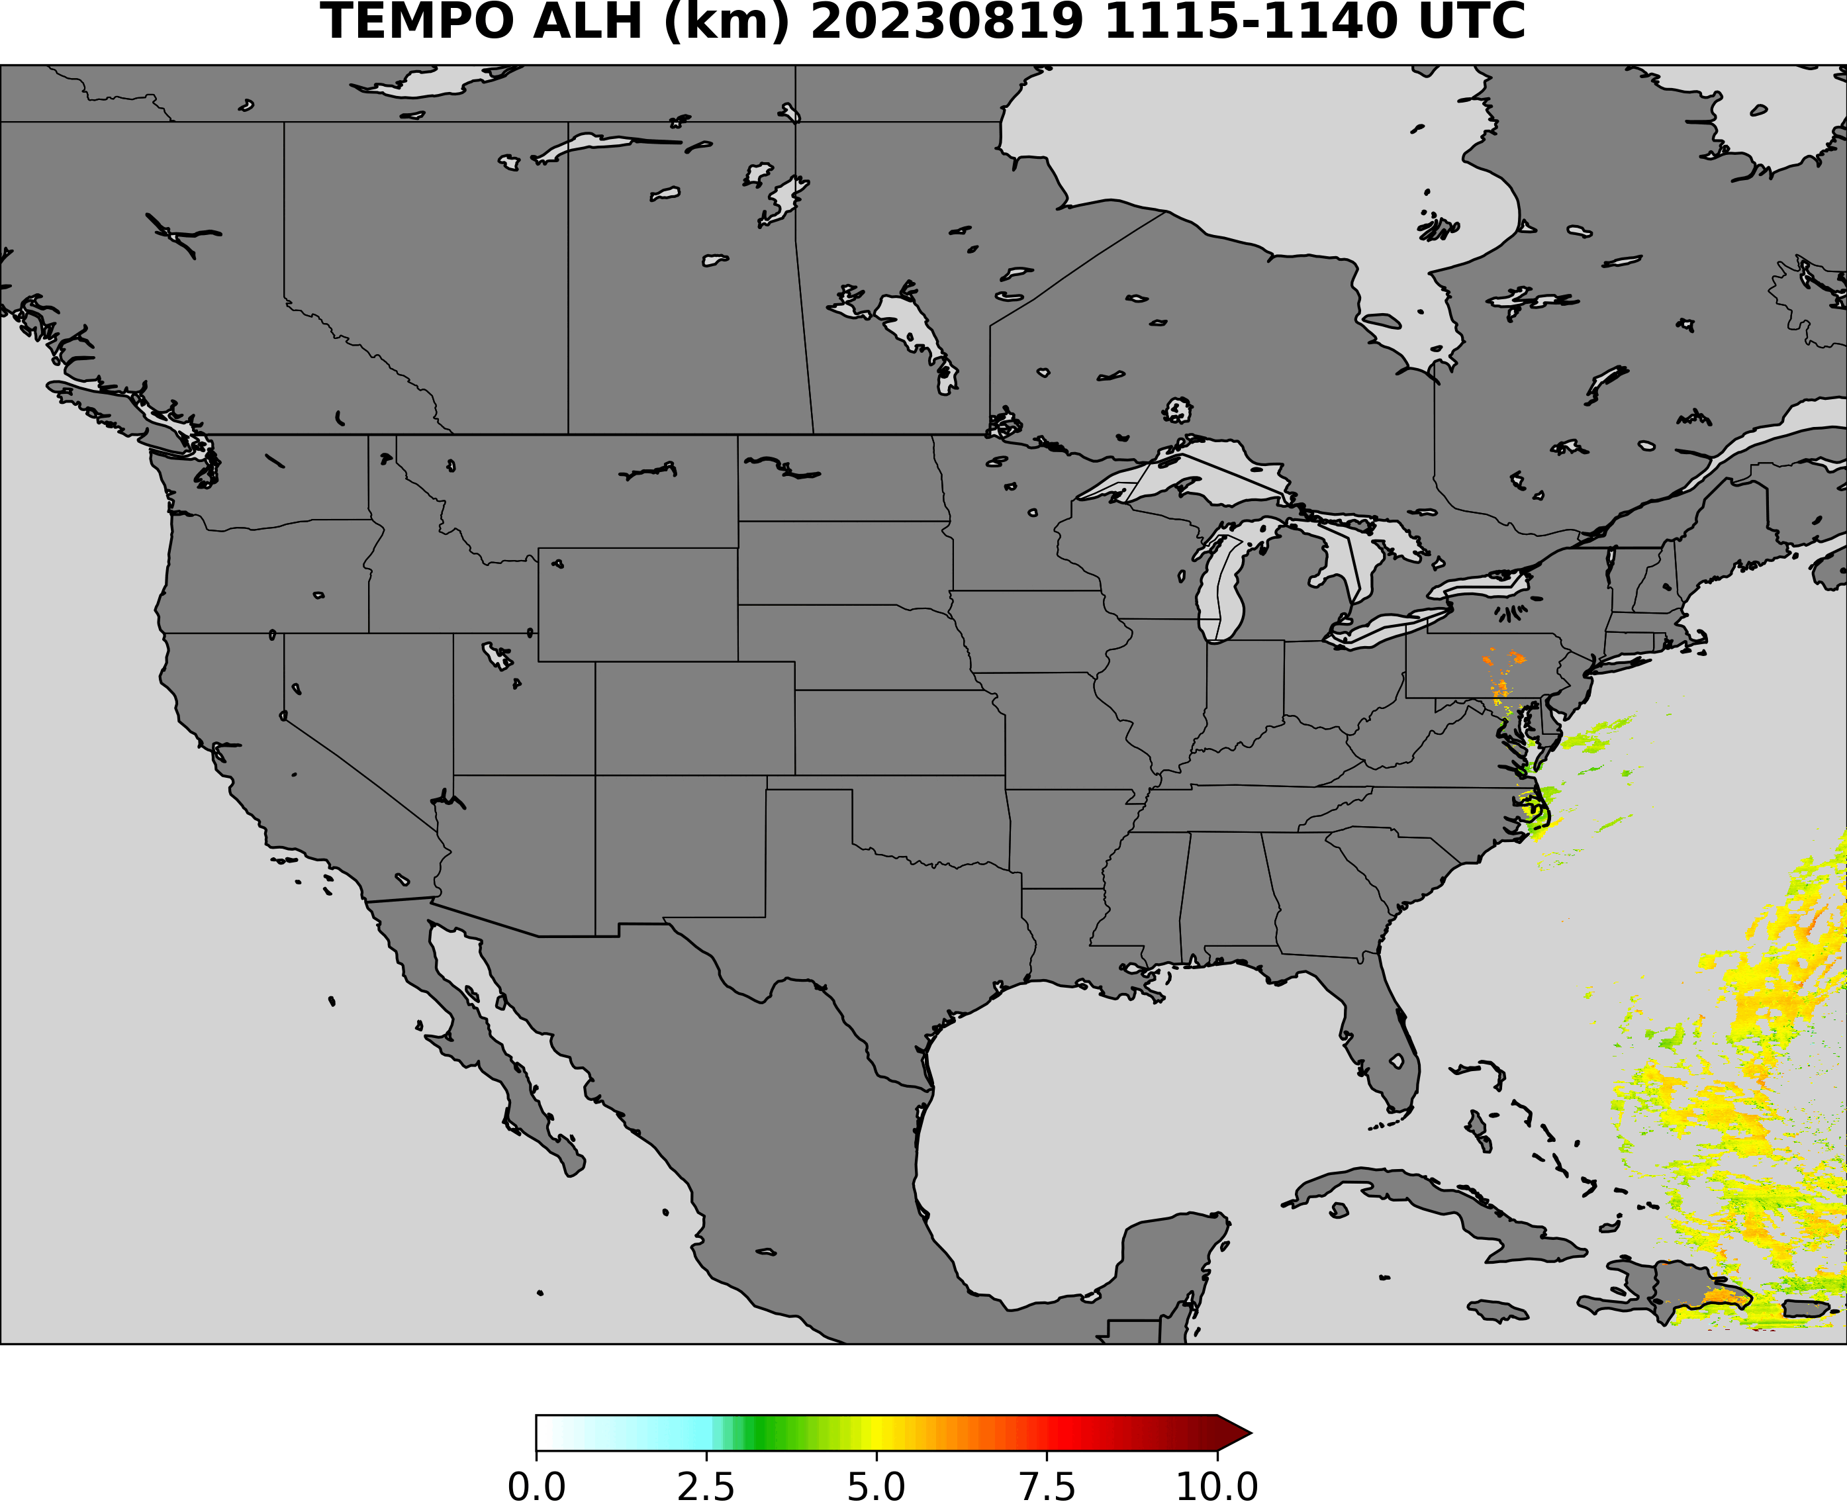
Example TEMPO retrieval August 19, 2023
(AOD>0.3)
Disclaimer：TEMPO L1B data courtesy of NASA and all results are preliminary.

Slide 8
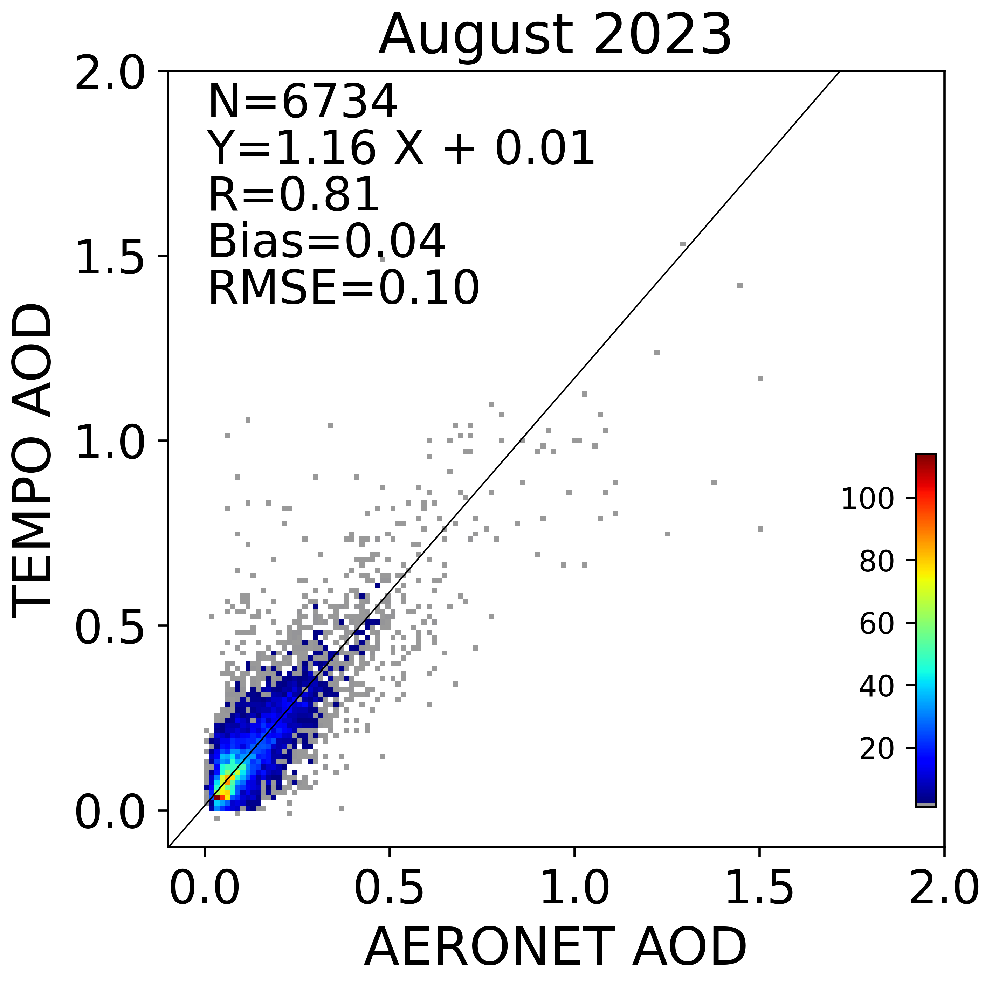
TEMPO AOD vs AERONET AOD August 2023
Disclaimer：TEMPO L1B data courtesy of NASA and all results are preliminary.

Slide 9
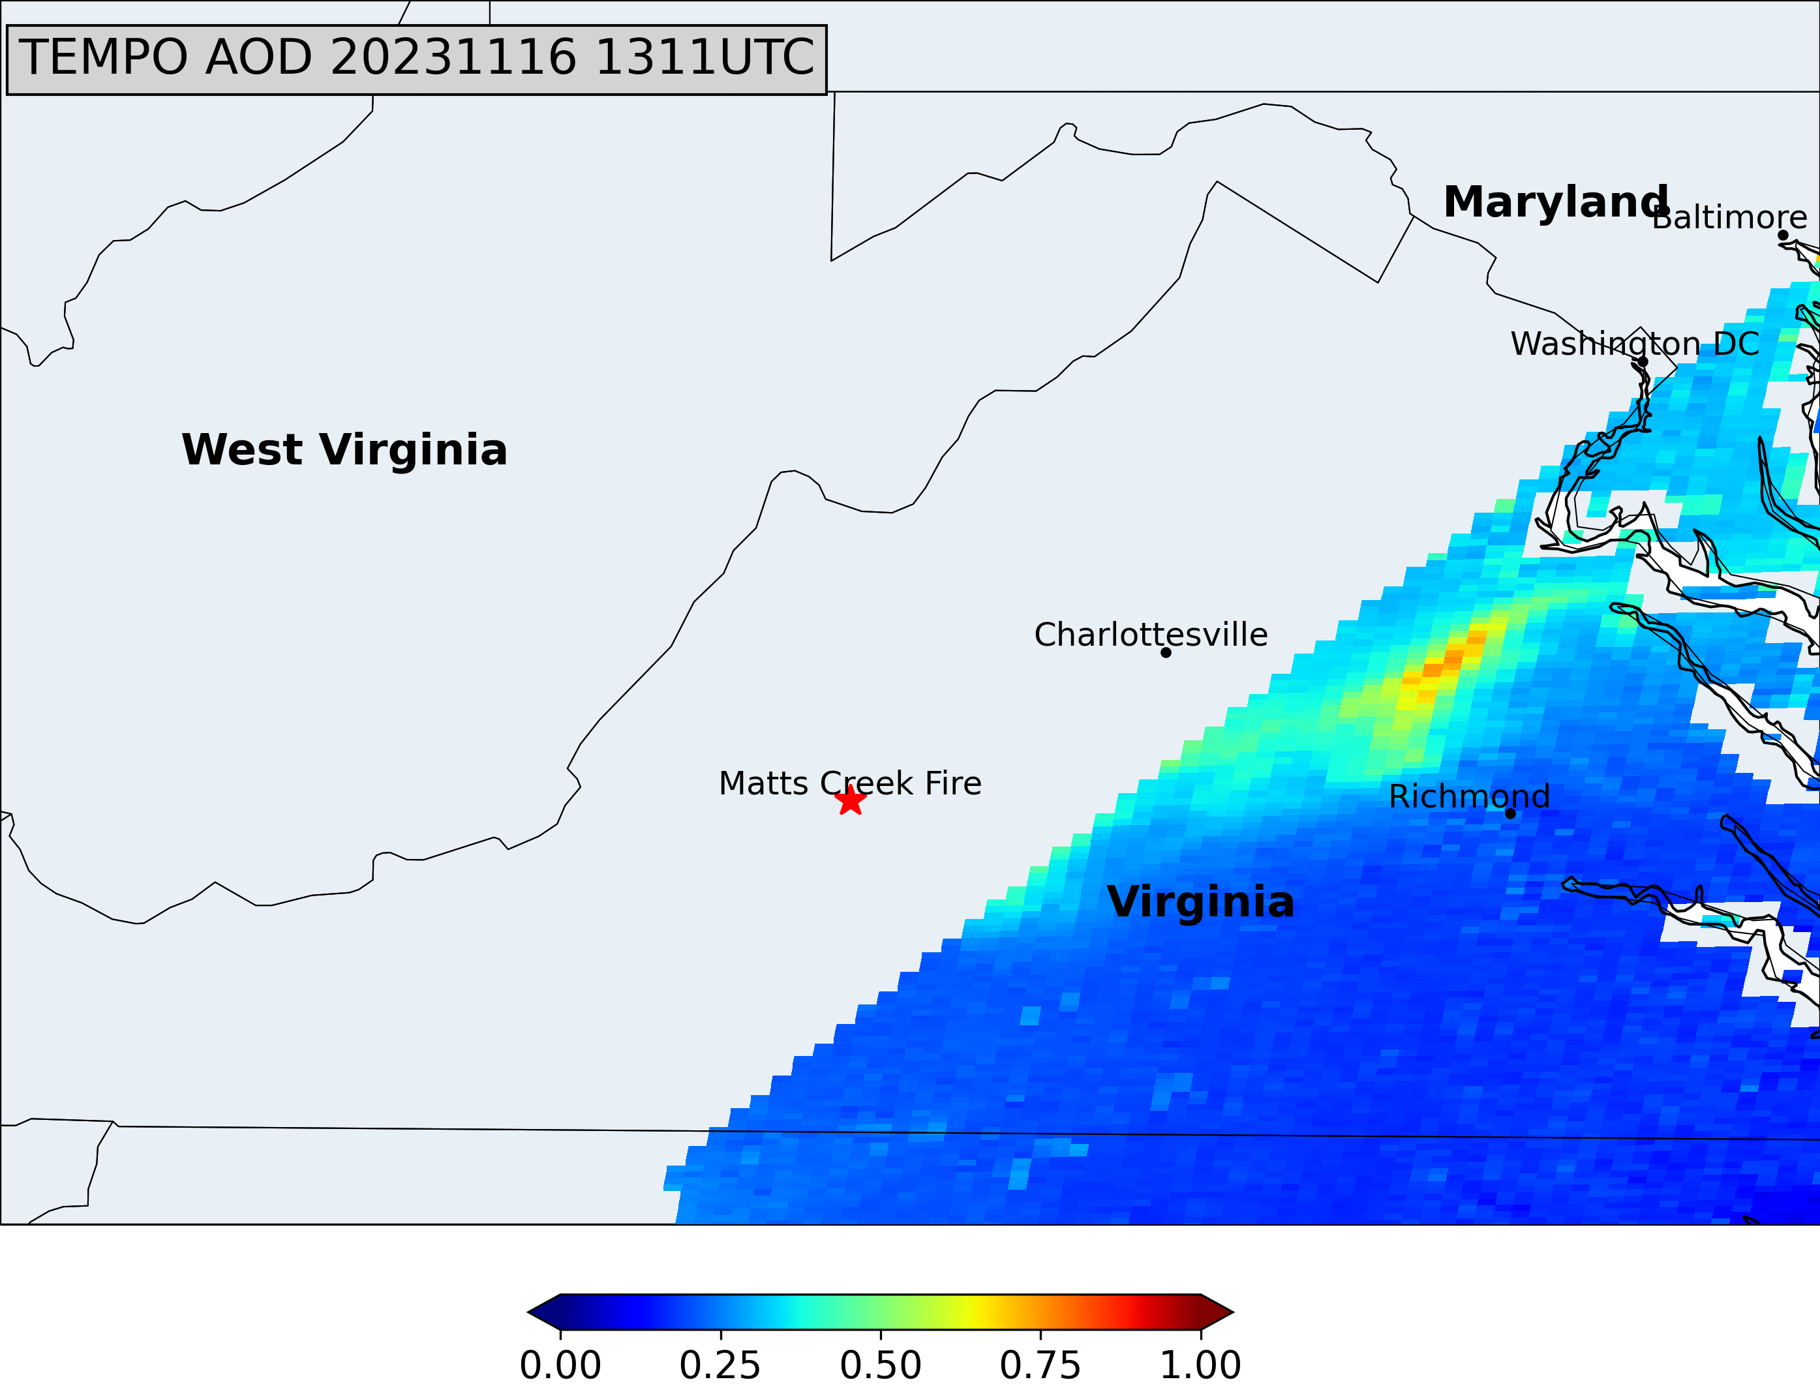
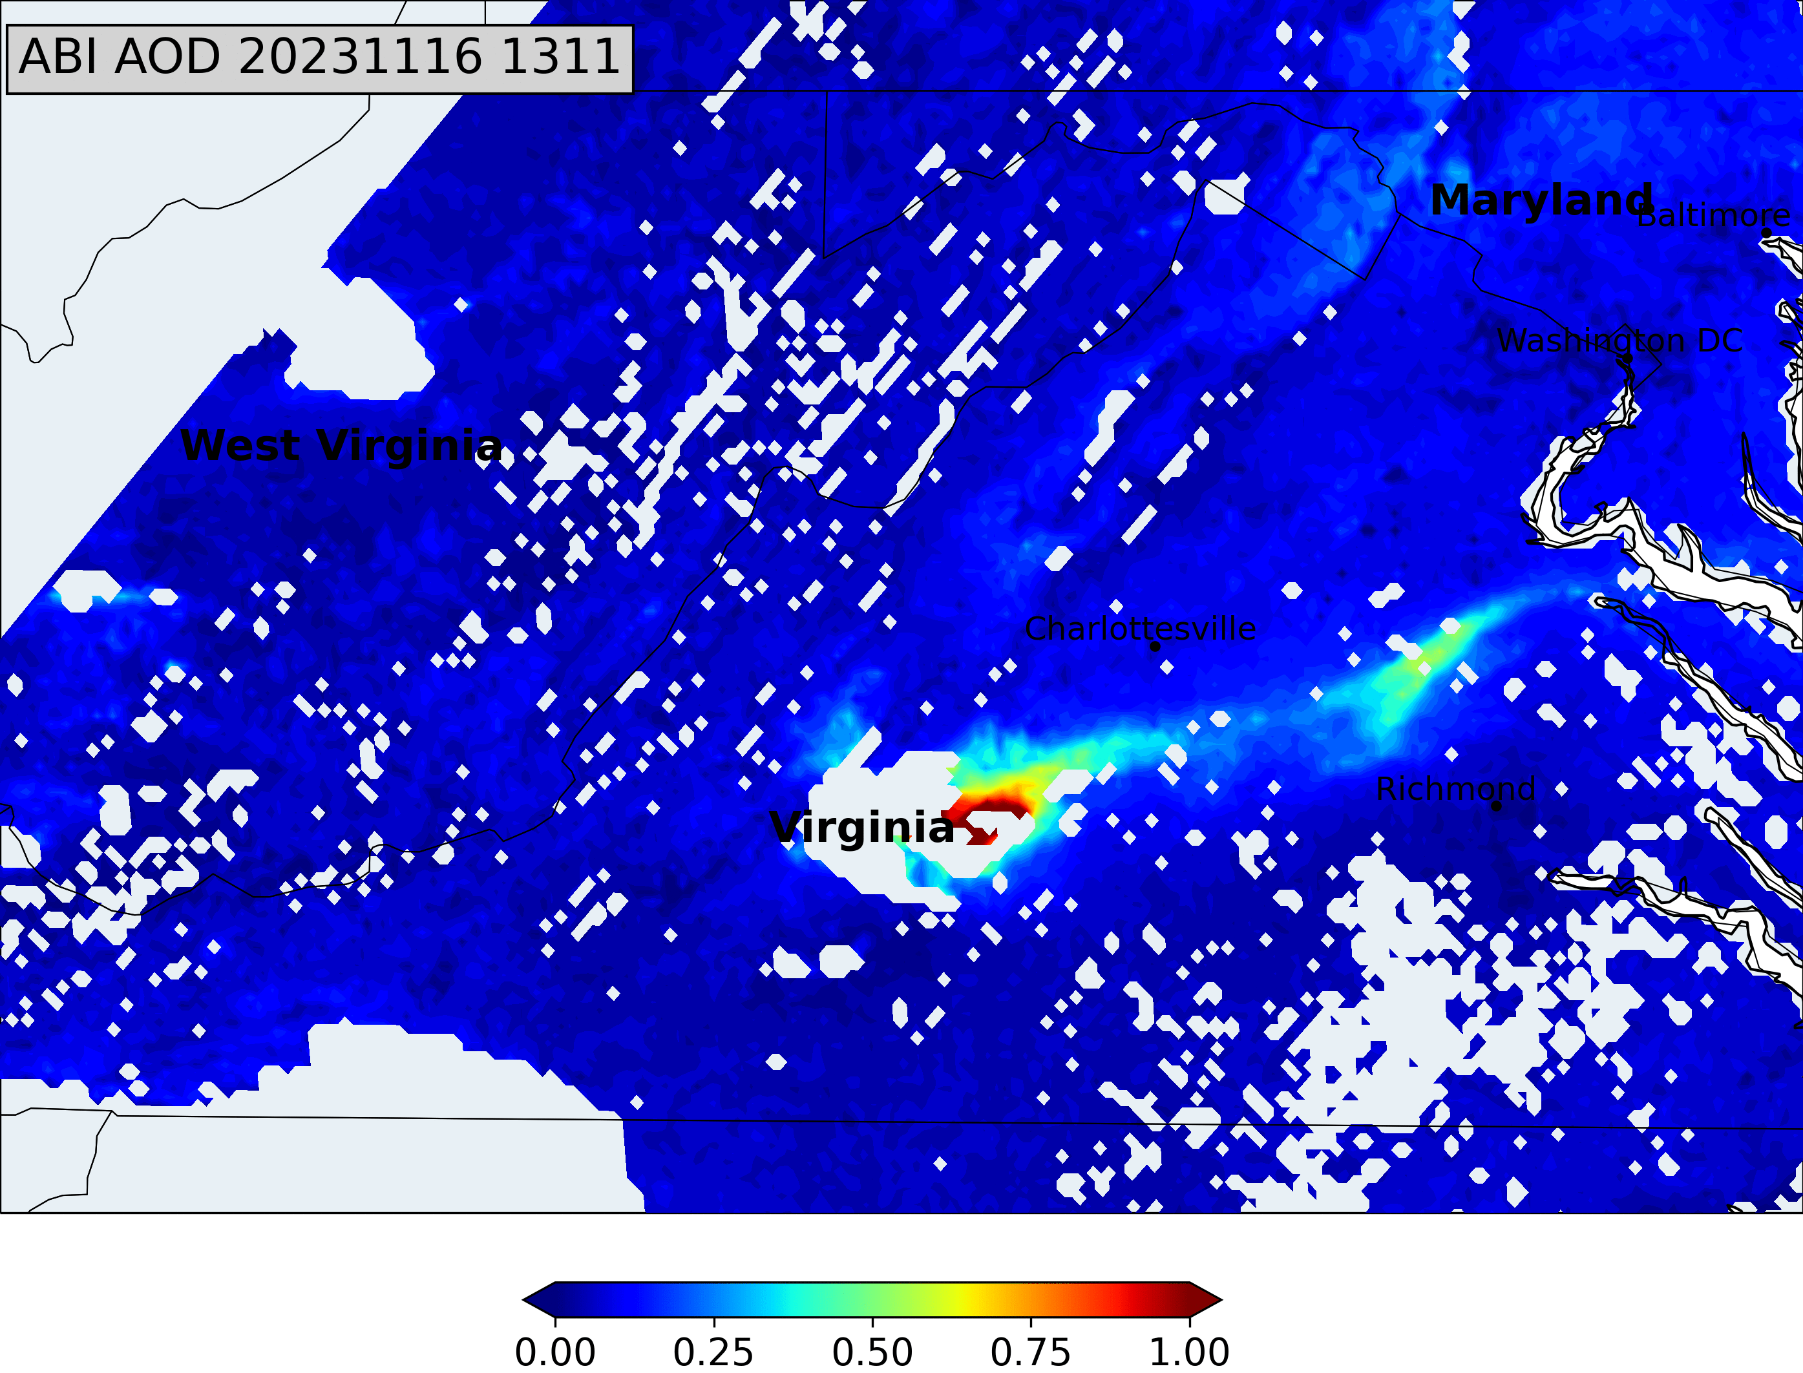
TEMPO retrievals of AOD for 20231116 fire case in VA and comparison to ABI AOD
Disclaimer：TEMPO L1B data courtesy of NASA and all results are preliminary.

Slide 10
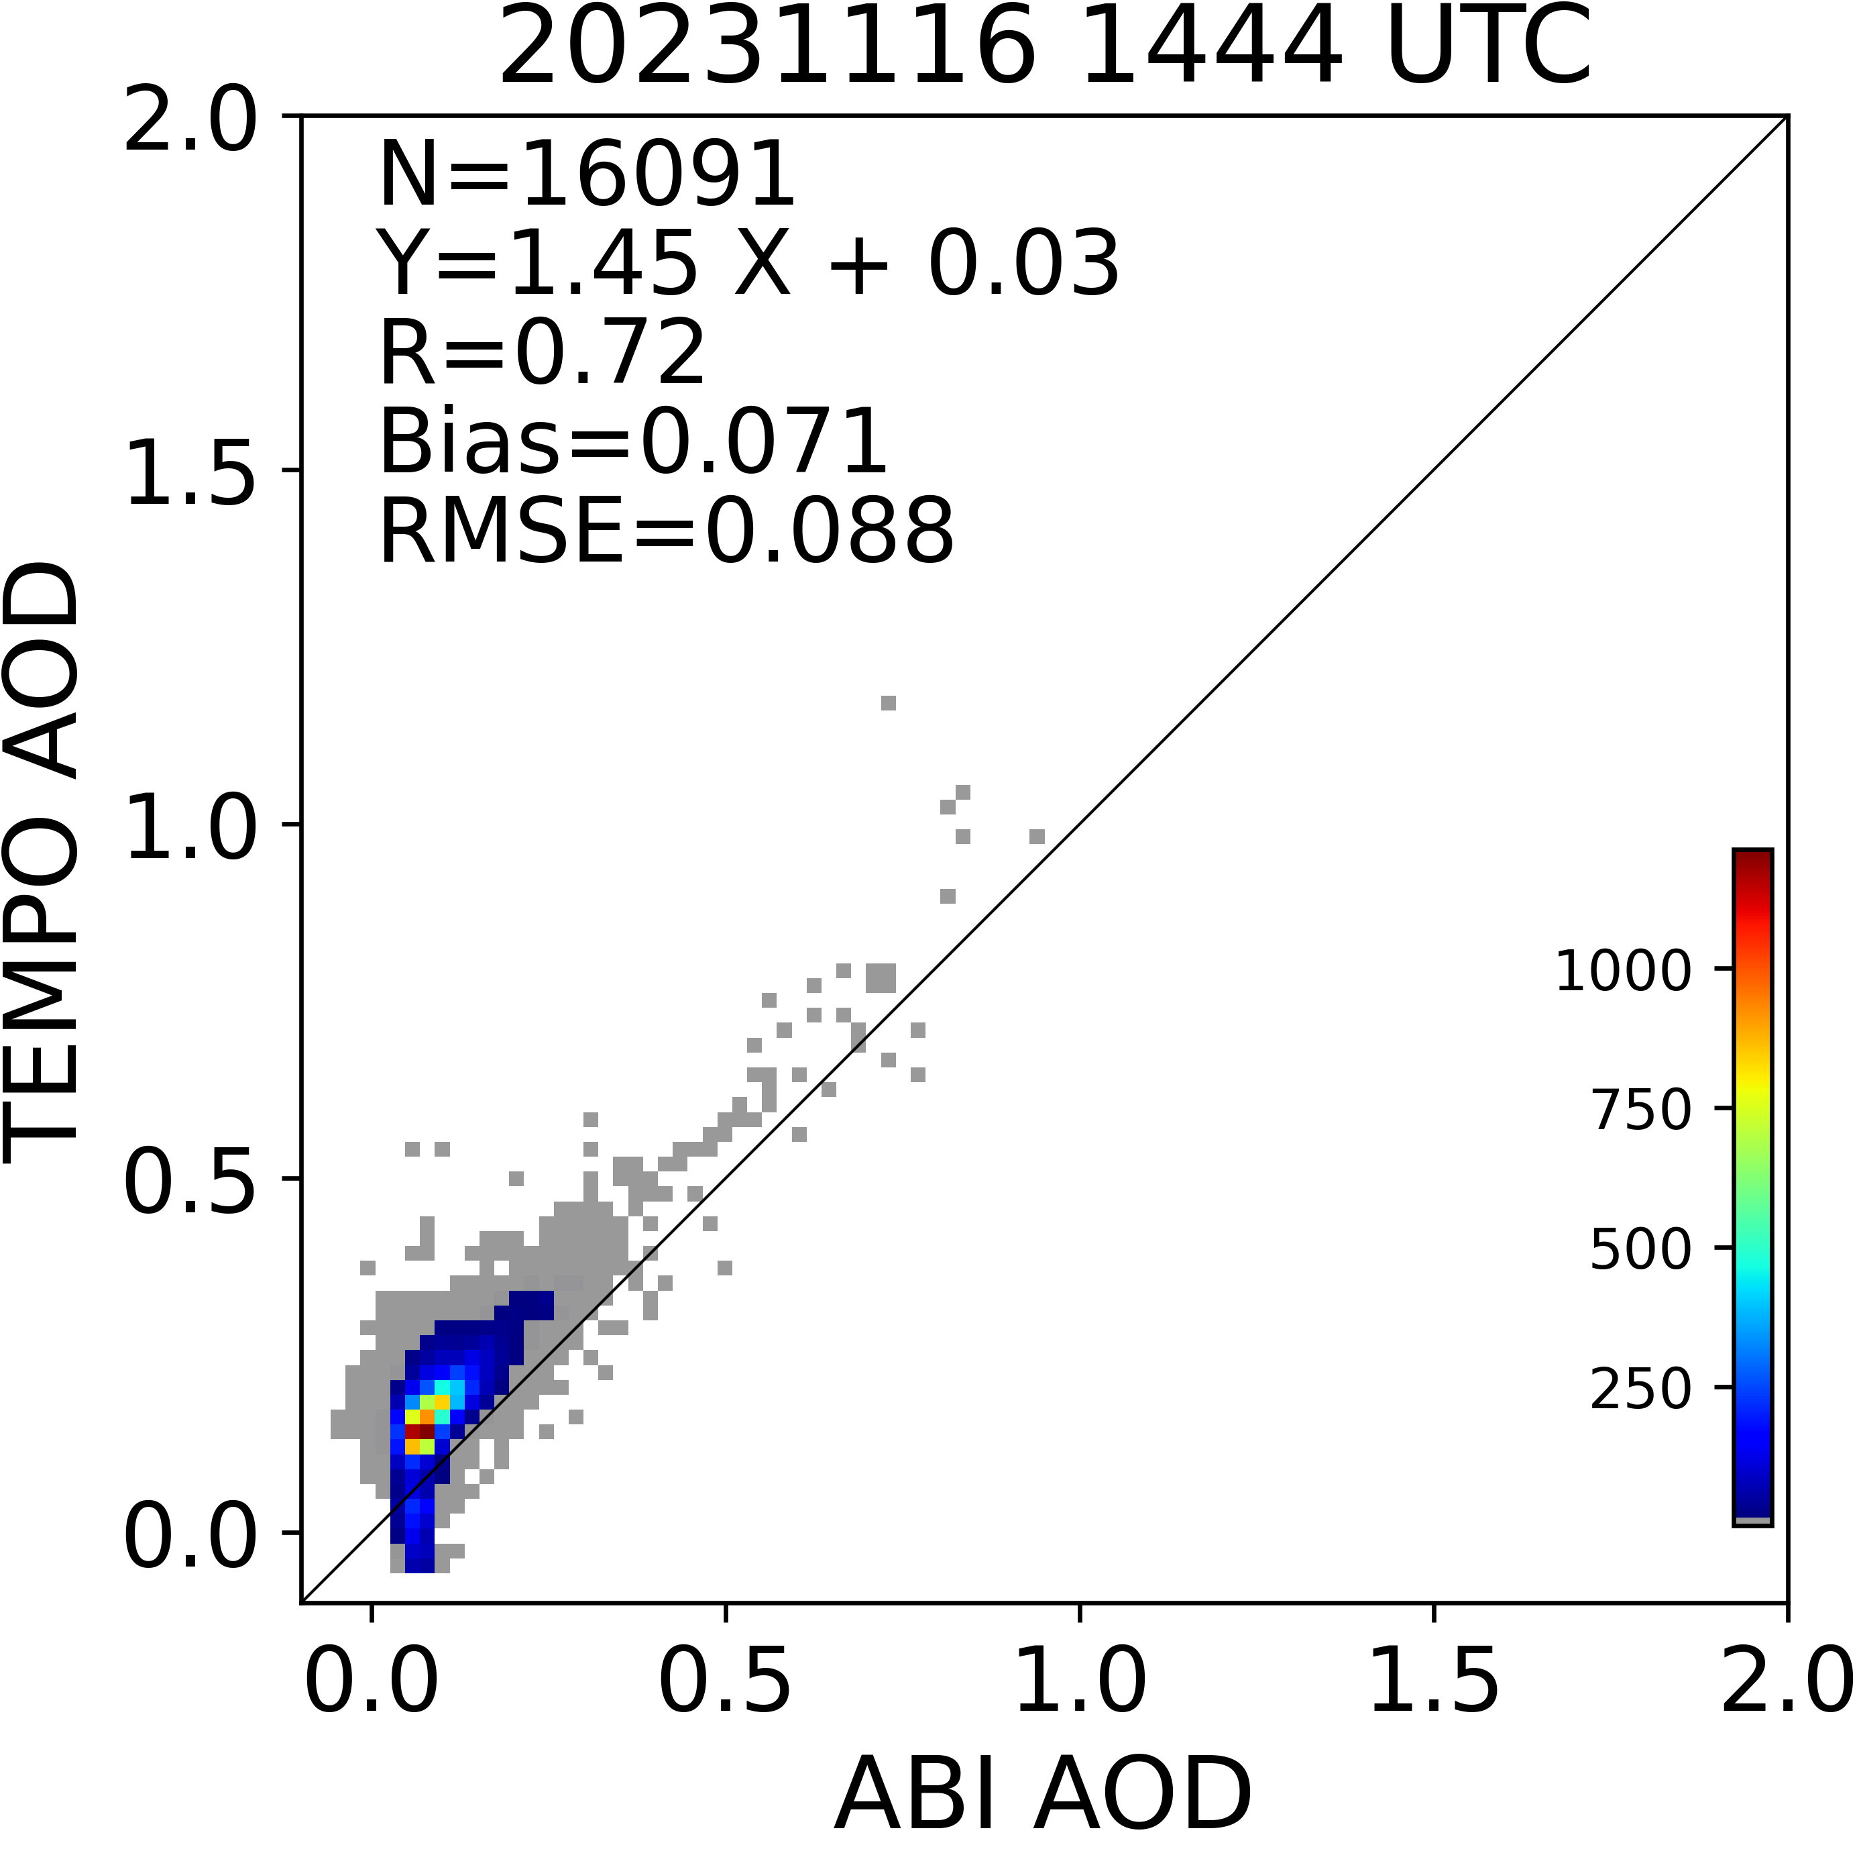
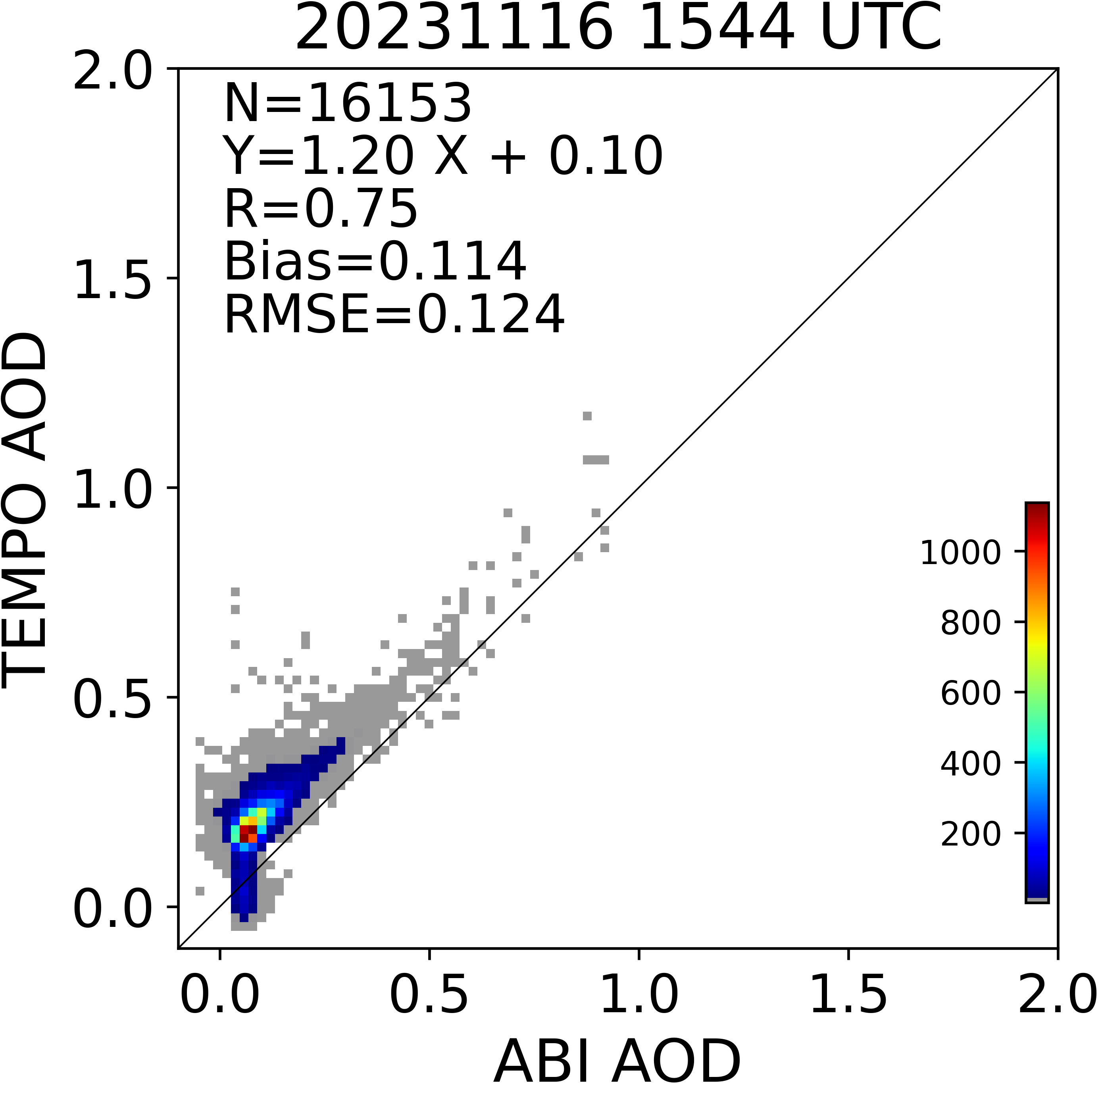
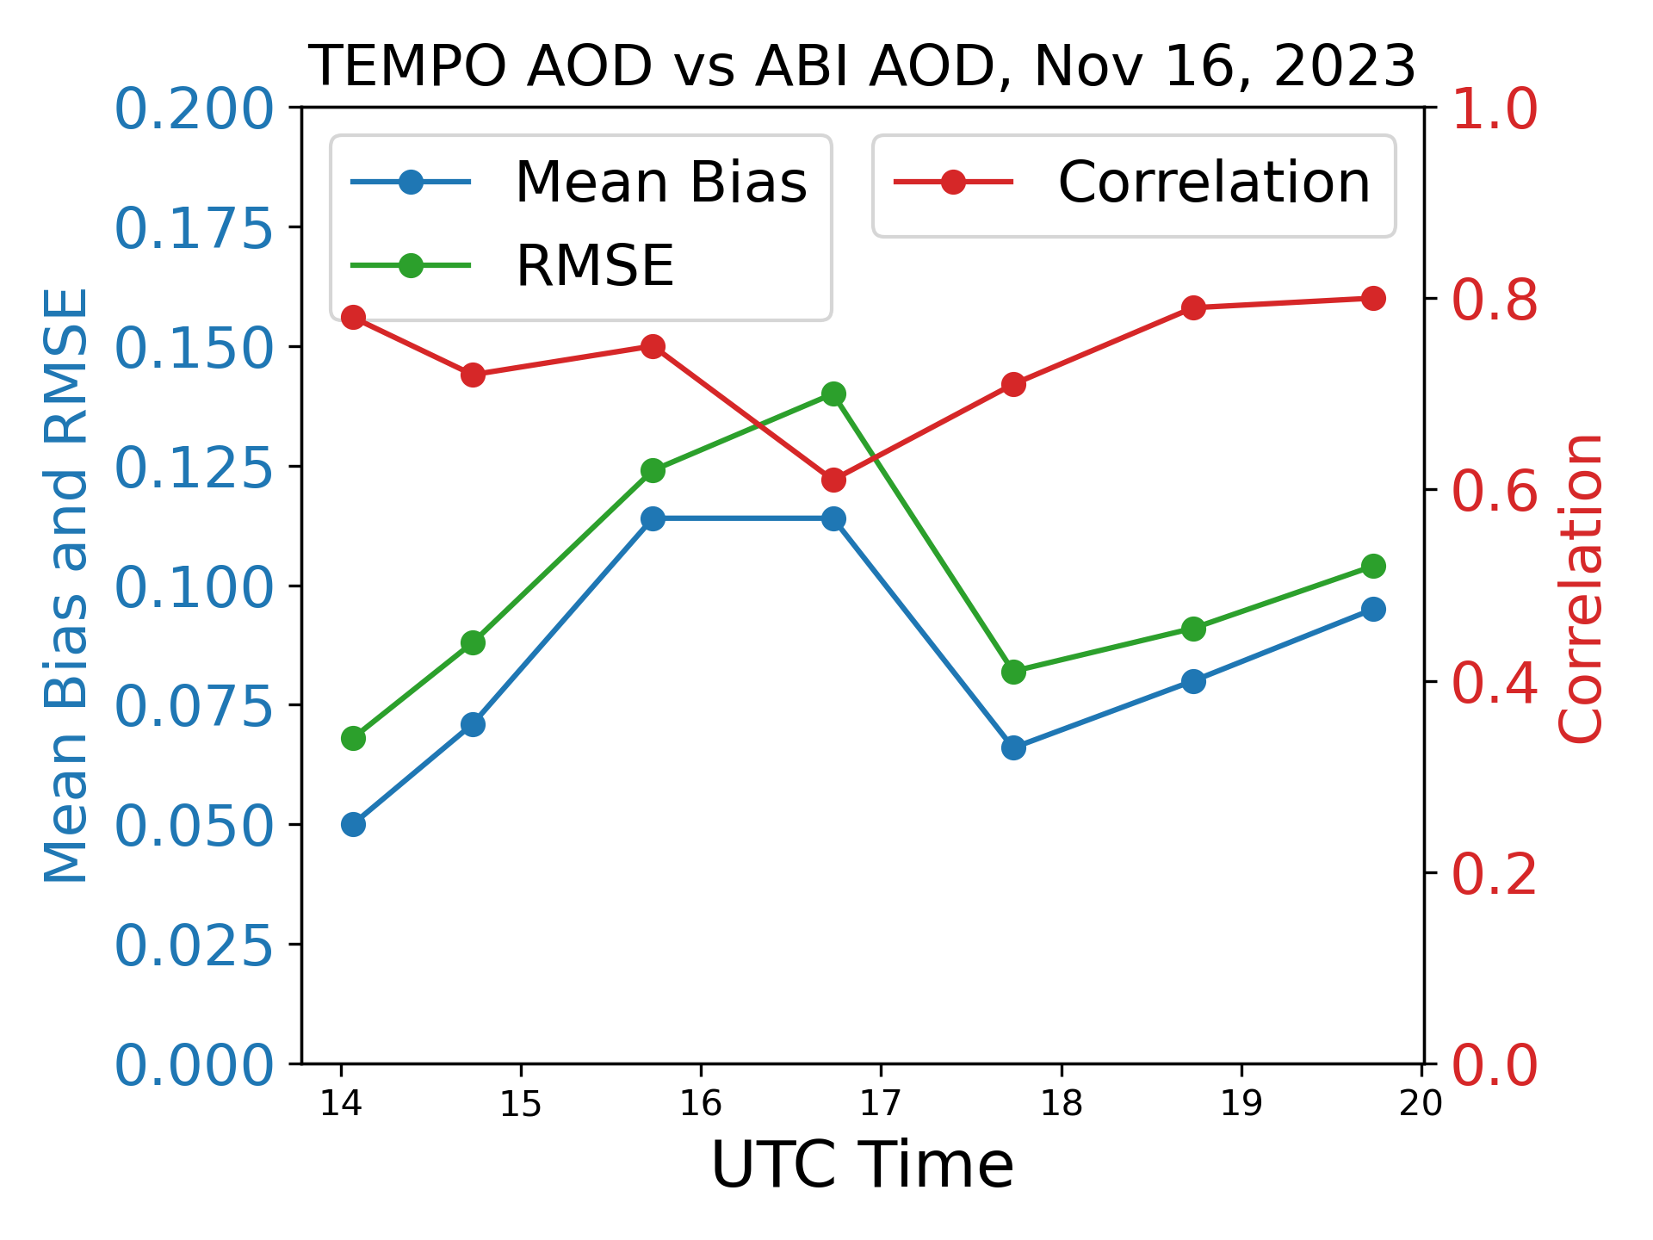
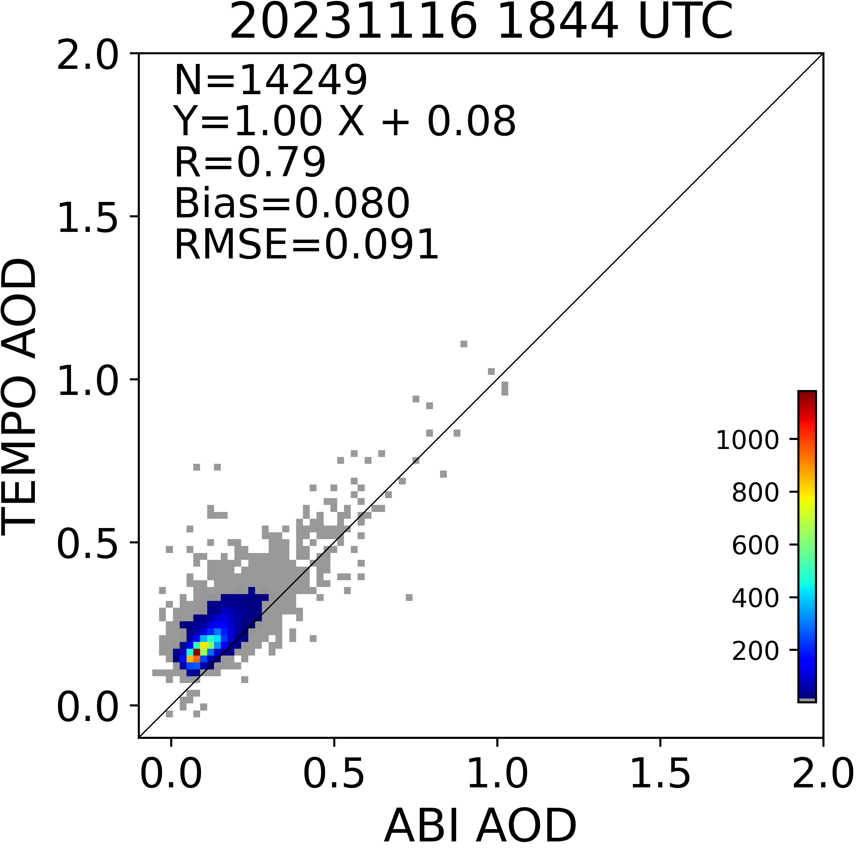
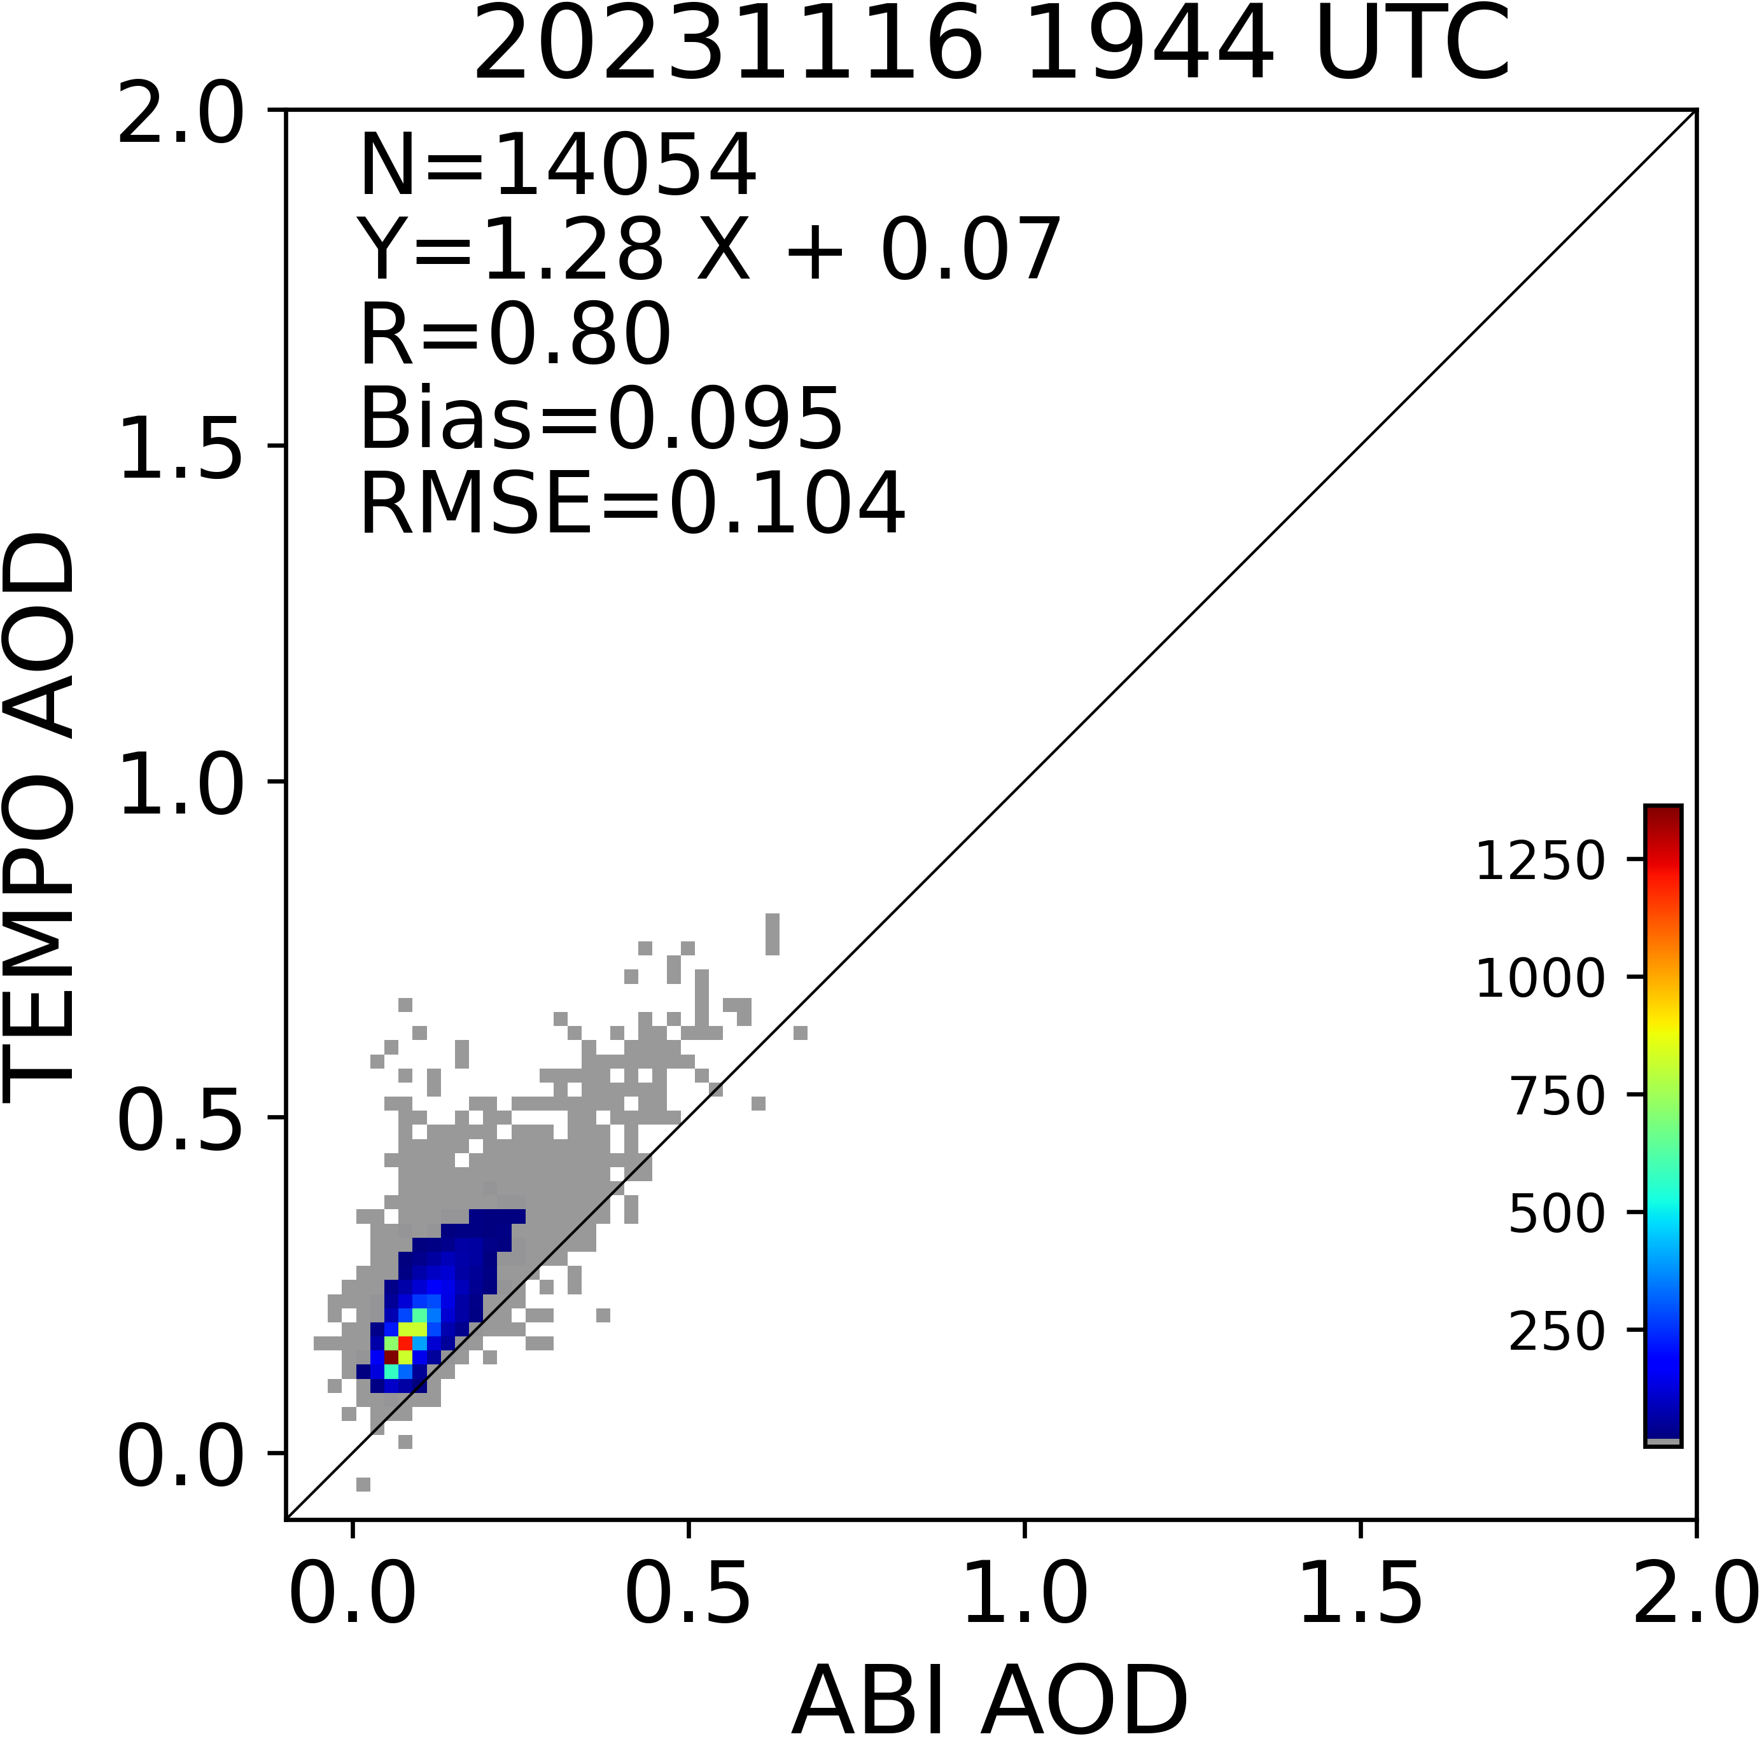
TEMPO AOD vs ABI AOD in the VA fire region
Disclaimer：TEMPO L1B data courtesy of NASA and all results are preliminary.

Slide 11
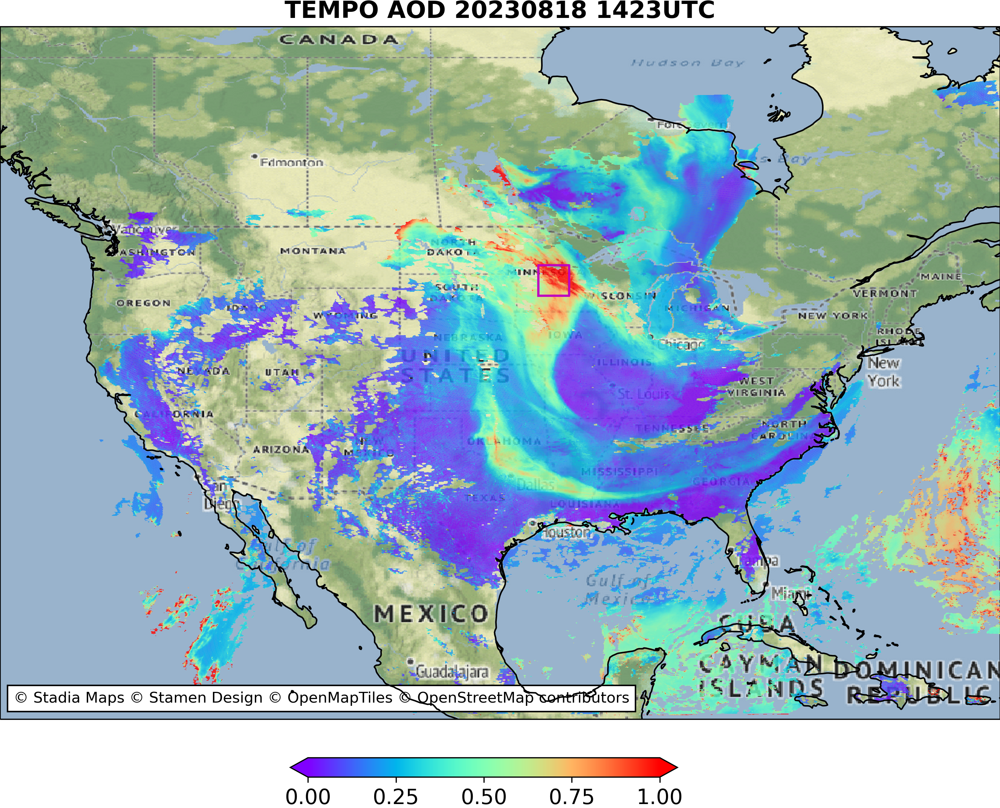
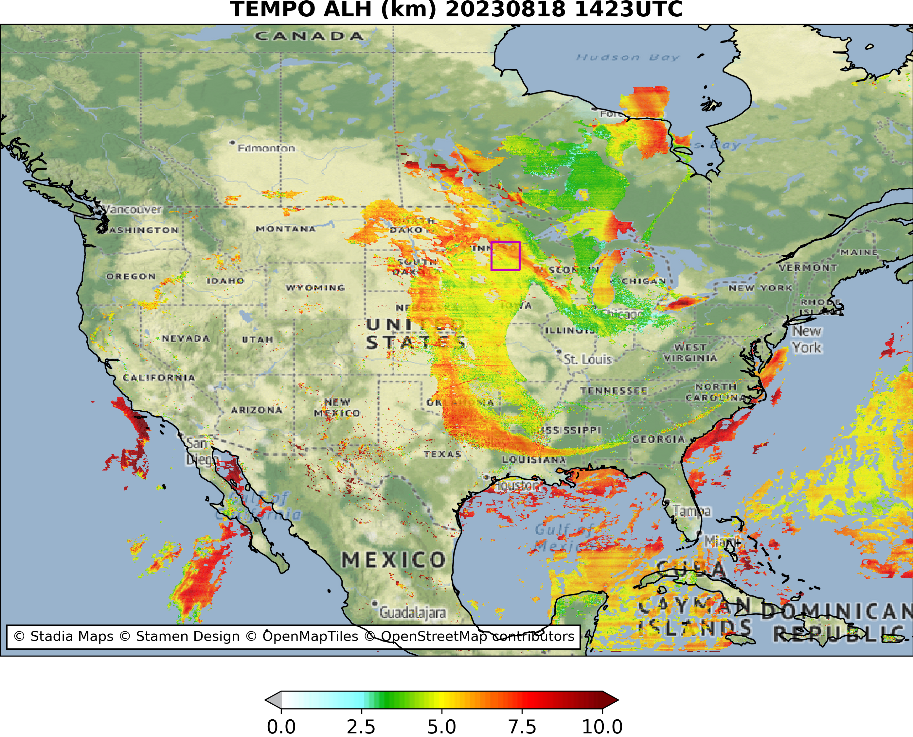
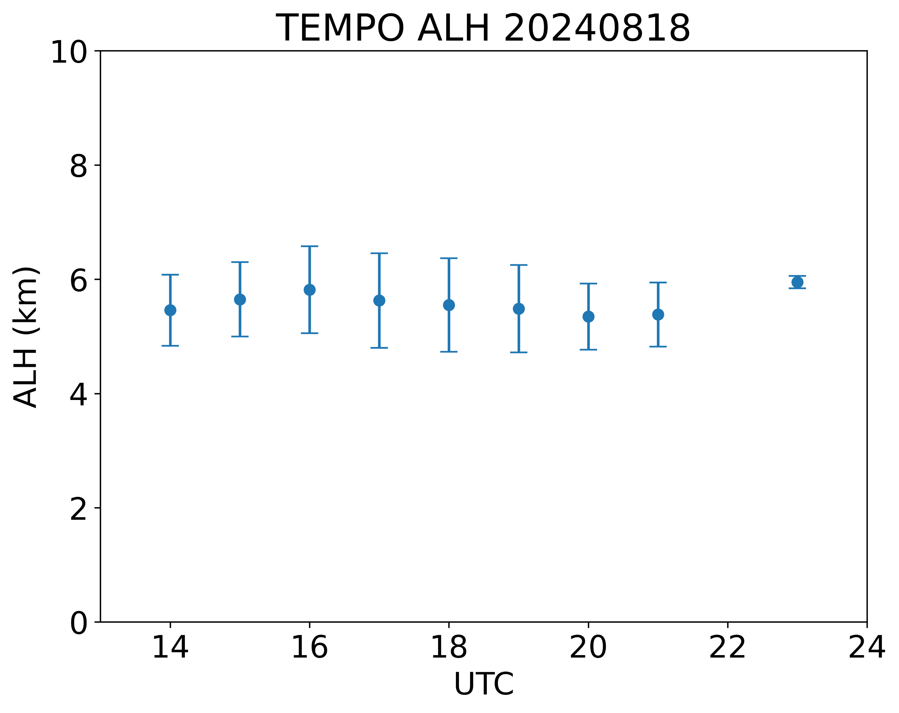
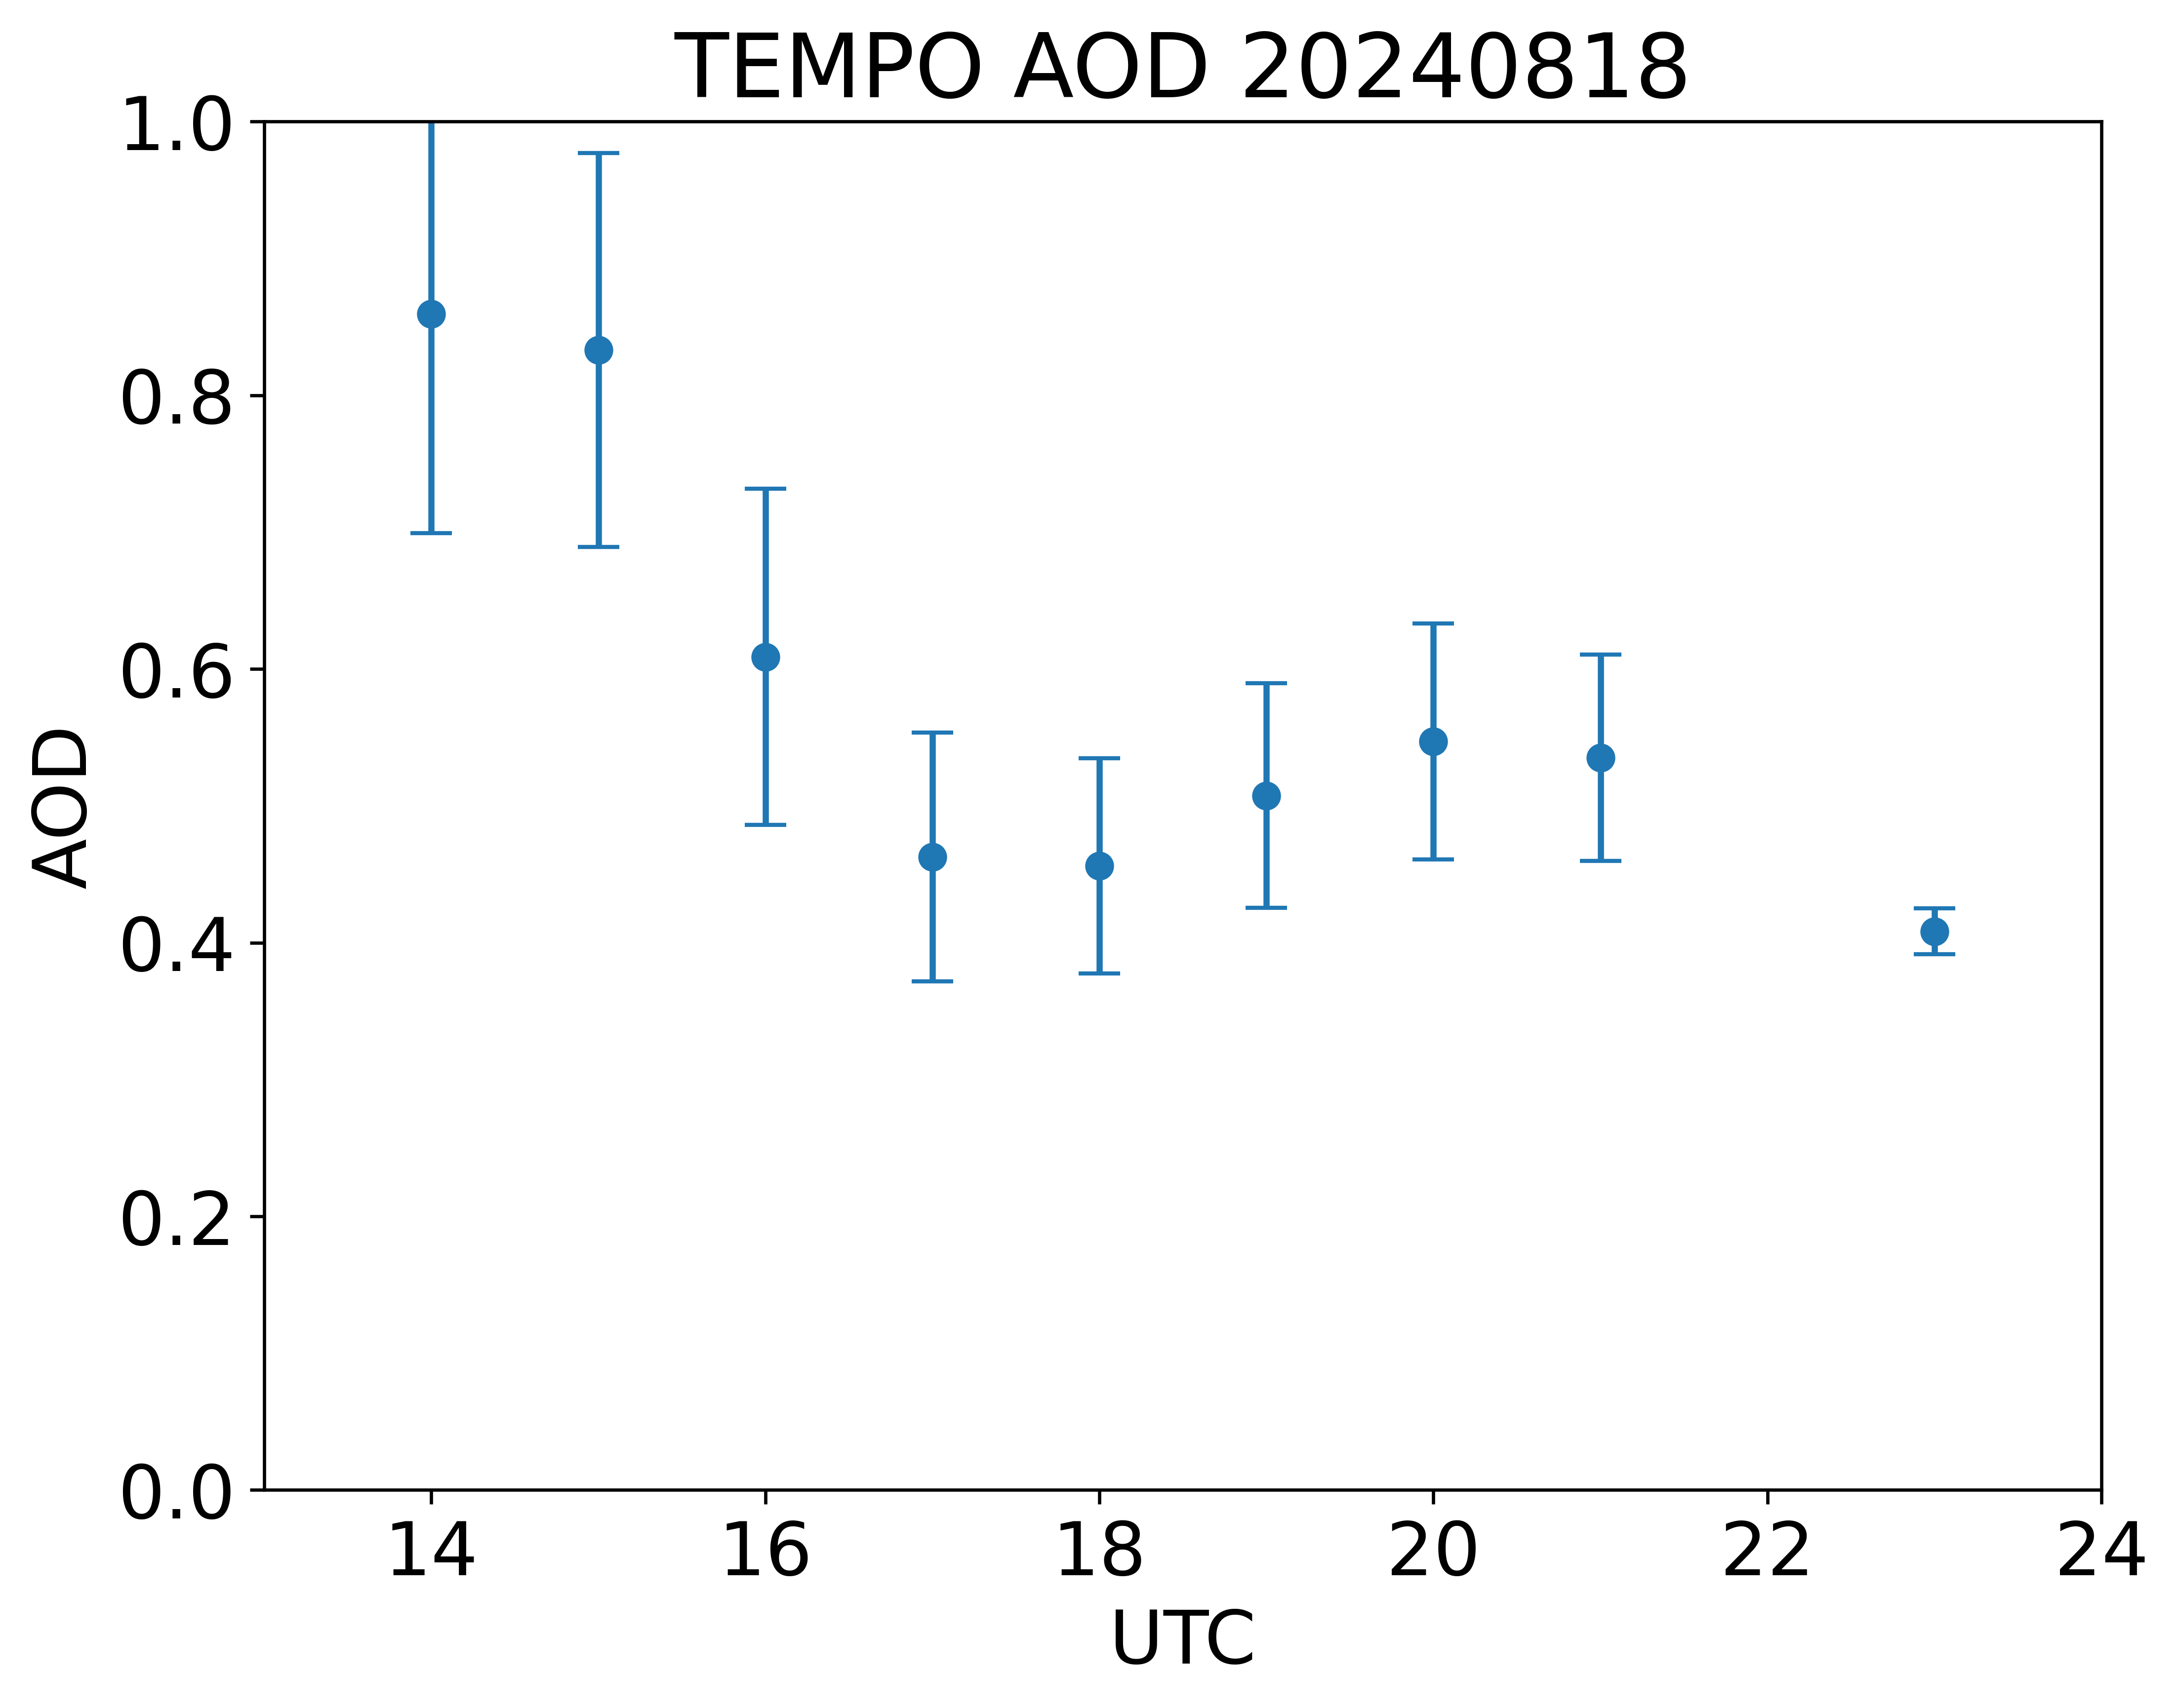
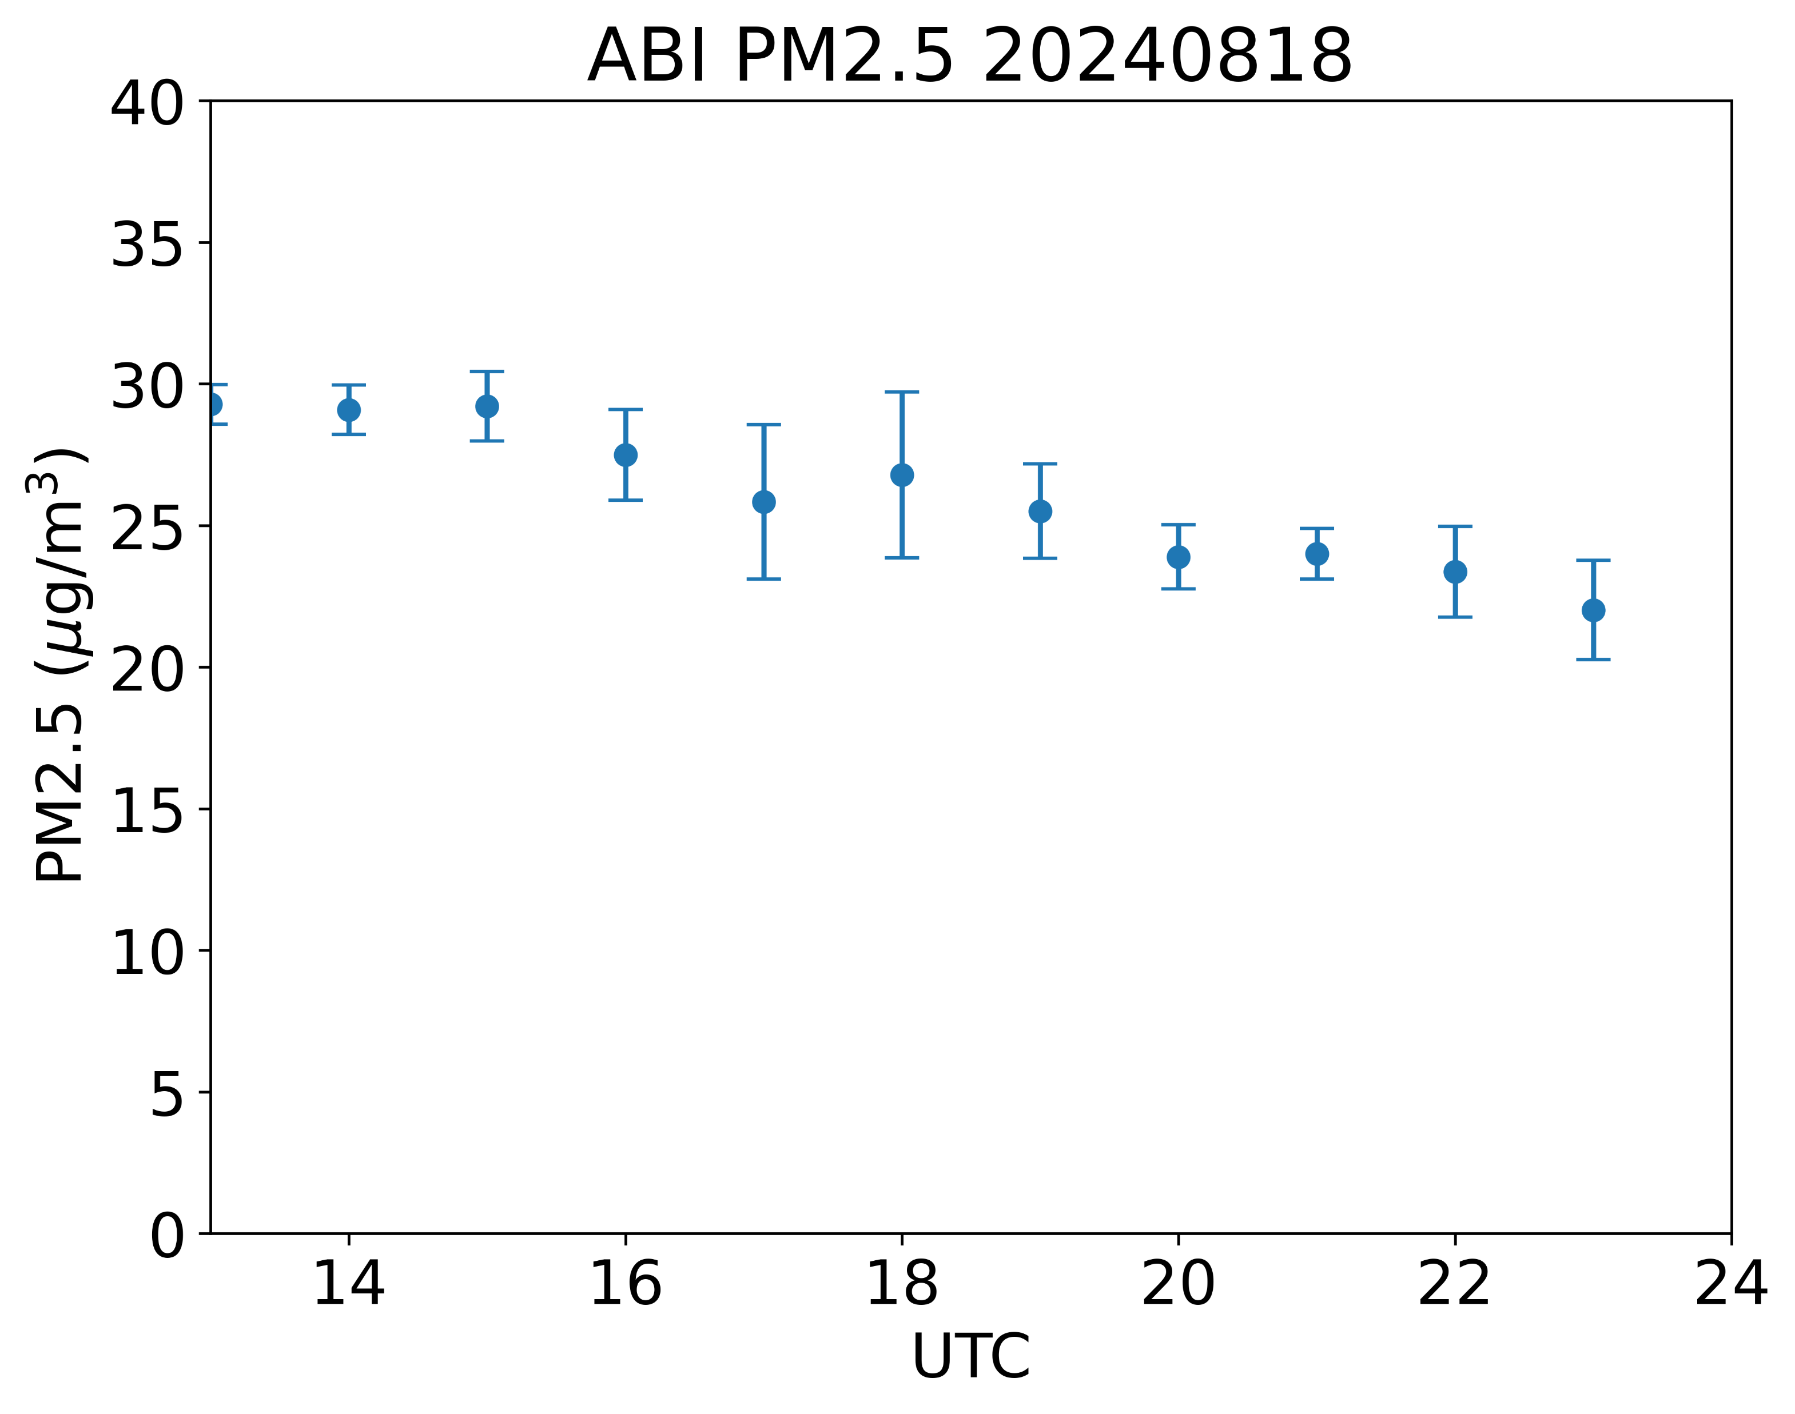
Diurnal variations over a region with high AOD (lat: 44.5N-46.5N, lon: 95W-93W)
Disclaimer：TEMPO L1B data courtesy of NASA and all results are preliminary.

Slide 12
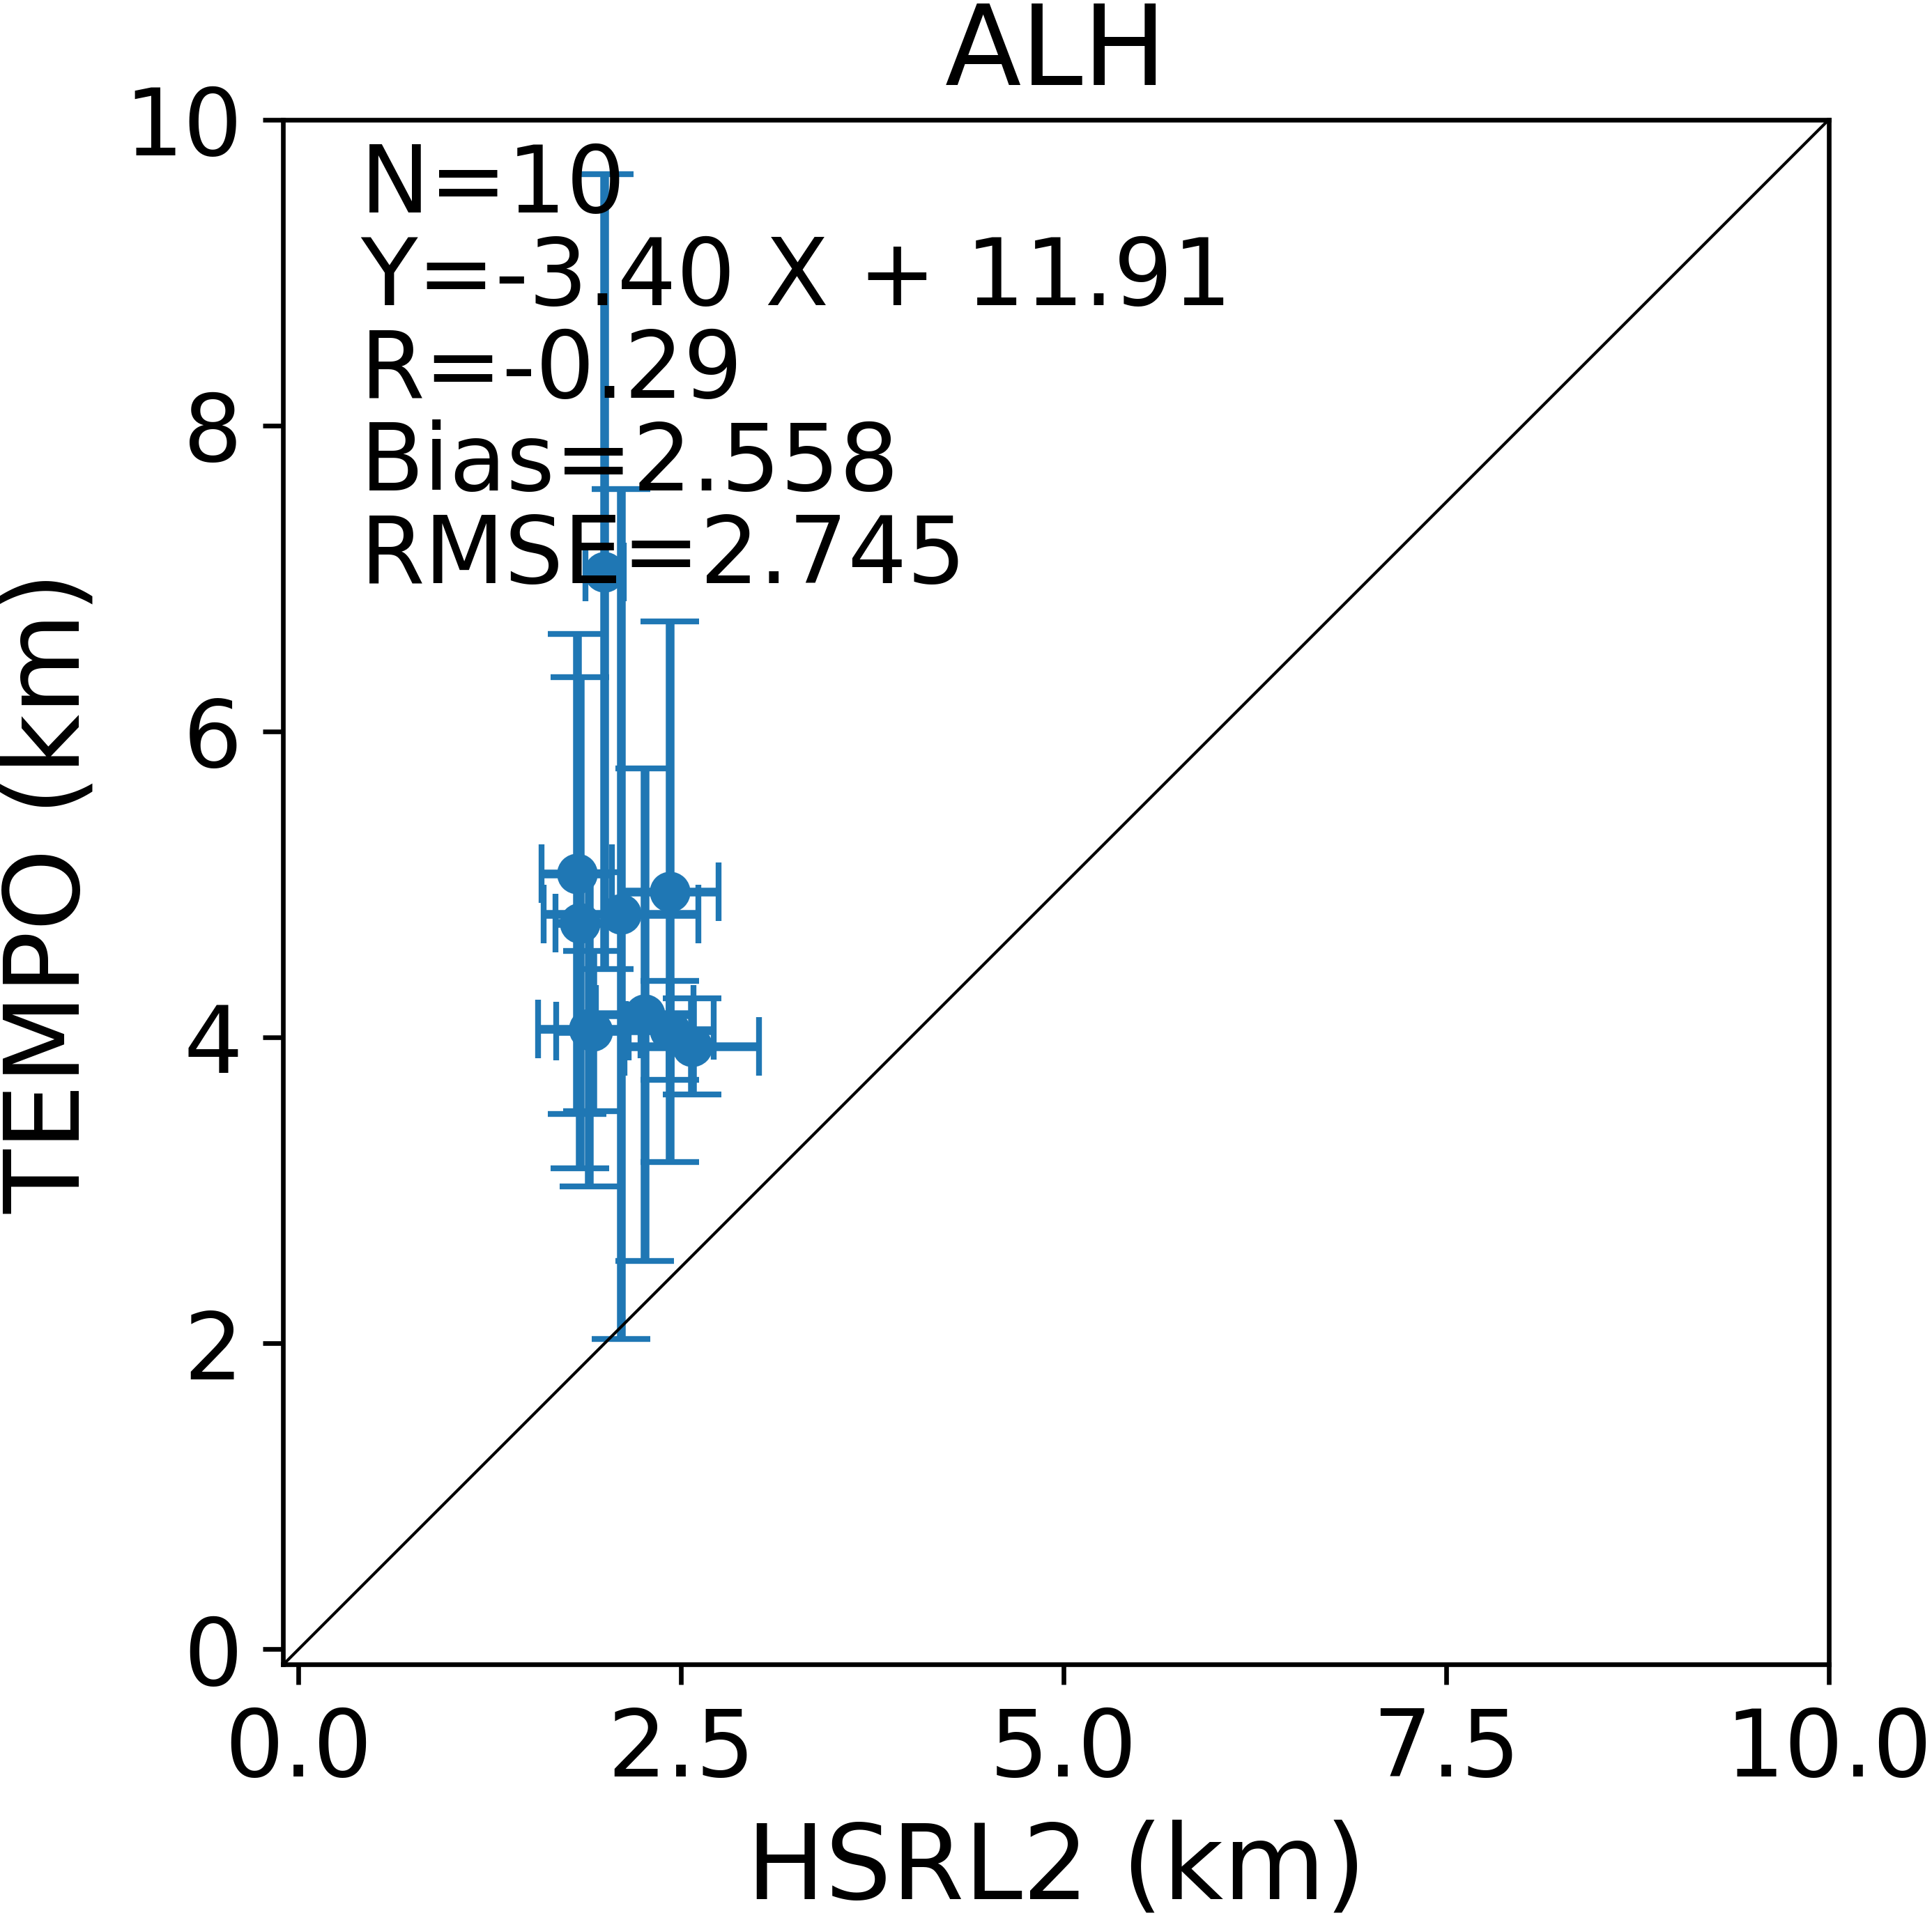
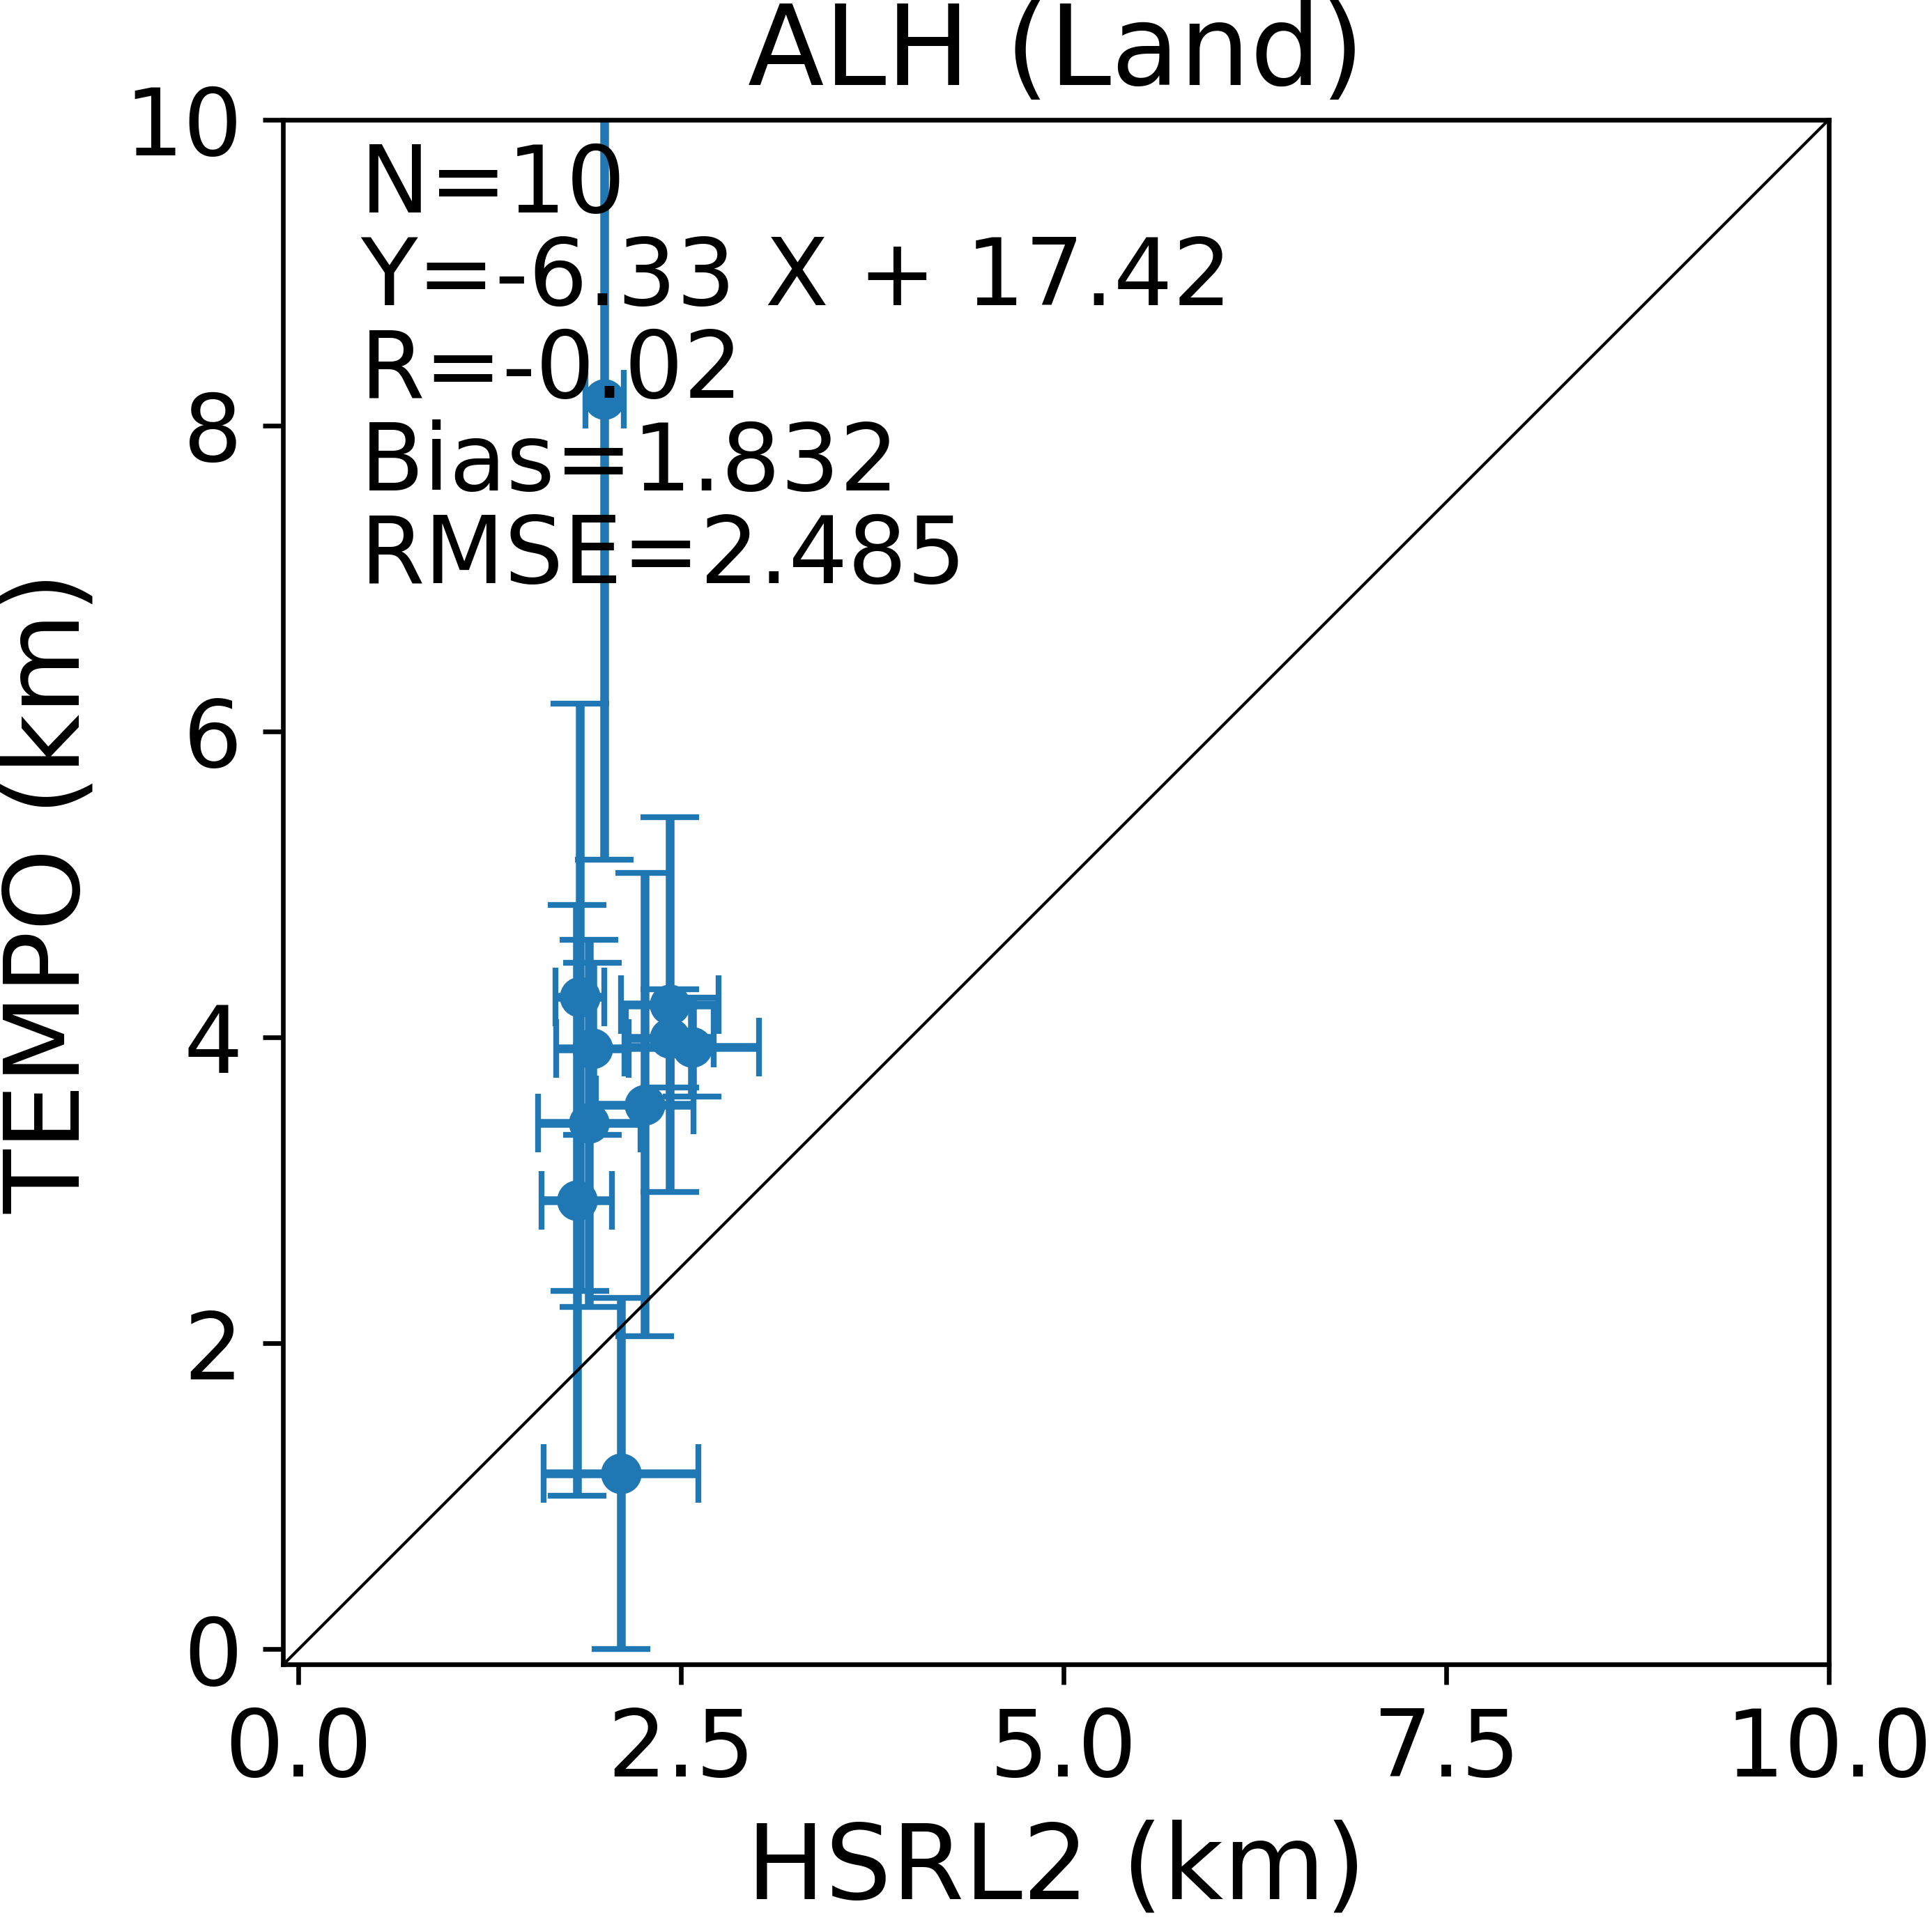
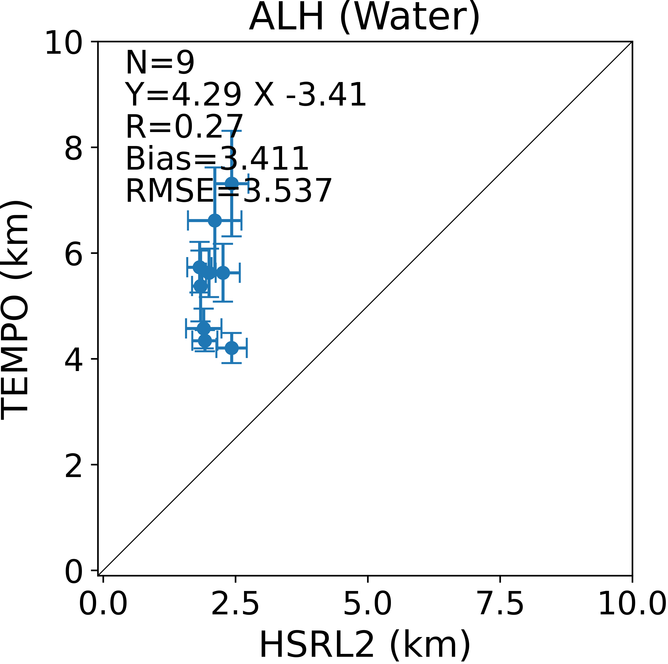
TEMPO ALH Compared to Lidar data
Compared to flight field campaign in August, 2023 over Chicago, Toronto and New York City
HSRL2 ALH is obtained from the aerosol extinction profile weighted height
Only 10 matchup points
Positive biases are observed in TEMPO ALH retrievals. Probably caused by the calibration.
ALH over land has less positive bias than that over ocean.
HSRL2 data curtesy of Richard Ferrare at NASA
Disclaimer：TEMPO L1B data courtesy of NASA and all results are preliminary.

Slide 13
Summary
The aerosol optical depth and aerosol layer height retrieval algorithm was developed for TEMPO
The LUT and surface DLER database were built
The preliminary retrieval results from TEMPO compare well with AERONET and ABI AOD
Reprocessing with V3 L1B ongoing
The algorithm was also evaluated for ALH using TROPOMI data and the results compare well to CALIOP ALH
TEMPO AOD and ALH retrieval algorithm will run near-real-time at NOAA
One year (August 2023 to July 2024) of TEMPO AOD and ALH will be released in the Fall.
Disclaimer：TEMPO L1B data courtesy of NASA and all results are preliminary.

