Slide 1

Development of TEMPO Aerosol Detection Product
Pubu Ciren^{1,2} and Shobha Kondragunta²
¹IMSG@NOAA ²NOAA/NESDIS/STAR
TEMPO/GEMS Joint Science Team Meeting, 26 - 30 August 2024, Hawaii
Disclaimer: The scientific results and conclusions, as well as any views or opinions expressed
herein, are those of the author(s) and do not necessarily reflect those of NOAA or
the Department of Commerce.

Slide 2
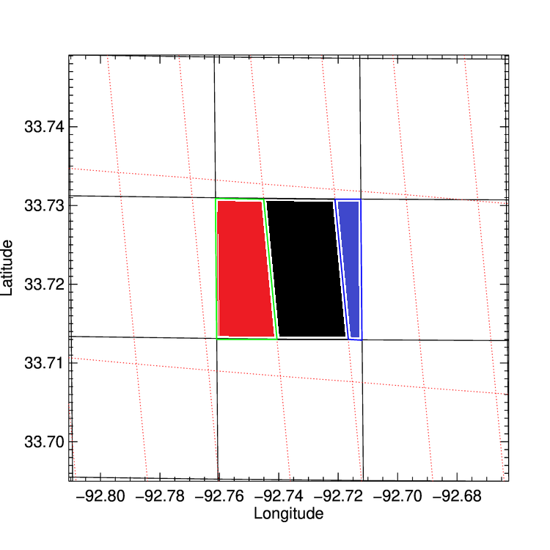
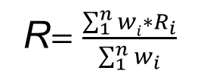
NOAA TEMPO/ABI Hybrid Aerosol Detection Algorithm
Red dotted line grid: GOES-16/ABI 2 km
Black line grid: TEMPO 2.0 x4.7 km
Developed a hybrid algorithm for smoke/dust Detection
  GEMS and AHI as proxy
  TROPOMI and VIIRS as proxy
Utilizing synergy between TEMPO and ABI
Co-registration tables generated to map ABI to TEMPO grid, and TEMPO UV band to Visible band
Cloud screening
  Remapped cloud mask from ABI
Outputs
  Smoke and dust detection
  UV AAI (354/388 nm)
  Visible AAI (412/440 nm)
Absorbing Aerosol Index
Visible AAI = -100[1og₁₀(R₄₁₂/R₄₄₀) – log₁₀(R’₄₁₂/R’₄₄₀)]
UV AAI = -100[1og₁₀(R₃₅₄/R₃₈₈) – log₁₀(R’₃₅₄/R’₃₈₈)]
Dust Smoke Discrimination Index
DSDI = -10[1og₁₀(R₄₁₂/R₂₂₅₀)
Weight=overlapped area/ABI pixel area
0.55
0.731
0.204
R$=\frac{\sum_{1}^{n}{wi∗R_{i}}}{\sum_{1}^{n}{w_{i}}}$

Slide 3
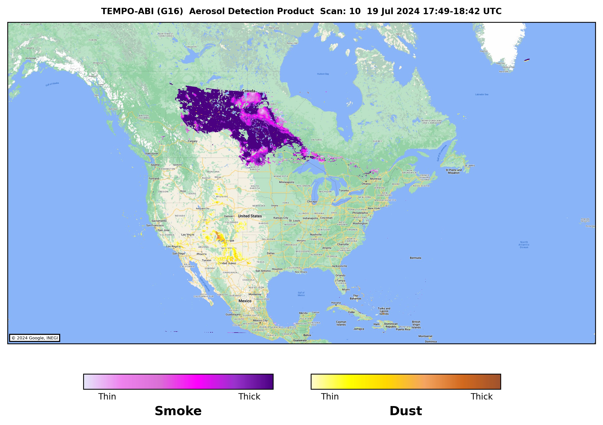
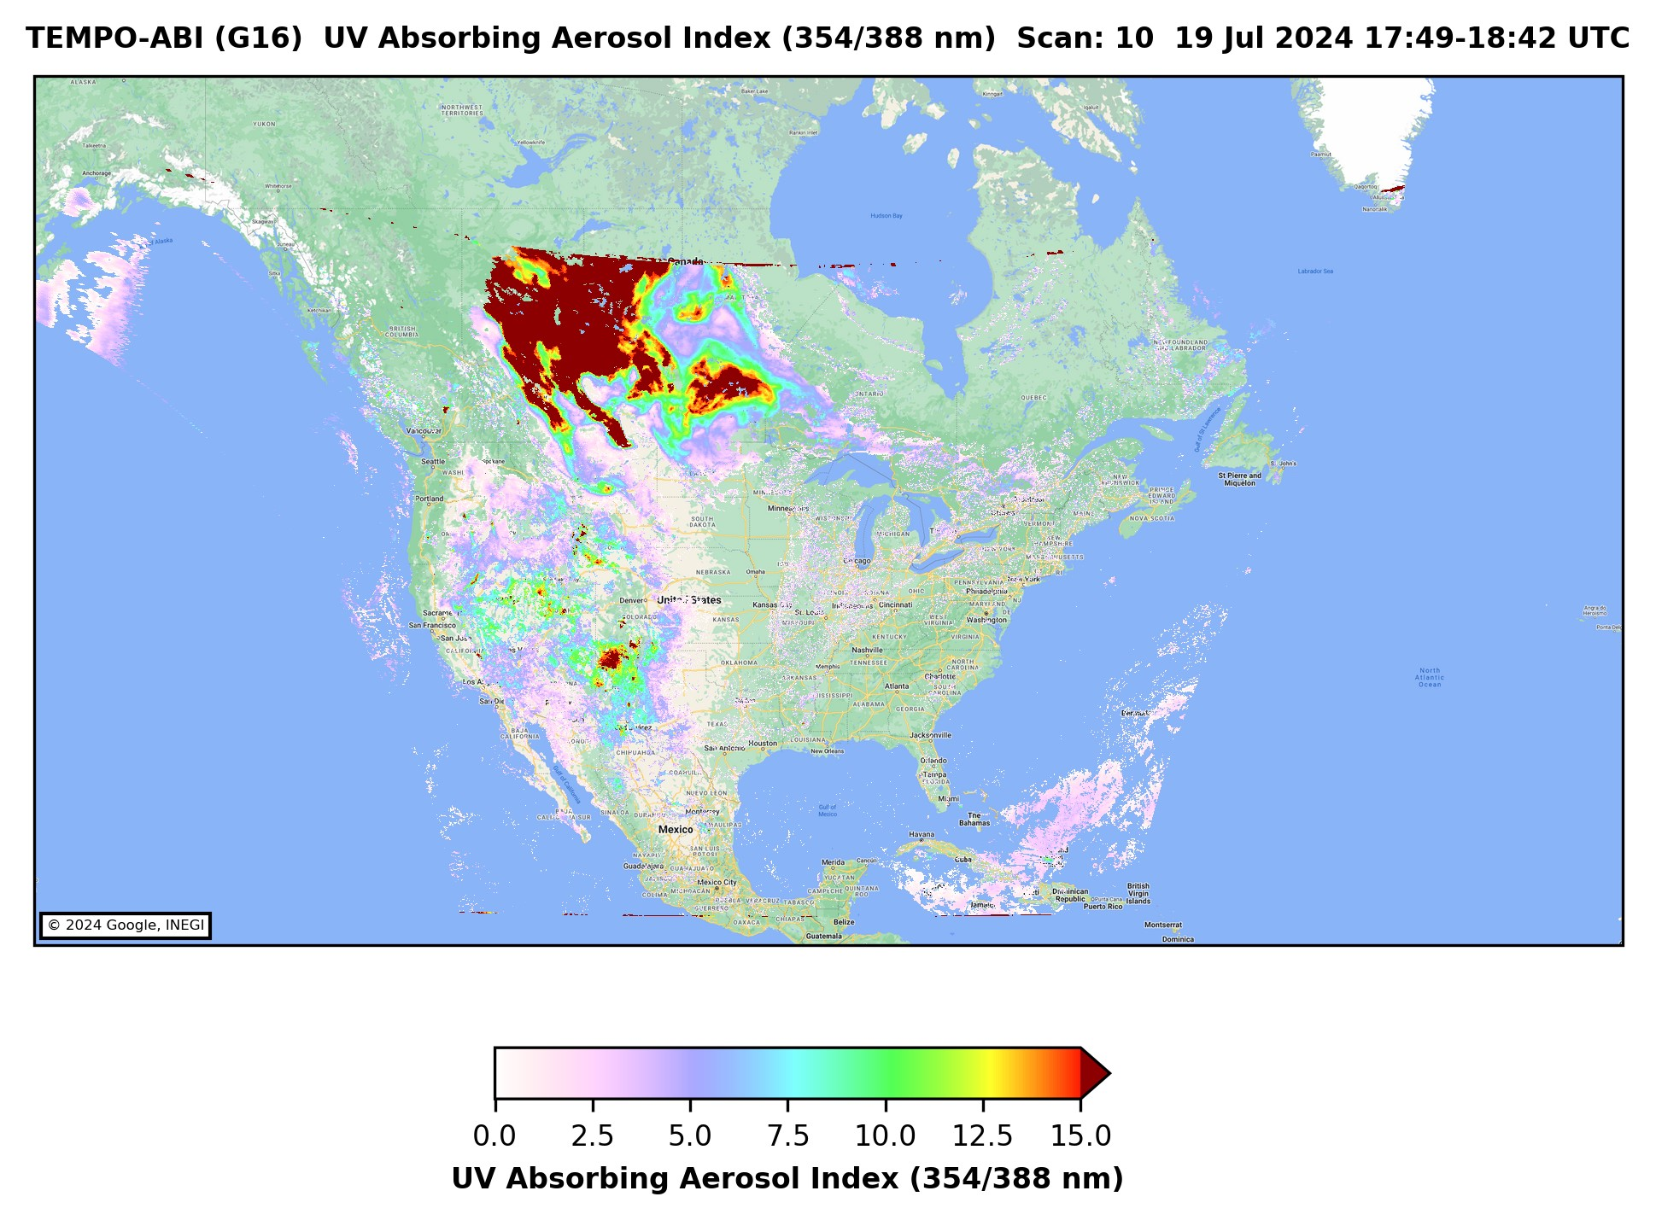
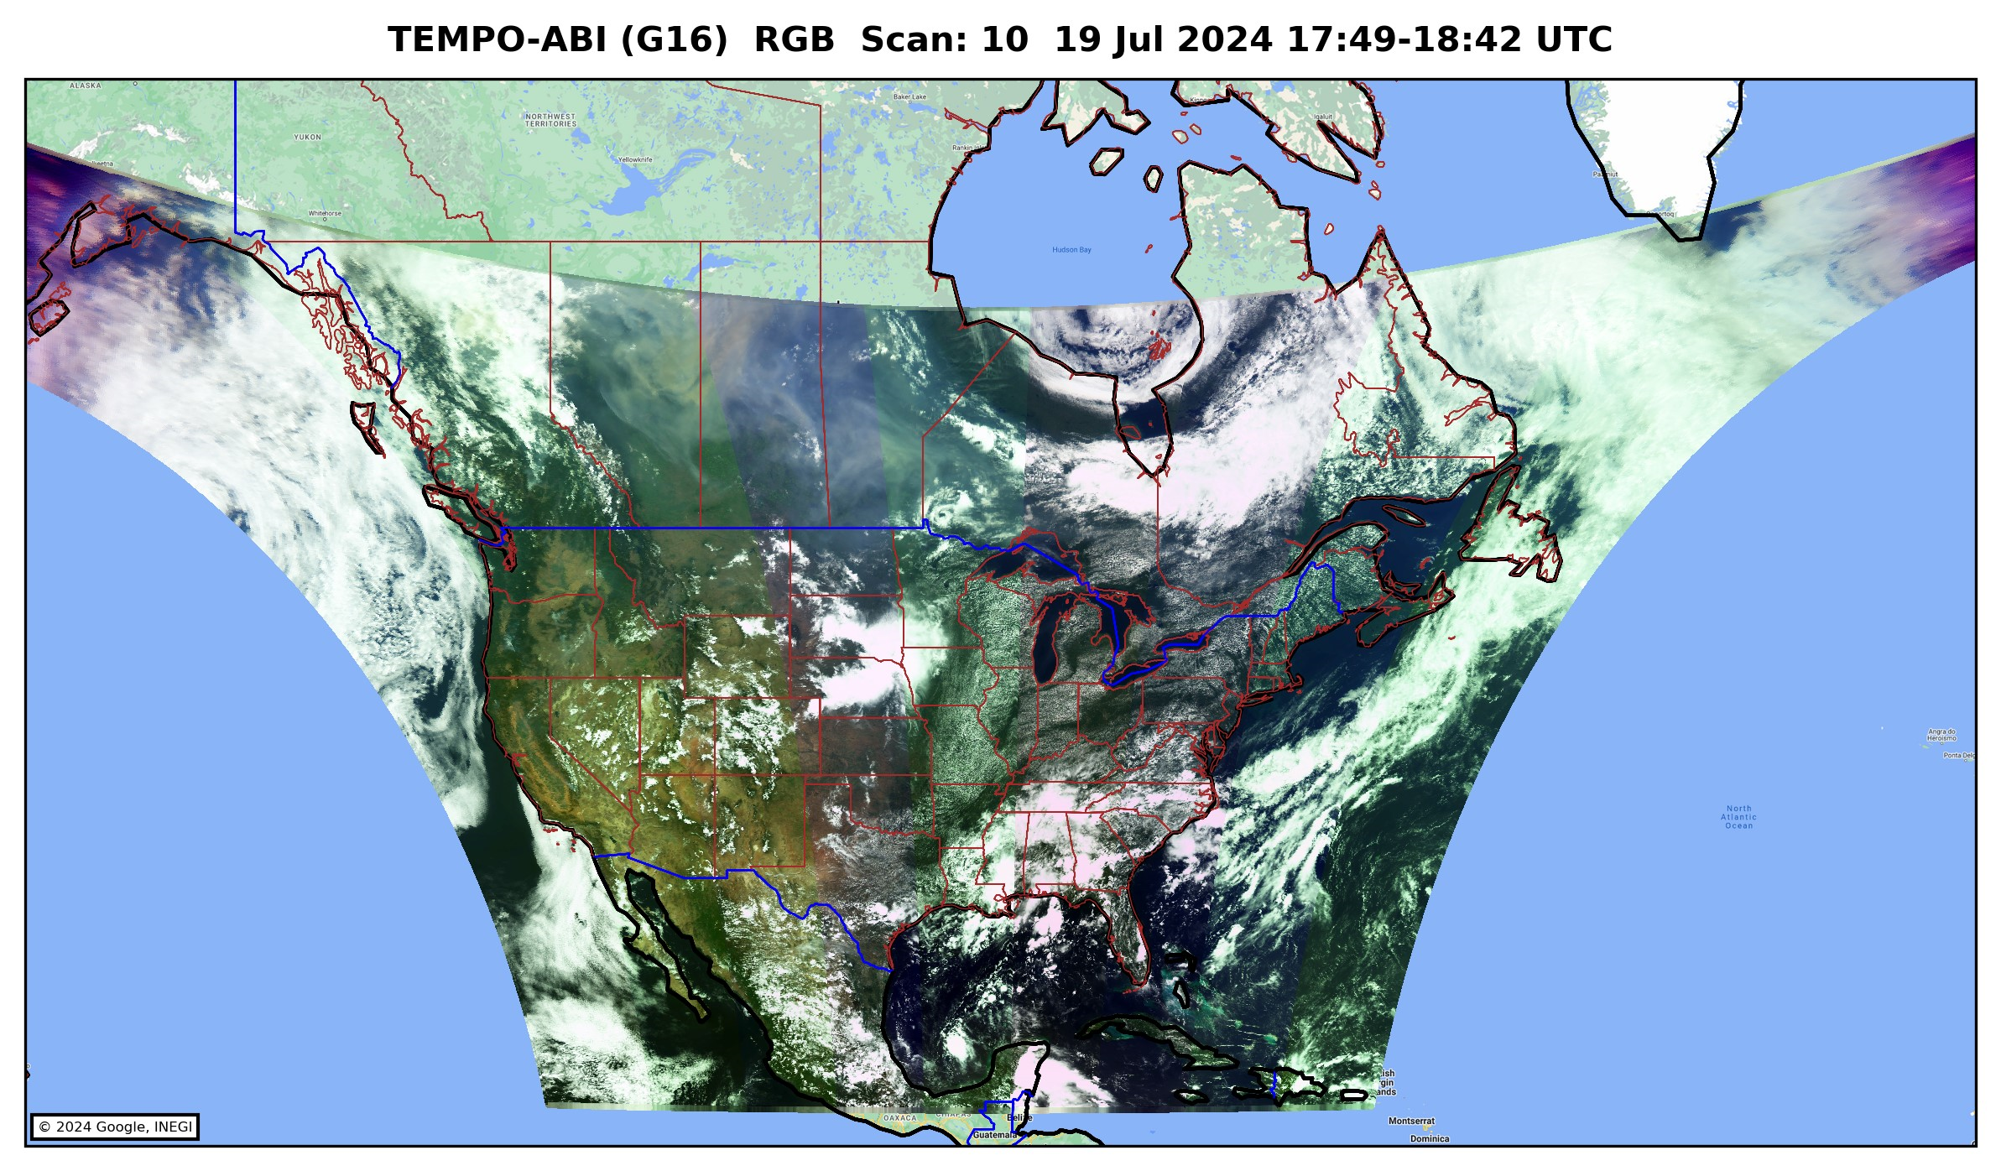
NOAA TEMPO/ABI Hybrid Aerosol Detection Product Status
Updated TEMPO/ABI ADP Product Algorithm
  Adopting UV AAI for smoke/dust detection
  Taking advantage of high sensitivity of UV spectrum
NRT processing of TEMPO/ABI ADP product
  Routine generation of TEMPO/ABI ADP product
  Tested and proved the processing capability on both AWS and local Linux server environment
  Latency depends on the latency of TEMPO L1B availability
Reprocessing of TEMPO/ABI ADP
  Reprocessed with the TEMPO L1B V03
  August-September,2023 and May, 2024-present
Validation
  Carried out preliminary validation with the reprocessed data against AERONET observations
Documentations
  Finished the first draft of user guide
  Ready to distribute along with reader (in IDL/Python)

Slide 4
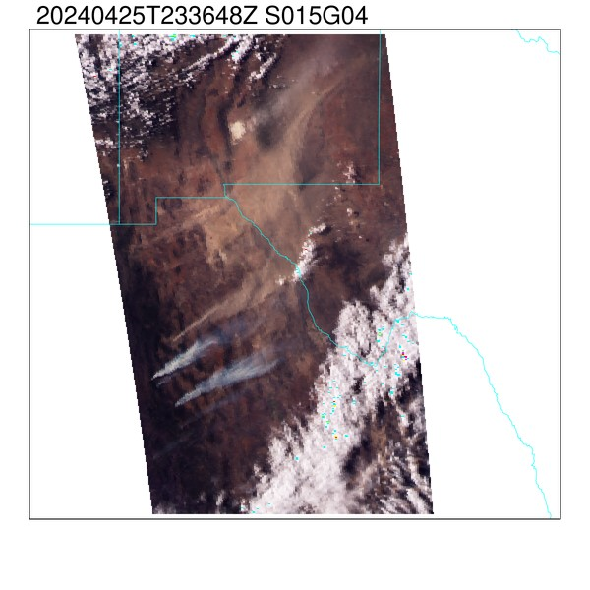
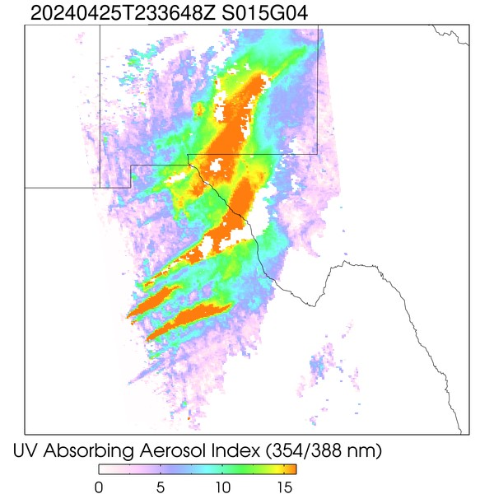
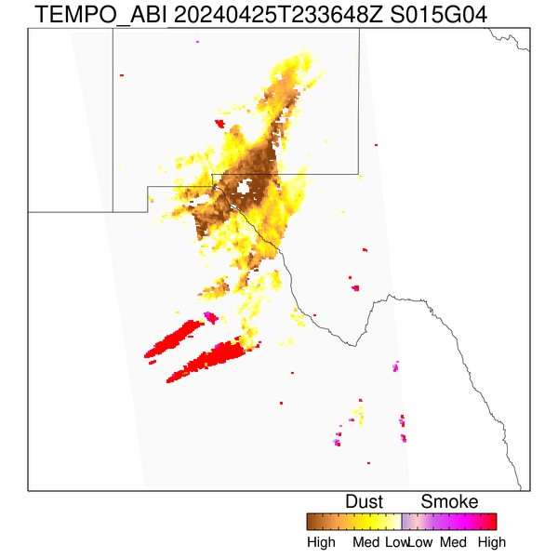
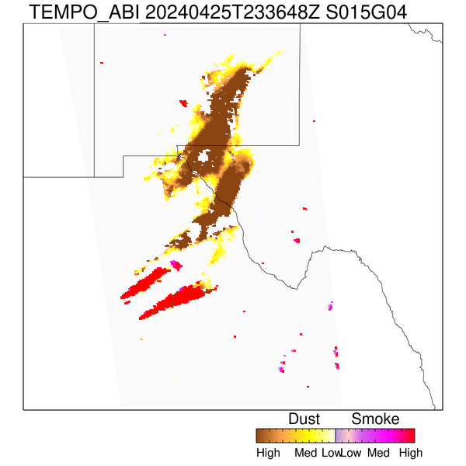
Advantages of UV Algorithm Path for Detecting Smoke and Dust
TEMPO RGB
TEMPO UV AAI
TEMPO+GOES 16
Deep-blue path
UV path
Enhanced sensitivity when using UVAI compared to Visible AI

Slide 5
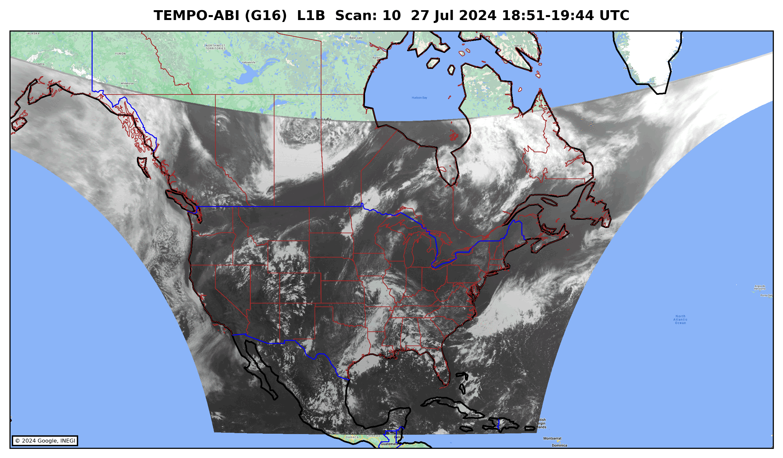
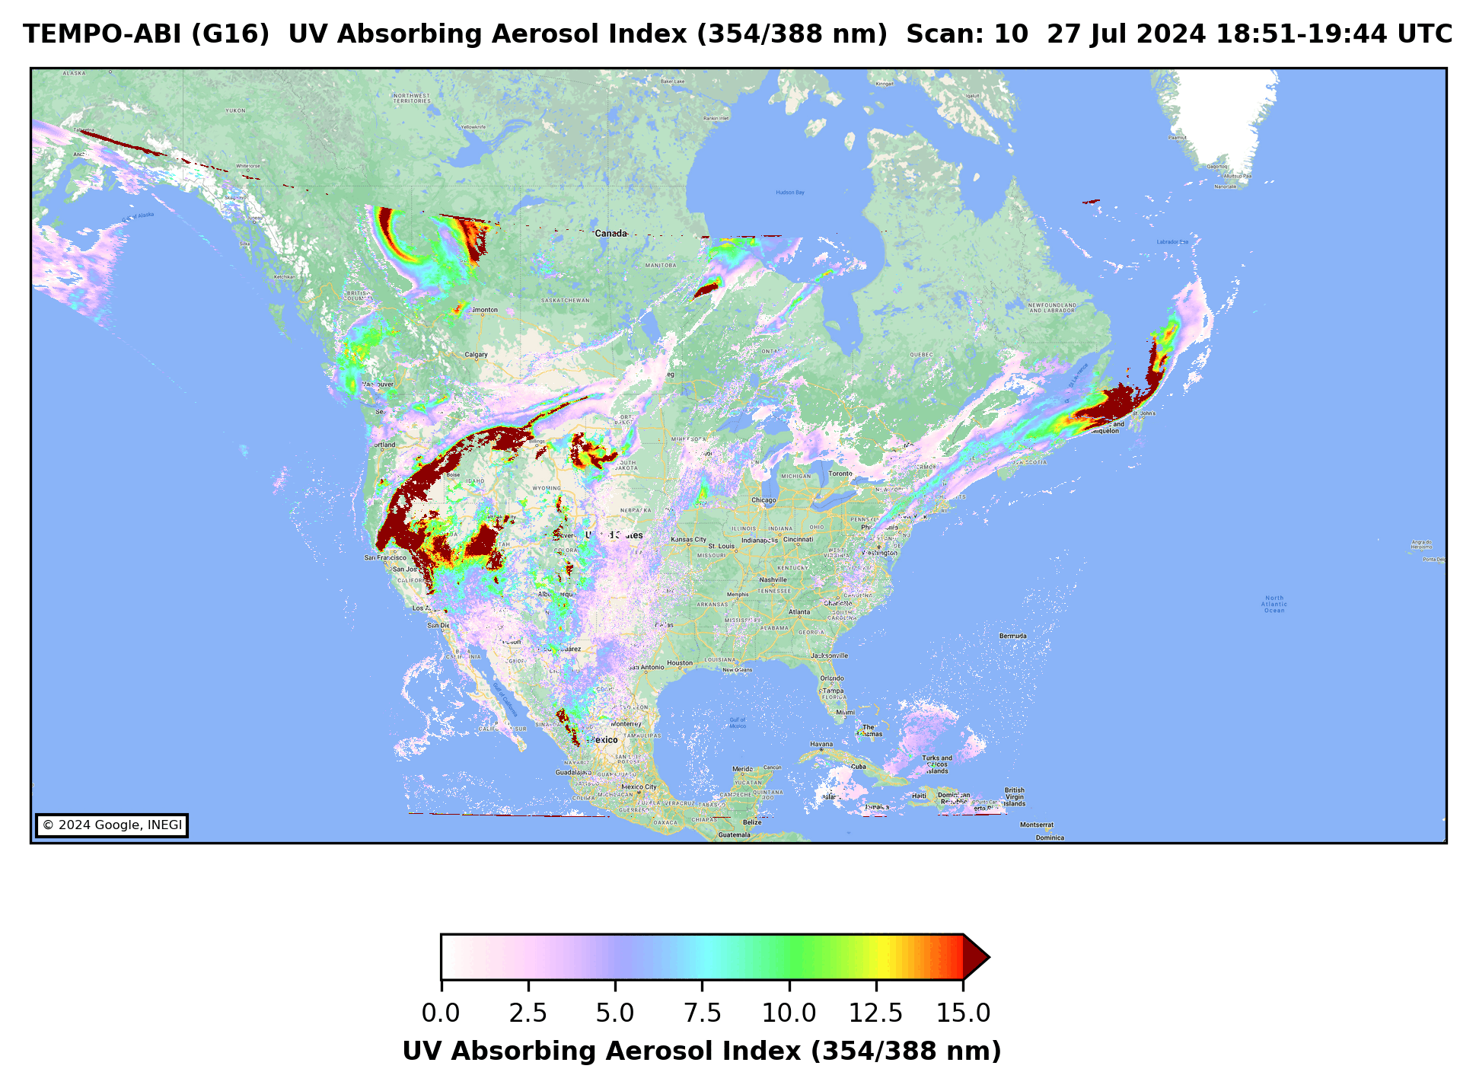
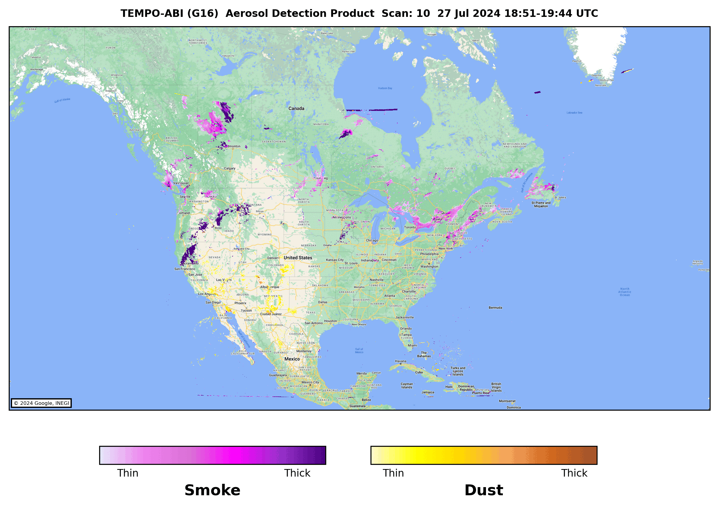

TEMPO Hybrid ADP Captures the Movement of Smoke Plumes
(07/27, 2024)
Smoke plume movement is well captured in TEMPO/ABI ADP
Transatlantic dust over the Caribbean is also detected

Slide 6


Validation with AERONET Data
Daily matchups with ~150 AERONET stations
Level 1.5 AERONET data
  AERONET AOD interpolated to 550nm
  AERONET Ångström exponent at 440nm/870nm
08-09/2023 and 05-08/2024
  Short validation period
  Statistics not calculated separately for matchups over land and over water
AERONET Detections |  | AOD @550nm | Ångström Exponent (440nm/870nm)
Smoke | Yes | > 0.2 | > 1.0
 | No |  | < 0.5
Dust | Yes | > 0.2 | < 0.5
 | No |  | > 1.0
 | AERONET
 |  | Yes | No
 | Yes | A | B
 | No | C | D
ABI ADP
Probability of Correct Detection (POCD) =
$$\frac{A}{A+C}$$

Slide 7
TEMPO/ABI Hybrid Aerosol Detection Product Validation
Smoke Detection
AERONET |  | True positive | False positive | False negative | True negative | POCD | POFD | Accuracy
08-09/2023 | G16 | 633 | 62 | 344 | 4380 | 64.8 | 8.9 | 92.5
08-09/2023 | G18 | 526 | 21 | 325 | 3118 | 61.8 | 3.8 | 91.3
05-08/2024 | G16 | 2498 | 221 | 879 | 9229 | 74.9 | 8.1 | 90.7
05-08/2024 | G18 | 2422 | 53 | 1071 | 7551 | 69.3 | 2.1 | 89.8
Dust Detection
AERONET |  | True positive | False positive | False negative | True negative | POCD | POFD | Accuracy
08-09/2023 | G16 | 68 | 27 | 74 | 1823 | 47.8 | 28.0 | 94.9
08-09/2023 | G18 | 60 | 16 | 80 | 1529 | 42.8 | 21.0 | 94.3
05-08/2024 | G16 | 218 | 71 | 271 | 4758 | 44.5 | 24.6 | 93.5
05-08/2024 | G18 | 208 | 60 | 263 | 4658 | 44.1 | 12.9 | 91.5
Statistics Matrix is largely affected by short data period and less matchups, especially for dust detection.

Slide 8
Summary
NOAA has developed a TEMPO/ABI hybrid aerosol detection algorithm and processing system
  With a capability of NRT processing on both AWS and local Linux environment
  One day latency currently due to TEMPO L1B availability
  Preliminary results show that the hybrid algorithm generally works well
Reprocessed TEMPO/ABI ADP with the updated algorithm and TEMPO L1B V03.
  Available dates: 08-09/2023 and 05/2024-present.
Next Steps
Complete product generation for one full year (August 2023 to July 2024) and distribute the product to users for evaluation
Refine algorithm
  Including subpixel cloud screening – reducing false and missing smoke detection
  Applying DLER developed for AOD retrieval – reducing false dust detection
  Investigate the impact of UV channel saturation on the UVAI

