Slide 1
Preparing for GeoXO ACX using TEMPO
TEMPO-GEMS Science Team Meeting 26-30 August 2024
Shobha Kondragunta¹, Greg Frost², Joanna Joiner³
¹NOAA NESDIS GeoXO ACX Product Scientist
²NOAA OAR GeoXO ACX User Scientist
³NASA GSFC GeoXO ACX Instrument Scientist and GeoXO Project Scientist
Acknowledgement: NESDIS GeoXO Program Office and Office of Common Services
Notes:
Emphasize after info briefing, we will introduce Science Team

Slide 2
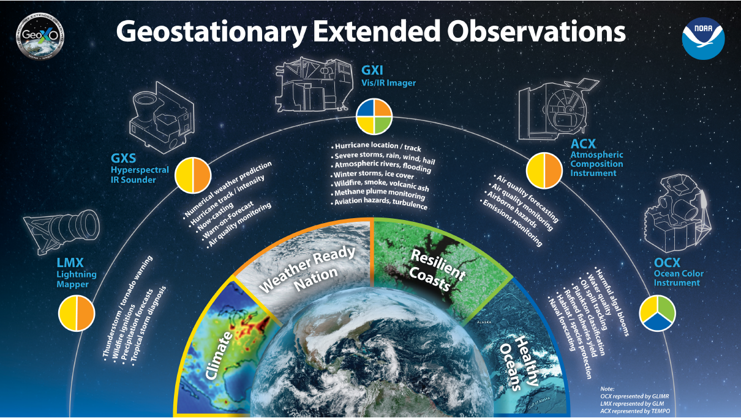
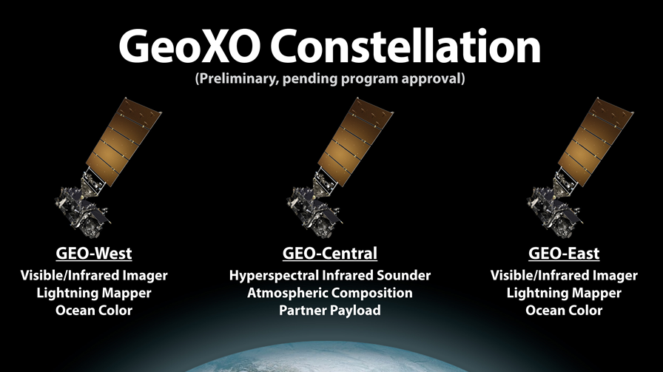
GeoXO Atmospheric Composition is a multi-instrument strategy serving many NOAA applications

Slide 3



Preparing for GeoXO ACX
Analysis
Analyze existing aerosol and trace gas products to understand retrieval performance
Proxy Data
Algorithm Development
Adapt NOAA enterprise processing system algorithms to run on existing L1B data
Calibration and Validation
Support field campaigns and long-term monitoring to validate existing satellite aerosol and trace gas products

Slide 4
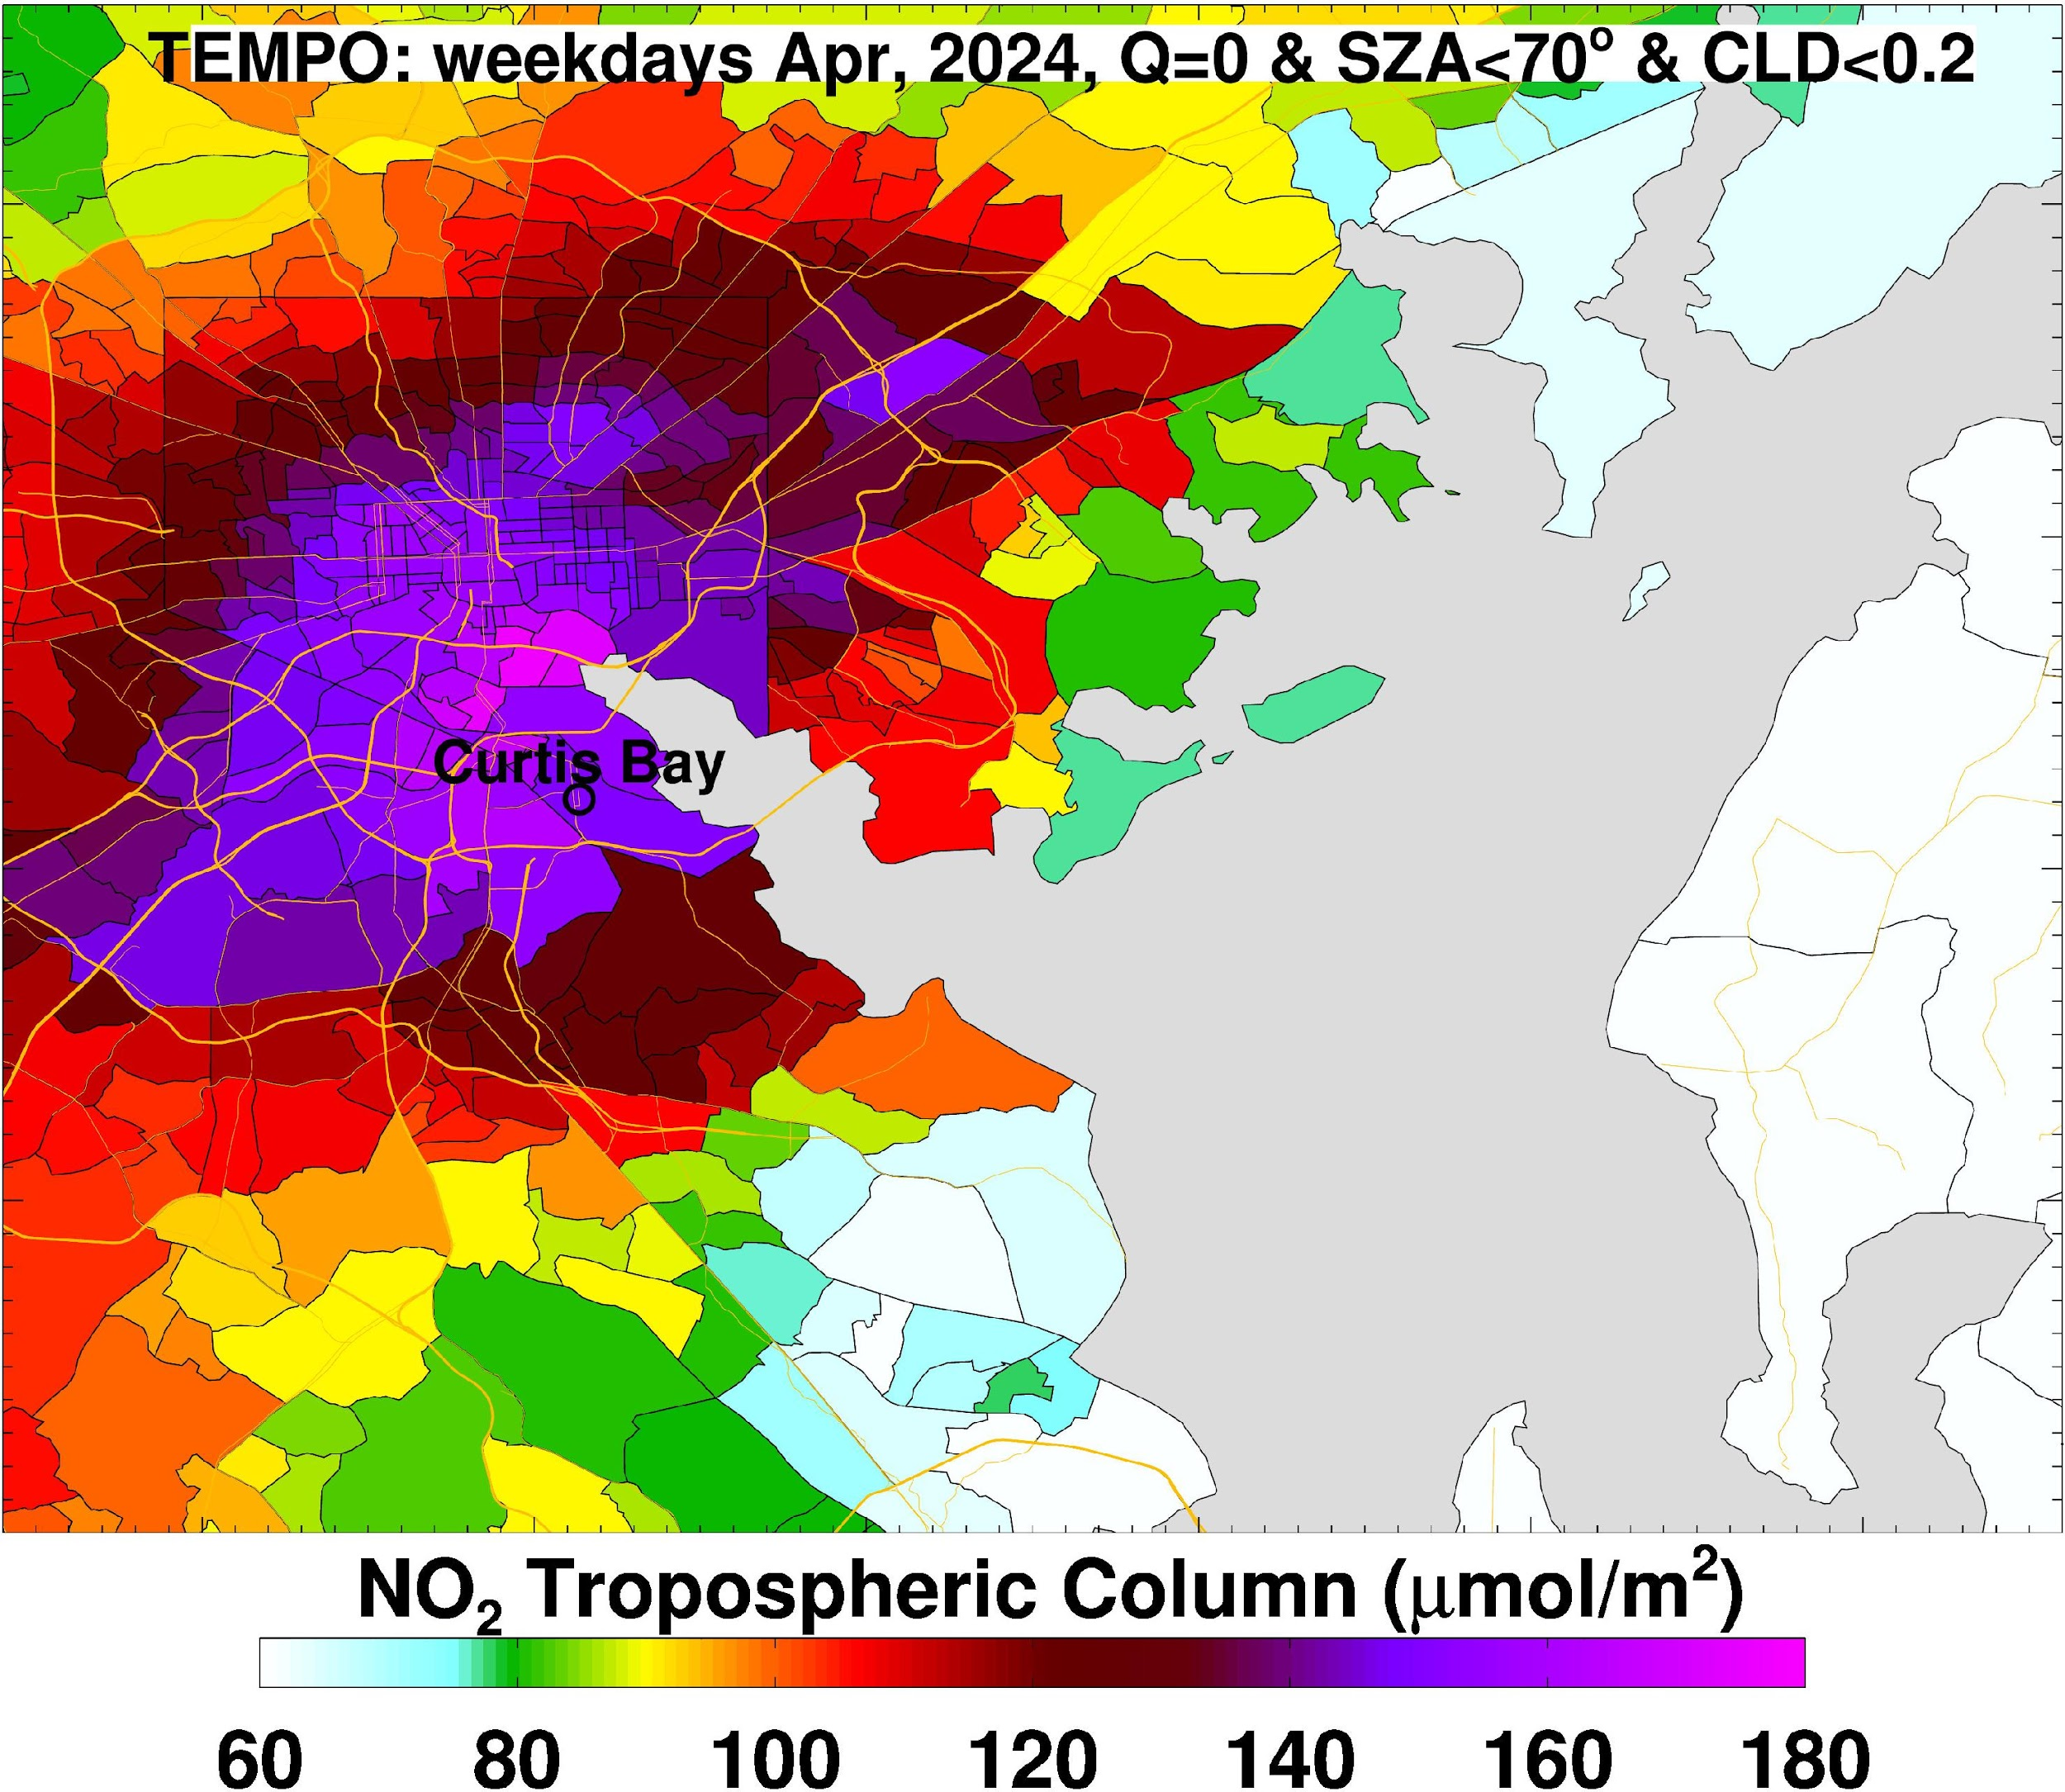
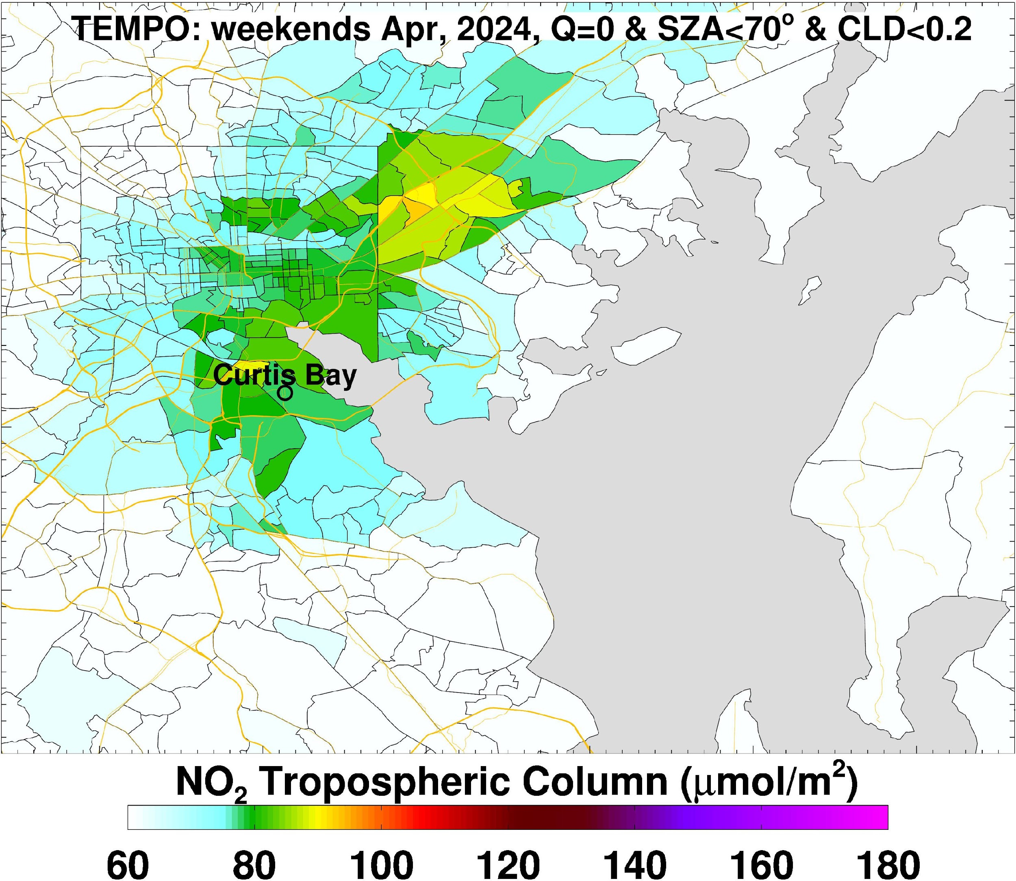
Analysis
TEMPO V2 tropNO₂ mapped to census tracts for Baltimore, MD

Slide 5
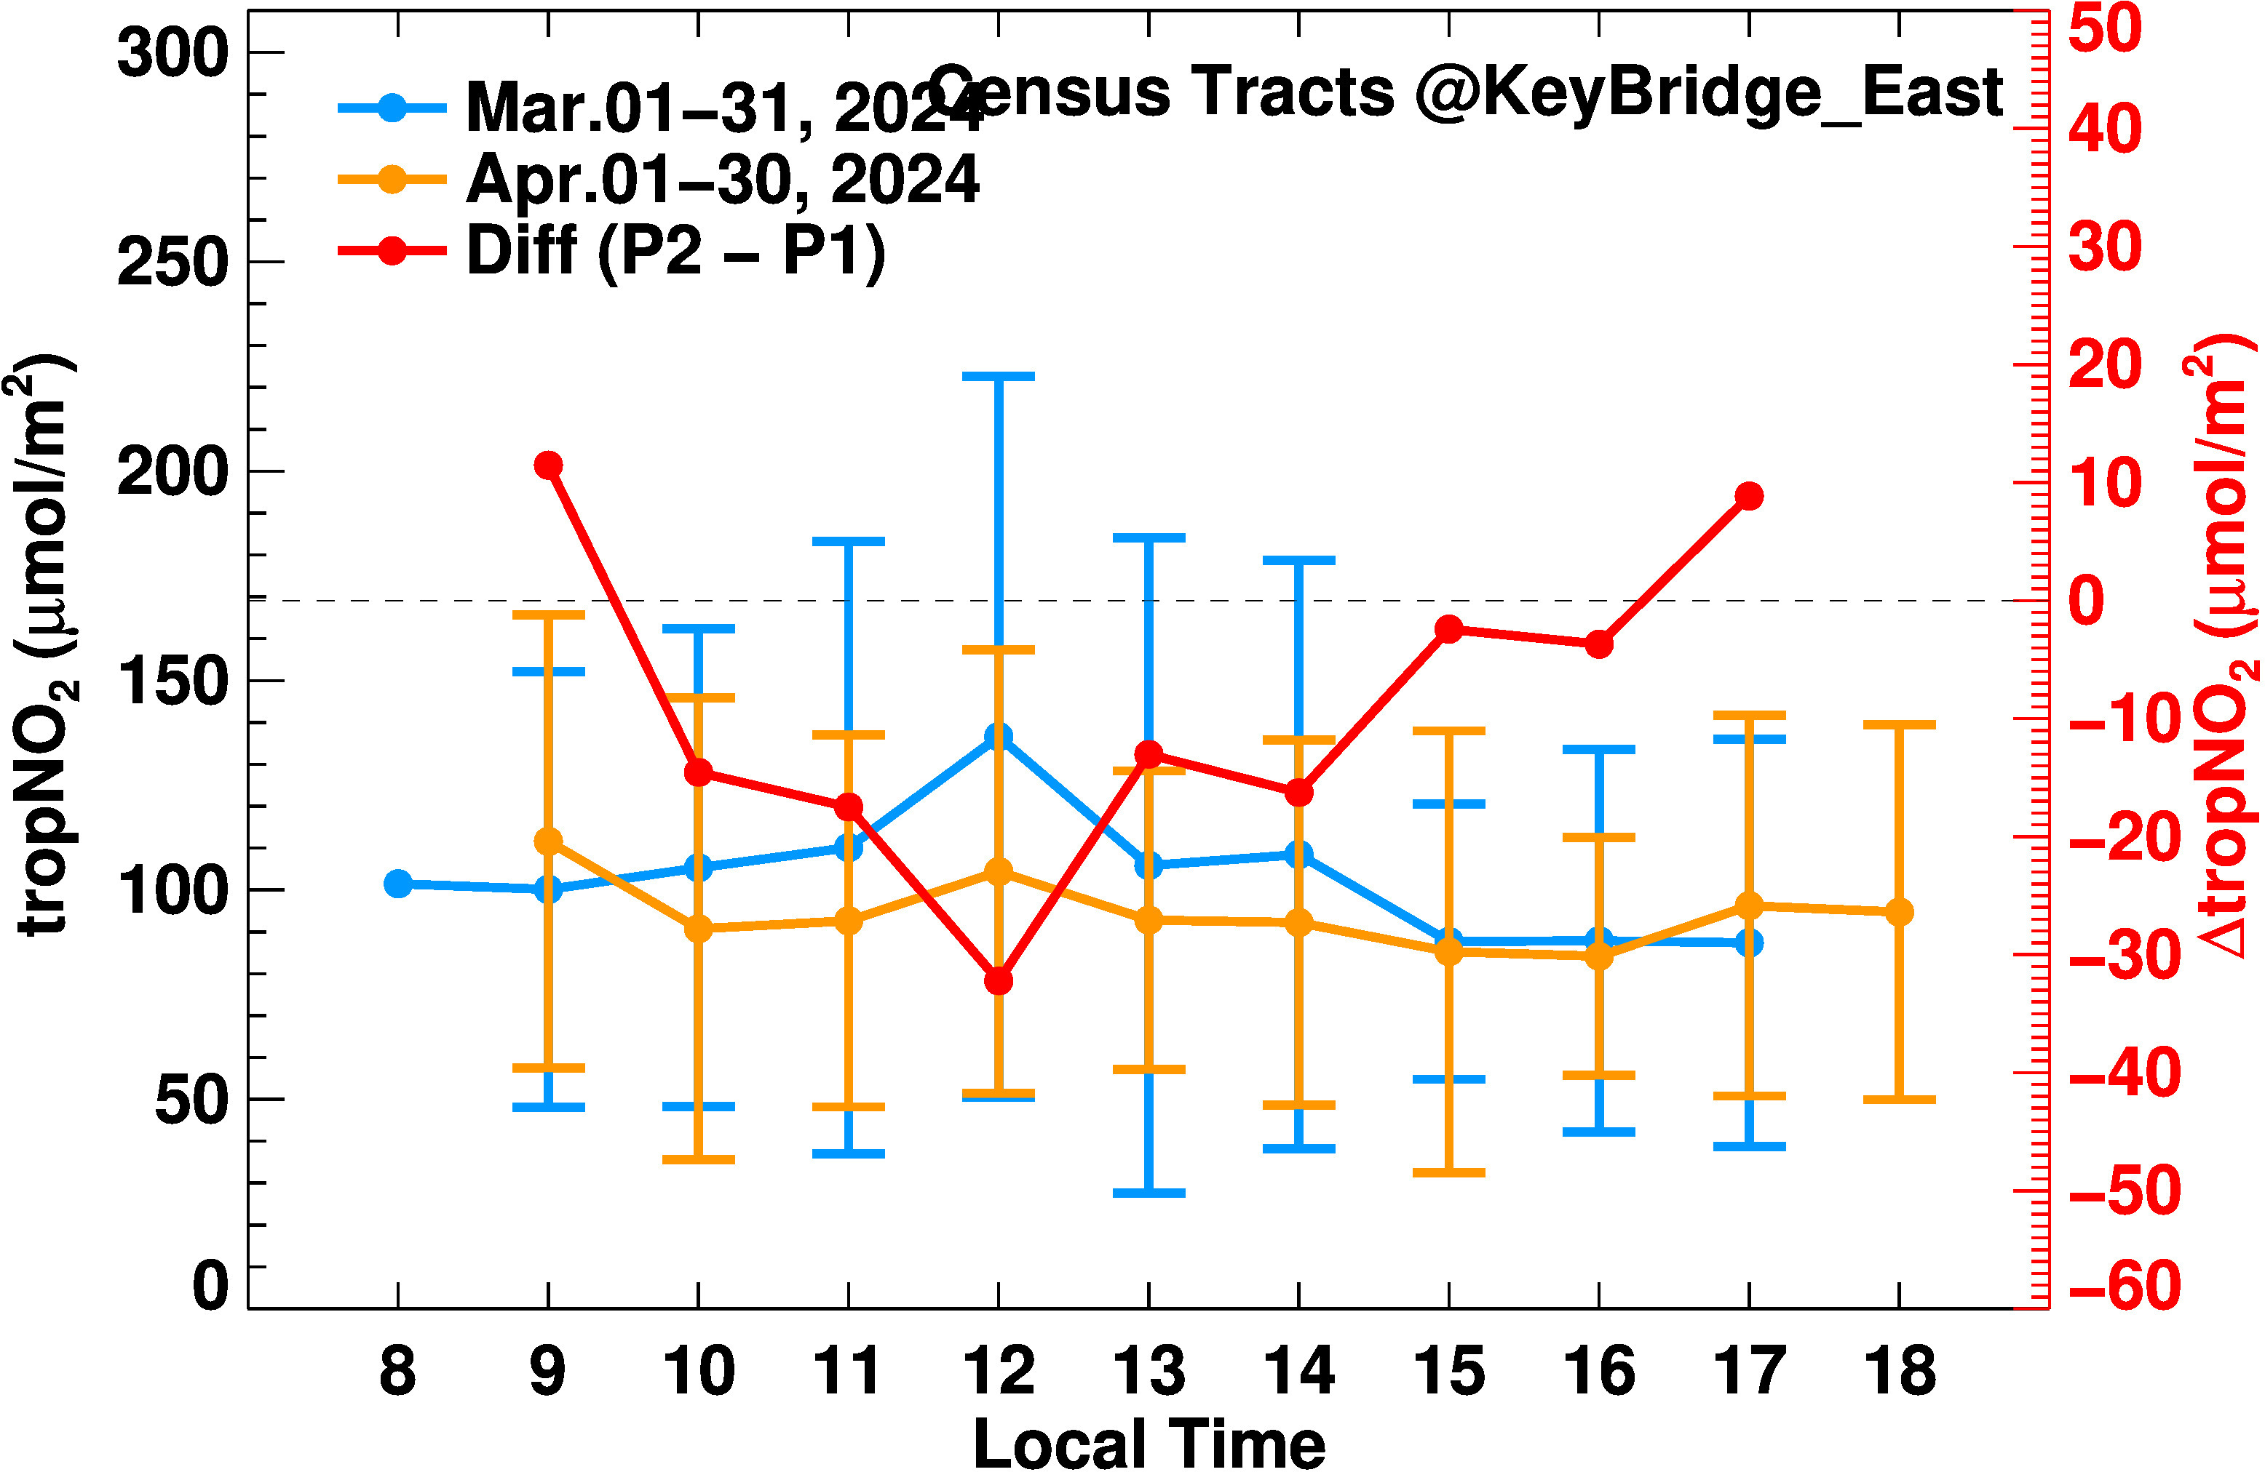
Impact of Baltimore Key Bridge Collapse on NOx emissions
Analysis
MDE reports reduced traffic after the bridge collapse

Slide 6
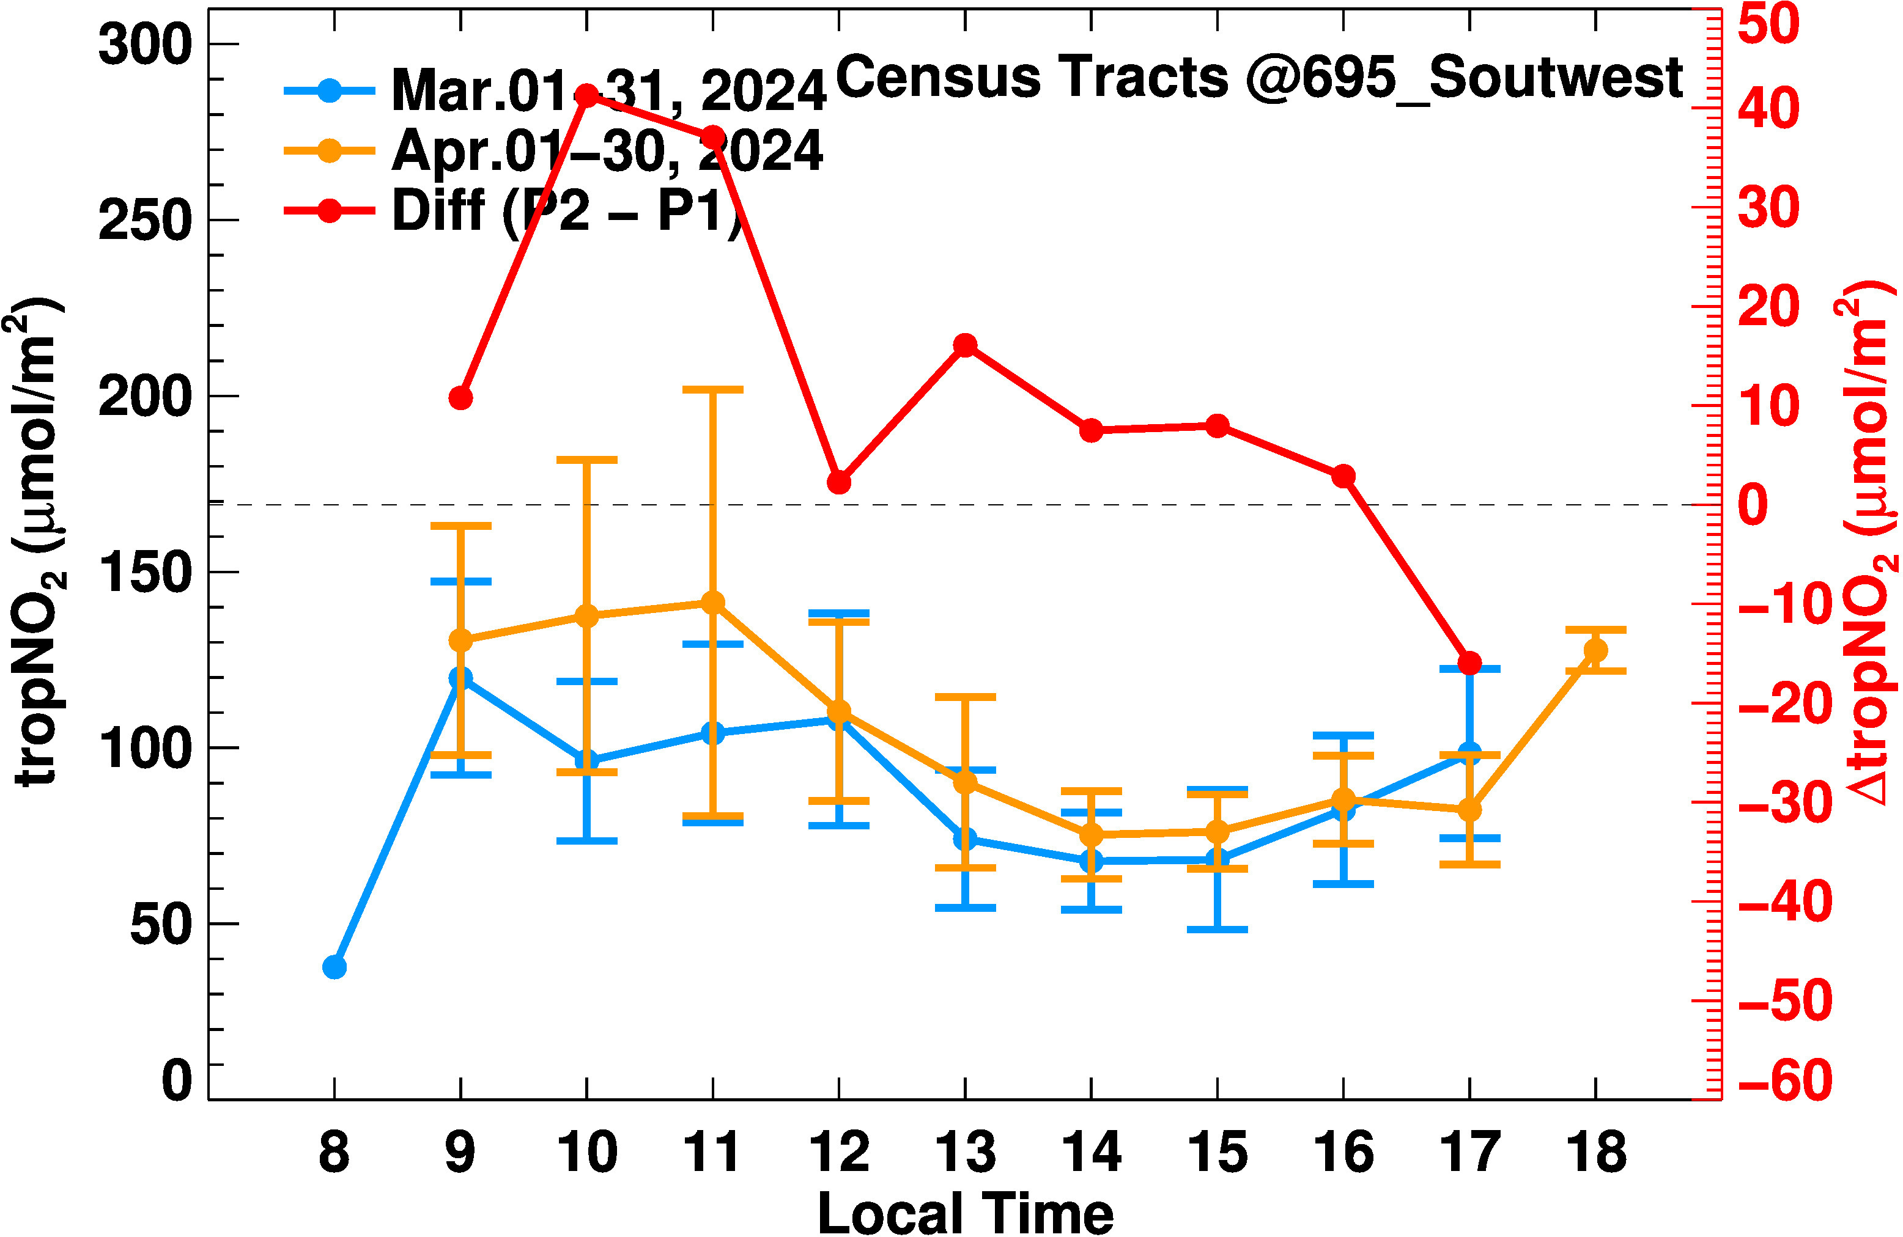
Impact of Baltimore Key Bridge Collapse on NOx emissions
Analysis
MDE reports traffic congestion after the bridge collapse

Slide 7
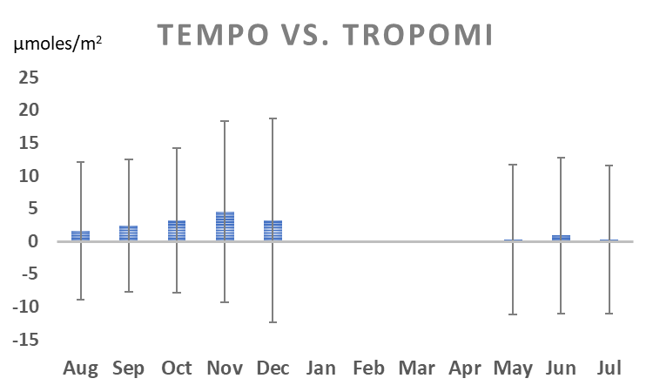
Cal/Val
TEMPO vs. TROPOMI as a reference dataset
Qualitative comparison of
Statistical regression analysis
Quantile-quantile plots
Histogram analysis
Calendar plots
Bias
Waiting for reprocessed V3 data to become available
Key Findings
TEMPO V3 tropNO₂ is higher than TROPOMI tropNO₂ in urban/industrial areas;
Correlation between TEMPO and TROPOMI tropNO₂ is better in the winter months compared to summer months
TEMPO slant column NO₂ is lower than TROPOMI slant column NO₂ but the two are very well correlated. Visual inspection of the maps indicate that TEMPO spatial patterns are more realistic;
TEMPO tropNO₂ is biased “high” in urban areas and biased “low” in rural areas;
TEMPO L1B reflectances are higher than TROPOMI by ~30% in the NO₂ spectral absorption region
2023
2024
Lower bias in 2024 compared to 2023!!!

Slide 8
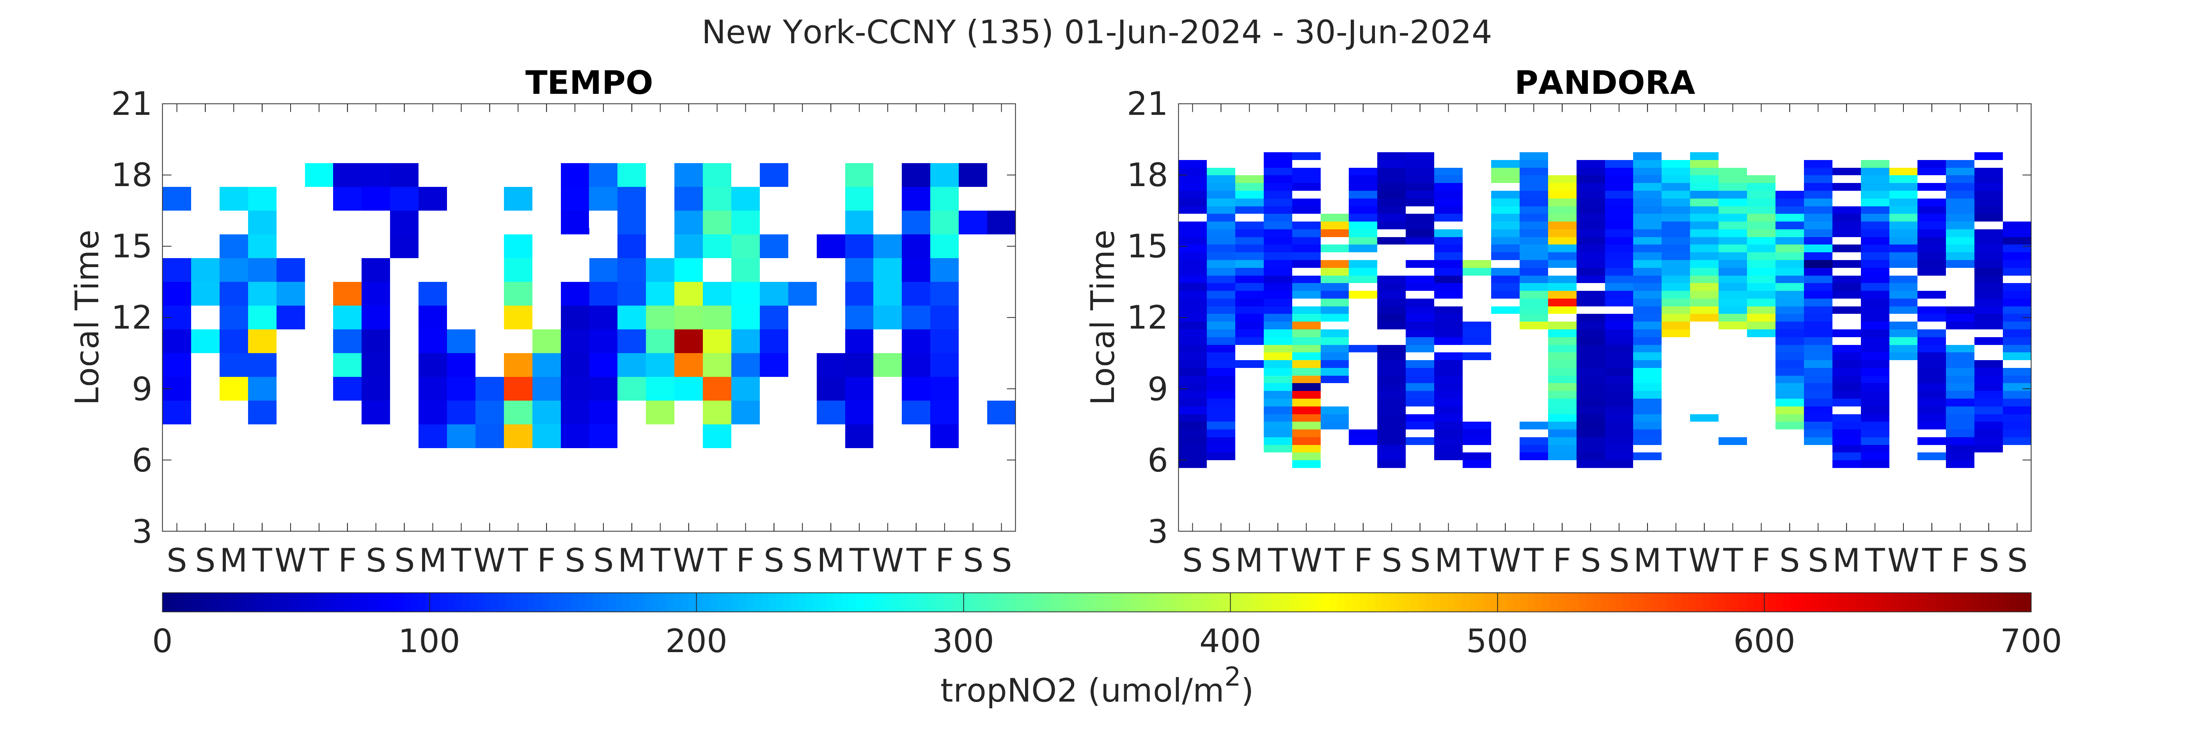
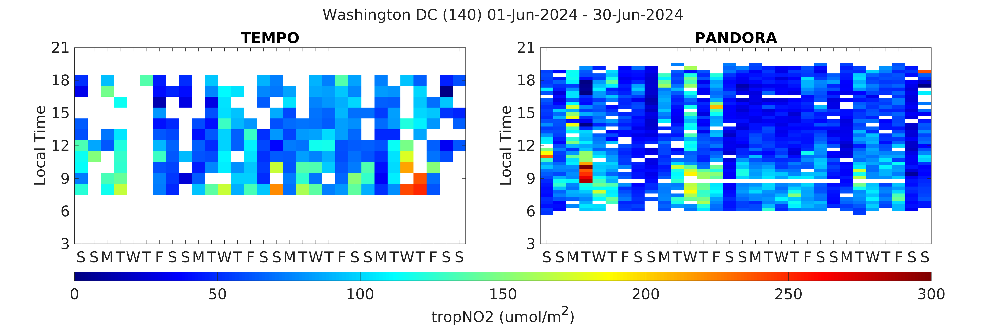
Cal/Val
Monthly calendar plots of TEMPO matched with Pandora will show if satellite observations are consistent with ground observations diurnally and weekly
TEMPO data only includes pixels with cloud fraction < 0.2 and solar zenith angle < 70˚
Pandora data only includes retrievals with high and medium quality
Thomas Ely (CCNY) and Zigang Wei (NOAA)

Slide 9
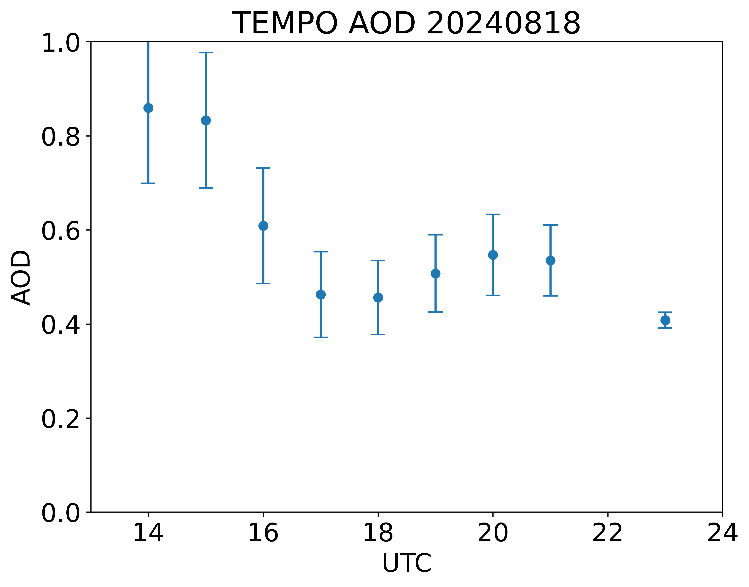
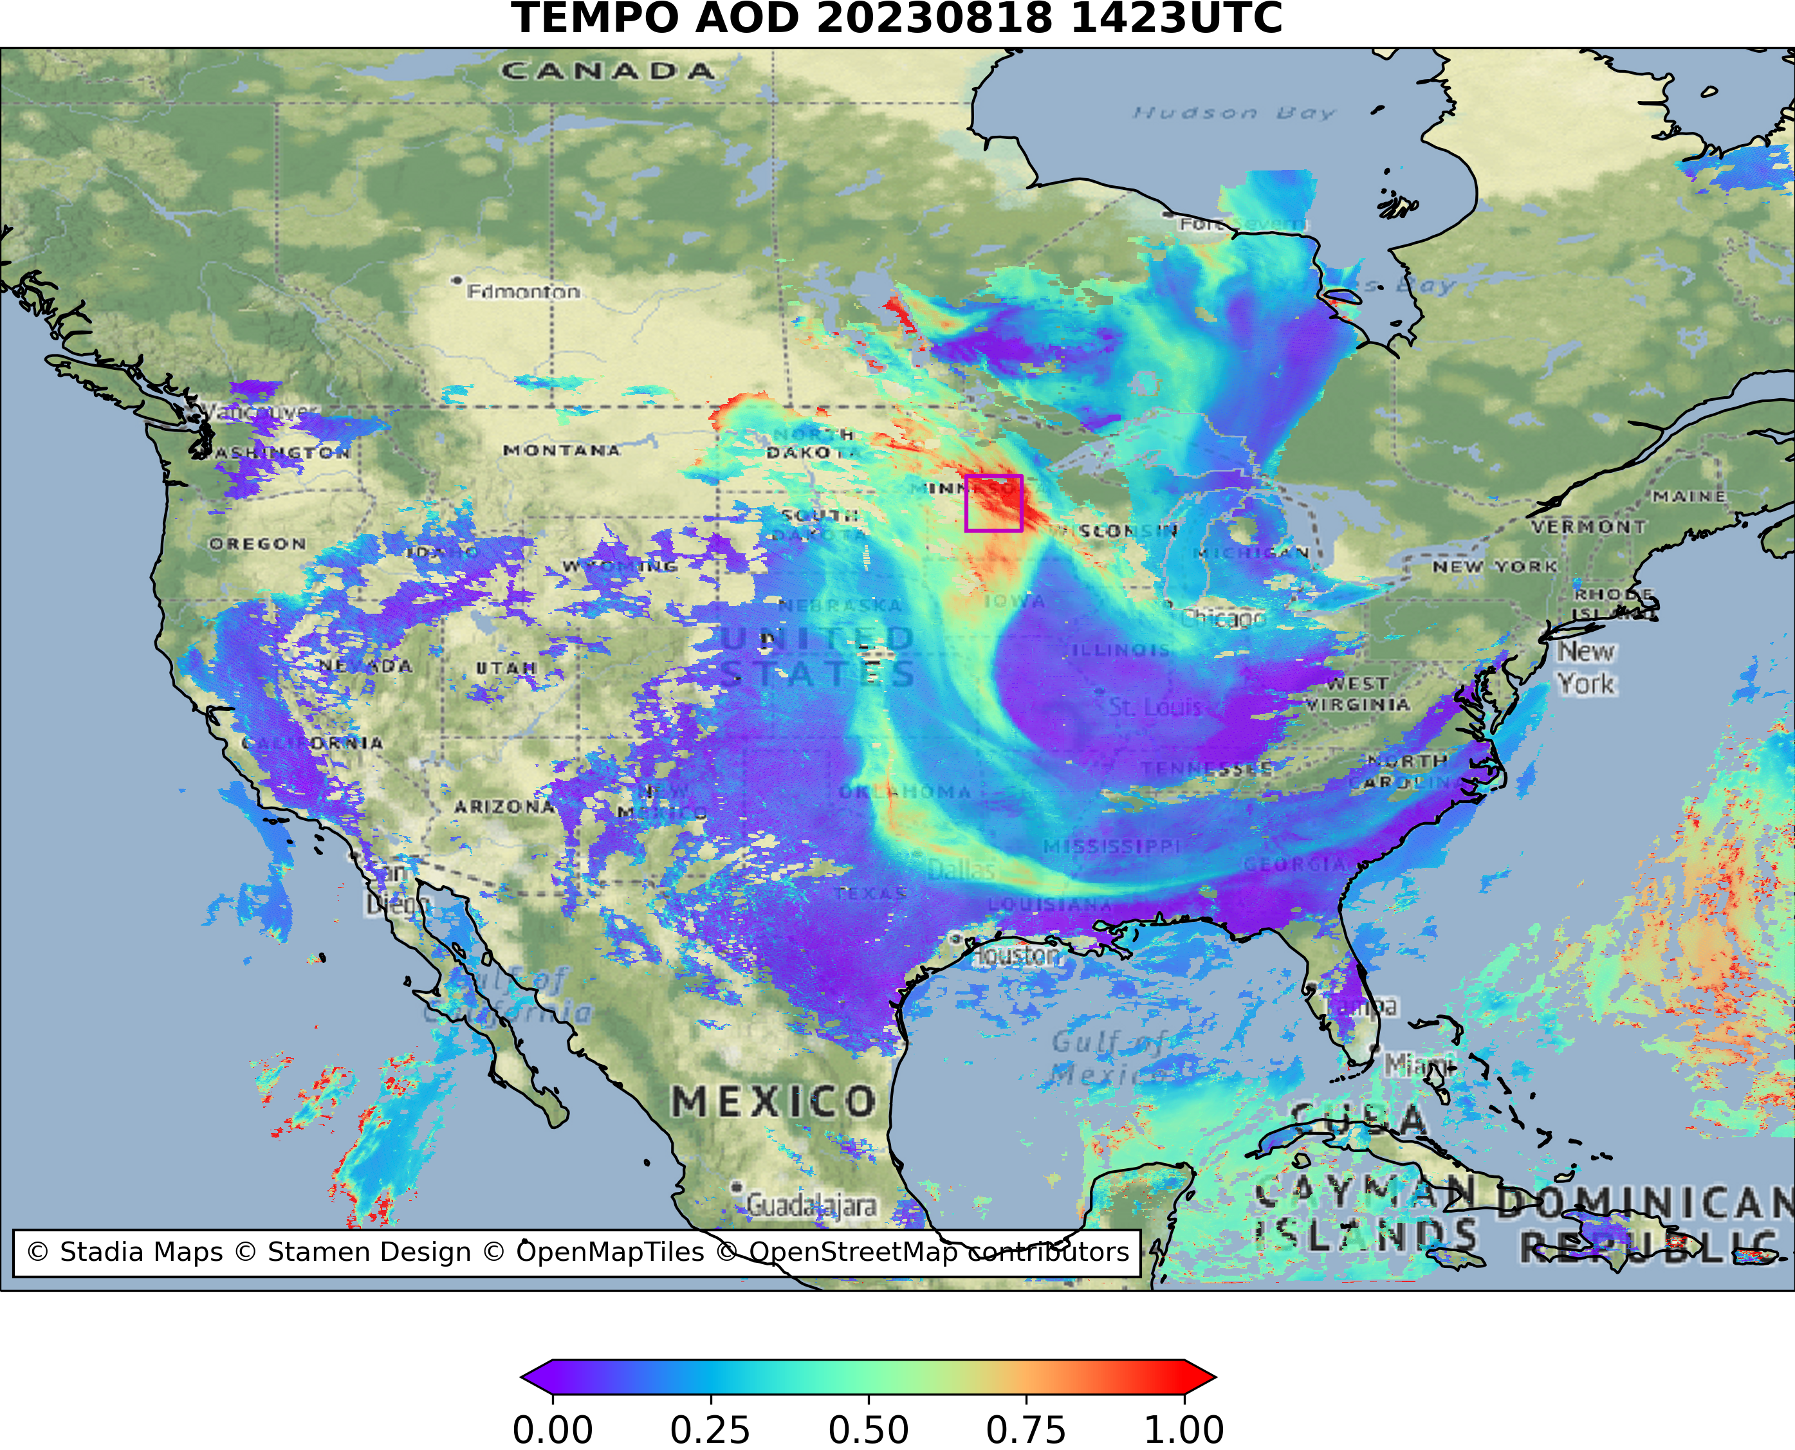
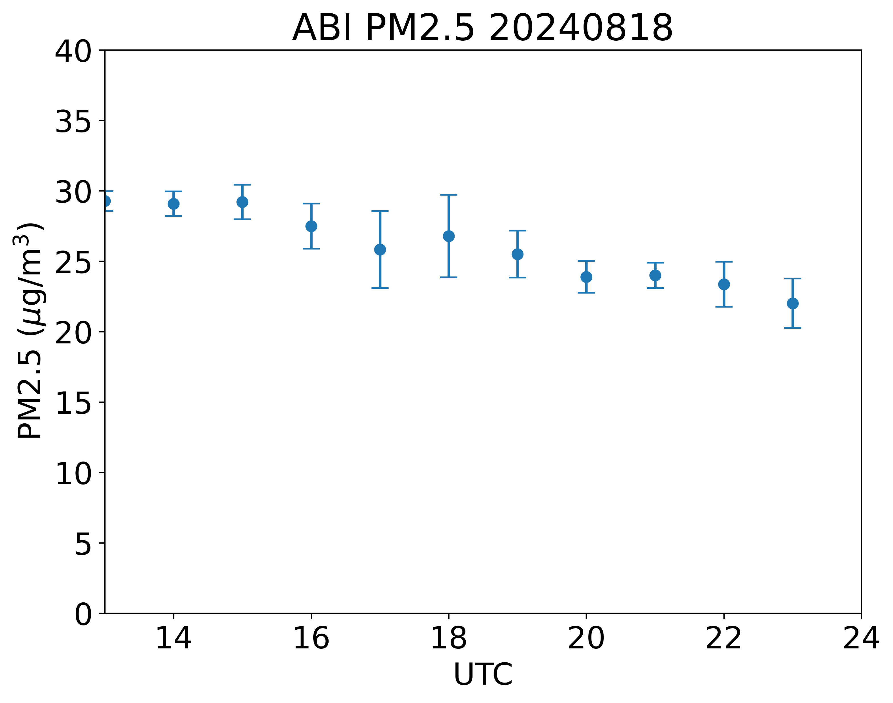
Algorithm Development
44.5N-46.5N
95.0W-93.0W
44.5N-46.5N
95.0W-93.0W
Hai Zhang (NOAA)

Slide 10






















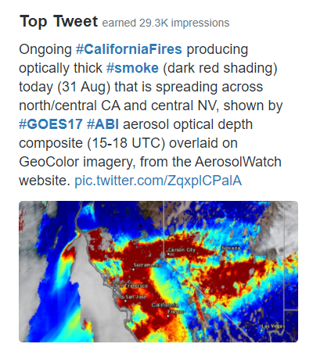


Engaging the user community
Who are our stakeholders?
Operational forecasters for air quality and weather
Federal, state, & local environmental regulators
Climate, stratospheric, & air quality monitoring teams
Environmental assessment bodies
Public health officials
Diplomats
Research community
Media
General public
How are we connecting with them?
Town halls
1-on-1 meetings
Website
GeoXO Pathfinder process
Trainings: e.g., https://tinyurl.com/fnyvdzsx
Social media: e.g., @AerosolWatch

Slide 11
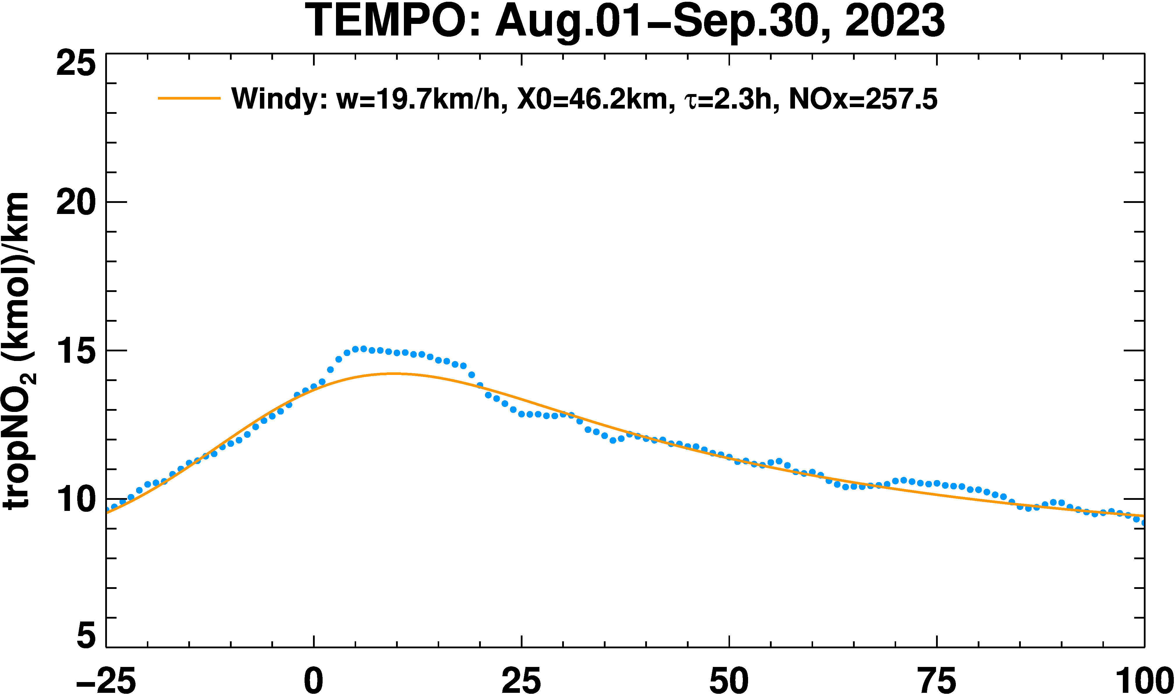
Conclusions
Downloading TEMPO L1B and L2 data products to conduct analysis and understand the strengths and weaknesses;
Contributed to EPA-led NO2 validation report
Conducted analysis of L1B reflectances and reported to Harvard SAO as a feedback
Other Line Offices within NOAA are conducting analysis of TEMPO products by utilizing AEROMMA field campaign data
Developing algorithms to derive routine hourly NOx emissions to update emissions inventories for air quality forecasting models
Developing aerosol algorithms. Experimental near real time
production starts December 2024
NO2 Line Density Plot over Baltimore
Estimated emissions 11.9 Gigagrams/hour
TEMPO Observations
Fit to the Observations
Updating of diurnally varying emissions inventories on a monthly basis using TEMPO observations to improve air quality predictions is a primary target for NOAA
City Center
Km
Zigang Wei (NOAA)

