Slide 1
Potential land applications of geostationary UV/Vis/NIR spectrometers: preliminary results with TEMPO
Joanna Joiner¹, Zachary Fasnacht², Matthew Bandel², Heesung Chong³, Yasuko Yoshida²,
Can Li¹, Lok Lamsal⁴, Xiong Liu³, Dan Lindsey⁵, Andrew Heidinger⁵ and TEMPO team
¹NASA GSFC, ²SSAI, ³Harvard Smithsonian Astrophysical Observatory, ⁴UMBC/GESTAR II, ⁵NOAA

Slide 2
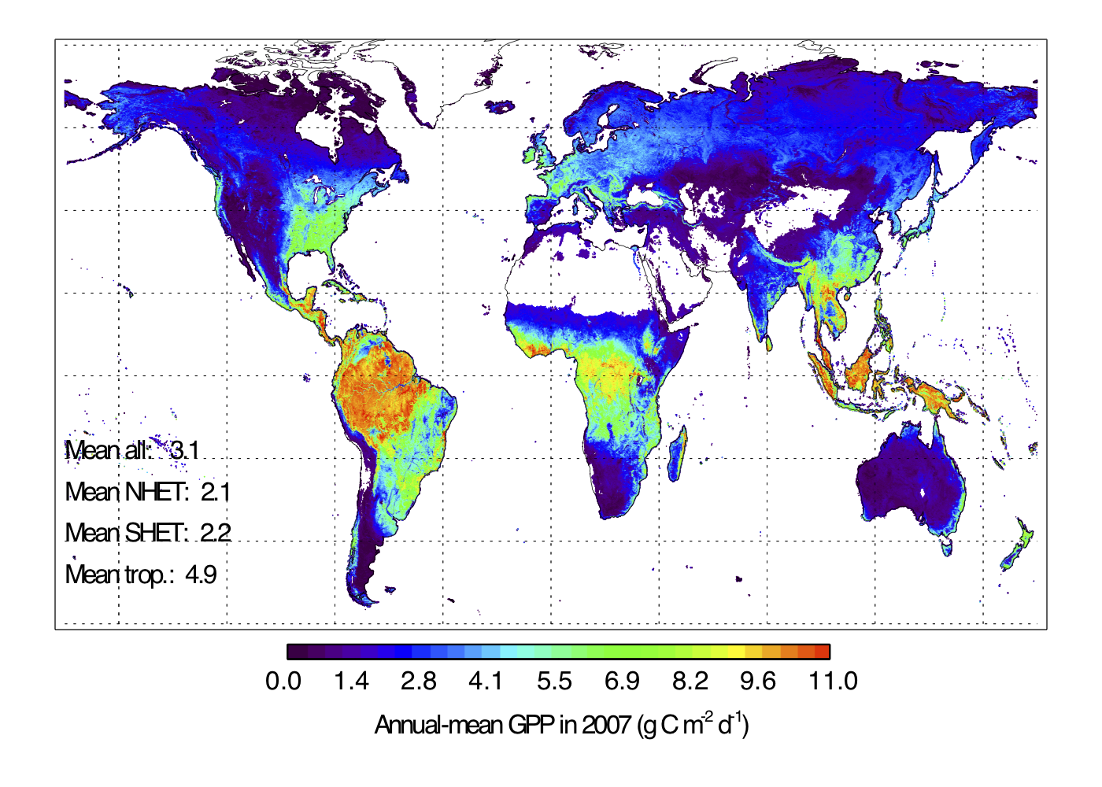
Motivation
Spectrometers in geostationary orbit can serve multiple disciplines and have far reaching and sometimes unplanned applications, such as for land
TEMPO “super-spectral” observations can be harnessed to see through clouds and provide near-real-time estimates of terrestrial quantities such as gross primary production (GPP)
Potential applications include
Precision agriculture
Forestry
Food security (crop yield prediction)
Drought monitoring and impact

Slide 3
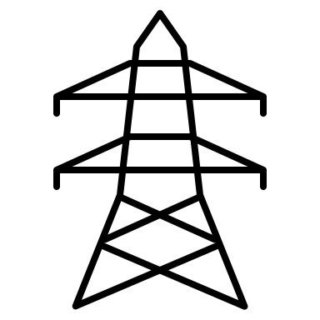
Estimating GPP with satellite observations
Photosynthetically active radiation (PAR)
Machine learning: e.g., neural network with hidden nodes
Inputs
Outputs
Satellite reflectances (optional: principal component analysis)
Top-of-atmosphere PAR
Optional: Additional satellite-sun geometry; meteorological data
Eddy covariance (EC) provides estimates of GPP
Surface signals such as terrestrial gross primary production (GPP)
Eddy covariance flux tower - GPP
MODIS (clear sky, BRDF adjusted)
TEMPO (cloudy) hourly spectra
Note: V3 PRELIMINARY BETA RESULTS!
MODIS-based GPP (FluxSat)

Slide 4
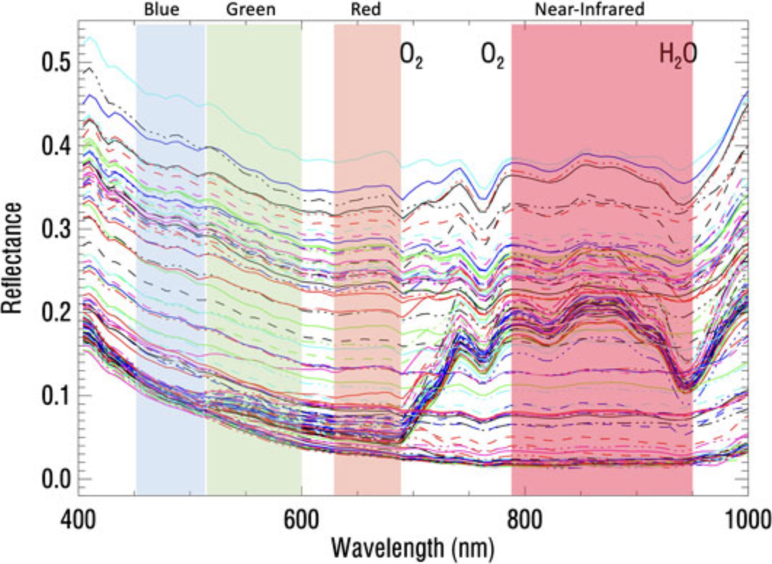
Seeing through clouds with hyper to super-spectral observations
For clouds of low to moderate optical thicknesses, some of the observed light is transmitted and reflected from surface back to satellite
Training with cloudy spectra over land with clear-sky 16 day MODIS based FluxSat GPP teaches neural network how to disentangle cloud and surface spectral signatures
HICO spectra
Red edge (land)
Dark ocean

Slide 5
Example: Hyper-spectral observations better than our eyes
Original RGB clear sky reconstructed
14 days earlier with spectra only
HICO (~90 m) land data from ISS Panama Beach, FL
Many high spatial resolution features, high contrast features are well captured even through clouds of moderate optical thickness
Reconstructed image (right) uses only spectral data from the cloudy scene (left), trained on only spectral data from the clear sky scene (middle) – no spatial information used

Slide 6
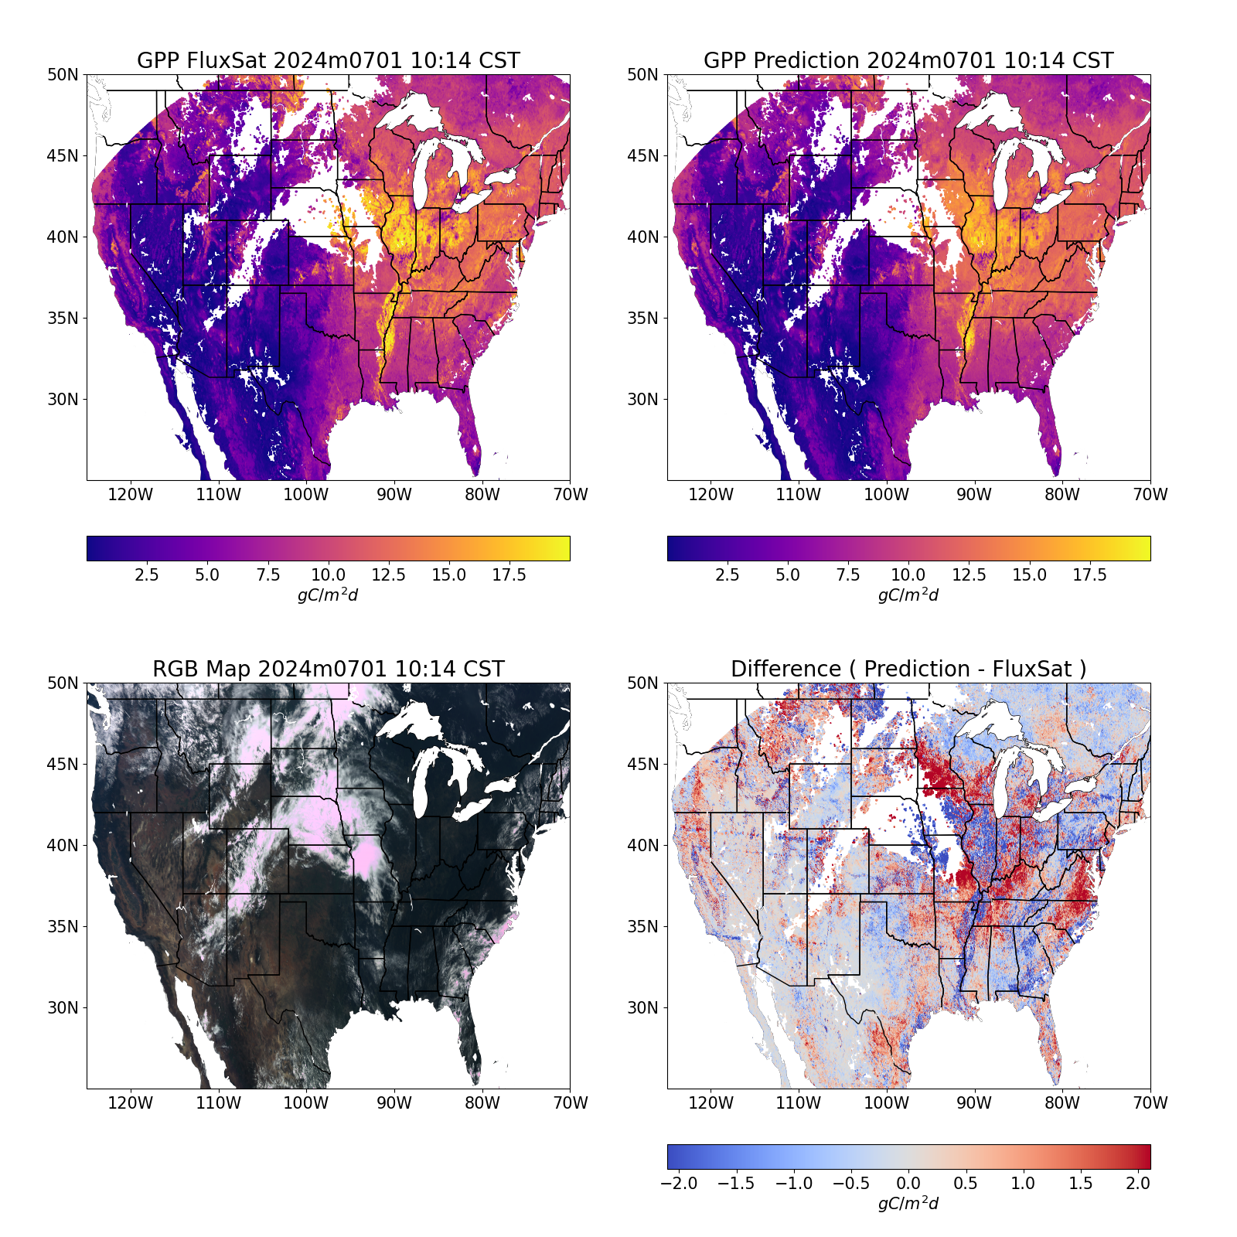
Results with TEMPO
FluxSat uses MODIS Nadir BRDF-Adjusted Reflectances (NBARs), RGB+NIR+SWIR that are available more than a week after overpass and taken over 16 day period (perfect agreement not expected)
With machine learning, TEMPO data can be used to disentangle land and cloud/aerosol spectral signatures to provide excellent coverage in a single overpass
MODIS-based, training TEMPO, single scan

Slide 7
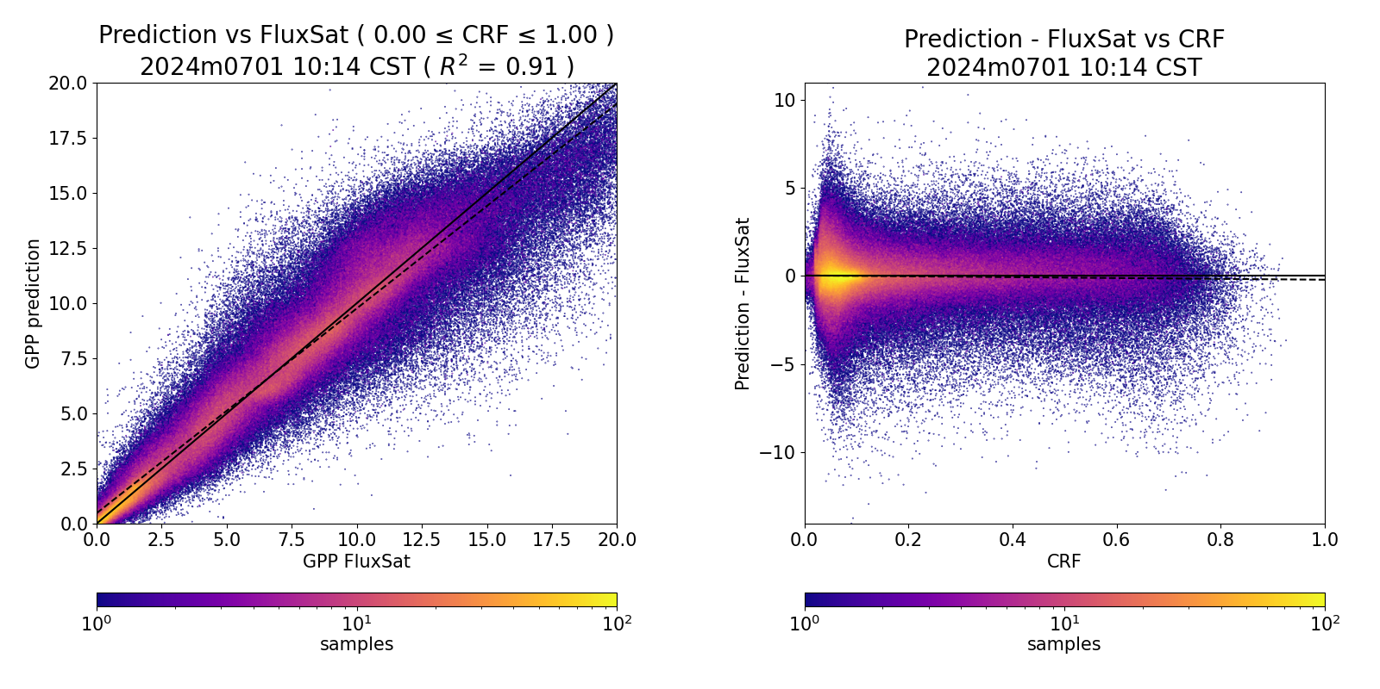
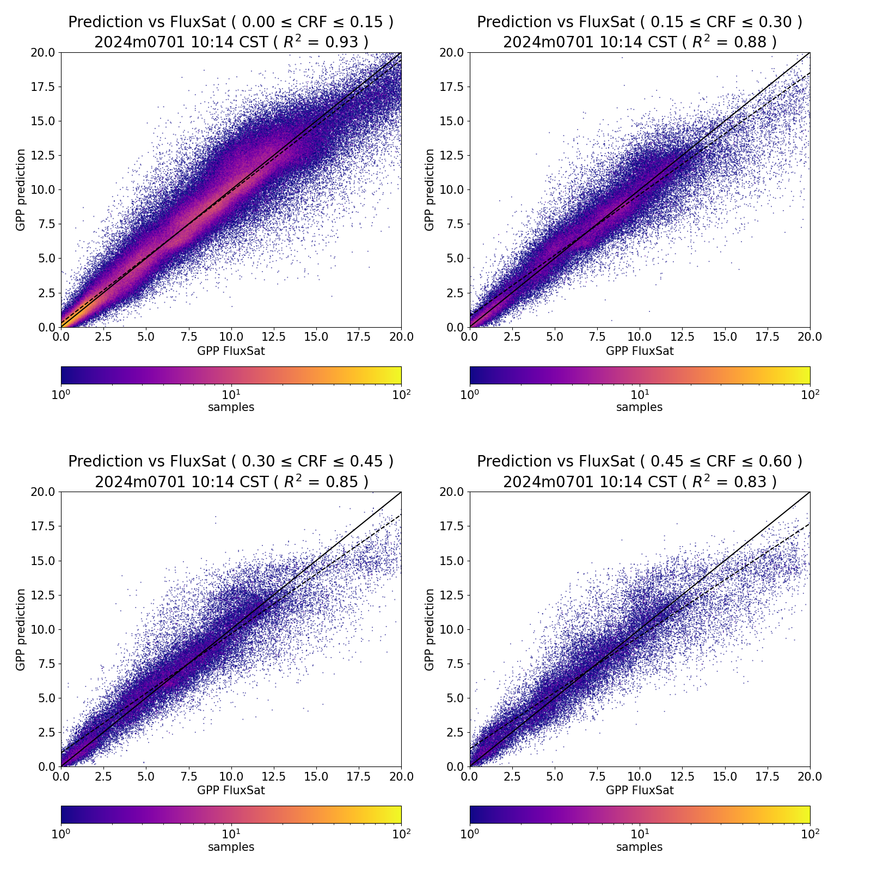
Only slight decline in performance with cloud fraction
All cloud rad. fractions (0-100%) R²=0.91
TEMPO vs MODIS-based GPP 7/1/24
Cloud rad. fractions (<15%) R²=0.93
15-30% R²=0.88
TEMPO-based GPP
TEMPO – MODIS-based GPP
TEMPO-based GPP
TEMPO-based GPP
MODIS-based GPP
MODIS-based GPP
MODIS-based GPP
cloud radiance fraction
30-45% R²=0.85
45-60% R²=0.83
Low bias at high GPP, but at higher cloud fractions, there appears more bias
Even at low cloud fractions, there is an underestimate at the highest GPP values; could be due to TEMPO spectral coverage of only part of red edge and no SWIR (not seeing full canopy scattering.
TEMPO-based GPP
TEMPO-based GPP
MODIS-based GPP
MODIS-based GPP

Slide 8
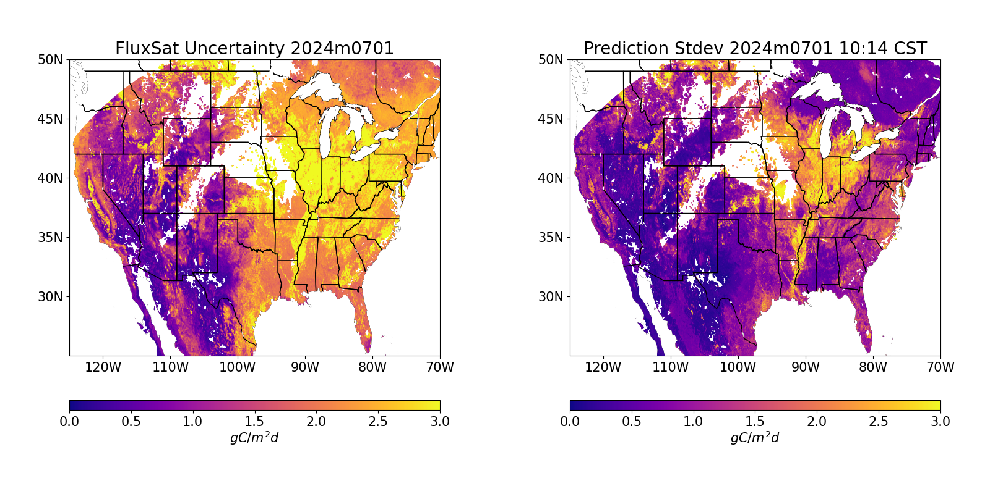
Uncertainties in training and trained GPP
Largest uncertainties in MODIS-based training data (FluxSat) are in agricultural areas
Largest uncertainties in training with TEMPO are also in agricultural areas (likely low bias in TEMPO-based data)
MODIS-based GPP uncertainty 7/1/24
Additional TEMPO-based GPP uncertainty 7/1/24

Slide 9
Summary and Future Work
Preliminary look at TEMPO data for land applications such as GPP is encouraging
Despite some biases, spatial features are well captured
Reasonably good results are obtained even in moderate amounts of clouds
Near-real-time GPP estimates possible
Biases could be related to spectral coverage – not seeing full canopy
More optimization of training is needed
More analysis is needed to assess capabilities to detect short time scale changes such as due to drought
Other vegetation indices can be produced (green based)
Combine with ABI collocated data

