Slide 1
Cloud-sliced free tropospheric NO₂ observations from
the TEMPO geostationary satellite instrument
Ruijun Dang (rjdang@g.harvard.edu)
Daniel J. Jacob, Yujin Oak, Laura H. Yang (ACMG, Harvard)
Helen Wang (Harvard-Smithsonian)
TEMPO/GEMS Workshop, 27th August 2024

Slide 2
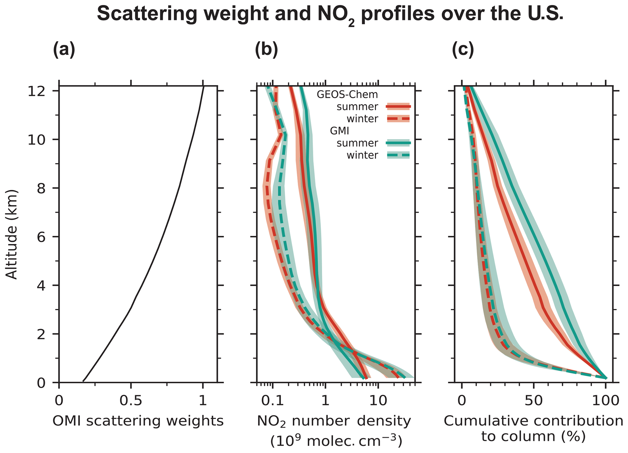
The importance of free tropospheric (FT) NO₂
Free troposphere: the troposphere above the boundary layer (~2km - tropopause)
FT NO₂ is a major driver of global oxidant chemistry.
FT NO₂ contributes a background tropospheric NO₂ column that must be accounted for when interpreting satellite data.
OH
CH₄ lifetime
65% in summer
25% in winter
O₃
FT NO_{x} impacts GHGs abundance
Shah et al. (2023)
NO
NO₂
FT
~2 km
BL

Slide 3
Cloud-slicing technique – deriving FT NO₂ concentrations
from satellite observations under cloudy conditions
LEO products have poor spatial resolution and high uncertainties
With higher spatial and temporal resolution,
TEMPO can better define fully cloudy scenes and offer greater data density
Measured above-cloud NO₂ vertical column densities (VCD)
Regression between
cloud pressure and NO₂ VCD
$${FT NO}_{2} Volume Mixing Ratio(VMR)∝ \frac{∆VCD}{∆p}$$
300 hPa
450 hPa
Cloud optical
centroid pressure (OCP)
Above-cloud NO₂ VCD
$$∆VCD$$
700 hPa
$$∆p$$
50km
Cloud pressure (OCP)
50km

Slide 4
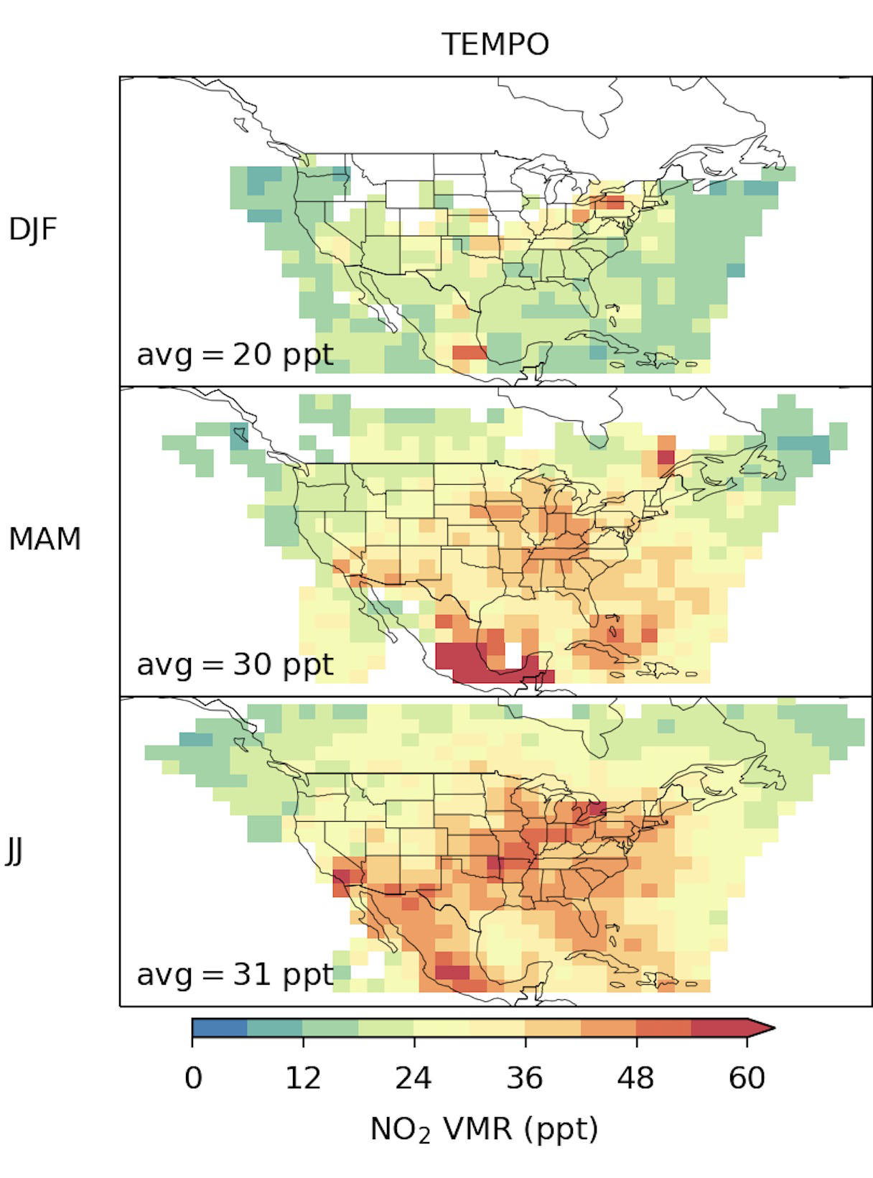
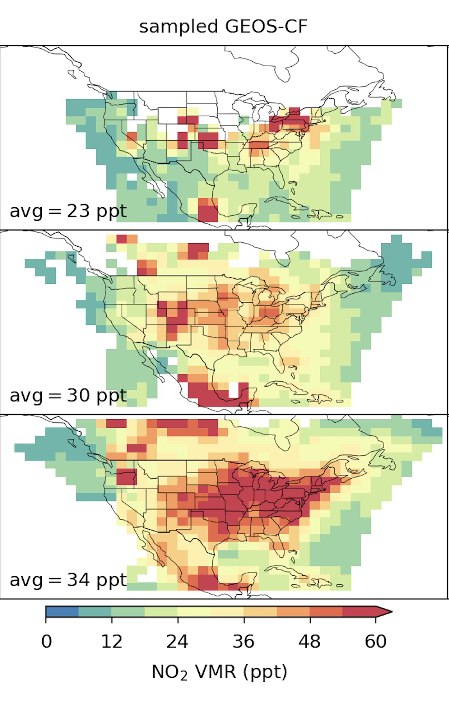
TEMPO cloud-sliced observation of FT NO₂ (700-300 hPa)
TEMPO
Sampled GEOS-CF
Seasonal mean product at 2° x 2.5°
Uncertainty: 40-50%
TEMPO NO₂ and cloud product:
Dec 2023-Feb 2024, v1
Feb-May 2024, v2
May-Jul 2024, v3
Use cloud radiance fraction>0.9
GEOS-CF model:
Online GEOS-Chem in GEOS system
Provides NO₂ vertical shape factors for TEMPO retrieval
DJF
MAM
JJ
NO₂ (ppt)
NO₂ (ppt)

Slide 5
TEMPO cloud-sliced observation of FT NO₂ (700-300 hPa)
TEMPO
Sampled GEOS-CF
Observations and model are encouragingly consistent:
Comparable magnitude
Seasonal variation
Spatial distribution
Uncertainty: 40-50%
DJF
Some important discrepancies:
TEMPO does not detect GEOS-CF hotspots in winter
TEMPO > GEOS-CF offshore of east coast in spring-summer
TEMPO < GEOS-CF over land in summer
(2) and (3) suggest model error in parameterizing lightning NO_{x} emissions
MAM
JJ
NO₂ (ppt)
NO₂ (ppt)

Slide 6
High TEMPO FT NO₂ over oceans linked to lightning activity,
not captured by GEOS-CF
Observation
GEOS-CF model
Flash count
(GLM onboard GOES-16)
Flash count
(function of cloud top height)
Lightning NO_{x} emissions
500 mol N flash⁻¹
MAM
35 °N
260 mol N flash⁻¹
JJ
Combination of TEMPO and GLM will allow improved parameterization of
lightning NO_{x} emissions in models!
Model underestimates the lightning flashes over the Gulf of Mexico and the western Atlantic.
Lightning NO_{x} production rate is likely set too high north of 35°N in the model, leading to a high bias.

Slide 7
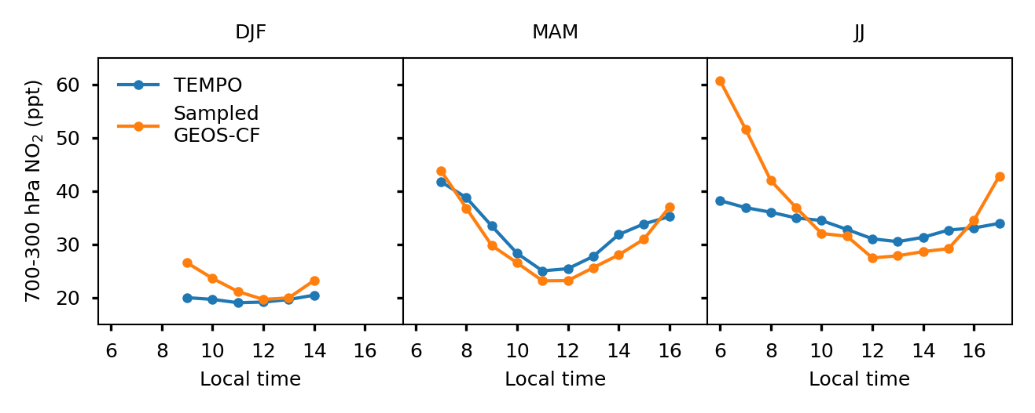
TEMPO enables diurnal observations of FT NO₂
DJF
MAM
JJ
TEMPO
Sampled GEOS-CF
Free trop
NO₂ (ppt)
Encouragingly good agreement between TEMPO and model in spring!
The afternoon minimum in spring FT NO₂ may be due to enhanced NO₂ photolysis (further investigation is needed with models)
Discrepancy in summer: TEMPO shows a flatter pattern in summer compared to spring, while the model exhibits a similar pattern to spring.

Slide 8
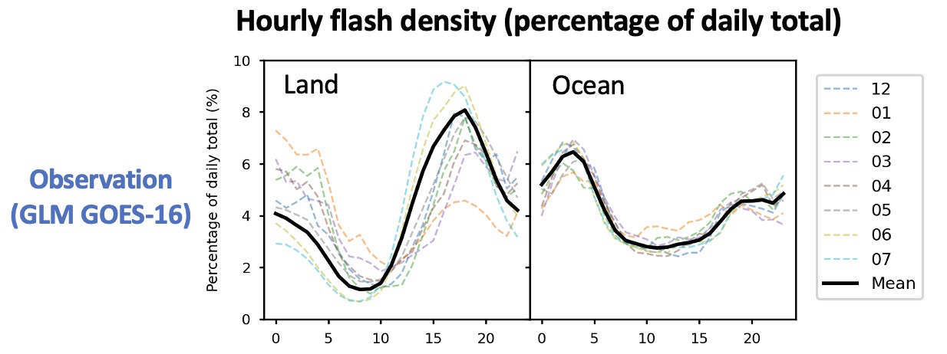
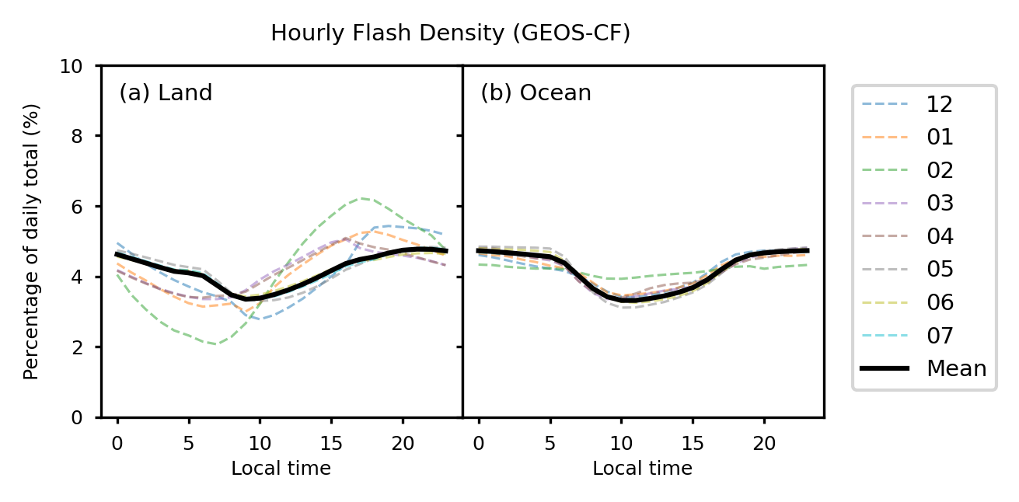
GLM indicates an error in GEOS-CF lightning diurnal variation
GEOS-CF is flatter, which would affect modeled FT NO₂ diurnal cycle
GEOS-CF lightning flashes are a function of cloud-top height
Land
Ocean
Model
(GEOS-CF)

Slide 9
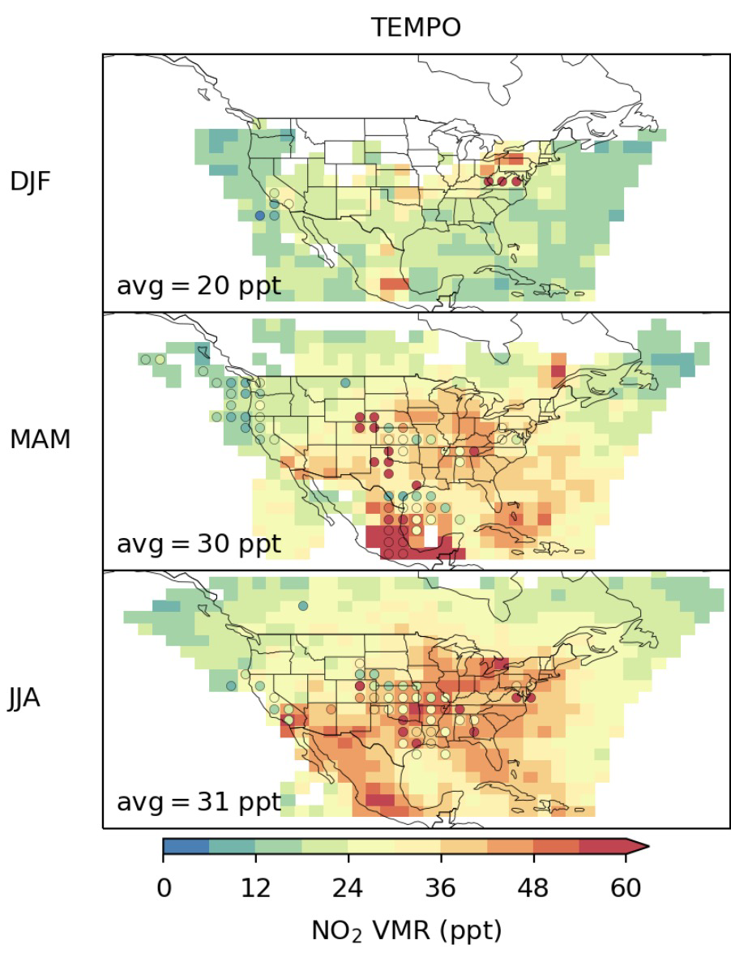
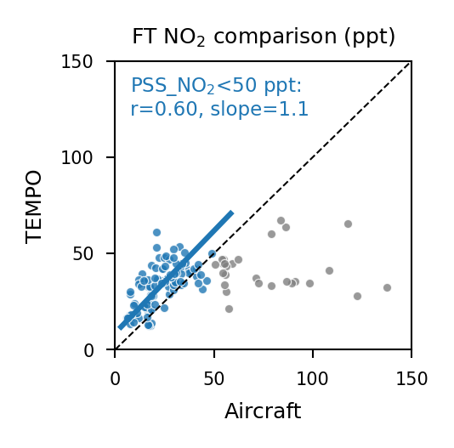
Evaluating TEMPO FT NO₂ against aircraft observations
700-300 FT NO₂
Two different populations:
TEMPO does not capture the observed high values in NO₂ plumes.
TEMPO shows fair consistency with aircraft observations below 50 ppt (r=0.6, slope=1.1).
DJF
Campaigns
INTEX-B
ARCTAS
DC-3
SEAC4RS
DISCOVER-AQ
WINTER
MAM
TEMPO
JJ
Aircraft PSS NO₂

Slide 10
Takeaways
We present a new TEMPO cloud-sliced free tropospheric (FT, 700-300 hPa) NO₂ seasonal product at a 2° × 2.5° spatial resolution and diurnal resolution over North America.
There is a general agreement between TEMPO and GEOS-CF in terms of seasonality, spatial pattern, and diurnal variations.
Discrepancies suggest model errors in parameterizing lightning NO_{x} emissions.
TEMPO FT NO₂ (700-300 hPa) shows fair consistency with aircraft observations.
Further analysis is needed: Combining TEMPO and GLM geostationary observations to improve lightning NO_{x} parameterization; Using model to understand TEMPO FT NO₂ diurnal variations.
Any suggestions are welcome!
Contact: rjdang@g.Harvard.edu

