Slide 1
Evaluating TEMPO with WRF-Chem
and AGES+ Observations
Chia-Hua Hsu
(CU)
Arthur Mizzi
(NASA/CU)
Daven Henze
(CU)
Colin Harkins
(CU)
Trammell Lyu
(CU)
Brian McDonald, Program Lead
Atmospheric Composition Modeling

Slide 2
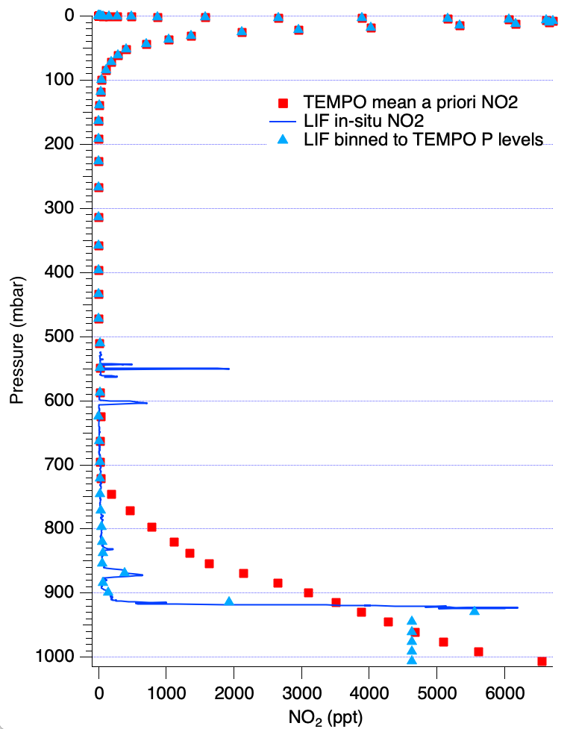
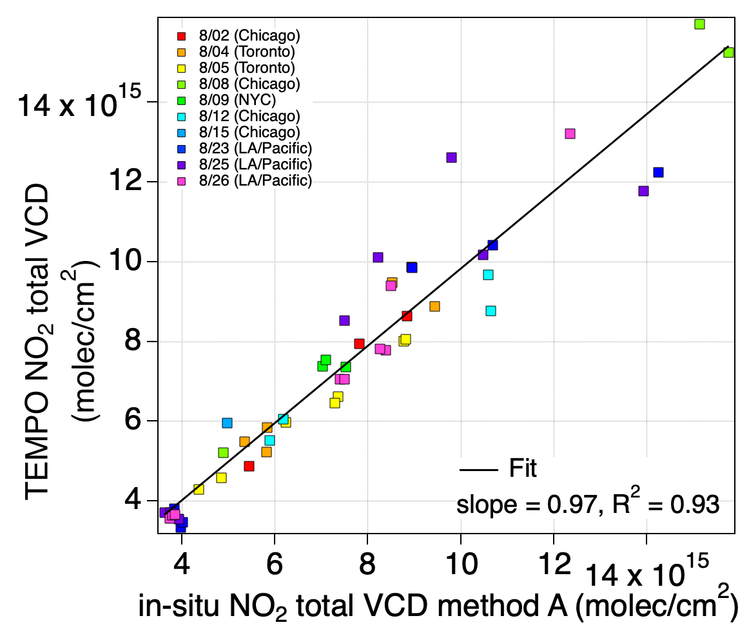
Estimating NO₂ Vertical Column Density from AEROMMA Spirals
GEOS-CF a priori
Eleanor Waxman
(CU)
Boundary layer mean

Slide 3
Research Objectives
Quantify Bias in TEMPO / TROPOMI NO₂ versus Pandora network
Assimilate TEMPO / TROPOMI NO₂ during AGES+ field campaigns to adjust NO_{x} Emissions
Evaluate satellite assimilated NO₂ with AGES+ airborne observations and assess impact on O₃
See poster by Chia-Hua Hsu (CU):
“Intercomparison of top-down estimates of anthropogenic and soil NO_{x} emissions using TEMPO and TROPOMI NO2 remote sensing observations in the U.S.”

Slide 4
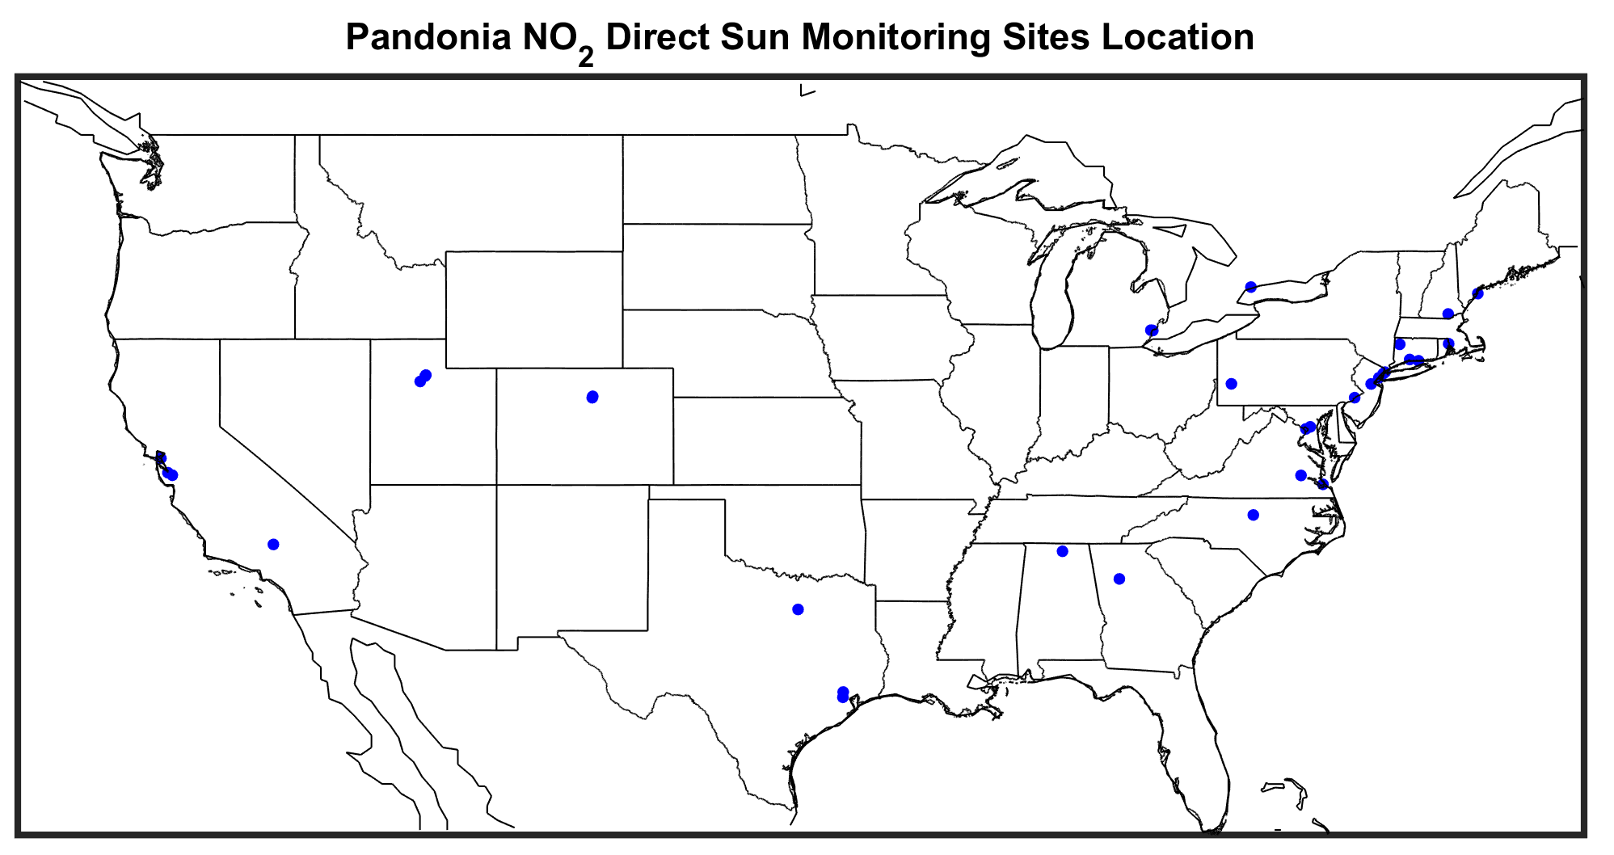
Pandora NO₂ Sites during Aug-Sep 2023

Slide 5
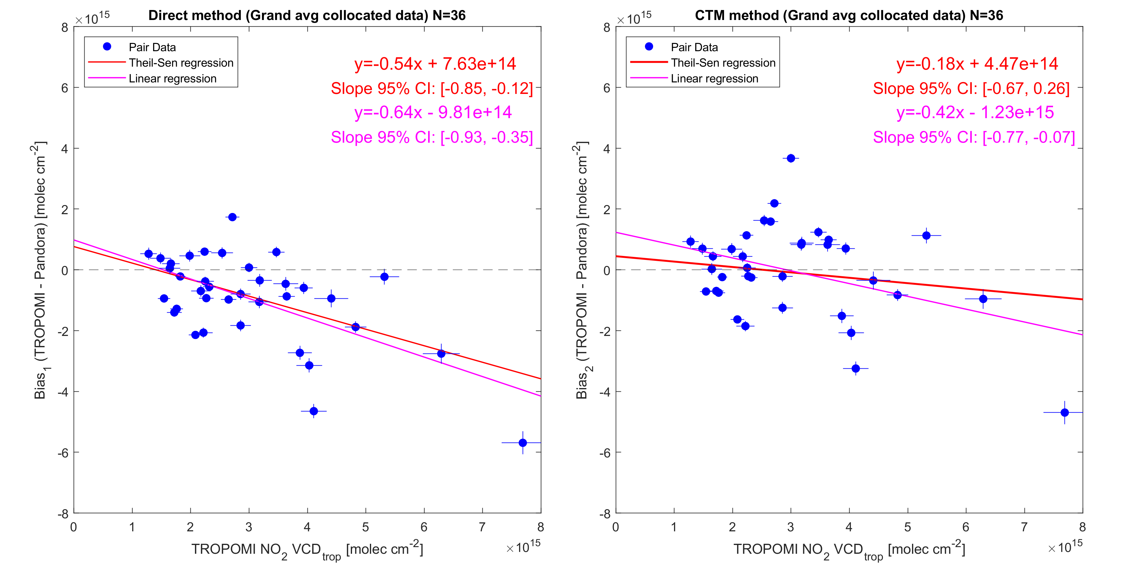
Evaluation of TROPOMI NO₂ with Pandora (Aug – Sep 2023)
Direct Comparison
Model as Transfer Standard
Significant
Low Bias
Reduced
Low Bias
-12%
Bias (TROPOMI – Pandora) [molec cm⁻²]
-44%
TROPOMI NO₂ VCD_{trop} [molec cm⁻²]
TROPOMI NO₂ VCD_{trop} [molec cm⁻²]

Slide 6
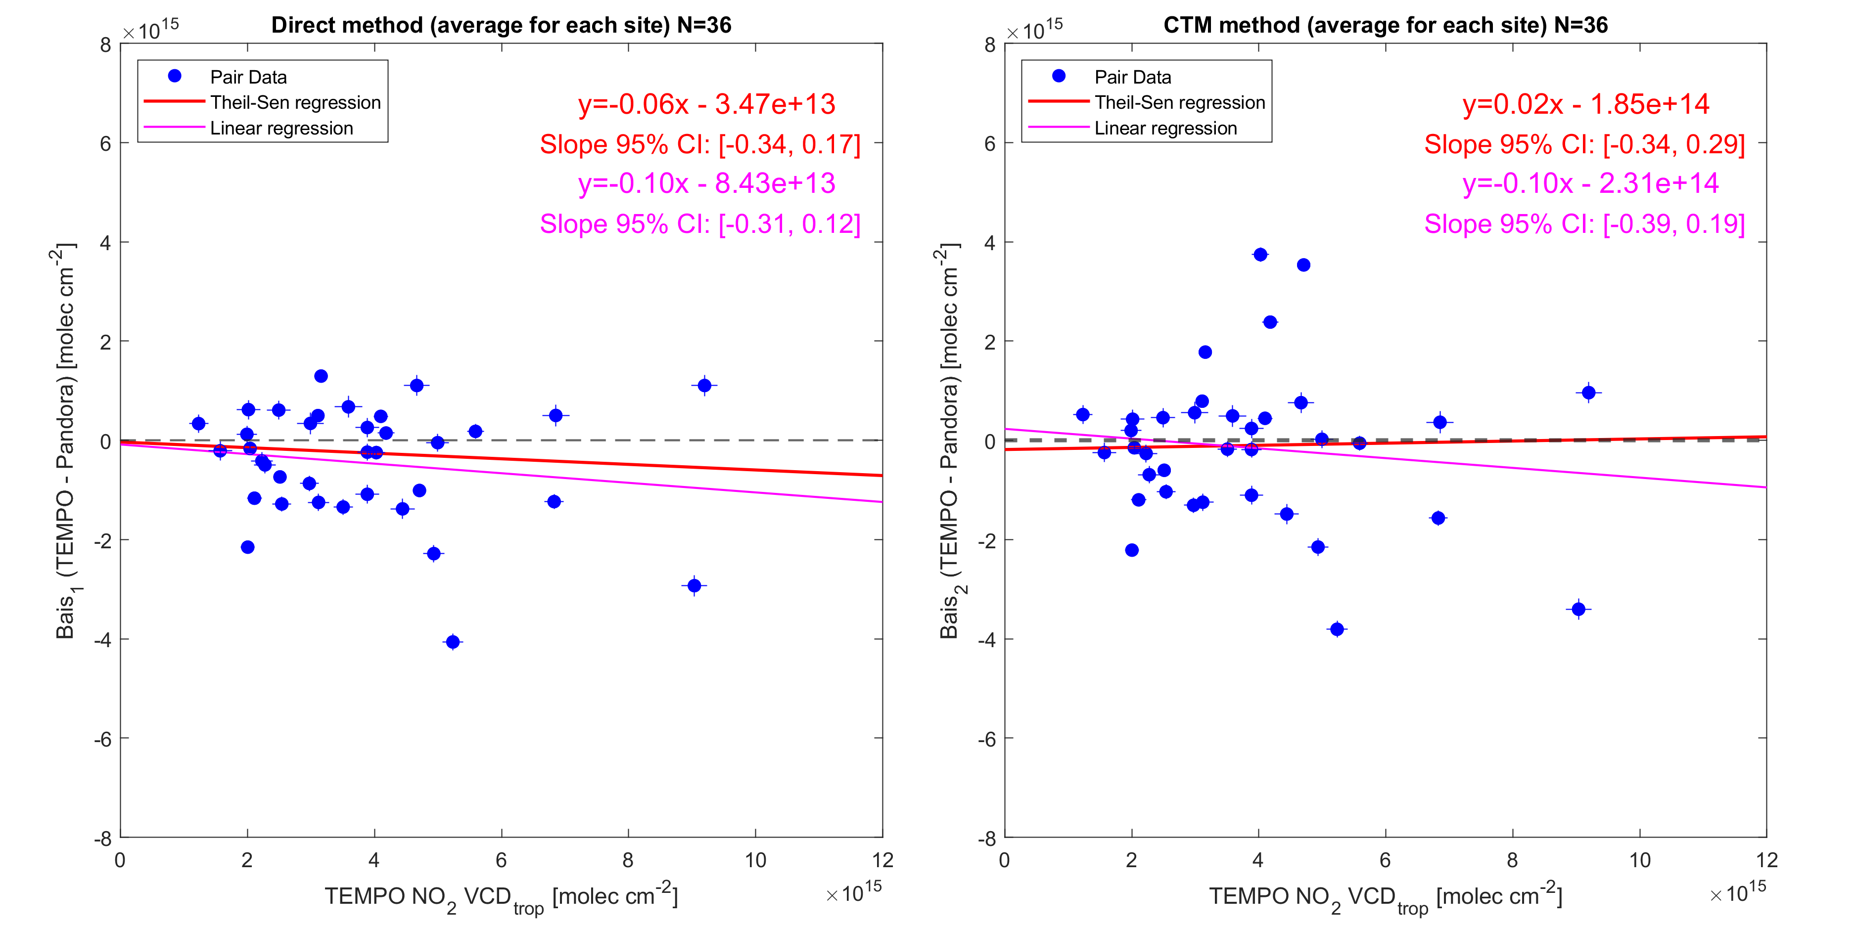
Evaluation of TEMPO NO₂ with Pandora (Aug – Sep 2023)
Direct Comparison
Model as Transfer Standard
Reduced
Low Bias
Bias Near
Zero
-9%
Bias (TEMPO – Pandora) [molec cm⁻²]
17 – 22 UTC only
(midday)
TEMPO NO₂ VCD_{trop} [molec cm⁻²]
TEMPO NO₂ VCD_{trop} [molec cm⁻²]

Slide 7
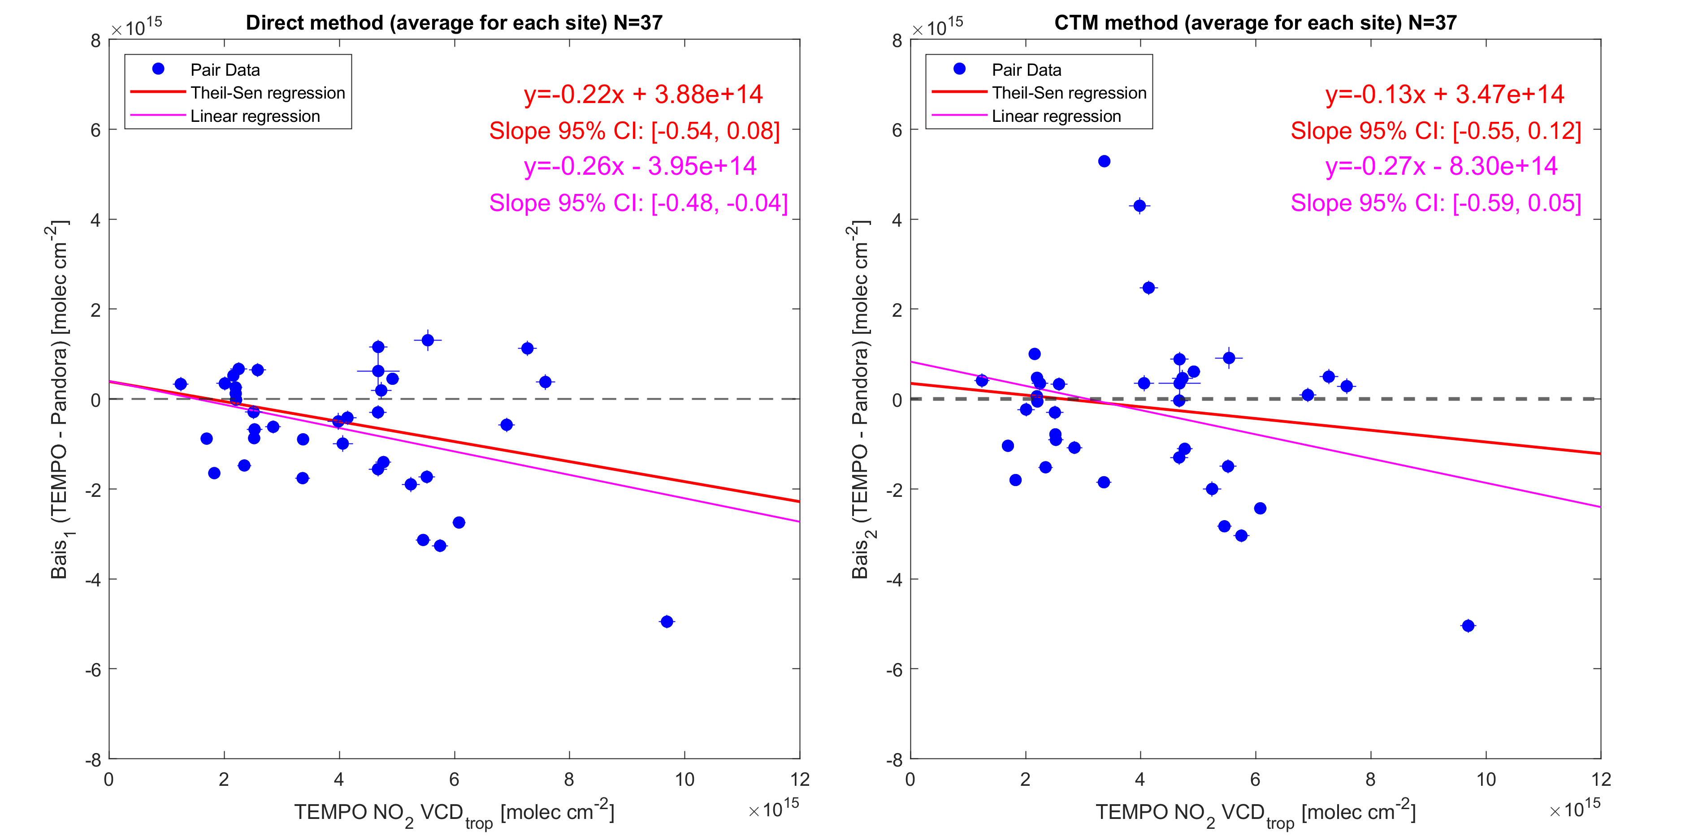
Evaluation of TEMPO NO₂ with Pandora (Aug – Sep 2023)
Direct Comparison
Model as Transfer Standard
Noticeable
Low Bias
Reduced
Low Bias
-15%
Bias (TEMPO – Pandora) [molec cm⁻²]
-28%
11 – 17, 22 – 00 UTC
(morning, evening)
TEMPO NO₂ VCD_{trop} [molec cm⁻²]
TEMPO NO₂ VCD_{trop} [molec cm⁻²]

Slide 8
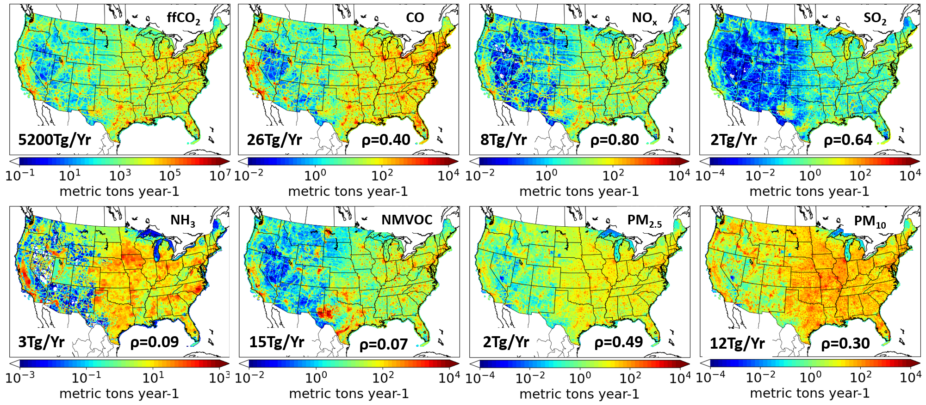
GReenhouse gas And Air Pollutants Emissions System (GRA²PES)
Colin Harkins
(CU)
Trammell Lyu
(CU)
https://csl.noaa.gov/groups/csl4/gra2pes/
Lyu et al. (in preparation)

Slide 9
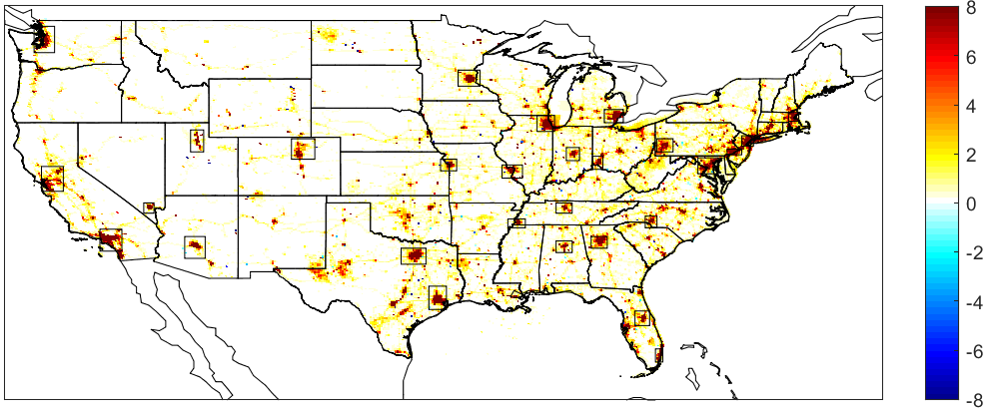
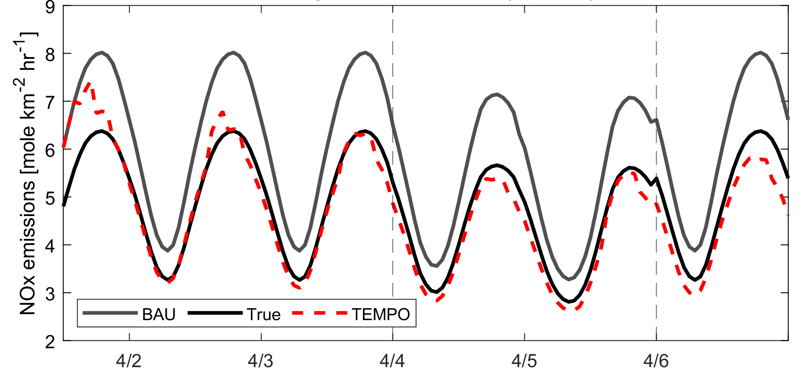
Utilizing WRF-Chem-DART for NRT Emissions Estimation
Business-as-usual (BAU) – COVID-19
NO_{x}
mole/km²/h
Business-as-usual (BAU) – COVID-19
Without COVID-19 pandemic, NO_{x} emissions
would be ~30% higher in April 2020
Geostationary NO₂ observations can update NO_{x} emissions within 1-3 days accounting for pandemic
Chia-Hua Hsu
(CU)
Arthur Mizzi
(NASA/CU)
Daven Henze
(CU)
Hsu et al. (JGR, 2024)

Slide 10
TROPOMI / TEMPO NO₂ Reduces GRA2PES NO_{x} Emissions
GRA2PES Prior
reduced by
TROPOMI NO₂
(midday)
TEMPO NO₂
(midday only)
TEMPO NO₂
(all hours)
-14%
-9%
-18%

Slide 11
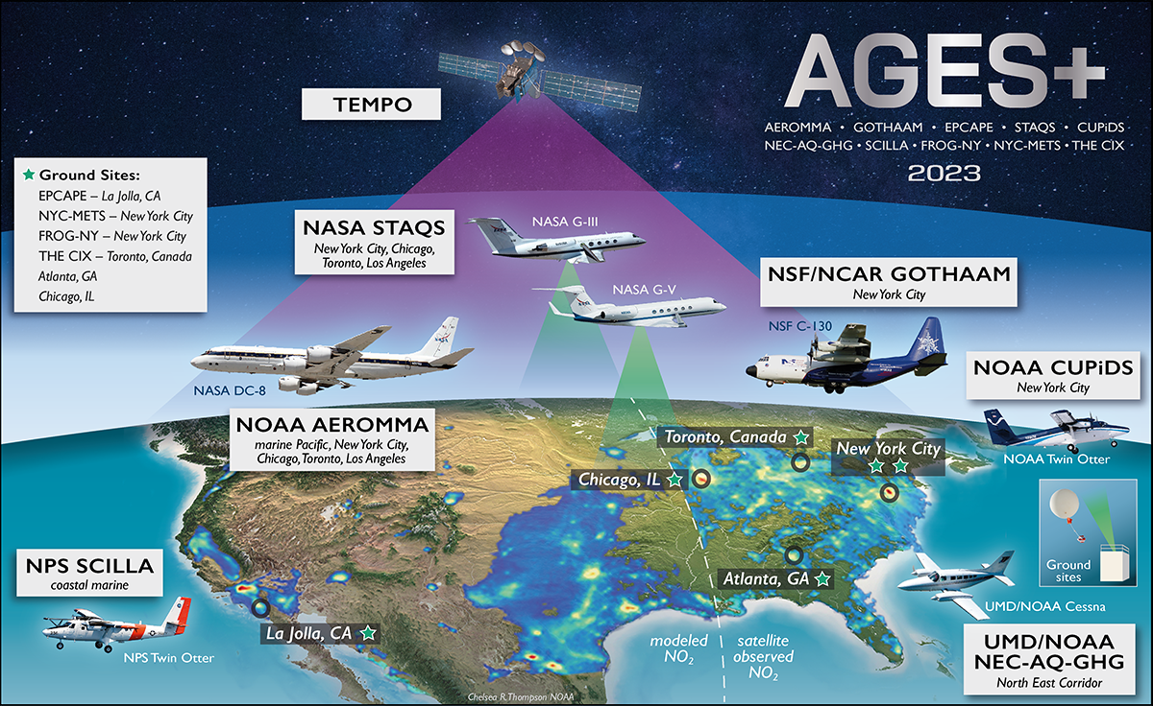
Airborne Field Campaigns in Summer 2023
https://csl.noaa.gov/projects/ages/

Slide 12
Evaluating Model NO_{x} with AGES+ Observations
NASA DC8 (CHI, NYC, TOR)
NO_{x}
GRA2PES No DA (+11%, R² = 0.41) → TEMPO midday DA (-13%, R² = 0.48)
NOAA TO (NYC only)
GRA2PES No DA (+12%, R² = 0.33)
NO_{x}
GRA2PES No DA (+12%, R² = 0.33) → TEMPO midday DA (-15%, R² = 0.34)

Slide 13
Evaluating Model O₃ with AGES+ Observations
NASA DC8 (CHI, NYC, TOR)
O₃
GRA2PES No DA (+11 ppb, R² = 0.44) → TEMPO midday DA (+9.5 ppb, R² = 0.50)
NOAA TO (NYC only)
O₃
GRA2PES No DA (+8.7 ppb, R² = 0.33) → TEMPO midday DA (+6.7 ppb, R² = 0.21)

Slide 14
Summary
TEMPO NO₂ agreement better midday with Pandora network than during morning / evening hours
Assimilating TEMPO midday NO₂ lowers GRA²PES prior emissions by ~10%
Compared to airborne data, TEMPO midday assimilation has similar NO_{x} bias and improved correlation versus modeling without data assimilation
Lowered NO_{x} emissions lowers high model O₃ bias by 1-2 ppb
See poster by Chia-Hua Hsu (CU):
“Intercomparison of top-down estimates of anthropogenic and soil NO_{x} emissions using TEMPO and TROPOMI NO2 remote sensing observations in the U.S.”

