Slide 1
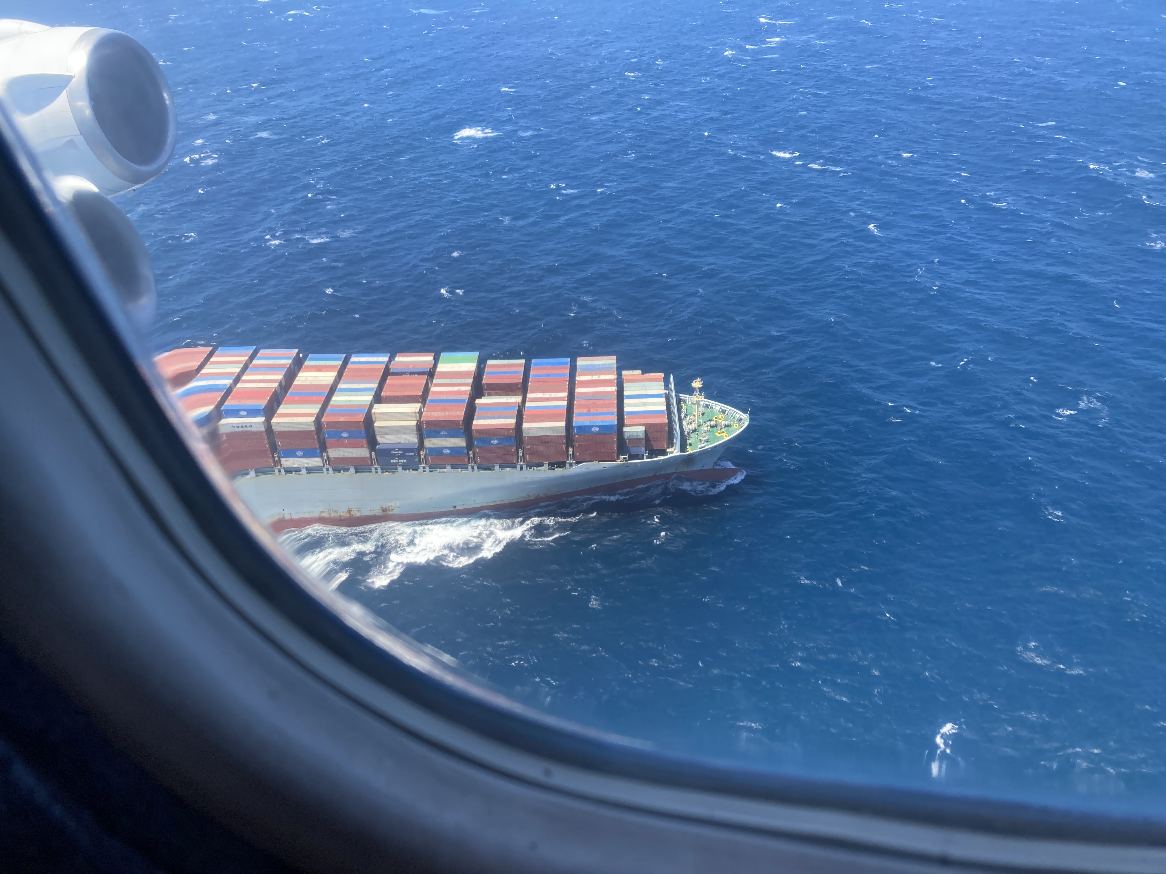
Aircraft-based validation of TEMPO during the AEROMMA campaign
Eleanor Waxman^{1,2}, Drew Rollins², Kristen Zuraski^{1,2}, Glenn Wolfe³, Abby Sebol^{3,4}, Caroline Nowlan⁵, Gonzalo Gonzalez-Abad⁵
¹CIRES, University of Colorado Boulder, Boulder, CO
²NOAA Chemical Sciences Laboratory, Boulder, CO
³NASA Goddard Space Flight Center, Greenbelt, MD
⁴University of Maryland College Park, College Park, MD
⁵Harvard Smithsonian Center for Astrophysics, Cambridge, MA

Slide 2
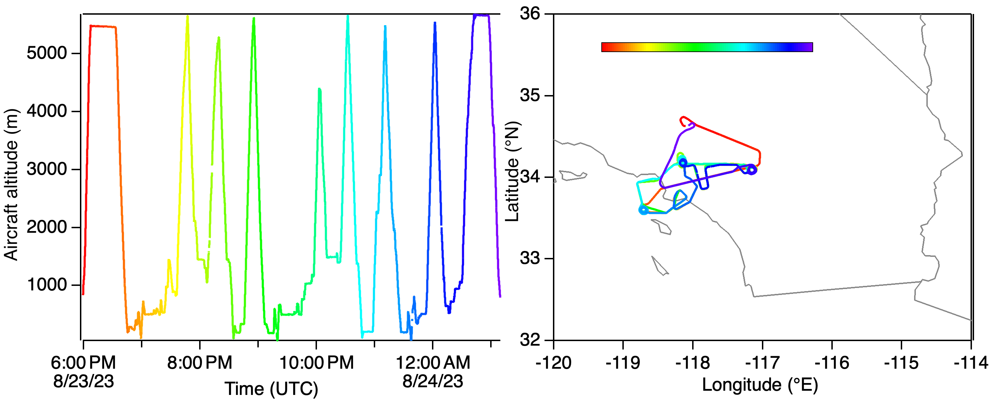
AEROMMA flights for TEMPO validation
Example: 23 Aug. 2023, LA and Pacific
JPL/Pasadena
Redlands/San Bernardino
Pacific

Slide 3
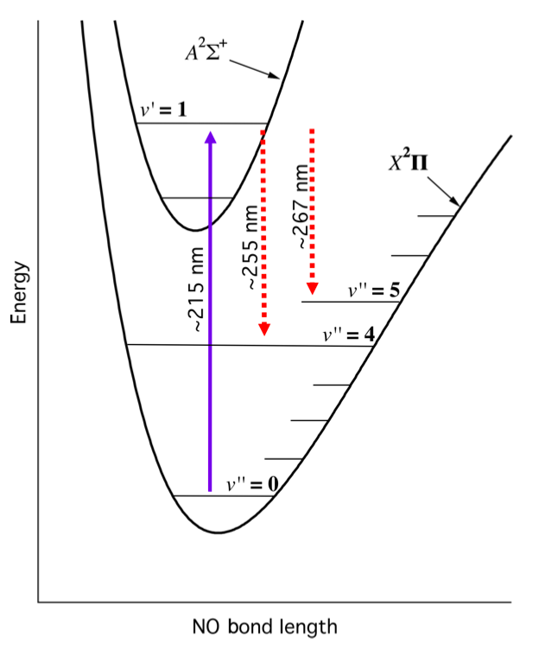
Laser-Induced Fluorescence NO₂ instrument
1075 nm laser
Fiber
Lens
PPLN
LBO
BBO
Prism
NO cell
NO cell
NO_{x} cell
NO_{y} cell
Rollins et al. (2020) AMT
HCHO (ISAF) operates on a similar principle. See Cazorla et al. (2015)

Slide 4
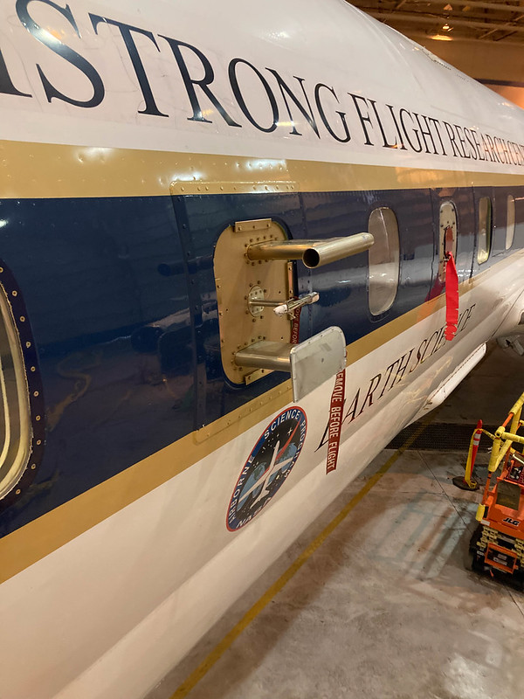
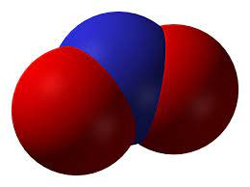
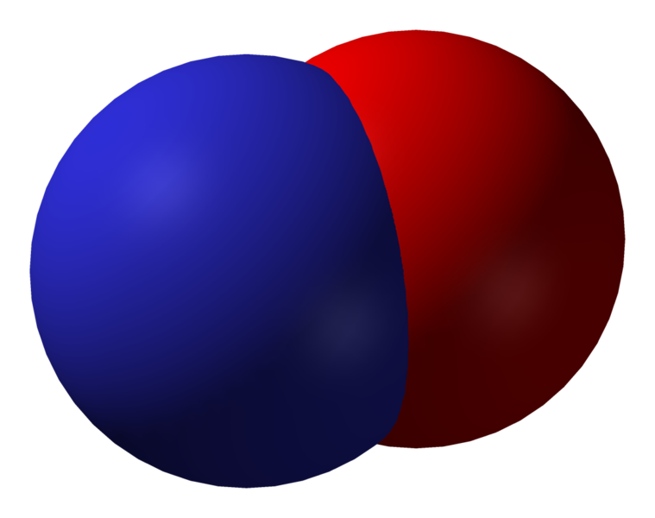
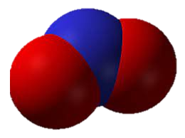
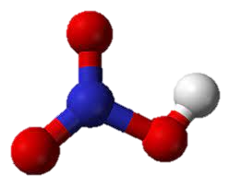
LIF inlet to get NO₂ and NO_{y}
Ambient air
LIF instrument
DC-8 window inlet
NO inlet
to NO channel
NO_{x} inlet
to NO_{x} channel
395 nm LED
Gold converter at 300 C
to NO_{y} channel
Photo credit: Chelsea Thompson, NOAA CSL

Slide 5
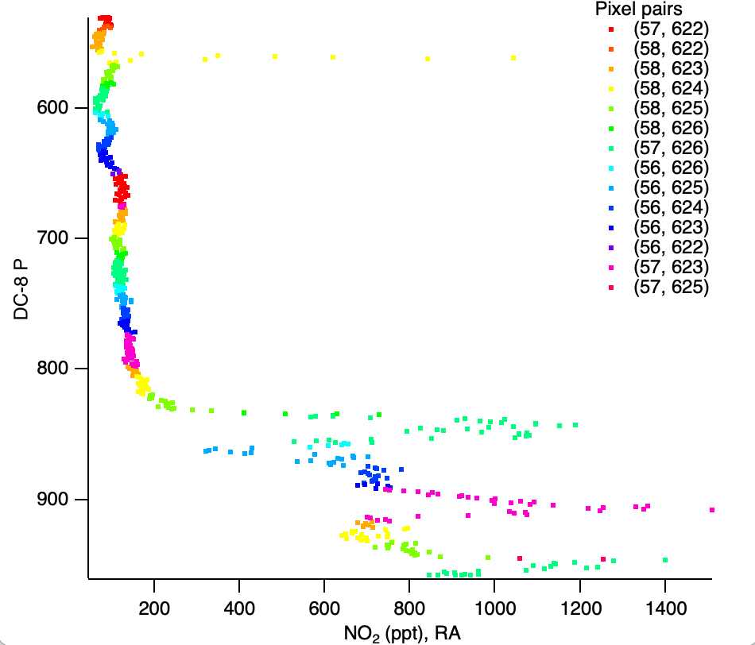
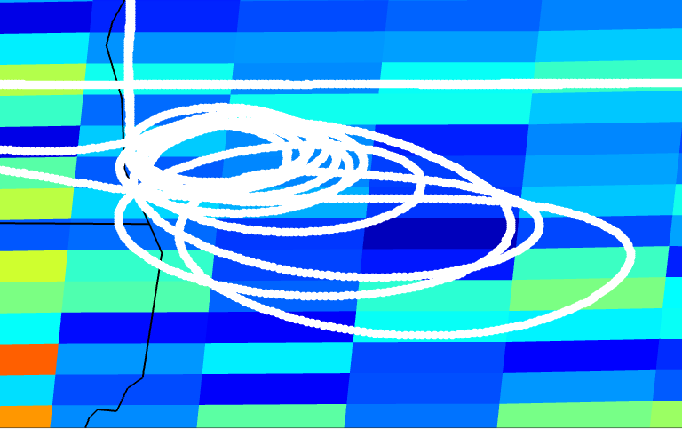
Comparison methodology
DC-8 spirals over Lake Michigan on 8/02
42.65 N
42.35 N
-87.85 E
-87.6 E

Slide 6
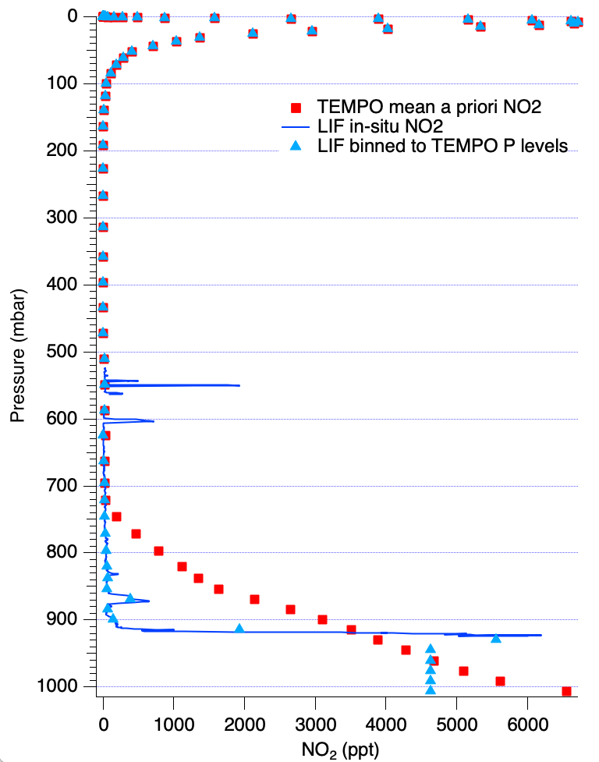
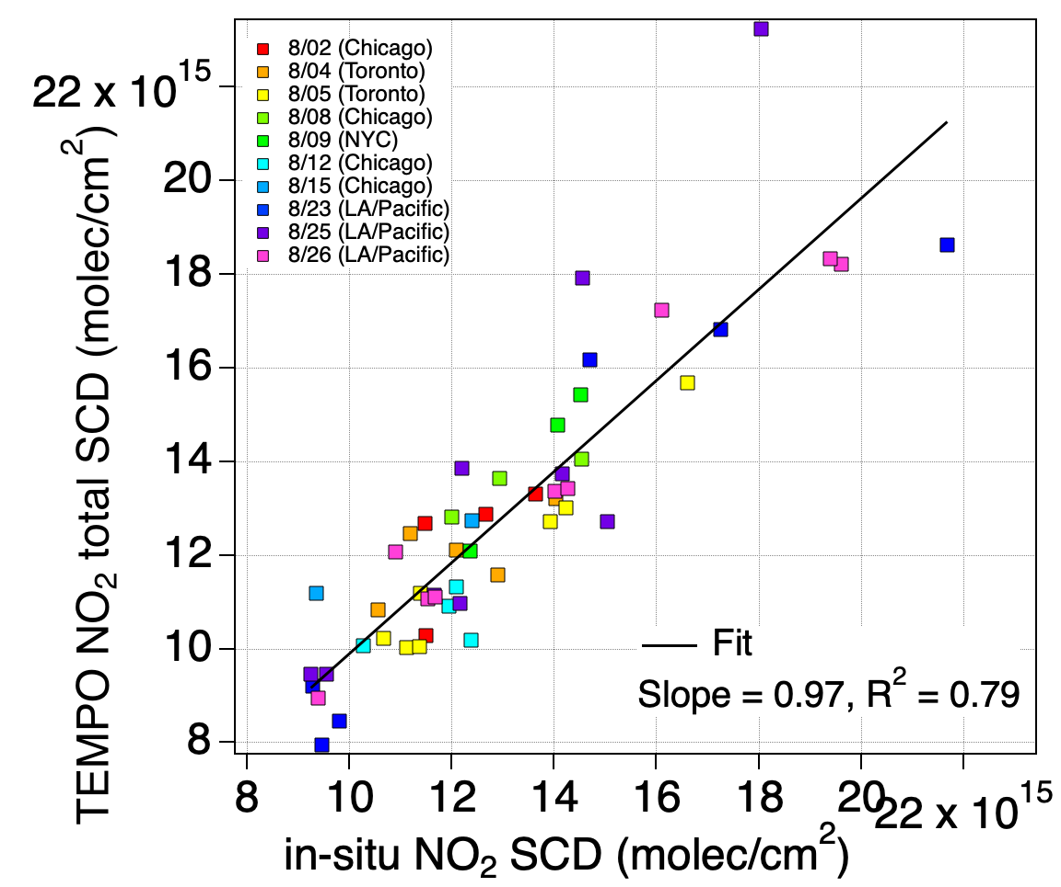
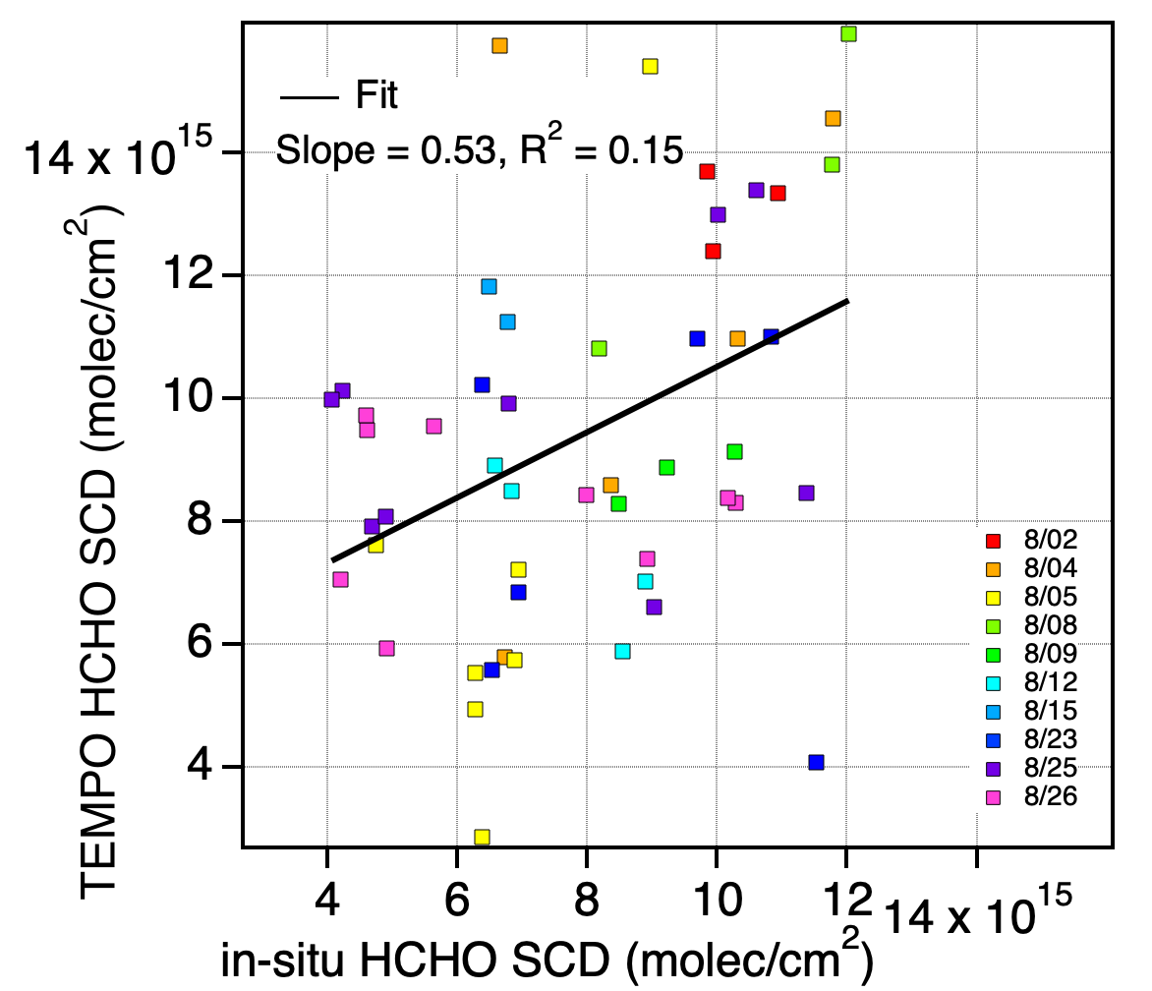
Comparison methodology
GEOS-CF a priori
  NO₂ SCD = Σ(NO₂ partial column x mean scattering weight x T correction)
  HCHO SCD = Σ(HCHO partial column x mean scattering weight)
NO₂
HCHO
Boundary layer mean

Slide 7
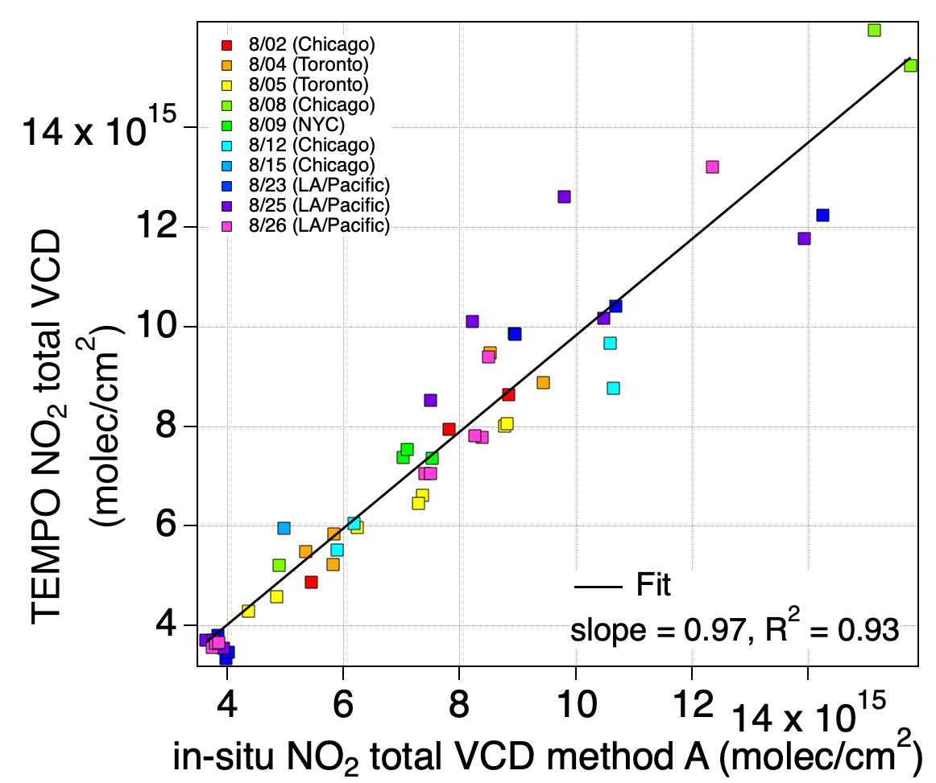
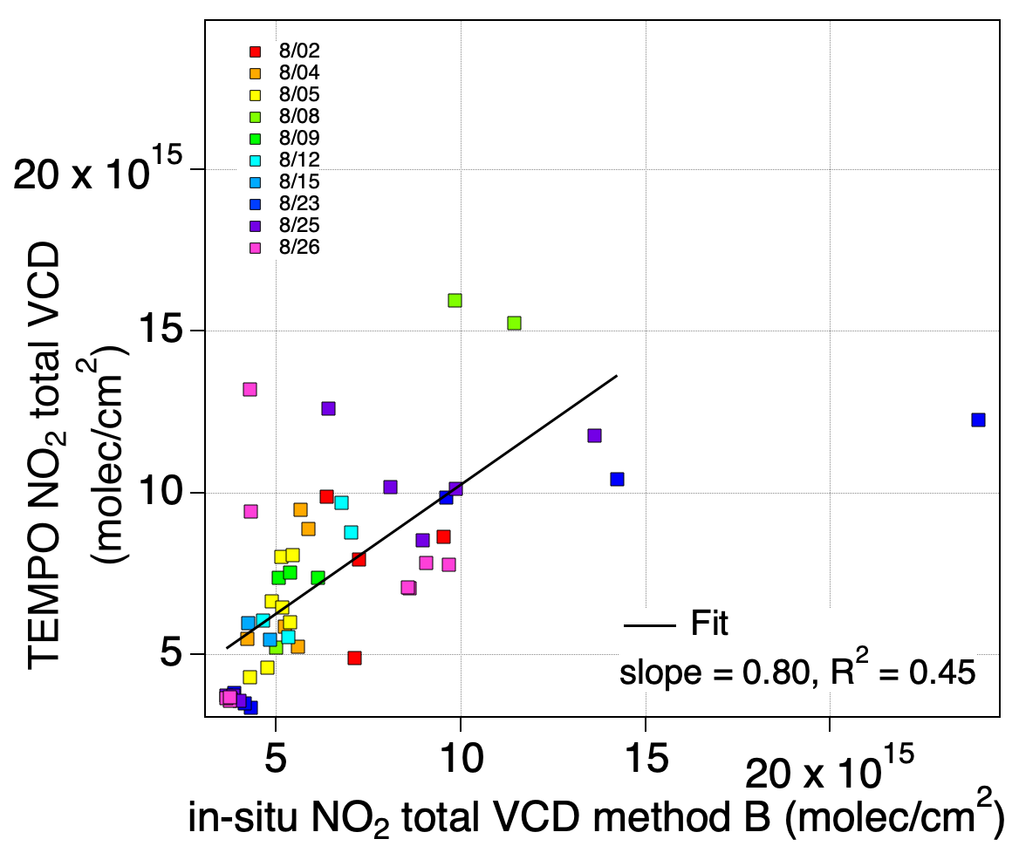
Total vertical column comparison
A) VCD = SCD/AMF B) VCD = Σ(in-situ partial columns)
NO₂, method A
NO₂, method B

Slide 8
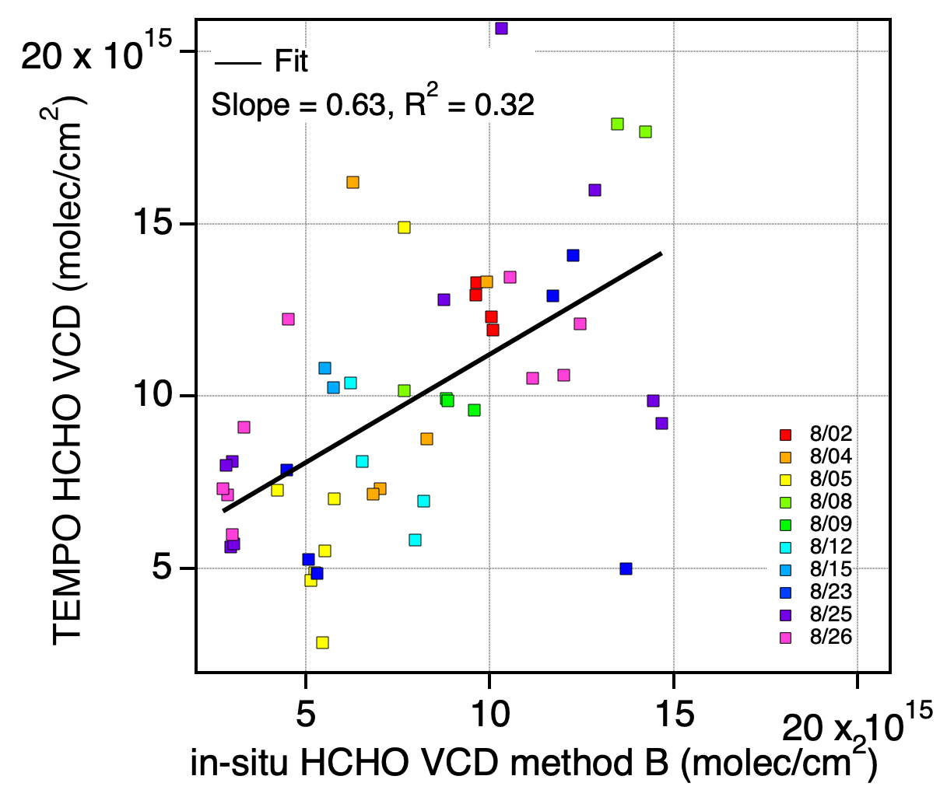
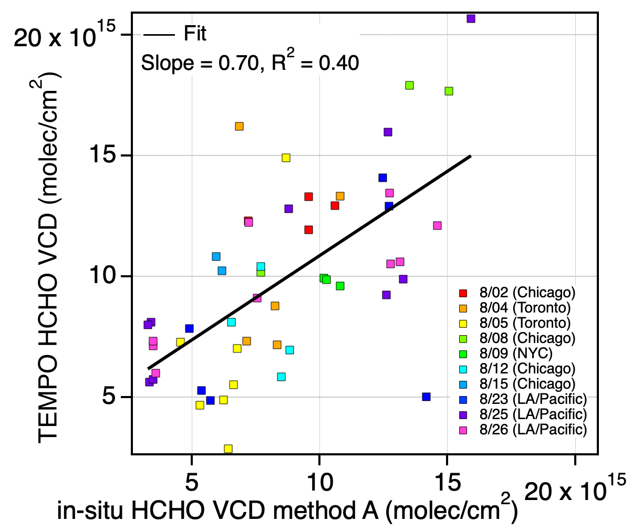
Vertical column comparison
A) VCD = SCD/AMF B) VCD = Σ(in-situ partial columns)
HCHO, method A
HCHO, method B

Slide 9
Conclusions, Ongoing work
For NO₂, strong correlation between TEMPO and in-situ based SCDs and VCDs.
For HCHO, weaker correlations (but expected based on much weaker signal)
Interesting differences between VCD methods A and B...
Incorporate high-resolution modeling below the aircraft
  4-km WRF Chem from Brad Pierce for the NYC/Chicago/Toronto
  12-km WRF Chem from NCAR for LA/Pacific
Expand to SO₂ when TEMPO product becomes available
Keep up with TEMPO version updates (V04 in progress?)

Slide 10
Extra slides

Slide 11
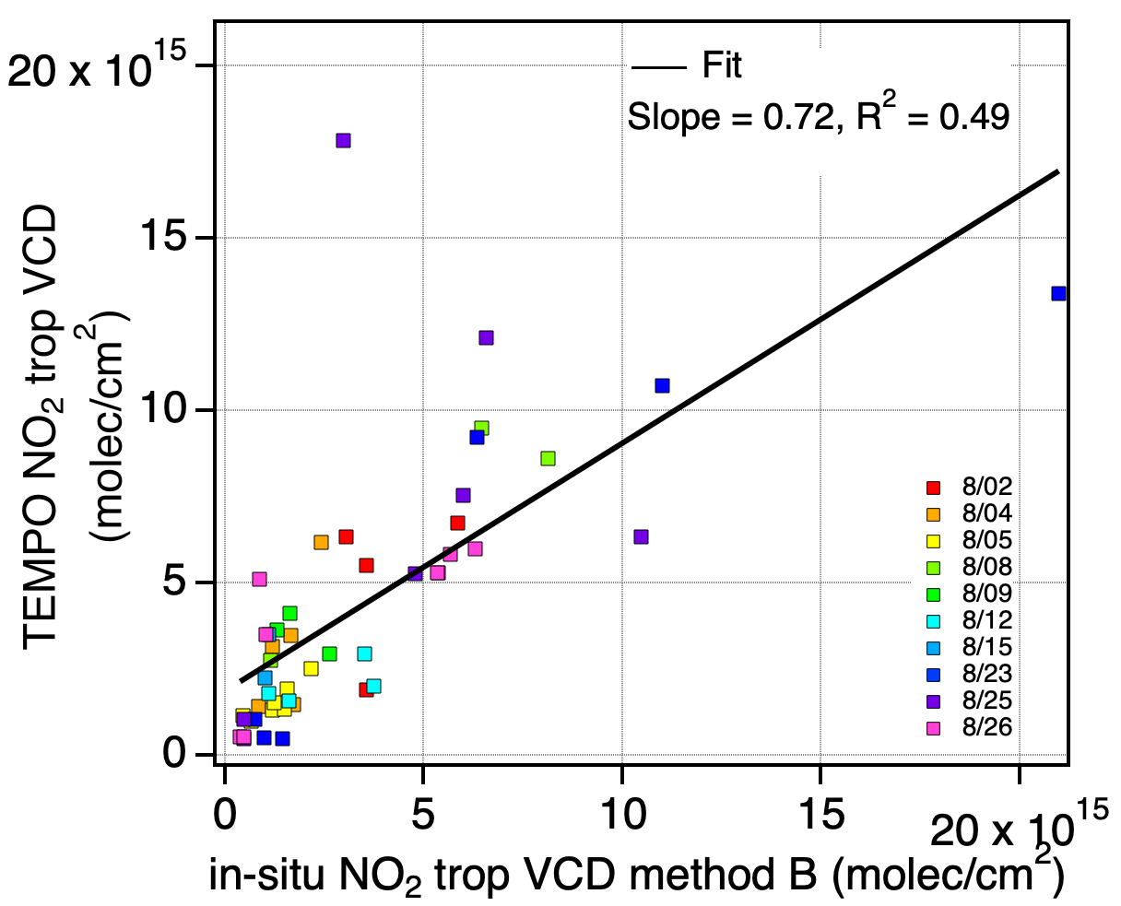
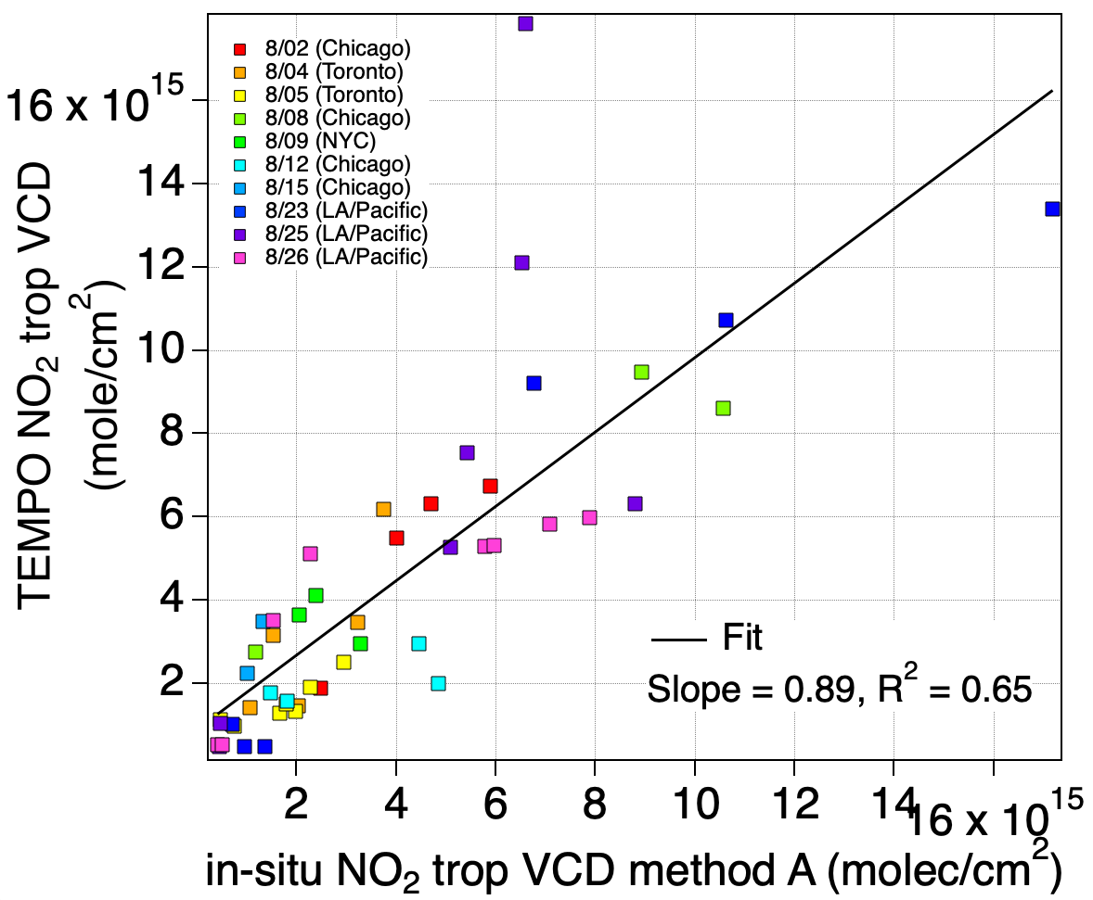
Tropospheric column comparison
A) VCD = SCD/AMF B) VCD = Σ(in-situ partial columns)
NO₂, method A
NO₂, method B

Slide 12
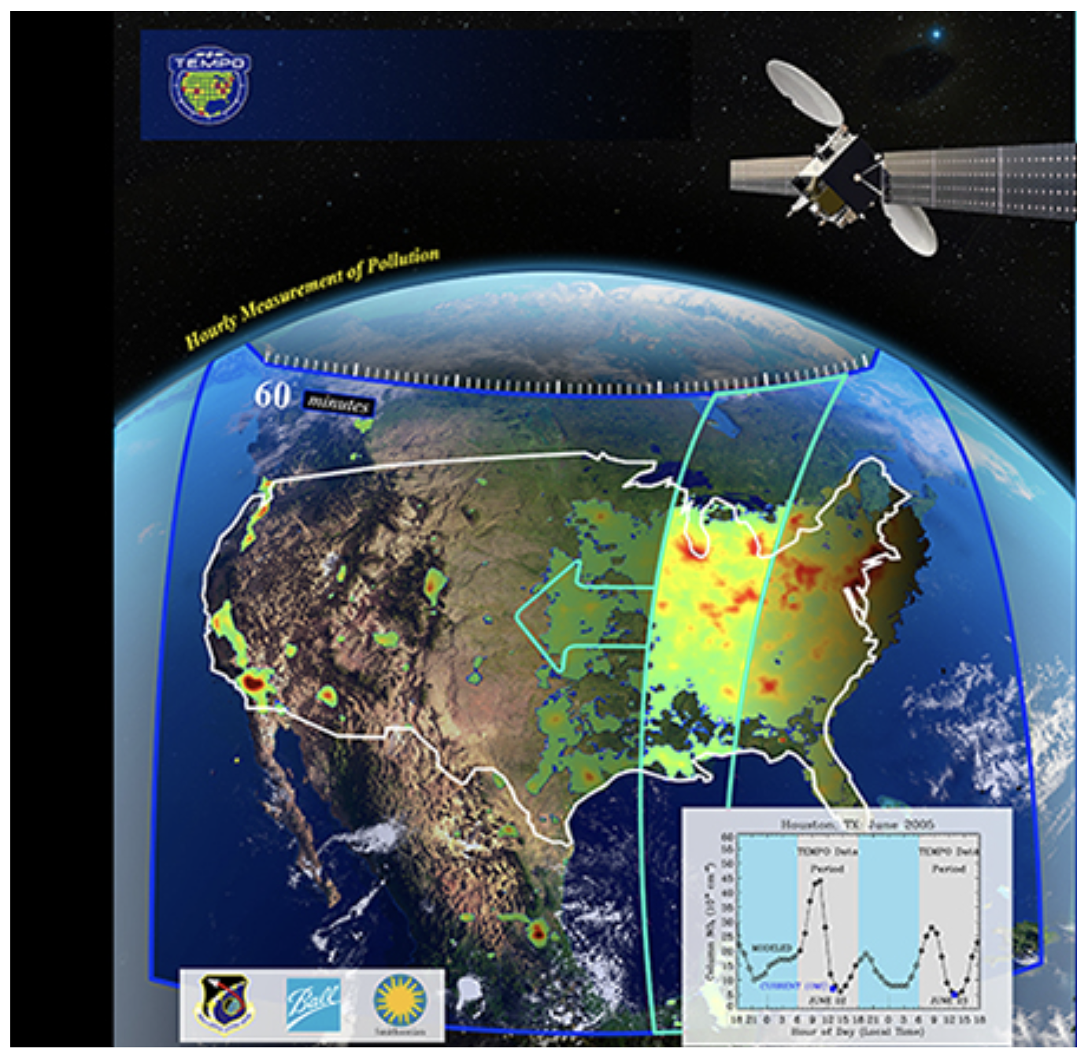
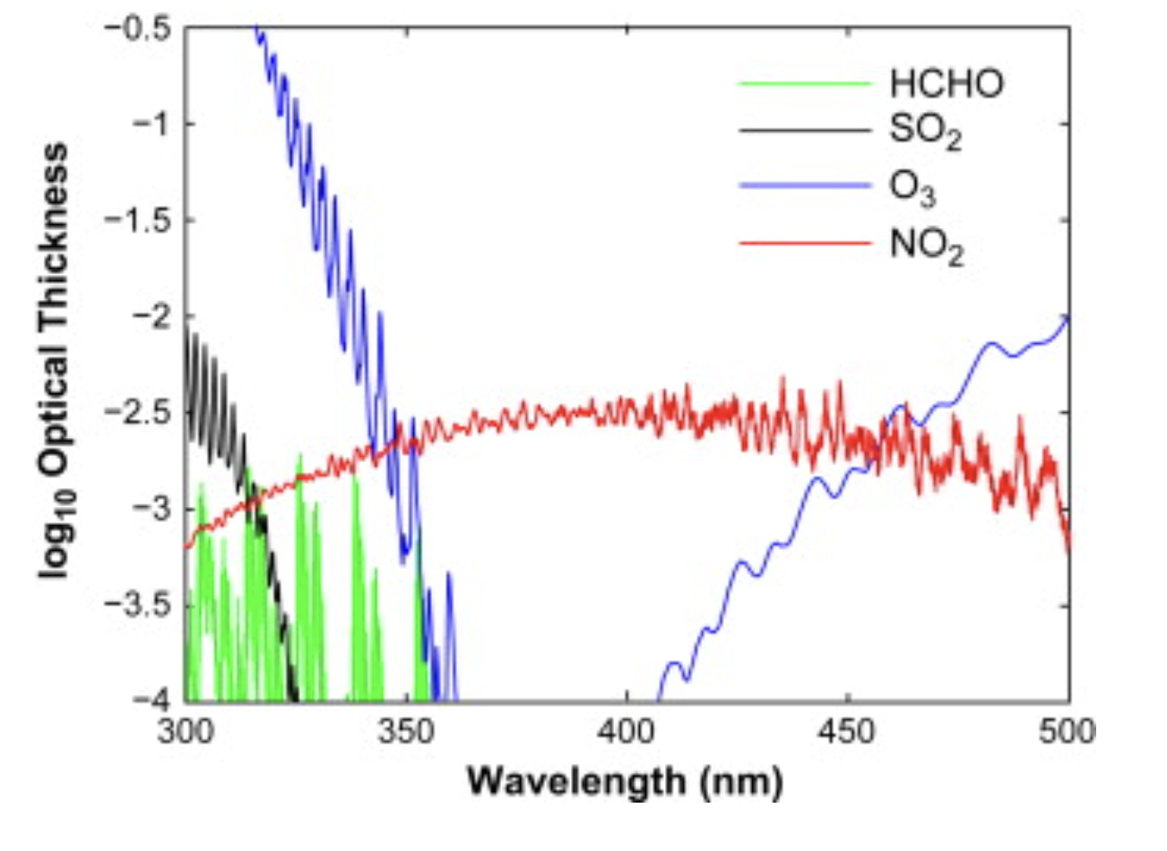
Satellite measurements
Fit measured spectrum
Slant column
(SCD)
Divide by air mass factor (AMF)
to
Account for atmospheric path, instrument altitude sensitivity, a priori profile, etc
Vertical column
(VCD)
Image modified from tempo.si.edu
Figure: Martin (2008) Atmos Environ

Slide 13
TEMPO vs in-situ variability (V02 data)
LA on 8/25
NYC on 8/9

