Slide 1
From Aerosol Optical Centroid Height (AOCH) to aerosol vertical profile retrieval: TEMPO’s advancement
Jun Wang
James E. Ashton Professor
College of Engineering, The University of Iowa
Many thanks to:
Zhendong Lu, Xi Chen, Hyerim Kim, Univ. of Iowa
Shobha Kongdragunta, NOAA NESDIS
Xiong Liu, Kelly Chance, Smithsonian Astrophysical Observatory
Omar Torres, NASA Goddard Space Flight Center
Acknowledgements: TEMPO and RST/NASA; MURI/NRL, and NOAA

Slide 2
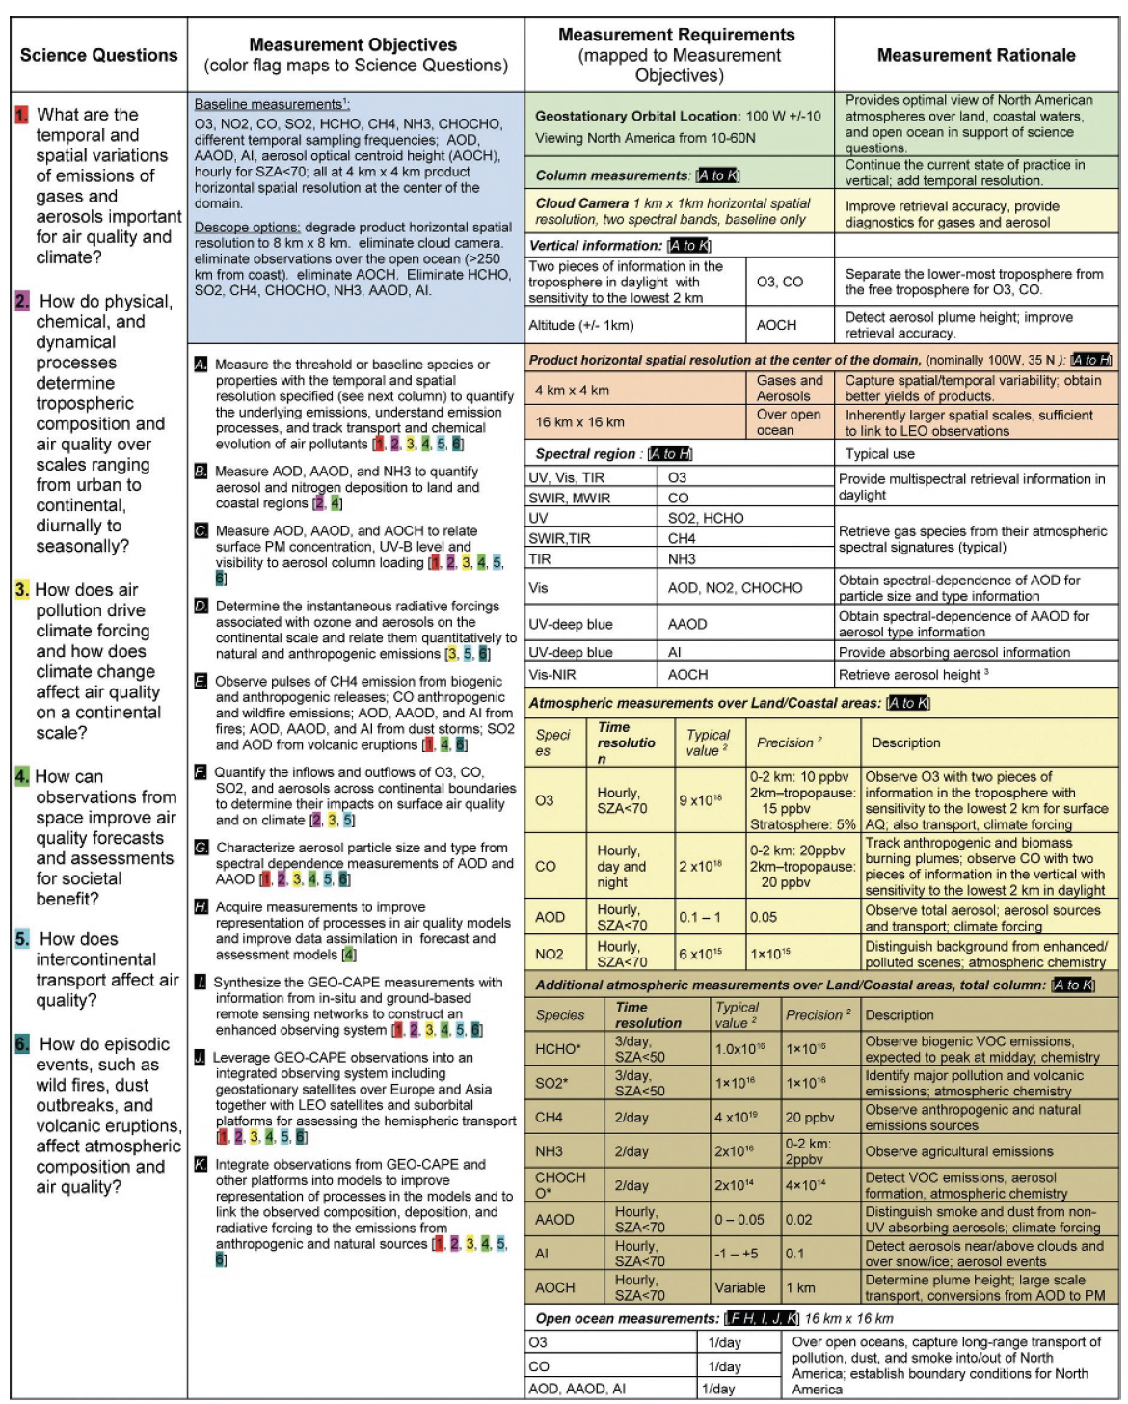
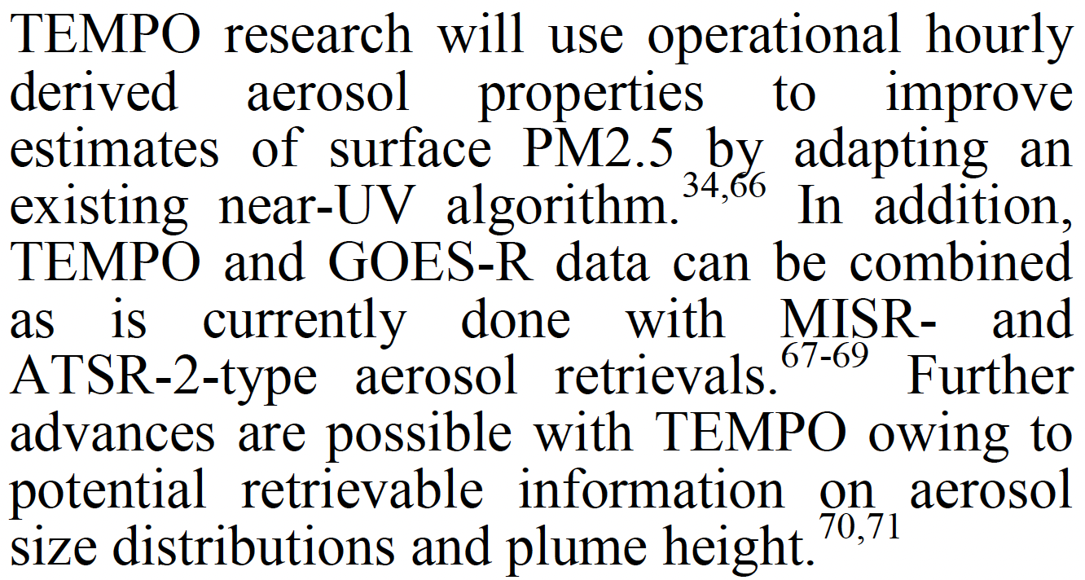
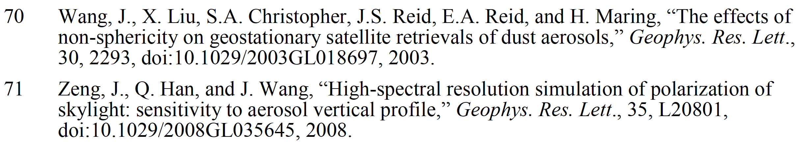
AOCH was proposed as part of GEO-CAPE and TEMPO original concept
Chance, Liu et al. 2012, TEMPO proposal
Fishman et al. 2012. GEO-CAPE, BAMS

Slide 3
Our 16-year journey of passive sensing of AOCH
2023
First Mapping of Monthly and Diurnal Climatology of Saharan Dust Layer Height Over the Atlantic Ocean From EPIC/DSCOVR in Deep Space, GRL., Lu Wang et al.
2024
PACE O2 bands for ALH over ocean, JRS, Xu et al.
2021
Hourly Mapping of the Layer Height of Thick Smoke Plumes Over the Western U.S. in 2020 Severe Fire Season, FRS, Lu, Wang, et al.,
First retrieval of absorbing aerosol height over dark target using TROPOMI oxygen B band, RSE, Chen, Wang et al.
Can multi-angular polarimetric measurements in the oxygen-A and B bands improve the retrieval of aerosol vertical distribution? JQSRT, Chen, Wang, et al.
2019, Detecting layer height of smoke aerosols over vegetated land and water surfaces via oxygen absorption bands: Hourly results from EPIC/DSCOVR satellite in deep space
Passive remote sensing of aerosol height, in Remote Sensing of Aerosols, Clouds, and Precipitation, Xu, Wang, et al. in Remote Sensing of Aerosols, Clouds, and Precipitation
2017, Passive remote sensing of altitude and optical depth of dust plumes using the oxygen A and B bands: First results from EPIC/DSCOVR at Lagrange-1 point, GRL, Xu, Wang, et al.,
2016, Polarimetric remote sensing in O2 A and B bands: Sensitivity study and information content analysis for vertical profile of aerosols, AMT, Ding, Wang et al.
2014, A numerical testbed for remote sensing of aerosols, and its demonstration for evaluating retrieval synergy from a geostationary satellite constellation of GEO-CAPE and GOES-R, JQSRT, Wang et al.
Thanks to NASA, NOAA, ONR …
2008, High-spectral resolution simulation of polarization of skylight: sensitivity to aerosol vertical profile, GRL, Zeng, Wang, & Han.

Slide 4
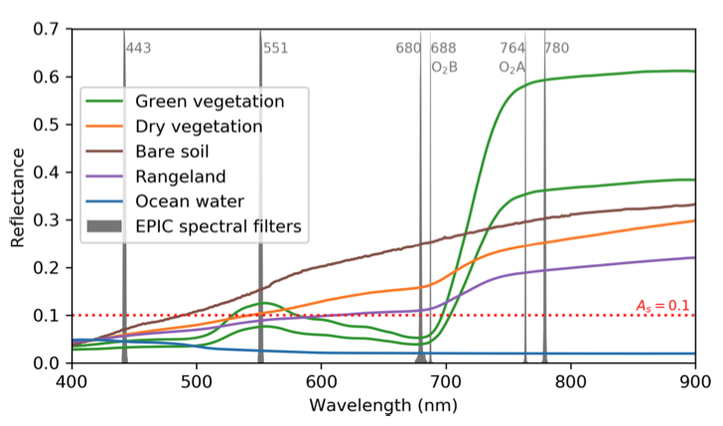
Oxygen absorption bands vs. surface reflectance spectra
Blue band
O2-O2 477 nm
Xu et al., 2019
O2 B-band has moderate absorption, stronger than O2-O2 at 477 nm and weaker than O2 A. O2 B-band also has very low surface reflectance, comparable if not lower than blue bands, due to Chlorophyll-a absorption.

Slide 5
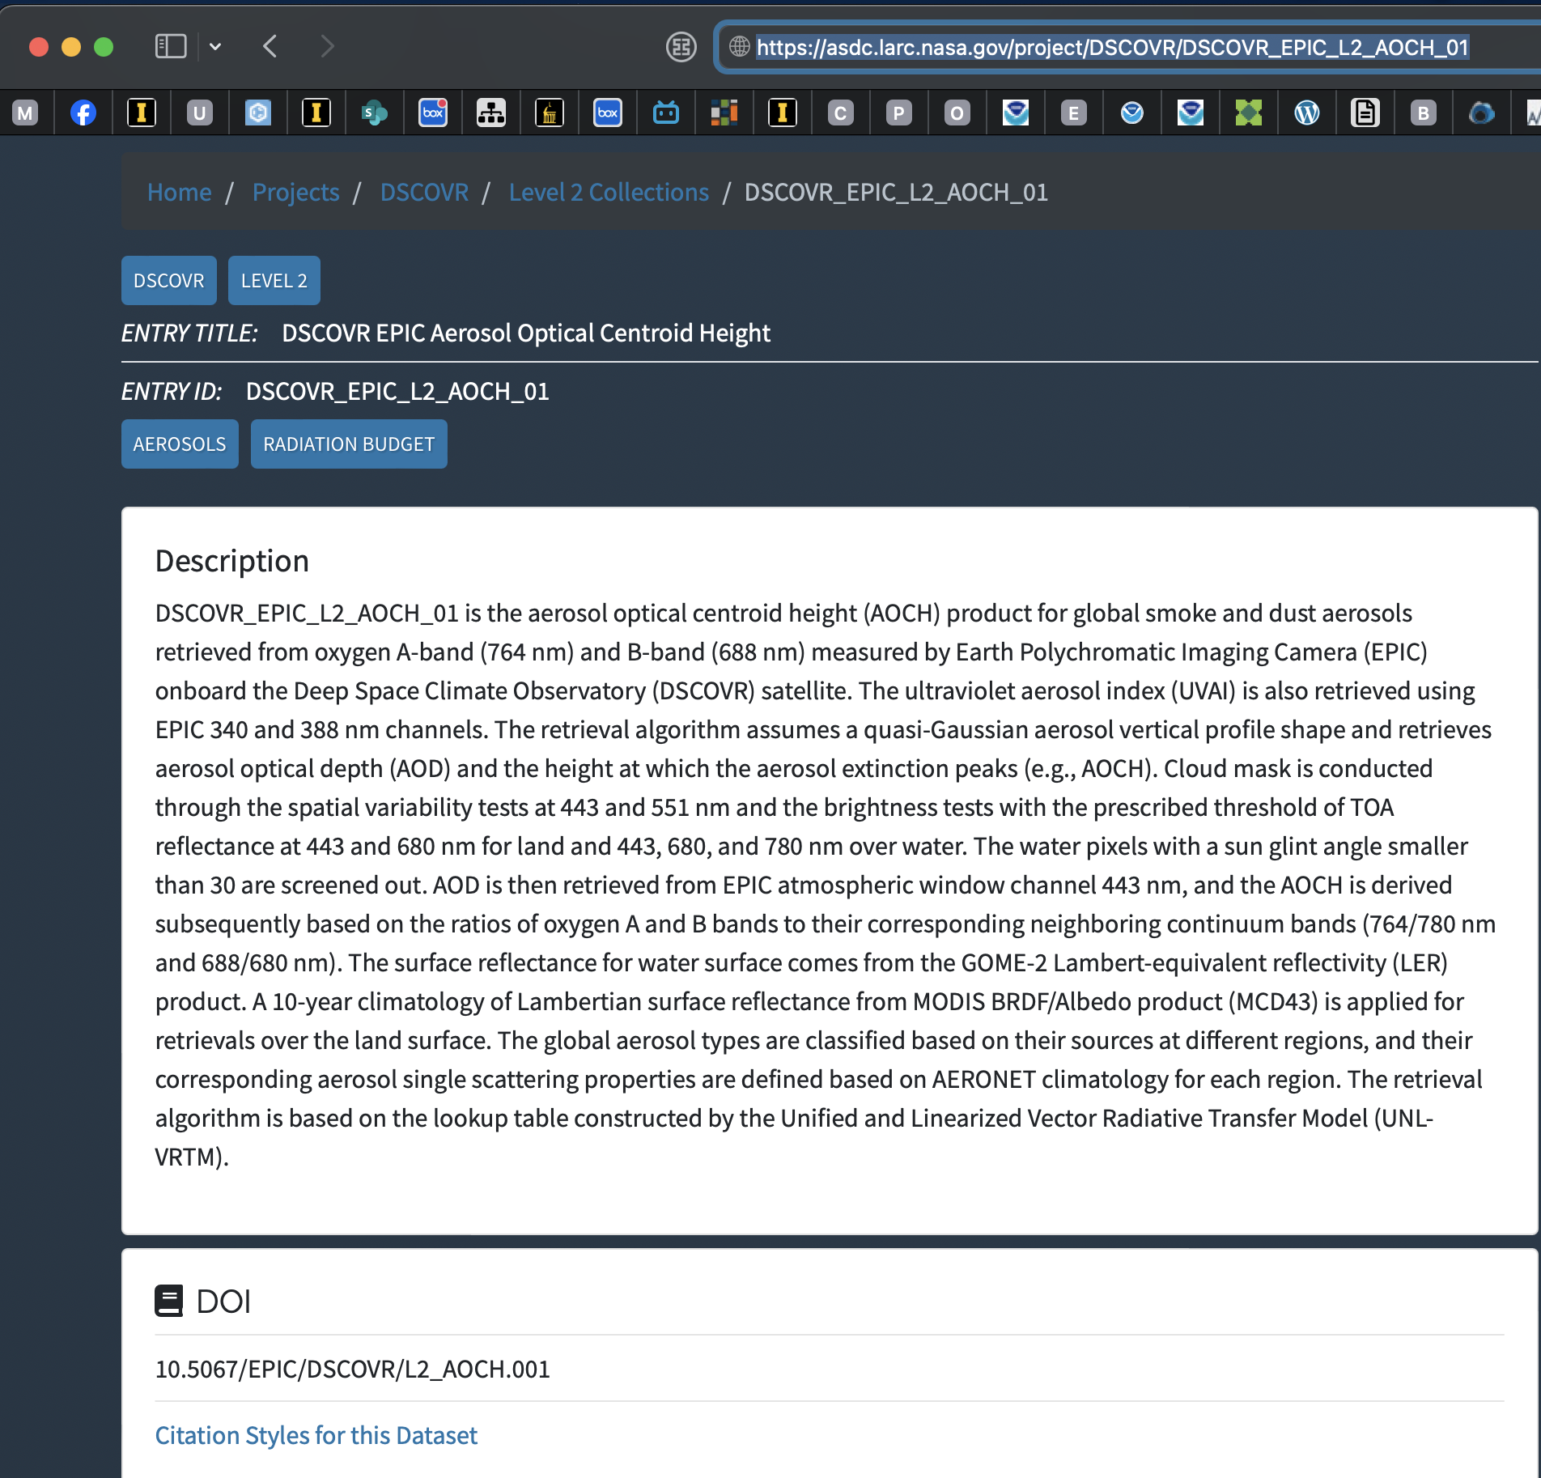
https://asdc.larc.nasa.gov/project/DSCOVR/DSCOVR_EPIC_L2_AOCH_01
Level-2 data product:
DSCOVR_EPIC_AOCH_01 data production in ASDC/LaRC.
Thanks to Marshall Sutton and EPIC project team in GSFC to make the RTO happen.

Slide 6
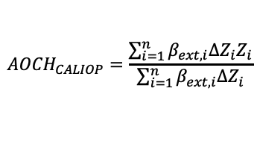
Development/Results with primary use of TROPOMI O2 B-band
Chen, Wang, et al., 2021, RSE
$${AOCH}_{CALIOP}=\frac{\sum_{i=1}^{n}{β_{ext, i}{∆Z}_{i}Z_{i}}}{\sum_{i=1}^{n}{β_{ext, i}{∆Z}_{i}}}$$
VIIRS
This study
KNMI
CALIOP

Slide 7
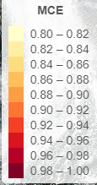
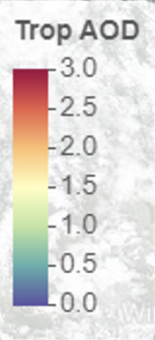
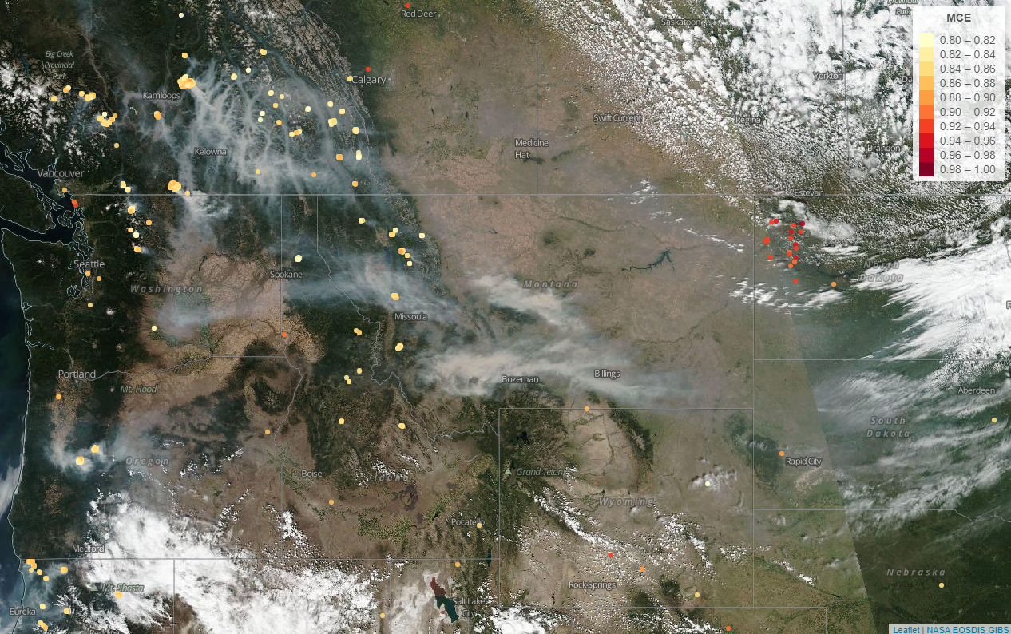
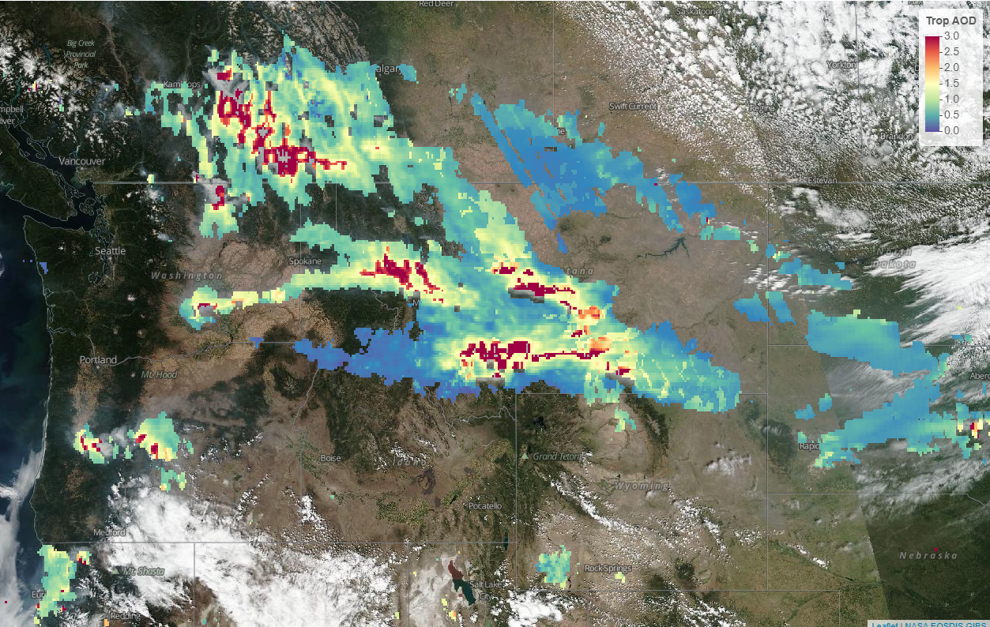
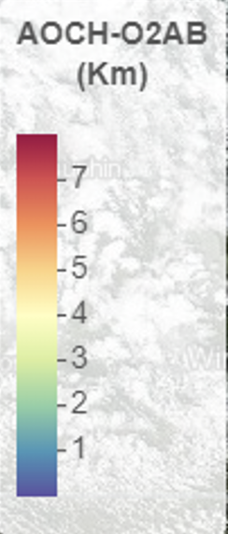
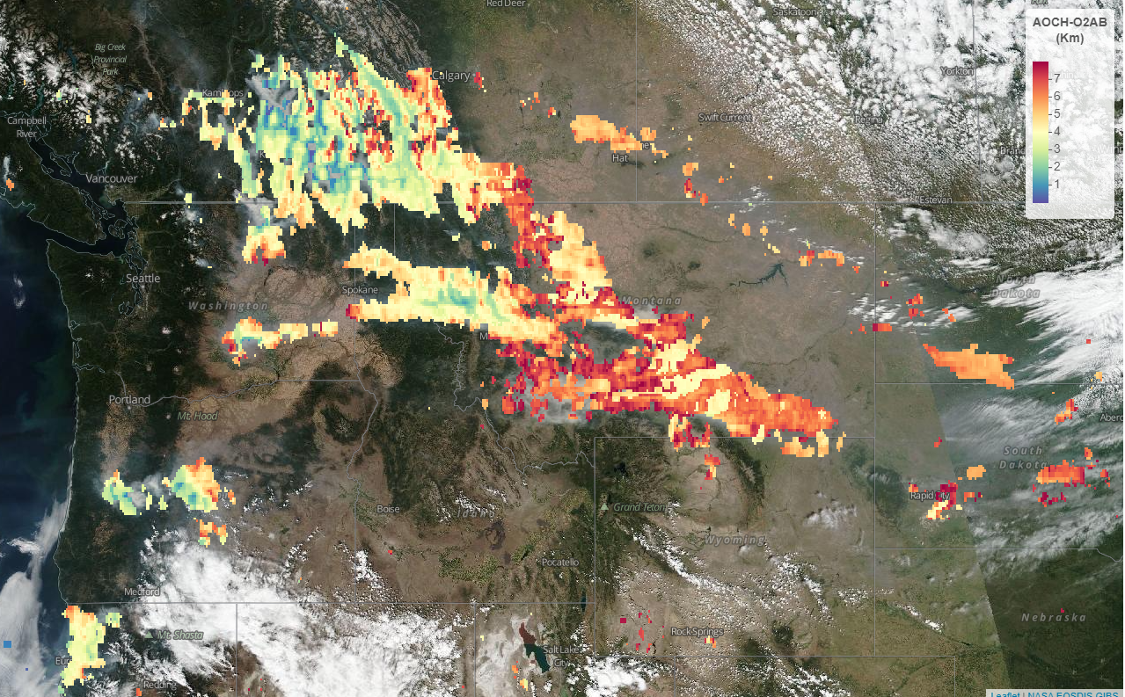
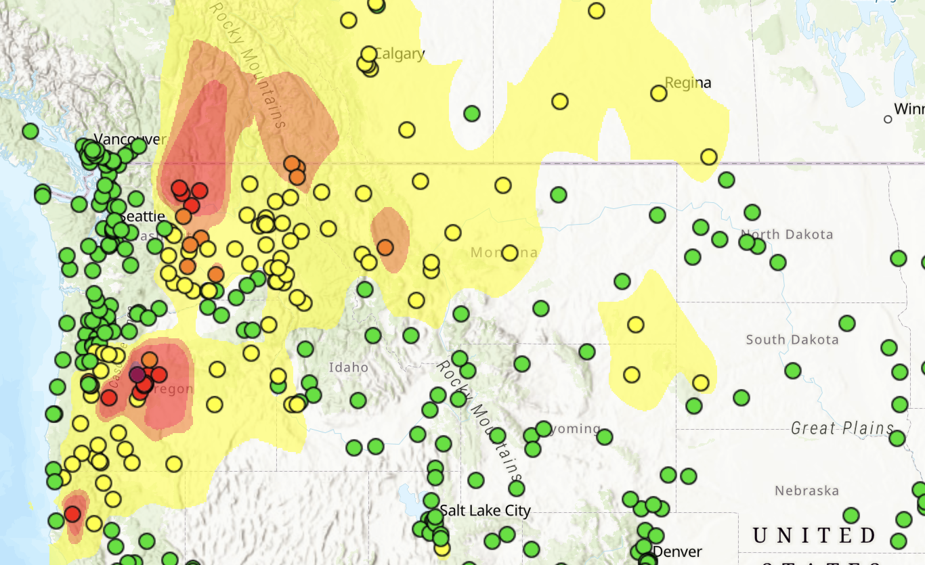
FILDA2 MCE
AQ Applications
MT
MT
WA
WA
OR
SD
OR
SD
TROPOMI AOD
August 16, 2023
MT
MT
WA
WA
OR
SD
OR
SD
TROPOMI AOCH

Slide 8
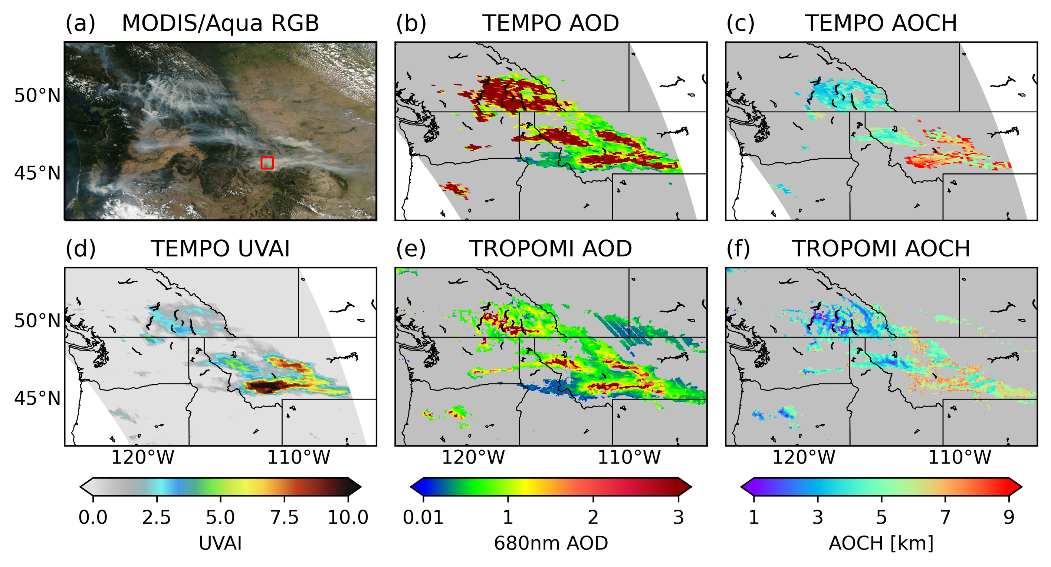
Retrieval AOD and AOCH from TEMPO preliminary results; overall consistent with TROPOMI
But, TEMPO provides much more dense observations

Slide 9
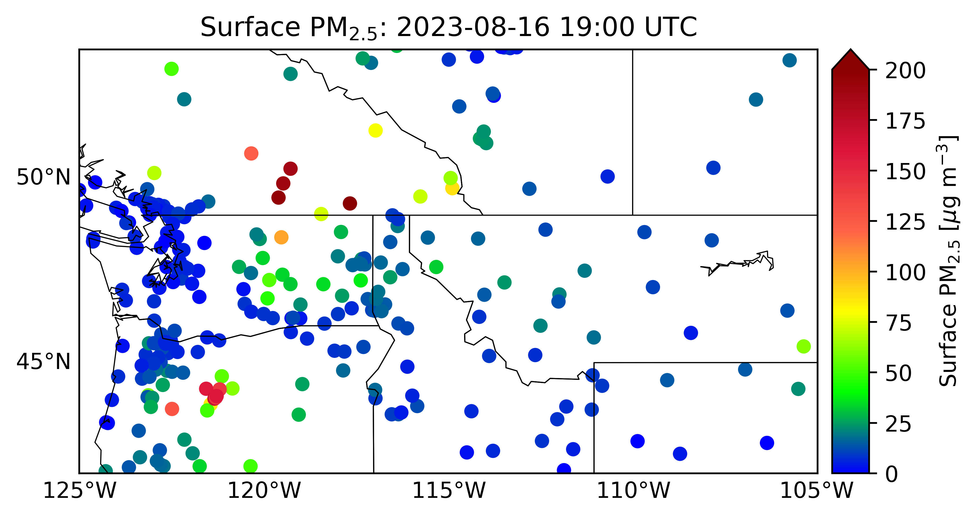

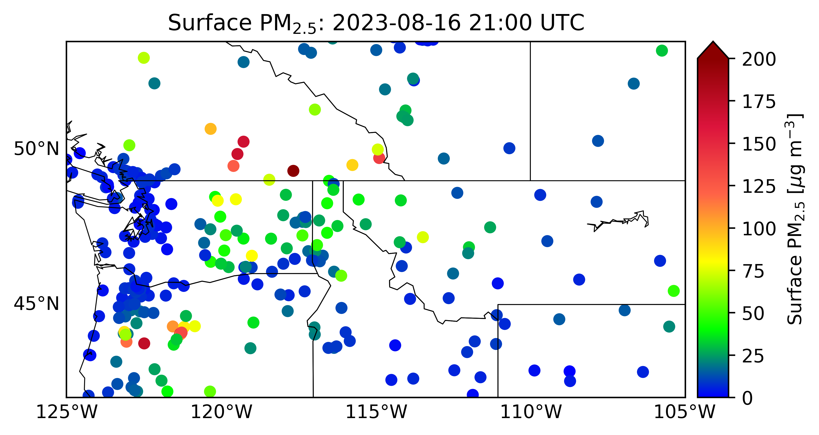
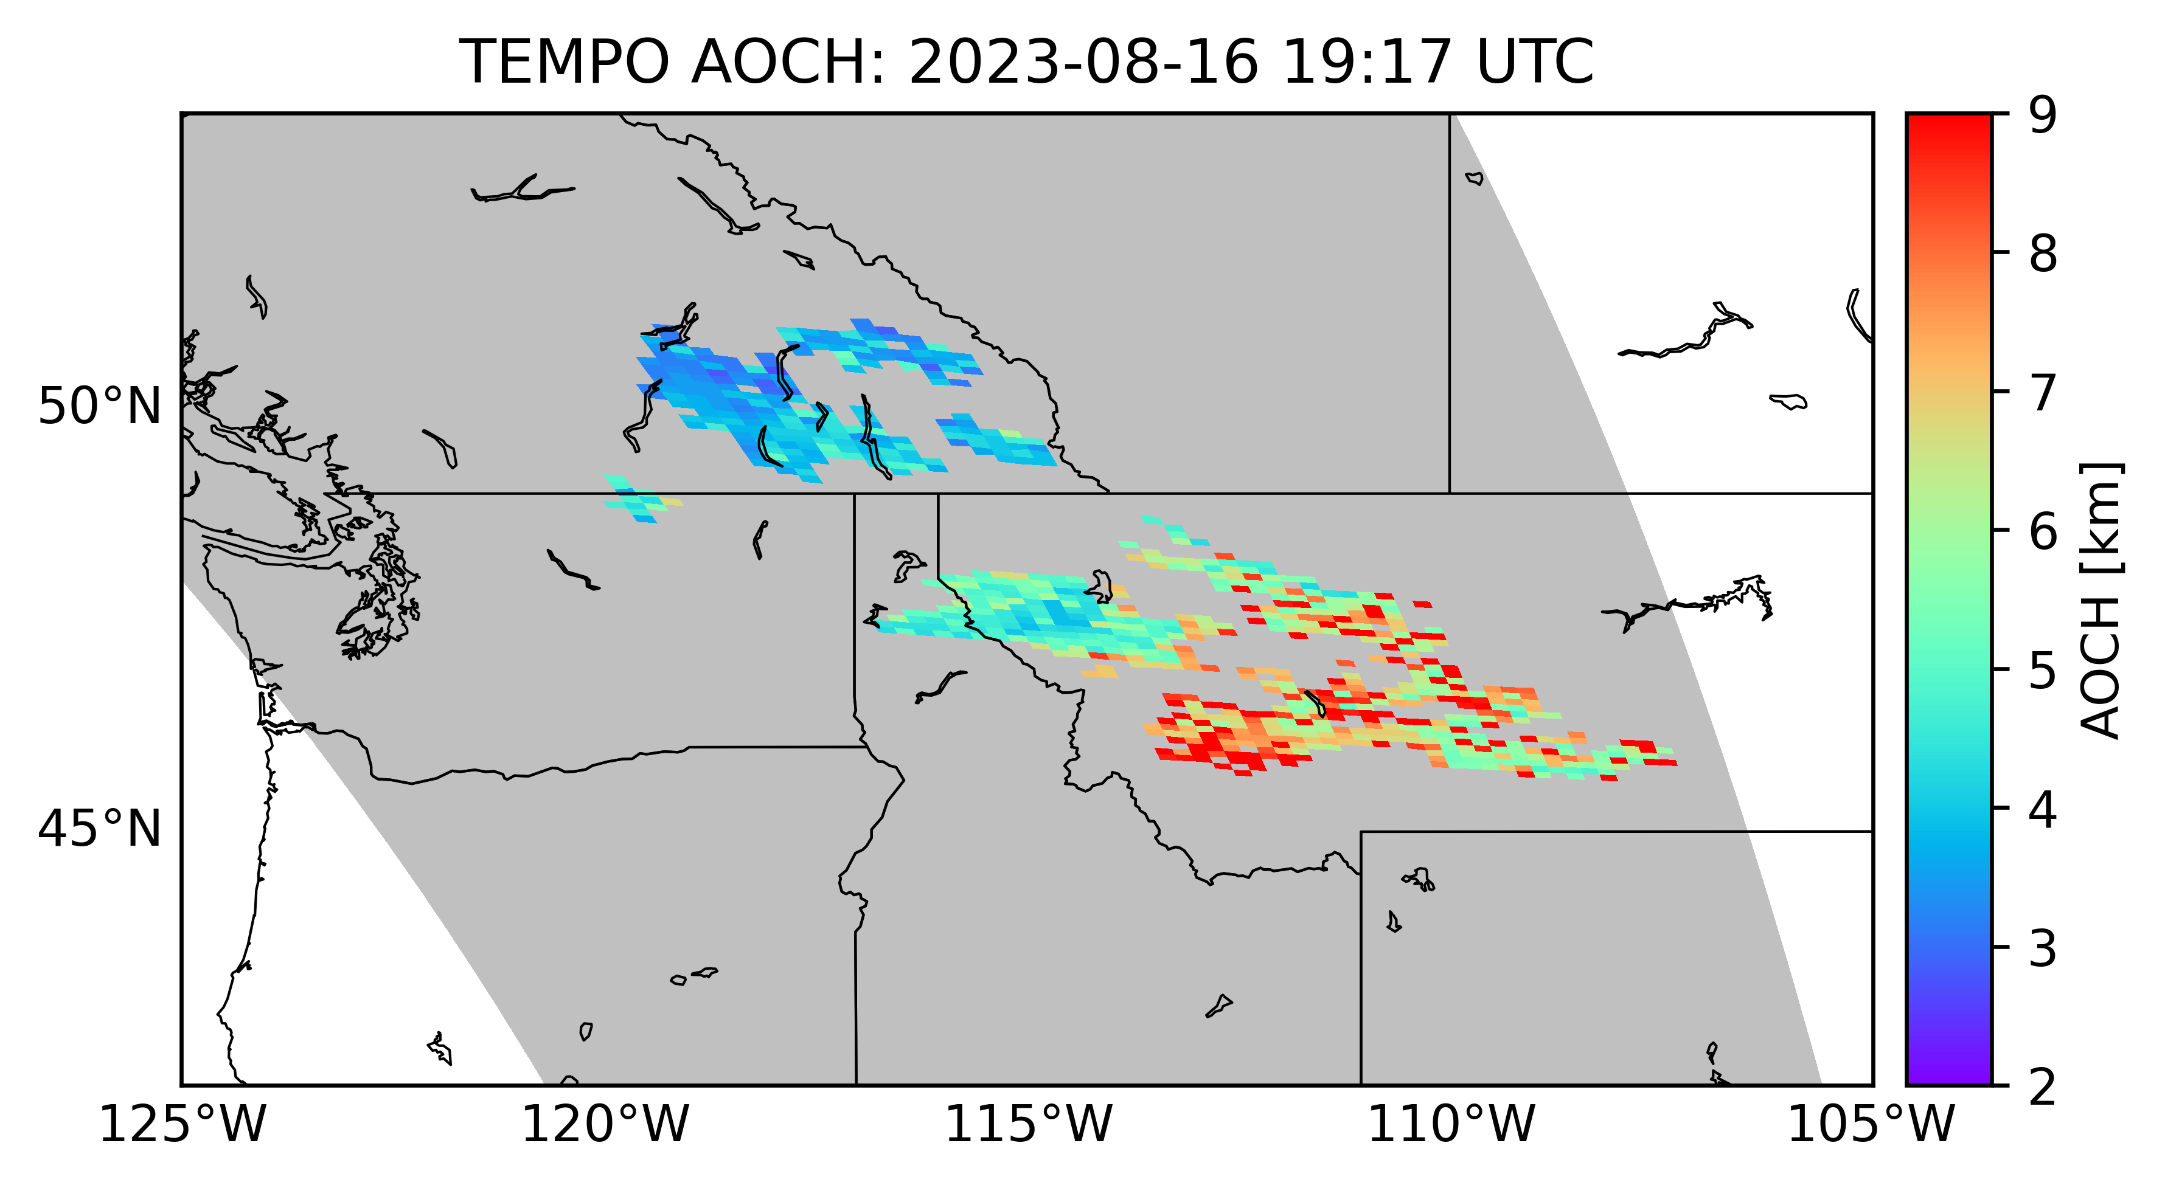
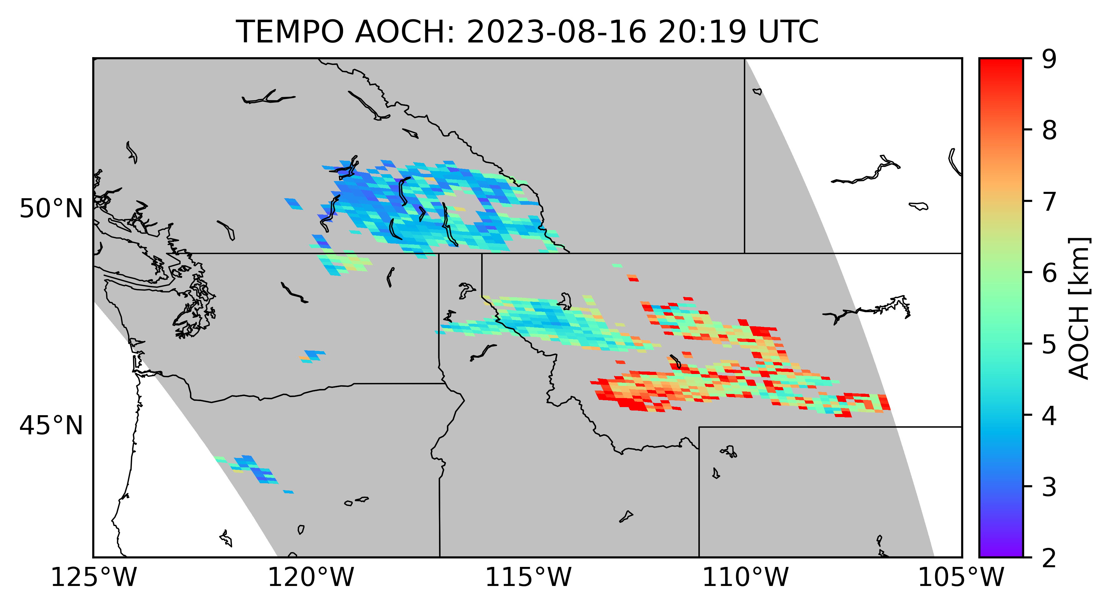
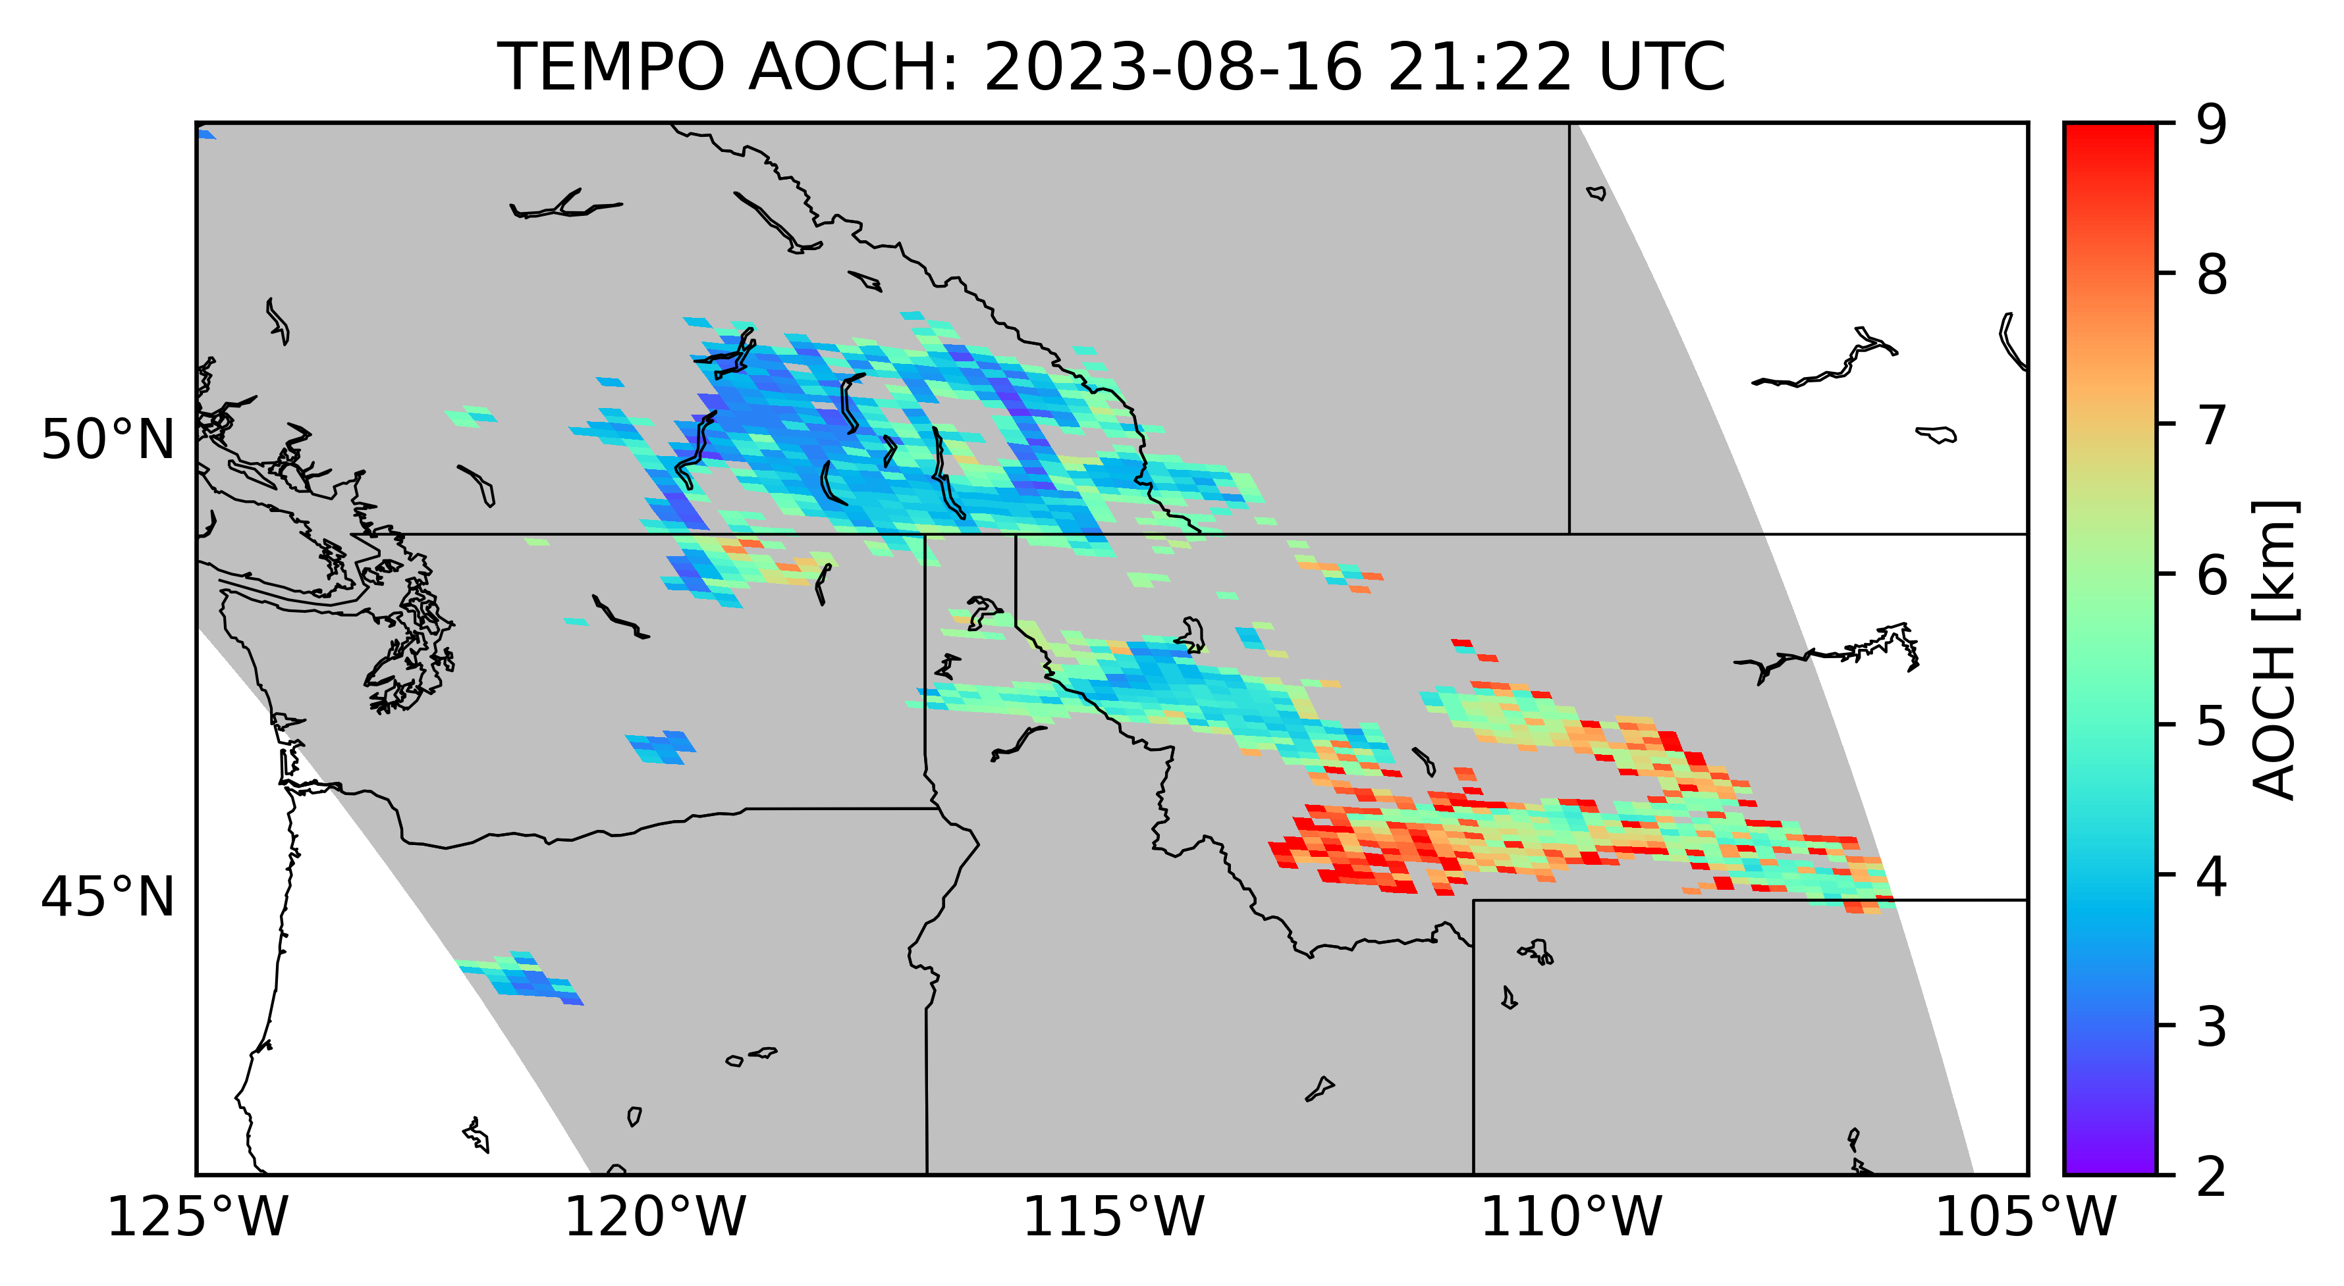
Diurnal variation of the TEMPO AOCH and surface PM2.5
08/16/2023 19:00 UTC 20:00 UTC 21:00 UTC

Slide 10
Zoom-in view at regional/community scale
08/16/2023 19:00 UTC 20:00 UTC 21:00 UTC

Slide 11
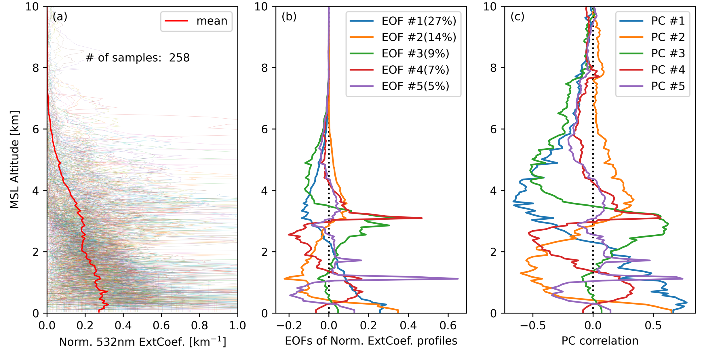
New development: toward retrieval of aerosol vertical profile
PCA of CALIOP aerosol vertical profiles; obtain the major modes in the variation of aerosol vertical distribution
Retrieval the weights for each major modes, which can be then used to construct the aerosol vertical profile.

Slide 12
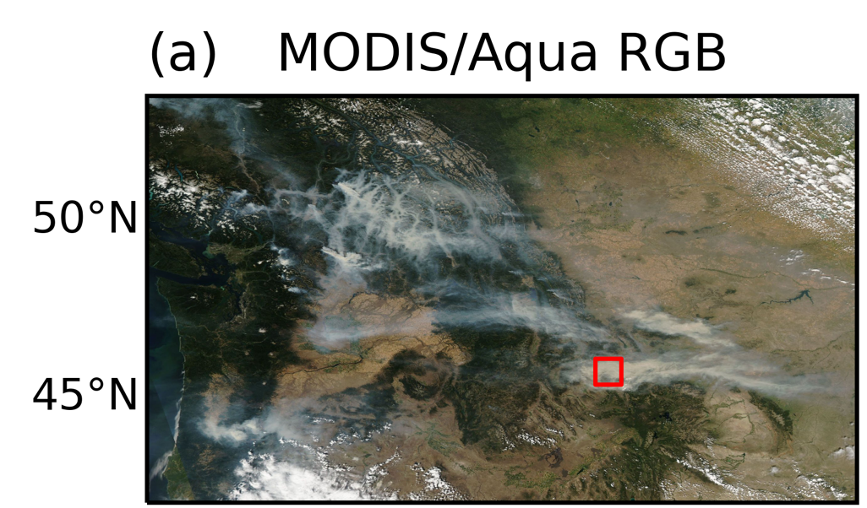
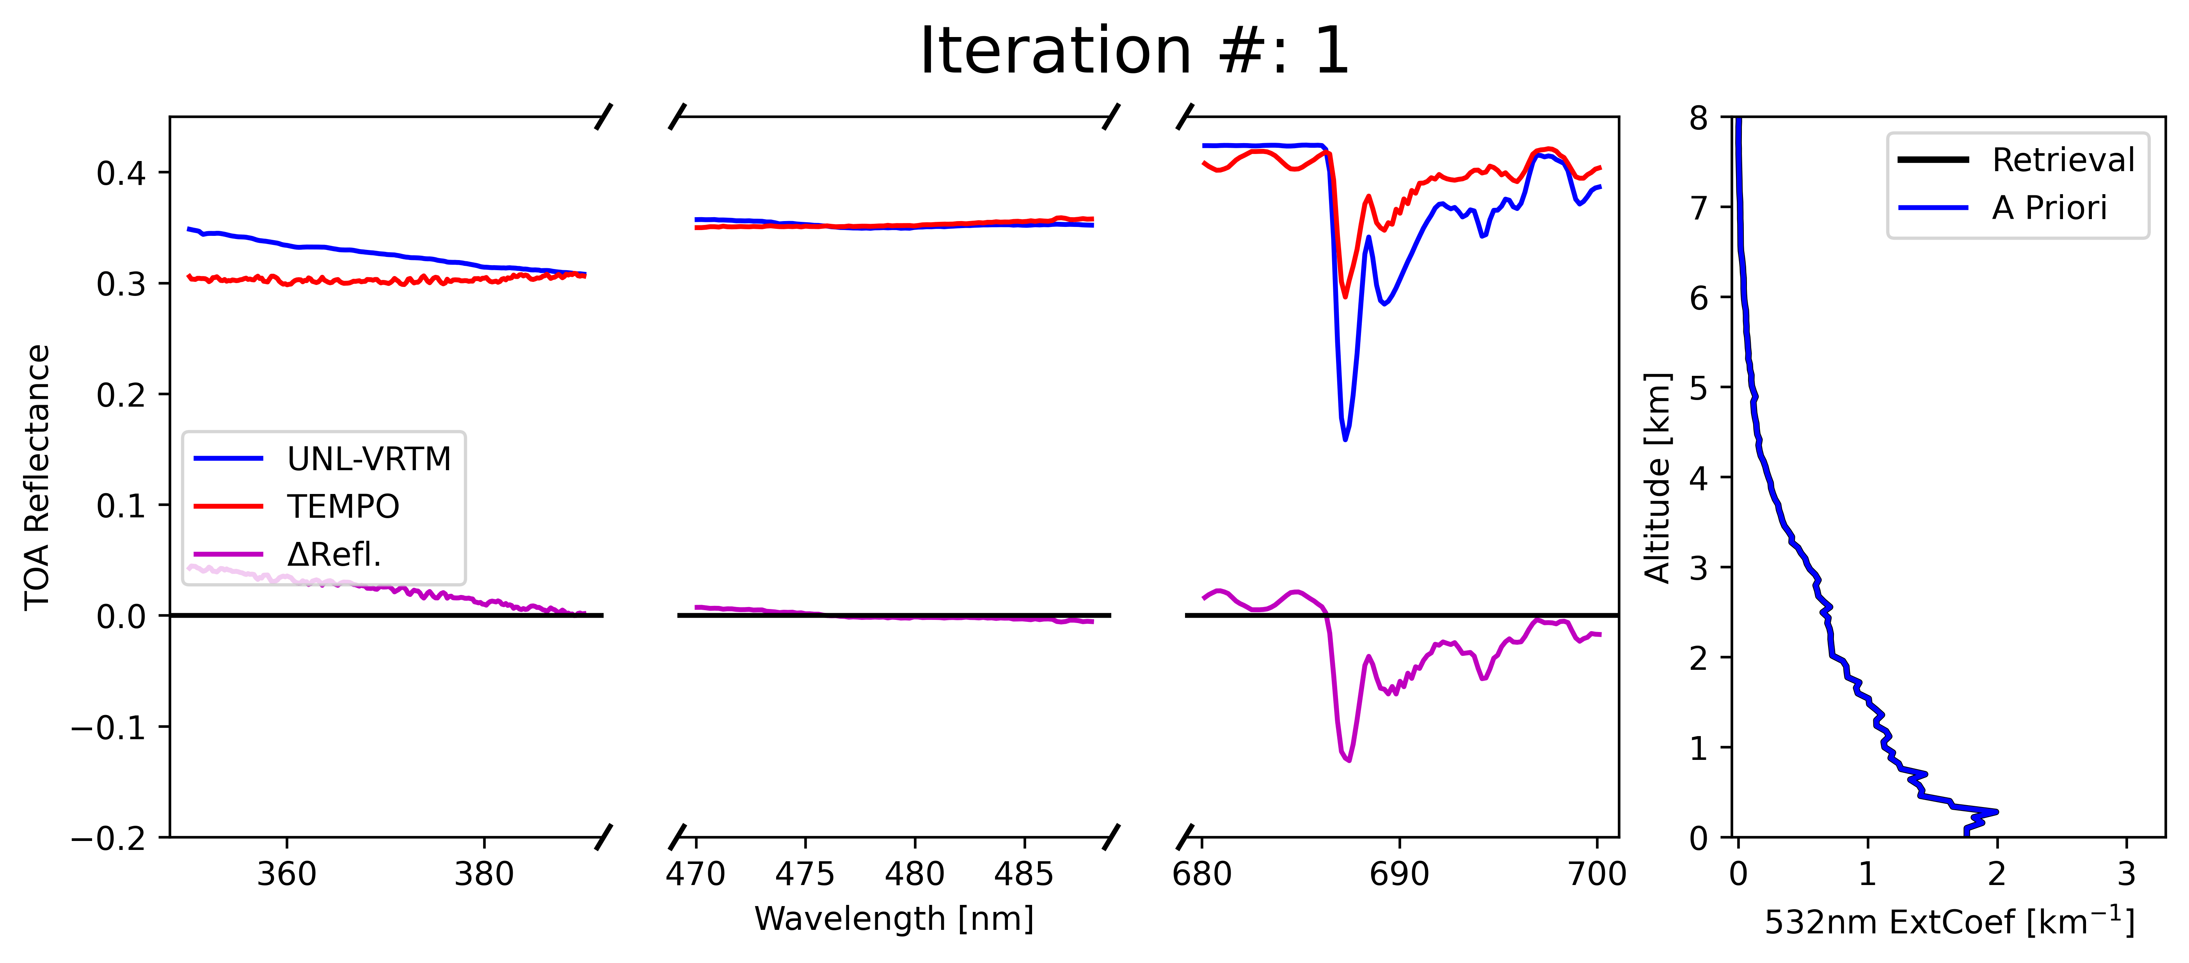
Preliminary Results From TEMPO
16 Aug. 2023

Slide 13
Summary
AOCH is an optical parameter that is well defined with mathematical rigor and can be derived from and validated with the aerosol extinction profile measured by lidar measurements.
Passive sensing retrieval of AOCH from TEMPO have its unique advantage in spatial and temporal coverage, providing rich context and quantitative information to link AOD to surface PM2.5.
It appears promising to use UV, blue and O2-B band from TEMPO (and future GEO-XO ACX) to retrieve aerosol extinction profile.
Passing sensing of aerosol vertical distortion is urgently needed, considering (a) large fires can inject aerosols into middle troposphere and above; (b) no CALIOP-like instrument is now planed in the coming 10 years.
ACX, TEMPO, and TROPOMI can fill in this critical need and data gap to quantify aerosol vertical profile with large spatial coverage and hourly temporal resolution.

Slide 15

16 March 2023

Slide 16
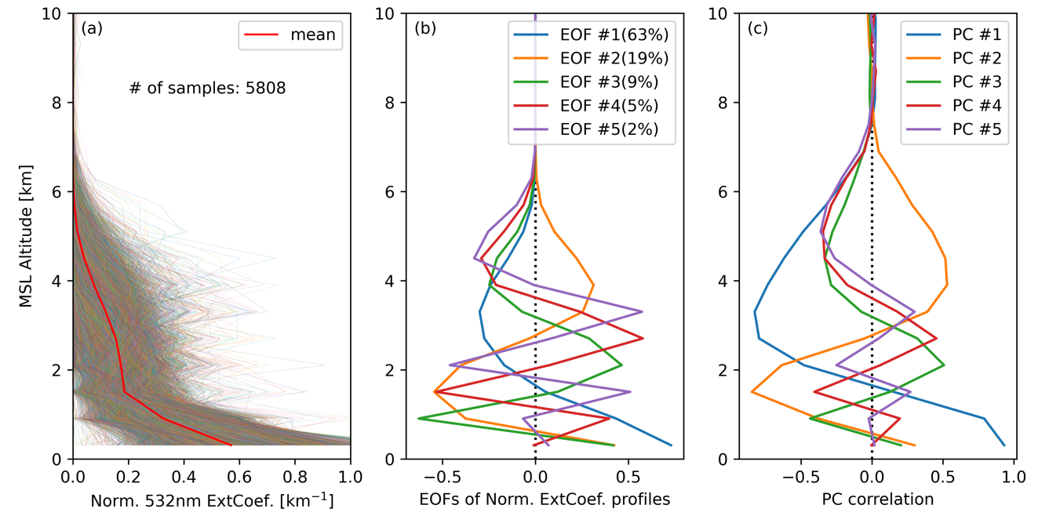
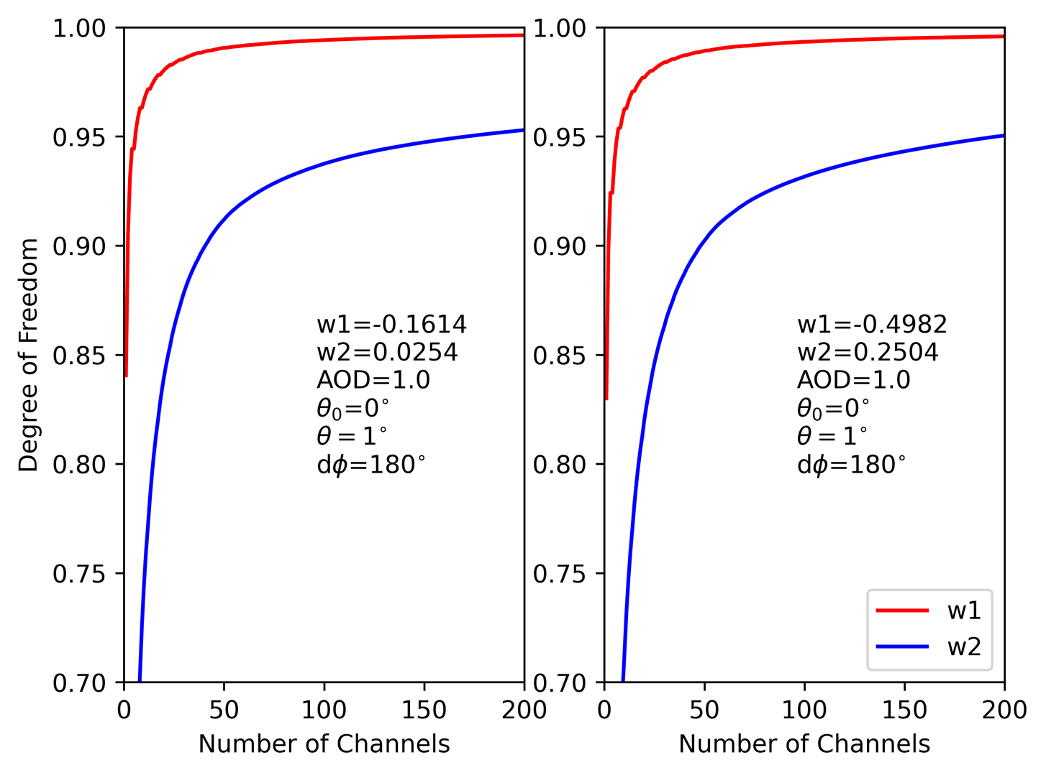
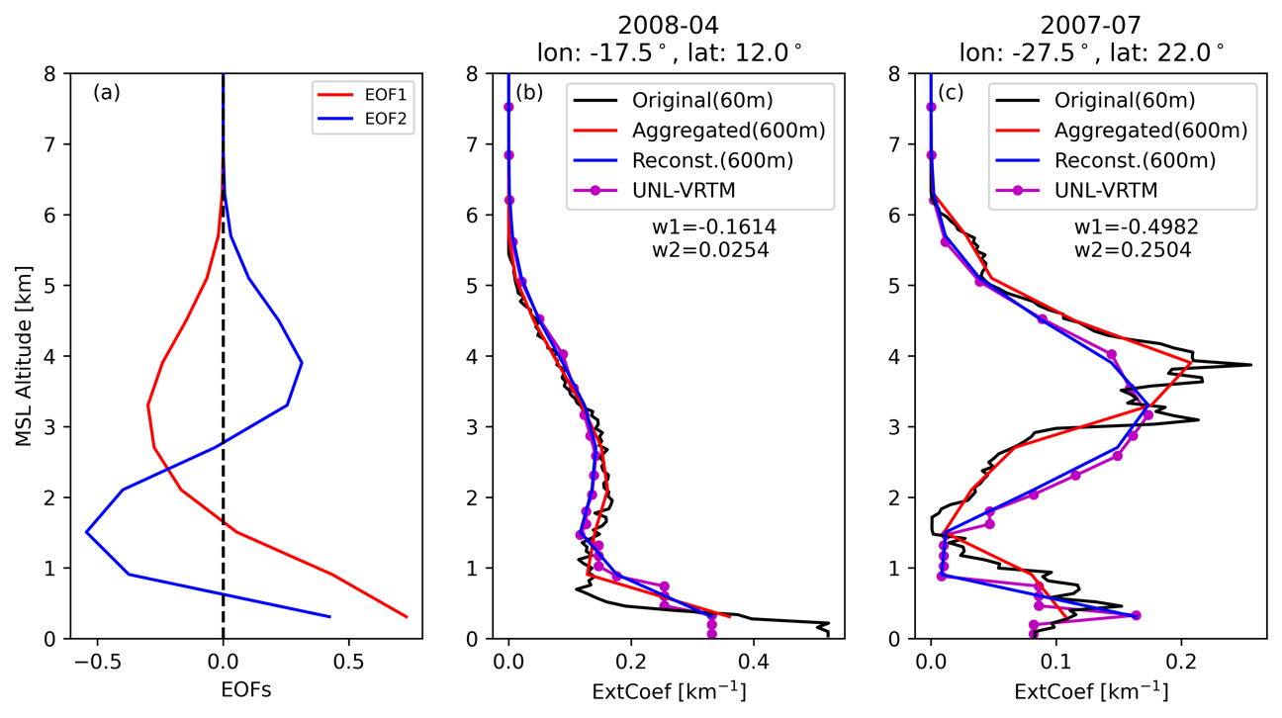
Retrieve only 2 EOF weights: vertical aggregation
Each CALIOP aerosol extinction profile is normalized and aggregated to 600 m vertical resolution.
First 2 EOFs explain ~82% of total variability in the vertical.
It is feasible to retrieve the Saharan dust profiles using PCA technique.
Notes:
13 years of CALIOP L3 data (daytime) are involved: Jun. 2006 – Jun. 2019
Each CALIOP aerosol extinction profile is normalized by its AOD and aggregated to 600-m vertical resolution before conducting PCA

Slide 17
Improvement on prediction and analysis
MERRA-2
false alarm!
MERRA-2 Corrected by AOCH

Slide 18
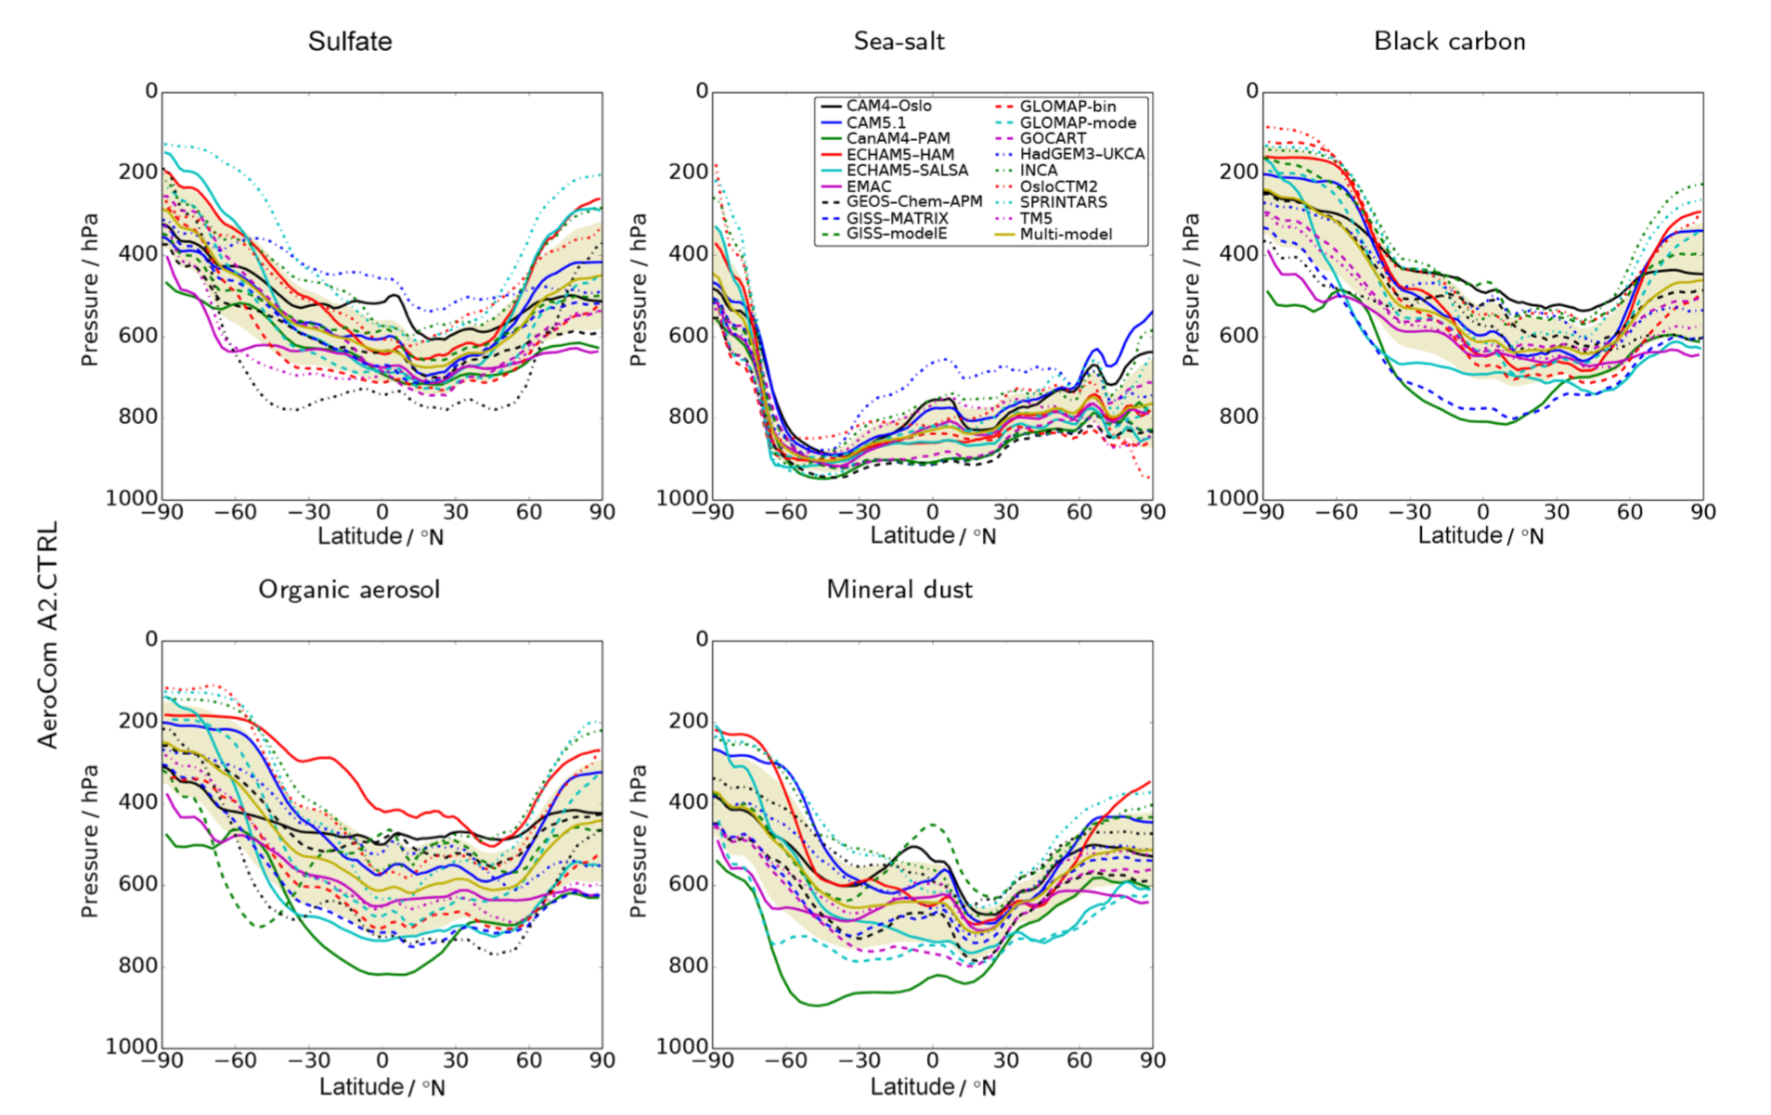
Large uncertainty in aerosol vertical profile
Sulfate Sea Salt Black Carbon
Pressure
Latitude
Organic Mineral dust
Annual- and zonal-mean mass-weighted mean pressure level (vertical center of mass in pressure coordinates)
Kipling et al., 2016;
ACP. AeroCOM-II

Slide 19
New Development/Results with primary use of TROPOMI O2 B-band
Deriving Aerosol Optical Centroid Height (AOCH) and AOD by primarily using 420, 680, and 688 nm
Surface reflectance from MODIS climatology and ASTER/USGS spectral reflectance library
Aerosol optical properties derived from AERONET climatology (varying with region)
Quasi-Gaussian distribution for the shape of aerosol vertical extinction profile
Compared with CALIOP data for many many cases
Chen, Wang, et al., 2021, RSE

Slide 20
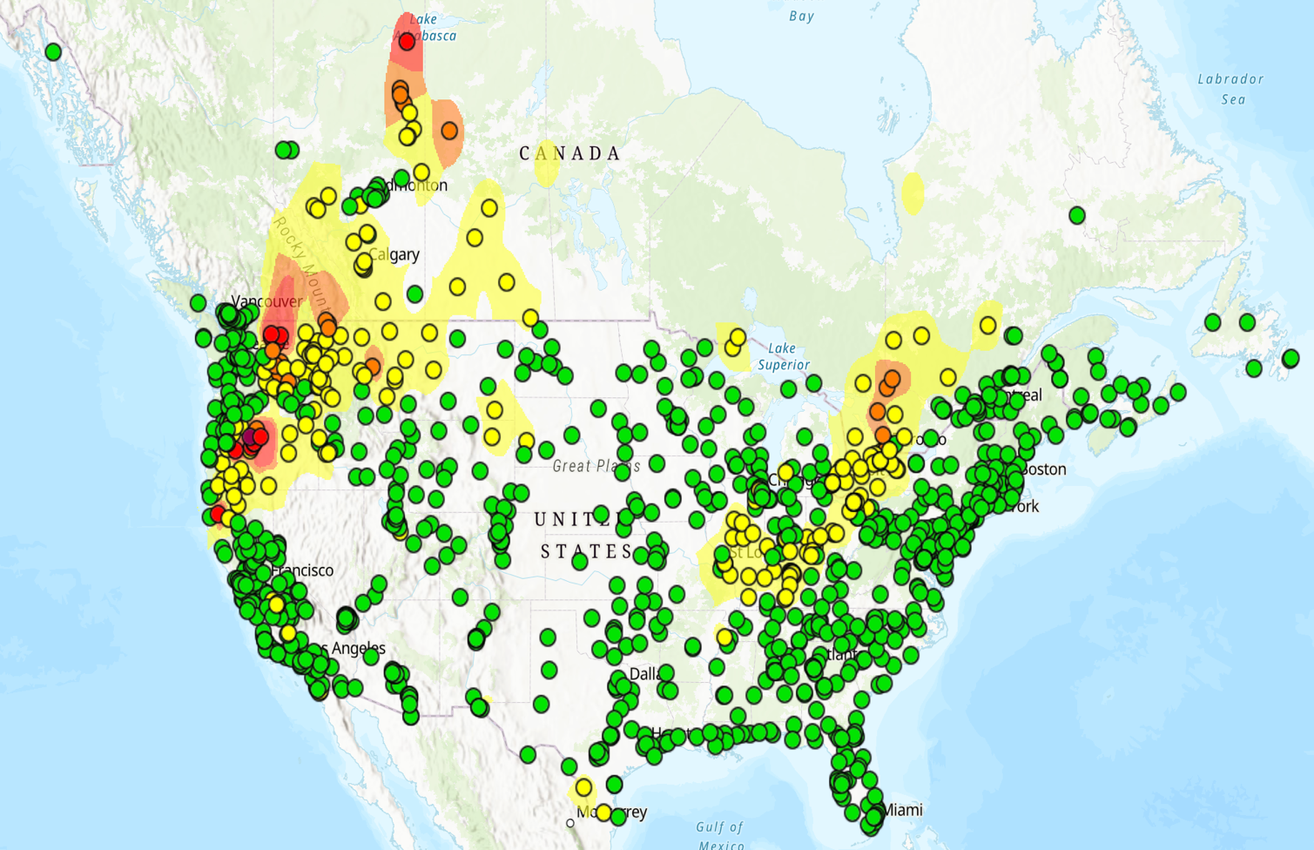
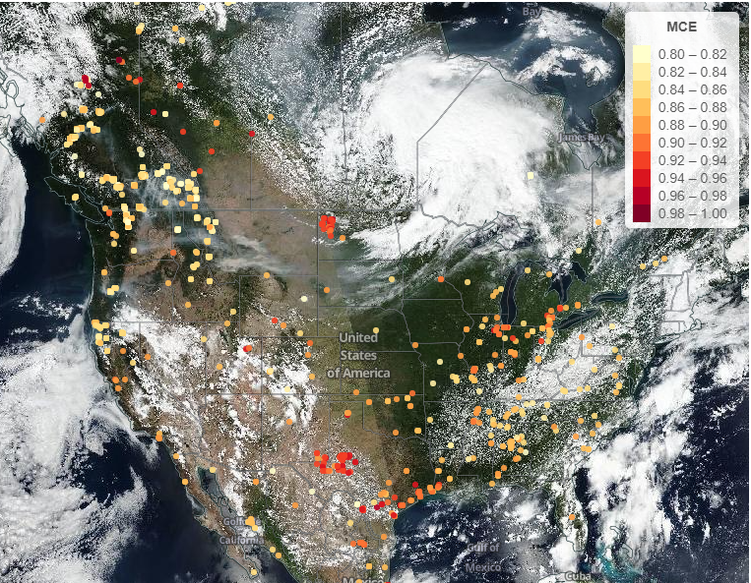
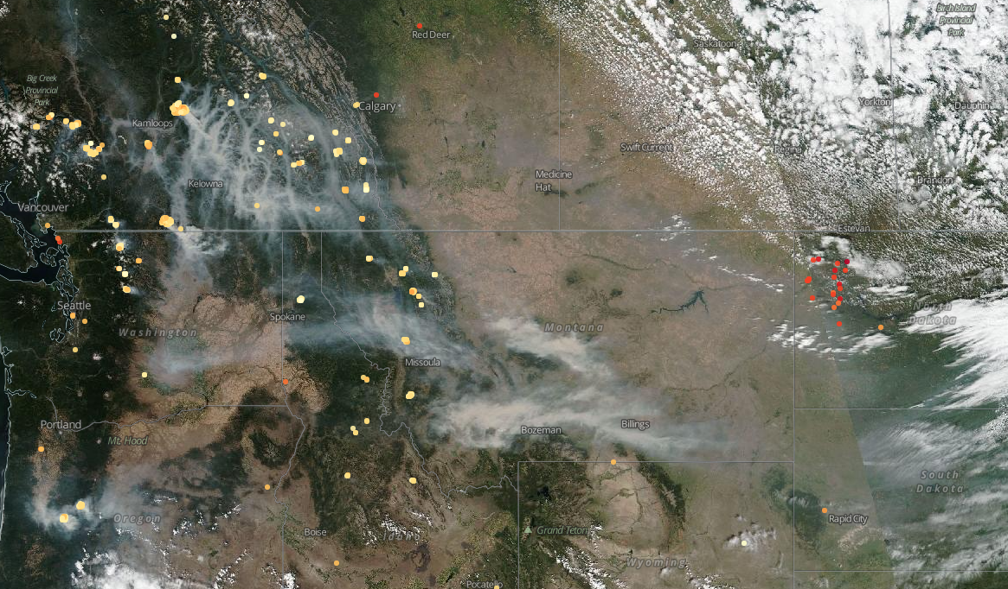
AQ Applications
http://fireaq.uiowa.edu for weekly briefing of FireAQ in 2023
MT
useful
August 16, 2023
WA
MT
OR
SD

