Slide 1

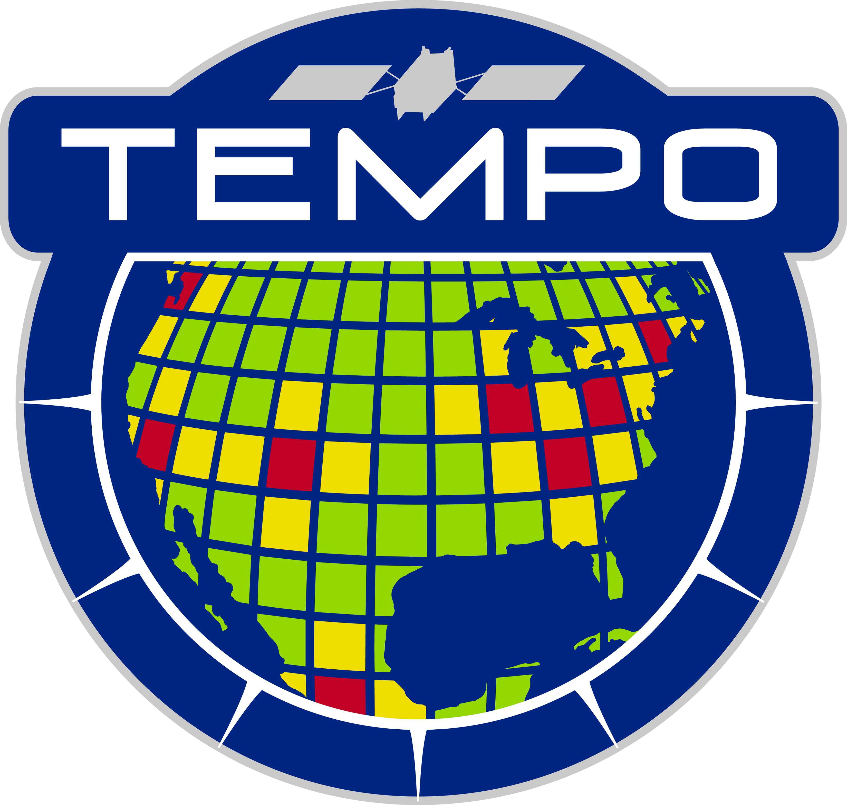
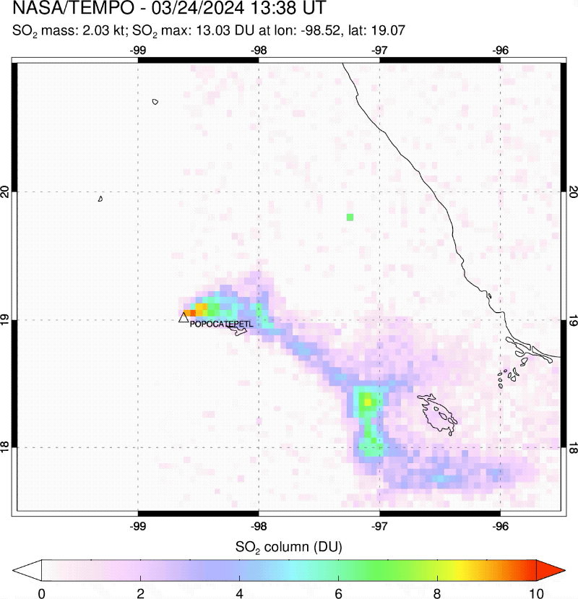
TEMPO Sulfur Dioxide Retrievals Using a PCA-based Algorithm : Preliminary Results and Potential Applications
Dobson Units: 1 DU = 2.69×10¹⁶ molecules/cm²
Can Li¹, Nickolay Krotkov^{1*}, Joanna Joiner¹, Simon Carn²,
Vitali Fioletov³, Chris McLinden³, Debora Griffin³
¹NASA Goddard Space Flight Center
²Michigan Technological University
³Environment and Climate Change Canada
2024 TEMPO/GEMS Joint Science Team Workshop
Hourly TEMPO SO₂ over Popocatépetl volcano
*Presenting Author
Notes:
According to an EoS article, Popocatépetl volcano in central Mexico has been a major environmental concern for local residents.
Hourly TEMPO SO2 retrievals will be valuable for monitoring volcanic activities, emissions, and hazards.

Slide 2
Motivation and Outline
There is currently no SO₂ product from TEMPO, yet one would help to:
  Enhance monitoring of SO₂ sources, especially the southern part of TEMPO field of regard.
  Provide monitoring of volcanic hazards at higher frequency.
Challenges for TEMPO SO₂ retrievals:
  Need for speed - TEMPO data volume ~10 times > OMI.
  Need for sensitivity - U.S. SO₂ emissions further decreased by ~90% since 2005.
Our Strategy:
  Adapting mature OMI/OMPS principal component analysis (PCA) SO₂ algorithm for TEMPO.
  An efficient data-driven algorithm that offers good sensitivity and is easily adapted for other sensors (Li et al., 2013, 2017, 2020, 2024).
  Algorithm changes to speed up processing (primarily Jacobian/AMF calculations).
Today’s presentation:
  Focus on our preliminary TEMPO SO₂ retrievals (Unofficial Data). Will also show some previous GEMS SO₂ results, if time allows.
  Updates since ACX meeting in May:
    Switch to V3 L1B data.
    Preliminary vertical column density (VCD) retrievals.
    Preliminary SO₂ emission estimates using TEMPO retrievals.
Notes:
We shared some of the first TEMPO SO2 results at the ACX meeting in May, but also made some updates.

Slide 3
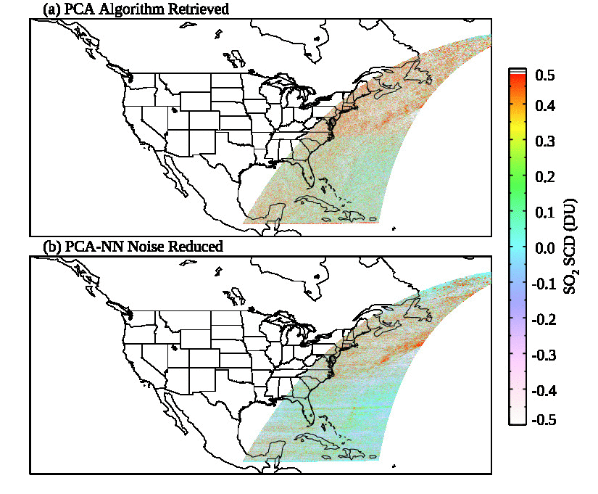
Can TEMPO Provide a Quality SO₂ Product? Yes, and some more!
Preliminary PCA-based SO₂ slant column density (SCD) retrievals:
Prototype algorithm with minimal changes worked well out of the box.
Captured Klyuchevskoy volcanic plume on 11/06/2023.
Noise Reduced SO₂ SCD retrievals:
Further improvement with a machine learning technique (Joiner et al., 2023) – ongoing effort.
The rest of the presentation will focus on PCA-based retrievals.
11/06/2023, Scans 3-13 (13:01-22:35 UTC)
Notes:
- Biggest question when we first started this work is whether TEMPO can provide a good quality SO2 product. We were able to answer this question soon.
NASA HQ provided some support for developing a prototype TEMPO SO2 algorithm using synthetic data.
We were able to produce real TEMPO SO2 retrievals with minimal changes to the algorithm, within just a couple of weeks after getting access to real L1B data.
There is much more that can be done to improve TEMPO SO2 product, including the example given here on noise reduction.
The approach combines PCA and neural networks, and can reduce noise especially at higher latitudes. At the same time, it retains the SO2 signals.

Slide 4
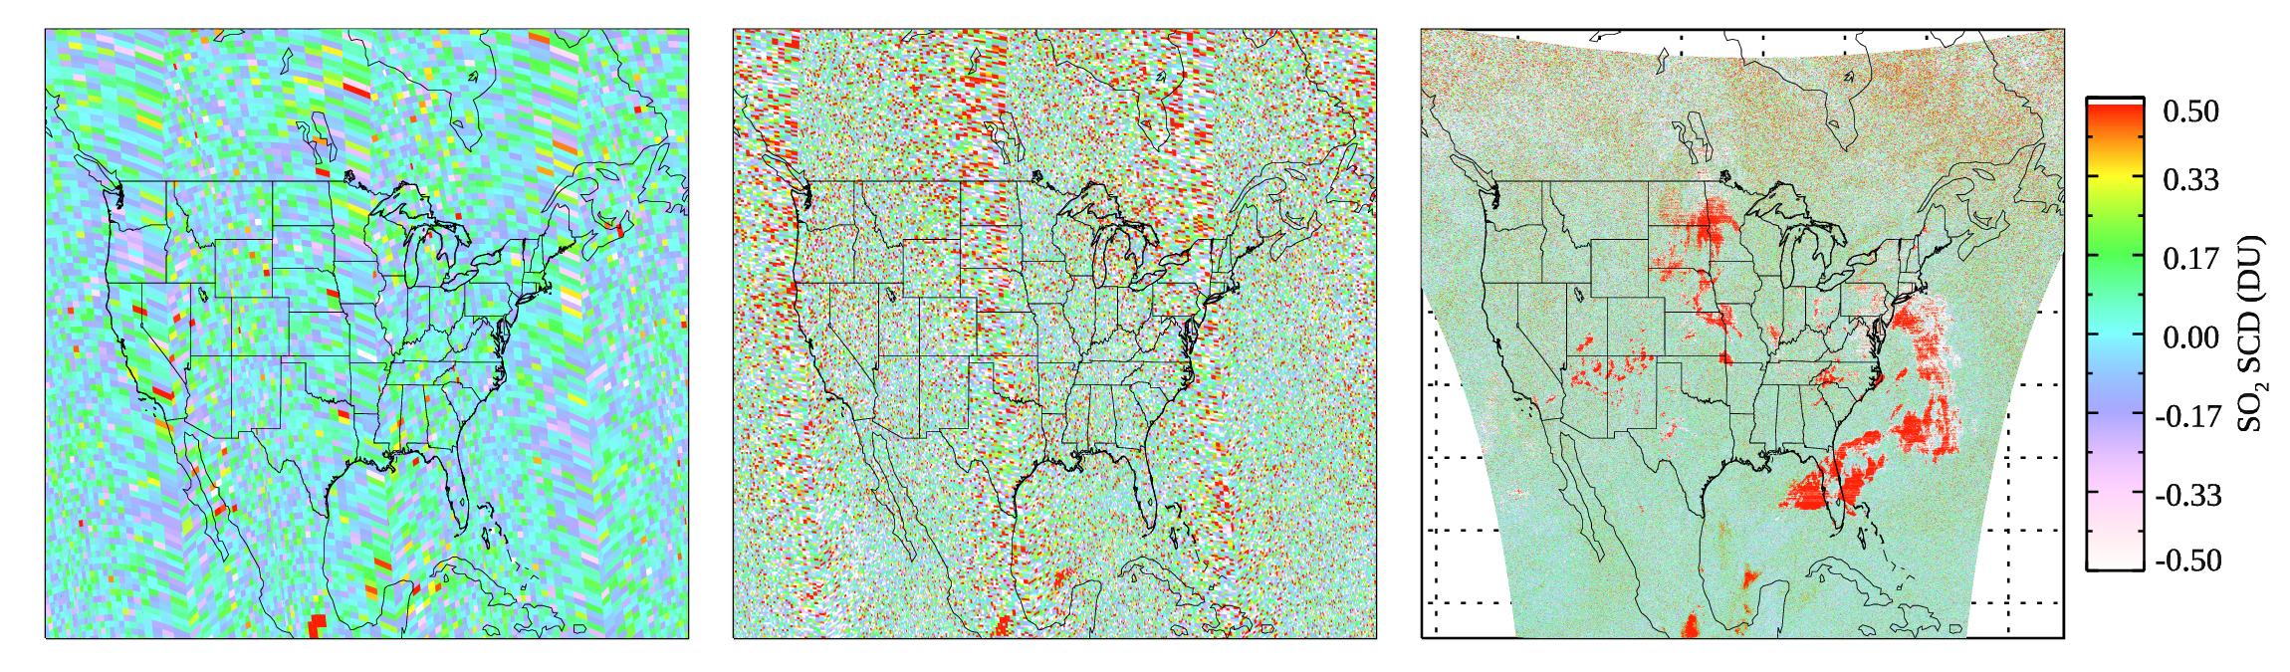
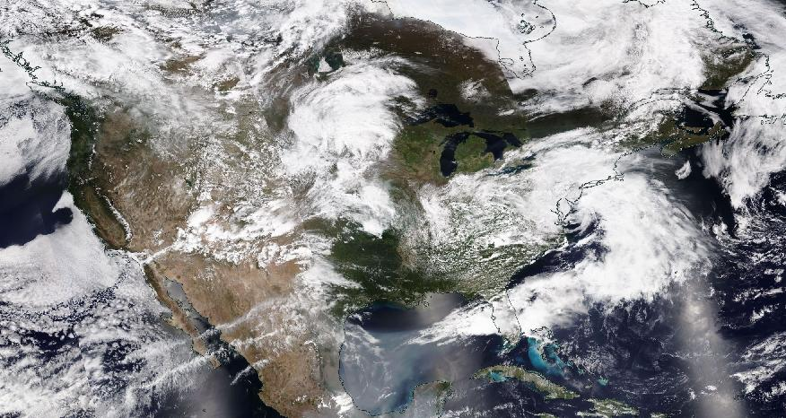
SCD Retrievals: Comparison with OMPS (05/15/2024)
SNPP (50×50 km²)
NOAA-20 (17×13 km²)
TEMPO, Scan 010, (2×4.5 km²)
False positives in TEMPO SO₂ SCDs (circled) found over bright cloudy scenes – probably related to known saturation issues (previously shown for V2, also present in V3 data here).
A filter checking for pixels with large fitting residuals can effectively screen them out (see following slides).
Both OMPS and TEMPO show enhanced SO₂ over Popocatépetl volcano and downwind transport.
TEMPO SCD noise greater than SNPP/OMPS, but smaller than NOAA-20/OMPS.
RGB: NOAA-20/VIIRS
Notes:
First comparisons of OMPS and TEMPO SO2 SCD retrievals for one TEMPO scan.
Spatial resolution quite different between the instruments.
Hotspots over the continental U.S. due to known saturation issue in L1 – previously noticed this in V2 data. Our results here are based on V3 L1B data.
But we can screen out these problematic pixels based on fitting residuals from SCD retrievals.

Slide 5
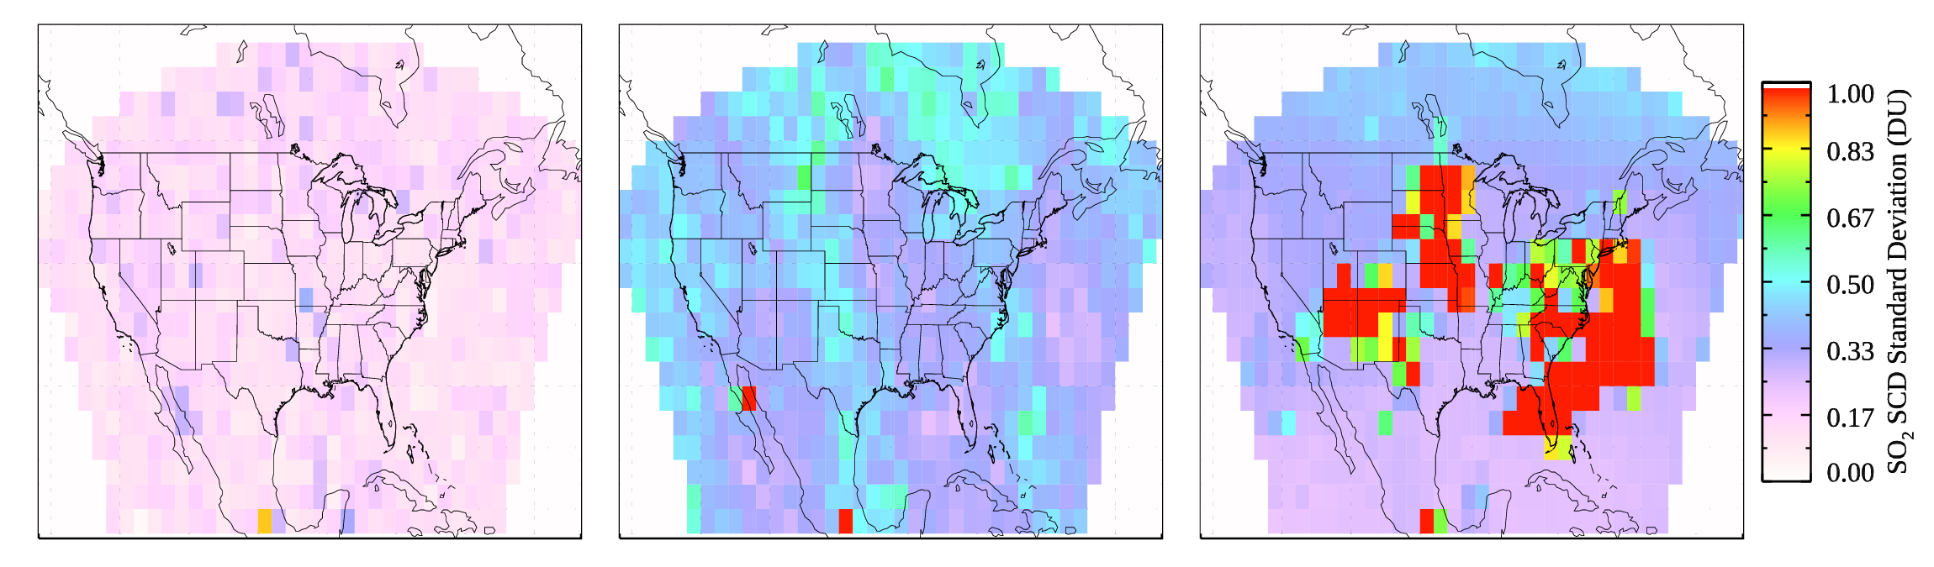
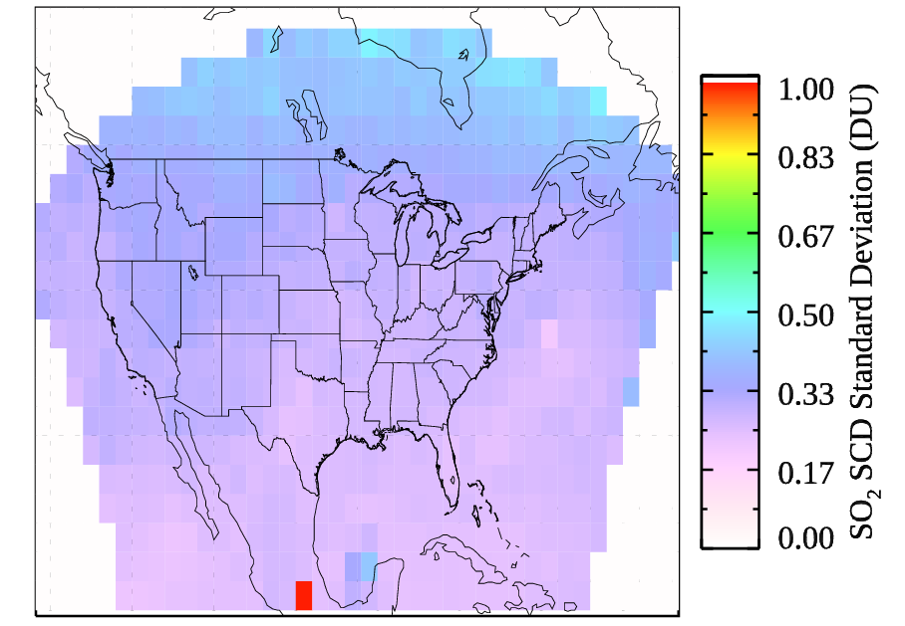
SCD Retrieval Noise (Estimated from Gridded Standard Deviation): Comparison with OMPS (05/15/2024)
SNPP
NOAA-20
TEMPO Scan 010
Mean of σ: 0.142 DU
Mean of σ: 0.409 DU
Mean of σ: 0.659 DU
TEMPO Scan 010 with Filtering
Standard deviation calculated for 2°×2° grid cells.
Retrieval noise scales with square root of spatial resolution between SNPP and NOAA-20 OMPS (Li et al., 2024).
Superior performance in retrieval noise for TEMPO - each SNPP/OMPS nadir pixel is ~250 TEMPO pixels in terms of area coverage.
Mean of σ: 0.316 DU
Notes:
Here we compare retrieval noise between SNPP/OMPS, NOAA-20/OMPS, and TEMPO.
Our paper earlier this year shows that between SNPP and NOAA-20, the retrieval noise scales with the square root of spatial resolution – this is to be expected given the two OMPS instruments are similar.
For TEMPO, if we filter out pixels with potential saturation (lower right), the retrieval noise is greater than SNPP at its native resolution.
Since TEMPO has > 200 times higher spatial resolution, this shows that TEMPO has superior performance in terms of SO2 retrieval noise.

Slide 6
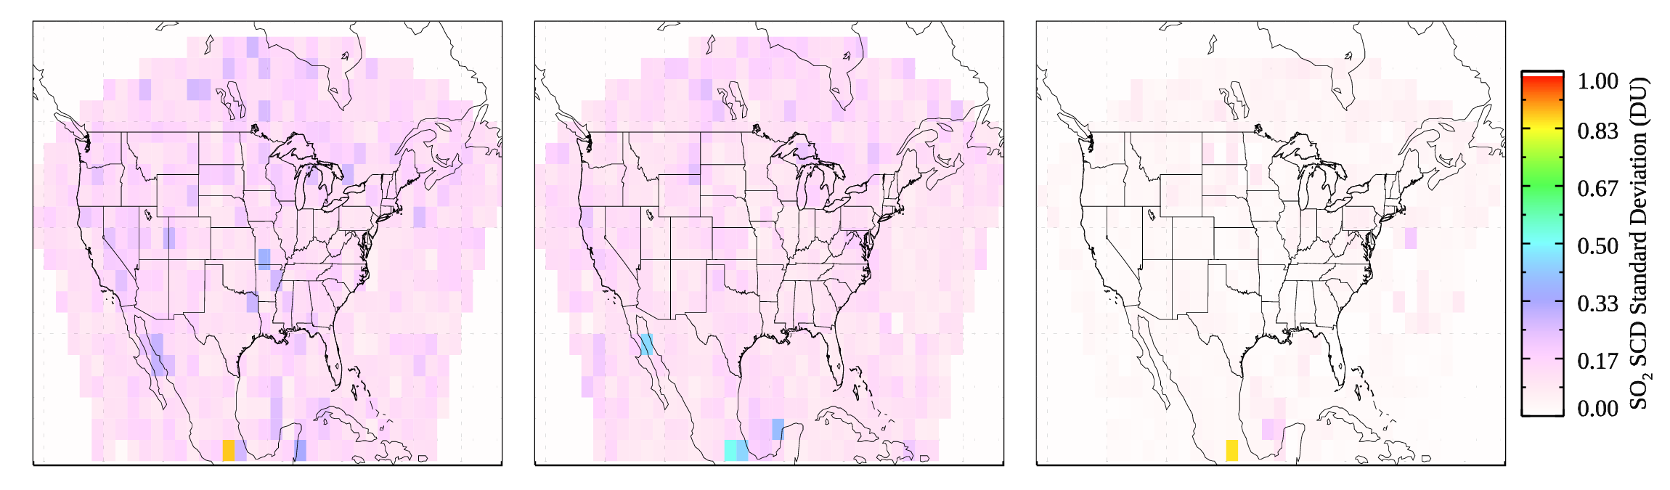
What if TEMPO Had the Same Spatial Resolution as SNPP/OMPS?
SNPP
NOAA-20 (binned to SNPP)
TEMPO (binned to SNPP)
Mean of σ: 0.142 DU
Mean of σ: 0.123 DU
Mean of σ: 0.032 DU
First bin N20/OMPS and TEMPO pixels to SNPP/OMPS resolution, then calculate standard deviation for 2°×2° grid cells.
Apple-to-apple comparisons of SO₂ SCD noise for instruments with different spatial resolution.
Similar noise between SNPP and N20 at the same resolution (Li et al., 2024).
Much smaller noise for SO₂ SCDs from TEMPO at SNPP/OMPS resolution.
Notes:
The previous slide shows retrieval noise estimated using retrievals at native resolution of each instrument.
Here we try to make a fair comparison, by first binning NOAA-20 and TEMPO retrievals to the same resolution as SNPP, and then calculating the retrieval noise.
Results confirm similar retrieval noise between SNPP and N20/OMPS at the same resolution, and much smaller noise for TEMPO.

Slide 7
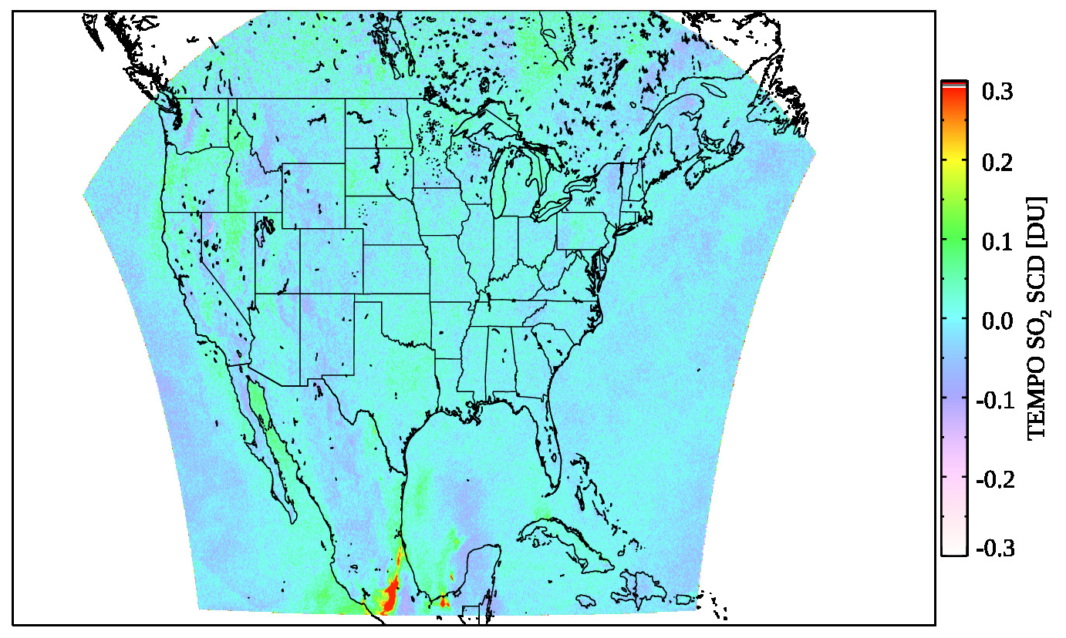
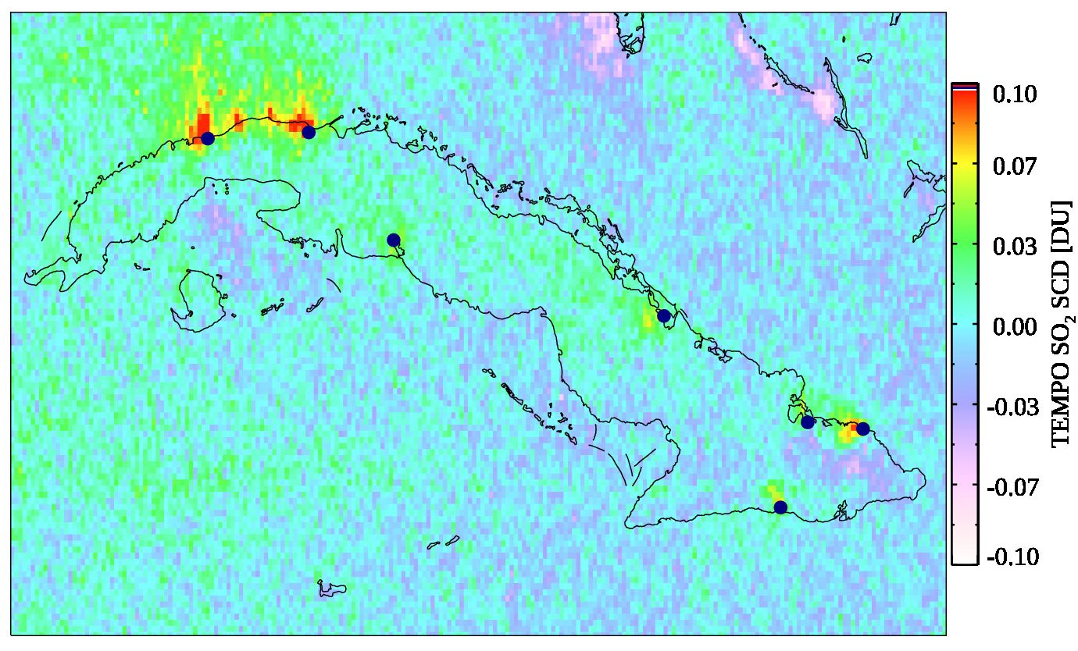
Averaging Data for Emission Source Detection/Quantification
TEMPO Mean SO₂ SCDs (05/13-06/16, 2024, Scans 5-12)
Mean SCDs over Cuba
Solid circles: sources in emission catalogue based on OMI/TROPOMI/OMPS (Fioletov et al., 2023, https://doi.org/10.5194/essd-15-75-2023)
Mean SCDs for 0.05°×0.05° grid cells, filtering based on SZAs and VZAs (< 65) and fitting residuals, no cloud filtering.
Small biases related to terrain and near the edge of the field of regard.
Major known SO₂ sources in Mexico visible on map.
Effort underway to look into emission sources.
Notes:
SO2 retrievals are relatively noisy, and except for the largest sources, we typically average one year’s worth of data from LEO instruments to estimate SO2 emissions from point sources.
Here we show mean SO2 SCDs from ~1 month of TEMPO data.
Note that we didn’t do any filtering based on cloud fraction, only based on SZA/VZA and fitting residuals.
There are some biases, for example, negative biases over mountainous areas and near the edges of TEMPO FoR.
But we can also see a number of sources including the Popocatépetl volcano, the offshore oil field over the Gulf of Mexico.
On the right, we show a zoomed in map for Cuba for the same period, but on a different color scale. Circles are SO2 point sources that have been quantified with LEO instruments. From the monthly mean SCDs, the enhanced SO2 can be seen over those sources.

Slide 8
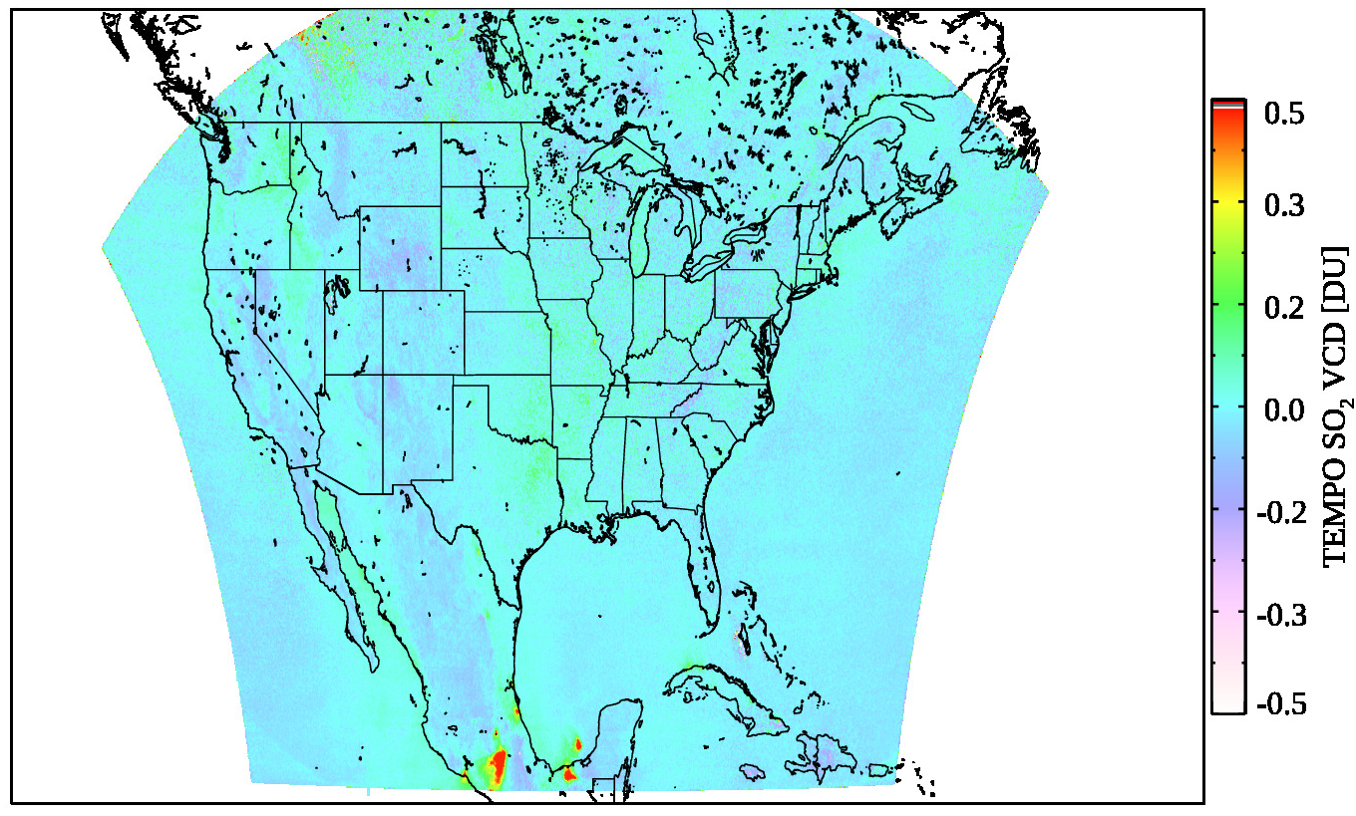
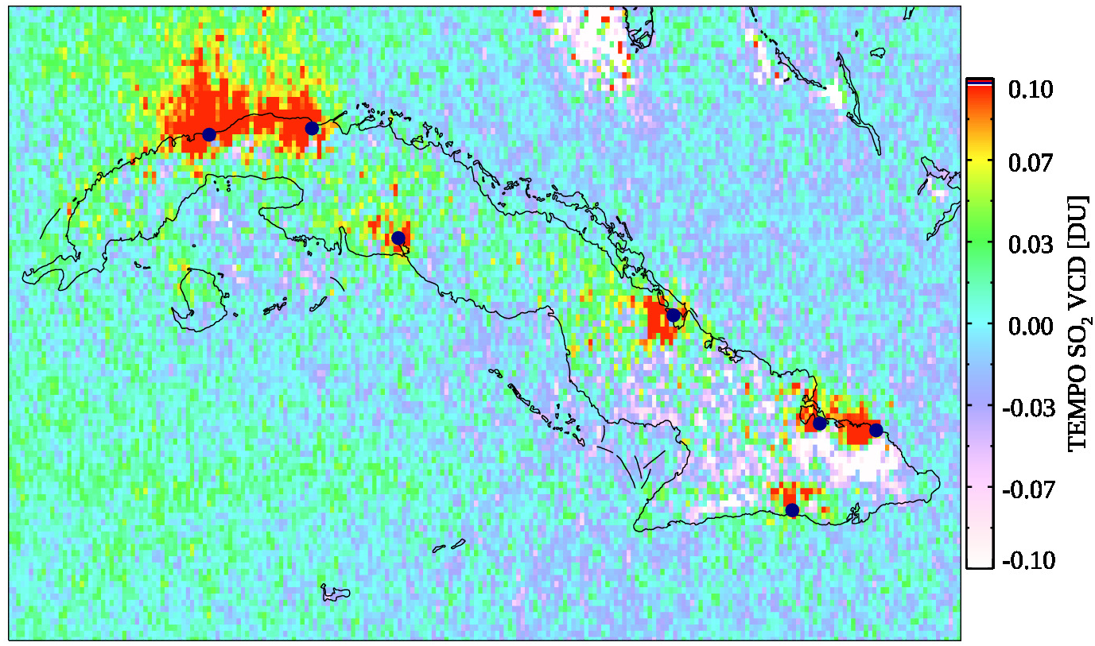
Preliminary TEMPO SO₂ VCD Retrievals
TEMPO Mean SO₂ VCDs (05/13-06/16, 2024, Scans 5-12)
Mean VCDs over Cuba
Solid circles: sources in emission catalogue based on OMI/TROPOMI/OMPS (Fioletov et al., 2023, https://doi.org/10.5194/essd-15-75-2023)
Use climatology a priori profiles built from GEOS-CF simulations for 2023 (depend on lat/lon, month of the year, and hour of the day).
Use existing TEMPO standard products for surface/clouds in AMF calculations.
Filtering based on cloud fraction (CRF < 0.3), SZA and VZA (< 65) and fitting residuals.
Enhanced signals over known emission sources (e.g., Cuba).
Notes:
For VCDs, we filter data based on cloud radiance fraction and geometry, as well as fitting residuals for SCD retrievals.
Map on the left shows similar spatial distribution as SCDs.
The zoomed in map over Cuba show enhanced SO2 signals over known point sources.
This is still preliminary and further improvements can be made to different aspects of AMF calculations. For example, better a priori profiles.

Slide 9
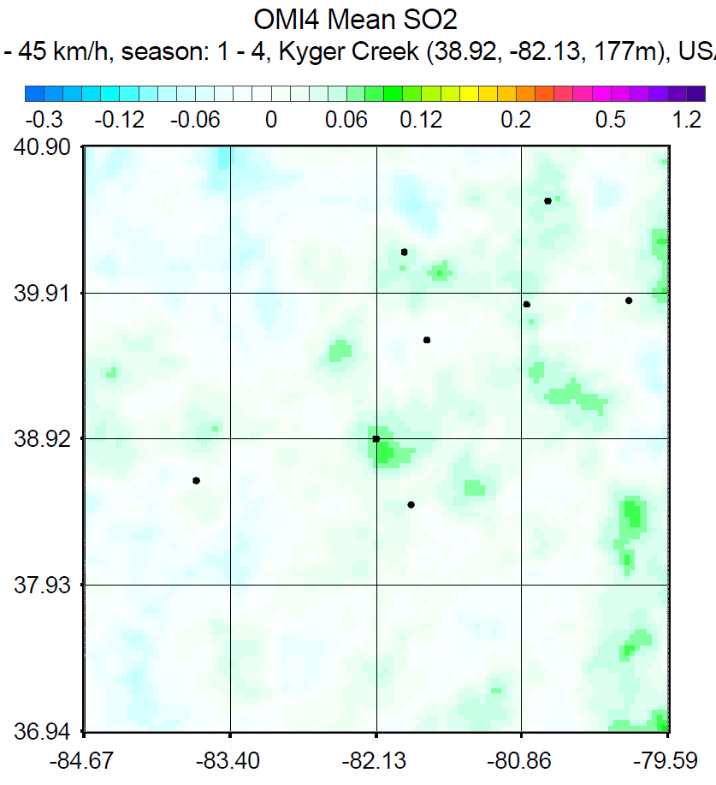
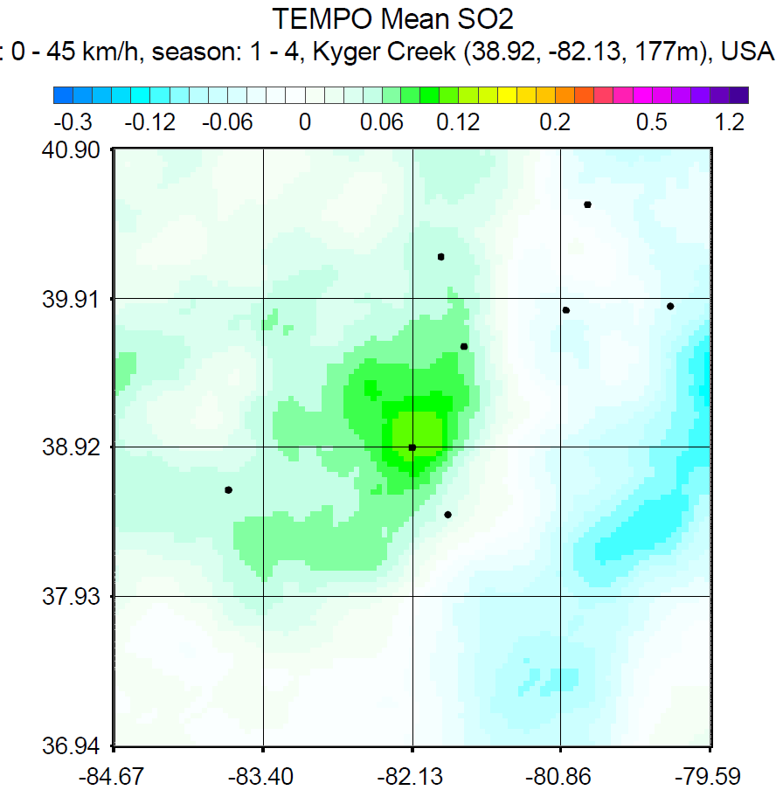
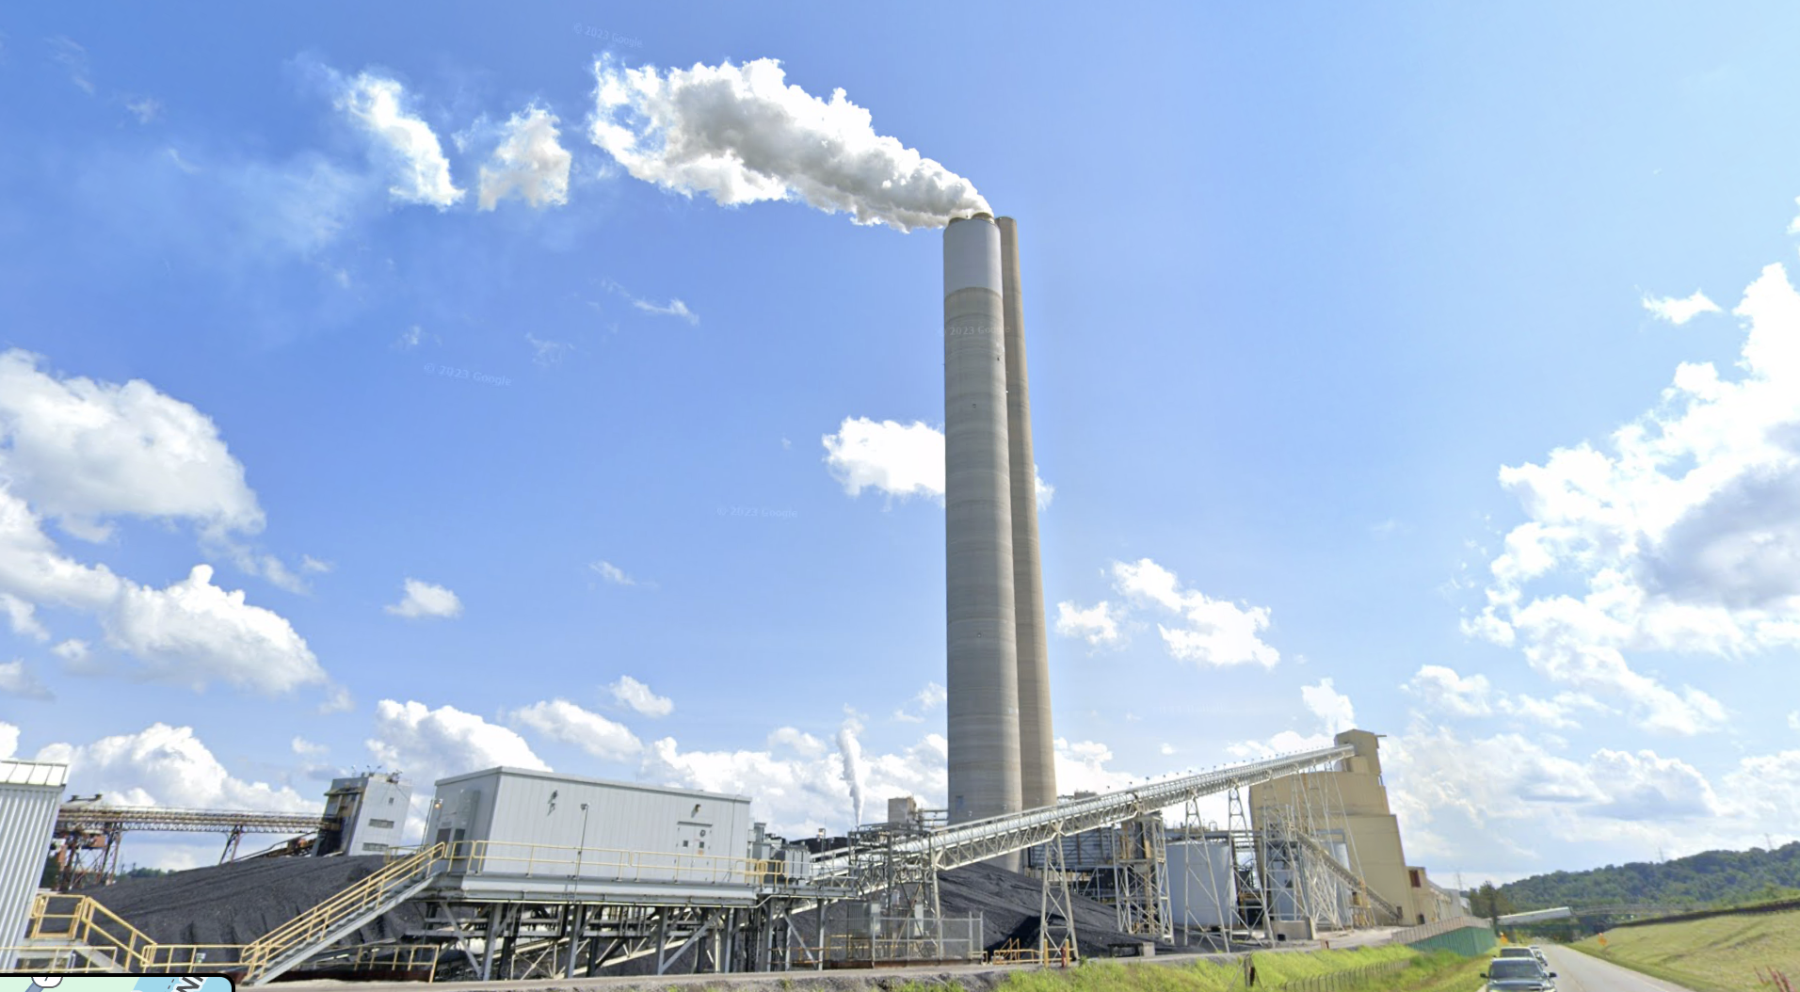
Preliminary SO₂ Source Emission Estimates Using TEMPO
OMI: 2018-2023
TEMPO (~65 days: March-April, May-June, 2024)
Mean SO₂ over Kyger Creek Power Plant in the Ohio River Valley
Estimated emissions: 24 kt/yr*
Estimated emissions: 44±6.8 kt/yr
*May not be statistically significant
Emission estimates made for 44 point sources over TEMPO field of regard, using ~65 days of preliminary SO₂ retrievals.
In the particular case above, TEMPO observed SO₂ signals from a much shorter period of time are stronger than OMI.
Further investigation necessary to reconcile differences in the estimated emissions between TEMPO and LEO sensors
Need more TEMPO SO₂ data for more in-depth analysis (e.g., screening of volcanic SO₂, understanding diurnal changes in retrieved SO₂ and emissions).
Notes:
GEO-based SO2 emissions are different from LEO and would take some more effort to develop and understand.
For sources in the U.S. and Canada, they are expected to be a challenge to quantify with just ~60 days of data.
Most importantly, need more TEMPO data for analysis,

Slide 10
Summary and Next Steps
Preliminary results suggest that a science quality SO₂ product can be generated with TEMPO.
Some speeding up may be necessary, but NRT processing is feasible (SCD takes ~1-1.5 hour for one hourly scan, VCD takes ~0.5 hour for each granule, on a single CPU).
Next steps for algorithm development (best effort basis):
  Machine learning based SO₂ flagging – simplifies and accelerates the algorithm.
  Refined AMF calculation for VCD retrievals.
  Machine learning based noise reduction.
Next steps for applications:
  Further investigation of top-down constraints on emission sources.
  Monitoring of volcanic hazard and synergy with other sensors (e.g., ABI) for process studies.

Slide 11
Backup Slides on GEMS SO₂ Retrievals

Slide 12
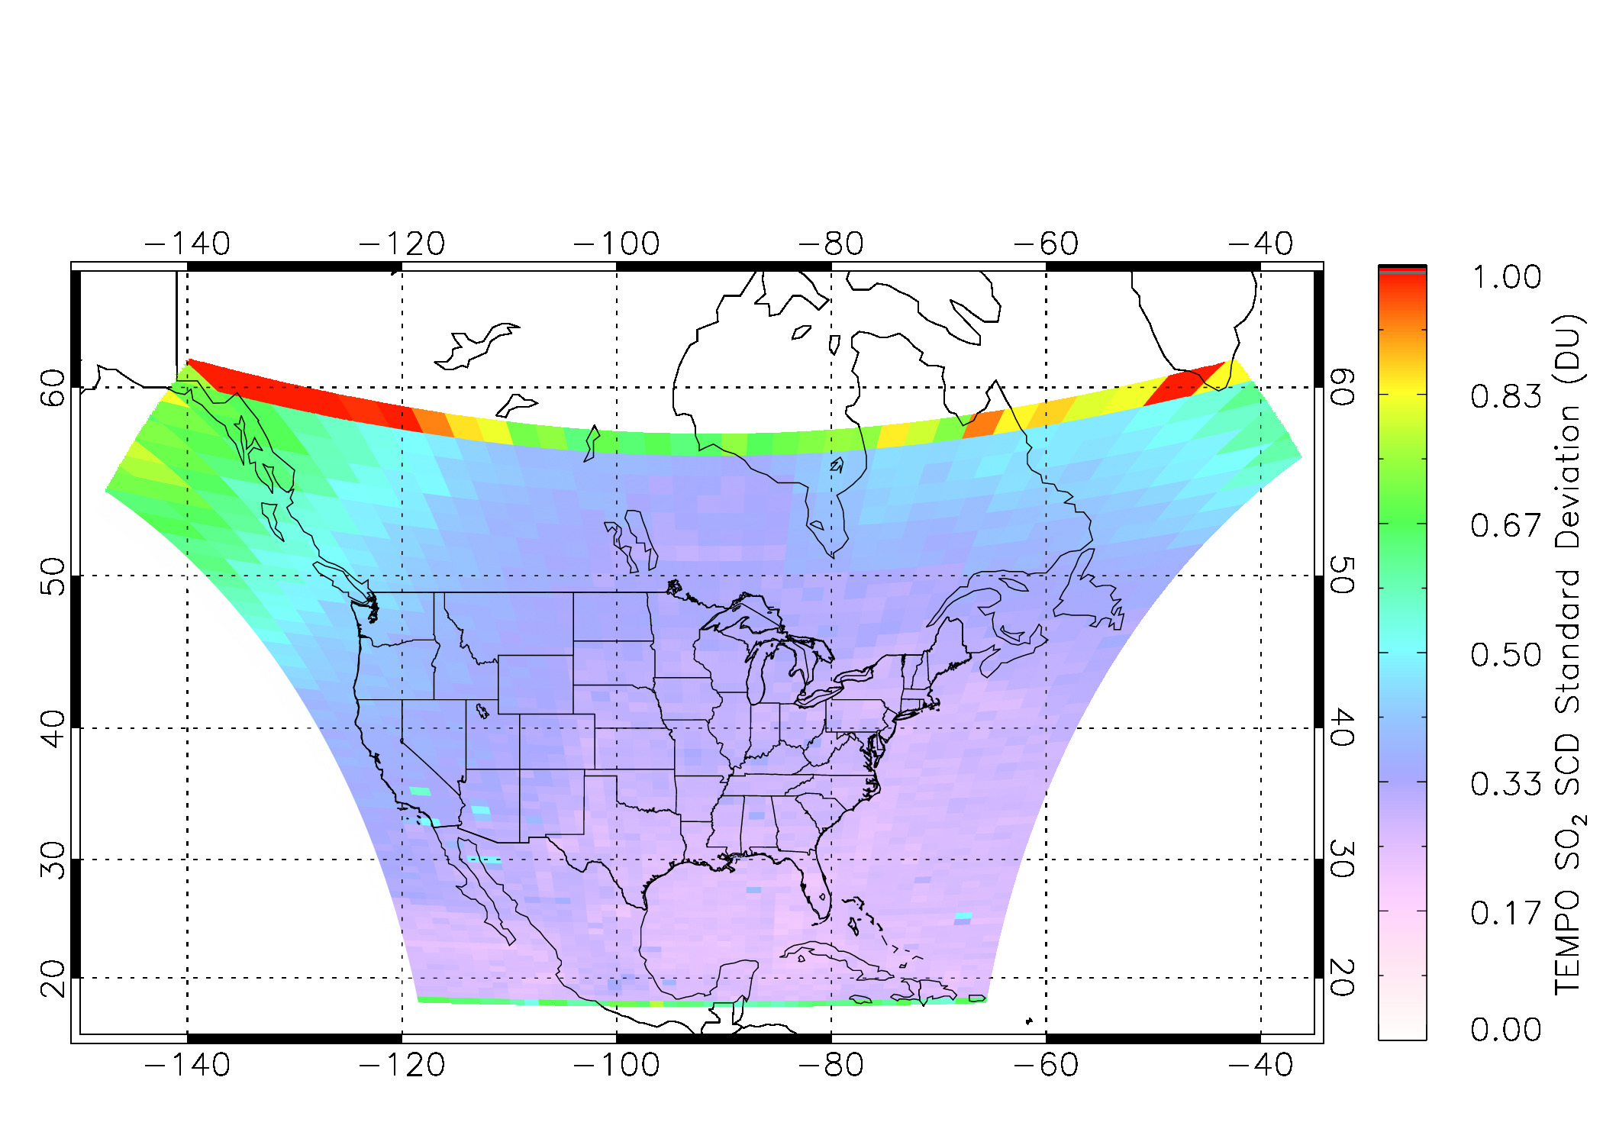
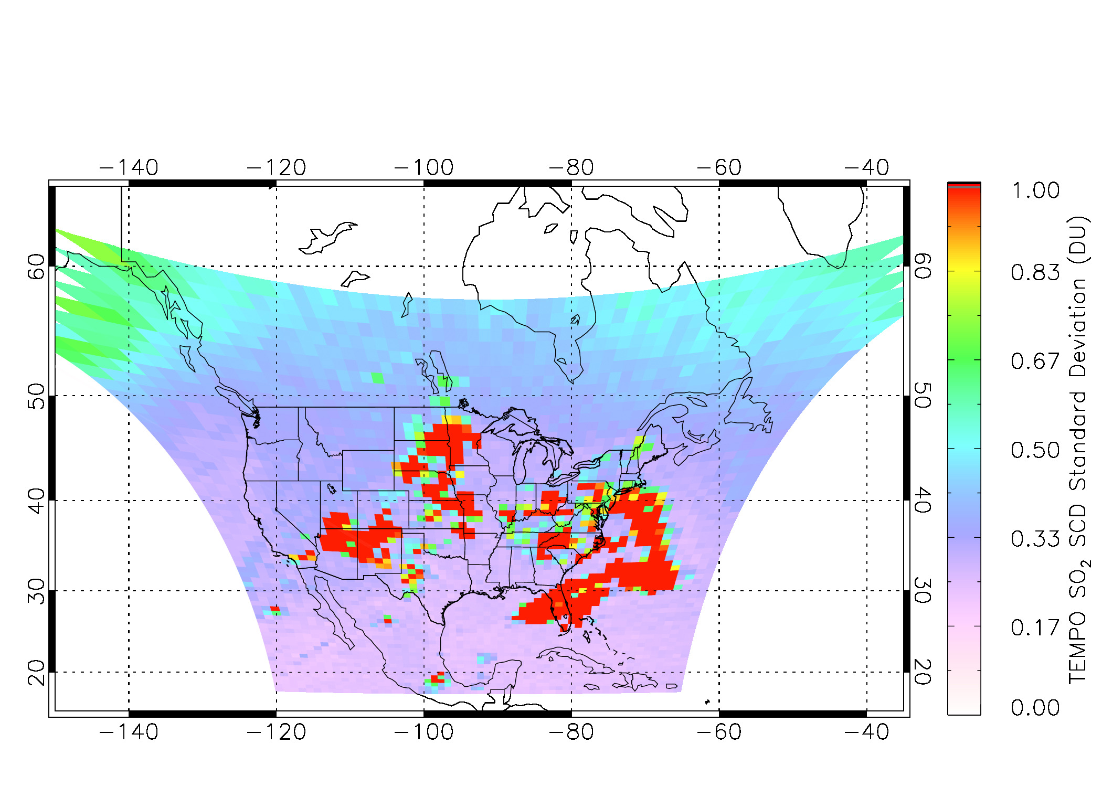
SCD Retrieval Noise (Estimated from Gridded Standard Deviation): Comparison with Synthetic Data
Retrievals using synthetic data, one scan (07/01/2013)
Real TEMPO Retrievals, one scan (05/15/2024)
Standard deviation calculated for blocks of 30 × 32 pixels.
For CONUS (outside of areas with hotspots), real SO₂ SCD retrievals show typical standard deviation of ~0.2-0.3 DU, similar to synthetic test.
Hotspots over the CONUS are due to false positives and again could be related to known saturation issues.
Notes:
Estimate retrieval noise based on standard deviation calculated over small areas.
Retrieval noise comparable between estimates based on synthetic data and real TEMPO retrievals on the right, if we ignore areas affected by saturation.

Slide 13
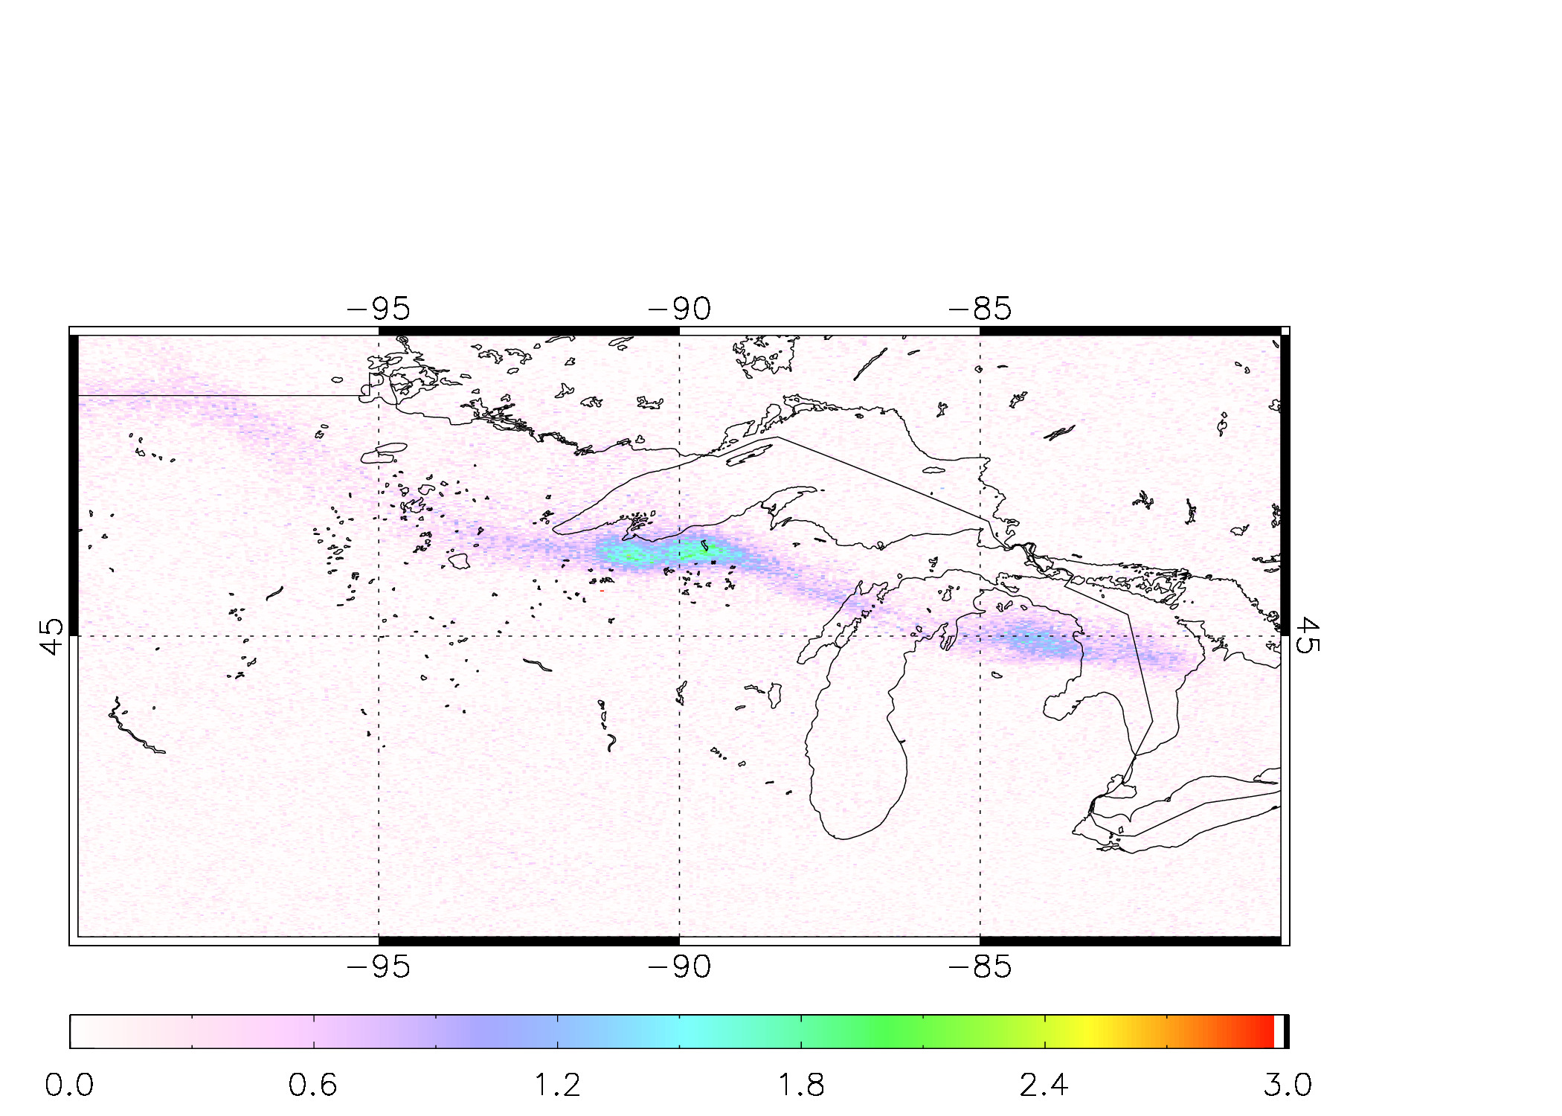
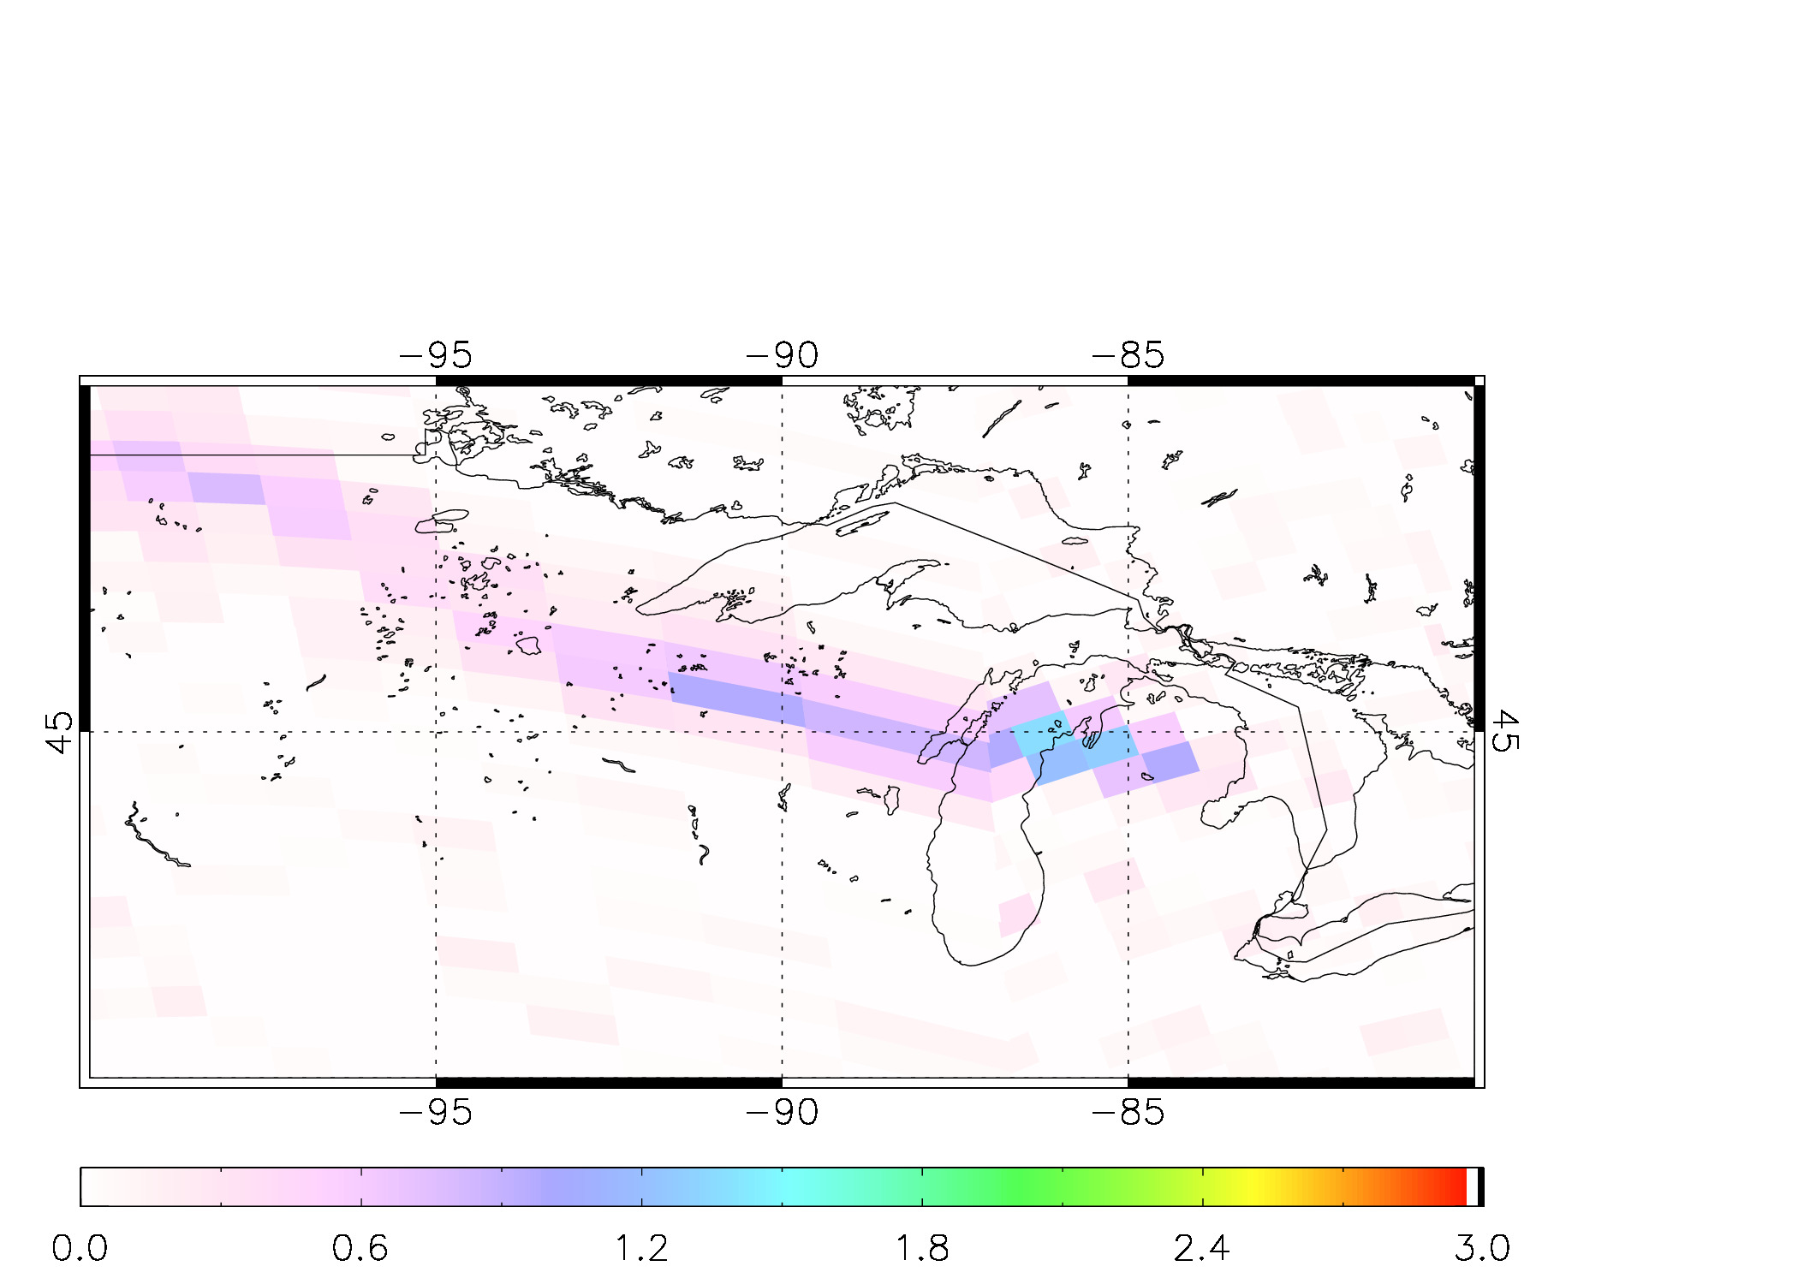
Comparisons of Volcanic SO₂ VCDs: Klyuchevskoy Volcanic Plume on 11/06/2023
TEMPO, Scan 010, 19:22-20:15 UTC
SNPP/OMPS, ~17:56 UTC
SO₂ VCD (DU), assumed height@18 km;
Estimate total SO₂ mass = 3.4 kt
SO₂ VCD (DU), assumed height@18 km;
Estimate total SO₂ mass = 4.3 kt
Superior spatial resolution of TEMPO offers more details and precise location of the volcanic plume.
Estimated SO₂ loading comparable between TEMPO and OMPS, despite the very different pixel size and geometry.
Notes:
Quantitative comparisons between TEMPO and our standard SNPP/OMPS retrievals for volcanic SO2.
Consistent results for SO2 loading, but TMEPO provides more details.

Slide 14
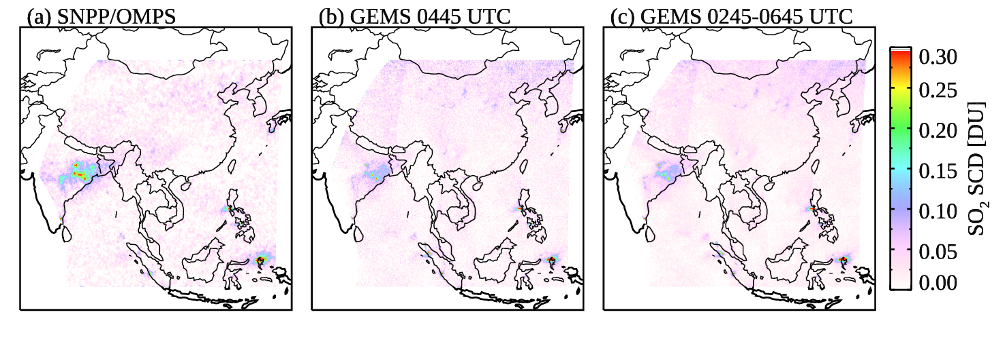
Mean SO₂ SCDs over Asia: GEMS vs. SNPP/OMPS, April – May 2021
(~2-7 UTC)
50 × 50 km² at nadir, once a day
7 × 8 km², 1 scan/day
7 × 8 km², up to 5 scans/day
Qualitatively, similar spatial distribution of SO₂ sources between GEMS and OMPS.
Relatively small bias along GEMS scan direction (east-west) – an issue under investigation.
SO₂ sources over N China more clearly identified in GEMS – important with decreasing emissions.
For power plants in NE India, OMPS SCDs are larger - observation geometries are quite different (e.g., VZAs for GEMS ~55°, OMPS ~0-60°).

Slide 15
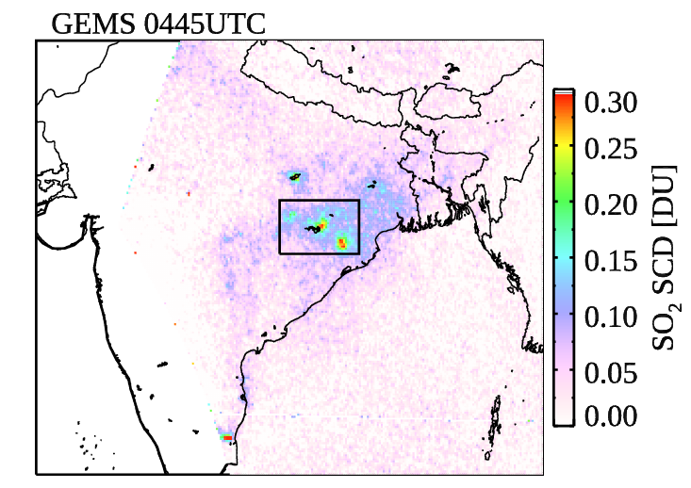
GEMS Observations of Diurnal Changes in SO₂
Error bars: ±1𝜎
Based on RT and typical geometries
VCD = SCD/AMF
May 2021
Overall increase in SCDs over NE India (coal-fired power plants) from morning to afternoon.
This could be explained by changes in SZAs and RAZs throughout the day, no obvious pattern in VCDs.
Note: diurnal changes in cloud, surface reflectivity, and PBL height/SO₂ profiles not accounted for here.
Notes:
Diurnal changes in SO2 calculated for the hotspots in NE India (black box on the map).

