Slide 1




Tropospheric Emissions:
Monitoring of Pollution
Status of the TEMPO total ozone
and TEMPO ozone profile algorithm:
Evaluation using the other satellites
and ground-based observations
Junsung Park¹, Xiong Liu¹, Juseon Bak², Dave P. Haffner³, Gonzalo González Abad¹, Laurel Carpenter¹, James Carr⁴, Kelly Chance¹, Heesung Chong¹, John E. Davis¹, Jean Fitzmaurice¹, David E. Flittner⁵, Stacey M. Frith³, Jay Herman³, Weizhen Hou¹, John Houck¹, Joanna Joiner³, K. Emma Knowland³, Natalya Kramarova³,
Christopher Chan Miller¹, Caroline R. Nowlan¹, Michael J. Newchurch⁶,
Ewan O'Sullivan¹, Brad Pierce⁷, Robert Spurr⁸, Raid Suleiman¹, Huiqun Wang¹,
Kai Yang⁹, Xiaoyi Zhao¹⁰, Jerry R. Ziemke³, and the TEMPO Team
¹SAO, CfA | Harvard & Smithsonian, ²Busan National University,
³NASA Goddard Space Flight Center, ⁴Carr Astronautics,
⁵NASA Langley Research Center, ⁶University of Alabama,
⁷University of Wisconsin-Madison, ⁸RT Solutions Inc.,
⁹University of Maryland, and ¹⁰Environment and Climate Change Canada
TEMPO/GEMS 2024 Joint Science Team Workshop
August 26, 2024

Slide 2

Tropospheric Emissions: Monitoring of Pollution
(TEMPO)
NASA’s first Earth Venture Instrument (EVI) selected in 2012
  PI-led at Smithsonian Astrophysical Observatory (SAO): Science team, ground systems, science data processing center
  Hourly daytime air pollution measurements over North America
Geostationary orbit means TEMPO can scan the continent continuously
  High temporal resolution (1 hour)
  High spatial resolution (2 km $×$ 4.75 km)
Baseline data products:
  Nitrogen dioxide
  Formaldehyde
  Ozone (total and profile)

Slide 3

TEMPO O3TOT algorithm
TEMPO O3TOT (total column ozone) algorithm
  OMTO3 V8.5 (TOMS V8.5) based algorithm
  Uses two wavelength pairs ([317.5 and 331.2 nm] and [331.2 and 360 nm])
  Total O₃, AI, and cloud fraction
  Spatial resolution of 2.0 km $×$ 4.75 km
  SDPC v4.4 (V03) TEMPO O3T product has been released on May 20, 2024
Recommendation filtering:
Use the ‘warning_input_radiance’ provided by the ‘quality_flag’ from the TEMPO O3TOT product (quality_flag >= 4096).

Slide 4
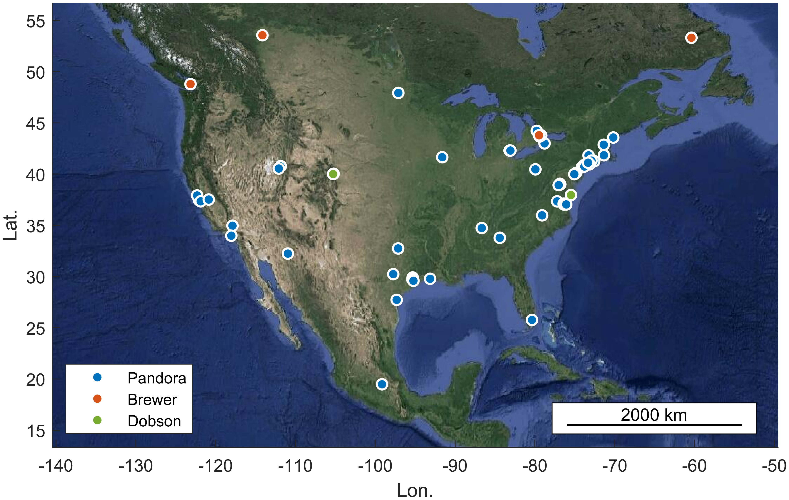
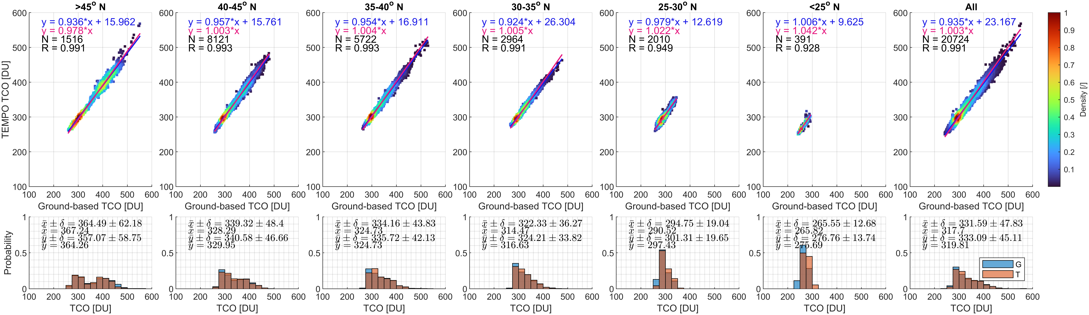
Comparison of TEMPO total ozone with ground-based observations
Courtesy of Xiaoyi Zhao, ECCC
  56 PGN sites
  4 Brewer sites
  2 Dobson sites
TEMPO V03
- Mean +/- std
- The median
TEMPO V3 total ozone have good correlation with those from ground-based observations (Dobson, Pandora, and Brewer).
4

Slide 5
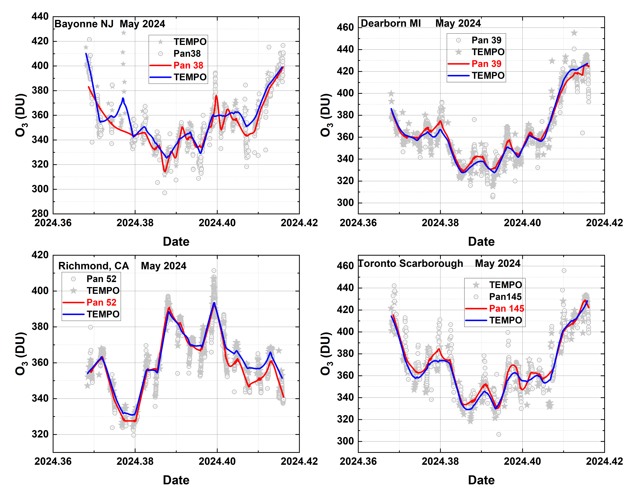
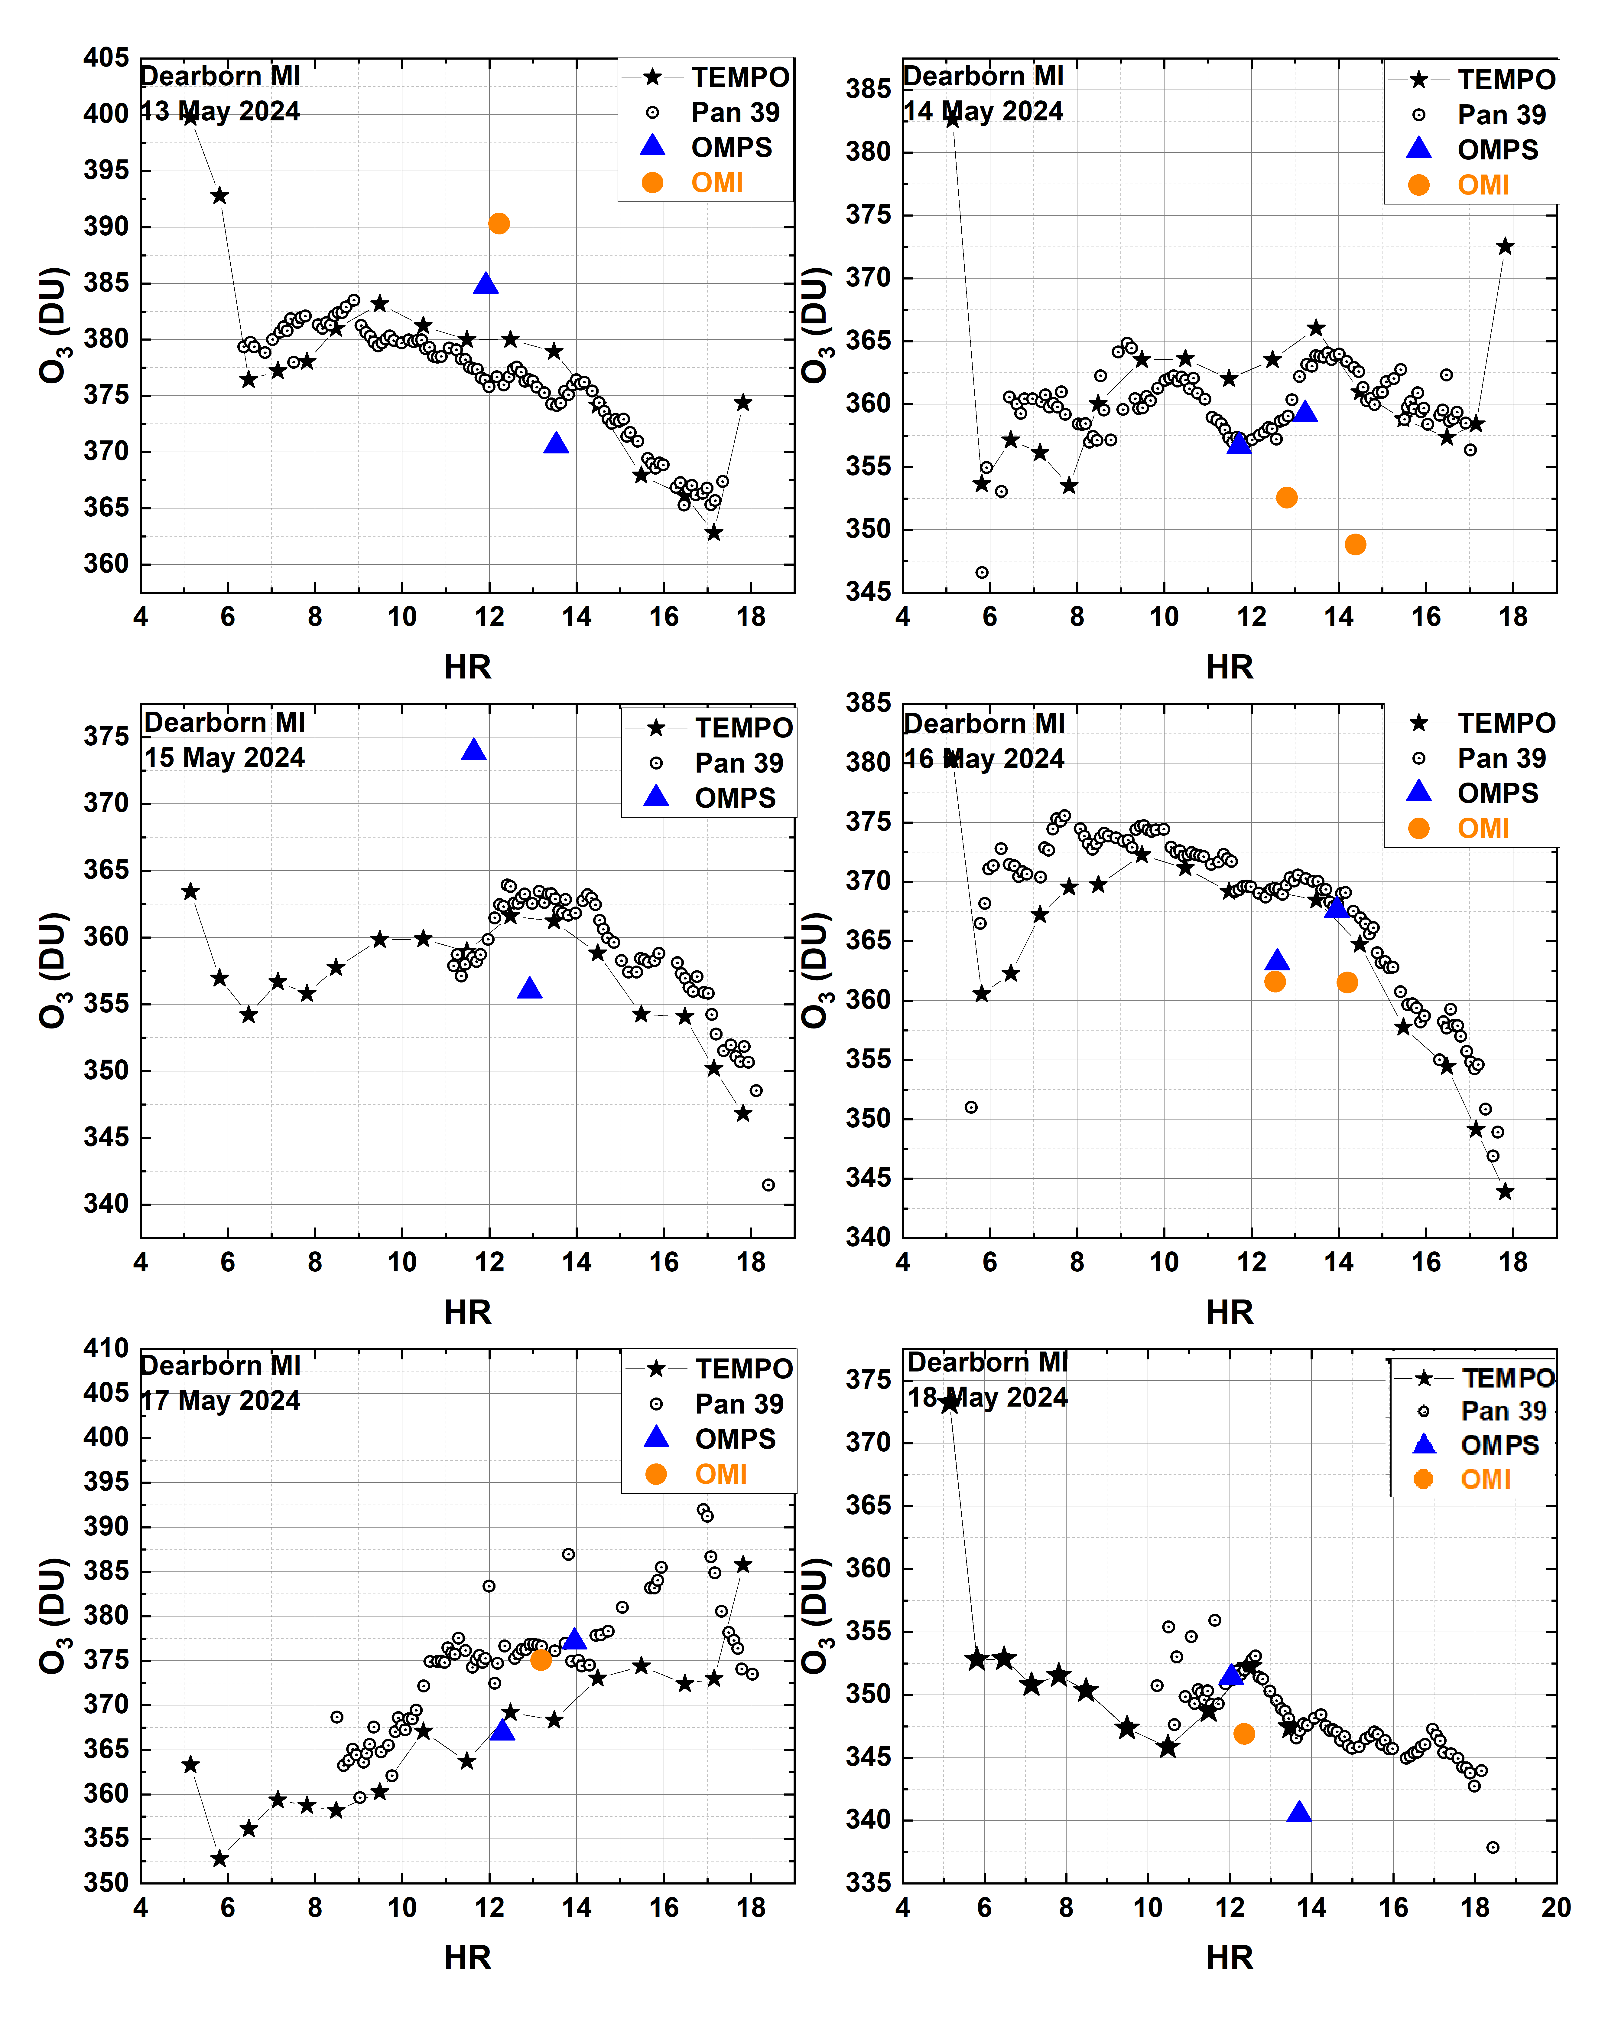
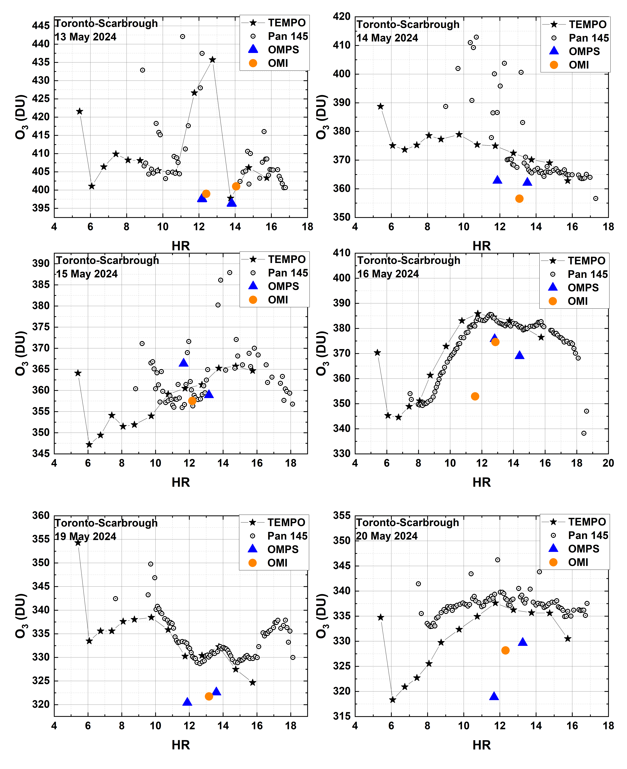
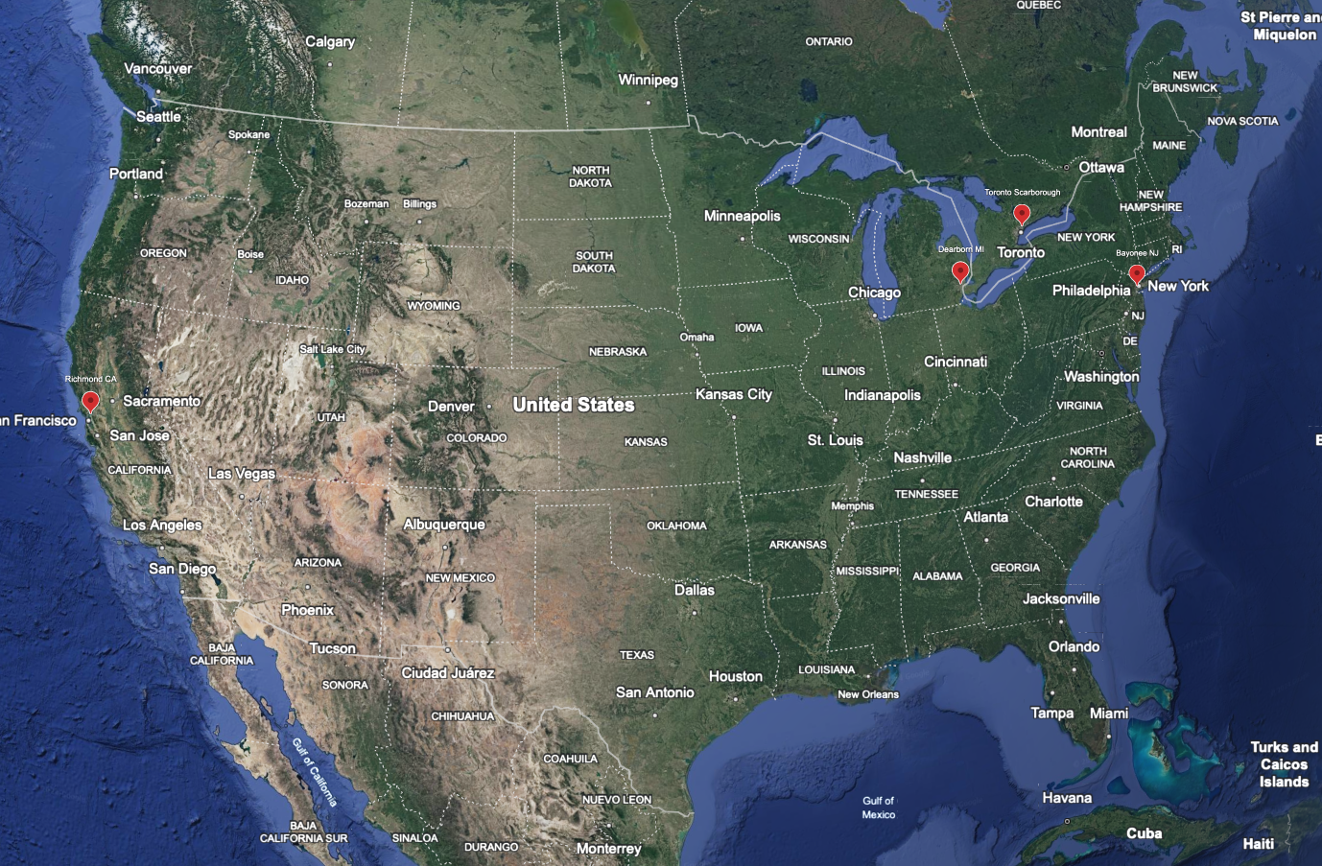
Comparison of TEMPO total ozone with ground-based observations
TEMPO V03
Courtesy of Jay Herman, GSFC
Comparison of TEMPO O₃ retrievals at multiple Pandora sites shows good agreement on a weekly average basis for May 2024
In many case, diurnal variation of O₃ from TEMPO observation shows good correlation with Pandora.
5

Slide 6
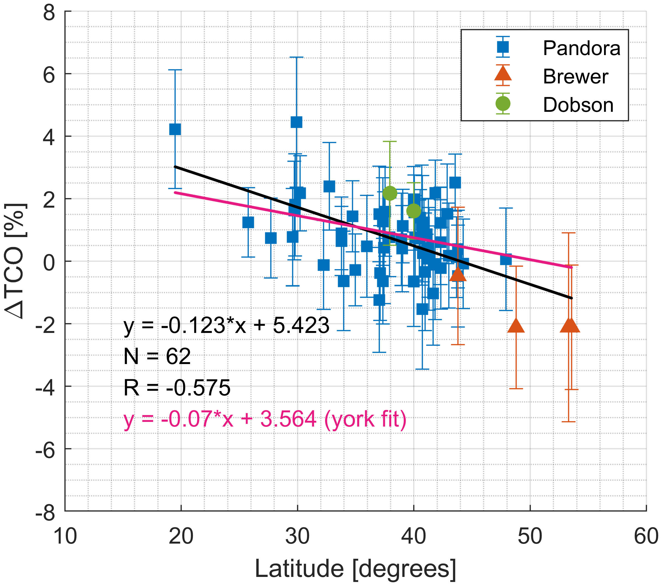
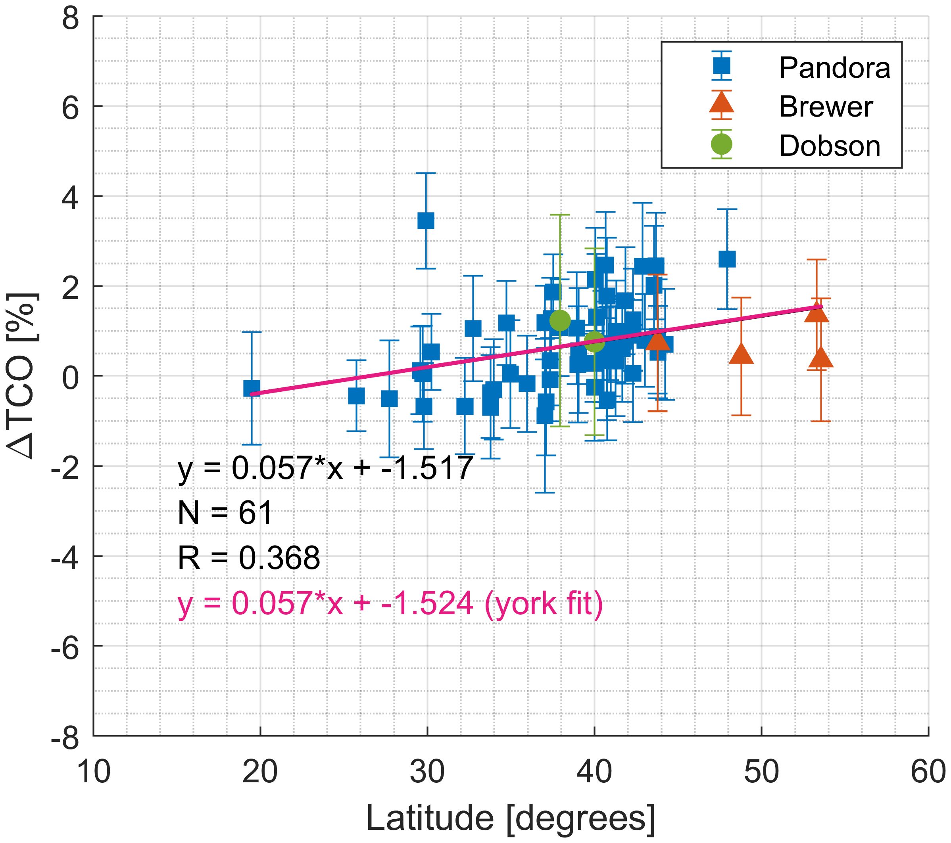
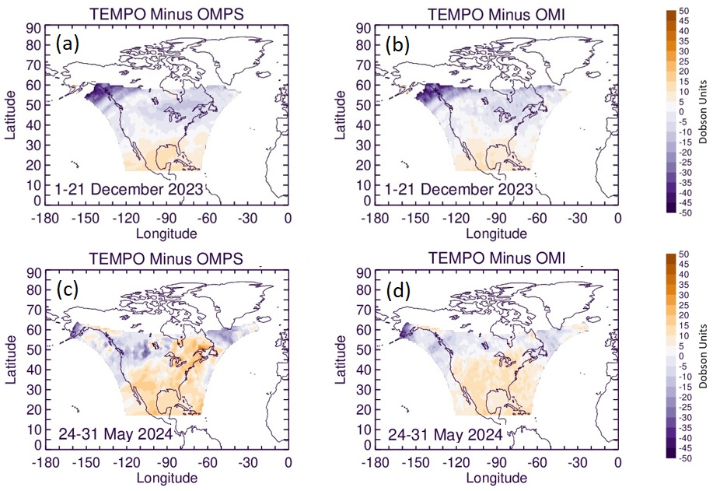
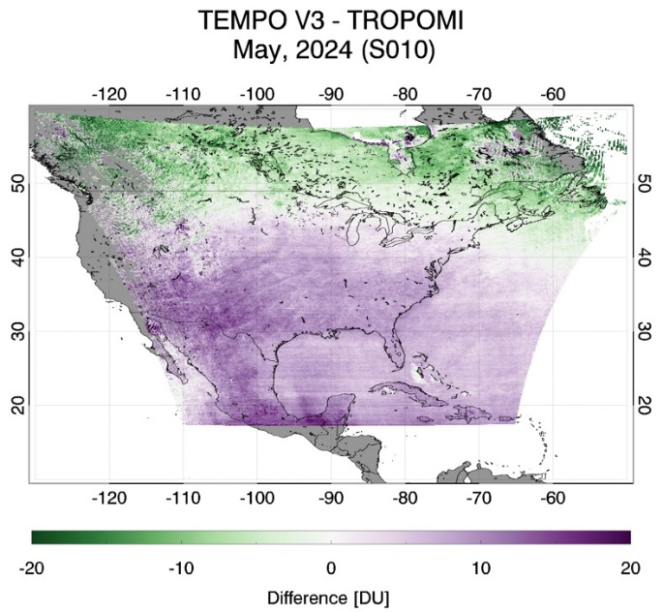
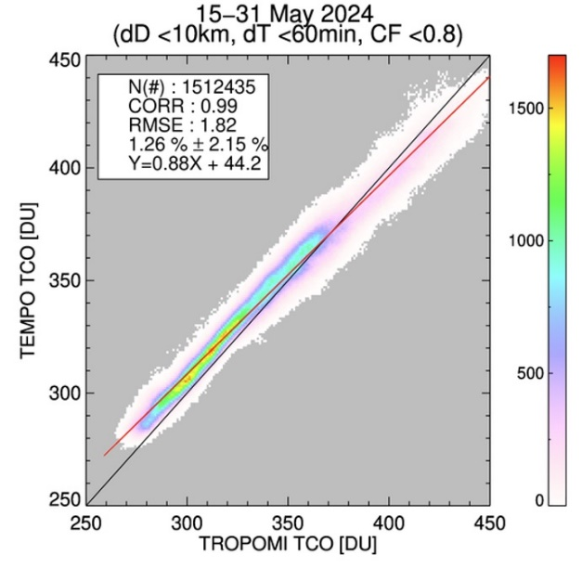
Issues of TEMPO O3TOT
Courtesy of Xiaoyi Zhao, ECCC
Courtesy of Jerry Ziemke, GSFC
TEMPO V03
(A) TEMPO V3
(B) TROPOMI
MexicoCity-Vallejo
AldineTX
AldineTX
MexicoCity-Vallejo
The percent difference of the total ozone between TEMPO and ground-based observations as a function of latitude shows opposite tendencies compared with TROPOMI.
TROPOMI shows slightly better prevision than TEMPO but is similar.
TEMPO total ozone tends to be high at low latitude and low at high latitude regions (latitudinal dependency).
6

Slide 7
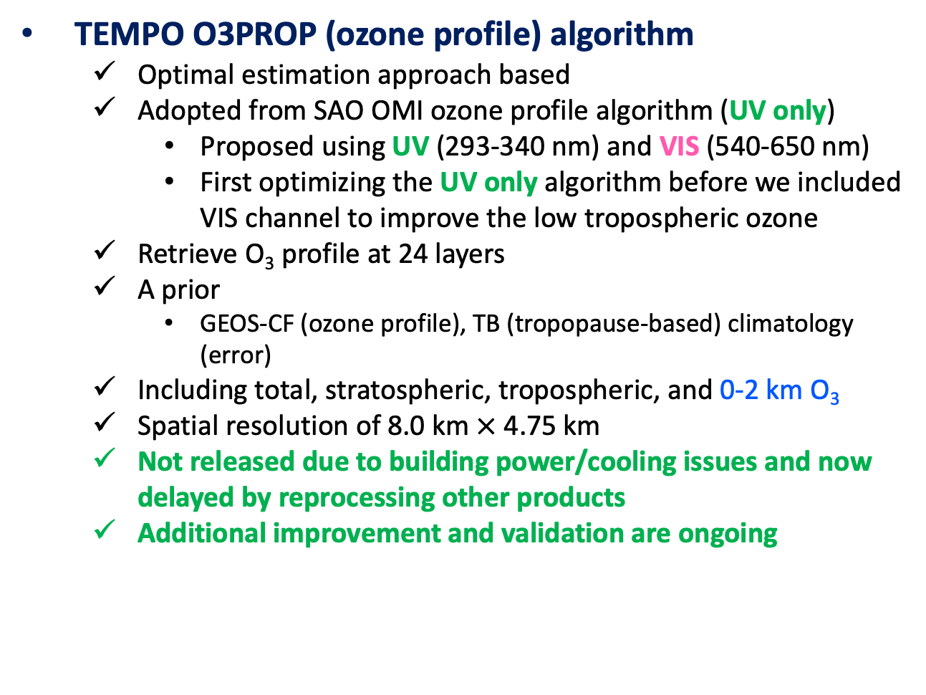
TEMPO O3PROF algorithm
TEMPO O3PROP (ozone profile) algorithm
  Optimal estimation approach based
  Adopted from SAO OMI ozone profile algorithm (UV only)
    Proposed using UV (293-340 nm) and VIS (540-650 nm)
    First optimizing the UV only algorithm before we included VIS channel to improve the low tropospheric ozone
  Retrieve O₃ profile at 24 layers
  A prior
    GEOS-CF (ozone profile), TB (tropopause-based) climatology (error)
  Including total, stratospheric, tropospheric, and 0-2 km O₃
  Spatial resolution of 8.0 km $×$ 4.75 km
  Not released due to building power/cooling issues and now delayed by reprocessing other products
  Additional improvement and validation are ongoing
UV & VIS, @0.6 nm, 0.2nm/pixel Optimal estimation approach based

Slide 8
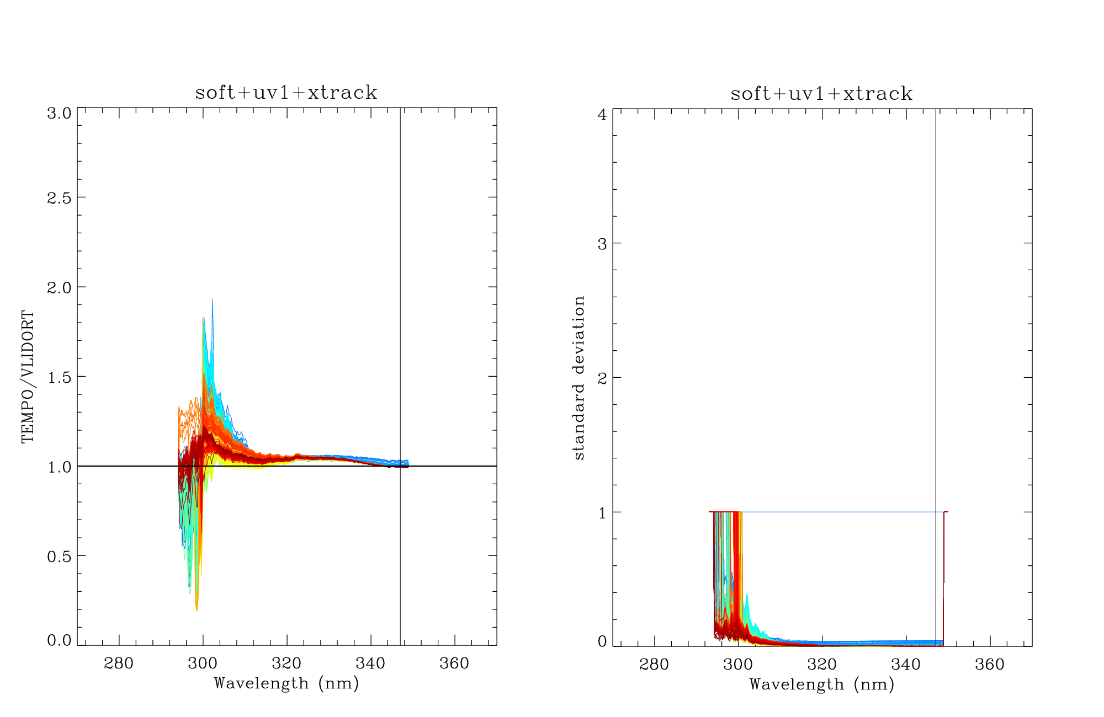
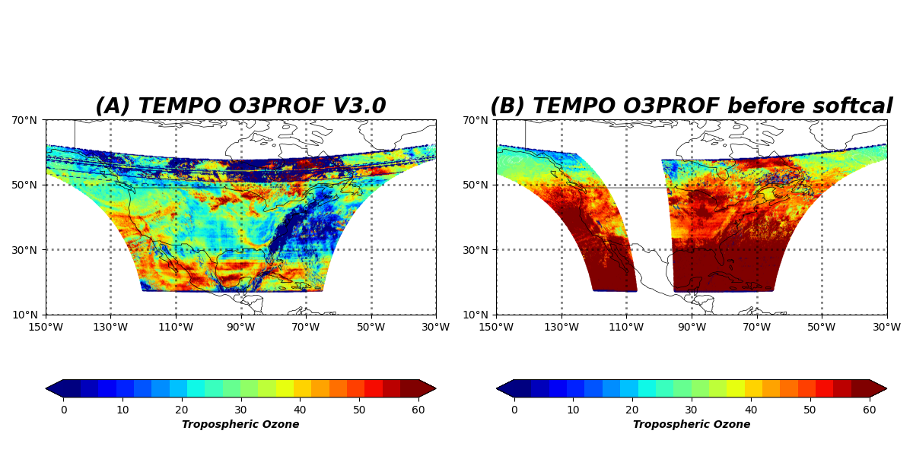
Soft calibration
Using limited TEMPO O3PROF data (November 2023)
Stray light correction v3.16 (L1B V3)
The empirical soft calibration spectra are used to remove the systematic biases between measured and simulated radiances.
This may be sensitive in absolute radiometric calibration in L1B.
This should be updated by the next update using more TEMPO products.
March 28, 2024
(A) After applied Softcal
(B) Before applied Softcal
Criteria for calculating: LAT = [-20, 90], CF = [0, 0.2], ALB = [0, 0.2], SZA = [0, 90], TOC = [200, 350]

Slide 9
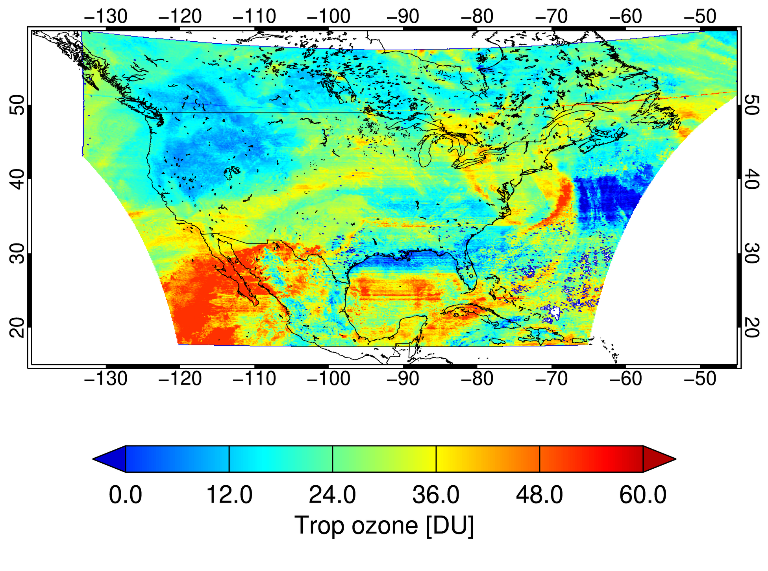
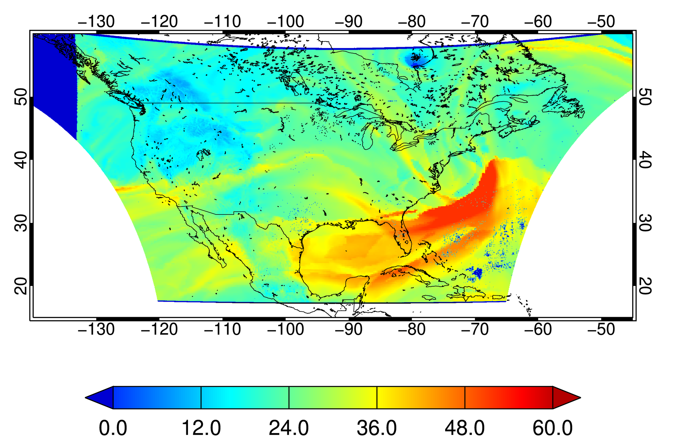
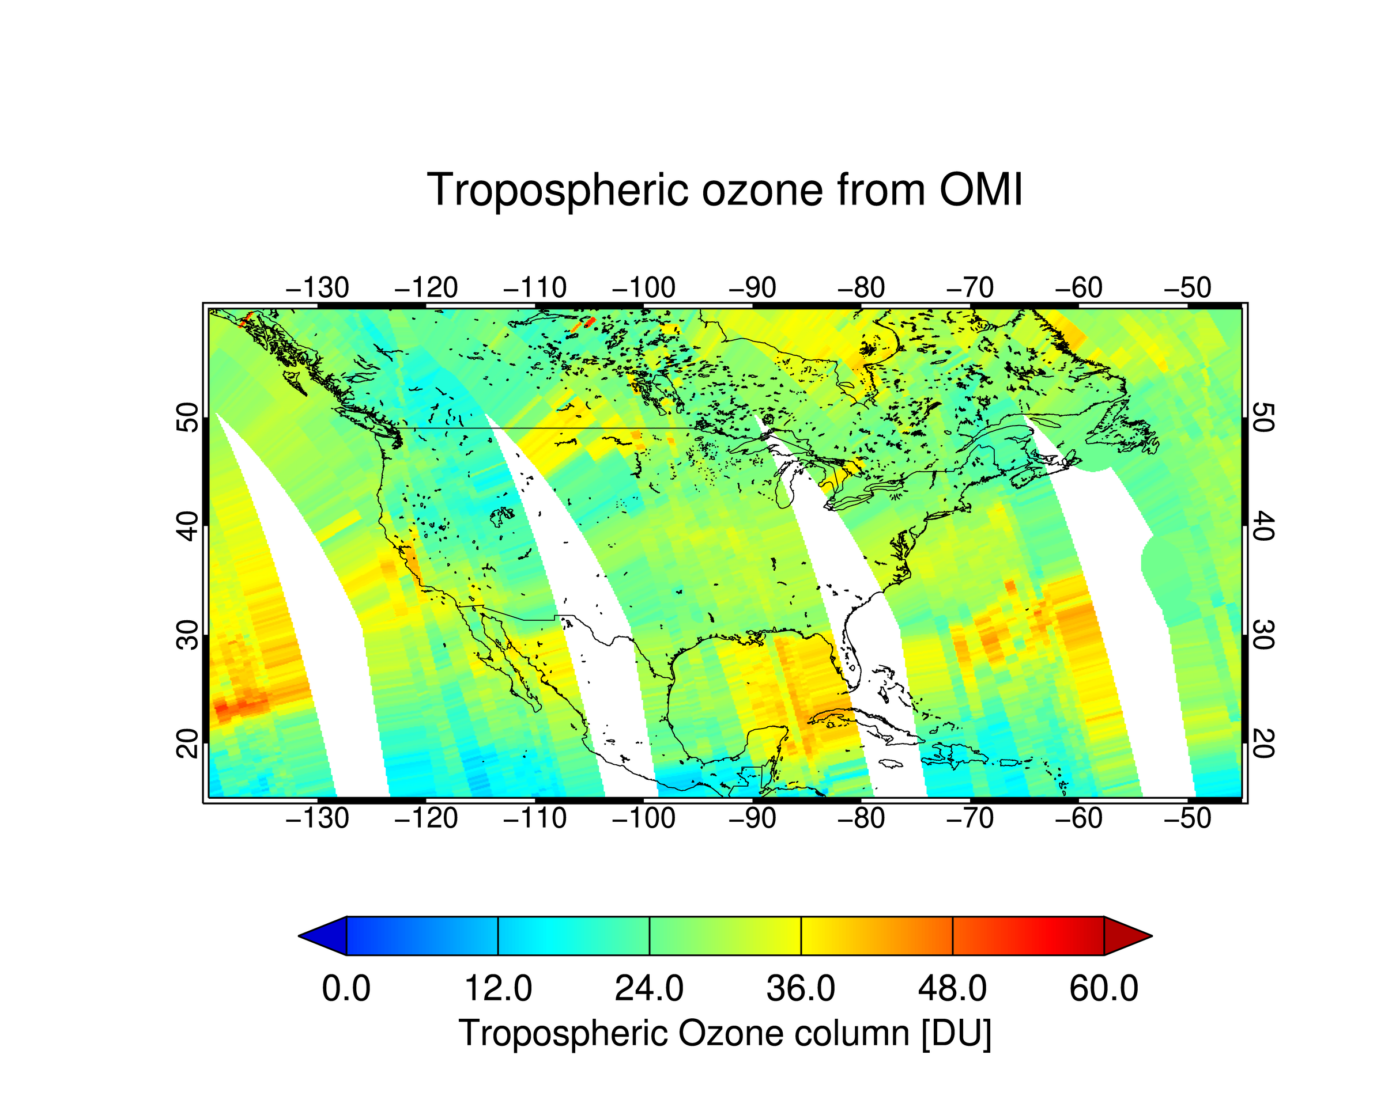
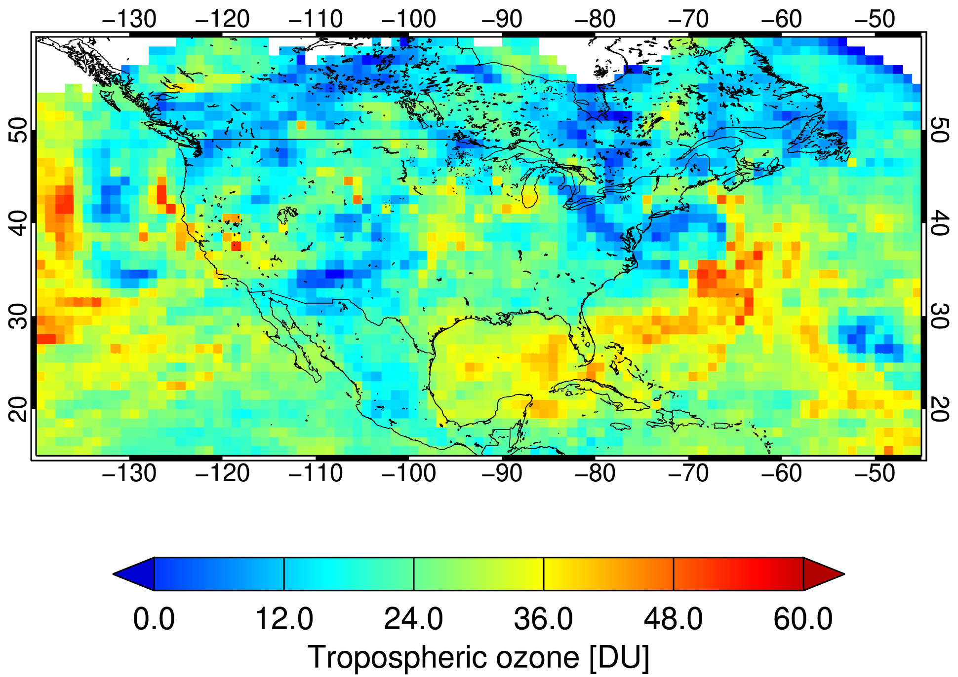
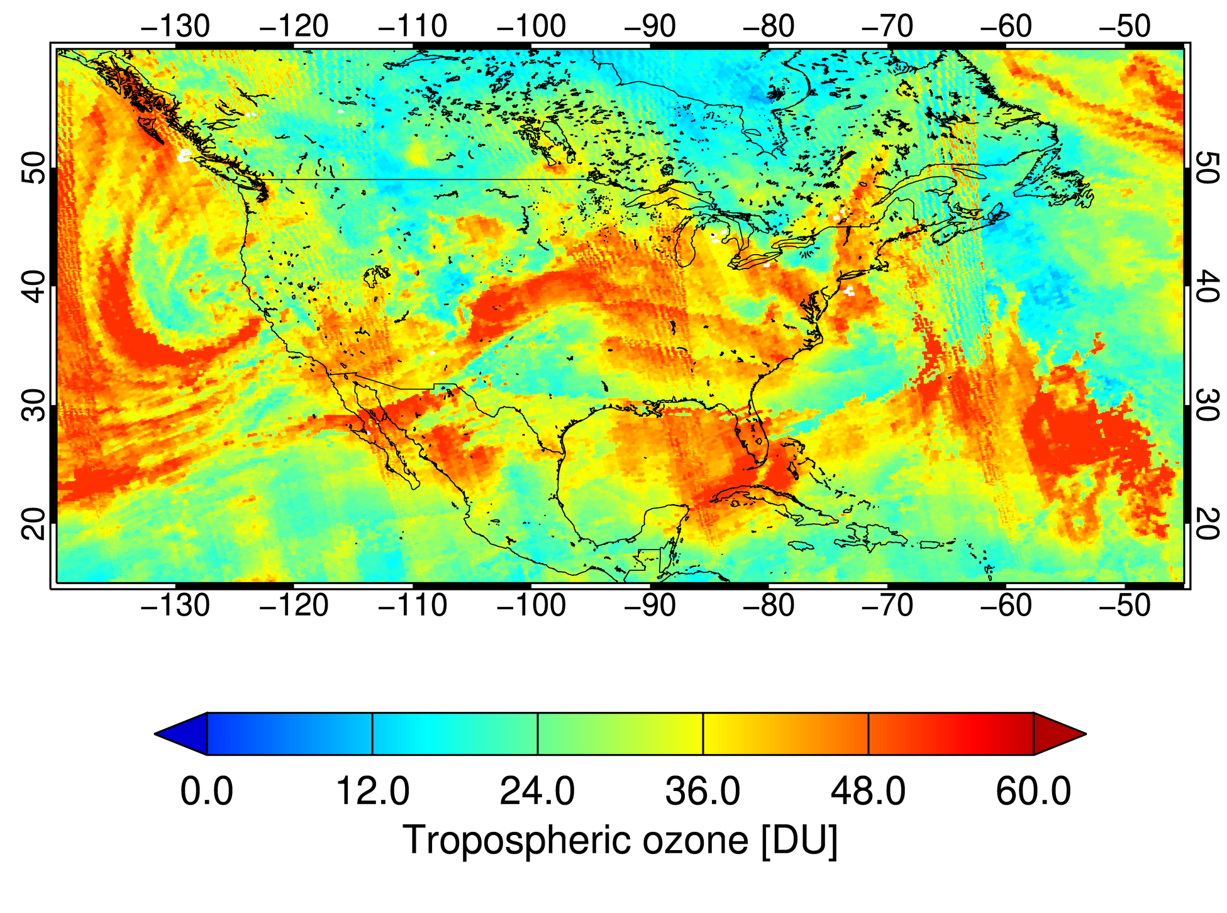
TEMPO O3PROF (3/29/2024 Scan 006)
PRELIMINARY!
Tropospheric O₃ from TEMPO O3PROF
Tropospheric O₃ from GEOS-CF
[Juseon Bak provides OMI data]
[Jerry Ziemke provides EPIC data]
[tropomi.gesdisc.eosdis.nasa.gov]
Tropospheric O₃ from OMI
Tropospheric O₃ from EPIC
Tropospheric O₃ from GESDISC TROPOMI
Note different tropopause pressure from OMI, EPIC, and TROPOMI !!!

Slide 10
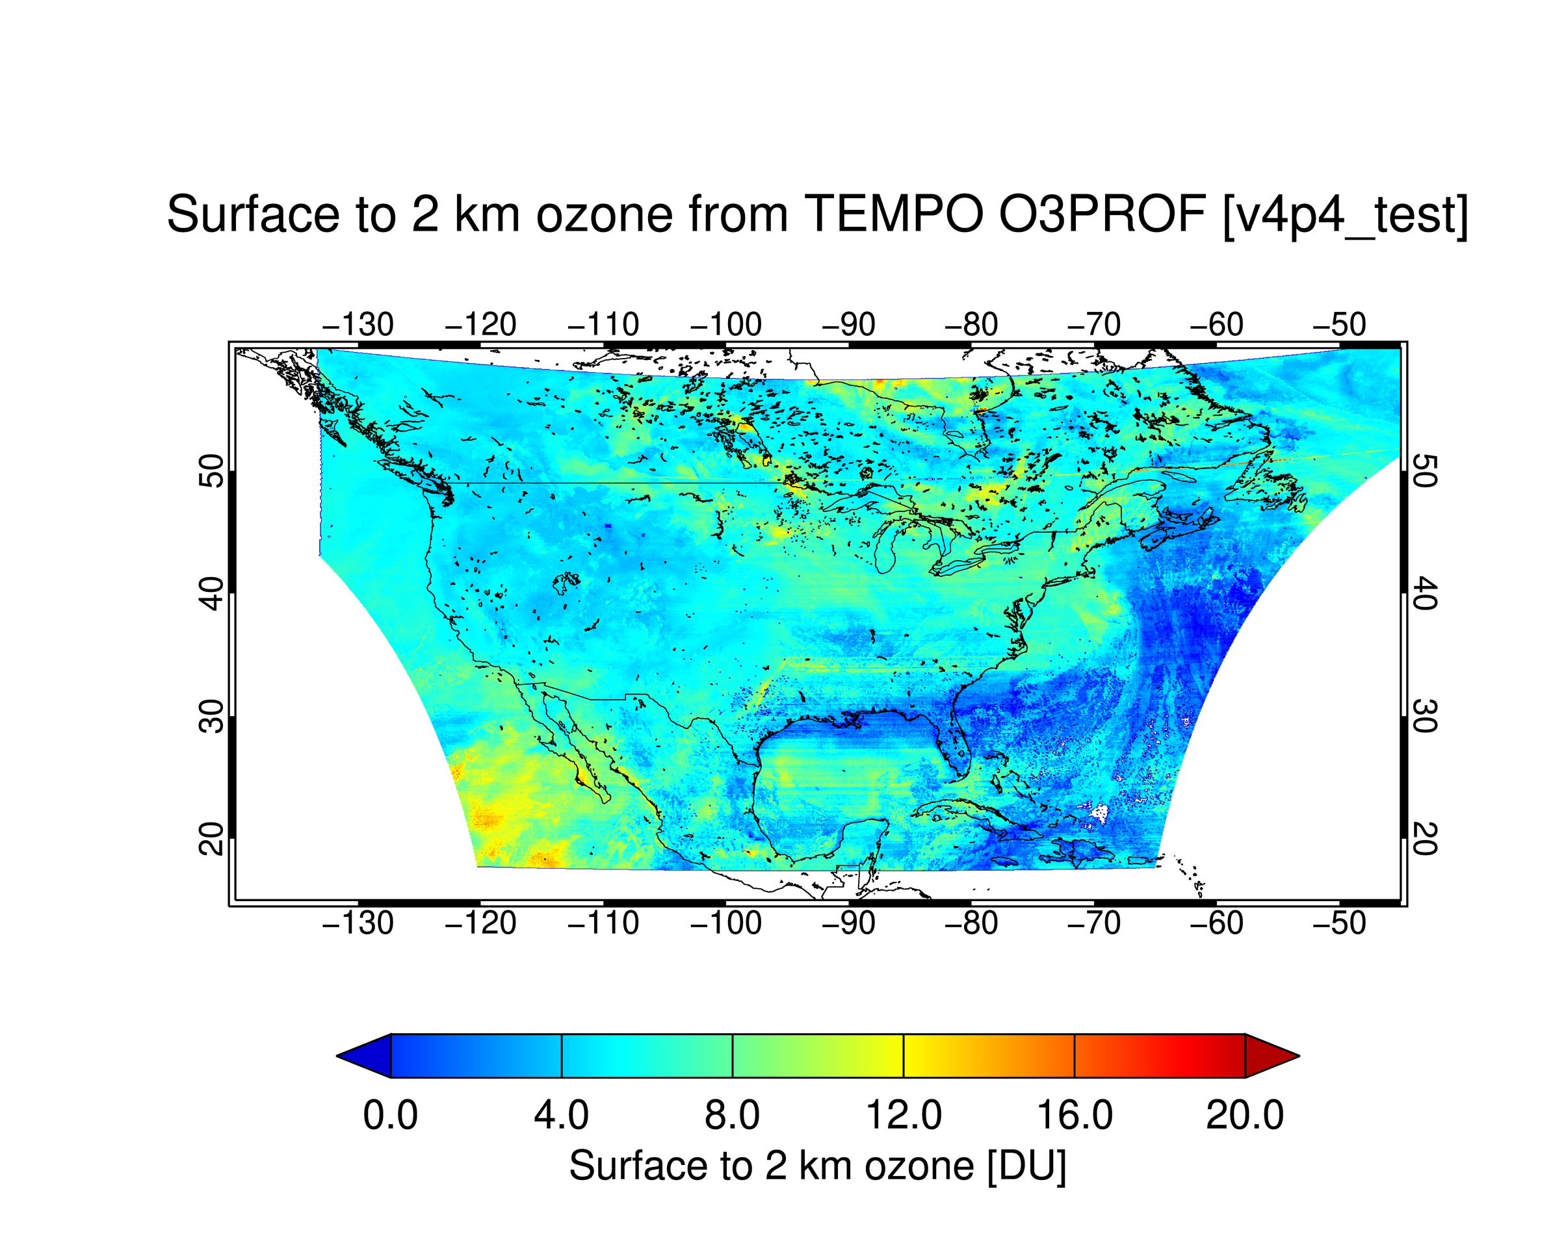
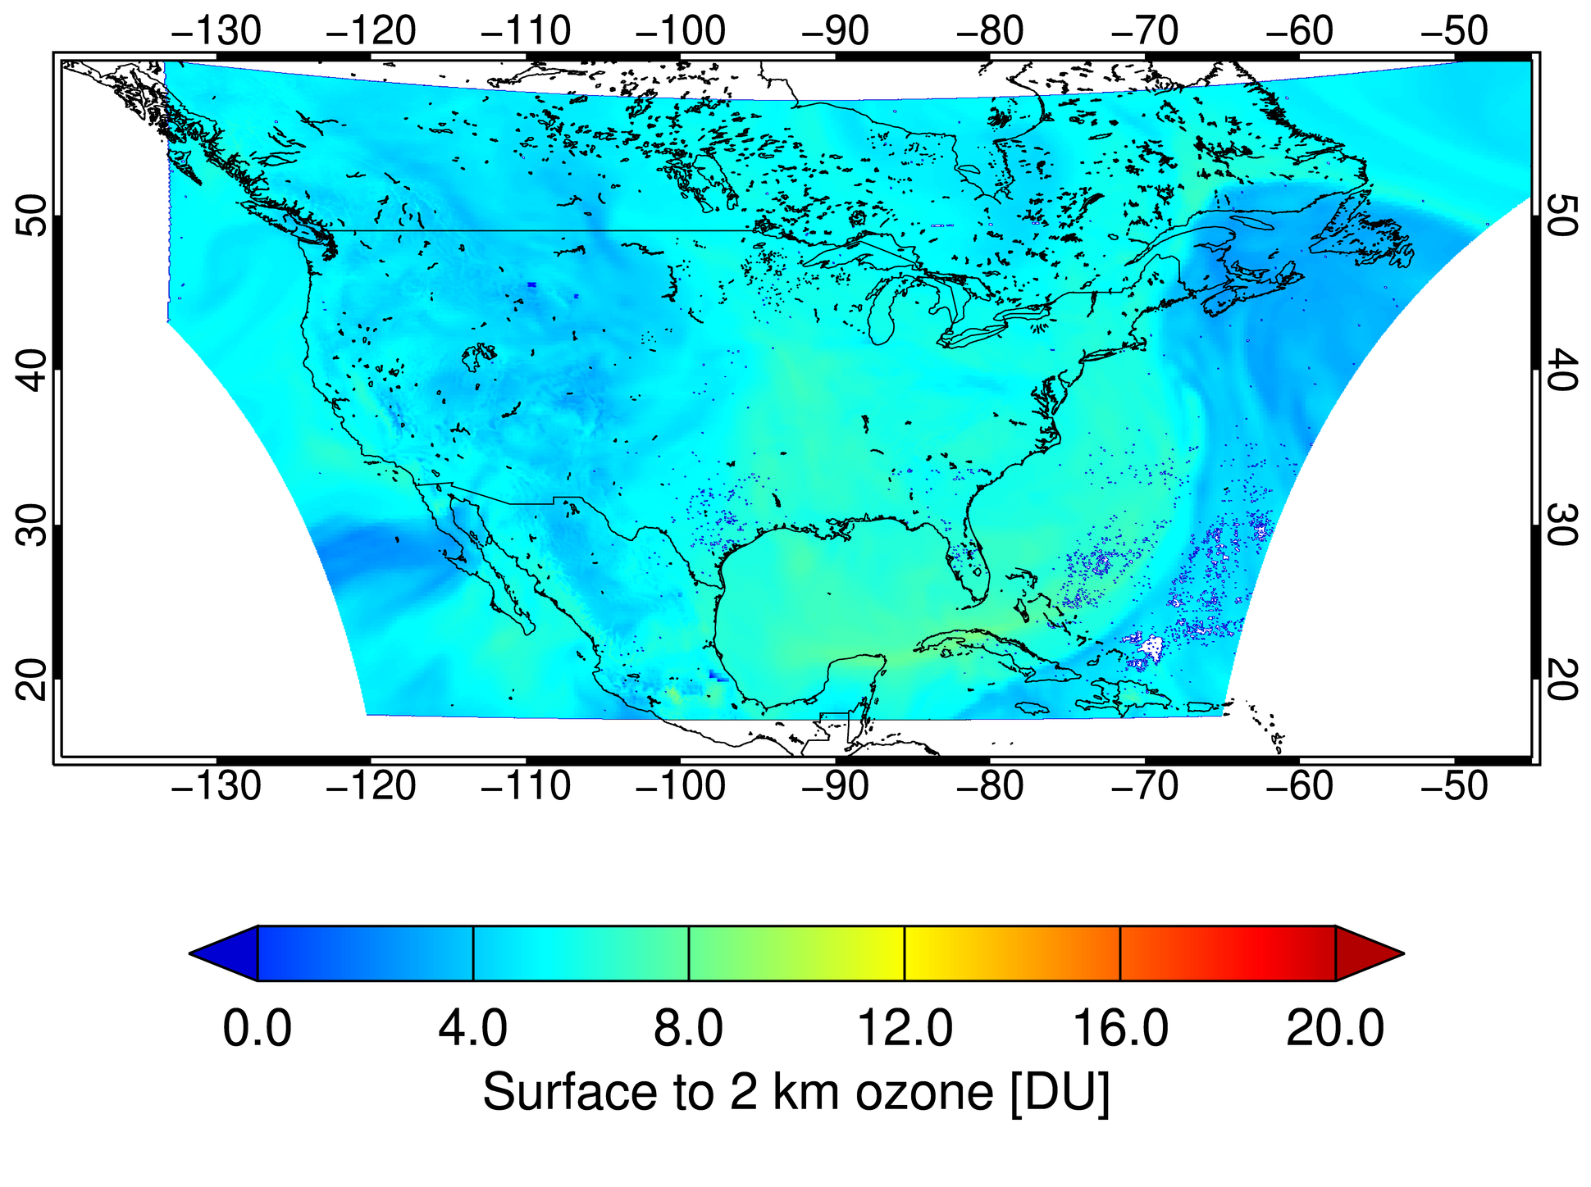
TEMPO O3PROF (3/29/2024 Scan 006)
PRELIMINARY!
Surface to 2 km O₃ from TEMPO O3PROF
Surface to 2 km O₃ from GEOS CF
Surface to 2 km column ozone [DU]

Slide 11
Summary
TEMPO O3TOT product
  Total ozone from TEMPO observation shows a good correlation with ground-based observations
  TEMPO total product has similar precision with TROPOMI (slightly lower)
  The known issues: Latitudinal dependency
TEMPO O3PROF product
  Public release has been delayed due to the unexpected issue
  Initial version of O3PROF product looks promising
  Soft calibration spectrum should be updated using more data of real observation
  Need to be evaluate using various observations

Slide 12
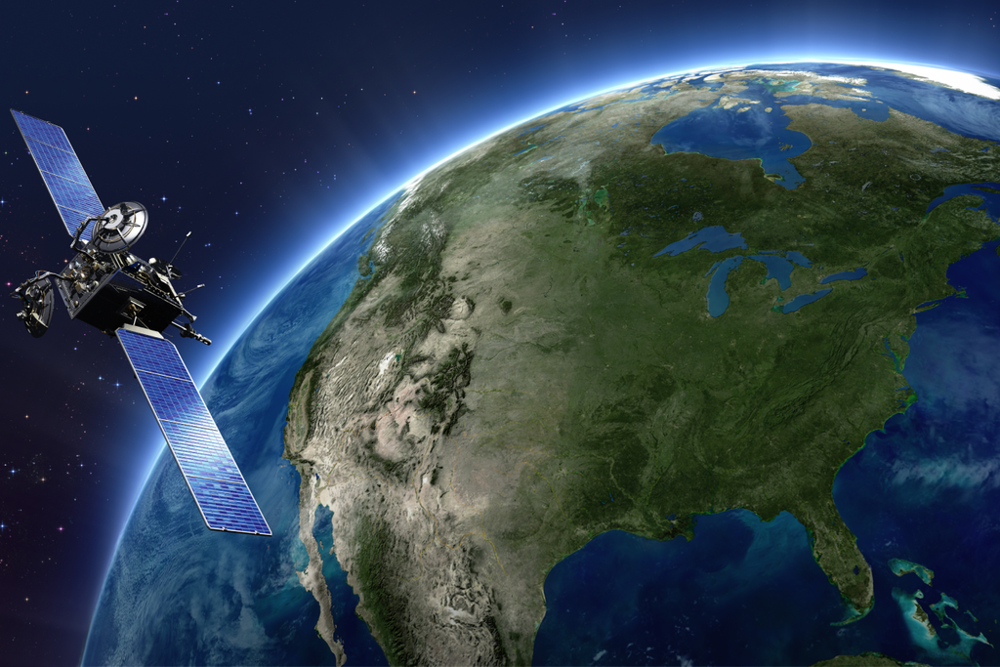
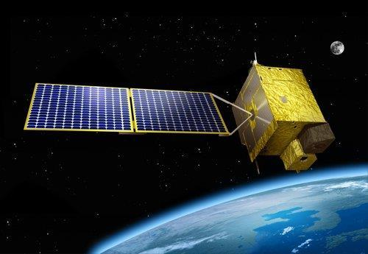
Thank you!
Thank you for your attention!

Slide 13
Backup Slides

Slide 14
Including Visible to Improve
Tropospheric Ozone Retrieval Sensitivity
This example is for solar zenith angle =25, viewing zenith angle 45, relative azimuthal angle 86, Signal to noise Ratio (SNR) with 4 pixels coadded
Add visible to improve retrieval sensitivity in the lower troposphere and help separate free tropospheric O₃ from boundary layer O₃
Under ideal conditions: 3-5 total Degree of Freedom for Signal (DFS) with up to ~1.5 in the troposphere, and up to ~0.5 DFS in 0-2 km
Adapted from OMI (Liu et al., 2010): Spectral fitting + VLIDORT + Optimal Estimation (OE) from Fitting windows: 293-345 nm, 540-650 nm
Retrieve partial O₃ columns at ~24 layers (bottom layer is 0-2 km above the surface) as well as total, stratospheric, and tropospheric O₃ columns, other trace gases, and auxiliary parameters.
A priori: a combination of tropopause-based climatology (Bak et al., 2013) with diurnally-resolved GEOS-CF data

Slide 15
TEMPO Timeline
Date | Details
7 April 2023 | Launch
June-July 2023 | TEMPO power on + dry-out, cool down, etc.
2 August 2023 | First light
19 October 2023 | Nominal Operations
Public Release | Details
V01 | Limited 3 weeks released in February 2024
V02 | L1 (radiances) released in February 2024
V03 | L1 updated, L2 and L3 product released May 2024 (except for O₃ profile) Currently 13 May 2024 onwards; reprocessing has on-going

Slide 16
TEMPO Timeline

Slide 17
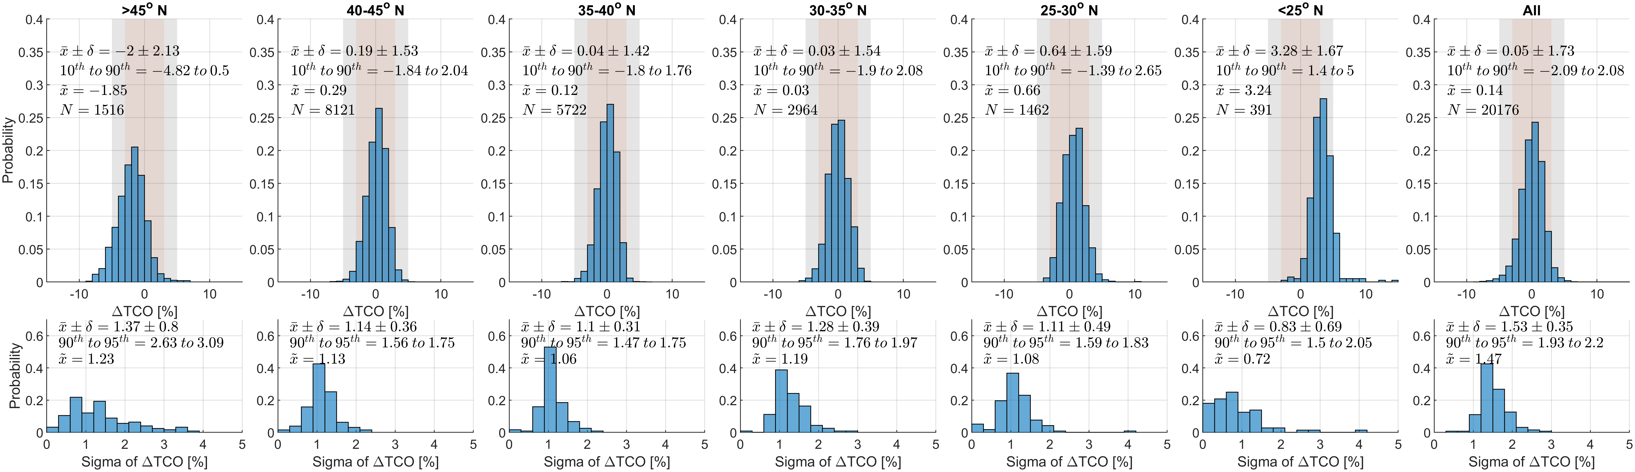
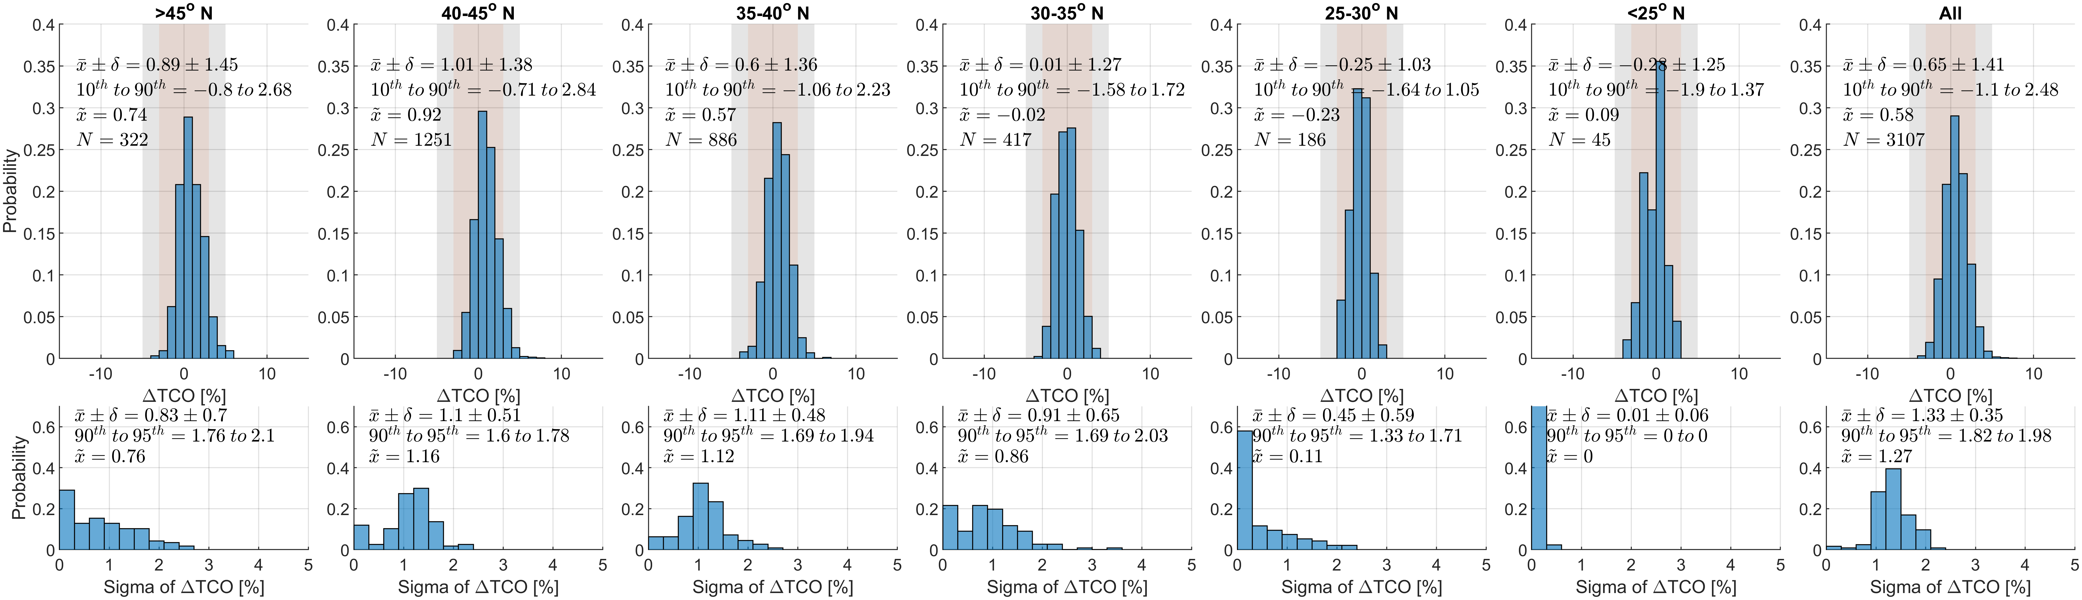
TEMPO Timeline
TEMPO +
SZA correction
TROPOMI shows better precision than TEMPO
Histogram of Delta Ozone and its sigma values for TEMPO (with SZA correction)
TROPOMI
Histogram of Delta Ozone and its sigma values for TROPOMI

Slide 18
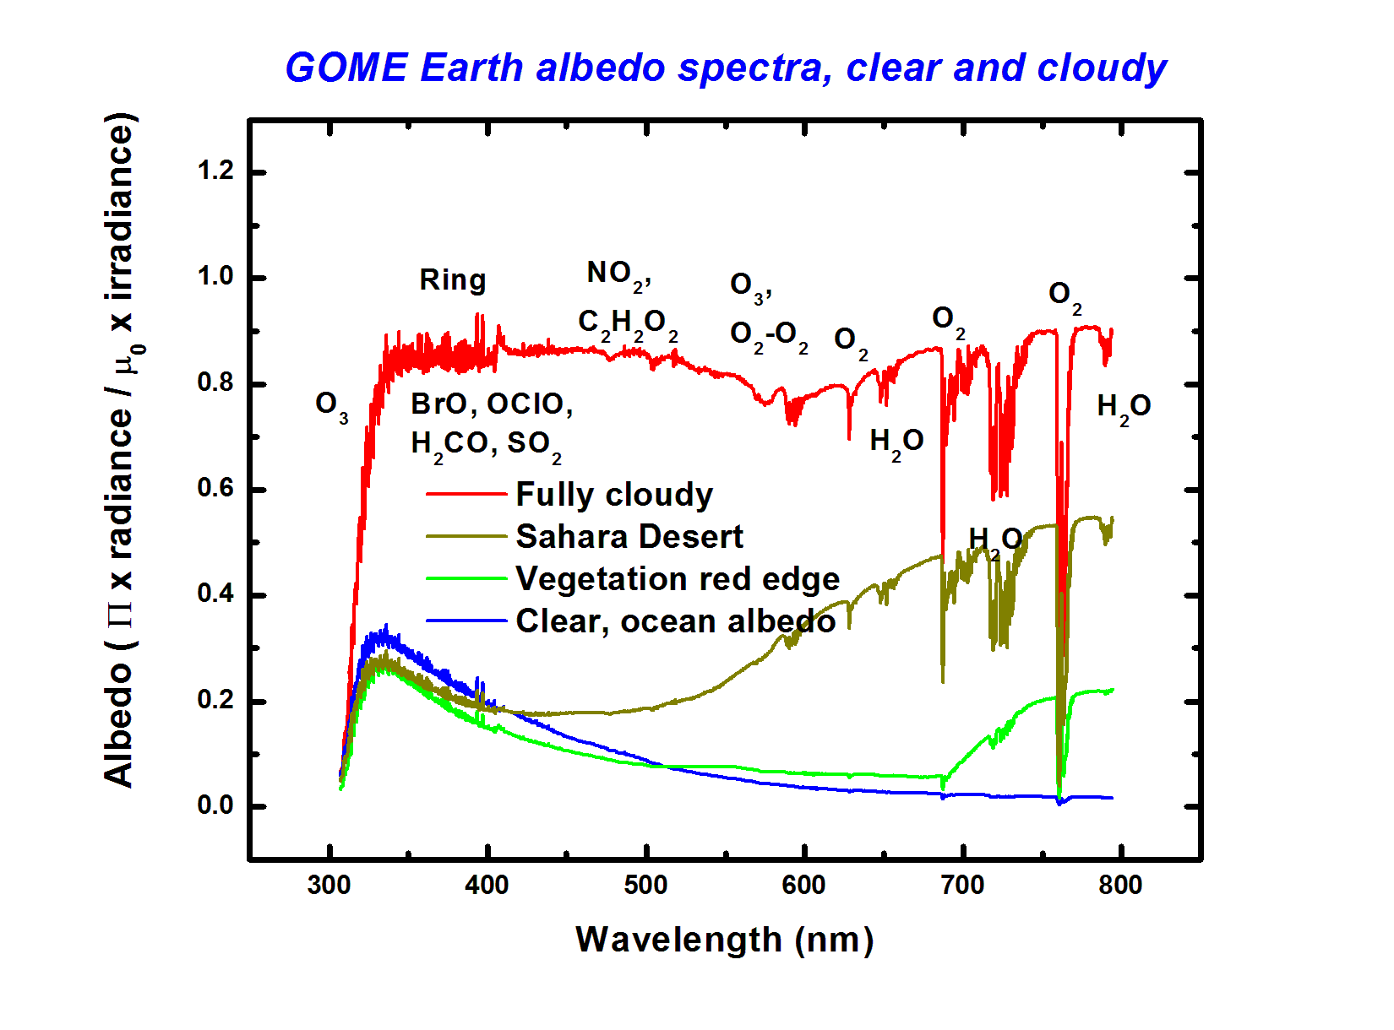
TEMPO UV/VIS jointed O3PROF algorithm
UV & VIS, @0.6 nm, 0.2nm/pixel Optimal estimation approach based
Benefits of visible fitting (Natraj et al., 2011; Zoogman et al., 2017)
  UV + visible to help distinguish boundary layer O₃ from free tropospheric O₃.
Challenges of visible fitting
  weak O₃ absorption, strong interferences from surface reflectance and aerosols/clouds,
  other gases (O₄, O₂, H₂O)
  Need accurate radiometric calibration across the spectral range

