Slide 1
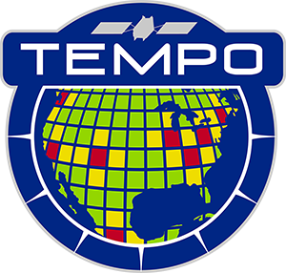
Tropospheric Emissions:
Monitoring of Pollution
TEMPO HCHO retrieval status update
Gonzalo González Abad on behalf of the TEMPO Science Data Processing Center and Validation Teams
Kelly Chance, Heesung Chong, John Davis, Jean Fitzmaurice, Barron Hendenson, Weizhen Hou, John Houck, Laura Judd, Xiong Liu, Caroline Nowlan, Ivan Ortega, Junsung Park, Raid Suleiman, Huiqun Wang, Jim Carr and many more
TEMPO/GEMS Joint Science Workshop
August 19, 2024

Slide 2
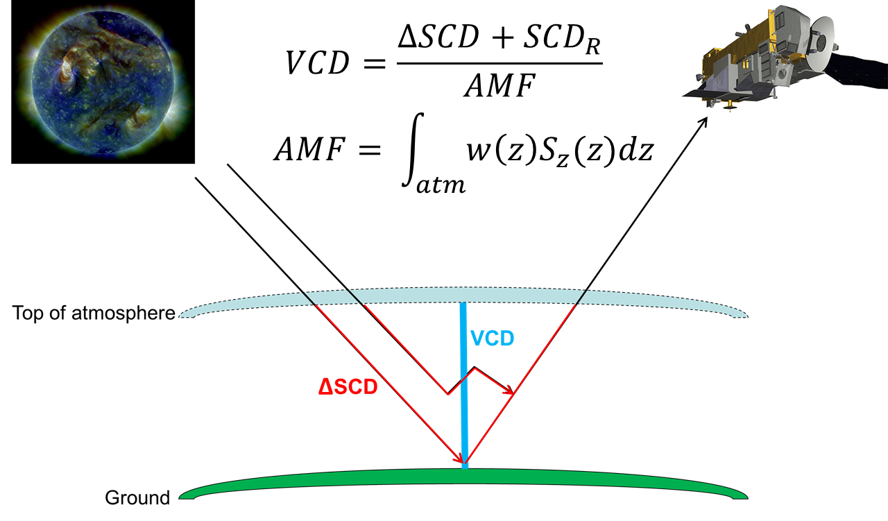
TEMPO NO₂ and HCHO retrieval basics
TEMPO HCHO shares the differential slant column fit (also used for cloud O₂-O₂ columns), and air mass factor calculation with NO₂.
HCHO columns are corrected to account for the use of radiance reference source spectra with a GEOS-CF based “background correction”
TROPOMI NO₂, ESA

Slide 3
Algorithm updates from pre-launch version till public release (version 3)
Update O₂-O₂ cross sections
Optimize wavelength shift parameter limits
Optimize order of closure polynomials in solar and radiance fit
Use radiance reference as source term in HCHO retrievals
New GLER LUTs (v6.0->v6.1, snow free + 100% snow, quality flag 2 & 5, fill in gaps via interpolation)
Revisit logic to calculate surface albedo in the presence of ice and snow
Extrapolate scattering weights for the bottom layers if necessary
Avoid including residual stratospheric air masses in tropospheric AMF calculation
Use TSIS solar spectrum in wavelength and slit calibrations

Slide 4
We must use radiance references
First light August 2, 2023 - SCAN #3 (17:15:51Z – 18:20:01Z)
Slant column
Differential slant column
molecules cm⁻²
molecules cm⁻²
Using solar irradiance as spectral fit source
Using radiance reference calculated using same scan observations

Slide 5
V03 July 2024 average columns
08 -12 UTC
18 -20 UTC
12 -16 UTC
20 -24 UTC
Pixels included have main_data_quality_flag = 0, amf_cloud_fraction < 0.2 and fit_rms_residual < 0.001

Slide 6
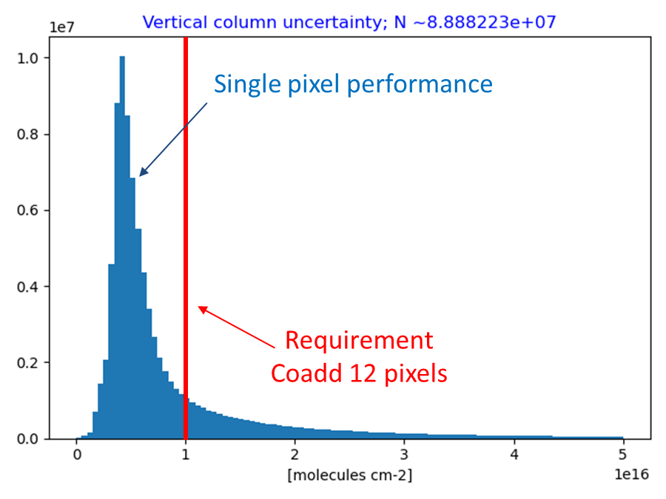
HCHO fulfill the fitting uncertainty requirements (credit: Laura Judd)
HCHO vertical column uncertainty (fitting)
N~1e8
TROPOMI NO₂, ESA
TEMPO HCHO meets the requirement for 93% of cloud-free scenes with no pixel coadding!

Slide 7
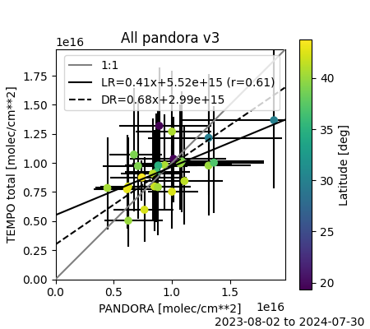
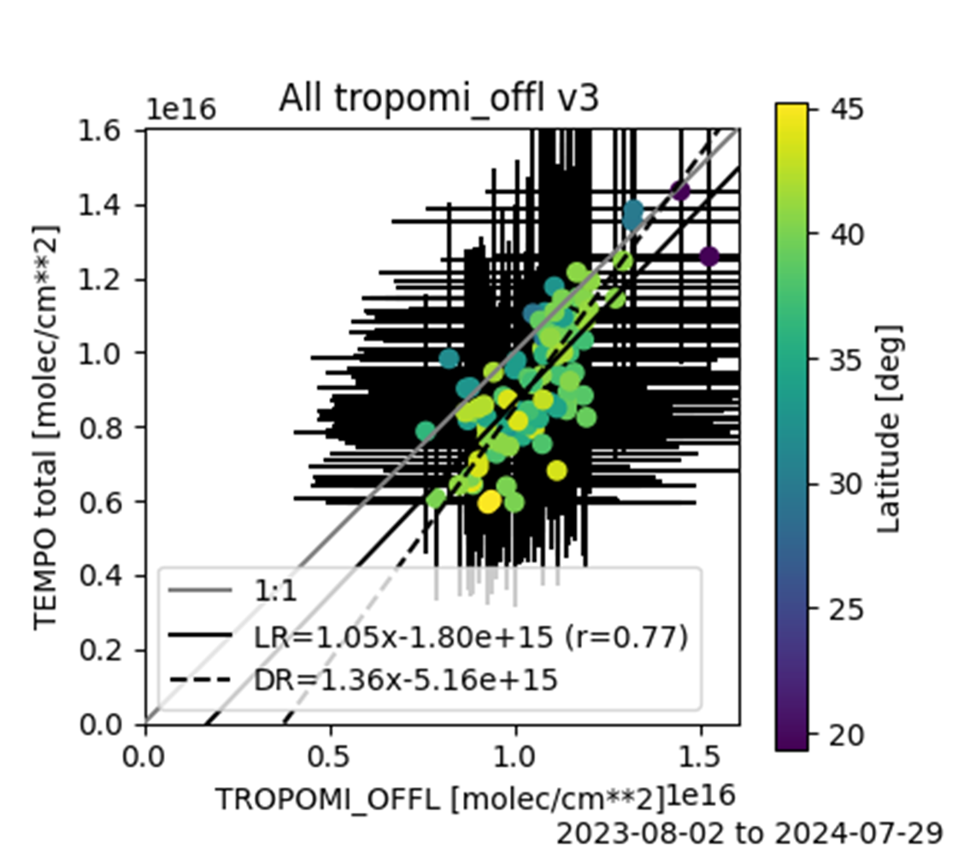
V3 validation vs Pandora and TROPOMI (credit Barron Henderson)
TEMPO correlates well with Pandora and TROPOMI showing a negative bias with respect to TROPOMI, more details in Barron’s talk tomorrow
TROPOMI NO₂, ESA

Slide 8
V3 validation vs FTIR (credit Ivan Ortega)
Station | Bias [%]
Mexico City | -23.6 ± 32.0
Boulder | -41.3 ± 21.3
Toronto | -37.9 ± 32.2
TEMPO shows a good correlation with FTIR, displaying a negative bias like TROPOMI comparisons. It remains to be seen if changes to the radiance reference and background corrections will result in a reduction of these biases.

Slide 9
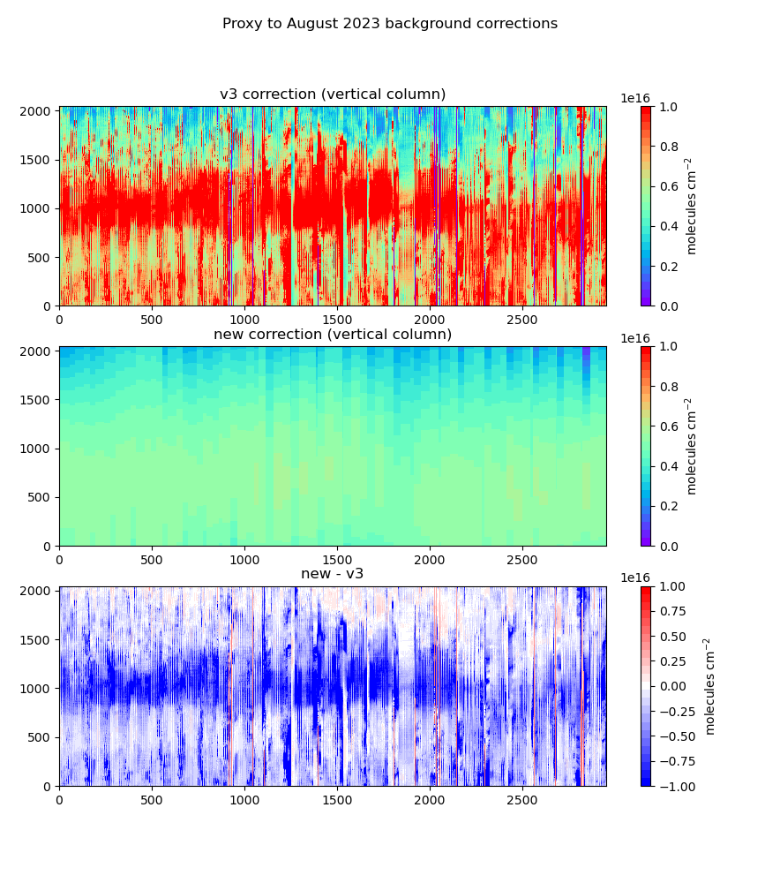
Possible upgrades to radiance reference and background correction
August 2023 08-12 UTC
August 2023 12-16 UTC
August 2023 08-12 UTC
dSCD increase; background correction decreases

Slide 10
Summary and future outlook
TEMPO HCHO shows good Signal to Noise Ration, meeting precision requirements by a lot.
Validation against (V02 and V03) shows good correlation and some low biases with respect to TROPOMI and FTIR
Future updates:
Radiance reference
Surface reflectance
Migration to GEOS-CF new version
Fittings of inhomogeneous scenes
Radiative transfer sphericity correction
Cloud fraction bias
Clear sky AMF and scattering weights to level 2 files
Work has started on the NRT product
TROPOMI NO₂, ESA

Slide 11
Questions?

Slide 12
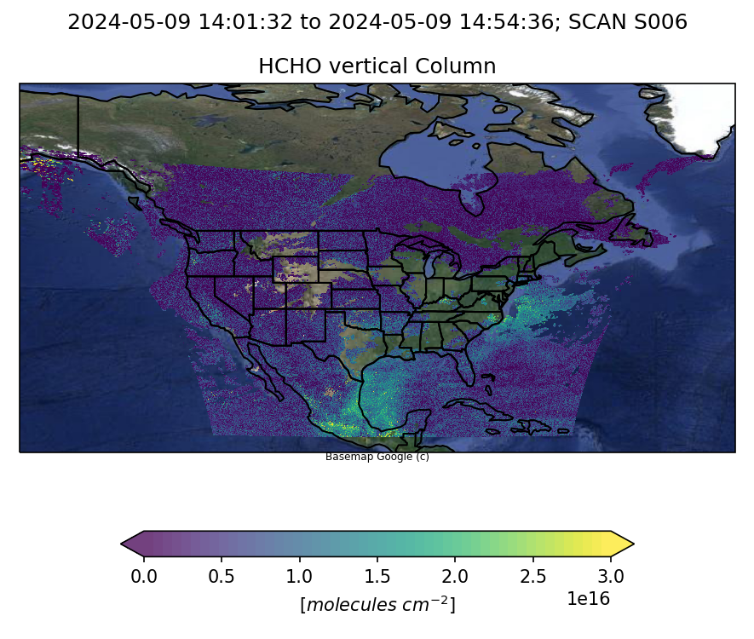
Version 3
Get the data here https://asdc.larc.nasa.gov/project/TEMPO
Please check the user guide packed with useful information about data quality and best practices
https://asdc.larc.nasa.gov/documents/tempo/guide/TEMPO_Level-2-3_trace_gas_clouds_user_guide_V1.0.pdf
TROPOMI NO₂, ESA

Slide 13
HCHO Radiance Reference
We are developing a more complex approach taking into consideration GEOS-CF modeled HCHO and multiple days of observations.
TROPOMI NO₂, ESA

Slide 14
V2 validation vs FTIR (credit Ivan Ortega)
Station | Bias [%]
Mexico City | -35.8 ± 33.8
Boulder | -39.5 ± 27.4
Toronto | -48.1 ± 36.8
TEMPO correlates well with FTIR showing a negative bias (like TROPOMI’s comparisons). It remains to be seen if changes to the radiance reference and background corrections will result in a reduction of these biases.

Slide 15
Air mass factor calculation inputs
Input | Source
Cloud fraction and pressure | TEMPO cloud product. Defaults to a cloud pressure climatology (OMI-derived) if cloud retrieval is unavailable.
Trace gas profiles | GEOS-CF hourly forecast from prior day (25-km resolution). Defaults to monthly 1-hour climatology derived from GEOS-CF if forecast is unavailable.
Vertical layers | 72 layers on GEOS-CF vertical grid
Surface albedo | GLER climatology (0.05° resolution) using OMI GSFC team methodology over land (Fasnacht et al., 2019) and water (Qin et al., 2019). Derived from MODIS BRDF v6.1, extended to shorter wavelengths 340 nm (HCHO) using visible surface reflectance EOFs updated from Zoogman et al. (2016) and SCIAMACHY reflectance climatologies.
Snow/ice fraction | IMS snow and ice (1-km resolution)
Meteorological variables: Temperature profile (for hypsometric equation and NO₂ T-dependency), surface pressure, tropopause pressure (for NO₂ stratospheric correction), wind speed (for ocean GLER) | GEOS-CF hourly forecast from prior day (25-km resolution). Defaults to monthly 1-hour climatology derived from GEOS-CF if forecast is unavailable.
Terrain height correction | Corrected following Boersma et al. (2011) using GMTED2010 (30 arcsec) DEM
Aerosols | Not applied (considered implicitly in cloud retrieval)

Slide 16
Differential slant column spectral fit set up
Fitting window | 328.5 - 356.5 nm
I₀ | CCD position dependent radiance reference calculated using same scan
Baseline polynomial | 3rd order
Scaling polynomial | 3rd order
Solar reference spectrum | Chance and Kurucz (2010)
Raman Scattering | Derived using Chance and Spurr (1997)
Undersampling correction | Derived using Chance et al. (2005)
O₃ | Serdyuchenko et al. (2014) at 223K and 243K
NO₂ | Vandaele et al. (1998) 220K
O₂-O₂ | Finkenzeller and Volkamer (2022) 293K
BrO | Wilmouth et al. (1999) 228K
HCHO | Chance and Orphal (2011) 300K

Slide 17
Algorithm updates from pre-launch version till public release (version 3)
SDPC v4.2 (V1) pre-PLAR
Update O₂-O₂ cross sections
Optimize wavelength shift parameter limits
Optimize order of closure polynomials in solar and radiance fit
Use radiance reference as source term in HCHO retrievals
Fix bug on AMF calculation wavelength set up
Minor updates related to file formatting
SDPC v4.3 (V2)
Carry on retrieval for a given North-South position even if radiance wavelength calibration fails
Increase spatial resolution of Level 3 files to 0.02° x 0.02°
Address some Level 2 & 3 file format feedback from ASDC

Slide 18
Algorithm updates from pre-launch version till public release (version 3)
SDPC v4.4 (V3) & Level 2-3 release: May 20, 2024
Perform retrievals up to SZA 90
Update main data quality flag (AMF > 6 as suspect, ~SZA 70 + VZA 70)
Revisit convergence flag & AMF diagnostic flag
Add temperature profile to output (for AMF)
Revise Level 3 quality flag logic
Address remaining Level 2 & 3 file format feedback from ASDC (fill in attributes, valid range…)

