Slide 1
Tropospheric Emissions:
Monitoring of Pollution
TEMPO Nitrogen Dioxide:
Algorithm and Status
Caroline Nowlan
Center for Astrophysics | Harvard & Smithsonian
Xiong Liu, Kelly Chance, Gonzalo González Abad, Laurel Carpenter, Chris Chan Miller, Heesung Chong, John Davis, Jean Fitzmaurice, Weizhen Hou, John Houck, Raid Suleiman, Huiqun Wang, James Carr, Barron Henderson, Laura Judd, Luke Valin, James Szykman and the TEMPO Team
TEMPO/GEMS Joint Science Team Workshop
August 26, 2024

Slide 2
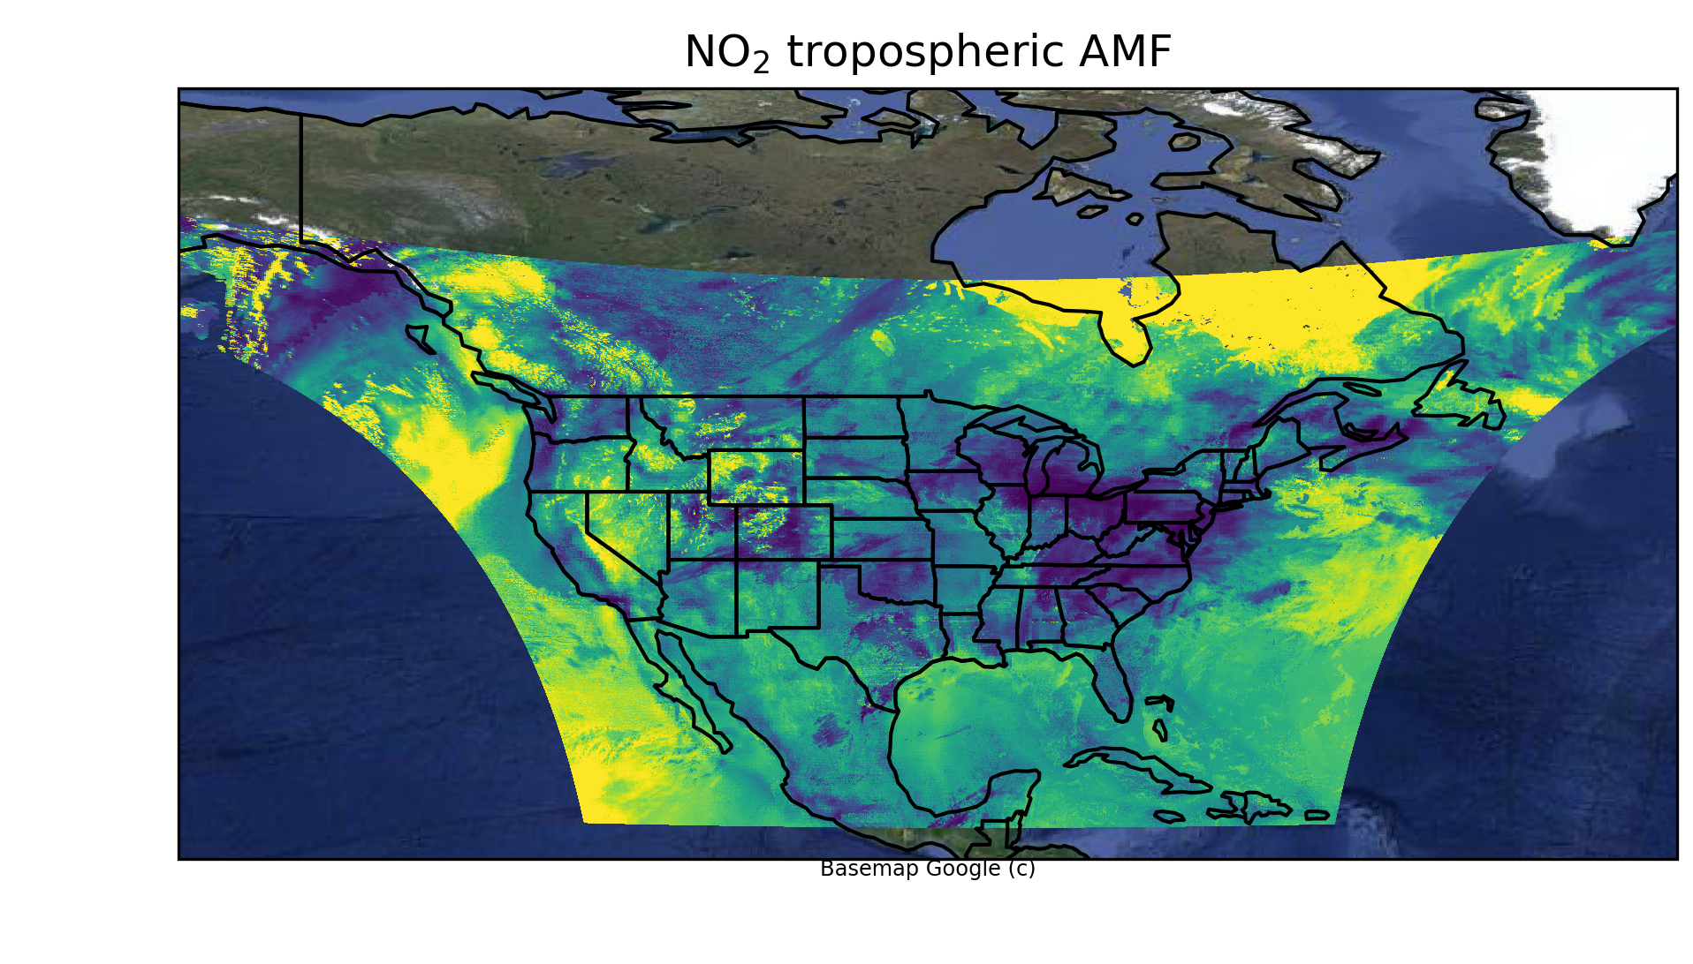
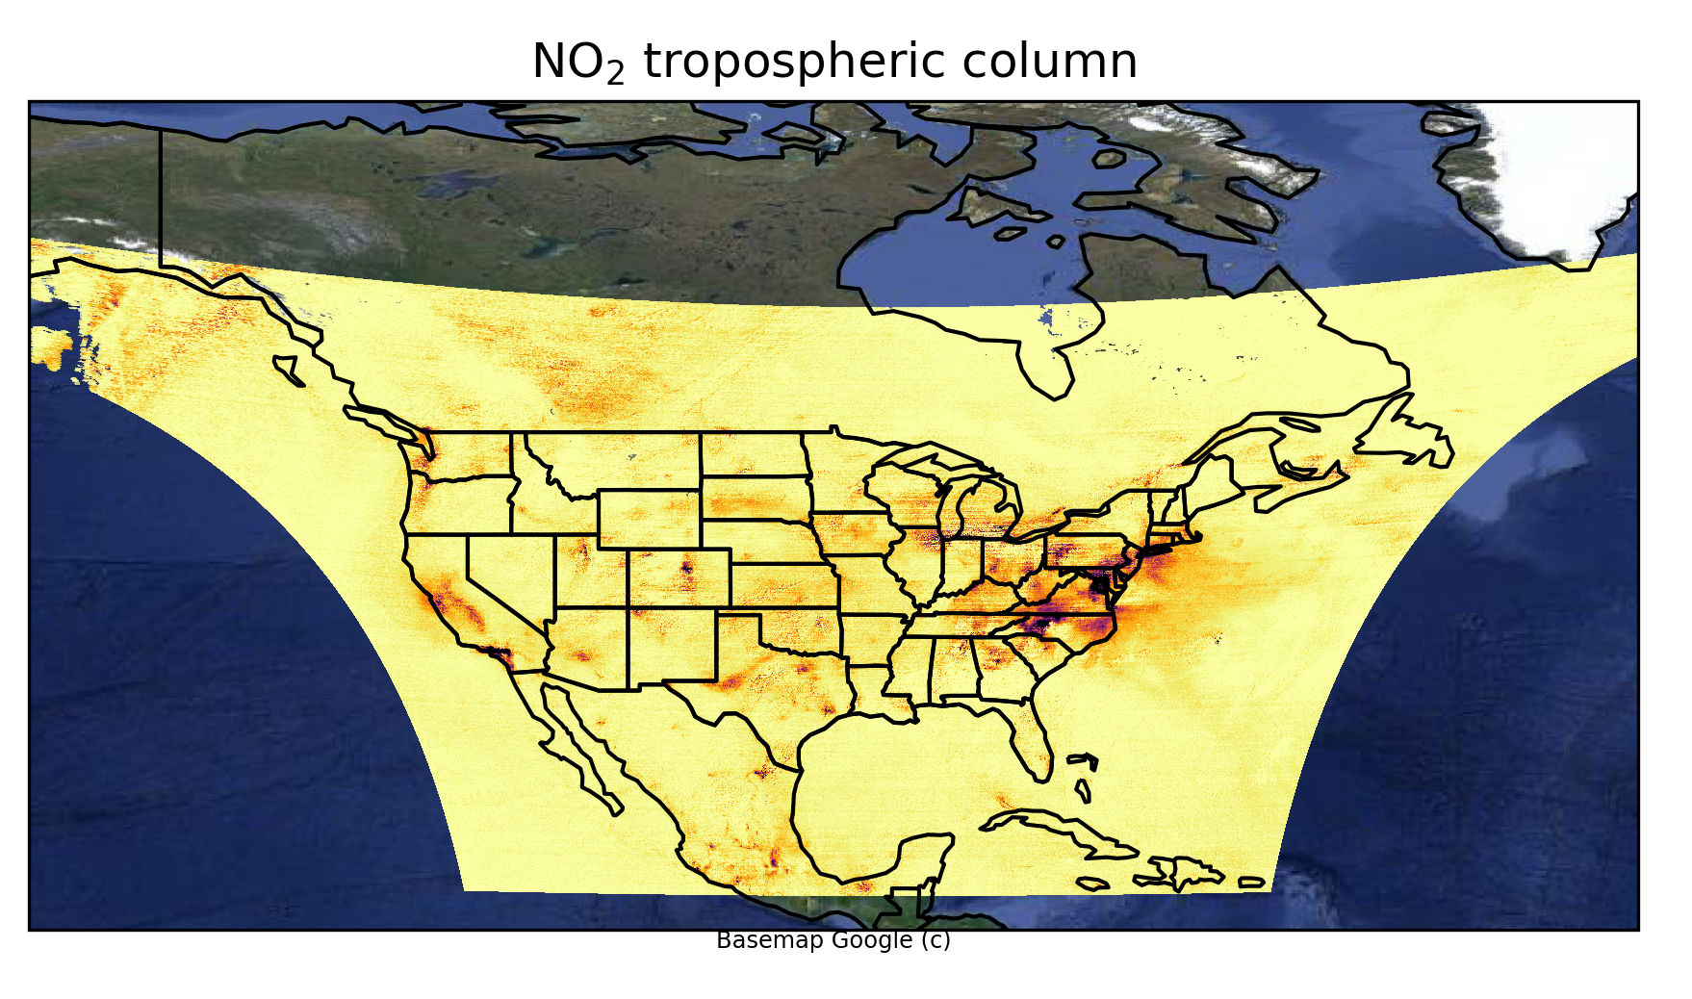
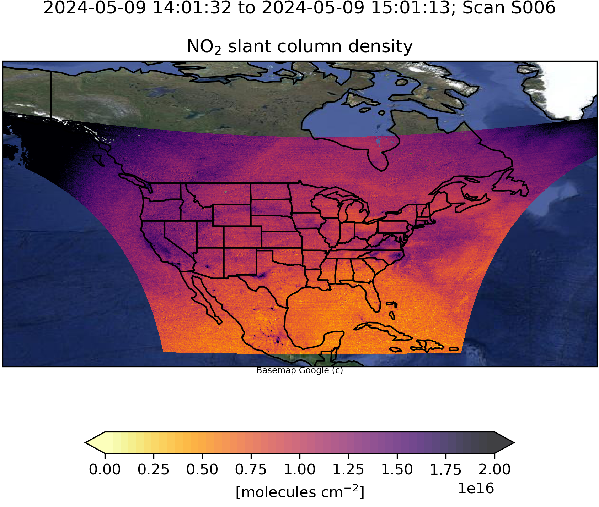
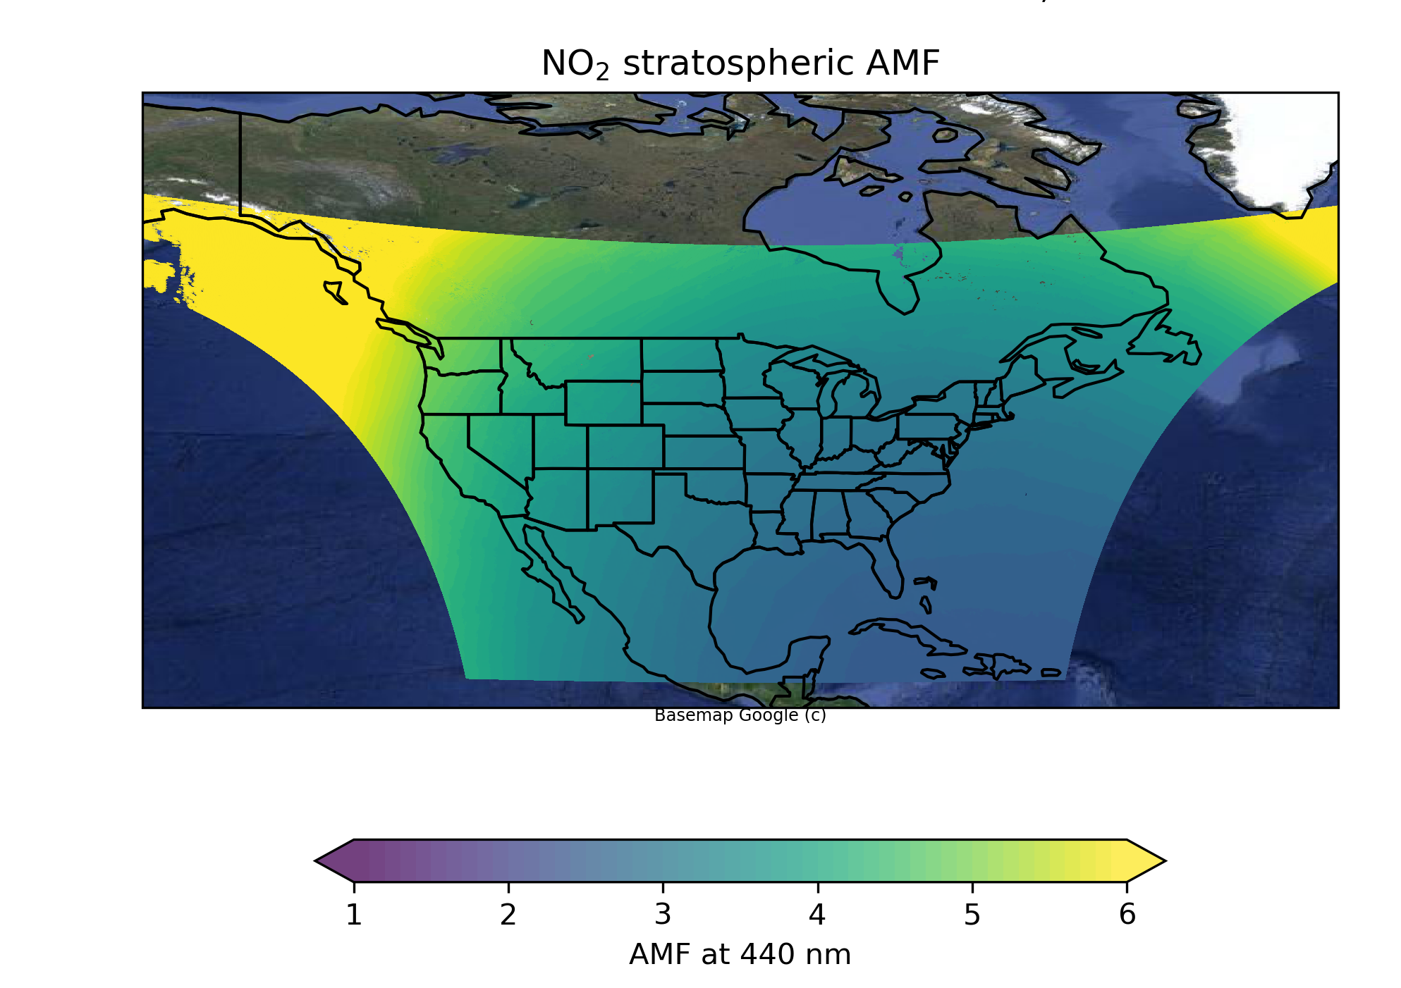
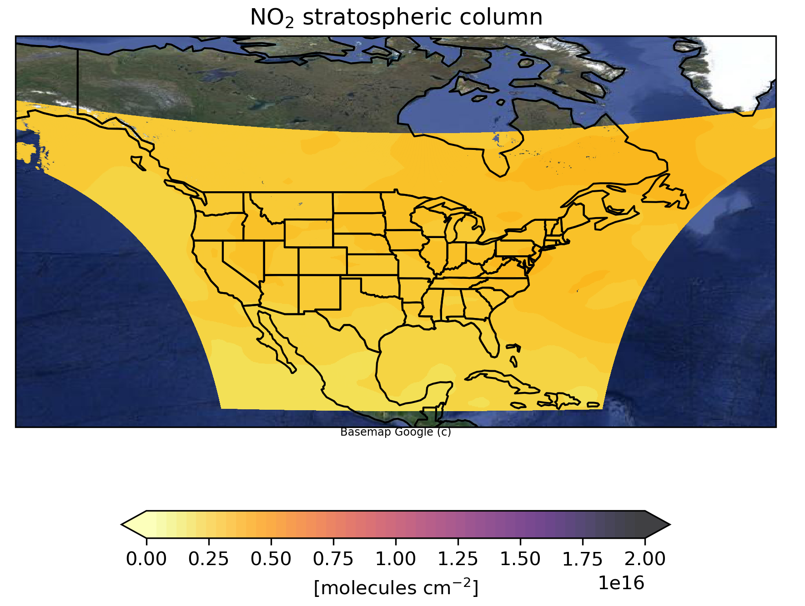
NO₂ Retrieval Algorithm
1) Slant column density retrieval (spectral fitting)
2) Air mass factor (AMF) calculation
3) Stratosphere/troposphere separation

Slide 3
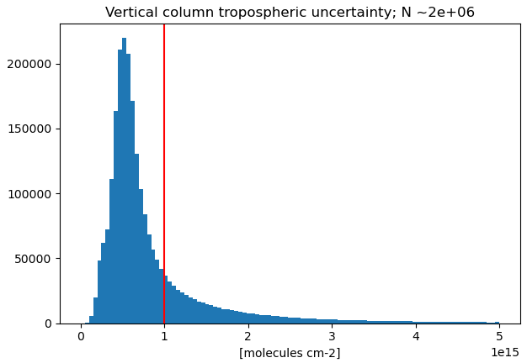
NO₂ Uncertainties (Fitting Precision)
30 May 2024
Tropospheric NO₂ vertical column uncertainty
9 May 2024, Scan 6
Single pixel performance
Requirement for 4 co-added pixels
TEMPO NO₂ meets the requirement for 95% of cloud-free scenes with no pixel coadding!
[Credit: Laura Judd]

Slide 4
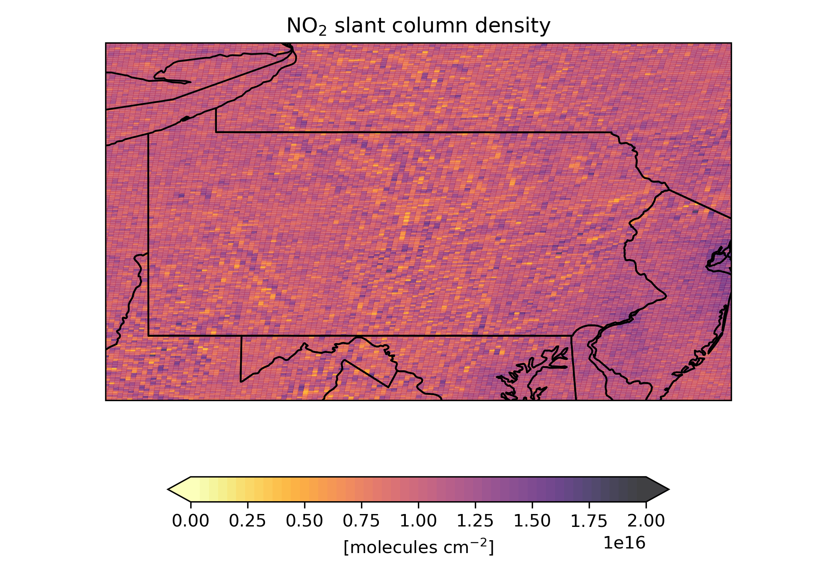
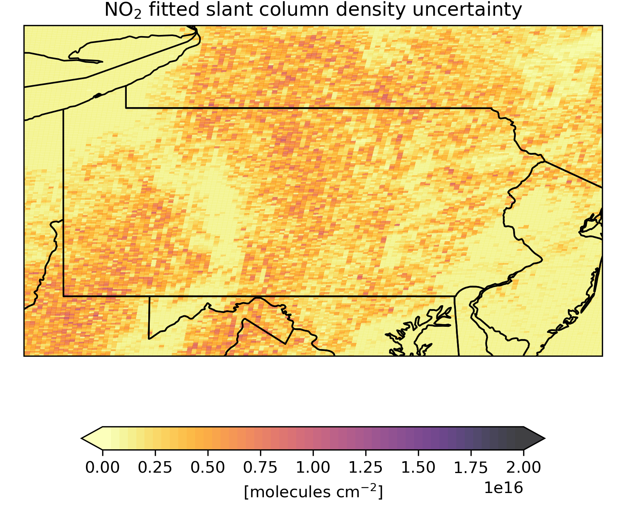
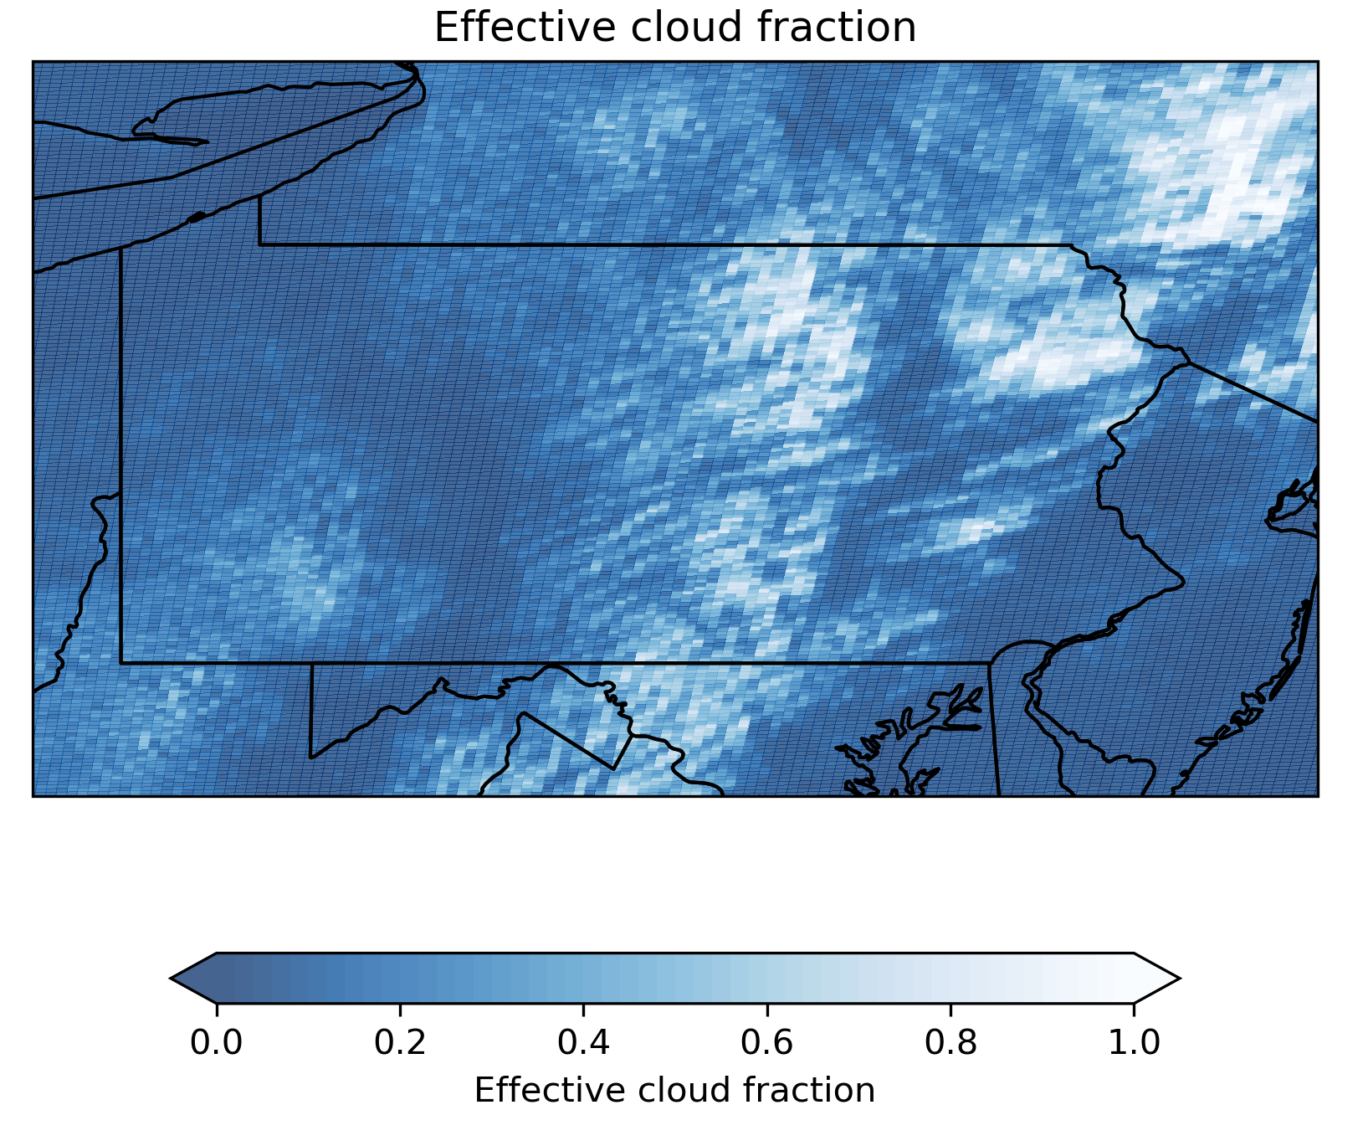
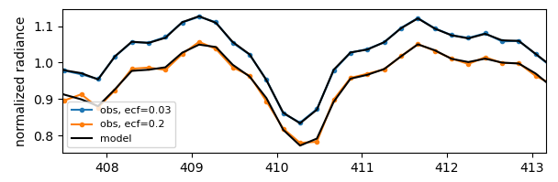
Improving NO₂ SCD: Partly cloudy scenes
1 July 2024, S006
Spectral fit for clear and partly-cloudy pixels
Skewed absorption features over partly cloudy scenes
→ larger fitting residuals
→ larger fitting uncertainties
* Formaldehyde and other trace gases also affected
wavelength [nm]
4

Slide 5
Improving NO₂ SCD: De-striping
Cross-track striping is common in retrievals from CCD array instruments
Striping correction is implemented in pipeline but not yet turned on
Currently testing for robustness, and NRT implementation
De-striping correction
1 July 2024, S008

Slide 6
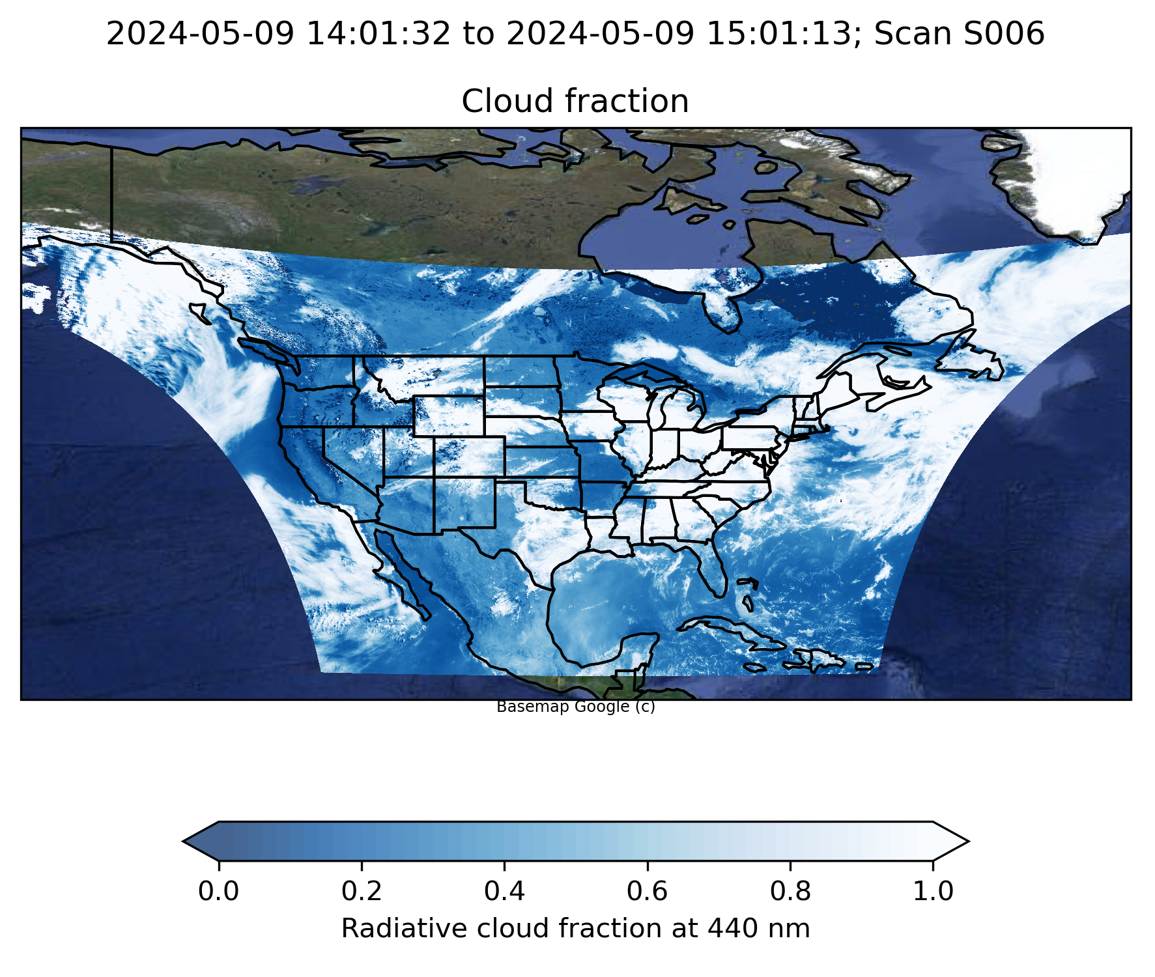
Improving NO₂ AMF
Normalized radiance biases can cause general high bias in cloud fraction
Surface reflectance errors affect trace gas AMF through both scattering weights and clouds
And more:
Include sphericity in look-up tables
Switch to new GEOS-CF version

Slide 7
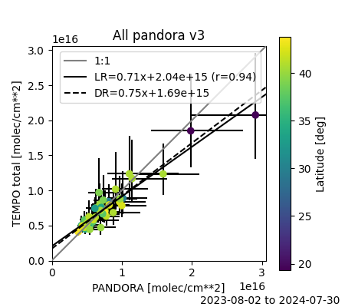
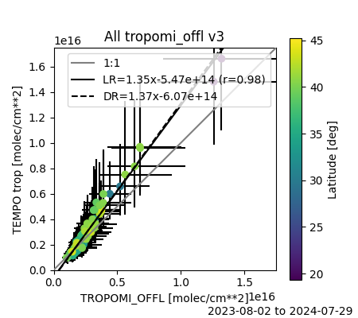
TEMPO NO₂ vs. Pandora and TROPOMI
[Credit: Barron Henderson, Luke Valin, Jim Szykman]
* TROPOMI comparisons are for Pandora locations + ozone non-attainment areas

Slide 8
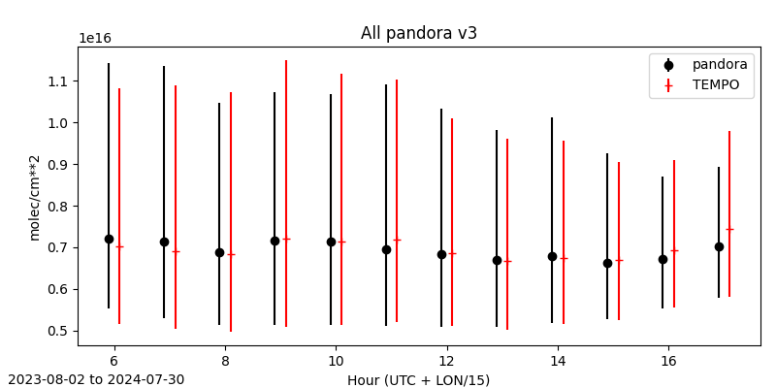
TEMPO NO₂ vs. Pandora (Diurnal Change)
***Note: Early AM and late PM TEMPO NO₂ likely has large contribution from the prior (GEOS-CF)
[Credit: Barron Henderson, Luke Valin, Jim Szykman]

Slide 9
Summary and Outlook
NO₂ easily meets pre-launch precision requirements
Validation team is assessing NO₂ data, with recent update to V3
Upcoming plans:
Update to new version of GEOS-CF (see Emma Knowland’s talk)
North/South stripe correction
Files will include cloud-free scattering weights and AMFs
Improve fitting in partly cloudy pixels
Improvements to surface reflectance
NO₂ will likely see significant changes with radiance calibration improvements (from clouds)
TEMPO NO₂ NRT products under development

