Slide 1
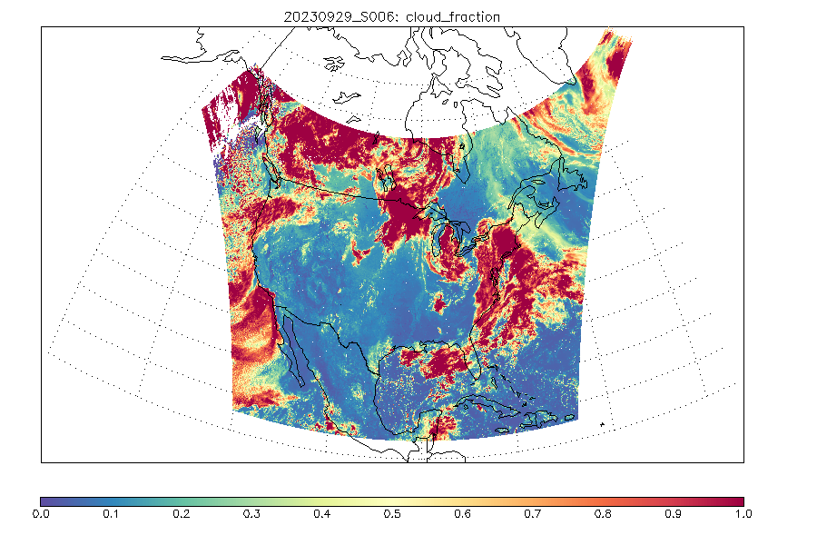
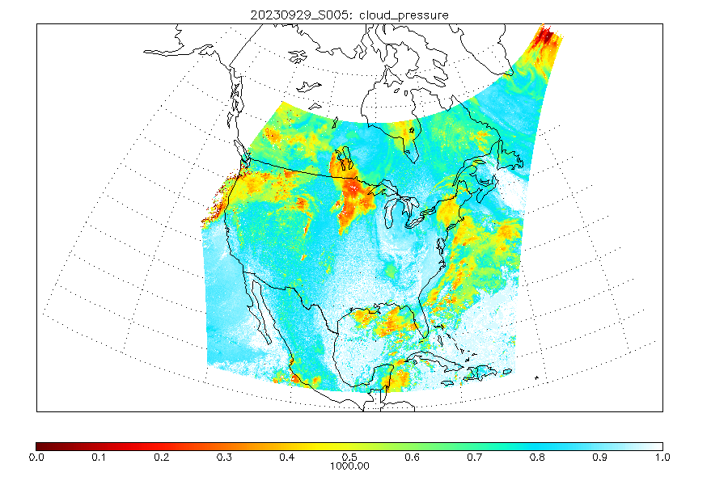
TEMPO O₂-O₂ Cloud (CLDO4)
Helen (Huiqun) Wang, Gonzalo Gonzalez Abad, Caroline Nowlan, Heesung Chong, Weizhen Hou, John Houck, Xiong Liu, Kelly Chance, Eun-su Yang, Alexander Vasilkov, Joanna Joiner, and the TEMPO team
(contact: hwang@cfa.Harvard.edu)
L1B
Effective Cloud Fraction (ECF)
Cloud Optical Centroid Pressure (OCP)
CLDO4
Trace Gases
Cloud Filtering
Simple parameterization
Suitable & practical
Vertical Column Density = Slant Column Density /Air Mass Factor

Slide 2
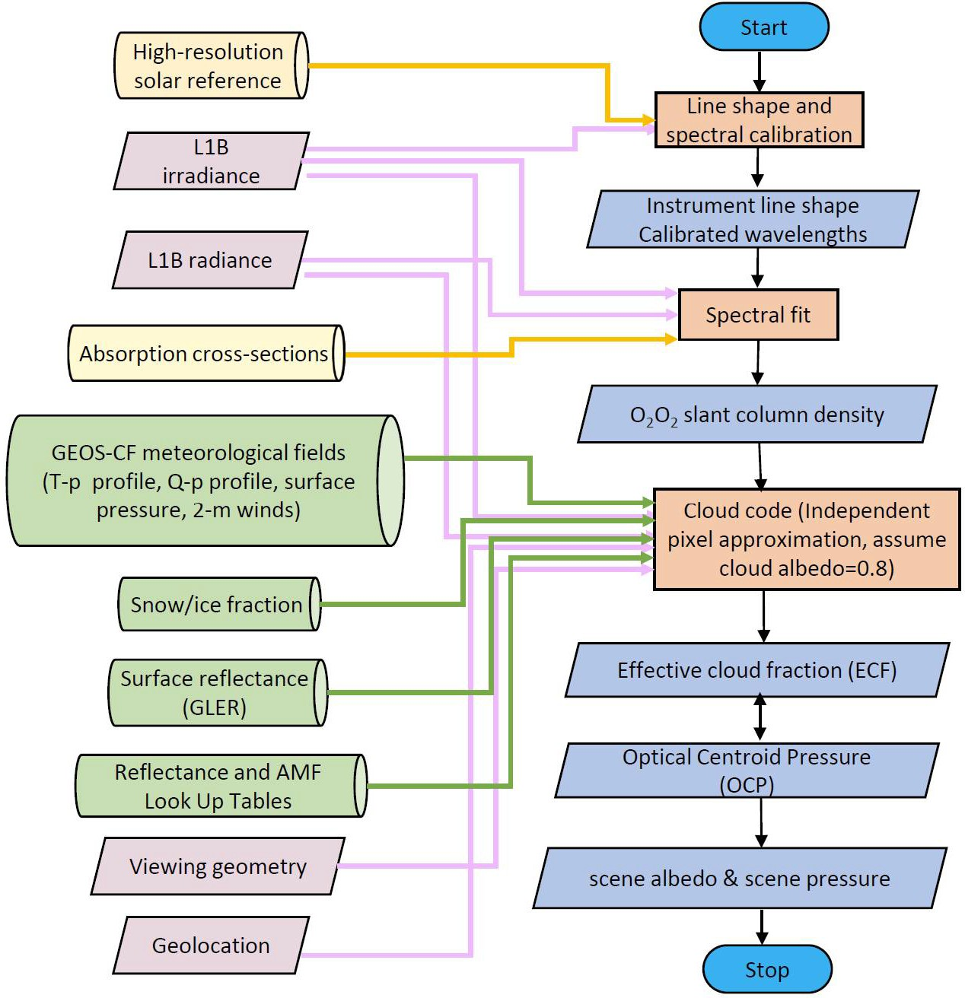
TEMPO CLDO4 Flow Chart
principle
Observation Model
Take Hours
SAO fitting code & algorithm
Slant Column Density (SCD):
Spectra within fitting window
(2) Take Minutes
SAO TEMPO adaption of NASA GSFC OMI code & algorithm
Effective Cloud Fraction (ECF):
Normalized Radiance at a wavelength
Optical Centroid Pressure (OCP):
O₂O₂ SCD

Slide 3
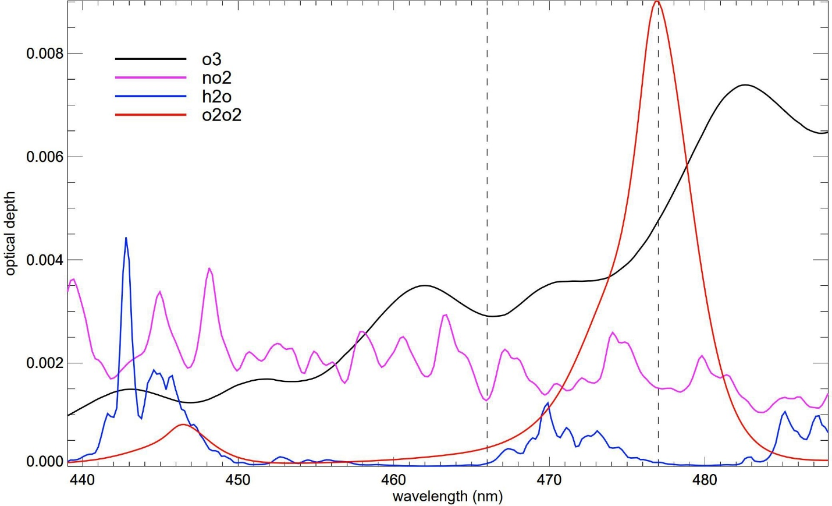
O₂-O₂ SCD fitting window: 439 – 488nm
439nm
466nm
477nm
488nm
ECF:
RAD/IRR
$$F\left(λ\right)= \left[χ_{α}Ι_{0}\left(λ\right)+ b_{u}\left(λ\right)χ_{u}+ b_{r}\left(λ\right)χ_{r}+b_{v}\left(λ\right)x_{v}\right]e^{−\sum_{i}{b_{i}\left(λ\right)χ_{i}}}\sum_{j}{{\left(λ−\overline{λ}\right)}^{j}}χ_{j}^{SC}+ \sum_{k}{{\left(λ−\overline{λ}\right)}^{k}χ_{k}^{BL}}$$
RAD
IRR
ECF is more sensitive to L1B calibration than Spectral Fitting
single wavelength v.s. closure polynomials

Slide 4
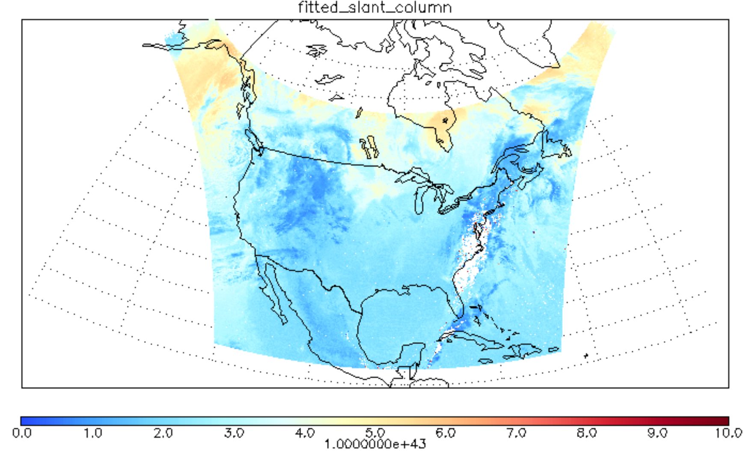
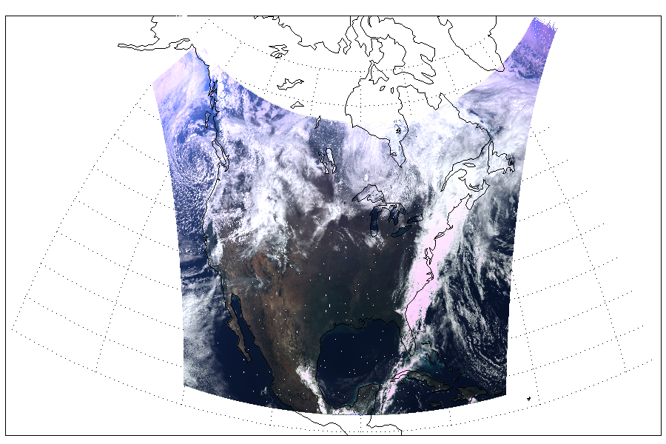
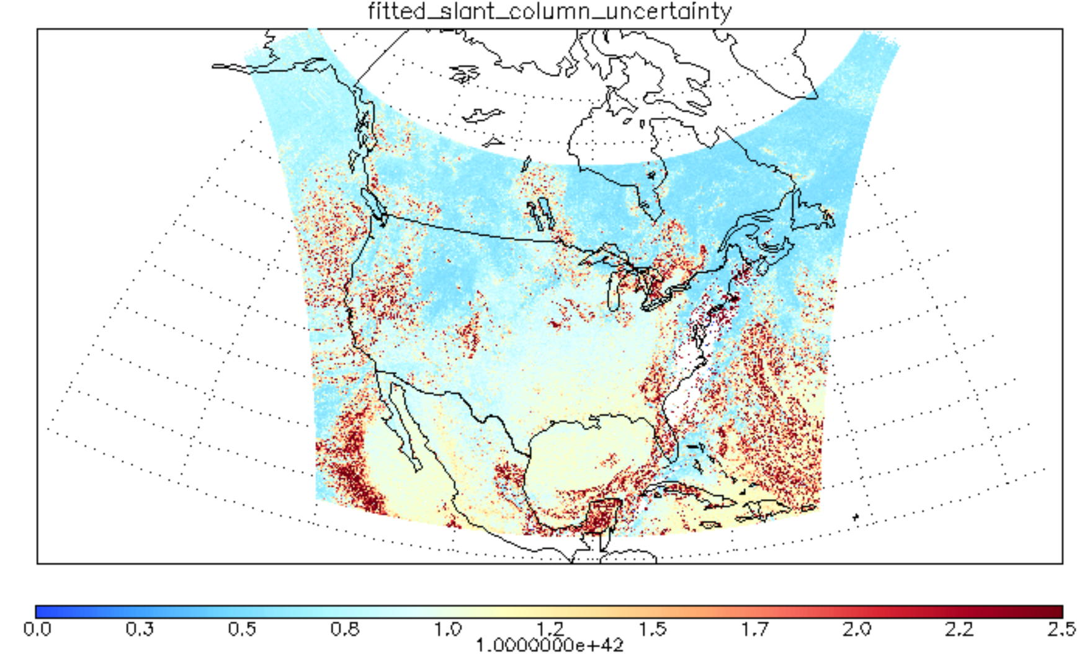
O2O2 SCD
20240328 S008
O2O2 SCD uncertainty
Larger uncertainty for non-homogeneous scenes

Slide 5
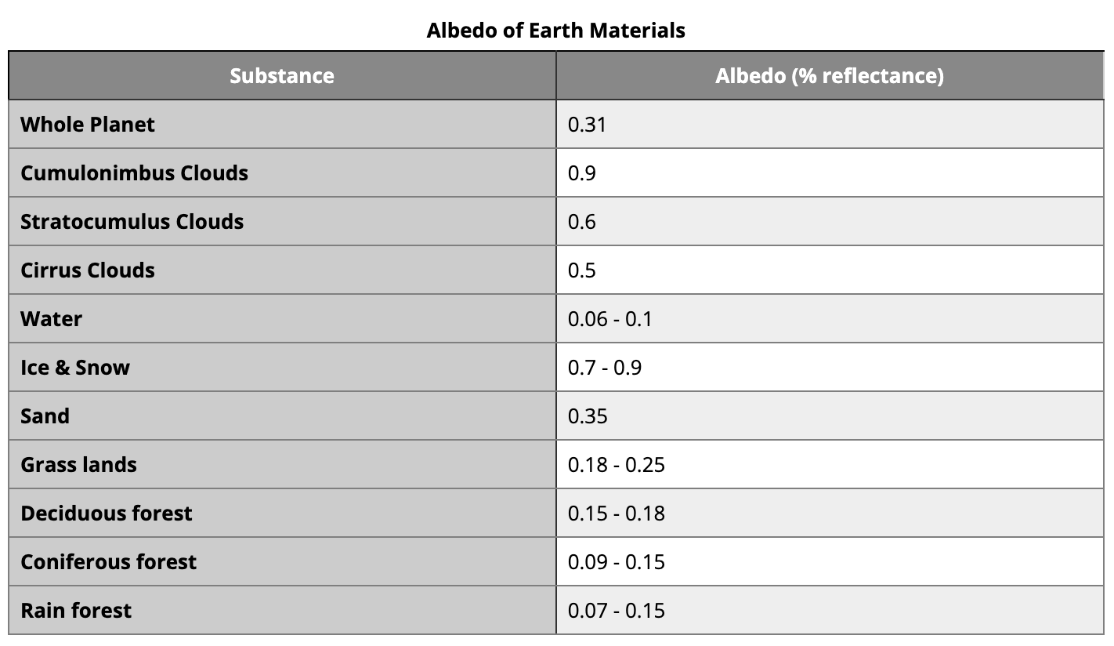
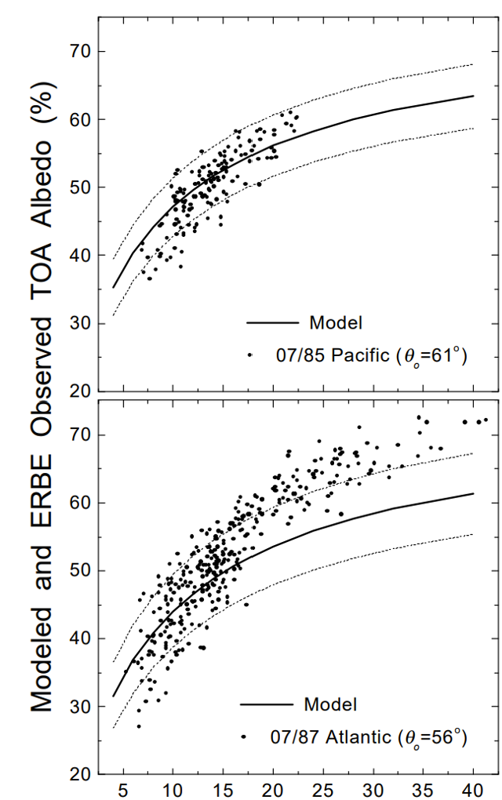
Cloud albedo varies with cloud type, optical depth
Cloud fraction & Cloud pressure depends on observational resolution
Cloud fraction & cloud pressure
work in pairs
https://www.e-education.psu.edu/earth103/node/1002
Cloud optical depth
[Chang et al., 1998]
OCP=f(ECF, SCD, …)

Slide 6
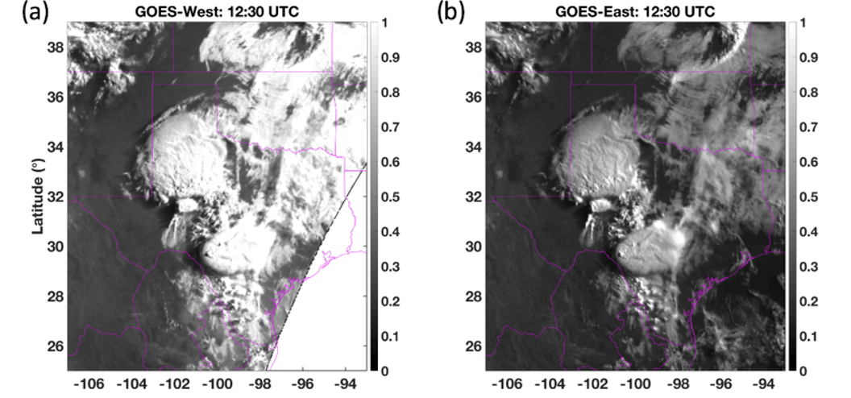
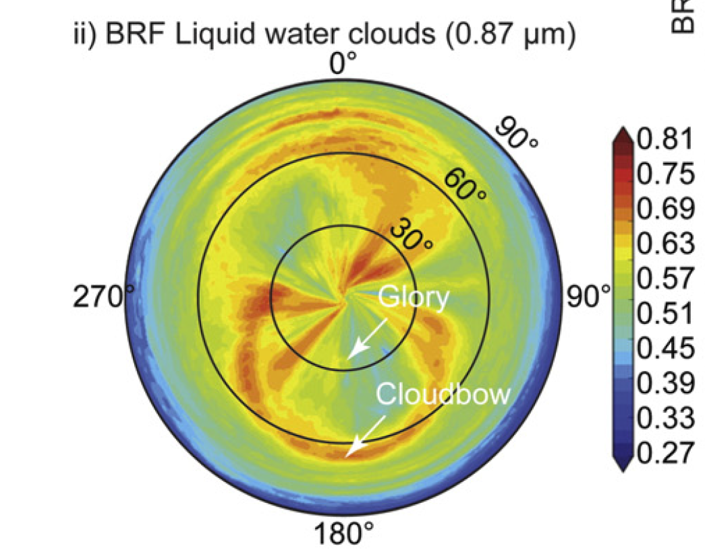
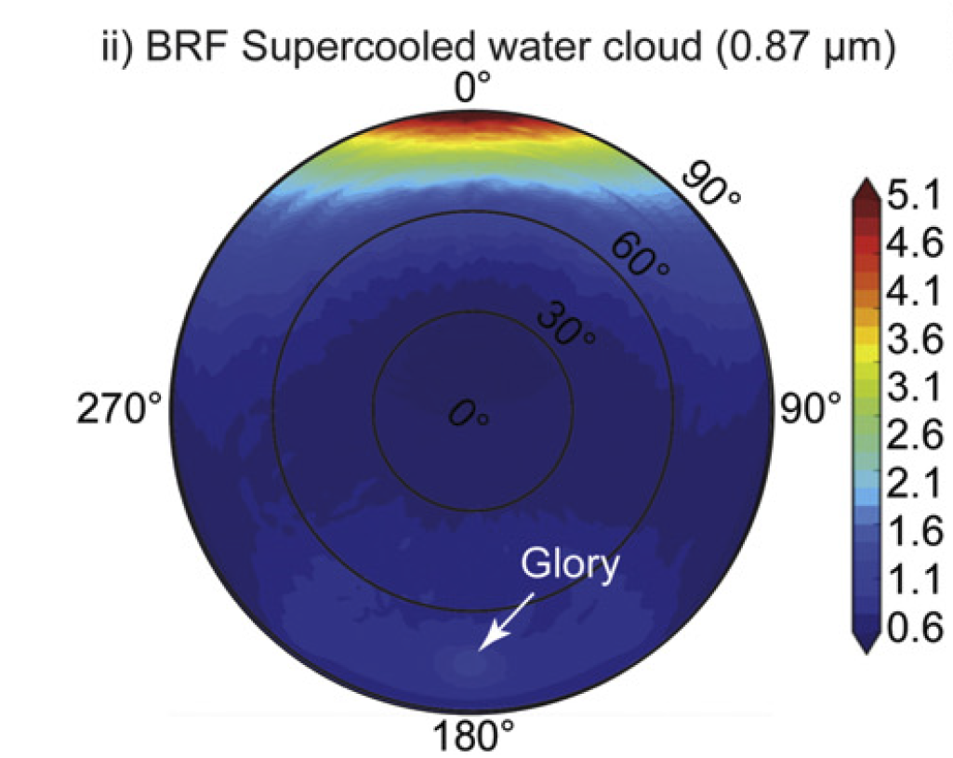
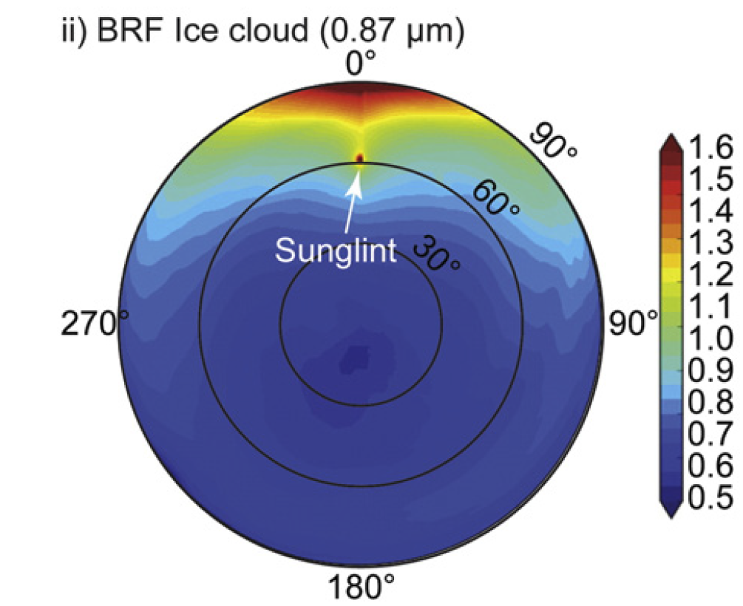
Cloud albedo varies with
Geometry
Cloud Phase
Complexity needs simplification
Azimuth
VZA
[Gatebe and King, 2016]

Slide 7
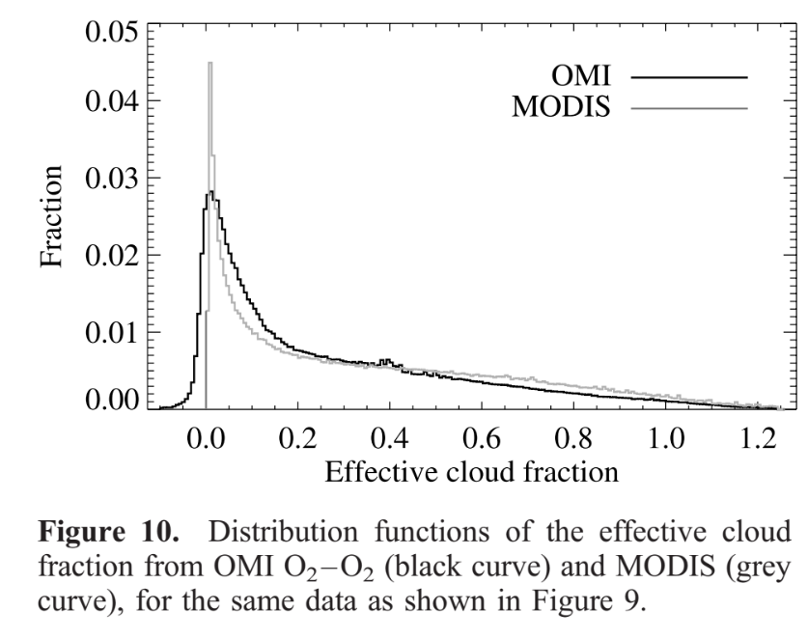
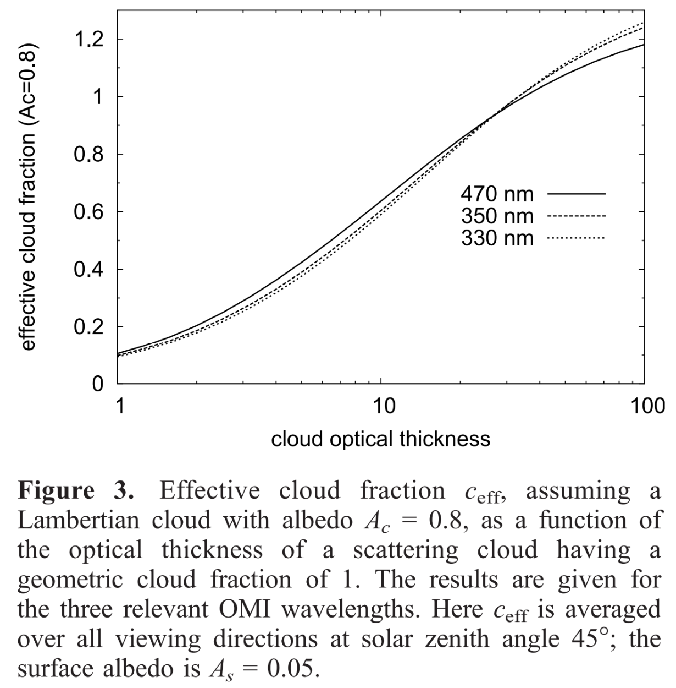
Lambertian Cloud with Ac = 0.8 assumption is necessary and functional, however,
Effective Cloud Fraction can be different from geometric cloud fraction
Effective Cloud Fraction can go beyond the [0., 1.] range
Histogram probability of ECF
Effect of cloud optical thickness on ECF
[Stammes et al., 2008]
[Stammes et al., 2008]

Slide 8
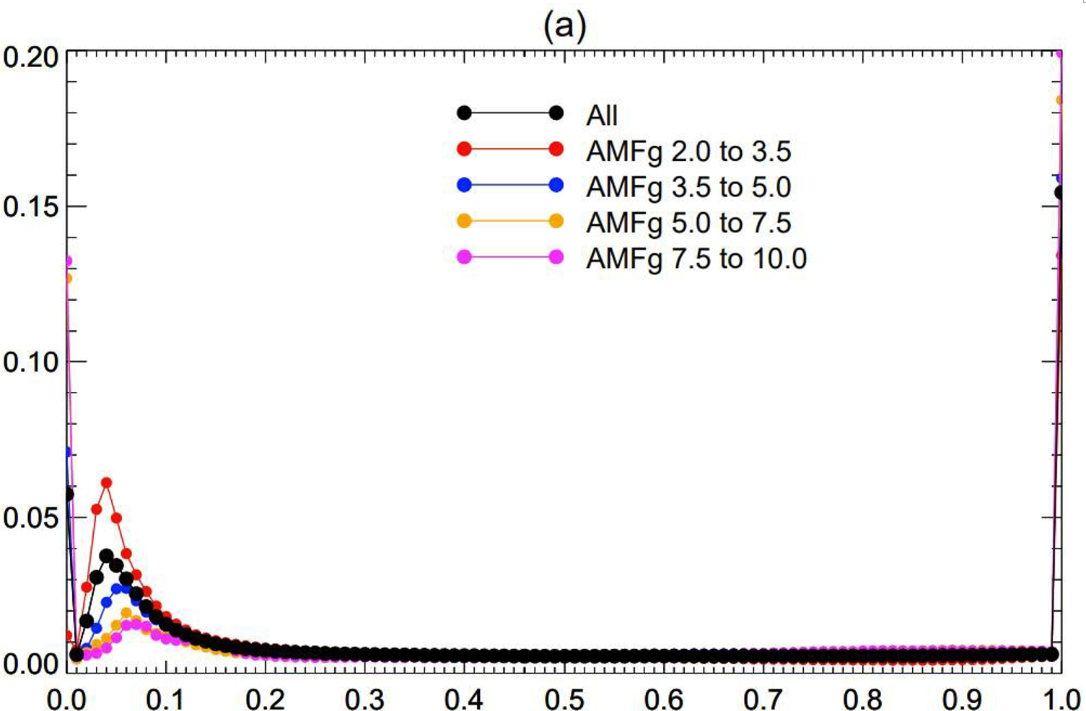
TEMPO CLDO4 ECF Histogram Probablity
Shifted ECF histogram:
Positive ECF bias
Measured RAD/IRR = Calculated RAD/IRR (GLER, Clouds, …)
Effective Cloud Fraction (ECF)

Slide 9
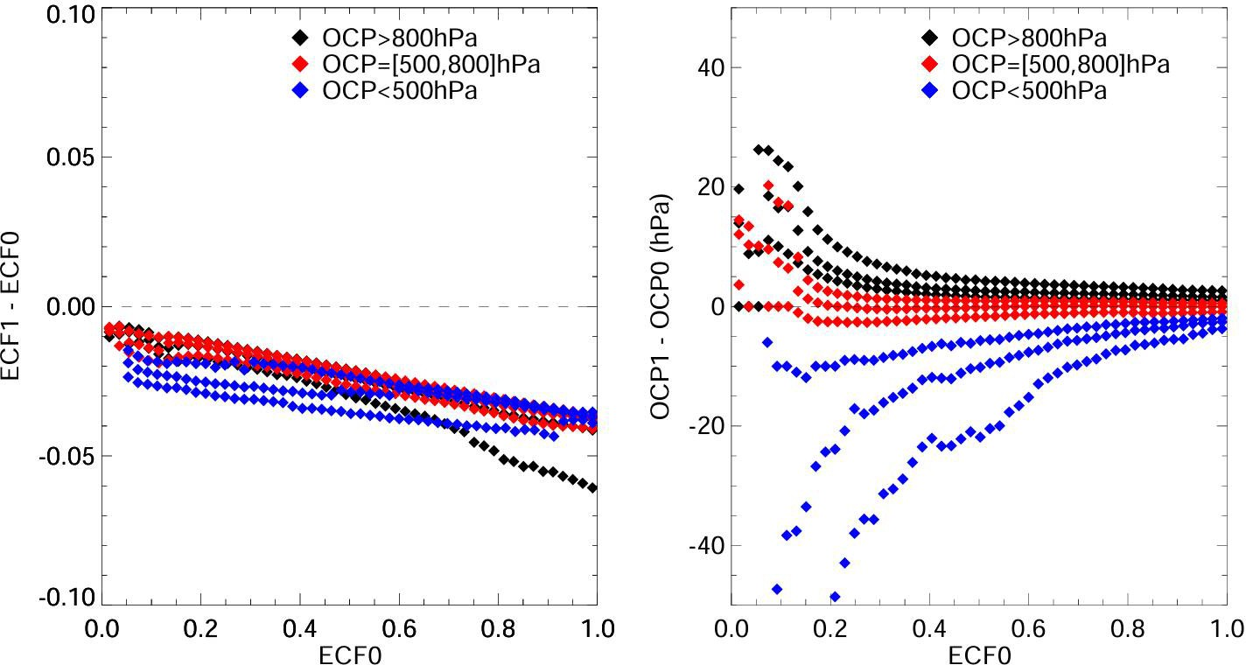
Change of ECF & OCP due to RAD/IRR decrease of 3%
New - Reference
High ECF is affected more
OCP @ low ECF changes more
OCP for High-altitude cloud is more sensitive

Slide 10
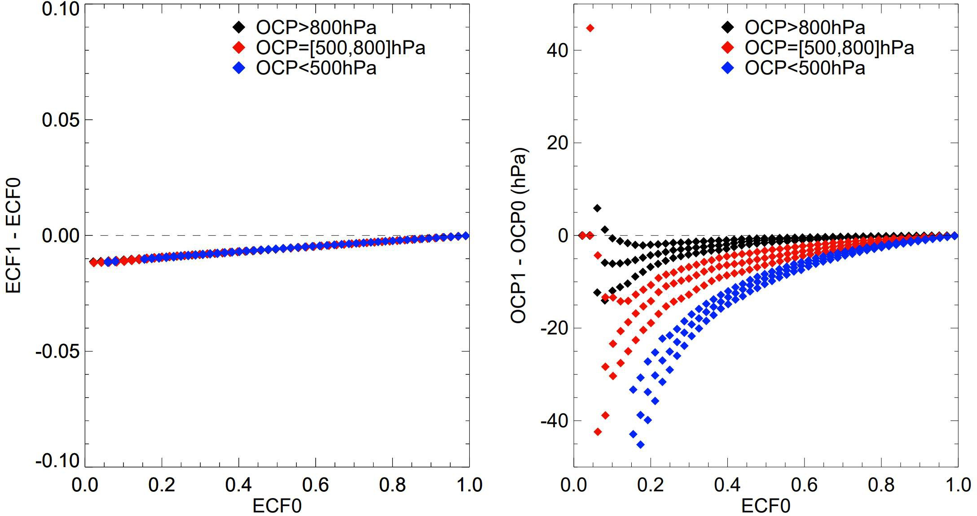
Change of ECF and OCP due to GLER increase of 0.01
New - Reference
Low ECF & high-altitude clouds are more sensitive to GLER

Slide 11
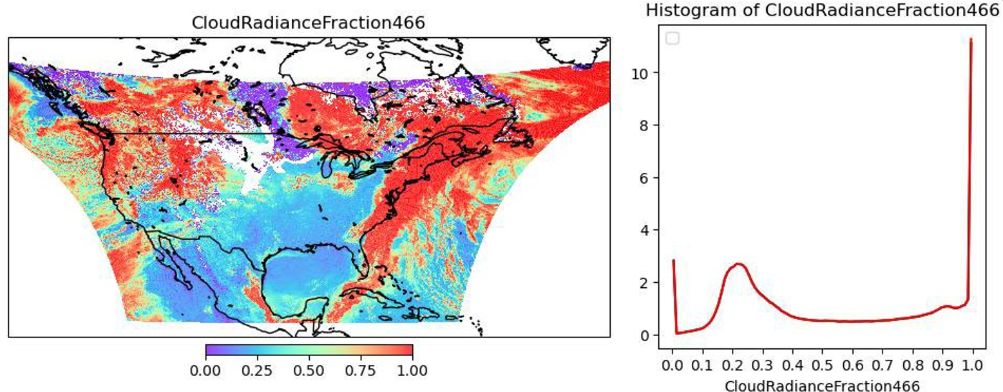
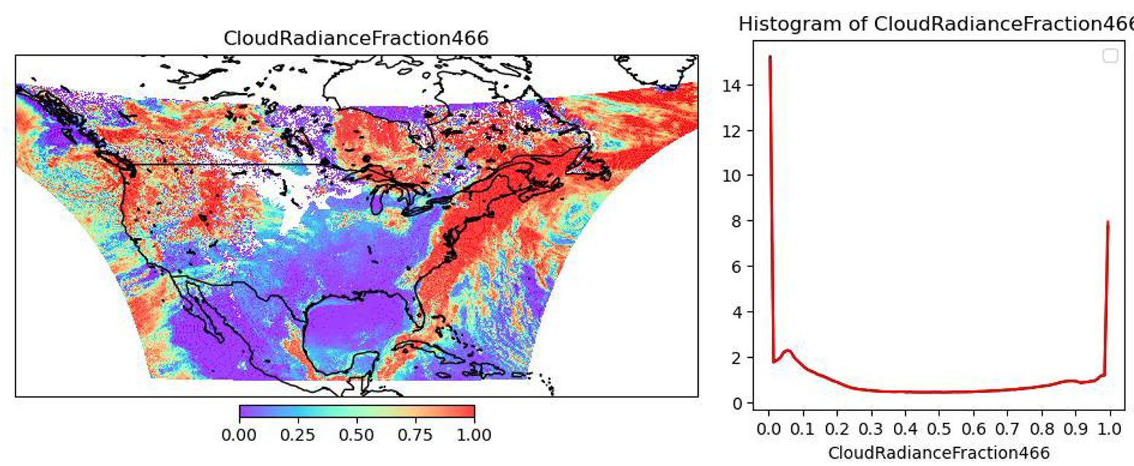
Combination of RAD/IRR decrease &
GLER increase
Shifts the ECF towards the right direction
decrease RAD/IRR by 5%
Increase GLER by 0.01

Slide 12
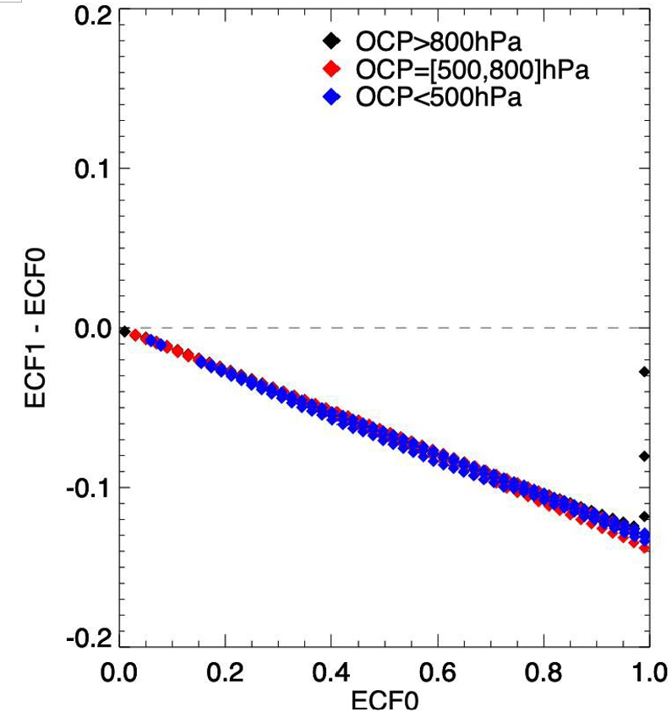
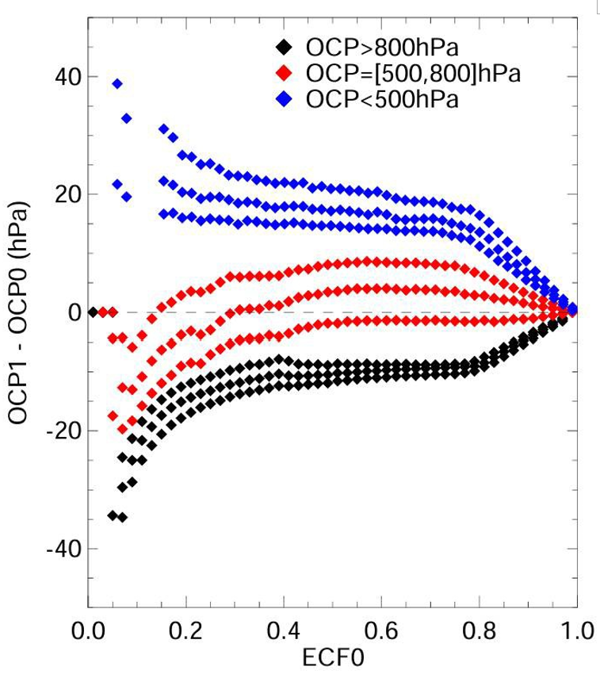
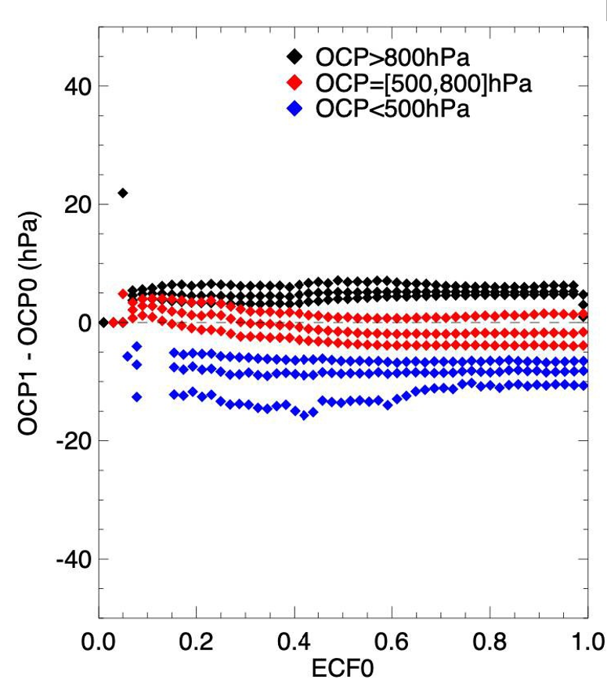
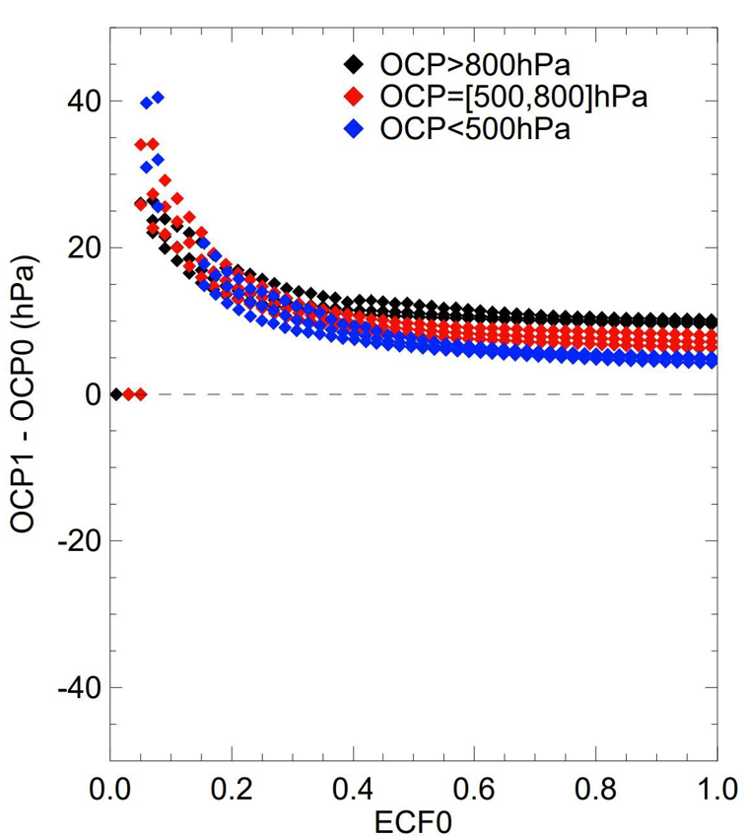
(Details in CLDO4 ATBD
Draft available through ASDC)
Influences of Various factors are different &
depends on ECF
Clouds at different altitudes can respond differently
In most cases, OCP for
low ECF & high-altitude clouds are more sensitive -> filtering
ECF to Ac
OCP to CRF466
OCP to Ac
OCP to SCD

Slide 13
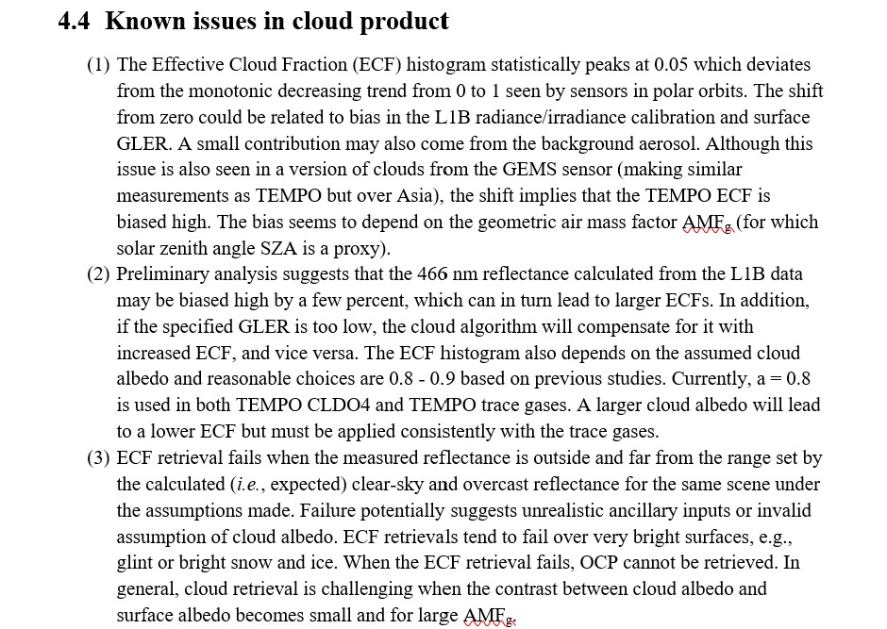
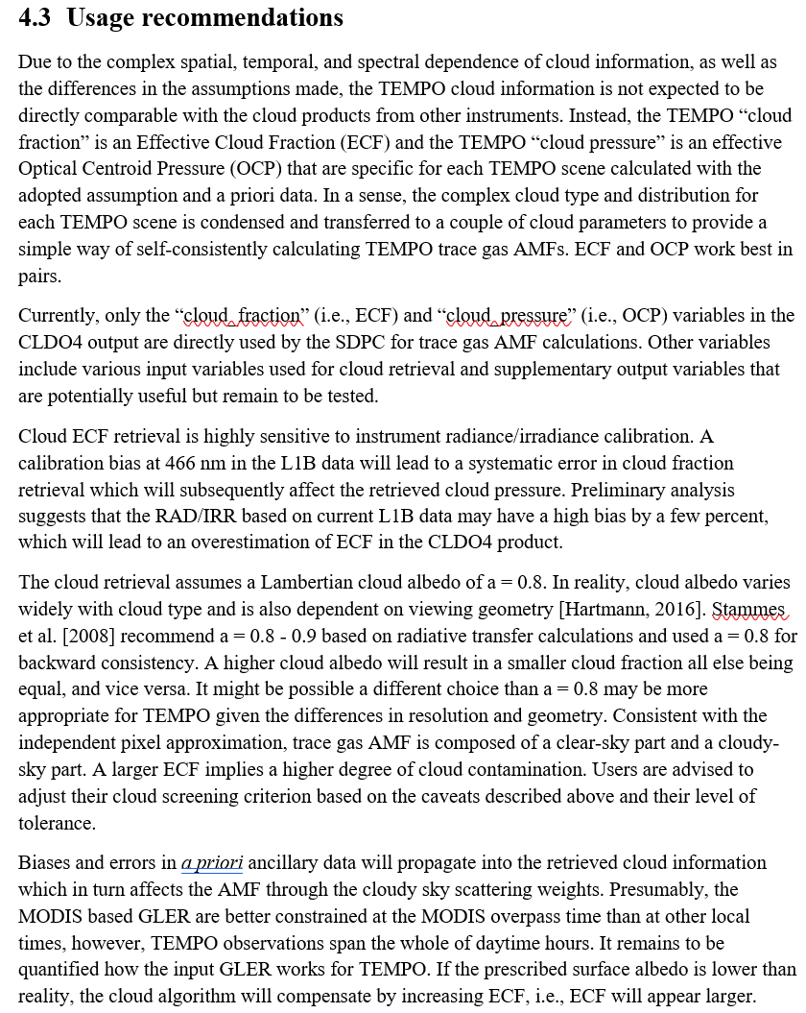
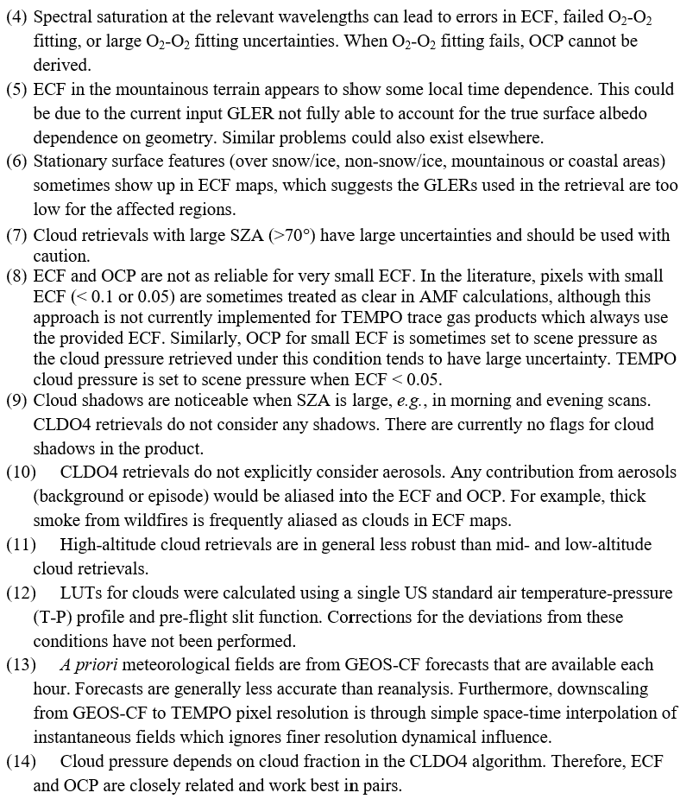
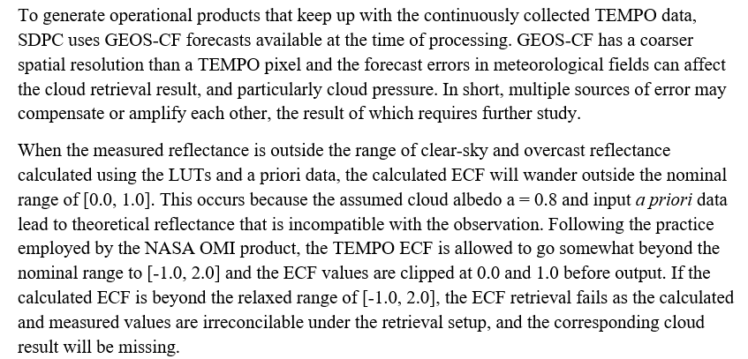
Usage Recommendations
Known Issues

Slide 14
Future Plans:
Improve CLDO4
L1B RAD/IRR
Surface albedo GLER
Look Up Tables
Misc(Quality Flag, SCD Destriping,…)

Slide 17
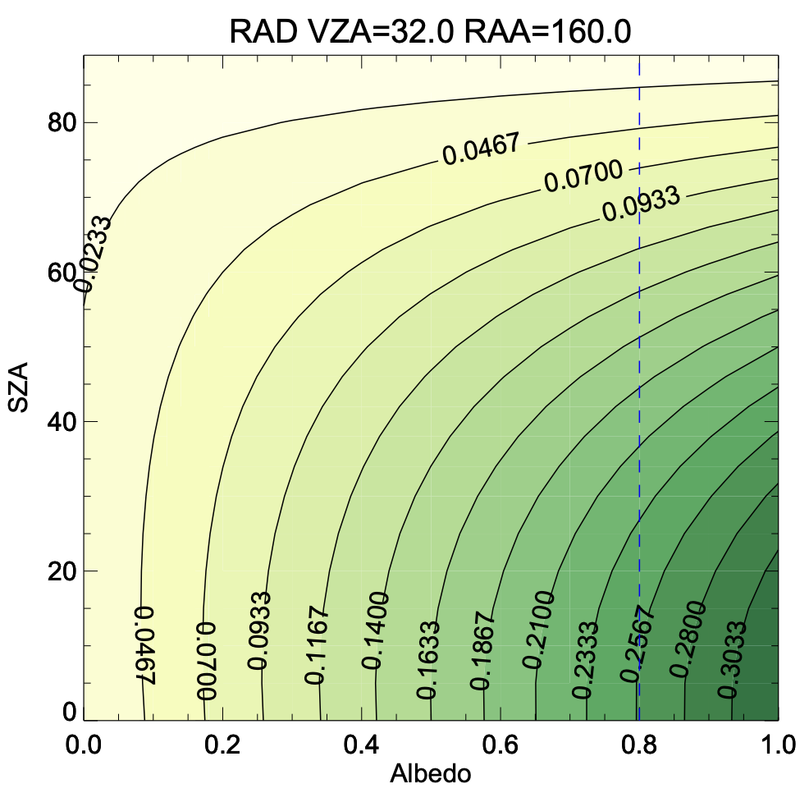
TOA RAD/IRR
ECF
ground
cloud
Clear-sky
ground
Overcast
cloud
ECF depends on the contrast

Slide 18
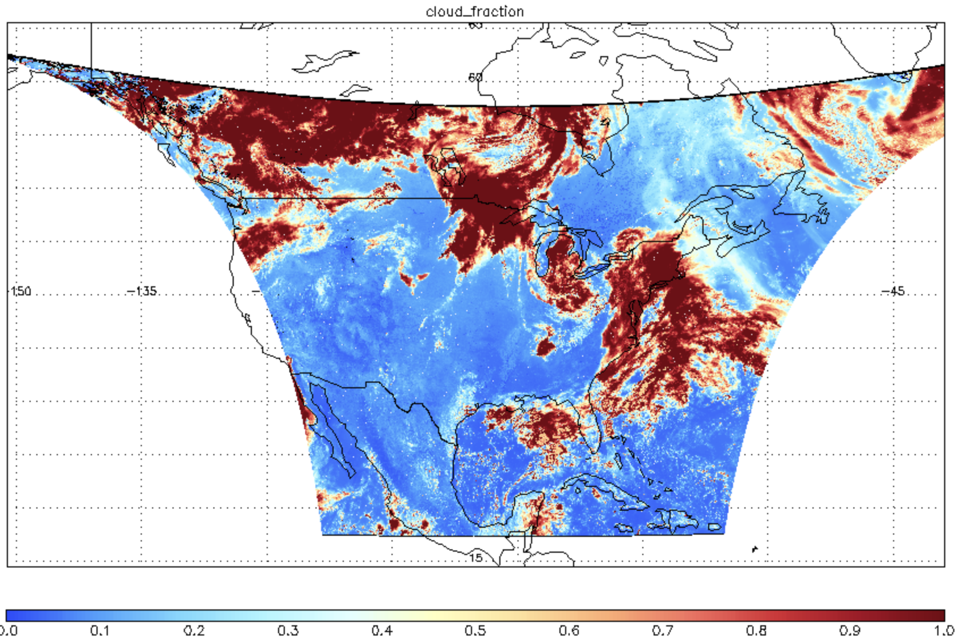
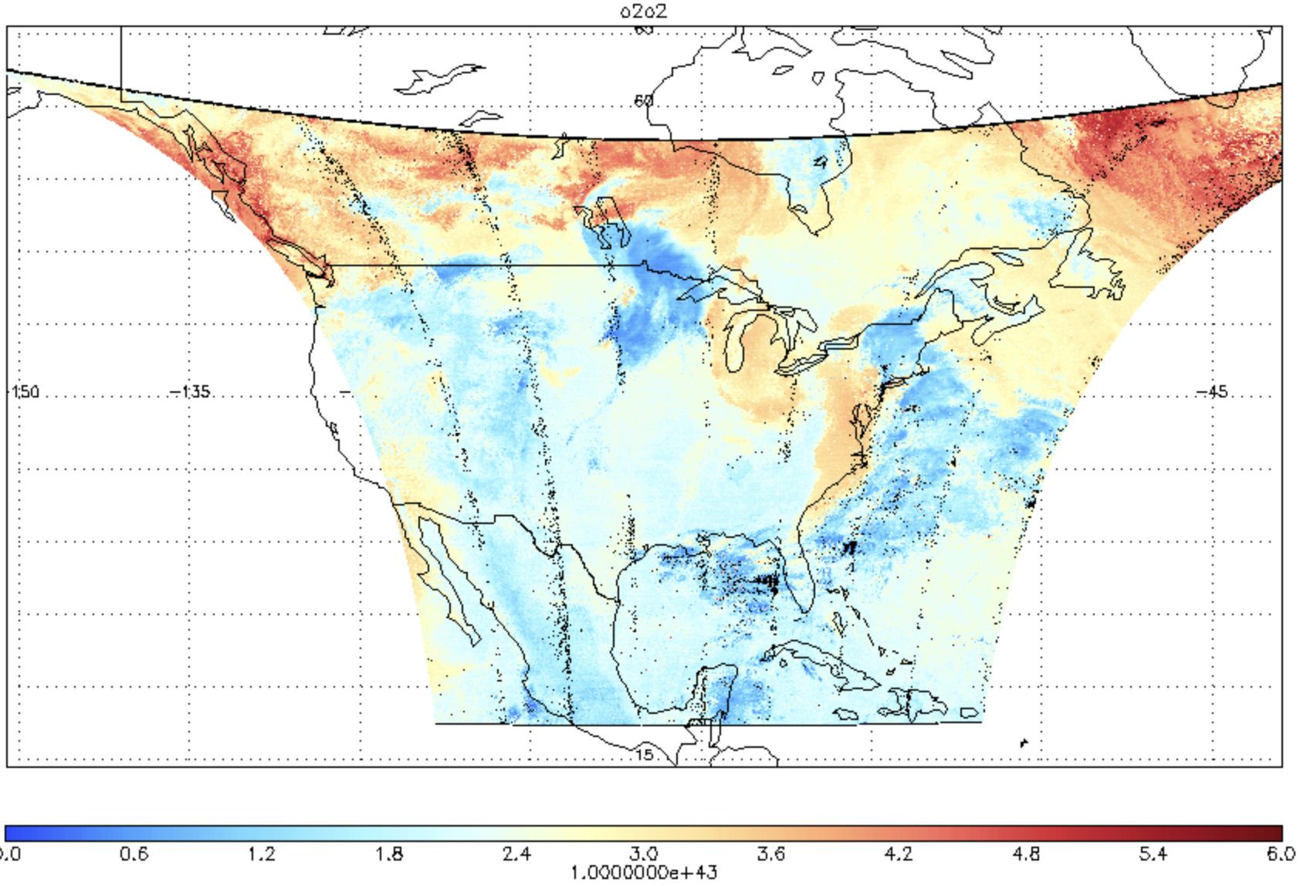
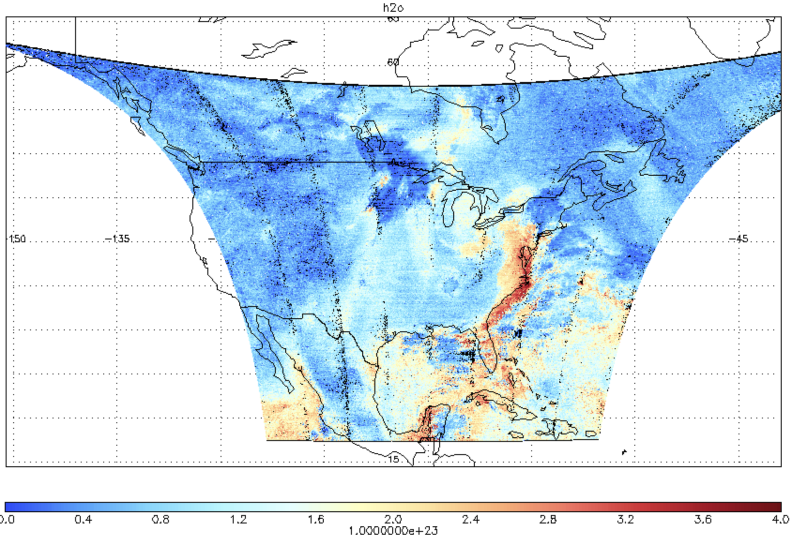
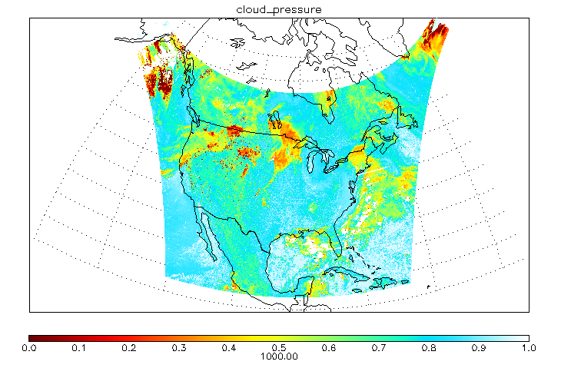
ECF
O2O2
H2O
OCP

Slide 19
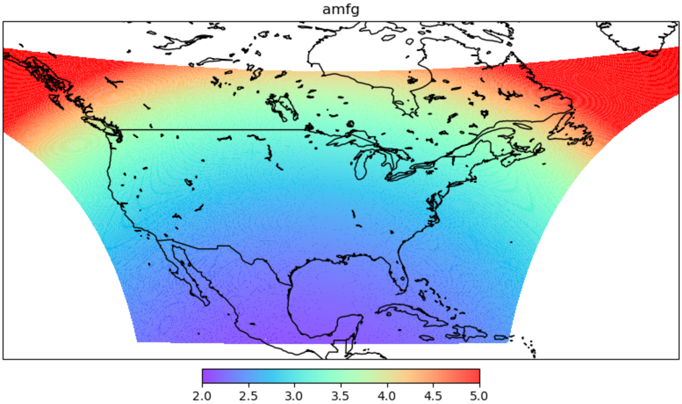
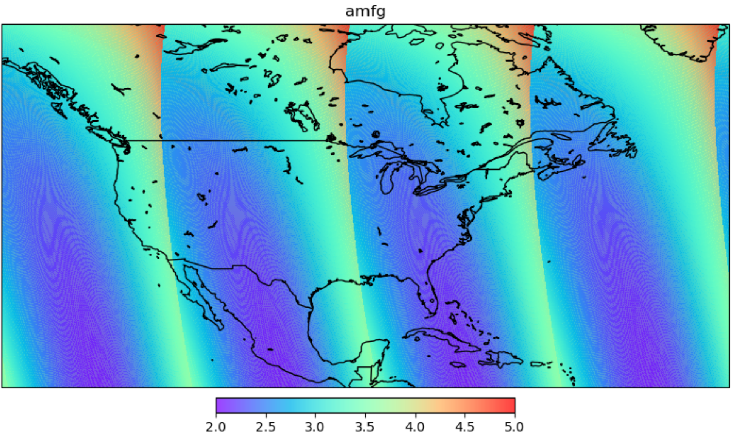
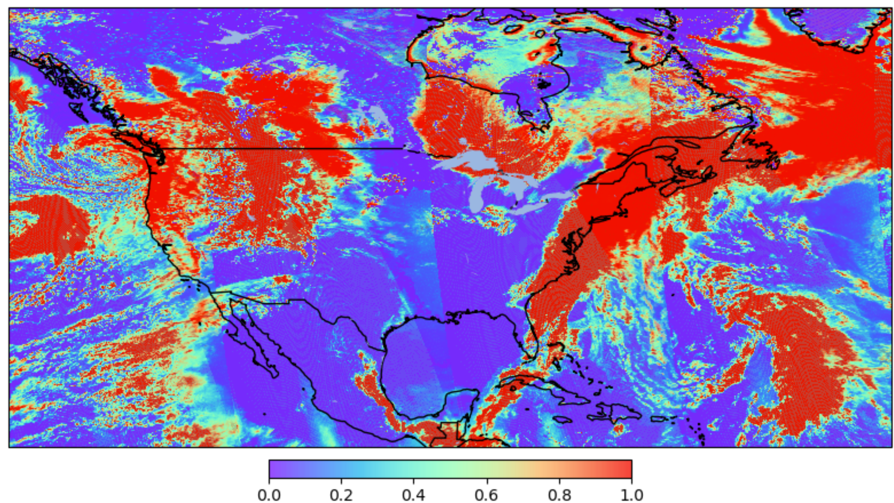
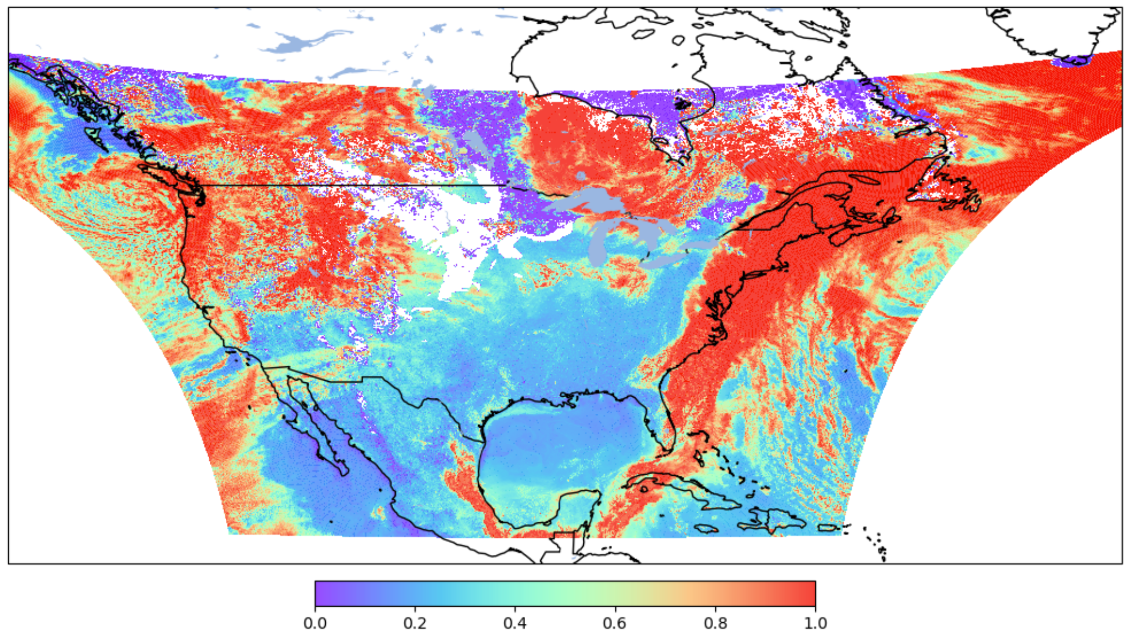
TROPOMI
Geometric AMF
TEMPO
Cloud_fraction_crb
Cloud radiance Fration 466
S011

Slide 20
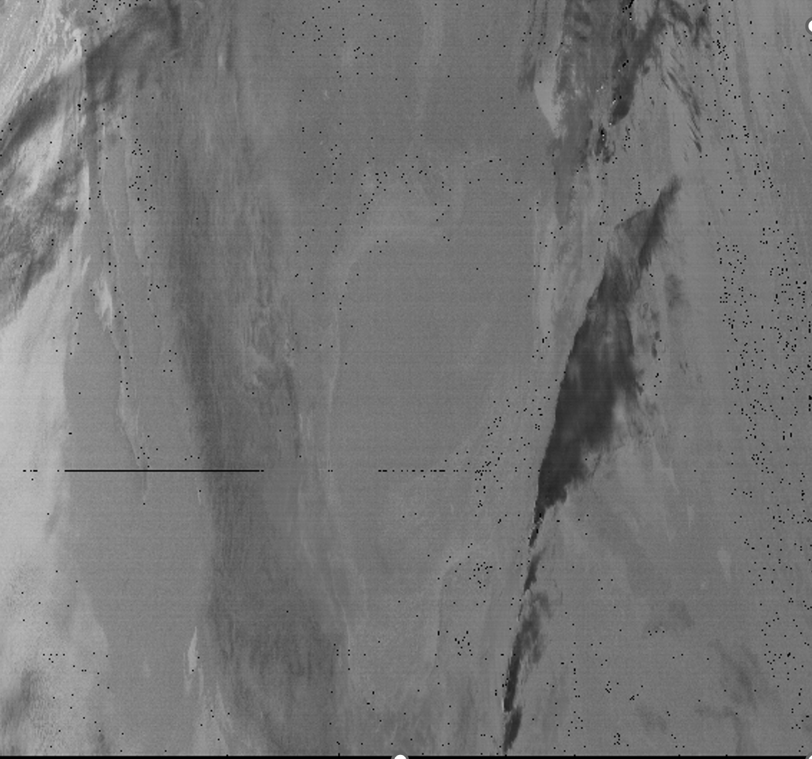
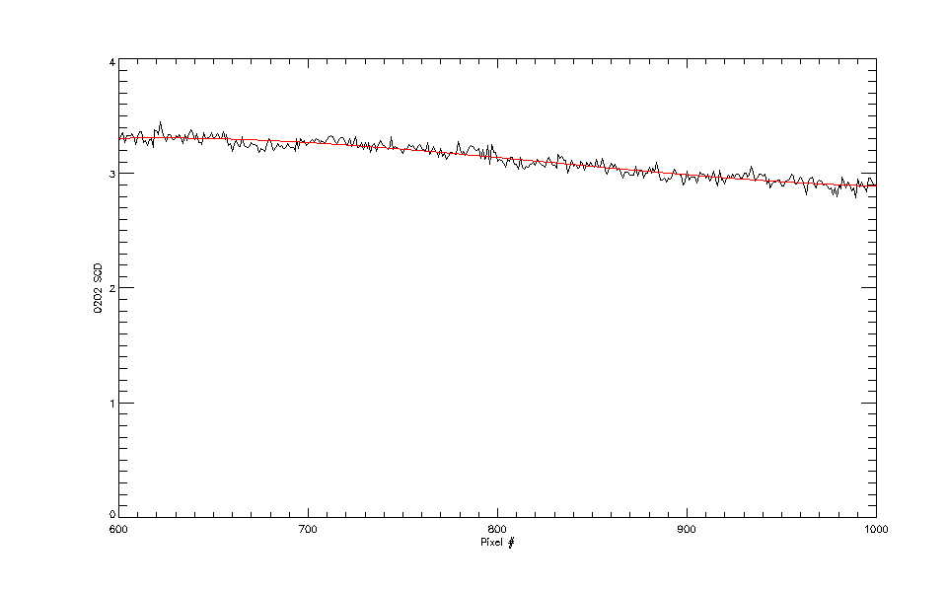
O2-O2 SCD stripes ~1.3%

Slide 21
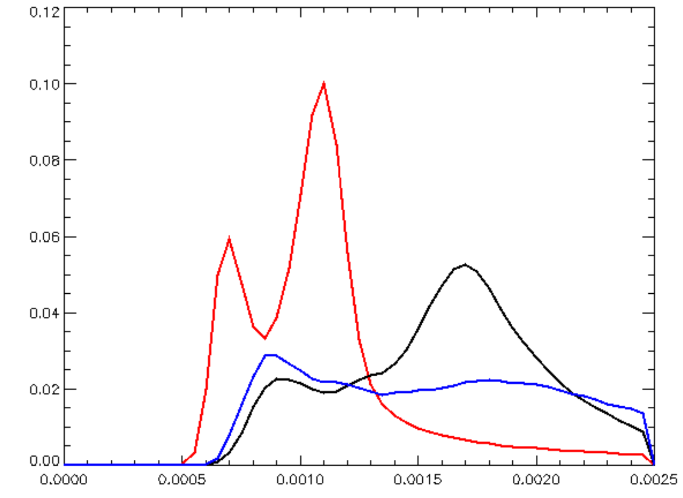
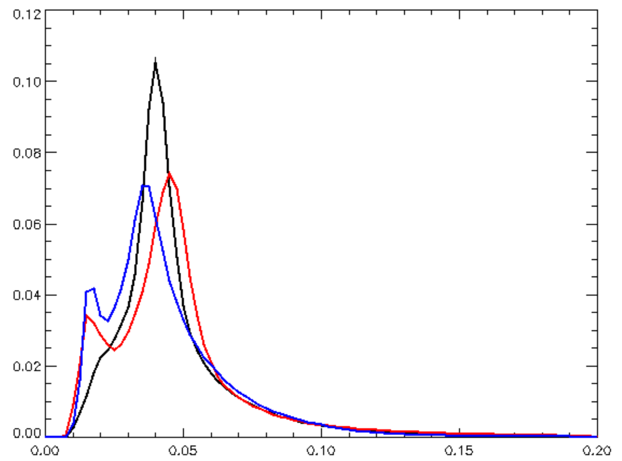
Normalized histogram
Normalized Histogram
S003 morning
S011 nominal
S016 evening
S003 morning
S011 nominal
S016 evening
Fitting RMS
Relative Uncertainty=
FittingUncertainty/SCD

