Slide 1
TEMPO Solar Calibration
David Flittner#
Xiong Liu*, Heesung Chong*, Weizhen Hou*, John Houck*, John E. Davis*, James Carr*, Raid M. Suleiman*, Kelly Chance*
August 26, 2024
david.e.flittner@nasa.gov
# NASA Langley Research Center
* Smithsonian Astrophysical Observatory

Slide 2
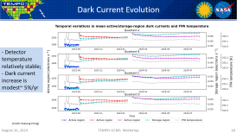
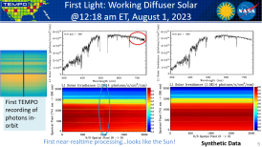
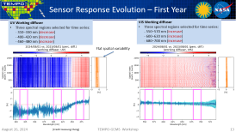
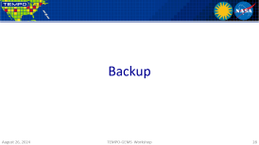
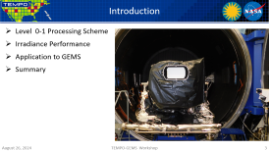
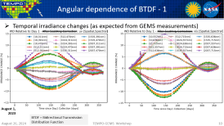
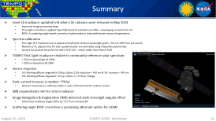
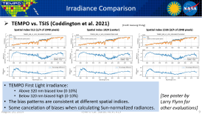
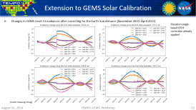
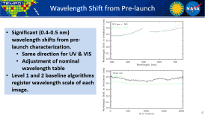
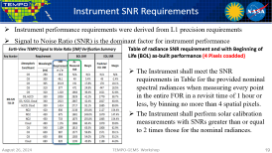

Slide 3
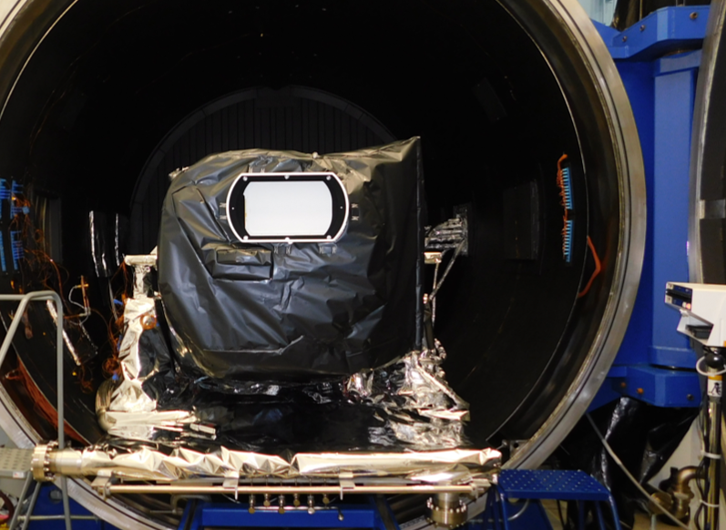
Introduction
Level 0-1 Processing Scheme
Irradiance Performance
Application to GEMS
Summary

Slide 4
TEMPO L0–1 processor
= Not turned on at launch
Flow chart
Radiance
Image processing
L0
Current (e- s^{–1}) derivation
Dark current
subtraction
Photon
derivation
INR
Spectral
calibration
Polarization
correction
L1b
(including
stray light correction)
Irradiance
L0
Current (e- s^{–1}) derivation
Dark current
subtraction
Photon
derivation
BTDF
correction
Diffuser
polarization
correction
Spectral
calibration
L1b
(including
stray light correction)
Dark current
L0
Current (e- s^{–1}) derivation
L1a
Approach for TEMPO adapts elements from GEMS, TropOMI, OMI
(See next talk by Heesung Chong for status)

Slide 5
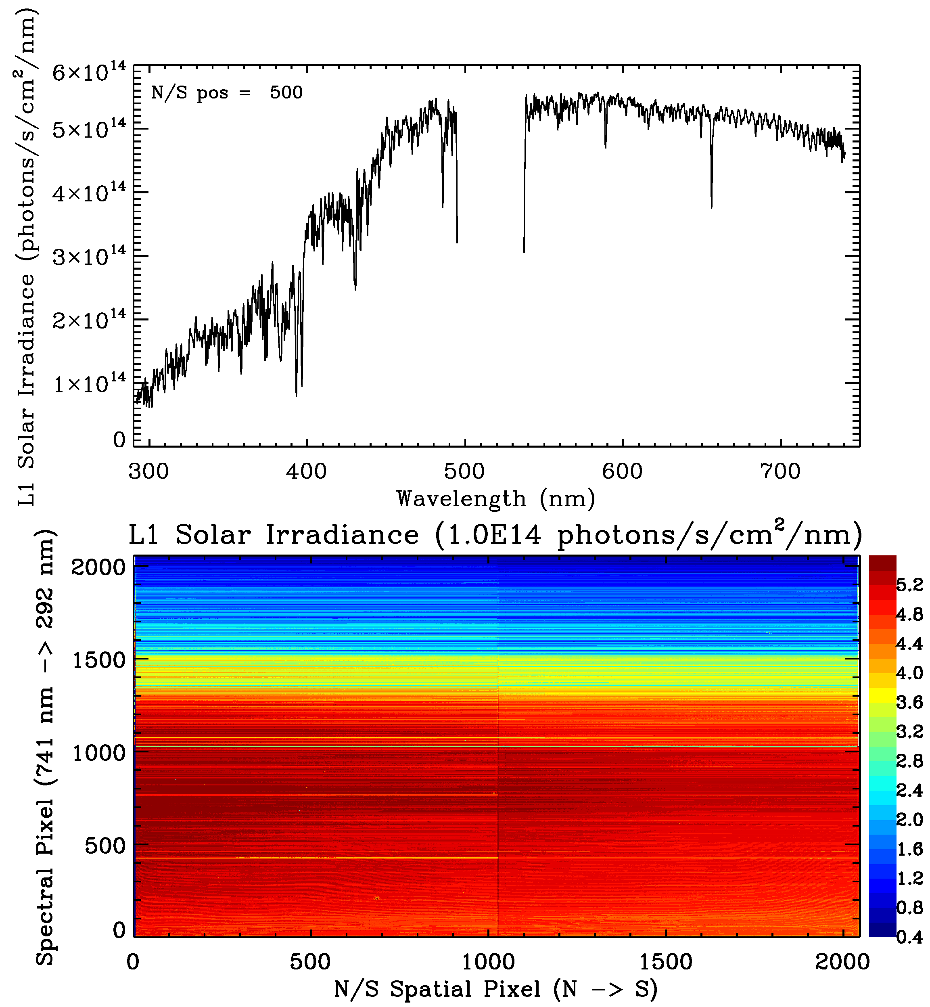
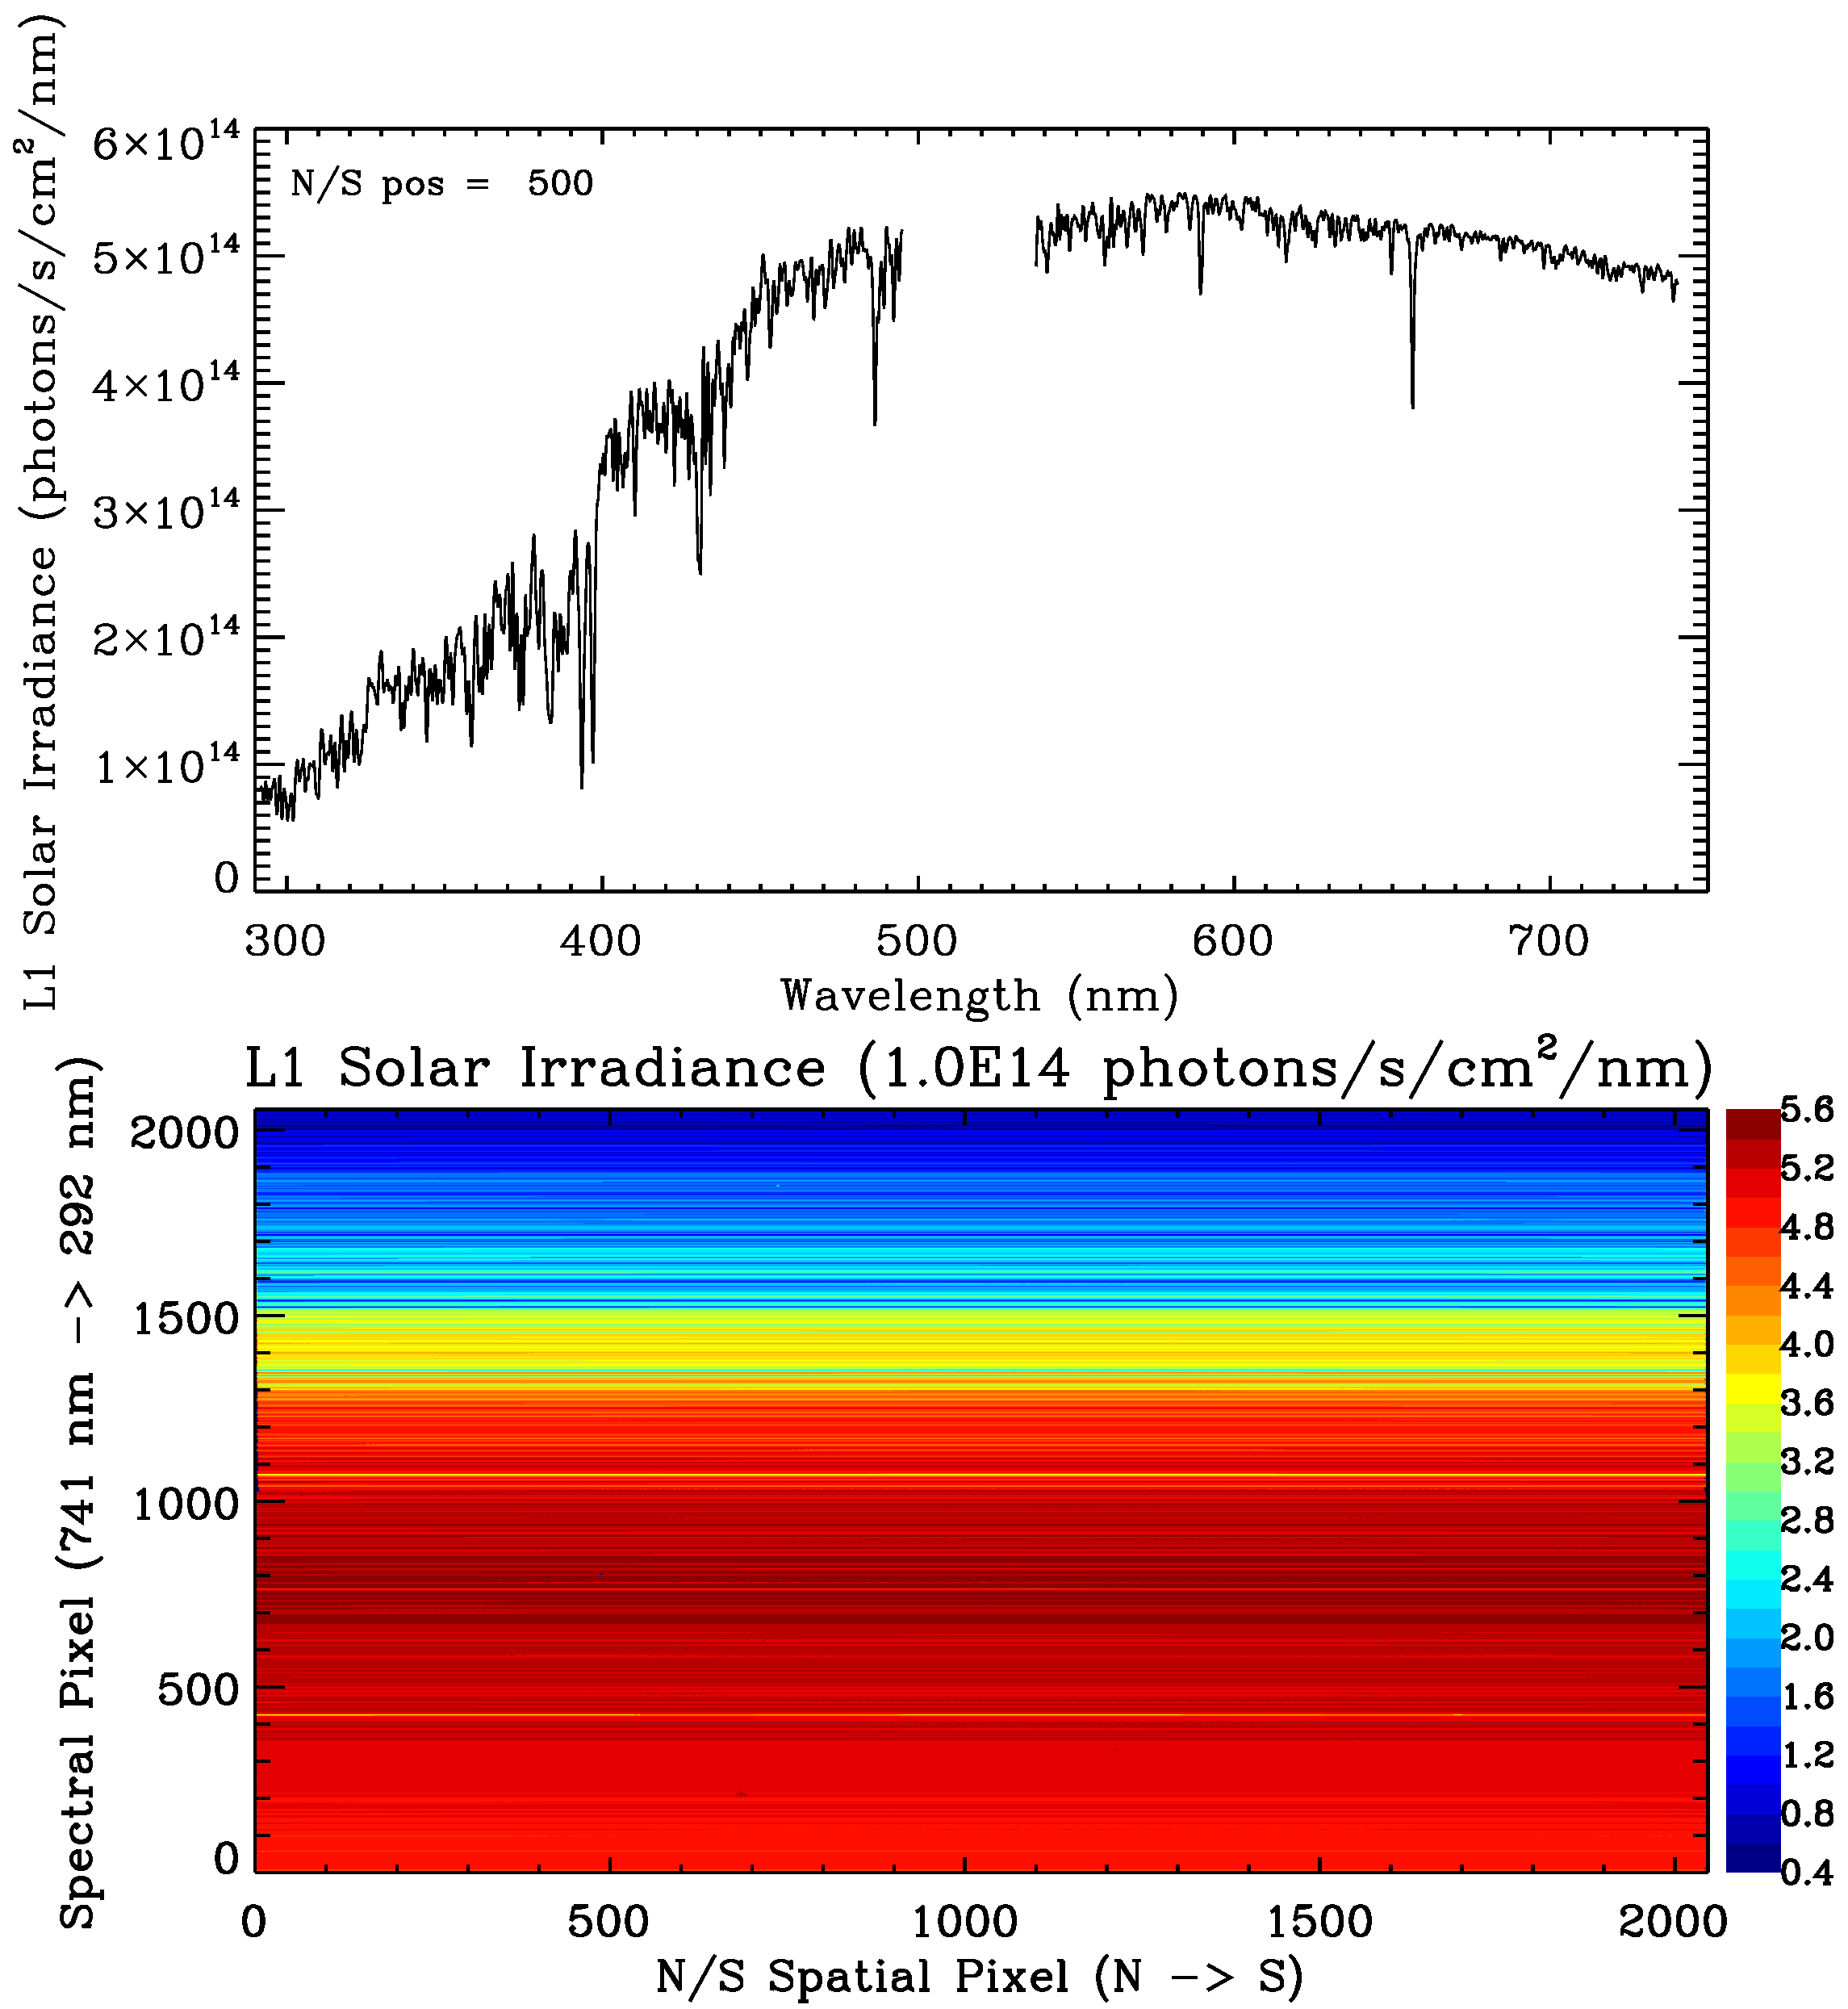
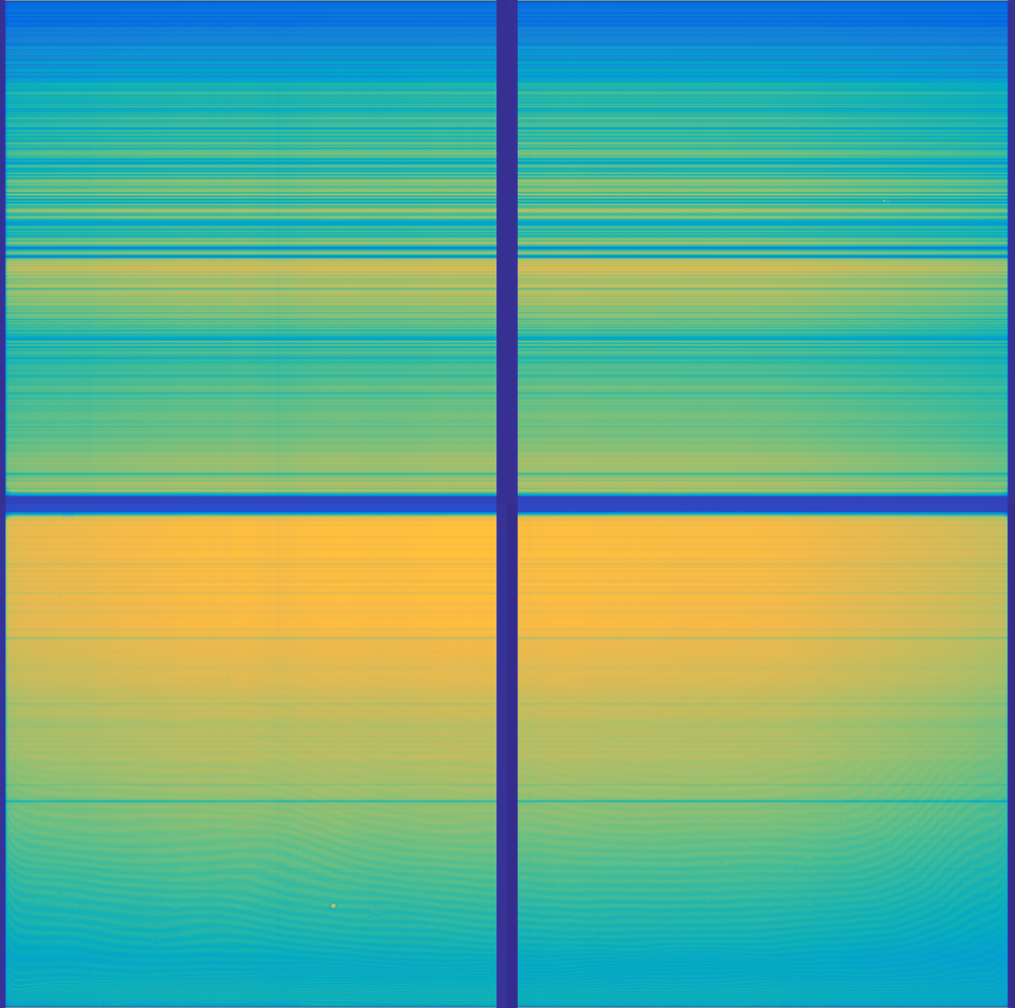
First Light: Working Diffuser Solar
@12:18 am ET, August 1, 2023
First TEMPO recording of photons in-orbit
First near-realtime processing…looks like the Sun!
Synthetic Data

Slide 6
Wavelength Shift from Pre-launch
Significant (0.4-0.5 nm) wavelength shifts from pre-launch characterization.
  Same direction for UV & VIS
  Adjustment of nominal wavelength table
Level 1 and 2 baseline algorithms register wavelength scale of each image.

Slide 7
Wavelength Stability
Wavelength scale has changed (shifted) ever so slightly since First Light
Much more stable since ~ Spring 2024
Spectral range nearly constant
L1b IRR/IRRR contains estimated shift (wavecal_param)
See Weizhen Hou’s poster for spectral calibration

Slide 8
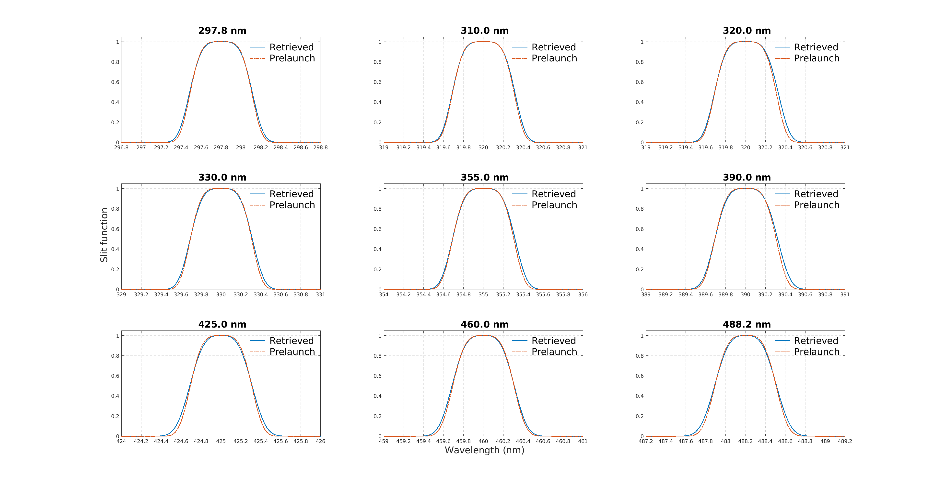
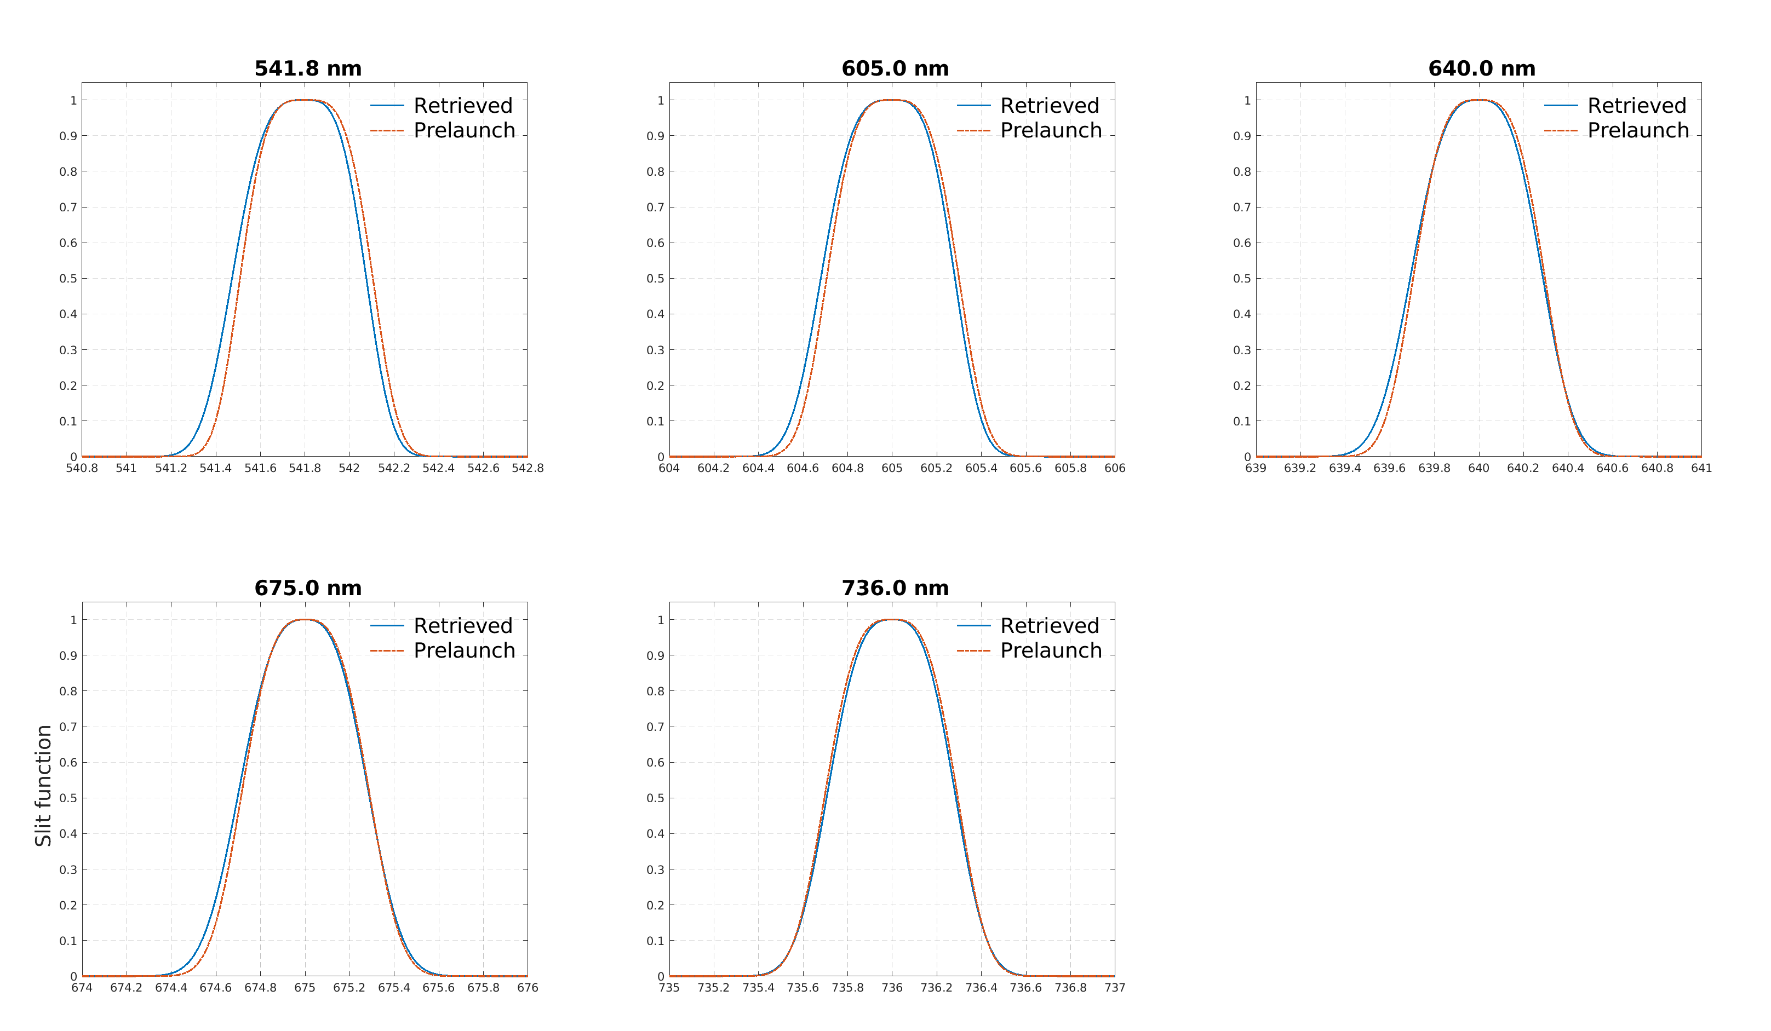
Spectral bandpass calibration
Deriving in-flight spectral response function assuming asymmetric super Gaussian – wings slightly wider than prelaunch
UV CCD
VIS CCD
[Credit: Weizhen Hou]

Slide 9
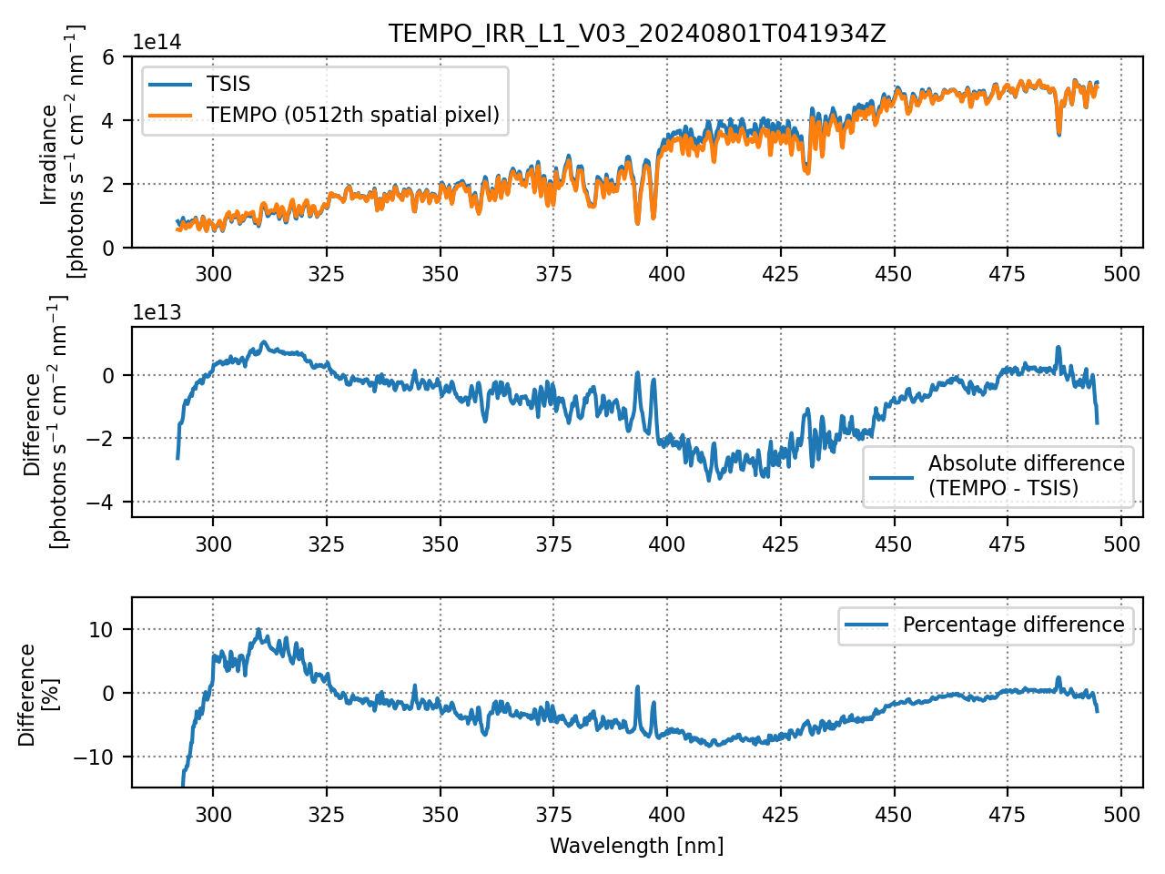
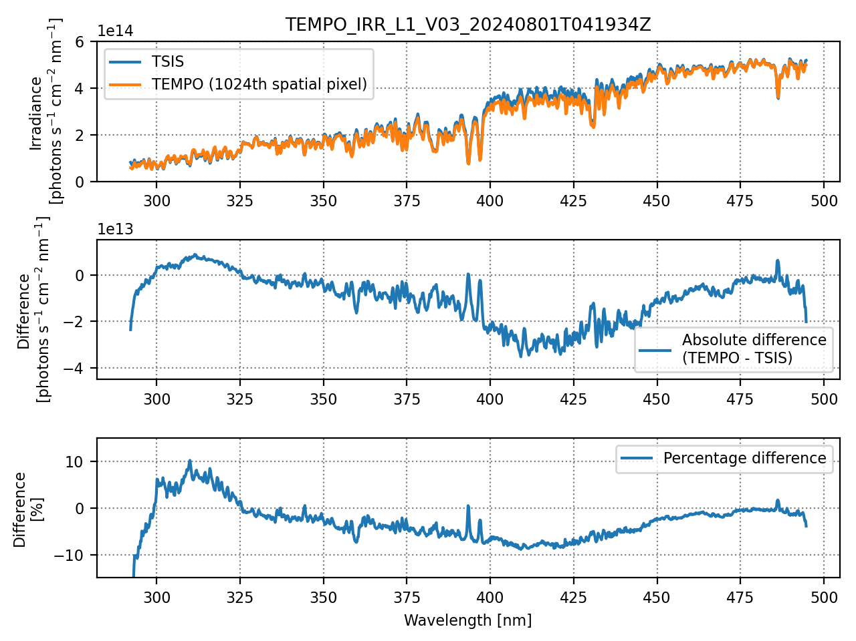
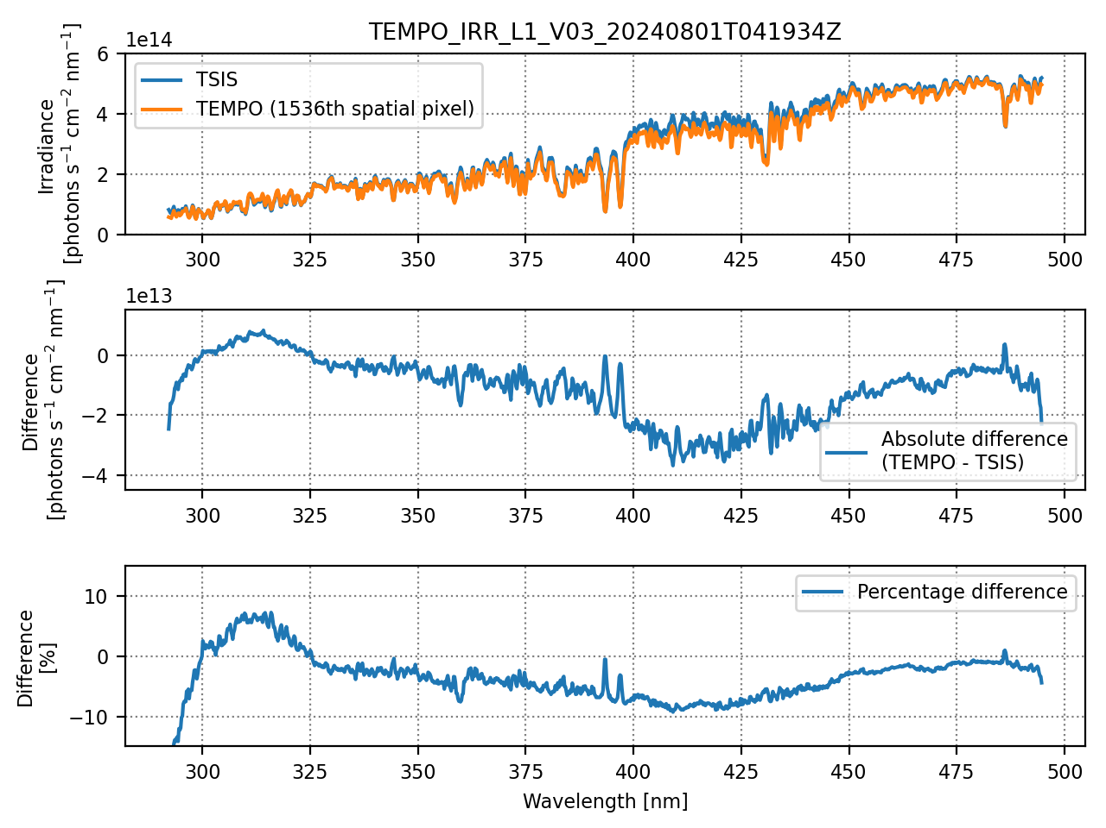
Irradiance Comparison
TEMPO vs. TSIS (Coddington et al. 2021)
[Credit: Heesung Chong]
Spatial index 512 (1/4 of 2048 pixels)
Spatial index 1024 (center)
Spatial index 1536 (3/4 of 2048 pixels)
TEMPO First Light irradiance:
  Above 320 nm biased low (0-10%)
  Below 320 nm biased high (0-10%)
The bias patterns are consistent at different spatial indices.
Some cancelation of biases when calculating Sun-normalized radiances.
[See poster by Larry Flynn for other evaluations]

Slide 10
Angular dependence of BTDF - 1
Temporal irradiance changes (as expected from GEMS measurements)
August 1, 2023
BTDF = Bidirectional Transmission Distribution Function

Slide 11
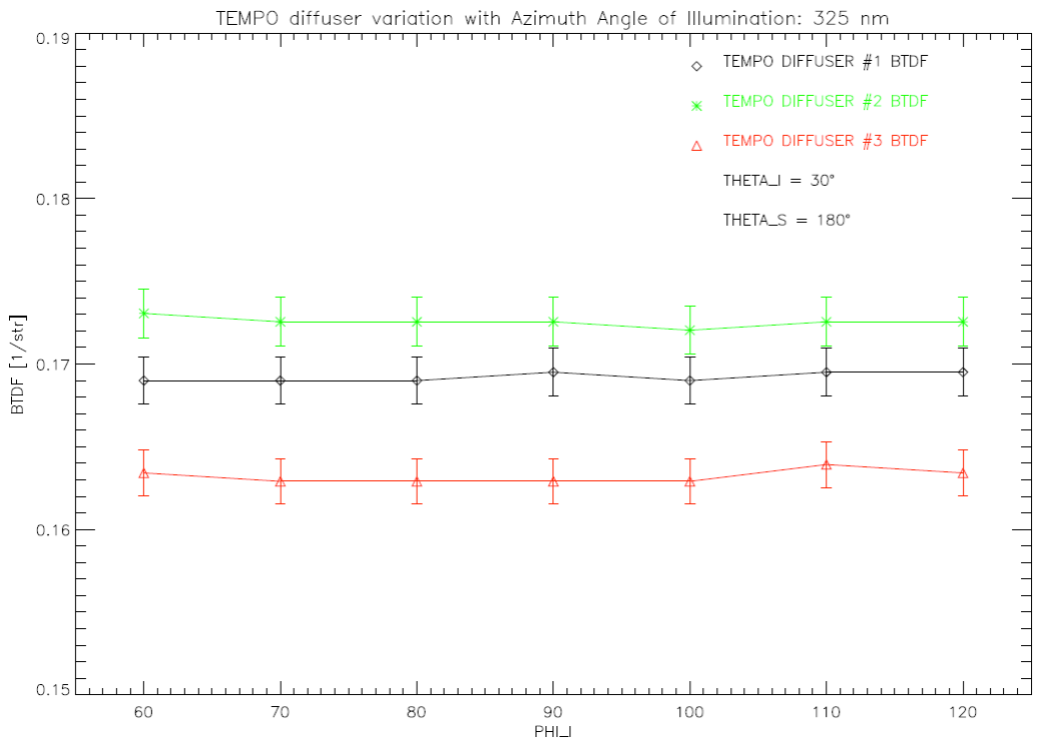
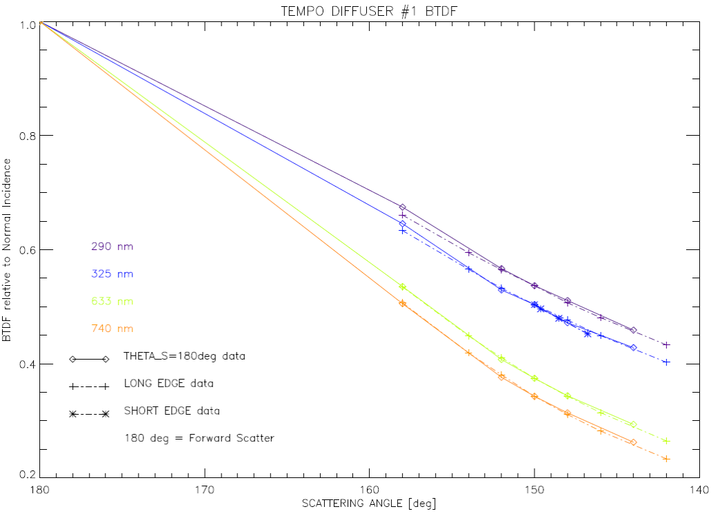
Correcting angle-dependence of BTDF -2
First-principle correction using ‘scattering angles’ implemented.
BTDF at center of diffuser (aka middle of N-S slit) independent of azimuth angle
BTDF has robust dependence on scattering angle
Geometry of solar cal.
z
Incident
elevation
angle
(~30º)
Scattering
angle
Working Solar Diffuser
Incident
azimuth
angle
Diffuser
x
Slit
y
North
South
[Credit: Heesung Chong]
Incident Azimuth Angle
(Forward)
Scattering Angle
BTDF = Bidirectional Transmission Distribution Function

Slide 12
Correcting angle-dependence of BTDF - 3
After applying scattering angle correction, trend is significantly reduced

Slide 13
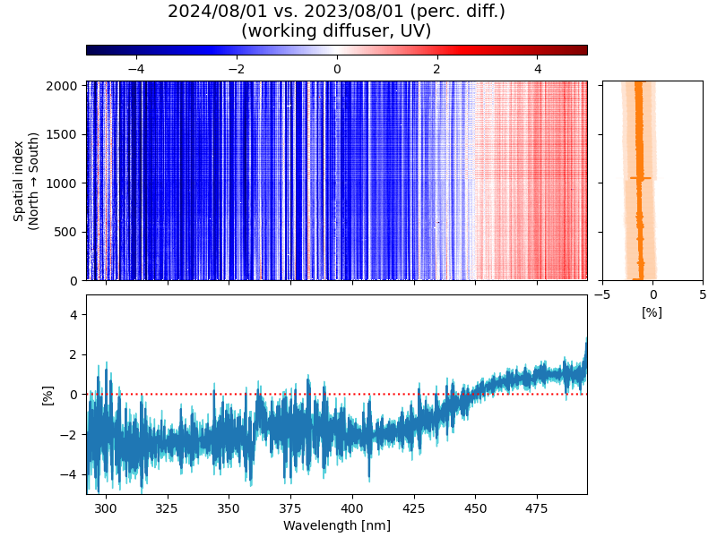
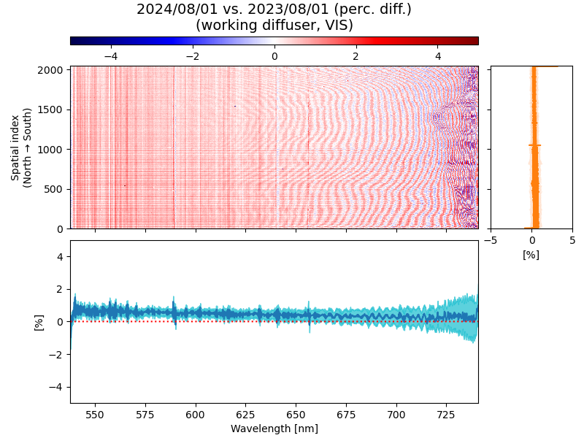
Sensor Response Evolution – First Year
UV Working diffuser
Three spectral regions selected for time series:
- 310–330 nm (decrease)
- 400–420 nm (decrease)
- 460–480 nm (increase)
VIS Working diffuser
Three spectral regions selected for time series:
- 550–570 nm (increase)
- 600–620 nm (increase)
- 680–700 nm (increase)
Flat spatial variability
[Credit: Heesung Chong]

Slide 14
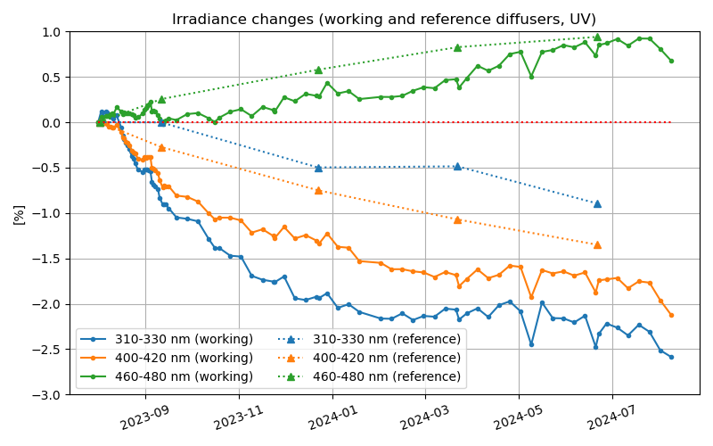
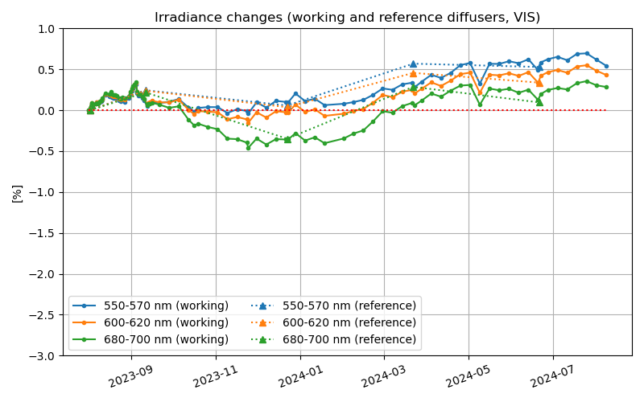
Irradiance changes at selected channels
[ Assumptions ]
Changes in working irradiances caused by diffuser + optics changes.
Changes in reference irradiances are exclusively optics changes.
(degradation of reference diffuser neglected)
[Credit: Heesung Chong]

Slide 15
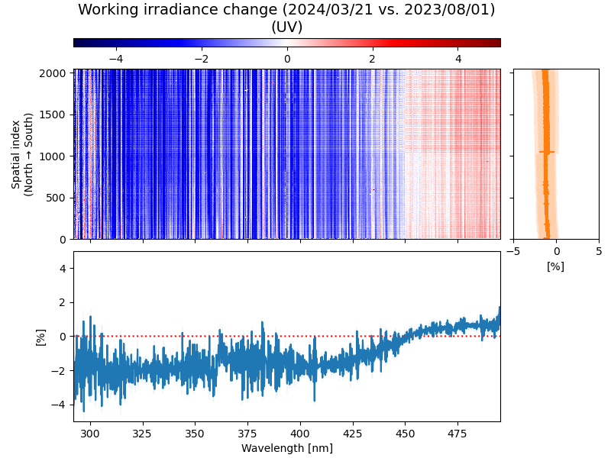
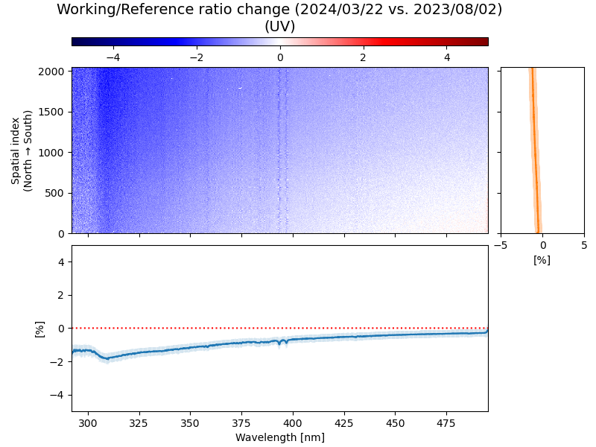
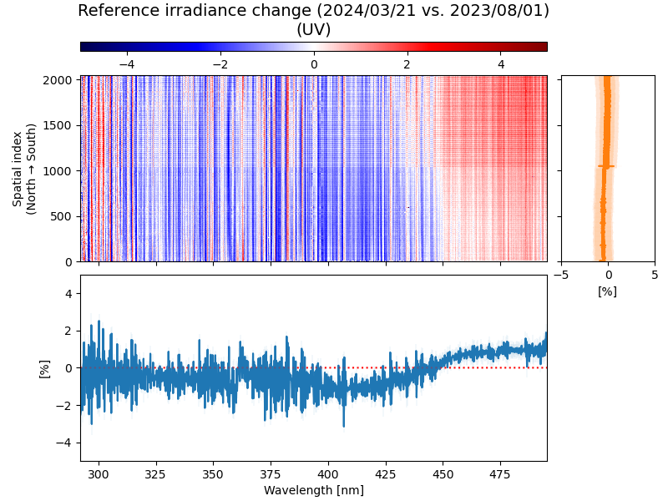
Contribution separation
Spring (Vernal) Equinox (2024/03/21)
Working irradiance changes
Proxy for working diffuser changes
Proxy for optics changes
=
+
Working diffuser changes lead to irradiance decreases;
Optics changes have wavelength dependence.
[Credit: Heesung Chong]

Slide 16
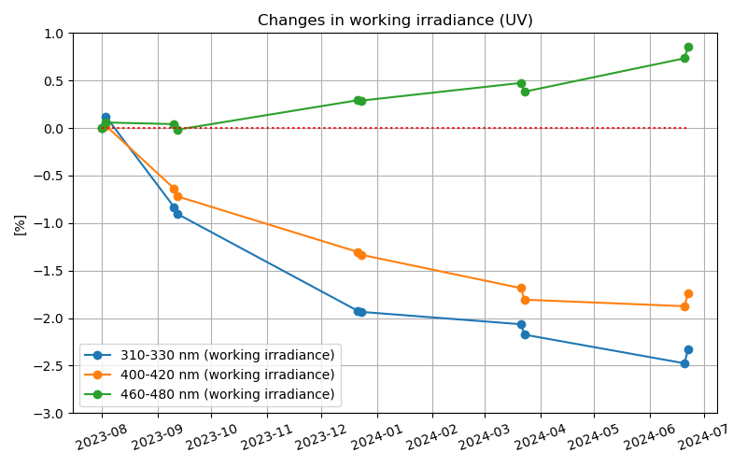
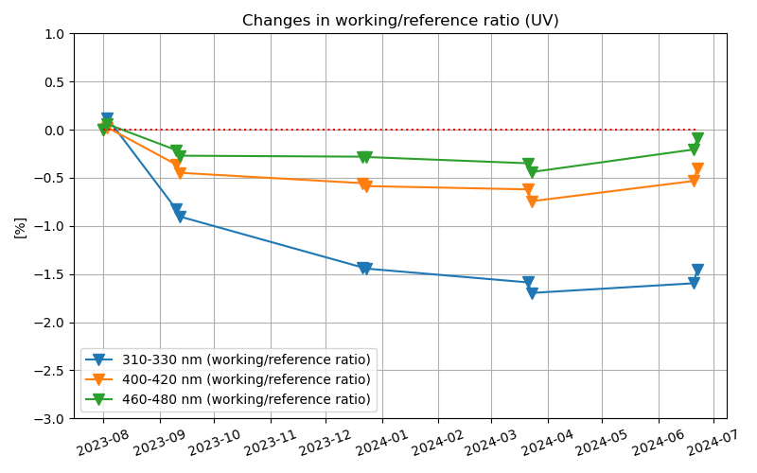
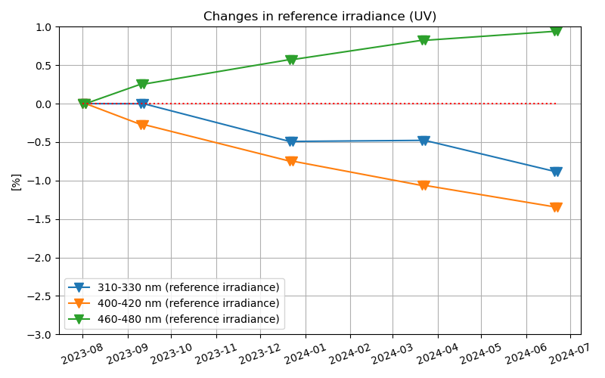
Contribution separation (UV)
Time series for the selected channels
Working irradiance changes
Proxy for working diffuser changes
Proxy for optics changes
=
+
Working diffuser changes lead to irradiance decreases;
Optics changes have wavelength dependence.
[Credit: Heesung Chong]

Slide 17
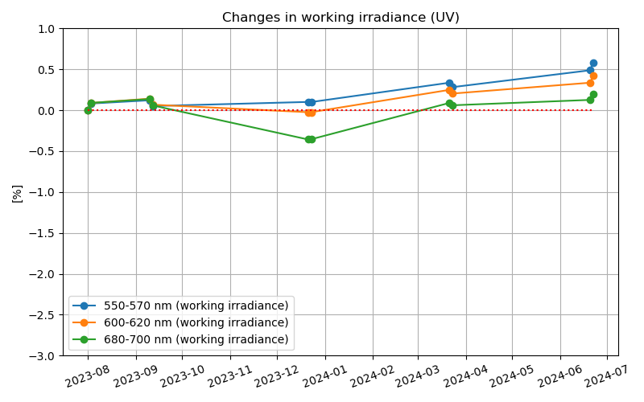
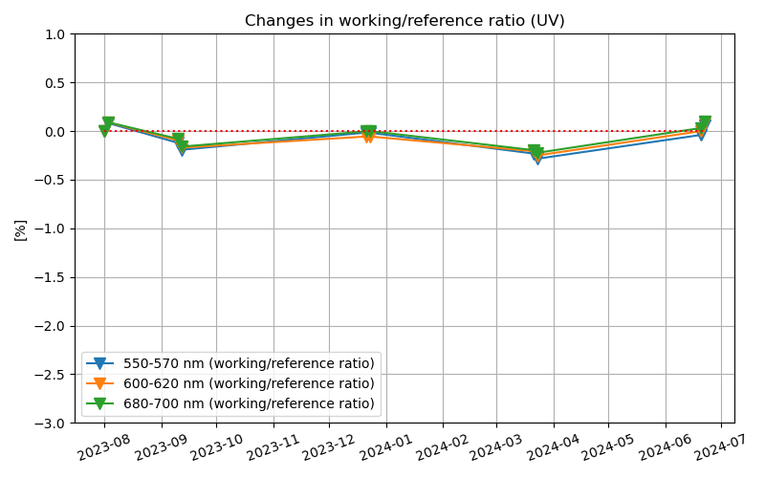
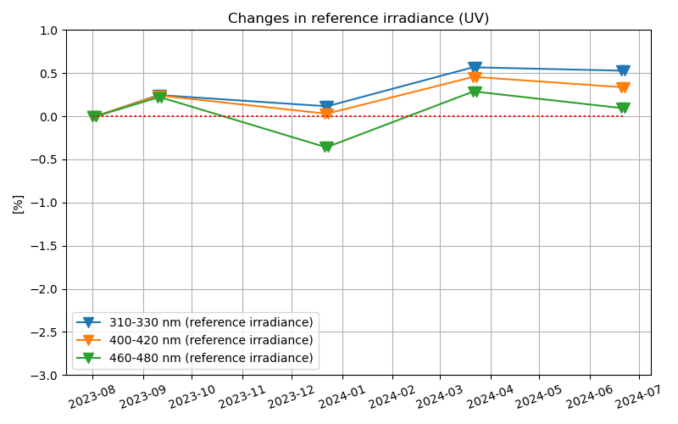
Contribution separation (VIS)
Time series for the selected channels
Working irradiance changes
Proxy for working diffuser changes
Proxy for optics changes
=
+
Optics changes have consistent patterns between different wavelengths in the VIS CCD.
[Credit: Heesung Chong]

Slide 18
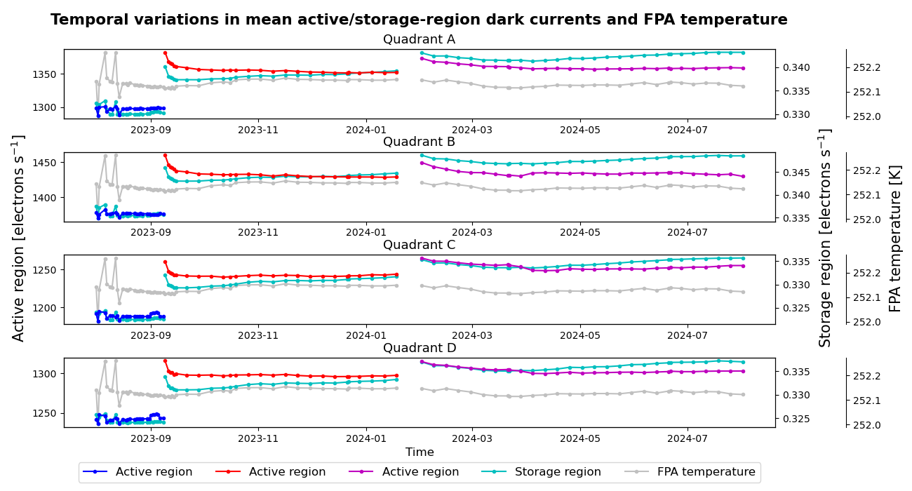
Dark Current Evolution
- Detector temperature relatively stable;
- Dark current increase is modest~ 5%/yr
[Credit: Heesung Chong]

Slide 19
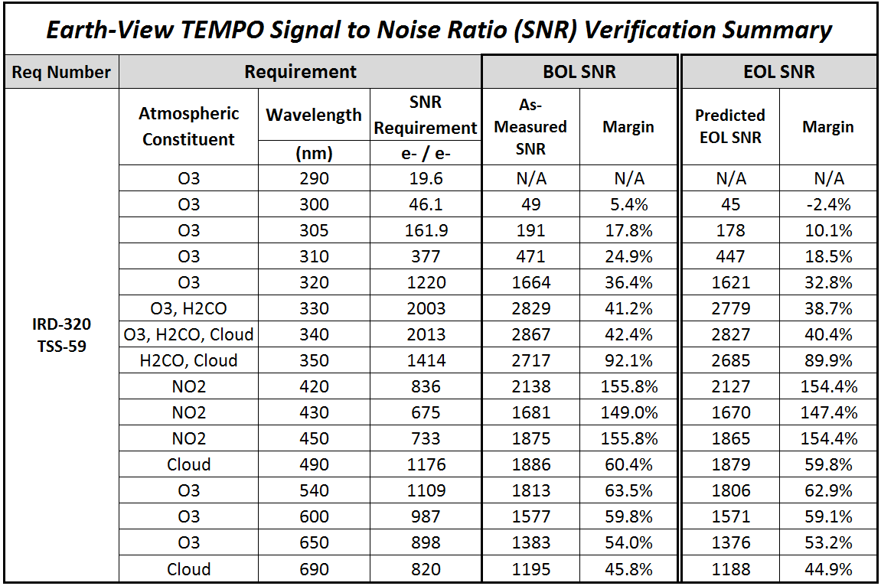
Instrument SNR Requirements
Instrument performance requirements were derived from L1 precision requirements
Signal to Noise Ratio (SNR) is the dominant factor for instrument performance
Table of radiance SNR requirement and with Beginning of Life (BOL) as-built performance (4 Pixels coadded)
The Instrument shall meet the SNR requirements in Table for the provided nominal spectral radiances when measuring every point in the entire FOR in a revisit time of 1 hour or less, by binning no more than 4 spatial pixels.
The Instrument shall perform solar calibration measurements with SNRs greater than or equal to 2 times those for the nominal radiances.

Slide 20
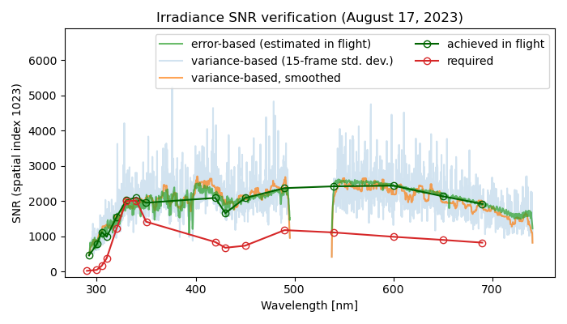
Solar Irradiance SNR
15 frames of working solar diffuser measurements on 8/17/2023 for SNR verification.
After accounting for variation with solar geometry:
  L1 Signal to Noise Ratio (SNR) calculation is correct
  We can meet the solar SNR requirement.
[Credit: Heesung Chong]

Slide 21
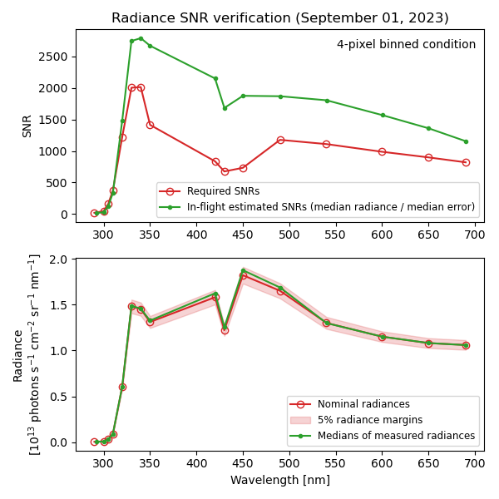
Radiance SNR
Used radiance data from all thirteen scans on September 1.
  For each nominal wavelength, select pixels within +/-5% of the nominal radiance.
  Calculate median of SNRs for the searched pixels for each wavelength (upper panel).
  Calculate the median of radiances for the searched pixels for each wavelength (lower panel).
Meets SNR requirement > 315 nm
10-30% below SNR req. < 315 nm
[Credit: Heesung Chong]

Slide 22
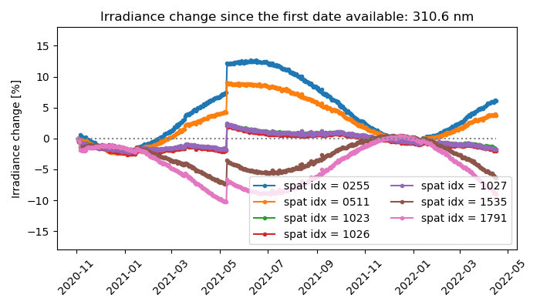
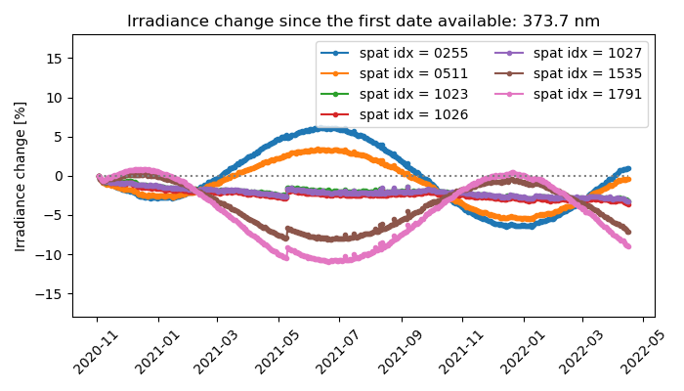
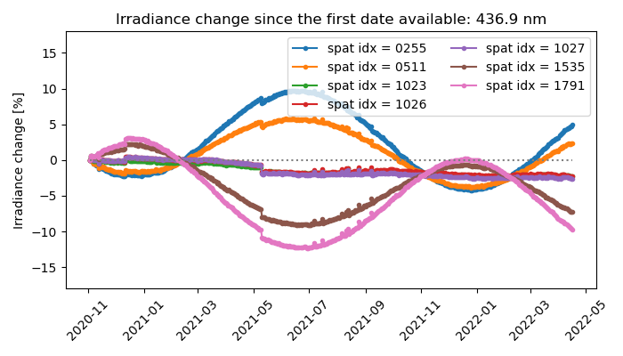
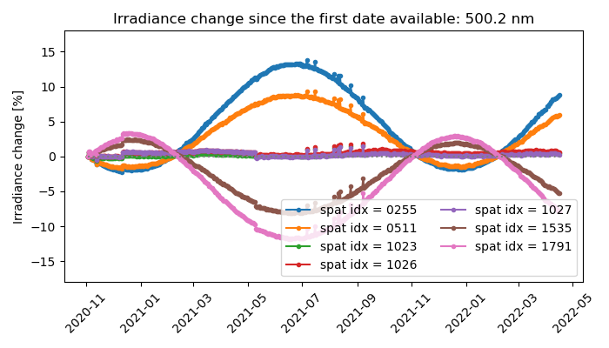
Extension to GEMS Solar Calibration
Changes in GEMS Level-1 irradiances after correcting for the Earth-Sun distance (November 2020–April 2022)
Elevation-angle-based BTDF correction already applied
[Credit: Heesung Chong]

Slide 23
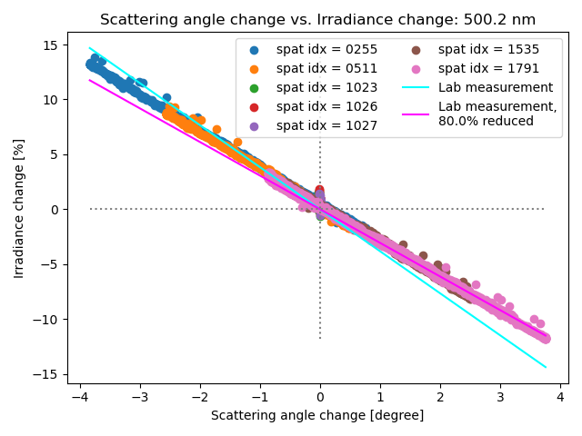
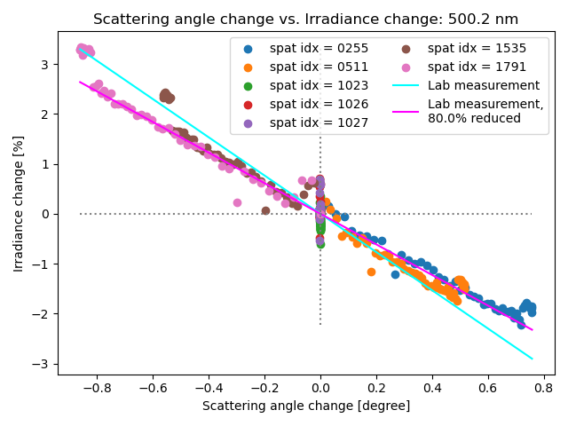
Irradiance change as a function of the scattering angle change
November 2020–April 2022
The earliest 50 days (November–December 2020)
[Credit: Heesung Chong]

Slide 24
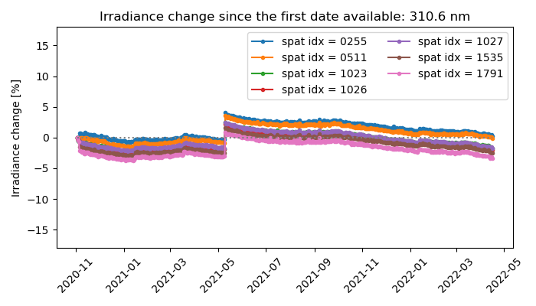
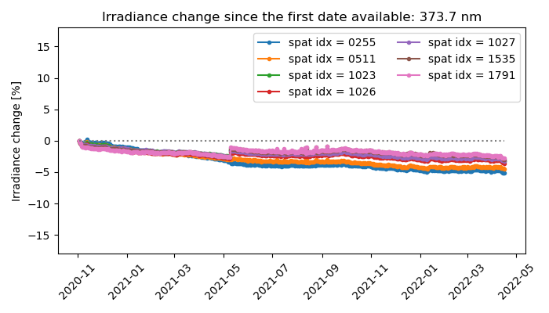
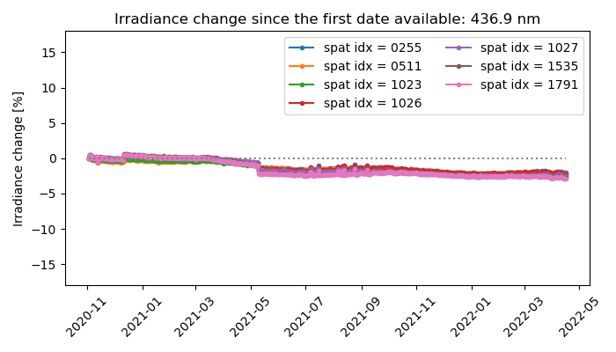
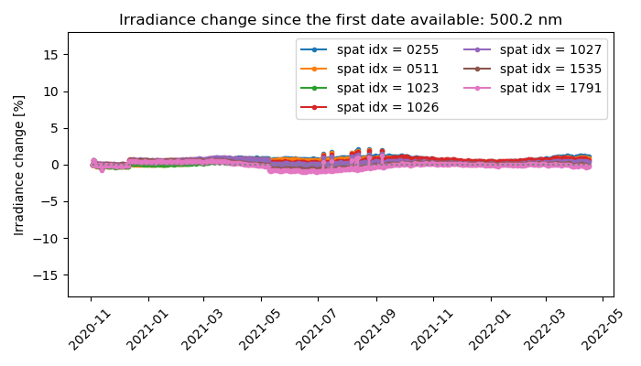
Applying TEMPO method to GEMS
[Credit: Heesung Chong]

Slide 25
Calibration and L1b Validation
Verify and update image correction steps in the L0-1 processing during Commissioning Phase and Nominal Operation
  System linearity, zero-input, relative gains, saturation blooming, dark current variation and temperature-dependent correction, check quality flags, evolution of solar diffuser, noise calculation, straylight
Assess wavelength calibration and its performance
  Will assess performance of routine processing (wavelength calibration in both L0-1b & L1-2 via high-resolution solar reference and atmospheric absorption)
  Pre-launch measured instrument line shape will be compared with that derived from solar irradiance
Assess radiometric calibration using a multi-pronged approach
  Internal assessment of images, assess performance of routine processing
  Comparison solar irradiance with solar reference and correlative contemporaneous sensors (e.g., OMPS, TROPOMI, GOME-2, EPIC, MODIS, VIIRS)
  Comparison with radiative transfer simulation
Assess and improve INR accuracy
  Alignment issue, ephemeris reliability, IRU time synchronization, scan tailoring verification
  Different configuration for special observation

Slide 26
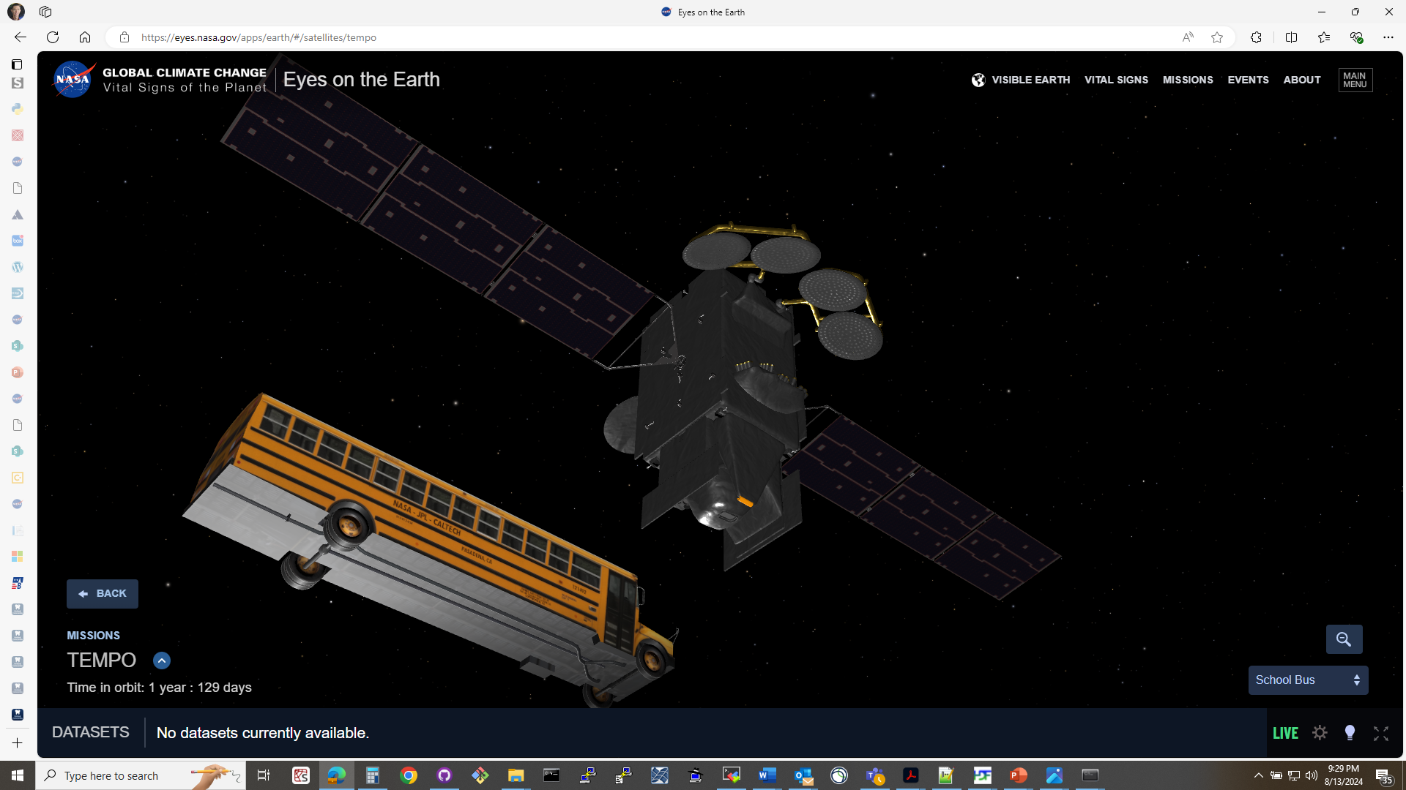
Summary
Level 1b irradiance updated (v3) when L1b radiance were released in May 2024
  Improved image processing steps
  Stray light correction is applied: Spectrally bland SL residual is possible – developing correction for UV
  BTDF: A scattering-angle-based correction implemented to reduce/eliminate seasonal dependance
Spectral calibration
  First Light (FL) irradiance use to update and optimize nominal wavelength grids; > 0.4 nm shift from pre-launch
  Relative to FL, adjustments for each spatial location are estimated using Chebyshev polynomials
  Spectra has gradual temporal red shift (UV & VIS) – nearly stable since March 2024
TEMPO First Light irradiance relative to community reference solar spectrum:
  < 320 nm biased high (0-10%);
  > 320 nm biased low (0-10%)
Sensor response
  UV: Working diffuser degraded 0-2%/yr; Optics 1.5% reduction < 450 nm & 1% increase > 450 nm
  VIS: Working diffuser degraded < 0.5/yr; Optics +/- 0.5%/yr change
Dark current increase is modest ~5%/yr
  Detector temperature relatively stable in-spite of diminished S/C radiator system
SNR requirements met for solar irradiance
Image Navigation & Registration (INR) detected static boresight angular offset
  Initial solar incidence angles differ by ~0.3° from nominal 30°
Scattering-angle BTDF correction is promising alternate option for GEMS

Slide 28
Backup

Slide 29


Slide 30


Slide 31


Slide 33
Solar Calibration Geometry

