Slide 1




Tropospheric Emissions:
Monitoring of Pollution
Status of TEMPO: Commissioning and
First Year Operation Results
Xiong Liu¹, K. Chance¹, R. Suleiman¹, J. Houck¹, J. Davis¹, G. Gonzalez Abad¹,
C.R. Nowlan¹, H. Wang¹, H. Chong¹, W. Hou¹, J. Park¹, J. Bak¹, L. Carpenter¹,
C. Chan Miller¹, J. Fitzmaurice¹, A. Oppenheimer¹, E. O’Sullivan¹, Z. Ayazpour¹,
K. Daugherty², D.E. Flittner², C. Fenn², D. Rosenbaum², C. Brown², N. Mishra²,
R.T. Neece² , E. Roback², J. Strickland², L. Judd², P. Rawat², K. Travis², J. Carr³,
X. Lei³, J. Szykman⁴, B. Henderson⁴, L. Valin⁴, J. Joiner⁵, Z. Fasnacht⁵,
S. Frith⁵, D. Haffner⁵, E. Knowland⁵, N. Kramarova⁵, W. Qin⁵, C. Seftor⁵,
Vasilkov⁵, E.-S. Yang⁵, J. Ziemke⁵, M. Newchurch⁶, A. Naeger⁶, R. Cohen⁷,
J. Geddes⁸, J. Herman⁹, B. Pierce¹⁰, R. Spurr¹¹, S. Kondragunta¹²,
H. Zhang¹², P. Ciren¹², J. Wang¹³, X. Zhao¹⁴, Ivan Orteg¹⁵, and the TEMPO Team
¹SAO, CfA ²NASA LaRc ³Carr Astro. ⁴EPA ⁵NASA GSFC ⁶UAH
⁷UCB ⁸BU ⁹UMBC ¹⁰UWM ¹¹RT Sol. Inc ¹²NOAA ¹³UI ¹⁴ECCC ¹⁵UCAR
TEMPO-GEMS Joint Science Team Workshop
Kailua-Kona, Hawaii, USA
August 26-30, 2024

Slide 2
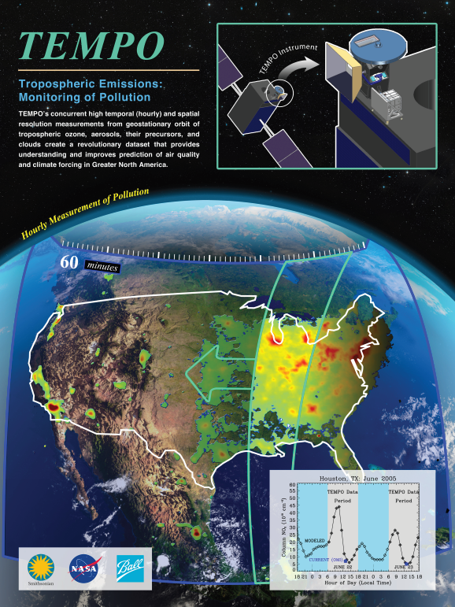
The TEMPO Mission
NASA’s first Earth Venture Instrument (EVI) selected in 2012
PI-led at Smithsonian Astrophysical Observatory (SAO): Science team, instrument operation center (IOC), science data processing center (SDPC)
Instrument Project Management: NASA LaRC → SAO (Phase E)
Instrument Development: Ball Aerospace (now part of BAE Systems, Inc.)
Other Institutions: NASA GSFC, NOAA, EPA, NCAR, Harvard, UC Berkeley, St. Louis U, UAH, U Iowa, Sitting Bull College, RT Solutions, Carr Astro.
International collaboration: Mexico, Canada, Cuba, Korea, U.K., ESA, Spain
NASA’s first host payload, launched on April 7, 2023
  Mission Project Management: NASA LaRC
  Host Satellite Provider: Maxar Technologies
  Satellite Host: Intelsat (IS-40e)
  Launch: SpaceX
TEMPO Early Adopter Program at NASA MSFC/UAH (funded by NASA Applied Science): >600 early adopters
TEMPO: It’s about Time!

Slide 3
TEMPO Commissioning and
Early Nominal Operation
TEMPO commissioning: SAO + LaRC + Intelsat + Maxar + Ball + Carr Astronautics
Nominal operation: after the Post Launch Acceptance Review (PLAR) on 10/18-19/2023
  Weekly commanding (2 weeks of commands, updated weekly)
  Optimize off-nominal twilight (city lights) observations
  No special observation (before public release) except during 2024 RRV Cal-Val Campaign (6/13-18/2024)
  Several anomalies: Safe mode, scan mirror stopped advancing midway through scan, TEMPO simulator
    TEMPO simulator failure, 7/31/2024: no data on 8/7-8/21:
      (1) Identified NI chassis failure, procured the replacement part and will try to fix the simulator next week.
      (2) Got ESSP approval last week to command using only validated command blocks (CBMs) when simulator not working.
TEMPO
Power On
Launch
First Light
PLAR
L+0 (4/7/23)
L+61 days (6/7/23)
L+115 days (7/31-8/2/23)
L+194 days
(10/19/23)
Outgassing
S/C Activity
(TEMPO Off)
TEMPO Commissioning
Nominal Operations
Activation
Instrument Characterization and Analysis
Successful TEMPO commissioning and early nominal operation!

Slide 4
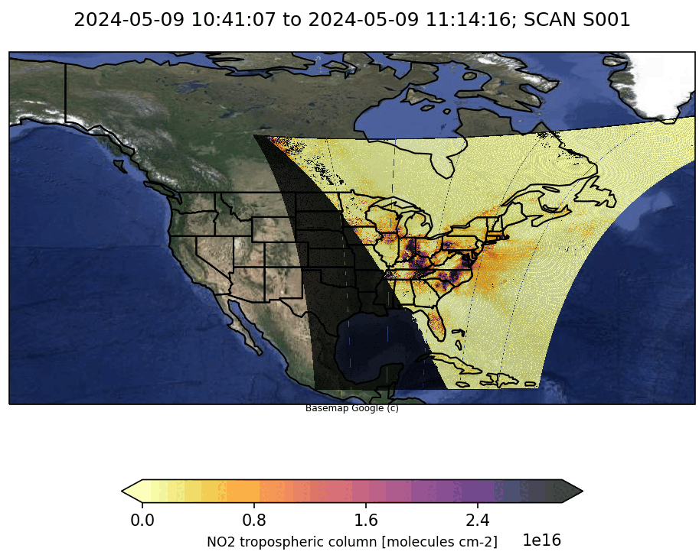

TEMPO Scanning and Special Observations
  Operate on Intelsat 40e (IS-40e) at 91 ∘ W
Nominal scans
  2048 North/South pixels
  1181 East/West steps per hour
  2 x 4.75 km² at center of field of regard
Optimized scans
  Higher temporal resolution AM and PM scans over coasts (40 minutes)
Twilight scans (city lights)
  Performed during darkness (~Aug. 15-Apr. 15)
Special observations: can be requested (after fixing simulator) with strong science justification
https://weather.ndc.nasa.gov/tempo/green_paper.html
  High-time scans (5-10 mins) over selected longitudes (several hours, alternate hourly scan/1 hour high-time scans)
  Oversampling in the E/W
  Slightly change of field of regard

Slide 5
TEMPO Baseline Mission and Its Extension
TEMPO cost-cap baseline mission
  Phase E: 20 months, 10/19/2023-6/18/2025
  Baseline mission review, ~60-90 days after baseline mission ending
TEMPO mission extension via either
  Senior review: proposal due ~3/2026, funding starts FY2027, gap funding 6/2025-9/2026 based on PPBE26, or
  Out of cycle review: presentations
  NASA HQ decision in ~3-4 months
TEMPO is a great pathfinder for GeoXO ACX.

Slide 6
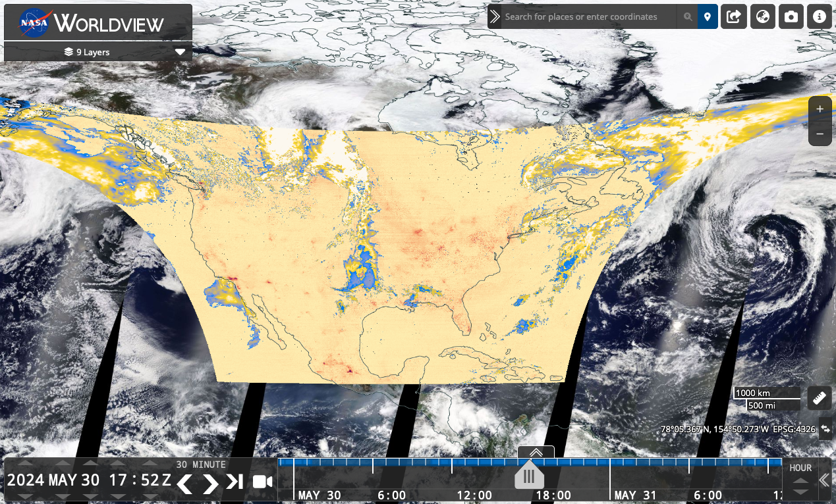
TEMPO Baseline Data Products Release via NASA ASDC
Public Release | Details
V01 | Limited 3 weeks released on February 5, 2024
V02 | Level 1 (radiances) released on February 27, 2024
V03 | Level 1 updated, Level 2/3 NO₂, HCHO, total O₃ released on 5/20/2024 (5/13/2024 onwards). Reprocessing almost finished (08/2023-03/2024 done).
Multiple services/tools:
  Earthdata Search, OPeNDAP
  NASA Worldview: all data products
  ArcGIS services: currently NO2
  RSIG (EPA)
  TEMPO-Lite (CfA): currently NO2
For more information check out:
  User Guide
  Daily operation log
  Validation plan
  Validation reports (coming soon)
  Algorithm Theoretical Basis Documents (drafts available upon request, to be reviewed soon)
NASA Webinar recording for new users: https://youtu.be/meySKqVuVT0?si=uiLTRXsgtKIGS_OT

Slide 7
Baseline TEMPO Data Products
Level | Product | Validation Status
L1 | Irradiance ^{NRT} | Beta
 | Radiance ^{NRT} | Beta
 | Radiance (twilight – city lights) | Beta
L2 | Clouds ^{NRT} | Beta
 | NO₂ ^{NRT} | Beta
 | HCHO ^{NRT} | Beta
 | O₃ (total) | Beta
 | O₃ (profile) | Production/Release on hold
L3 | L2 gridded to 0.02° × 0.02°
After several months of validation activities following the public release, the validation team expect all released data products to reach provisional level after the public release of the validation report.
*Beta: “minimally validated”, publication “not recommended and highly discouraged”
→ Hope to go to provisional status after validation team approval

Slide 8
Baseline Data Products Updates
Priorities for V04: ~early next year
  Radiances: check and improve absolute calibration, include polarization correction
  GEOS-CF meteorology and trace gases (as a priori): V1→V2
  Cloud: cloud fraction bias (L1b, GLER), de-striping, scene inhomogeneity
  HCHO: radiance reference and background correction, GLER, scene inhomogeneity
  NO₂: GLER, de-striping, scene inhomogeneity
  Total O₃: latitude-dependent bias
  O₃ profile: soft/empirical correction and optimization, validation and release of O₃ profile product (UV only first)

Slide 9
Baseline TEMPO Data Products
+ SNWG TEMPO NRT + TEMPO Enhanced
Level | Product | Lead developer
L1 | Irradiance ^{NRT} | Heesung Chong
 | Radiance ^{NRT} | Heesung Chong
 | Radiance (twilight – city lights) | Heesung Chong/Jim Carr
L2 | Clouds ^{NRT} | Huiqun Wang
 | NO₂ ^{NRT} | Caroline Nowlan
 | HCHO ^{NRT} | Gonzalo Gonzalez Abad
 | O₃ (total) | Junsung Park/Xiong Liu
 | O₃ (profile) | Junsung Park/Xiong Liu
 | SO₂ ^{NRT} | GSFC: Nickolay Krotkov/Can Li
 | UVAOD | GSFC: Omar Torres
 | Aerosol height | Univ. Iowa: Jun Wang
 | CHOCHO | SAO: Gonzalo/Caroline (Postdoc)
 | H2O | SAO: Huiqun Wang (Postdoc)
 | BrO | SAO: Heesung Chong (Postdoc)
L? | UVB | SAO?: Postdoc
SNWG C3 TEMPO NRT (2-3 hrs)
Satellite needs working group funded TEMPO NRT products (public release ~June 2025)
NOAA to produce NRT aerosols
SNWG C4 TEMPO NRT SO₂ and Enhanced Products
To be funded soon, SOW due in ~1 month
SO2 NRT
SO2, UVAOD, Aerosol height, CHOCHO, H2O, BrO, UVB
Other research products
Ocean color, vegetation, SIF, HNO2, IO, NO₃, surface albedo, surface concentrations, emissions, lighting types, etc.

Slide 10
AGU Special Collection
TEMPO Data Products, Science, and Applications
Editors: Jun Wang, Xiong Liu, Kelly Chance, Joanna Joiner, Shobha Kondragunta, James Szykman
We invites articles focusing on TEMPO data products, including:
  Development, calibration, and validation
  Operational applications and demonstration of societal benefits
  Usage through data assimilation or analysis to improve understanding and prediction of Earth and atmospheric processes
  Synergy with other satellite data products
  Interdisciplinary research utilizing TEMPO data to study atmospheric greenhouse gases, land surface (crops, fires, and soil) processes, air quality, public health, environmental justice, and hazard surveillance
  Contributions aimed at enhancing TEMPO data usage through machine learning or citizen science approaches are of great interest.
  TMEPO team recommends only data products at the provisional level and above be used for scientific investigation.
Primary Journals: Journal of Geophysical Research – Atmosphere, Earth and Space Science, Geophysical Research Letters
Open for 1.5-2 years

Slide 11
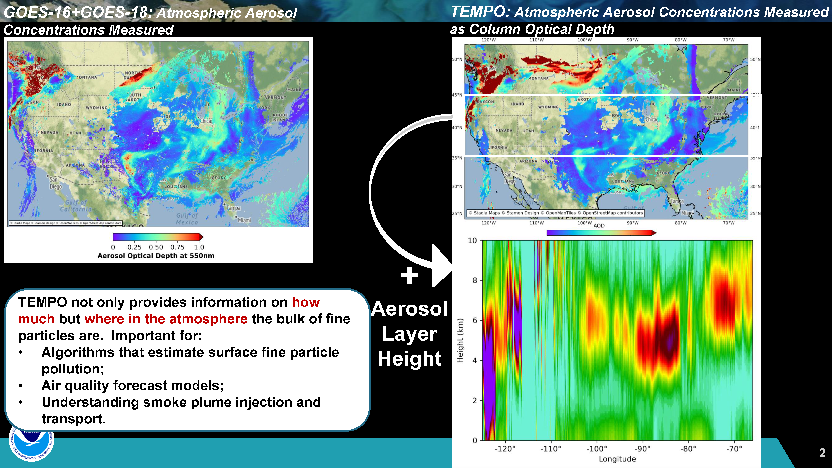
TEMPO Aerosol Retrieval
Credits: NOAA GeoXO Team, H. Zhang, P. Ciren, Z. Wei and S. Kondragunta

Slide 12
Geostationary Ocean Color from TEMPO
TEMPO used as a proxy to explore Chlorophyll (Chl) data from future GEO spectrometers over N America: GLIMR and GeoXO/OCX
Principal Component and Machine Learning (PCA+ML) approach introduced by Fasnacht et al. 2022 applied to TEMPO L1B to derive hourly Chl
  PCA+ML approach can provide information under cloud/aerosol conditions
First TEMPO hourly Chl retrievals during passage of Hurricane Idalia (top) compared with LEO average Chl (middle)
  Show higher Chl concentrations being pulled into Gulf of Mexico after passage of hurricane
Talk by Zachary Fasnacht in Session 4 on Tuesday afternoon will further explain the details of the approach and benefits of geostationary ocean color
Credits: Zachary Fasnacht, Joanna Joiner et al.

Slide 13
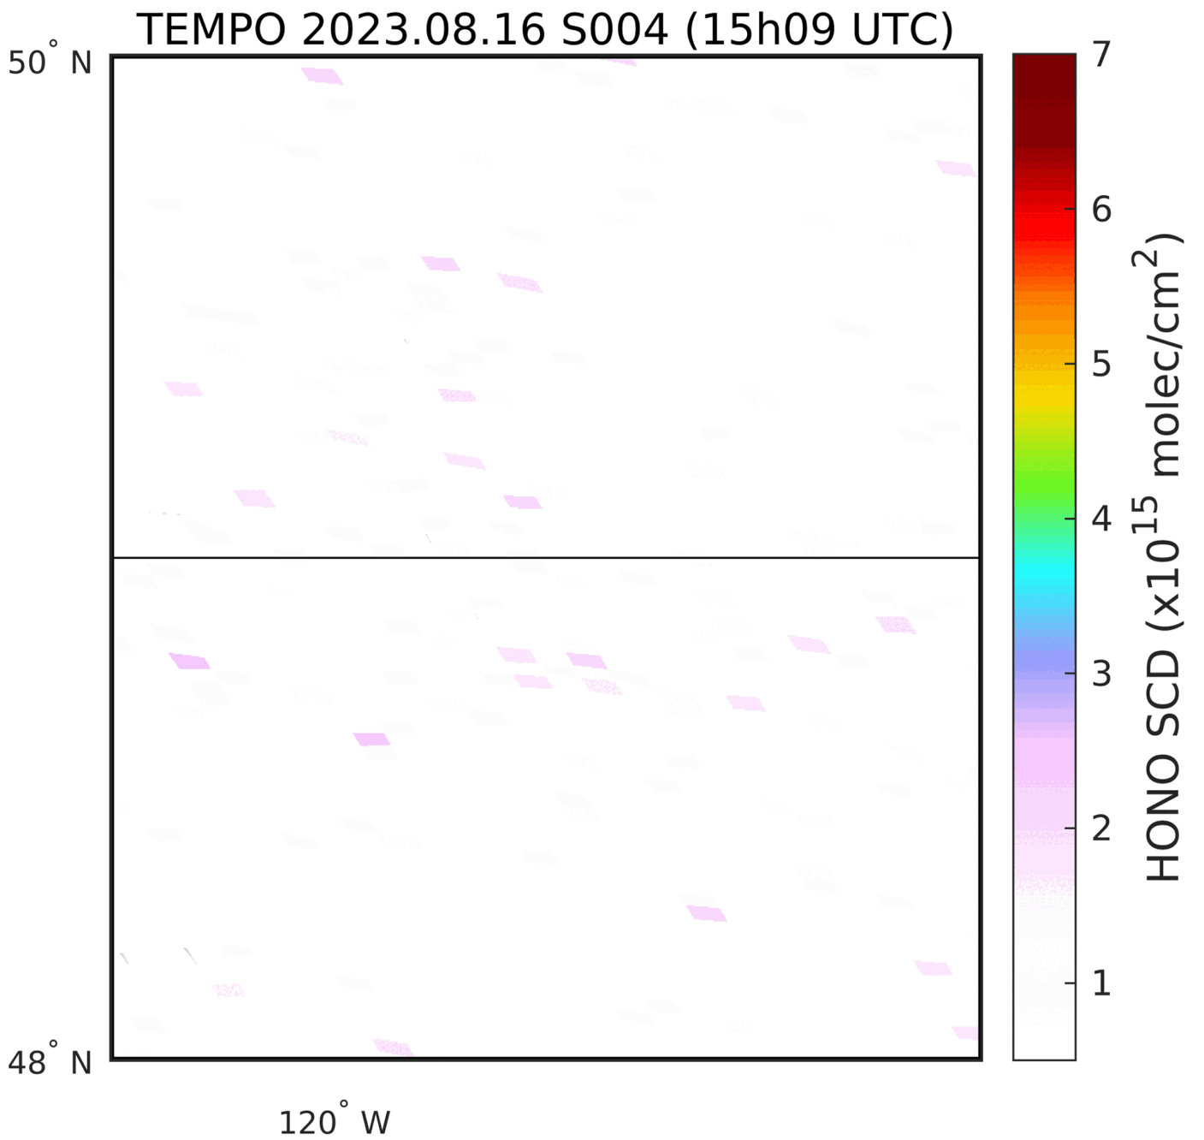
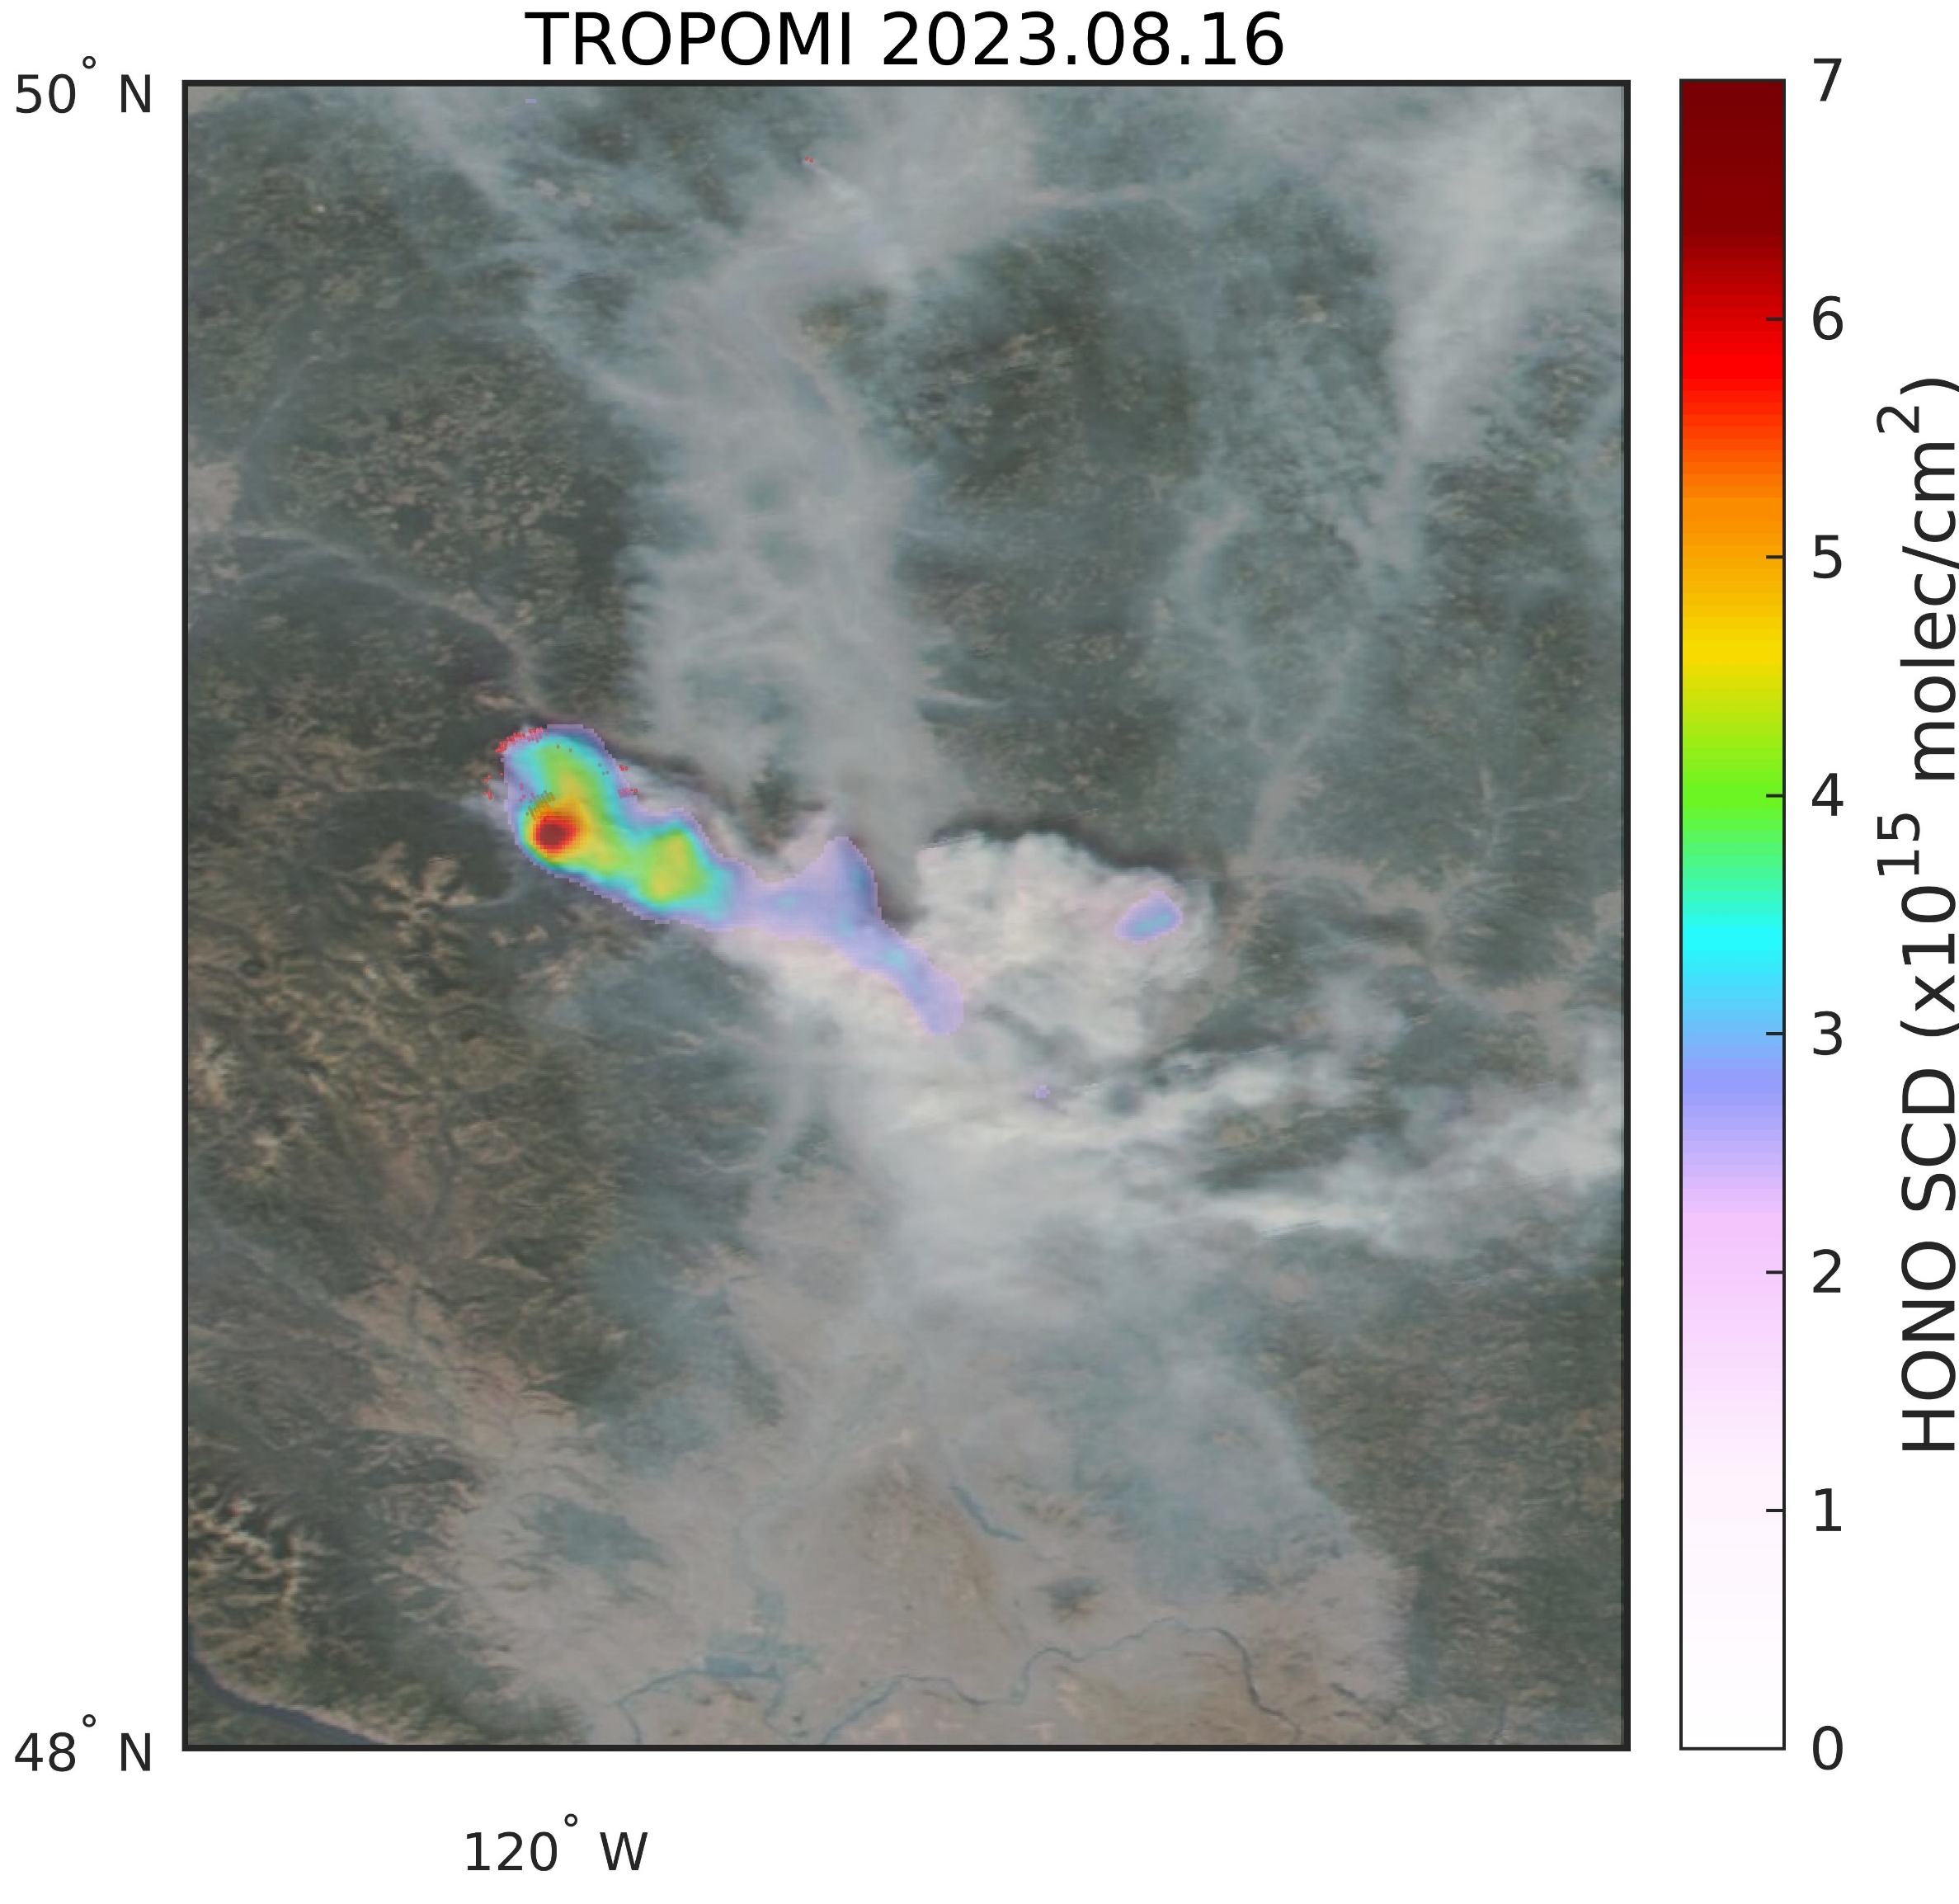
Princeton fire, British Columbia
TEMPO HONO from Fire
PRELIMINARY!
Credits: Nicolas Theys, BIRA-IASB

Slide 14
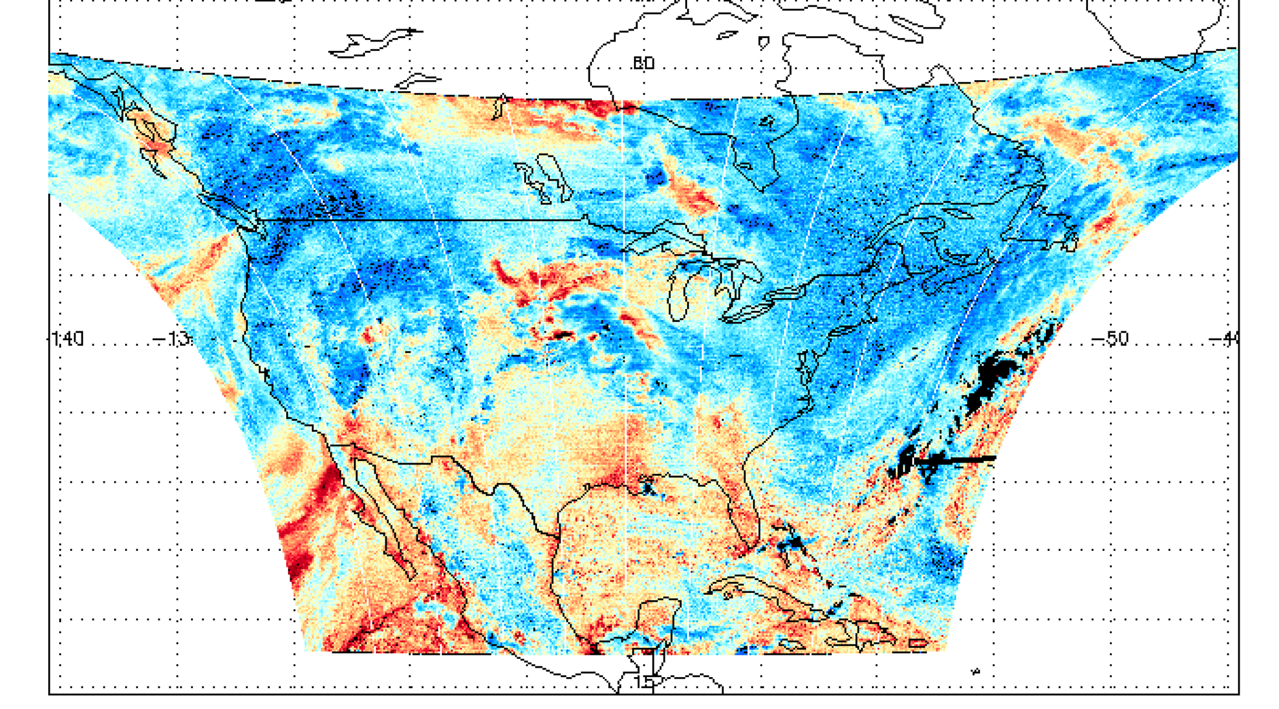
First Light H₂O SCD (2 August 2023)
PRELIMINARY!
[Credit: Huiqun Wang]

Slide 15
Summary and Outlook
TEMPO commissioning and first year nominal operation have gone on very well.
Most data products (L1b, cloud, NO₂, HCHO, total O₃) are publicly available.
Validation team are validating the data products to advance them to provisional
Priorities for V04:
  Radiances → improve absolute calibration, include polarization correction
  NO₂ , HCHO, cloud → improve surface albedo, cloud fraction bias, HCHO background correction, scene inhomogeneity, de-striping
  Total O₃ → latitude-dependent bias
  Continued development, validation and release of O₃ profile product
SNWG funded TEMPO NRT products (L1b, cloud, NO2, HCHO) and to fund TEMPO SO₂ NRT and enhanced data products. (Looking for postdocs soon!)
AGU Special Collection about TEMPO Data Products, Science and Applications is open!
Acknowledgements: Funding from NASA (TEMPO, NNL13AA09C; SNWG TEMPO NRT, 80MSFC24CA004)
Thank you!

Slide 16










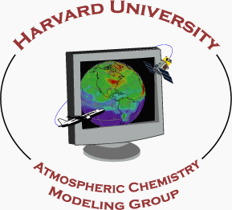













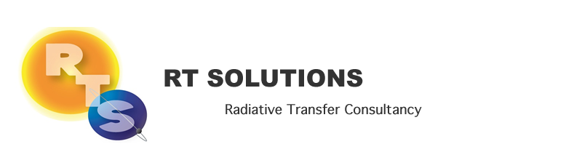






Slide 18
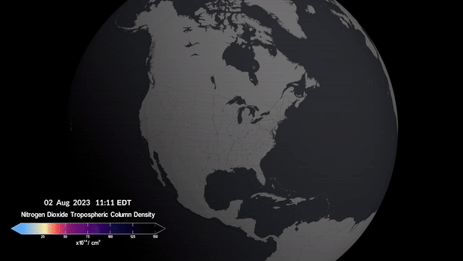
Tropospheric Emissions:
Monitoring of Pollution
Hourly daytime air pollution measurements over North America
Geostationary orbit means TEMPO can scan the continent continuously
High temporal resolution
High spatial resolution
Baseline data products:
  Nitrogen dioxide
  Formaldehyde
  Ozone (total and profile)
  Clouds
Credit: NASA’s Scientific Visualization Studio

Slide 19
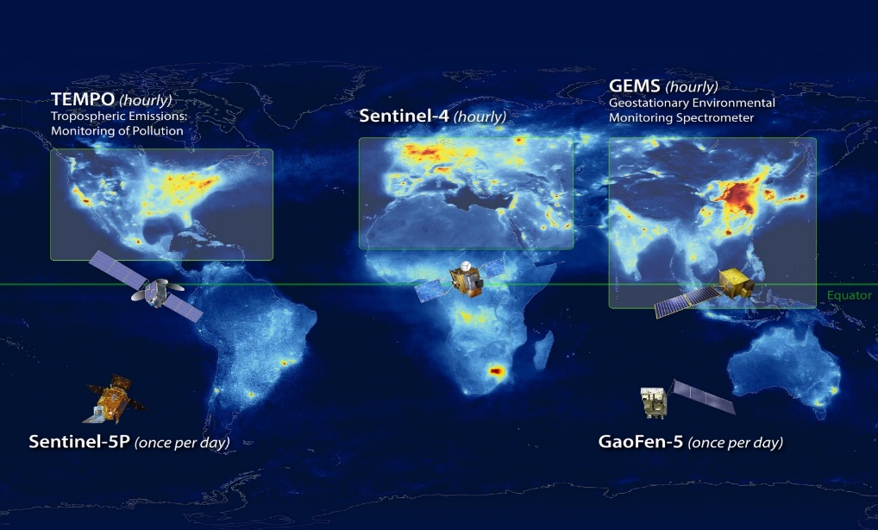
Geostationary Air Quality Constellation
Launch April 2023
Launch 2025
Launch Feb 2020
MEASMA (hourly)
Image Credit: NASA LaRC

Slide 20
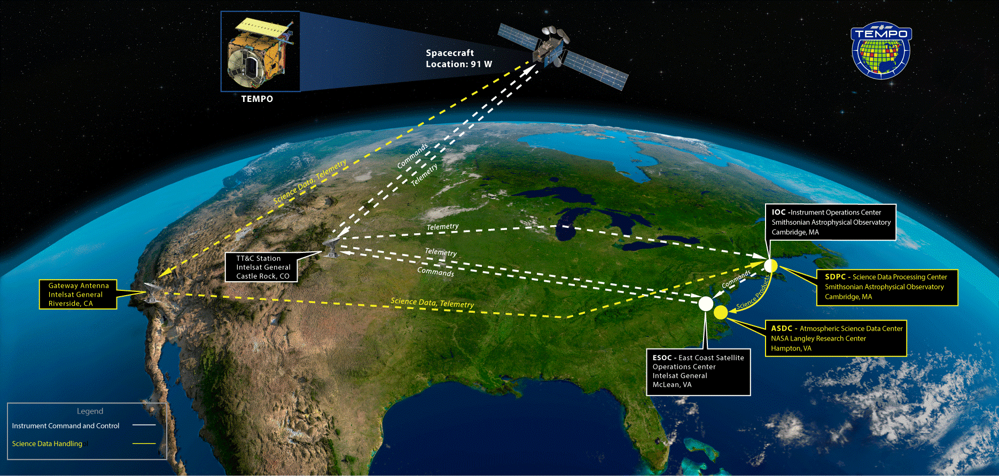
Ground System Architecture Review

Slide 21
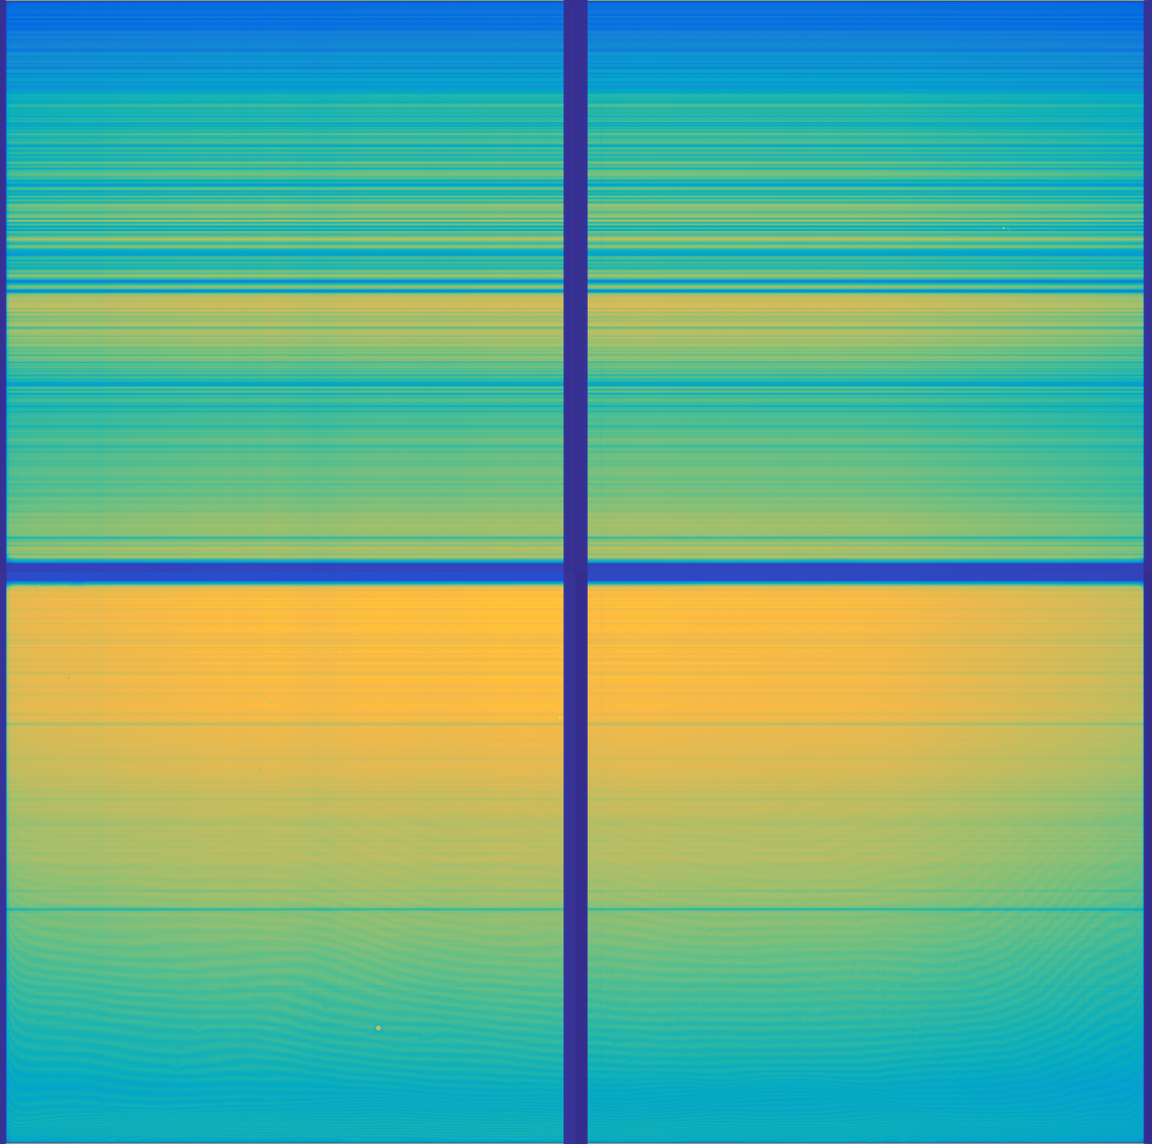
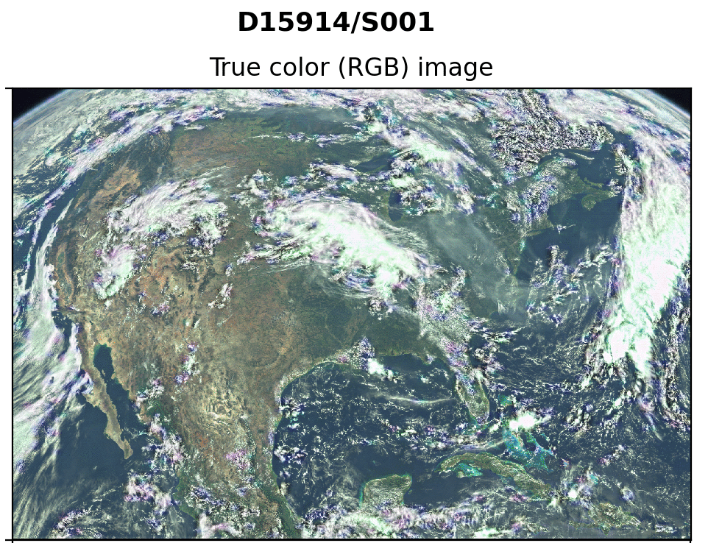
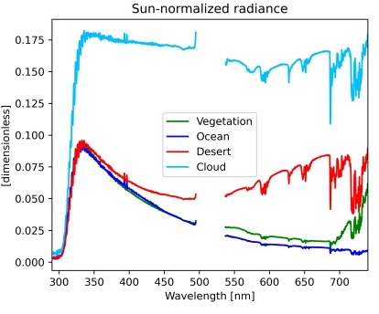
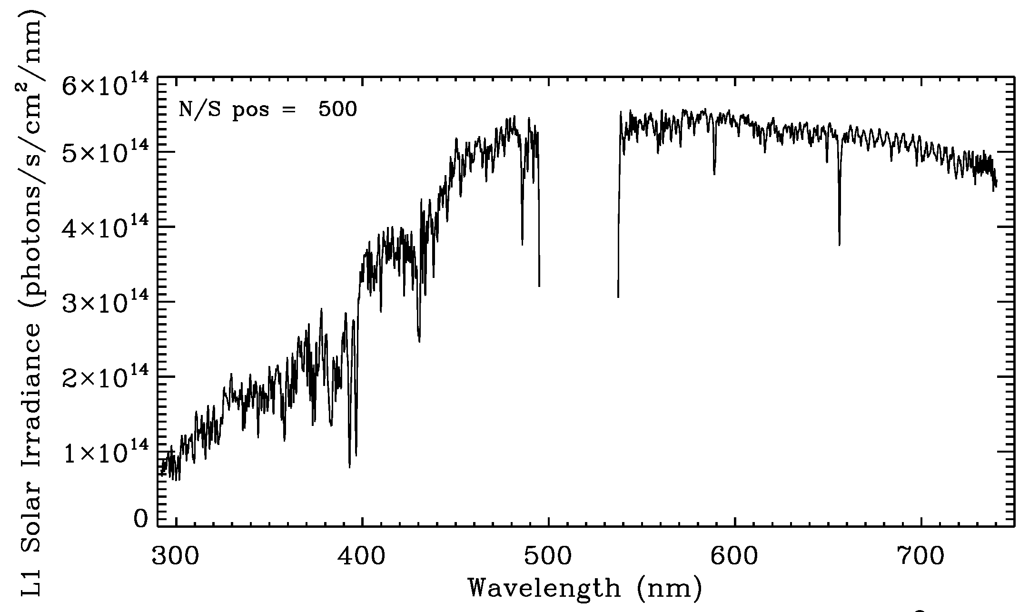
TEMPO Instrument
First Light (8/1-2/2023)
Imaging spectrometer measuring solar irradiance and solar backscattered Earth radiance
First Light Solar
8/1/2023 @12:18 am ET
First Light Earth 8/2/2023 @11:13-17:16 ET
RGB Images
[Credit: Heesung Chong]
[Credit: John Davis]

Slide 22
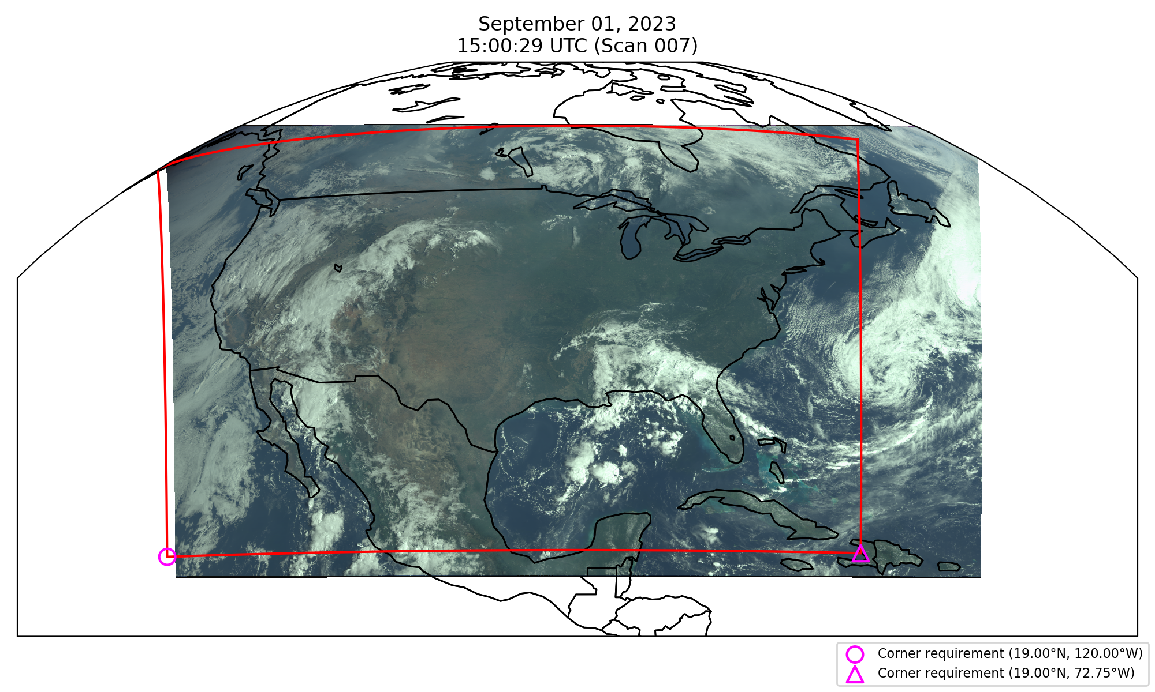
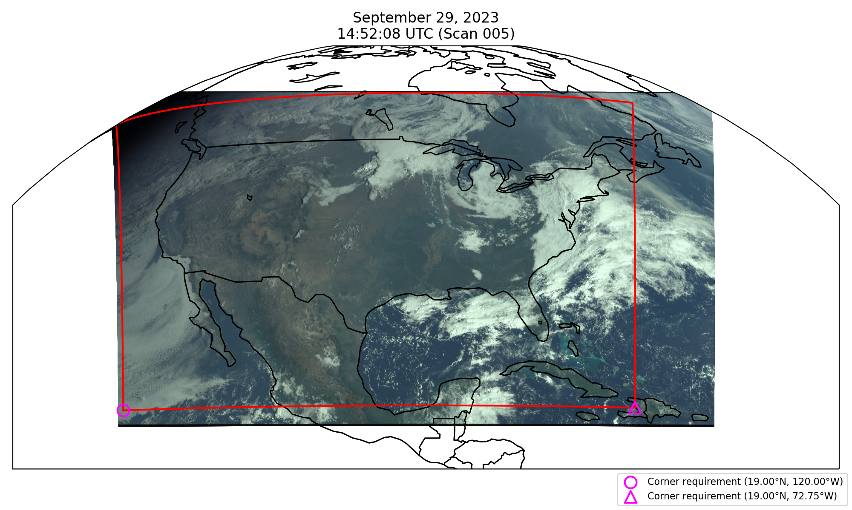
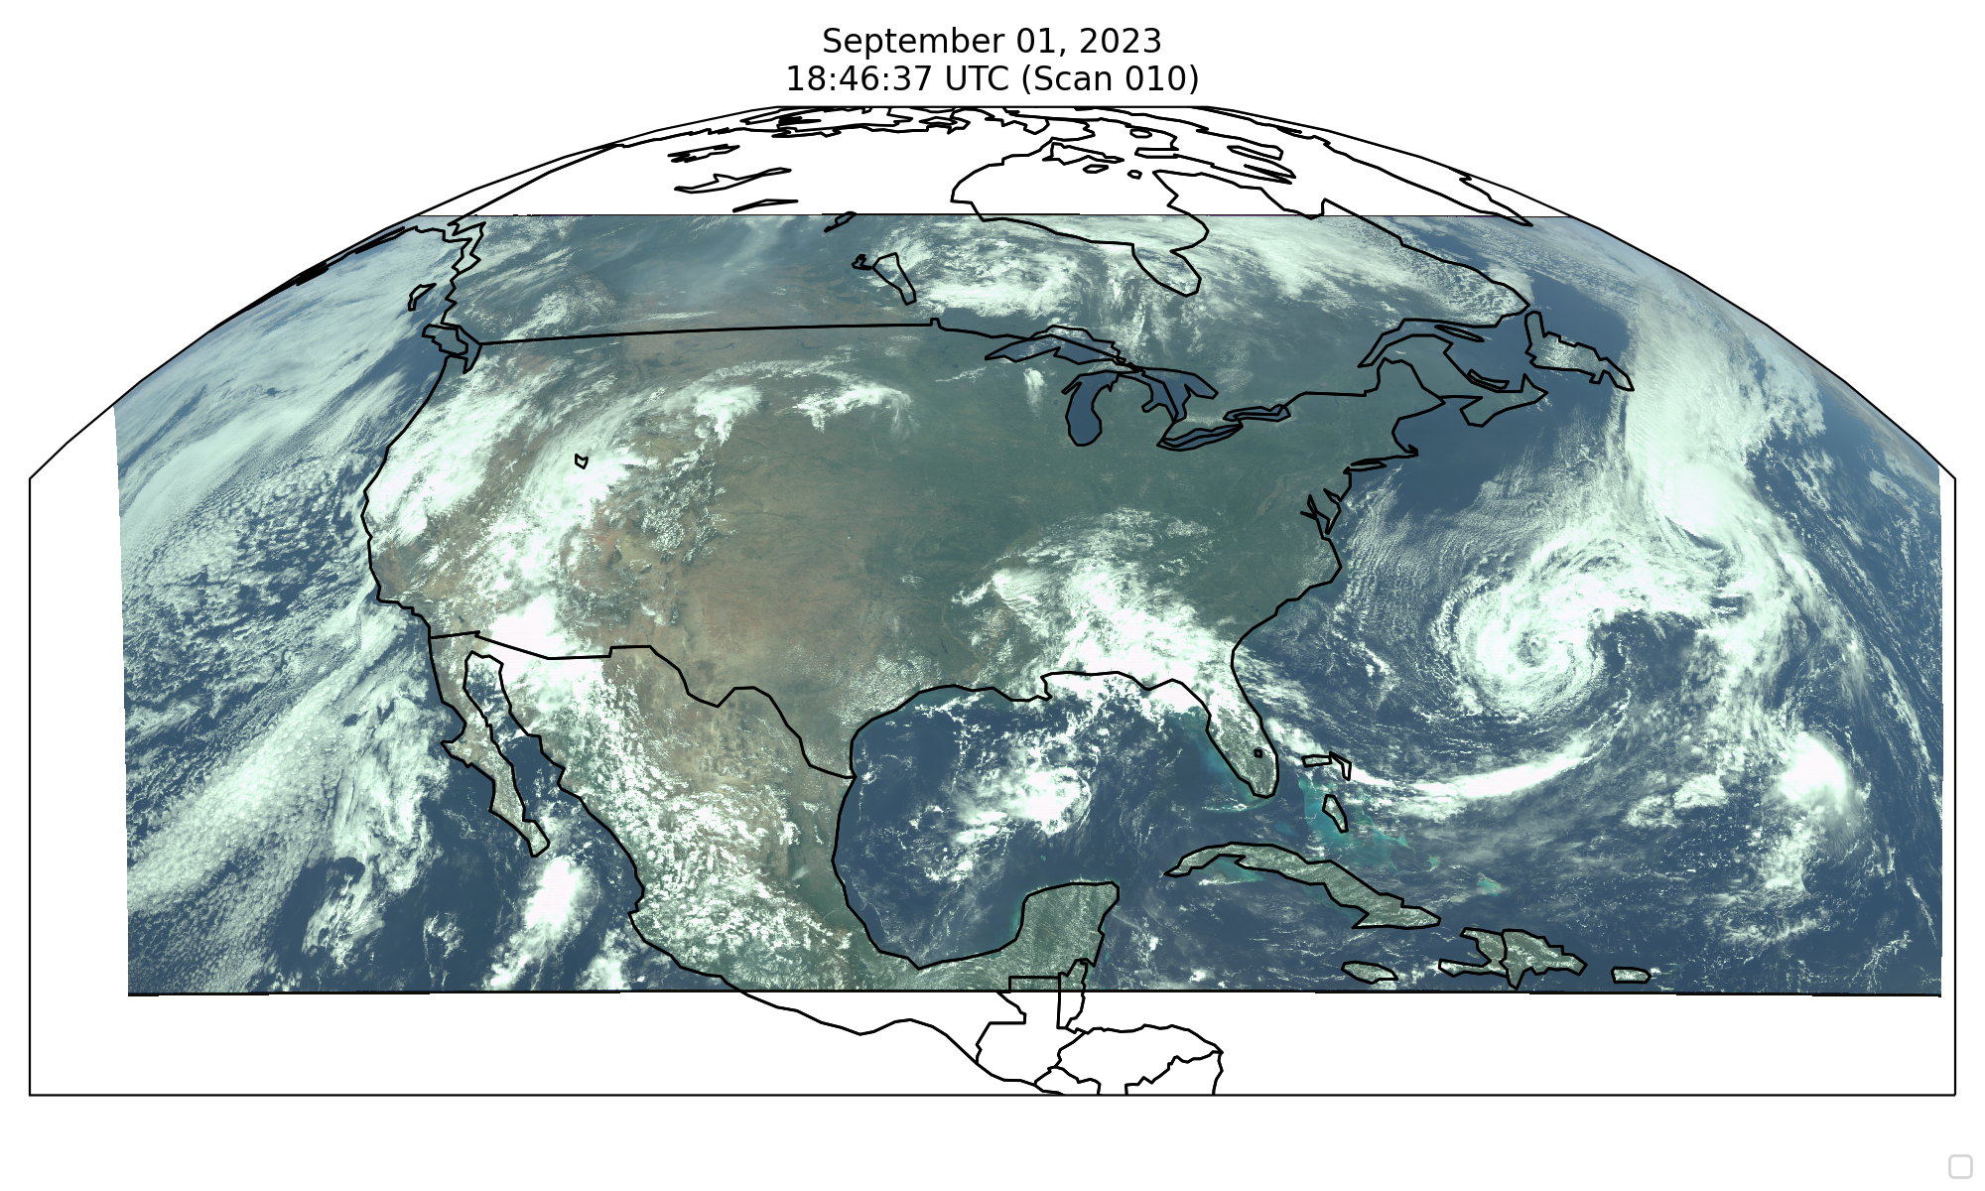
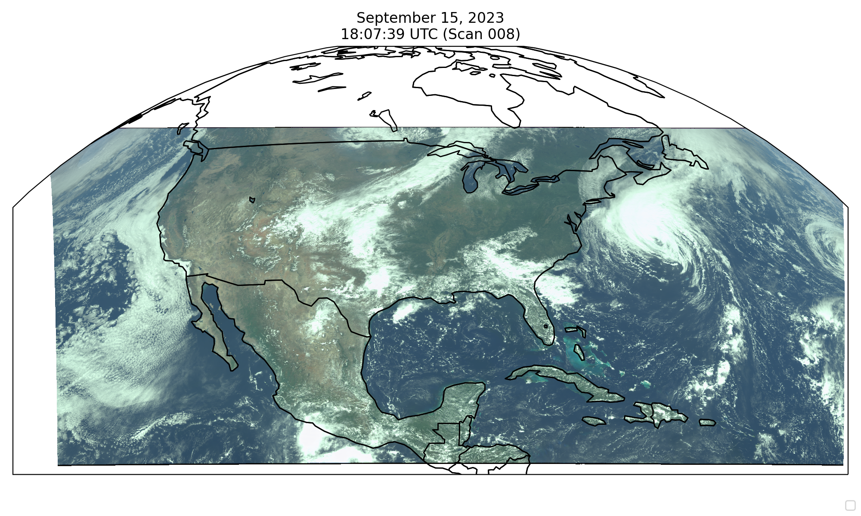
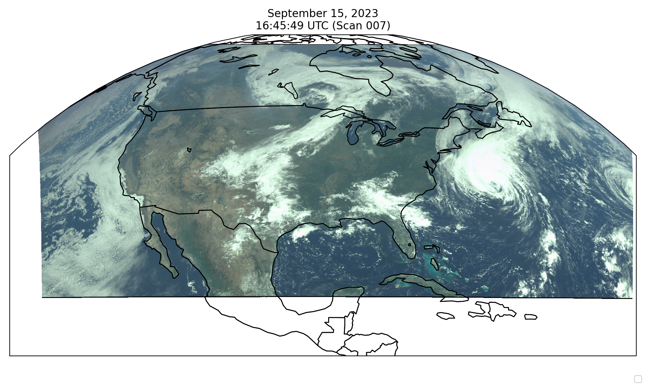
Field of Regard
Requirement
Performance
First light 8/2 field of Regard: 62.7 mins
(100 ms integration time, 26 coadds, 61.5 µrad)
Optimized field of Regard in late Sep.: 59.75 mins
(100 ms integration time, 26 coadds, 64 µrad)
Fields of regard characterization (FOR mapping) with different N-S SMA angles
[Credit: Heesung Chong]

Slide 23
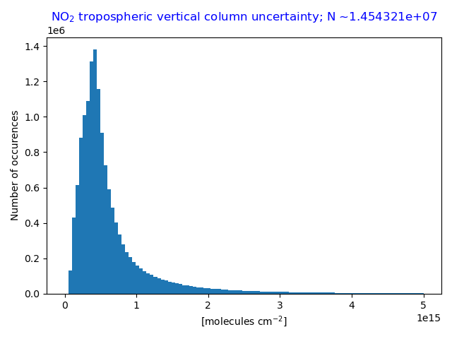
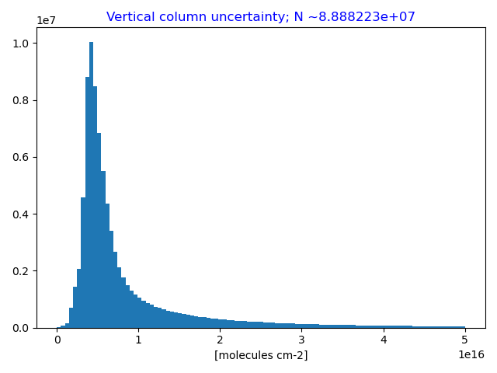
NO₂ Tropospheric Column &
HCHO Column Uncertainties
Single pixel performance
Single pixel performance
Aug. 29-Sep. 1
SZA < 70°
All cloud fractions
All scans
Aug. 29-30
SZA < 70°
All cloud fractions
All scans
Requirement
Coadd 4 pixels
Requirement
Coadd 12 pixels
NO₂ Median uncertainty = 0.46 × 10¹⁵ molecules/cm² (SZA < 70°, all clouds)
HCHO Median uncertainty = 5.5 x 10¹⁵ molecules/cm² (SZA < 70˚, all clouds)
TEMPO NO₂ & HCHO meets requirement for >90% of cloud-free scenes with no pixel coadding!

Slide 24
TEMPO Software/Algorithm Teams
Operational Algorithm | Personnel
Instrument Operation Center (IOC) including Raw-L0 | John Davis
L0-1b | Heesung Chong, John Houck, Weizhen Hou, Xiong Liu, Dave Flittner, Jim Carr
Ozone profile | Junsung Park, Xiong Liu
Total ozone | Junsung Park, Xiong Liu
Nitrogen dioxide | Caroline Nowlan, Gonzalo González Abad
Formaldehyde | Gonzalo González Abad, Caroline Nowlan
Clouds | Huiqun (Helen) Wang, González Abad, Caroline Nowlan, GSFC
Science Data Processing Center Operational Implementation & Processing Pipeline | John Houck

Slide 25
Science Algorithms
Launch-ready Science Data Processing Center (SDPC) V4 software completed in Mar 2023
Algorithm mostly based on OMI heritage algorithms except for new L0-1b processor including Imaging Navigation and Registration (INR) using GOES-R by Carr Astronautics
SAO trace gas algorithm (HCHO, NO₂): spectral fitting to derive Slant Column Densities (SCDs), calculate air mass factor (AMFs) and derive Vertical Column Densities (VCDs)
  NO₂ requires stratospheric/tropospheric separation based on spatial filtering method (Geddes et al., 2018)
Cloud algorithm: SAO O₂-O₂ fitting + NASA GSFC’s O₂-O₂ cloud at ~477/466 nm
Total ozone algorithm: heritage TOMS V8.5, using ozone absorbing and non ozone absorbing pairs to derive total ozone column
Ozone profile algorithm: heritage SAO OMI O₃ profile, using 290-340, 540-650 nm, retrieve O₃ profile at 24 layers, including total, stratospheric, tropospheric, and 0-2 km O₃
Main L1-2 algorithms updates include:
  NASA GMAO’s GEOS-CF trace gas profiles and meteorology
  Hourly resolved monthly mean Geometry-dependent Lambertian Equivalent Reflectivity (GLER) climatology

Slide 26
Including Visible to Improve
Tropospheric Ozone Retrieval Sensitivity
This example is for solar zenith angle =25, viewing zenith angle 45, relative azimuthal angle 86, Signal to noise Ratio (SNR) with 4 pixels coadded
Add visible to improve retrieval sensitivity in the lower troposphere and help separate free tropospheric O₃ from boundary layer O₃
Under ideal conditions: 3-5 total Degree of Freedom for Signal (DFS) with up to ~1.5 in the troposphere, and up to ~0.5 DFS in 0-2 km
Adapted from OMI (Liu et al., 2010): Spectral fitting + VLIDORT + Optimal Estimation (OE) from Fitting windows: 293-345 nm, 540-650 nm
Retrieve partial O₃ columns at ~24 layers (bottom layer is 0-2 km above the surface) as well as total, stratospheric, and tropospheric O₃ columns, other trace gases, and auxiliary parameters.
A priori: a combination of tropopause-based climatology (Bak et al., 2013) with diurnally-resolved GEOS-CF data

