Slide 1
Sentinel-5P Mission Status

Slide 2
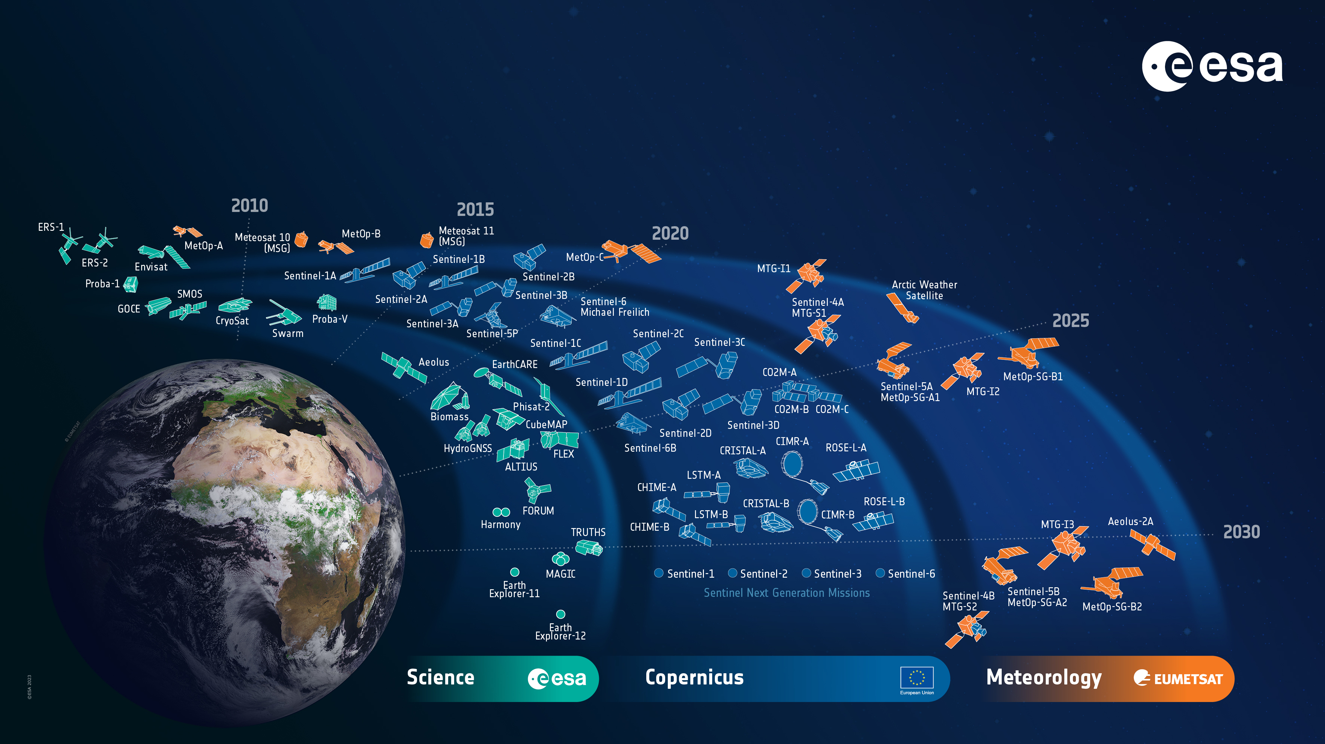

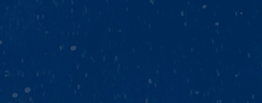





















European Space Agency
Notes:
D/EOP has three main lines of activities: Earth Science, Copernicus and Meteorology

Slide 3

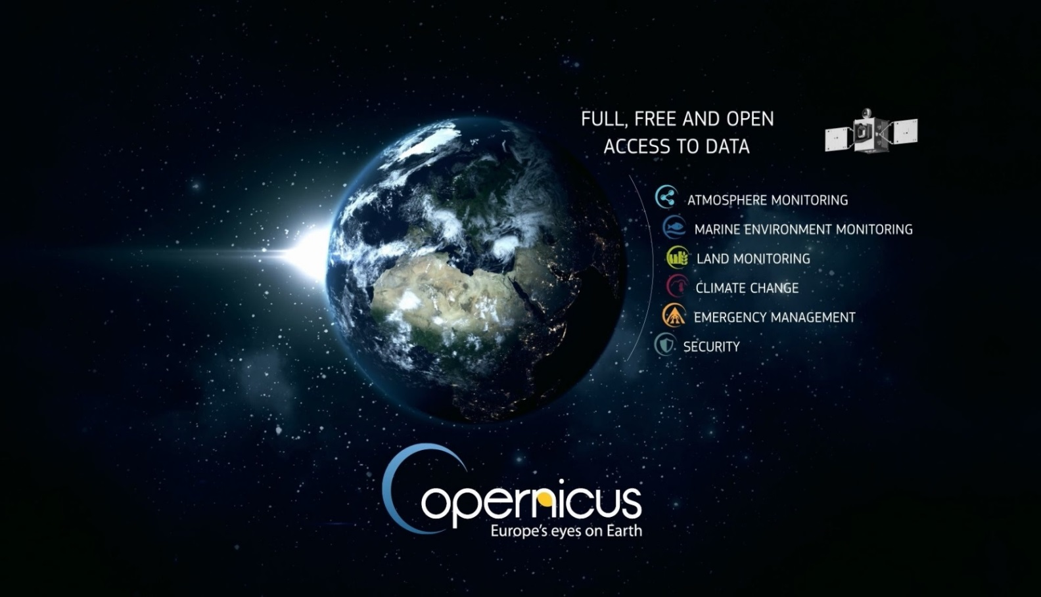
Copernicus – a new Phase in EO
European Earth Observation System
Led by the EU
EU-ESA Collaboration
European response to
global needs:
to manage the environment
to mitigate the effects of climate change
to ensure civil security
European independence, contribution to global system (GEOSS)
ESA UNCLASSIFIED – For Official Use
European Space Agency
Notes:
What is Copernicus?
Copernicus Main Points:
Copernicus is a System for Global Monitoring of the Environment & Security (formerly known as GMES)
Integrated “system of systems”, space & in-situ
Led & mainly financed by the European Union
Dawn of an operational phase in EO
Six Services + Full and Open Data Policy
ESA is the coordinator of the Copernicus Space Component (6 Sentinels and the related Ground Segment)
ESA is the development and procurement agency for the dedicated space infrastructure.
ESA is responsible for the definition of the overall Copernicus Space Component architecture and its future evolution

Slide 4
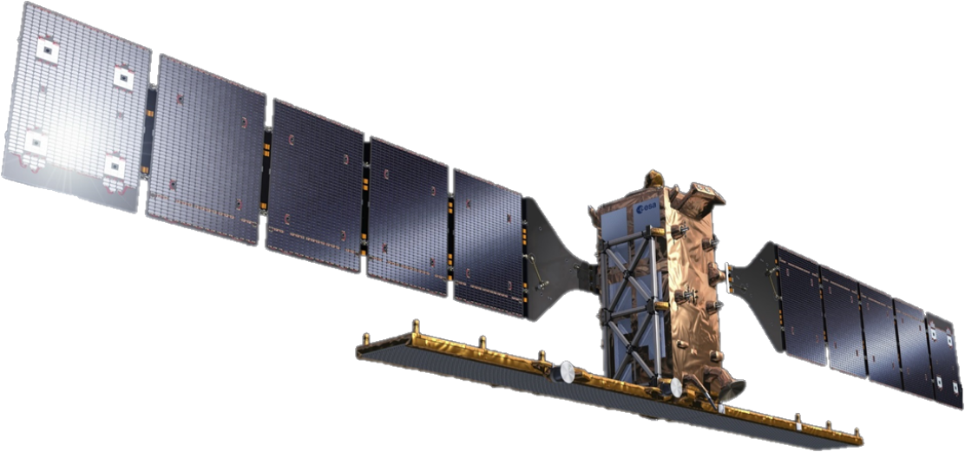
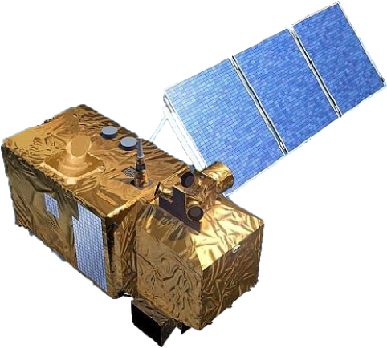
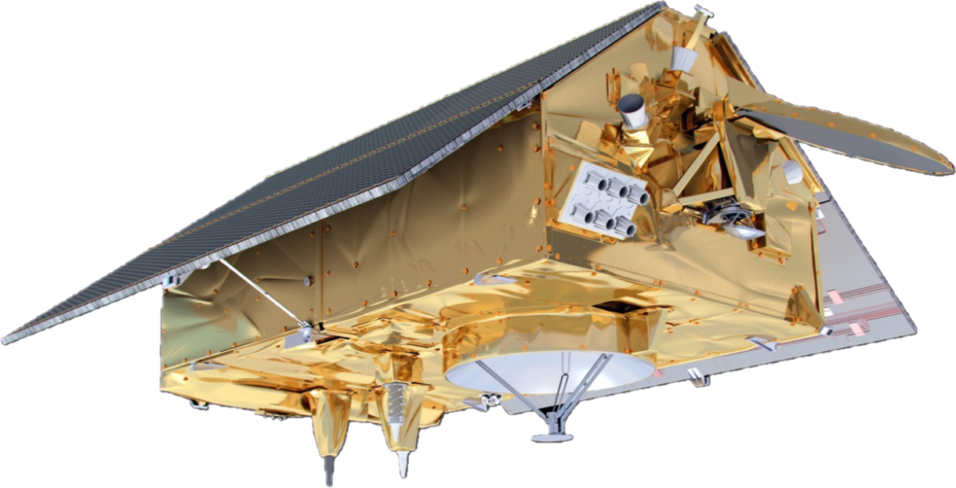
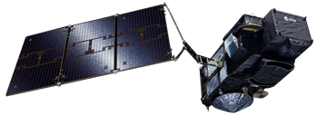

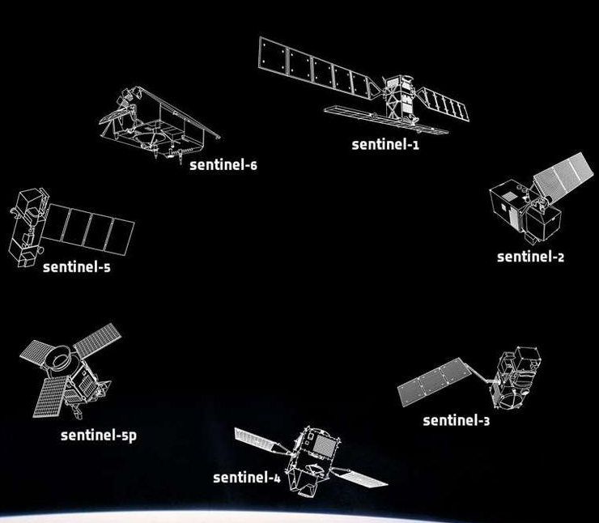
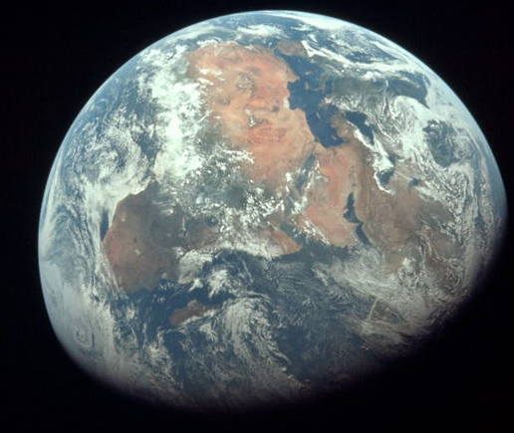
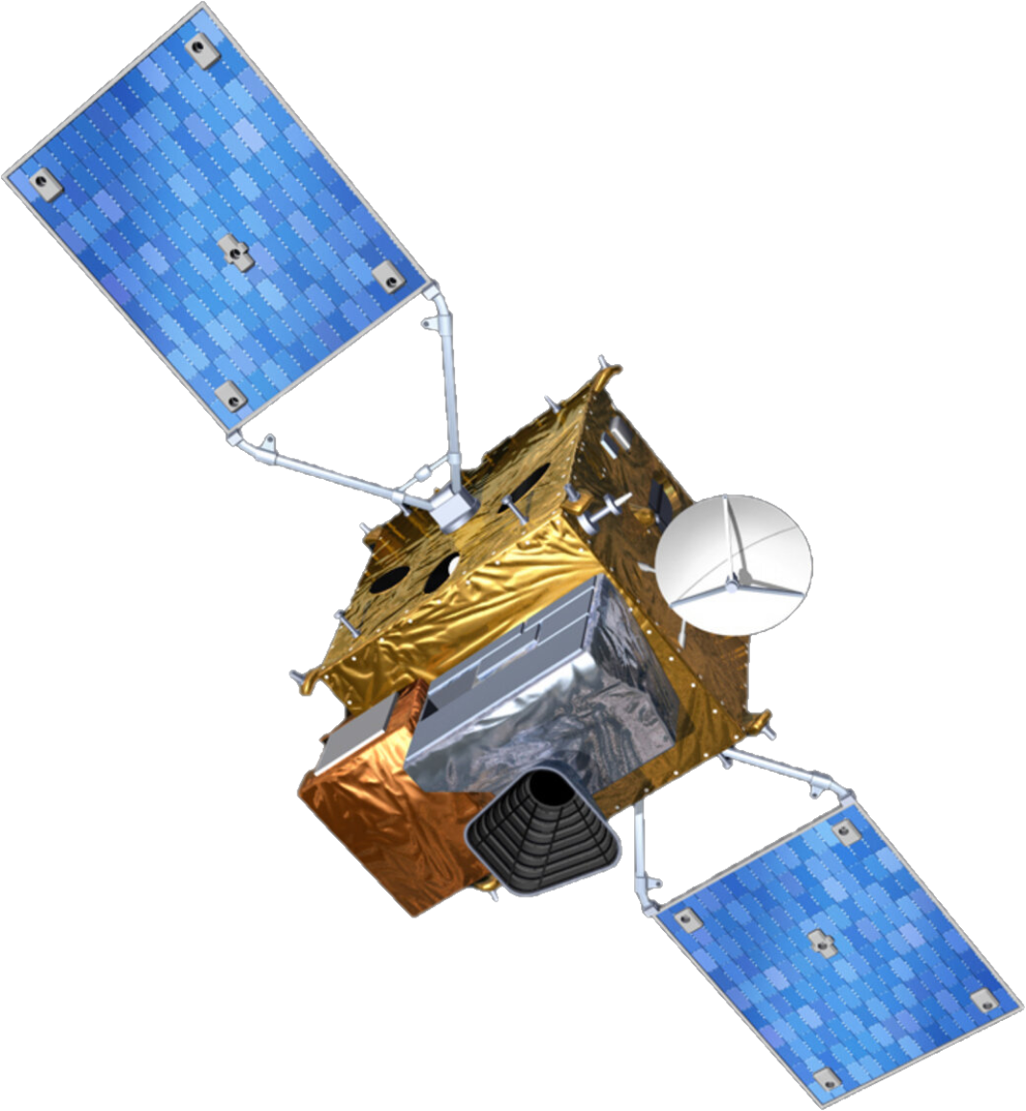


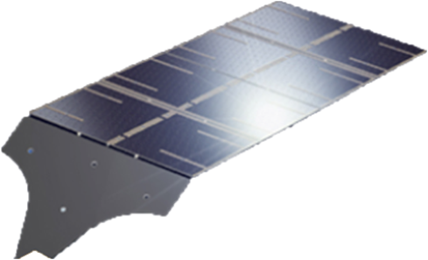
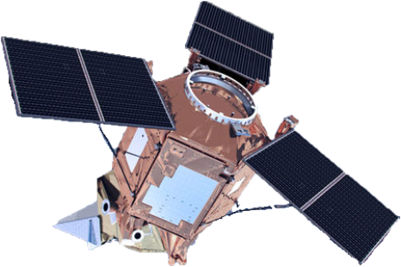
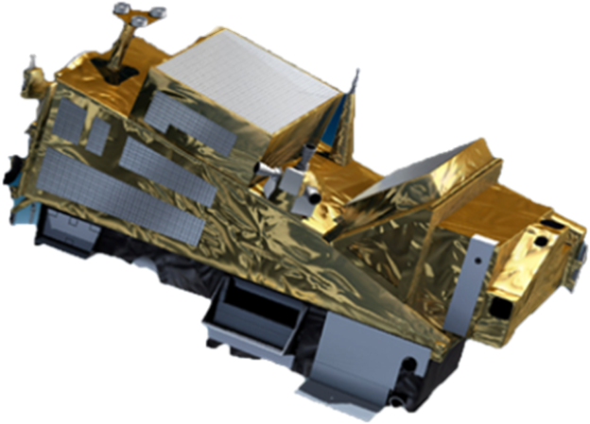
An ESA Built Copernicus Space Component
The first generation of ESA developed Sentinel satellites
1 to 6
Providing systematic observations of land, water and atmosphere worldwide

Slide 5

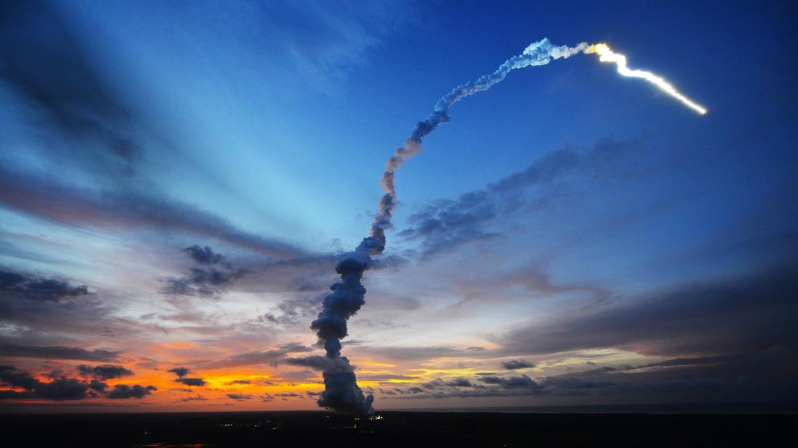







Copernicus – Sentinels Status
S-1
S-2
S-3
S-4
S-5P
S-5
S-6
Radar
High Res. Optical
Medium Res. Optical & Altimetry
Atmospheric Chemistry (GEO)
Atmospheric Chemistry (LEO)
Atmospheric Chemistry (LEO)
Altimetry
A
3 Apr 2014
A
23 Jun 2015
A
16 Feb 2016
A
>2025
A
13 Oct 2017
A
2025
5
A
21 Nov 2020
B
25 Apr 2016
B
6 Mar 2017
B
25 Apr 2018
B
2032
B
2030
B
2025
C
2024
C
>2024
C
>2025
C
> 2030
D
> 2026
D
> 2026
D
> 2027
Notes:
Green = launched
Blue = under development / to be developed

Slide 6








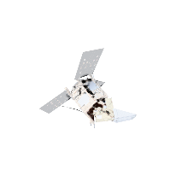
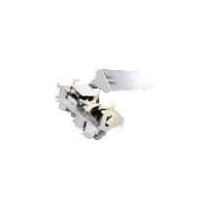
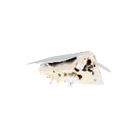
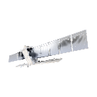



Copernicus – continue global leadership in EO
> 700.000
6 operational services
registered users
= tip of the iceberg
Land
Atmosphere
Ocean
Climate
Disaster
Security
8 Sentinel satellites flying
250 TB satellite data distributed per day
S1 | S2 | S3 | S4 | S5P | S5 | S6
●● | ●● | ●● |  | ●
full, free & open data policy
●
preparing Copernicus 4.0
ESA UNCLASSIFIED – For Official Use
European Space Agency
Notes:
This infographic captures the key elements of the Copernicus EO system ➔ explain a few.
Copernicus is the Reference Backbone for an integrated EO observing system and, it is an excellent example of European global leadership in space.
Copernicus enables us to provide a routine health check of our planet.

Slide 7
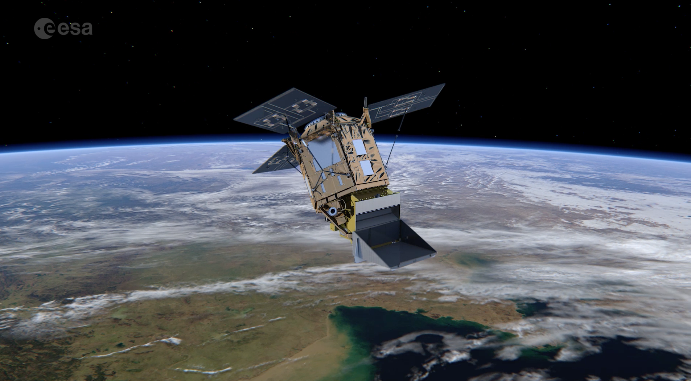
Sentinel-5 Precursor:
first atmospheric Sentinel Mission
Launched: 13 October 2017, Plesetks
Launcher: Rockot
Main Payload: TROPOMI (co-funded by The Netherlands and ESA) - Hyper-spectral push-broom imaging spectrometer, 4 spectrometers with 2D detectors with 4000 spectral channels
Orbit: Altitude of 820 km, 227 orbit repeat cycle
Daily Global Coverage: 13:30 ascending node crossing time
Spatial Sampling: 5.5 x 3.5 km (mission requirement: 7 x 7 km)
Mission Control: ESOC
TROPOMI Mission Planning: KNMI
Ground Stations: Svalbard (NOR) and Inuvik (Canada)
Operational Data Processing: DLR (on behalf of ESA)
Mission Design Life Time: ~7 years
National co-funding during Routine Operations (e.g. on Algorithm Development/QA Monitoring): Belgium, Germany, and The Netherlands
Key User: Copernicus Atmosphere Monitoring Service (ECMWF)

Slide 8
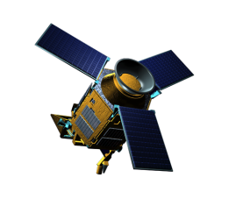
Aeolus Mission Objectives
Sentinel-5 Precursor
Mission Objectives
Ozone, Air Quality, and Climate Monitoring and Forecasting
Extending the time series of GOME, SCIAMACHY, OMI, GOME2 measurements
Precursor of the Copernicus Sentinel-4 and Sentinel-5 missions

Slide 9
Sentinel-5 Precursor Products
13 Operational Products - forward processing and reprocessed over instrument lifetime - Level 1B Radiance/Irradiance, Level 2 Methane, Tropospheric Ozone (Offline); Aerosol Absorbing Index, Aerosol Layer Height, Carbon Monoxide, Cloud, Formaldehyde, Nitrogen Dioxide, Ozone Profile, Sulphur Dioxide, and Total Ozone products (Offline and Near Real Time) are available at the Copernicus Data Space Ecosystem - https://dataspace.copernicus.eu/.
6 Pre-operational Products via the S5P PAL (product Algorith Laboratory) - forward processing and reprocessed over instrument lifetime - (Aerosol Optical Thickness, Bromine Monoxide, Glyoxal, Sun-Induced Fluorescence, Water Vapour, and a Sulphur Dioxide product using the new Covariance-Based Retrieval Algorithm (COBRA)) are being provided to the public via: https://data-portal.s5p-pal.com
Difference between Pre-operational and Operational Products: the data quality is not operationally checked by the Sentinel-5P Mission Performance Centre, Offline data provision only
If agreed and financed by the EC pre-operational products could become operational (core) products in the furu
Level 3 Products via PAL: https://maps.s5p-pal.com/

Slide 10
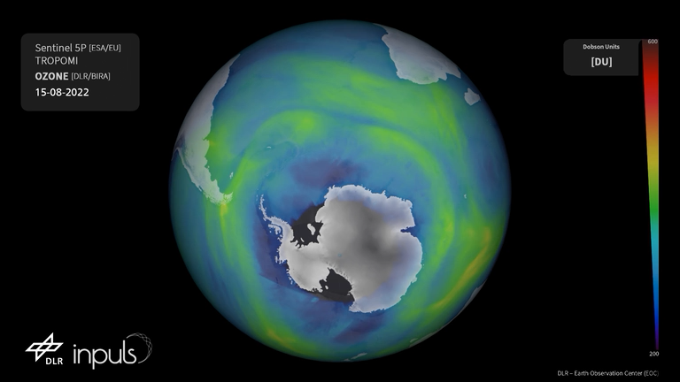
Sentinel-5P Ozone Monitoring
Ozone Hole Opening during 2022
https://www.esa.int/Applications/Observing_the_Earth/Copernicus/Sentinel-5P/How_do_satellites_monitor_the_ozone_layer
Copyright: Contains modified Copernicus Sentinel data (2022) / processed by DLR

Slide 11
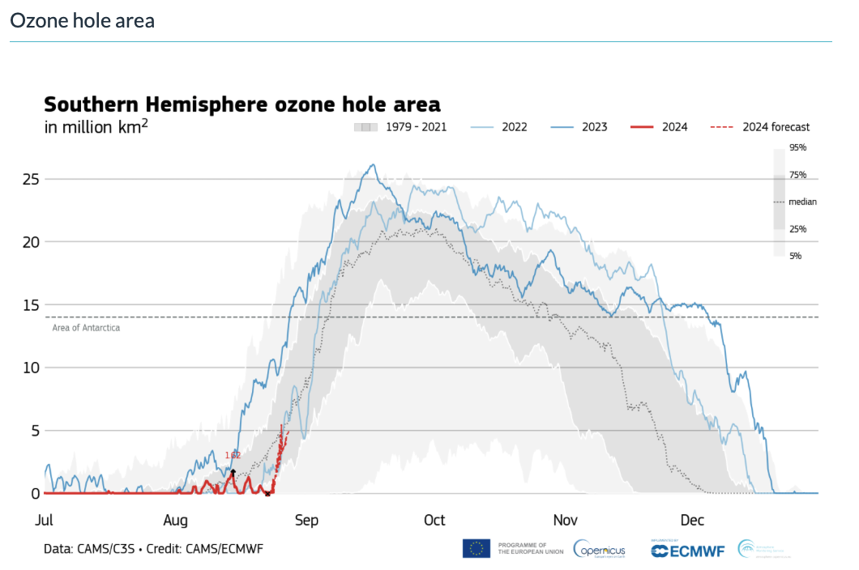
Sentinel-5P Ozone Monitoring

Slide 12
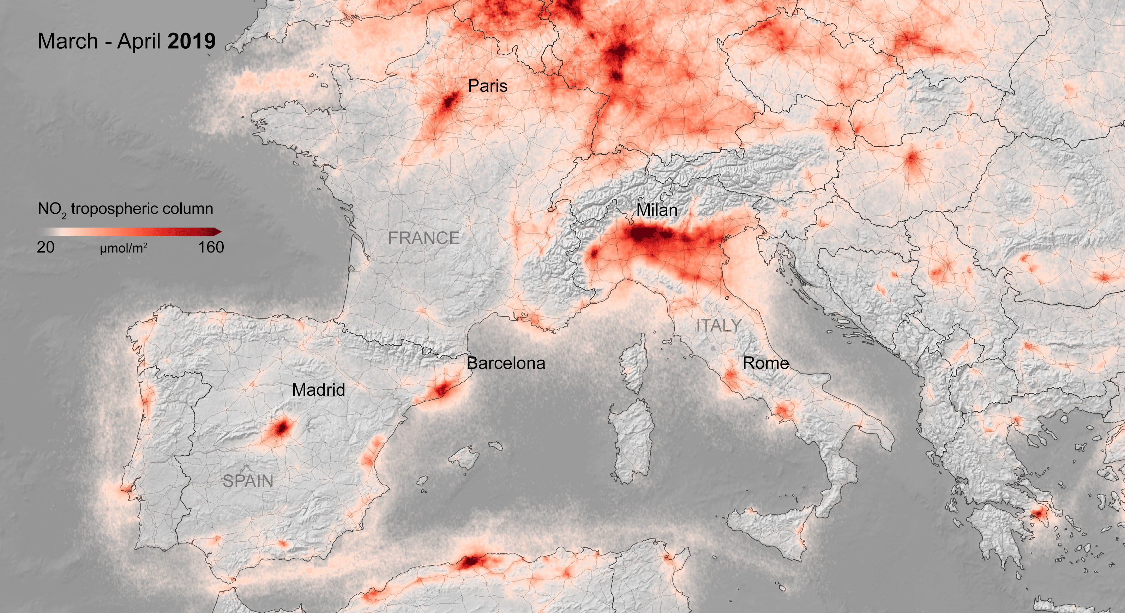
Dropping Air Pollution in Europe during COVID Lockdown
ESA UNCLASSIFIED – For Official Use
European Space Agency

Slide 13
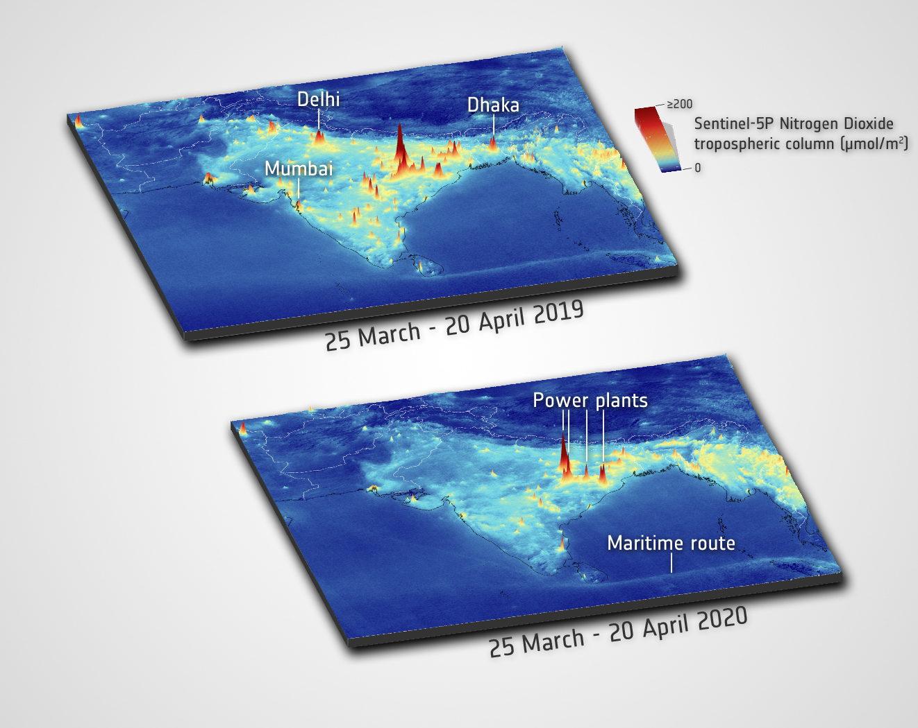
COVID-19 impact as ‘seen’ by Sentinel-5P
http://www.esa.int/Applications/Observing_the_Earth/Copernicus/Sentinel-5P/Air_pollution_drops_in_India_following_lockdown
Copyright: Contains modified Copernicus Sentinel data (2019/20) / processed by ESA

Slide 14
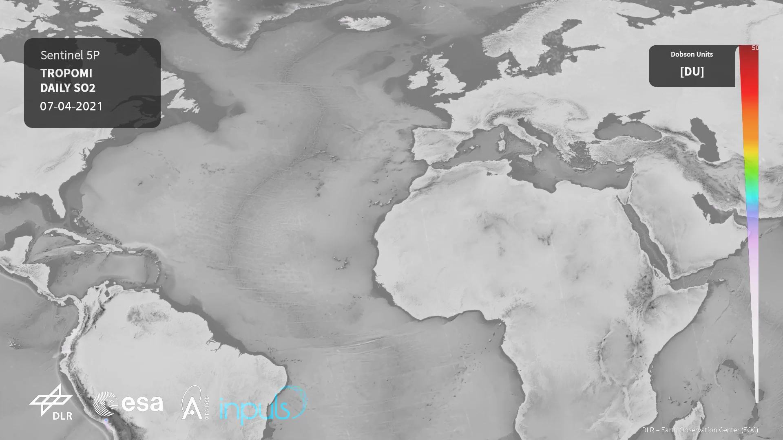
Sentinel-5P Air Pollution Monitoring
Vulcano – La Soufriere
Credits: contains modified Copernicus data (2021) processed by DLR

Slide 15

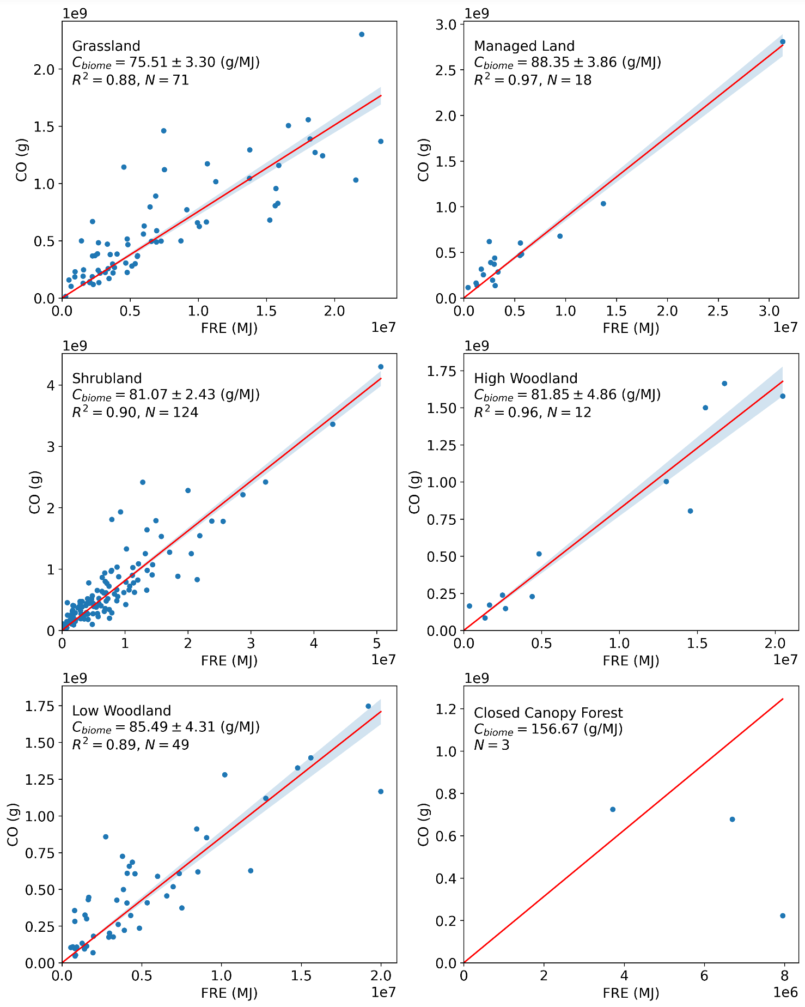
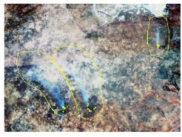
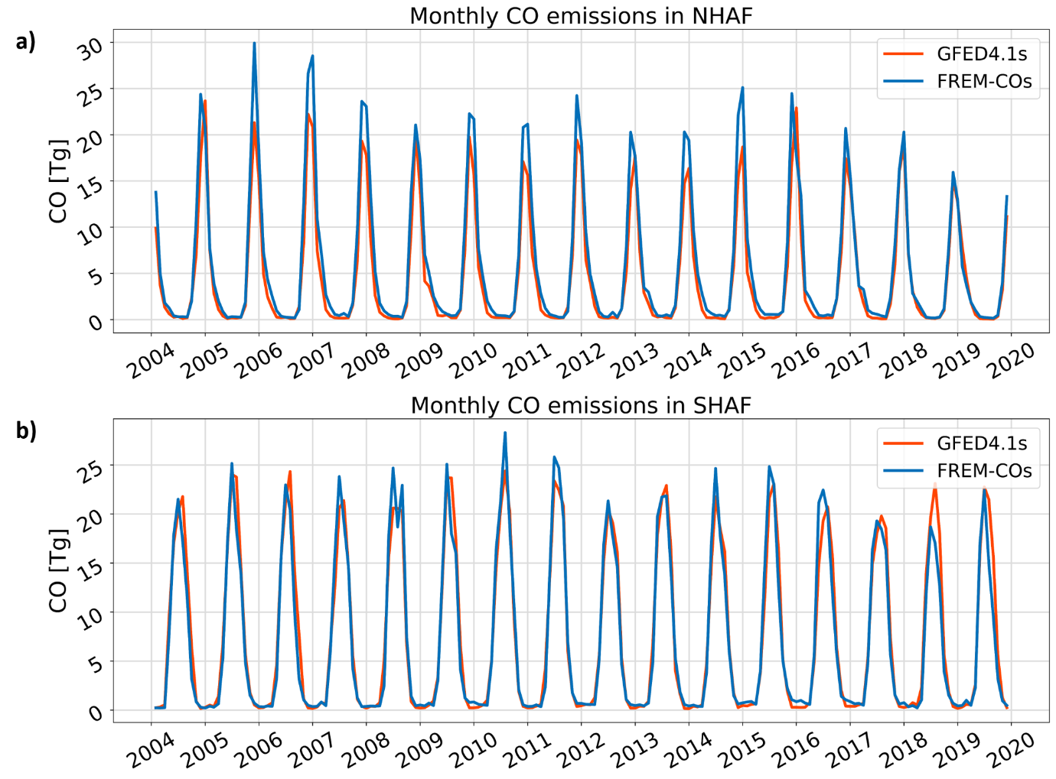
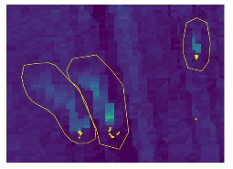
Meteosat / S5P Fire Emissions Product Derivation
Emissions are derived from coefficients linking Meteosat-derived Fire Radiative Energy (FRE) totals to atmospheric species (CO) for different biomes - Nguyen et al. (ACPD)
Coeffs for Six different “fire biomes”
Applied to LSA SAF FRP-PIXEL record (2004-2019) across whole Africa (NH and SH)
CO emissions very close to GFED4.1s - derived using completely different datasets and methods
Example for Three Fires
AOD
VIIRS RGB Image showing plumes
Sentinel-5P Total Column CO
Meteosat Active Fire pixels from which FRE is derived

Slide 16
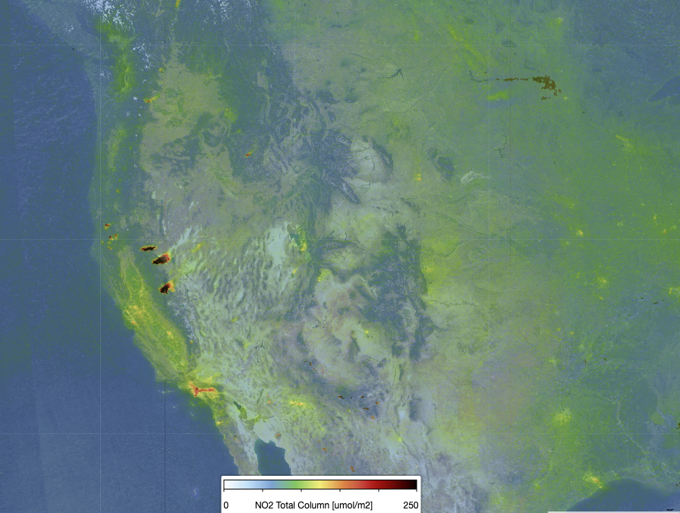
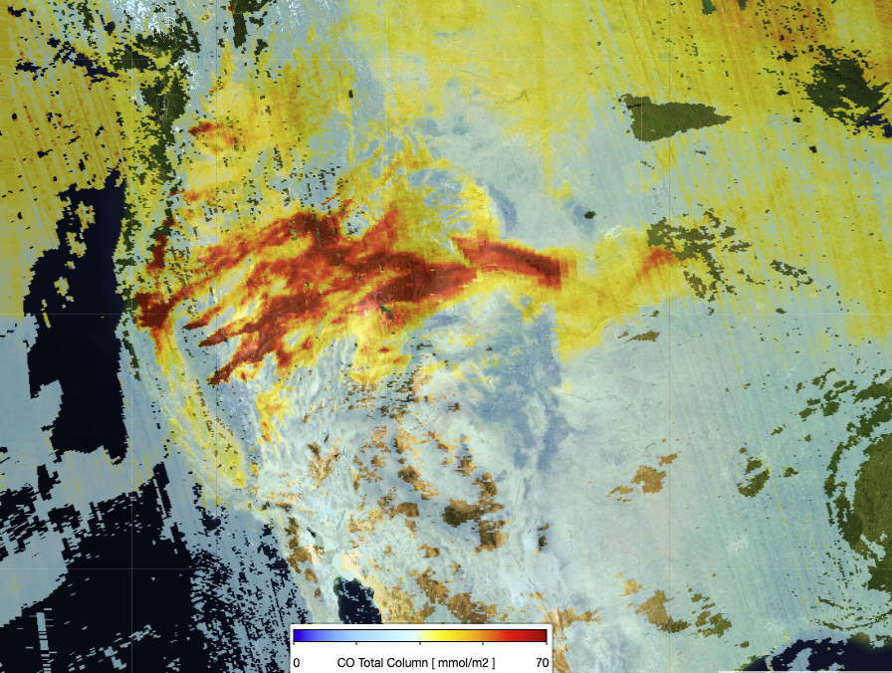
SENTINEL-5p APPLICATIONS DURING WILDFIRES
Wildfire emission measurements over Western USA (30 Aug 2021)
NO2
CO
Copyright: contains modified Copernicus Sentinel data (2021), processed by KNMI

Slide 17
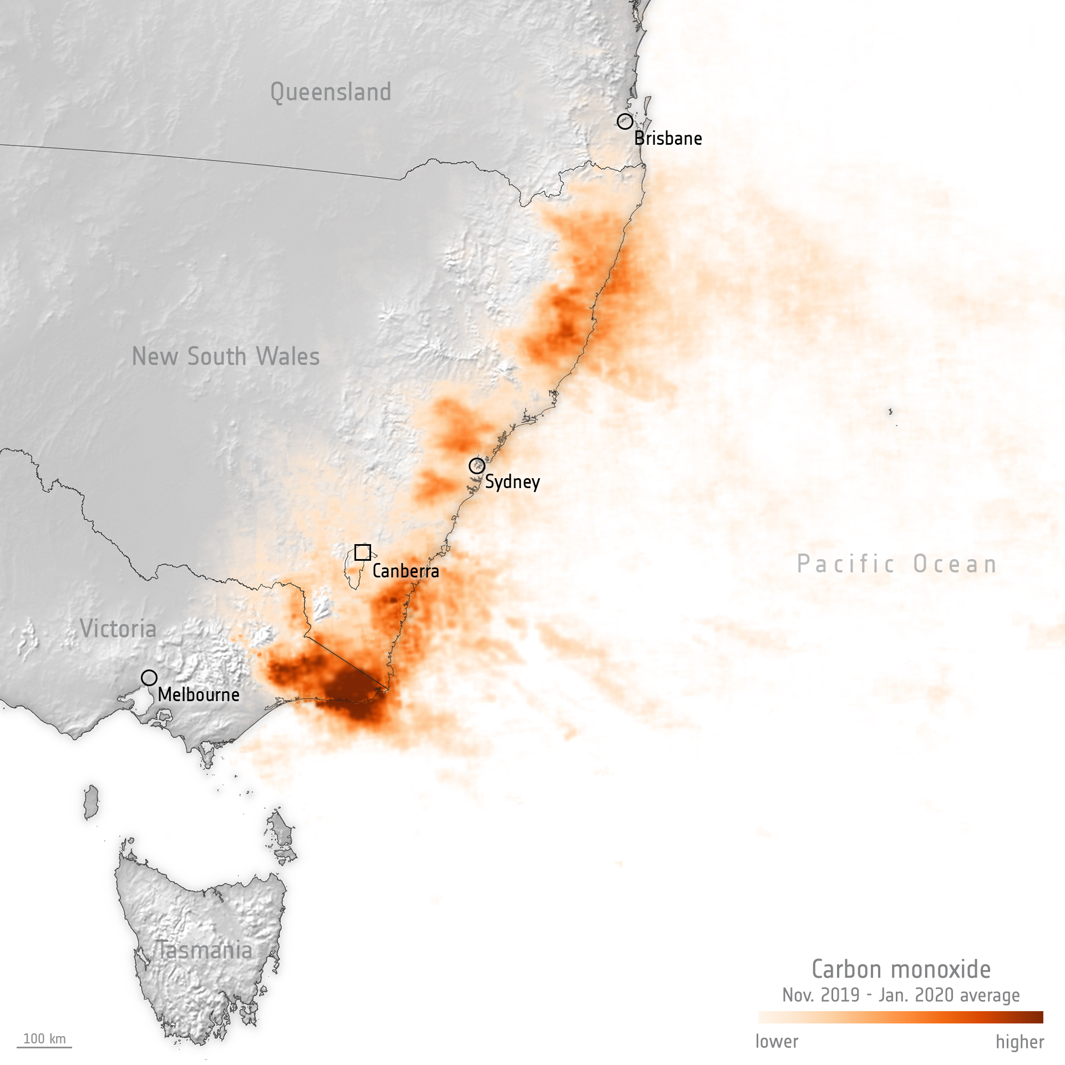
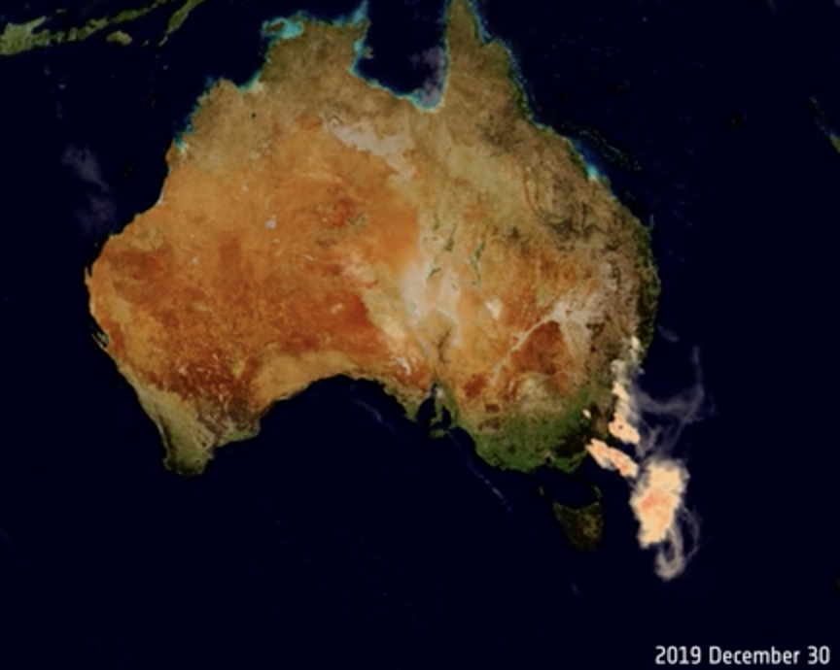
Sentinel-5P Air Pollution Monitoring
Bush-Fire Emissions in Australia
https://www.esa.int/Applications/Observing_the_Earth/Aerosols_released_from_Australian_bushfires_triggers_algal_blooms
these bushfires (Nov. 2019 – Jan. 2020) released CO equivalent to 715 million tonnes of CO2 in just three months
van der Velde, I.R., van der Werf, G.R., Houweling, S. et al. Vast CO₂ release from Australian fires in 2019–2020 constrained by satellite.
Nature 597, 366–369 (2021). https://doi.org/10.1038/s41586-021-03712-y
Sentinel-5P Aerosol Absorbing Index measurements
Credits: contains modified Copernicus data (2019/20) processed by SRON

Slide 18
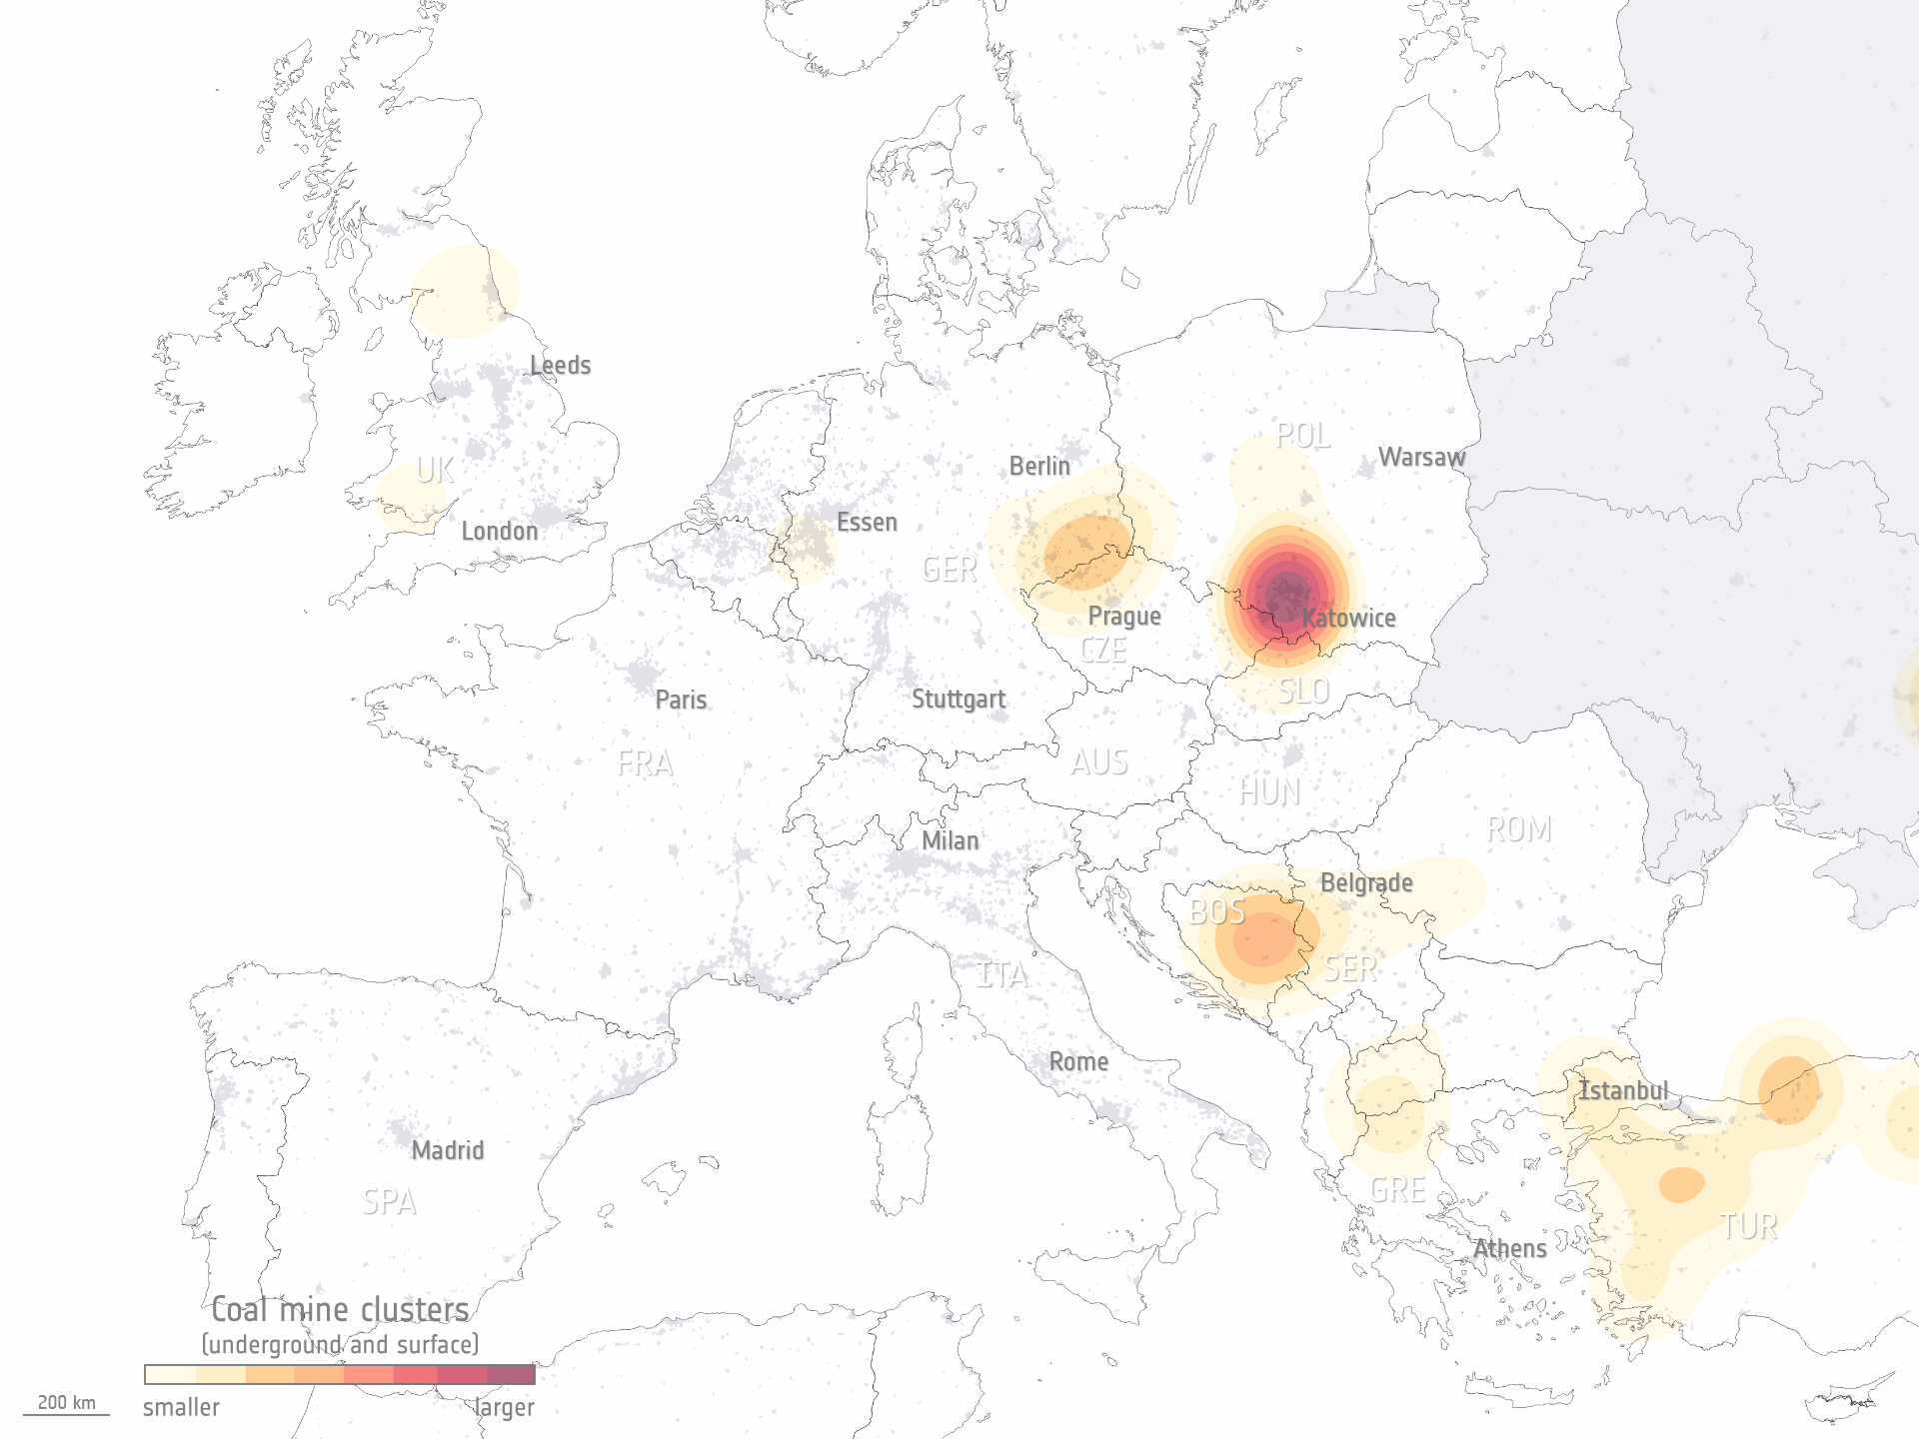
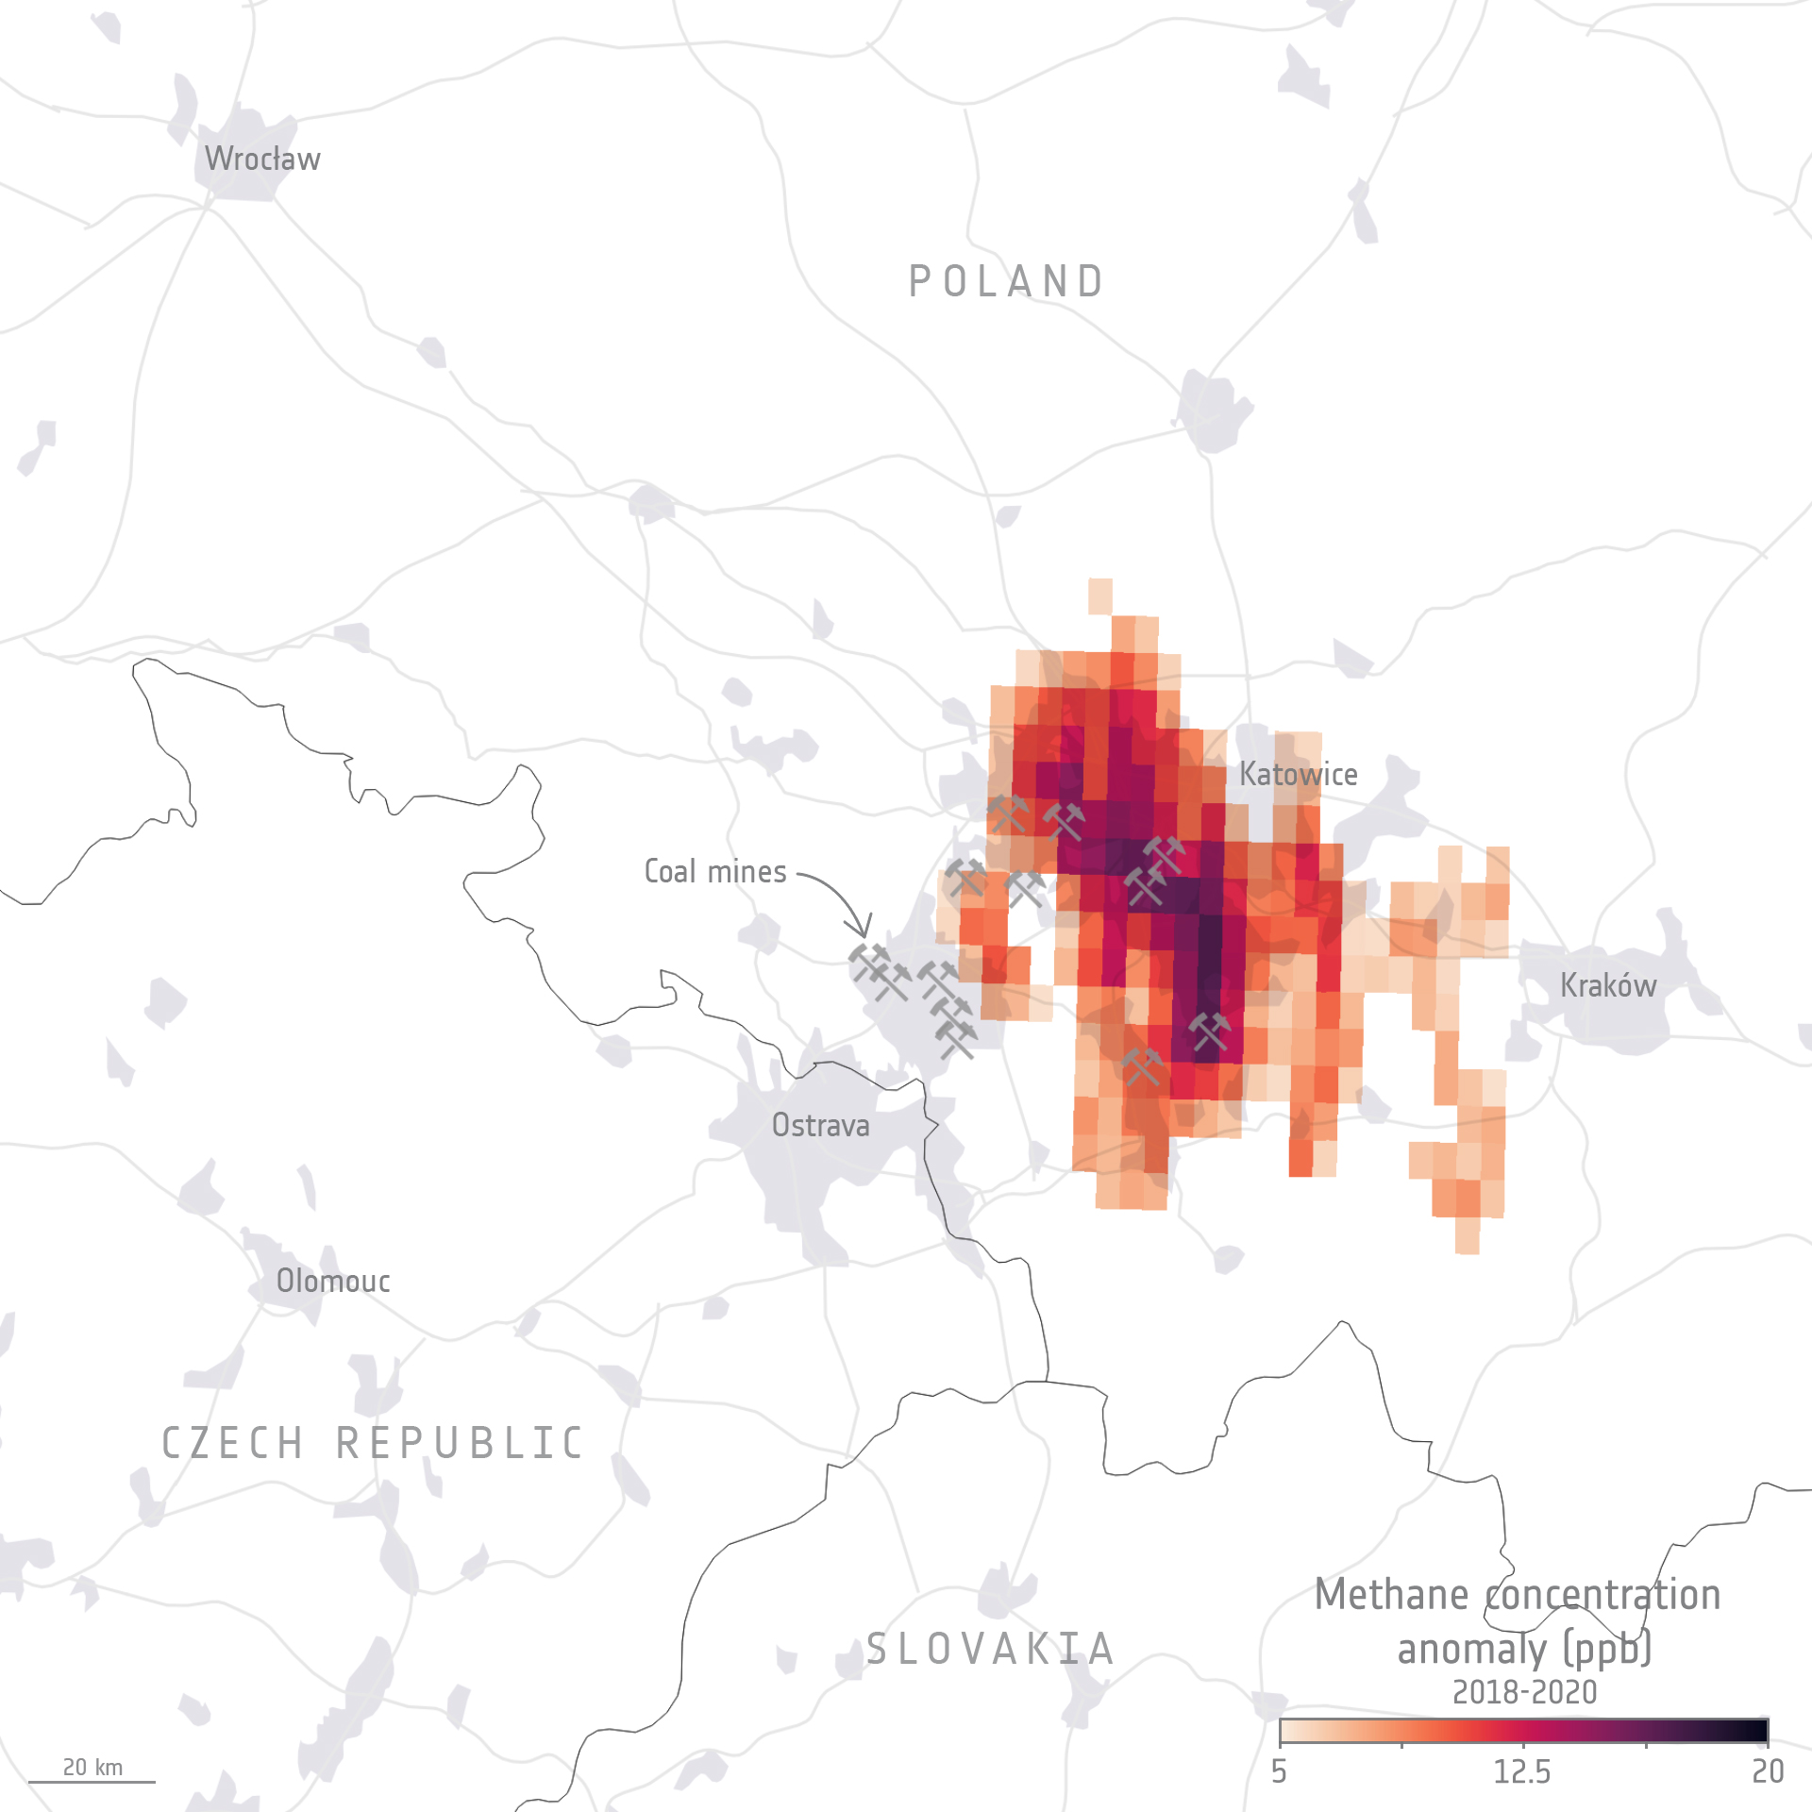
Sentinel-5P GHG Methane Monitoring Coal Mines over Poland
https://www.esa.int/Applications/Observing_the_Earth/Copernicus/Sentinel-5P/Methane_detected_over_Poland_s_coal_mines
This map shows the clusters of both underground and surface coal mines in Europe.
Copyright: Contains modified Copernicus Sentinel data (2018-20)
processed by University of Leicester

Slide 19
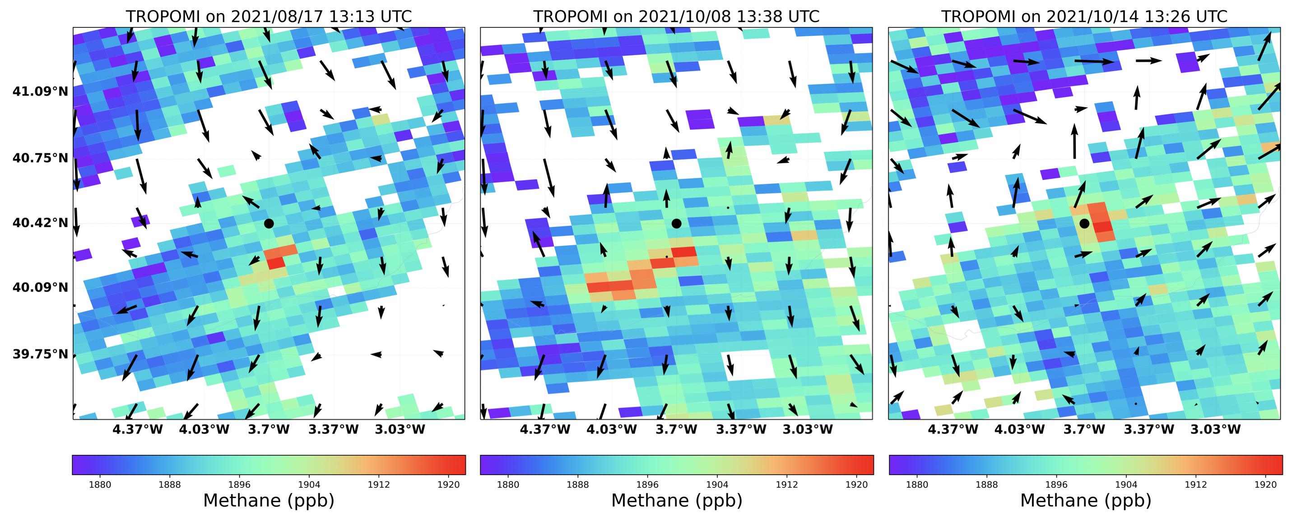
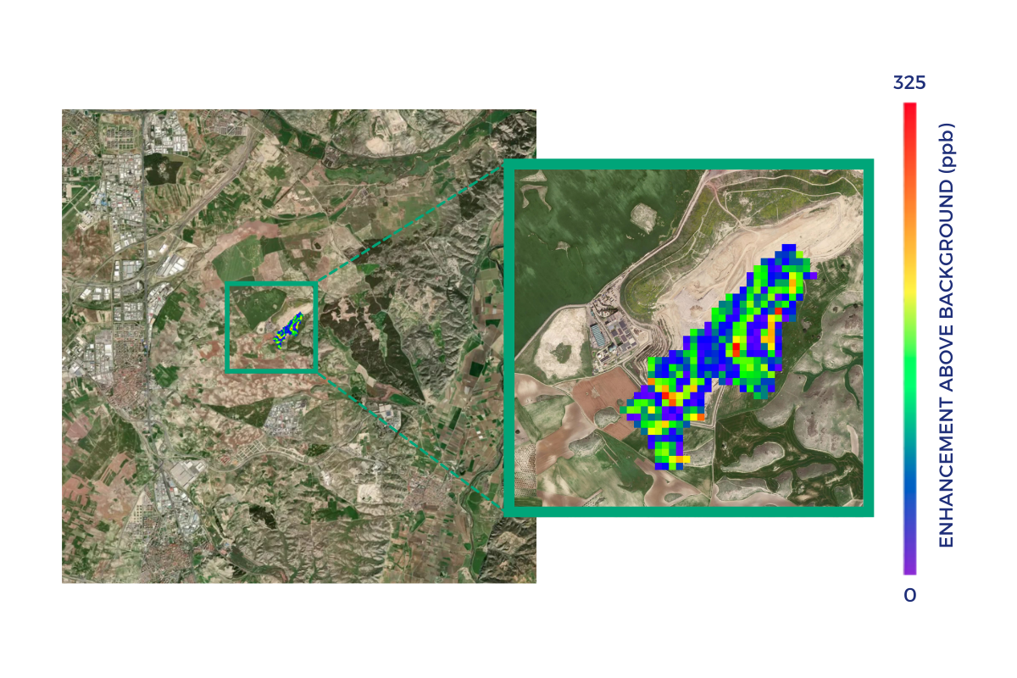
Sentinel-5P GHG Methane Monitoring
Synergy with GHGSat (ESA TPM Mission)
Methane Concentration/Emissions from land fills close to Madrid: https://www.esa.int/Applications/Observing_the_Earth/Satellites_detect_large_methane_emissions_from_Madrid_landfills
Madrid
GHGSat Methane Measurements (Oct. 13 2021)
copyright GHGSat
Copyright: Contains modified Copernicus Sentinel data (2021) / processed by SRON

Slide 20
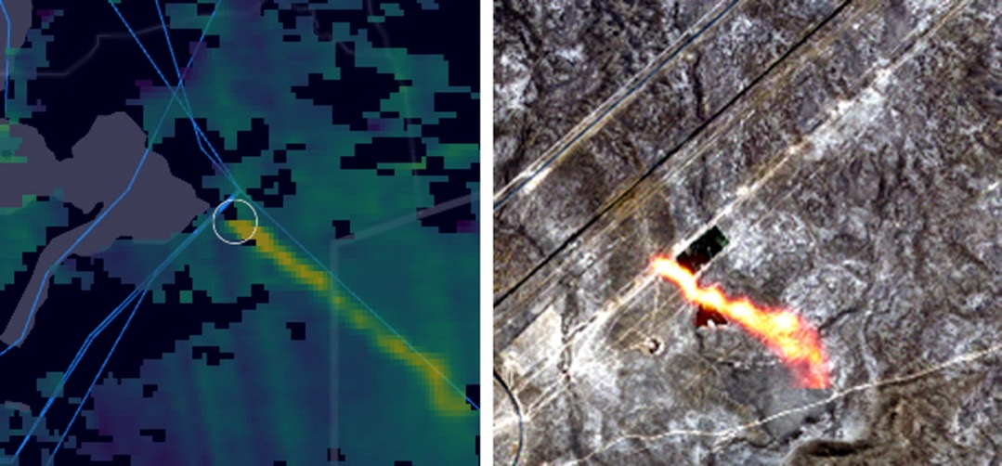
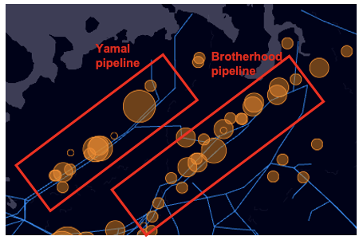
Sentinel-2 Mapping High-resolution Methane Emissions
Sentinel-2 used to detect individual methane leakages from natural gas facilities worldwide.
S5P
S2
S5P
Copyright: Contains modified Copernicus Sentinel data (2020) processed by Kayrros
https://www.esa.int/Applications/Observing_the_Earth/Copernicus/Sentinel-5P/Monitoring_methane_emissions_from_gas_pipelines

Slide 21
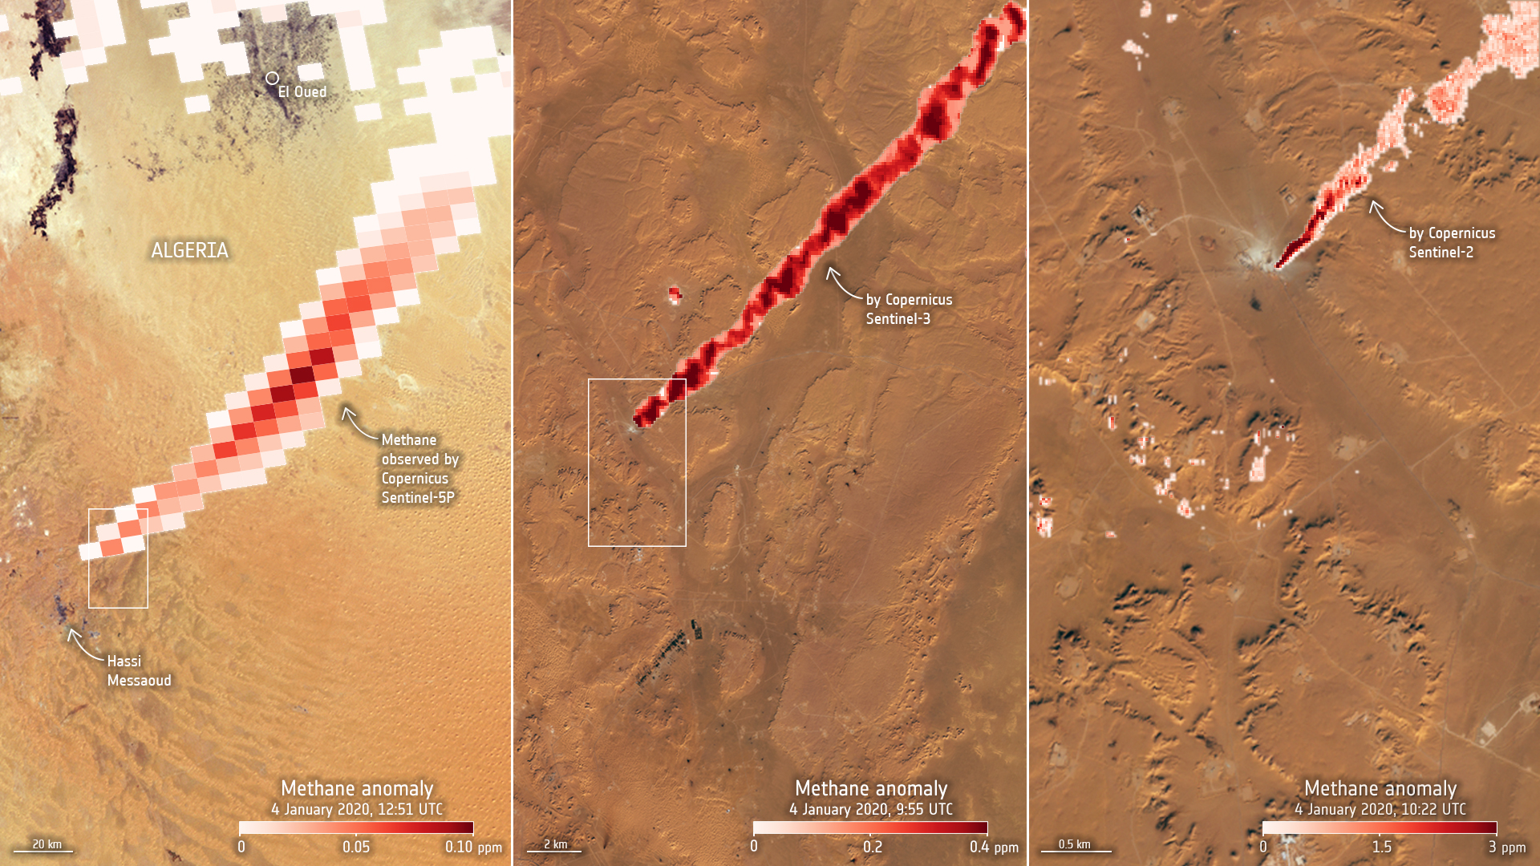
3 Sentinels to detect Methane Emissions
S5P
S2
S5P
https://www.esa.int/Applications/Observing_the_Earth/Copernicus/Trio_of_Sentinel_satellites_map_methane_super-emitters

Slide 22
Sentinel-5 Precursor Outlook
Funding for operations until end of 2027
Continuous improvement of algorithms/products (e.g. SO₂, Methane)
Adding new products into the Sentinel-5P PAL (e.g. Nitrous Acid (HONO))

