Slide 1
Tropospheric Composition/Air Quality Research at NASA: From Early Days to TEMPO
Jack A. Kaye
Associate Director for Research
26 August, 2024

Slide 2
Outline of Talk
Early history (space, air, …)
Current observational and organizational environment
First thoughts about geostationary observations for tropospheric composition
Decadal Assessment – GeoCAPE – and then some
Today: (including TEMPO -only mentioned here, since those doing the work can talk about it!)

Slide 3
Early (Very Abbreviated!) History of Air Quality Research at NASA
NASA has long history of studying air quality from air, space, and surface, and integrates observations and models to test understanding, provide predictive capability, and produce integrated hybrid products.
Significant early work on global tropospheric chemistry involved airborne measurements (Global Tropospheric Experiment – GTE) to study background atmosphere, interactions with surface, and mechanisms of transport and transformation of trace constituents. As time went on focus shifted to areas impacted by long-range transport from biomass burning and other sources, local anthropogenic air pollution (including precursors), and wildfires.
Surface-based measurement networks provide spatial and temporal context, as well as complementary information for field campaigns and calibration/validation information for satellites.
Seminal work on extracting tropospheric ozone information from satellites (Tropospheric Ozone Residual from TOMS/SAGE) broadened NASA program and strengthened linkage between satellite and airborne program.
Additional work by research community added to knowledge of troposphere by extracting information about tropospheric ozone, aerosols, nitrogen dioxide, and sulfur dioxide, using satellites from NASA and international partners.
Space measurement programs focusing on troposphere were nurtured (from MAPS on Space Shuttle, through EOS and other platforms, and now TEMPO).
Programmatic evolution encouraged integrated approach to atmospheric composition that captured synergies between programs (within NASA, with US and international partners – like GEMS!)

Slide 4
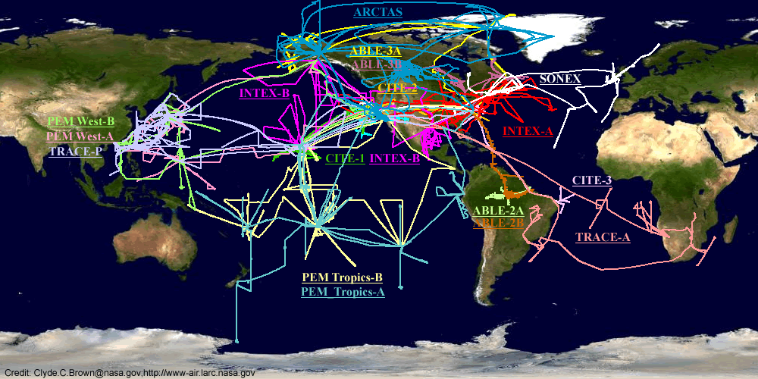
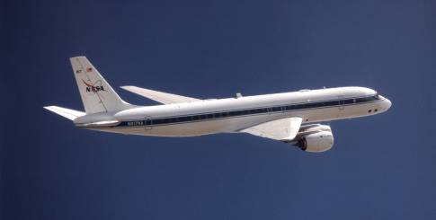
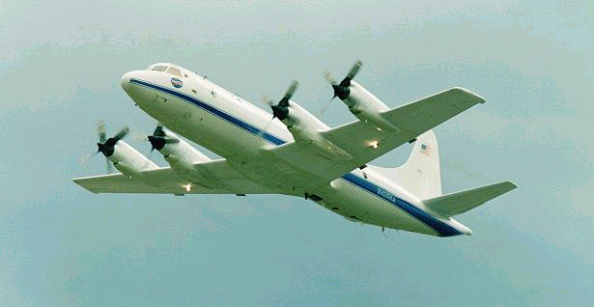
NASA Tropospheric Chemistry Field Campaigns (1983-2008)

Slide 5
Partial History of NASA Air Quality Field Campaigns
Year(s) | Campaign | Location(s) | Platform(s) | Partner(s) | Key Objective(s)
1992 | TRACE-A | Multiple | DC-8 | INPE (Brazil) | Impacts of biomass burning on ozone over Atlantic
2001 | TRACE-P | Yokota Air Base, Japan, Hong Kong | DC-8, P-3B |  | Impact of Asian air outflow over Western Pacific Ocean
2006 | INTEX-B | Mexico City | DC-8, C-130, B-200, J-31 | N/A | Trans/intercontinental transport and impact on air quality/ climate.
2008 | ARCTAS | Cold Lake, Alberta Yellowknife, NWTt | DC-8, P-3B, B-200 |  | Air quality in Arctic, especially impact of smoke plumes from fires
2011-2014 | DISCOVER AQ | MD, CA, TX, CO | P-3, B-200 | Multiple local | Air quality over polluted regions with in situ and remote sensing
2016 | KORUS AQ | Osan Air Base, Korea | DC-8 | NIER (Korea) | Local and imported sources of air pollution around Seoul
2016-2018 | AToM | 8 in Atlantic/Pacific | DC-8 | Multiple | Impact of human-produced air pollution on greenhouse gases and on chemically reactive gases in the atmosphere
2017 | LMOS | Chicago, IL and nearby areas | Multiple airborne, ships, … | NOAA, EPA, EPRI, LADCO | Atmospheric chemistry over Lake Michigan and nearby cities,
2018 | LISTOS | Long Island area | Multiple | NOAA, EPA, NESCAUM | Air quality over LI Sound and nearby; TROPOMI Validation, Precursor for TEMPO
2019 | FIREX AQ | Boise, Salina | DC-8, ER-2 | NOAA | Atmospheric impact of wildfires and agricultural burning
2021 | TRACER-AQ | Houston | G-III, G-V | DOE, TX | Air pollution around Houston
2023 | STAQS | Palmdale, Dayton | DC-8, G-III, G-V | NOAA | Air pollution around LA, Chicago, NYC, TEMPO underflights/comparison
2024 | ASIA AQ | Korea, Thailand, Philippines | DC8, G-III | Multiple | Megacity air pollution in Asia, GEMS/GK2B comparisons
* There are many more – going back to 1980s. Note that campaigns focused mainly on GHGs are not included here. No offense intended to those

Slide 6
Selected History of Air Quality Related Satellites/Instruments*
Instrument/Platform | Date(s) | Agency(ies) | Key Observables
MAPS/Space Shuttle | 1981, 1984, 1994 (2x) | NASA | Carbon Monoxide column – tropics/mid-latitudes
GOME/ERS-2 | 1995-2011 | ESA | Column O₃, NO₂
SCIAMACHY/ENVISAT | 2002-2012 | ESA | Column O₃, NO₂
GOME-2/Metop (multiple) | 2006 - Present | EUMETSAT | Column O₃, NO₂
MOPITT/Aura | 1999- Present | CSA | Column CO
OMI/Aura | 2004 – Present | NASA, FMI, NIVR | Column O₃, NO₂
TES/Aura | 2004 - | NASA | Multiple columns, profiles
Sentinel-5P/TROPOMI | 2017 - Present | EC/ESA/EUMETSAT | Column CH₄, NO₂
GEMS/GK2B | 2020 – Present | NIER (Korea) | Geostationary Column O₃, NO₂ Over E Asia/W Pacific
TEMPO | Launched 4/7/2023 | NASA (HSAO) | Geostationary Column O₃, NO₂ Over US
* This does not include ”combined approaches” (e.g., TOMS/SAGE)

Slide 7
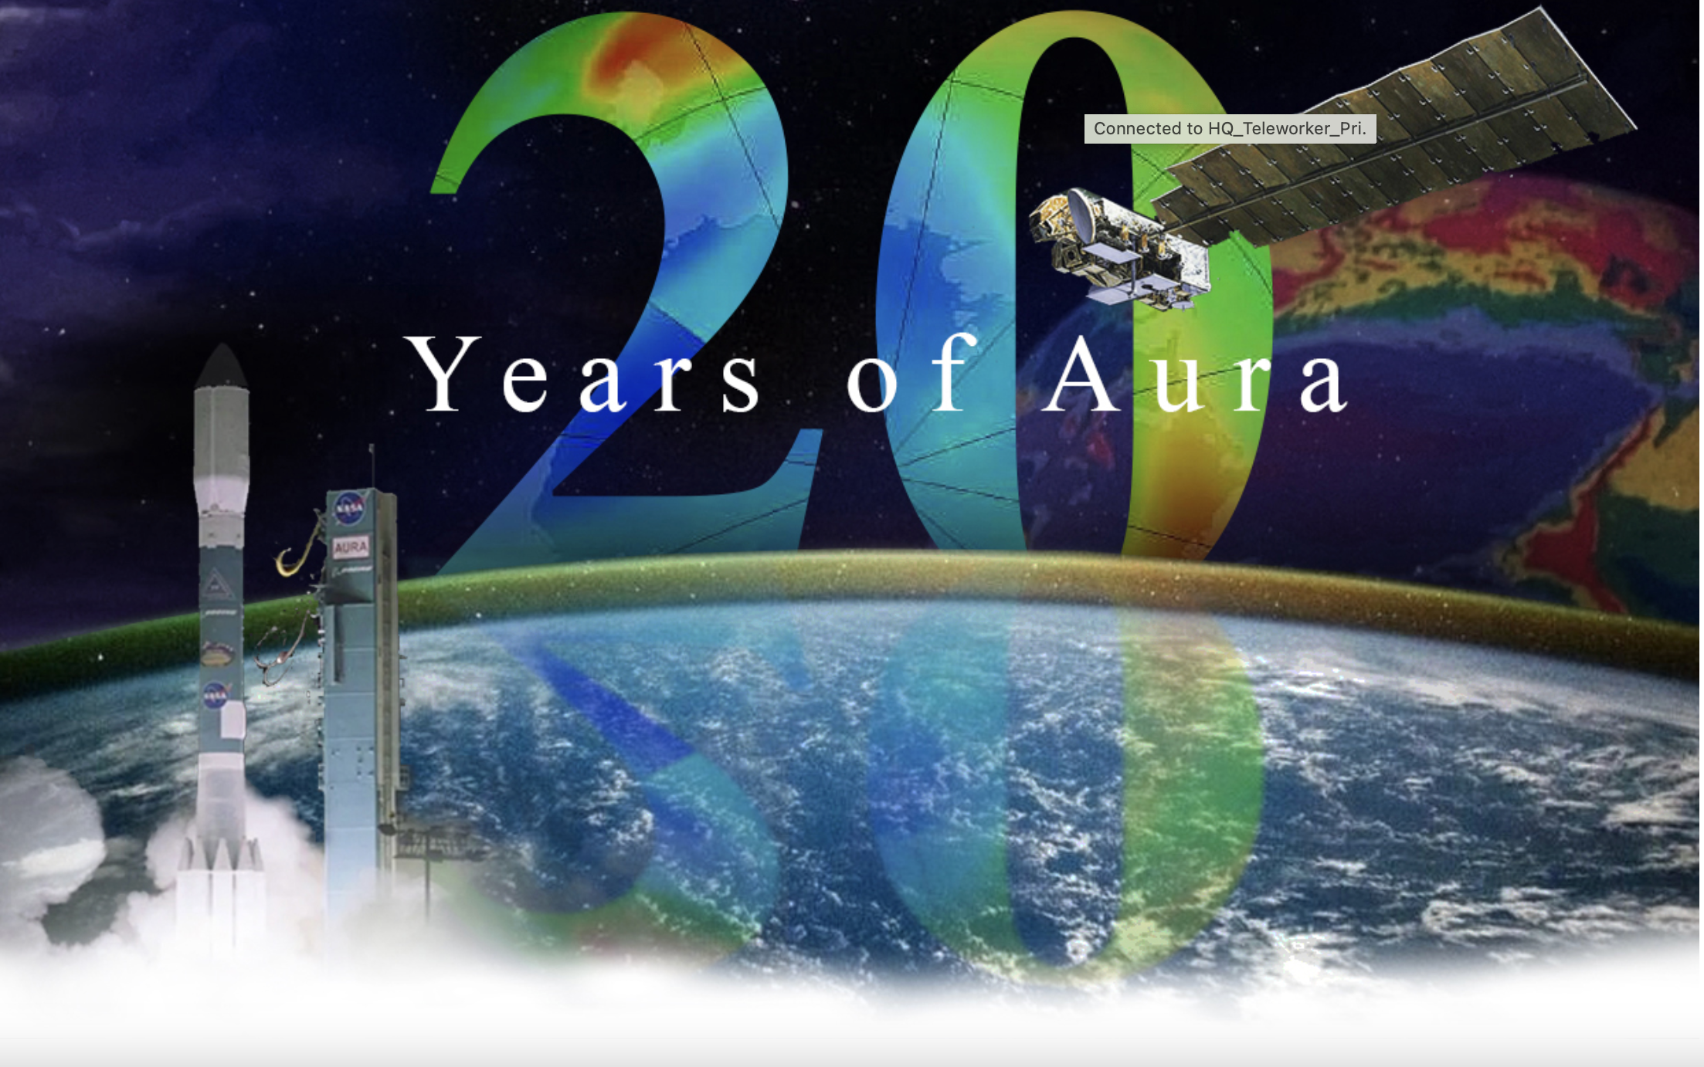
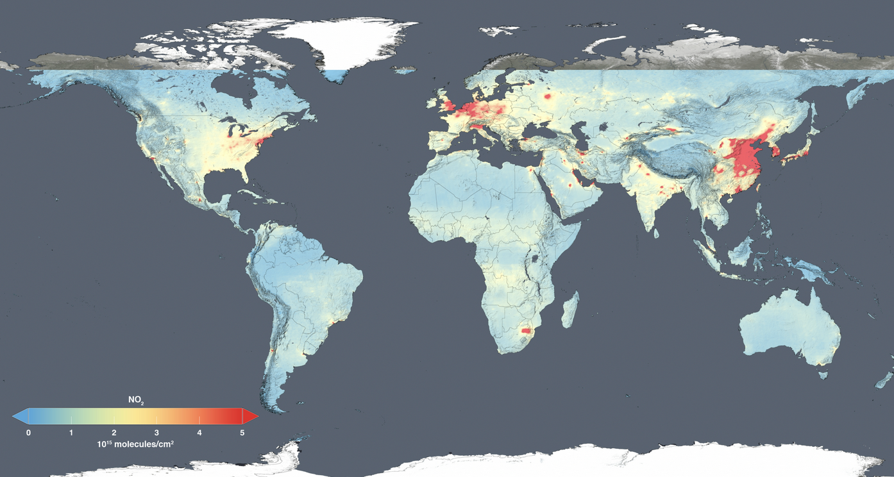
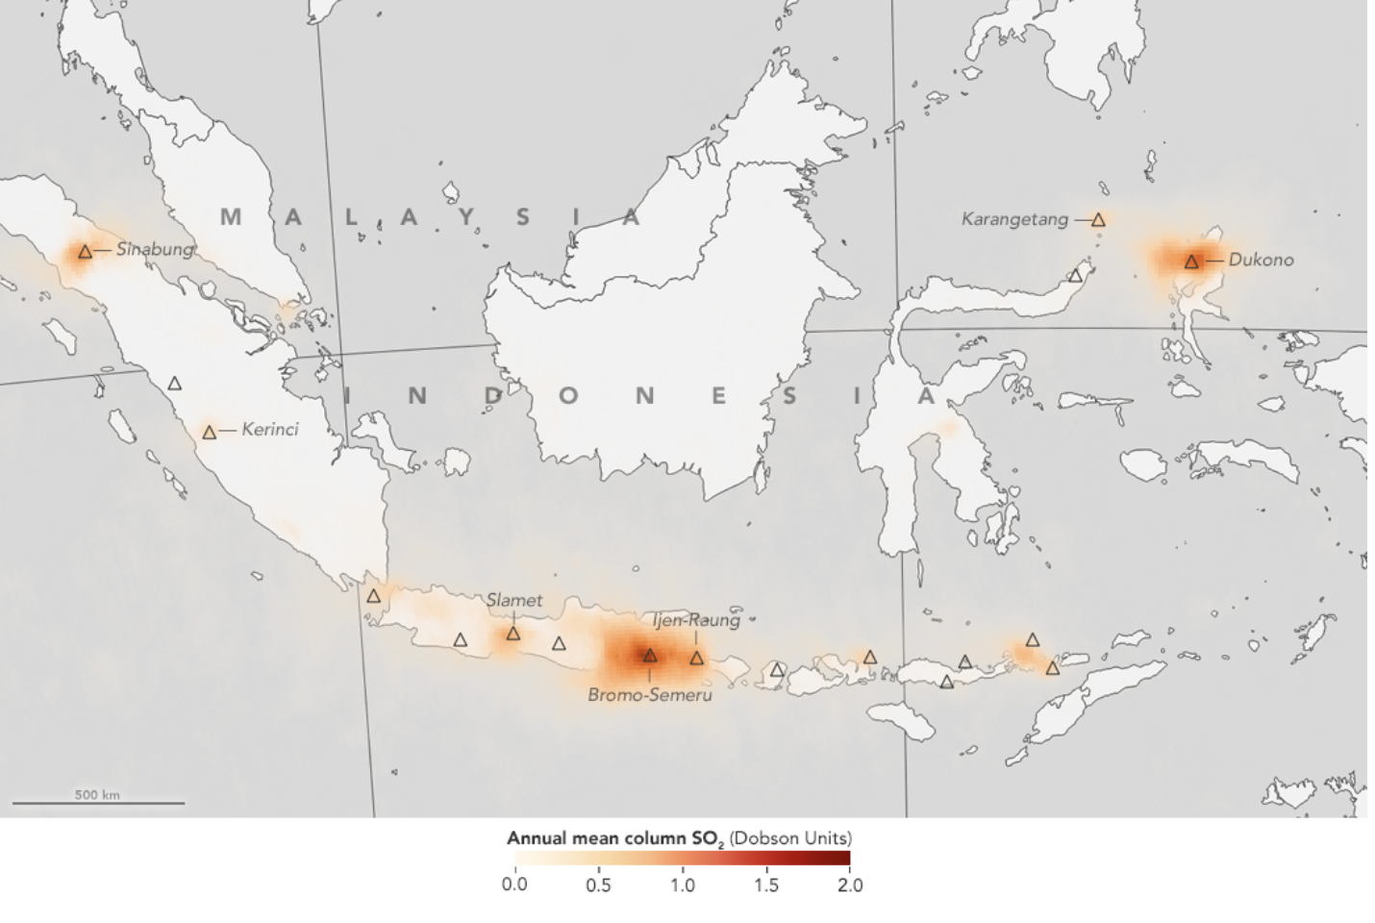
Aura 20th Annniverary!
This global map shows the concentration of nitrogen dioxide in the troposphere as detected by the Ozone Monitoring Instrument aboard the Aura satellite, averaged over 2014.
Aura's 20th Launch Anniversary Event
All are invited to join us for an informal, hybrid event on September 18th to celebrate the 20th anniversary of Aura's launch, which is on July 15th, 2004. We will have coffee/tea and cake along with an open mic!
Date/Time: September 18, 2024; 12:30-2:30 pm EDT.
In-Person: Barney and Bea Recreational Center (9998 Good Luck Rd., Greenbelt, MD 20771).
Volcanic sulfur dioxide emissions from Indonesia’s many volcanoes are shown in shades of orange. The data was produced from observations from NASA’s Aura satellite.
https://science.nasa.gov/earth/nasa-celebrates-20-years-of-earth-observing-aura-satellite/

Slide 8
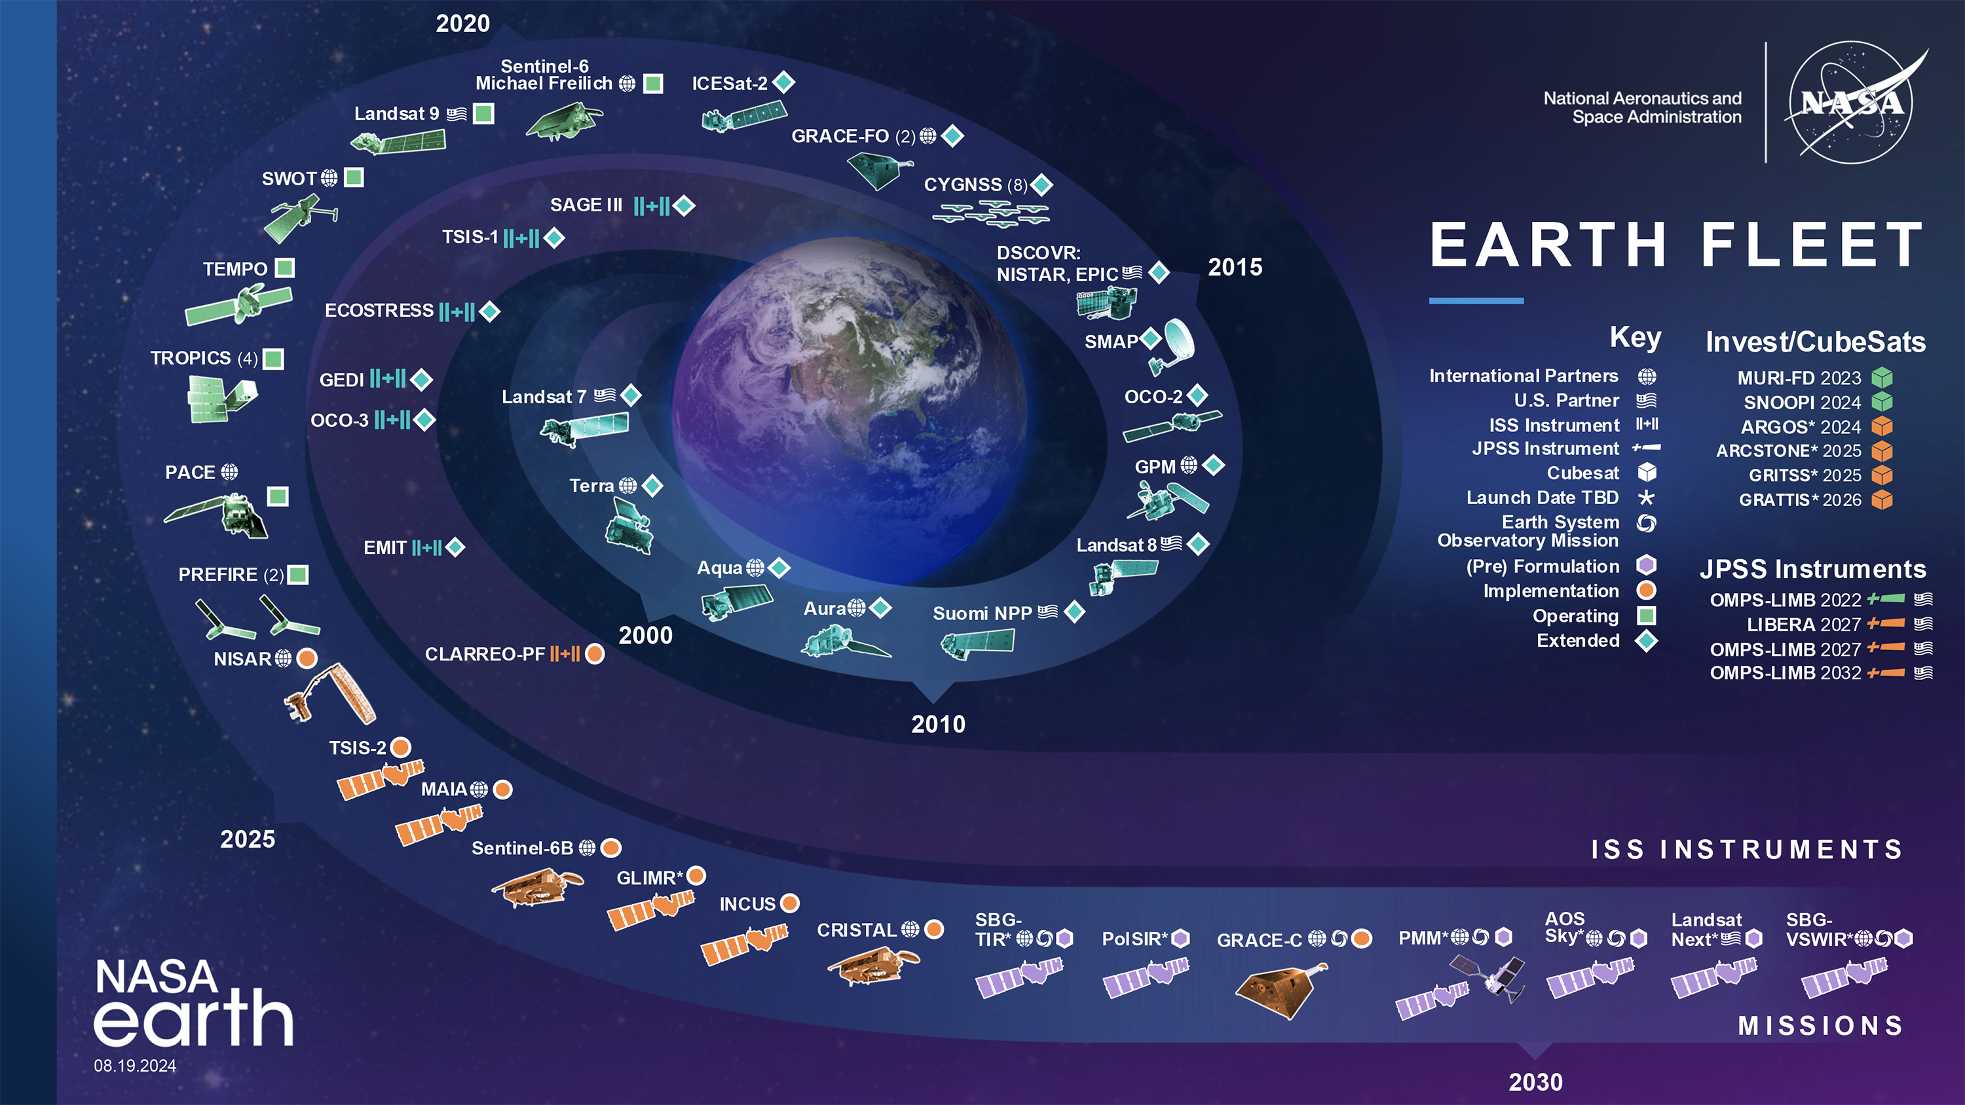

Slide 9
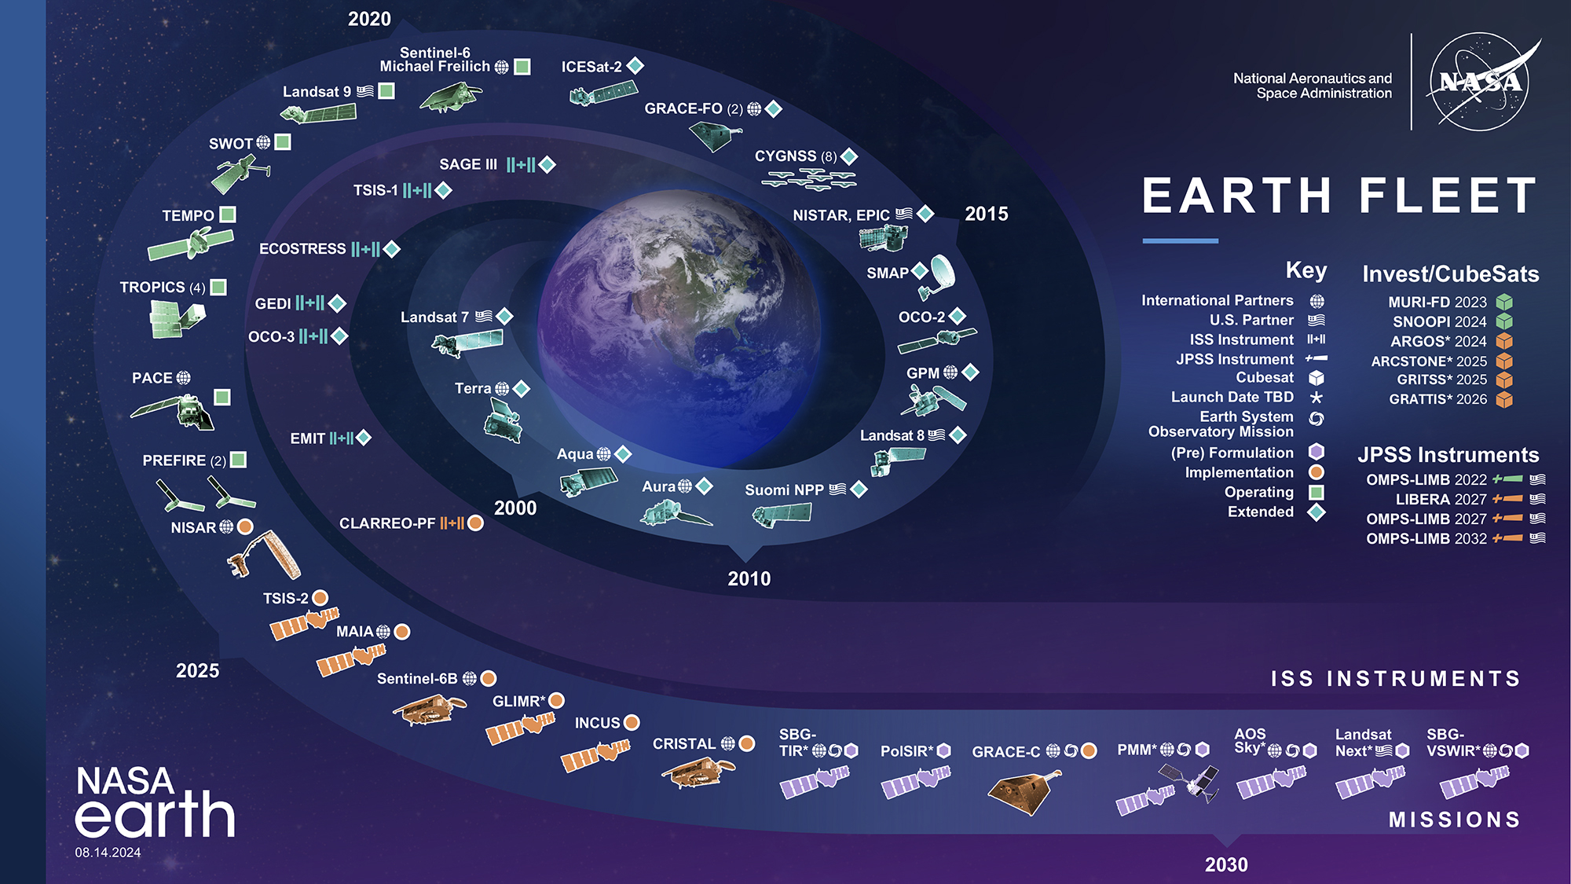
Satellites with atmospheric composition as significant focus.
Satellites with atmospheric aserosols as significant focus.

Slide 10

(Pre) Formulation
Implementation
Primary Ops
Extended Ops
NASA Earth Fleet
International Collaborations
GRACE-C
CRISTAL
PMM
AOS Sky
Sentinel-6B
SBG
MAIA
NISAR
PACE
SWOT
SENTINEL-6 Michael Freilich/B
GRACE-FO
GPM
TERRA
AURA
AQUA
05.31.2024

Slide 11









Earth Science to Action Strategy
Virtuous Cycle
User needs inform next iteration of programs, missions and initiatives
Earth Science to Action
Public Understanding & Exchange
Put more scientific understanding into public sphere
Deliver applied science to users
Participate in multi-way info exchange
Use input to inform subsequent work
Solutions & Societal Value
Offer models, scientific findings and info through Open-Source Science principles
Support climate services
Provide science applications and tools to inform decisions
Earth System Science & Applied Research
Grow scientific understanding of Earth’s systems
Develop predictive modeling for science applications and tools to mitigate, adapt and respond to climate change
Foundational Knowledge,
Technology, Missions & Data
Technology innovation
Earth observations missions
Data collected from space, air and ground
05.01.2024

Slide 12
Integration of Vantage Points and Approaches for Air Quality Research

Slide 13
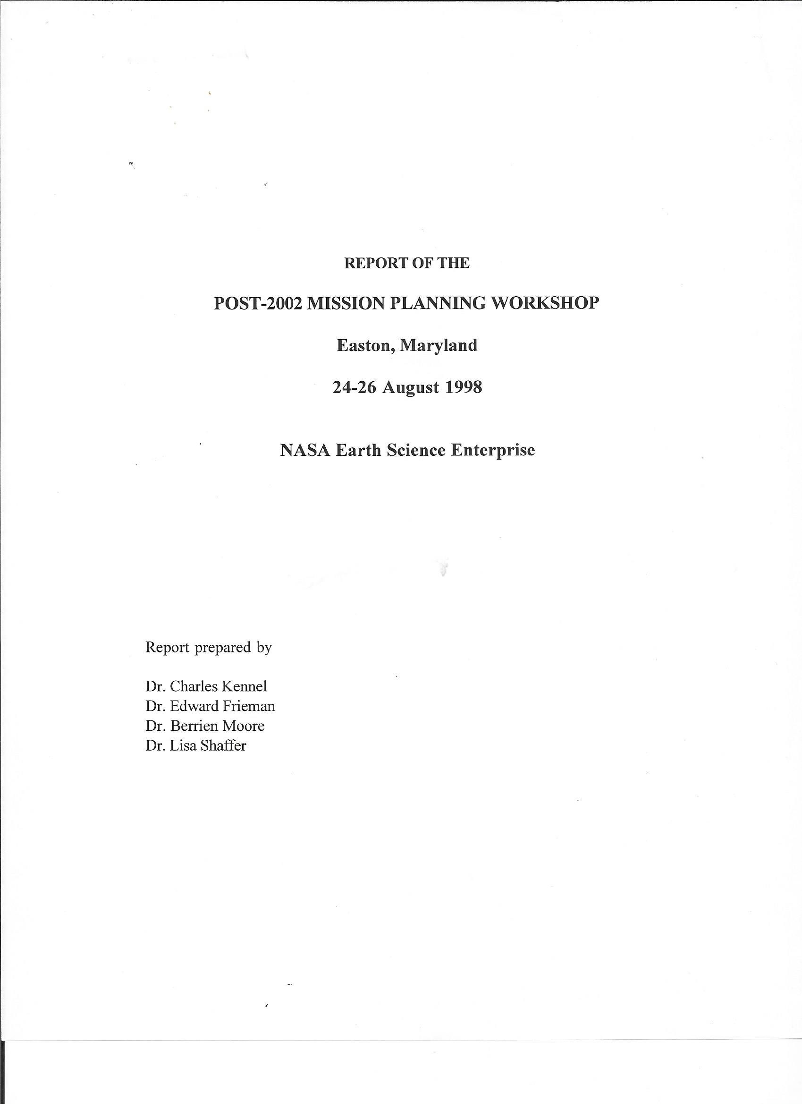
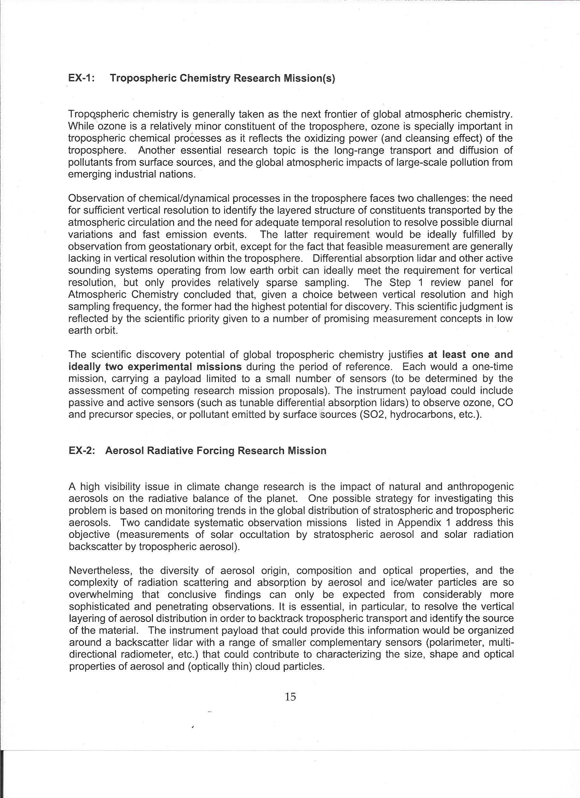
Early Thoughts About Geostationary Observations for Tropospheric Composition – Easton Meeting (1998)
”Observation of chemical/dynamical processes in the troposphere faces two challenges: the need for sufficient vertical resolution to identify the layered structure of constituents transported by the atmospheric circulation and the need for adequate temporal resolution to resolve possible diurnal variations and fast emission events. The latter requirement would be ideally fulfilled by observation from geostationary orbit, except for the fact that the feasible measurement are generally lacking in vertical resolution from within the troposphere … The Step 1 review panel for Atmospheric Chemistry concluded that, given a choice between vertical resolution and high sampling frequency, the former had the highest potential for discovery.”

Slide 14
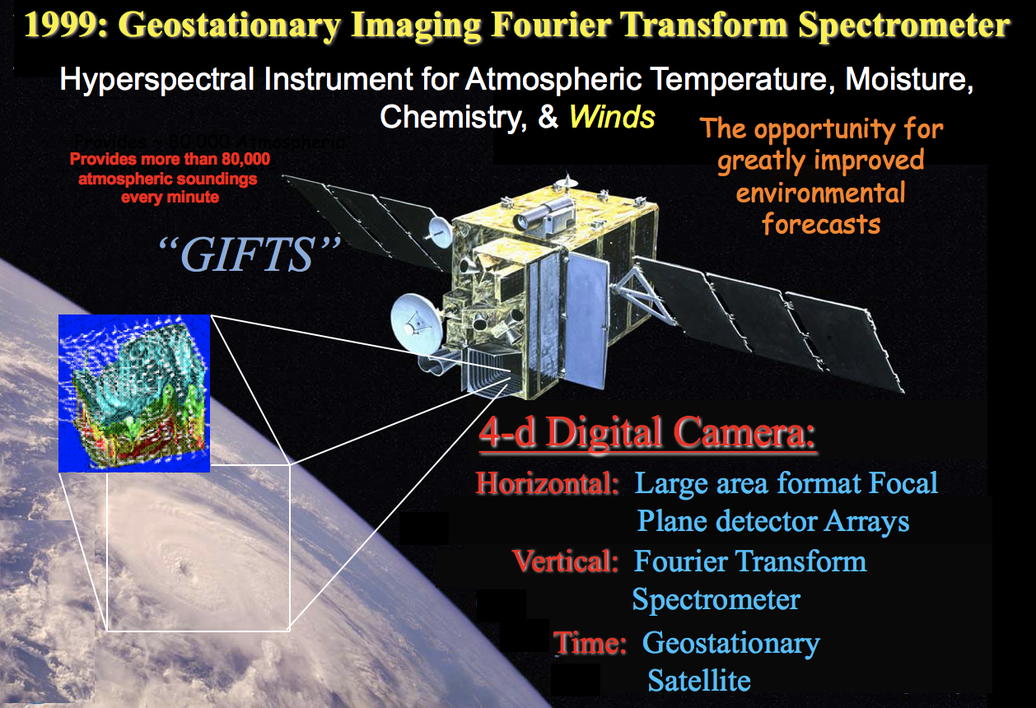
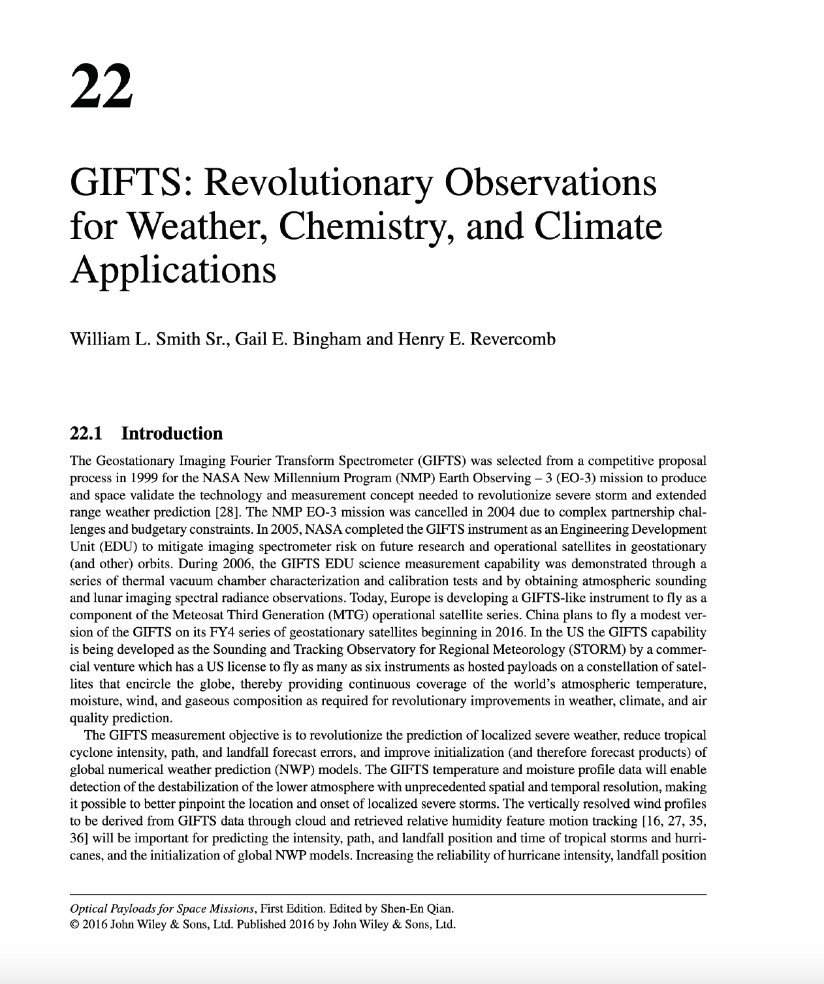
Early Thoughts About Geostationary Observations for Tropospheric Composition – GIFTS (1999)
Thanks to Bill Smith (U. Wisconsin) for providing charts and references!

Slide 15
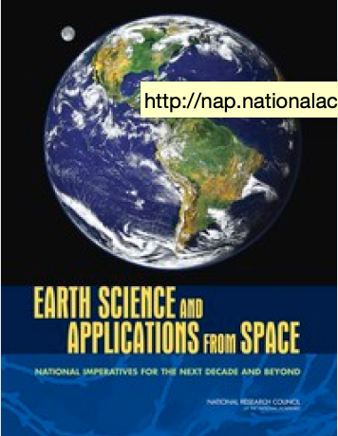
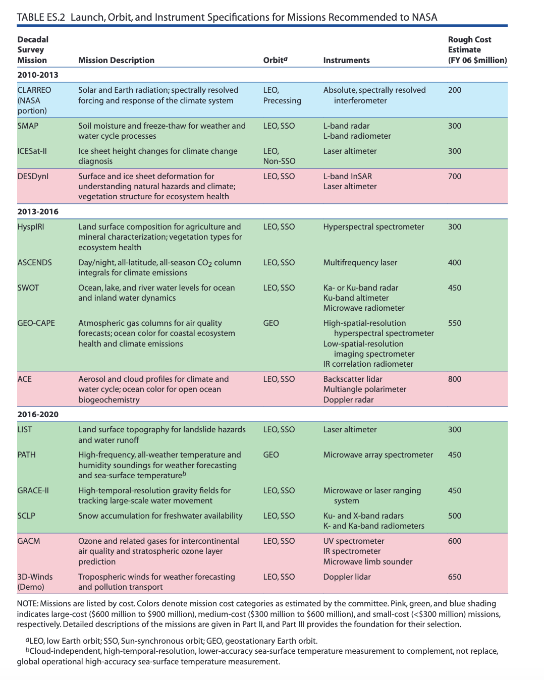
First Decadal Assessment: GEO-CAPE (and then some…)

Slide 16
Overview from GEO-CAPE Mission Implementation Study*
GEO-CAPE mission concept as described in the Decadal Survey was studied in 2010 using a planning payload representative of the instrumentation needed for GEO-CAPE measurements
  The mission would be implemented as a “dedicated NASA only mission”
  All instrumentation would fly on the same spacecraft
  Ocean color measurements need companion atmospheric composition measurements (O₃, NO₂) for atmospheric correction
  8 years of development, 3 years of operations, life-cycle cost ~$1.5B
GEO-CAPE science and mission design groups are making good progress on defining a cost constrained mission implementation approach that accomplishes the GEO-CAPE science requirements at lower risk and cost than the approach implied in the DS
  The mission would be implemented as secondary payloads hosted on commercial GEO communications missions
  Each instrument could fly separately on different spacecraft
  GEO-CAPE ocean color measurements can be independent of GEO-CAPE atmosphere measurements
  < 8 years of development, > 3 years of operations, life-cycle cost target
  ~$600-700M tbc (~ same as DS cost estimate with inflation)
* From Report on FY 2012 Deliverable 1, “Provide a recommendation on a risk reduction (pathfinder) mission” – 12 Sept. 2012

Slide 17
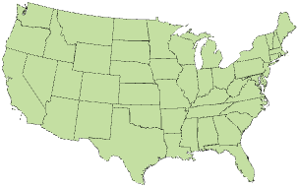

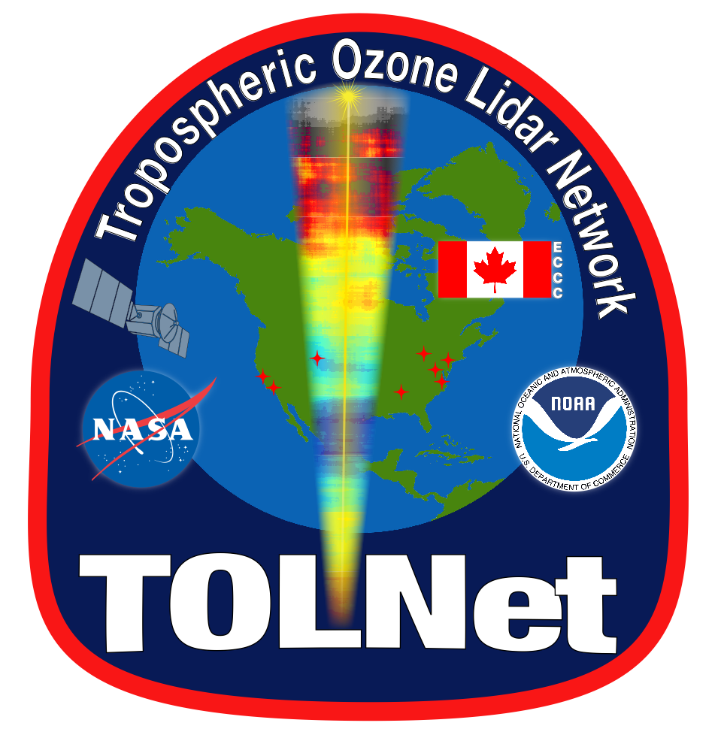
TOLNet – Initiated to Get Ozone Data with Improved Temporal Sampling
Feb 17th
Feb 17th
Feb 18-19th
Website and Data
Feb 18-19th
Feb 17-18th
Feb 18-19th

Slide 18
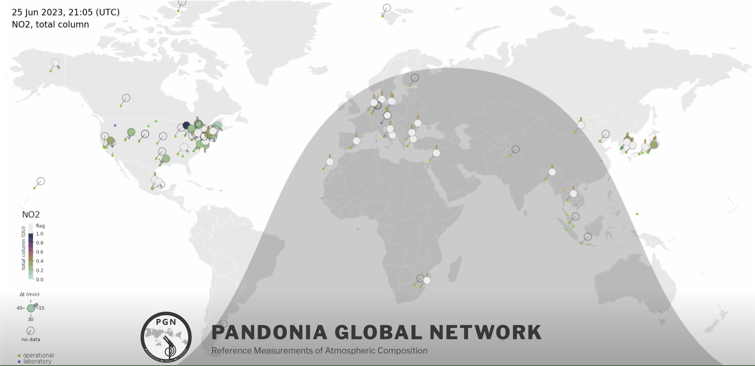
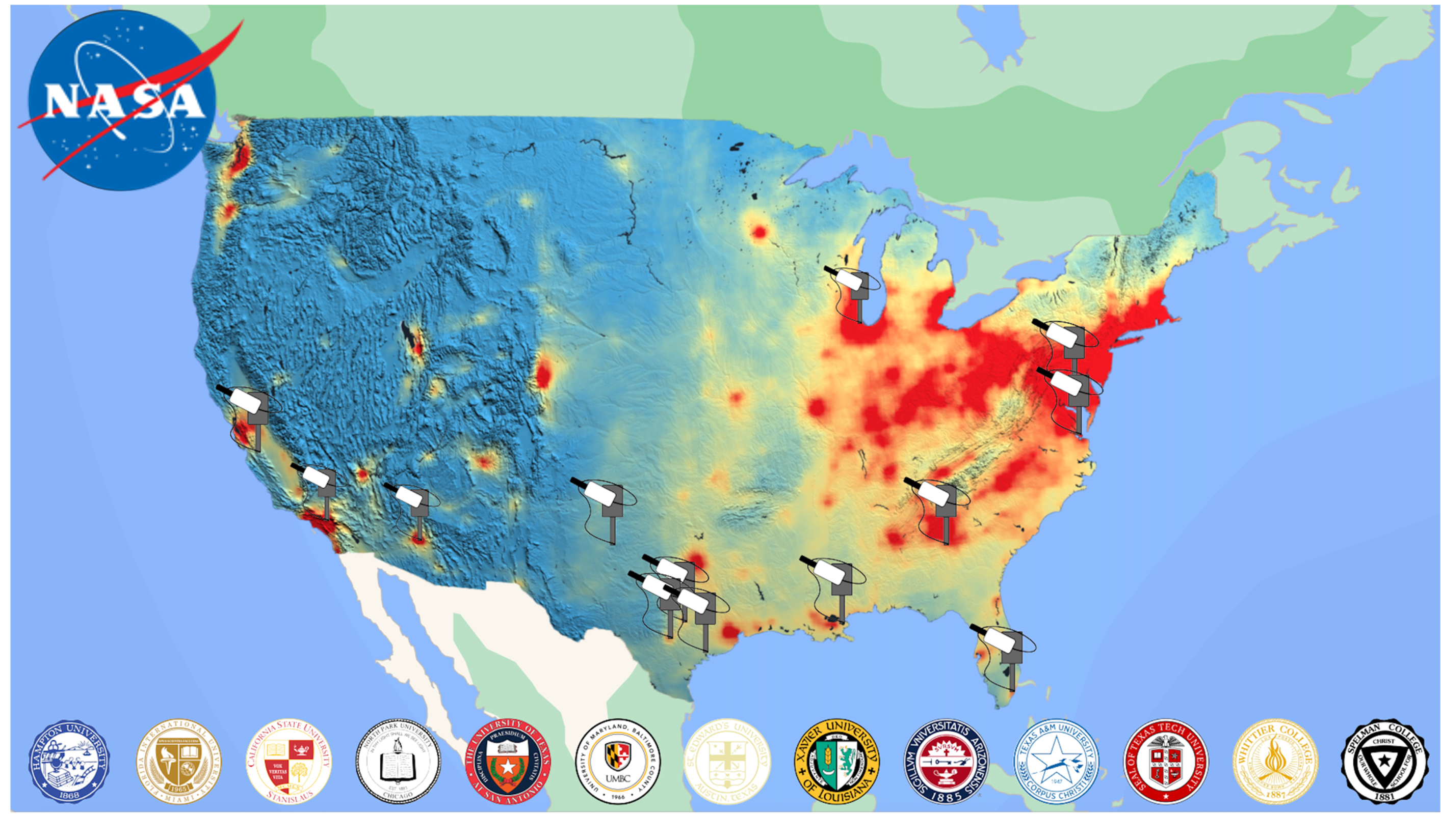
PANDORA/Pandonia Global Network
New US stations as part of IPMSI (Improving Participation of Minority Serving Institutions) program
Providing the interconnected perspective between surface and satellite air quality observations at 100+ Sites Globally with accurate and precise observations of ozone, NO₂, and HCHO. https://www.pandonia-global-network.org/

Slide 19
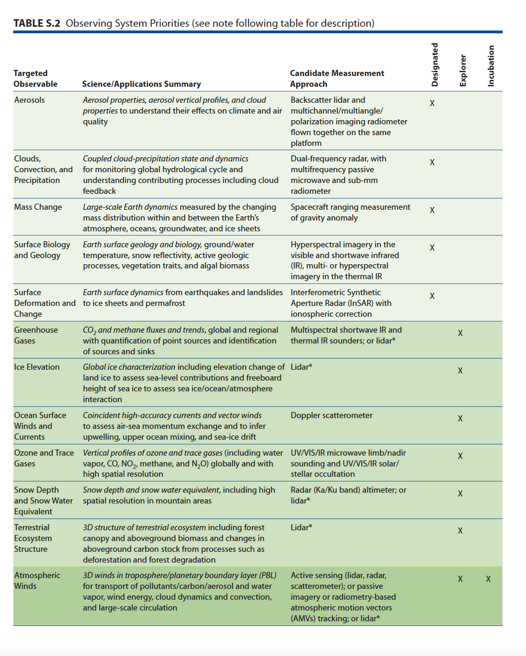

Second Decadal Survey

Slide 20
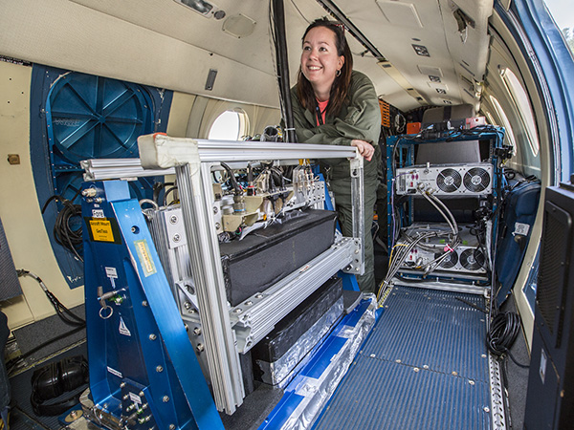
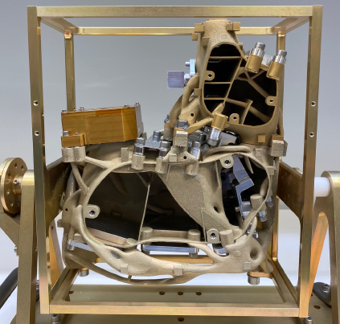
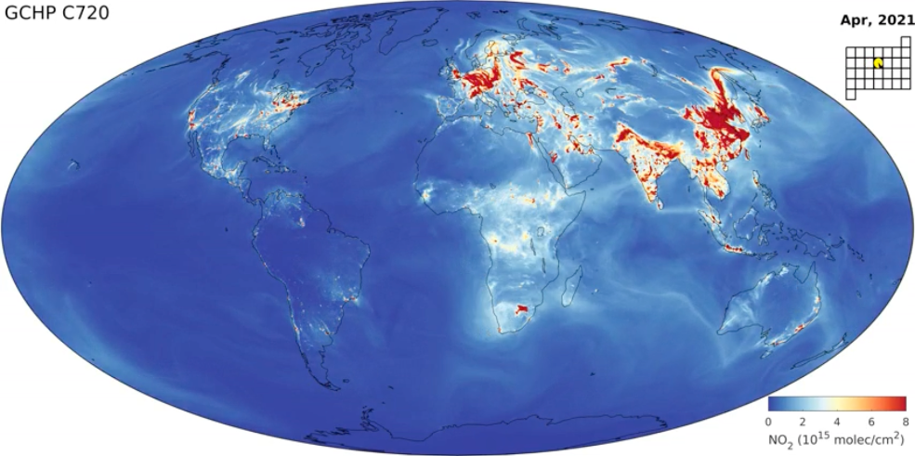
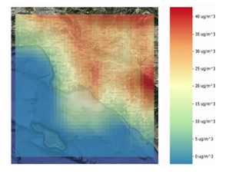
ESD Technology Investments in Support of Air Quality Observations and Modeling
Geostationary Trace gas and Aerosol Sensor Optimization (GeoTASO)
James Leitch (Ball Aerospace)
Instrument Incubator Program (2010)
Has flown on numerous campaigns beginning with DISCOVER-AQ starting in 2013 and in others since then!
﻿
﻿Compact Hyperspectral Air Pollution Sensor (CHAPS-D)
William Swartz (JHU APL)
Instrument Incubator Program (2019)
High Performance GEOS-Chem
Randall Martin (Washington Univ.)
Advanced Information Systems Technology (2018)
Predicting What we Breathe (PWWB)
Jeanne Holm / Dawn Comer (City of Los Angeles)
Advanced Information Systems Technology (2018)
Thanks to Philip Larkin of NASA Earth Science Technology Office

Slide 21
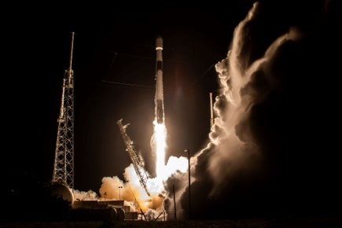
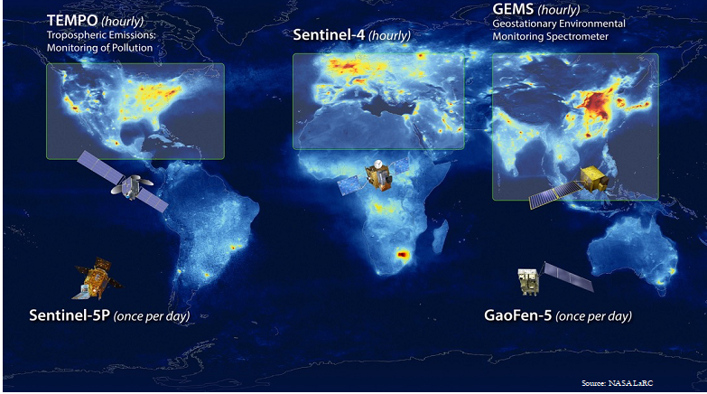
Today: A ”Golden Age” for Space-Based Air Quality Measurements – with more to come!
Joint (NASA/NOAA) Solicitation for TEMPO Data Analysis and Interpretation in NASA ROSES-2024 (A.21 TEMPO/ACX Science and Applications Team)
https://nspires.nasaprs.com/external/solicitations/summary!init.do?solId={87C7C157-AA32-9A5E-3FC2-9035763B385D}&path=open
NOIs due 30 August 2024
Anonymized Proposals due 18 October 2024
Launched 07 April 2023, 12:30 Eastern on Space X Falcon 9​

Slide 22

NASA Health & Air Quality Applied Science Team (HAQAST)
Now in its 3rd Generation (2021-2025).
14 Members (Principal Investigators) were competitively selected in December 2020.
Core projects are executed by each PI.
A unique feature of HAQAST are its Tiger Teams (TTs):
  Short-term, high-impact collaborative efforts between HAQAST members and public stakeholders to identify and solve critical problems using NASA data and products.
  Topics include, Environmental Justice, accurately characterizing emissions from oil and gas emissions facilities, supporting use of data from TEMPO, etc.
  For details: https://haqast.org/tiger-teams/.
Public meetings held semi-annually.
For additional information: https://haqast.org/

Slide 23
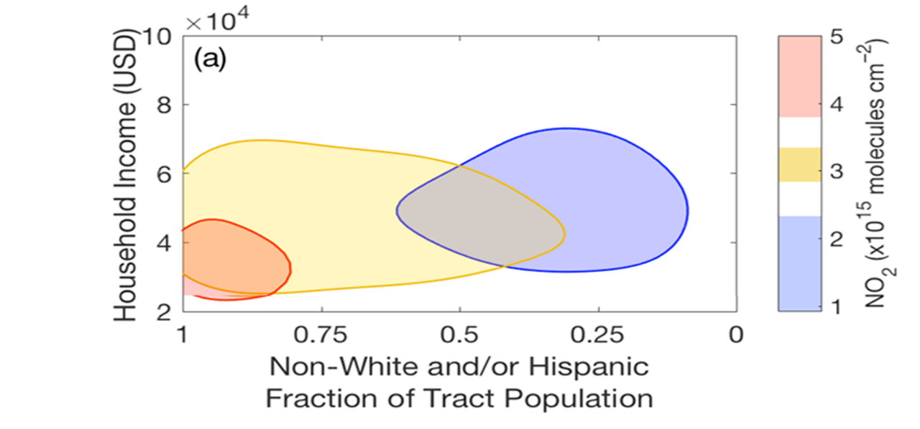
Converting Knowledge into Action
Satellite data has documented higher levels of NO₂ pollution in low-income non-white communities vs. high-income white communities. (Demetillo et al., 2020; 2021)
These inequalities can be dramatically reduced with policies targeting heavy-duty diesel truck emissions
Executive Order 14037 targets reduction of NO_{x} emissions from heavy duty engines and vehicles starting in 2027, making it the first update to clean air standards for this sector in more 20 years.

