Slide 1
Geolocation improvement for EPIC/DSCOVR
Víctor Molina García, Ronny Lutz, Diego Loyola
German Aerospace Center (DLR)
Earth Observation Center (EOC)
Institut für Methodik der Fernerkundung
Joint Geostationary Science Team Meeting
Harvard-Smithsonian Center for Astrophysics
Cambridge, MA, USA
26-27 September 2019

Slide 2
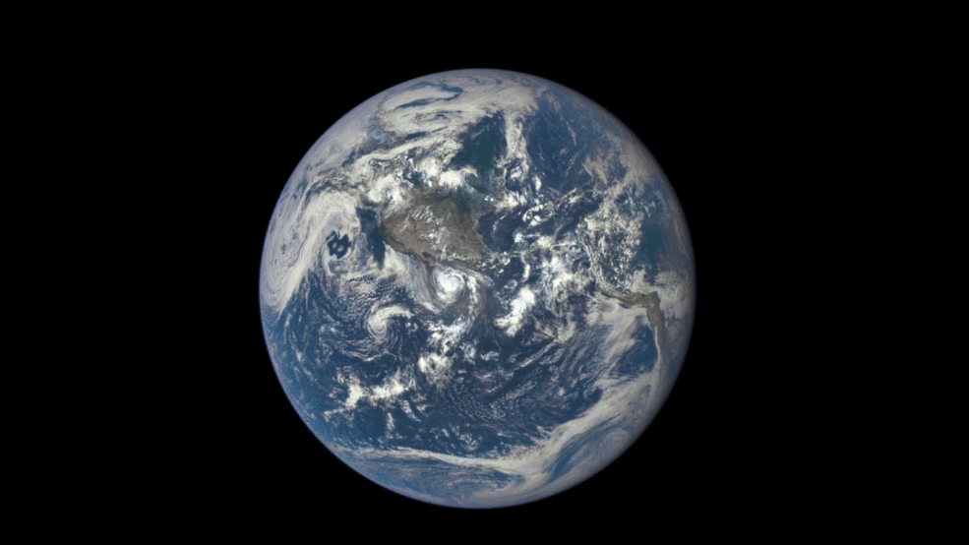
Introduction
Mission:
Satellite: DSCOVR (Deep Space Climate Observatory)
Launch date: 11th February 2015
Arrival to destination: 8th June 2015
Location: Lagrangian point L1 (approx. 1.5 million km distance to the Earth)
Sensor: EPIC (Earth Polychromatic Imaging Camera)
10 channels UV / VIS / NIR
1 image every 2 hours (2048 x 2048 pixels)
12 x 12 km² pixel size (subsatellite point)
2015/07/16
© NASA: https://www.nasa.gov/sites/default/files/styles/full_width/public/thumbnails/image/dscovrepicmoontransitfull.gif?itok=m-pCEXqi

Slide 3
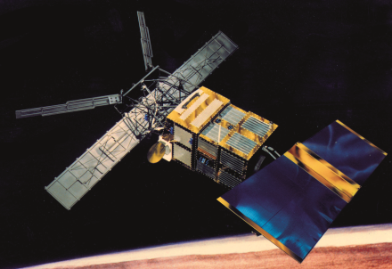
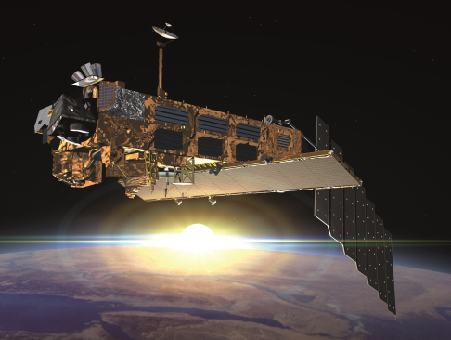
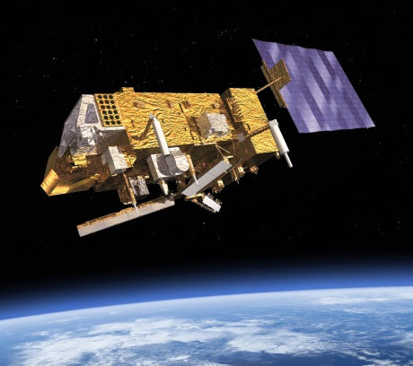
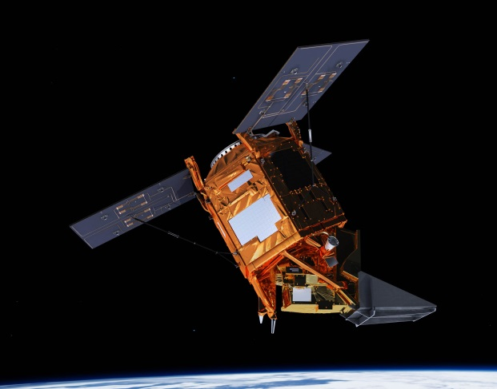
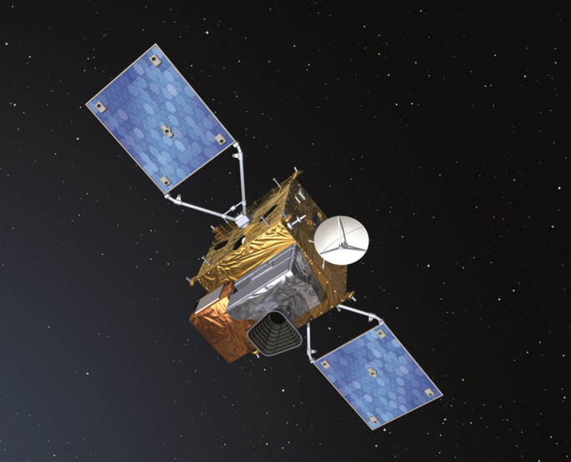
Motivation – OCRA/ROCINN Cloud Products from EPIC/DSCOVR
1995
TROPOMI/Sentinel-5P since 2017
GOME/ERS-2
1995-2011
SCIAMACHY/ENVISAT
2002-2012
UVN/Sentinel-4 from 2023
GOME-2/MetOp-A since 2007
GOME-2/MetOp-B since 2012
GOME-2/MetOp-C since 2018
Status: operational cloud products for many UVN sensors
Goal: generate cloud products also for EPIC/DSCOVR
2023+

Slide 4
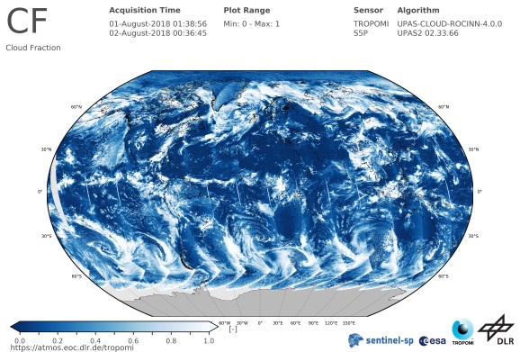
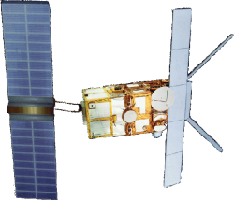
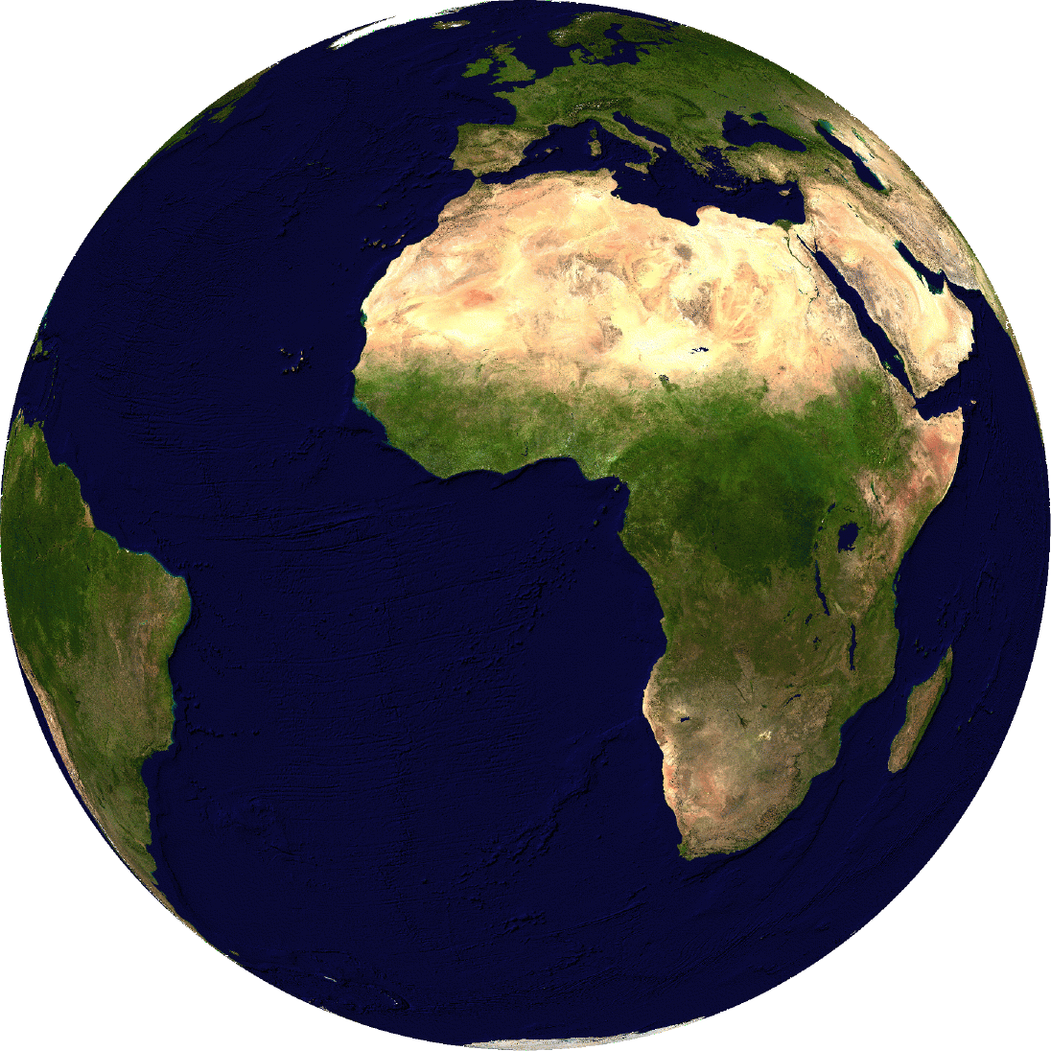
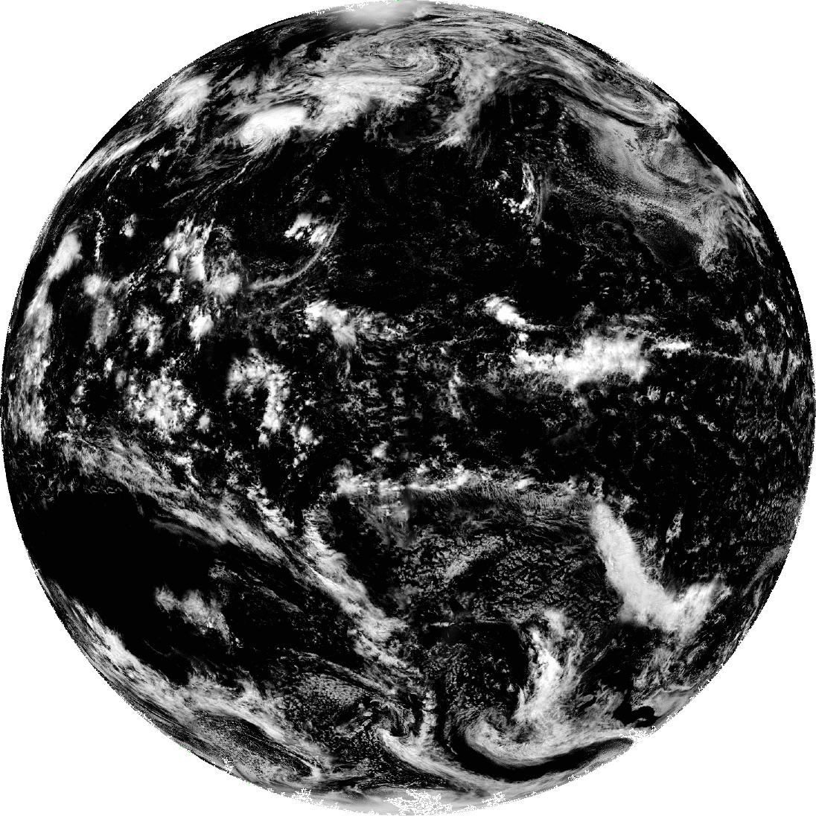
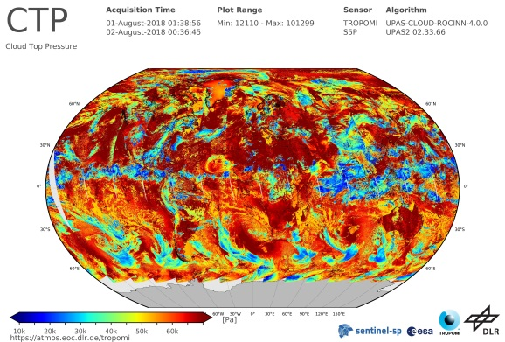
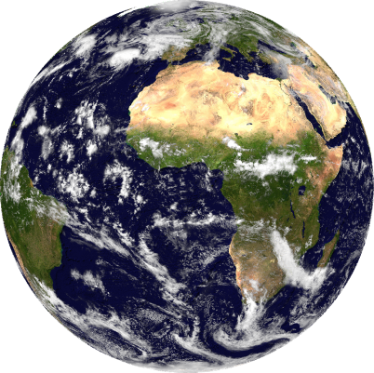
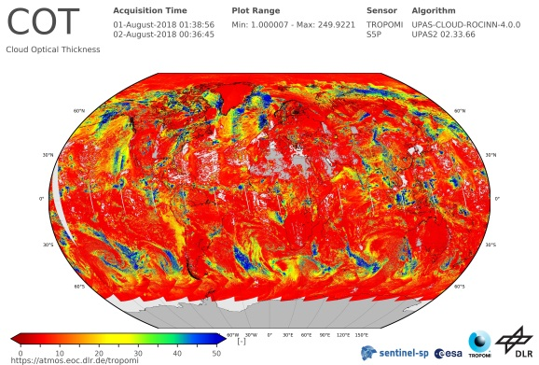
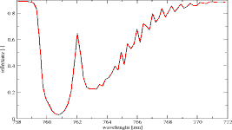
Motivation – Cloud Retrieval with OCRA & ROCINN
OCRA
RGB color space
UV VIS NIR
Cloud fraction
ROCINN
(CRB+CAL)
Cloud-top pressure/
Cloud-top height
O2 A-Band, NIR
forward model
neural network
Optical thickness/
Cloud albedo

Slide 5
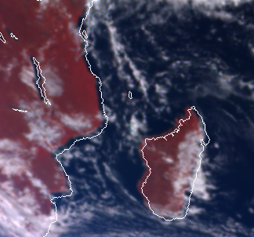
Motivation – Cloud Products for EPIC/DSCOVR
Problem encountered:
Misalignment of EPIC L1B images between the arrays of Earth coordinates and the arrays storing the actual measurement images
E.g. ocean pixels could be wrongly regridded into a land cell when constructing the clear-sky composite map
Proposed solution:
Develop an automated registration correction

Slide 6
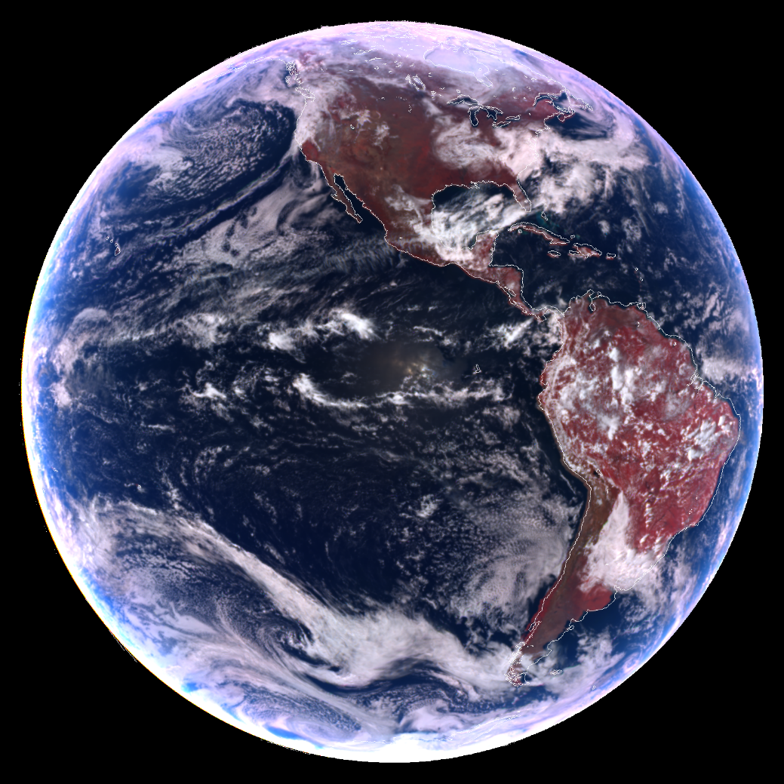
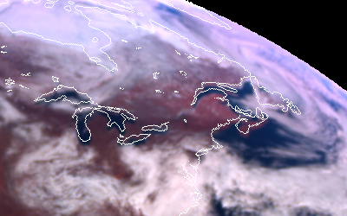
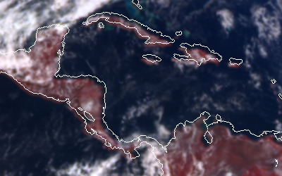
Automatic EPIC registration correction
Current state of EPIC registration quality:
Misalignment of EPIC L1B images between the arrays of Earth coordinates and the arrays storing the actual measurement images
Scientific issues for any development in which the arrays of Earth coordinates are required
Selection of surface albedo from a reference map
Generation of EPIC product mean maps
Assumptions to fix the EPIC registration issue:
The misalignment between the arrays of coordinates and the arrays of measurements is not extreme
The correction can be performed by a specific transformation on the arrays of measurements, while keeping the arrays of coordinates unmodified
EPIC L1B 2016/03/20 18:36:56 UTC (v02)
Credit: NASA

Slide 7
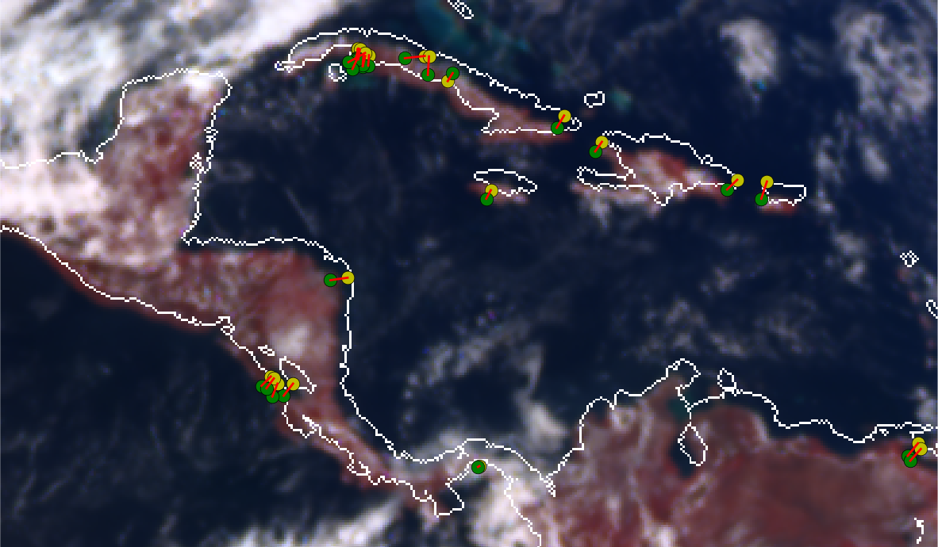
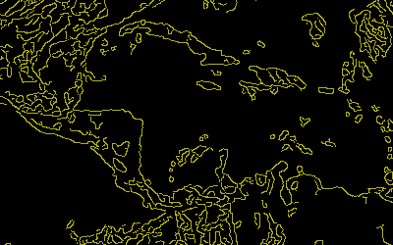
Automatic EPIC registration correction
How to select pairs of misaligned and correct pixels:
Generate the theoretical coastline mask with the arrays of latitudes and longitudes
Generate the radiometric coastline mask with the arrays of true reflectances
Canny edge detector
Polluted with the cloud borders
Detect and describe features in the theoretical and radiometric coastlines by using the computer vision algorithm ORB (Oriented FAST and Rotated BRIEF)
Find matching features from both images using a Brute Force Matcher and filter the results based on descriptor distance and pixel distance
Theoretical features (yellow circles) and radiometric features (green circles)

Slide 8
Automatic EPIC registration correction
How to fix the EPIC registration issue:
Misregistration model that describes how a pixel location is degradated by specific sensor or algorithm issues
Radial distortion correction around a center of distortion
Rotation around a center of rotation
Shift
Gauss-Newton optimisation with regularisation term (Tikhonov) over the transformation parameters when used for the pairs of matching features found by using the computer vision techniques
A priori knowledge from image inspection

Slide 9
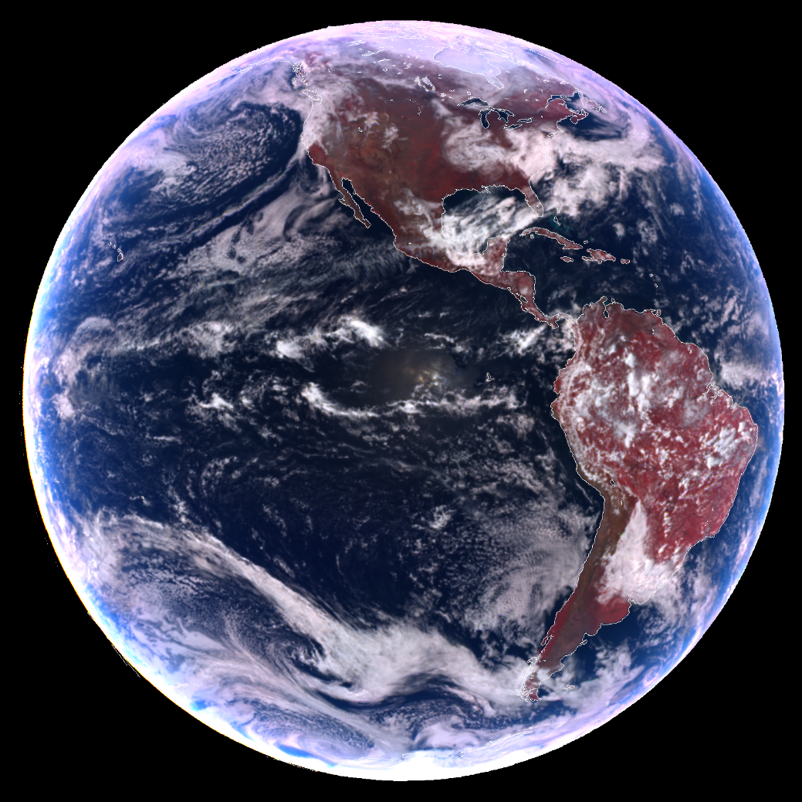
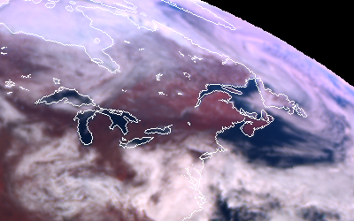
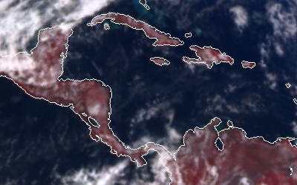
Automatic EPIC registration correction
Basic conclusions from EPIC registration correction:
The radial distortion parameter does not change significantly over the images, and is approximately equal to $−5×{10}^{−9}$ (barrel distortion)
The rotation angle does not change significantly over the images, and is approximately equal to$+0.5°$
The shift is image-dependent but it shows an oscillating behaviour whose period is similar to DSCOVR Lissajous orbit period around the Lagrangian point L1
Performance of EPIC registration correction:
Misalignment before correction: ~5.0 pixels
Misalignment after correction: ~1.5 pixels
Computation time per image: ~15 seconds
EPIC L1B 2016/03/20 18:36:56 UTC (v02)
Credit: NASA

Slide 10
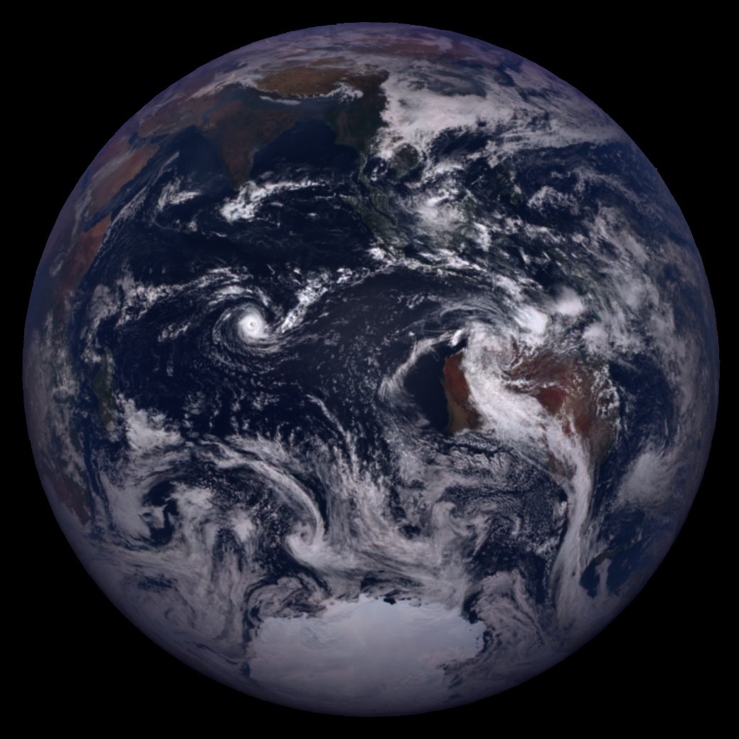
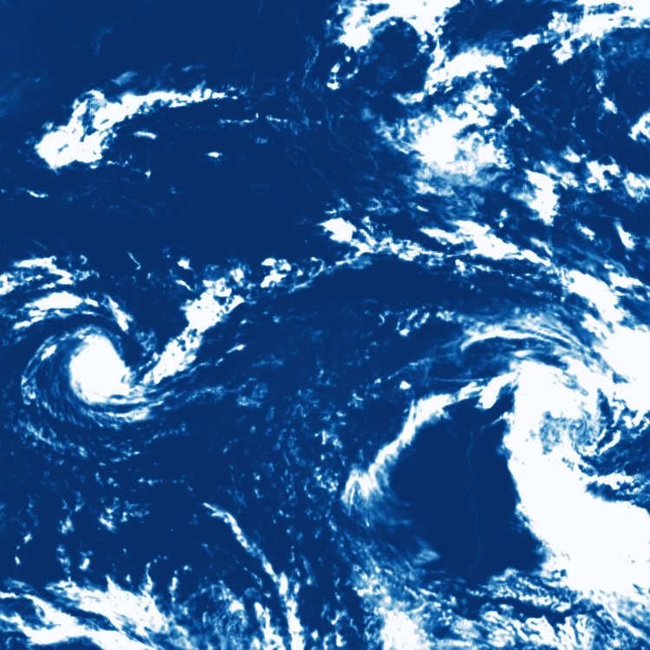
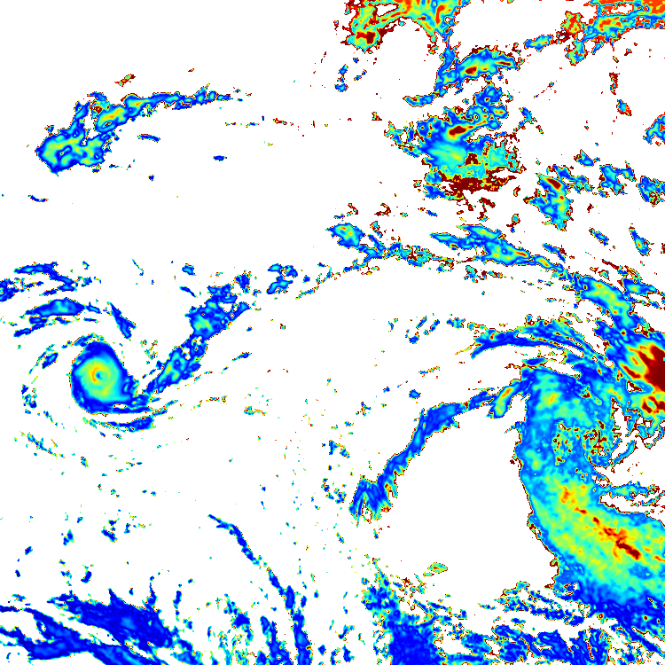
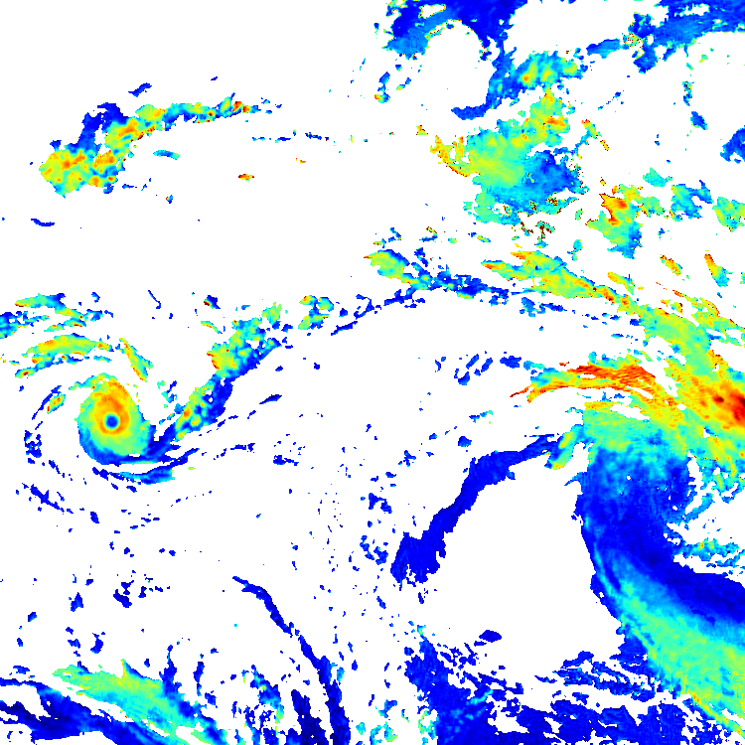
OCRA/ROCINN: Retrieval of Cloud Properties from EPIC
OCRA radiometric cloud fraction
ROCINN cloud optical thickness
ROCINN cloud-top height / km
EPIC L1B 2018/01/30 05:32:37 UTC (v02)
Credit: NASA

Slide 11
Reference for further reading

Slide 12
Additional slides

Slide 13
Additional slide – EPIC channels
Channel description:
2 channels in the oxygen B-band (absorption peak plus reference)
2 channels in the oxygen A-band (absorption peak plus reference)
Estimation of cloud properties:
Cloud optical thickness
Cloud-top height
Cloud fraction
Band | Central wavelength / nm | Band width / nm | Use
1 | 317.5 ± 0.1 | 1.0 ± 0.2 | Ozone, sulphur dioxide
2 | 325.0 ± 0.1 | 2.0 ± 0.2 | Ozone
3 | 340.0 ± 0.3 | 3.0 ± 0.6 | Ozone, aerosols, clouds
4 | 388.0 ± 0.3 | 3.0 ± 0.6 | Aerosols, clouds
5 | 443.0 ± 1.0 | 3.0 ± 0.6 | Aerosols
6 | 551.0 ± 1.0 | 3.0 ± 0.6 | Aerosols, vegetation
7 | 680.0 ± 0.2 | 3.0 ± 0.6 | Aerosols, clouds, vegetation
8 | 687.75 ± 0.20 | 0.80 ± 0.20 | Aerosols, clouds, vegetation
9 | 764.0 ± 0.2 | 1.0 ± 0.2 | Clouds
10 | 779.5 ± 0.3 | 2.0 ± 0.4 | Clouds, vegetation
Oxygen B-band
Oxygen A-band

