Slide 1





Tropospheric Emissions:
Monitoring of Pollution
TEMPO Status Update
Kelly Chance, TEMPO PI
Steve Hall, TEMPO PM
September 2019

Slide 2
Agenda
Project Overview
Project Team
Host Selection
Flight Hardware Status
Ground System Status
Next Steps

Slide 3
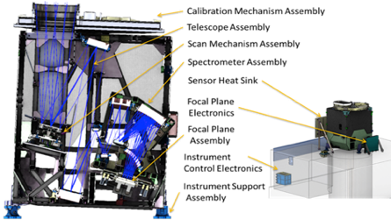
Tropospheric Emissions:
Monitoring of Pollution (TEMPO)
Science Objectives:
Collect simultaneous high temporal and spatial resolution measurements of pollutants over Greater North America
Measure the key elements in tropospheric ozone chemistry and aerosol cycles
Observe aerosols and gases for quantifying and tracking evolution of pollution
Integrate observations from TEMPO and other platforms in models to improve representation of processes
Serve as the North American geostationary Acomponent of an international constellation for air quality monitoring
Project Approach: 2 Class C Projects – One Mission
Instrument Project.
Earth Venture Instrument-1 (competitively selected)
Investigation is led by Principal Investigator & is cost capped
Instrument delivered to the Government November 2018
Measurements built on heritage from 5 spectrometers flown in LEO and operational algorithms
Mission Project.
Directed project
Procure commercial satellite hosting services
  I&T with commercial satellite
  Launch services to GEO
  On-orbit and data transmission services
  Contract awarded 2019
  On-Orbit Availability: 2022
Project Team
Smithsonian Astrophysical Observatory: Principal Investigator, Science Team, Science Data Processing, Instrument Ops Center
  Principal Investigator: Dr. Kelly Chance, Deputy PI: Dr. Xiong Liu
NASA Langley: Project Management, Systems Engineering, Safety/Mission Assurance, Spacecraft hosting services
Ball Aerospace: Instrument developer and spacecraft integration support
Maxar Technologies (formerly Space Systems Loral): Spacecraft hosting services
USAF Space and Missile Systems Center (SMC): Hosted Payload Solutions (HoPS) Contract Administrator
Science Team and International Science Advisory:
NOAA, EPA, GSFC, NCAR, Harvard, St. Louis U, UC Berkley, U Alabama, U of Iowa, UMBC, Dalhousie U, Carr Astro, Radiative Trans Solutions;
South Korea (GEMS) & Europe (Sentinel)

Slide 4
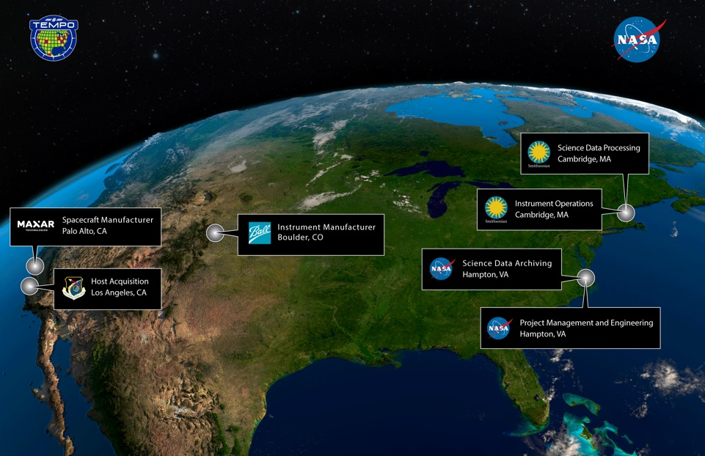
TEMPO Team Map

Slide 5
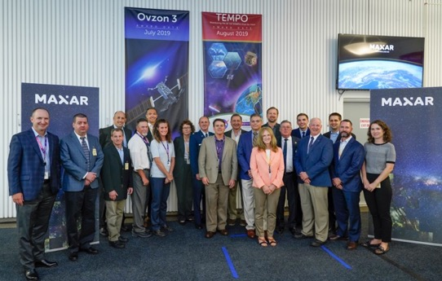
Maxar Technologies
Palo Alto, CA
Contract for TEMPO Hosting Services awarded to Maxar Technologies (formerly Space Systems Loral)
  Awarded June 2019
  Initial face to face, September 2019
Maxar to build the host
spacecraft and integrate TEMPO
Spacecraft “owner-operator” not yet on contract
  Targeting mid-October 2019
  Will set the: final spacecraft configuration, final orbital location, and launch date

Slide 6


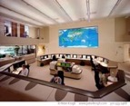
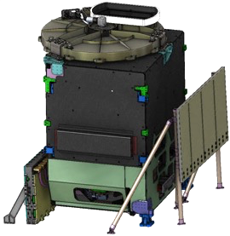
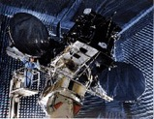
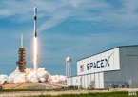
TEMPO’s hosting contract relationships
Prime Contractor
Sub-Contractors
TEMPO
Hosted Payload
Maxar Builds Customized Commercial Spacecraft
Data Transmission Services & Commercial Ops Services
NASA Buys Hosting Services via USAF Contract
Prime Provides Via Sub- Contractor
Contract with Maxar is FFP and includes:
I&T, launch services, operations services, and data services
Commercial Launch Services
6

Slide 7
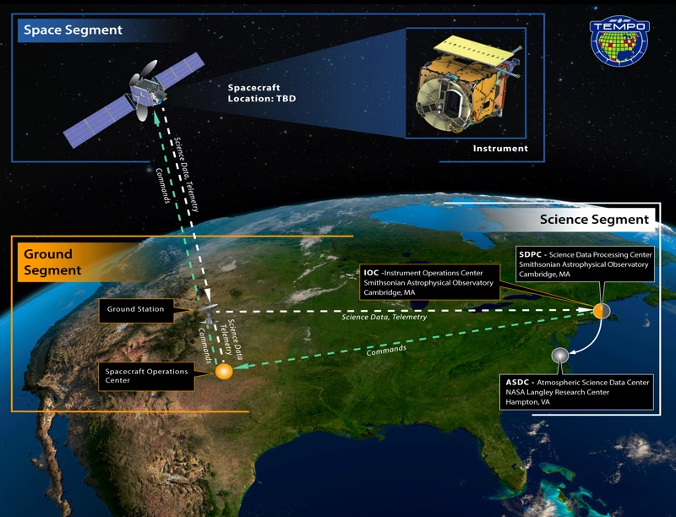
TEMPO concept of operations

Slide 8
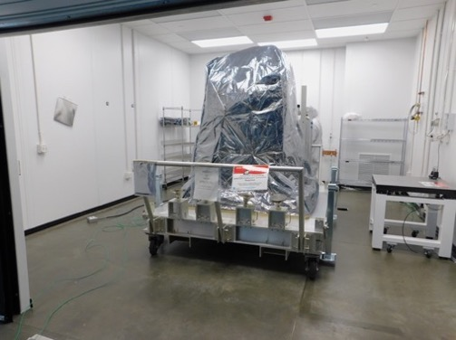
Flight hardware status
TEMPO instrument was built by Ball Aerospace in Boulder CO
  Accepted by the government, November 2018
  Instrument is safely in storage in Boulder CO and tested quarterly
  Will be shipped b Ball Aerospace to Maxar
  (Palo Alto, CA) when needed for integration
TEMPO instrument in storage at Ball Aerospace
8

Slide 9
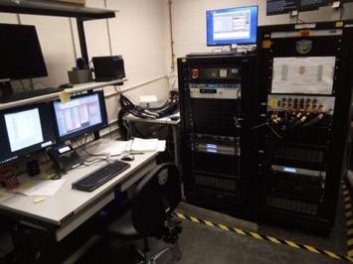
Ground System status
Instrument Operations Center (IOC) software complete
IOC system-level testing andaAcceptance, Sep-Oct 2019
IOC will integrate with Host ground systems prior to launch
Science Data Processing Center (SDPC) version 1 software completed, April 2019
TEMPO instrument simulator integrated at SAO
9

Slide 10
Next steps
Satellite owner-operator on contract, October 2019
Science Data Processing Center (SDPC) complete, late 2020
Host Integration Planning, 2019-2021
TEMPO Shipment to Maxar, 2021
Host Integration and Environmental Testing, 2021- 2022
Launch, 2022

Slide 11
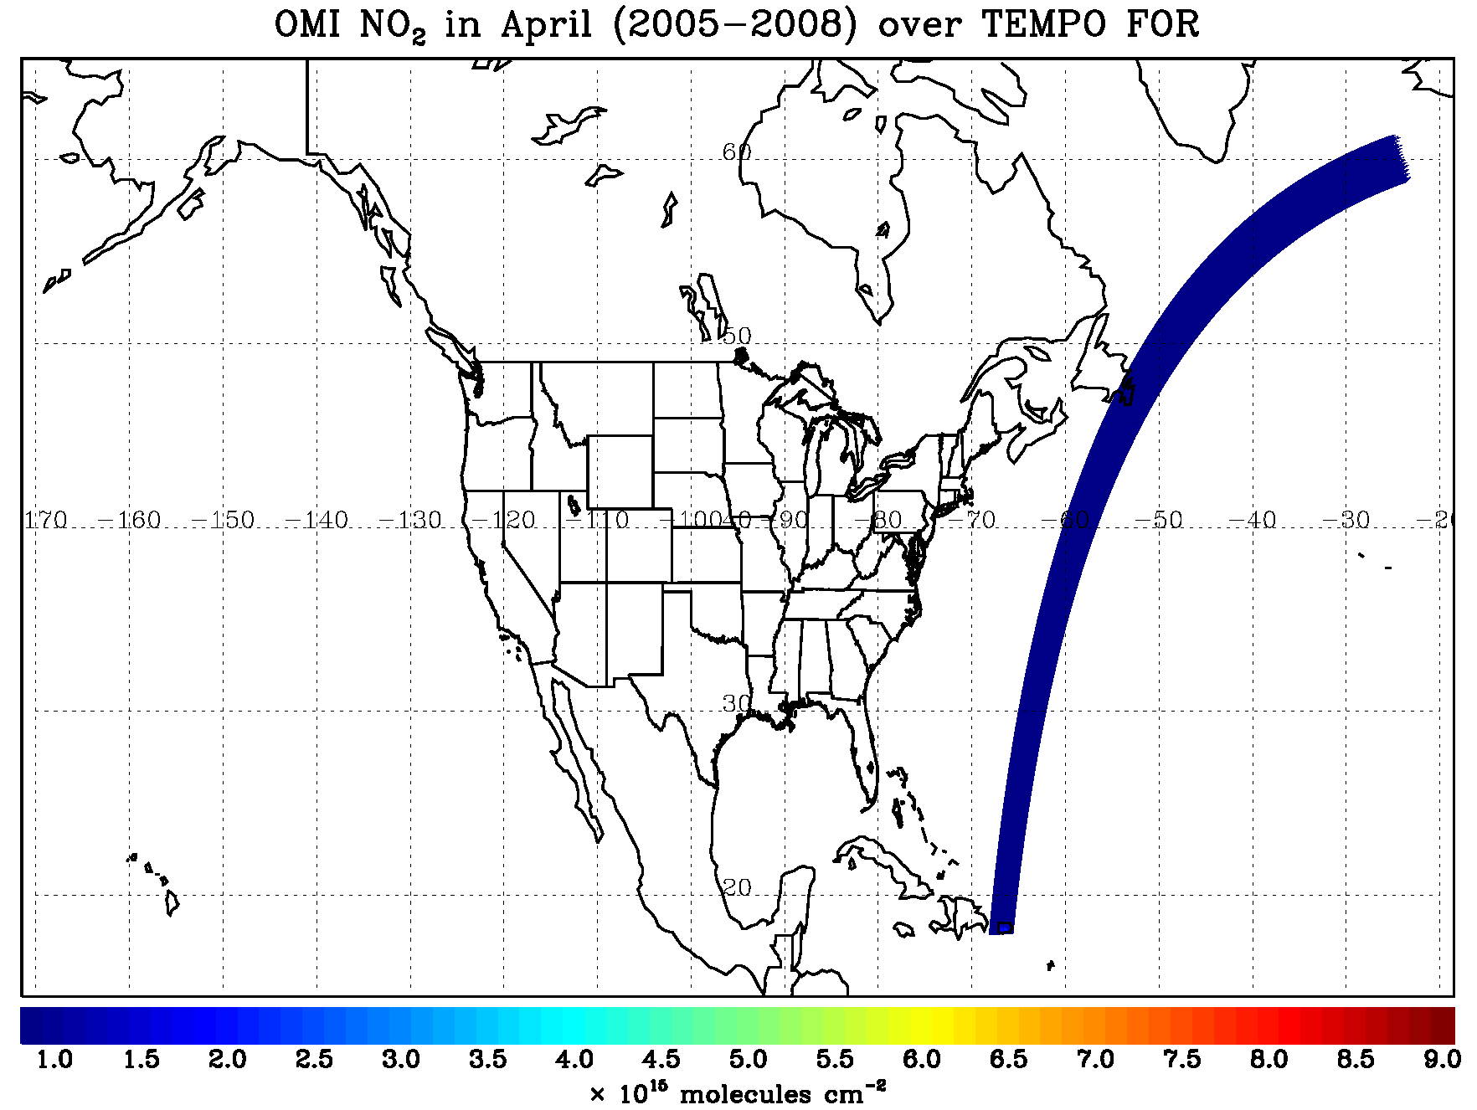
TEMPO hourly sweep
(GEO @ 92.85W)
Boresight: 33.8ºN, 92.85ºW
~ 2034 good N/S pixels
~ 1282 scans/hour
~ 2.6 M pixels/hour
Data rate: ~31.2 Mbs
11

Slide 12
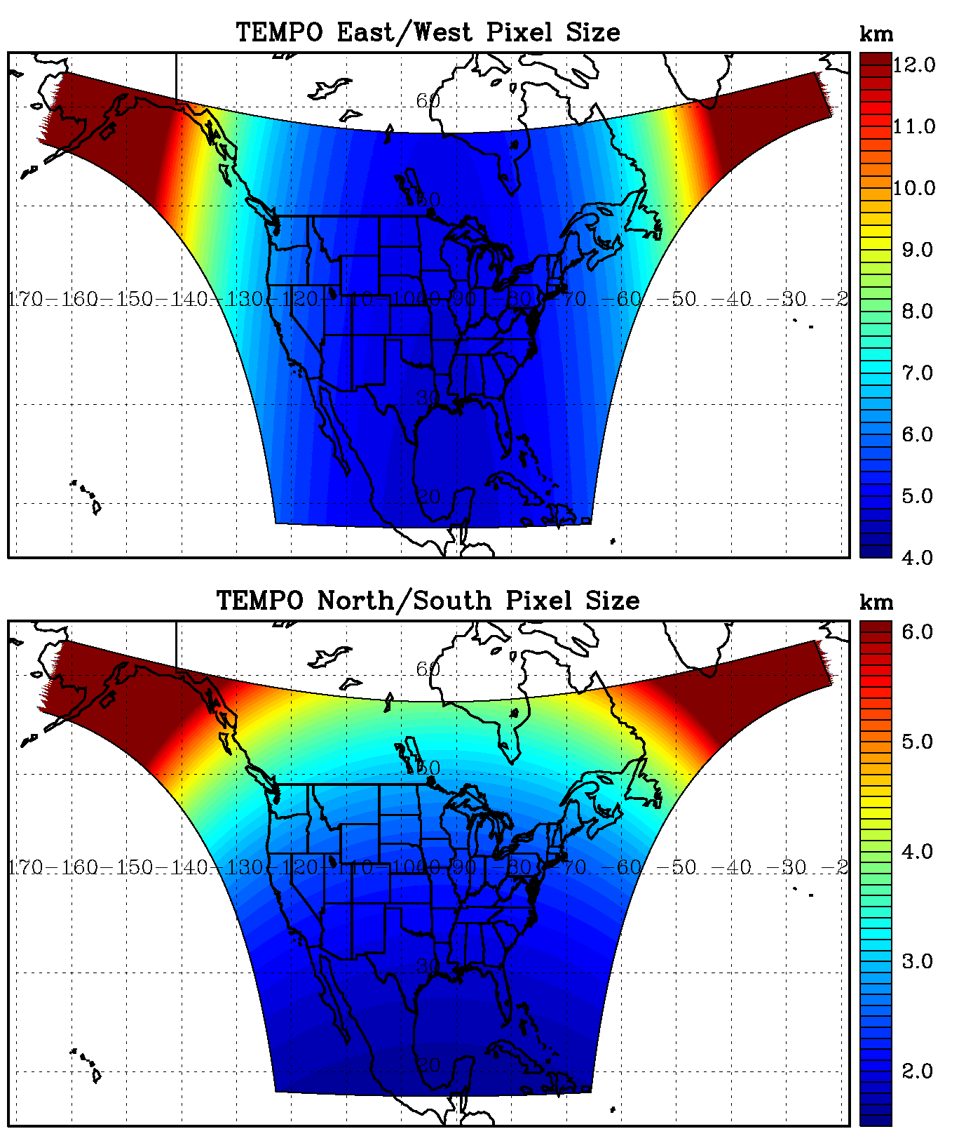
TEMPO footprint (GEO @92.85º W)
Boresight at 33.76ºN, 92.85ºW
Location | N/S (km) | E/W (km) | GSA (km²) | VZA (º)
Boresight | 2.0 | 4.8 | 9.5 | 39.3
36.5ºN, 100ºW | 2.1 | 4.8 | 10.1 | 42.4
Washington, DC | 2.3 | 5.1 | 11.3 | 48.0
Seattle | 3.2 | 6.2 | 16.8 | 61.7
Los Angeles | 2.1 | 5.6 | 11.3 | 48.0
Boston | 2.5 | 5.5 | 13.0 | 53.7
Miami | 1.8 | 4.9 | 8.6 | 33.2
San Juan | 1.7 | 5.6 | 9.2 | 37.4
Mexico City | 1.6 | 4.7 | 7.7 | 23.9
Can. oil sands | 4.1 | 5.6 | 20.8 | 67.0
Juneau | 6.1 | 9.1 | 33.3 | 75.3

Slide 13
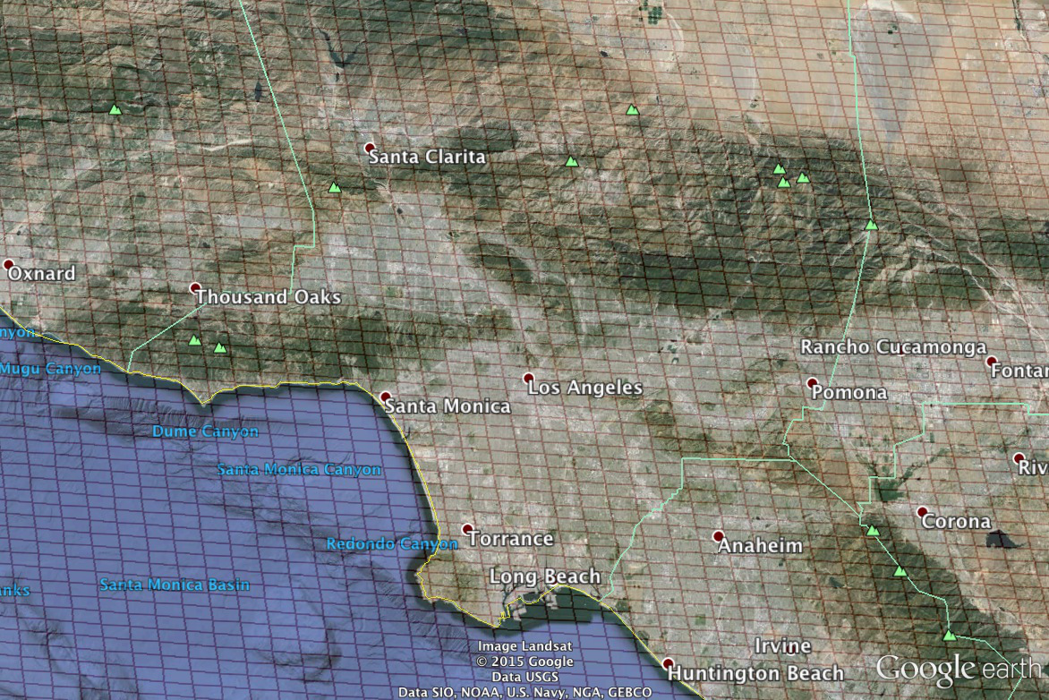
Los Angeles coverage
Every hour!

Slide 14
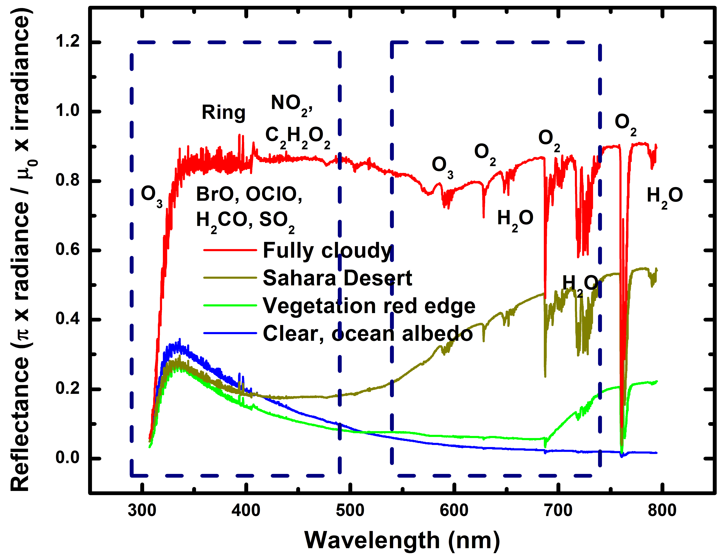
Typical TEMPO-range spectra (from ESA GOME-1)

Slide 15
Baseline and threshold data products
Species/Products | Required Precision | Temporal Revisit
0-2 km O₃ (Selected Scenes) Baseline only | 10 ppbv | 2 hour
Tropospheric O₃ | 10 ppbv | 1 hour
Total O₃ | 3% | 1 hour
Tropospheric NO₂ | 1.0 × 10¹⁵ molecules cm⁻² | 1 hour
Tropospheric H₂CO | 1.0 × 10¹⁶ molecules cm⁻² | 3 hour
Tropospheric SO₂ | 1.0 × 10¹⁶ molecules cm⁻² | 3 hour
Tropospheric C₂H₂O₂ | 4.0 × 10¹⁴ molecules cm⁻² | 3 hour
Aerosol Optical Depth | 0.10 | 1 hour
Minimal set of products sufficient for constraining air quality
Across Greater North America (GNA): 18°N to 58°N near 100°W, 67°W to 125°W near 42°N
Data products at urban-regional spatial scales
  Baseline ≤ 60 km² at center of Field Of Regard (FOR)
  Threshold ≤ 300 km² at center of FOR
Temporal scales to resolve diurnal changes in pollutant distributions
Geolocation uncertainty of less than 4 km
Mission duration, subject to instrument availability
  Baseline 20 months
  Threshold 12 months

Slide 16
TEMPO Science Team, U.S.
Team Member | Institution | Role | Responsibility
K. Chance | SAO | PI | Overall science development; Level 1b, H₂CO, C₂H₂O₂
X. Liu | SAO | Deputy PI | Science development, data processing; O₃ profile, tropospheric O₃
J. Al-Saadi | LaRC | Deputy PS | Project science development
J. Carr | Carr Astronautics | Co-I | INR Modeling and algorithm
M. Chin | GSFC | Co-I | Aerosol science
R. Cohen | U.C. Berkeley | Co-I | NO₂ validation, atmospheric chemistry modeling, process studies
D. Edwards | NCAR | Co-I | VOC science, synergy with carbon monoxide measurements
J. Fishman | St. Louis U. | Co-I | AQ impact on agriculture and the biosphere
D. Flittner | LaRC | Project Scientist | Overall project development; STM; instrument cal./char.
J. Herman | UMBC | Co-I | Validation (PANDORA measurements)
D. Jacob | Harvard | Co-I | Science requirements, atmospheric modeling, process studies
S. Janz | GSFC | Co-I | Instrument calibration and characterization
J. Joiner | GSFC | Co-I | Cloud, total O₃, TOA shortwave flux research product
N. Krotkov | GSFC | Co-I | NO₂, SO₂, UVB
M. Newchurch | U. Alabama Huntsville | Co-I | Validation (O₃ sondes, O₃ lidar)
R.B. Pierce | NOAA/NESDIS | Co-I | AQ modeling, data assimilation
R. Spurr | RT Solutions, Inc. | Co-I | Radiative transfer modeling for algorithm development
R. Suleiman | SAO | Co-I, Data Mgr. | Managing science data processing, BrO, H₂O, and L3 products
J. Szykman | EPA | Co-I | AIRNow AQI development, validation (PANDORA measurements)
O. Torres | GSFC | Co-I | UV aerosol product, AI
J. Wang | U. Nebraska | Co-I | Synergy w/GOES-R ABI, aerosol research products
J. Geddes | Boston University | Collaborator | NO₂ separation algorithm
R. Martin | Wash. U. St. Louis | Col-I | NO₂ separation algorithm

Slide 17
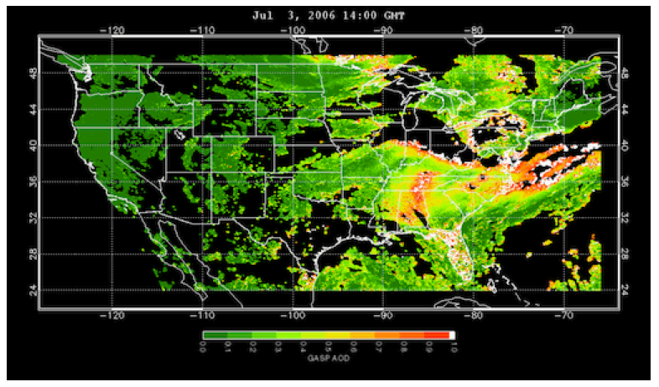
www.epa.gov/rsig
TEMPO will use the EPA’s Remote Sensing Information Gateway (RSIG) for subsetting, visualization, and product distribution – to make TEMPO YOUR instrument

Slide 18







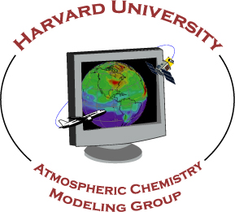








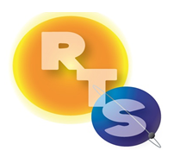





The end!

Slide 19
Backups

Slide 20
TEMPO Science Team, non-U.S.
Team Member | Institution | Role | Responsibility
Chris McLinden | Environment Canada | Collaborator | Canadian air quality coordination
Michel Grutter de la Mora | UNAM, Mexico | Collaborator | Mexican air quality coordination
Gabriel Vazquez | UNAM, Mexico | Collaborator | Mexican air quality, algorithm physics
Amparo Martinez | INECC, Mexico | Collaborator | Mexican environmental pollution and health
J. Victor Hugo Paramo Figeuroa | INECC, Mexico | Collaborator | Mexican environmental pollution and health
Brian Kerridge | Rutherford Appleton Laboratory, UK | Collaborator | Ozone profiling studies, algorithm development
Paul Palmer | Edinburgh U., UK | Collaborator | Atmospheric modeling, process studies
Alfonso Saiz-Lopez | CSIC, Spain | Collaborator | Atmospheric modeling, process studies
Juan Carlos Antuña Marrero | GOAC, Cuba | Collaborator | Cuban Science team lead, Cuban air quality
Osvaldo Cuesta | GOAC, Cuba | Collaborator | TEMPO validation, Cuban air quality
René Estevan Arredondo | GOAC, Cuba | Collaborator | TEMPO validation, Cuban air quality
J. Kim | Yonsei U. | Collaborators, Science Advisory Panel | Korean GEMS, CEOS constellation of GEO pollution monitoring
C.T. McElroy | York U. Canada |  | CSA PHEOS, CEOS constellation of GEO pollution monitoring
B. Veihelmann | ESA |  | ESA Sentinel-4, CEOS constellation of GEO pollution monitoring
J.P. Veefkind | KNMI |  | ESA Sentinel-5P (TROPOMI)

Slide 21
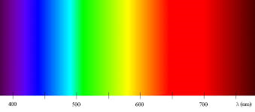
City lights spectroscopic signatures
VIIRS – Day-Night Band (DNB)
Laboratory Spectra of Lighting Types (C. Elvidge): http://www.ngdc.noaa.gov/eog/night_sat/spectra.html
TEMPO
Ultraviolet
TEMPO
Visible

Slide 22
TEMPO Organization
22

