Slide 1
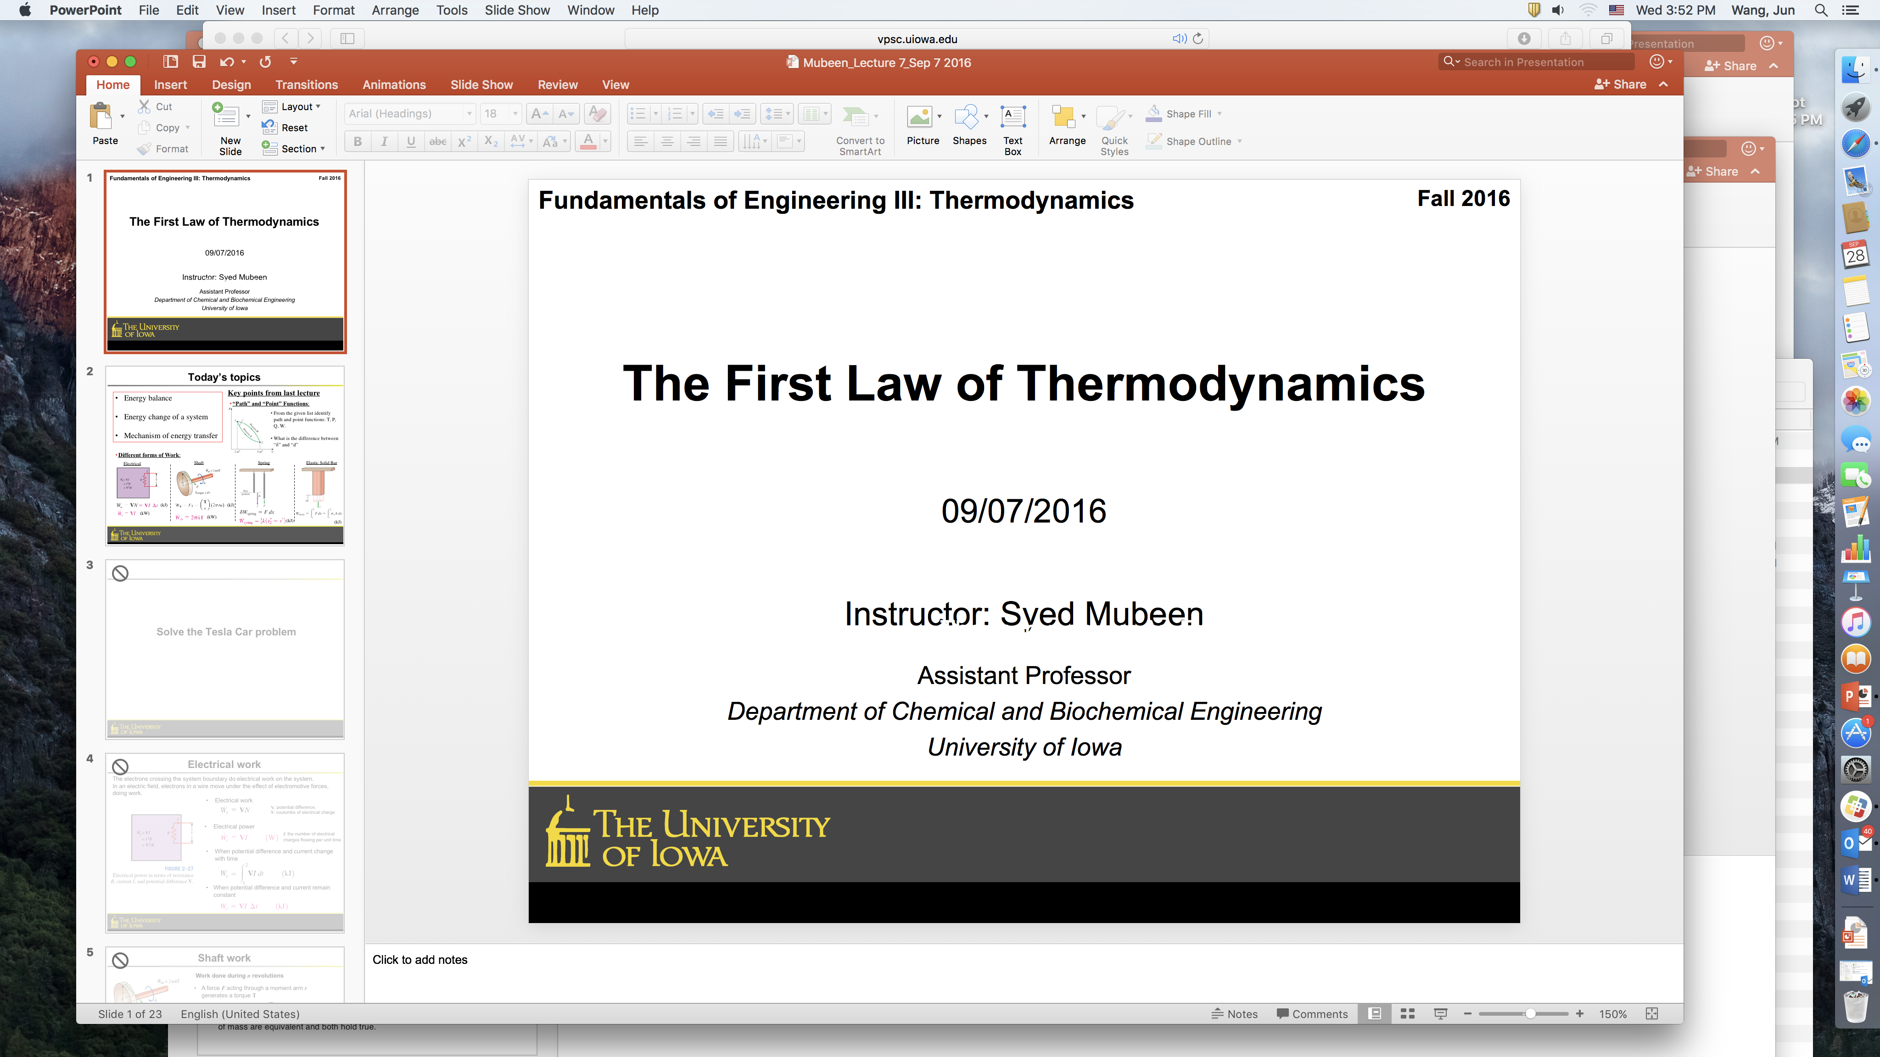
TEMPO and GOES-R Synergy
How strong is it?
TEMPO Aerosol Workshop
11 Sept. 2017
Jun Wang, Weizhen Hou, Xiong Liu, Kelly Chance

Slide 2
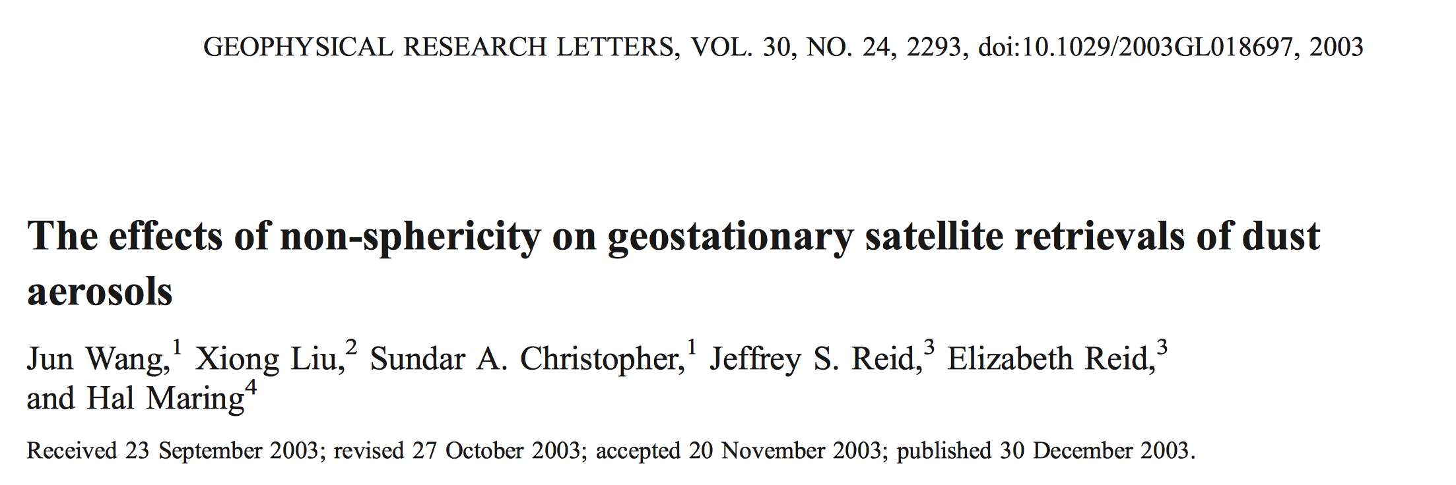
Get back to the old & good days …
“When compared to polar-orbiters like MODIS and MISR, one advantage of geostationary satellites is their high temporal resolution, through which observations over a wide range of scattering angles become available even for the same dust layer on the same day”

Slide 3
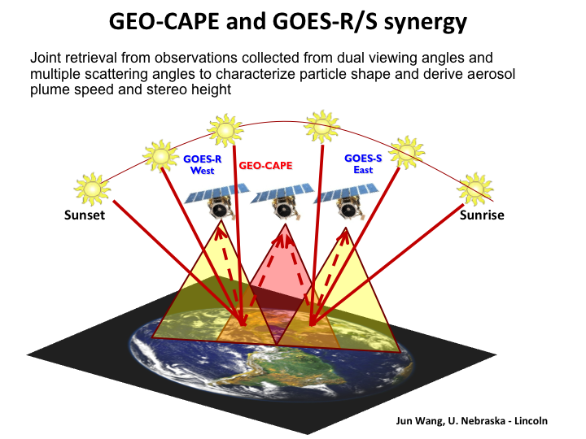
Geo-CAPE meeting, Maryland, 2009

Slide 4
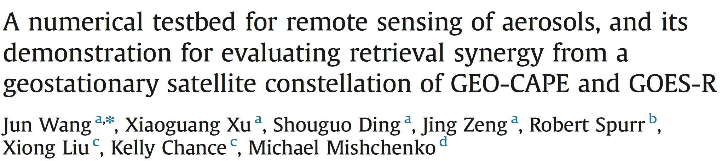
After a decade:
Linearly and coupled scattering and radiative transfer codes, optimization code included.
Joint retrieval reduces AOD and fine-mode AOD uncertainties respectively from 30% to 10% and from 40% to 20%.

Slide 5
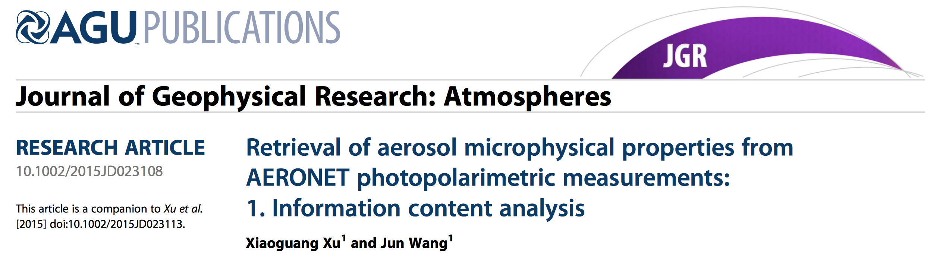
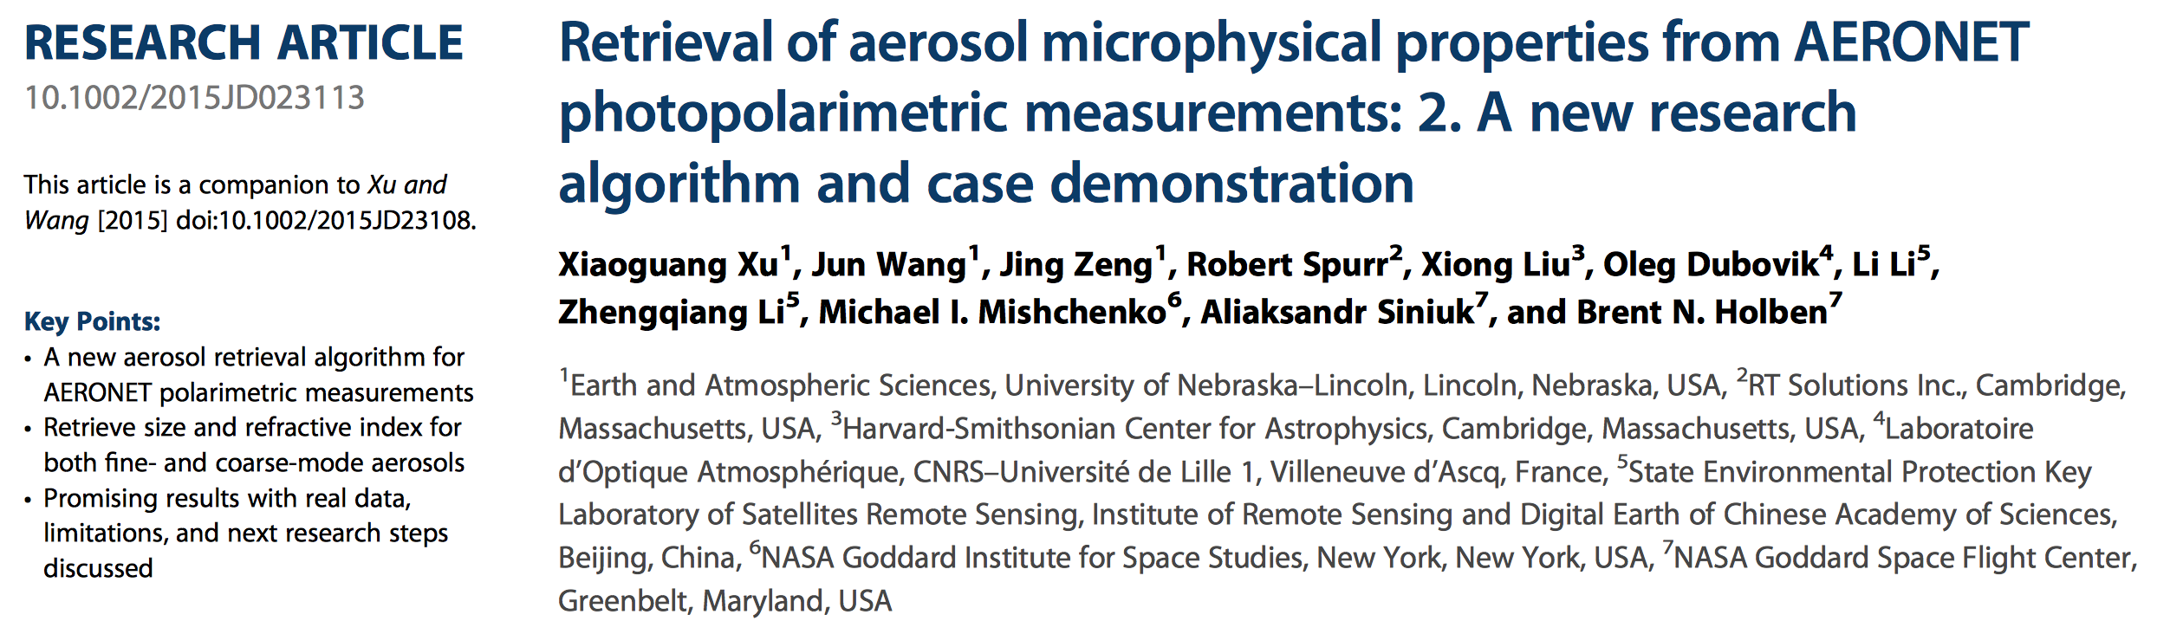
The theory and algorithm now are tested with
AERONET multiple spectral and polarization data

Slide 6
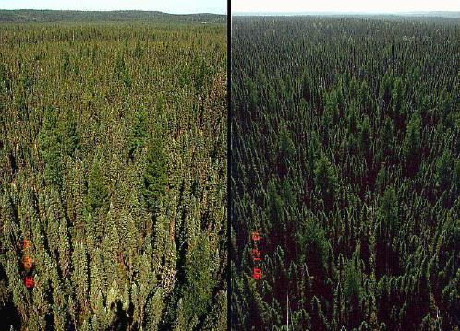
Boundary surface conditions for aerosol retrieval
Surface bi-directional reflectance (BRDF)
Surface reflectance has strong angular dependence.
Backscattering Forward scattering
(sun is behind) facing the sun

Slide 7
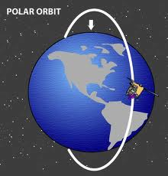
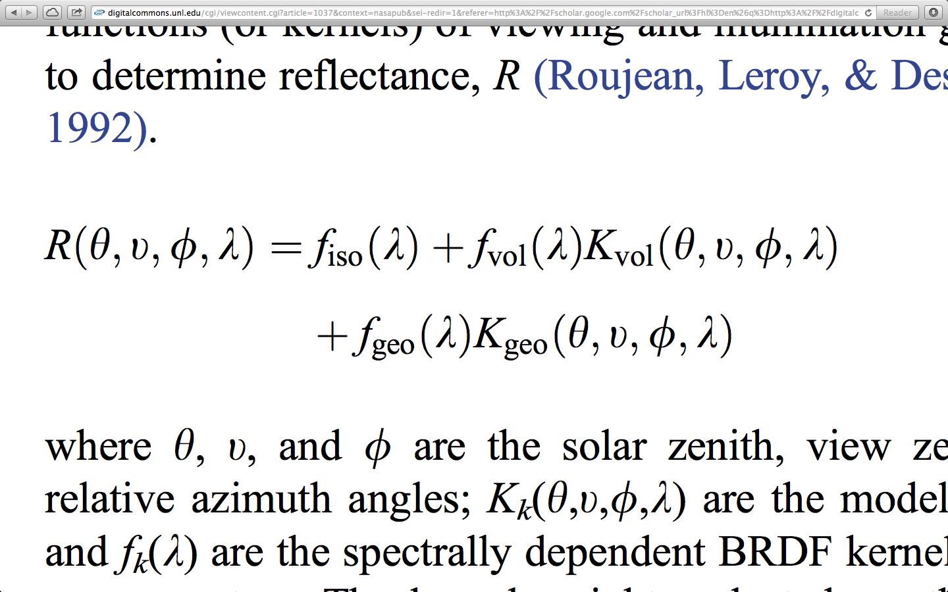
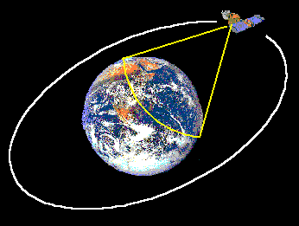
How do we get BRDF from space?
MODIS-type land algorithm (Schaaf et al., 2002)
RossThickLiSparse RTLS Reciprocal kernel combination:
Retrieving 3 parameters every 16 days
LEO
GOES-type algorithm
(Knapp et al., 2005; Wang et al., 2003):
Minimum composite method: taking second minimum reflectance every 15-20 days.
Composite time window can be moving sequentially with date.
Surface reflectance is obtained at exact GOES reviewing geometry and schedule.
GEO
Notes:
RossThickLiSparse Reciprocal kernel combination: describe BRDF as weighted sum of 3 kernels representing isotropic, volume and surface scattering.
Retrieval of three parameters were made every 16 days from clear-sky measurements over the same area, assuming constant surface characteristic

Slide 8
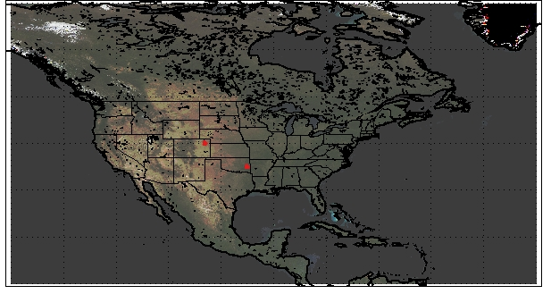
Questions
Can we derive TEMPO visible reflectance from GOES-R 2.3 μm?
If we apply minimum composite method to derive surface reflectance respectively at TEMPO and GOES-R geometry, what is their synergy in aerosol retrievals?
Data
MODIS BRDF in first week of Sep. 2012.
Start with two locations, then move to N-America continent.

Slide 9
Boundary surface conditions for aerosol retrieval
BRDF
SZA = 40°
0.65 um, vegetation
0.65 um, soil
Azimuth
120
90
← Azimuth
60
Azimuth
120
90
← Azimuth
60
150
30
150
30
75 60 45 30 15 0 15 30 45 60 75
← VZA (°) →
75 60 45 30 15 0 15 30 45 60 75
← VZA (°) →
RTLS model is not valid at large VZA or SZA

Slide 10
Boundary surface conditions for aerosol retrieval
Vis/NIR ratio
SZA = 40°
Vegetation
Soil
Azimuth
120
90
← Azimuth
60
Azimuth
120
90
← Azimuth
60
150
30
150
30
75 60 45 30 15 0 15 30 45 60 75
← VZA (°) →
75 60 45 30 15 0 15 30 45 60 75
← VZA (°) →
Vis/NIR ratio shows strong and somewhat complex angular variations.
Using NIR at one angle to estimate Vis at another angle appear to be very challenging: too many combinations and hard to parameterize.

Slide 11
Angular dependence of Vis/NIR ratio
SZA = 60°
Vegetation
Soil
Azimuth
120
90
← Azimuth
60
Azimuth
120
90
← Azimuth
60
150
30
150
30
75 60 45 30 15 0 15 30 45 60 75
← VZA (°) →
75 60 45 30 15 0 15 30 45 60 75
← VZA (°) →

Slide 12
If we apply minimum composite method to derive surface reflectance respectively at TEMPO and GOES-R geometry, what is their synergy in aerosol retrievals?
GOES-R
TEMPO

Slide 13
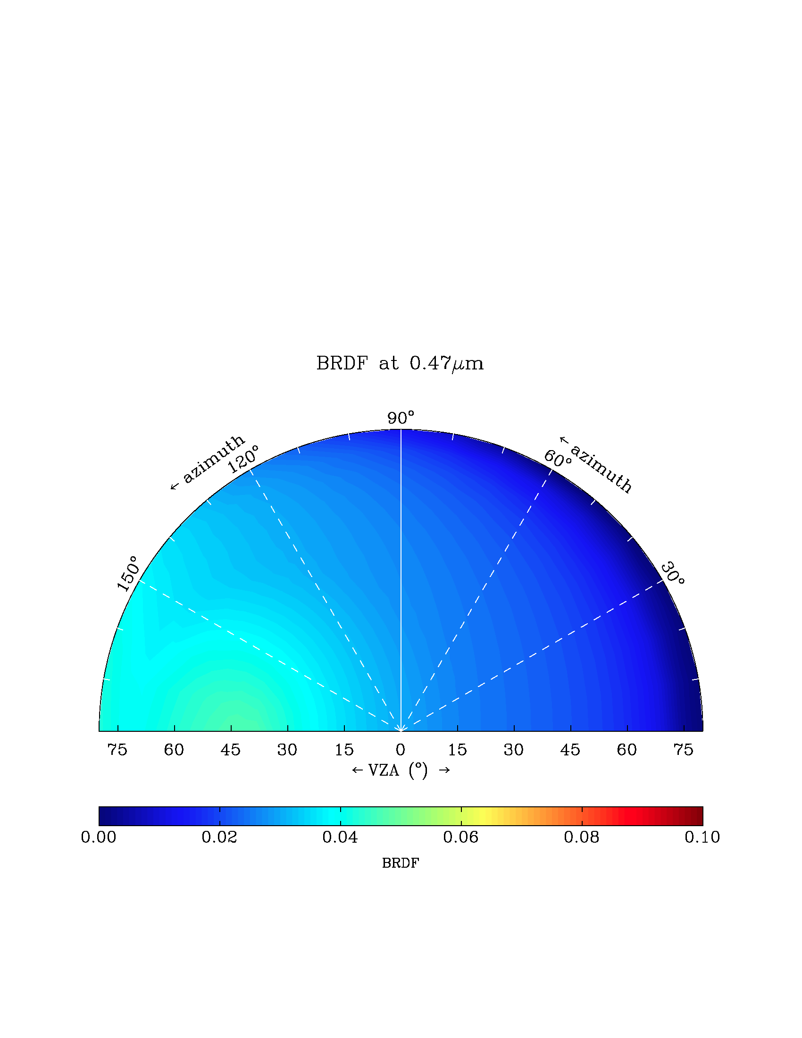
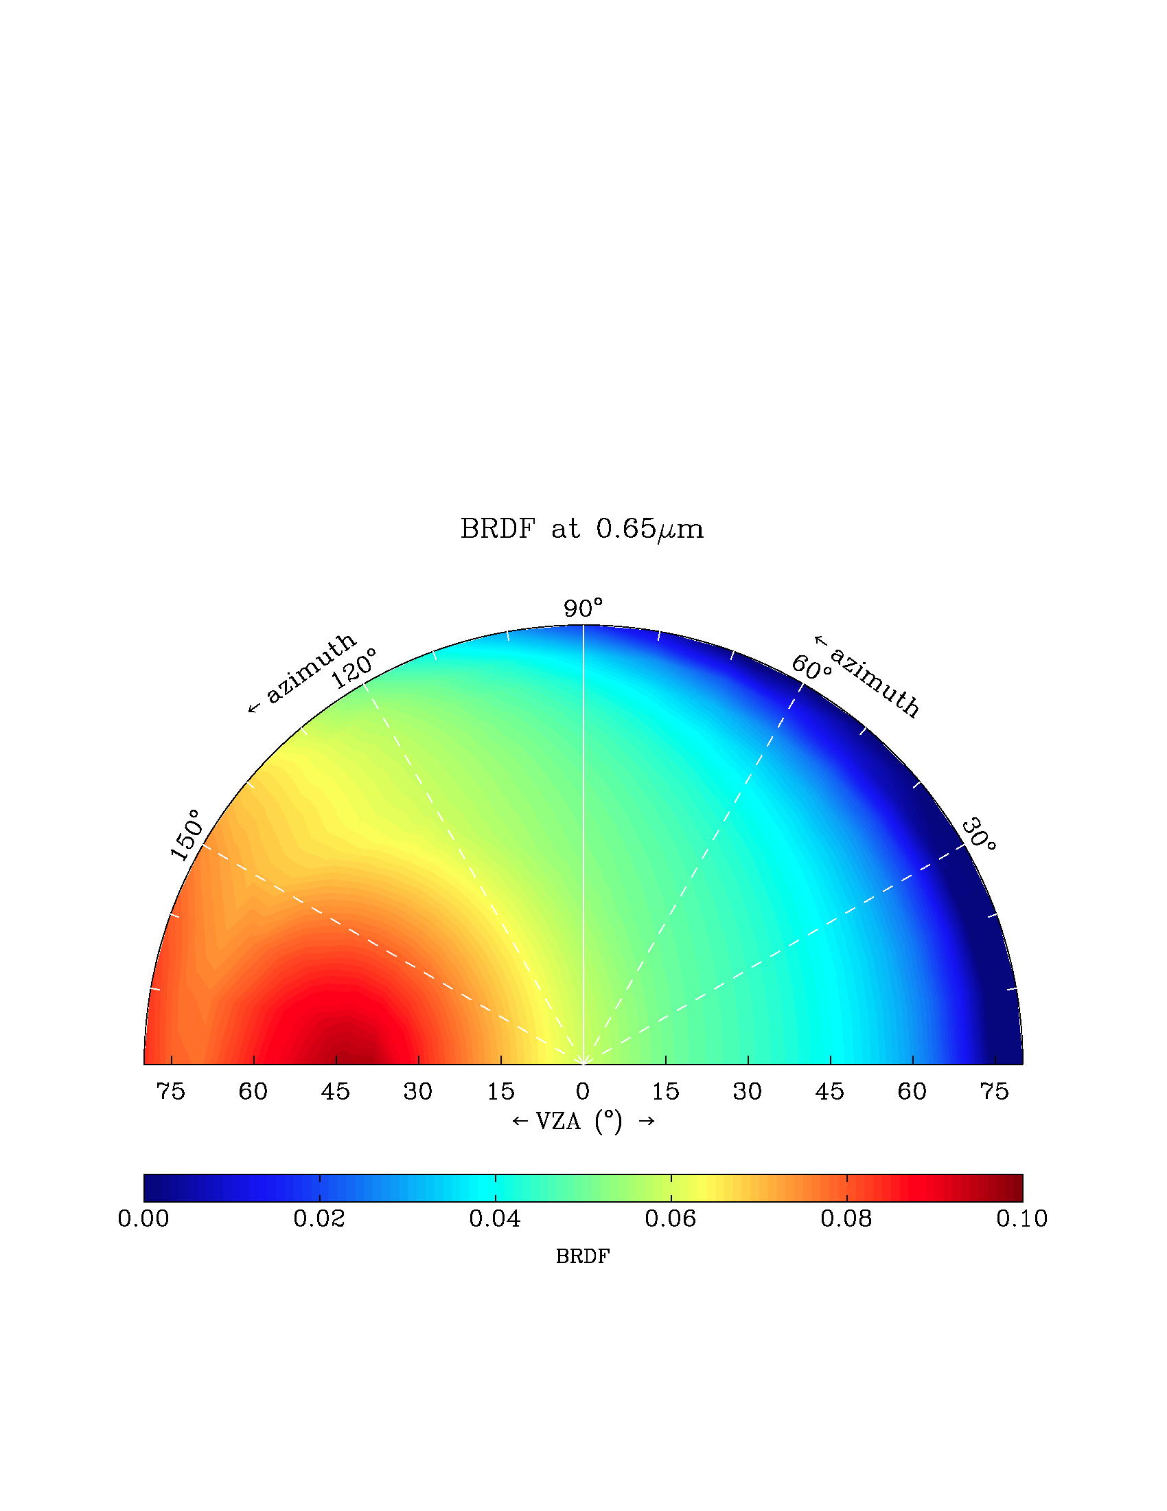
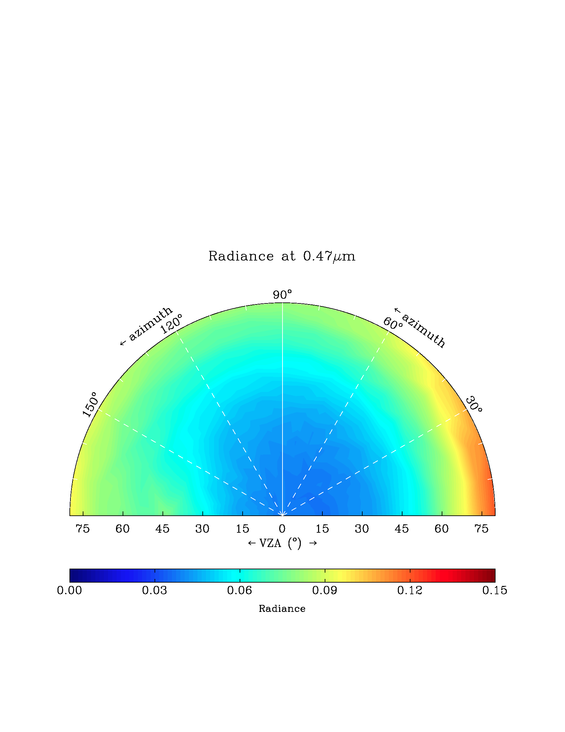
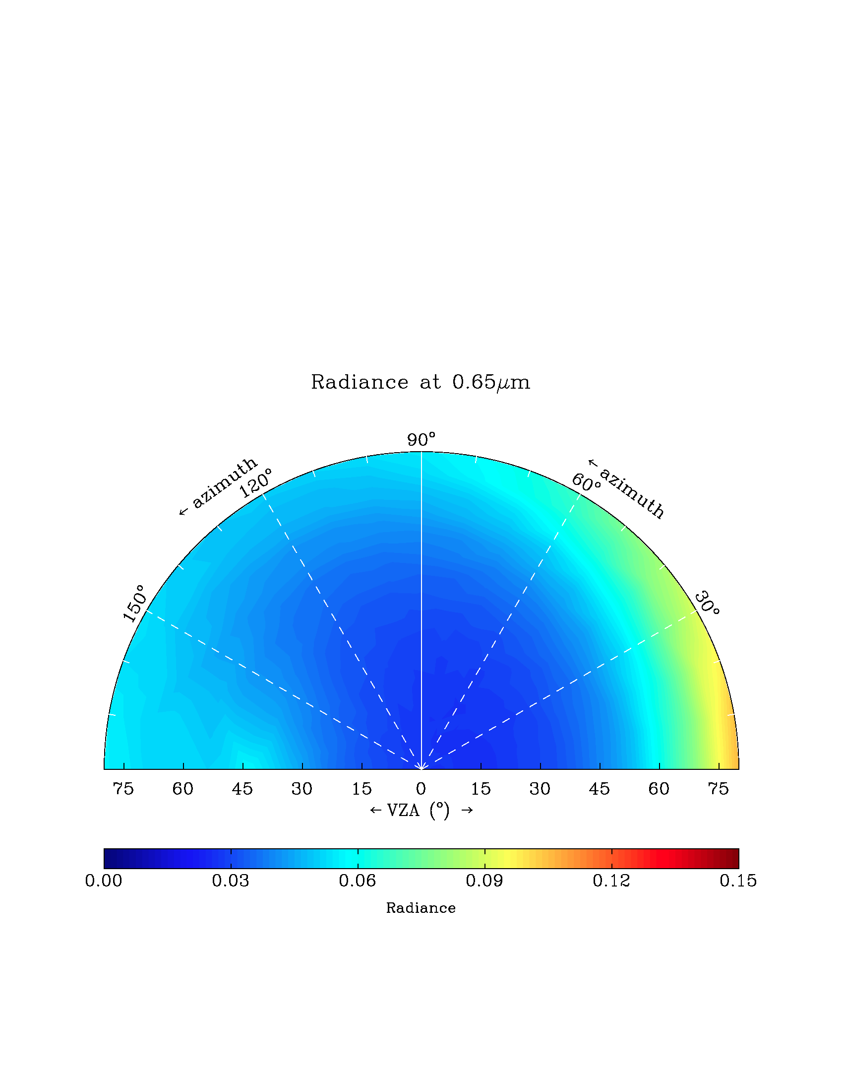
At shorter wavelength, aerosol effect rivals sfc. BRDF effect on reflectance at TOA
Azimuth
120
90
← Azimuth
60
Azimuth
120
90
← Azimuth
60
Surface reflectance
150
30
150
30
0.47 um
0.65 um
TOA reflectance
Azimuth
120
90
← Azimuth
60
Azimuth
120
90
← Azimuth
60
150
30
150
30
75 60 45 30 15 0 15 30 45 60 75
← VZA (°) →
75 60 45 30 15 0 15 30 45 60 75
← VZA (°) →

Slide 14
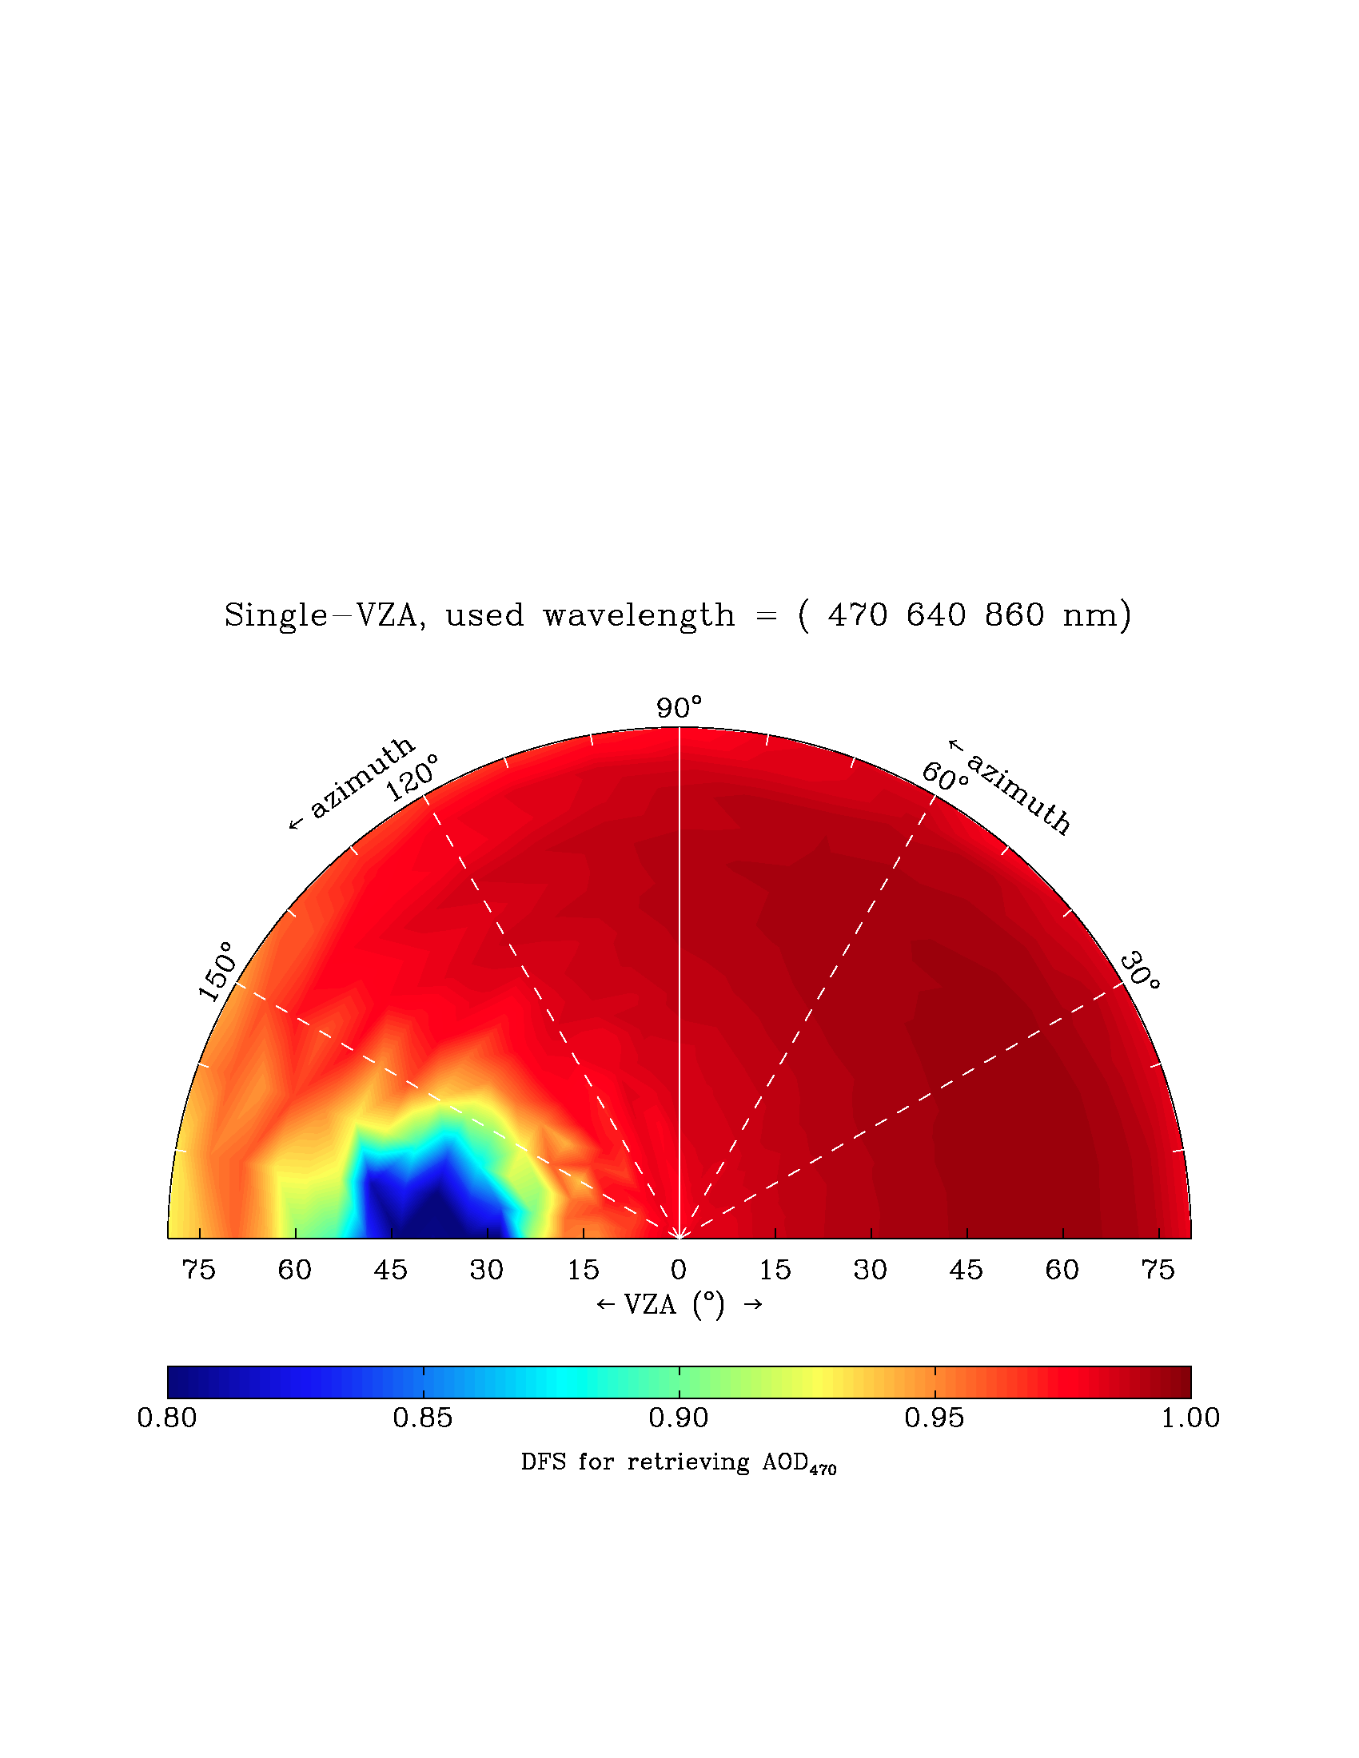
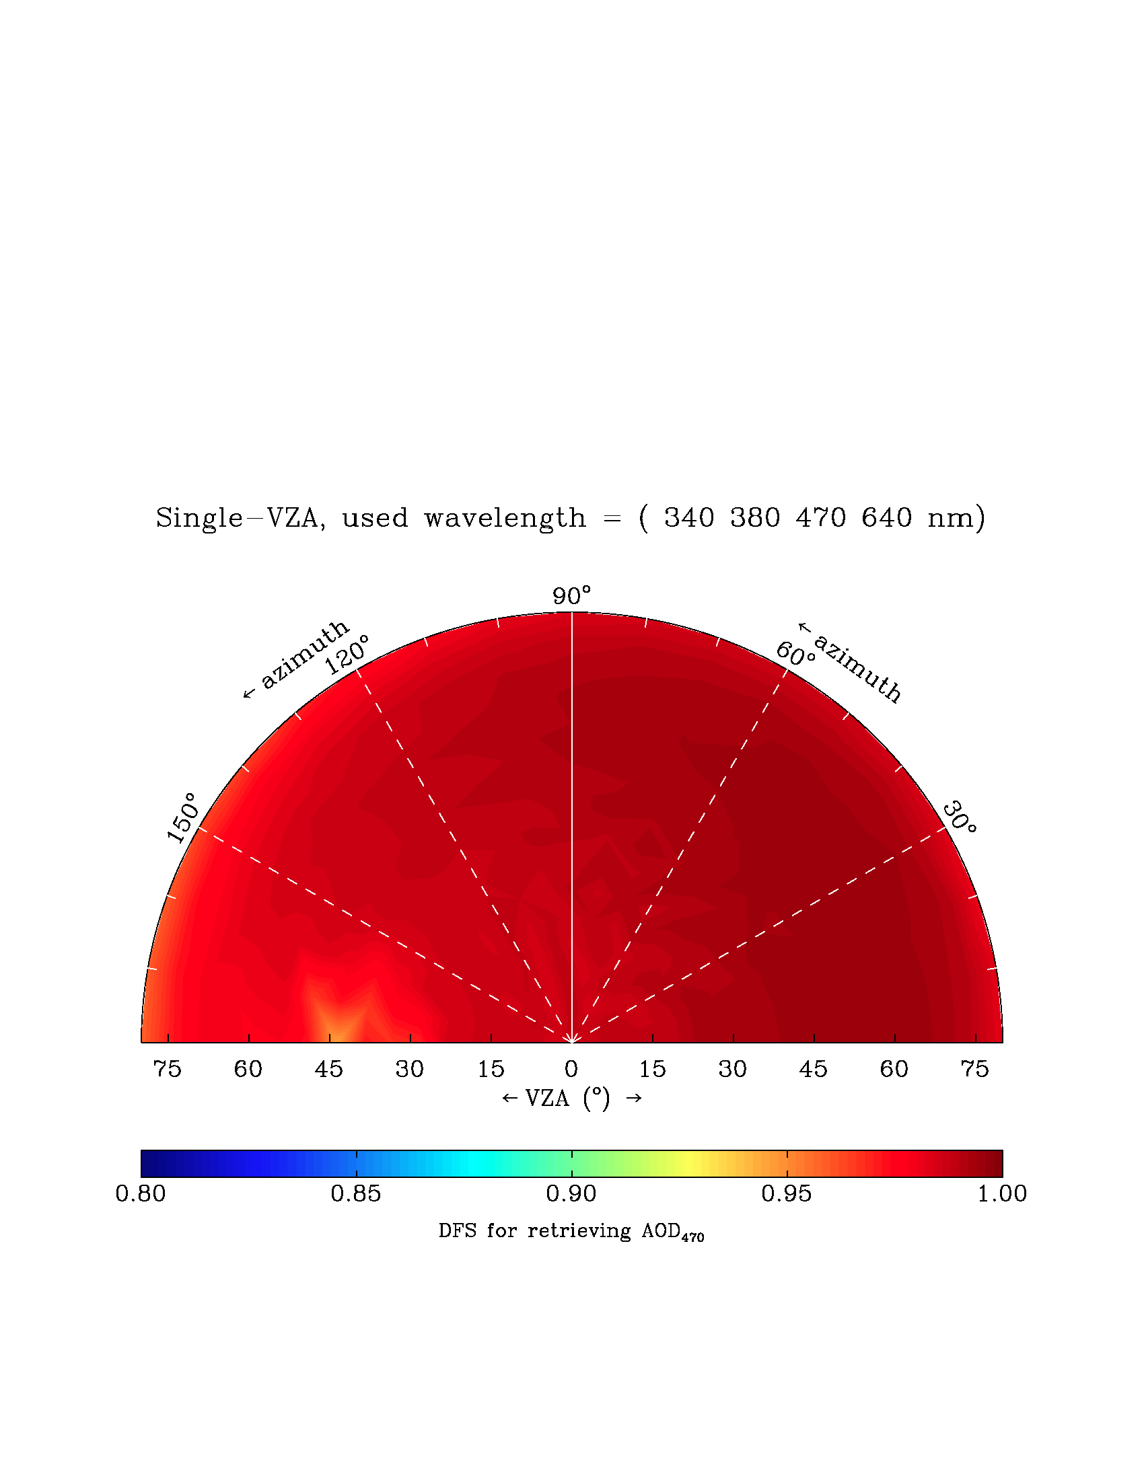
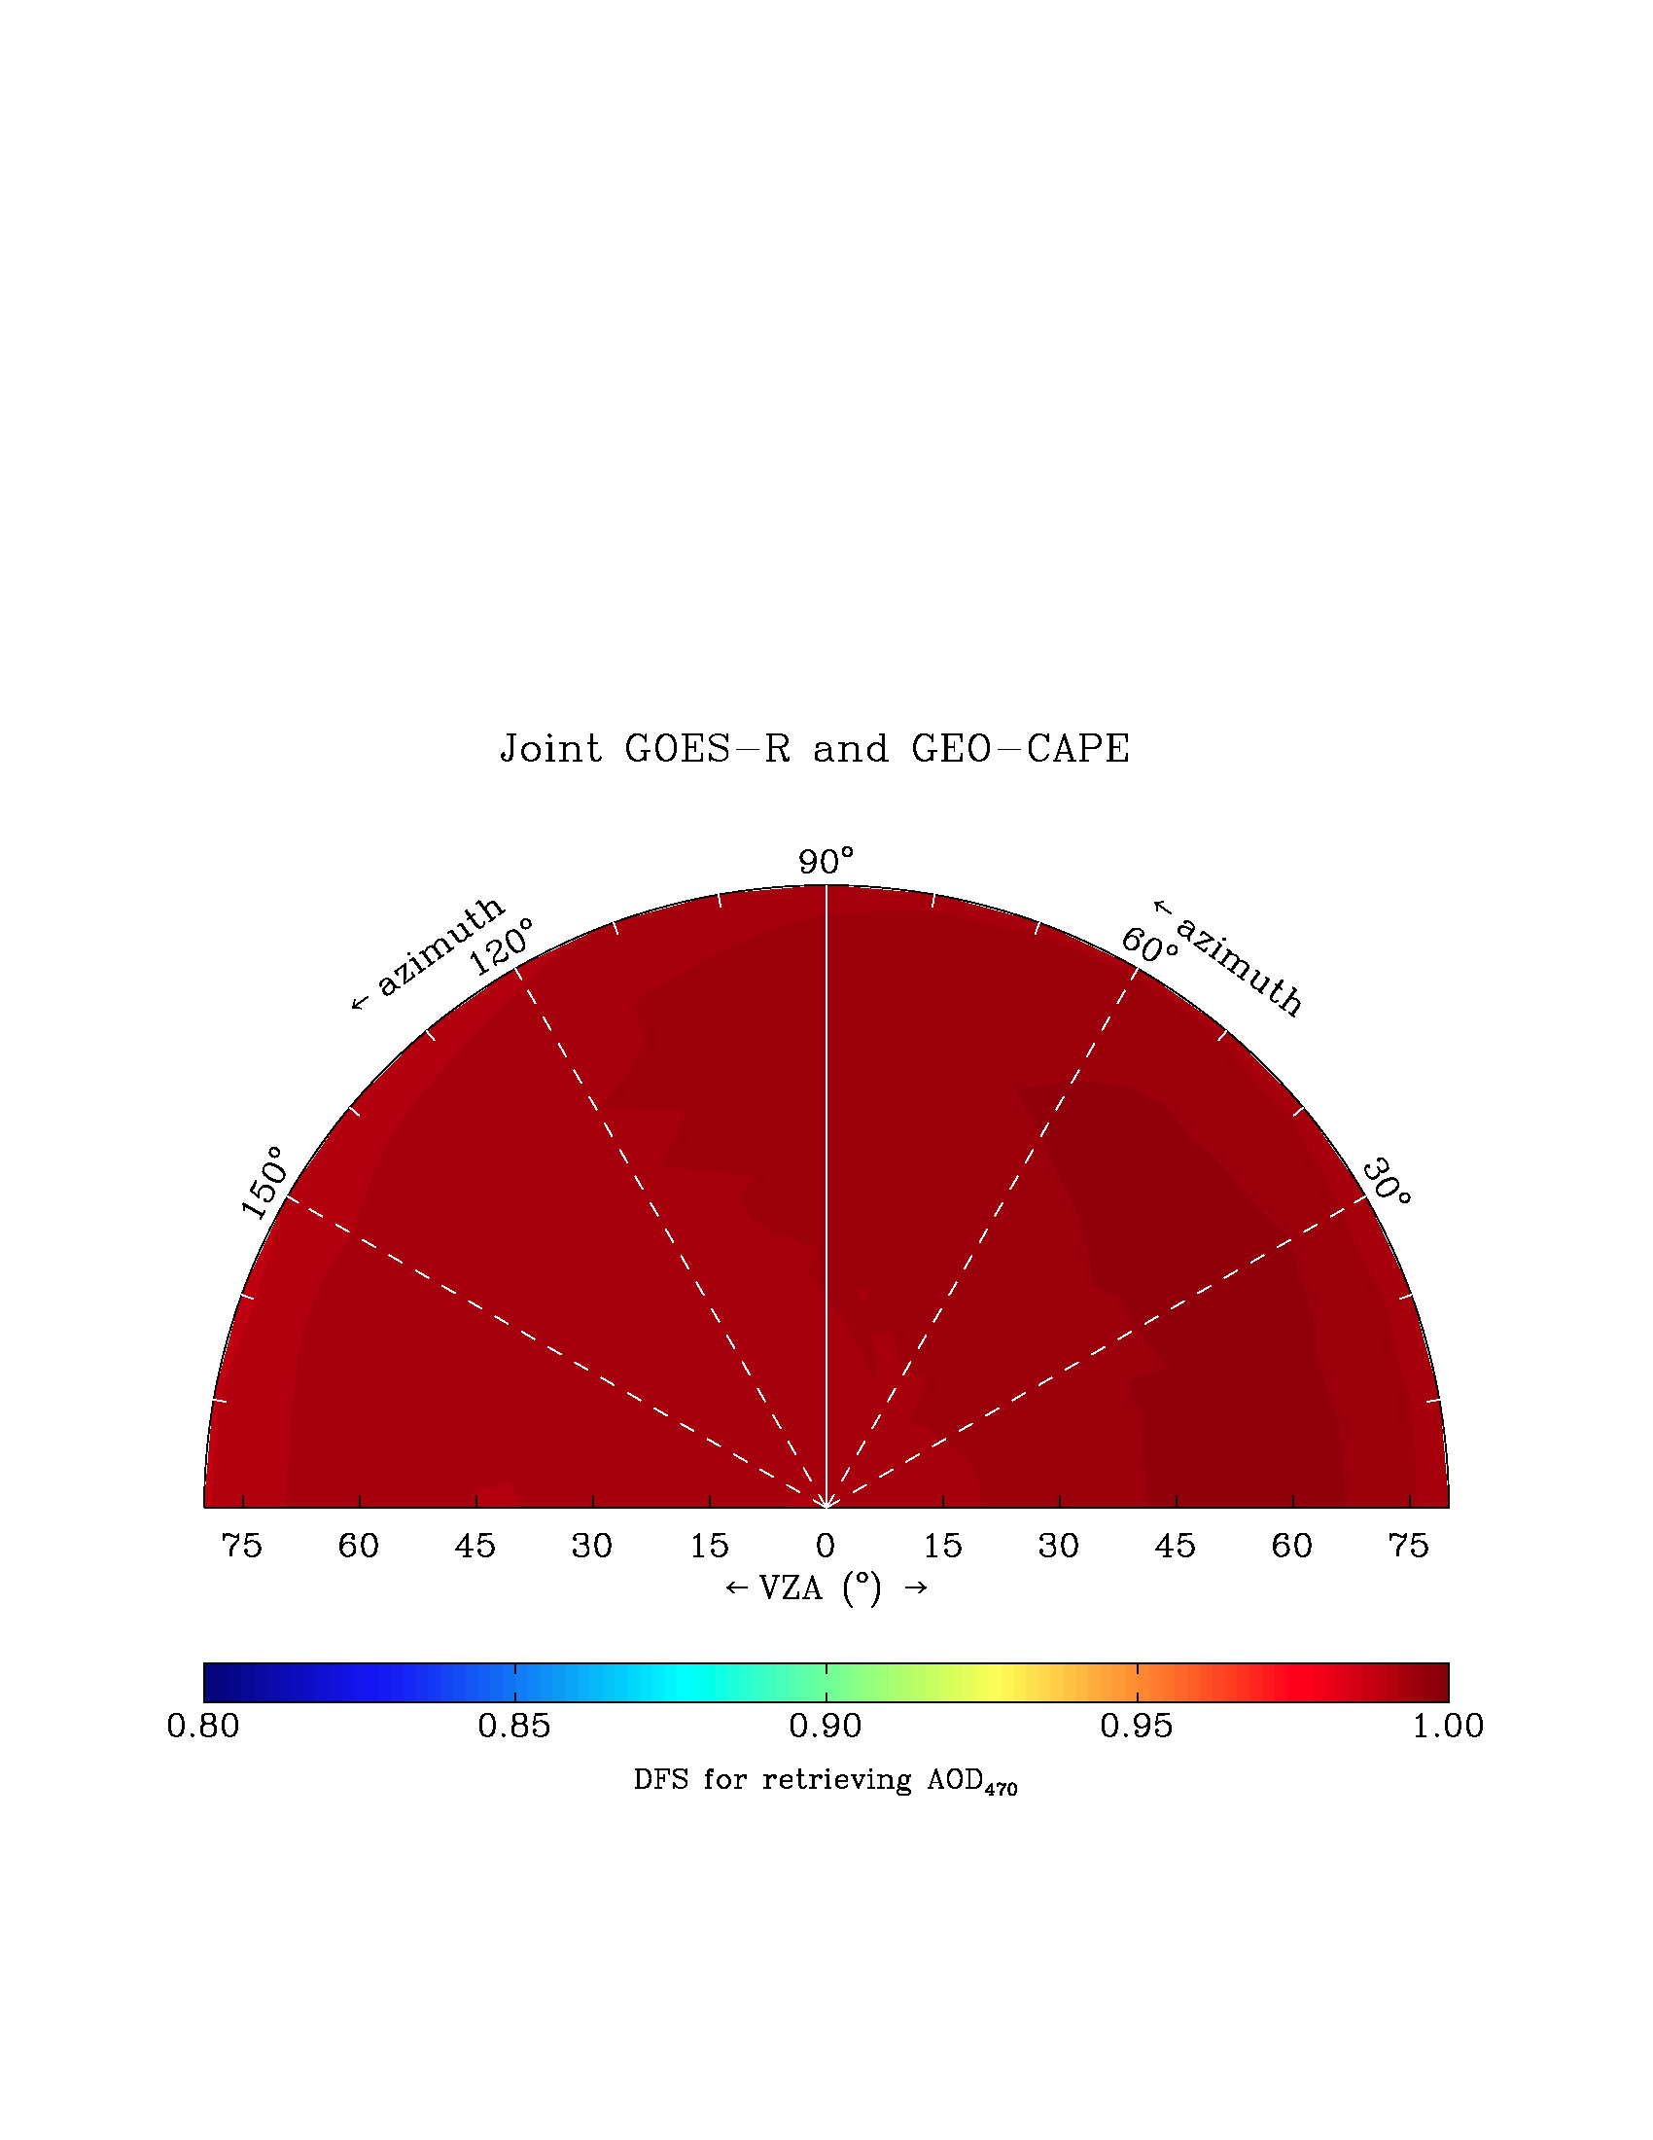
Implication of BRDF for AOD retrievals
GOES-R
470, 640, 860 nm
TEMPO/GEO-CAPE
340, 380, 470, 640 nm
GOES-R +
TEMPO/GEO-CAPE
Azimuth
120
Azimuth
120
Azimuth
120
SZA = 40°
90
90
90
← azimuth
60
← Azimuth
60
← azimuth
60
150
30
150
30
150
30
75 60 45 30 15 0 15 30 45 60 75
VZA (°)
75 60 45 30 15 0 15 30 45 60 75
VZA (°)
75 60 45 30 15 0 15 30 45 60 75
VZA (°)
0.80 0.85 0 0.95 1.0
Degree of Freedom for retrieving AOD
TEMPO/GEO-CAPE UV wavelengths improve DOFs in AOD retrieval.
Strong synergy between GOES-R and TEMPO/GEO-CAPE during the time when one of them is at the direction close to the Sun’s illumination angle.
BRDF is considered with uncertainty of 20%.

Slide 15
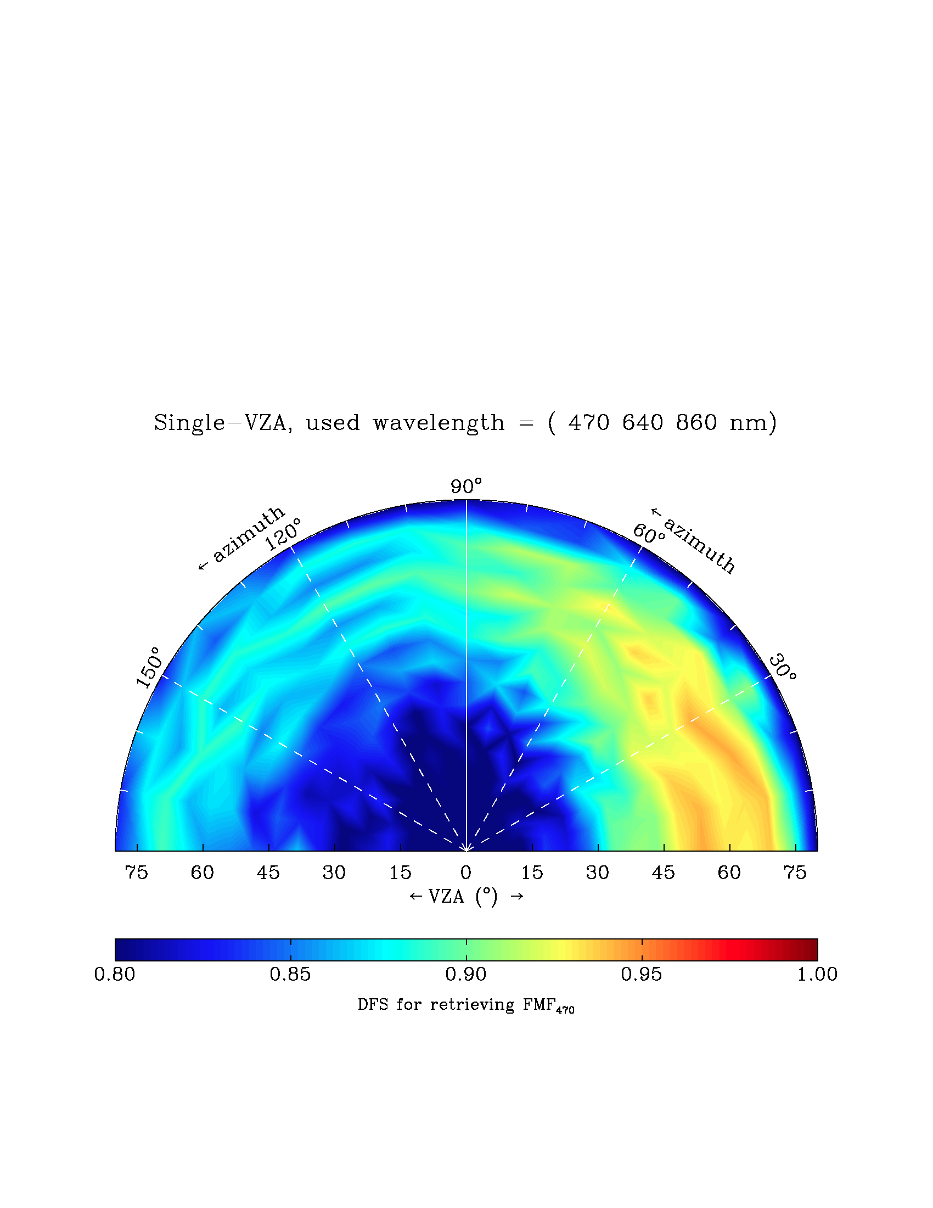
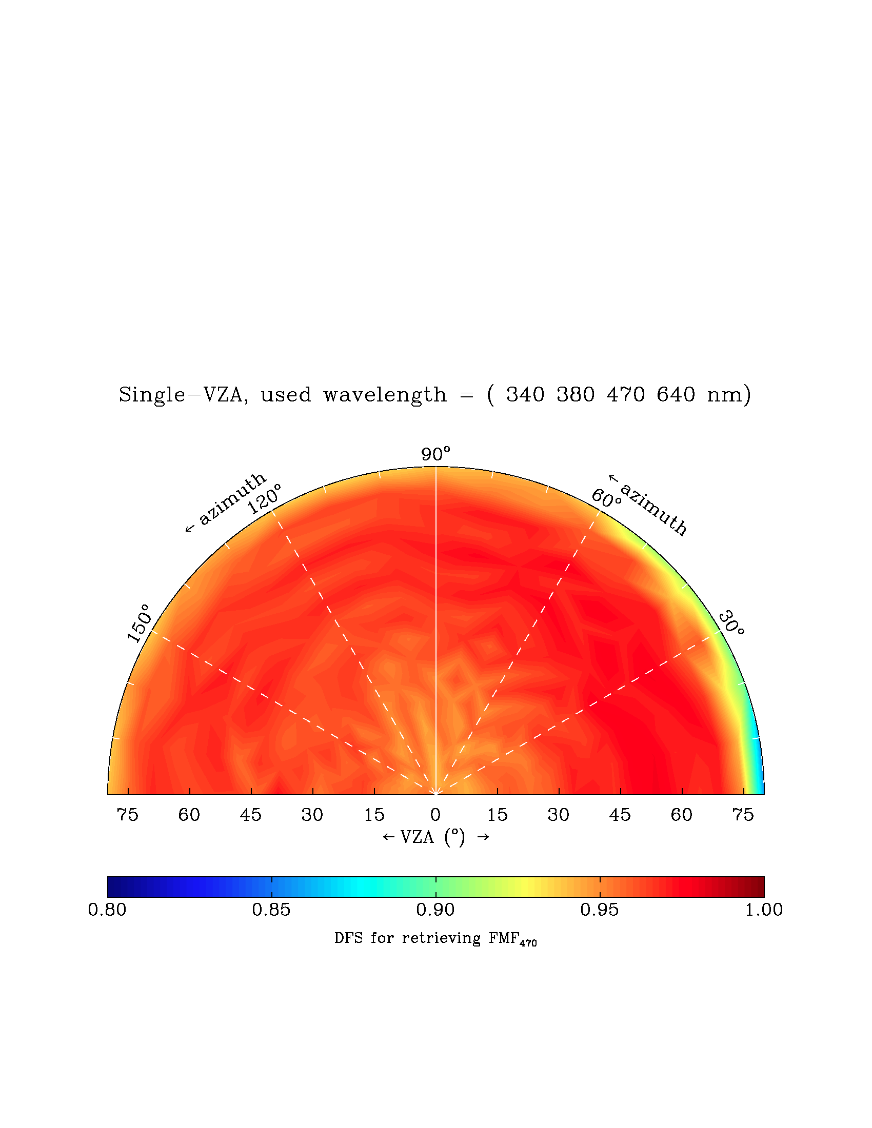
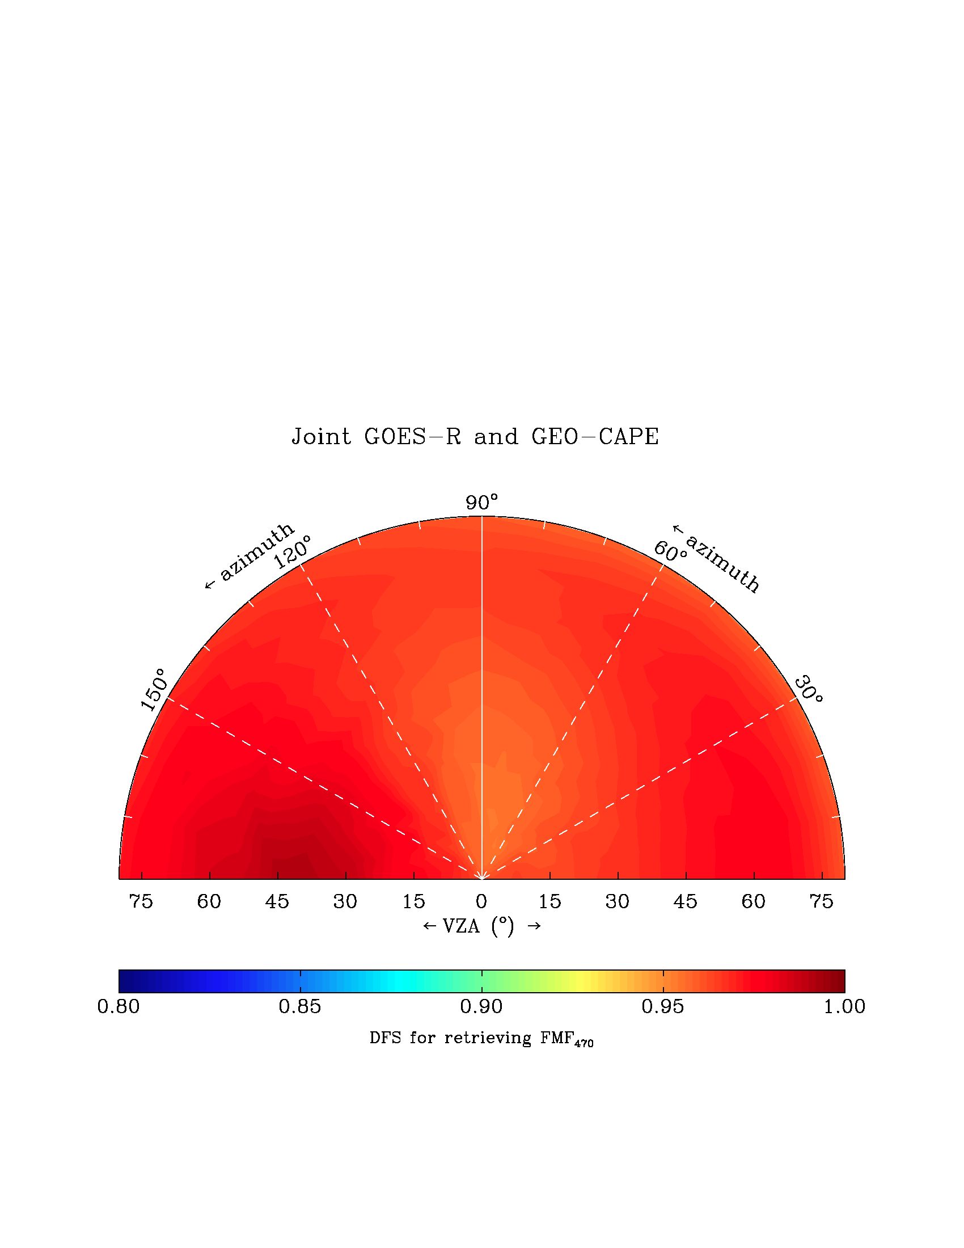
Impact on fine-mode AOD retrieval
GOES-R
470, 640, 860 nm
TEMPO/GEO-CAPE
340, 380, 470, 640 nm
GOES-R +
TEMPO/GEO-CAPE
Azimuth
120
Azimuth
120
Azimuth
120
SZA = 40°
90
90
90
← azimuth
60
← Azimuth
60
← azimuth
60
150
30
150
30
150
30
75 60 45 30 15 0 15 30 45 60 75
VZA (°)
75 60 45 30 15 0 15 30 45 60 75
VZA (°)
75 60 45 30 15 0 15 30 45 60 75
VZA (°)
0.80 0.85 0 0.95 1.0
Degree of Freedom for retrieving AOD
BRDF appears to have less impact on retrieval of fine-mode AOD
TEMPO/GEO-CAPE, due to its UV wavelength, is more sensitive for change of fine-mode AOD.
Overall, synergy of GOES and TEMPO/GEO-CAPE can improve the retrieval of fine-mode AOD as well. Large spectral range offers more characterization of particle size.

Slide 16
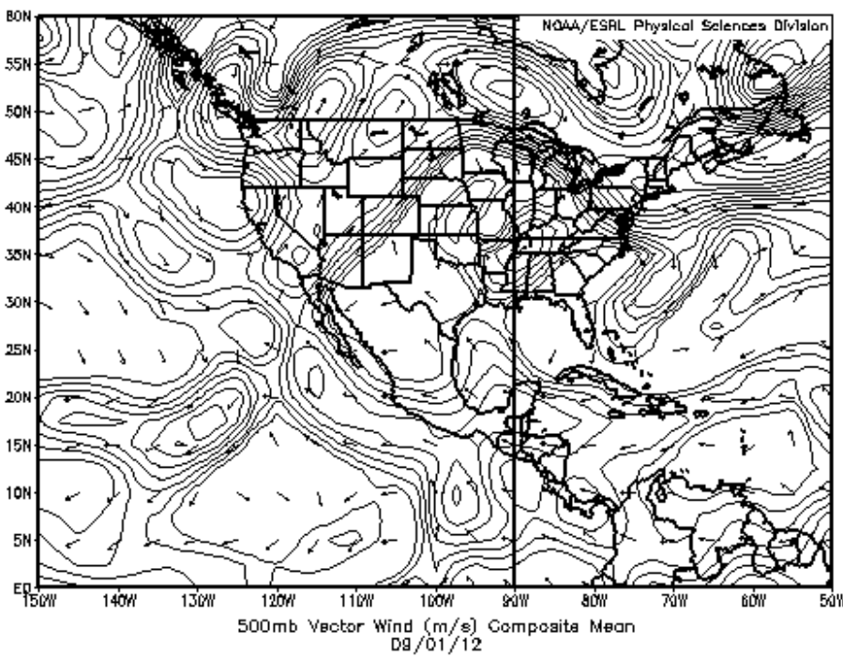
Move to the N-America continents. Examine the retrieval improvement by GOES+TEMPO synergy as a function of time and space?
Develop GEO satellite simulator based upon MODIS BRDF for surface, GEOS-Chem for atmosphere, and VLIDORT for radiative transfer calculation. Examine the retrieval over the TEMPO/GOES-E overlap regions.
L
L
L
L
500 hPa
1 Sep. 2012

Slide 17
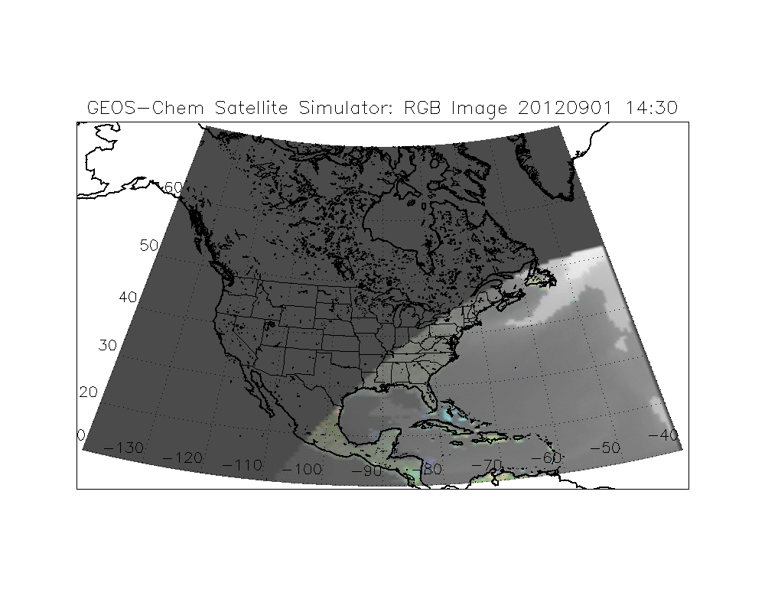
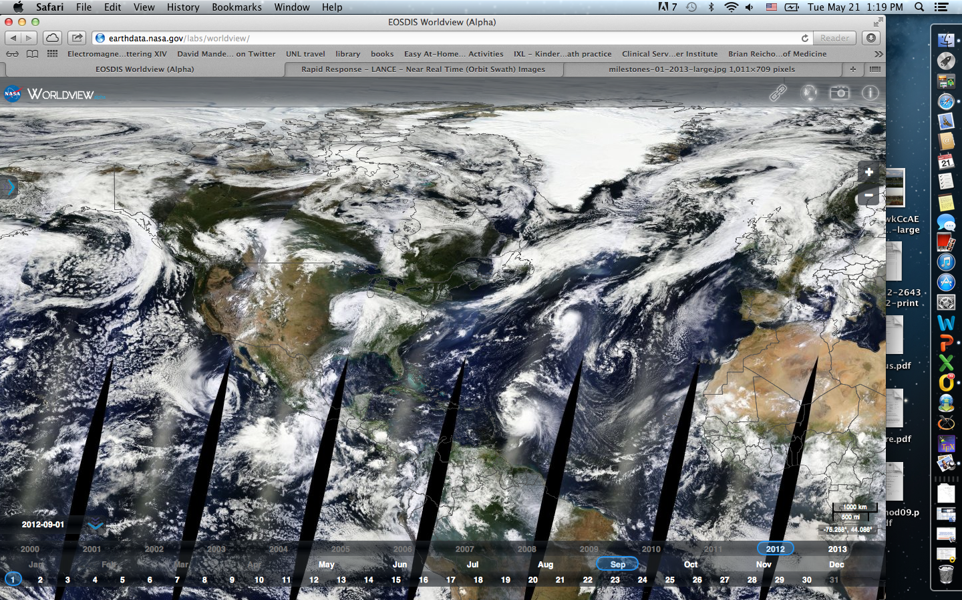
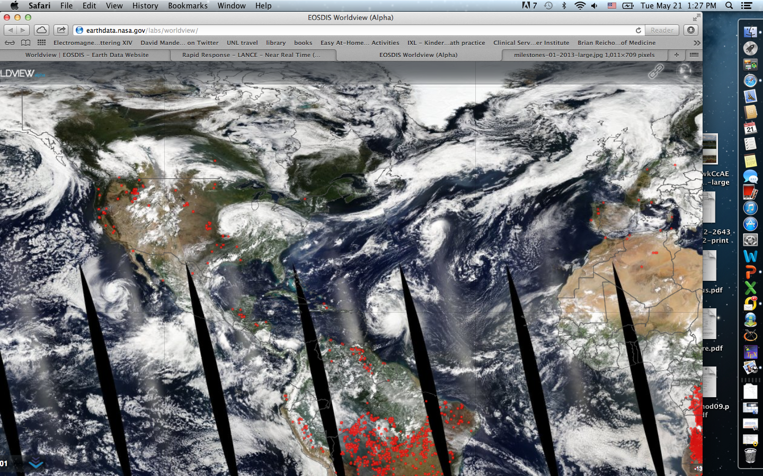
Satellite simulator for TEMPO/GEO-CAPE
1 Sep. 2012; SZA > 75° is masked out;
cloud is not considered
Terra
Aqua

Slide 18
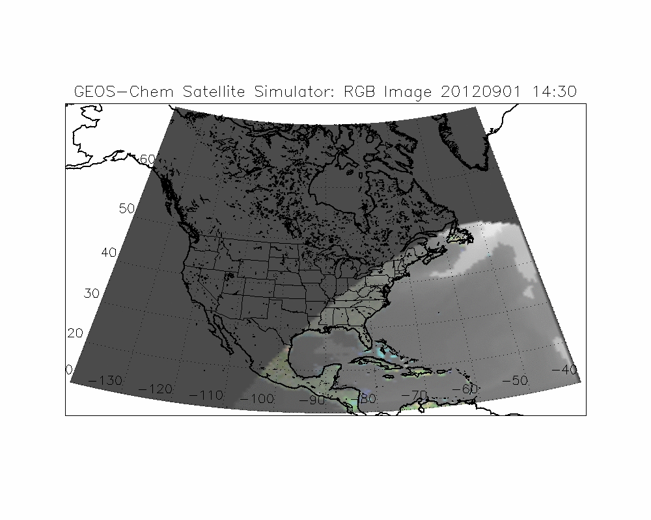
Overlap area between GEO@75W and @100W

Slide 19
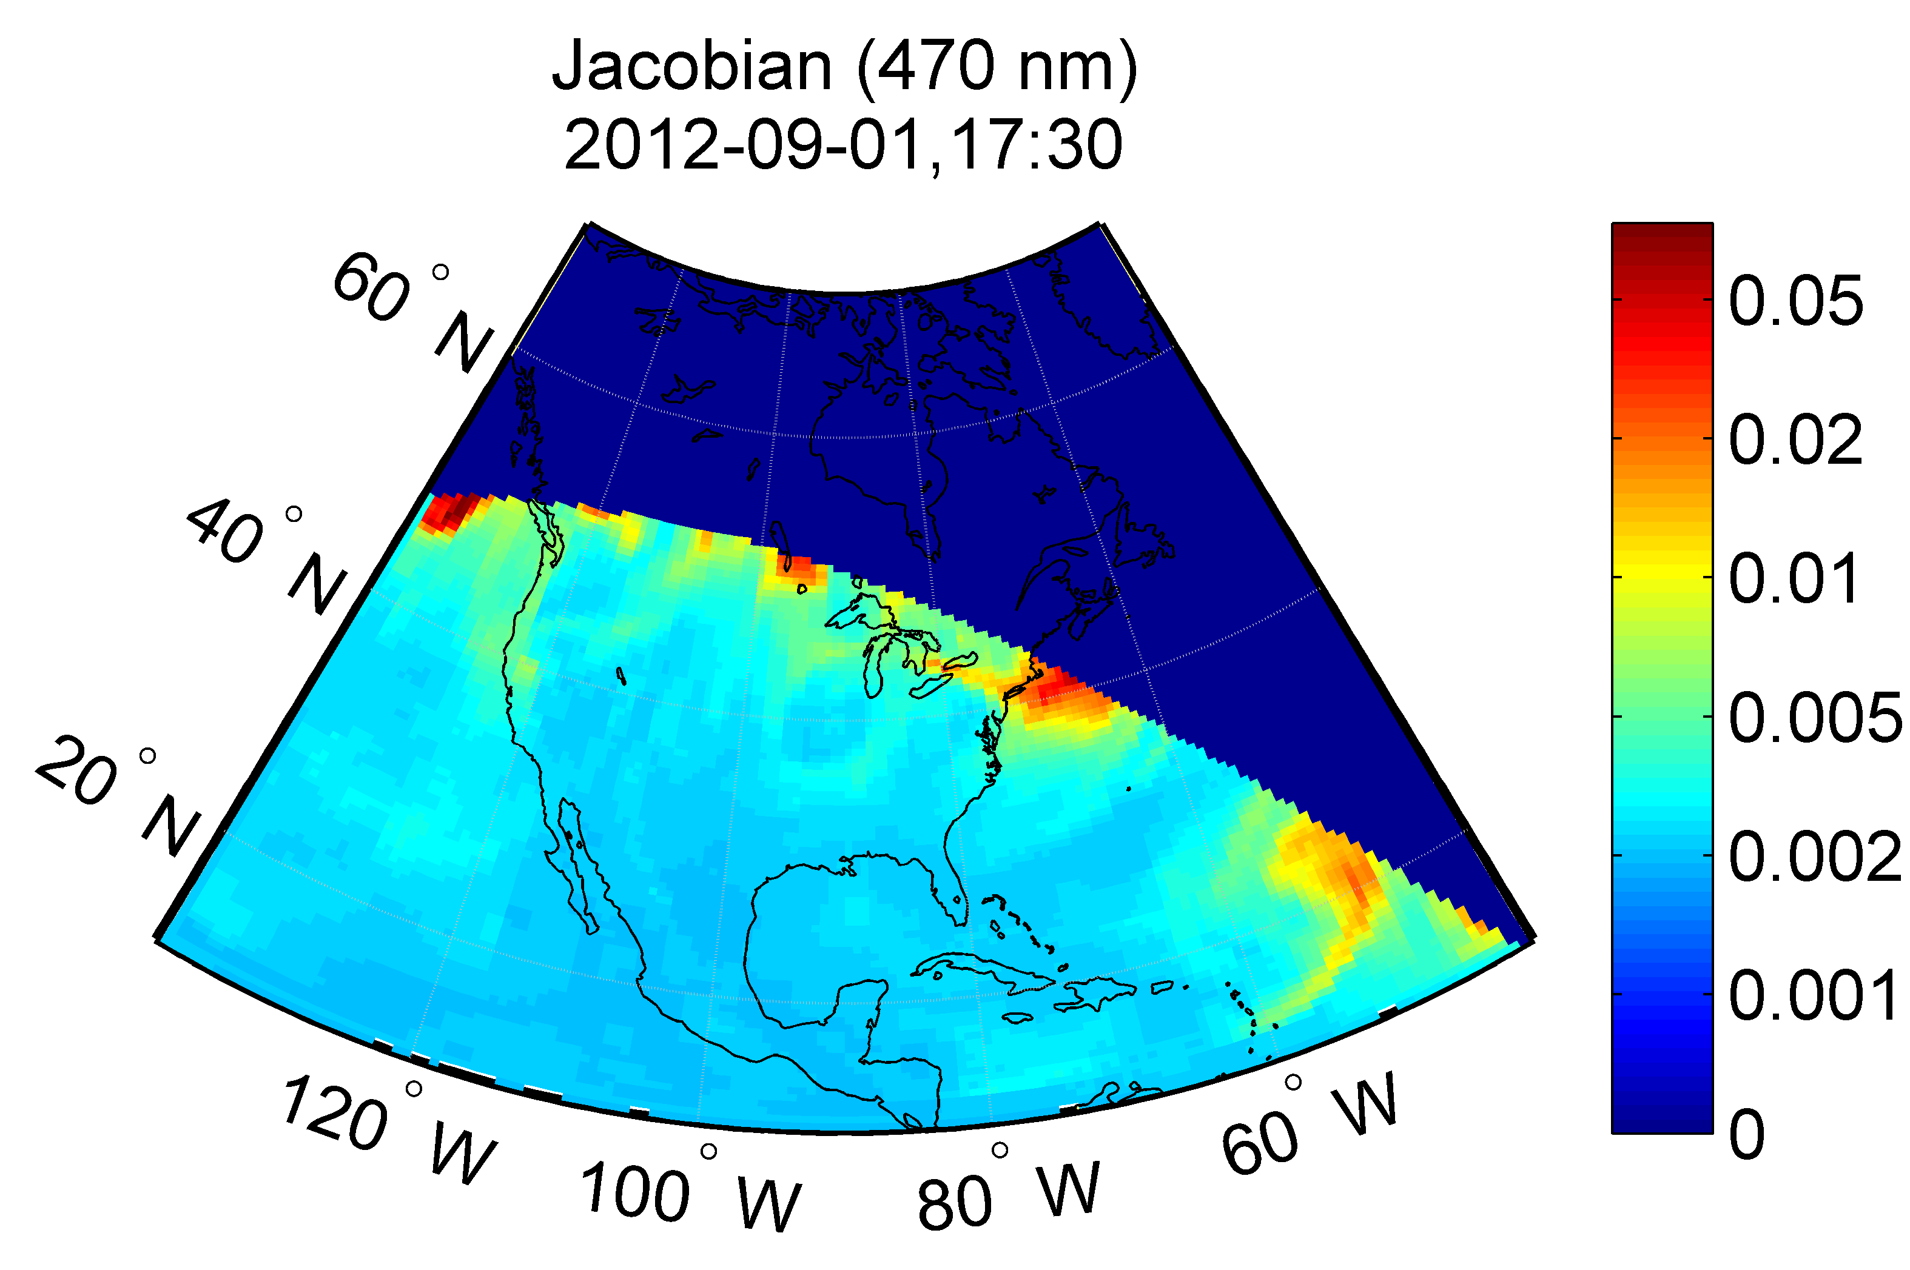

Spatial Distribution of Jacobians
(J₄₇₀ – J₆₅₀)
Jacobian of radiance w.r.t. AOD are now analyzed spatially as a function of time. They can be used to:
analyze the GOES and TEMPO/GEO-CAPE synergy in retrievals;
for OSSE studies looking at the GOES and TEMPO/GEO-CAPE synergy for improving emission estimate.

Slide 20
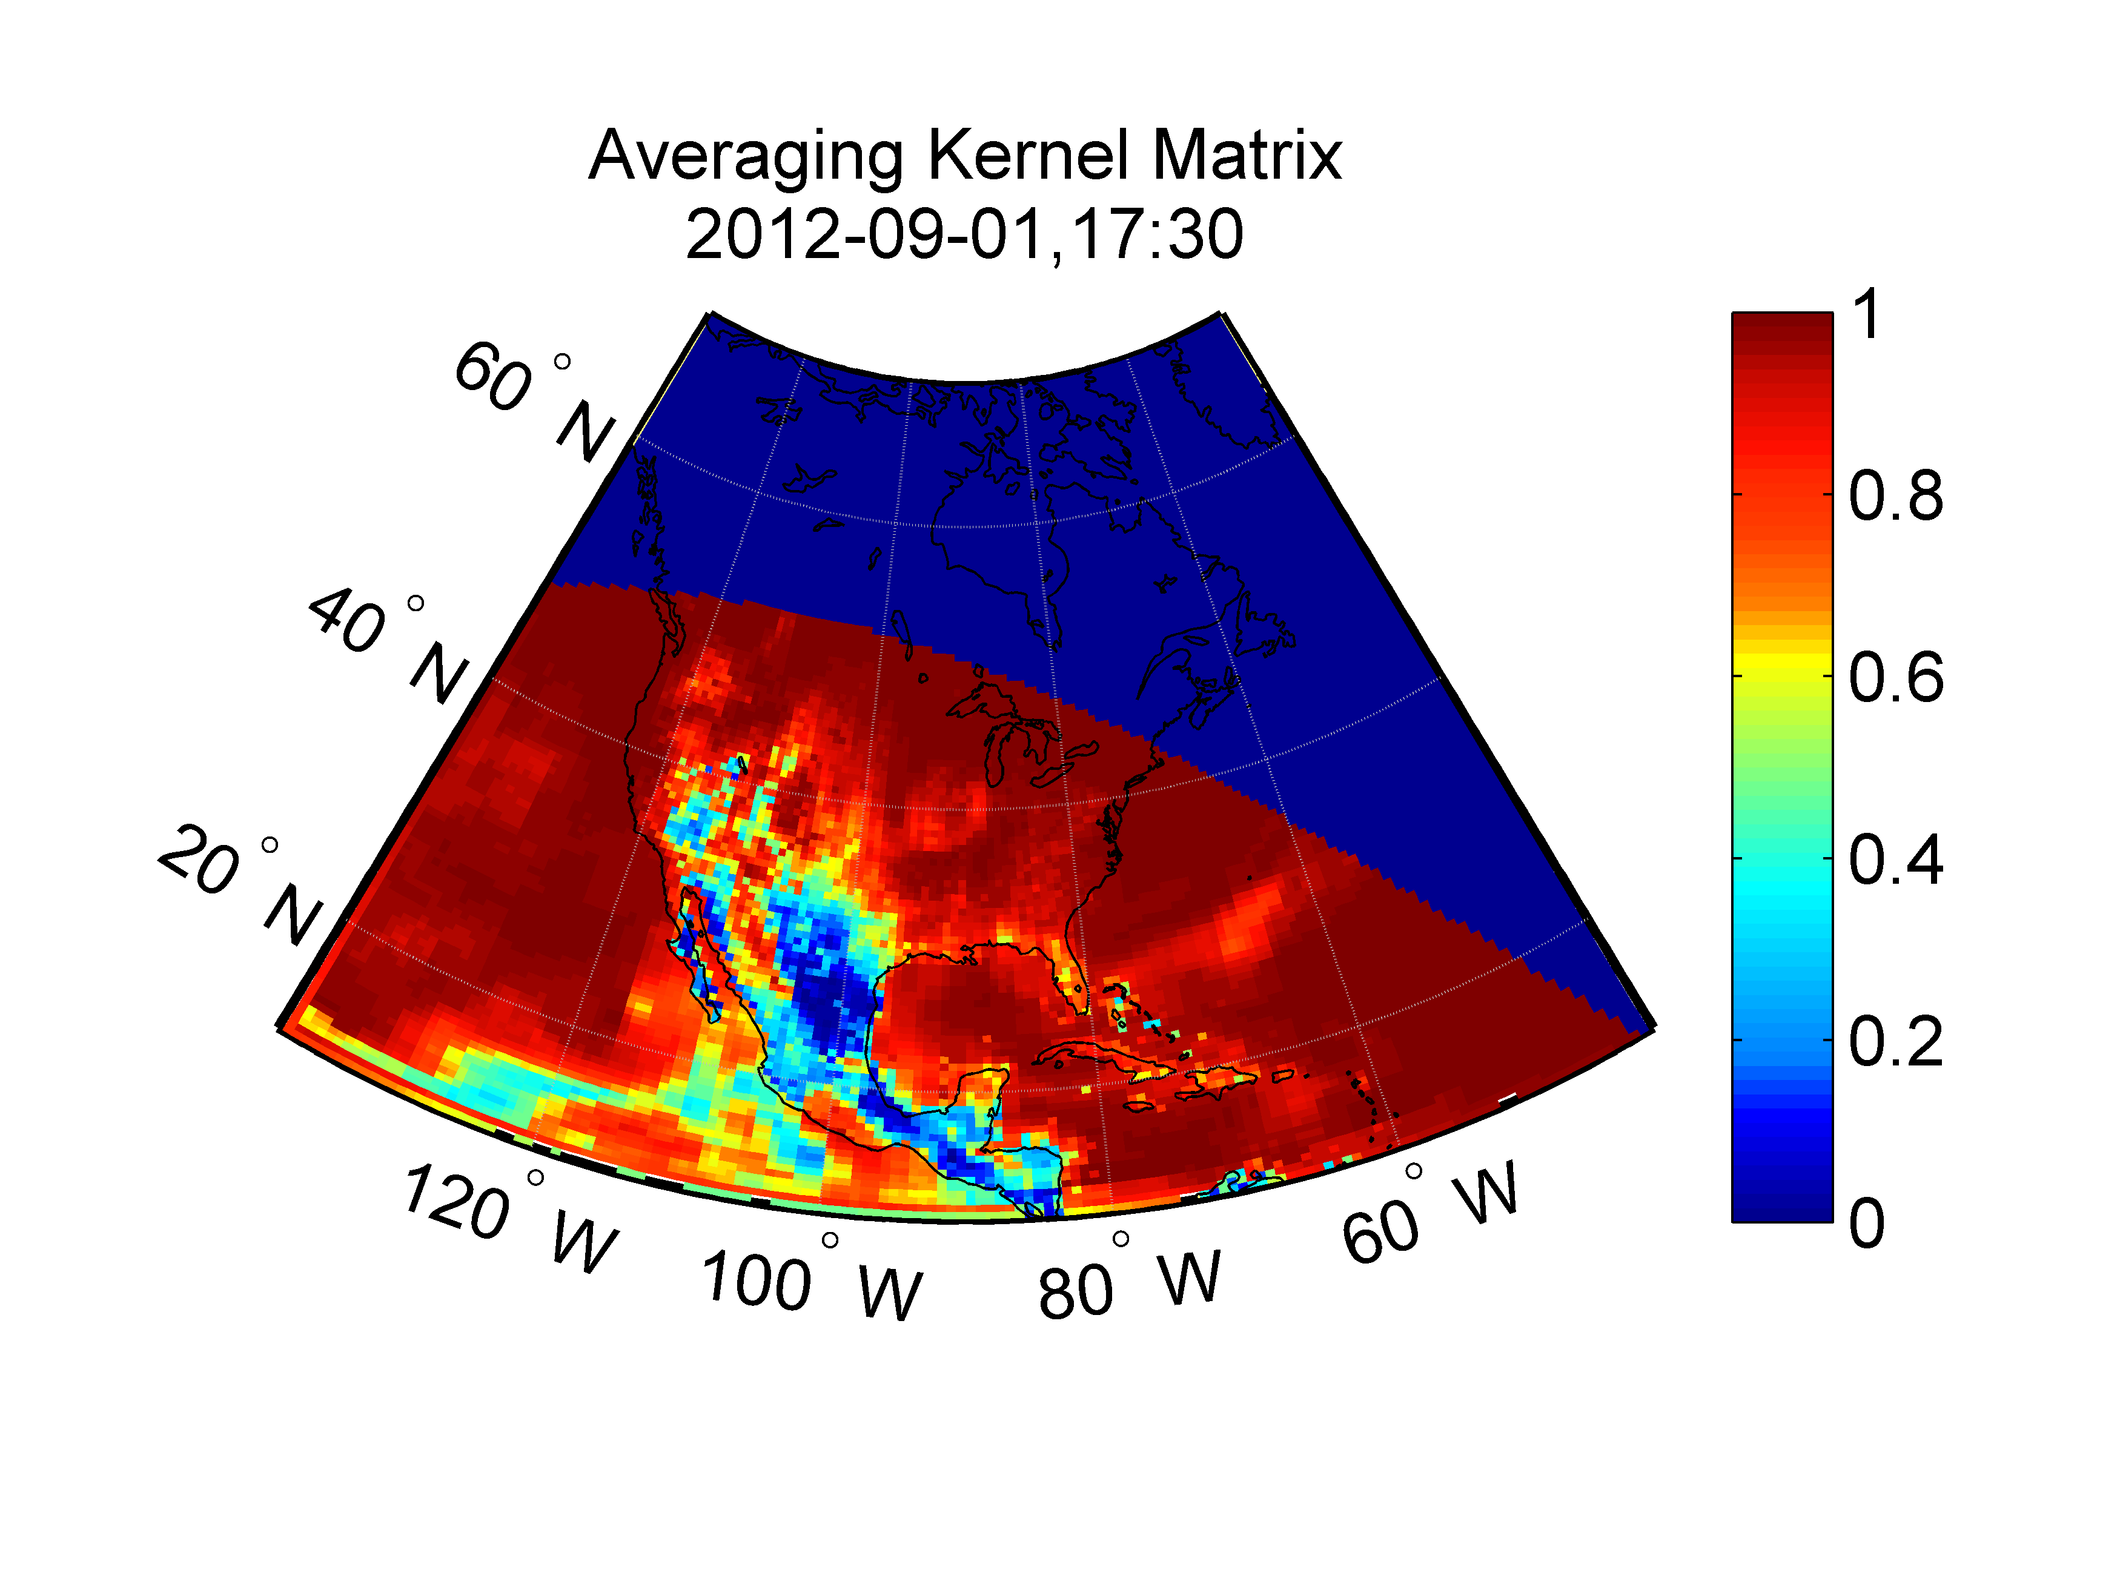
Analyze of DOFs for AOD
75W

Slide 21
Summary
At large VZA or SZA, BRDF model fitting has large errors, and minimum composite method is recommended to derive the surface visible reflectance for TEMPO and/or GOES aerosol retrieval.
Deriving TEMPO VIS/GOES-R NIR ratio have potential, but needs to consider the directional difference.
Strong synergy exists between TEMPO and GOES for improving AOD and fine-mode AOD retrievals. TEMPO: UV channels, low sfc. reflectance + high sensitivity to aerosols; GOES: add a different viewing angle and measurements. Significant improvement in times when TEMPO is near the sun illumination angle while GOES is not.
Given strong geometry dependence in the aerosol retrieval, we need to study the distribution of aerosol retrieval improvement in GEO-CAPE/TEMPO and GOES-R series overlap regions as a function of time.

Slide 22

Thank you !

Slide 23
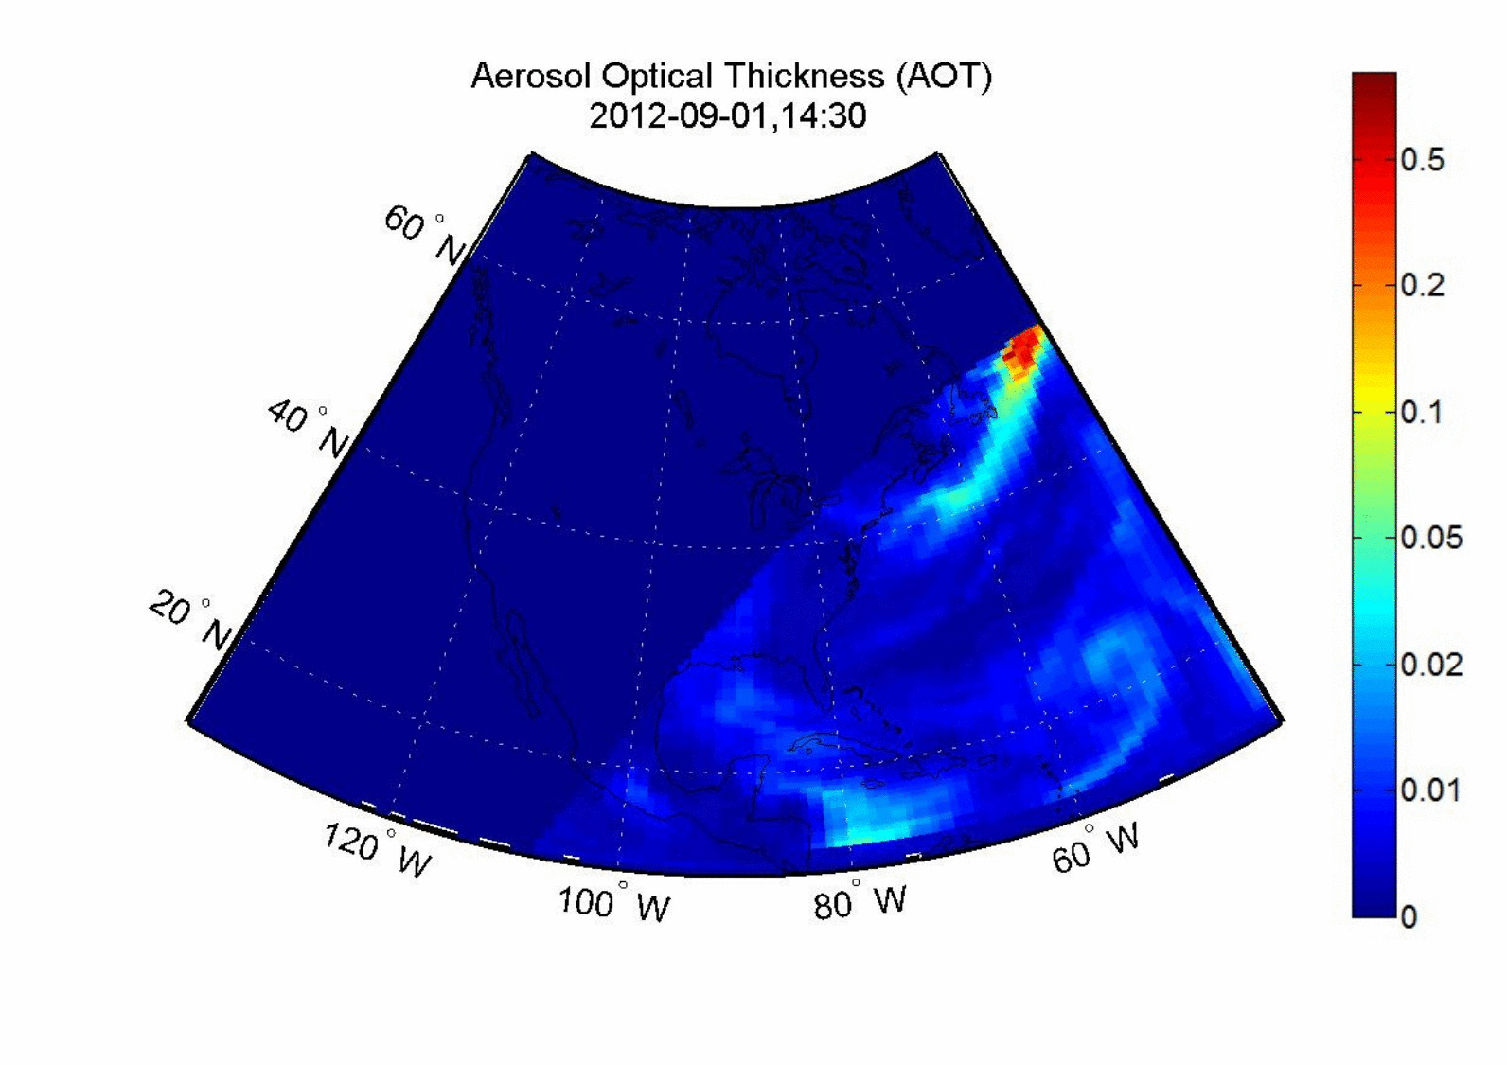

Slide 24
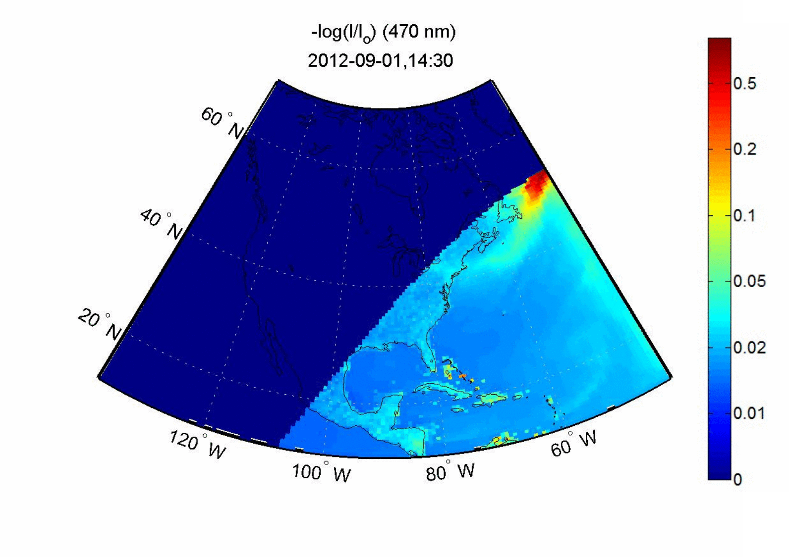
GEO at 100W@
ln(I_{SFC}/I_{TOA}) ~ AOD

