Slide 1


Fine Particulate Matter and Cardiovascular Admissions in NY State: An Assessment of Exposure Model Choice Sensitivity and Spatial-Temporal Effect Modification
MIKE HE
mike.he@columbia.edu
TEMPO Health Conference
October 10, 2019

Slide 2
Introduction
Air pollution and health – widely studied, effects well-documented
Historically, time-series studies used monitoring data (e.g. AQS)

Slide 3
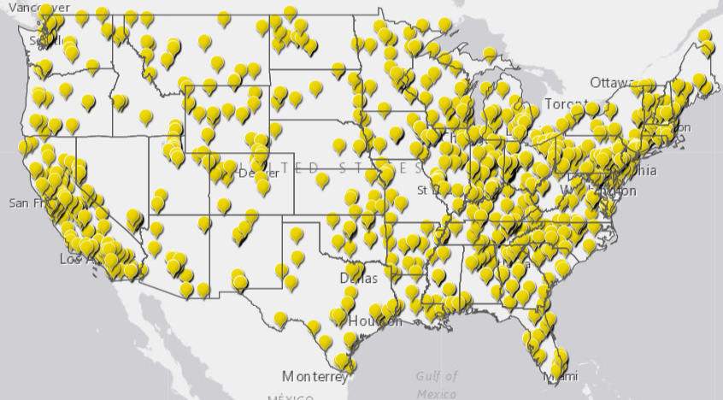
AQS Monitors in the United States (PM_{2.5})
https://www.epa.gov/outdoor-air-quality-data/interactive-map-air-quality-monitors (Oct 9 2019)

Slide 4
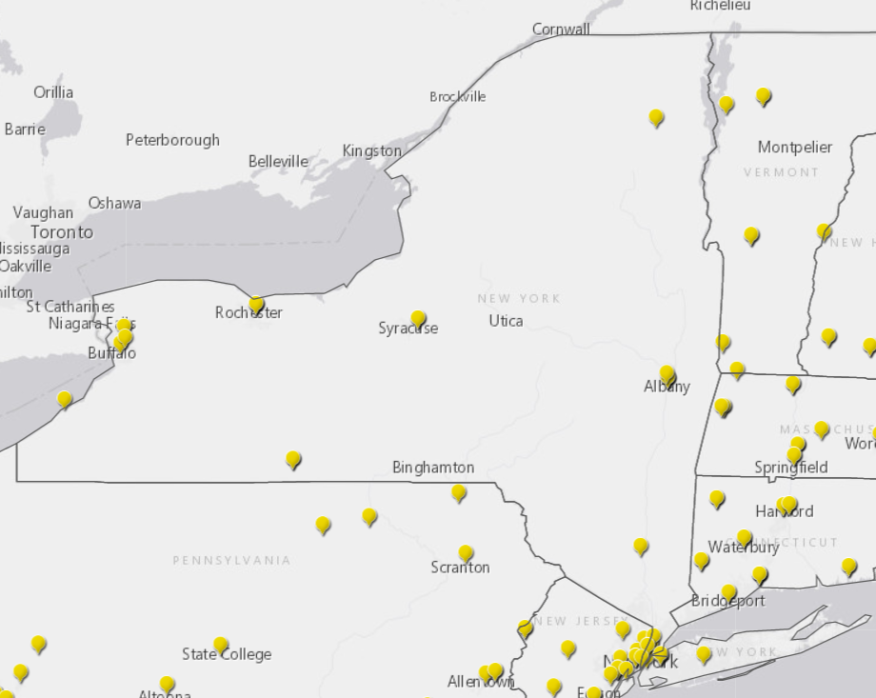
AQS Monitors in New York (PM_{2.5})
https://www.epa.gov/outdoor-air-quality-data/interactive-map-air-quality-monitors (Oct 9 2019)

Slide 5
Prediction Models
Increasing use of prediction models to reduce exposure measurement error and include populations in areas without monitors
Models predict both spatial and temporal changes in air pollution
Initially, models were “simple”
  Land use regression models
  Generalized additive mixed models
More recently, more sophisticated models
  Fuse remote sensing data, predictions from chemical transport models, etc.
  More robust methods for higher predictive accuracy (e.g. random forests, neural networks, ensembles)
  Higher spatial and temporal resolution

Slide 6
Prediction Models in Health Studies
Many groups are developing these models for exposure assessment in epidemiologic studies
To date, most health studies use predictions from a single model to assign exposures
  PM_{2.5} and Mortality (Kloog, Epidemiology, 2013)
  Long-Term Ozone and Mortality (Turner et al, AJRCCM, 2016)
  Air Pollution and Mortality in the Medicare Population (Di et al, NEJM, 2018)
Notes:
Kloog: combines satellite aerosol optical depth and land-use data, for Massachusetts (2000-2008)
Turner: uses Bayesian space-time downscaler model for ozone exposure (1982-2004)
Di: uses artificial neural network that incorporated satellite, simulation, land-use, meteorologic data, entire Medicare population (2000-2012)

Slide 7
Prediction Models in Health Studies
Results of these papers are used to inform regulations
But…are these models telling the same story?
  Exposure measurement error?
  Are variations in space (e.g. urban vs. rural) different by prediction model?
  How about in time (e.g. seasons?)

Slide 8
One Story, Five Ways
PM_{2.5} and cardiovascular admissions over NY State, 2002-2012
  Five exposure datasets
  Goal: assess sensitivity of health effect estimates on the choice of different prediction models for exposure assessment

Slide 9
Methods
Exposure assessment
  Five daily county-average PM_{2.5} datasets: AQS, CMAQ, AQS + CMAQ Fused, CDC WONDER, Emory model
  Meteorological data from NASA
Outcome assessment: daily inpatient cardiovascular admissions from NYS DOH
  On average, 7 admissions per day per county
Statistical analysis: Poisson regression models
  Indicator variables for counties and day of week
  Temperature (3 df), relative humidity (3 df), and long-term and seasonal trends (4 df per year)
Notes:
Fused Air Quality Surface Using Downscaling (FAQSD): county-average PM2.5 data calculated from fused AQS+CMAQ datasets developed by the EPA. Dataset uses a Bayesian approach to combine modeled and observed PM2.5, with better quality than CMAQ and larger spatial coverage than AQS (best of both worlds)
NASA’s North American Land Data Assimilation System (NLDAS) model provides 1/8th degree grids for meteorological data over all of North America
Statewide Planning and Research Cooperative System (SPARCS) collects information on hospital inpatient stay
Overdispersed Poisson regression: the Poisson distribution is optimal for modeling count data (in this case hospital admissions), and the overdispersion relaxes the mean=variance assumption in the Poisson model
In the model, we include indicator variables (dummy variables) for all counties, and adjust for temperature, relative humidity, as well as long-term and seasonal trends non-linearly. The degrees of freedom here are chosen based on a set of model selection criteria and are consistent with existing literature

Slide 10
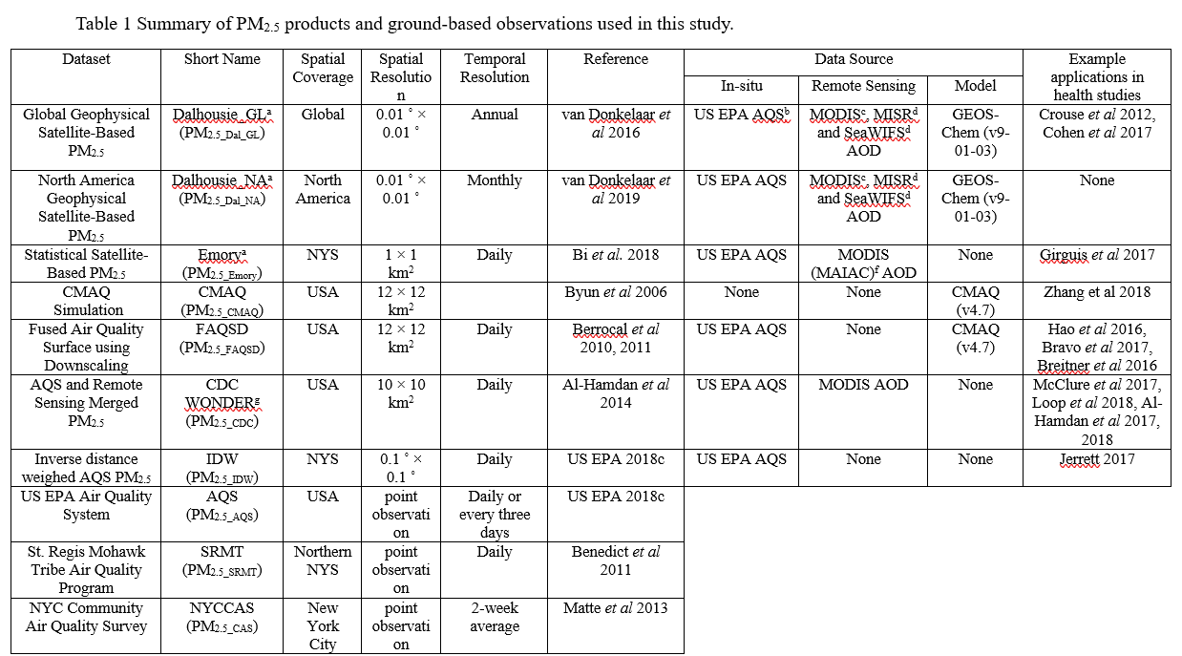
Jin et al. (ERL 2019)

Slide 11
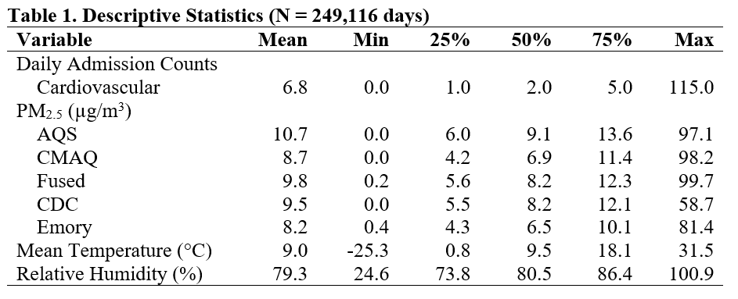

Slide 12

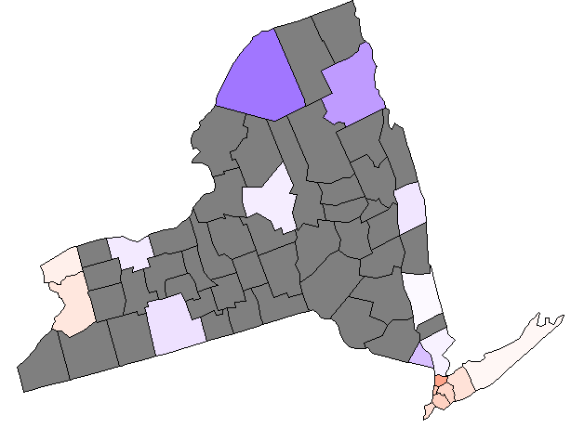
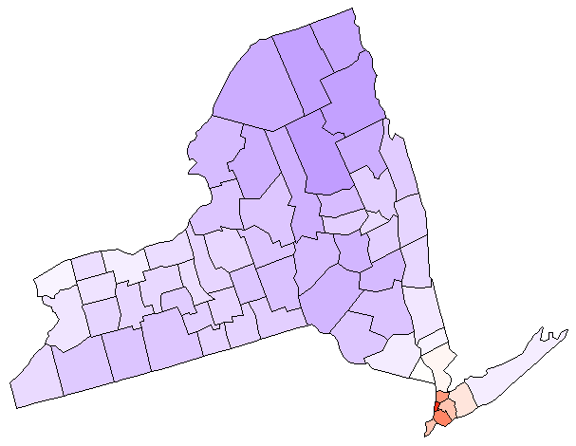
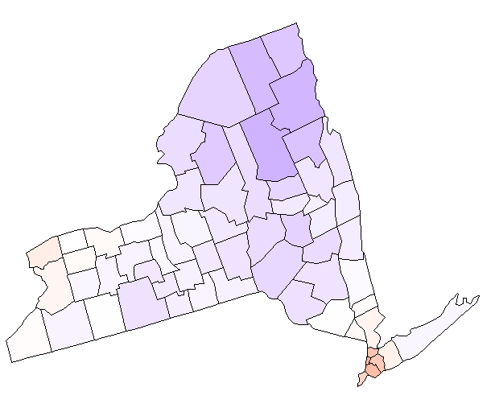
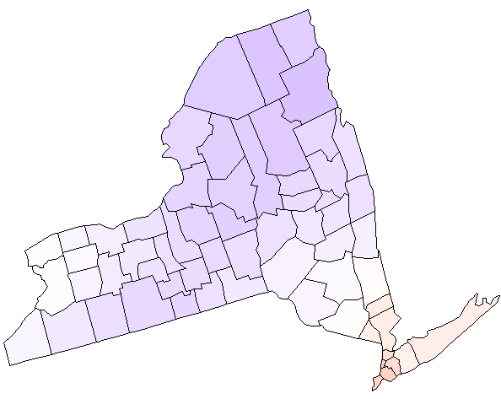
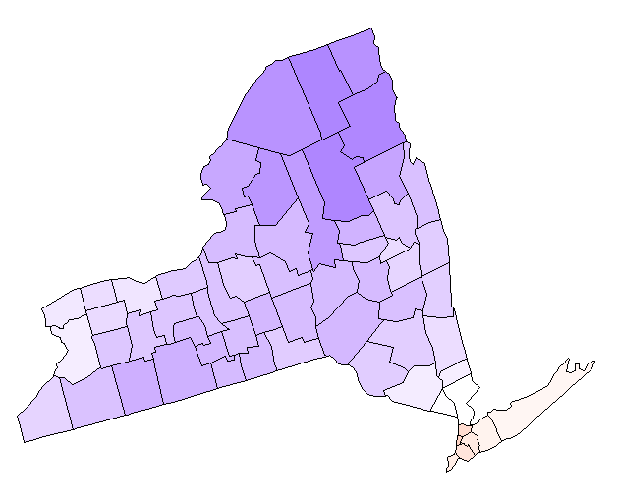
Results
AQS
CMAQ
Fused
CDC
Emory
 | AQS | CMAQ | Fused | CDC | Emory
AQS | 1.00
CMAQ | 0.52 | 1.00
Fused | 0.89 | 0.61 | 1.00
CDC | 0.83 | 0.49 | 0.86 | 1.00
Emory | 0.90 | 0.52 | 0.92 | 0.85 | 1.00

Slide 13
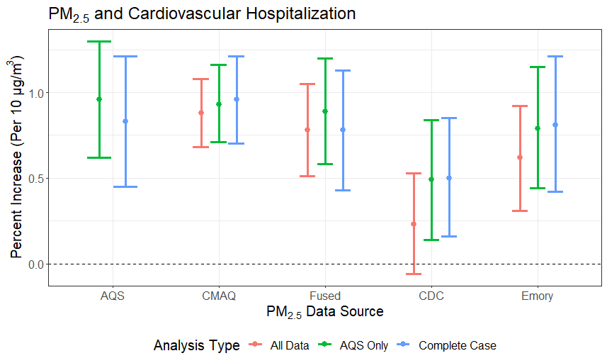

Slide 14
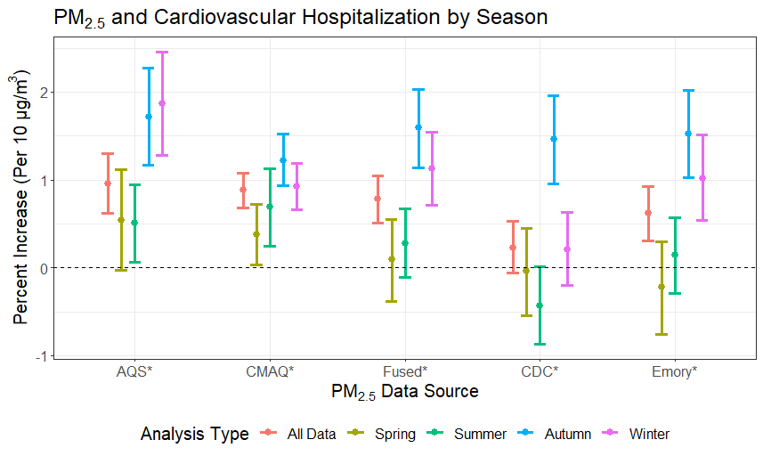
Notes:
Generally, higher in Fall/Winter, lower effect estimates in spring/summer
This could be attributable to higher contribution from more localized particles, such as traffic; since the mixing height in the winter is generally lower (same mass over smaller volume = more concentrated)
Traffic has been consistently identified as a particularly toxic source of PM, full of combustion products and metals
However, models do look somewhat different, which indicates that the performance of each prediction model likely varies by season, inducing exposure measurement error that varies by season
(However, some studies have also found higher effect estimates in the summer)
Local particles that have higher concentrations in the winter; we recognize that other studies have found different results, the fact that we see the same results across all the models here that they’re still consistent across exposure models in our model
PM2.5 in NYC

Slide 15
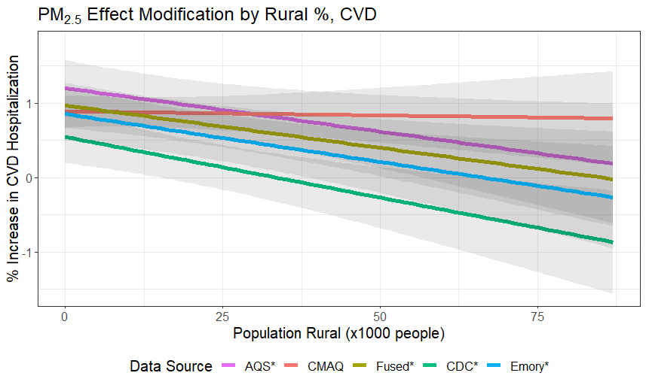
Notes:
Population rural
* 1000 people who are living in the rural areas of each county
Models predict better at urban areas, less measurement errors
Could be due to biological reason (more stressful lifestyle in urban areas)
Wouldn’t necessarily interpret these at higher levels, just look at overall trend (there are still very few counties with such high rural population)

Slide 16
Conclusions
Significant, positive associations between PM_{2.5} and cardiovascular admissions for all (but one) model
Some fluctuation in effect estimates depending on analysis type
  Differences could be due to measurement error
  However, conclusion remains the same!
Effect modification:
  Spatial: higher estimates in more urban areas
  Temporal: generally higher estimates in fall/winter, but some differences across models
Notes:
CMAQ not developed for epi studies, but people have used it regardless of actual purposes (check emission scenarios impacts and help with state implementation plans, etc)
That’s why we included it

Slide 17
Acknowledgments
Collaborators:
MARIANTHI-ANNA KIOUMOURTZOGLOU¹
PATRICK KINNEY²
ARLENE FIORE¹
XIAOMENG JIN¹
VIVIAN DO¹
SILIANG LIU¹
TABASSUM INSAF³
ADRIAN MICHALSKI³
¹Columbia University
²Boston University
³NYS Dept. of Health
Funding:
NIEHS Individual Fellowship F31 ES029372
NIH Institutional Research T32 ES023770
NIEHS Center Core P30 ES009089
NASA HAQAST Grant (#NNX16AQ20G)
NASA HAQAST5 Travel Award
NYSERDA Grant (#91268)

Slide 18

Thank You!

