Slide 1
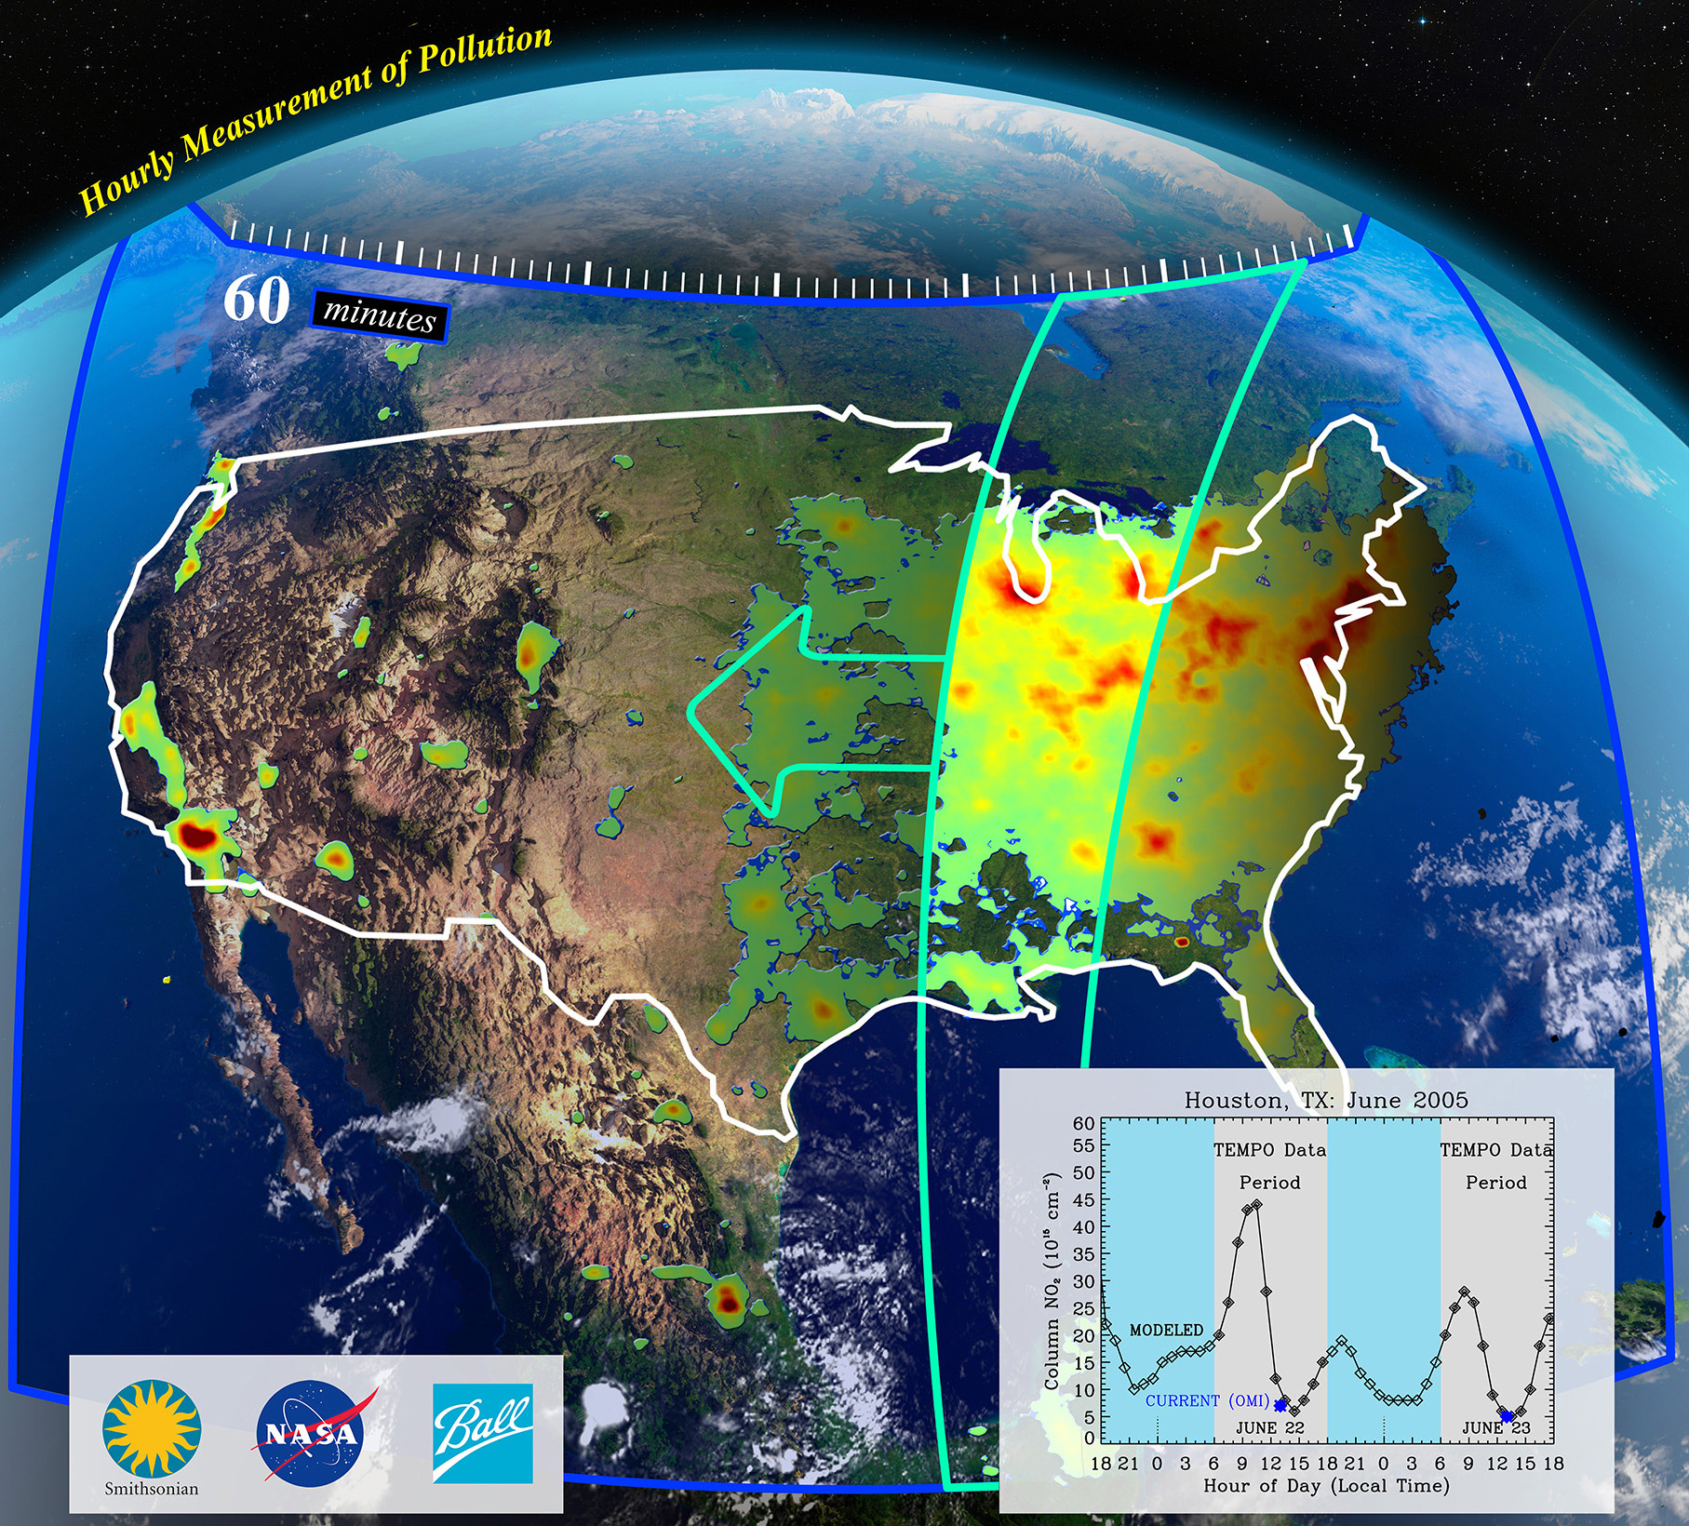
Tropospheric Emissions: Monitoring of Pollution
TEMPO Data Products for Health Studies
Susan Alexander^{1,} Aaron Naeger²
Michael Newchurch³, Chris Chan Miller⁴, NASA SPoRT Team, TEMPO Team
¹University of Alabama in Huntsville / College of Nursing ²University of Alabama in Huntsville / NASA SPoRT
³Department of Atmospheric and Earth Science
⁴Harvard-Smithsonian Center for Astrophysics
October 10, 2019
TEMPO Health Applications Conference
Huntsville, AL

Slide 2
Response to Comments from 2016 TEMPO EA Meeting
Early engagement with the TEMPO mission has been achieved through 2 EA meetings
1st TEMPO Applications Workshop in July 2016 at UAH
Health was identified as one of 4 core applications areas for TEMPO
Optimal Spatial Resolution for matching with health data (county, zip code)
Surface-level concentrations (O3 and trace gas retrievals)
Acute v Chronic studies
https://weather.msfc.nasa.gov/tempo/
Notes:
1.
2. Nose-level
3. Yang Liu—short-term, acute ‘hours to minutes to months’
O3 –respiratory disorders-causal--need nose level O3 which TEMPO may be able to provide
NO2—near roadways
SO2 –linked to asthma related IP admissions and ED visits even at short durations (<1 day)

Slide 3
Response to Comments from 2018 TEMPO EA Meeting
2nd TEMPO EA Workshop in April 2018 at Fort Collins
Need for preparing health end users to integrate TEMPO data
TEMPO data products are expected to improve quality of research on public health impact of pollutants
Public health workshop on TEMPO data was strongly encouraged
Consider designating health as a separate application area
https://weather.msfc.nasa.gov/tempo/
Notes:
GCP—more later
2. Address confounders
Temporal resolution:
Hourly NO₂ and aerosol
0–2 km O₃ every 2 hours (possibly at 1 hour at target locations)
SO₂ sampled every 3 hours
Spatial resolution: required at 8.4 x 4.7 km² (possibly at 2.1 x 4.7 km² at target locations)
Reduce measurement error
Designing a model that can manage the imbalance between volume and source of health and AQ data may be difficult. Failure to consider these potential sources of error can lead to inaccuracy in surface exposure estimates and health effects (Sheppard, 2012).
3. Here we are…
4. Total agreement due to many possibilities particularly if can be combined with MAIA
Well established for PM_{2.5} (not sure if in the upcoming ISA)
A lot of methods proposed to convert AOD to PM_{2.5} and fill data gaps
Have been used to drive both acute and chronic effects studies in the US and worldwide
Spatial resolution: as high as 1 km
Applications of other species are lacking due to
Poor spatial resolution (e.g., SO₂ and NO₂)
Poor sensitivity in boundary layer (e.g., O₃)
Low correlation with ground observations
Study duration
Means sample size in acute studies
Makes more accurate exposure estimates in chronic studies
Temporal resolution
Acute study NEEDS accurate short-term fluctuation of exposure
Chronic study cares less about temporal resolution
Spatial resolution
Acute study can get more accurate effect estimates with high resolution exposure data
Chronic study NEEDS accurate spatial gradient of exposure
Accuracy and spatial coverage
Important to both study types

Slide 4
Seasonal Variations
Inpatient Admissions by Month—State of Alabama
(Patient-level aggregated by month and county)
Inpatient Admissions by Month in a single county—State of Alabama
(Patient-level aggregated by month and county)
https://weather.msfc.nasa.gov/tempo/
Notes:
The second example comes from Memorial Hospital at Gulfport. The hospital was faced with declining revenue due to changes in Medicare and Medicaid reimbursements. Hospital leaders knew additional methods of providing more efficient and cost-effective quality care were needed to maintain long-term success. Improving and reducing length of stay (LOS) improves financial, operational, and clinical outcomes by decreasing the costs of care for a patient. It can also improve outcomes by minimizing the risk of hospital-acquired conditions.
Hospital leaders embraced the challenge of reducing LOS to lower costs and lessen risk for its patients. By adopting a systematic, data-driven, and multi-pronged approach, Memorial has achieved significant results in one year, including:
$2 million in cost savings, the result of decreased LOS and decreased utilization of supplies and medications.
47-day percentage point reduction in LOS.
Improved care coordination and physician engagement have successfully reduced LOS.
The 30-day readmission rate has remained stable.
Three percent increase in the number of discharges occurring on the weekend.
Overall, an organization’s goal is to improve care delivery and improve patient outcomes. As complex systems underpin the clinical care change, it is important to ensure an organization’s performance is improving toward its goal. Performance is generally tracked on a monthly, or at minimum, a quarterly basis. A graphic depiction of performance over time assists an organization to know that its efforts are resulting in improved performance. Examples of data displays used by other organizations can be found in the

Slide 5
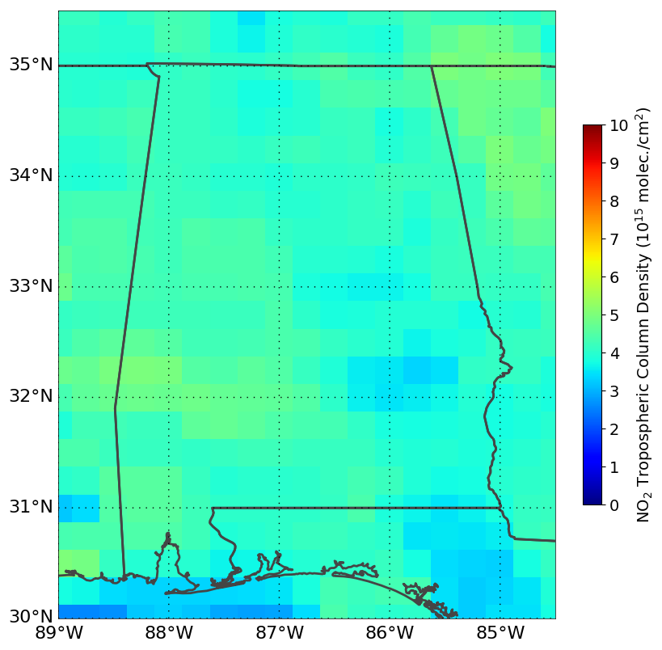
NO₂ OMI Satellite Retrievals
OMI satellite NO2 retrievals at ~0.25° resolution and 1900 UTC
Source: Naeger, A. (NASA SPoRT). OMI satellite retrievals NO2 across Alabama August 2013.
https://weather.msfc.nasa.gov/tempo/
Notes:
GCP—more later
2. Address confounders
Reduce measurement error
Designing a model that can manage the imbalance between volume and source of health and AQ data may be difficult. Failure to consider these potential sources of error can lead to inaccuracy in surface exposure estimates and health effects (Sheppard, 2012).
3. Here we are…
4. Total agreement due to many possibilities particularly if can be combined with MAIA

Slide 6
Tailored TEMPO data products
Formatted ASCII files of TEMPO L2 trace gas concentrations spatially interpolated to county level
Development of tailored/specialized TEMPO data products!
https://weather.msfc.nasa.gov/tempo/

Slide 7
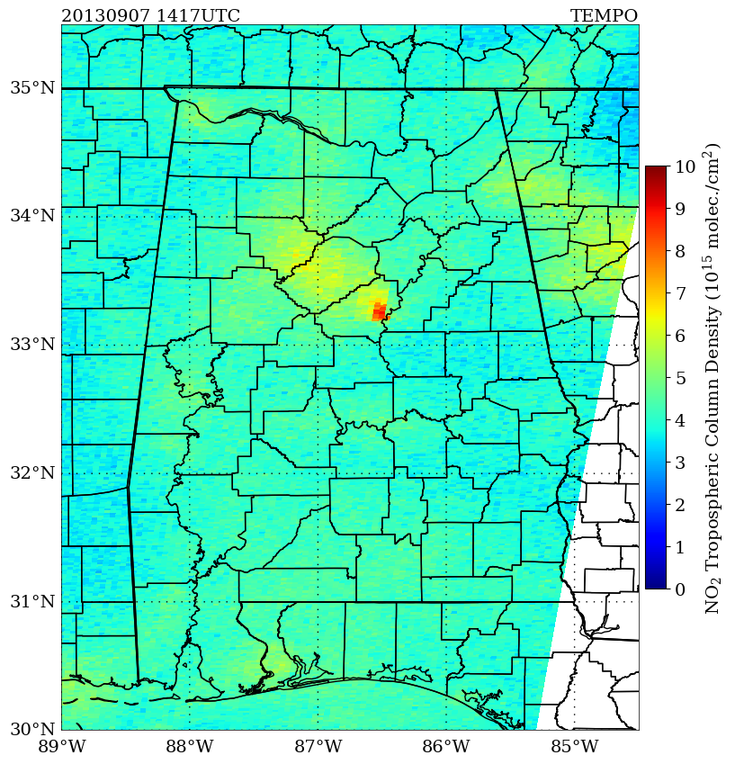
NO₂ (Synthetic)TEMPO Retrievals
Zoom of AL – interpolated by county.
Mobile source emissions over Birmingham area?
Source: Naeger, A. (NASA SPoRT). OMI satellite retrievals NO2 across Alabama August 2013.
https://weather.msfc.nasa.gov/tempo/
Notes:
GCP—more later
2. Address confounders
Reduce measurement error
Designing a model that can manage the imbalance between volume and source of health and AQ data may be difficult. Failure to consider these potential sources of error can lead to inaccuracy in surface exposure estimates and health effects (Sheppard, 2012).
3. Here we are…
4. Total agreement due to many possibilities particularly if can be combined with MAIA

Slide 8
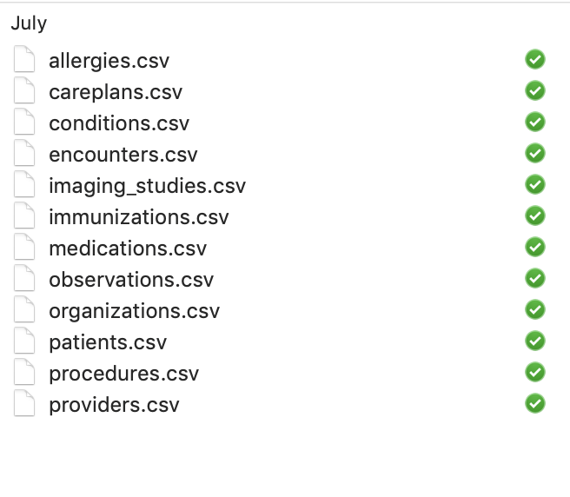
Matching TEMPO to Health Data
Synthetic patient-level health data: Examples of Datasets from Clinical Electronic Health Record (Synthea)
https://weather.msfc.nasa.gov/tempo/
Notes:
GCP—more later
2. Address confounders
Reduce measurement error
Designing a model that can manage the imbalance between volume and source of health and AQ data may be difficult. Failure to consider these potential sources of error can lead to inaccuracy in surface exposure estimates and health effects (Sheppard, 2012).
3. Here we are…
4. Total agreement due to many possibilities particularly if can be combined with MAIA

Slide 9
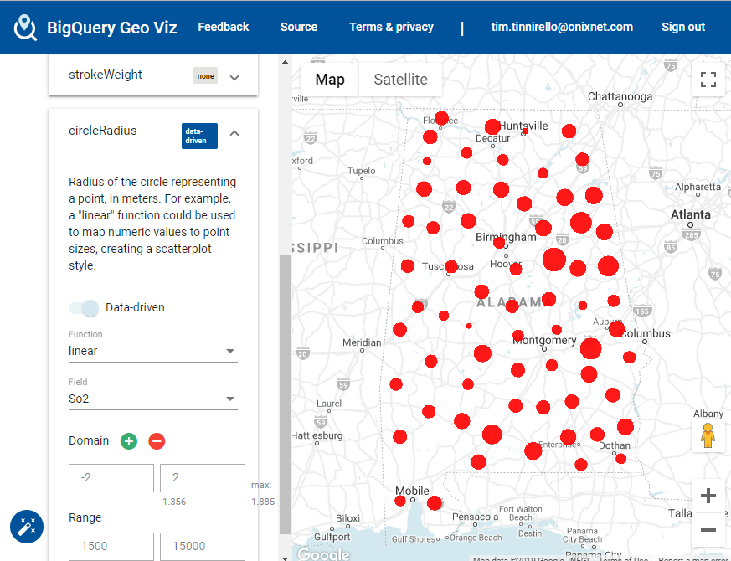
Synthetic TEMPO-SO2
https://weather.msfc.nasa.gov/tempo/
Notes:
GCP—more later
2. Address confounders
Reduce measurement error
Designing a model that can manage the imbalance between volume and source of health and AQ data may be difficult. Failure to consider these potential sources of error can lead to inaccuracy in surface exposure estimates and health effects (Sheppard, 2012).
3. Here we are…
4. Total agreement due to many possibilities particularly if can be combined with MAIA

Slide 10
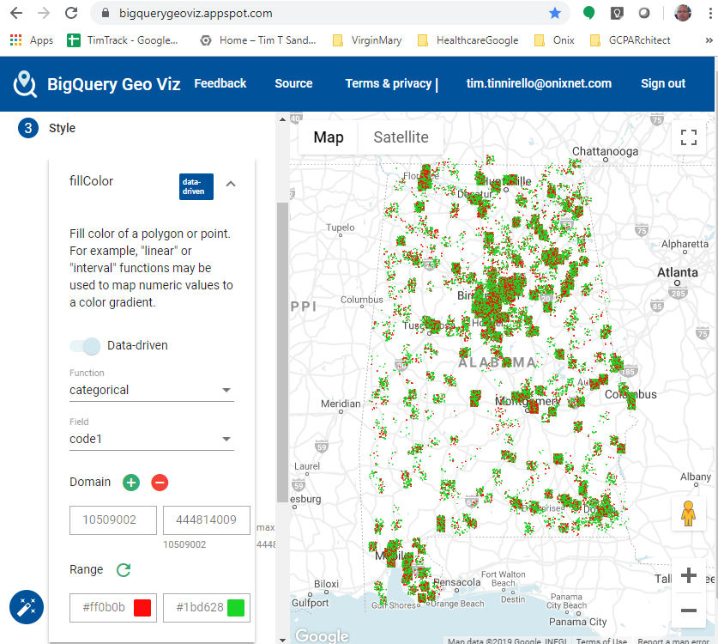
Simulated Health Data
Systematized Nomenclature of Medicine Code.
(SNOMED)
444814009 = Viral Sinusitis
10509002 = Acute Bronchitis
https://weather.msfc.nasa.gov/tempo/
Notes:
GCP—more later
2. Address confounders
Reduce measurement error
Designing a model that can manage the imbalance between volume and source of health and AQ data may be difficult. Failure to consider these potential sources of error can lead to inaccuracy in surface exposure estimates and health effects (Sheppard, 2012).
3. Here we are…
4. Total agreement due to many possibilities particularly if can be combined with MAIA

Slide 11
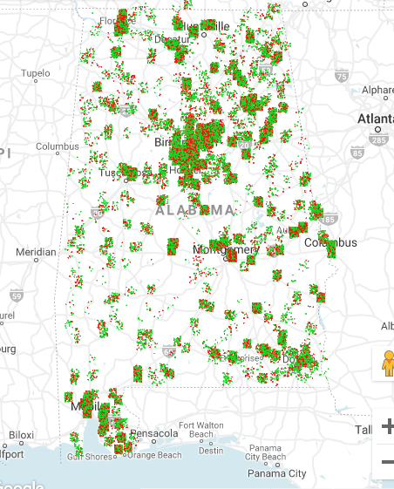
Combining Synthetic Health and TEMPO Data
https://weather.msfc.nasa.gov/tempo/
Notes:
GCP—more later
2. Address confounders
Reduce measurement error
Designing a model that can manage the imbalance between volume and source of health and AQ data may be difficult. Failure to consider these potential sources of error can lead to inaccuracy in surface exposure estimates and health effects (Sheppard, 2012).
3. Here we are…
4. Total agreement due to many possibilities particularly if can be combined with MAIA

Slide 12
Thanks!
Questions/Comments
Susan Alexander, UAH
Susan.alexander@uah.edu
https://weather.msfc.nasa.gov/tempo/

