Slide 1
A Discussion on TEMPO Draft
CH₂O Validation Plan
Jim Szykman, Jay Herman,
& all interested in CH₂O
May 27-28, 2015
3rd TEMPO Science Team Meeting
UAH-NSSTC
Huntsville, AL

Slide 2
Proposed Approach for validation
(presented at 1st STM)
Validation conducted from commissioning till end of Phase E (end of operations)
Mission duration, subject to instrument availability
  Baseline 20 months
  Threshold 12 months
Level | Product Definition |  | Approach
0 | Raw instr. Sci. and HK data |  | Quality flags for duplicates, missing files, checksums
1b | Level 1 geo-located, calibrated spectral radiances |  | Comparisons with measured and modeled radiances based on coincident column measurements
2 | Retrieved gas columns and profiles, aerosol, clouds, UVB |  | Comparisons with ground-based, balloon-borne, sub-orbital, and satellite remote-sensed products
2 NRT | Retrieved gas, aerosols, clouds, UVB |  | Comparison with L2 normal delivery products
3† | Gridded monthly means of L2 data |  | Comp. with correlative measurements and climatologies

Slide 3
PLRA 4.1.1 and 4.1.2
Baseline and threshold data products
Species/Products | Required Precision | Temporal Revisit
0-2 km O₃ (Selected Scenes) Baseline only | 10 ppbv | 2 hour
Tropospheric O₃ | 10 ppbv | 1 hour
Total O₃ | 3% | 1 hour
Tropospheric NO₂ | 1.0 × 10¹⁵ molecules cm⁻² | 1 hour
Tropospheric H₂CO | 1.0 × 10¹⁶ molecules cm⁻² | 3 hour
Tropospheric SO₂ | 1.0 × 10¹⁶ molecules cm⁻² | 3 hour
Tropospheric C₂H₂O₂ | 4.0 × 10¹⁴ molecules cm⁻² | 3 hour
Aerosol Optical Depth | 0.10 | 1 hour
PLRA Table 1
Across Greater North America (GNA): 19°N to 57.5°N near 100°W, 67°W to 125°W near 42°N
Data products at urban-regional spatial scales
  Baseline ≤ 60 km² at center of Field Of Regard (FOR)
  Threshold ≤ 300 km² at center of FOR
Temporal scales to resolve diurnal changes in pollutant distributions
Collected in cloud-free scenes
Geolocation uncertainty of less than 4 km

Slide 4
Validation Challenges
Validation challenges for TEMPO CH₂O column measurements:
Adequacy (or lack) of correlative measurements - vertical distribution (especially within the BL)
Impact a priori vertical diurnal profiles
Aerosols and clouds
Albedo changes and spatial gradients
Sources of independent sources of CH₂O measurements:
Satellite data sets from independent sensors: TropOMI
Aircraft observations; GCAS, GeoTASO, Aircarft in-situ profiles
Ground-based measurements; Pandora
For CH₂O a-priori vertical profile shapes have the largest systematic impact on the satellite column errors due to the strong decrease of the satellite UV measurement sensitivity near the surface.

Slide 5
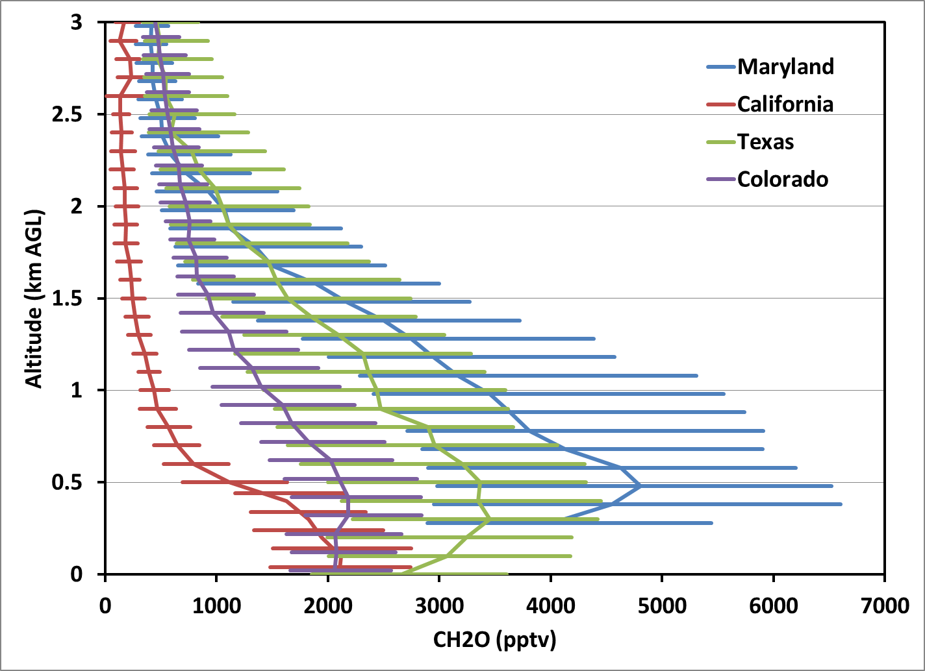
DISCOVER-AQ
P-3 Median CH₂O Profiles
5

Slide 6
Daily CH₂O P-3 Spirals (Profiles)
DISCOVER-AQ Baltimore, MD July 2011

