Slide 1
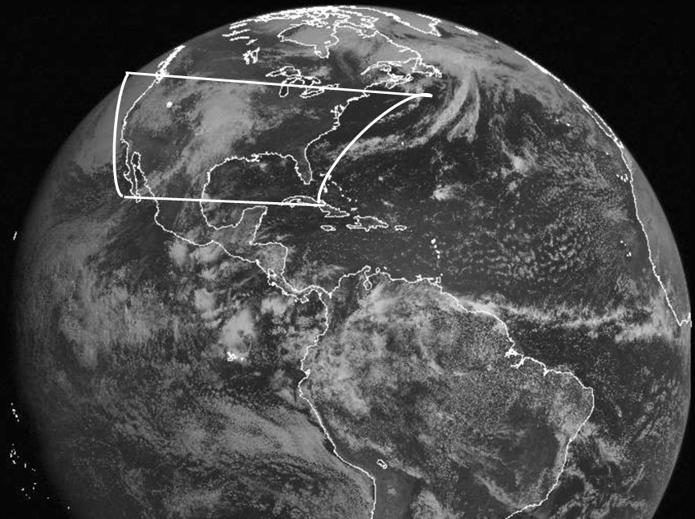
Validation of TEMPO using Pandora Data Products
O₃, SO₂, HCHO, BrO, NO₂, H₂O Total Column & Profiles
Jay Herman, Elena Spinei, Nader Abuhassan, Alexander Cede

Slide 2
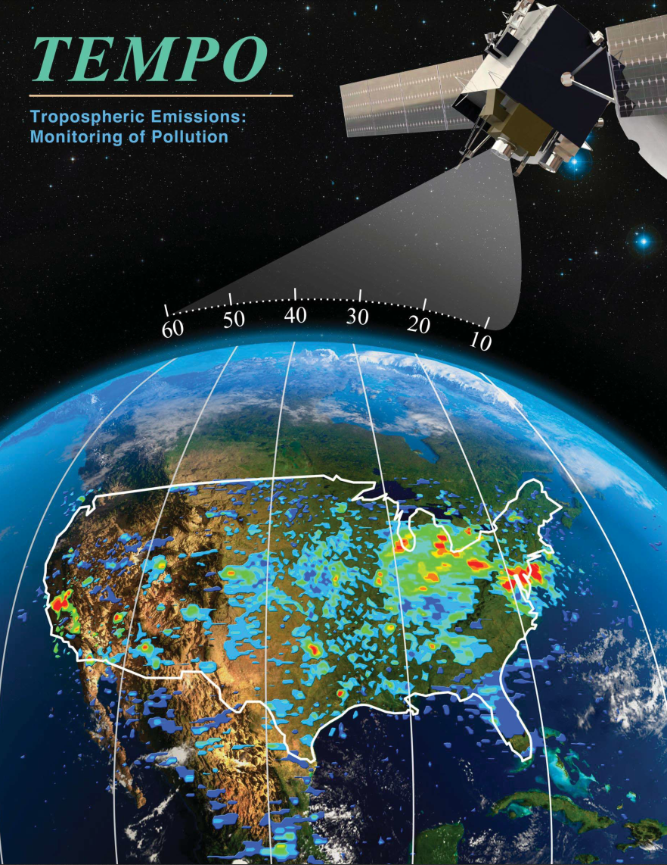
TEMPO Proposal Cover
Geostationary Satellite
Focused on the US
Coastal waters
Part of Canada
Part of Mexico
Goal
Hourly Change in Atmospheric
Composition, Clouds, Aerosols,
Surface Properties, and Coastal
Oceans

Slide 3
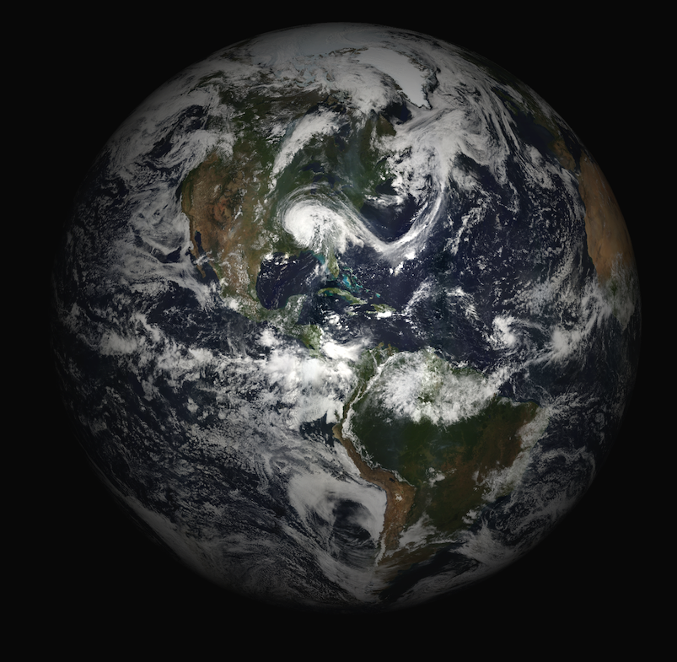
Earth and Clouds
TEMPO
Multiple images per day
O3, NO2, SO2, HCHO, H2O
Clouds and Aerosols
Resolution 5 x 8 km²
290 – 690 mn Res 0.6 nm
3x Oversampled

Slide 4
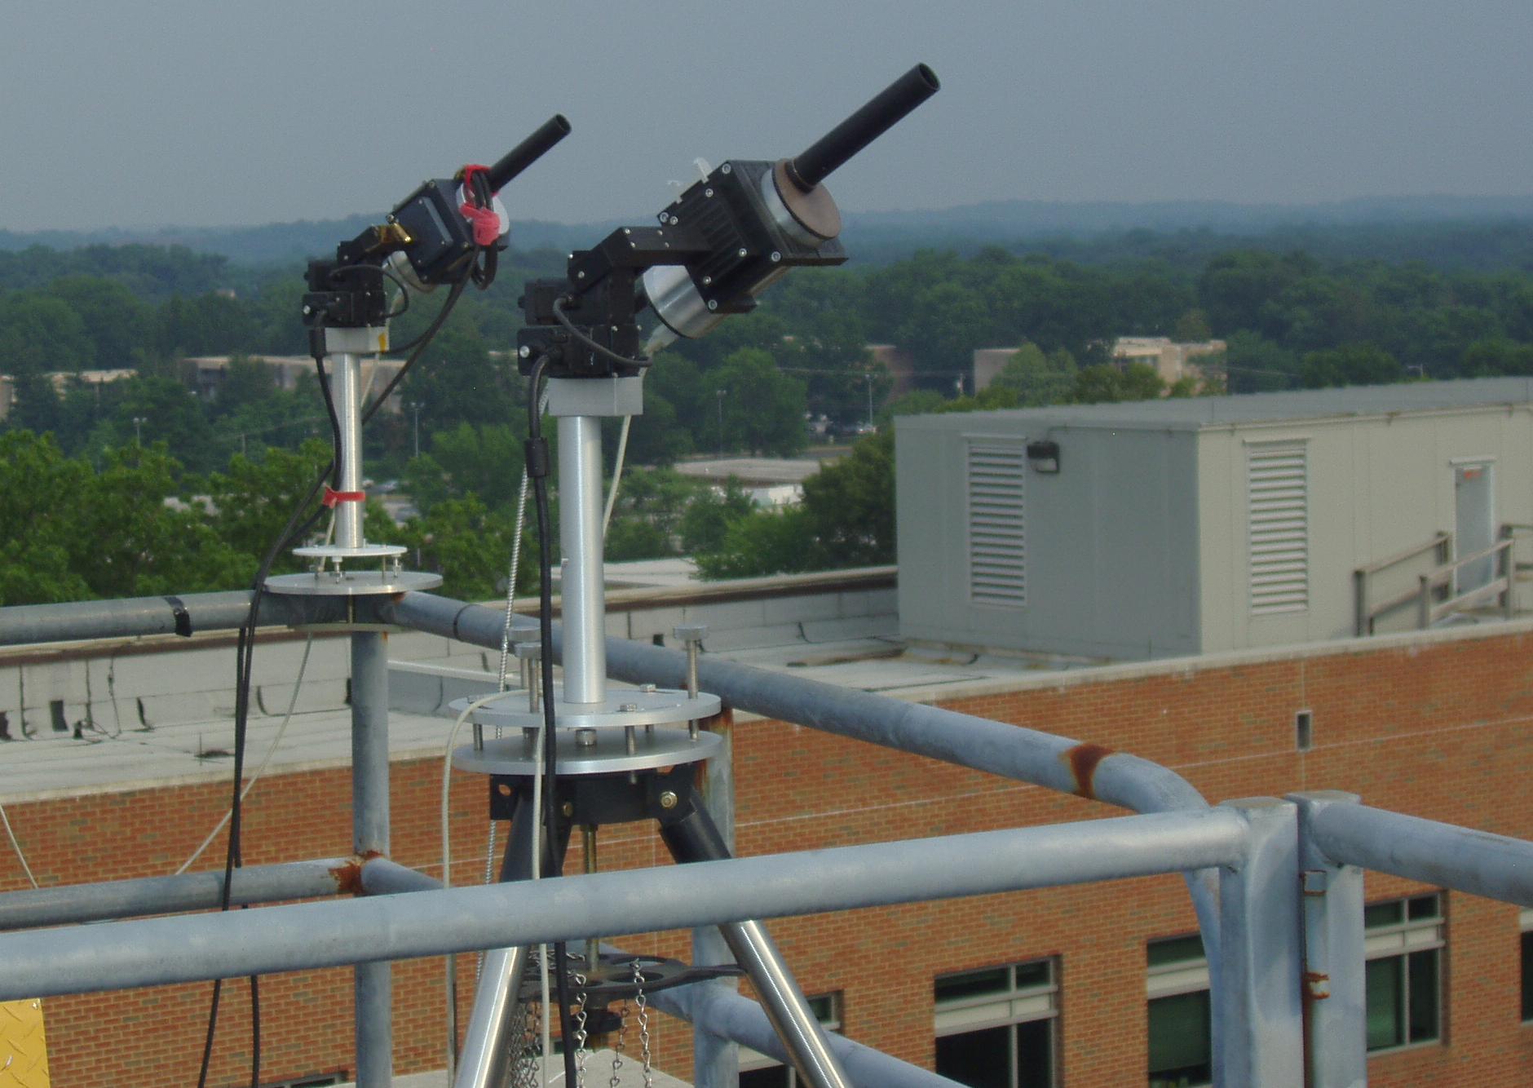
Ground Validation:
Two Pandoras in Direct Sun & Sky-Scan Modes
Total Column every 80 seconds
Profiles every 20 minutes
O₃
SO₂
HCHO
BrO
NO₂
H₂O
Pandora For TEMPO
2015 New Optics
New Sun Tracker
2016 New Electronics
2016 Extended Range
2016 0.08 nm resolution
2016 Echelle Grating Spectrometer for HCHO and BrO

Slide 5
2
2
10
6
2
New Pandoras: Wallops Island VA
CCNY (NYC). Chesapeake Bay
Saint Louis MO Richmond VA
Boulder CO. Huntsville AL
Wallops VA Table Mtn, CA
Locations of 29 operating Pandoras
1Colorado 2 Canada 1 Tenerife 1 New Mexico
10 GSFC 2 Boston 1 Houston 1 Taiwan
2 Langley 2 Finland 6 S. Korea

Slide 6
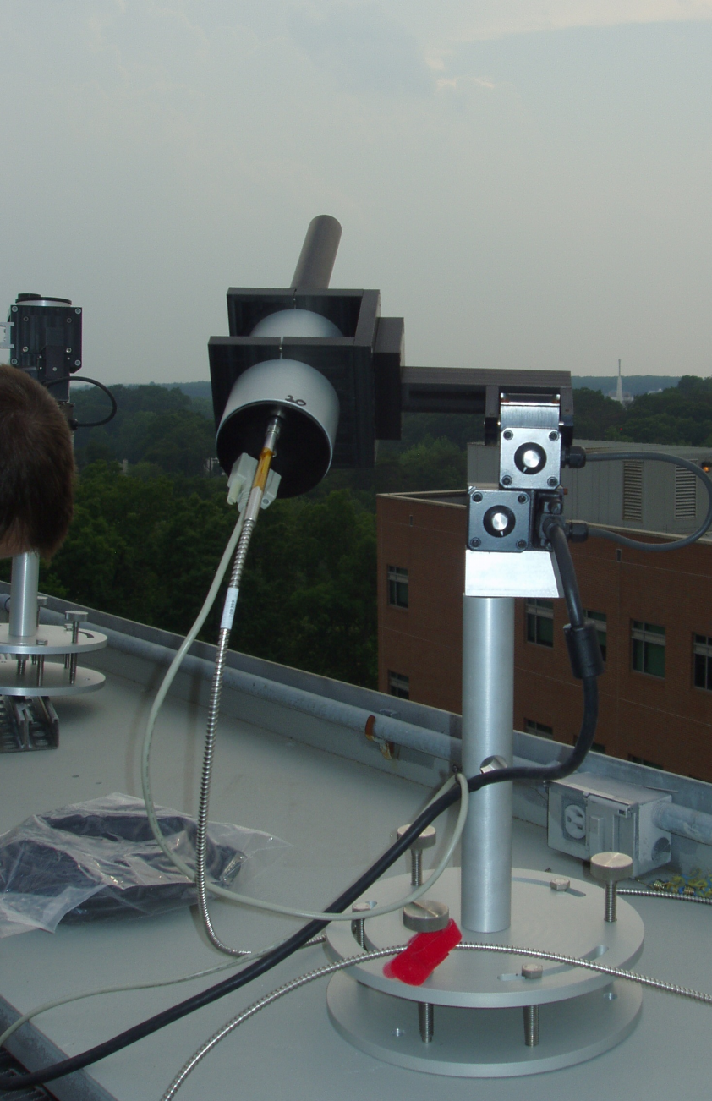
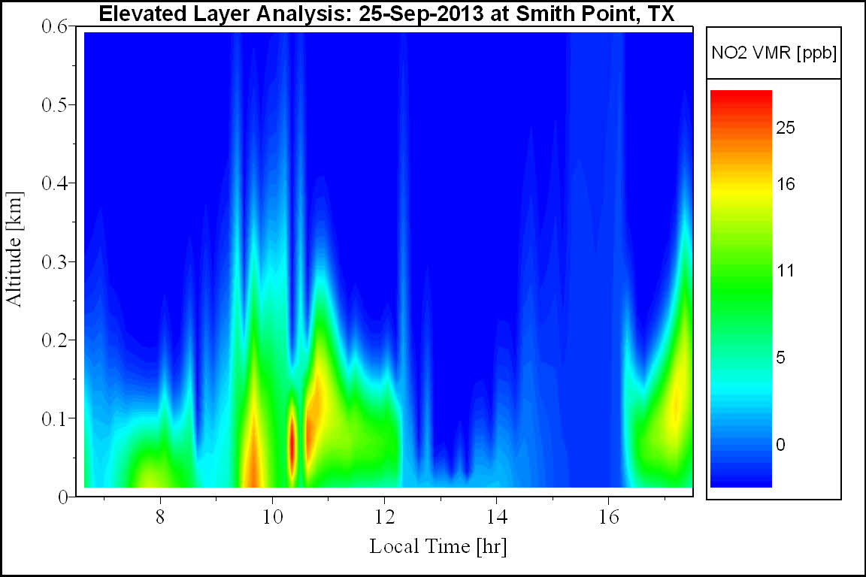
Pandoras in Sky-Scan Mode
NO₂
Polluted Wind
Blowing from the Land
Clean Air
Blowing from the Gulf of Mexico
Vertical resolution better than 25-50 meters for NO₂ profiles depending on aerosol conditions

Slide 7
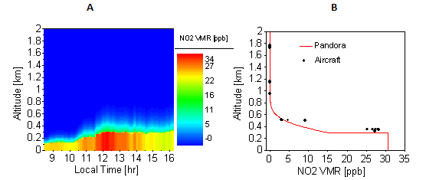
Profiles of NO₂ Compared with Aircraft Measurements Discover-AQ
Variation of Boundary Layer
NO₂ Profile
NO₂ profiles derived from Pandora direct-sun and MAXDOAS observations over Fresno, California on 18-Jan-2013
Comparison of Pandora retrieval to aircraft (P3B) measured NO₂ profile (Fresno California).

Slide 8
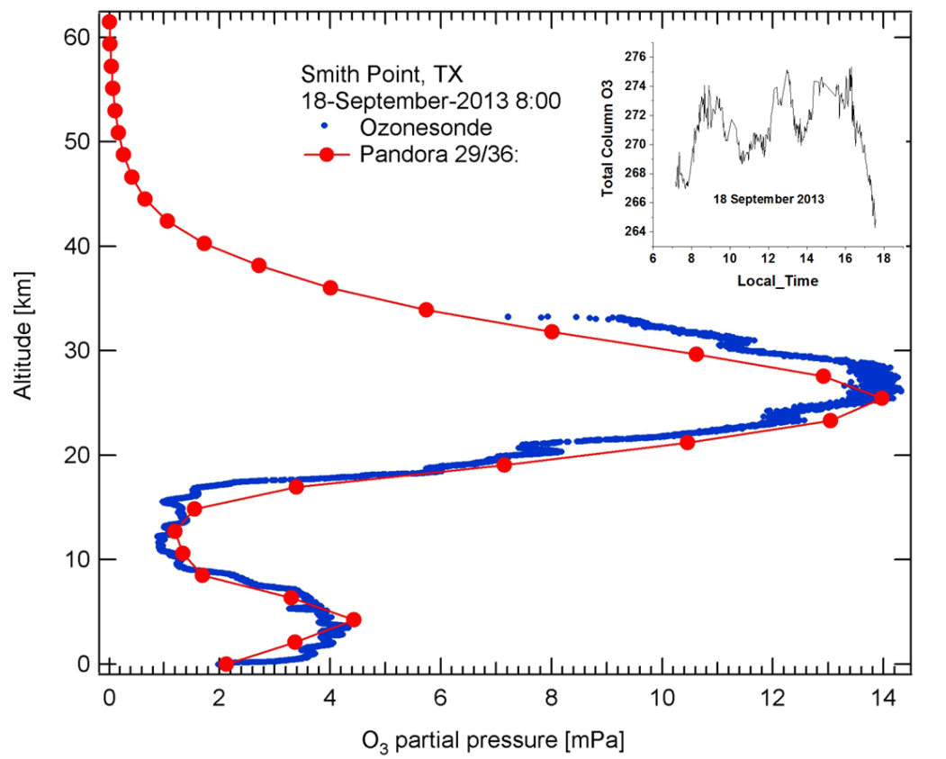
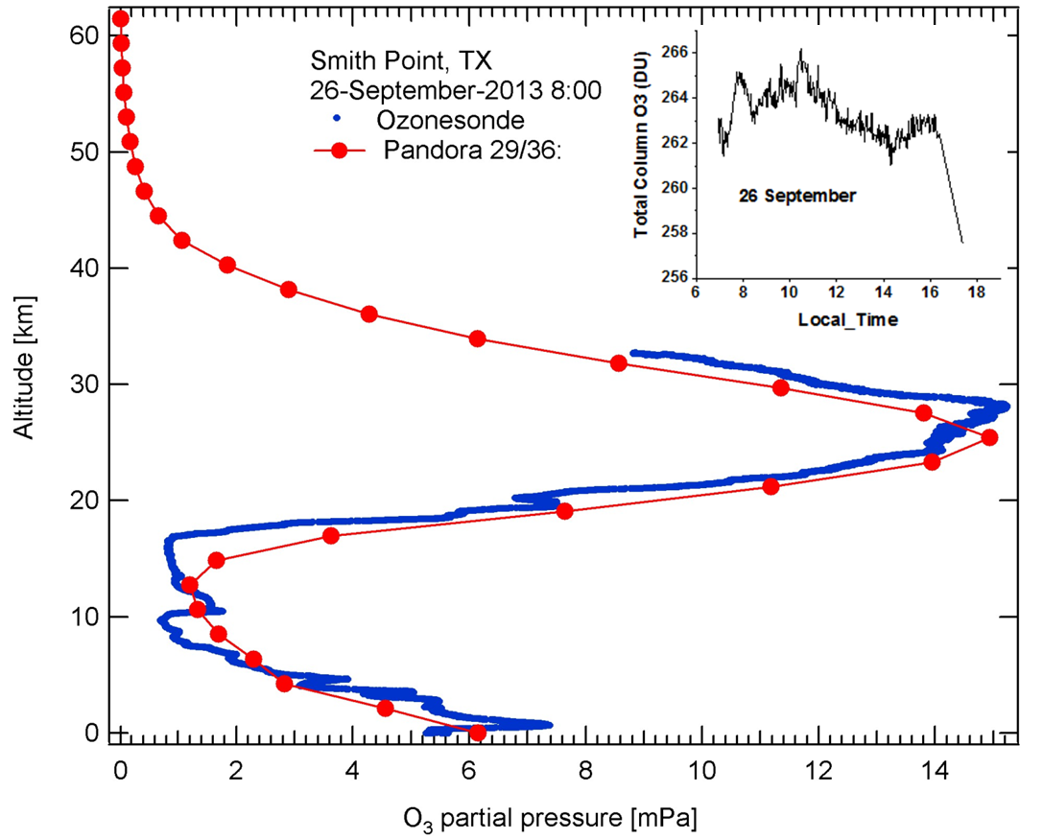
Pandora Measurements of Ozone Profiles Compared with O₃ Balloon Sondes
Smith Point, Texas on Sept 18 and 26, 2013
Pandora O₃ Profile
Notice the profile agreement in the Troposphere
Balloon Sonde O₃ Profile

Slide 9
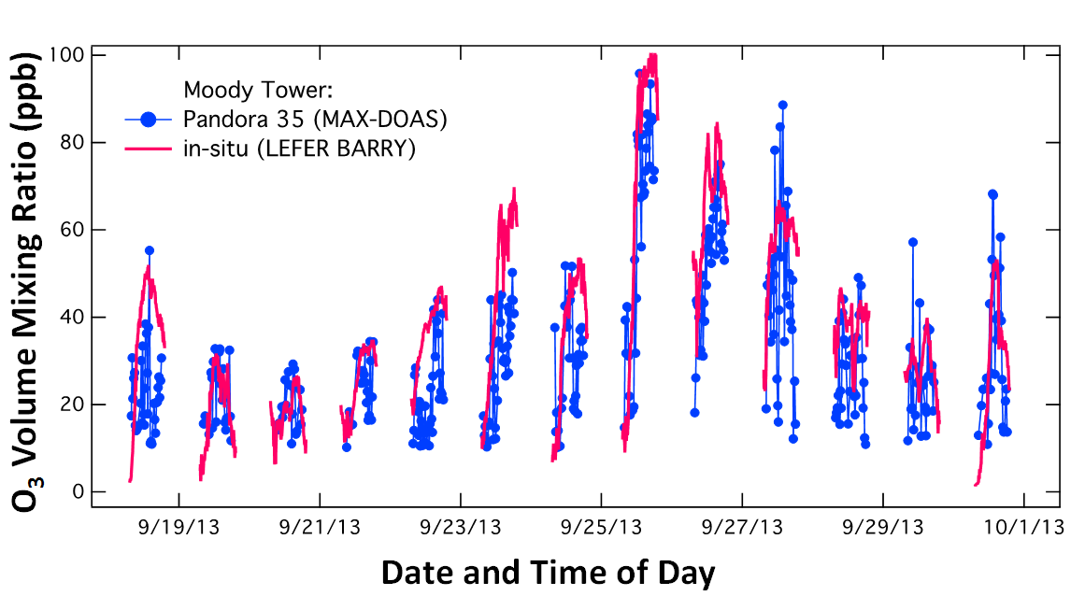
Pandora Near Surface O₃ Volume Mixing Ratios at Moody Tower

Slide 10
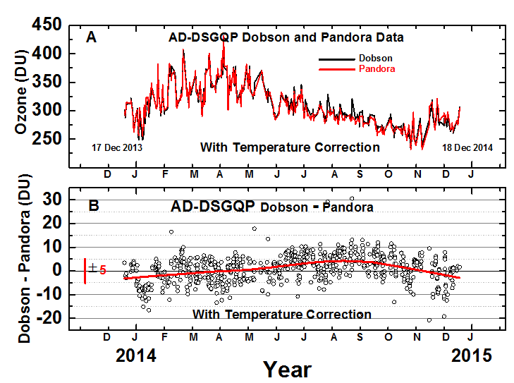
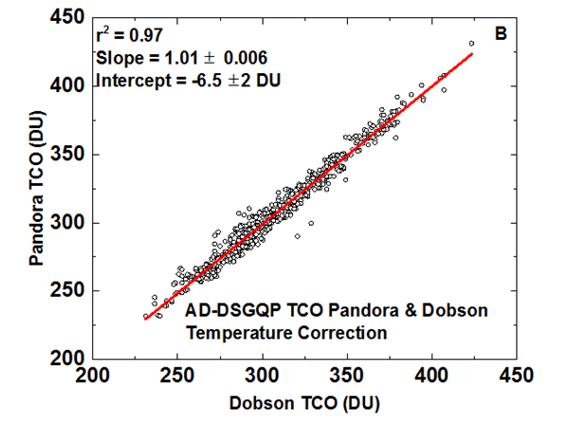
Pandora O₃ Compared with a Standard Dobson

Slide 11
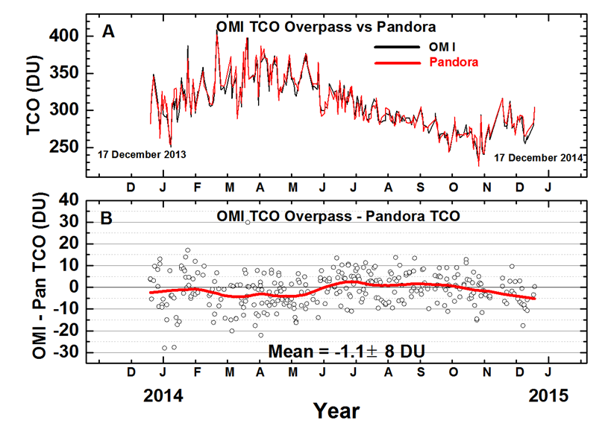
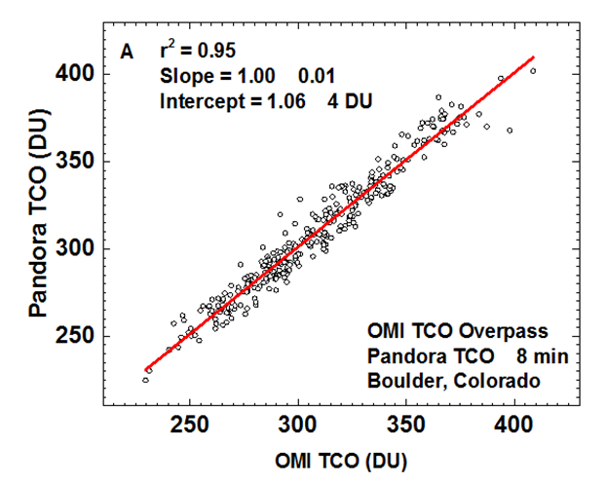
Pandora O₃ Compared with OMI

Slide 12
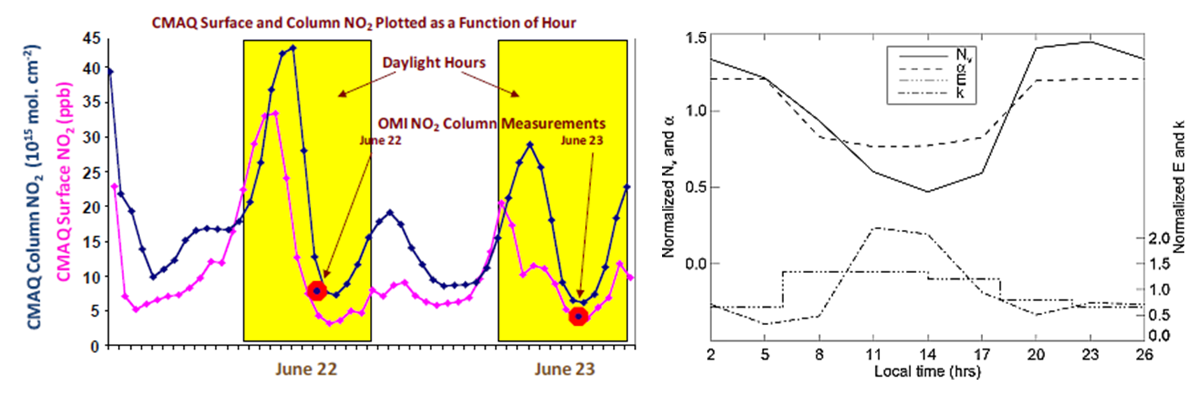
Why Should We Use Pandora for TEMPO Validation
Model Runs and Surface Measurements do not match Pandora Total Column Measurements (J. Crawford)
CMAQ Model Predictions Sources and Sinks
NO₂/NO_{X}
Loss
Emissions
MODEL RUNS: (left panel, from Fishman et al., 2008) Diurnal variability in column and surface NO2 from CMAQ simulations over Houston. (right panel, from Boersma et al., 2008) GEOS-Chem simulations of tropospheric NO2 column (N_{v}) over a typical region dominated by fossil fuel use. Also shown are the model diurnal partitioning of NO₂/NOx (α), emissions E, and chemical loss (k).

Slide 13
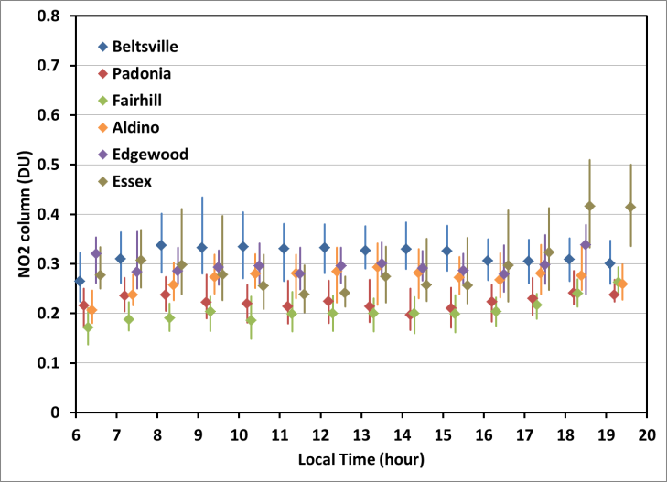
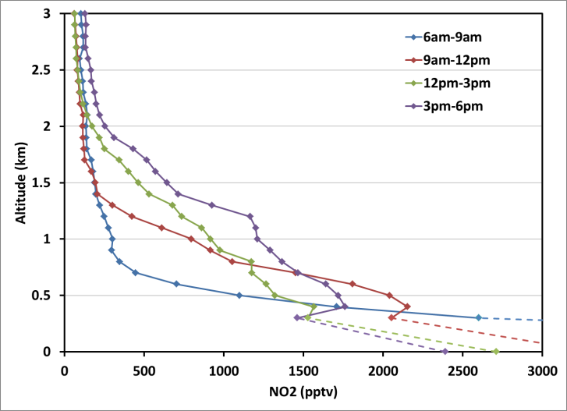
Why Should We Use Pandora for TEMPO Validation
Average NO₂ in situ profiles for
different times of day
Diurnal variability in Column NO₂
DISCOVER-AQ observations over the Baltimore-Washington area in July 2011 L. Diurnal variability in total column NO₂ observed by Pandora spectrometers.
R. Average NO₂ in situ profiles for different times of day.
Dashed lines connect measurements for the lowest flight altitude to average surface values.

Slide 14
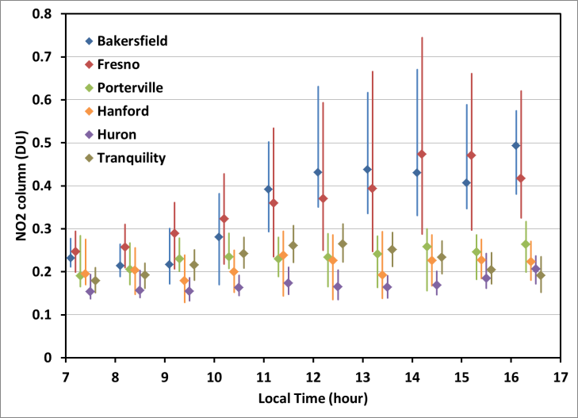
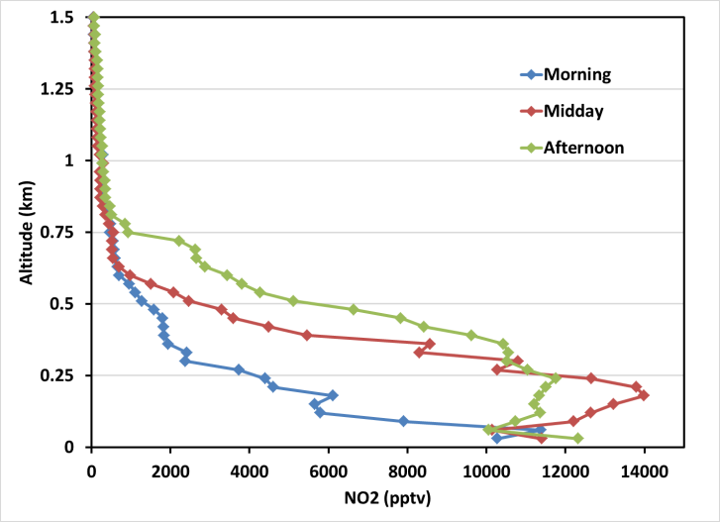
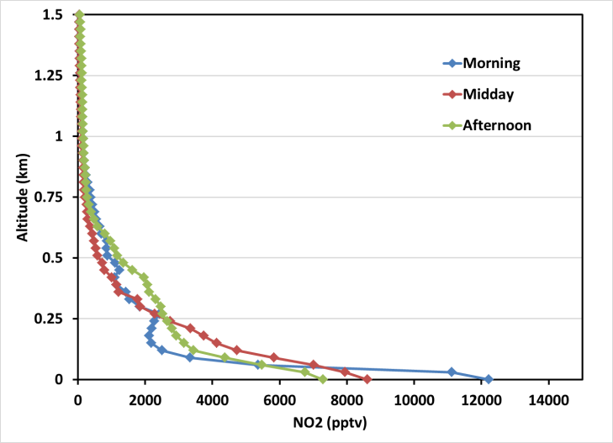
Why Should We Use Pandora for TEMPO Validation
Pandora
Diurnal variability in Column NO₂
Aircraft
Average NO₂ in situ profiles
Bakersfield and Fresno.
DISCOVER-AQ observations over California’s San Joaquin Valley in January-February 2011 (left) Diurnal variability in total column NO₂ observed by Pandora spectrometers. (right) Average NO₂ in situ profiles for different times of day over Bakersfield and Fresno. (bottom) Average NO₂ in situ profiles for different times of day over the other four remote sites.
Porterville
Hanford
Huron
Tranquility

Slide 15
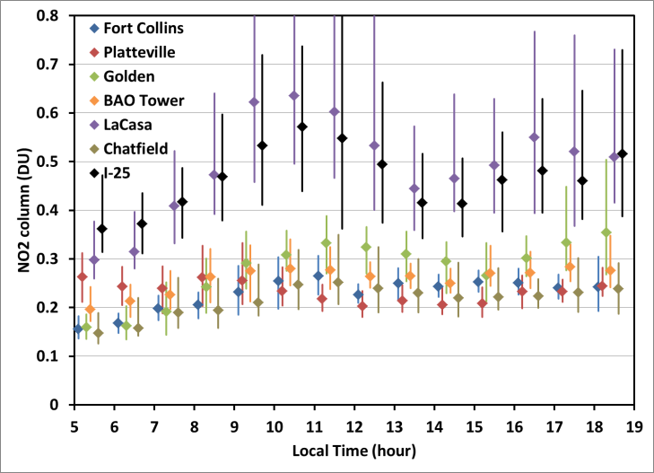
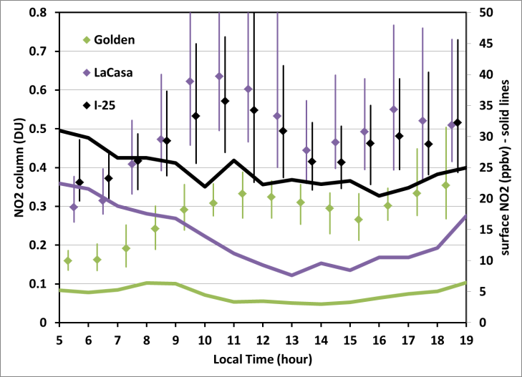
Why Should We Use Pandora for TEMPO Validation
Pandora
Diurnal variability in Column NO₂
Aircraft and Surface
Average NO₂ in situ profiles
La Casa
I-25
Pandora
Platteville, Golden, BAO, Chatfield
Surface
DISCOVER-AQ observations over Colorado in August-September 2014 (L) Diurnal variability in total column NO₂ observed by Pandora spectrometers.
(R) Comparison of diurnal variability in total column and surface NO₂ for the three sites with the highest NO₂ abundances.

Slide 16
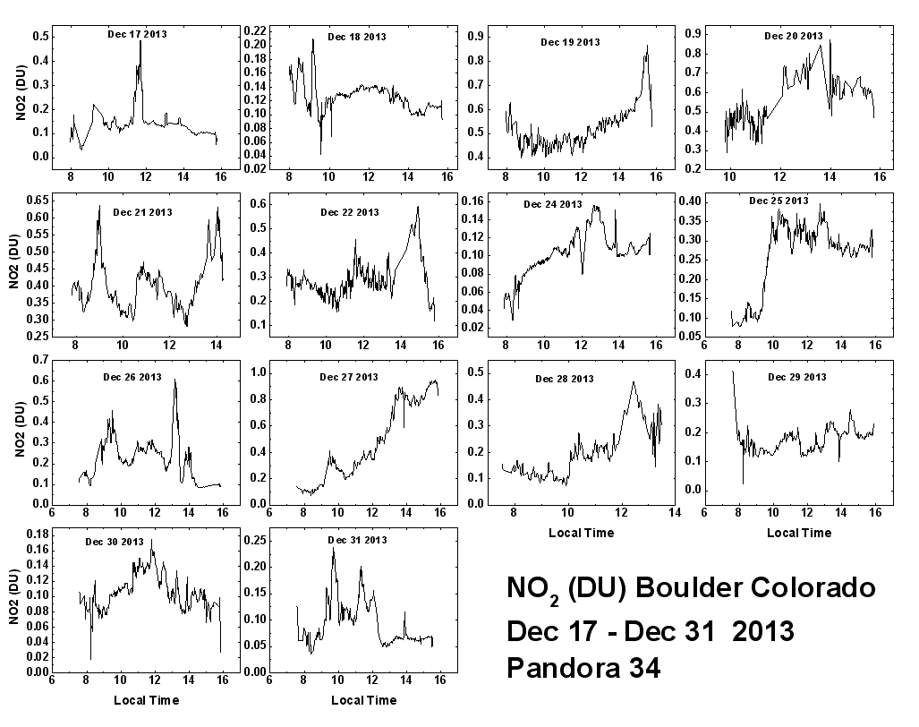
Examples of NO₂ Column Variation

Slide 17
Examples of O₃ Column Variation

Slide 18
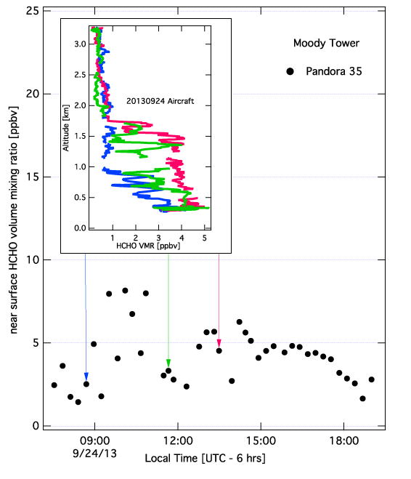
Formaldehyde Surface Values from Pandora
Comparison with Aircraft (D-AQ)
Moody Tower Houston Texas
Spectral Window: 325-360 nm
Technique: MAX-DOAS
08:50
3.5 ppbv
11:50
4
13:30
4.8 ppbv
Aircraft Surface HCHO
Pandora Surface HCHO

Slide 19
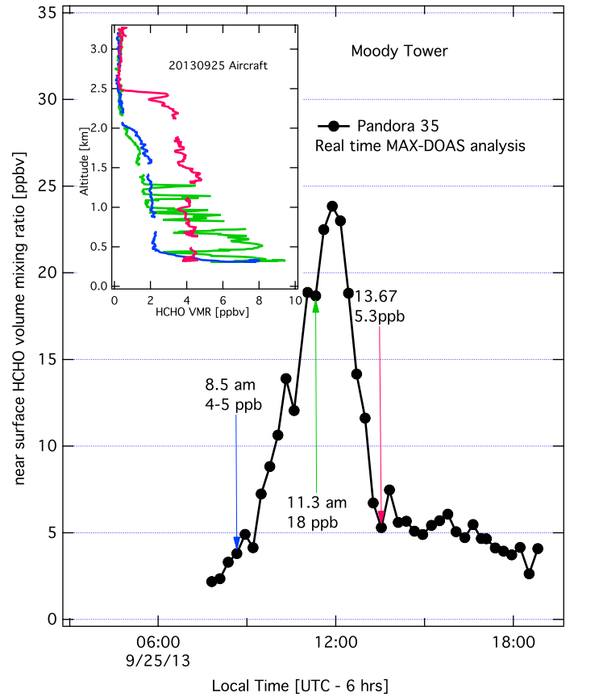
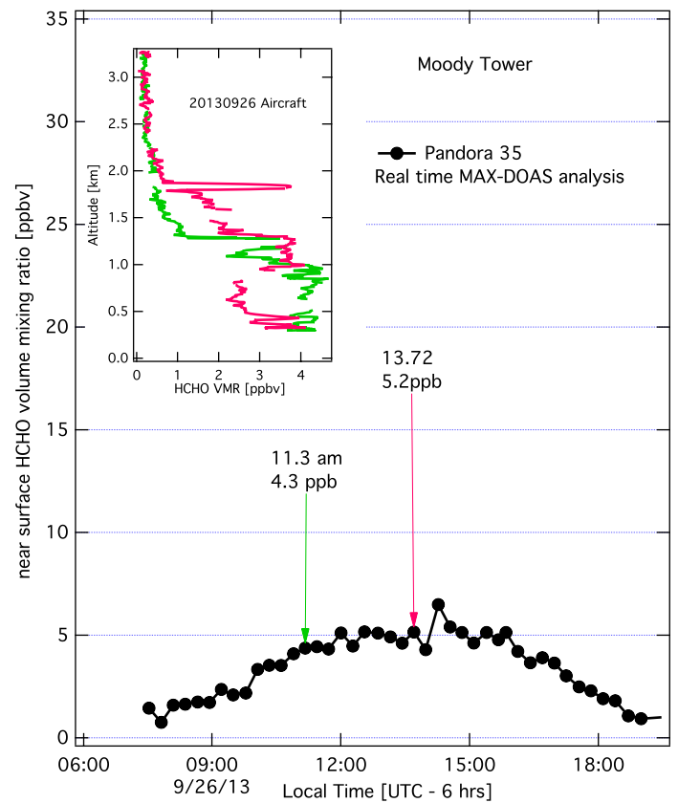
Formaldehyde Surface Values from Pandora
Comparison with Aircraft (D-AQ)
Moody Tower Houston Texas
Sept 25, 2013
Sept 26, 2013
Pandora
Pandora
Pandora
Pandora
Very Sharp Gradients

Slide 20
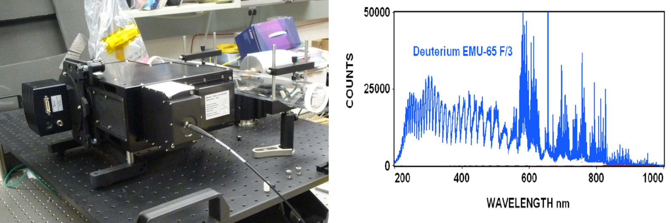
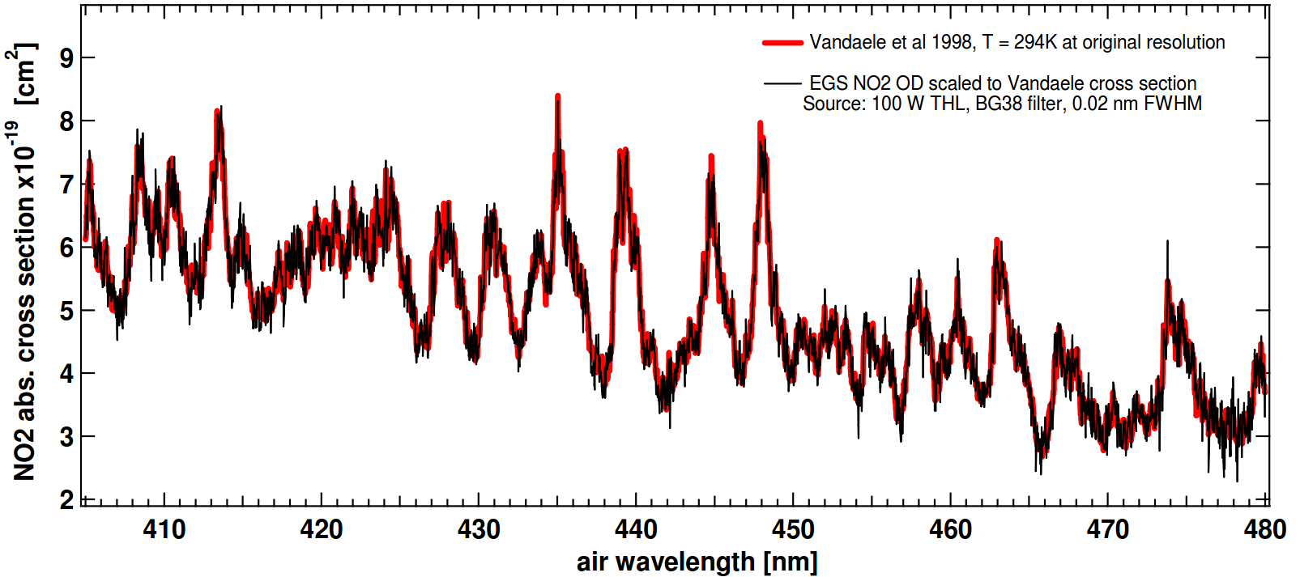
GSFC Echelle Grating Spectrometer (20 pico-meters)
D₂
NO₂

Slide 21
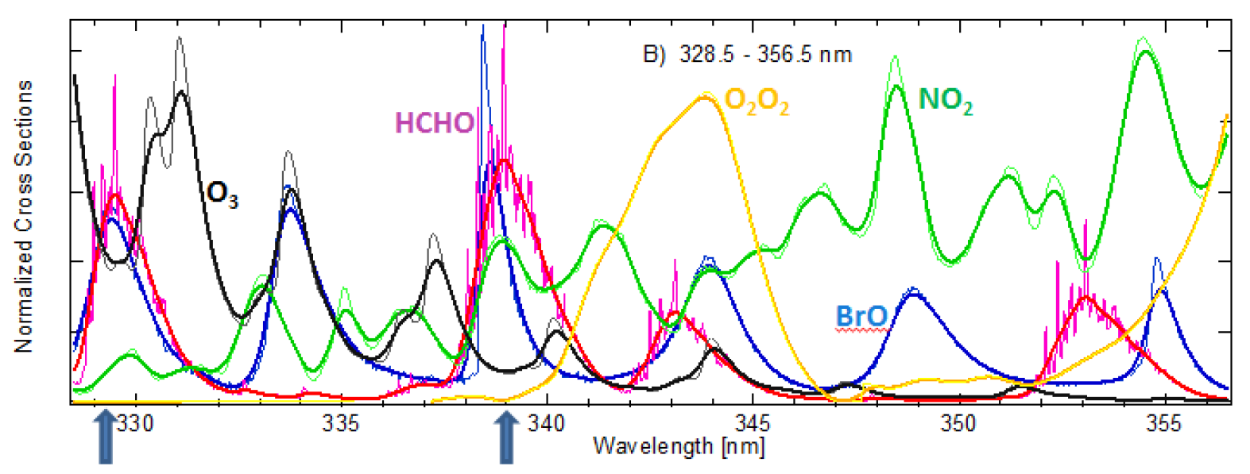
Basic Reason for Echelle Grating Spectrometer Studies
Find a Window at 0.6 nm that gives a good answer for HCHO
High resolution (0.03 nm per FWHM) and low resolution (0.5 nm per FWHM) normalized absorption cross sections of HCHO [Chance and Orphal, 2011; 300K], O₃ [Macilet et al., 1995; 228K], NO₂ [Vandaele et al., 1998 220K], BrO [Fleischmann et al., 2004; 223K] and O₂O₂ [Hermans et al,. 2003] (arbitrary scale): A) from 315 to 370 nm and B) OMI fitting HCHO wavelength region from 328.5 to 356.5 nm. Arrows indicate the major cross correlation regions.

Slide 22
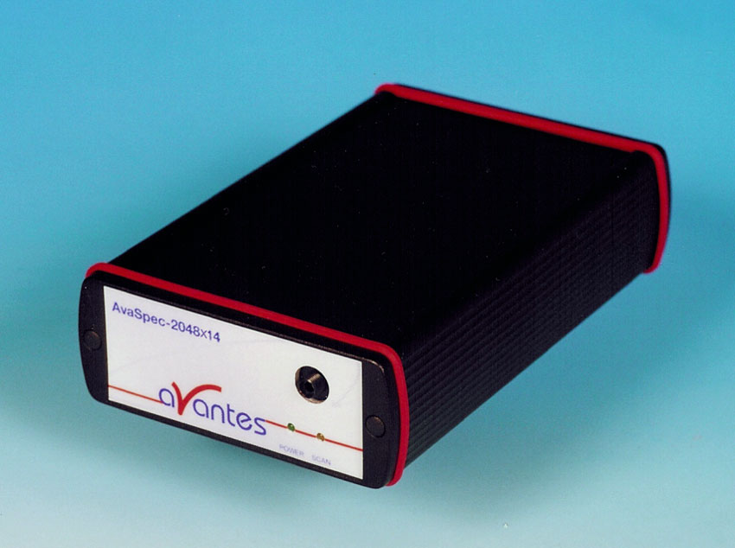
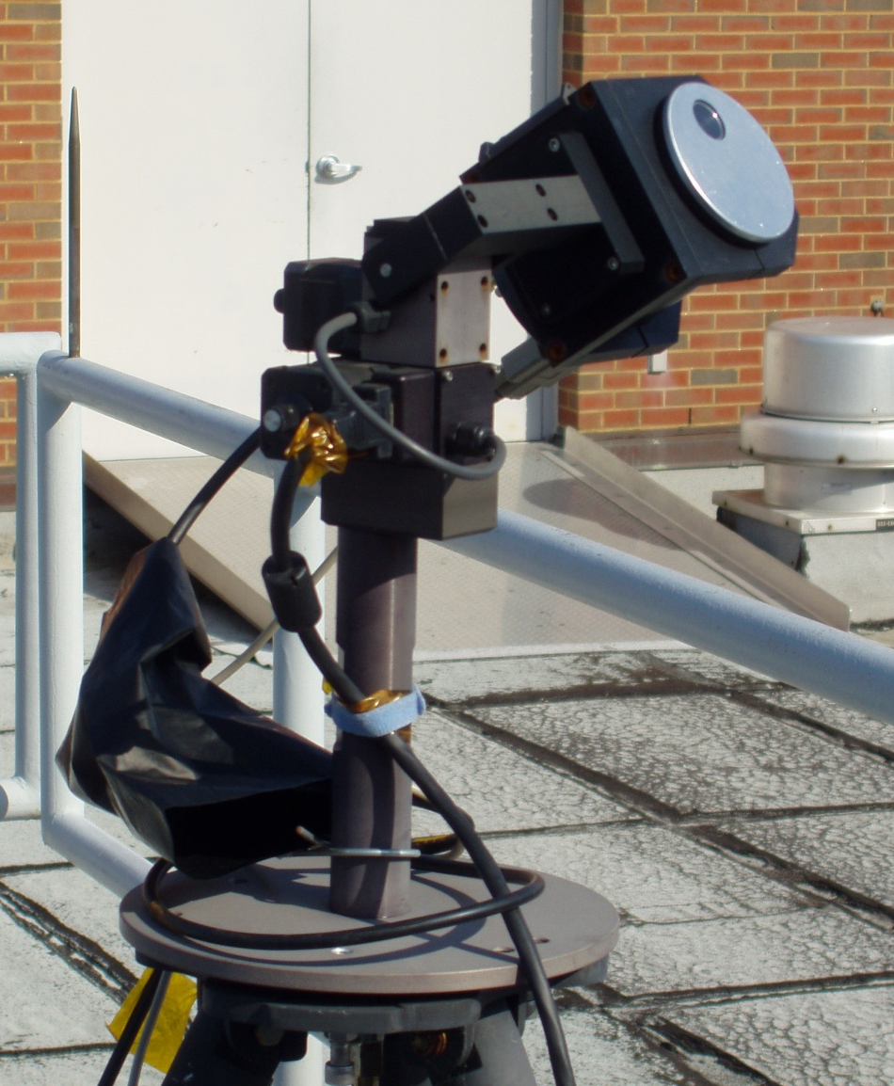
What is PANDORA?
Pandora is a small spectrometer system, which we have been developing since 2006. We now have over 30 Pandoras. It consists of …
a “miniature”
spectrometer
Temperature controlled
and a head sensor on a sun tracker
Measures sun and sky radiance from 280 to 525 nm in 0.5 nm steps with a 1.6º field of view. Products: NO₂, H₂O, O₃, SO₂, HCHO, and aerosol properties. Grey = under development
O₃: 3 DU accuracy and 1 DU precision
NO₂: 0.1 DU accuracy and 0.01 DU precision

Slide 23
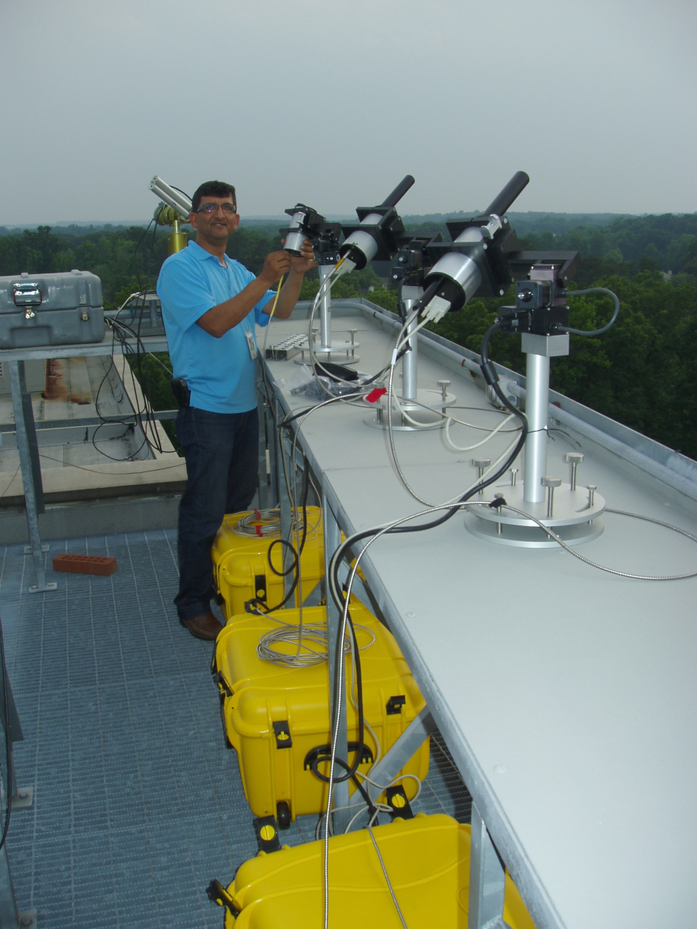
Pandora Setup
The Pandora optical heads are shown mounted on a shelf. The yellow boxes contain the spectrometer and computer in a temperature controlled environment at 25C to within 1 degree by internal thermoelectric cooling
The optical head can track the sun to obtain total column amounts of trace gases or look at the sky to obtain altitude profiles of O₃ and NO₂

Slide 24
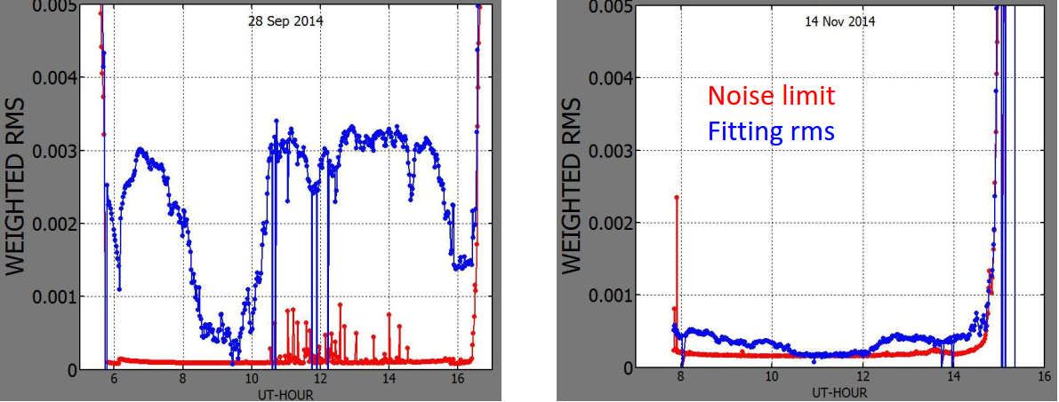
An Optics Problem Affecting Direct-Sun Measurements
Improved Accuracy for NO₂ and Ozone and Will Make
Possible Direct Sun Measurements of
Formaldehyde
BrO
Old Optics New Optics
RMS of Residuals in NO₂ Fitting

Slide 25
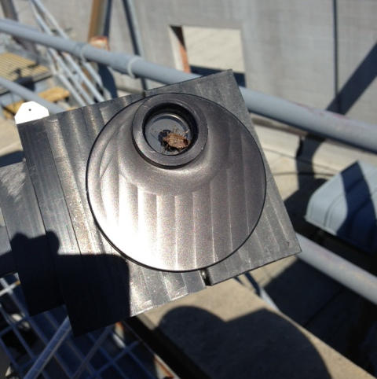
Known Pandora Bugs
EFFECTS
Reduced Transmission
Reduced SNR
Variable Signal
False Diurnal Change
Main Goal of Pandora
Project
ELIMINATE BUGS
BEFORE TEMPO FLIES

