Slide 1
TEMPO Plan for Early Adopters:
GOES-R Proving Ground Approach
Brad Pierce
(NOAA)
Proving Ground Mission Statement The GOES-R Proving Ground program was initiated to facilitate research-to-operations with the principal focus being on the forecaster/AWIPS-II environment; to prepare for the GOES-R information, to get real-world experience by leveraging existing resources, and to evaluate product tailoring. The GOES-R Proving Ground engages NWS, EPA, DoD, and other operational environments in pre-operational demonstrations of selected capabilities of next generation GOES with the objective to bridge the gap between research and operations by:
• | Utilizing current systems (satellite, terrestrial, or model/synthetic) to emulate future GOES-R capabilities;
• | Infusing GOES-R-like products and techniques into NWS operations with emphasis on AWIPS and transitioning to AWIPS-II;
• | Engaging in a dialogue to provide feedback between developers and users.
3rd TEMPO Science Team Meeting, May 27-28, 2015, University of Alabama in Huntsville Huntsville, AL

Slide 2
The Proving Ground is a collaborative effort between the GOES-R Program Office, NOAA Cooperative Institutes, a NASA center, NWS Weather Forecast Offices, NCEP National Centers, and NOAA Test Beds across the country.
The Proving Ground is a project in which simulated GOES-R products can be tested and evaluated before the GOES-R satellite is launched into space.
The Proving Ground was established to realize the benefits of the GOES-R system as soon as the satellites are launched and operational.
The simulated GOES-R products are generated using combinations of currently available GOES data, along with higher resolution data provided by instruments on polar-orbiting satellites such as MODIS on NASA’s Aqua and Terra satellites as well as model synthetic satellite data.
http://www.goes-r.gov/users/proving-ground.html

Slide 3
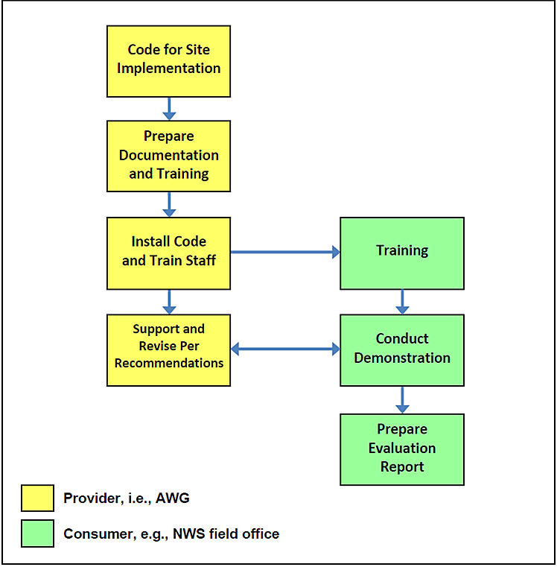
The Proving Ground works through providers and consumers:
Providers consist of NOAA Cooperative Institutes, NASA Short-term Prediction Research and Transition Center
(SPoRT), and NCEP National Centers under the direction of an Algorithm Working Group Team Lead. They prepare the product algorithm for implementation to the consumers. Consumers consist of one or more NWS Weather Forecast Offices, NOAA Test Beds, and/or NWS Regional Headquarters. They test, demonstrate, and prepare reports on the products designed by the providers.

Slide 4
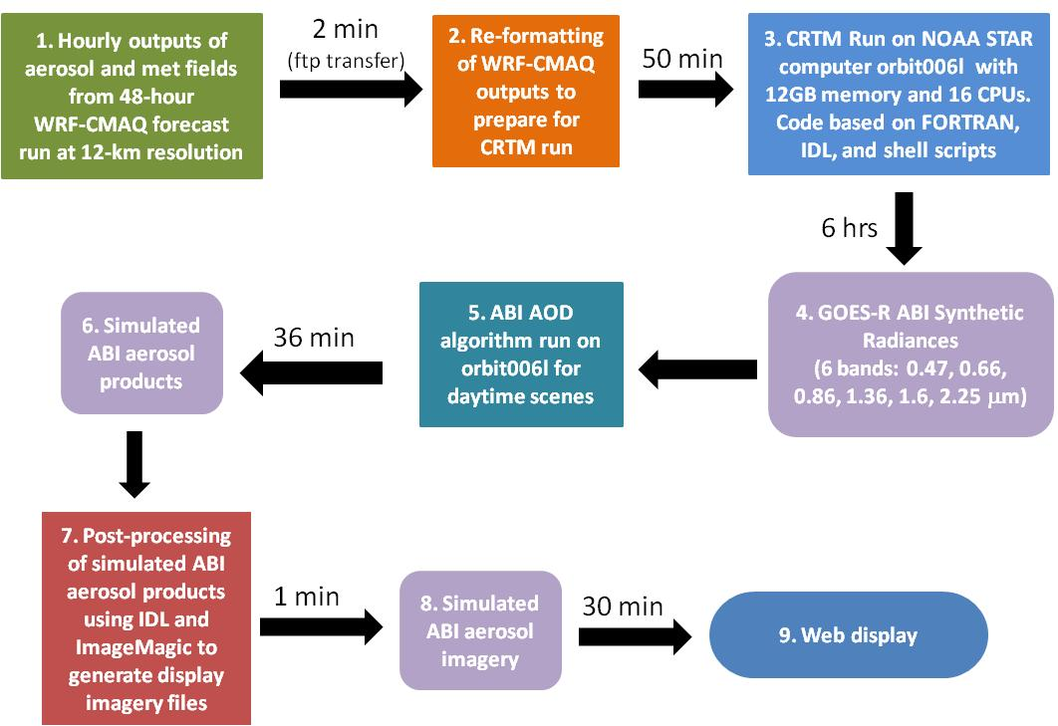
Modeled after the GOES-R Air Quality Proving Ground (http://alg.umbc.edu/aqpg/) for the Advanced Baseline Imager (ABI)
OSSE for GOES-R ABI in real-time
http://www.star.nesdis.noaa.gov/smcd/spb/aq/aqpg_2014/index.php

Slide 5
TEMPO Proving Ground
Providers: TEMPO Science Team algorithm leads
Consumers: US EPA, NOAA NWS Air Quality Forecasting Capability (AQFC), Regional Planning Organizations such as Western Regional Air Partnership (WRAP), Central States Air Resource Agencies (CENSARA), Mid-Atlantic Regional Air Management Association (MARAMA), Lake Michigan Air Directors Consortium (LADCO)
Simulated TEMPO products: Airborne Compact Atmospheric Mapper (ACAM), GEO-CAPE Airborne Simulator (GCAS), Geostationary Trace gas and Aerosol Sensor Optimization (GeoTASO), TROPOspheric Monitoring Instrument (TROPOMI), GEOCAPE OSSE, Spatially enhanced OMI retrievals
Funding (?): NASA Applied Sciences Program, NASA Air Quality Applied Science Team (AQAST)

Slide 6
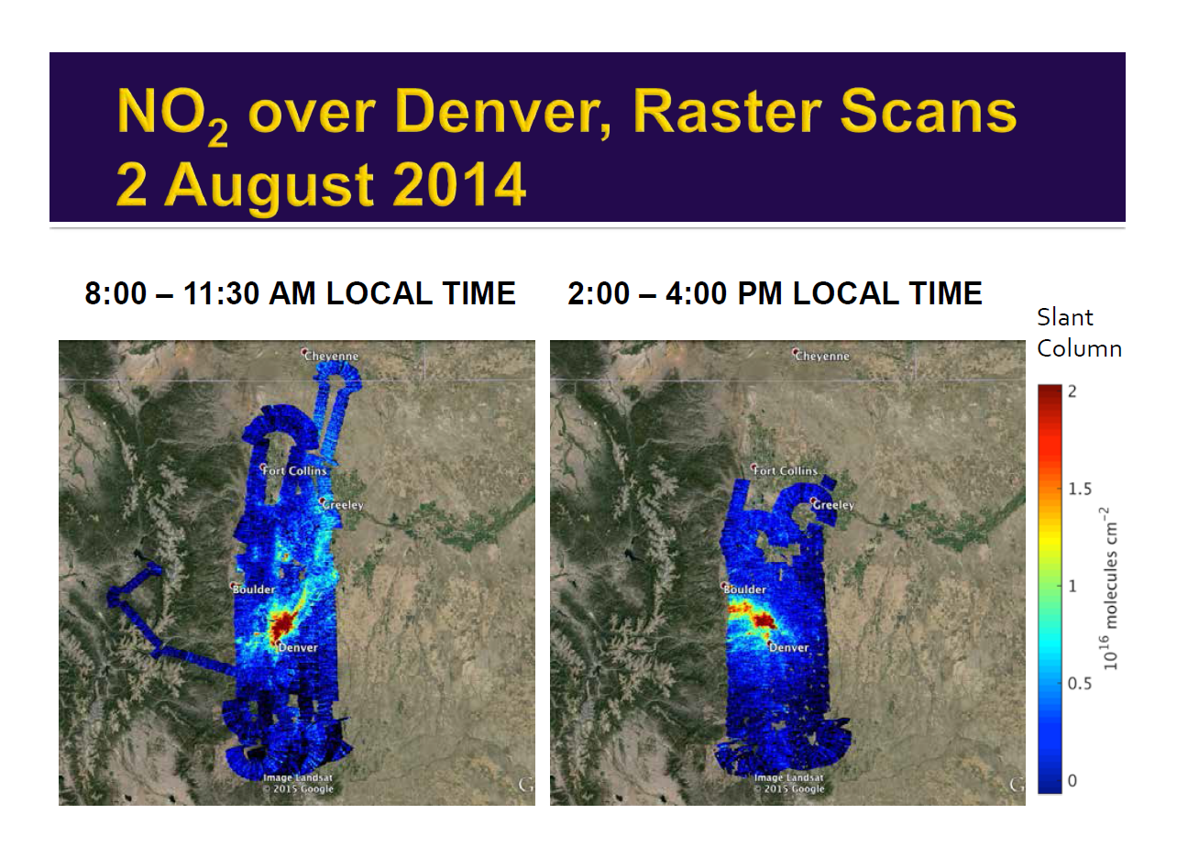
From Caroline Nowlan (Harvard-Smithsonian Center for Astrophysics, Cambridge, MA)

Slide 7
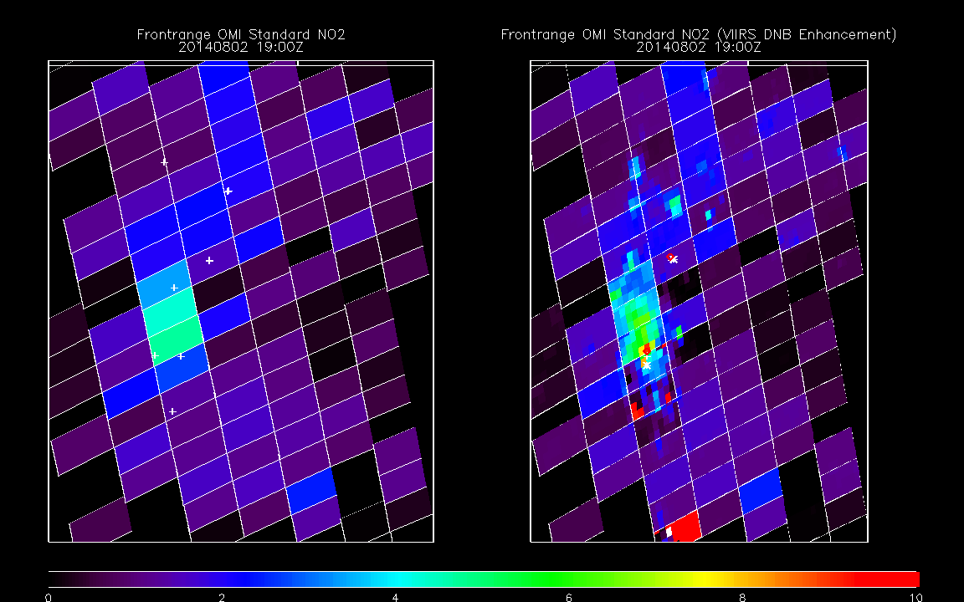
Fine-scale (4x4km at nadir) nitrogen dioxide (NO2) retrievals are developed by combining OMI standard retrievals with Suomi NPP Visible Infrared Imaging Radiometer Suite day night band (VIIRS DNB)
Tropospheric NO2 column 10¹⁵ mol/cm²

Slide 8
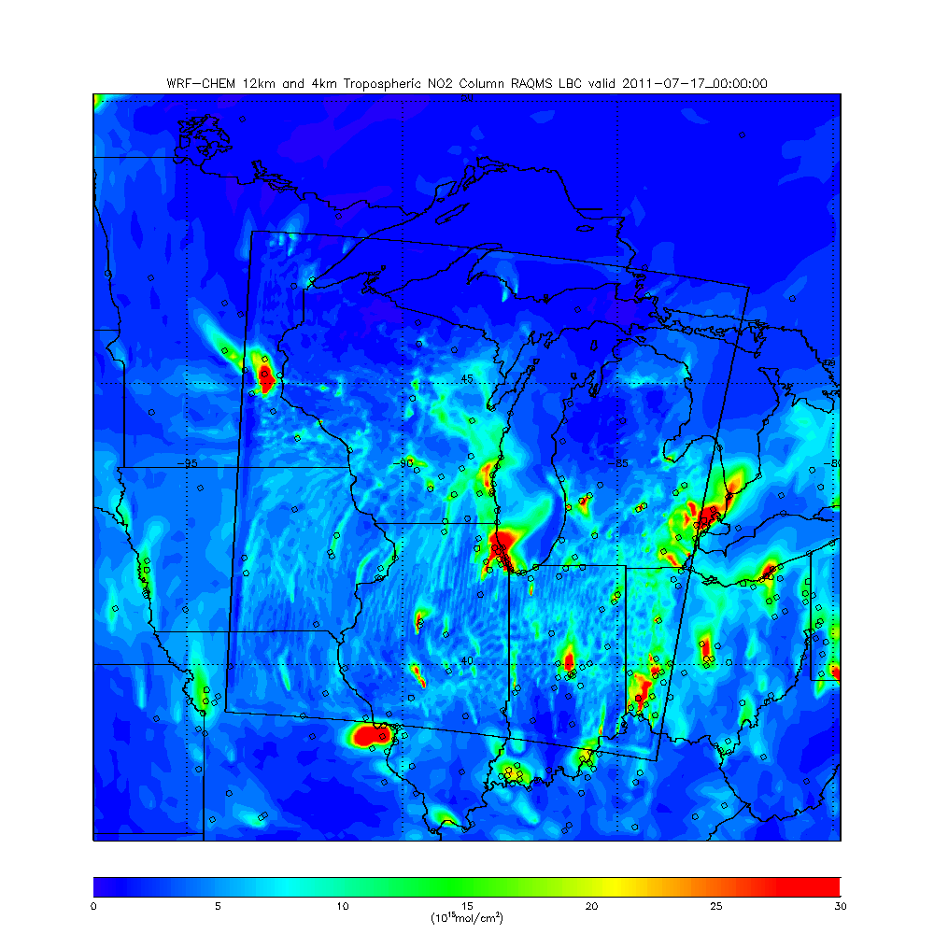
Nested 12km and 4km Tropospheric NO2 columns from July 2011 GEOCAPE OSSE

