Slide 1
TEMPO Science Studies:
The Green Paper
Kelly Chance
Smithsonian Astrophysical
Observatory
3rd TEMPO Science
Team Meeting
May 27, 2015

Slide 2
TEMPO Green Paper
TEMPO is required to spend much of its observing time scanning the full field of regard (FOR) each hour, for as much of the daylight portion of the diurnal cycle as we can arrange (but certainly to 70º solar zenith angle). However, some observing time, perhaps as much as 25%, is available for non-standard observations. Non-standard operations simply means observing a portion of the FOR (an East/West slice, as North/South is fixed) at higher temporal resolution.
Non standard observations may be of two types: First, events, which might include volcanic eruptions, forest fires, significant storms. Second, “chemistry experiments” which use the world’s highest chemistry set to inform atmospheric pollution science in general and satellite retrievals of pollution (especially for TEMPO) in general.

Slide 3
Green Paper notes
Image Navigation and Registration (INR, think “pointing”) is likely to be slightly worse in the first hour of daylight and also in the Easternmost several hundred km of the FOR.
Research scans may need supplemental hand registration to take full advantage of the spatial resolution.
We do not yet know at what time of the year we will be launched and thus what time of year we will be in commissioning phase. It is reasonable to think that some experiments will be done in commissioning phase but they are not required to be.
We hope as we fully retire instrument risk to add SO₂, aerosol, C₂H₂O₂ back as operational products and provide validation for them. However, they are always in the spectra, so they can perfectly reasonably be included in chemistry experiments.
If we do our job of insuring that command sequences are pre-loaded, about 1-hour notice is required to initiate a special sequence.
Discussion of special observations now hopefully insures that flexibility remains when operations become more fully developed.

Slide 4
High time resolution experiments - 1
For purposes of discussion I am assuming that special operations have 10-minute time resolution and 800 km E/W swath but they don’t have to be. For oversampling studies, for example, they could be quicker and narrower. Anything down to step and stare (with several km jitter) should be possible.

Slide 5
High time resolution experiments - 2
Lightning NO_{x}
  B. Pierce says cirrus contamination hard to avoid. Can we/should we evaluate that beforehand?
High O₃ events
  E.g., in the Intermountain West
Soil NO_{x} after fertilizer application
  Central Valley? Midwest? Oversampling?
NO_{x} on/off and AM/PM rush hours
  Are weekday/weekend studies science or novelty?
Forest fires
Volcanoes
Dwell-time studies to improve detection limits
  E.g., HONO, methylglyoxal, your molecule here

Slide 6
Normal time resolution experiments
Cloud field correlation with pollution
  (O. Torres, R. Chatfield) Are there any 10-minute requirements or suggestions?
Ship emission tracks, highways
Gulf platform plumes
  High temporal resolution to improve detection?
NO₂/H₂CO correlation helps H₂CO retrieval
  Do we get this automatically?
Night lights?

Slide 7
Nightlights
Artificial lights have been observed for years by OLS and now VIIRS-DNB
Can increase number of co-adds and do spectral binning to boost SNR
Preliminary assessment
  TEMPO can make an adequate panchromatic nightlights map
  Spectral discrimination should be possible with a spectral matched filter
http://www.ngdc.noaa.gov/eog/night_sat/spectra.html
Radiance is uniformly spread to estimate
the signal in a single spectral bin.

Slide 8
Old baseline and threshold data products
Species/Products | Required Precision | Temporal Revisit
0-2 km O₃ (Selected Scenes) Baseline only | 10 ppbv | 2 hour
Tropospheric O₃ | 10 ppbv | 1 hour
Total O₃ | 3% | 1 hour
Tropospheric NO₂ | 1.0 × 10¹⁵ molecules cm⁻² | 1 hour
Tropospheric H₂CO | 1.0 × 10¹⁶ molecules cm⁻² | 3 hour
Tropospheric SO₂ | 1.0 × 10¹⁶ molecules cm⁻² | 3 hour
Tropospheric C₂H₂O₂ | 4.0 × 10¹⁴ molecules cm⁻² | 3 hour
Aerosol Optical Depth | 0.10 | 1 hour
Minimal set of products sufficient for constraining air quality
Across Greater North America (GNA): 18°N to 58°N near 100°W, 67°W to 125°W near 42°N
Data products at urban-regional spatial scales
  Baseline ≤ 60 km² at center of Field Of Regard (FOR)
  Threshold ≤ 300 km² at center of FOR
Temporal scales to resolve diurnal changes in pollutant distributions
Collected in cloud-free scenes
Geolocation uncertainty of less than 4 km
Mission duration, subject to instrument availability
  Baseline 20 months
  Threshold 12 months

Slide 9
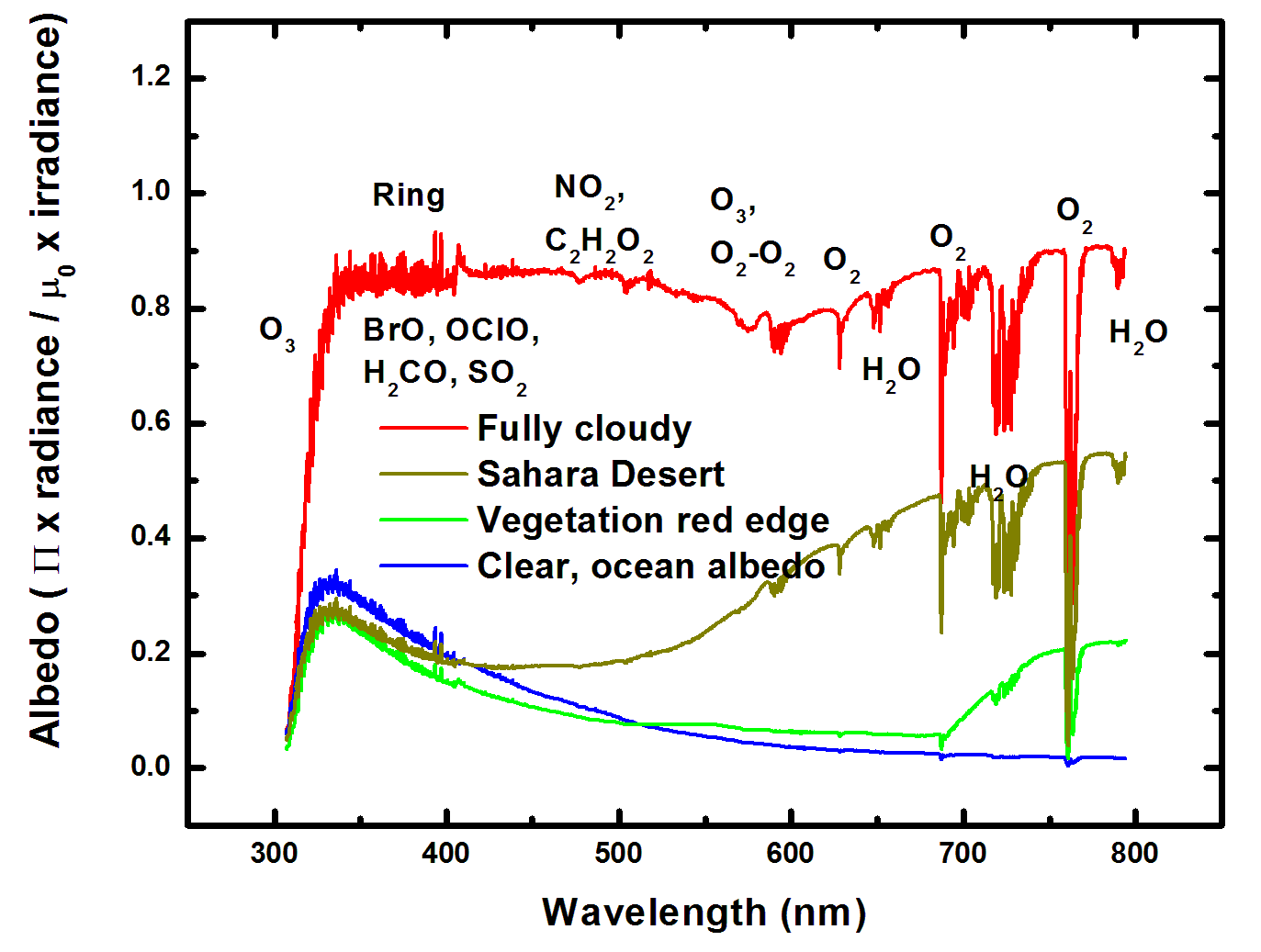
Typical TEMPO-range spectra (from ESA GOME-1)

Slide 10
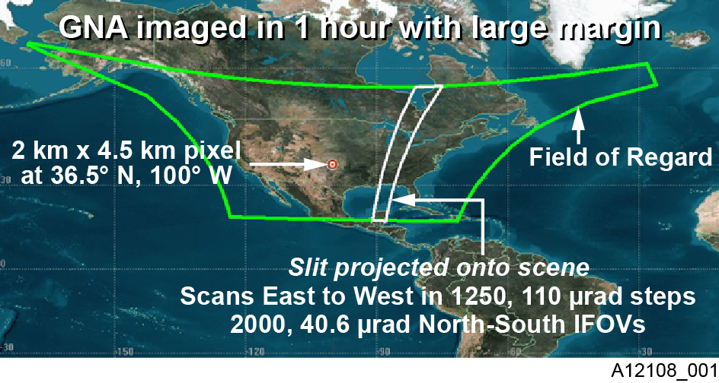
TEMPO footprint, ground sample distance and field of regard
2.1 km × 4.7
__________
Each 2.1 km × 4.7 km pixel is a 2K element spectrum from 290-740 nm
GEO platform selected by NASA for viewing Greater North America

Slide 11
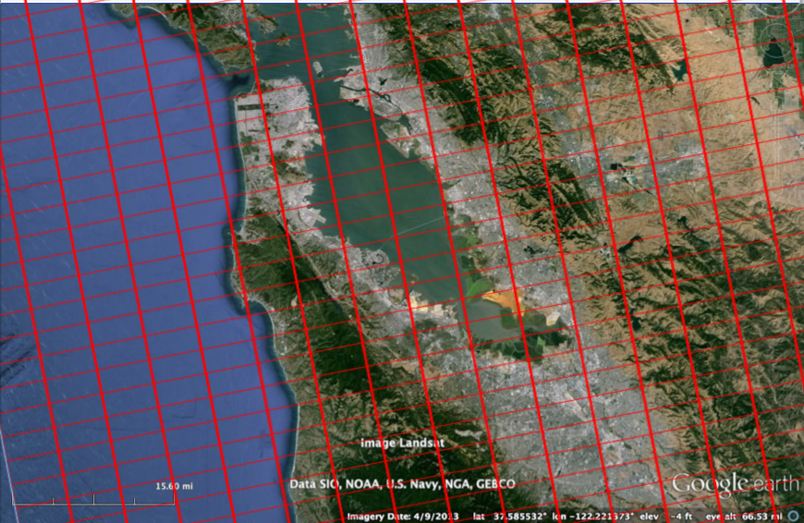
Bay Area coverage
Every hour!

Slide 12
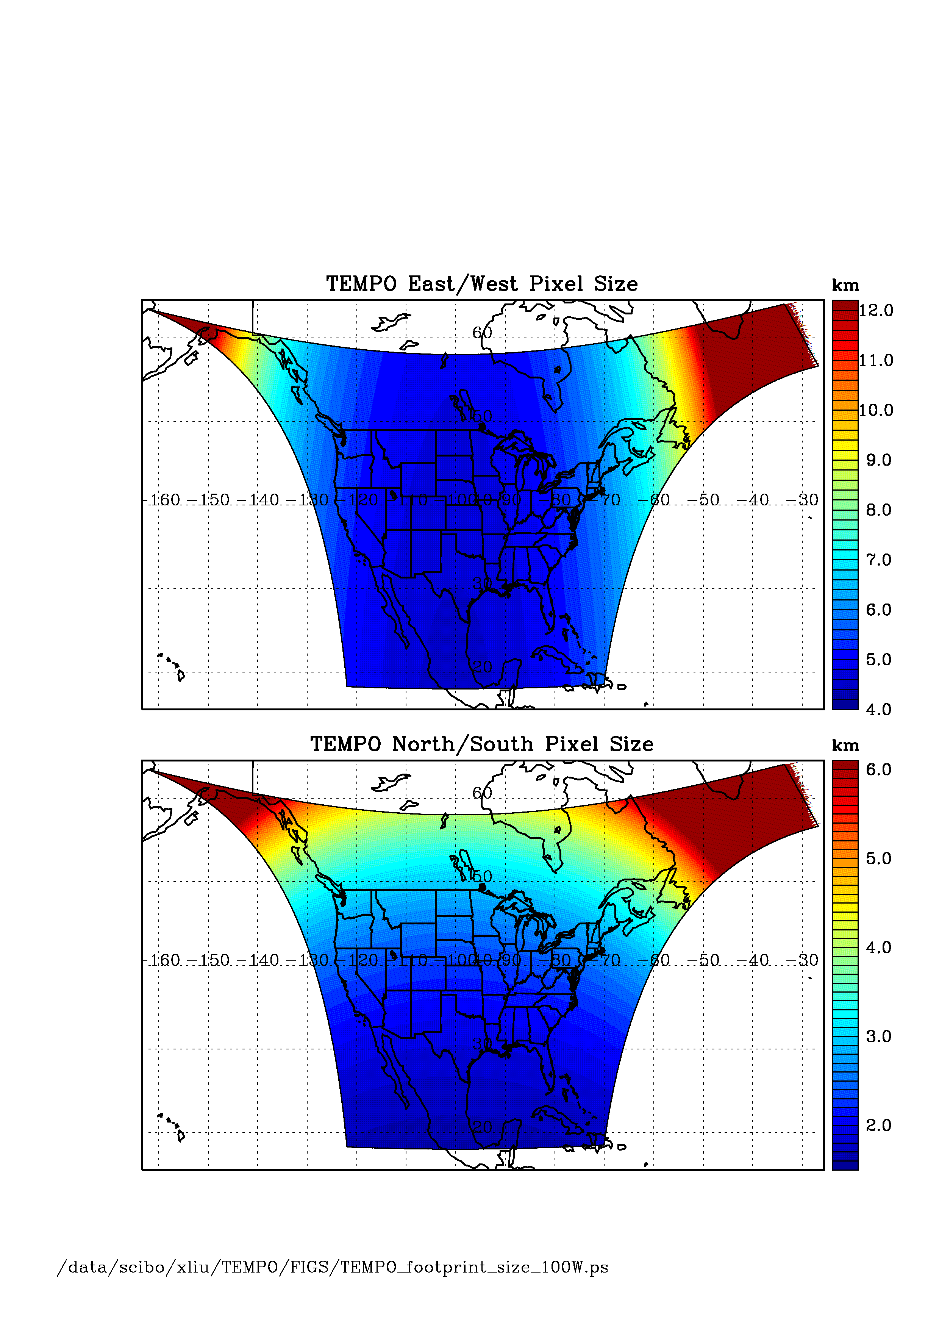
TEMPO footprint (GEO at 100º W)
Location | N/S (km) | E/W (km) | GSA (km²)
36.5ºN, 100ºW | 2.11 | 4.65 | 9.8
Washington, DC | 2.37 | 5.36 | 11.9
Seattle | 2.99 | 5.46 | 14.9
Los Angeles | 2.09 | 5.04 | 10.2
Boston | 2.71 | 5.90 | 14.1
Miami | 1.83 | 5.04 | 9.0
Mexico City | 1.65 | 4.54 | 7.5
Canadian tar sands | 3.94 | 5.05 | 19.2
Assumes 2000 N/S pixels
For GEO at 80ºW, pixel size at 36.5ºN, 100ºW is 2.2 km × 5.2 km.

Slide 13
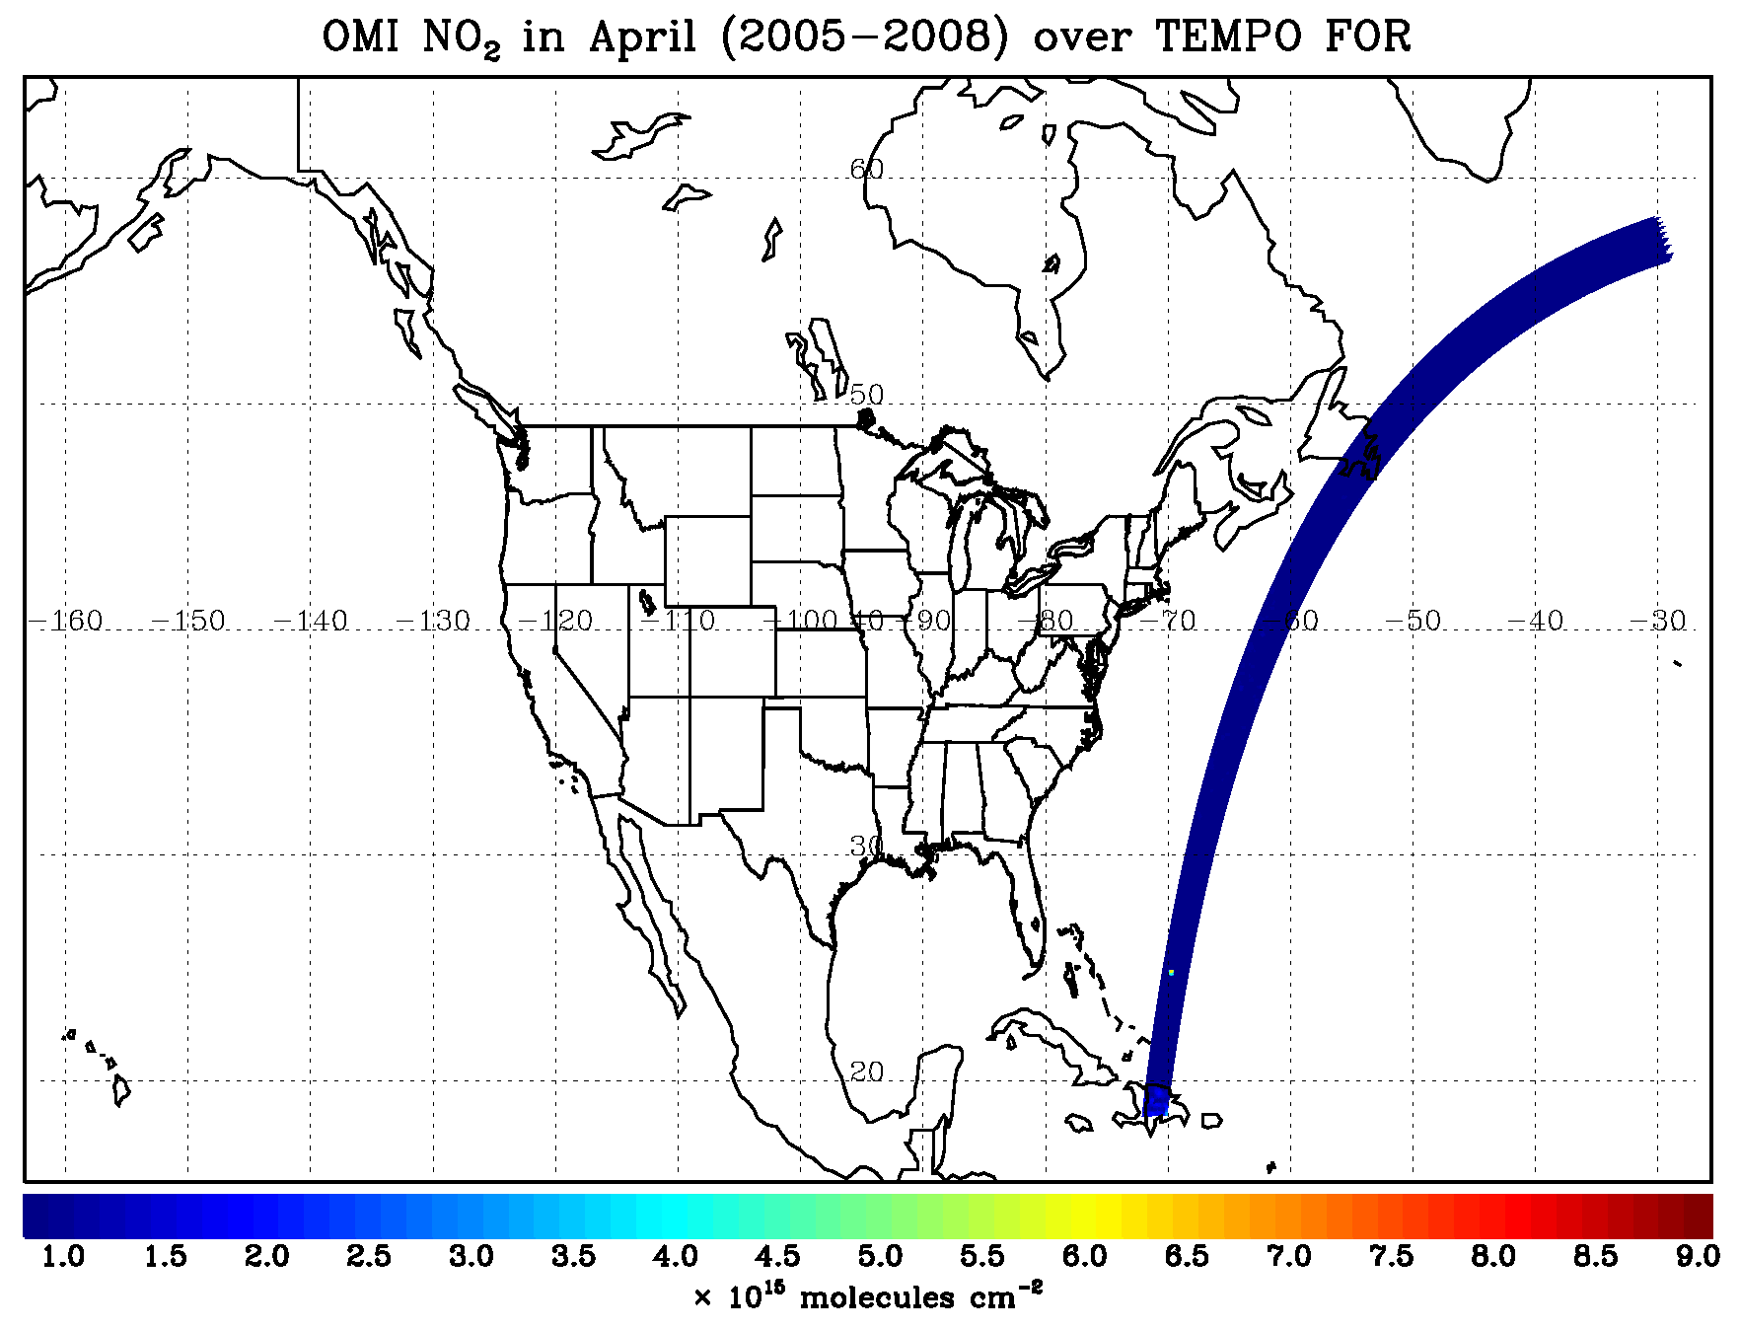
TEMPO hourly NO₂ sweep

Slide 14
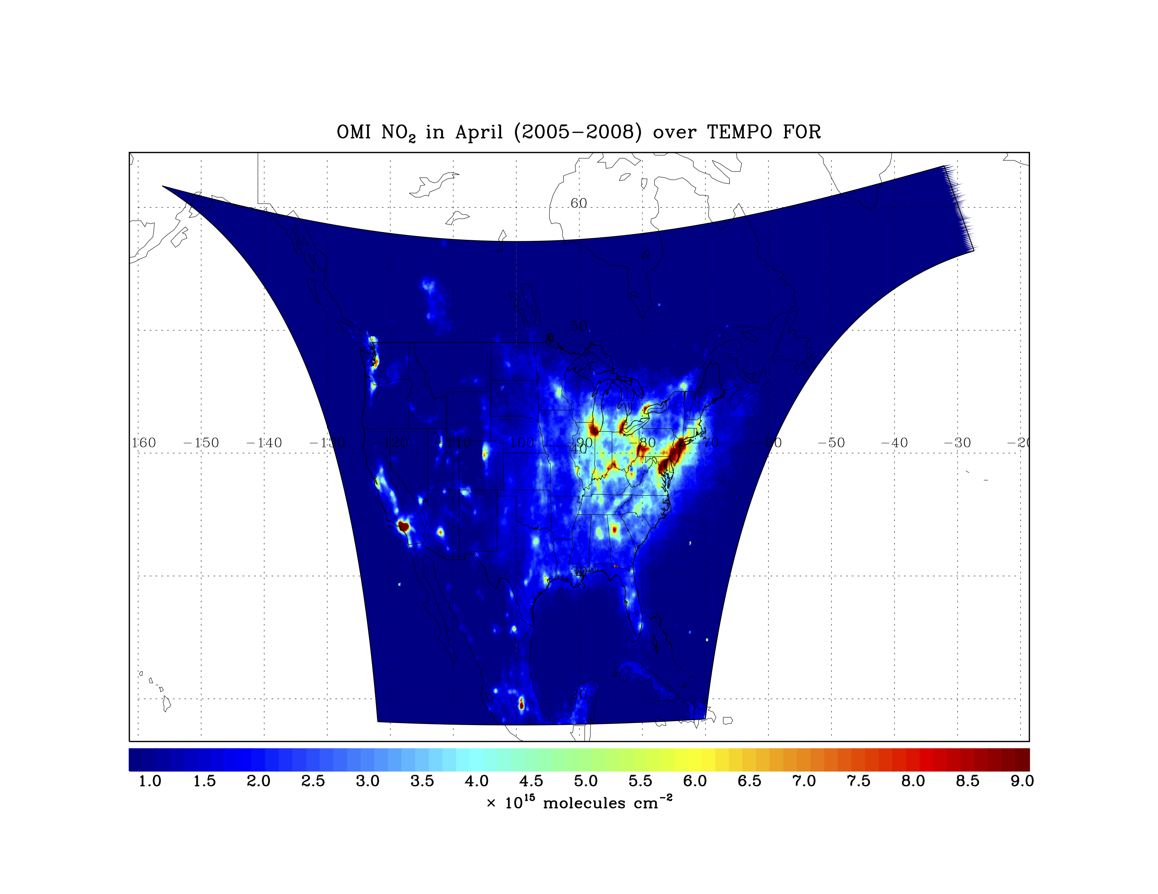
TEMPO 10-minute resolution

Slide 15
TEMPO 10-minute resolution
Forest fires
NO_{x}, O₃ on/off

Slide 16
TEMPO 10-minute resolution
Spring/summer
O₃ in the Intermountain
West

Slide 17
TEMPO 10-minute resolution
Soil NO_{x}
after fertilization
Volcanoes

Slide 18
TEMPO 10-minute resolution
Soil NO_{x}
after fertilization
Lightning NO_{x}

Slide 19
TEMPO 10-minute resolution
Soil NO_{x}
after fertilization
Lightning NO_{x}
NO_{x}, O₃ on/off

Slide 20
TEMPO 10-minute resolution
NO_{x}, O₃ on/off

Slide 21




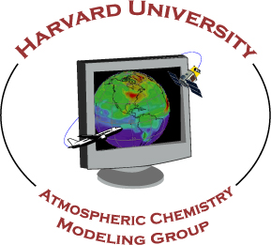


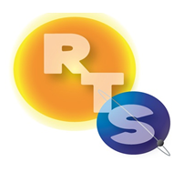


The end!

Slide 22
Backups

Slide 23
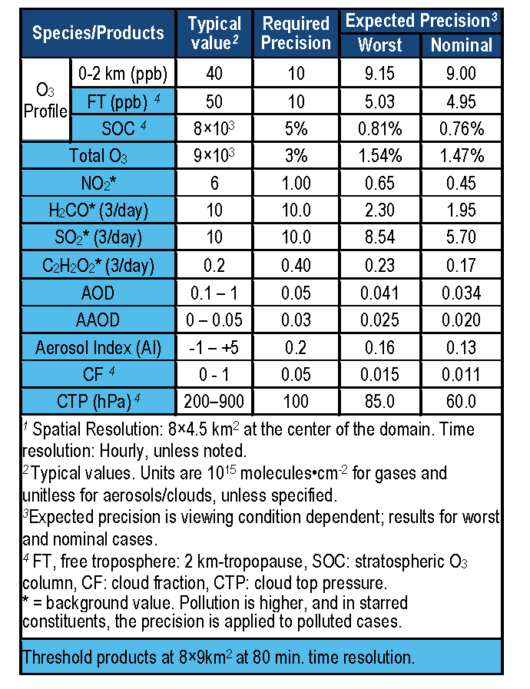
TEMPO baseline products
TEMPO has a minimally-redundant measurement set for air quality.
Near-real time products will allow for pollution alerts, chemical weather, app-based local air quality.
Revised PLRA has O₃, NO₂, H₂CO as baseline

Slide 24
TEMPO hourly NO₂ sweep

