Slide 1
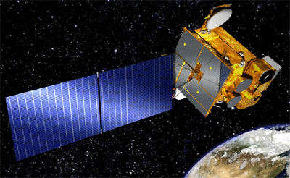



Geostationary Environment Monitoring Spectrometer (GEMS) Status
Jhoon Kim¹, M.J. Kim¹, K. J. Moon²
GEMS Science Team³, GEMS Program Office²
¹ Department of Atmospheric Sciences, Yonsei University
² National Institute of Environmental Research, Ministry of Environmentm, Korea
³ EWU, GIST, GWNU, PNU, PkNU, SNU, YSU, ⁵ NIER, Korea

Slide 2
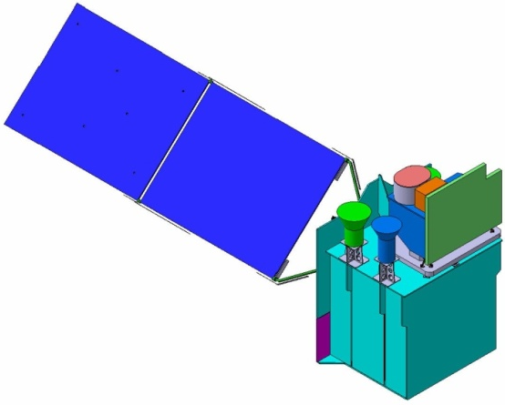
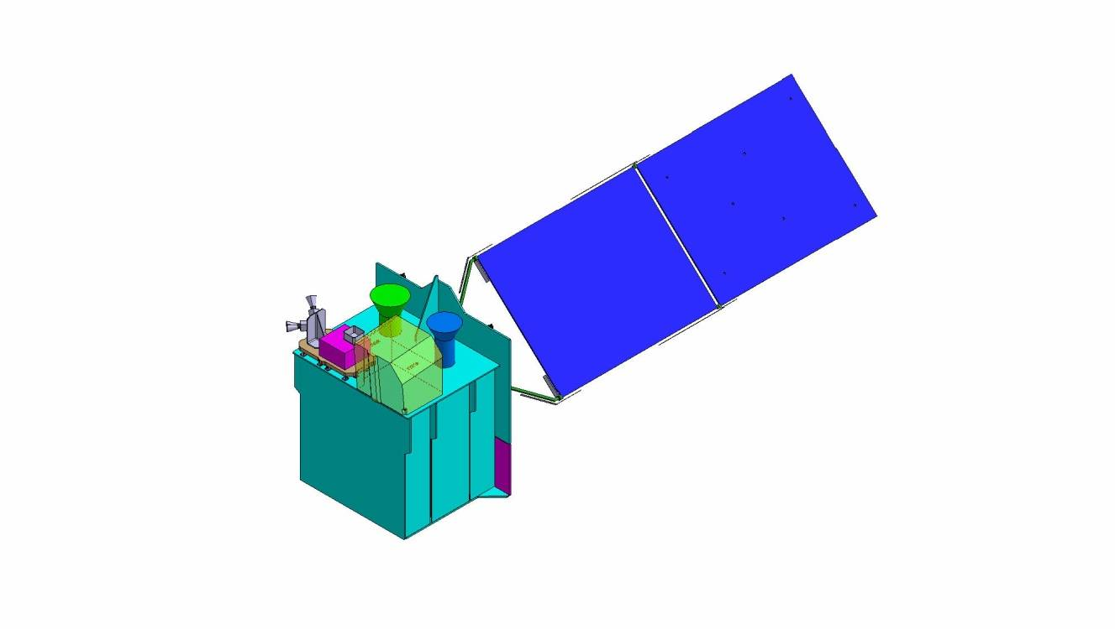
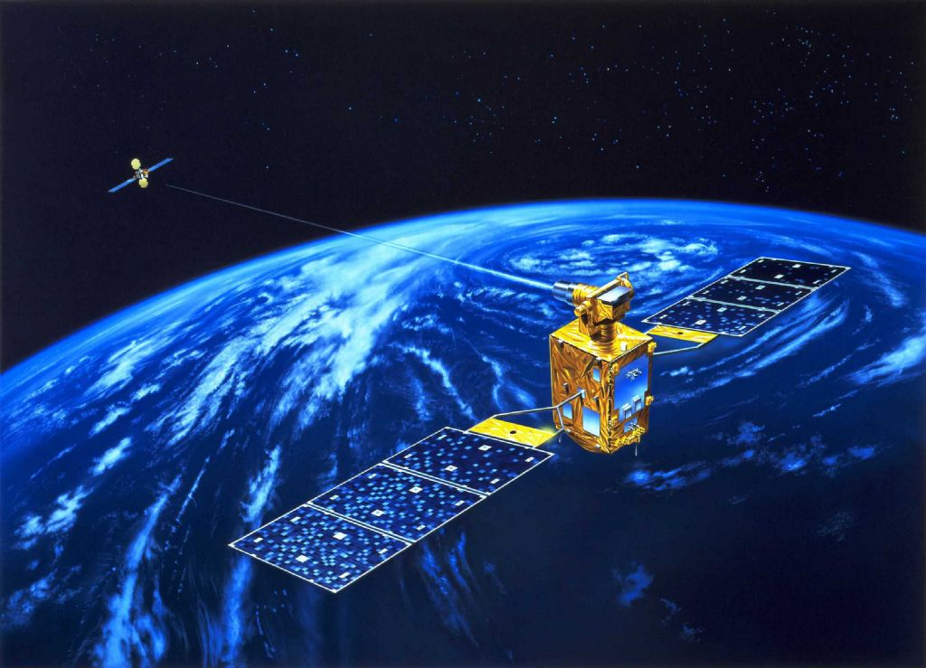
GEO-KOMPSAT 2
2A Sat. : AMI
2B Sat. : GEMS,
GOCI-2
Launch: May 2018(2A), Mar. 2019 (2B)
Specification
 | 2A | 2B
Payload | AMI | GOCI-2 | GEMS
Lifetime | 10 years
Channels | 16 | 13 | 1000
Wavelength range | 0.4 - 13 μm | 375 - 860 nm | 300-500 nm
Spatial resolution | 0.5 / 1 km (Vis) 2 km (IR) | 250 m@ eq 1 km (FD) | 7 x 8 km² @ Seoul 3.5x8 km² (aerosol)
Temporal resolution | 10 min (FD) | 1 hour | 1 hour
(Twin Satellite)

Slide 3

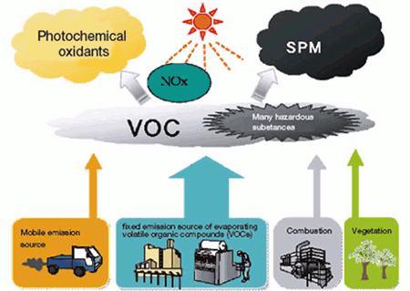
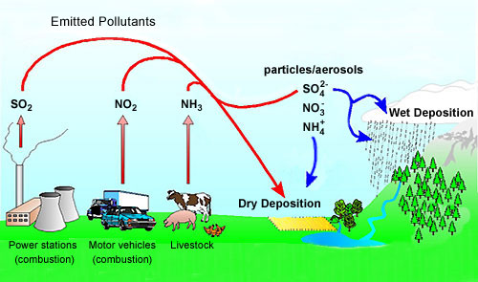
Objective: Measurements of O₃ & aerosol with precursors
hν (λ<345 nm)
O
O₃
HCHO
hν (<420 nm)
NO
NO₂
Oxidation
(OH, O₃, NO₃)
t~an hour
O₃, RO₂
AOD, type,
Height
Aerosol
Notes:
Formaldehyde (HCHO) is important as a tracer for HOx production,1 and has the potential to provide insight into the nature of convective events. It is one of the most abundant gas phase carbonyls in the atmosphere;2 tropospheric mixing ratios vary typically from 0.2 parts per billion by volume (ppbv) to 20 ppbv,3 depending on elevation and geography, and can reach as high as 60 ppbv.4 Stratospheric HCHO background concentrations are estimated to be much lower (~0.02 ppbv), but current methods lack sufficient sensitivity for a direct measurement. The dominant sources in urban areas include primary emissions from combustion and industrial processing and photochemical oxidation of numerous anthropogenic volatile organic compounds (AVOCs).2,5 Oxidation of biogenic VOCs (BVOCs) becomes important as a source in rural areas,2,5 while methane oxidation provides a source of HCHO (Fig. 1) in the remote troposphere and in the stratosphere.5
HCHO is fairly short-lived (τ ≈ 3 hours)6,7 and is removed from the atmosphere primarily by reaction with OH and by photolysis.2,3 Both of these processes produce HO2,3,6,8,9 and result in a net production of ozone (O3) in the presence of NOx (such as found in polluted urban areas).2 The interaction of HCHO in HOx chemistry has wide-reaching significance. HOx is a major oxidizer throughout the entire atmosphere and is central to catalytic cycles generating O3 in the troposphere and as well as those destroying O3 in the stratosphere, making accurate estimates of these species crucial to atmospheric modeling on both local and global scales.
Because of its implication in HOx cycling, as well as its role as an intermediate in the oxidation of numerous VOCs, HCHO is a useful tracer of the oxidative capacity of the atmosphere. HCHO may provide insight into oxidation processes in complex environments such as the atmosphere above snow-pack, where unexpectedly high OH concentrations have been observed,10 and that within forest canopies.11,12 For the second application, knowledge of HCHO fluxes would be especially useful. Fluxes can be approximated using Monin-Obukhov similarity theory,13 but because of the assumptions required for similarity theory direct HCHO flux measurement by eddy correlation is more desirable, leading to a more accurate closed budget of the species of interest.14–17

Slide 4
Status of GEMS
GEO-KOMPSAT-2 Program
  SRR in Apr., 2012; SDR in Feb. 2014, PDR in Jul., 2014,
  CDR planned in Sep. 2015 for GK-2A, and Jan. 2016 for GK-2B
Budget
  GEMS Program passed Mid-term review on Dec. 4, 2013, and now is in Main Phase till launch. (* Launch : Mar., 2019)
Prime Contractor
  Ball Aerospace & Technologies Corp.( selected on May 13th, 2013)
  * AMI contract with ITT; GOCI-2 contract with Astrium
GEMS Development
  SDR in Oct., 2013, PDR in Mar., 2014, CDR in Feb., 2015
  GEMS Telescope shall be assembled, aligned, and tested at KARI in 2015 (JDAK)
  GEMS System integration and test shall be performed in 2016
  GEMS shall be delivered to KARI from BATC spring of 2017
Changes in Environment
  Air quality forecast in operation since 2013 by NIER/ME
    → GEMS to be an operational sat. (e.g. data assimilation of model with sat. data)
  ‘KORUS-AQ’ airborne campaign planned in 2016 (with GEOTASO)

Slide 5
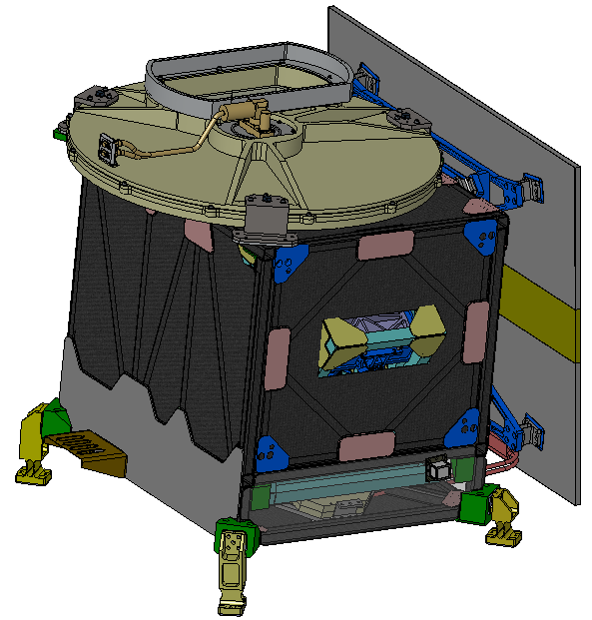
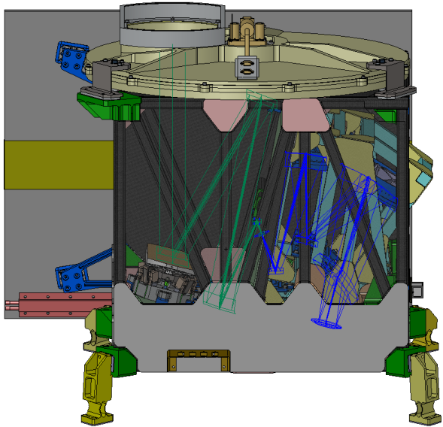
GEMS Design
Step-and-stare UV-Visible imaging spectrometer scanning at least 8 x per day in 30 minutes
Daily solar and dark calibration
images coadded at each position + mirror move back < 30 minutes
Scanning Schmidt telescope and Offner spectrometer
Diffusers for on-orbit solar calibration and onboard LED light source
2-axis scan mechanism with gyro feed capability
Redundant electronics for 10-year lifetime
Calibration assembly
(open/closed/Diff1/Diff2)
Telescope assembly
Telescope
Optics
Spectrometer
Optics
Courtesy, KARI / BATC
FPA
Scan mechanism

Slide 6
GEMS Concept of Operations
GEMS Observation Timeline(TBD)
  GEMS/GOCI-II have the same priority.
    30minutes for GEMS mission and another 30 minutes for GOCI-II mission
  Wheel offloading will be performed in one of GEMS & GOCI-II imaging slots
    4 consecutive months in GEMS slots and another 4 consecutive months in GOCI-II slots

Slide 7
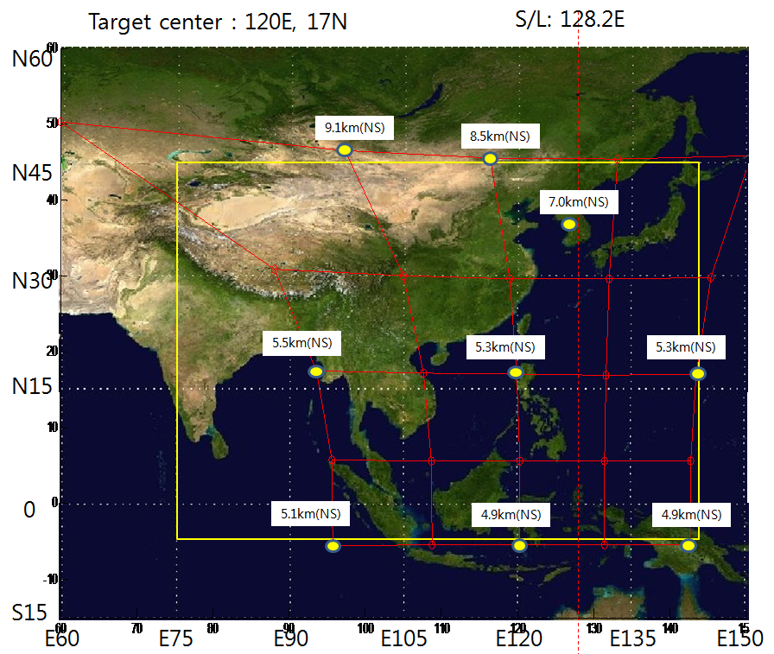
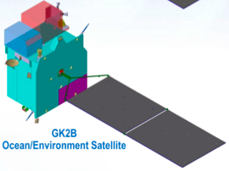
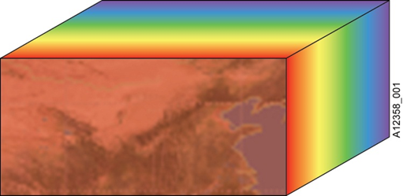
Projected FOV & GSD - NS GSD @ Seoul : 7.0km
Projected FOV
Region of interest
λ
Normal operation
For clear sector method
y(t)

Slide 8
Baseline products
Product | Impor- tance | Min (cm⁻²) | Max (cm⁻²) | Nominal (cm⁻²) | Accuracy | Spectral window (nm) | Spatial Resolution Km² @ Seoul | SZA (deg) | Retriev-al
NO₂ | Ozone precursor | 3x10¹³ | 1x10¹⁷ | 1x10¹⁴ | 1x10¹⁵ | 425-450 | 7 x 8 x 2 pixels | < 70 | DOAS
SO₂ | Aerosol precursor | 6x10⁸ | 1x10¹⁷ | 6x10¹⁴ | 1x10¹⁶ | 310-330 | 7 x 8 x 4 pixels x 3 hours | < 50 (60*)
HCHO | Proxy for VOCs | 1x10¹⁵ | 3x10¹⁶ | 3x10¹⁵ | 1x10¹⁶ | 327-357 | 7 x 8 x 4 pixels | < 50 (60*)
O₃ | Oxidant, pollutant | 4x10¹⁷ | 2x10¹⁸ | 1x10¹⁸ | 3%(TOz) 5%(Strat) 20%(Trop) | 300-340 | 7 x 8 | < 70 | TOMS, OE
AOD (AI, SSA, AEH) | Air quality, Climate | 0 (AOD) | 5 (AOD) | 0.2 (AOD) | 20% or 0.1@ 400nm | 300-500 | 3.5 x 8 | < 70 | OE O₂-O₂
Clouds | Data quality, climate | 0 (COD) | 50 (COD) | 17 (COD) |  | 300-500 | 7 x 8 |  | Raman, O₂-O₂
Surface Property | Environ-ment | 0 | 1 | - |  | 300-500 | 7 x 8 |  | Multi-spectral

Slide 9
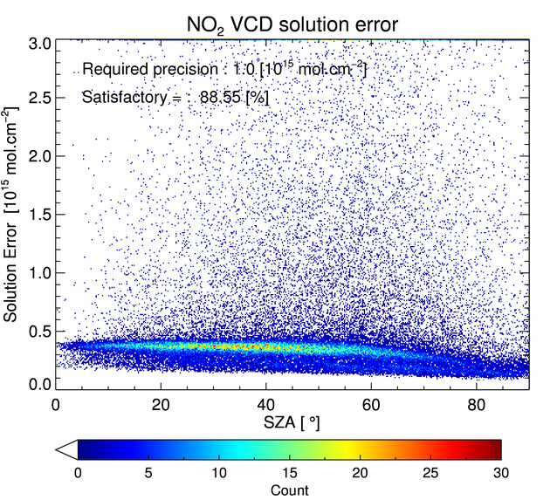
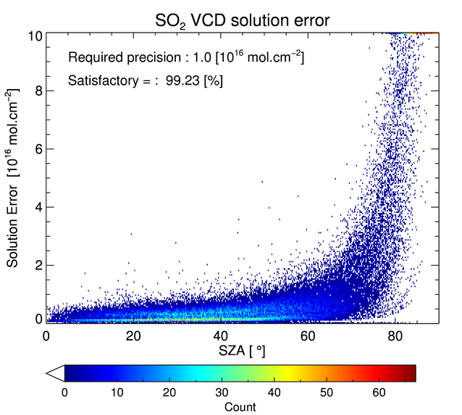
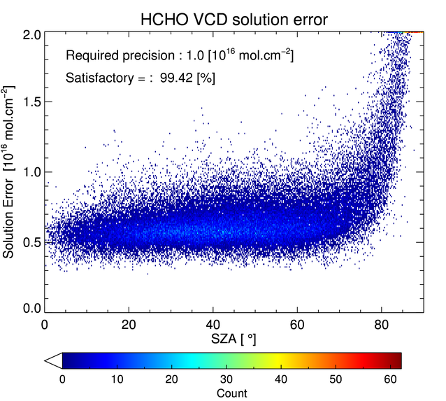
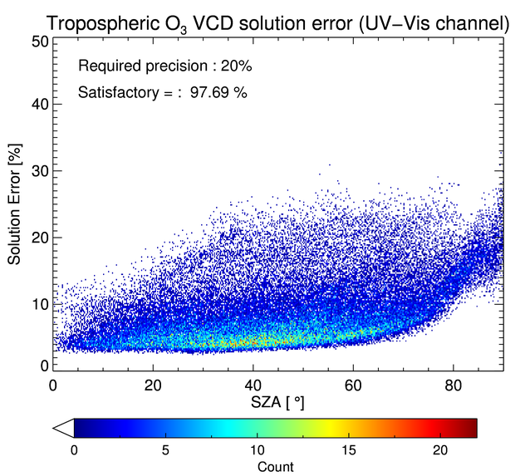
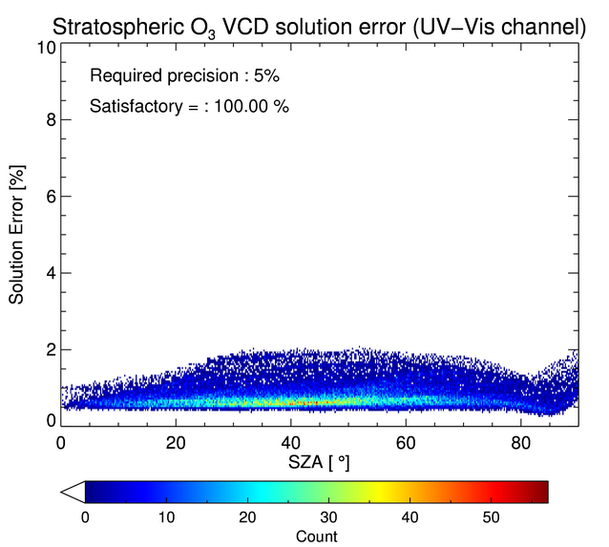
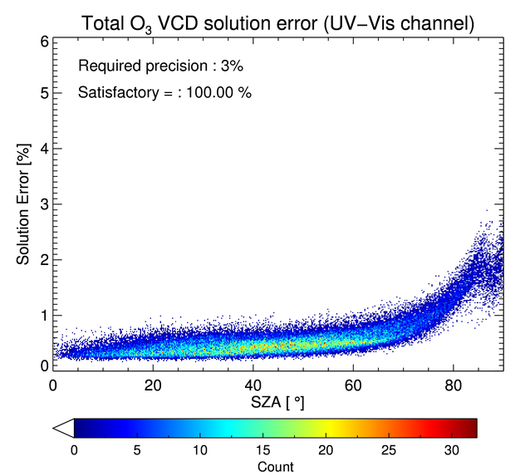
Predicted Performance (with aerosol)
NO₂ 88.6%
2 spatial coadding
SO₂ 99.2%
4 spatial coadding
+3 temporal coadding
HCHO 99.4%
4 spatial coadding
Trop. O₃ 97.7%
4 spatial coadding
Solution error
Stratospheric O₃ 100%
Total O₃ 100%
(Ukkyo
Jeong)
Req
SZA
Notes:
With aerosol

Slide 10
Target Product [Unit] |  |  |  |  | Requirement satisfaction
 | Mean ± σ | Median | Maximum | Minimum
NO₂ [10¹⁵ molecules·cm⁻²] | 0.35 ± 0.10 | 0.34 | 1.74 | 0.09 | 99.8%
SO₂ [10¹⁶ molecules·cm⁻²] | 0.80 ± 0.53 | 0.64 | 9.34 | 0.18 | 74.4%
HCHO [10¹⁶ molecules·cm⁻²] | 0.35 ± 0.08 | 0.33 | 0.75 | 0.12 | 100.0%
Tropospheric O₃ [%] | 18.9 ± 10.4 | 15.8 | 180.7 | 6.2 | 69.7
Stratospheric O₃ [%] | 0.87 ± 0.15 | 0.85 | 2.62 | 0.40 | 100.0%
Total O₃ [%] | 1.25 ± 0.43 | 1.16 | 7.28 | 0.68 | 98.8%
Target Product [Unit] | Error sources of the
 |  | BSDF calibration | Polarization sensitivity | Stray light
NO₂ [10¹⁵ molecules·cm⁻²] | 0.34 ± 0.09 | 0.02 ± 0.06 | 0.00 ± 0.00 | 0.00 ± 0.00
SO₂ [10¹⁶ molecules·cm⁻²] | 0.79 ± 0.52 | 0.02 ± 0.05 | 0.00 ± 0.00 | 0.11 ± 0.09
HCHO [10¹⁶ molecules·cm⁻²] | 0.34 ± 0.08 | 0.03 ± 0.02 | 0.00 ± 0.00 | 0.01 ± 0.00
Tropospheric O₃ [%] | 12.2 ± 5.6 | 10.2 ± 7.7 | 1.6 ± 1.0 | 7.4 ± 7.7
Stratospheric O₃ [%] | 0.57 ± 0.08 | 0.23 ± 0.15 | 0.54 ± 0.22 | 0.15 ± 0.13
Total O₃ [%] | 0.61 ± 0.14 | 0.62 ± 0.55 | 0.77 ± 0.21 | 0.16 ± 0.09

Slide 11
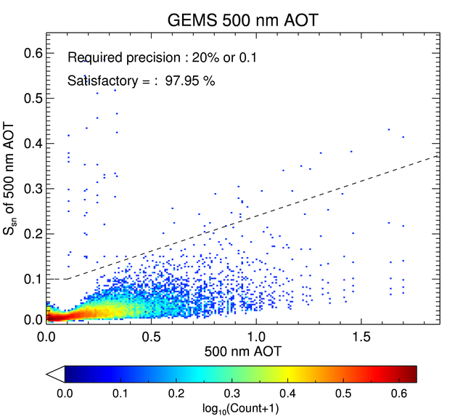
Predicted Performance (with systematic bias)
NO₂
SO₂
AOD
HCHO
TropO₃
(U. Jeong)
Notes:
Stray light, polarization,

Slide 12
Unified Data Retrieval Algorithm
Basic design for the unified algorithm to be operated at system level
In the order of CLD/SFC/AOD, then O3T/O3P/HCHO/NO2/SO2
START
1/5/10
Invoker
6/11
Read
L2
2/7/12
Read
L1B/
ALBD
13
13
13
8
8
HCHO
Pgm
NO2
Pgm
SO2
Pgm
O3P
Pgm
O3T
Pgm
3
3
CLD
Pgm
AOD
Pgm
L1B
LUT
LUT
LUT
LUT
LUT
LUT
ENV
ENV
ENV
ENV
ENV
ENV
Other
LUT
ENV
Surface
Pgm
4/9/14
L2Create
L2Write
Write
L2CLD/
AOD
END
ALBD
L2
Notes:
After defining the GEMS Level2 data structure,
As the below diagram,
We should develop the program based on the design of the unified data processing program.
L2자료구조를 정의한 후
아래그림과 같이 성능 개선된 통합 자료 처리 프로그램 설계를 기반으로 프로그램을 구현할 것입니다.

Slide 13
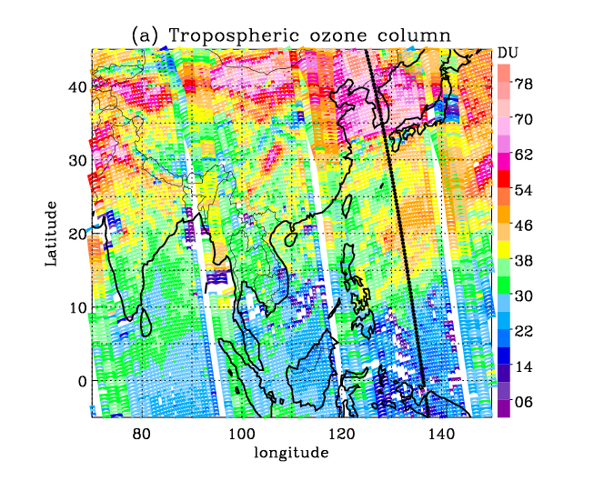
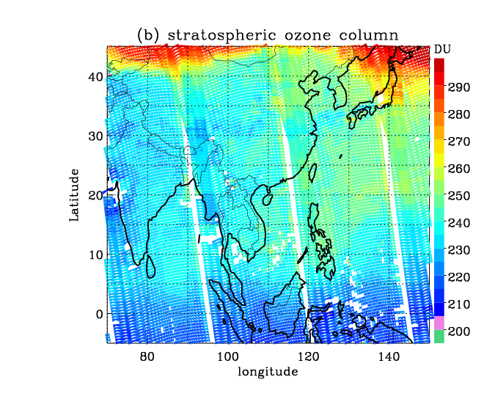
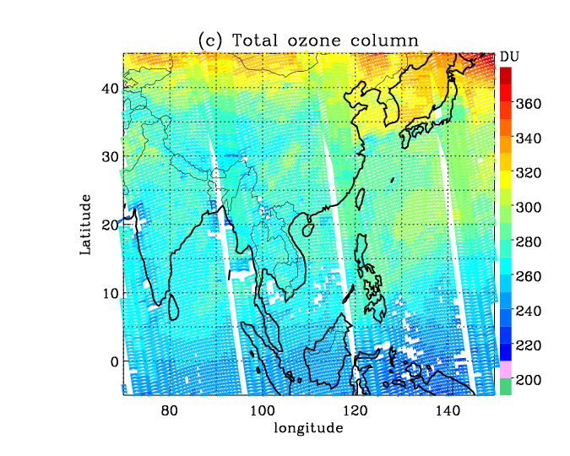
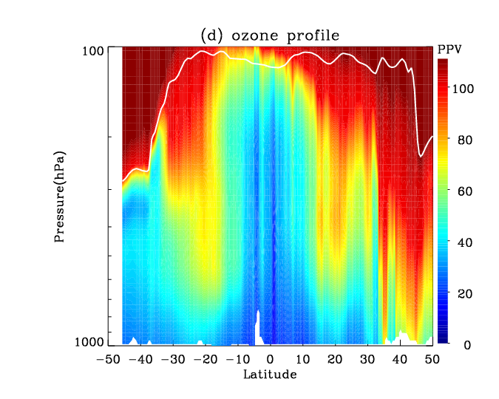
Example of retrieved ozone using OMI (July 1st, 2007)
13
(Jae H. Kim)

Slide 14
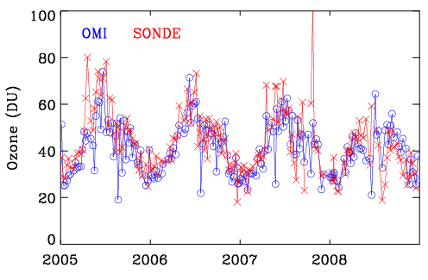
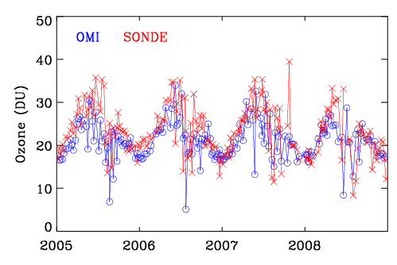
Intercomparison of Tropospheric ozone (OMI vs. sonde)
TCO (Surface – tropopause)
TCO500(surface – 500hPa)
 | TCO | TCO500
R | 0.64 | 0.51
Regression | y=0.84x+10.7 | Y=0.67x+9.3
OMI-SON(DU) | -3.6±7.6 | -2.0±4.3
OMI-SON(%) | -7.1±18.8 | -7.0±20.9
(Jae H. Kim)
Notes:
앞서 사용한 포항 오존 존데 자료를 이용하여 대류권 오존 column 산출 결과를 평가한 것입니다.
왼쪽 그림은 OMI와 SONDE로 관측된 지표에서 대류권계면 까지의 대류권 오존에 대한 시계열 비교 결과이며, 왼쪽은 지표엣 500hPa까지 하부대류권 오존에 대한 결과 입니다.
보시는 바와 같이 OMI 대류권 오존은 오존존데에서 관측된 오존의 시간 변동성을 잘 따라감을 보여 주며,
아래 그래프는 통계치 비교 결과인데, 빨간색이 3차년도 알고리즘 산출 목표치를 보여주는데, 현재 저희 알고리즘 성능은 이 목표치를 모두 초과하여 도달하였음이 증명됩니다.

Slide 15
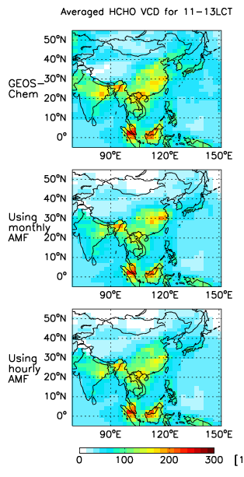
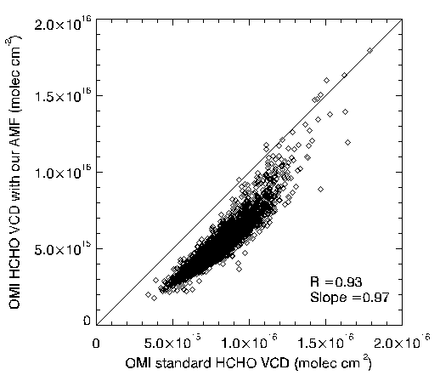
Retrieved HCHO using OMI
HCHO | R | 0.93
 | Regression line slope | 0.97
(Rokjin Park)

Slide 16
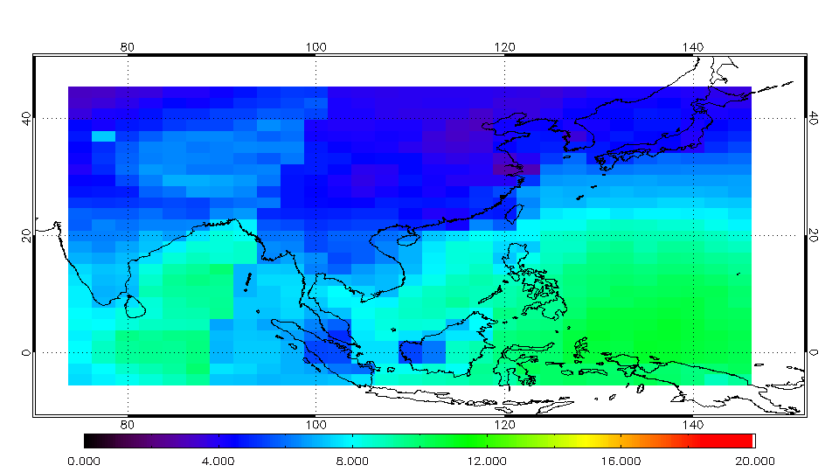
Retrieved NO₂
Calculated NO₂ VCD vs. true NO₂ VCD
NO₂ SCD error (%)
CDR (Q4, 2014) | Correlation coefficient (R) | a, Slope | b, Intercept | RMSE | Error (%)
NO₂ (achieved) | 0.94 | 1.1 | 0.056 [10¹⁶cm⁻²] | N/A | 7%
(Hanlim Lee)
Notes:
좌측그림의 x축은 true NO2 VCD를 y축은 NO2 algorithm을 통하여 계산된 calculated NO2 VCD이다. 두 값의 scatterplot을 그려본 결과 R는 0.94 slope은 1.1, intercep는 0.056 * 1016 mole /cm2로 3년 차 목표치인 0.6, 0.2, 1.1에 크게 웃도는 결과임을 알 수 있다. 또한 slant column density 계산시 생기는 error는 약 7%로 추정되나, 향후 troposphere-stratosphere separation 및 구름의 영향을 살펴보면 그 error값은 증가할 가능성이있다.

Slide 17
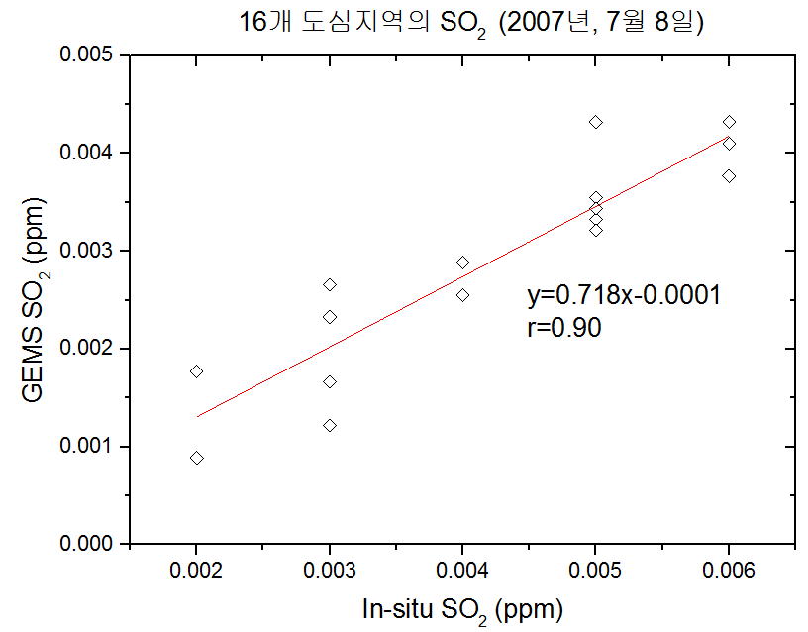

Retrieved SO₂
Site | Sfc. Obs | GEMS
 | SO₂(ppm) | SO₂(DU) |  | SO₂(ppm)
Seoul | 0.005 | 0.30 | → | 0.0033
Busan | 0.005 | 0.39 | → | 0.0043
Daegu | 0.005 | 0.32 | → | 0.0035
Inchon | 0.006 | 0.39 | → | 0.0043
Gwangju | 0.002 | 0.16 | → | 0.0017
Daejon | 0.003 | 0.11 | → | 0.0012
Ulsan | 0.006 | 0.34 | → | 0.0037
Gyeonggi | 0.004 | 0.23 | → | 0.0025
Gangwon | 0.003 | 0.21 | → | 0.0023
Chungbuk | 0.004 | 0.26 | → | 0.0028
Chungnam | 0.003 | 0.15 | → | 0.0016
Jeonbook | 0.003 | 0.24 | → | 0.0026
Jeonnam | 0.006 | 0.37 | → | 0.0041
Gyeongbook | 0.005 | 0.29 | → | 0.0032
Gyeongnam | 0.005 | 0.31 | → | 0.0034
Jeju | 0.002 | 0.08 | → | 0.0008
SO₂ intercomparison
- SO₂ in urban area
16 Urban site (July 8th, 2007)
(Young Joon Kim)

Slide 18
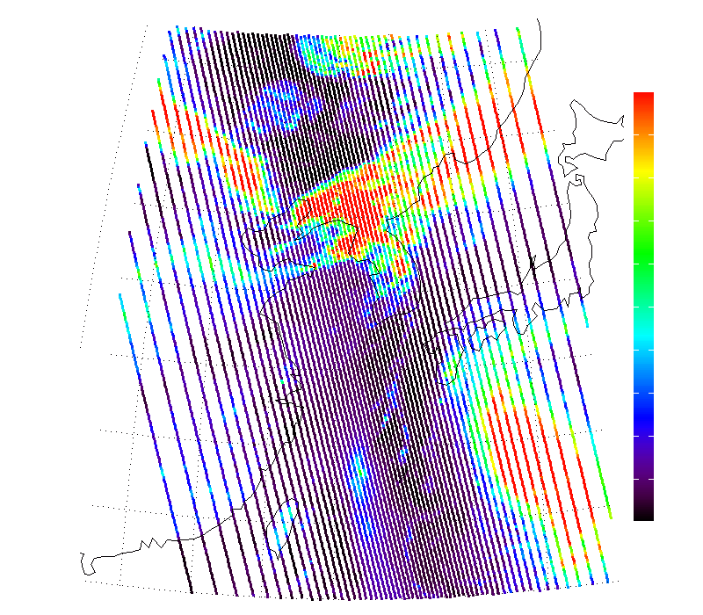
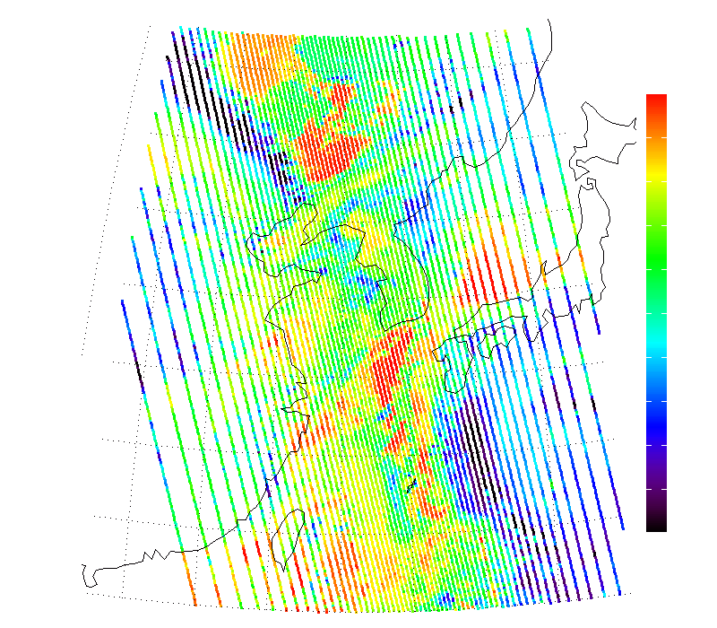
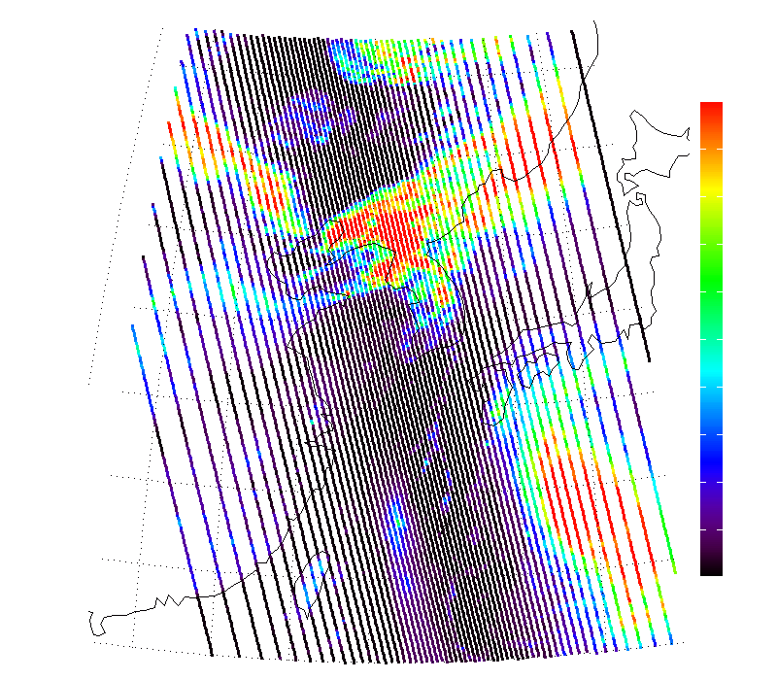
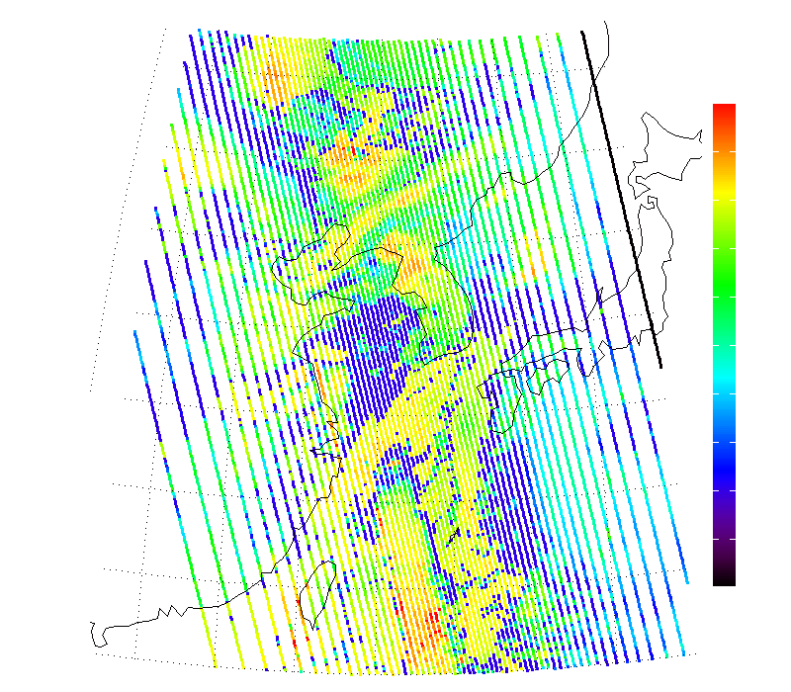
Retrieved cloud products
OMIlv2 ECF
OMIlv2 CP
1
1013
0
0
GCA ECF
GCA CP
1
1013
0
0
Slope | R | RMSE
0.99 | 0.98 | 0.08
Slope | R | RMSE
0.84 | 0.66 | 230
(Yong Sang Choi)

Slide 19
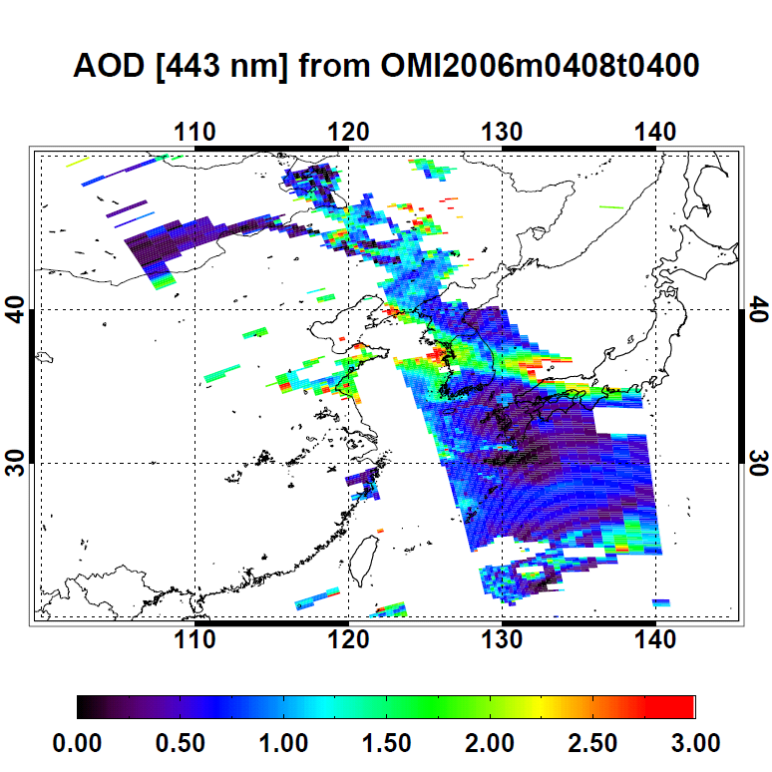
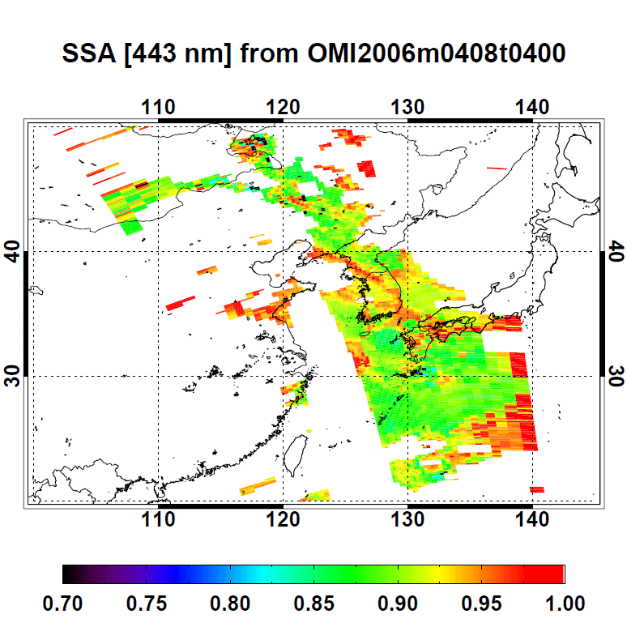
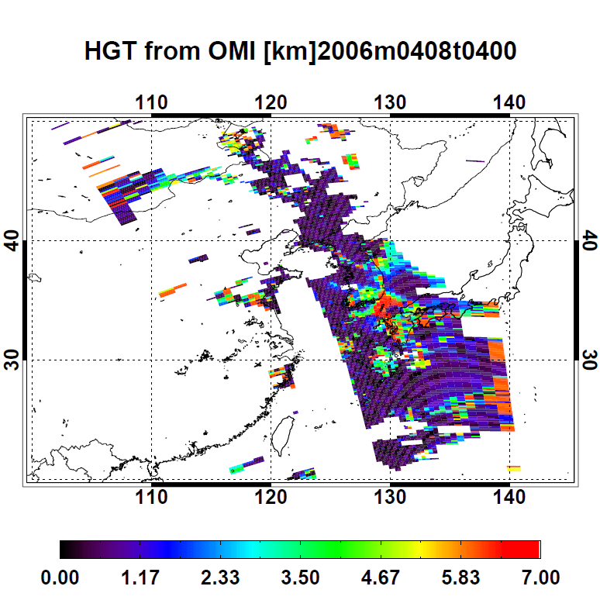
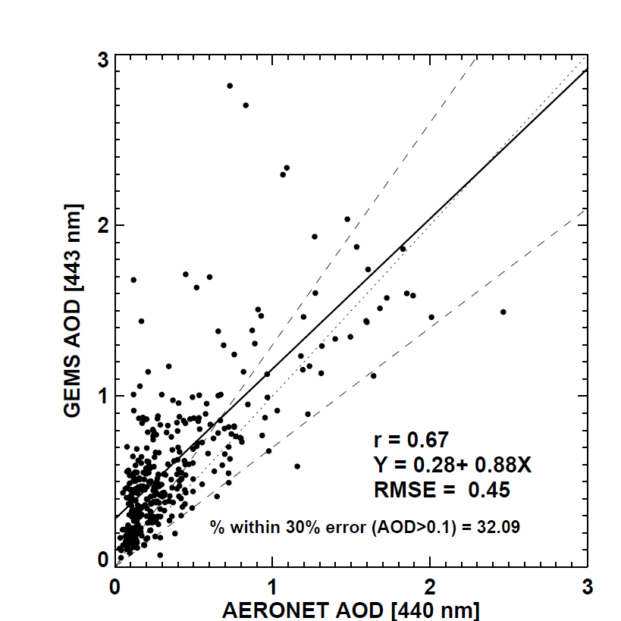
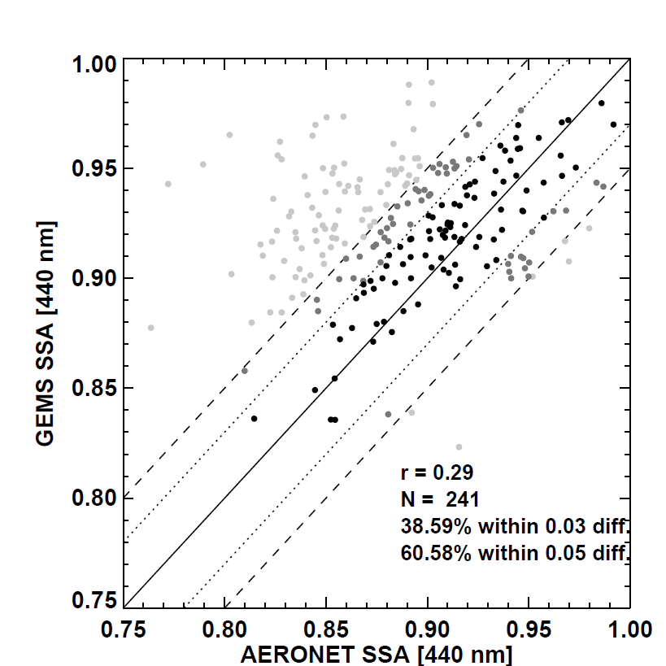
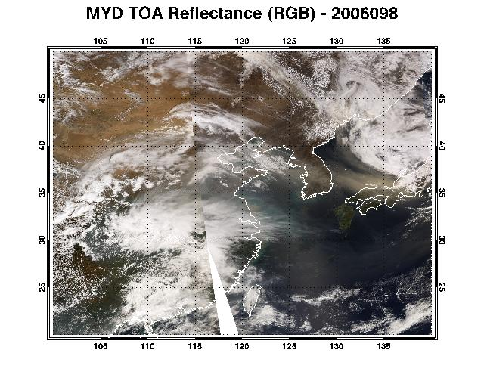
Retrieved Aerosol Properties(AOD, SSA, Height)
Retrieved AOD [443 nm]
Retrieved SSA [443 nm]
Retrieved HGT [km]
MODIS RGB :2006/04/08
(Mijin Kim)

Slide 20
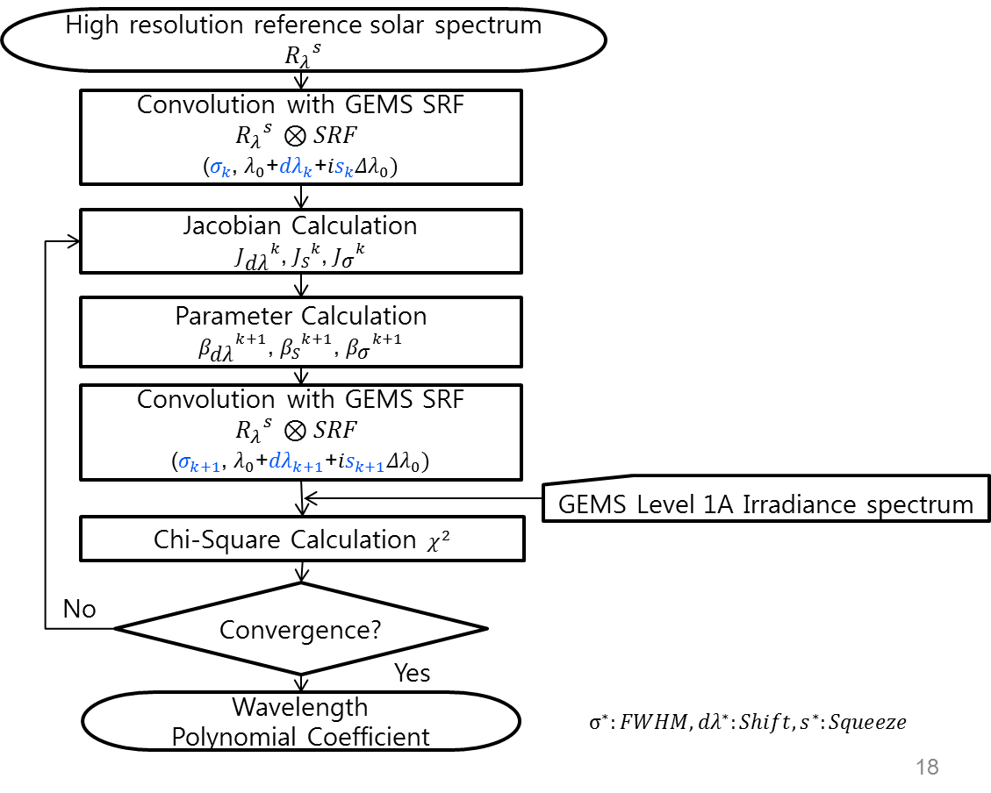
Calibration Algorithm : wavelength correction
(M.H. Ahn)
On-Ground
Observation
Database
Spectral Fitting Coefficient =f(X)
(5th-order)
SNR = f(λ)
Slit Response Function
FWHM = 0.6 nm
Spectral Fitting
for shift correction
Simulated input |  |  |  | Algorithm output
Shift | Squeeze | FWHM | SNR | Shift | Squeeze | FWHM | Shift 1σ error | Squeeze 1σ error | FWHM 1σ error | Chi square | Mean δR (%) | Mean δλ
-0.0100 | -0.0050 | 0.7000 | - 10 % | -0.0099 | 0.0050 | 0.6994 | 4.05e⁻⁵ | 4.79e⁻⁴ | 7.74e⁻⁴ | 15.9e⁻⁷ | 3.74e⁻³ | 2.15e⁻⁵
-0.0100 | -0.0050 | 0.7000 | - 20 % | -0.0100 | 0.0050 | 0.6995 | 3.61e⁻⁵ | 4.26e⁻⁴ | 6.88e⁻⁴ | 12.5e⁻⁷ | 3.32e⁻³ | 1.91e⁻⁵
-0.0100 | -0.0050 | 0.7000 | Req. | -0.0097 | -0.0050 | 0.7006 | 3.24e⁻⁵ | 3.83e⁻⁴ | 6.19e⁻⁴ | 10.1e⁻⁷ | 2.98e⁻³ | 1.78e⁻⁵
-0.0100 | -0.0050 | 0.7000 | + 10 % | -0.0100 | -0.0050 | 0.7000 | 2.95e⁻⁵ | 3.48e⁻⁴ | 5.63e⁻⁴ | 8.38e⁻⁷ | 2.71e⁻³ | 1.57e⁻⁵
-0.0100 | -0.0050 | 0.7000 | + 20 % | -0.0097 | -0.0050 | 0.7006 | 2.70e⁻⁵ | 3.20e⁻⁴ | 5.16e⁻⁴ | 7.04e⁻⁷ | 2.48e⁻³ | 1.45e⁻⁵

Slide 21
Summary
CDR of GEMS has been completed successfully and GEMS is now in manufacturing phase to be delivered to KARI by spring, 2017. The launch date for GEMS is now March, 2019.
GEMS onboard the Geo-KOMPSAT-2B is expected to provide information on aerosol and O₃ together with their precursors in high spatial and temporal resolution
  O₃ NO₂ HCHO SO₂ AOD/AI/AEH, (possibly CHOCHO, BrO)
  Clouds, surface reflectance, UV radiation.
The predicted performance of trace gases from the initial design of GEMS satisfies the product accuracy requirements of NO₂, HCHO, O₃. Meanwhile, the performance is expected to be poor in winter near Korea in particular.
Collaboration with Team of TROPOMI, Sentinel-4 & TEMPO is valuable in calibration, algorithm development and application.

Slide 22
Acknowledgement
GEMS Science Team
Ministry of Environment (MoE)
NIER, MoE
KEITI, MoE
Korea Meteorological Administration (KMA)
Korea Ocean R&D Institute (KORDI)
Ministry of Science, ICT & future Planning (MSIP)
KARI

Slide 23

GEMS Science Team
Changwoo Ahn
Jay Al-Saadi
P.K. Bhartia
Kevin Bowman
Greg Carmichael
Kelly Chance
Mian Chin
Yunsoo Choi
Ron Cohen
Russ Dickerson
David Edwards
Annmarie Eldering
Ernest Hilsenrath
Daneil Jacob
Scott Janz
Siwan Kim
Thomas Kurosu
Qinbin Li
Xiong Liu
Randall Martin
Steve Massie
Jack McConnel*
Tom McElroy
Jessica Neu
Mike Newchurch
Stan Sander
Jochen Stutz
Omar Torres
Dong Wu
Liang Xu
Ping Yang
Dusanka Zupanski
Milija Zupanski
Myung Hwan Ahn
Yong Sang Choi
Myeongjae Jeong
Jae Hwan Kim
Young Joon Kim
Hanlim Lee
Kwang Mog Lee
Rokjin Park
Seon Ki Park
Chul Han Song
Jung Hun Woo
Jung-Moon Yoo
Ji-hyung Hong
Sang-kyoon Kim
Chang Keun Song
Jae-Hyun Lim
K.J. Moon
M.H. Lee
H.W. Seo
Sukjo Lee
Jin Seok Han
Youdeog Hong
J.S. Kim
Heinrich Bovensmann
John Burrows
Joerg Langen
Pieternel Levelt
Ulrich Platt
Piet Stamnes
Pepijn Veefkind
Ben Veihelmann
Thomas Wagner
Seung Hoon Lee
Sang Soon Yong
D.G. Lee
J.P. Gong
Dai Ho Ko
S.H. Kim
J.H. Yeon
Y.C. Youk
…
Hajime Akimoto
Sachiko
Hayashida
Hitoshi Irie
Yasko Kasai
Kawakami Shuji
Charles Wong
Sangseo Park, Mijin Kim, Ukkyo Jeong, M.J. Choi, J.H. Kim, S.J. Ko; Ju Seon Bak, Kanghyun Baek; Hyeong-Ahn Kwon, H.J. Cho; K.M. Han, Jihyo Chong, Kwanchul Kim; J.H. Park, Y.J. Lee …, Bo-Ram Kim, M.A. Kang, J.H. Yang, Sujeong Lim, S.W. Jeong ;

Slide 24
Synergistic products
Ocean current,
AOD, Aerosol type
Green tide, Red tide
SST, AMV, Fog
AMI
GOCI-2
Cloud center height
AOD over desert
AI
SSA
SO₂
O₃
AMV
AOD(10 min)
Aerosol type
Sfc. ref.
Cloud mask
Cloud top pressure
…
AOD
Aerosol type
Sfc. ref.
NO₂
UV spectrum
GEMS
24 hr Asian dust monitoring over dark and bright surface
Cloud morphology (thickness, fraction, type …)

