Slide 1
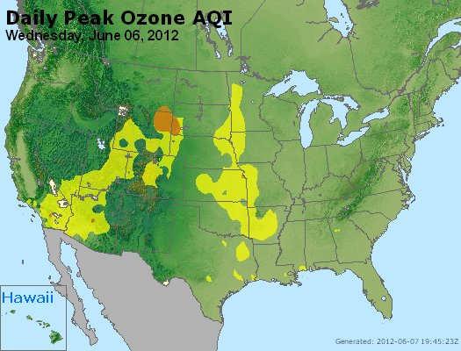
June 06, 2012 Thunder Basin, WY Stratospheric Intrusion (SI) event
http://deq.state.wy.us/aqd/Exceptional%20Events/June_6_2012ThunderBasin/June_6_2012_SI_Package.pdf

Slide 2
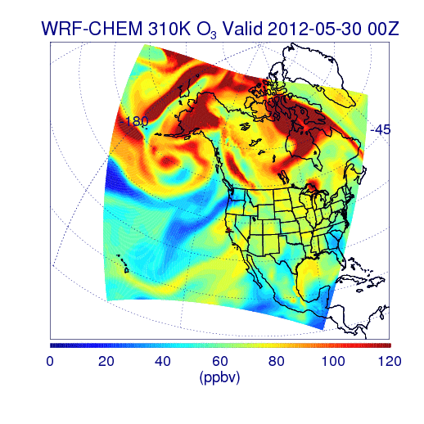
310K O3 from RAQMS/WRF-CHEM Simulation
00Z 05/30 – 00Z 06/07, 2012
Stratosphere/tropospheric exchange processes within a quasi-stationary low pressure system over the Gulf of Alaska played a critical role in the SI event

Slide 3
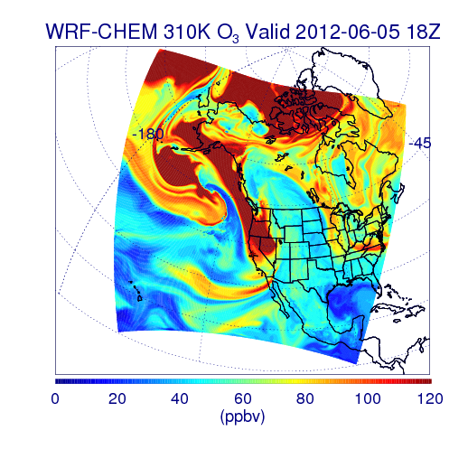
310K O3 from RAQMS/WRF-CHEM Simulation
Southeasterly transport of stratospheric air along the 310K isentropic surface leads to the SI event sampled by the AJAX flight over CA on June 5, 2012

Slide 4
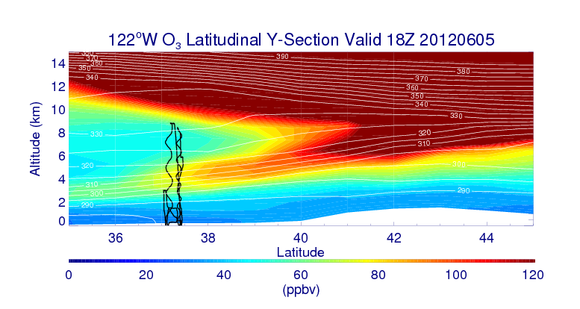
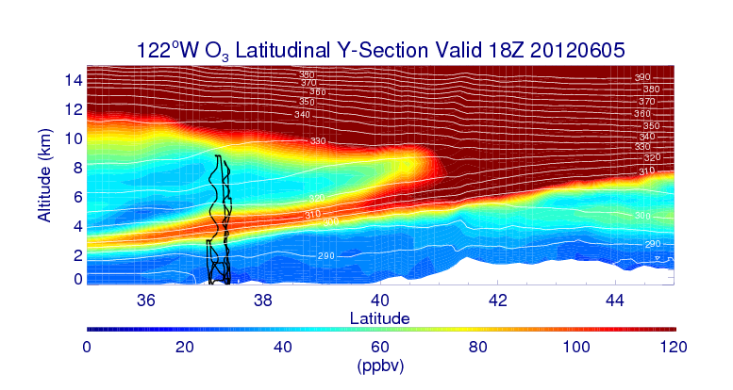
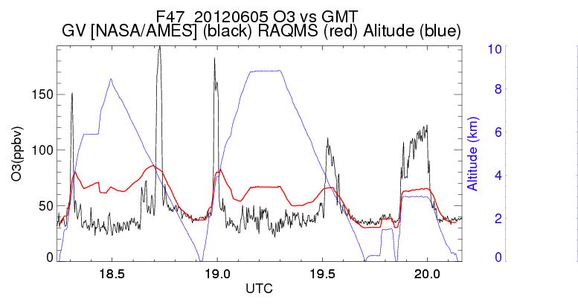
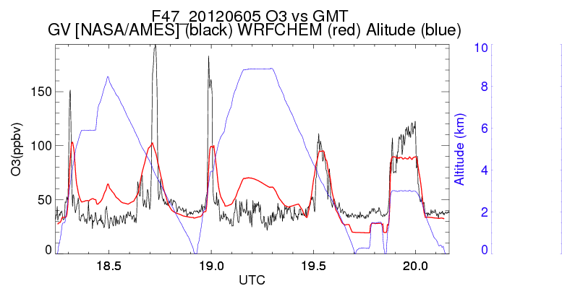
NASA AJAX Flight 47, June 5, 2012
RAQMS
Nested RAQMS/WRFCHEM
310K isentrope
RAQMS (red)
AJAX (black)
WRFCHEM (red)
AJAX (black)
(A)
(B)
(A)
(B)
Nested RAQMS/WRFCHEM simulations significantly improve the agreement with AJAX measurements during the off-shore spiral (B) but still underestimate ozone within the narrow filament sampled during the spiral over the San Joaquin Valley, CA (A)

Slide 5
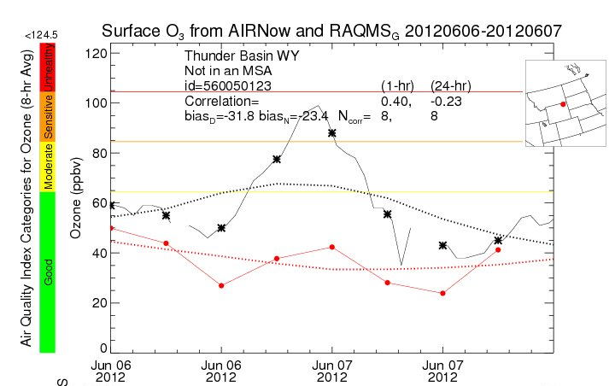
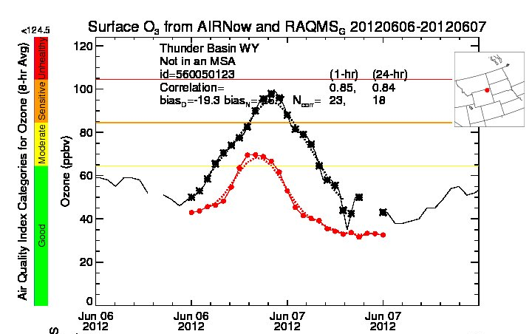
June 6-7, 2012 Surface ozone comparison: Thunder Basin, WY
RAQMS
Nested RAQMS/WRFCHEM
Surface O3 from AIRNow and RAQMS
Surface O3 from AIRNow and Nested RAQMS/WRF-CHEM
RAQMS (red)
AIRNow (black)
WRFCHEM (red)
AIRNow (black)
Improved estimates of ozone within the SI event lead to significant improvements (19.3 vs 31.8ppbv daytime bias) in predictions of ozone at the Thunder Basin, WY surface site in the nested RAQMS/WRF-CHEM simulation.
However, peak ozone mixing ratios are still underestimated by nearly 30ppbv

Slide 6
NO2 trends associated with Oil and Gas Extraction
A. R. Russell, L. C. Valin, and R. C. Cohen, Trends in OMI NO2 observations over the United States: effects of emission control technology and the economic recession. Atmos. Chem. Phys., 12, 12197–12209, 2012 www.atmos-chem-phys.net/12/12197/2012/
doi:10.5194/acp-12-12197-2012

Slide 7
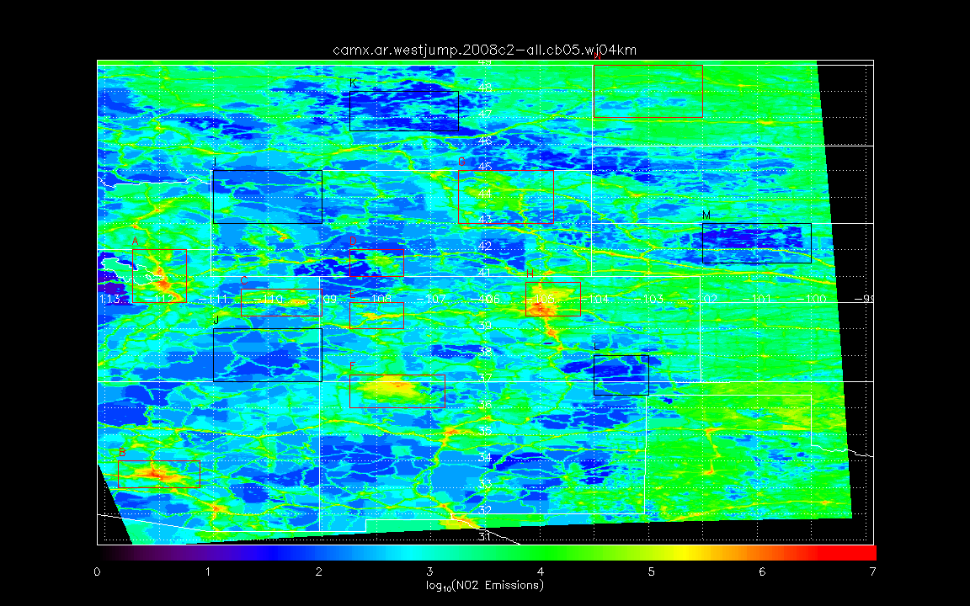
WRAP WestJumpAQMS Phase III O&G NO2 modeled/gridded emissions
(all area sources)
Provided by Tom Moore WRAP
Williston Basin
N Background
NW Background
Powder River Basin
E Background
Salt Lake City
Green River Basin
Denver
Denver-
Julesburg
Basin
SE Background
Uinta Basin
Piceance Basin
Phoenix
SW Background
San Juan Basin

Slide 8
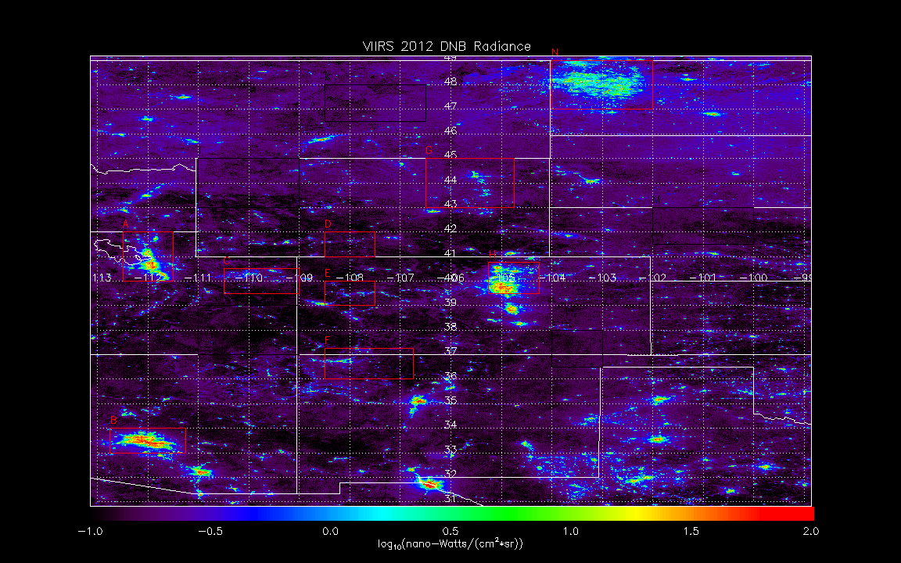
VIIRS DNB cloud cleared radiance composite (2012/4/18-26 and 2012/10/11-23)
(15 arc second)
Provided by NOAA NGDC
Williston Basin
N Background
NW Background
Powder River Basin
E Background
Salt Lake City
Green River Basin
Denver
Denver-
Julesburg
Basin
SE Background
Uinta Basin
Piceance Basin
Phoenix
SW Background
San Juan Basin

Slide 9
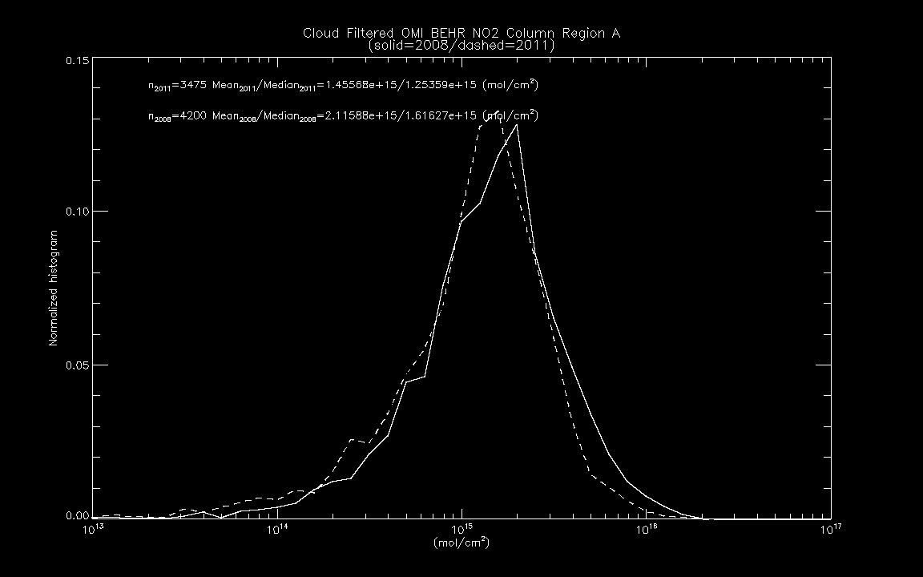
2008 vs 2011 OMI BEHR NO2 column
Region A: Salt Lake City
(OMI BEHR NO2 retrieval provided by Ron Cohen)
General declines in mean and median NO2 columns within the WestJumpAQMS urban OMI NO2 between 2008 and 2011.

Slide 10
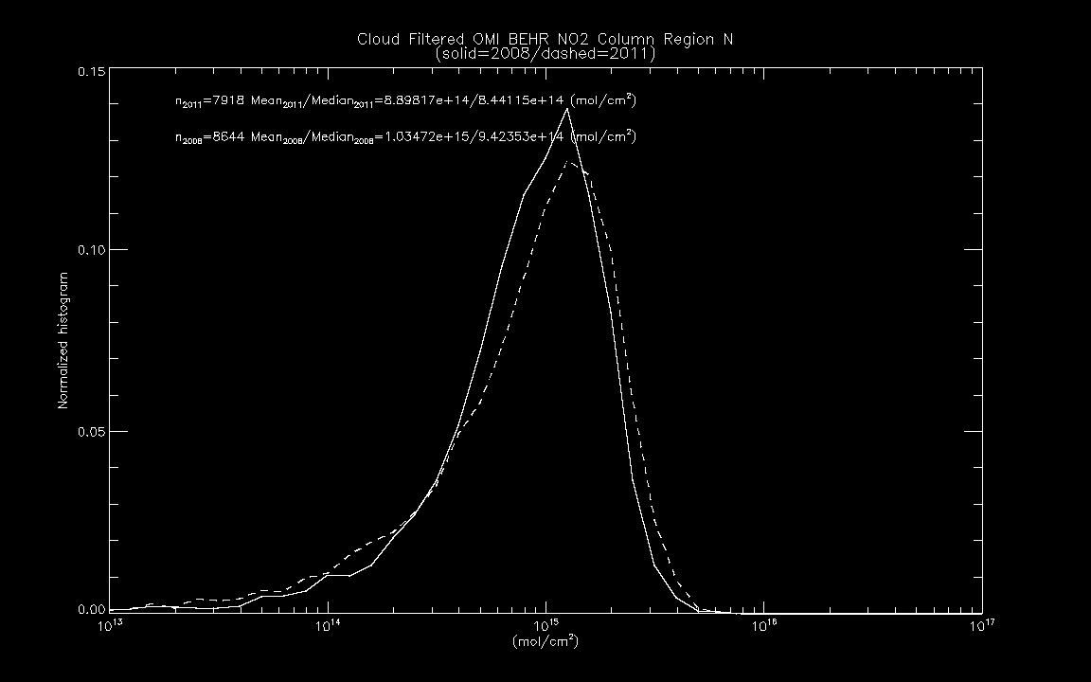
2008 vs 2011 OMI BEHR NO2 column
Region E: Williston Basin
(OMI BEHR NO2 retrieval provided by Ron Cohen)
Williston Basin shows (decrease/increase) in the frequency of (low/high) NO2 columns, respectively

Slide 11
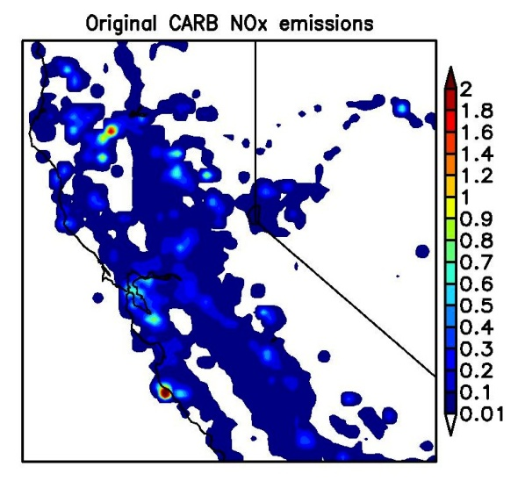
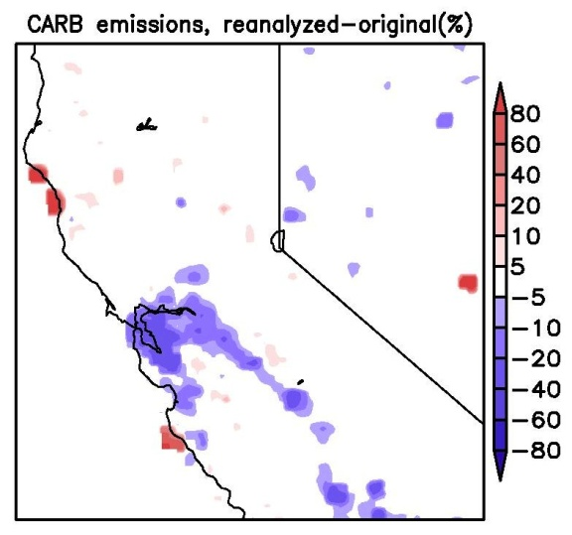
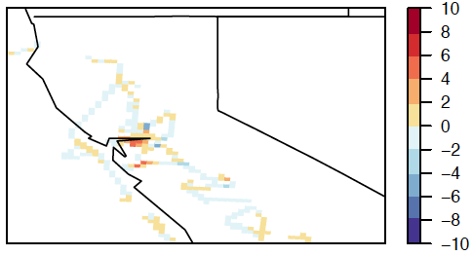
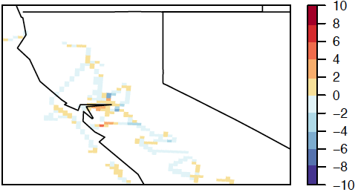
Impact of assimilating OMI NO₂ columns in STEM (before/after assimilation) on
near-surface (< 2 km a.g.l.) NO₂ along DC-8 flights
Assimilation of OMI reduced NOx emissions by ~1.7%:
-(5-20)% urban areas;
>+80% at some fire locations
10⁻⁹ kg/s/m²
STEM NO₂: Model-Obs along DC-8 flights in ppb
Before
After
Assimilation of OMI reduced NO₂ mixing ratios along DC-8 by ~10%,
and the error by ~8%, mostly occurred in the valley and the Bay area
Slides from Min Huang (min.huang@jpl.nasa.gov) AQAST 6th Biannual Meeting

Slide 12
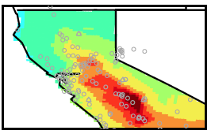
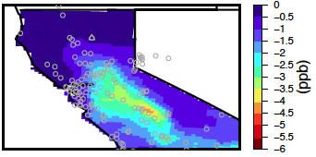
Impact of assimilating OMI NO₂ columns on STEM ozone:
Change in absolute mixing ratios near the surface
After assimilation
After-Before
Period-mean near-surface (<~2 km a.g.l.) daytime ozone
Contributions from US emissions on modeled ozone decreased by up to ~5 ppb after the assimilation.
This drop in ozone compensated the increases resulted from assimilating TES in GEOS-Chem - We repartitioned the ozone contributions from local and non-local sources.
Slides from Min Huang (min.huang@jpl.nasa.gov) AQAST 6th Biannual Meeting

Slide 13
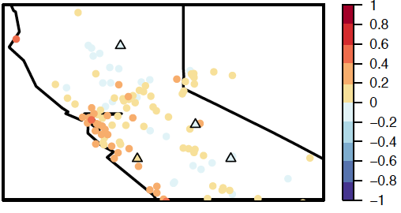
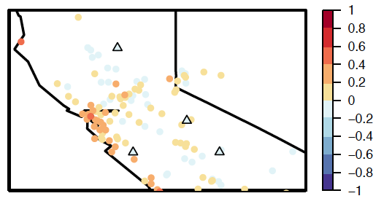
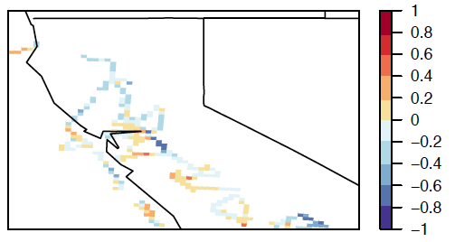
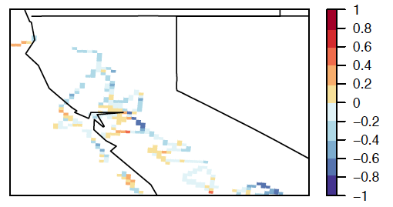
Impact of assimilating OMI NO₂ columns on STEM ozone:
Fractional bias (unitless): 2x(model-obs)/(model+obs)
Before
After
Period-mean surface (AQS & CASTNET) daily-max 8h average ozone
Mean:
0.10
Mean:
0.07
Period-mean “near-surface” (< 2 km a.g.l.) ozone along DC-8 flights
Mean:
-0.08
Mean:
-0.11
Assimilation reduced the positive biases near Sacramento-Fresno regions by 0.1-0.2
Not much improvement near the Bay area (VOC-limited chemical regime affected)
Slides from Min Huang (min.huang@jpl.nasa.gov) AQAST 6th Biannual Meeting

