Slide 1
Update on the Status of the (V)LIDORT Radiative Transfer Models
Robert Spurr, RT Solutions Inc.
9 Channing Street, Cambridge, Mass.
Second TEMPO Science Team Meeting
NIA, 21-22 May 2014

Slide 2
Outline of Talk
Quick LIDORT Family Overview (2 slides)
LIDORT/VLIDORT main codes
Other codes (RRS, FO,2STREAM,2OS,Mie/Tmatrix)
Upgrades to codes (8 slides)
Profile Jacobians at level boundaries
Thread-safe, OpenMP usage
Planck function Jacobians
New BRDF/Surface-leaving capabilities
Accelerated RT using PCA
New releases soon (3.7 LIDORT, 2.7 VLIDORT)

Slide 3
LIDORT Family Overview (1): LIDORT/VLIDORT
:
LIDORT and VLIDORT are multiple-scattering linearized discrete ordinate radiative transfer codes in stratified atmospheres. LIDORT is scalar (no polarization); generates radiance I. VLIDORT is vector (with polarization); generates Stokes 4-vector [I,Q,U,V] → fully compatible in every respect with the scalar LIDORT code.
The pseudo-spherical approximation - solar attenuation (before scattering) treated spherically. Diffuse (multiple) scattering in plane-parallel medium. Precise single scattering – Nakajima/Tanaka ansatz, delta-M scaling.
“Linearized codes” → able to simultaneously generate any number of analytically derived Jacobians (partial derivatives of I,Q,U,V) w.r.t. profile quantities (e.g. O₃) or total-atmosphere “column” quantities (e.g. total AOD, total O₃), or surface properties(e.g. albedo, wind speed).
Atmospheric and surface thermal emission, with Planck functions specified at surface and atmospheric levels. New for 2.7/3.7 release: profile Jacobians w.r.t. Planck functions in multiple-scattering situations → complete analytic derivation of temperature Jacobians in the thermal scattering regime.
The LIDORT/VLIDORT BRDF and “surface-leaving” supplements are separate modules providing necessary inputs to the main RT codes code. New for 2.7/3.7 release: white-sky and black-sky albedo scaling, revised water-leaving code.
Also, mean-value output is available (fluxes, actinic fluxes + Jacobians thereof).
Currently: Versions 3.6 (LIDORT), 2.6 (VLIDORT). Internet: www.rtslidort.com.
Codes in public domain. Available from RT SOLUTIONS (rtsolutions@verizon.net)

Slide 4
LIDORT Family Overview (2): Other codes
LIDORT-RRS code is a scalar LIDORT-based multiple-scattering RT code with rotational-Raman scattering by air molecules. Photons scattered inelastically just once; elastic scattering to all orders. Compatible with LIDORT when RRS is turned off. Linearized in 2011; vector model still under construction. This is research code.
FO (First-order) model: stand-alone fast/accurate fully linearized single scattering codes. Thermal Emission, BRDFs, etc. Fully compatible with other models.
2STREAM model is a fast multiple-scatter-only scalar code for TOA upwelling and BOA downwelling output. Just 2 discrete ordinates, fully linearized, pseudo-spherical, thermal emission, BRDFs. New for 2.4 release → Flux outputs.
2OS model is a second order of scattering code developed originally for OCO. Fast model to generate intensity corrections and polarization estimates. Currently undergoing upgrade to extend Jacobian capabilities.
Linearized Mie and T-matrix codes . Monochromatic or polydisperse. Usual choices of PSD (lognormal, gamma, etc.). Full Bimodal. Linearization: Jacobians of optical properties w.r.t. microphysical aerosol quantities: components of refractive index, shape factor (T-matrix), and PSD parameters.

Slide 5
Upgrades (1): Layer-to-level Jacobians
LIDORT is pure scattering model based on layer optical thicknesses, single-scattering albedos, and phase-function expansion coefficients. Profile Jacobians output w.r.t. layer quantities, either optical properties themselves or quantities such as the column of ozone in a given layer.
However, layer optical inputs are usually constructed from atmospheric physical quantities defined at level boundaries (e.g. pressure and temperature, trace species VMRs). Question: how to get RT Jacobians w.r.t. these level quantities, given the layer Jacobian output from LIDORT?
During optical property setups, need to develop derivatives of layer optical inputs w.r.t. level atmospheric quantities, then apply a series of chain-rule transformations to the LIDORT output after the RT calculation.
Useful for things like temperature and VMR Jacobians. T-Jacobians in the thermal scattering regime require extra consideration (see later).
Technote. Spurr and Christi, JQSRT, 142,109 (2014).

Slide 6
Upgrades (2): Running in OpenMP
Feedback - in the last year, a number of users have asked about using thread-safe LIDORT code in the OpenMP distributed parallel-computing environment.
Some codes (FO, non-linearized parts of 2STREAM) found to be compatible with OpenMP immediately, but main models not so.
Typical application. Hyperspectral calculation; many calls to LIDORT. Only the optical inputs change from wavelength to wavelength → in this case, thread setups in OpenMP do not take up much overhead, should lead to good timing results.
Spring 2014: entire LIDORT package has now been made thread-safe for OpenMP → next release (3.7) will contain test-case examples on how to set this up. First customer usage May 2014 with AMFs in DOAS setup, reports “excellent scalability” (close to 4x faster for 4-core CPU).
Summer 2014: VLIDORT code to be made thread-safe and tested in OpenMP → next release (2.7) will contain test-case examples.

Slide 7
Upgrades (3): Black-body Jacobians
In the solar-only regime, LIDORT and VLIDORT have always had ability to generate temperature (T) Jacobians for the light field; only the input optical properties have T-dependence (e.g. O3 cross-sections).
In the thermal regime, optical properties and Planck functions are T-dependent (the latter directly so).
In the thermal transmittance-only mode (no scattering), it is relatively easy to generate T-Jacobians using Planck function derivatives. This has been implemented in VLIDORT.
So far in the models, there has been no way to pick up the Planck-function T-dependence in thermal emission situations where multiple scattering is present (either in thermal-mode only, or in the cross-over region with thermal and solar sources together).
This situation has now been remedied, and the entire discrete ordinate RT model now has analytic differentiation (linearization) with respect to the Black-body (BB) functions.
Final level-boundary T-Jacobians in this situation are now obtained after the LIDORT call, by combining regular layer-output optical-property profile Jacobians converted to level T-Jacobians (see earlier slide) and the new BB Jacobians multiplied by the appropriate Planck-function temperature derivatives.

Slide 8
Upgrades (4): BRDF/SLEAVE supplements
BRDF supplement generates the total BRDFs required for running LIDORT/VLIDORT. Exact BRDF ρ(μ,μ₀,φ−φ₀) for direct-bounce term, BRDF Fourier components ρ_{m}(μ_{i},μ_{j}) for the reflection of diffusely-scattered light.
BRDF supplement is fully linearized with respect to surface properties (e.g. wind speed) BRDF code formerly inside the RT models; now separate. Better modularity, easy to change.
BRDFs based on 3-kernel MODIS-type inputs (e.g. Ross-thin, Li-sparse), with additional options for glint reflectance. Kernels are semi-empirical models, to be used with caution (e.g. negative values).
Following feedback from a number of users (some in this room!), a new facility has recently been introduced for scaling the calculated 3-kernel total BRDFs with either the white-sky albedo or the black-sky albedo.
SLEAVE (Surface-leaving) supplement generates (sun-normalized) radiance source at the surface, for direct and diffuse light. Applications: fluorescence from vegetation surfaces; water-leaving light from ocean. Also fully linearized. SLEAVE fluorescence is currently isotropic.
Currently, water-leaving based on isotropic model of ocean optics (OO), with no attenuation across the ocean surface. Currently, just finished upgrade to include rough surface treatment including whitecap correction, more recent OO modeling and finite transmittance across the surface.

Slide 9
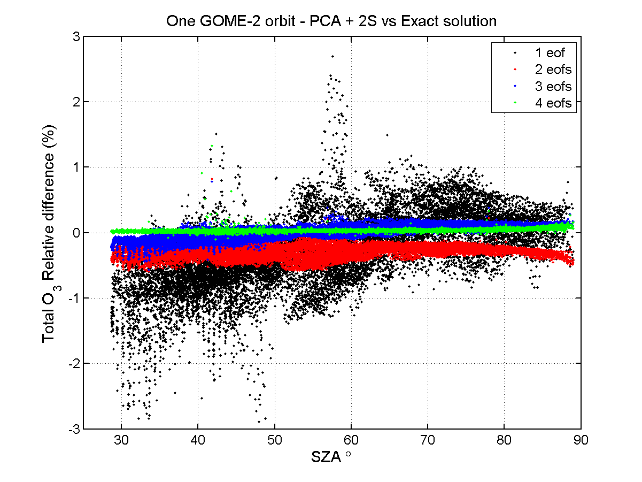
Upgrades (5): Accelerated RT using PCA
Set of profile optical properties (e.g., optical depths + single scattering albedos, 325-335 nm Rayleigh + O3 absorption).
Remove mean of this set, then perform PCA on it→ Use small set of “dominant” profiles (Mean and first few significant EOFs) as input to LIDORT and 2Stream multiple-scatter calculations → Use Principal Components to get correction factors → Use 2Stream and FO to get approximate fast-model radiances, then correct them.
Example: Relative differences in retrieved total ozone for one GOME-2 orbit; PCA using 1, 2, 3, 4 EOFs. Performance enhancements 4.16, 3.83, 3.50 and 3.08 compared to “full”.
LIDORT/2S/FO with PCA tool has now been upgraded to entire UV/Vis/SWIR solar source range; thermal regime currently under investigation; we have also looked at performance enhancement for fluxes (climate modeling application)
Started PCA work in UV with VLIDORT, 2STREAM, FO (next slide).

Slide 10
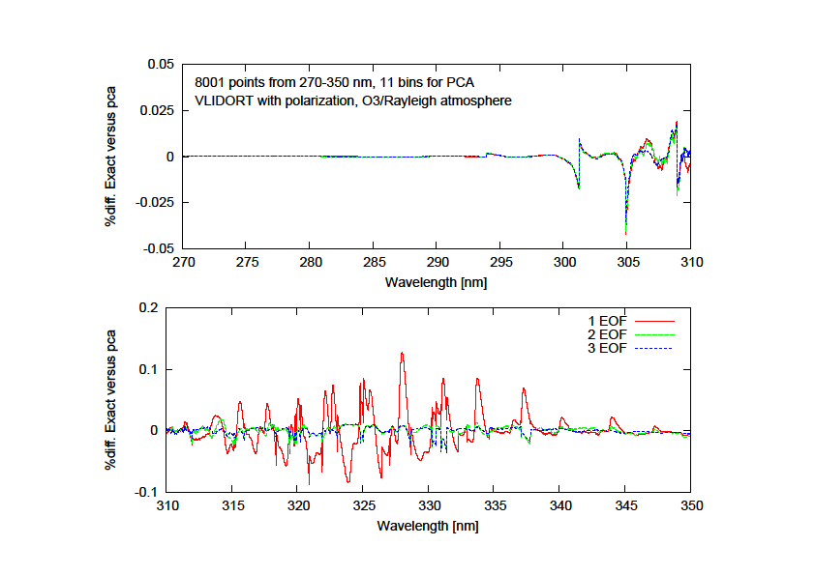
Upgrades (5): Accelerated RT using PCA
Example (data from X. Liu)
8001 points 270-350 nm, 11 bins for PCA, determined at decadal intervals of Log(total optical depth).
Albedo 10%, Rayleigh atmosphere + ozone (340 DU). 8 half-space streams, 47 layers, 2 geometries.
VLIDORT vector mode, 2S in scalar mode → only correction factors for I.
Timing FO VLIDORT extras 2S PCA TOTAL Faster
Exact 0.50 4799.23 0.10 --- --- 4799.88 ---
1 Eof 0.43 19.71 0.03 3.57 1.53 25.29 x 189.8
2 Eof 0.42 32.86 0.03 3.57 1.52 38.43 x 124.9
3 Eof 0.46 46.11 0.03 3.50 1.53 51.57 x 92.9

Slide 11
Upgrades (6): New (V)LIDORT releases
Been a while (~2 years) since last releases for both codes. Plan this summer to release versions 3.7 (LIDORT) and 2.7 (VLIDORT) concurrently, with the same upgrades for both models:
Taylor-series expansions for closely-adjacent polar-stream directions; purpose - to avoid spikes and singularities (especially in Jacobians). Half-done in 2.6/3.6: Expansions now extended and generalized to all cases.
New facility for generating Black-body (Planck function) Jacobians in the thermal regime including multiple scattering.
Supplement upgrades: Albedo-scaling options (BRDF) and extensions to the water-leaving source terms (SLEAVE)
Thread-safe code usable in OpenMP environment
Also, a while since the last LIDORT review paper came out in 2008 (in Light Scattering Reviews, Number 3). There has been many changes since then, over several versions of the codes. A major review paper is now under way. RT Solutions web site was upgraded last year.

