Slide 1
Project Overview
Wendy Pennington, TEMPO Instrument Project Manager
Science Team Meeting
Langley Research Center
May 21, 2014
(757).864.7126
Wendy.f.,pennington@nasa.gov

Slide 2
Project Management Overview Agenda
Remember the Cake!
Agenda
Organization
Key Issues and Concerns
Accomplishments
Our Health
My Assessment
Chief Engineer’s Assessment
Schedule
Conclusion
February 7, 2013

Slide 3
TEMPO Organization
Earth Science Division
Mike Freilich
Steve Volz
PE: Betsy Edwards
PS: Alex Pzenny
ESSP PO
Mission Manager: Diane Hope
TEMPO Instrument Project
PI: Kelly Chance
Deputy PI: Xiong Liu
Investigation Advisory Panel
Science Advisory Panel
Color code
Science Team
Instrument Project
Mission Project
Mission Project Manager: Alan Little
Mission Project
Coordination of Mission activities
Instrument Management
Instrument PM: W. Pennington
Instrument DPM/COR: Craig Jones
CE: Dave Rosenbaum
Project Scientist: David Flittner
Deputy PS: Jay Al-Saadi

Slide 4
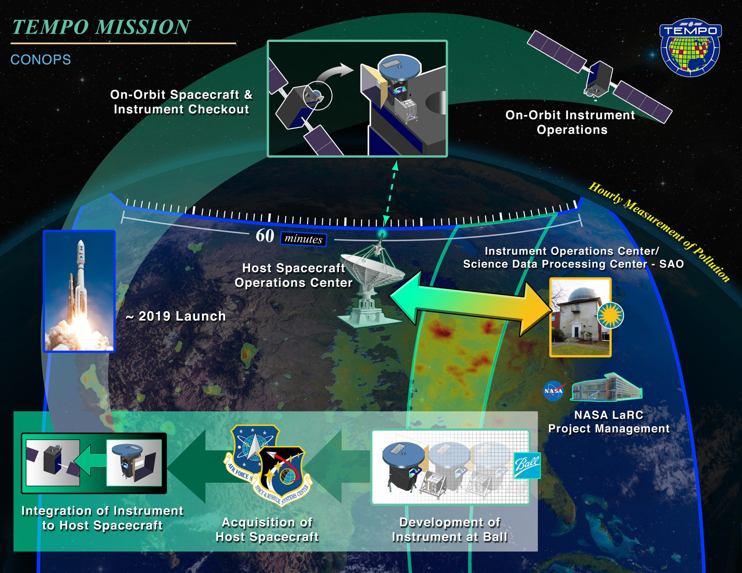
Concept of Operations

Slide 5
Technical Issues and Concerns Same as last year
S/C Interface and Environments Definition
TBD Interfaces between the Instrument and the Host Spacecraft, and the SOC and the IOC will be updated through studies with Host Spacecraft providers and finalized after the Host Spacecraft is selected.
Key challenge is to limit “Over-Engineering” the Instrument design while enveloping options with considering Instrument and Mission System costs
Instrument to Host Interface Requirements Document is baselined
Cost cap is challenging… Evaluating opportunities to reduce cost while incurring acceptable technical risk
Still challenging! Independent Estimates indicate much higher cost
We have made great strides solving hard problems, closing on technical trades and keeping cost risk low
Passed a key milestone –Key Decision Point B, approval to go to Phase B

Slide 6
Instrument Project Risk Summary
Issues:
0524: SNR Margin
Instrument Project:
“Red” Risks
(No change)
“Yellow” Risks
“Green” Risk
(No change)
0
4
1
This period:
10: Combined Development Implementation
12: INR Dependency on GOES-R
0
“New” risks identified
03: Ozone Retrieval Performance
0
“Closed” risks
09: Deviation from Shared Design
⬆
02: Orbital Longitude
WBS 5.0 risks below reviewed in detail at RMB. No risks to be elevated above WBS 5.0 at this time.
WBS 5.0
Specific:
0524: SNR Margin
0536: Spectral Features
0520: N/S MTF
0546: Space Charging Mitigations
0528: CCD Yields
⬆
0547: Stray Light
0538: FPE Cable Length
0549: Cal Transfer
New
0563: ICE Thermal Mitigation Impacts
0548: Spectral Stability

Slide 7
Accomplishments
September -Completed Instrument Contract Award
October- Government Shutdown 3 weeks
November - Completed SRR/MDR successfully (12 RFAs)
Requirements baseline
January-Established Resources Control Board-Kelly Chance Chair
Finalized multiple instrument trade studies and analyses
April-Completed Key Decision Point-Phase B Review
Approval to proceed through Phase B
April-Conducted Integrated Baseline Review at Ball
Verified Ball Performance Measurement Baseline, Earned Value Management reporting
April- Conducted Science Performance/Instrument TIM
May-INR requirements complete and error budgets finalized

Slide 8
TEMPO Instrument Manager’s Assessment
Program/Project: TEMPO Instrument
Status as of: 5/19/14
G
Progress according to plan. Meeting management plans or commitments.
No action required.
R
Significant problem. Deviating from plans or commitments, with insufficient approved
contingency/reserves to recover and successfully complete the program/project as approved.
Needs action. Help required beyond the reporting organization to address the problem.
Y
Area of concern. Deviating from plans or commitments, but approved contingency/reserves exists to recover and successfully complete the program/project as approved. Needs attention. Problem can be resolved within the reporting organization.
B
Change to original Baseline
Notes:
Purpose: This is the Project Manager’s assessment of the health of the project. The assessment should be based on the latest available information and performance to date.
CPMC is generally on a Wed. with charts due to SMO by COB the previous Monday. Cost assessment should be on actual information available through the previous Friday. (See next hart for further information)
Risks that have not yet occurred should not turn a cost, schedule or technical area to a higher level of concern, they should be documented and discussed in the Risk chart
The assessment should be supported by performance indicators on technical, schedule, cost and workforce charts in the package. Once presented, previous month’s assessment colors should not change.
Cost
Evaluate how the Program/Project budget is performing (EAC-Estimate At Complete) against the approved Program/Project Plan* budget (BAC-Budget At Complete), and FY Actual versus Planned performance. A recovery plan should be included for any delta from plan that is greater than 15%.
Schedule
Evaluate how the Program/Project schedule is performing to ensure major milestones and the Program/Project delivery date(s) approved in the Program/Project Plan* are met, consider remaining reserve, slack, critical path and milestone completion performance in assessment. A recovery plan should be included for any delta from plan that is greater than 15%.
Technical
Evaluate how the Program/Project is meeting the requirements that are documented in the approved Program/Project Plan* or Requirements Document
Management Issues
Evaluate management products/processes and other management responsibilities to ensure ability of the Program/project to meet commitments, such as: staffing levels, skill mix, facility infrastructure, external agreements, acquisition, documentation development and approvals, etc. If there is an area of concern that doesn’t show up in cost, schedule or technical include it here.
* If used in formulation, report against appropriate approval document

Slide 9
Engineering Score Card
Tech | Sched | Area | Comments
 |  | Overall Assessment | Instrument Technical Issues/Concerns resolved. IOC/SDPC preliminary design efforts in progress. Normal engineering work to do to prepare for PDR. PDR date is not on the critical path.
 |  | Systems Engineering | Requirements flow down and error budgeting almost complete. Requirements database development/population going very well. Performance Model, INR Simulation Model, and Instrument Radiometric Math Model development work continues.
 |  | Instrument | Instrument performance requirements identified as being difficult to meet as preliminary design concept has matured have been resolved. Trade Studies and Analyses in work to complete preliminary design. Tabletop and Peer Reviews continuing (en masse). Specification, schematic, drawing, document releases continuing. Completed Integrated Baseline Review.
 |  | Instrument to Spacecraft Interfaces and Environments | Instrument Project is proceeding with designing to IHIRD 25 W/m² thermal backload requirement. Provides for path forward, but might severely limit host opportunities or be a very expensive accommodation cost later on. Mission to add this to their risk list.
 |  | Ground Systems (IOC/SDPC) | Requirements flow down and error budgeting in progress. Preliminary design peer review held 05May14 indicates normal engineering work to go to get to PDR readiness. Software Management Plan almost complete.
LEGEND DEFINITIONS
Green. Progress according to plan. Meeting management plans or commitments. No action required.
Yellow. Area of concern. Deviating from plans or commitments, but approved contingency/reserves exists to recover and successfully complete the program/project as approved. Needs attention. Problem can be resolved within the reporting organization.
Red. Significant problem. Deviating from plans or commitments, with insufficient approved contingency/reserves to recover and successfully complete the program/project as approved. Needs action.

Slide 10
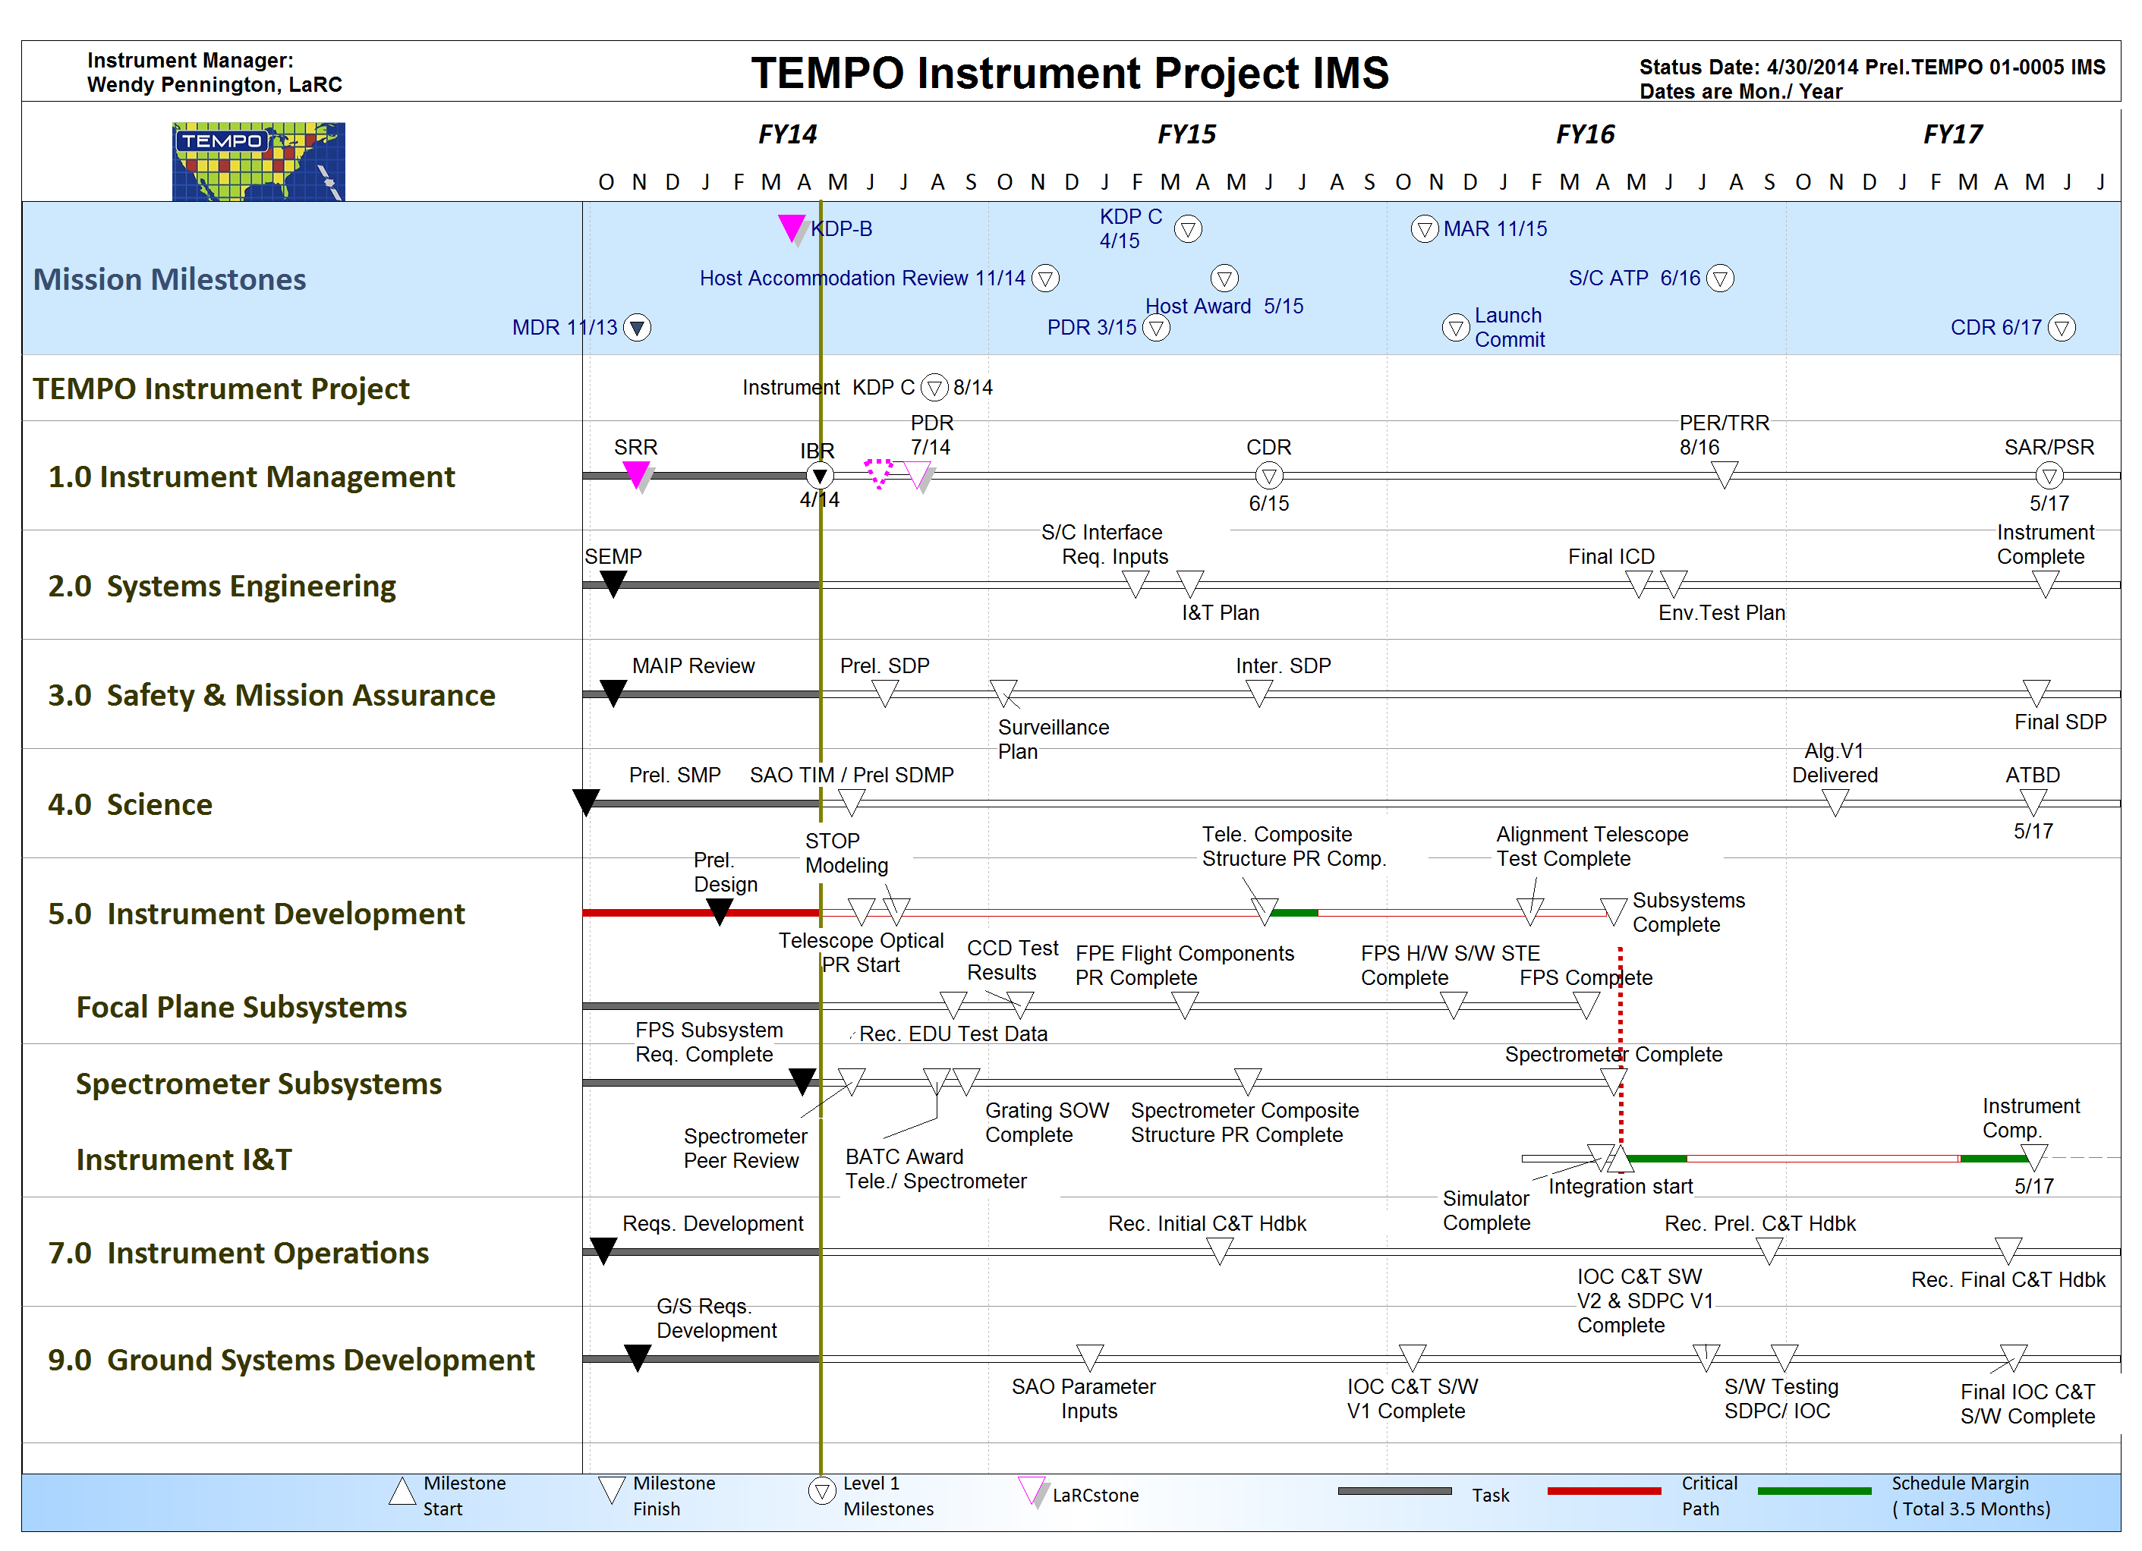
TEMPO Instrument Project IMS
7/15/14
8/15/14

Slide 11
Conclusion
The TEMPO IP Team is well established and working well together-making agreements, communicating openly
Project Control is in place
Established technical interface baselines with few TBDs left
If everyone is moving forward together, then success takes care of itself.
Henry Ford

