Slide 1
Overview of TEMPO Status
Kelly Chance
2nd TEMPO Science Team meeting
May 21, 2014

Slide 2

Team TEMPO!

Slide 3
Baseline and threshold
data products
Implementation of SO₂, C₂H₂O₂, and aerosols delayed until instrument cost and schedule risks retired
Likely ~October 2015
Derived UVB also delayed
All still ready for launch if successful
Clouds being implemented at present
Species/Products | Required Precision | Temporal Revisit
0-2 km O₃ (Selected Scenes) Baseline only | 10 ppbv | 2 hour
Tropospheric O₃ | 10 ppbv | 1 hour
Total O₃ | 3% | 1 hour
Tropospheric NO₂ | 1.0 × 10¹⁵ molecules cm⁻² | 1 hour
Tropospheric H₂CO | 1.0 × 10¹⁶ molecules cm⁻² | 3 hour
Tropospheric SO₂ | 1.0 × 10¹⁶ molecules cm⁻² | 3 hour
Tropospheric C₂H₂O₂ | 4.0 × 10¹⁴ molecules cm⁻² | 3 hour
Aerosol Optical Depth | 0.10 | 1 hour
PLRA Table 1
Minimal set of products sufficient for constraining air quality
Across Greater North America (GNA): 1819°N to 5857.5°N near 100°W, 67°W to 125°W near 42°N (worst case combo of instrument and host pointing; best case still 18-58)
Data products at urban-regional spatial scales
  Baseline ≤ 60 km² at center of Field Of Regard (FOR)
  Threshold ≤ 300 km² at center of FOR
Temporal scales to resolve diurnal changes in pollutant distributions
Collected in cloud-free scenes
Geolocation uncertainty of less than 4 km
Mission duration, subject to instrument availability
  Baseline 20 months
  Threshold 12 months

Slide 4
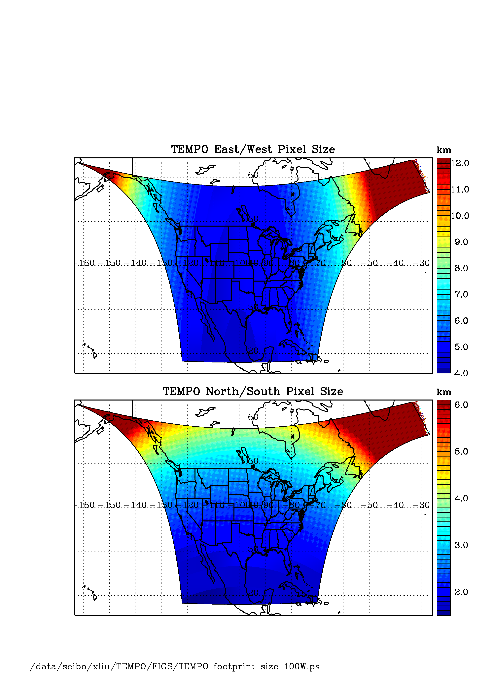
TEMPO footprint (GEO at 100º W)
Location | N/S (km) | E/W (km) | GSA (km²)
36.5ºN, 100ºW | 2.11 | 4.65 | 9.8
Washington, DC | 2.37 | 5.36 | 11.9
Seattle | 2.99 | 5.46 | 14.9
Los Angeles | 2.09 | 5.04 | 10.2
Boston | 2.71 | 5.90 | 14.1
Miami | 1.83 | 5.04 | 9.0
Mexico City | 1.65 | 4.54 | 7.5
Canadian tar sands | 3.94 | 5.05 | 19.2
Assumes 2000 N/S pixels
For GEO at 80ºW, pixel size at 36.5ºN, 100ºW is 2.2 km × 5.2 km.

Slide 5
TEMPO Milestones
Passed System Requirements Review and Mission Definition Review in November 2013
Passed KDP-B April 2014: Now in Phase B
PDR scheduled for late July 2014
KDP-C TBD

Slide 6
Technical issues
Most technical issues solved at the preliminary design level, following technical interchange meeting at Ball, April 2014.
Details in Ball instrument status talk

Slide 7
Meeting emphasis
TEMPO science studies during and after commissioning
Fluorescence
Lightning NO_{x}
Soil NO_{x}
NO/NO₂ at high dawn and dusk time resolution
Forest fires at high time resolution
Subsampling and spatial resolution
••••

Slide 8







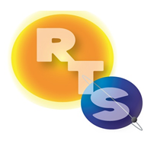


The End!

Slide 9
Backups

Slide 10
TEMPO Science
Traceability Matrix

Slide 11
TEMPO science team
Team Member | Institution | Role | Responsibility
K. Chance | SAO | PI | Overall science development; Level 1b, H₂CO, C₂H₂O₂
X. Liu | SAO | Deputy PI | Science development, data processing; O₃ profile, tropospheric O₃
J. Al-Saadi | LaRC | Deputy PS | Project science development
J. Carr | Carr Astronautics | Co-I | INR Modeling and algorithm
M. Chin | GSFC | Co-I | Aerosol science
R. Cohen | U.C. Berkeley | Co-I | NO₂ validation, atmospheric chemistry modeling, process studies
D. Edwards | NCAR | Co-I | VOC science, synergy with carbon monoxide measurements
J. Fishman | St. Louis U. | Co-I | AQ impact on agriculture and the biosphere
D. Flittner | LaRC | Project Scientist | Overall project development; STM; instrument cal./char.
J. Herman | UMBC | Co-I | Validation (PANDORA measurements)
D. Jacob | Harvard | Co-I | Science requirements, atmospheric modeling, process studies
S. Janz | GSFC | Co-I | Instrument calibration and characterization
J. Joiner | GSFC | Co-I | Cloud, total O₃, TOA shortwave flux research product
N. Krotkov | GSFC | Co-I | NO₂, SO₂, UVB
M. Newchurch | U. Alabama Huntsville | Co-I | Validation (O₃ sondes, O₃ lidar)
R.B. Pierce | NOAA/NESDIS | Co-I | AQ modeling, data assimilation
R. Spurr | RT Solutions, Inc. | Co-I | Radiative transfer modeling for algorithm development
R. Suleiman | SAO | Co-I, Data Mgr. | Managing science data processing, BrO, H₂O, and L3 products
J. Szykman | EPA | Co-I | AIRNow AQI development, validation (PANDORA measurements)
O. Torres | GSFC | Co-I | UV aerosol product, AI
J. Wang | U. Nebraska | Co-I | Synergy w/GOES-R ABI, aerosol research products
J. Leitch | Ball Aerospace | Collaborator | Aircraft validation, instrument calibration and characterization
D. Neil | LaRC | Collaborator | GEO-CAPE mission design team member
R. Martin | Dalhousie U. | Collaborator | Atmospheric modeling, air mass factors, AQI development
Chris McLinden | Environment Canada | Collaborator | Canadian air quality coordination
Michel Grutter de la Mora | UNAM, Mexico | Collaborator | Mexican air quality coordination
J. Kim | Yonsei U. | Collaborators, Science Advisory Panel | Korean GEMS, CEOS constellation of GEO pollution monitoring
C.T. McElroy | York U. Canada |  | CSA PHEOS, CEOS constellation of GEO pollution monitoring
B. Veihelmann | ESA |  | ESA Sentinel-4, CEOS constellation of GEO pollution monitoring

Slide 12
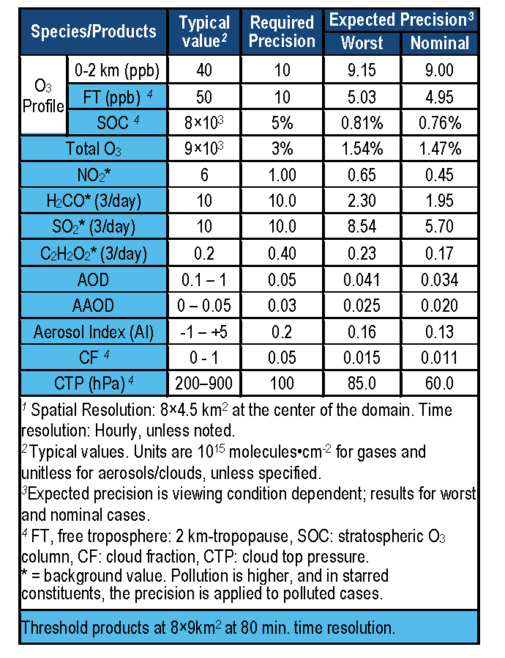
TEMPO baseline products
TEMPO has a minimally-redundant measurement set for air quality.

Slide 13
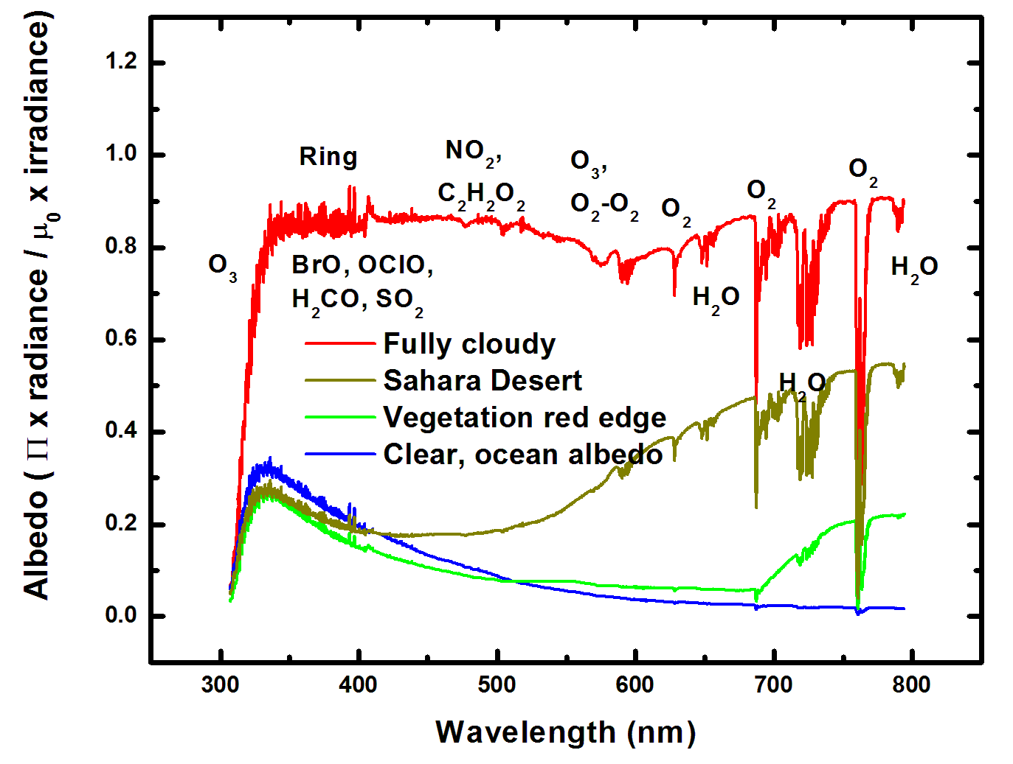
Typical TEMPO-range spectra (from ESA GOME-1)

Slide 14
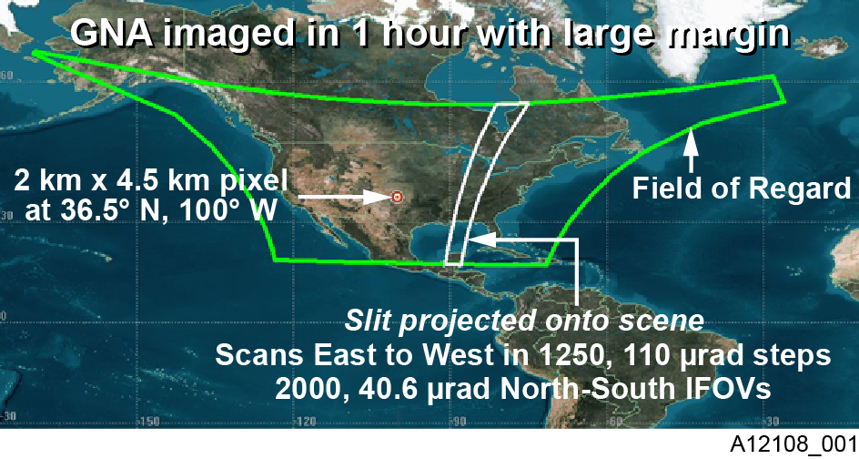
TEMPO footprint, ground sample distance and field of regard
2.1 km × 4.7
__________
Each 2.1 km × 4.7 km pixel is a 2K element spectrum from 290-740 nm
GEO platform selected by NASA for viewing Greater North America

Slide 15
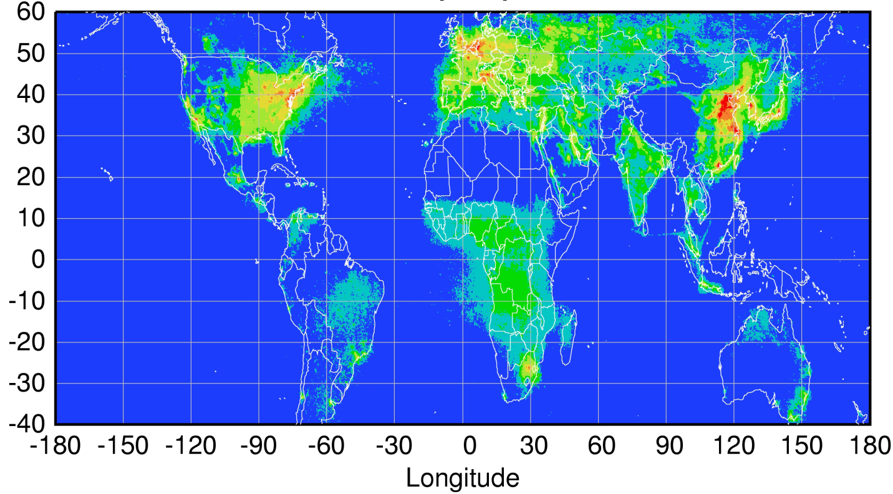
Global pollution monitoring constellation (2018-2020)
Sentinel-4
(hourly)
TEMPO
(hourly)
GEMS
(hourly)
Sentinel-5P
(once per day)
Courtesy Jhoon Kim,
Andreas Richter
Policy-relevant science and environmental services enabled by common observations
Improved emissions, at common confidence levels, over industrialized Northern Hemisphere
Improved air quality forecasts and assimilation systems
Improved assessment, e.g., observations to support United Nations Convention on Long Range Transboundary Air Pollution

Slide 16
Baseline and Threshold
Data Products
Species/Products | Required Precision | Temporal Revisit
0-2 km O₃ (Selected Scenes) Baseline only | 10 ppbv | 2 hour
Tropospheric O₃ | 10 ppbv | 1 hour
Total O₃ | 3% | 1 hour
Tropospheric NO₂ | 1.0 × 10¹⁵ molecules cm⁻² | 1 hour
Tropospheric H₂CO | 1.0 × 10¹⁶ molecules cm⁻² | 3 hour
Tropospheric SO₂ | 1.0 × 10¹⁶ molecules cm⁻² | 3 hour
Tropospheric C₂H₂O₂ | 4.0 × 10¹⁴ molecules cm⁻² | 3 hour
Aerosol Optical Depth | 0.10 | 1 hour
PLRA Table 1
Minimal set of products sufficient for constraining air quality
Across Greater North America (GNA): 18°N to 58°N near 100°W, 67°W to 125°W near 42°N
Data products at urban-regional spatial scales
  Baseline ≤ 60 km² at center of Field Of Regard (FOR)
  Threshold ≤ 300 km² at center of FOR
Temporal scales to resolve diurnal changes in pollutant distributions
Collected in cloud-free scenes
Geolocation uncertainty of less than 4 km
Mission duration, subject to instrument availability
  Baseline 20 months
  Threshold 12 months

Slide 17
Data Product Definitions and Details
Data Product | Description | Time beyond on-orbit checkout to deliver initial data | Maximum data latency after first release for ≥ 80% of all products†
Level 0 | Reconstructed, Unprocessed Instrument Data | 2 months | Within 2 hours of receipt at SAO
Level 1b | Calibrated, Geolocated Radiances | 4 months | Within 3 hours of Level 0 and ancillary data receipt at SAO
Level 2 | Derived Geophysical Data Products | 6 months | Within 24 hours of production of Level 1 at SAO
Level 3 | Derived Gridded Geophysical Data Products | 6 months | 1 month after completion of data accumulation required for individual geophysical products
All original observation data and standard science data products listed here, along with the scientific source code for algorithm software, coefficients, and ancillary data used to generate these products, shall be delivered to the designated NASA SMD/ESD-assigned DAAC within six months of completion of the prime mission. Data products are publicly distributed during the mission.
†80% of the products, not 80% of the product types, will be produced within this latency time.

Slide 18
TEMPO

