Slide 1
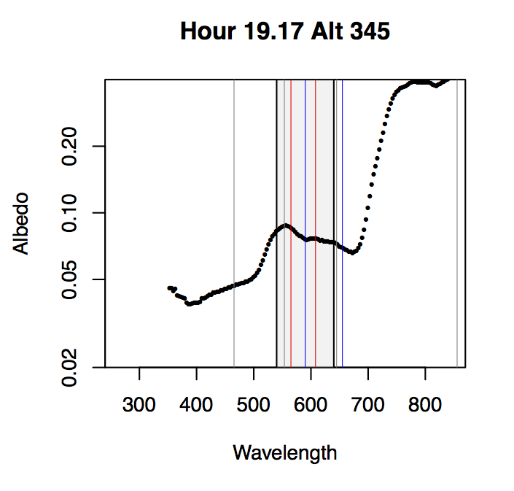
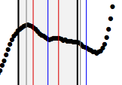
Defining a slope across the Chappuis core region:
(is just a slope enough?) R.Chatfield, NASA Ames
Chappuis
“horn”
Chappuis
“horn”
slope
Strong
H2O
line
Strong
H2O
line
Higher Albedo,
Vegetation +
Soil/Road/DrA(λ)
MODIS
line
centers
Real Curvature
Here at 550 nm
Huge Credit to
S.-Schmidt/Pilewskie group
at CU Boulder, esp. Bruce Kindel
These are simple ratios of upward to downward:
all low altitude (0-500 m), minimal aerosol effect

Slide 2
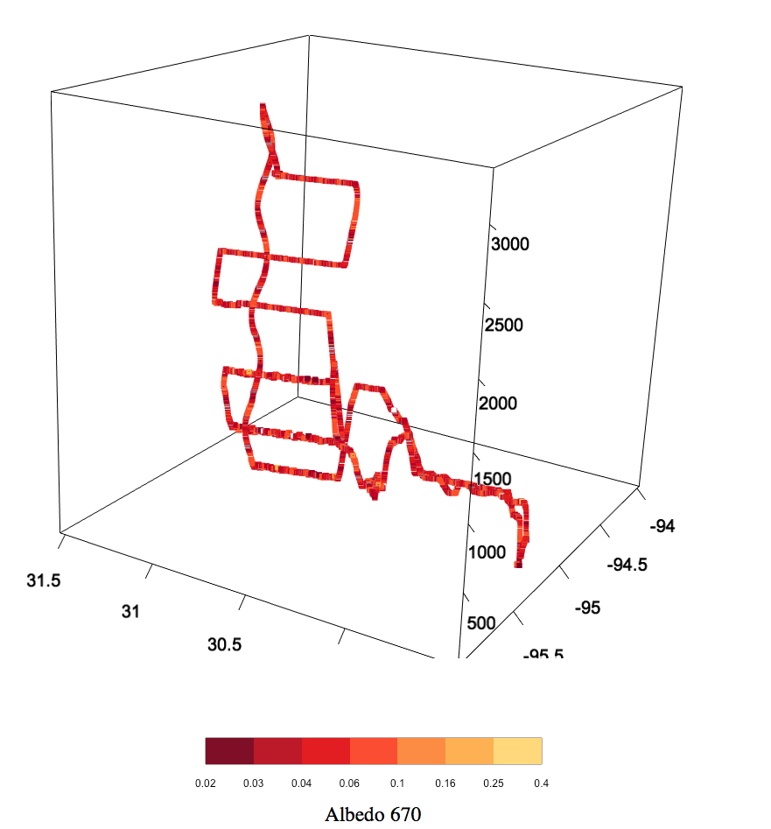
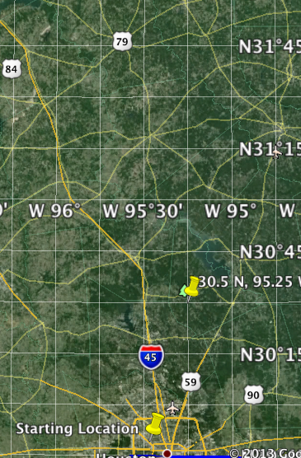
Solar spectrum flux radiometer (CU-Ames) provides the best-understood, most direct evidence about spectral shape
Flight path north of Houston, 2006, mostly vegetated
“Half of SSFR's signal (not an imager but irradiance radiometer) comes from within a cone that has a ground cross-section about the same as the flight altitude” Sebastian Schmidt
Credit to
S.-Schmidt /Pilewskie group
at CU Boulder, esp. Bruce Kindel

Slide 3
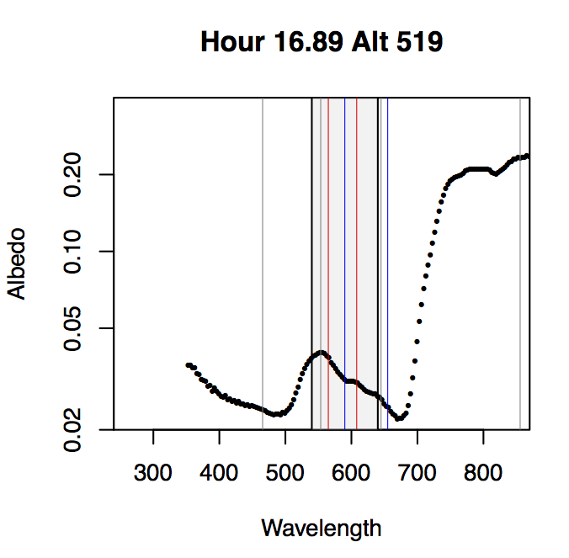
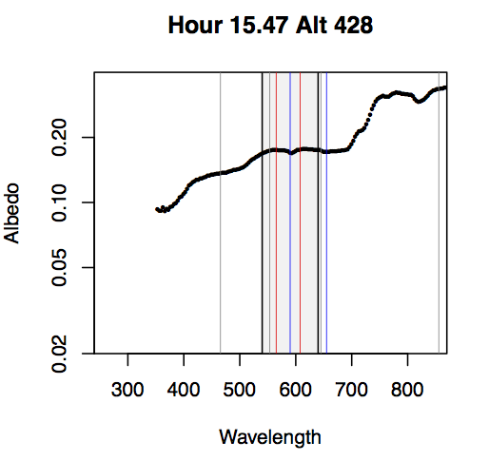
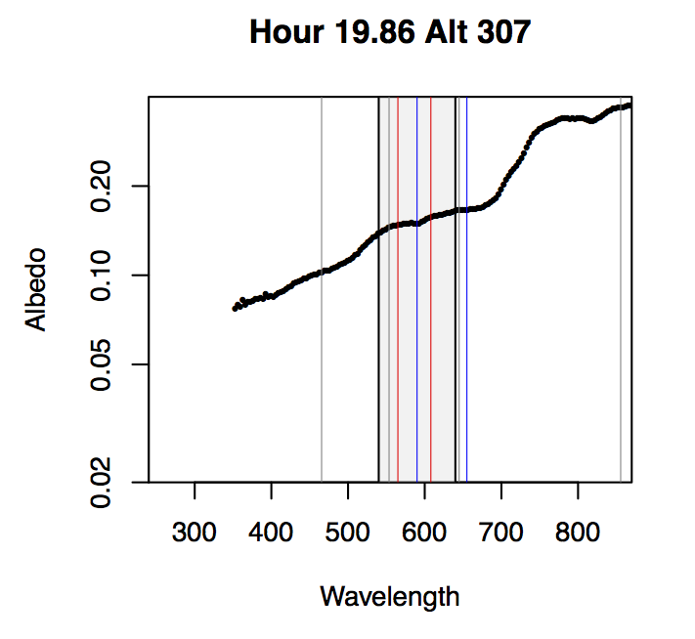
Examples of naïve albedo from SSFR data: ratio of upward flux to downward flux: this spotlights our concern: λ-variation
Soil/Road/Dry A(λ)
? Red Soil ?
Vegetation A(λ)
What happens with drought, Ozone damage?
Yellowing?
These are simple ratios of upward to downward:
all low altitude (0-500 m), minimal aerosol effect

Slide 4
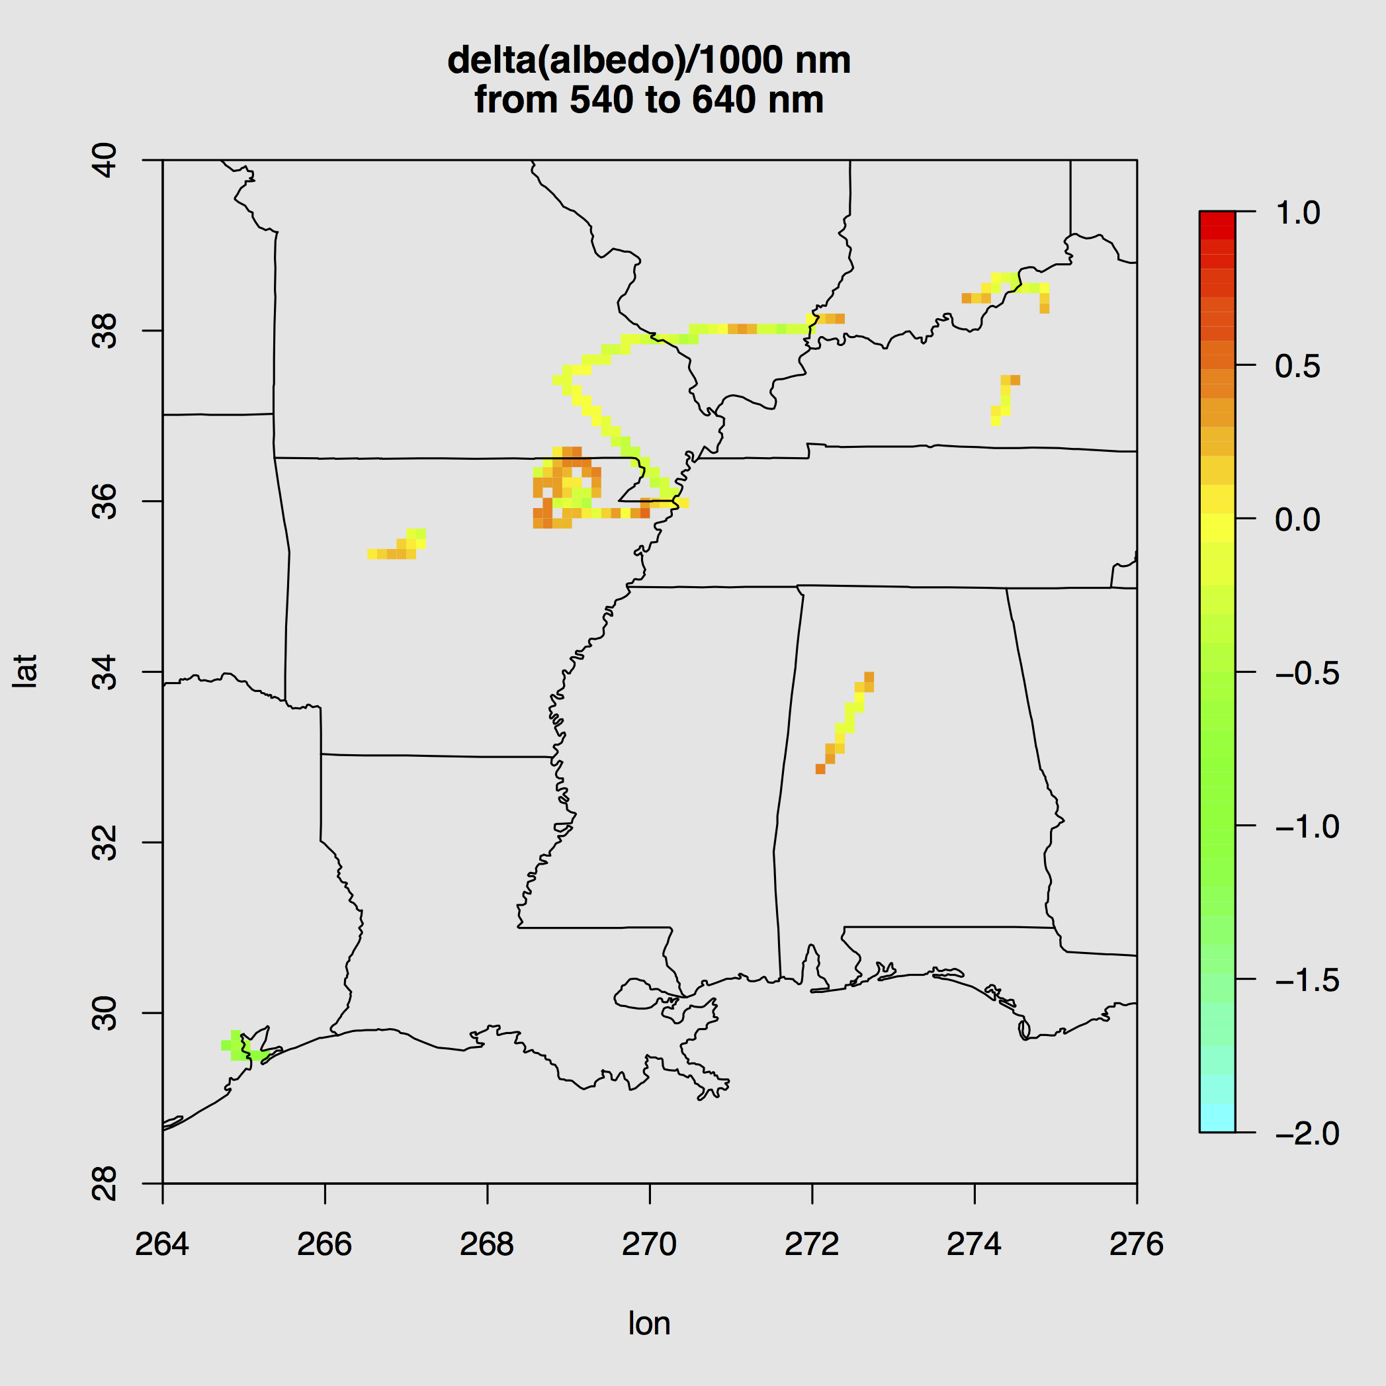
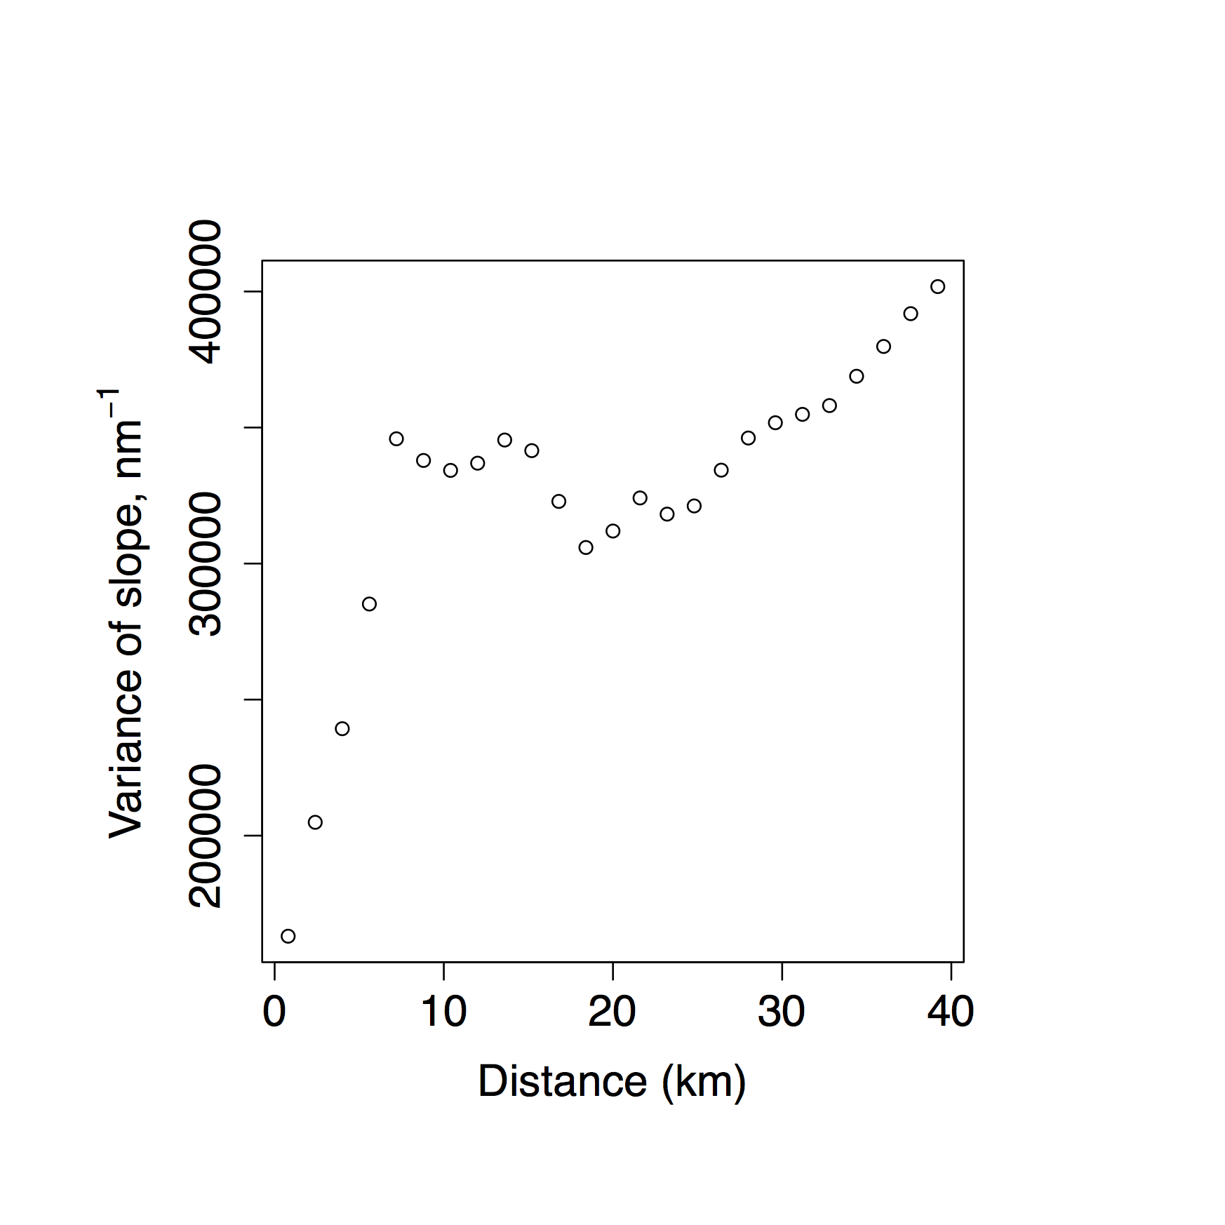
Slopes can change very rapidly over < 6 km, but there are also broad regional patterns
slope
Higher Albedo,
Vegetation +
Soil/Road
Δ A(λ) / Δ λ
Map of slopes, unitless/(1000 nm)
August/ September 2013
Variogram shows strong increase of variability of slope up to 10 km, …then similar variability up to 40 km

Slide 5
Analysis Overview
General direction of tasks:
• Identify “types” and “mixtures” using aircraft data to check and extend “pure-land-use” (lab) albedo. What might we be missing?
• Chose “components” method, paying attention to advice from MODIS land-use scientists.
• Produce sample dA/dλ descriptions with 2–3 degrees of freedom per description, or as TEMPO instrument error covariances mandate (do small 10-nm features matter?)
MAIAC:Repeat analysis Albedos in MODIS bands at 0.5–1 km resolution, with careful multi-footprint filtering and rationalization (in time and space domains). Lyapustin data will be available to GEO-CAPE (Aerosol) group by late March.
R.Chatfield, NASA Ames Robert.B.Chatfield@nasa.gov
ADDITIONAL SLIDES

Slide 6
Usefulness of Some RT “Modeling”

