Slide 1
Image Navigation and Registration (INR)
James L Carr, Co-I (INR)
May 21, 2013
(301).220.7350
jcarr@carrastro.com

Slide 2
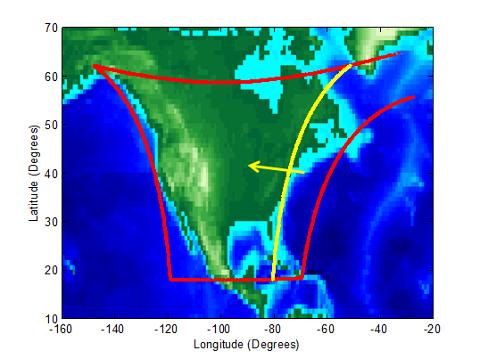
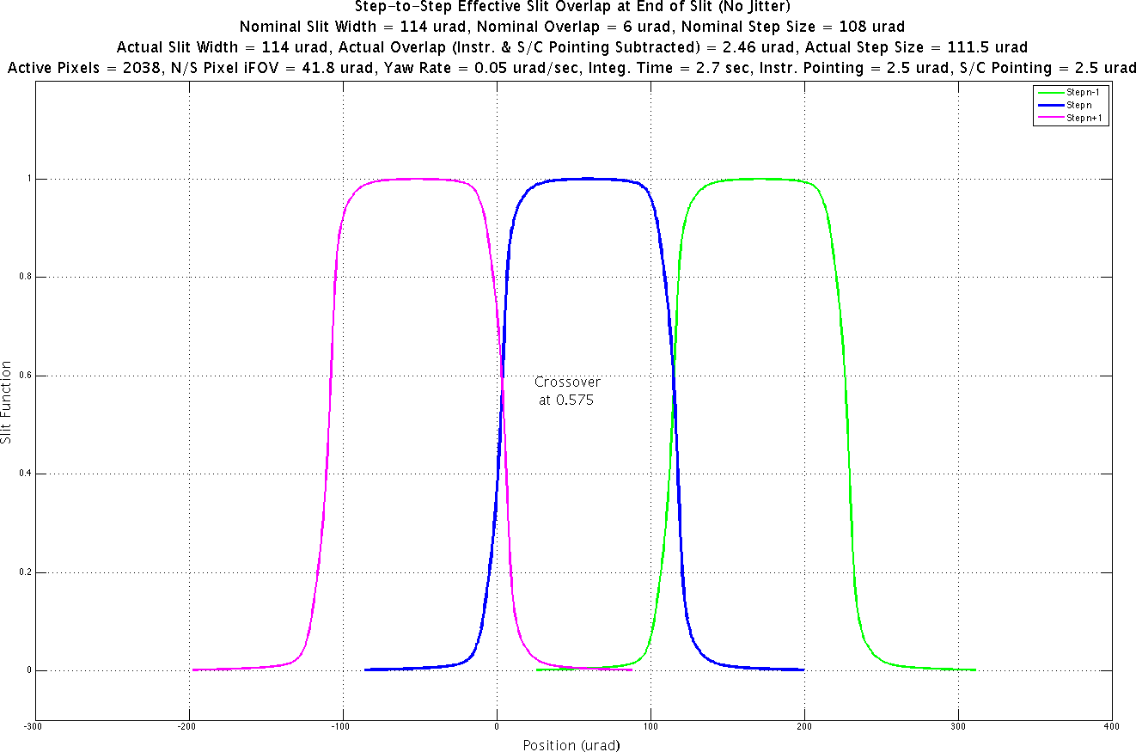
INR System Objectives
Provide geographic
coordinates for all
pixels in the data cube.
Control the Line-of-Sight for:
< 82 μrad uncertainty (3σ) everywhere.
Maps to 4km at center of Greater North America (GNA) for a satellite at -100° longitude.
(a) Spatially Uniform Sampling
(b) Gapless Coverage of GNA
< 10% of a
pixel (3σ)
Binned Pixel
25%
Overlap >0 (3σ)
Column N
Column N+1

Slide 3
Level-1 INR Product
Blue: Spatial Metadata
Gold: Radiometric Data
Data >> Metadata
 | Center | Corners
Latitude | 1 | 4
Longitude | 1 | 4
Ellipsoid Altitude | 1 | 4
Cov(EW,NS) | 3 | -
INR Data Quality Flag | 1
Metadata per pixel:
INR Software in Science Data Processing Center (SDPC) at SAO applies spatial metadata
Real-Time (R/T) with Coarse and Post-R/T with Refined INR
Encapsulated in HDF5
Styled after GOME
λ
λ
y
y
290-490 nm
Radiances
540-740 nm
Radiances
x
x
Metadata per column (temporal):
Time (t - t₀)
Satellite x, y, z
Sun x, y, z
Moon x, y, z
Metadata per scan:
UTC Date/Time String (t₀)
Band
WGS84 geographic coordinates

Slide 4
TEMPO INR Challenge
INR Solution must be Low Cost,
Flexible, and Robust!
Opportunity (Maximize)
Host Spacecraft (S/C)
Attitude Control
Orbit Determination
Gyroscopes
Constrain with Spec
TEMPO Instrument
Creates L0
Scan Mechanism
Control with Spec
Instrument
Gyros
Spacecraft
INR
Ground
System
TEMPO Ground System
Navigates (geolocates) Pixels
Algorithms Designed for TEMPO
Control with SW Requirements
Build for
Purpose

Slide 5
Systems Engineering Status
Passed Systems Requirements Review (SRR)
  INR Requirements allocated to L4
  INR Kalman Filter-Smoother
  approach based on U.S. Patent
  developed for TEMPO
  INR Error Budgets
  INR Simulation
  Key Technology Demonstration
Preliminary Design Review on track
for Summer 2014
L1
L2
4 Requirements
L3
8 Requirements
L4
≈80 Requirements

Slide 6
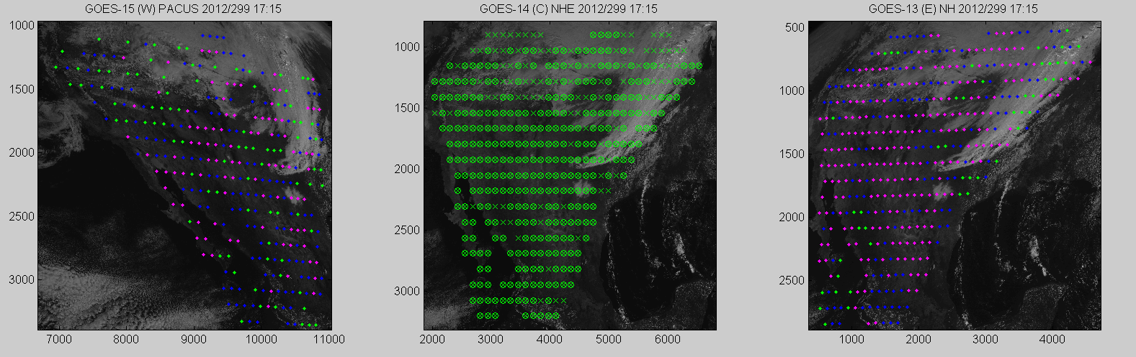
INR Enabled by Tie-Points
TEMPO
GOES-W
GOES-E
Height

Slide 7
INR Simulation
Geolocation Requirement is Satisfied with Margin
Solar Zenith Angle < 70°
All Solar Zenith Angles
Spec
No VIS Tie-Points to Earth,
uncompensated gyro random walk
VIS Tie-Points to Earth,
compensated gyro random walk

