Slide 1
Using Machine Learning to Retrieve Ocean Color Properties from Hyperspectral Instruments in the Presence of Clouds, Aerosols, and Sunglint
Zachary Fasnacht^{1,2}, Joanna Joiner², David Haffner^{1,2}, Wenhan Qin^{1,2}, Alexander Vasilkov^{1,2}, Patricia Castellanos³, and Nickolay Krotkov²,
¹Science Systems and Applications Inc, ² NASA GSFC Code 614, ³NASA GSFC Code 610.1
Fasnacht Z, Joiner J, Haffner D, Qin W, Vasilkov A, Castellanos P and Krotkov N., Using Machine Learning for Timely Estimates of Ocean Color Information From Hyperspectral Satellite Measurements in the Presence of Clouds, Aerosols, and Sunglint. Front. Remote Sens., 3:846174. doi: 10.3389/frsen.2022.846174, 2022. Published May 5, 2022, https://www.frontiersin.org/articles/10.3389/frsen.2022.846174/full

Slide 2
Background
• Most traditional ocean color (OC) algorithms are limited in less-than-ideal conditions such as clouds, denser aerosols, and sunglint (MODIS Aqua+Terra chlorophyll retrieval shown on right)
• Previous work (Gross-Colzy et al. 2007, Joiner et al. 2021) has shown that principal components of simulated or measured spectra contain information about the atmosphere and underlying surface
• Approach applied to estimate OC properties using hyperspectral measurements
October 10, 2020

Slide 3
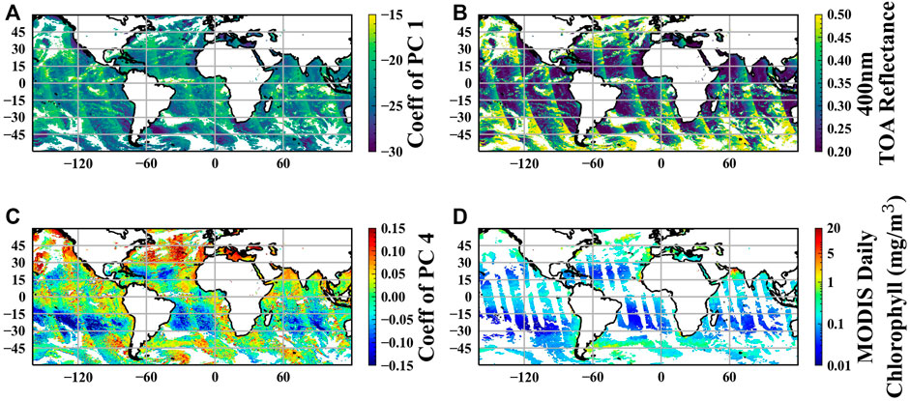
ML Ocean Color Approach
Can a ML model be developed to improve coverage of ocean color retrievals using hyperspectral instruments?
First step to decompose ultraviolet and visible hyperspectral radiances into principal components (PC’s) which extracts various features in the spectrum
Principal component decomposition from Ozone Monitoring Instrument (OMI) shown on left (2.5nm FWHM, 2.5nm spacing from 320-500nm)
Leading PC’s provide information about scattering in atmosphere (such as clouds
Lesser important PC’s provide information about scattering at surface (such as from chlorophyll in ocean)
Coefficient of 1st PC
OMI TOA Reflectance
Coefficient of 4th PC
MODIS Chl on OMI FoV

Slide 4
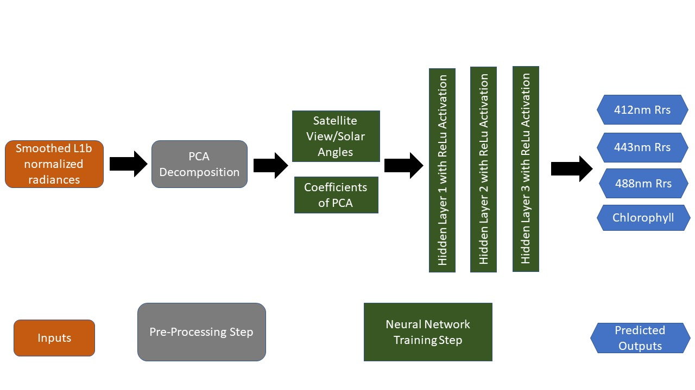
ML Ocean Color Approach (continued)
PCA provides information about spectral features caused by scattering/absorption of atmosphere and underlying surface
BUT! It is noisy and information is spread amongst different PC’s
Second step to train a neural network using the PC’s as input to essentially predict physically based retrievals such as chlorophyll content in ocean
Satellite view and solar geometries provided as additional inputs to NN
Ocean color information from MODIS satellite used as truth when training the model
Simple neural network approach used with 3 hidden layers
Tested other approaches such as convolutional NN but found no improvement

Slide 5
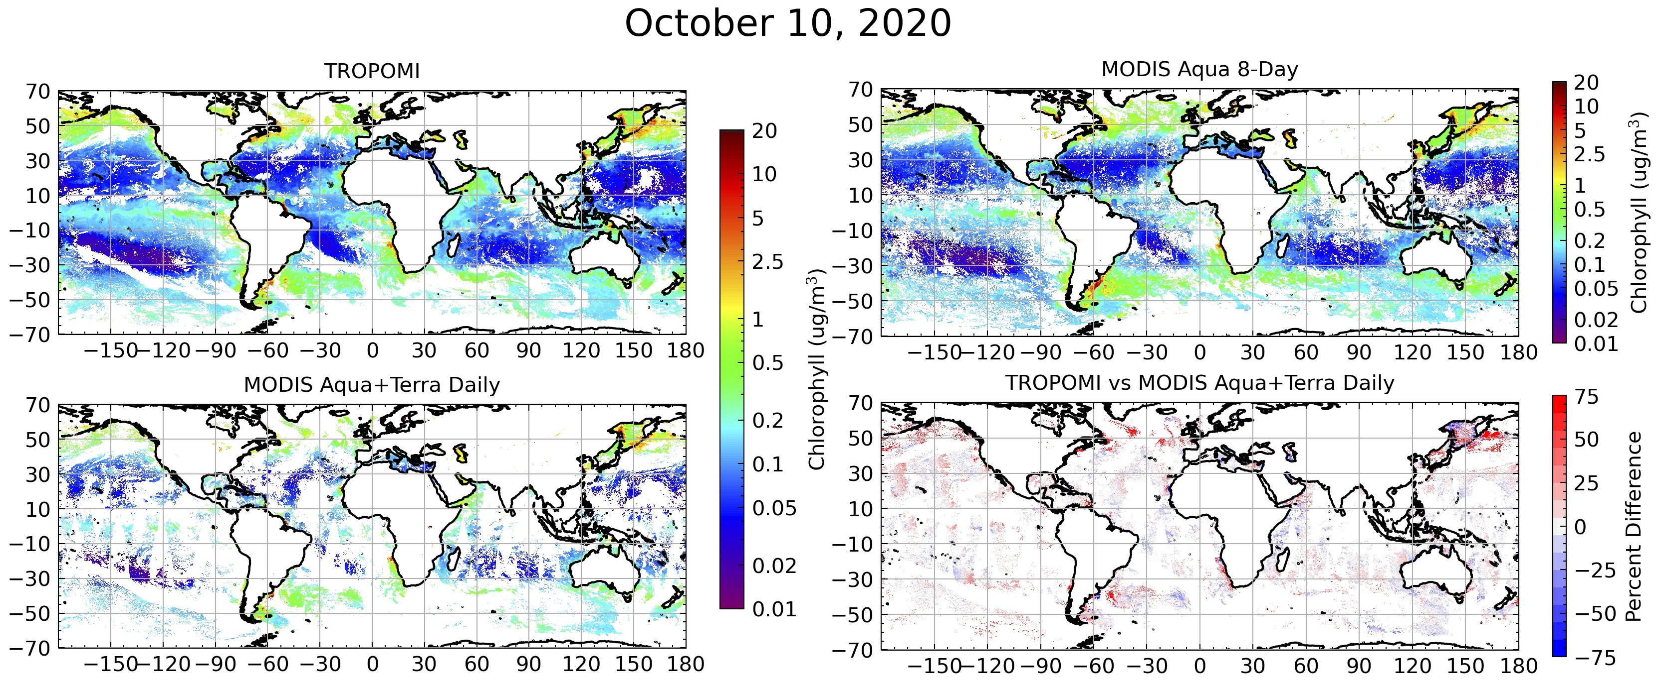
October 10, 2020
Patterns of chlorophyll very similar between TROPOMI NN approach and MODIS retrievals
Much improved spatial coverage from TROPOMI (47% global coverage) compared to the MODIS Aqua+Terra daily chlorophyll (16% global coverage) and MODIS Aqua 8-day composite (42% global coverage)

Slide 6
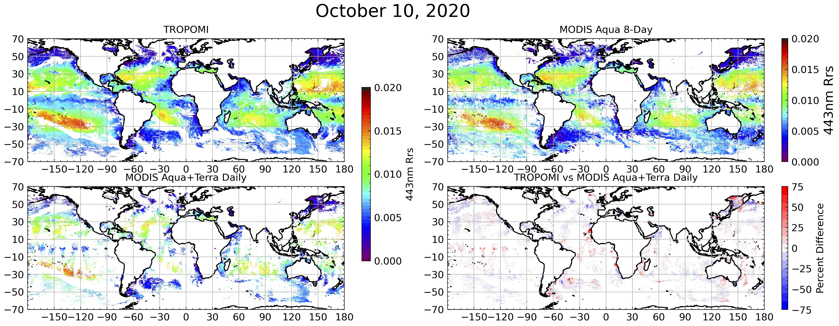
October 10, 2020
As with previous slide, patterns in remote sensing reflectance (Rrs) at 443nm very similar between TROPOMI and MODIS but TROPOMI has much improved spatial coverage

Slide 7
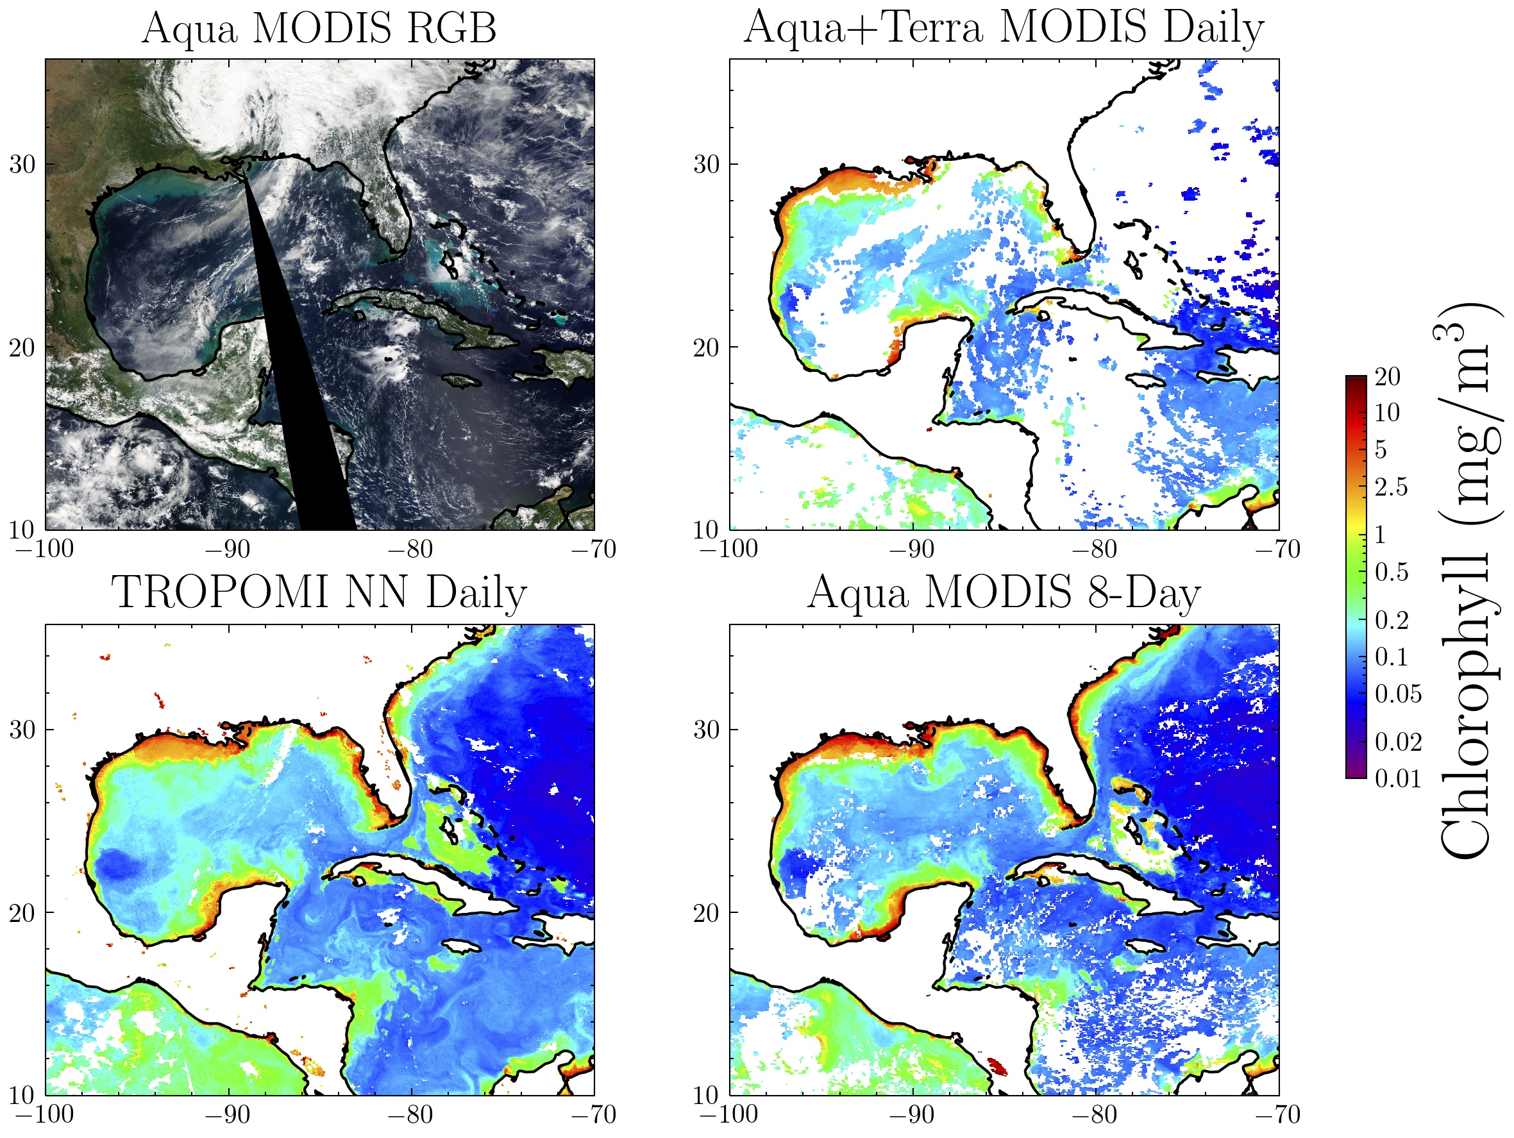
October 10, 2020
Much improved spatial coverage from TROPOMI, particularly in open ocean
Captures many of the coastal features seen in the MODIS retrieval
Smaller scale features in Caribbean (dashed black circle) captured with TROPOMI but not daily or 8-day MODIS chlorophyll
***All Gridded to 4km

Slide 8
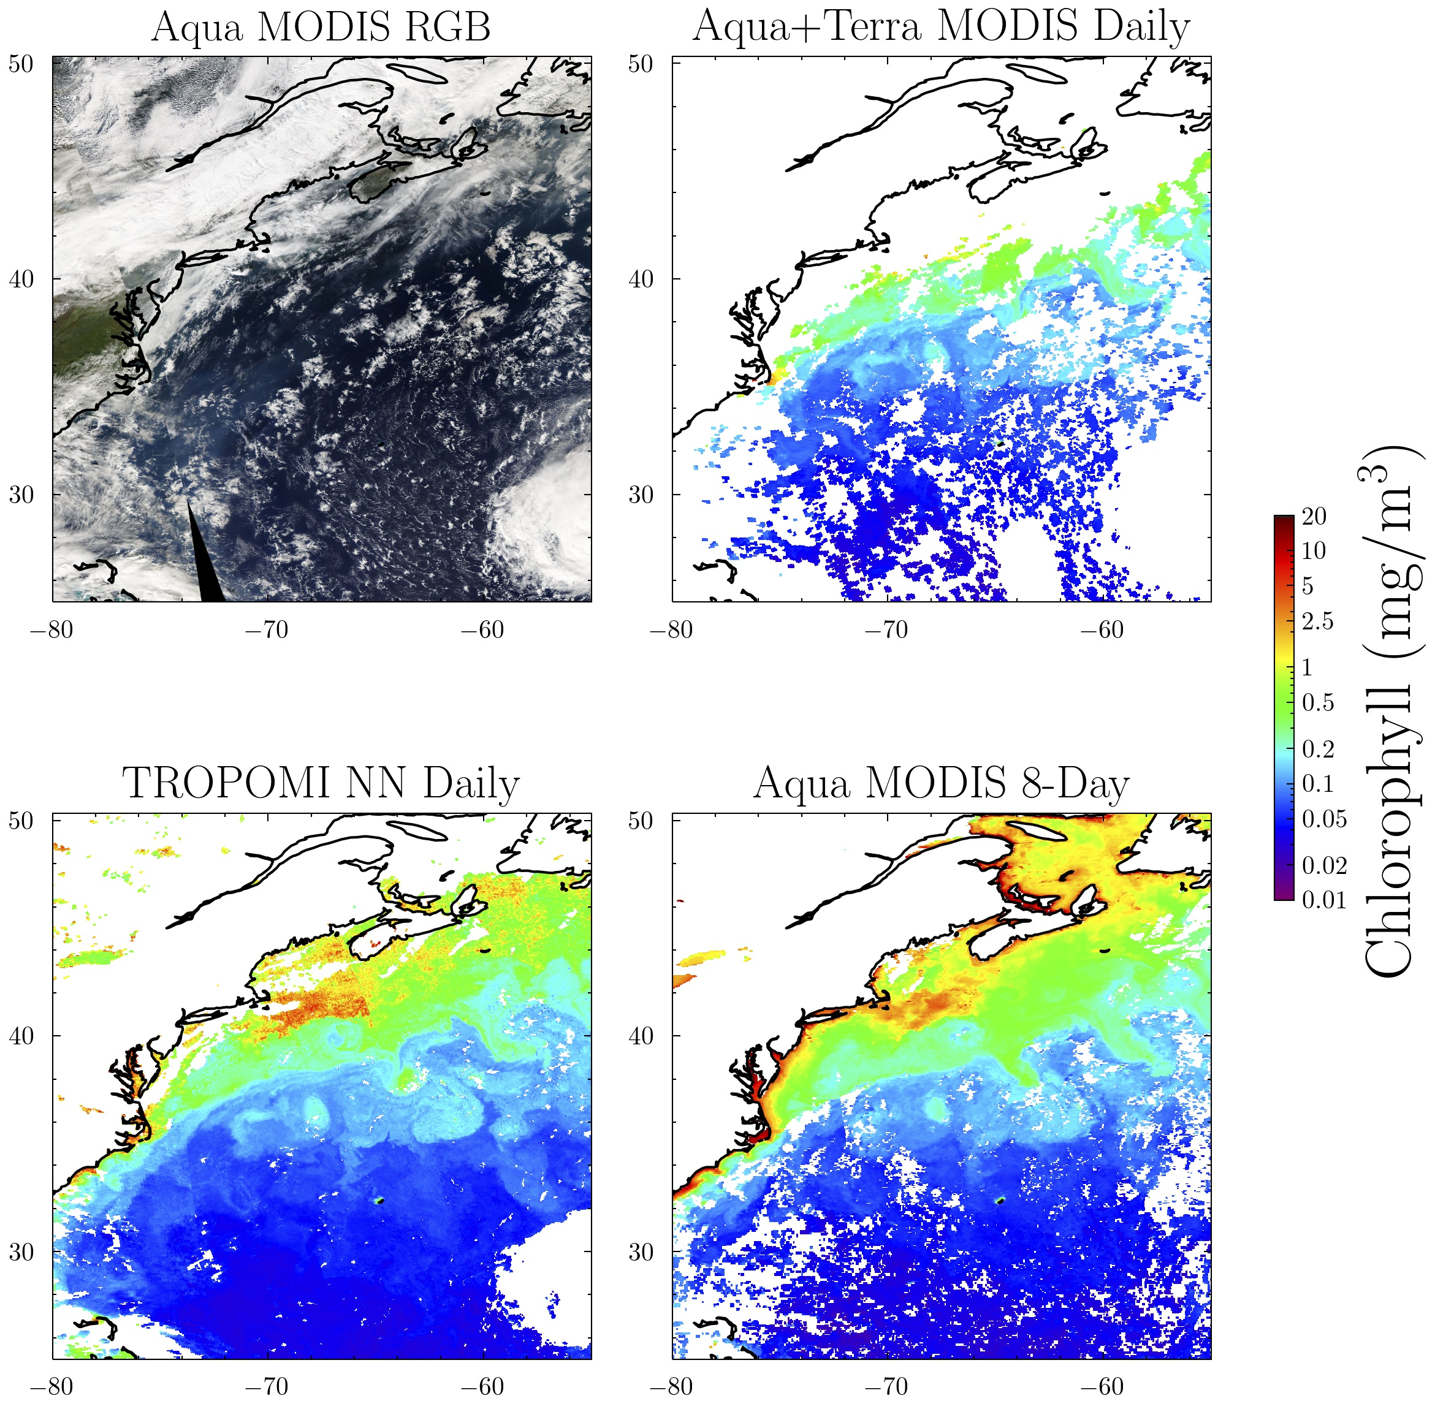
October 20, 2020
Much better daily spatial coverage from TROPOMI along coastline
Chlorophyll in this region compares well with 8-day MOD Chlorophyll
Some features (dashed black circle) appear better represented in daily retrieval than 8-day from MODIS
***All Gridded to 4km

Slide 9
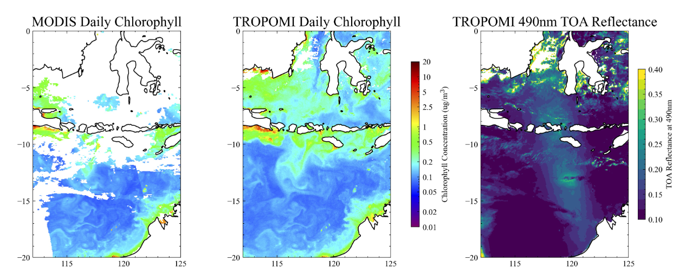
Sunglint Case Study
Approach seems to work despite the presence of sunglint because sunglint has a smooth spectral dependence that differs from that of ocean color
Example shown below for Oct 14, 2020
As shown in right, TROPOMI TOA Reflectance as high as 0.3 due to sun glint but no noticeable degradation in TROPOMI chlorophyll (middle panel)

Slide 10
Take Home Messages
PCA/ML approach can be used to perform atmospheric correction in less-than-ideal conditions such as clouds, aerosols, and sun glint
Method is not meant to replace physically-based retrievals (physical retrievals needed for training!), but rather complement those retrievals by providing data in challenging conditions with an efficient algorithm
Approach could also provide near real time ocean color retrievals to assist in monitoring of effects such as harmful algae blooms
Method is applicable to TEMPO geo-stationary mission providing unique opportunity to explore hourly changes in ocean properties
Future work will explore whether red edge wavelengths provide additional information that could improve the machine learning ocean color estimates

