Slide 1

Day 2 TEMPO Lightning Talks Agenda also on website: https://meeting-info.org/tempo-stm2022/
Room # | Presenter | Title
1 | Ayazpour | Estimates of spatially complete PBLH over the US
2 | Berkoff/Gronoff | Coastal & Over-Water Ozone Profile Observations
3 | Carr | Stereo-3D Observing of Volcanic Plumes
4 | Chutia/Zhang | Development of UI-WRF-Chem for MAIA-TEMPO Synergy
5 | Crowell | GeoCarb Mission Updates
6 | Fasnacht | Using ML to Retrieve Ocean Color from Hyperspectral
7 | Gaudel | Tropical tropospheric ozone distribution and trends
8 | Knowland | NASA GEOS Composition Forecast system: "GEOS-CF”
9 | Kotsakis | Diurnal Pandora Measurements during TRACER-AQ Houston
10 | Lu | Diurnal variation of AOCH and application on air quality
11 | Pearlman | Polarization Performance Simulation for the GeoXO ACX
12 | Spinei Lind | Mapping urban pollution w/ ground-based DOAS measurements
13 | Stremme | Column NO2 measurements over Mexico City
14 | Tisdale | Coming Soon to a DAAC Near You:Proposed TEMPO Services
15 | Travis | Can ΩHCHO observations inform air quality strategies?
16 | Valin | LISTOS: An example of the “3D” monitoring System
17 |  | Networking / hangout room for casual discussion after poster visits

Slide 2

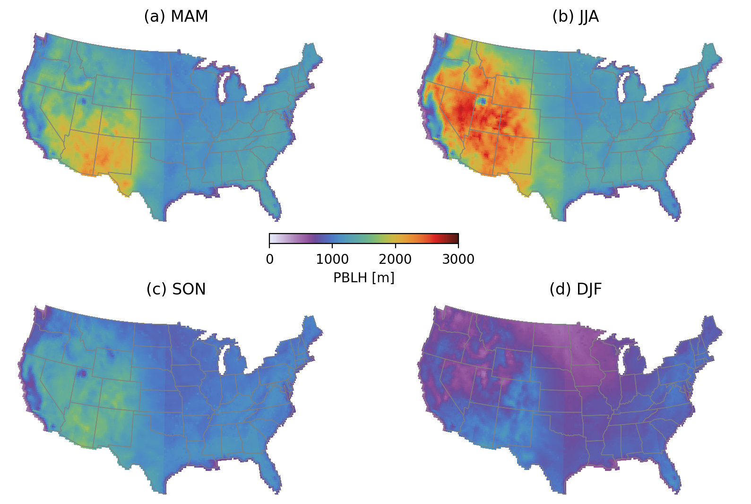
1-Ayazpour–Estimates of spatially complete PBLH over the US
Zolal Ayazpour, Kang Sun, University at Buffalo,
Dan Li, Shiqi Tao, Boston University
The observations of planetary boundary layer height (PBLH) are sparse in space and time.
This study aims to generate a spatially complete PBLH product over the contiguous United States.
An eXtreme gradient boosting (XGBoost) regression model is developed using meteorological and geographical parameters to fit the Aircraft Meteorological DAta Reporting (AMDAR) PBLH hourly profiles at 13:00- 14:00 local solar time during 2007-2019.
The PBLHs predicted by this observational data-driven model are compared with ERA5, MERRA-2, and NARR products and validated by PBLH observations from airborne lidar (High Spectral Resolution Lidar, HSRL), spaceborne lidar (CALIPSO), and in-situ aircraft profiles from the DISCOVER-AQ campaigns.
PBLH climatology at 1300 local time

Slide 3
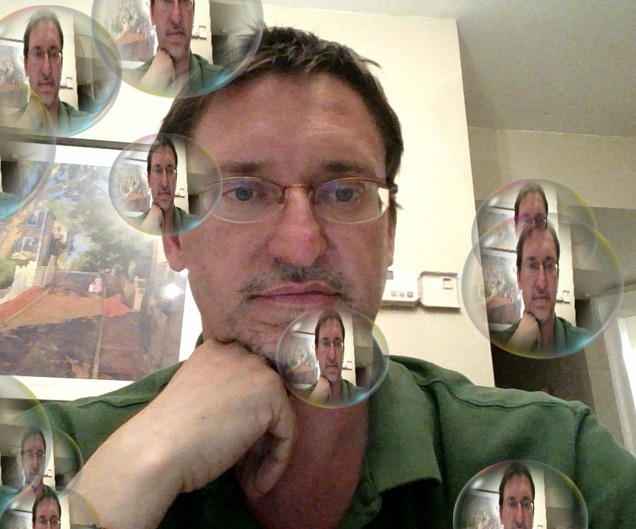
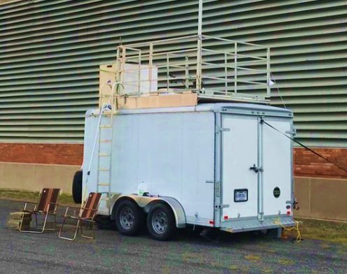
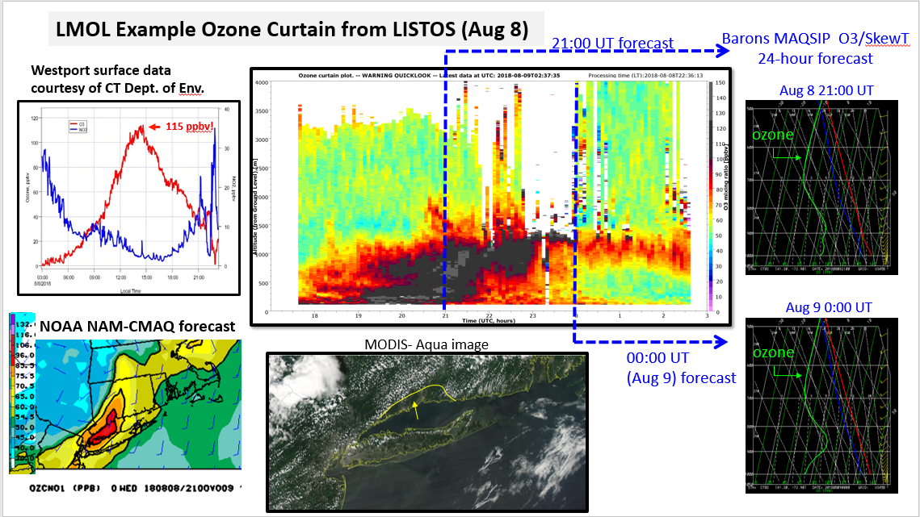
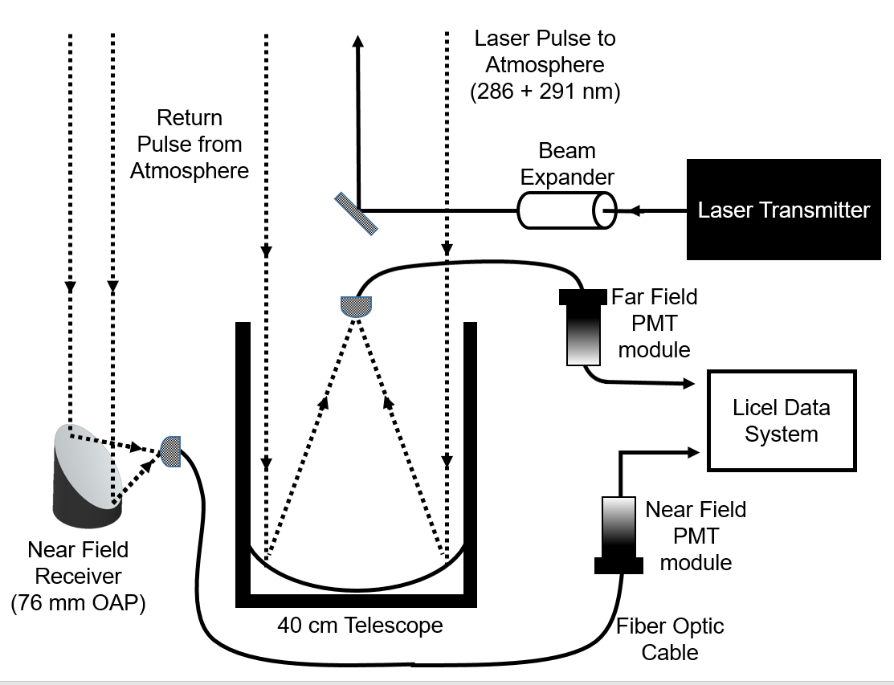
2-Berkoff-Coastal and Over-Water Ozone Profile Observations
Timothy Berkoff, NASA Langley Research Center
Guillaume Gronoff (Co-PI), Daniel Phoenix, Joseph Sparrow, William Carrion, Claudia Bernier (U of H)
LMOL trailer during OWLETS-1
Langley Mobile Ozone Lidar (LMOL):
Time-multiplexed laser pulses at different wavelengths in the UV (286-292) to produce vertical profiles of ozone & aerosol (and in the future SO₂!)
Aircraft “eye-safe” at the rooftop – improving safety and ease of approval for deployments
Semi-autonomous (3-5 days of continual operations at a time)
~4 km altitude range daytime, 10 km nighttime for 10-minute temporal averaging
“Real-time” website display
Mobile trailer
TOLNet participant
O₃ curtain
System diagram
Field Campaigns since 2014:
DISCOVER-AQ 2014 (Colorado)
SCOOP 2016 (California)
OWLETS-1 2017 (Virginia)
OWLETS-2 2018 (Maryland)
LISTOS 2018 (Connecticut)
TRACER-AQ 2021 (Houston, TX)
Planned: 2023 NYC

Slide 4

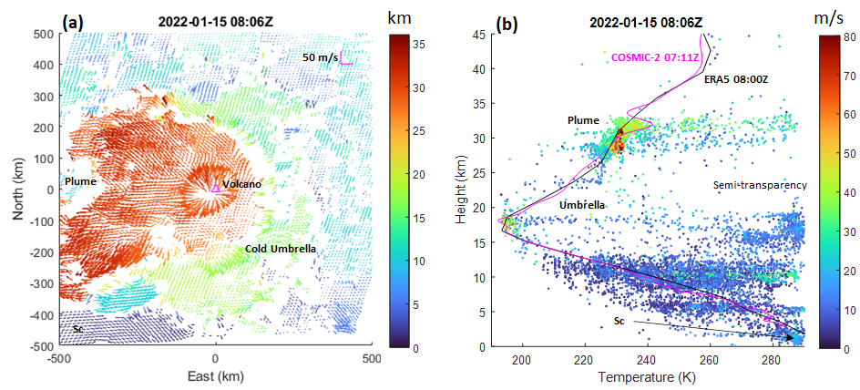
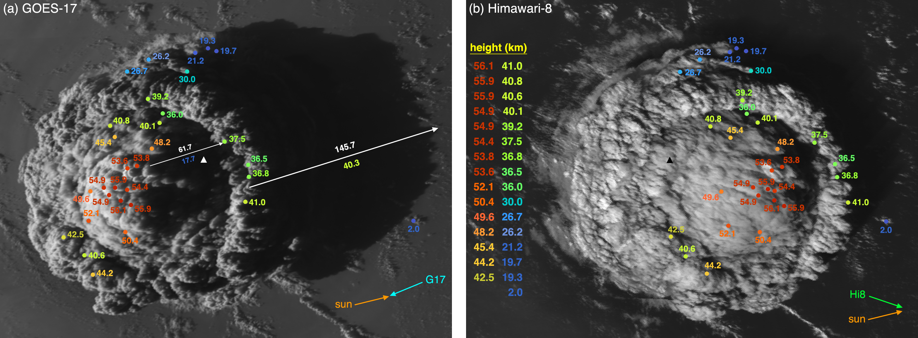
3-Stereo-3D Observing of Volcanic Plumes
James L. Carr, Carr Astronautics, Greenbelt, MD 20770 USA, jcarr@carrastro.com
Ákos Horváth, Meteorological Institute, Universität Hamburg, Hamburg, Germany
Dong L. Wu, NASA/GSFC, and Mariel D. Friberg, NASA/GSFC and University of Maryland
Satellite stereo observing is a powerful tool for resolving the 3D structure and dynamics of volcanic plumes. We have applied these methods to eruptions of Hunga Tonga-Hunga Ha’apai (lofted as high as 55 km!), La Soufriere, and Raikoke.
Our Poster presents some of our work using GOES-R, Himawari, and Terra/Aqua in various pairs and complementary GNSS-RO observations confirming our results.

Slide 5


4-Chutia/Zhang–Development of UI-WRF-Chem for MAIA-TEMPO Synergy
Huanxin (Jessie) Zhang, Lakhima Chutia, Nathan Janechek, Cui Ge, Jun Wang, University of Iowa
2
Corun scripts
Real-time Run
1.Development of
UI-WRF-Chem:
Unified initial/boundary conditions from NASA GEOS-5 system to drive WRF-Chem
2. Case study over India: aerosol-radiation interactions
3. Case study over Beijing: dust transport
NASA GMAO/GEOS
1
GEOS-5 FP
GEOS-5 MERRA-2
GLDAS/NLDAS
Soil moisture, etc.
Post-processing:
Parameter outputs Bias correction
Chemical Boundary Data
Meteorological/Soil boundary/initial Data (update landtype, LAI, GVF, ALBEDO using MODIS data)
Real Time
3
WRF-Chem
New Deve.
WRF-BC
WRF
(“new mech”:
Chem_opt = 903,904,905)
5
Soil NOx emission
Emission Data
Anthropogenic-Emission
4
FLAMBE (gas + aerosols)
Global-EDGAR
US-NEI 2011, 2014
Delhi
Beijing-MEIC
Taiwan

Slide 6

5-Crowell – GeoCarb Mission Updates
Sean Crowell, University of Oklahoma, on behalf of
Berrien Moore III, University of Oklahoma and the GeoCarb Team
GeoCarb will observe radiances in the 0.76um, 1.6um, 2.0um, and 2.3um in order to retrieve column average CO₂, CH₄, CO, and solar induced fluorescence (SIF) from geostationary orbit over North and South America
GeoCarb will launch in late 2024 to an expected orbital slot of 85W
Science Goal: Disaggregating natural and anthropogenic carbon fluxes on urban to regional spatial scales and weekly time scales.
Observation details:
  1024 North-South footprints every 9s
  3km N-S by 6km E-W at nadir
  10-11 hours of scan time per day depending on season
  Notional scan pattern: focus on US and Amazon on even days and entire hemisphere on odd days with multiple revisits per day at “intensive scan” locations
Relevance to TEMPO: NO₂-CO tracer ratios with TROPOMI have shown the capacity to distinguish fires; distinguishing plumes from the background (NO₂), aerosol information for retrievals

Slide 7



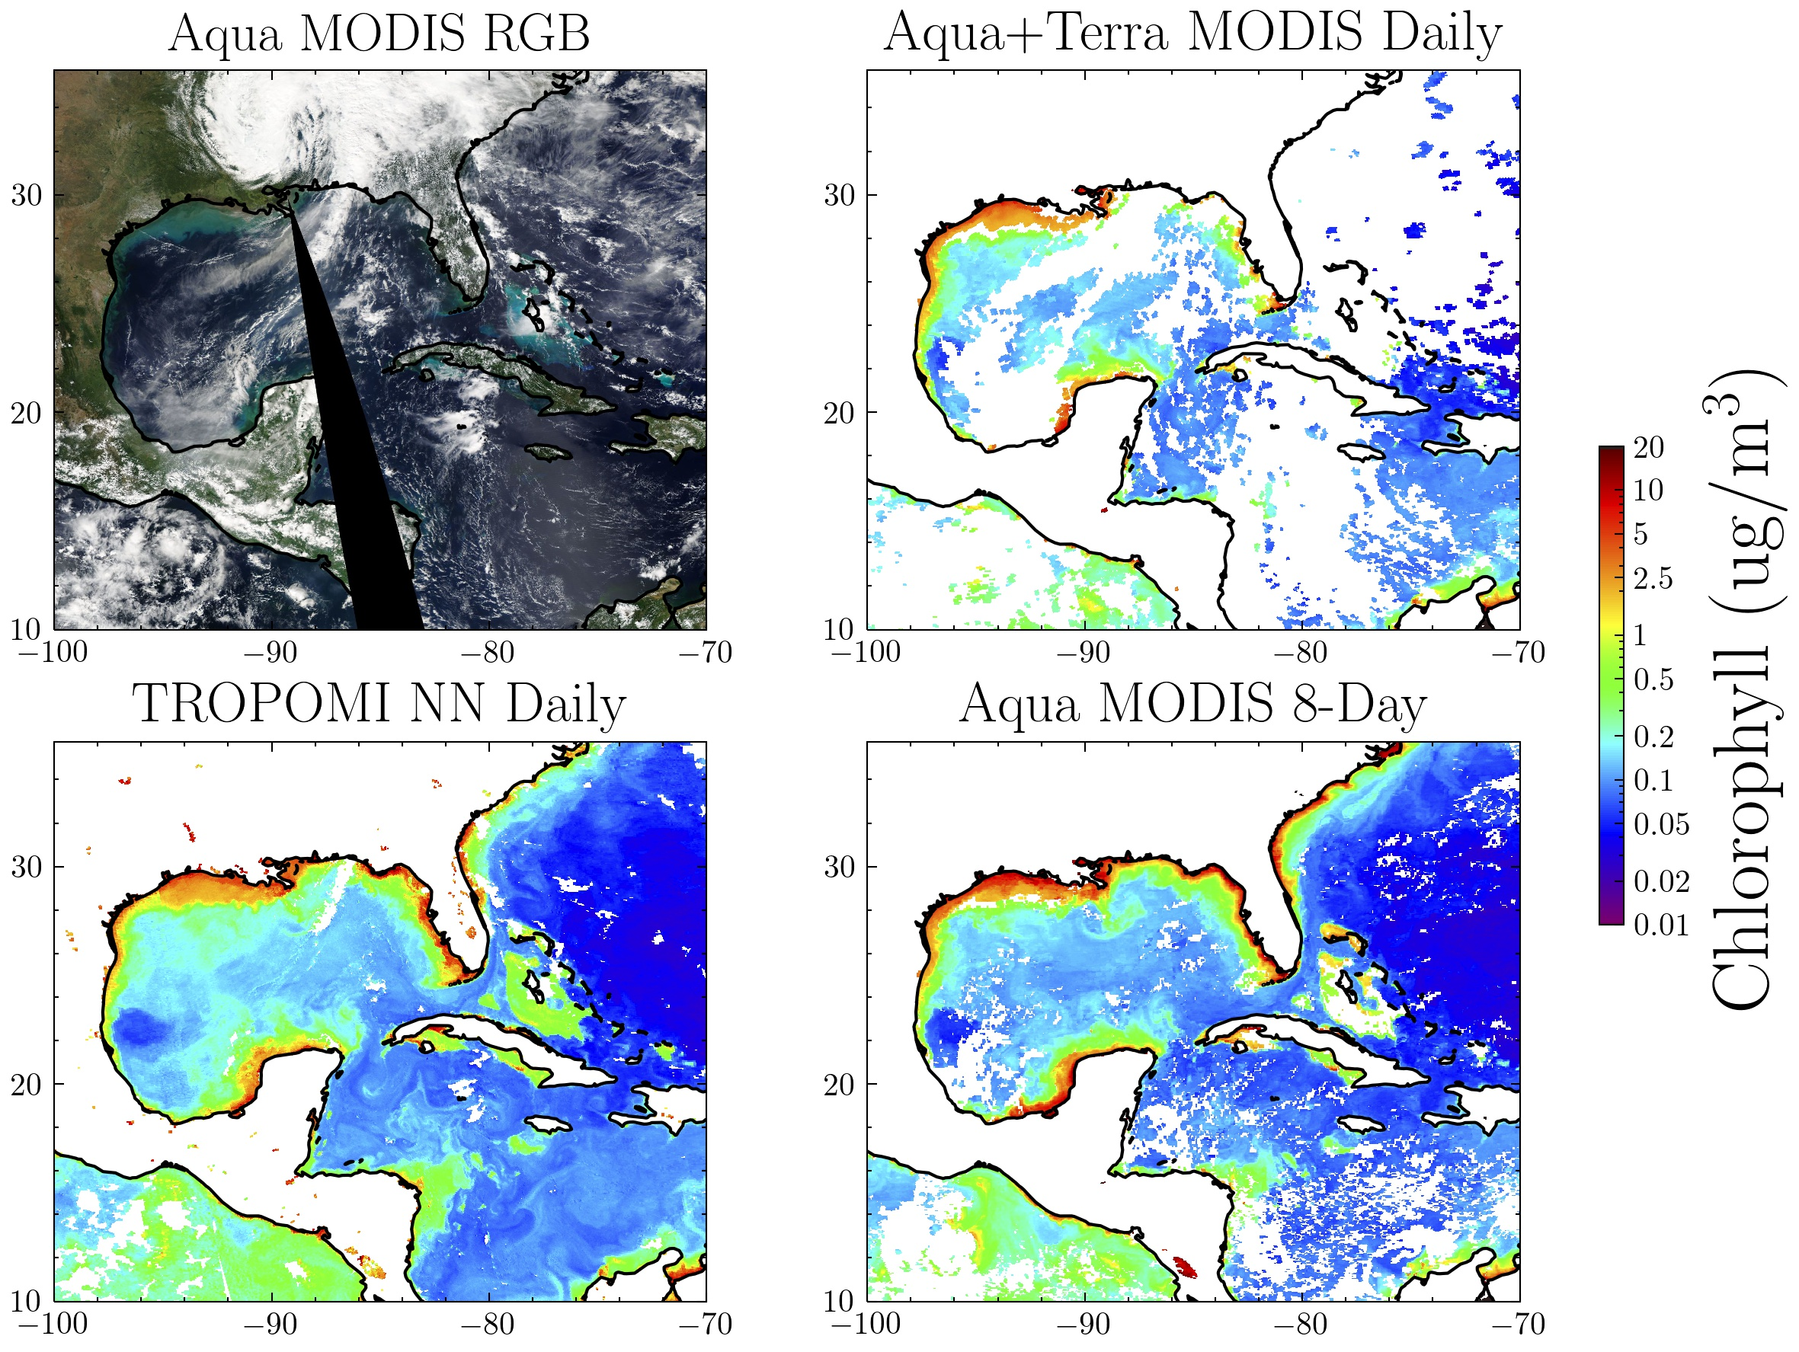
6-Fasnacht–Using ML to Retrieve Ocean Color from Hyperspectral Sensors
Zachary Fasnacht^{1,2}, Joanna Joiner², David Haffner^{1,2}, Wenhan Qin^{1,2}, Alexander Vasilkov^{1,2}, Patricia Castellanos³, and Nickolay Krotkov²
¹SSAI, ²NASA GSFC Code 614, ³NASA GSFC Code 610.1
Can a machine learning model be developed to improve coverage of ocean color retrievals using hyperspectral instruments?
A neural network is trained to predict physically-based MODIS chlorophyll concentration using principal components decomposed from hyperspectral data (similar to Joiner et. al., 2021a,b Front. Rem. Sens)
Right: approach applied to Gulf of Mexico/Caribbean Sea
  TROPOMI provides enhanced spatial coverage compared with MODIS under cloud and sunglint conditions
  Some features are not captured well in 8-day MODIS composite, but are captured in TROPOMI data (dashed circle)
Method is not meant to replace physically-based retrievals but rather compliment those retrievals
October 10, 2020

Slide 8


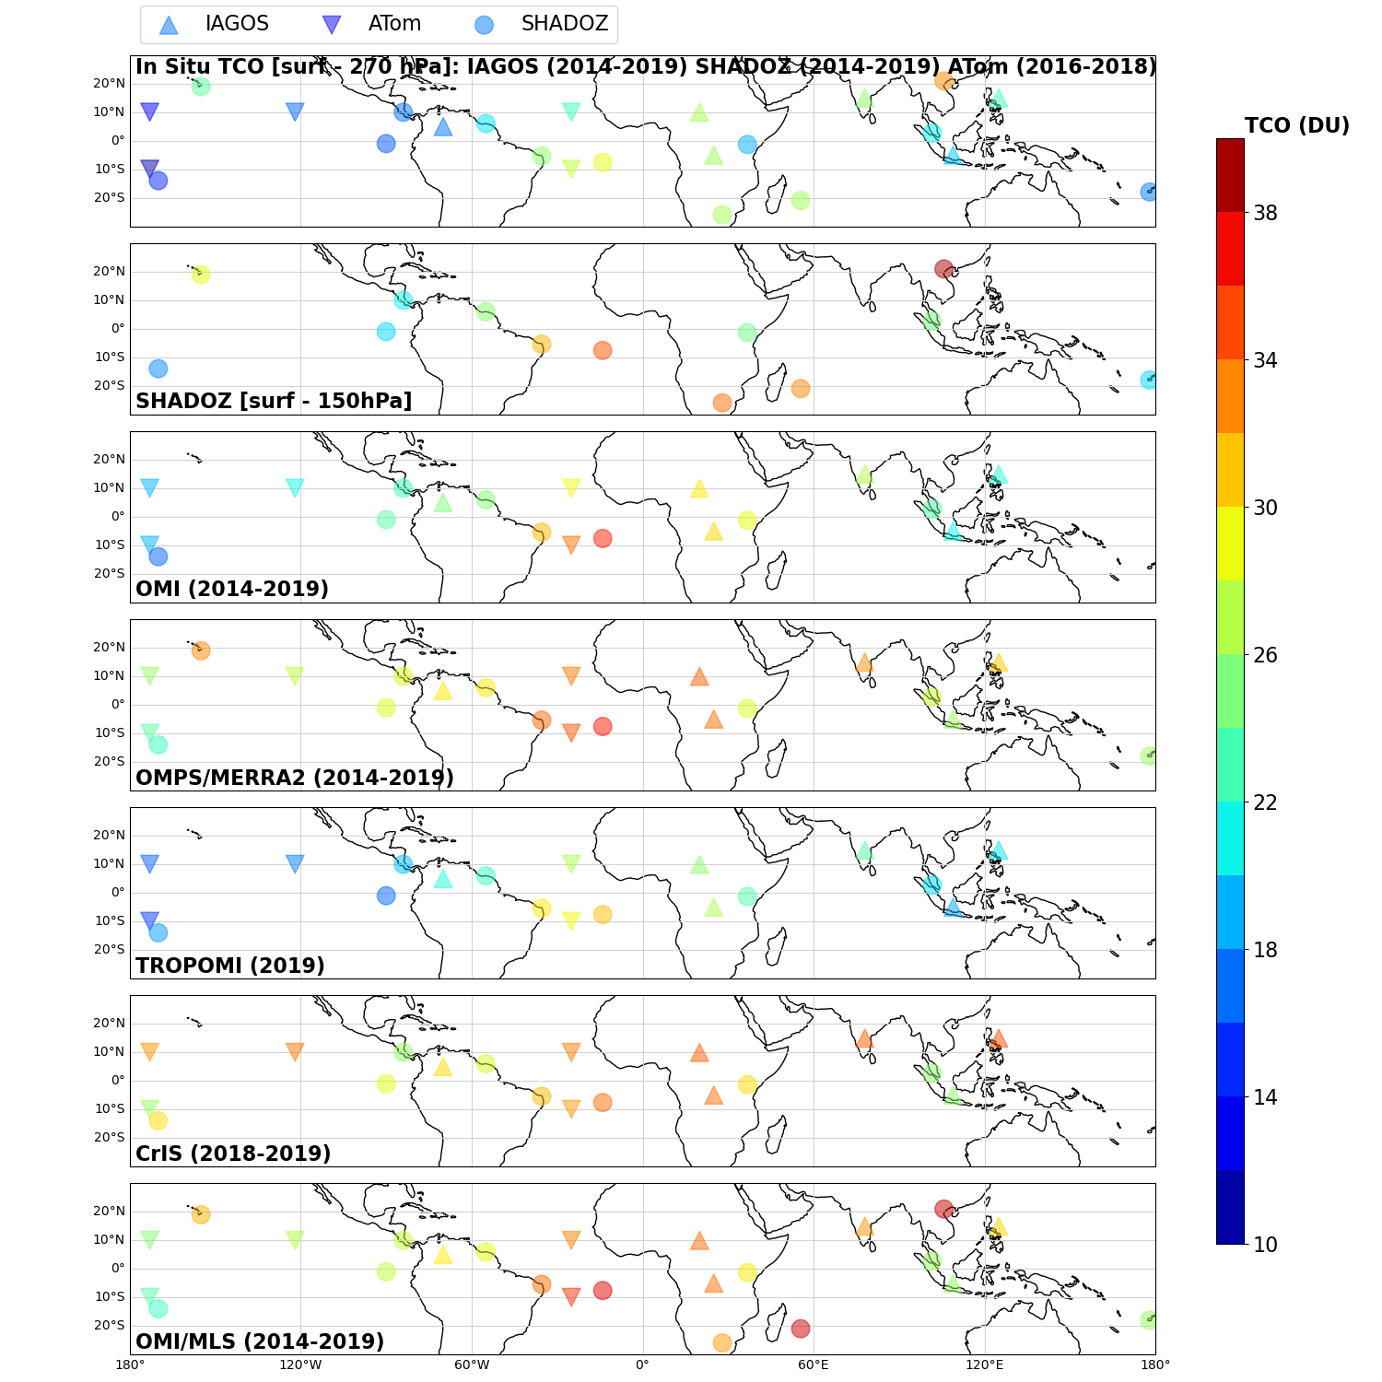




Place a headshot of yourself here
7-GAUDEL–Tropical Ozone
Audrey Gaudel, CIRES U. Of Colorado, NOAA Chemical Sciences Laboratory
Meng Li, Ilann Bourgeois, Owen Cooper, Kai-Lan Chang, Bastien Sauvage, Jerry Ziemke, Anne Thompson, Ryan Stauffer, Nadia Smith
Satellites see more ozone in the Tropical Pacific than in situ observations
Tropospheric Column Ozone (DU)
In situ
Satellites

Slide 9

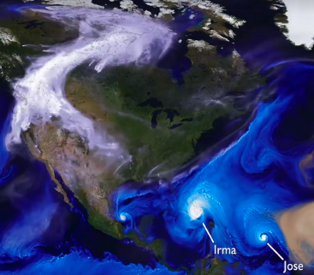
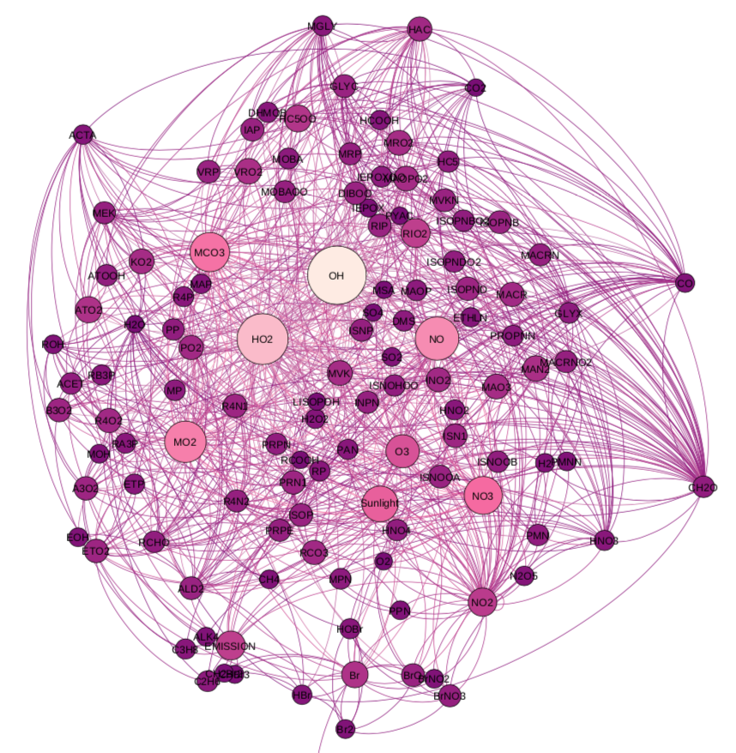
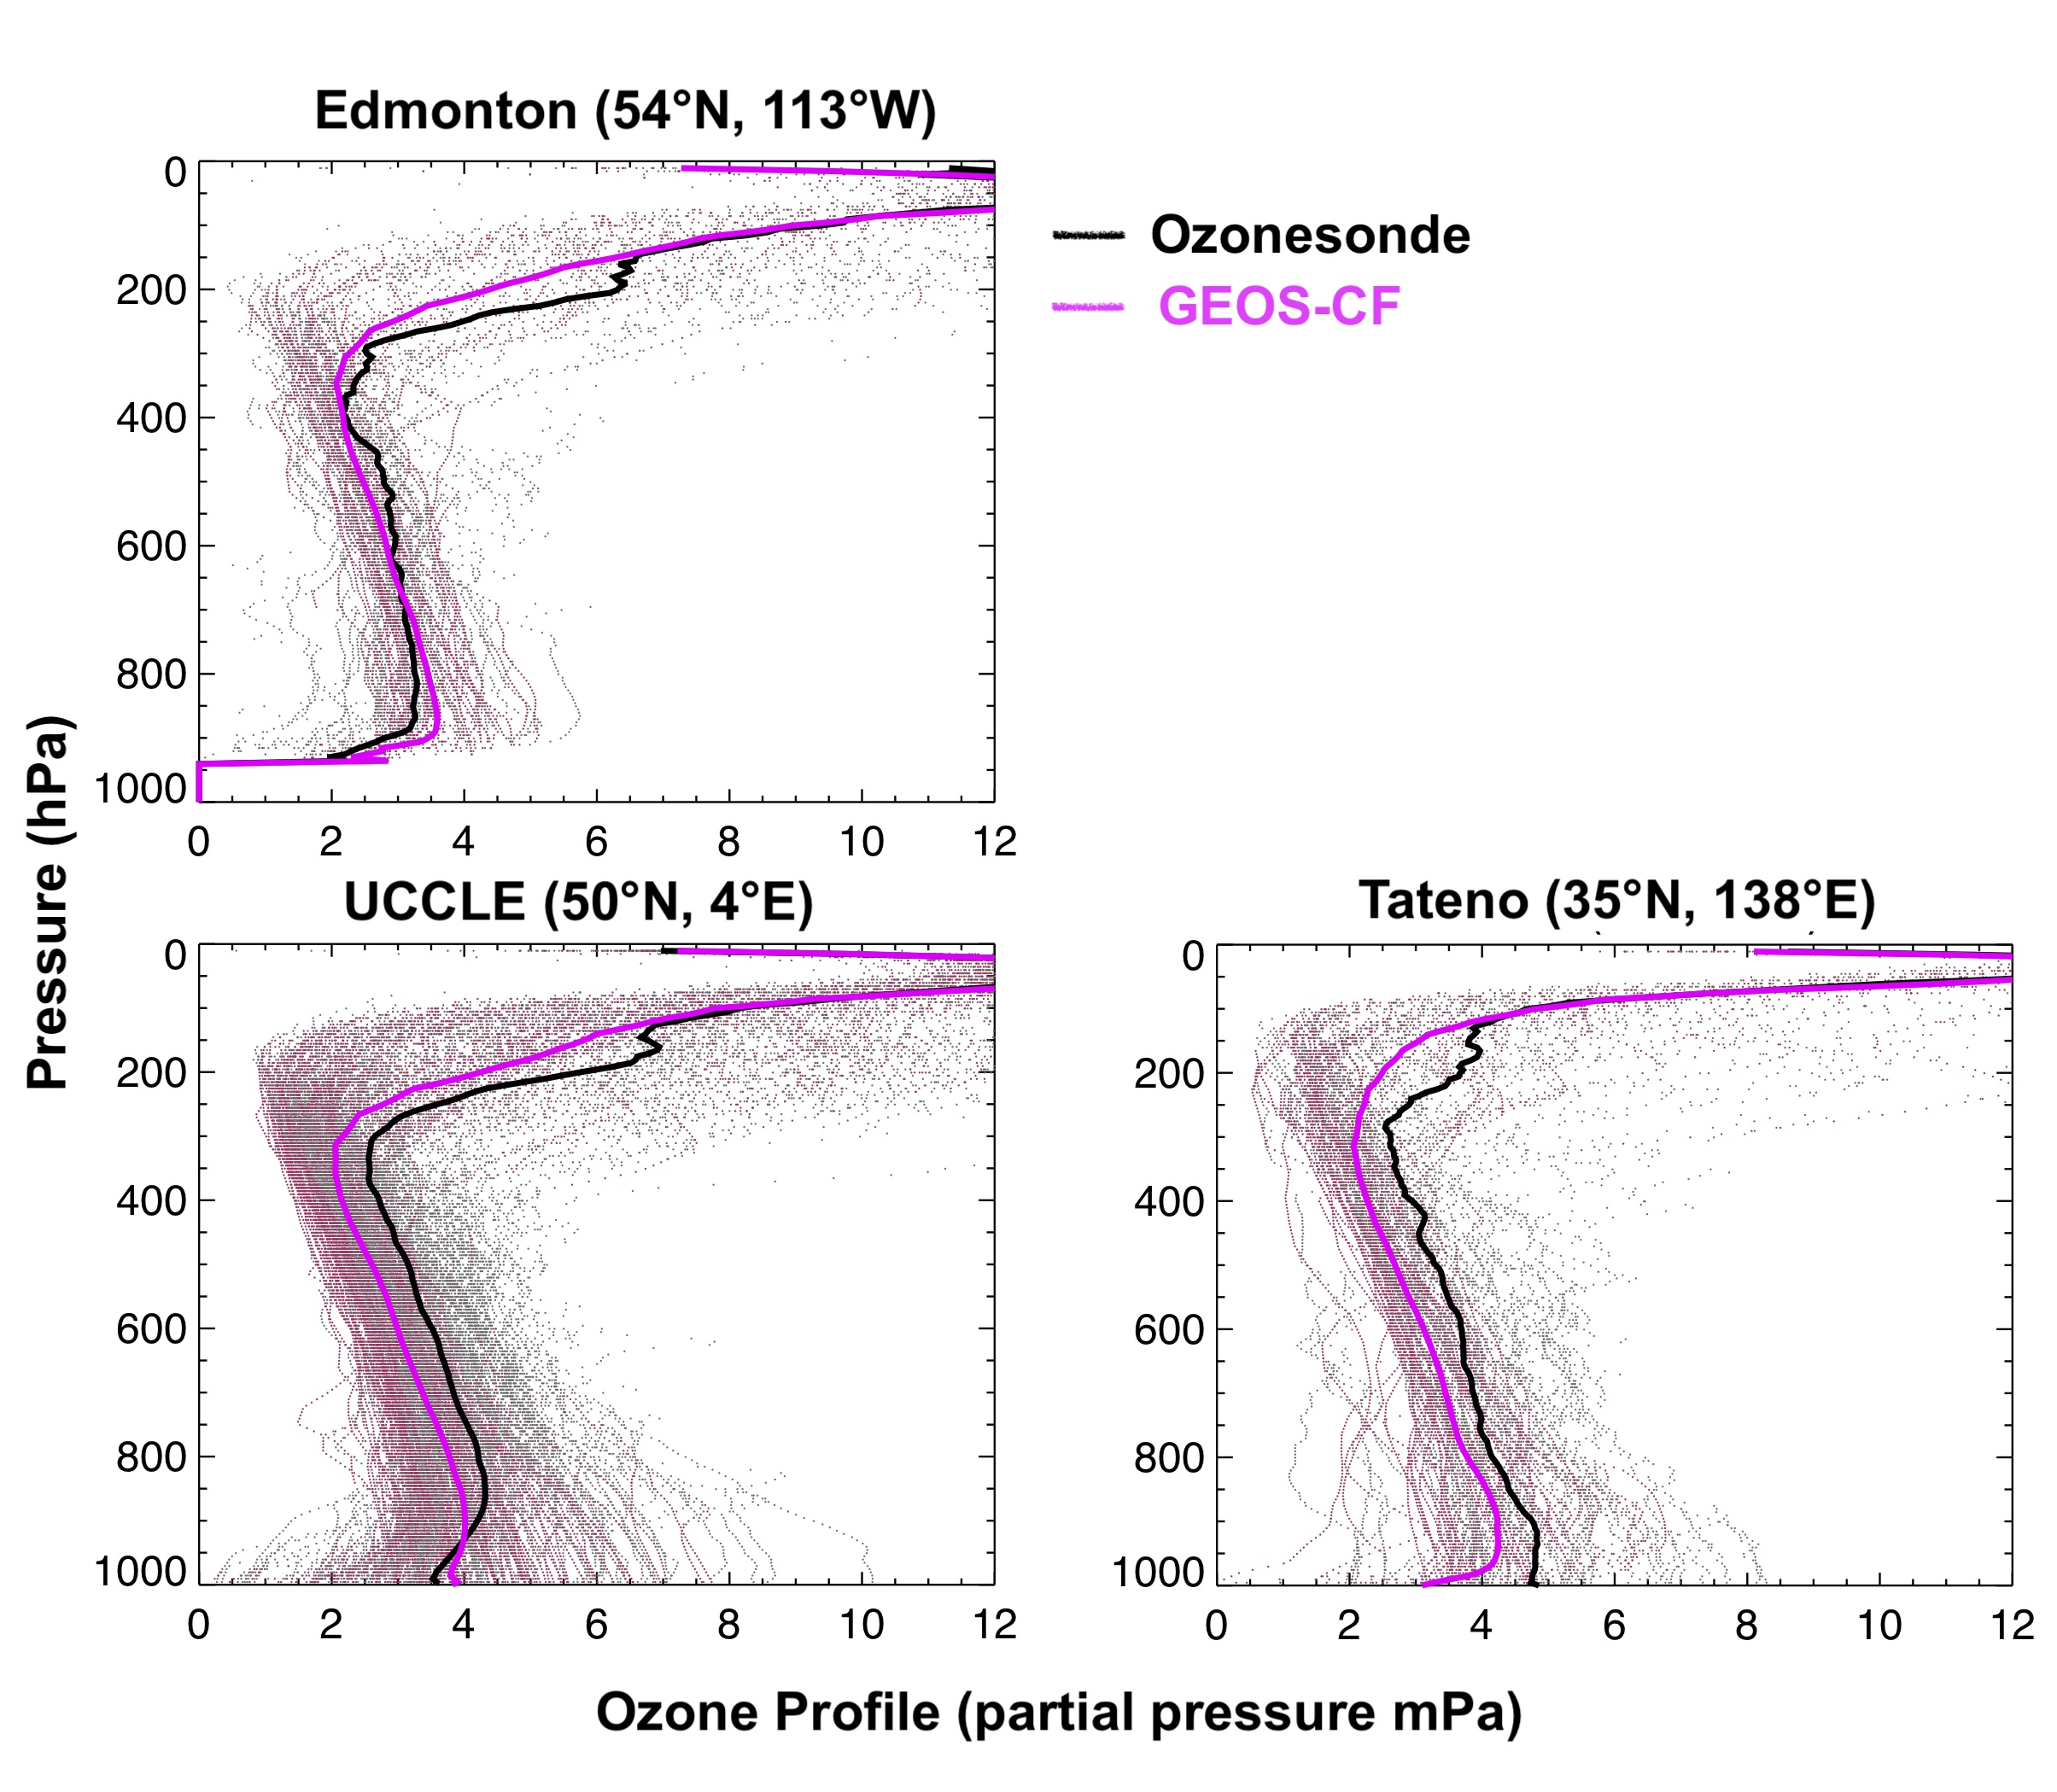

8-Knowland–NASA GEOS Composition Forecast system: "GEOS-CF”
K. Emma Knowland, MSU/GESTAR-II NASA GSFC GMAO
Christoph Keller, Bryan Duncan, Junhua Liu, Sarah Strode, Pam Wales, Larry Coy, Eric Fleming, Julie Nicely, Kris Wargan, Lesley Ott, Steven Pawson
GEOS - CF
Keller, C. A., Knowland, K. E. et al. (2021). Description of the NASA GEOS composition forecast modeling system GEOS‐CF v1.0. JAMES 10.1029/2020MS002413
Knowland, K. E., Keller, C. A. et al. (2022). NASA GEOS Composition Forecast Modeling System GEOS‐CF v1.0: Stratospheric Composition. JAMES 10.1029/2021MS002852
One 5-day forecast per day
  Initialized at 12z
  1-day meteorological replay (“analysis”)
  5-day forecast
  25x25 km² resolution
  2D output at 15 minute and hourly frequency
  3D output at hourly and three hourly frequency
  Chemistry: O₃, NO_{x}, PM, CO, VOCs, …
  Meteorology: T, U, V, RH ....
  Since January 1, 2018
GEOS NWP
2018 Tropospheric O₃ : GEOS-CF, sondes
Emissions:
  HTAP (global bottom-up) for anthropogenic
  Near real-time fires (QFED)
  Online dust, sea salt, plant emissions
GEOS - Chem
https://gmao.gsfc.nasa.gov/weather_prediction/GEOS-CF

Slide 10

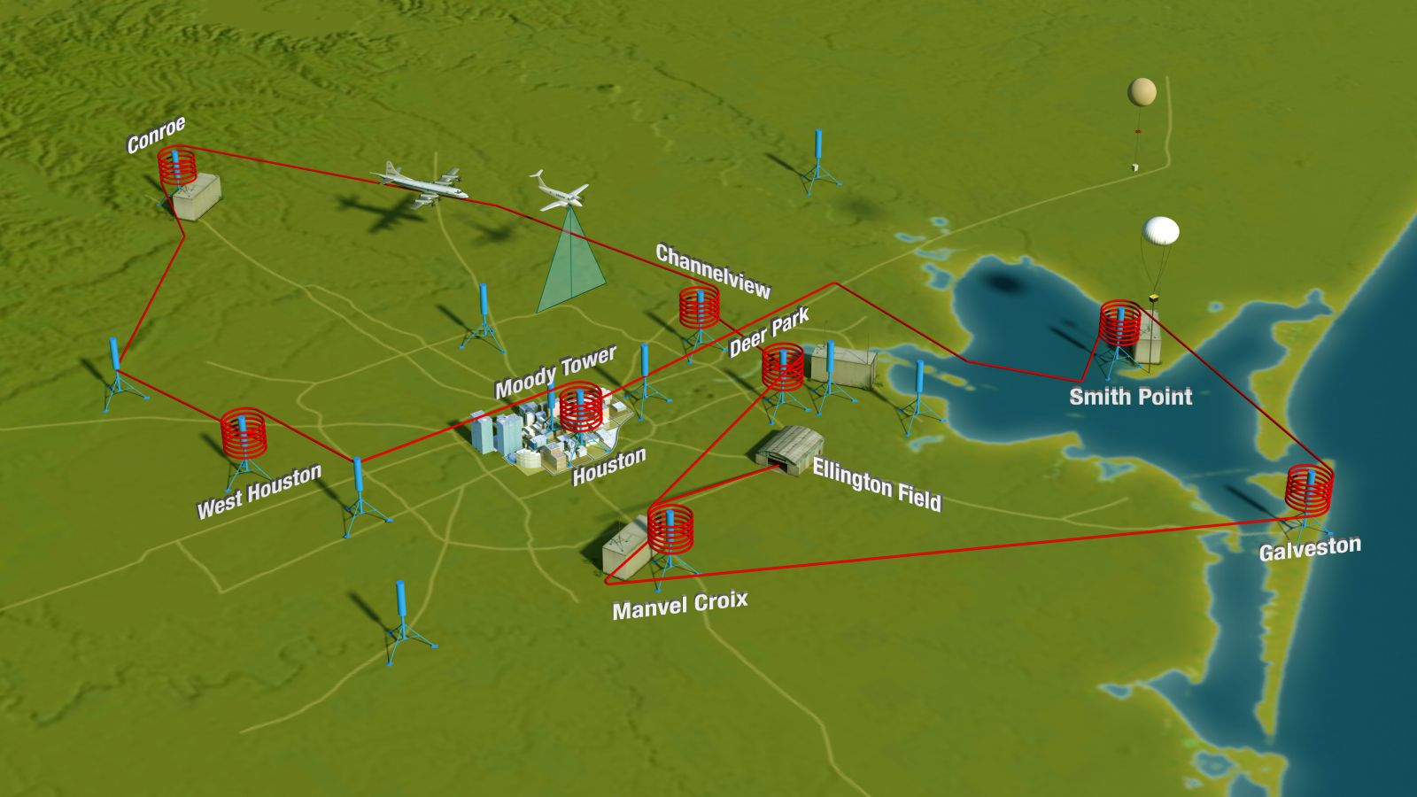
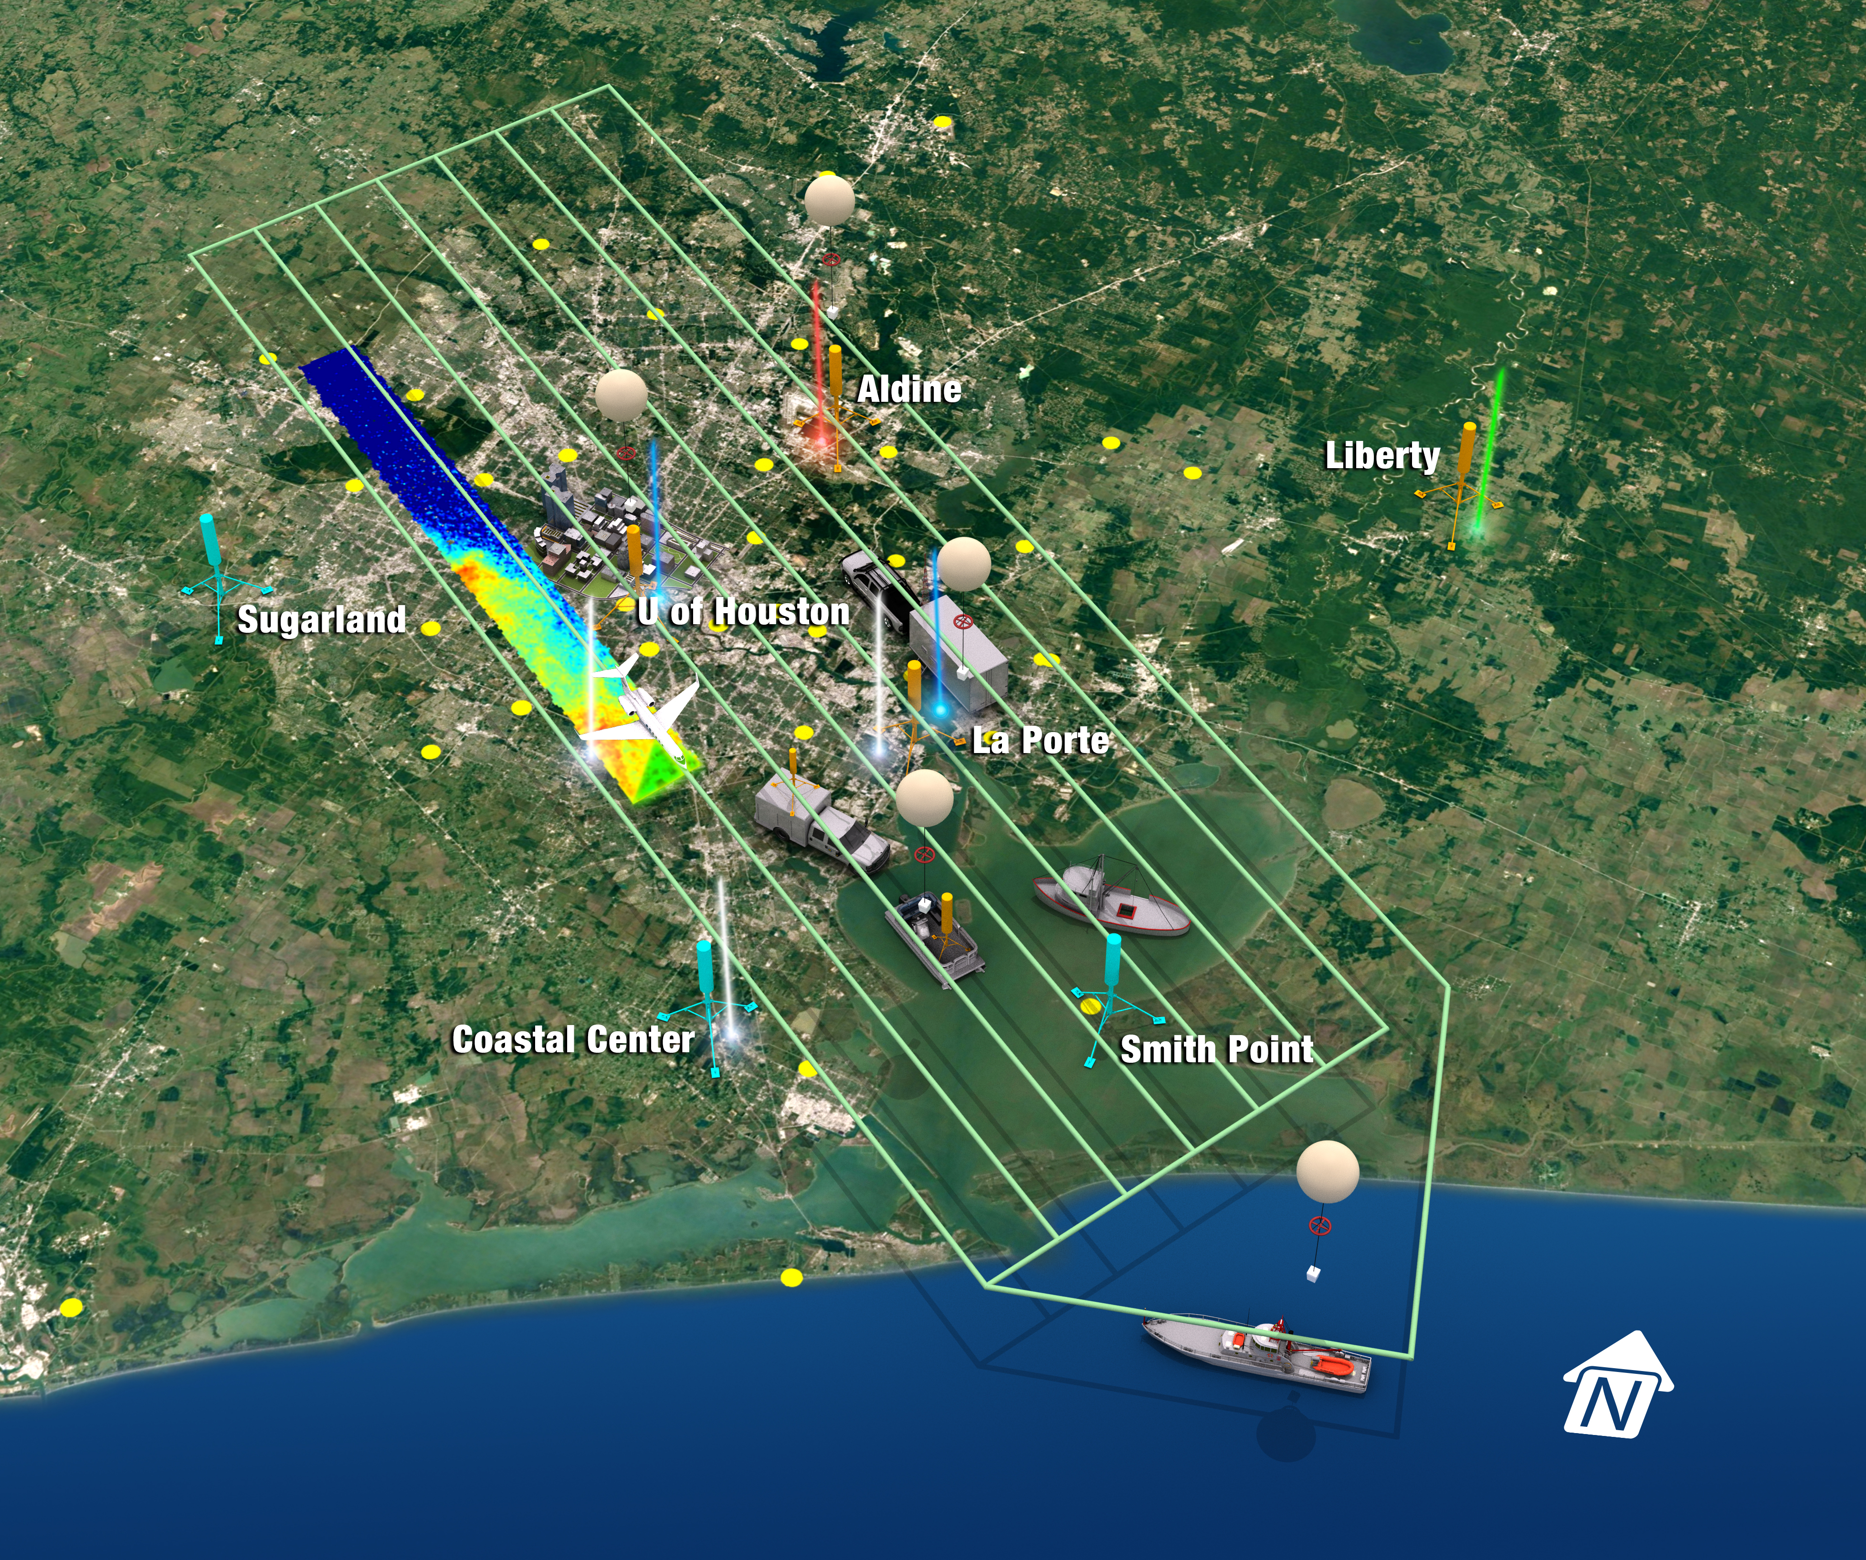
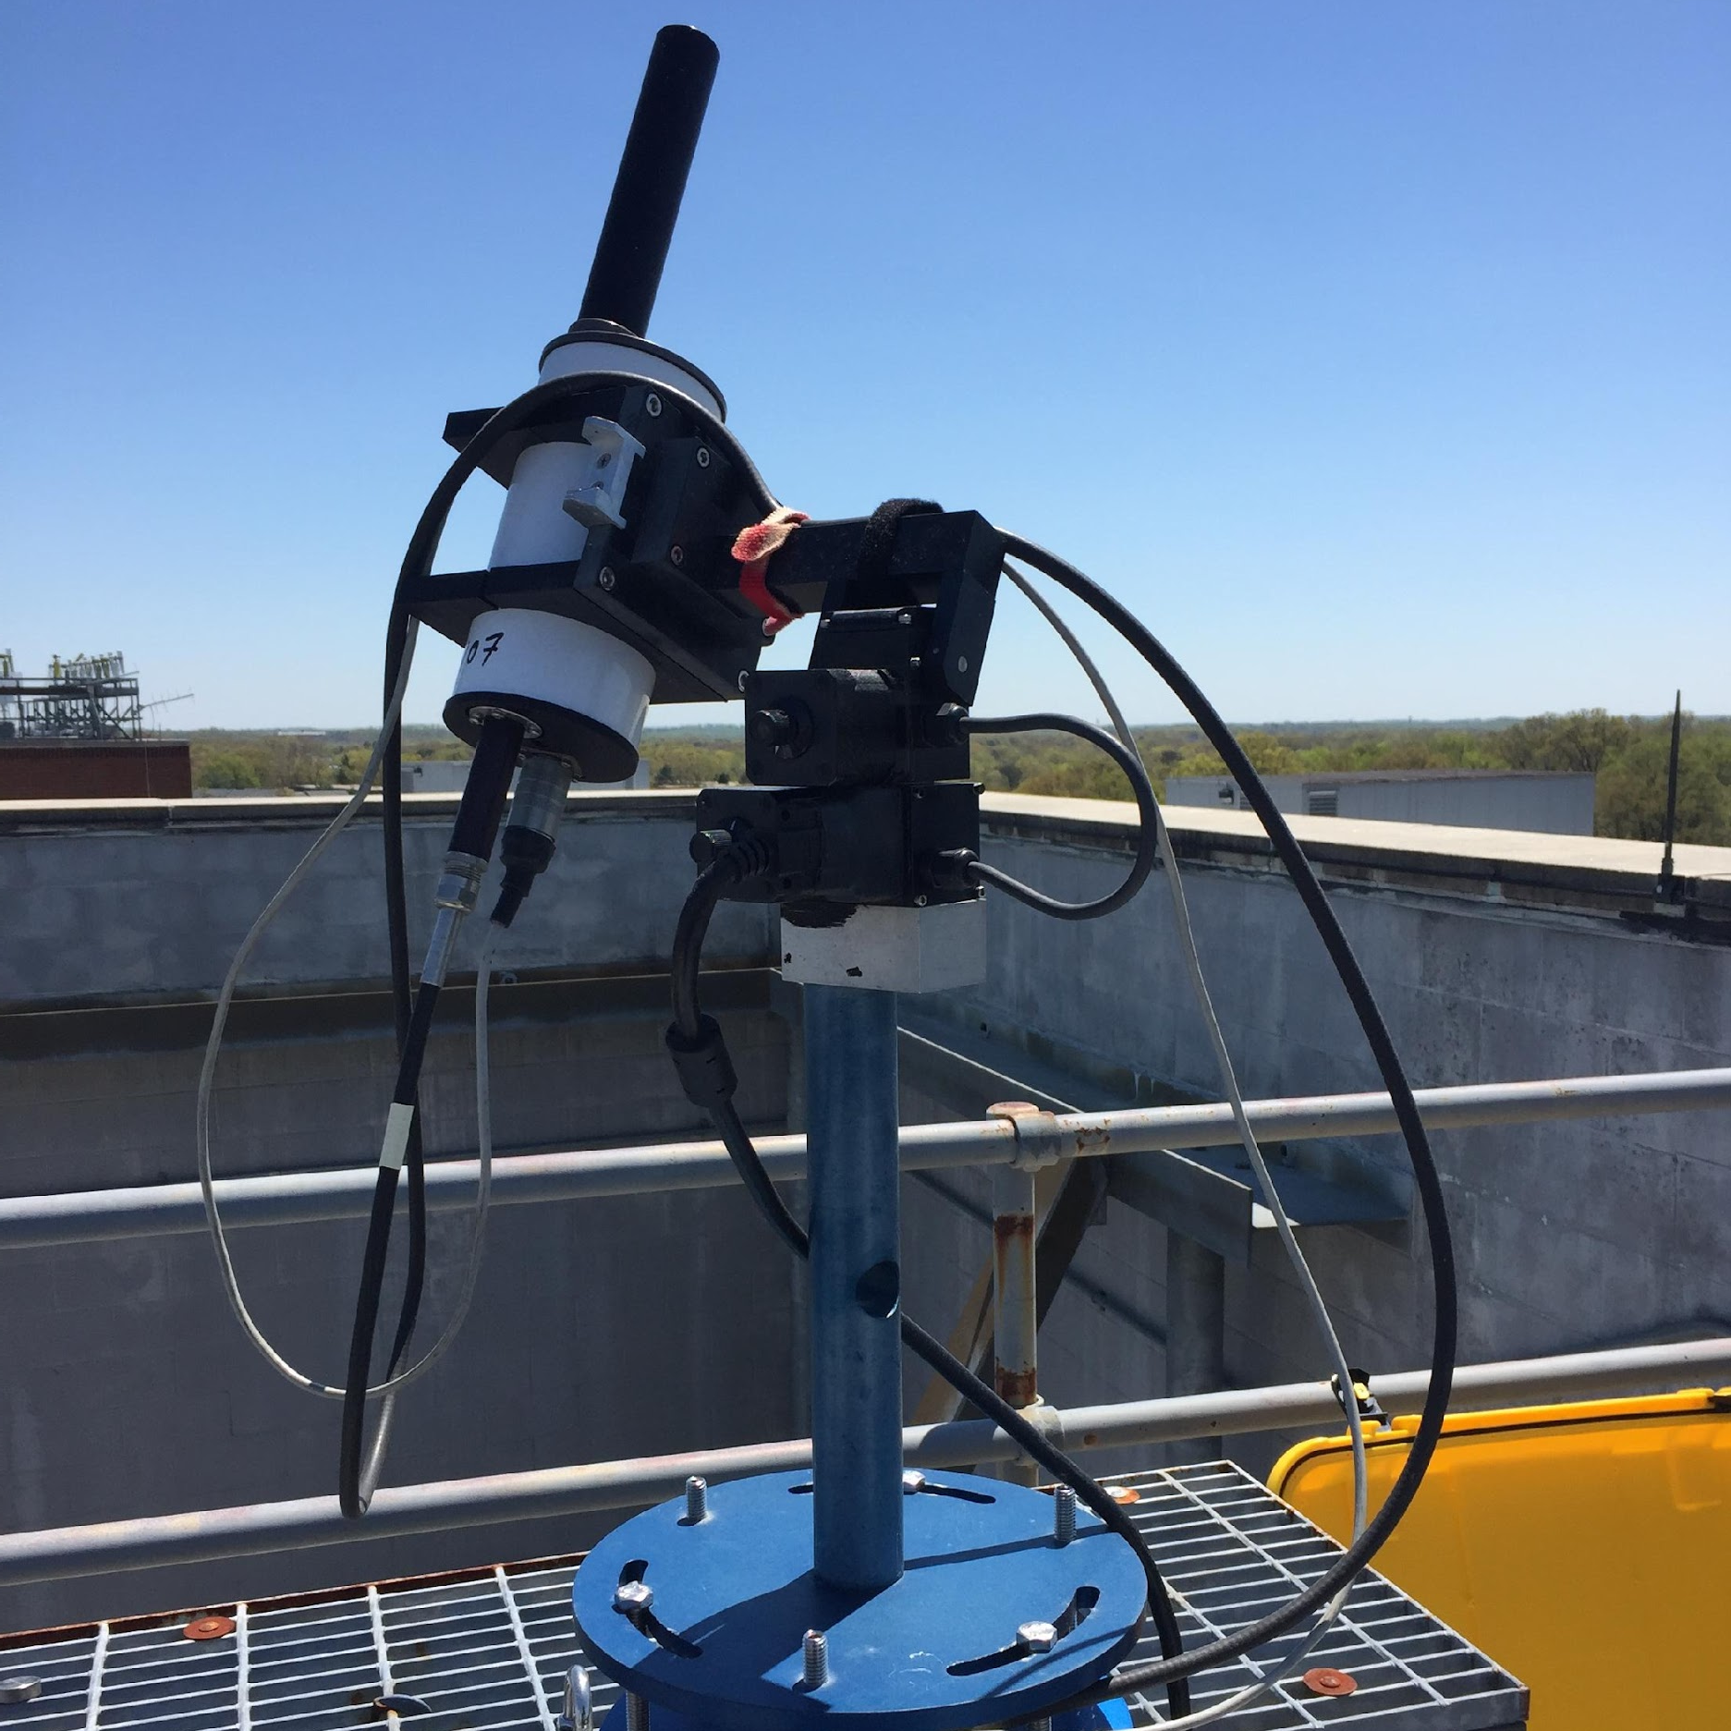
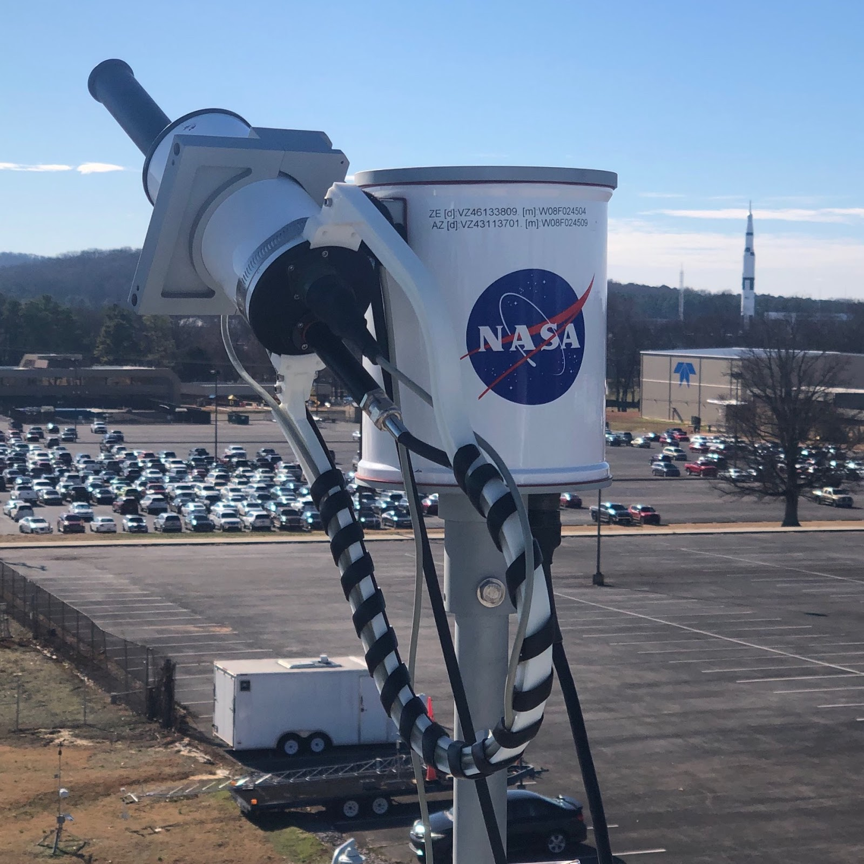
9-Kotsakis – Diurnal Pandora Measurements during TRACER-AQ Houston
Alexander Kotsakis, ERT Inc @ NASA GSFC
Elena Lind, Tom Hanisco, Nader Abuhassan, Alexander Cede, Michael Gray, Steven Smith, Lena Shalaby
First major of deployment of Pandoras to Houston since DISCOVER-AQ Houston (2013), a lot of has changed!
What this poster will show:
Variability in diurnal column NO₂ and HCHO observed between two high ozone events during TRACER-AQ
Extensive NO₂ and HCHO profiles provided insight into the diurnal vertical profile variability
Considerations for future field campaigns using Pandora
DISCOVER-AQ (2013)
TRACER-AQ (2021)
- NO_{x} and VOCs have changed in Houston since 2013
- Pandora has significantly new hardware, software, retrievals,
and capabilities. This includes being able to measure HCHO!

Slide 11

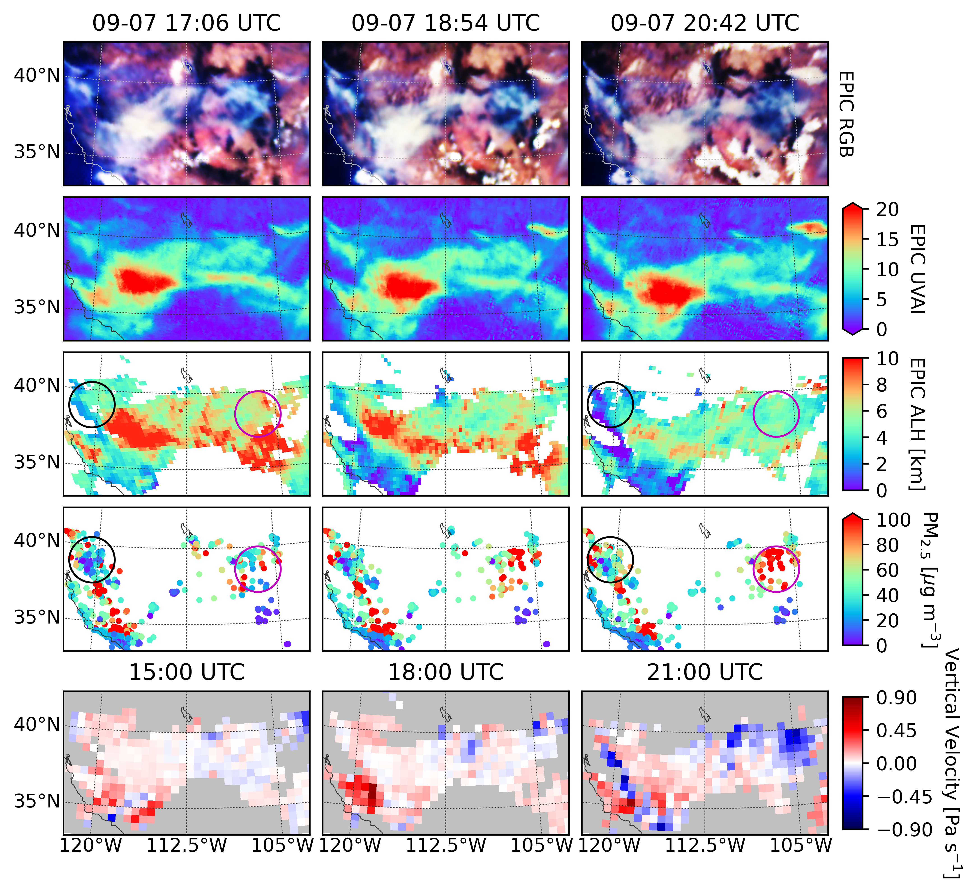
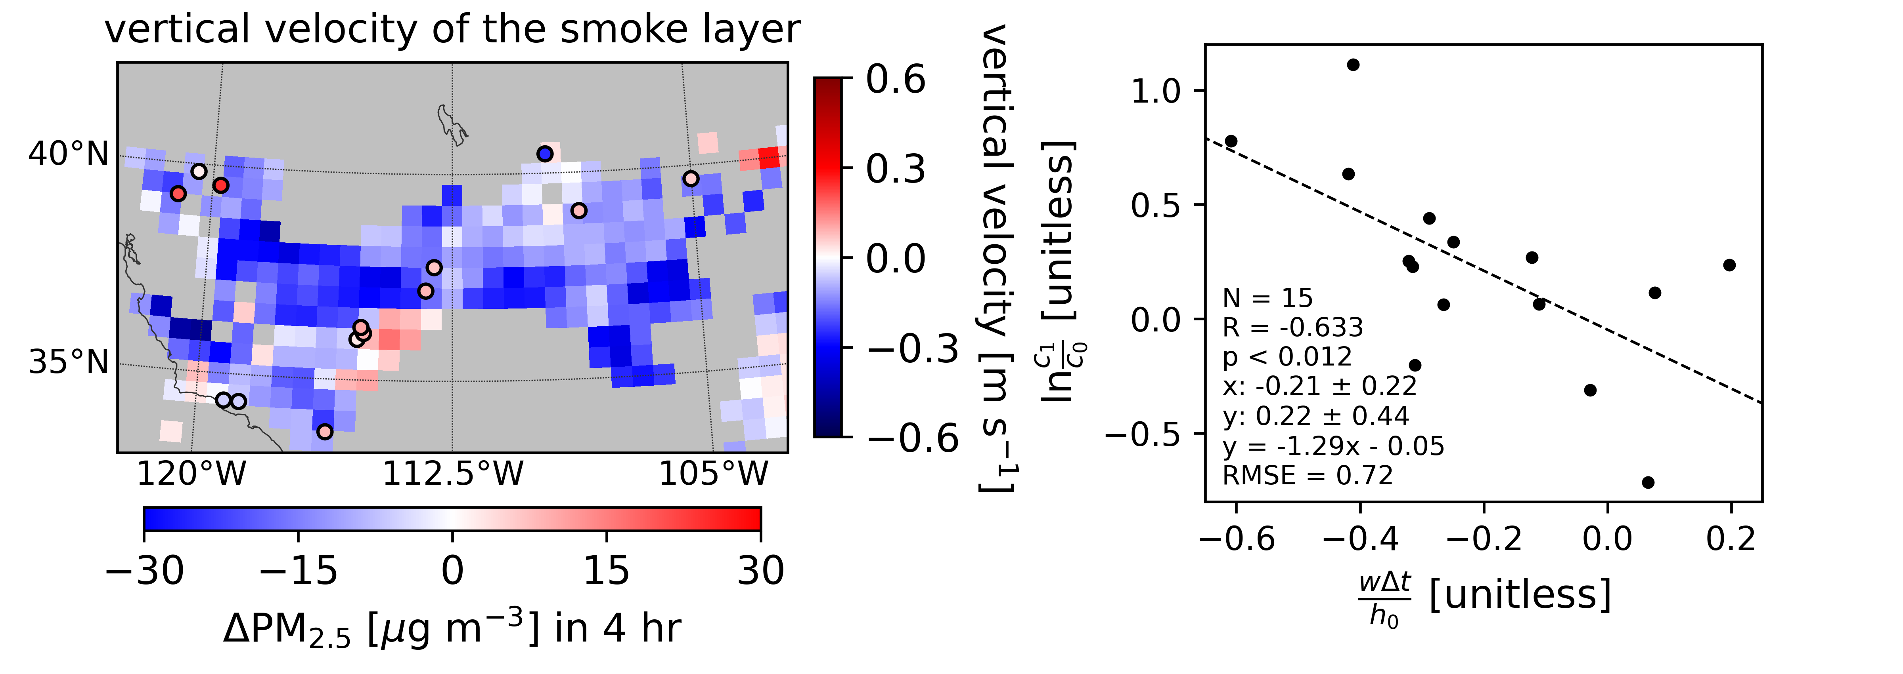
10-Lu–Diurnal variation of AOCH and application on air quality
Zhendong Lu¹, Jun Wang¹, Xi Chen¹, Xiaoguang Xu²
¹The University of Iowa; ²University of Maryland Baltimore County
Hourly mapping of smoke layer height using EPIC measurements is valuable for improving the estimation of diurnal surface PM_{2.5} concentration.
The relationship of vertical velocity of smoke layer and diurnal variation of surface PM_{2.5} concentration can be quantitatively explained by a simple box model very well.

Slide 12

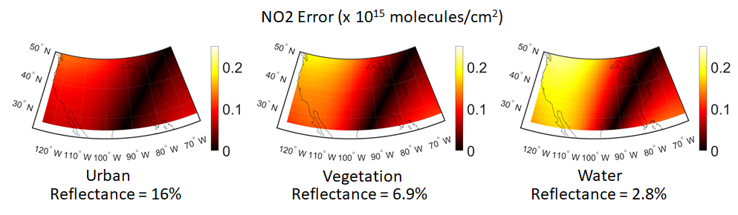
Place a headshot of yourself here
11- Pearlman- Polarization Performance Simulation for the GeoXO ACX
Aaron Pearlman¹, Monica Cook¹, Boryana Efremova¹, Francis Padula¹, Lok Lamsal², Joel McCorkel³, Joanna Joiner³
¹GeoThinkTank LLC, Miami, FL, ²University of Maryland Baltimore County, Baltimore MD
³NASA Goddard Space Flight Center, Greenbelt, MD
NOAA’s Geostationary Extended Observations (GeoXO) constellation will include a dedicated atmospheric composition instrument (ACX) to support air quality forecasting and monitoring by providing similar capabilities to missions such as TEMPO.
We conducted a study to investigate how radiometric impacts from instrument polarization sensitivity can affect NO₂ retrievals as part of an effort to understand the design tradeoffs between instrument parameters and trace gas retrieval impacts.
The results show that the maximum retrieval is lower than the TEMPO precision requirement except in the most extreme cases.
NO₂ errors assuming different scene types across CONUS for 5% polarization sensitivity in a vertical orientation and constant NO₂ profiles with 8.4 x 10¹⁵ molecules/cm²
https://doi.org/10.5194/egusphere-2022-207

Slide 13

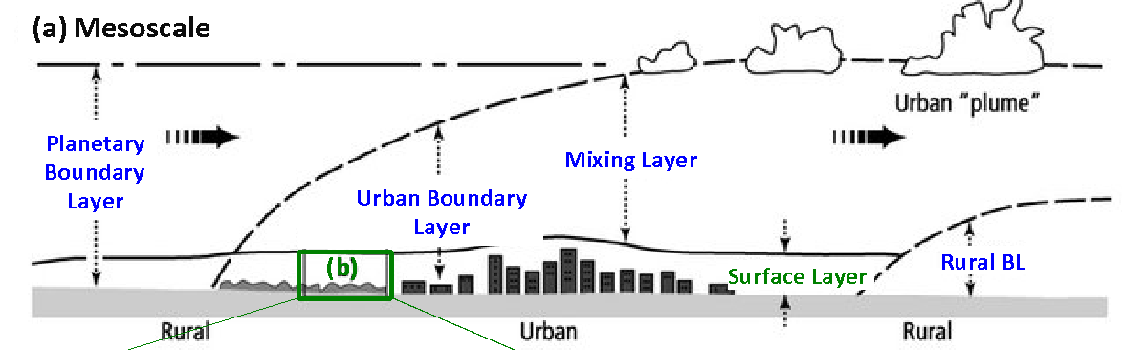
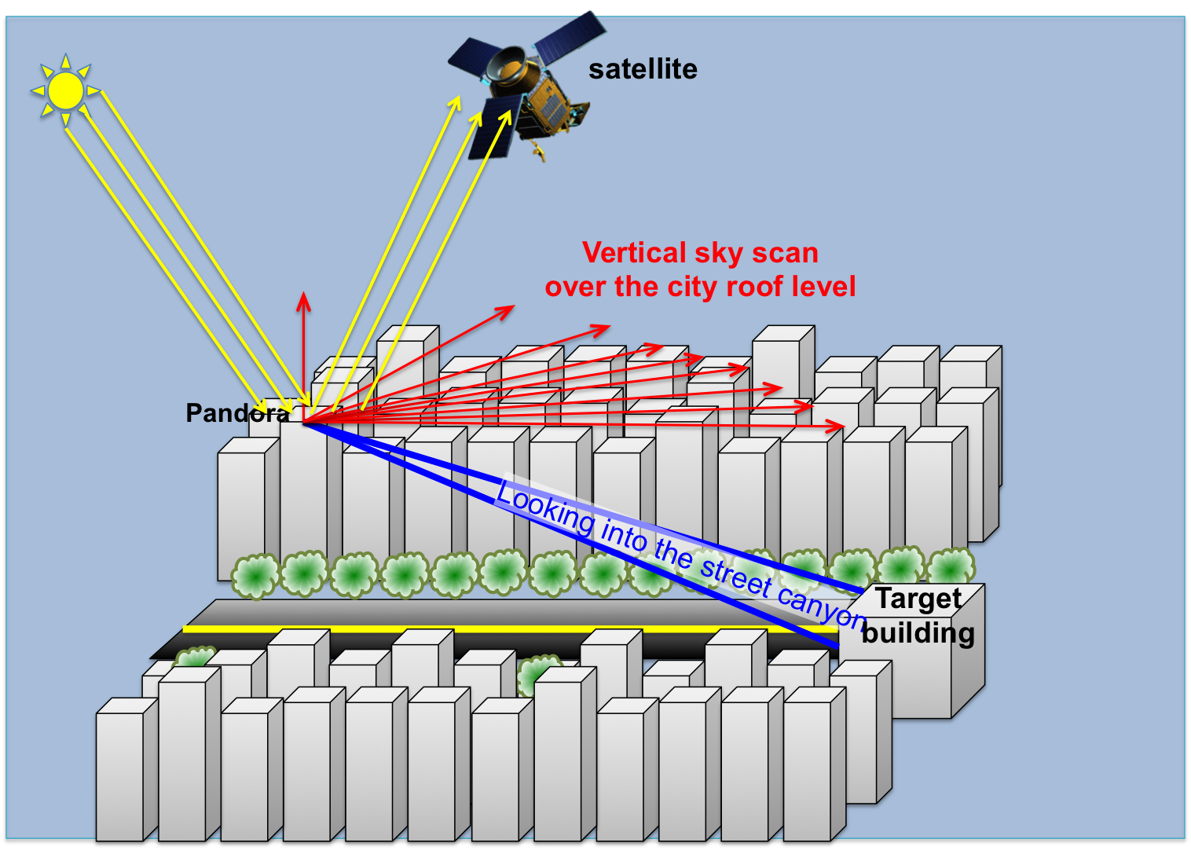
12-Spinei Lind–from street level to total columns with ground DOAS
Elena Spinei Lind: Virginia Tech; Jeffrey Geddes: Boston University;
Yun Dong: Virginia Tech; Taylor Adams: Boston University
Urban environment air quality is impacted by complex interactions on macro-, meso- and microscales;
DOAS technique can provide information about gasious air pollutant distribution at different scales;
This presentation covers street canyon, tropospheric and total column measurements at Boston University over a period of 1 year: Oct 2019 – Nov 2020

Slide 14

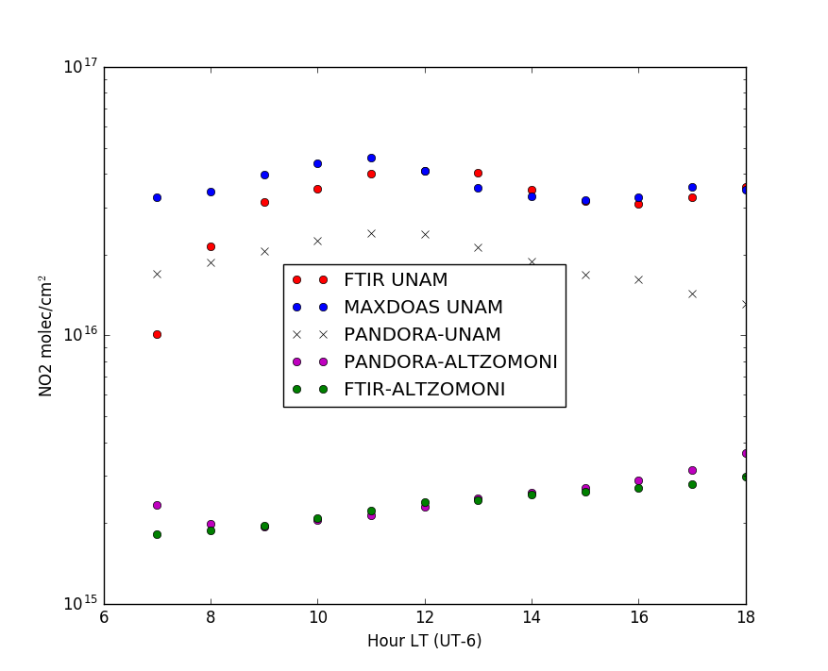
Place a headshot of yourself here
13-Stremme-Column NO2 measurements over Mexico City using various techniques
Wolfgang Stremme, Claudia Rivera, Michel Grutter, Alejandro Bezanilla, Ricardo Ambriz,
Noemie Taquet, Zuleica Ojeda, Adriana Ipina Hernandez, Benedetto Schiavo, Mixtli Campos
Josue Arellano, Alain Garcia Zuber, Ruben Pavia Hernandez et al. UNAM
Martina Michaela Friedrich, Corinne Vigouroux, BIRA
Thomas Blumenstock and Frank Hase, KIT
Nader Abuhassan et al., Pandora
We present and discuss retrieval of the vertical NO2 columns in Mexico City from MAXDOAS, and solar absorption spectroscopy by FTIR, PANDORA and two home made setups and retrieval code.
We show and compare the stratospheric NO2 columns measured by solar absorption spectroscopy using FTIR and PANDORA at the remote site, Altzomoni 4000 m.a.s.l. , 60 km southeast of Mexico City.

Slide 15

14-Tisdale-Coming Soon to a DAAC Near You:
Proposed TEMPO Services
Matthew Tisdale¹, Ashlee Autore¹, Austin Anderson¹, Brian Tisdale¹, Daniel Kaufman¹, Georgina Hayes-Crepps¹, Harsh Patel¹, Iman Nasif¹, Walt Baskin¹ (¹NASA Langley Research Center, Atmospheric Science Data Center)
Atmospheric Science Data Center Overview
Planned TEMPO data structure
TEMPO data browsing, accessing, and downloading
Proposed data enhanced services and use case examples
Your input

Slide 16

15-Travis–Can ΩHCHO observations inform air quality strategies?
K. R. Travis¹, L. M. Judd¹, J. H. Crawford¹, Gao Chen¹, James Szykman², Andrew Whitehill², Luke Valin², Elena Spinei³, Scott Janz⁴, Caroline Nowlan⁵, Hyeong-Ahn Kwon⁵, Alan Fried⁶, James Walega⁶
¹NASA Langley Research Center, Hampton, VA, USA. ²Office of Research and Development, United States Environmental Protection Agency, Research Triangle Park, NC, USA ³Virginia Polytechnic Institute and State University, Blacksburg, VA, USA ⁴NASA Goddard Space Flight Center, Greenbelt, MD, USA. ⁵Center for Astrophysics | Harvard & Smithsonian, Cambridge, MA, USA ⁶Institute of Arctic and Alpine Research (INSTAAR) at the University of Colorado, Boulder, CO, USA
Column formaldehyde (ΩHCHO) is related spatially & temporally with ozone during the LISTOS & KORUS-AQ field campaigns.
HCHO better correlates with O_{x} (ozone + NO₂) during KORUS-AQ.
Satellite ΩHCHO could be an indicator of elevated surface ozone and inform air quality monitoring strategies.
  *The views expressed in this poster are those of the authors and do not necessarily represent the views or policies of the U.S. Environmental Protection Agency. Any mention of trade names, manufacturers or products does not imply an endorsement by the United States Government or the U.S. Environmental Protection Agency. EPA and its employees do not endorse any commercial products, services, or enterprises.

Slide 17
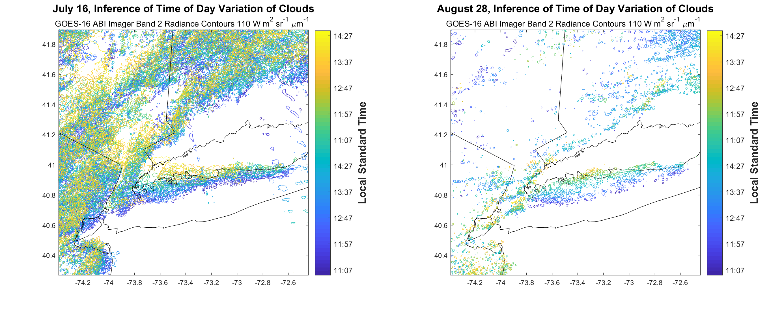
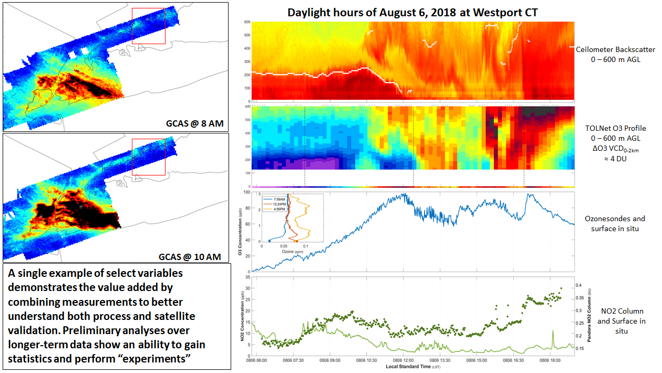
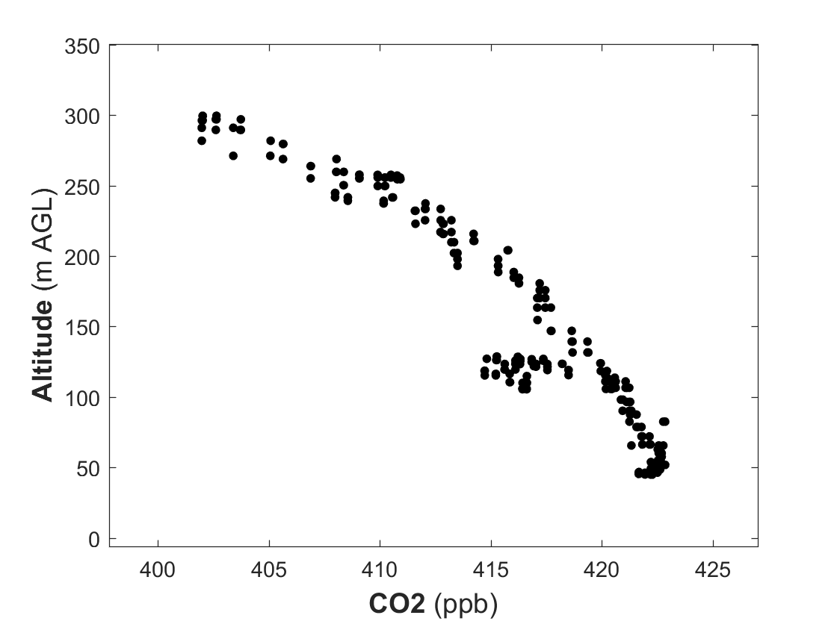

17-LISTOS: An example of the “3D” monitoring System
GOES ABI Cloud Front Maps (every 5 minutes)
Column NO2 maps
Ceilometer Backscatter
Ozone LIDAR
(Berkoff, NASA LaRC)
CT DEEP Surface O3 and NASA Sondes
Surface NO2 and EPA PGN NO2 column
Contracted
in situ profile sampling
Office of Research and Development

Slide 18
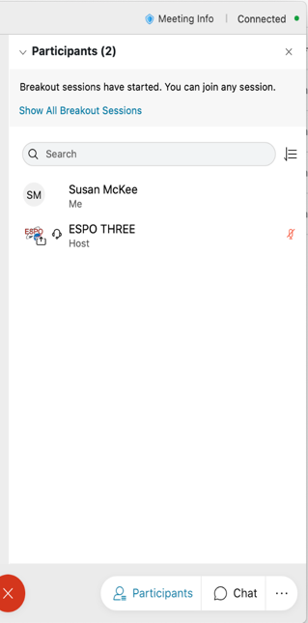

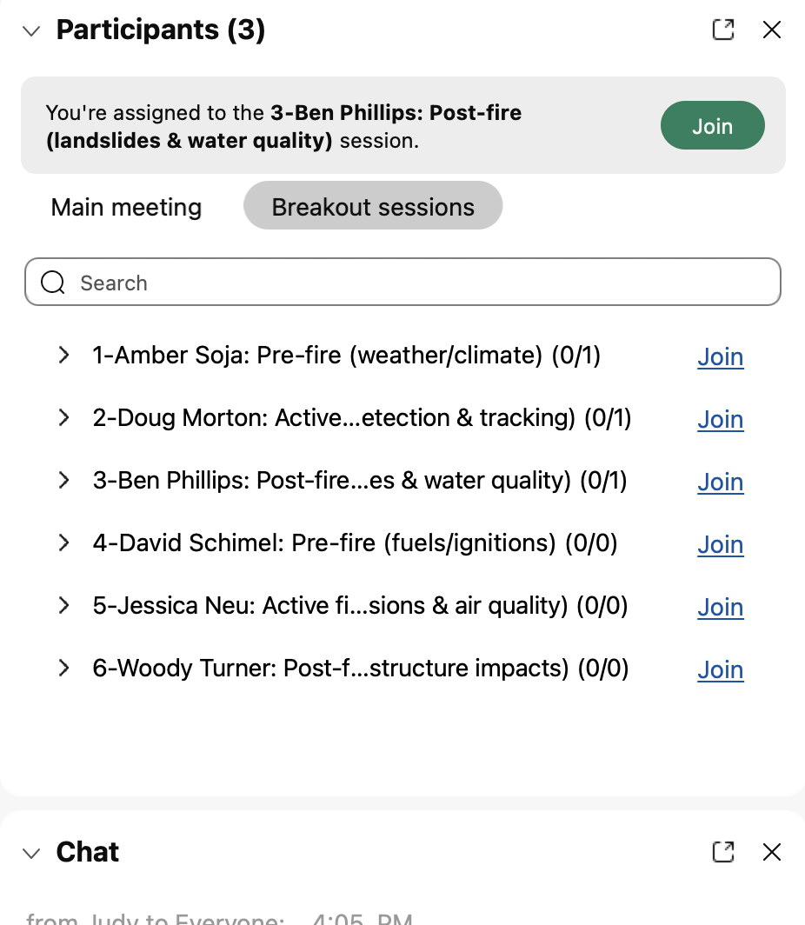
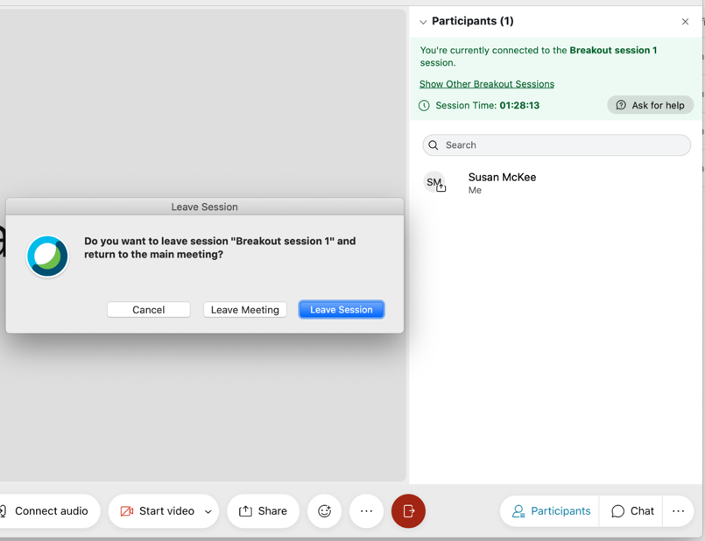
Joining WebEx Breakout Rooms
Open “Participants” panel
Click “Show All Breakout Sessions”
Click “Join” next to the poster session you want to attend first
Note: Poster presenters are preassigned to their rooms – click the green “Join” button to accept
2
3
Join another room
1
You can move between breakout rooms or return to the main room
  Click “Show Other Breakout Session” and “Join” one.
  Click “leave session.” Don’t click “leave meeting.”
Note: Dial-in phone connections cannot move to breakout rooms; connect via Webex audio (you can have Webex call you)
Leave Breakout Room for Main Room

Slide 19
WebEx Breakout Instructions
Breakout Instructions:
Once the host starts the breakout groups:
Go to the “Participants” panel
Click “Show all breakout sessions”
Click “Join” next to the group you would like to participate in
Note: Breakout hosts are preassigned to their rooms – click the green Join button to accept
Breakout Audio Instructions:
Dial-in phone connections cannot move to breakout rooms; connect via Webex audio
2
3
1

Slide 20
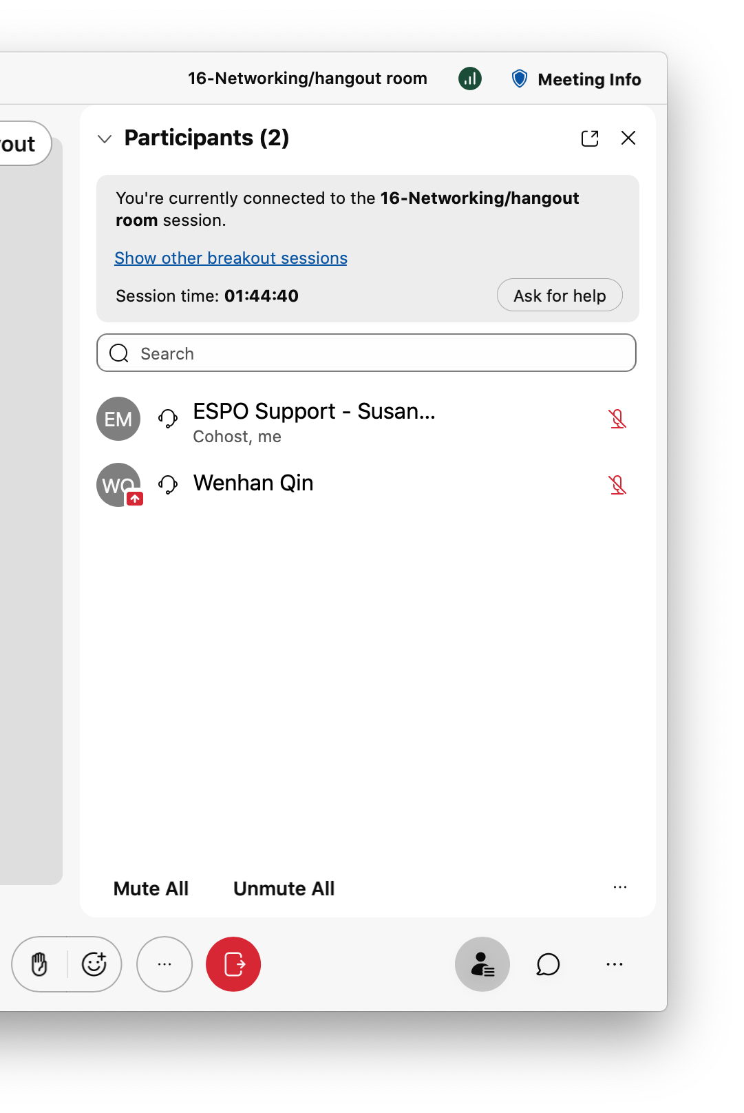
WebEx Breakout Instructions
Breakout Audio Instructions:
Dial-in phone connections cannot move to breakout rooms; connect via Webex audio.
Two ways to move to another room
1: Join another room
2: Leave Breakout Room
for Main Room

Slide 21

Joining WebEx breakout rooms
Switching to another room
Open “Participants” panel
Click “Show All Breakout Sessions”
Click “Join” next to the poster session you want to attend
Note: Poster presenters are preassigned to their rooms – click the green “Join” button to accept
Join another room
Leave Breakout Room for Main Room
3
You can move between breakout rooms or return to the main room
  Click “Show Other Breakout Session” and “Join” one.
  Click “leave session” to go back to main
Note: Dial-in phone connections cannot move to breakout rooms; connect via Webex audio (you can have Webex call you)

