Slide 1
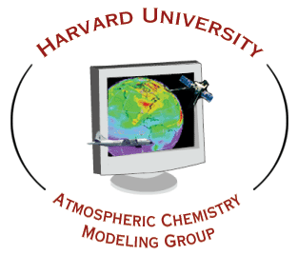
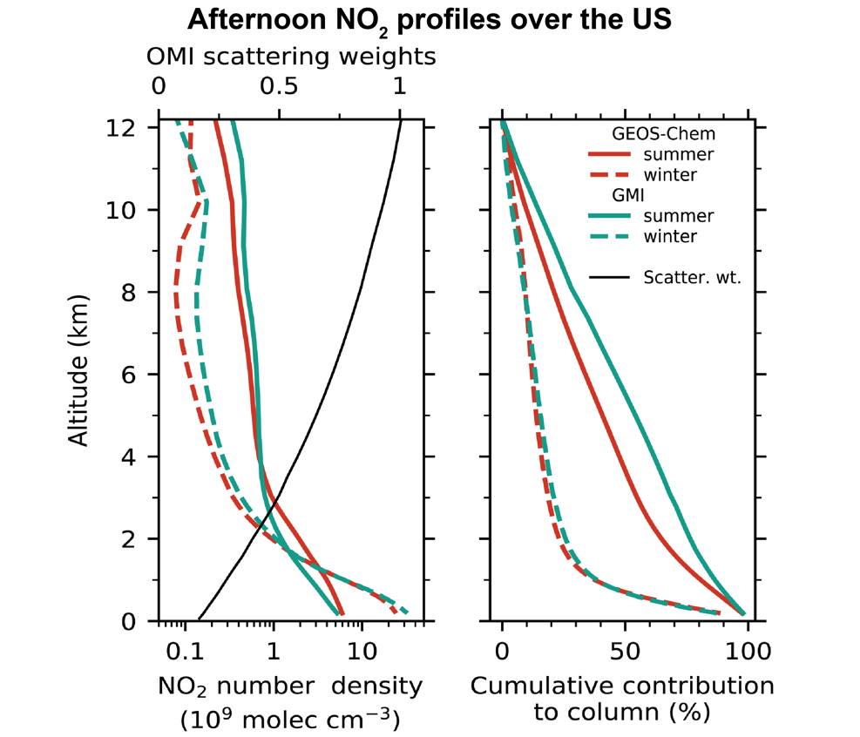
Exploiting TEMPO NO₂ observations to better understand background NO_{x} and NO_{x} emissions over North America
Daniel Jacob, Viral Shah, Ruijung Dang, Laura Yang
Lowest 2 km contributes only 30% of tropospheric NO₂ seen by satellite in summer, 70% in winter; model simulation of free troposphere is critical for interpretation of tropospheric NO₂ columns
Aircraft NO₂ measurements above 6 km have positive interference, better to use NO and PSS for model evaluation
Improved GEOS-Chem includes nitrate photolysis, updated aircraft emissions
Increasing aircraft emissions and fires may drive increase in background, affecting satellite trends
TEMPO may enable improved cloud slicing to separate free tropospheric NO₂.
Shah et al., in prep.; Dang et al., in prep.

Slide 2
AMF contribution to diurnal cycle of TEMPO NO₂
Diurnal cycle of NO₂ over Seoul during KORUS-AQ
Rush hour happens at a difficult time for boundary layer modeling
Low sun angle, collapsed mixed layer leads to increased importance of background
Need to understand diurnal cycle of AMF and its contribution to diurnal cycle of NO₂ observed by TEMPO
Yang et al., in prep.

