Slide 1
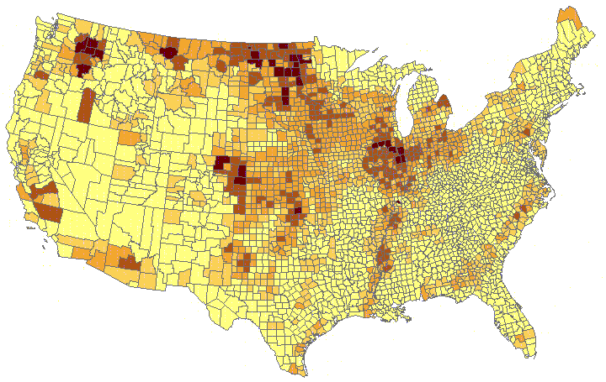
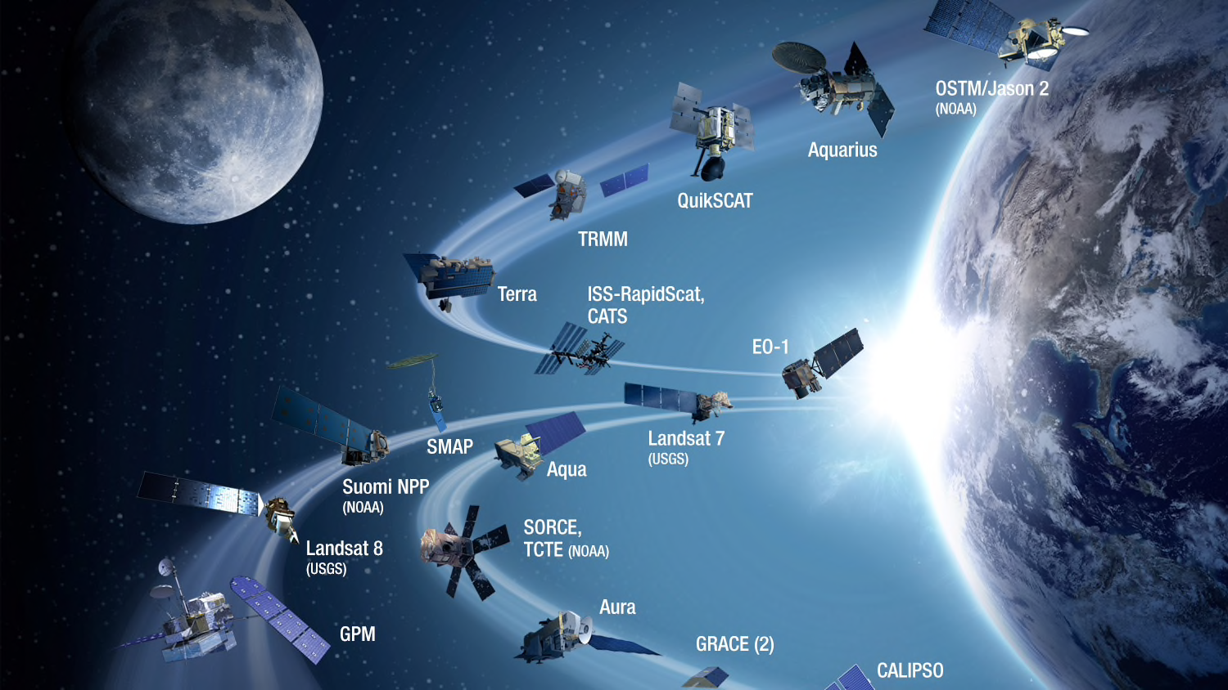
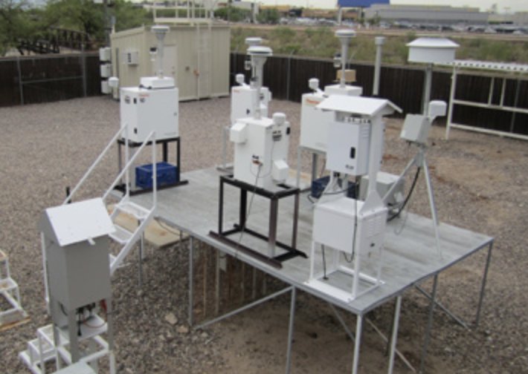
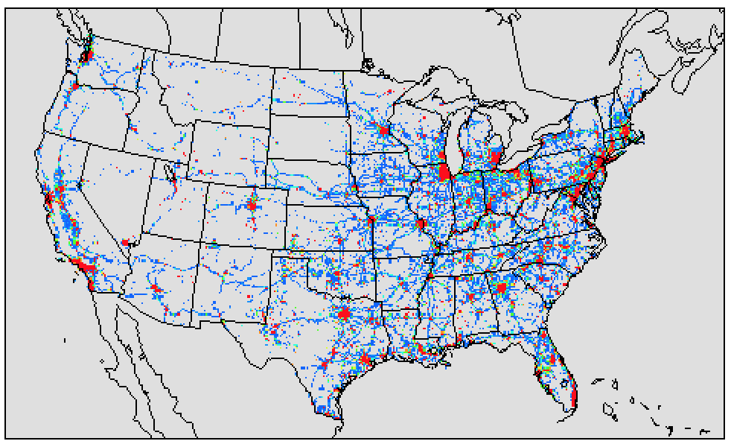
Emission Data Assimilation to Support Air Quality Forecasting
Daniel Tong, George Mason University
Assimilate satellite and in-situ observations to reduce emission uncertainties (source strength, temporal trends, spatial distribution, etc).
Raw Emission
Satellite Observations
Ground Observations
Air Quality Forecast
+
+
Meteorology Forecast
Emission Forecast
Satellite Adjusted Emission
EDA provides rapid emission refresh for air quality forecasting.
Notes:
NOTE: notes not added—please add to your slide.

Slide 2
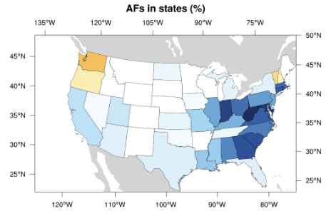
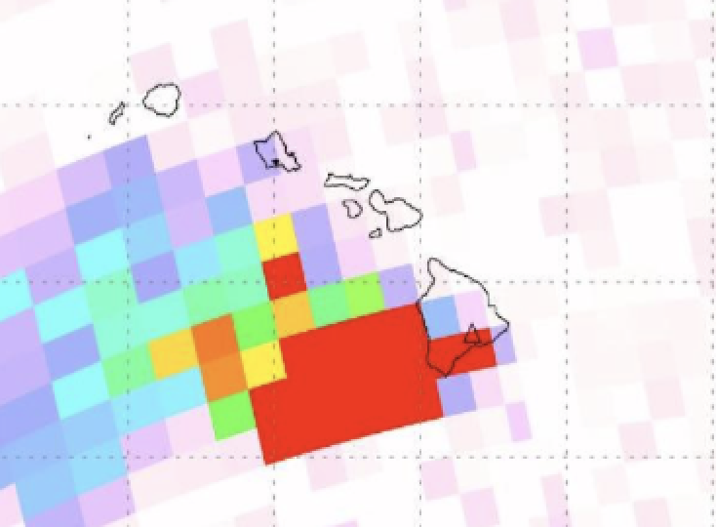
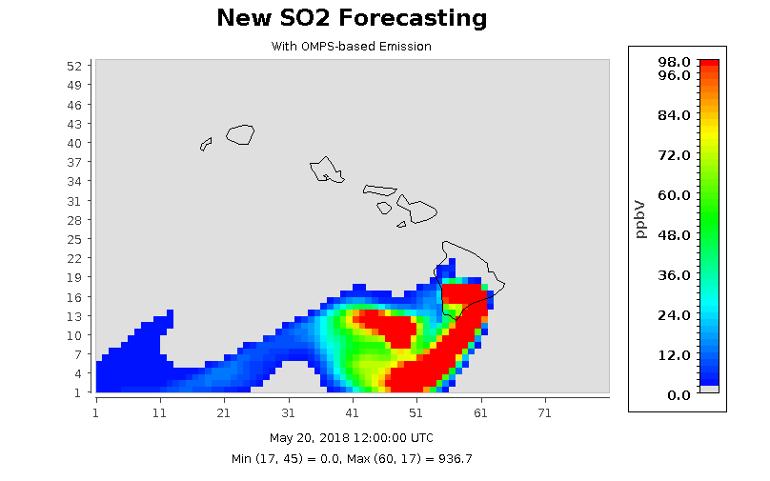
Satellite EDA Applications
Rapid updates of NOx emissions during COVID (Campbell et al, 2021)
SO₂ Emission Strength during Kilauea Eruption (Tang et al, 2020)
SNPP/OMPS
(Li Can and Nickolay Krotkov, NASA GSFC)
Adjustment Factor (AF) from fusing AQS & OMI
(Tong et al., 2016)
ΔS and N_{S} - rate of change and the number of satellite data (OMI)
ΔG and NG - rate of change and the number of ground data (AQS)
f_{S} and f_{G} - weighting factors applied to the satellite and ground data
Notes:
NOTE: notes not added—please add to your slide.

